Slide 1
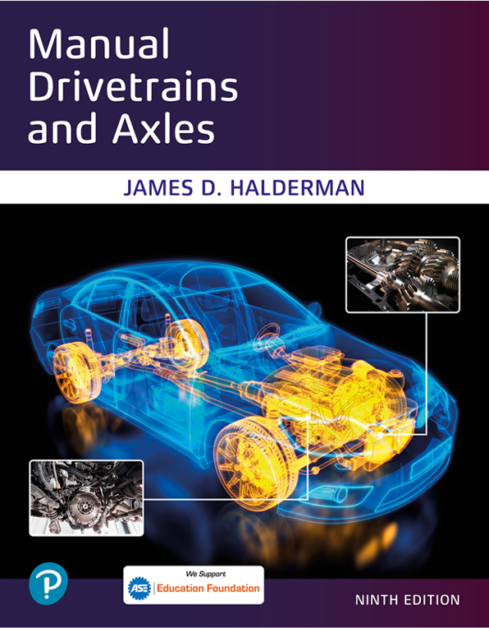
Manual Drivetrains and Axles
Ninth Edition
Chapter 5
Manual Transmissions Parts and Operation
Copyright © 2024, 2018, 2015 Pearson Education, Inc. All Rights Reserved
Notes:
If this PowerPoint presentation contains mathematical equations, you may need to check that your computer has the following installed:
1) Math Type Plugin
2) Math Player (free versions available)
3) NVDA Reader (free versions available)
INSTRUCTOR NOTE: This presentation includes text explanation notes, you can use to teach the course. When in SLIDE SHOW mode, you RIGHT CLICK and select SHOW PRESENTER VIEW, to use the notes.

Slide 2
Learning Objectives
5.1 Explain the construction of a manual transmission.
5.2 Discuss synchronizer operation.
5.3 Explain five-speed transmission torque flow.
5.4 Discuss shifter operation.
5.5 Explain the construction of manual transmission gears.
5.6 Discuss the purpose of transmission cases and bearings.

Slide 3
Purpose of Manual Transmissions
Provide neutral, forward gear speeds or ranges, and reverse.
It must be able to provide a gear ratio that is low enough
Multiplied by final drive ratio
Increase engine’s torque sufficiently to accelerate vehicle at desired rate.
Notes:
The purpose of the transmission is to provide neutral, for- ward gear speeds or ranges, and reverse. It must be able to provide a gear ratio that is low enough, when multiplied by the final drive ratio, to increase the engine’s torque sufficiently to accelerate the vehicle at the desired rate. The highest gear ratio should allow the vehicle to cruise at an engine speed that is low enough to conserve fuel and decrease noise. There also needs to be intermediate ratios that are spaced so that the engine will not overrev before a shift or lug after a shift. Reverse must be roughly the same ratio as first since the vehicle will be starting from a stop in both cases.

Slide 4
Construction
Power Paths
Parts: Cluster gear, input shaft, output shaft, reverse idler shaft
Shifting gears: constant mesh gears; speed gear
Gear ratios
Torque capacity
Notes:
A transmission has several different paths through which power can flow. These paths provide the required forward gear ranges and a reverse. In a R W D transmission, power enters the input shaft and passes through at least two gear sets before transferring to the main shaft. The power will exit through the main shaft and will then pass on to the driveshaft. The transmission main shaft, the output shaft, is directly in line with input shaft. ● Figure 5.1 .
R W D manual transmission includes the following 4 shafts:
1. A cluster gear, countershaft gear or layshaft (British term).
2. The input shaft , also called a main drive gear or clutch shaft .
3. The output shaft , also called a main shaft .
4. The reverse idler shaft .

Slide 5
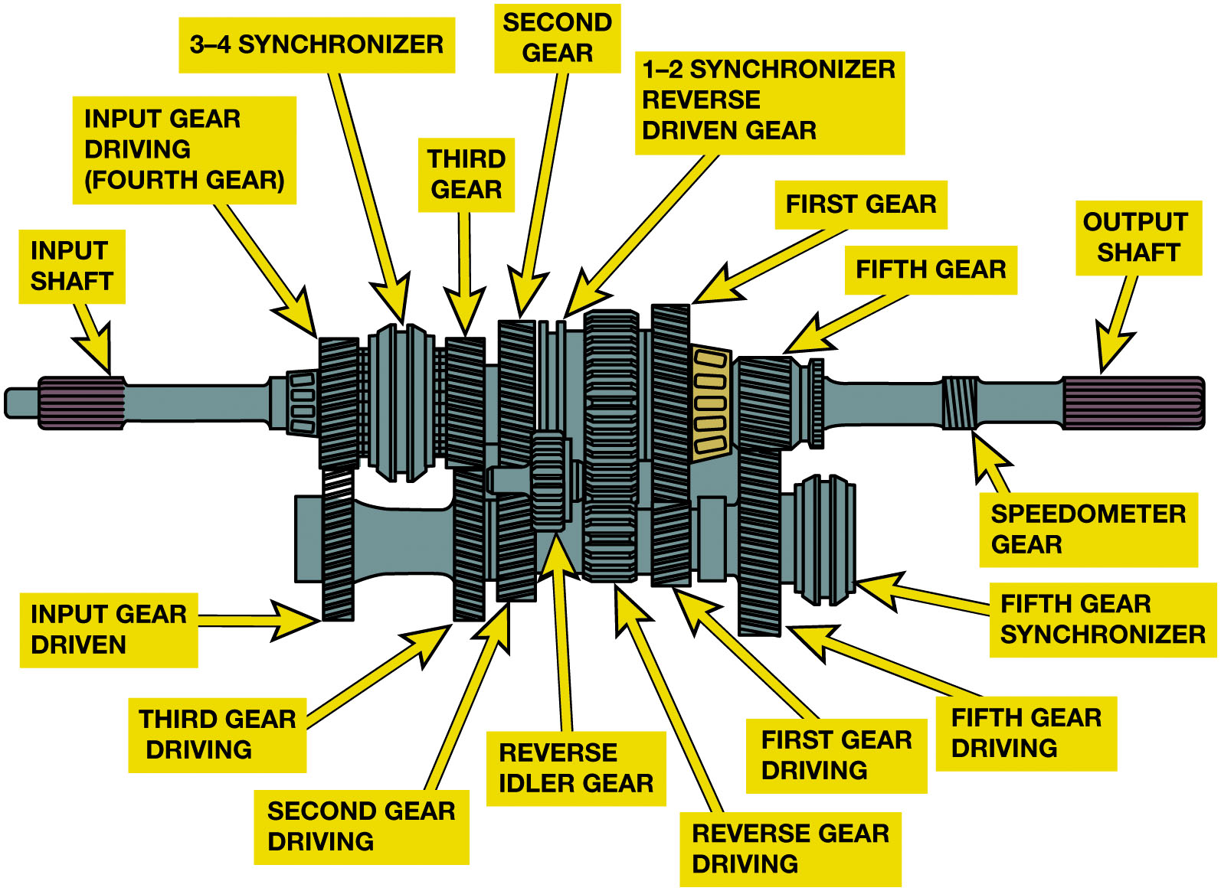
Figure 5.1
R W D Transmission
A five-speed transmission gear train. Power enters through the input shaft and leaves through the transmission output shaft.
Notes:
The main shaft is piloted into rear of input shaft gear with a bearing. It is also supported at rear of transmission case by another large bearing, and by universal joint slip yoke, which in turn is supported by a bushing at rear of the extension housing. The input shaft gear
is supported by a bearing at front of the transmission case and the pilot bearing at end of crankshaft. Most transmissions support cluster gear directly by a bearing set
Long Description:
The cross-section of the five-speed transmission gear train consists of a cylindrical input shaft with horizontal stripes on the left end and a similar but elongated output shaft on the right end. In between the input and output shafts, the gear train consists of a gear labeled input gear driving (fourth gear). The input gear driving is attached to a vertical input gear driven on the bottom. To the right of the input gear driving is a 3 to 4 synchronizer. The synchronizer has 2 rectangular faces on either side attached to a shorter rectangle in the middle. To the right of the synchronizer is a gear labeled third gear. The third gear is attached to a vertical gear labeled third gear driving on the bottom. To the right of the third gear is the second gear with a vertical extension on the bottom labeled second gear driving. 1 to 2 synchronizer reverse-driven gear is connected to the right side of the second gear. A small gear attached to the bottom of the 1 to 2 synchronizer is labeled reverse idler gear. To the right of the 1 to 2 synchronizer is an elongated gear labeled reverse gear driving. To the top right of the reverse gear driving is the first gear. The first gear is attached to a smaller gear on its bottom labeled first gear driving. To the right of the first gear is a wide and short gear labeled fifth gear. The fifth gear is attached to a narrow and elongated gear labeled fifth gear driving on the bottom. The fifth-gear synchronizer is attached to the right side of the fifth-gear driving. The fifth gear synchronizer has 2 rectangular faces on either side with a shorter rectangle attached in the middle. In between the fifth gear and the output shaft is a small gear labeled speedometer gear.

Slide 6
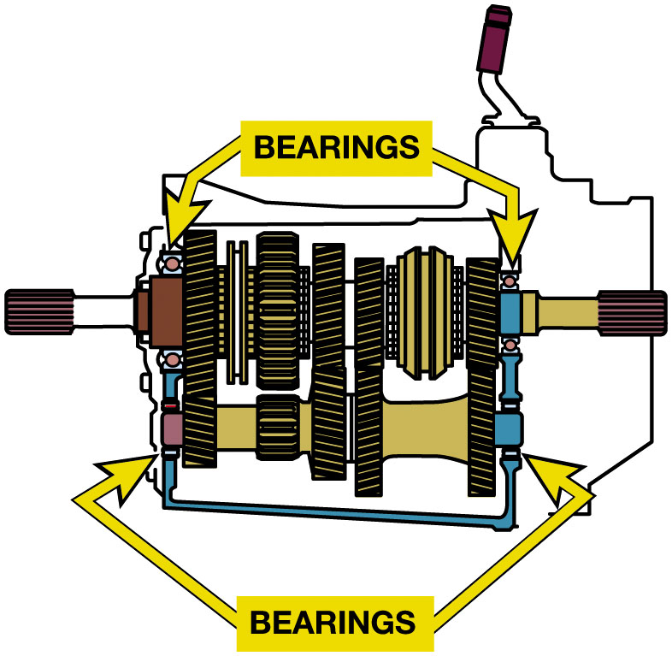
Figure 5.2
Bearings support the input shaft, countershaft, main shaft, and speed gears
Notes:
Some transmissions with very long cluster gears and main shaft gear groups use a support in the middle of the transmission with bearings for the cluster gear and main shaft. Figure 5.2.
Gear Ratios
In all gear speeds but one, power flows from the main drive gear (input) to cluster gear and then from cluster gear to main shaft (output). The power passes through 2 gear sets. The exception is a 1:1 ratio, where the power flows directly from the main drive gear to main shaft.
■ All the forward gears are normally in constant mesh so they always rotate at their designed speed relative to engine speed.
Gears of cluster gear rotate as an assembly.
Output (speed) gears usually are mounted on main shaft so they float or rotate freely.
Speed gears complete ratio for each gear speed when they become coupled to main shaft.
Main shaft includes synchronizer assemblies for each pair of gear speeds and can lock individual speed gears to main shaft. This is done for each shift.
Long Description:
The cross-section has square components with a circle in the middle labeled bearings in the main shaft. The bearings are attached to the top-left and bottom-left sides of the input gear driving and the top-right and bottom-right sides of the fifth gear. The cross-section has tiny slender horizontal bearings in the countershaft. The horizontal bearings are attached to the left side of the input gear driven and to the right side of the fifth gear driving. The bearings in the countershaft are connected by an open rectangular handle-like structure.

Slide 7
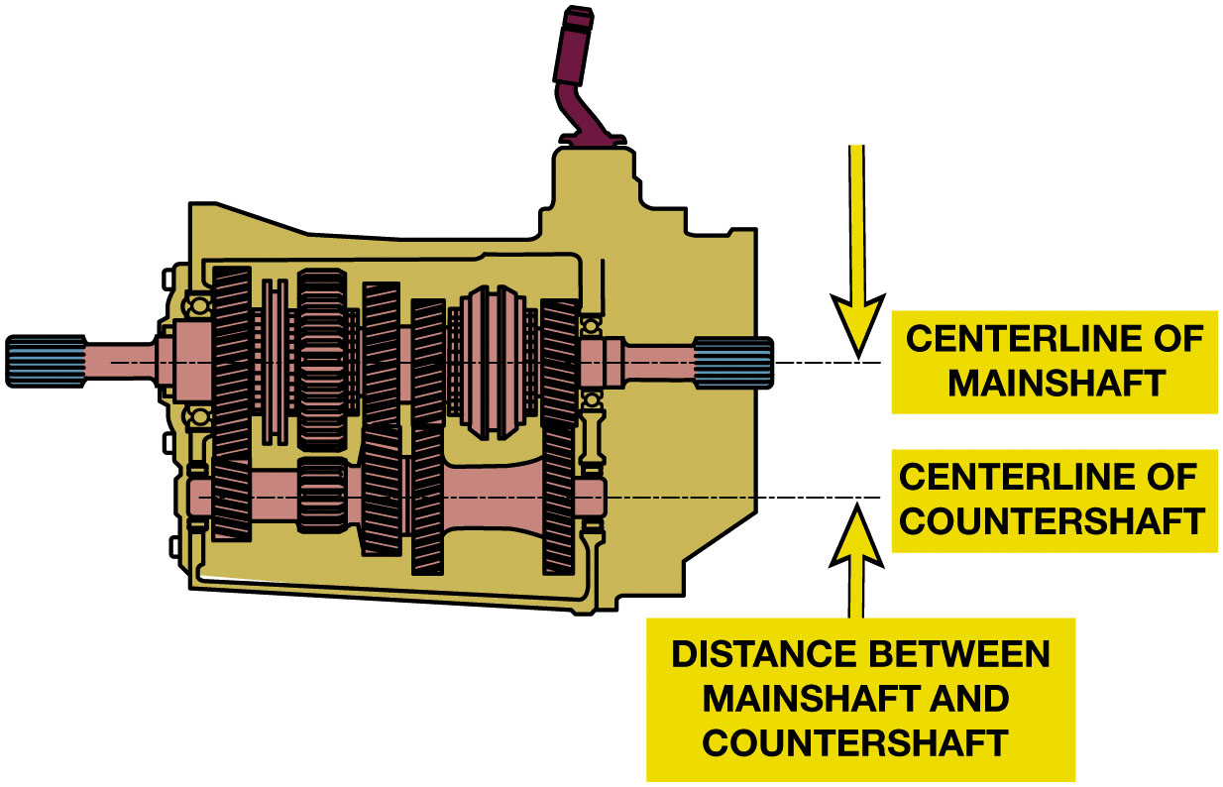
Figure 5.3
Torque Capacity
Diameters of input and output shafts of transmission enlarged.
Distance between main shaft and countershaft increased.
Allow space in case for larger gears & shafts.
The torque capacity of a transmission is determined by the size of the gear and bearings used. The greater the distance, usually measured in millimeters such as 77 m m, between the main shaft and the countershaft, the greater the torque capacity.
Notes:
TORQUE CAPACITY A transmission is designed to be strong enough to handle the torque output of the engine.
High torque requires large input shafts, even larger output shafts, wide gears, and large bearings. This increases weight of transmission and also increases the drag and power loss. Smaller transmissions improve fuel mileage, but they can break under load. Using an engine that has a higher torque output than the transmission is designed to handle will cause failure of the transmission. To handle
more torque, the following 2 factors are designed into transmission:
diameters of the input and output shafts of a transmission are enlarged.
distance between main shaft and countershaft is increased. This is needed to allow space in case for larger gears and shafts.
● SEE FIGURE 5.3.
Long Description:
The cross-section has a straight horizontal dashed dot line labeled centerline of main shaft that starts from the right side of the input shaft, passes through the cluster gear of the main shaft, and extends to the right side of the output shaft. The cross-section has a similar horizontal line labeled centerline of countershaft that passes through the center of the cluster gear in the countershaft. A set of up and down arrows pointing towards the horizontal parallel lines are labeled distance between main shaft and countershaft.

Slide 8
Reverse
Transmission has to reverse direction of rotation
Requiring one more gear in gear train.
When one external gear drives another
They will rotate in opposite directions.
Reverse idler

Slide 9
Figure 5.4
Reverse
(a) The input shaft rotates in a clockwise direction; the countershaft rotates in a counterclockwise direction and the first–reverse gear drives the output shaft in a clockwise direction. (b) When meshed with the idler gear, the first–reverse gear will be driven in a counterclockwise direction. A simple (single) idler is shown.
Notes:
Because engine is not able to operate backward, transmission has to reverse the direction of rotation, requiring one more gear in the gear train. When one external gear drives another, they will rotate in opposite directions. In a transmission,
Input shaft gear rotates in a clockwise direction same as the engine as viewed from the front of Engine (accessory drive belt end);
Cluster gear rotates in a counterclockwise direction;
Main shaft rotates clockwise when driven either through the gear train or by the direct coupling.
Long Description:
It shows the wheel of the input gear rotating in a clockwise direction while the countershaft rotates in a counterclockwise direction. The output gear rotates in a counterclockwise direction while the reverse idler gear rotates in a clockwise direction.

Slide 10
Animation: Transmission: Reverse (Animation will automatically start)

Slide 11
Speed Gears
All gears on countershaft are permanently attached to shaft.
When countershaft rotates, all gears on countershaft rotate.
Notes:
All gears on countershaft are permanently attached to shaft. When countershaft rotates, all gears on countershaft rotate. The input shaft gear is also part of input shaft. However, gears on main shaft are free to move on the shaft and are connected to the main shaft through the synchronizer hub when a shift is made. The gears that rotate on the main shaft are called speed gears and are free to rotate on a film of oil or on bearings.

Slide 12
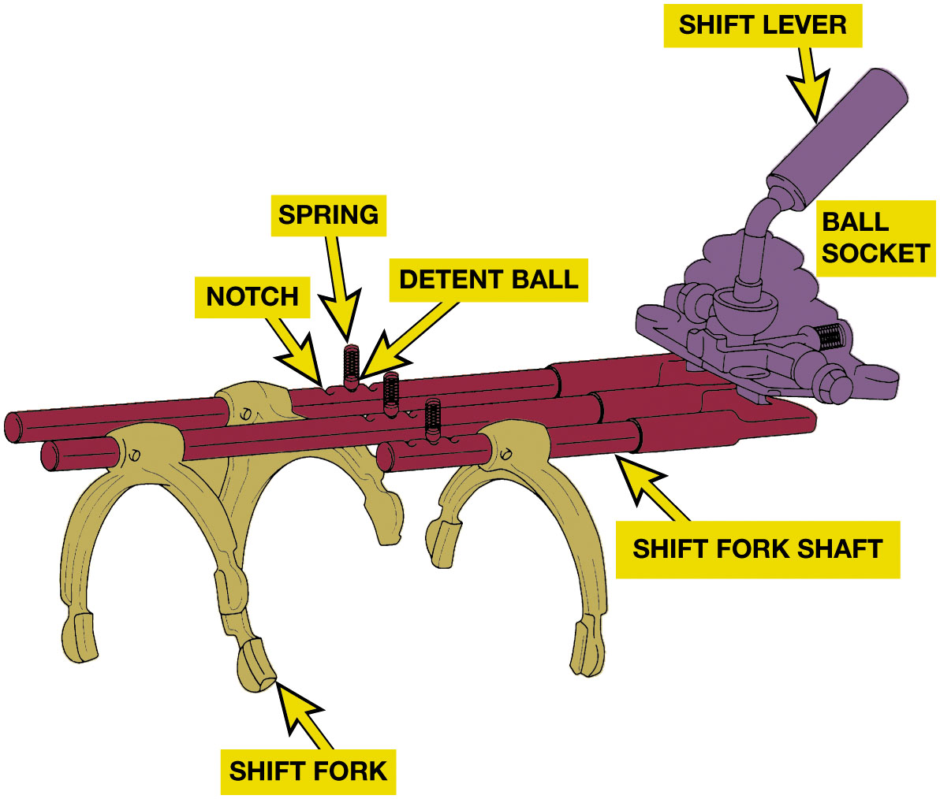
Figure 5.5
Shift Mechanism
To shift into gear, driver disengages clutch & moves shift linkage.
As sleeve moves, detent keys help guide stop ring toward speed gear.
Stop ring acts as a brake to slow down gear
Speed matches speed of synchronizer assembly.
A typical shift mechanism showing the shift detents designed to give the driver a solid feel when shifting. The shifter also prevents shifting into reverse except from the neutral position.
Notes:
Long Description:
The illustration has three horizontal rod-like components labeled shift fork shafts parallelly arranged. The third shift fork shaft on the rear end has the shortest length. Each shift fork shaft is hooked with an inverted U-shaped component labeled shift fork and a tiny ball labeled detent ball in the center. Each detent ball has a vertical spring attached to its top. Each detent ball with spring has two notches on either side of it on the shift fork shaft. On the right end of the shift fork shafts is a compilation of micro parts labeled ball socket. The ball socket has a cylindrical handle on top labeled shift lever.

Slide 13
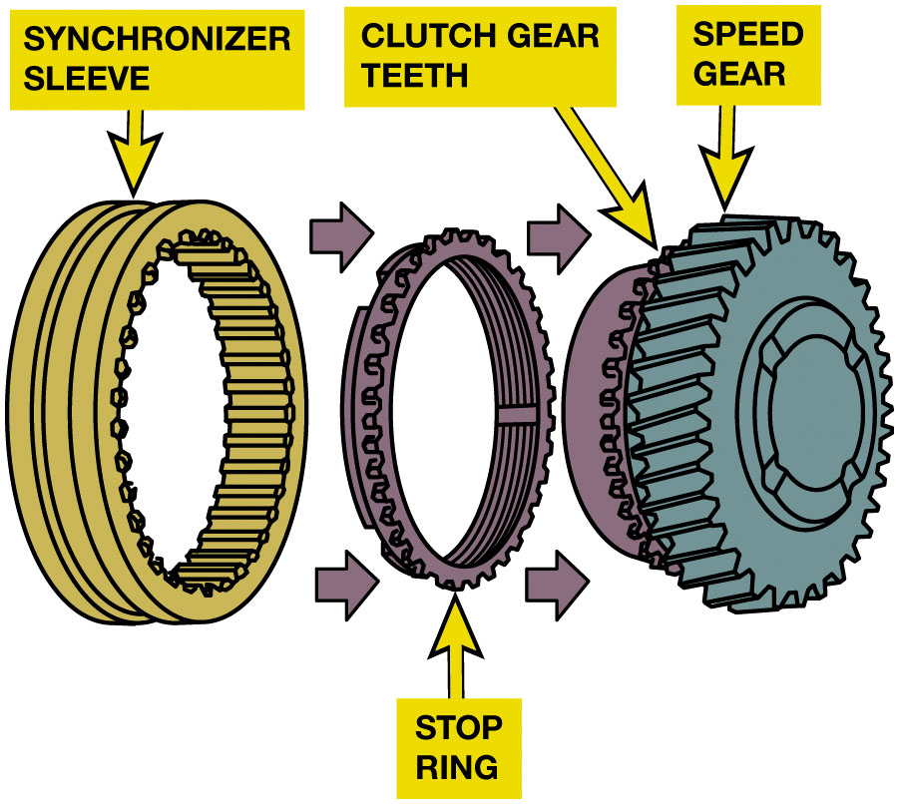
Figure 5.6
Synchronizer
Hub
Sliding sleeve
Blocker ring, or stop ring or synchronizer ring
Keys
Springs
The shifter fork fits into the groove of the synchronizer sleeve. When a shift is made, the sleeve is moved toward the speed gear. The sleeve presses the stop ring (synchronizer ring) against the cone area of the speed gear. The friction between the stop ring and the speed gear causes the speed of the two to become equal, permitting the sleeve to engage the gear clutch teeth of the speed gear. When this engagement occurs, the shift is complete.
Notes:
Although there are number of design variations, all are similar and include the following:
Hub
Sliding sleeve
Blocker ring, also called stop ring or synchronizer ring
Keys
Springs
In addition, tapered cone & coupling teeth machined on speed gear are part of synchronizer assembly. FIGURE 5.6.
In a typical synchronizer
Splines attach center hub of synchronizer to output shaft, so hub and output shaft rotate together. There are also splines machined on outer circumference of hub.
An outer sliding sleeve rides on the external hub splines with enough clearance so that it slides freely.
Splines on sleeve also match small coupling teeth of stop ring and speed gear. Coupling teeth are also called engagement or clutch teeth. The sleeve is splined to the hub, so it rotates with the output shaft.
Blocker ring sits between speed gear and sleeve. The coupling teeth on the stop ring match those on both the sleeve and the speed gear. The stop ring also has a tapered cone to match the cone machined on the speed gear.
Small, spring-loaded detent keys, also called synchronizer keys or struts, ride in slots on outer sleeve. The stop ring has slots to match these keys. This allows stop ring to rotate slightly, relative to the sleeve, before the keys hit the sides of their slots and stop the stop ring. As the sleeve moves, the synchronizer keys move with it, which pushes to the tapered cone of the speed gear.
Long Description:
The extreme left of the cross-section has a grooved gear labeled synchronizer sleeve. The inner lining of the synchronizer sleeve has carvings to fit gear teeth. Two right arrows from the synchronizer sleeve point to a slender grooved gear in the center labeled stop ring. The inner lining of the stop ring has parallel ring-like carvings. Two right arrows from the stop ring point to an encased gear labeled speed gear on the right. The left face of the speed gear is encased by a grooved gear labeled clutch gear teeth.

Slide 14
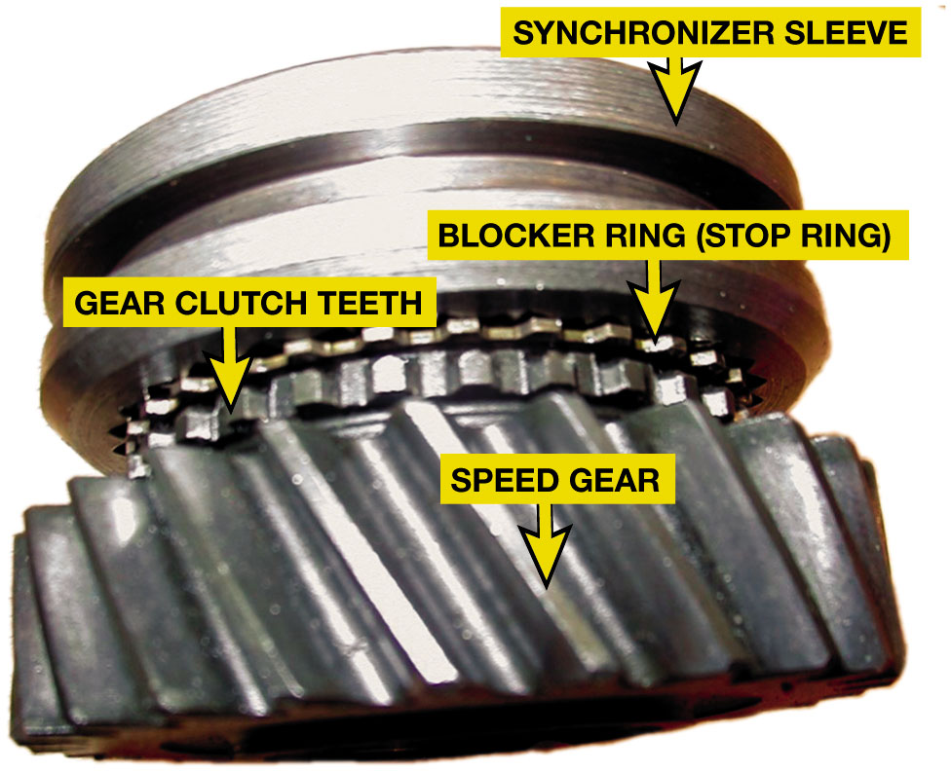
Figure 5.7
Typical synchronizer assembly.
As sleeve moves, detent keys help guide stop ring toward speed gear.
Cone slides onto tapered cone of speed gear.
Causes ring cone to slide onto tapered cone of speed gear
As shift made, stop ring acts as brake to slow down gear
Speed matches speed of synchronizer assembly.
Notes:
To shift into gear, driver disengages the clutch and moves shift linkage. The shift linkage, which is described later in this chapter, pushes the sleeve toward one of the speed gears. As sleeve moves, detent keys help guide stop ring toward speed gear. This causes the ring cone to slide onto the tapered cone of the speed gear. Speed gear is turning because it is in constant mesh with a countershaft gear. However, the gear may not be turning at the same speed as the synchronizer assembly even though both are on the same shaft. When the clutch is disengaged, the engine is no longer driving the transmission, so there is no torque applied to the input shaft, and the counter- shaft, or cluster gear, simply freewheels. As shift is made, stop ring acts as a brake to slow down the gear so that its Speed matches the speed of the synchronizer assembly. That is, it synchronizes the shift. This matched speed allows the internal hub splines to easily engage the coupling teeth on the stop ring and speed gear. When the clutch disengages, the crankshaft drives the input shaft, which drives countershaft, which in turn drives the output shaft through the selected gear.
Long Description:
The synchronizer assembly consists of gear with the largest diameter on the rear end labeled speed gear. The speed gear has vertically slanted teeth. The gear next to the speed gear is labeled gear clutch teeth. The diameter of the gear clutch teeth is less than that of the speed gear. Adjacent to the gear clutch teeth is a slender gear labeled blocker ring (stop ring). The diameter of the blocker ring is the same as that of the gear clutch teeth. The assembly on the front end has a giant gear labeled synchronizer sleeve. The synchronizer sleeve has a carved outer surface.

Slide 15
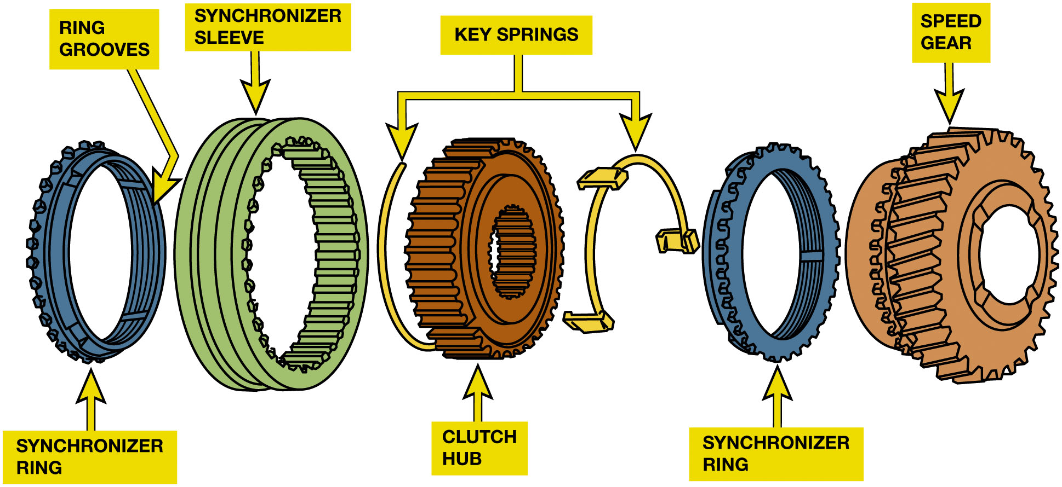
Figure 5.8
Synchronizer Operation
Synchronizer keys are attached to the clutch hub and push against the synchronizer ring when the sleeve is being moved during a shift. Notice the grooves on the synchronizer ring. These grooves prevent lubricating oil from becoming trapped between the ring and the cone surface of the speed gear. The grooves also help the ring release from the cone surface when a shift is made out of a gear.
Notes:
The synchronizer goes through three stages during a shift:
Shift is selected, synchronizer sleeve moves toward speed gear. If speeds of sliding sleeve (main shaft) and the speed gear (counter shaft) are not identical, the speed difference will cause tapered cone to “misalign” teeth of sleeve, stop ring, and speed gear. This “blocks” shift. Now, tapered teeth of sliding sleeve push against teeth of stop ring, which in turn pushes stop ring tapered surface up against tapered surface of speed gear. This causes the speed gear to either speed up or slow down based on difference between the main shaft speed (hub) and the counter gear speed (speed gear). When speeds are equal, the thrust is released on the tapered surface, which now allows “alignment” of the sliding sleeve teeth, stop ring teeth, and speed gear teeth, which allows the shift to be completed. Figure 5–8.
Sleeve overcomes force of detent key springs as shift linkage continues to move it toward gear. This allows stop ring to relax and move slightly so that sleeve splines begin to engage coupling teeth on the stop ring. At this point, the coupling teeth on the stop ring and speed gear may not line up with each other. However, friction continues to build between the ring and the cone, so the gear continues to slow down.
Long Description:
The extreme left of the illustration has a grooved gear labeled synchronizer ring. The parallelly lined grooves on the inner lining of the synchronizer ring are labeled ring grooves. To the right of the synchronizer ring is a grooved gear with a larger diameter labeled synchronizer sleeve. The inner grooves of the synchronizer sleeve are similar to those of the gear teeth. To the right of the synchronizer sleeve is a grooved gear labeled clutch hub. The diameter of the groove space in the clutch hub is comparatively lower than that of the previous gears. The clutch hub has a counterclockwise ring on its left and a clockwise ring on its right labeled key springs. To the right of the clockwise key spring is a grooved gear labeled synchronizer ring. The two mentioned synchronizer rings are oppositely faced, the left one is left faced and the right one is right-faced. To the right of the right-faced synchronizer ring is an encased grooved gear labeled speed gear.

Slide 16
Animation: Synchronizer Operation (Animation will automatically start)

Slide 17
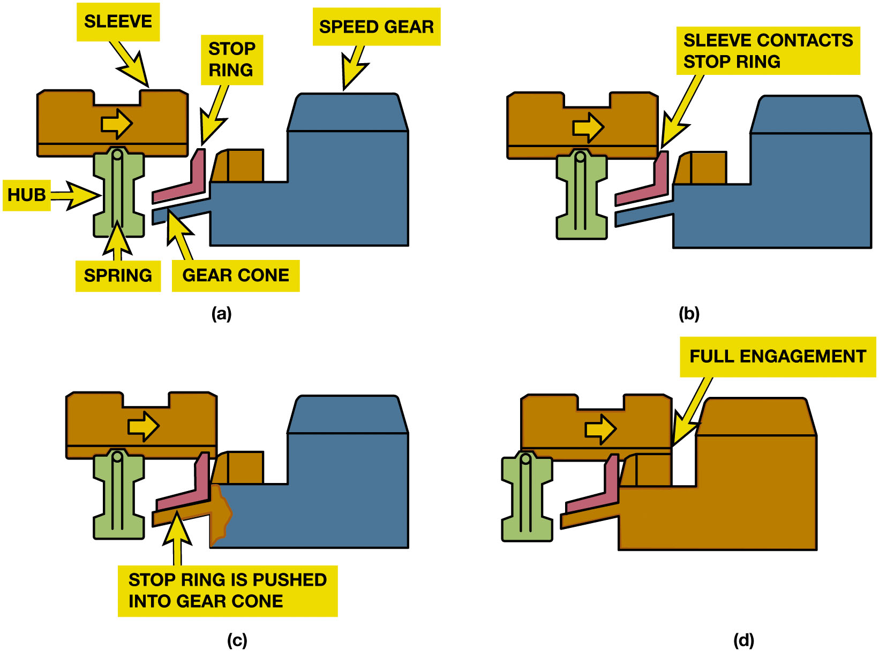
Figure 5.9
Synchronizer Stage 3
A shift sequence starts when the shift fork is moved by the driver. (a) Applying a force on the sleeve that moves it toward the speed gear. (b) The sleeve and the inserts contact the stop ring (blocking ring). (c) The synchronizer ring (stop ring) engages the cone on the speed gear, causing both assemblies to reach the same speed. (d) The shift is completed when the internal teeth of the sleeve mesh with the gear clutch teeth of the speed gear.
Notes:
Stage 3 Operation
Once sleeve, stop ring, and gear are all turning at same speed, it takes just a small movement between stop ring and gear to align the coupling teeth and allow sleeve to slip completely over both sets. The speed gear is now locked to the output shaft through the synchronizer stop ring and sleeve. ● Figure 5.9.
Synchronizer stop rings are a simple type of clutch, called a cone clutch for the shape of the mating surfaces. Some manufacturers refer to the synchronizer action as “clutching.” Synchronizer sleeves and hubs are gear-quality steel. Stop
rings are a softer metal—usually brass, copper, or a sintered metal—to absorb the friction of synchronizer operation. The tapered cone is relieved; that is, grooves are machined into its contact surface. These grooves serve two purposes:
They channel excess lubricant out from between the two pieces for better contact.
Retain a small amount of lubricant. This decreases wear when the cone clutch must slip slightly during coupling tooth alignment.
Long Description:
The top-left illustration labeled a has a horizontal sleeve on the left side. A right arrow is marked in the center of the sleeve. The sleeve is attached to a vertical hub on the bottom. The hub has a vertical spring in the center. To the right side of the spring and the bottom right of the sleeve has a left-faced L-shaped stop ring. Parallel to the stop ring is a horizontal gear cone on the bottom. The gear cone is attached to a left-faced inverted L-shaped rectangular speed gear on its right. The left side of the speed gear has a trapezoidal block attached to it. The top-right illustration labeled b has a similar configuration with the same components as that of part a. The gap between the bottom right edge of the sleeve and the tip of the stop ring has reduced to zero. The attachment between the sleeve and the stop ring is labeled sleeve contacts stop ring. The bottom left illustration labeled c has a similar configuration with the same components as that of part a. Here, the sleeve has crossed the tip of the stop ring and has attached itself to the trapezoidal block on the left of the speed gear. The gap between the stop ring and gear cone has reduced to zero, this attachment is labeled stop ring is pushed into gear cone. The bottom right illustration labeled d has a similar configuration with similar components to that of part a. Along with the attachment between the stop ring and the gear cone the sleeve is completely aligned with the trapezoidal block on the left side of the speed gear. This alignment is labeled full engagement.

Slide 18
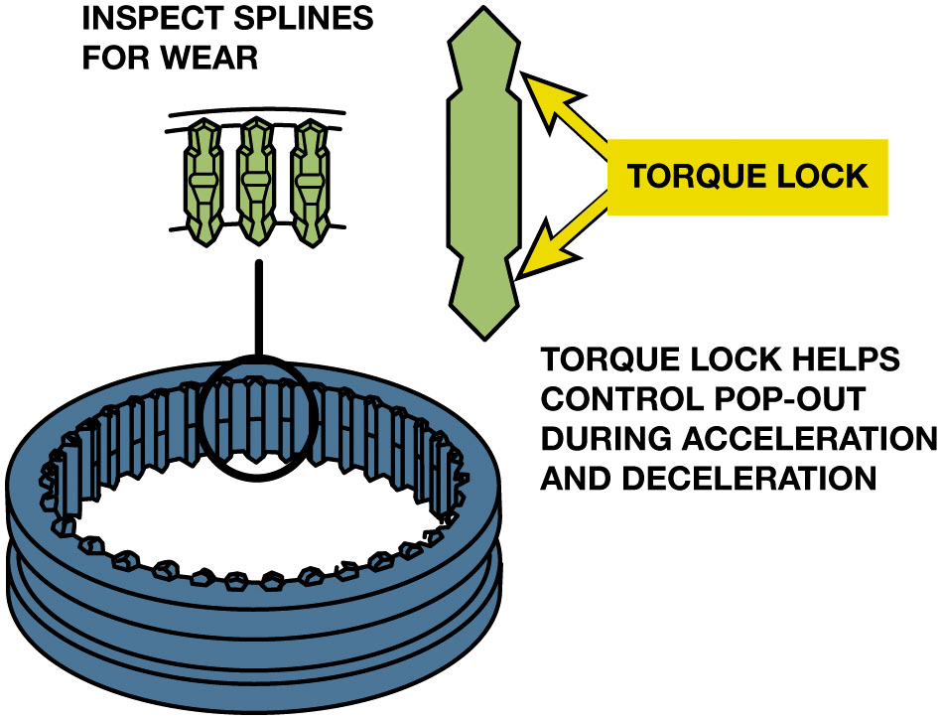
Figure 5.10
Torque Locks/Back Taper
Back Taper
Angle cut opposite to chamfer
Spline or tooth narrows
Just behind chamfered end
The shape of the splines helps prevent the transmission/transaxle from jumping out of gear during acceleration and deceleration.
Notes:
The internal splines on the synchronizer sleeve and coupling gear teeth on stop rings and speed gears have a special shape that works to hold the gear engaged once the driver releases the shift lever. The ends of the gear teeth are chamfered, giving them a triangular shape. These pointed ends allow easier sleeve-to-gear alignment as the angles tend to center the splines between the teeth. Once aligned, a back taper machined behind the chamfered end of the teeth and splines tends to keep the sleeve in place until the linkage pushes the sleeve away for another shift. Back taper is an angle cut opposite to the chamfer so that spline or tooth narrows just behind the chamfered end. ● Figure 5.10.
The back taper creates resistance to motion to keep the splines from sliding off the coupling teeth.
Long Description:
The cross-section has a grooved synchronizer sleeve on the bottom left. The top of the sleeve has enlarged views of three splines from the groove labeled inspect splines for wear. The splines have a pentagonal face on the top and bottom connected by an elongated vertical hexagon in the middle. The right side has a cross-section of the spline. The top and bottom pentagonal faces of the spline are labeled torque lock. A text on the bottom right reads torque lock helps control pop-out during acceleration and deceleration.

Slide 19
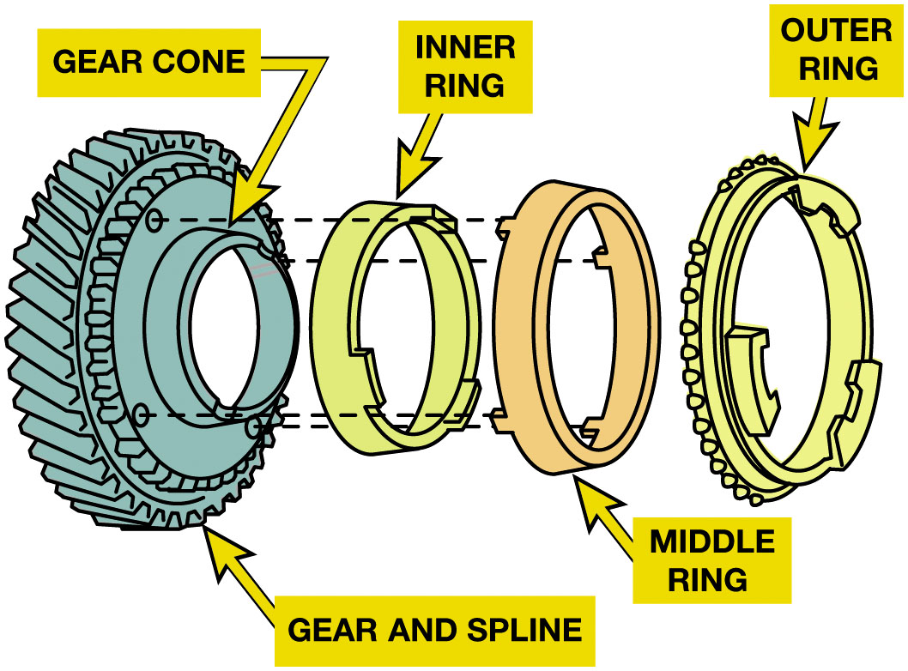
Figure 5.11
Triple-Cone Synchro
Double Cone Synchronizer
Multiple cones
More surface area
Better synchronization
Longer service life
Exploded view of a triple-cone synchronizer. The inner and outer rings rotate with the synchronizer sleeve while the middle ring rotates with the speed gear.
Notes:
A manual transmission with paper stop rings must use automatic transmission fluid (A T F). Other lubricants damage paper ring surface.
Some synchronizers use a double cone, with an outer cone and an inner cone along with the blocker ring. The multiple cones provide more surface area for better synchronization and longer service life. See Figure 5.11.
Long Description:
The cross-section has a grooved gear on its extreme left labeled gear and spline. The extended groove from the center of the gear and spline is labeled gear cone. The right face of the gear and spline has four tiny circular sockets. To the right of the gear and spline is a ring labeled inner ring. The inner ring has three rectangular holders on the right outline. To the right of the inner ring is another ring labeled middle ring. The middle ring has a larger diameter and comes with four pins on the left outline. Four straight horizontal dashed lines are drawn from the sockets of the gear and spline to the pins of the middle ring. To the right of the middle ring is another ring with a greater diameter labeled outer ring. The outer ring has teeth on its exterior surface and three holders on its right outline.

Slide 20
5-Speed Transmission Torque Flow (1 of 3)
Neutral: all synchronizer sleeves centered on their hubs.
First Gear:
Shift linkage slides 1–2 synchronizer sleeve rearward
Toward first speed gear.
Second Gear:
shift linkage slides 1–2 synchronizer sleeve forward
Away from first speed gear and toward second speed gear.
Notes:
5-SPEED RWD TRANSMISSION
A five-speed transmission has 6 gear sets that provide 5 forward speeds and 1 reverse speed. Either a sliding gear or constant-mesh gears may be used for reverse.
All forward gears are constant-mesh type.
Borg–Warner T 5 manual transmission serves as an example of a contemporary 5-speed design.
In addition to reverse, the T 5 provides three gear reduction ratios (first, second, and third), direct drive (fourth), and overdriven ratio (fifth).
A sliding idler gear is used to change output shaft direction and provide reverse.

Slide 21
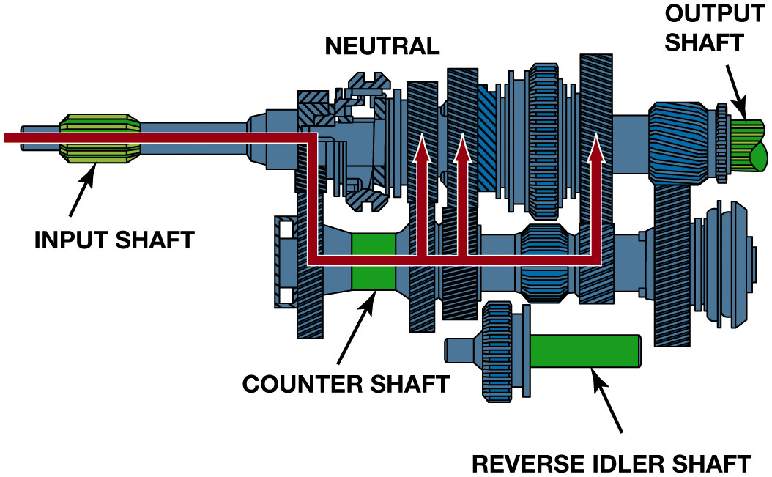
Figure 5.12
Neutral
In neutral, the input shaft and the countershaft are rotating if the clutch is engaged (clutch pedal up), but no torque is being transmitted through the transmission.
Notes:
Long Description:
The illustration has a transmission gear with a cylindrical input shaft on the left end and a partially cylindrical output shaft on the right end of the main shaft. The lower part of the transmission gear is labeled countershaft. A gear on the bottom right is attached to a horizontal rectangular component labeled reverse idler shaft on its right. A horizontal line from the left exterior enters the configuration, passes the input shaft, extends vertically downwards through the input gear driving on the main shaft and input gear driven on the countershaft, and then extends horizontally rightward. Three up arrows travel through the first, second, and third gears from the rightward horizontal extension.

Slide 22
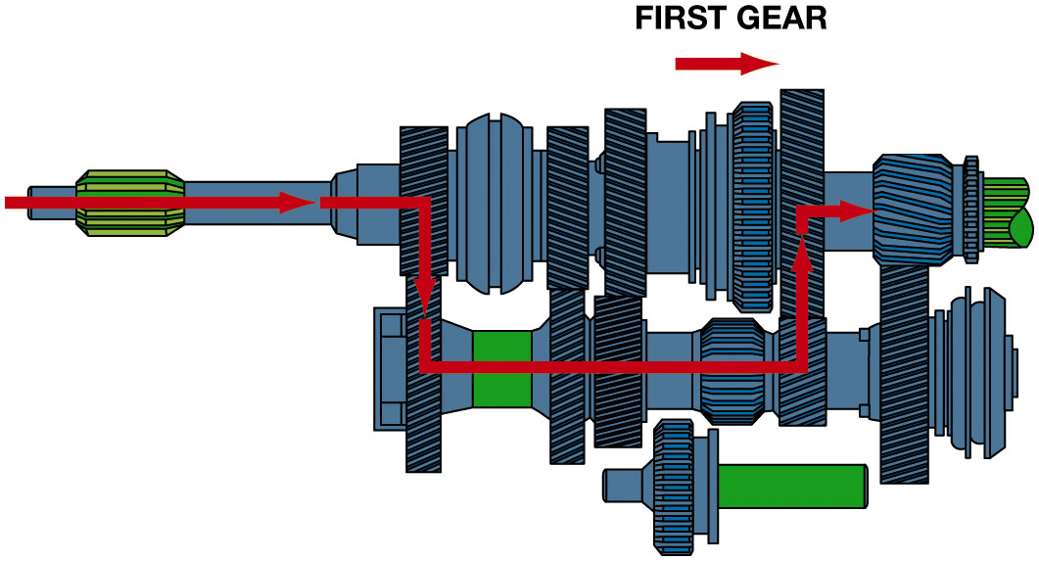
Figure 5.13
First Gear
In first gear, the 1–2 synchronizer sleeve is moved rearward, locking the first speed gear to the output shaft. Torque is transmitted from the input shaft to the countershaft and then to the output shaft.
Notes:
Long Description:
The illustration titled first gear has a transmission gear with a reverse idler shaft on the bottom. A right arrow is marked under the title. A horizontal right arrow enters the configuration through the left exterior, travels through the input shaft, then extends vertically downwards through the input gear driving on the main shaft and the input gear driven on the countershaft. It extends horizontally rightwards from the input gear driven and extends vertically upwards through the first gear driven on the countershaft and the first gear on the main shaft. It extends horizontally rightwards from the first gear to the fifth gear.

Slide 23
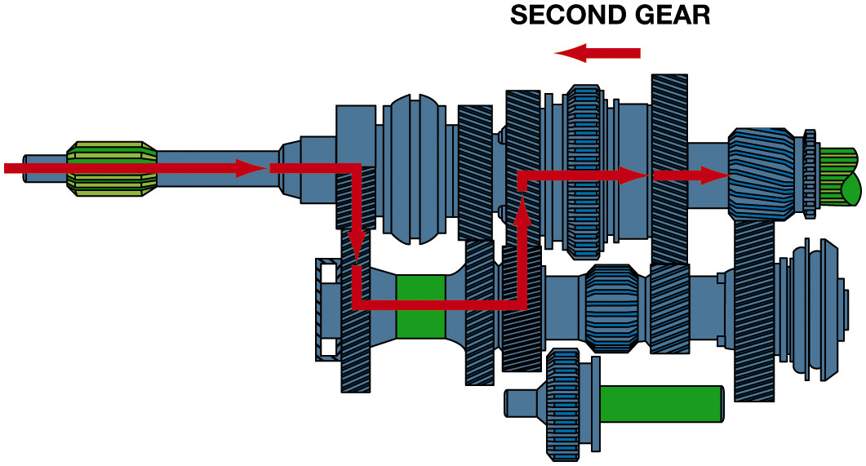
Figure 5.14
Second Gear
In second gear, the 1–2 synchronizer sleeve is moved forward, which locks the second speed gear to the output shaft.
Notes:
Long Description:
The illustration titled second gear has a transmission gear with a reverse idler shaft on the bottom. A left arrow is marked under the title. A horizontal right arrow enters the configuration through the left exterior, travels through the input shaft, then extends vertically downwards through the input gear driving on the main shaft and the input gear driven on the countershaft. It extends horizontally rightwards from the input gear driven and extends vertically upwards through the second gear driven on the countershaft and the second gear on the main shaft. It extends horizontally rightwards from the second gear to the first gear and from the first gear, it travels toward the fifth gear.

Slide 24
5-Speed Transmission Torque Flow (2 of 3)
Third Gear:
Shift linkage centers 1–2 synchronizer sleeve
Moves 3–4 synchronizer sleeve back toward the third speed gear.
Fourth Gear:
Shift linkage moves 3–4 synchronizer sleeve forward
Away from third speed gear and toward input shaft drive gear.

Slide 25
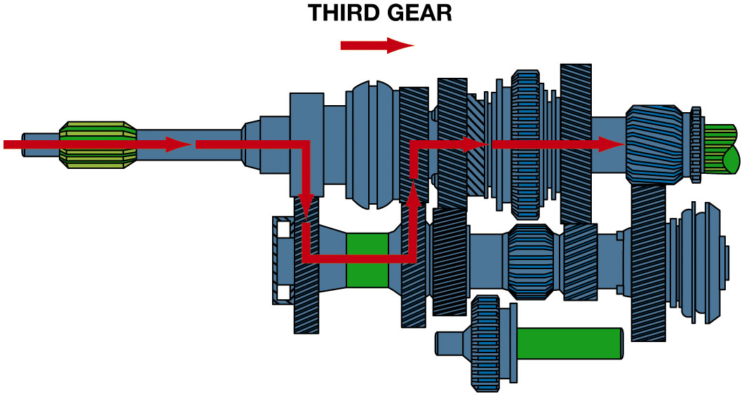
Figure 5.15
Third Gear
To achieve third gear, the shaft linkage first centers the 1–2 synchronizer sleeve and then moves the 3–4 synchronizer sleeve rearward, locking third speed gear to the output shaft.
Notes:
Long Description:
The illustration titled third gear has a transmission gear with a reverse idler shaft on the bottom. A right arrow is marked under the title. A horizontal right arrow enters the configuration through the left exterior, travels through the input shaft, then extends vertically downwards through the input gear driven on the countershaft. It extends horizontally rightwards from the input gear driven and extends vertically upwards through the third gear driven on the countershaft and the third gear on the main shaft. It extends horizontally rightwards from the third gear to the fifth gear.

Slide 26
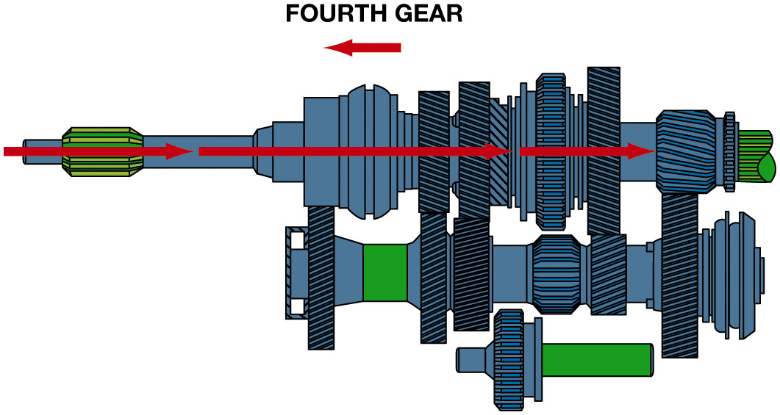
Figure 5.16
Fourth Gear
In fourth gear, the 3–4 synchronizer sleeve is moved forward, which locks the fourth speed gear to the output shaft.
Notes:
Long Description:
The illustration titled fourth gear has a transmission gear with a reverse idler shaft on the bottom. A left arrow is marked under the title. A horizontal right arrow enters the configuration through the left exterior, travels through the input shaft, then extends rightwards through the synchronizer, third gear, second gear, reverse gear, and the first gear on the main shaft. From the first gear the arrow points to the fifth gear.

Slide 27
5-Speed Transmission Torque Flow (3 of 3)
Fifth Gear:
Shift linkage centers 3–4 synchronizer sleeve
Moves fifth synchronizer sleeve toward fifth speed gear.
Reverse:
Sliding gear and constant-mesh gear.

Slide 28
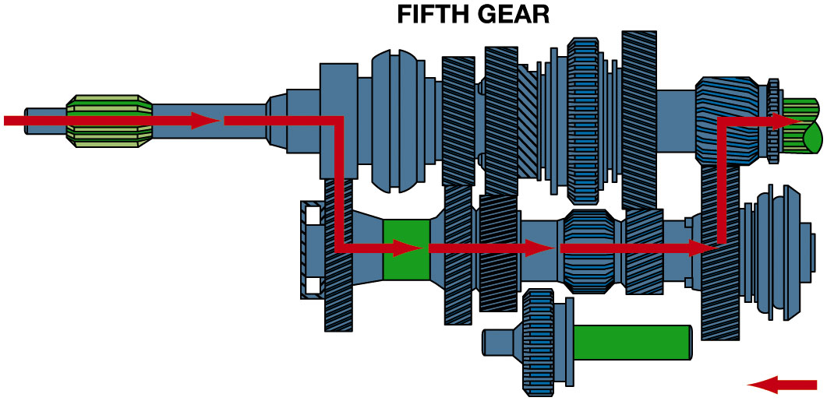
Figure 5.17
Fifth Gear
To achieve fifth gear, the shift linkage first centers the 3–4 synchronizer sleeve and then moves the fifth synchronizer sleeve toward the fifth speed gear, locking it to the output shaft.
Notes:
Long Description:
The illustration titled fourth gear has a transmission gear with a reverse idler shaft on the bottom. A horizontal right arrow enters the configuration through the left exterior, travels through the input shaft, then extends vertically downward through the input gear driven on the countershaft. From the input gear driven it extends horizontally rightwards and passes through the third gear driving, second gear driving, reverse idler gear driving, and first gear driving. From the first gear driving it extends vertically upwards through the fifth gear driving and the fifth gear. It extends horizontally rightward from the fifth gear to the output shaft. A left arrow is marked on the bottom right of the illustration.

Slide 29
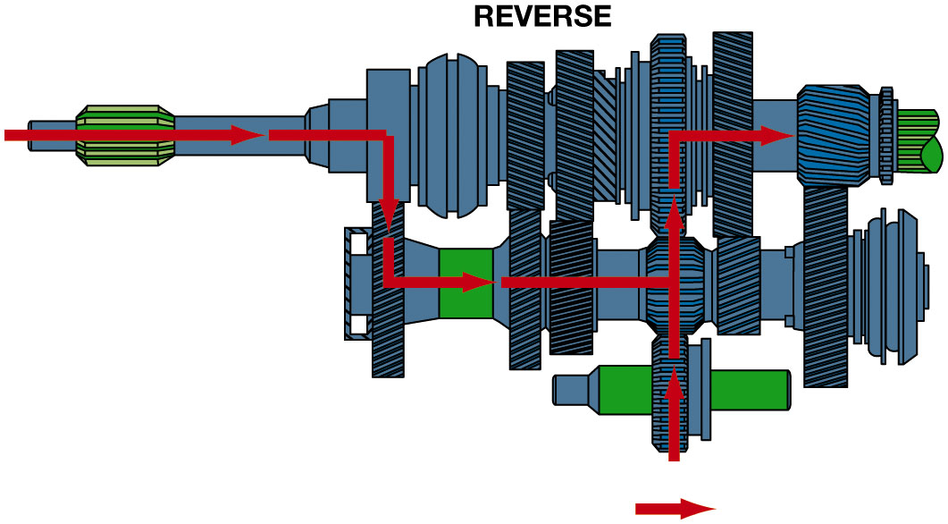
Figure 5.18
Reverse
Torque flows through the transmission in reverse gear. Note that the idler gear drives the 1–2 synchronizer sleeve gear, which is splined to the output shaft.
Notes:
There are two common reverse gear designs used on transmissions:
1. Sliding gear.
2. Constant-mesh gear.
With a sliding reverse gear design, such as on the Borg–Warner T 5, the shift linkage slides the
reverse idler gear on its shaft until it engages the reverse gears on the countershaft and output
shaft gear. Both gears are fixed to their respective shafts. This design uses spur gears for
reverse, not helical gears, because the gear teeth must move into and out of mesh. On some
gearboxes, the sliding gear splines to the output shaft. The linkage moves the gear along the
output shaft splines to engage the reverse idler gear. An unusual feature of the Borg–Warner T 5 is
that it does not have a separate reverse output shaft gear. Figure 5.18.
Long Description:
The illustration titled reverse has a transmission gear with a reverse idler shaft on the bottom. A horizontal right arrow enters the configuration through the left exterior, travels through the input shaft, then extends vertically downward through the input gear driven on the countershaft. From the input gear driven it extends horizontally rightwards and passes through the third gear driving and second gear driving. An up arrow enters the configuration through the bottom exterior and travels through the reverse idler shaft. The up-arrow travels through the reverse idler gear driving and the reverse idler gear. The horizontal arrow joins the vertical arrow from the left on the reverse idler gear driving. The vertical arrow extends horizontally from the reverse idler gear to the fifth gear. A right arrow is marked at the bottom of the illustration.

Slide 30
Animation: Transmission Power Flow (Animation will automatically start)

Slide 31
Animation: 5-Speed Transmission, 1st Gear (Animation will automatically start)

Slide 32
Animation: 5-Speed Transmission, 2nd Gear (Animation will automatically start)

Slide 33
Animation: 5-Speed Transmission, 3rd Gear (Animation will automatically start)

Slide 34
Animation: 5-Speed Transmission, 4th Gear (Animation will automatically start)

Slide 35
Animation: 5-Speed Transmission: 5th Gear (Animation will automatically start)

Slide 36
Animation: Transmission: Reverse (Animation will automatically start)

Slide 37
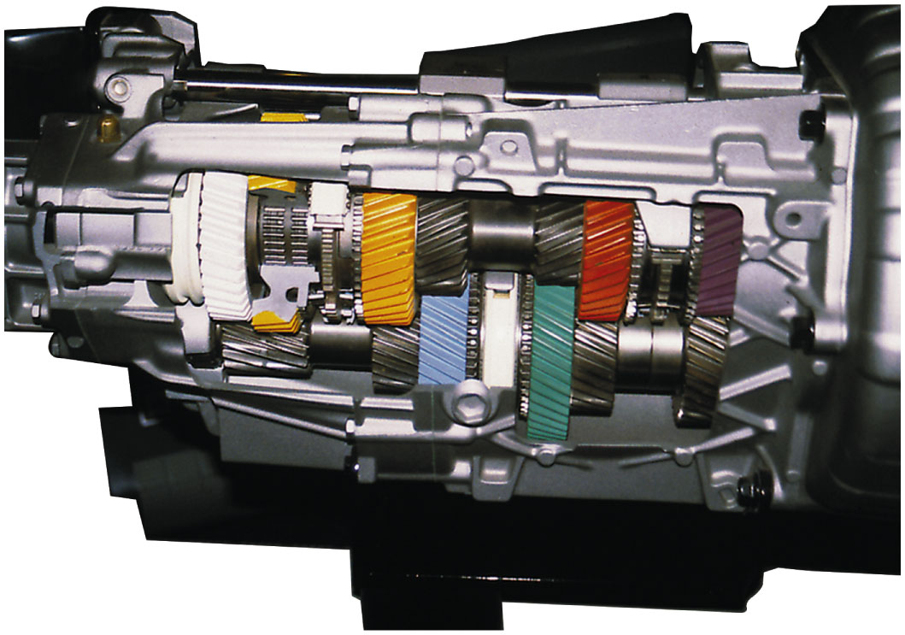
Figure 5.19
Six Speed Trans
Cutaway of a T 5 6 six-speed transmission showing all of its internal parts.
Notes:
A six-speed transmission requires one more gear on the cluster, an additional speed gear, and
one-half of a synchronizer assembly. This increases the weight, length, and cost of the unit. The
additional gear is usually another overdrive ratio. Some six-speeds have low and high gear ratios
similar to those of a five-speed, with the ratios closer together. See Figure 5.19.

Slide 38
Animation: 6-Speed Transmission Power Flow (Animation will automatically start)

Slide 39
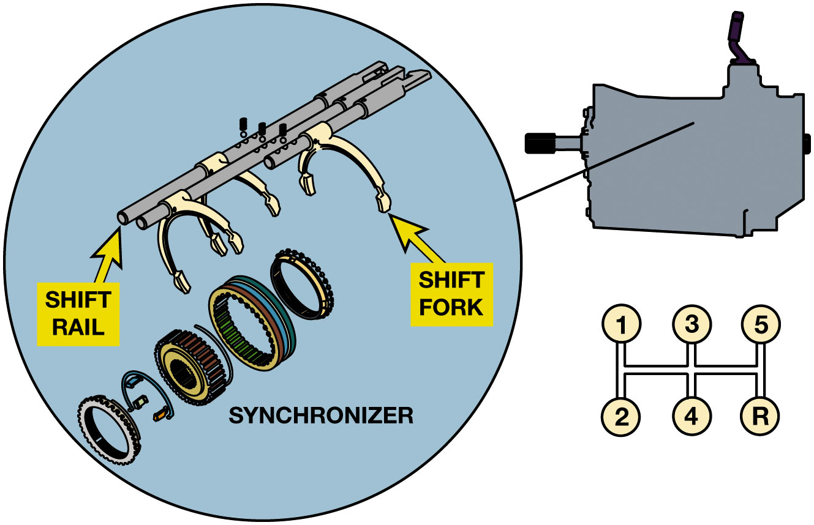
Figure 5.20
Shift Components
Shifter mechanism moves 1 or 2 synchronizer sleeves or gears to engage gear.
During upshift or downshift, one synchronizer sleeve is moved to neutral before sleeve of desired gear is moved to engage desired gear
When the gearshift lever is moved, the internal linkage (shift rails) moves the shift fork and synchronizer sleeve to shift gear speeds.
Notes:
Long Description:
The illustration has a covered transmission gear on the top right. The top-left side has an enlarged view of the internal linkage of the shift mechanism and the exploded view of the synchronizer. The front tips of the rod-like components of the shift-fork shaft are labeled shift rail. Each shift rail is hooked with an inverted U-shaped component labeled shift fork. The exploded view of the synchronizer on the bottom left has the synchronizer rings with ring grooves, synchronizer sleeve, clutch hub with the key springs, and speed gear. A rectangular grid on the bottom right has six nodes. The top three nodes from left to right are labeled 1, 3, and 5. The bottom nodes from left to right are labeled 2, 4, and R.

Slide 40
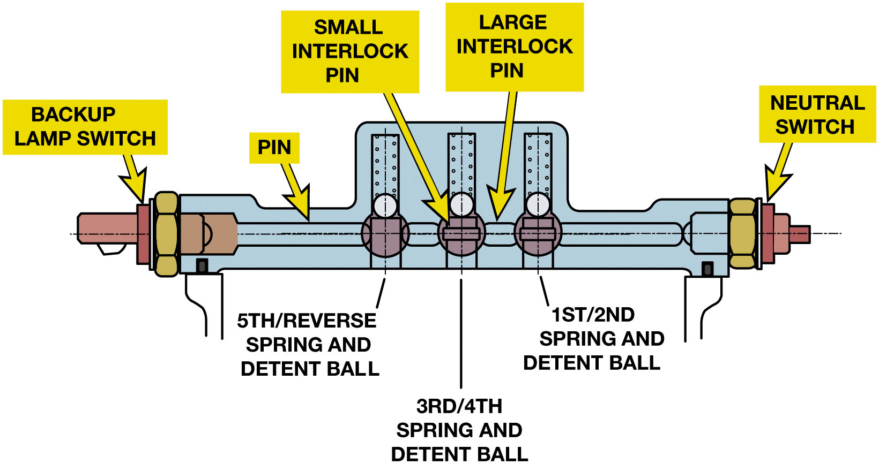
Figure 5.21
Shift Mechanism
Must include 2 features:
Interlock system
Series of detents
The internal shift mechanism includes the shift detents and the interlock to keep the shifter from selecting two gear ratios at the same time.
Notes:
INTERLOCK A shift mechanism must include the following two features:
1. An interlock system
2. A series of detents
Some transmissions also include a reverse lockout. The interlock prevents engagement of more than
one gear at a time. It is impossible for the transmission to transmit power through two different
ratios and have two different output shaft speeds at the same time. If two gears are engaged, the
transmission will lock up, and both the input and output shafts will become stationary.
The detents are used to locate the internal shift forks in one of their three positions—neutral plus a gear to each side. A detent is usually a
spring-loaded ball or bullet-shaped rod that is pushed into one of a series of three notches or a spring-loaded lever with three notches that drop over a cam. Figure 5.21.
The interlock prevents engagement of more than one gear at a time. It is impossible for the
transmission to transmit power through two different ratios and have two different output shaft
speeds at the same time. If two gears are engaged, the transmission will lock up, and both the
input and output shafts will become stationary.
Long Description:
The illustration is a narrow horizontal structure with a rectangular extension in the center. It has a vertical micro part labeled backup lamp switch on the left. Another vertical micropart labeled neutral switch on the right. Elongated oval outlines labeled pin are on the left and right ends of the horizontal center line of the configuration. Three circular balls are in between the two pins. The balls from the left to right are labeled as follows. Fifth slash reverse spring and detent ball, third slash fourth spring and detent ball, and first and second spring and detent ball. The third slash fourth and first slash second spring and detent balls have tiny rectangles in the center labeled small interlock pin. Two comparatively large horizontal ovals placed in between the balls are labeled large interlock pin. The three spring and detent balls are attached with tinier balls on top. Each spring and detent ball is attached with a vertical rectangle on top. These vertical rectangles have tiny dots on their outlines. Another set of vertical rectangles inserts the spring and detent balls from the bottom. A dashed and dotted horizontal centerline passes from the middle. Three dashed and dotted vertical lines pass through the center of the spring and detent ball configurations along with the micro parts.

Slide 41
Animation: Transmission Interlocks & Detents (Animation will automatically start)

Slide 42
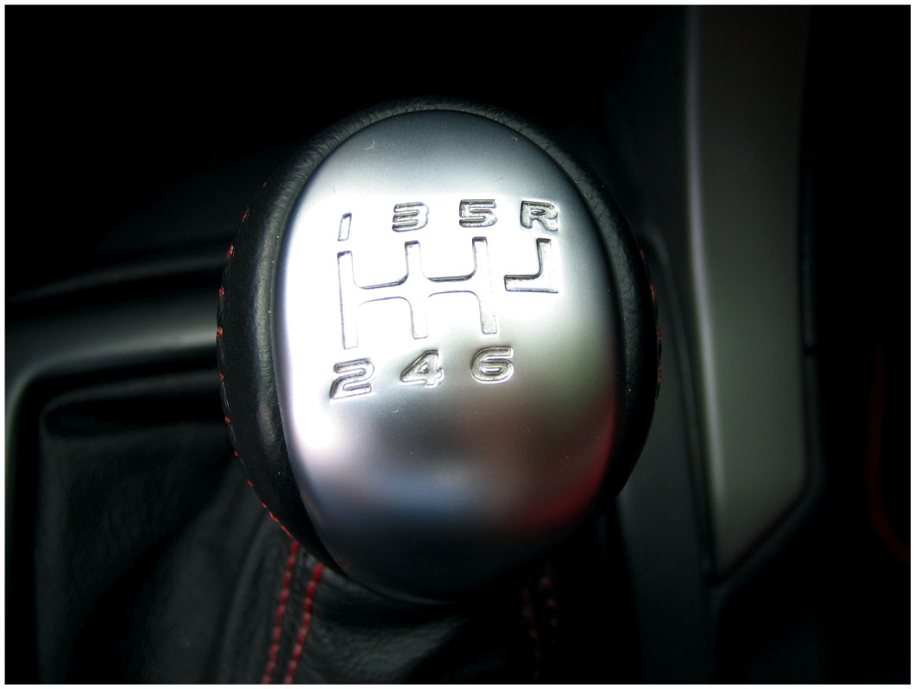
Figure 5.22
Reverse Lockout
Prevent accidental engagement of reverse while making an upshift.
Getting into reverse requires extra effort to overcome a strong centering spring.
Notes:
REVERSE LOCKOUT
A reverse lockout mechanism is used to prevent accidental engagement of reverse while making an
upshift. This mechanism requires the driver to perform an additional operation to shift into
reverse. This might require that the shift lever be pushed downward or lifted up, or there may be
an additional lever or button to be pushed. Some transmissions use a stronger shift lever centering
spring so it takes extra effort to move the shifter to select the reverse shift rail. See Figure 5.22

Slide 43
Frequently Asked Question: What is a Remote Shifter?
? Frequently Asked Question
What is a Remote Shifter? Some R W D manual transmissions such as the Getrag M T-82 used in newer Ford Mustangs use a remote-type shifter. See Figure 5-23 The use of a remote shifter allows the shifter to be placed in the same location as other types of manual transmissions such as the Tremec T R-6060 (lower unit) used in Shelby Mustang. Using a remote shifter allows the engineers to isolate road noise for a quieter cabin but at the expense of the direct feel that an internal shifter can provide.

Slide 44
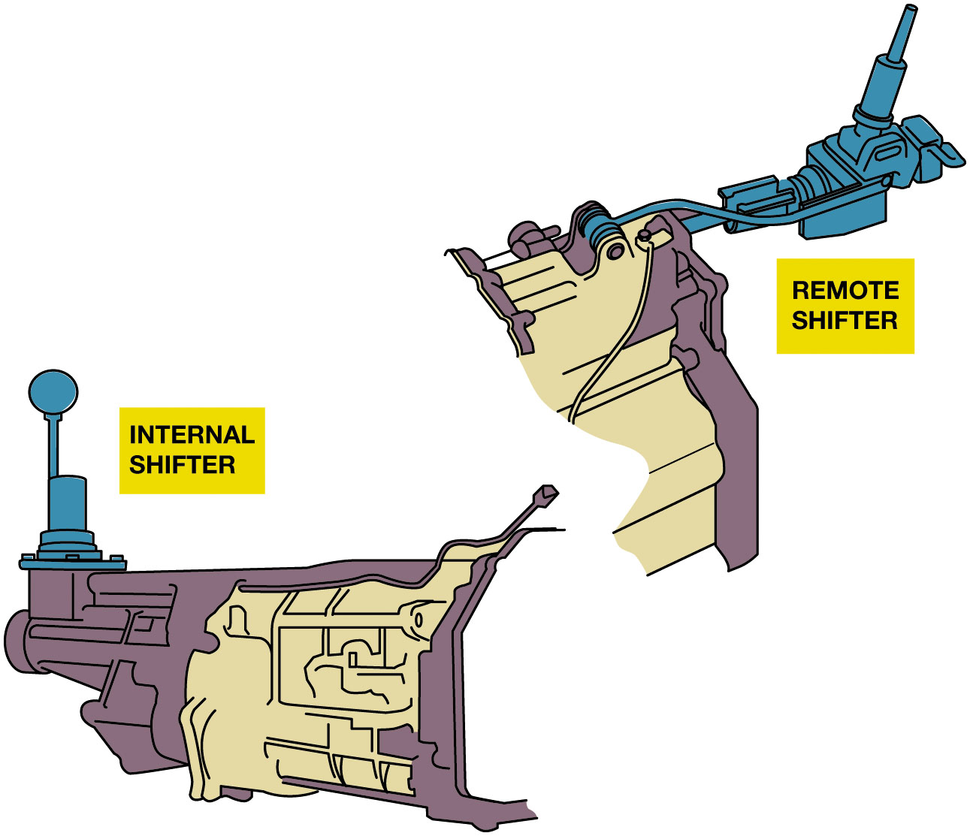
Figure 5.23
Remote Shifter
A remote shifter (upper unit) is used to locate the shifter inside the vehicle in the same location of another type used in a similar vehicle.
Notes:
Long Description:
The cross-section has the remote shifter on the top right. The remote shifter is connected to the machinery with a hooked cable and a horizontal rod. It has a vertically slanted cylindrical micropart on top inserted in a wider cylindrical micropart. The cross-section has the internal shifter on the bottom left. The internal shifter is secured to the top surface of the machinery with a circular base. It has a sphere on top attached to the cylindrical base with a vertical handle.

Slide 45
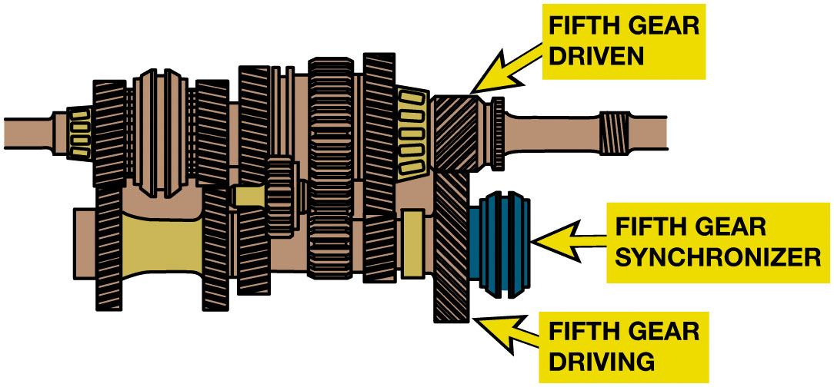
Figure 5.24
Greater Helix Angle
Notice the gear teeth in this transmission that those on the fifth gears have a finer pitch and a greater helix angle, to produce quieter operation while cruising.
Notes:
A helical gear can also be made with the helix cut at different angles. As the angle is increased, the gear will run more quietly, but end thrust will increase. Some modern five-speeds use fine-pitched gears with a greater helix angle for the fifth gear. This produces quiet operation at cruising speeds where low torque loading is encountered. Figure 5.24.
Long Description:
The last gear on the right side of the main shaft is labeled fifth gear driven. It has rightward slanted gear teeth on the visible surface. A slender and large gear attached on the bottom is labeled fifth gear driving. It has left-ward slanted gear teeth on the visible surface. A synchronizer labeled fifth gear synchronizer is attached to the right side of the fifth gear driving.

Slide 46
Manual Transmission Gears (1 of 2)
Main Shaft
Located by rear bearing, bearing surface, and retaining ring.
Surface for pilot bearing to main drive gear at front
Splines to match the U-joint splines at the rear.

Slide 47
Manual Transmission Gears (2 of 2)
Countershaft Cluster Gear
Supported by rod-like countershaft with needle bearings at each end .
Between countershaft and case is tight enough to prevent lubricant leaks.
Most cluster gears are one-piece units.
Figure 5.25 Two gears, (3) and (4), are press fit onto the cluster gear in a TR-3550 transmission.
Notes:
Long Description:
The exploded view has six parts. Part 1 on the left is a grooved gear with the lowest diameter. Part 2 is a clockwise spring. Part 3 is another grooved gear with the largest diameter. Part 4 is the extended gear cone of part 3. Part 5 is the horizontal cylindrical shaft to which part 3 is attached. Part 6 is two tiny semi-circular micro parts.

Slide 48
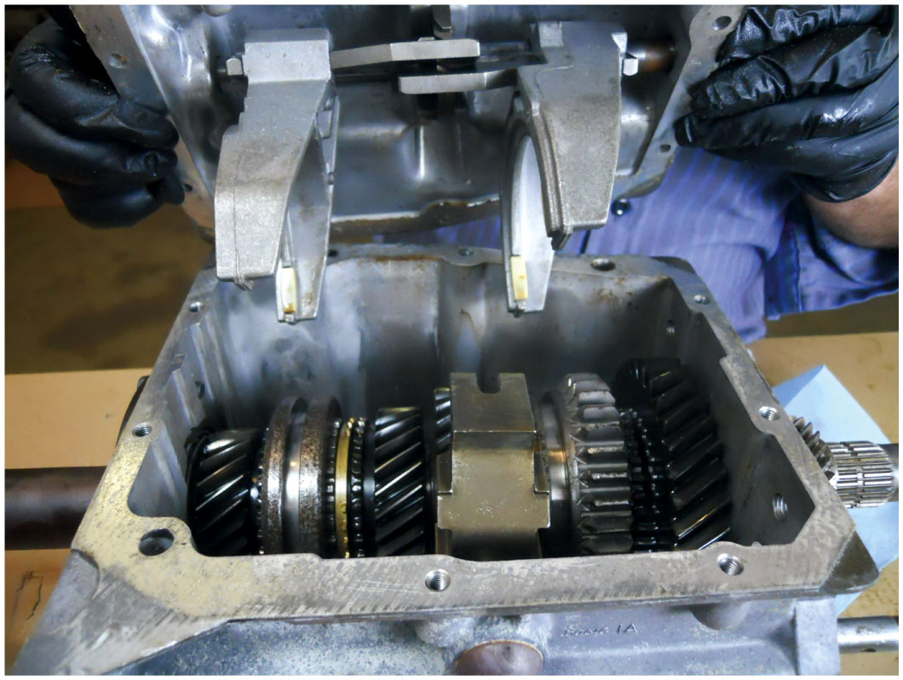
Figure 5.26
Borg–Warner T 5 five-speed transmission shown with the shifter cover removed.
Transmission Case
Made from aluminum castings
Use variety of bearings:
Needle (carry large side loads), ball (carry moderate to high side loads & thrust loads), tapered (carry large side and thrust loads), bushings (support slip yoke).
Notes:
The main case and extension housing are usually made from aluminum castings, whereas older
transmissions use cast iron cases. Most cases have openings for access to the gear train. The term
open case is sometimes used for a case in which the side or top cover is removable and includes the
shifting forks and other mechanisms. Figure 5.26.
Bearings
Transmissions use a variety of bearings, depending on particular design. The types used can
include following:
Needle bearings
Ball bearings
Tapered roller bearings
Bushings ● SEE FIGURE 5.27.
Needle bearings, either caged or free, can carry large side loads but are unable to control end thrust loads. Free needle bearings are used to support the cluster gear in older transmissions. The speed gears in many transmissions are mounted over caged needle bearings.
Ball bearings can carry moderate to high side loads & thrust loads. Therefore, they are commonly used for the main drive gear and main shaft. A “maxi” version of the ball bearing can carry even greater side loads. A maxi bearing can be identified by increased number of balls as well as loading notches at one side of the inner and outer races.

Slide 49
Figure 5.27
The types of frictionless bearings are ball bearings (a), straight roller bearings (b), needle bearings (c) and tapered roller bearings (d).
Notes:
Tapered roller bearings can carry large side and thrust loads and are generally used in pairs with the cones and cups facing in opposite directions. This bearing is normally installed with a method (usually shims) for adjusting end play or, in a few cases, preload. In some transmissions, tapered roller bearings are used to support the main drive gear, the main shaft, and the countershaft.
Bushing is used to support the driveshaft slip yoke in the extension housing. A bushing can support a large allows free in-and-out movement.
Long Description:
The bearing labeled a in the cross-section has two concentric layers. In between the two layers are seven circular micro parts. The bearing labeled b has semicircular grooves on the inner outline. The bearing labeled c has a comparatively lesser diameter than the previous two. It has striped grooves on the inner outlines. The bearing labeled d has a lower diameter on the top face and a greater diameter on the bottom face. It has a smooth surface on the inner outline and vertical rectangular teeth on the outer surface.

Slide 50
Manual Transmission Lubrication
Jobs of lubricant for manual transmissions?
Reduce friction
Transfer heat away from the gears and bearings
Reduce corrosion and rust
Flush dirt and wear particles away from moving parts
Notes:
Viscosity: measurement of fluid thickness. Viscosity is determined by observing how fast the fluid runs through a precisely sized orifice at a particular temperature. All oils are thicker and flow slower when cold and thinner and hot. The viscosity index (V I) is an indication of the flow difference between hot and cold. Viscosity index numbers are low, such as 80, if the lubricant is not able to maintain a consistent viscosity and high, such as 150, if the lubricant has a more stable viscosity throughout a wide temperature range. In a gearbox, a lubricant that is too thick will deliver poor lubrication when cold because the thick fluid will not flow into smaller areas. Too-thick gear oil might channel which means that it flows in a rope-like pattern. It also increases drag between parts so they do not turn as easily, and shift collars will not slide as easily. Synchronizer cones will not work very well because they cannot break through the thick oil film. This can cause hard shifting until the fluid warms. A too-thin lubricant will not provide the lubricating film under hot conditions. Thin fluids also cause more gear noise. The viscosity numbers used for gear oils are higher than those for engine oils, but the actual viscosity is similar. SEE FIGURE 5.28.

Slide 51
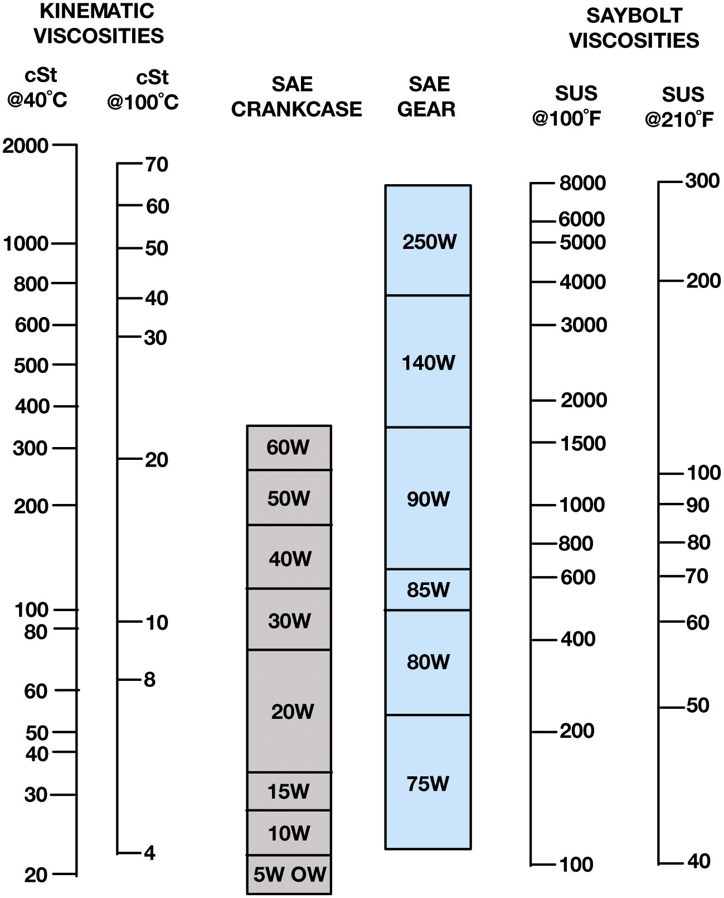
Figure 5.28
Chart
Gear oil and crankcase (engine oil) are shown together on this viscosity chart.
Notes:
Two rating systems are used to select the proper lubricant:
1. Society of Automotive Engineers (S A E) viscosity rating
2. American Petroleum Institute (A P I) Service Classification
Long Description:
The table has six columns and twenty-nine rows. The column headers from left to right are as follows. C S t at the rate 40 degree Celsius, c S t at the rate 100 degrees Celsius, S A E crankcase, S A E gear, S U S at the rate 100 degrees Fahrenheit, and S U S at the rate 210 degrees Fahrenheit. Columns one and two are categorized as kinematic viscosities. Columns five and six are categorized as say bolt viscosities. The row entries are as follows. Row 1: 2000, blank, blank, blank, blank, blank. Row 2: blank, 70, blank, blank, blank, blank. Row 3: blank, blank, blank, blank, 8000, 300. Row 4: blank, 60, blank, 250 W, blank, blank. Row 5: blank, blank, blank, 250 W, 6000, blank. Row 6: 1000, blank, blank, 250 W, 5000, blank. Row 7: blank, 50, blank, 250 W, blank, blank. Row 8: 800, blank, blank, 250 W, 4000, 200. Row 9: blank, 40, blank, 140 W, blank, blank. Row 10: 600, blank, blank, 140 W, 3000, blank. Row 11: blank, 30, blank, 140 W, blank, blank. Row 12: 500, blank, blank, 140 W, blank, blank. Row 13: 400, blank, blank, 140 W, 2000, blank. Row 14: 300, blank, 60 W, 90 W, 1500, blank. Row 15: blank, 20, 60 W, 90 W, blank, blank. Row 16: blank, blank, 50 W, 90 W, blank, 100. Row 17: 200, blank, 50 W, 90 W, 1000, 90. Row 18: blank, blank, 40 W, 90 W, 800, 80. Row 19: blank, blank, 40 W, 85 W, 600, 70. Row 20: 100, blank, 30 W, 80 W, blank, blank. Row 21: blank, 10, 30 W, 80 W, blank, 60. Row 22: blank, blank, 30 W, 80 W, 400, blank. Row 23: blank, 8, 20 W, 80 W, blank, blank. Row 24: 60, blank, 20 W, 80 W, blank, blank. Row 25: 50, blank 20 W, 75 W, 200, blank. Row 26: 40, blank, 20 W, 75 W, blank, blank. Row 27: 30, blank, 15 W, 75 W, blank, blank. Row 28: blank, 4, 10 W, blank, 100, 40. Row 29: 20, blank, 5 W O W, blank, blank, blank.

Slide 52
Figure 5.29
80W90 Gear Oil
When selecting the specified lubricant to be used in a manual transmission, always check that the viscosity and the rating match factory specifications.
Notes:
Long Description:
The labeling on the tub reads G L-5 80 W-90 gear oil; high-performance extreme pressure gear lubricant. On the bottom left, it reads port number 8 0 0 3 7 made in U S A. On the bottom right, it reads U S gallon 3.785 liters.

Slide 53
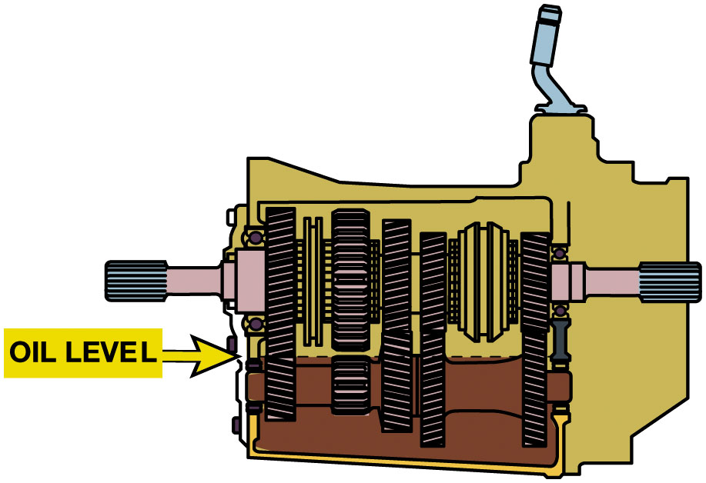
Figure 5.30
Fluid Level
The fluid level of most transmissions is at the bottom of the fill plug opening. Always check service information because some vehicle manufacturers specify that the correct full level is one inch (25 m m) below the bottom of the fill hole.

Slide 54
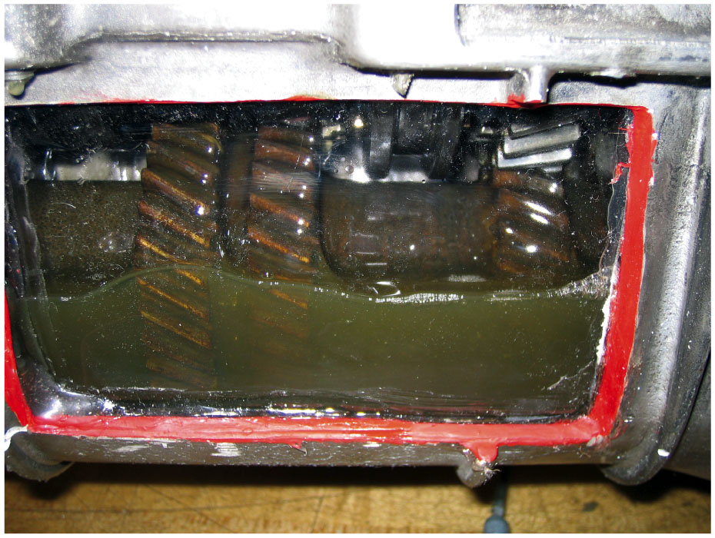
Figure 5.31
Gears Rotating
Caution
Transmission lubricated by oil thrown off cluster gear. If towed in neutral, cluster gear does not rotate & wear can occur between rotating main shaft & stationary gears that float on it.
The transmission gears rotating in the case is what forces the oil throughout the transmission as shown in this cutaway that is powered by an electric motor to show the action.
Notes:
A transmission with synchronizer on cluster gear will receive some lubrication through its gear action.

Slide 55
Question 1
A ___________ is used to prevent accidental engagement of reverse while making an upshift.
A. reverse lockout
B. internal shift linkage
C. external shift linkage
D. detent

Slide 56
Answer 1
A ___________ is used to prevent accidental engagement of reverse while making an upshift.
A. reverse lockout

Slide 57
Summary (1 of 2)
Transmissions provide gear sets for forward speeds/ reverse & neutral.
Synchronizer assemblies normally have a hub, sleeve, a set of keys
Two blocker rings, and a speed gear on each side.
Transmissions torque capacity determined by size of gears and shafts.

Slide 58
Summary (2 of 2)
Transmissions shifts use external or internal linkages that include
Detents, interlocks, and shift forks.
Transmissions lubricated with gear oil, engine oil, or M T F.
Special transmission design features include
Gear tooth helix angle, cluster gear variations, case construction
Bearing type.

Slide 59
Automotive Fundamentals Videos and Animations
Videos Link: (A3) Manual Drive Train Axles Videos
Animations Link: (A3) Manual Drive Train Axles Animations

Slide 60
Copyright
This work is protected by United States copyright laws and is provided solely for the use of instructors in teaching their courses and assessing student learning. Dissemination or sale of any part of this work (including on the World Wide Web) will destroy the integrity of the work and is not permitted. The work and materials from it should never be made available to students except by instructors using the accompanying text in their classes. All recipients of this work are expected to abide by these restrictions and to honor the intended pedagogical purposes and the needs of other instructors who rely on these materials.

