Slide 1
Manual Drivetrains and Axles
Ninth Edition
Chapter 4
Clutch Diagnosis and Service
Copyright © 2024, 2018, 2015 Pearson Education, Inc. All Rights Reserved
Notes:
If this PowerPoint presentation contains mathematical equations, you may need to check that your computer has the following installed:
1) Math Type Plugin
2) Math Player (free versions available)
3) NVDA Reader (free versions available)
INSTRUCTOR NOTE: This presentation includes text explanation notes, you can use to teach the course. When in SLIDE SHOW mode, you RIGHT CLICK and select SHOW PRESENTER VIEW, to use the notes.

Slide 2
Learning Objectives
4.1 Discuss clutch pedal free travel and clutch fluid level.
4.2 Explain the diagnosis of common clutch problems and recommend the proper repair procedures.
4.3 Explain how to remove and replace a clutch assembly
4.4 Discuss the inspection of used clutch components to determine if they are usable.

Slide 3
Introduction
Three different levels of clutch service.
What are they?
Preventive maintenance:
Troubleshooting and diagnosis:
Replacement:
Notes:
Most automotive technicians perform 3 different levels of clutch service.
Preventive maintenance: Check pedal free travel and fluid levels and make the necessary inspections and adjustments to ensure proper operation.
Troubleshooting and diagnosis: Determine the cause of a clutch concern and make recommendations for repair.
Replacement: Replace the clutch components to get the vehicle back in proper operation.

Slide 4
Clutch Inspection
Typical Clutch Maintenance & Service Items:
Checking clutch pedal free travel, or free play
Clutch pedal free travel is always first step!
Inspecting mechanical linkage systems
(older vehicles).
Checking fluid level in hydraulic systems.
Notes:
These operations are normally performed along with the other routine service checks. When diagnosing a clutch or
transmission concern, the first step is always a clutch pedal free travel check.
Excessive free travel will cause the clutch to not release completely.
Too little free travel will not allow the clutch to engage completely, which is more common because clutch pedal free travel will decrease as the clutch disc facing wears.
NOTE: Not all vehicle clutch systems use free-play. Always check with service information for the exact procedures to follow on the vehicle being checked.

Slide 5
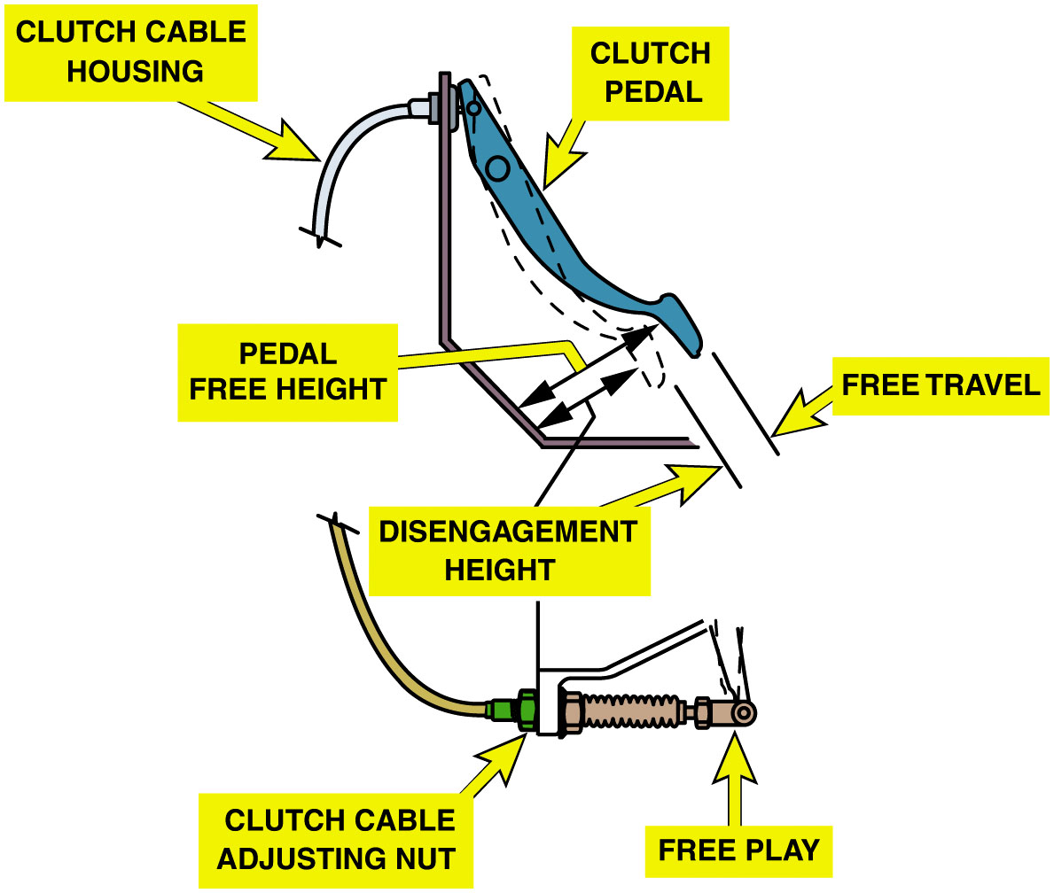
Figure 4.1
Clutch Inspection
Clutch Pedal Free Travel Test
Push clutch pedal downward by hand
Free travel
Distance pedal moves before greater resistance.
Measure free travel
Shorten or lengthen linkage as necessary
A typical cable-operated clutch adjustment location.
Notes:
Check & Adjust Clutch Pedal Free Travel Steps:
STEP 1 Push clutch pedal downward by hand, as pedal moves, there should be light resistance from clutch pedal return spring. Much greater resistance is felt as the release bearing contacts the release levers of the pressure plate. The free travel is distance pedal
moves before greater resistance of release levers is felt. Some O E M S recommend checking and measuring free travel at the clutch
fork or lever. In this case, push on end of fork in direction of release. Some resistance should be felt for a short distance, which is free travel.
STEP 2 Measure free travel with a ruler or tape. Compare distance measured with specifications. Free travel that is more or less than specifications indicates need for a clutch adjustment. It should be noted that some O E M S recommend measuring free travel with engine running. If no specifications are available, many will use 3/4 to 1inch (20 to 25 m m) at clutch pedal and 1/8 to 1/4 inch (3 to 6 m m) at clutch fork as a rule-of-thumb. FIGURE 4.1.
STEP 3 If an adjustment is necessary, locate adjuster and shorten or lengthen linkage to correct free travel. Operate clutch pedal through its full range of travel. It should operate smoothly without any unusual lags, skips, binding, roughness, or noise.
TECH TIP: The Tape Measure Trick:
Hook the end of a tape measure onto the pedal and run it through the steering wheel. Note the reading at the steering wheel as the pedal is depressed through its travel.
Clutches that use hydraulic or cable linkage should have a small amount of free travel, whereas rod and lever linkage clutches should have about one inch (25 m m) free travel.
Long Description:
The illustration on the top has a clutch pedal. It rests on a bent frame. A clutch cable housing is attached to the clutch pedal on the left. The distance between the bottom of the clutch pedal and the frame is labeled pedal free height. Below the clutch pedal is a free-travel lever and disengagement height. The illustration below has a clutch cable. A clutch cable adjusting nut is connected to it on the right. On its right is a free play.

Slide 6
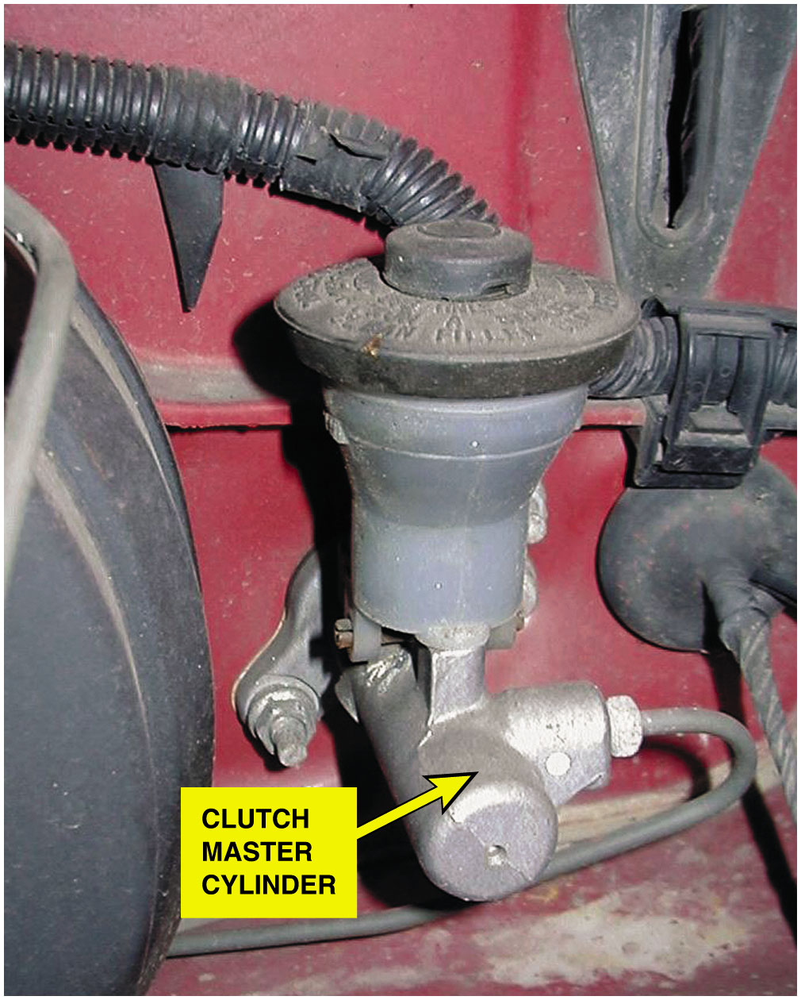
Figure 4.2
Clutch Inspection
Clutch Fluid Level Checked
Looking at fluid level at clutch master cylinder reservoir.
Fluid level will rise slightly as clutch facing wears.
Low fluid level indicates leak
A typical clutch master cylinder and reservoir mounted on the bulkhead on the driver's side of the vehicle. Brake fluid is used in the hydraulic system to operate the actuator cylinder located on the bell housing.
Notes:
TYPES OF HYDRAULIC CLUTCH FLUID
Brake fluid meeting DOT 3 designated specification is most commonly used fluid used in hydraulic clutch systems. However, there
are several fluids that may be specified depending on vehicle manufacturer, model, and year. The fluids that may be specified
include the following types:
DOT 3 brake fluid (Clear; amber)
DOT 4 brake fluid (Clear; amber)
DOT 4+ brake fluid (Clear; amber) (European vehicles)
Brake hydraulic fluid (Clear; amber) ● SEE FIGURE 4.3.

Slide 7
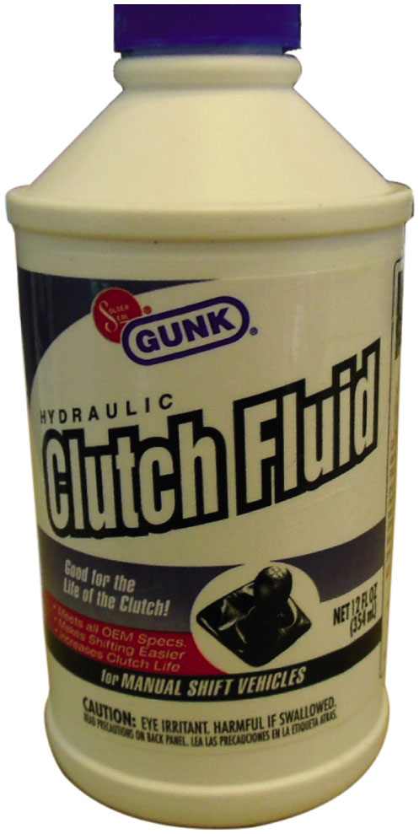
Figure 4.3
Clutch fluid is similar to brake fluid.
Hygroscopic
Absorbs water directly from air
Fluid needs to be drained
At Service intervals
To prevent corrosion
Notes:
Clutch hydraulic fluid is hygroscopic, and absorbs water directly from the moisture in the air. This means that the hydraulic system may need to be drained and refilled with new fluid to prevent corrosion and increase the service life

Slide 8
Clutch Problem Diagnosis (1 of 3)
Fault in Clutch, Linkage, Hydraulic System:
Transmission difficult (impossible) to shift into reverse
Transmission difficult (impossible) to shift between forward gears
Fluid leaks
Repairs could include:
Tightening loose line fitting
Replacing O-ring, fluid line or hose
Replacing clutch master cylinder or slave cylinder

Slide 9
Clutch Problem Diagnosis (2 of 3)
Check Slave Cylinder Travel.
Clutch Slippage
Check/adjust clutch pedal free travel.
Warm up engine to temperature
Block wheels, and apply parking brake completely.
Shift transmission into high gear
Let out clutch pedal smoothly.
Engine should stall immediately.
Delay indicates slow engagement and slipping.
Notes:
CASE STUDY: Stuck in Gear Jeep
removed, and an inspection A Jeep Wrangler (120,000 mi) sometimes got stuck in first or reverse, and the only way to get it out of gear is to shut the engine off. The transmission shifted okay most of the time. Thinking that clutch or related components were the most likely cause, the transmission was
revealed a seizing pilot bushing. Replacement of the bushing fixed this problem. The pilot bushing did not allow the input shaft to move independently of the flywheel when clutch was depressed.
Summary:
Complaint—Owner stated that the transmission was stuck in first or reverse.
Cause—Seized pilot bushing.
Correction—Replacement of the bushing corrected the stuck in gear concern.

Slide 10
Clutch Problem Diagnosis (3 of 3)
Clutch Spin-Down Test
Check/adjust clutch pedal free travel.
Warm up engine to operating temperature.
Push in clutch pedal, wait 9 seconds
Shift transmission into reverse.
Notes:
Gear clash or grinding indicates a dragging clutch that has not released completely. If a clutch fails the spin-down check, it likely needs to be replaced.
TECH TIP:
Take Precautions Whenever working on a clutch assembly, most O E M S recommend the use of P P E to protect against possible hazards. The items needed include the following:
1. Safety glasses
2. Protective gloves
Because clutch disc material may contain asbestos, precautions should include avoid causing any clutch friction material from becoming airborne by wetting the area. Check service information for specific precautions recommended by O E M

Slide 11
Clutch Symptom Guide
Clutch Slips
What are possible causes?
Clutch grabs
What are possible causes?
Clutch noises
What are possible causes?
Notes:
Clutch Slips Possible causes include:
Clutch is worn or out-of-adjustment.
Clutch disc has oil on surface.
Flywheel height is out-of-specifications.
Clutch Grabs Possible causes include:
Clutch disc has oil on surface.
Clutch linkage is binding.
Clutch Noises Possible causes include:
Pilot bearing is defective or worn.
Release bearing is defective or worn.
NOTE: A squeal that begins as the clutch pedal is depressed about 1 inch (25 m m) is probably caused by a defective or worn release (throwout) bearing.

Slide 12
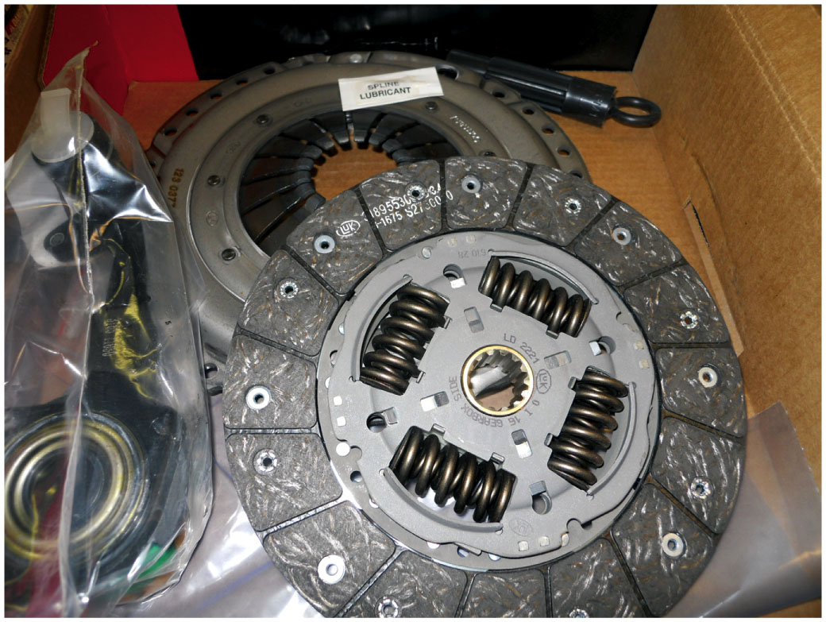
Figure 4.4
Clutch Replacement
Hoist Vehicle Safely
Remove driveshaft.
Disconnect linkage, speedometer, & reverse switch
Support transmission
Remove rear cross member
Remove bell housing bolts
A typical clutch kit, which includes the clutch disc, pressure plate, and release (throwout) bearing as well as grease for the spline and a clutch disc alignment tool.
Notes:
Case Study Broken Chevrolet Clutch
The clutch in a Chevrolet H H R (119,000 mi) would not disengage. A broken pressure plate or clutch disc was suspected, so the transaxle was removed.
Inspection showed normal clutch wear, nothing to prevent disengagement. A new pressure plate, disc, and throwout bearing were installed, and the flywheel was machined. The clutch still would not disengage. A small leak was found at the actuator cylinder, so the entire hydraulic system was replaced with a new assembly. The new assembly was full of fluid, so bleeding was not necessary.
The actuator cylinder push rod travel has normal movement during clutch pedal travel application. At the suggestion of the parts supplier, a flywheel shim was installed to compensate for the thinner machined flywheel, but this did not help.
Close inspection revealed that the release fork was bent and worn. Replacement of the fork and its bushings fixed this problem.
Summary:
Complaint—Clutch would not disengage.
Cause—The release fork was worn and bent.
Correction—Replacing the fork and the bushings corrected this customer concern.

Slide 13
Clutch Replacement
Carefully move transmission toward rear
After the transmission has cleared the clutch can be lowered and inspected before being reinstalled after clutch assembly replaced.
Mark pressure plate and flywheel if they are to be reused

Slide 14
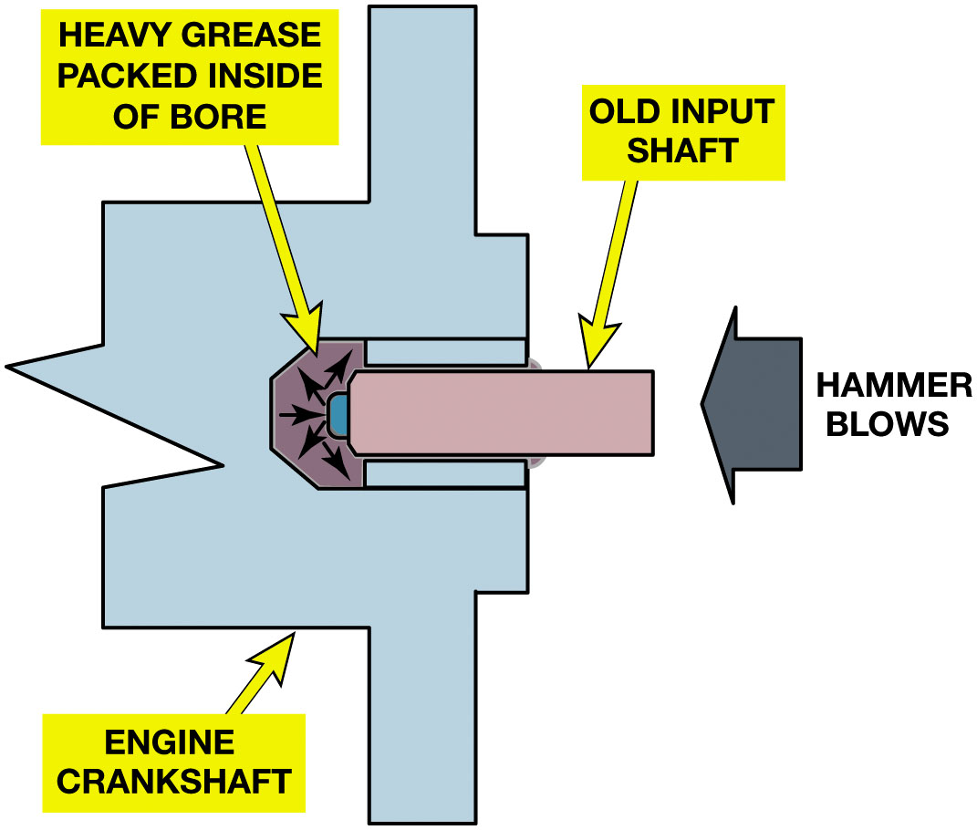
Figure 4.5
Clutch Replacement
Remove clutch pressure plate retaining bolts, & remove clutch assembly including release bearing, pressure plate, and clutch disc.
Pilot Bearing
An old input shaft obtained from a disassembled transmission can be used to force the old pilot bushing out.
Notes:
Warning The clutch driven disc may contain asbestos, which is known to be a cancer-causing agent. Never clean clutch surfaces with compressed air. Avoid inhaling any dust from any clutch surface. When cleaning the clutch surfaces, use a commercially available brake cleaning fluid.
Long Description:
The schematic consists of an engine crankshaft. It has a bore on the right. An old input shaft is inserted into a bore with a hammer. Inside the left end of the bore, heavy grease is packed.

Slide 15
Clutch Component Inspection (1 of 2)
Check Each Part
Importance of inspection
Flywheel
Check for grooves, nicks, heat damage.
Flywheel resurfacing
Flywheel axial runout
Pressure plate assembly inspection
Check for:
Friction surface damage
Release lever wear
Lever pivot wear
Cover distortion
Notes:
IMPORTANCE OF INSPECTION Technicians should check each part as it is disassembled to determine if it is reusable or
why it failed. This identifies any condition that needs special attention before the clutch is reassembled. If the clutch is
slipping, the disc and the pressure plate should be replaced.

Slide 16
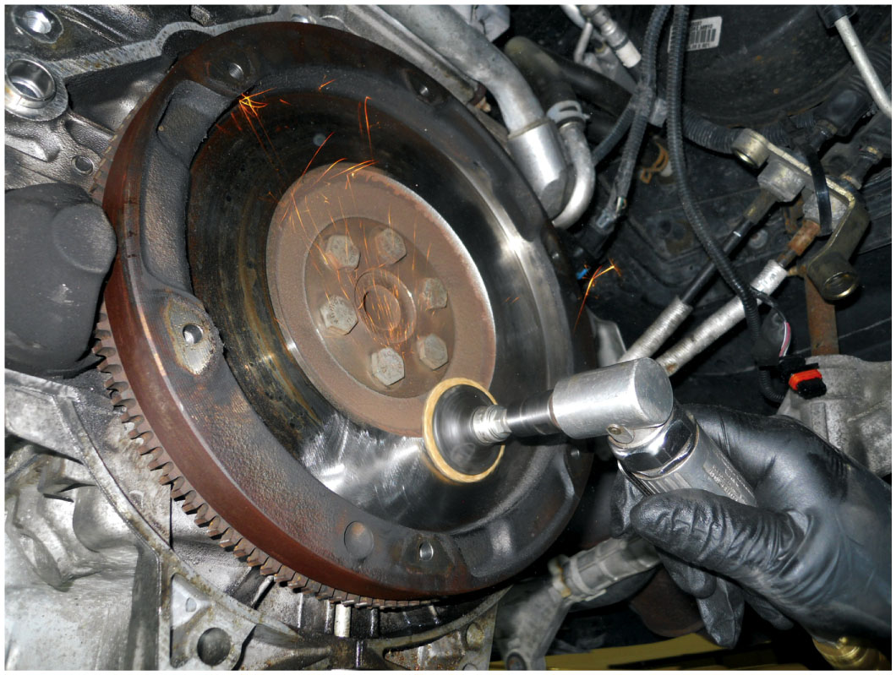
Figure 4.6
Abrasive Disc
Using an abrasive disc to remove the glaze and to restore the proper surface finish to a flywheel.
Notes:
REFACING
Blanchard grinding moves a spinning grinding stone around the flywheel surface. This is the recommended method of resurfacing because it leaves a truly flat surface with a circular, non directional pattern. A non directional finish promotes rapid disc facing-to-fly-wheel break-in.
If the friction surface is flat and smooth but highly polished or glazed, some technicians will sand the friction surface using a disc sander with 80- to 120-grit paper. When doing this, the sander is kept in motion while attempting to duplicate the ground finish of a new unit without cutting grooves.

Slide 17
Clutch Component Inspection (2 of 2)
Clutch Disc Inspection
Check: facing thickness, damper spring condition, wear of the hub splines, contaminated or oil soaked facing material, warpage or axial runout
Clutch/Bell Housing Inspection
Check: oil/grease residue, face and bore surfaces, excessive runout
House Bore Runout
Release Bearing
There are no effective checks except for feeling for roughness or seeing obvious wear/discoloration

Slide 18
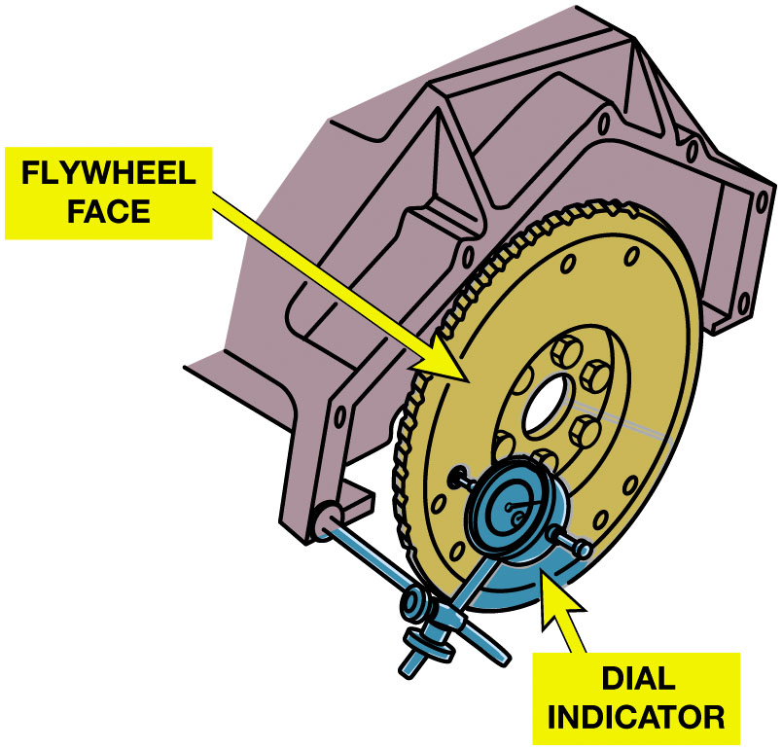
Figure 4.7
Axial Runout
Face or axial runout
Positioning dial indicator
Indicating stylus
Outer edge of flywheel
A dial indicator set up to measure flywheel face or axial runout.
Notes:
Axial Face Runout
Many flywheels are forged steel, which tends to warp (potato chip shape) or dish if overheated.
This is checked by placing a straightedge across the flywheel in several locations. Over 0.0005 inch (0.013 m m) of warpage per inch of diameter is considered excessive. This means that a 12-inch-diameter flywheel can have 0.006 inch (12 × 0.0005) of warpage error.
If there is a vibration concern or an odd wear pattern at the hub of the disc or pressure plate release levers, the fly- wheel should be checked for excessive runout. Face or axial runout is checked by positioning a dial indicator with the indicating stylus at the outer edge of the flywheel face. ● Figure 4.7.
Process
STEP 1 Mount the dial indicator so the measuring stem is parallel to the crankshaft and pointing directly to- ward the flywheel contacting the disc friction area, and adjust the indicator to read zero.
STEP 2 Rotate the flywheel while watching the dial indicator. Maintain an even pressure, either inward or outward, to maintain zero crankshaft end play. The variation in reading is the amount of axial runout.
STEP 3 Set up the dial indicator to measure lengthwise fly- wheel/crankshaft motion, and push and pull on the flywheel and crankshaft in a direction that is parallel to the crankshaft. The dial indicator is measuring crankshaft end play. Normal crankshaft end play should be about 0.002 to 0.010 inch (0.05 to 0.25 m m). Movement greater than specified indicates worn engine crankshaft thrust bearings.
To measure flywheel radial runout, perform the following steps:
STEP 1 Mount the dial indicator so it is at the edge of the flywheel, pointing directly toward the center of the flywheel.
STEP 2 Adjust the dial indicator to read zero.
Case Study: Stepped-Type Flywheel
The clutch in a V W (107,000 mi) has been replaced and the flywheel was resurfaced at the same time. But now there is noticeable clutch chatter. The technician was told that during the flywheel resurfacing, only the clutch mating surface was machined. The technician feels that the step height could be incorrect, but could not find the specification.
After contacting international Automotive Technician Network (I A T N), a fellow technician provided the step-height specification. A check of the flywheel showed that its step was at the limit, but the clutch surface also had 0.003 inch of runout. Machining the flywheel fixed this problem.
Summary:
Complaint—The technician discovered a clutch chatter after the clutch had been replaced.
Cause—Measuring the flywheel showed excessive runout.
Correction—The flywheel was machined which corrected the clutch chatter concern.
Long Description:
The illustration has a flywheel attached to the crankshaft. A dial indicator is on the right of the flywheel, connected to the crankshaft through a rod.

Slide 19
Animation: Measure Flywheel Runout (Animation will automatically start)

Slide 20
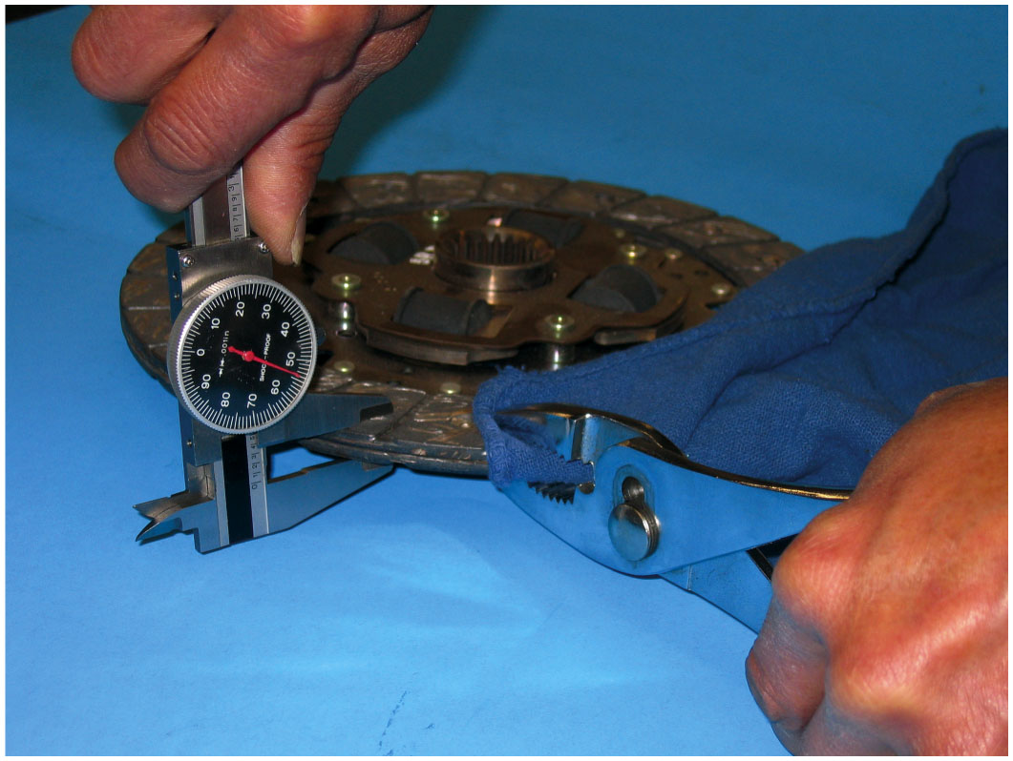
Figure 4.8
Method 1 Using Caliper
The thickness of clutch disc facing can be measured using a dial caliper.
Notes:
The thickness of the facing can be checked by two different methods.
Method 1. The first method is to place cardboard or a shop cloth over the facing to keep it clean and squeeze the facings together to compress the marcel spring. If specifications are not available, the minimum thickness of the compressed disc should be 0.280 inch (7.1 m m). ● SEE FIGURE 4.8.
Method 2. The most popular method is to measure the height of the facing surface above the rivets which is also called rivet head depth. With a new disc, rivet head depth will be about 0.050 inch (1.2 m m). A disc with less than 0.015 to 0.020 inch (0.38 to 0.5 m m) should be replaced. SEE FIGURE 4.9.

Slide 21
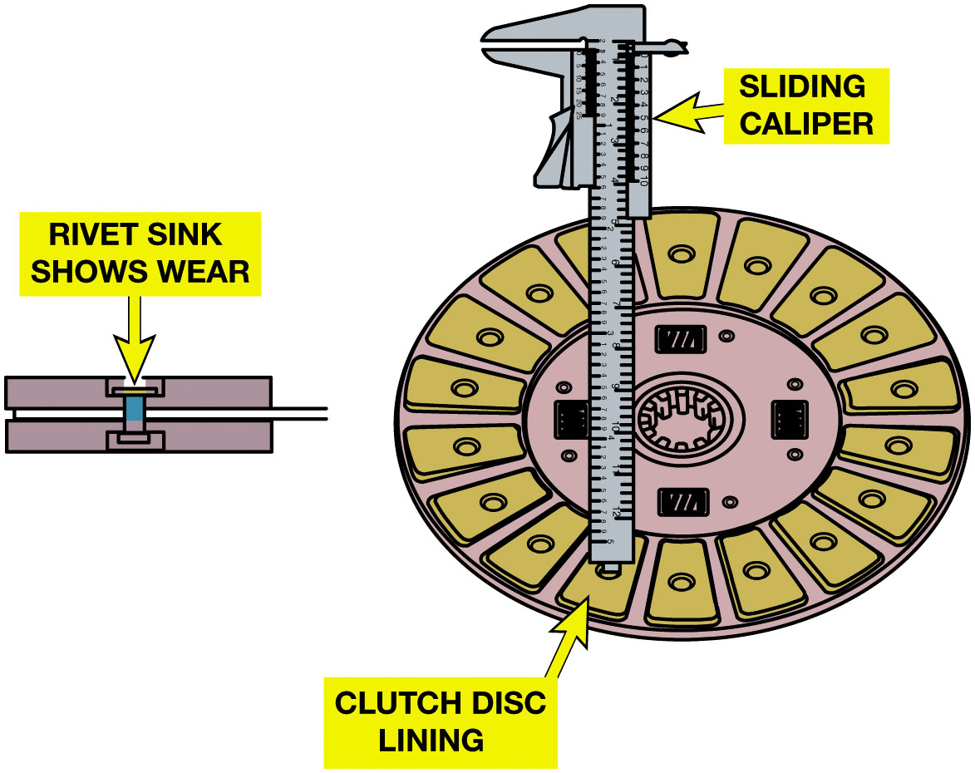
Figure 4.9
Method 2 Measuring Disc
The overall disc thickness can be measured using a vernier caliper by first compressing the marcel spring using pliers.
Notes:
The thickness of the facing can be checked by two different methods.
Method 1. The first method is to place cardboard or a shop cloth over the facing to keep it clean and squeeze the facings together to compress the marcel spring. If specifications are not available, the minimum thickness of the compressed disc should be 0.280 inch (7.1 m m). ● Figure 4.8.
Method 2. The most popular method is to measure the height of the facing surface above the rivets which is also called rivet head depth. With a new disc, rivet head depth will be about 0.050 inch (1.2 m m). A disc with less than 0.015 to 0.020 inch (0.38 to 0.5 m m) should be replaced. Figure 4.9.
Long Description:
The illustration on the left has a clutch disc. A vernier caliper is placed on the disc and the thickness is measured by sliding the caliper. The illustration on the right has two plates held together by a rivet. the rivet sink is worn out.

Slide 22
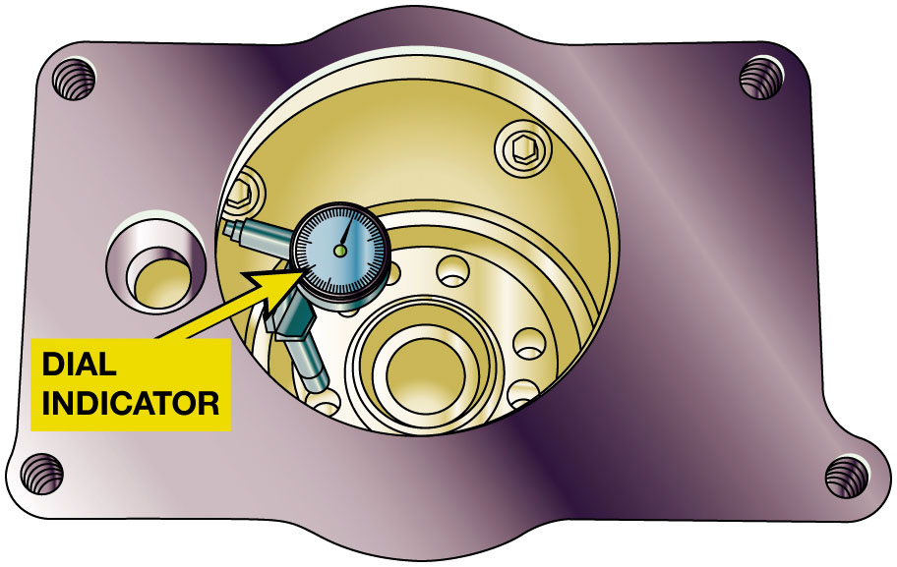
Figure 4.10
Clutch Housing Runout
The dial indicator has a lever added to check clutch housing bore runout. Excessive runout can be caused by damaged or missing dowels in the engine block. If the dowels are okay, excessive runout can be corrected by installing eccentric dowels.
Notes:
RUNOUT
To check clutch housing bore runout, perform the following steps:
STEP 1 Reposition the dial indicator so the measuring stem is inside the bore and pointing outward.
STEP 2 Adjust the dial indicator to read zero.
STEP 3 Rotate the crankshaft while watching the indicator reading.
STEP 4 Any variation in reading is the amount of bore runout. If the runout cannot be corrected, the bell housing is usually replaced, but it is possible to put shims between the
bell housing and the engine block to correct excessive run-out. The limit for bore runout is about 0.010 inch (0.25 m m). Bore runout can be corrected by using eccentric dowel pins to reposition the bell housing. These are available in different sizes. Position the bell housing so it is centered with the crankshaft. SEE FIGURE 4.10.
Long Description:
The schematic has a clutch housing bore. A dial indicator with an attached lever is placed inside the bore.

Slide 23
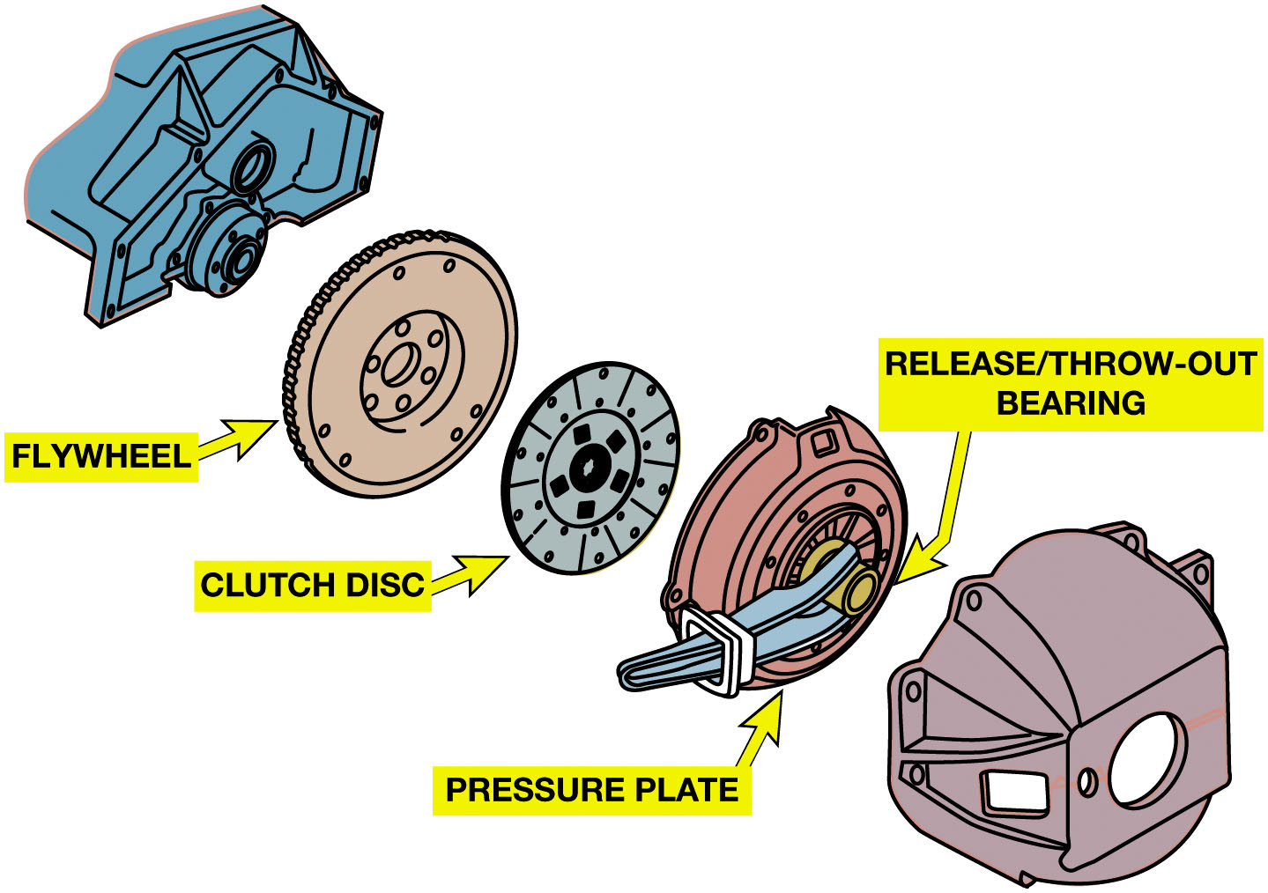
Figure 4.11
Replacement Summary
Replacement Summary
Follow 10 steps
Page 48
A summary of the entire rear-wheel-drive clutch replacement procedure.
Notes:
Precautions During replacement, the clutch components must be kept clean and dry. All grease and oil that contacts the friction surfaces must be cleaned off. Small amounts of oil on the clutch facing will cause the clutch to grab or chatter.
Clutch Installation
Check the flywheel bolts to make sure that they are tight and torqued to specifications.
Check the pilot bearing recess to ensure that it is clean, and drive the new pilot bearing into place. The best tool for this is a commercial or shop-made driver with a stem the same size as the bearing bore and a face that is larger than the diameter of the bearing. The new pilot bearing is driven in until it is fully seated or has entered completely into the crankshaft. Most pilot bearings do not require lubrication. Roller bearings with exposed rollers should be lubricated with a thin film of grease or a few drops of engine oil is all that is needed on a sintered bushing.
Place the new clutch disc over the transmission clutch shaft and make sure that it slides freely over the splines. Determine which side of the disc goes against the flywheel which will often be marked fly- wheel side. If not marked, the damper assembly normally faces the pressure plate.
Tighten the mounting bolts two turns at a time alternating back and forth across the pressure plate. Tighten the bolts to the correct torque.
Remove the alignment device and check to make sure that the pilot bearing is in the exact center of the disc. The height variation of the release levers can be checked after the pressure plate is installed. Using a Vernier or dial caliper, measure from the contact face for the release bearing to the clutch disc. All of the heights should be within 0.020 inch (0.5 m m). The readings will be more accurate after the clutch has been applied a few times.
Check the clutch linkage to make sure that it operates smoothly. On cable-operated clutches, this is a good time to remove, clean, and lubricate the cable.
Fill the groove inside the bore of the release bearing with grease, apply a thin film of the specified high-temperature grease on the fork contact areas, and slide the release bearing onto the transmission quill, making sure that the bearing collar slides smoothly. The quill portion of the transmission bearing retainer should be smooth and unworn. On clutch forks that use pivot balls, a thin film of grease should be put on the ball. On forks mounted on pivot shafts, the pivot bushings should be lubricated.
Replace the transmission/transaxle, being sure to observe the following found on pages 48-49 of the text.
Release Bearing Inspection Other than feeling for roughness or seeing obvious wear or discoloration, there are no effective bench checks for release bearings. This is one reason why they are normally replaced with the disc and pressure plate.
Long Description:
The illustration has a crankshaft on the left. On its right is a flywheel disc with. On its right is a clutch disc. Next to it is a pressure plate. A release or throw-out bearing is attached to the pressure plate.

Slide 24
Hydraulic Clutch Service
Hydraulic Clutch Bleeding
Bled by gravity bleeding
Others, a helper may be needed.
To bleed a clutch hydraulic system
using gravity method, perform the following 3 steps:
Pages 49-50 of text
See Figure 4.12, next slide
Notes:
Precautions
Fluid leaks or failure to release completely indicate the need for hydraulic system service. Clutch hydraulic systems have evolved from the early systems that had free travel adjustment and required clearance at the release bearing to newer systems that maintain a slight preload. Older systems used steel and reinforced rubber lines with threaded fittings, whereas the newer systems use plastic tubing sealed by O-rings and held together by locking pins at the connections.
STEP 1 Clean bleeder valve at the actuator cylinder and place a shop cloth under it to catch escaping fluid, FIGURE 4.12.
STEP 2 Open bleeder valve by loosening bleeder screw and observe the flow. If no flow occurs, have a helper depress the clutch pedal in a smooth, slow manner. Air bubbles coming from the bleed valve indicate that the system needed bleeding. After the air bubbles stop and a constant flow of fluid occurs, close the bleed valve. An alternative method is reverse, or back-bleeding. This is done by forcing fluid through the actuator cylinder bleed valve and upward to the reservoir.
STEP 3 Check the fluid level and correct it, if necessary.

Slide 25
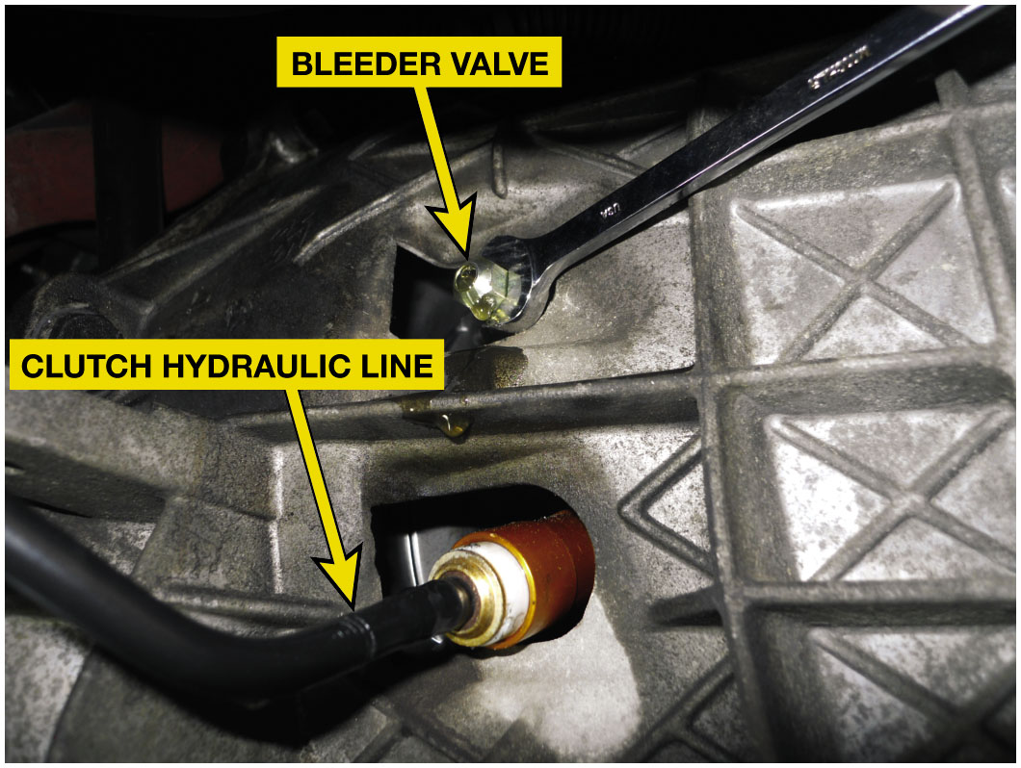
Figure 4.12
Bleeding Hydraulic Clutch
Gravity bleeding a hydraulic clutch. Opening the bleeder valve should allow air to escape and then fluid should flow.
Notes:
Case Study Case of Missing Bleeder
The clutch failed in the Nissan 300 Z X (181,000 mi) because the clutch arm pivot ball broke, which allowed the actuator cylinder to come apart. The broken part along with the actuator cylinder, clutch disc, pressure plate, and release bearing were replaced. But, the clutch pedal would go to the floor without releasing the clutch. The clutch master cylinder was replaced, and a clutch adjustment was made. The clutch worked so the vehicle was returned to the customer, but a few days later it returned with a slipping clutch.
The technician discovered that a bleeder screw was located near the right headlight. Opening bleeder let a lot of air out of the clutch line. Completely bleeding the clutch along with a free travel readjustment fixed this comeback.
Summary:
Complaint—Customer complained about a slipping clutch shortly after the clutch was replaced.
Cause—Air was found in the hydraulic clutch line.
Correction—The clutch system bleeder valve was located behind the right headlight and the system bled which corrected the slipping clutch concern.

Slide 26
Frequently Asked Question: What is a “Pre-filled” Hydraulic Clutch System?
? Frequently Asked Question
What is a “Pre-filled” Hydraulic Clutch System? Hydraulic clutch systems can be difficult to bleed the air out of system. Some systems are available as a complete assembly including the following:
Clutch master cylinder
Actuator cylinder
Line between the master and actuator cylinder
Pre-filled with fluid and bled
Using a pre-filled system makes replacement easier.

Slide 27
Question 1
Clutch chatter can be caused by
A. Grease or oil on the clutch friction material
B. Broken engine mount(s)
C. Low hydraulic clutch fluid level
D. Too little free play in the clutch pedal

Slide 28
Answer 1
Clutch chatter can be caused by
A. Grease or oil on the clutch friction material

Slide 29
Summary
Clutch system preventive maintenance ensures
Proper clutch pedal free travel and/or proper master cylinder fluid level.
Excessive slippage, grab, chatter, and unusual noise
Common indications of clutch problems.
A clutch job requires transmission/transaxle removal
Replace the pressure plate, disc, release bearing, and pilot bearing.
Abnormal clutch failure requires additional checks to locate root cause

Slide 30
R W D Clutch Replacement Photo Sequence

Slide 31
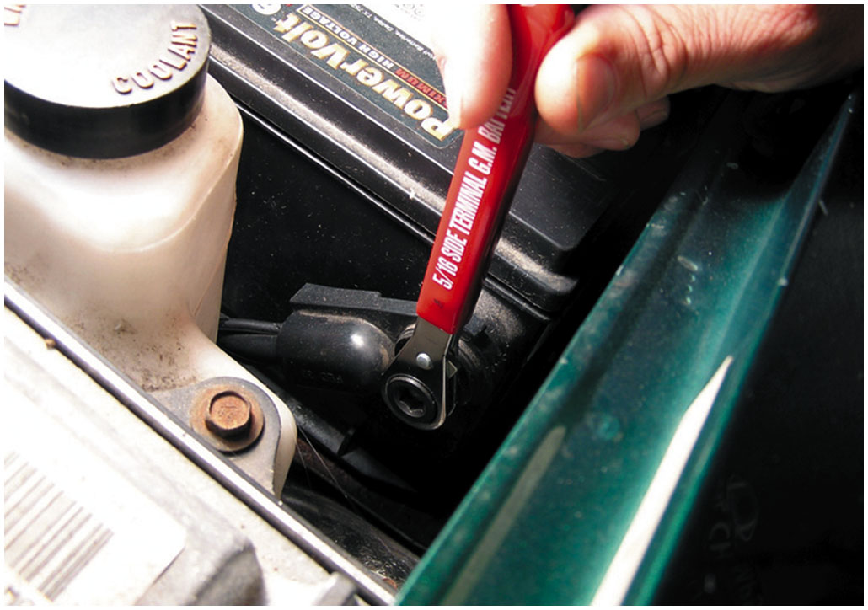
1. The first step in the process of replacing the clutch on this Chevrolet S-10 pickup truck is to remove the negative battery cable

Slide 32
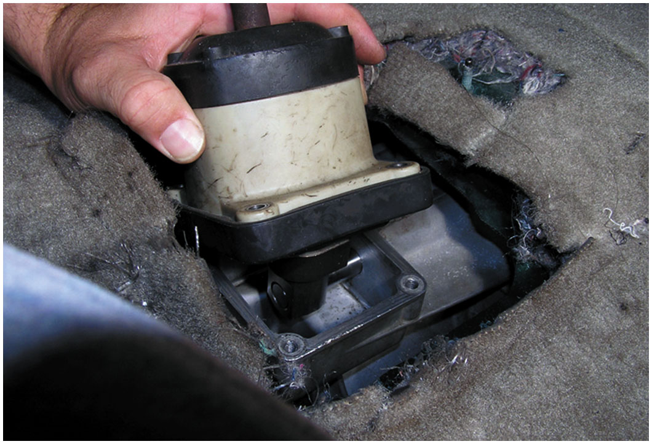
2. Remove the shifter mechanism inside the vehicle. This step may involve removing the center console and other components

Slide 33
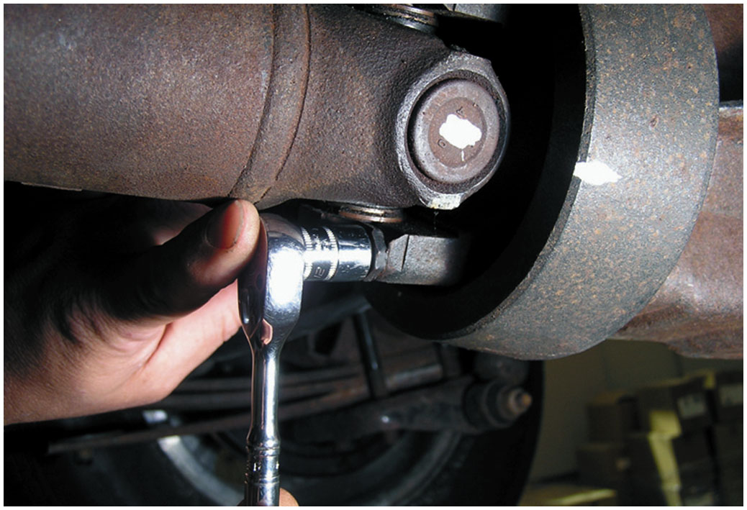
3. Mark and then remove the driveshaft

Slide 34
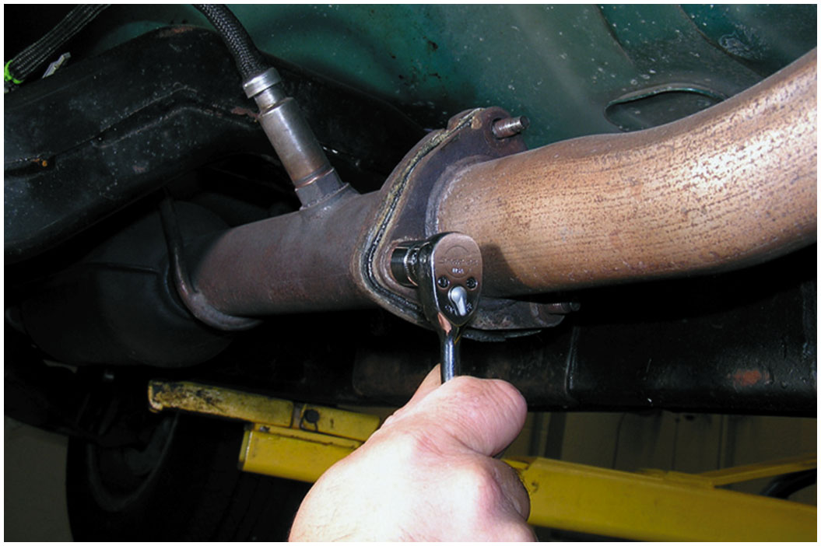
4. Remove the exhaust pipe if needed. It was needed in this case, according to service information

Slide 35
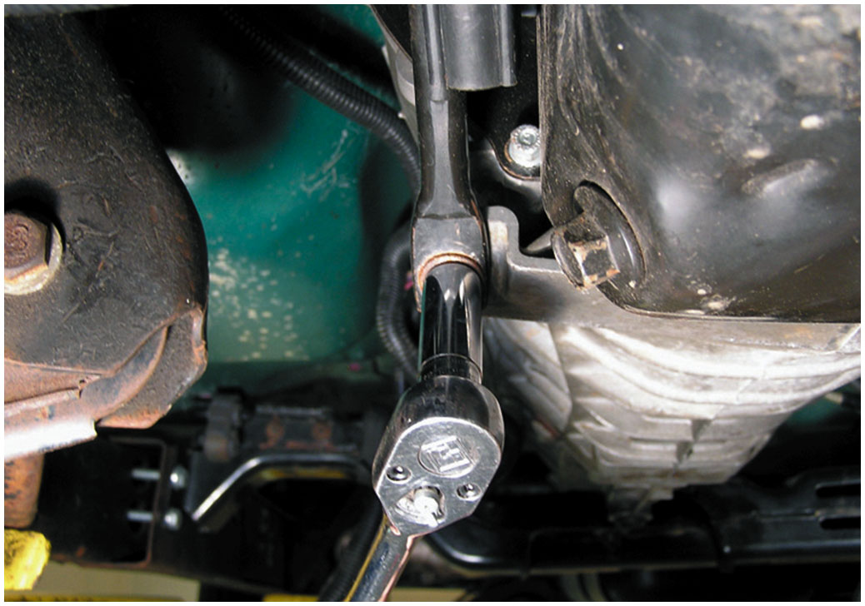
5. Remove the transmission mount fasteners

Slide 36
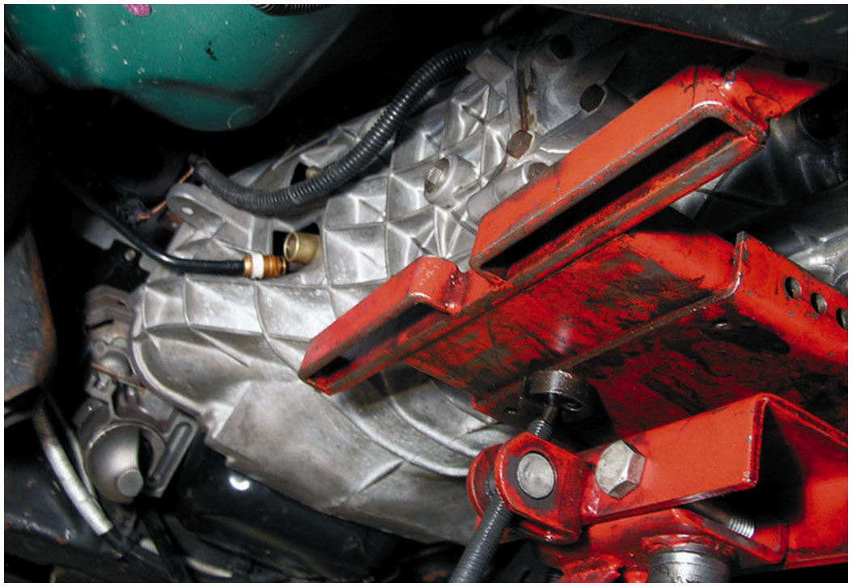
6. Using a transmission jack, support the transmission and remove the bell housing bolts

Slide 37
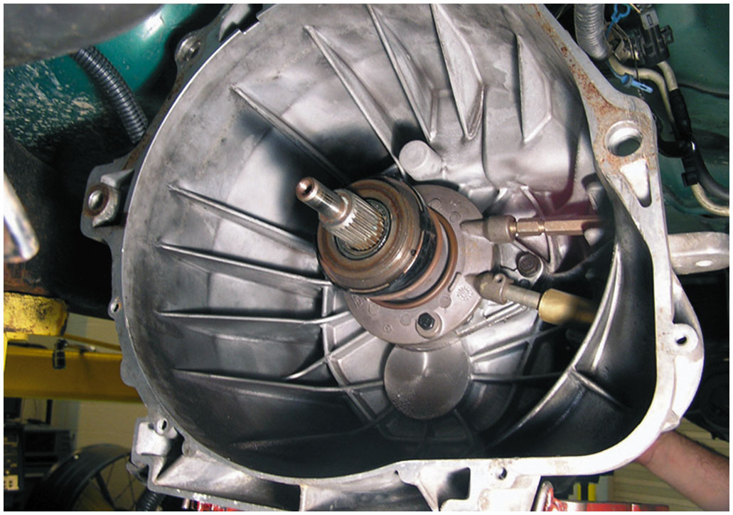
7. A View of the bell housing and throwout bearing as the transmission assembly is removed from the engine

Slide 38
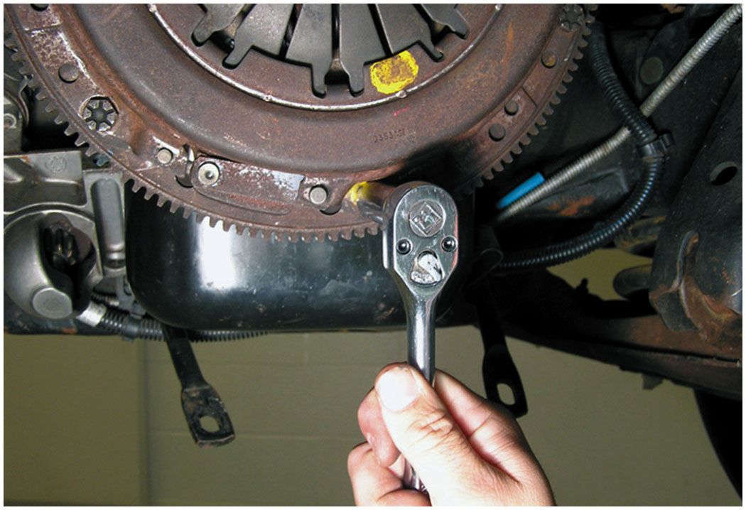
8. Removing the fasteners holding the pressure plate to the flywheel

Slide 39
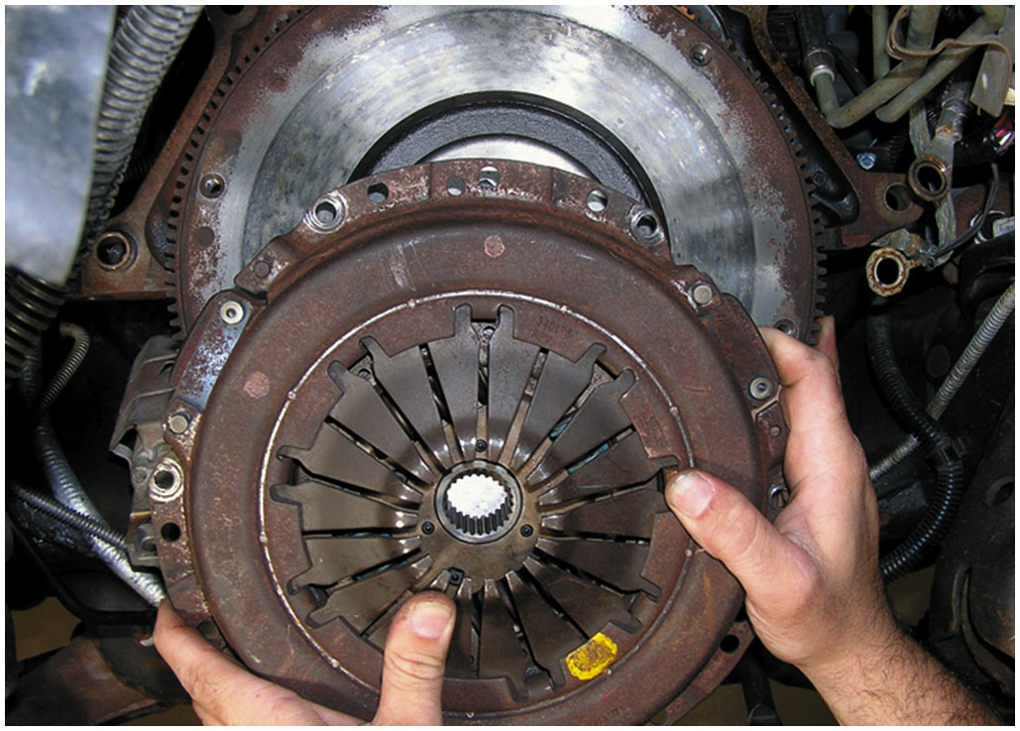
9. Removing the pressure plate and clutch disc

Slide 40
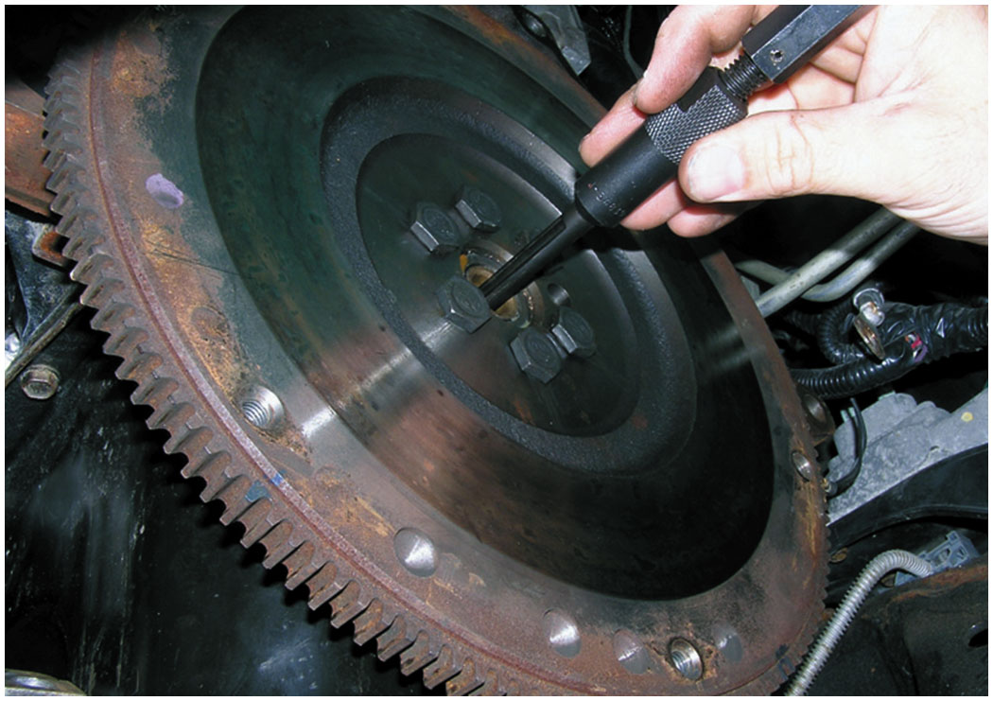
10. Using a special puller, remove the pilot bearing

Slide 41
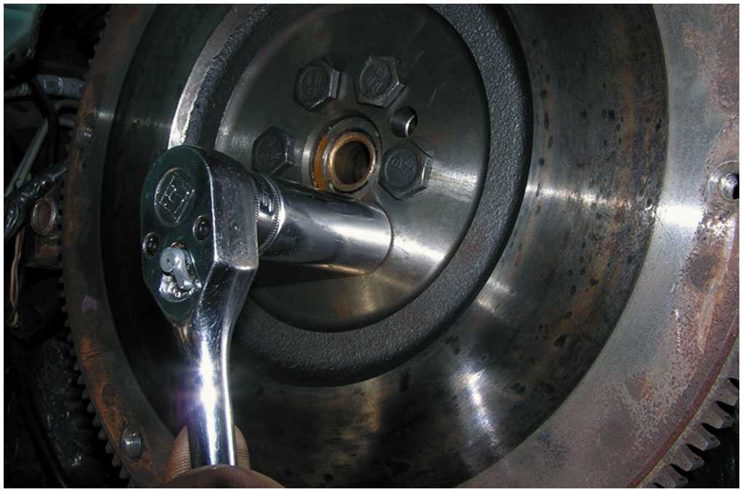
11. The flywheel is being removed to be refinished or replaced as needed

Slide 42
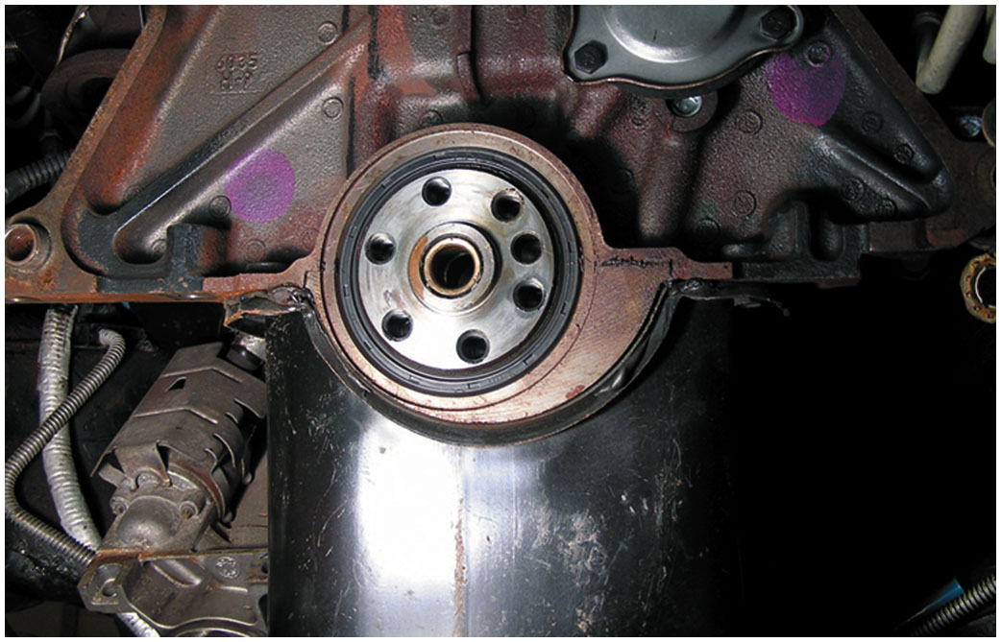
12. With the flywheel removed, check to see if the rear main seal is leaking and replace if needed

Slide 43
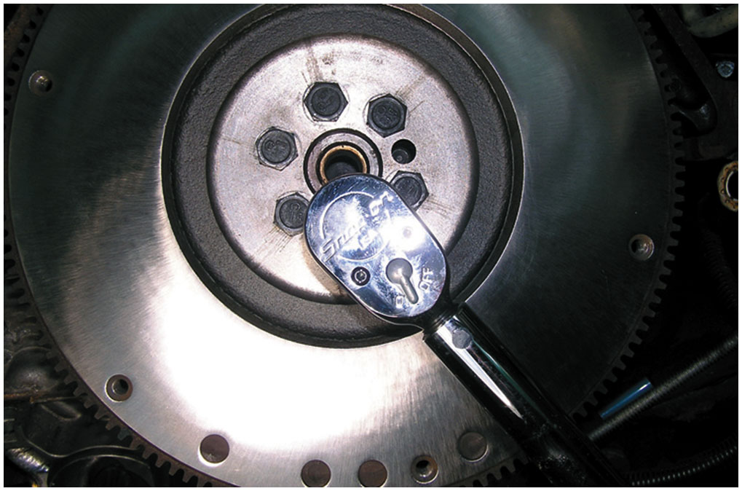
13. Installing a reconditioned flywheel and torquing new bolts to factory specifications

Slide 44
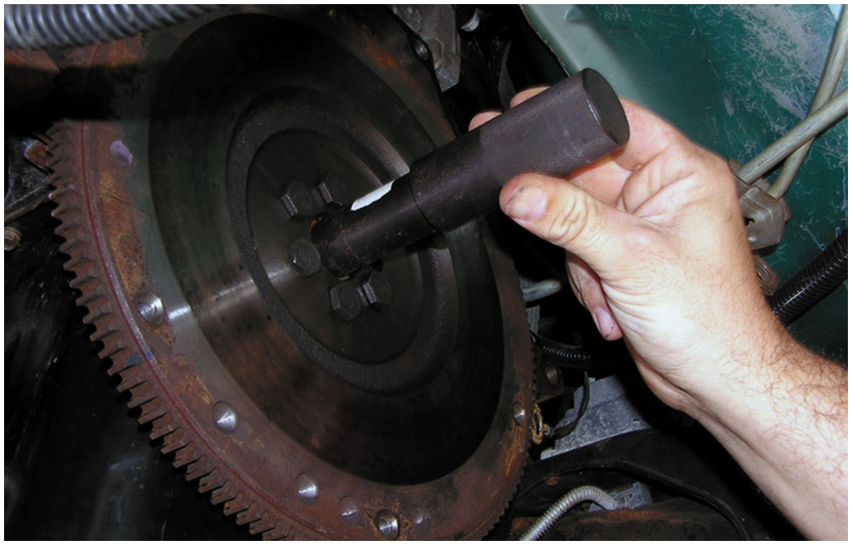
14. Installing a new pilot bearing and lubricate as per instructions in service information

Slide 45
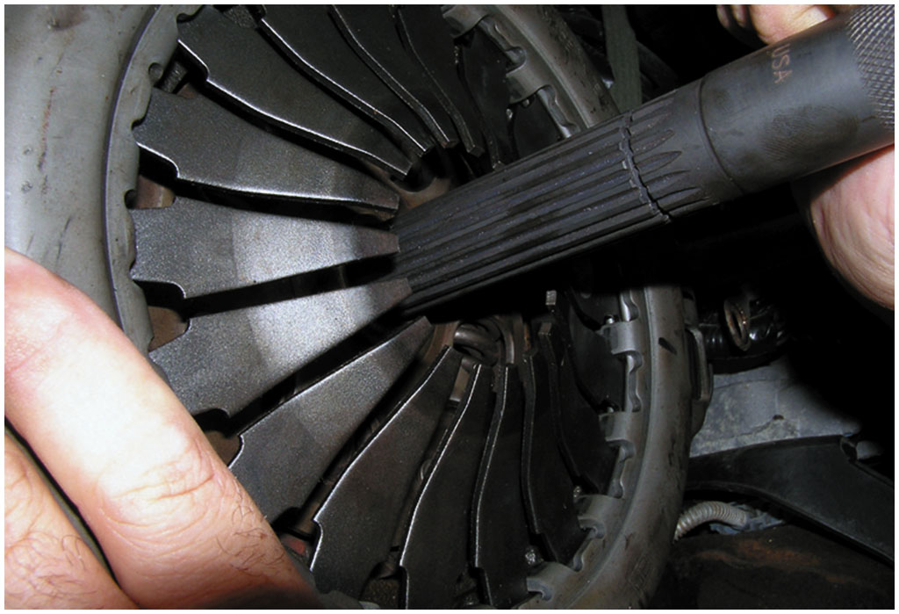
15. Using pilot tool to align the clutch disc with the pilot bearing through the center opening of the pressure plate

Slide 46
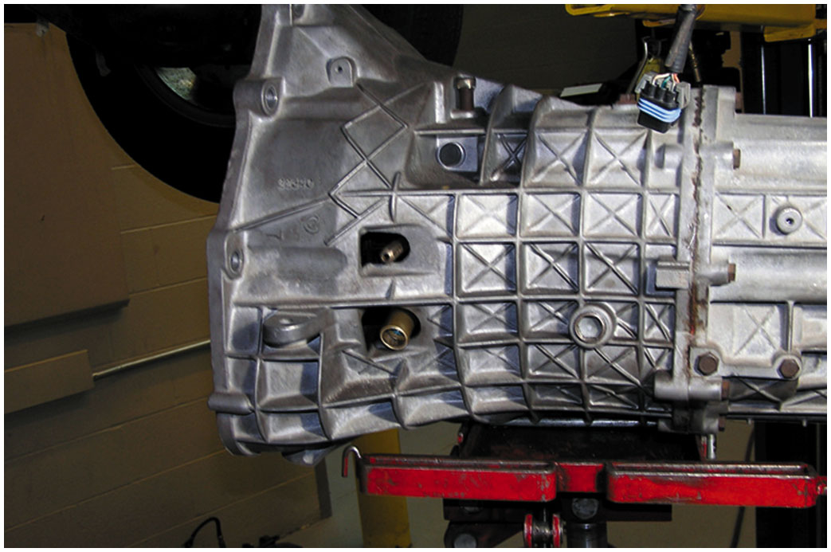
16. Installing the transmission assembly with a new throwout bearing

Slide 47
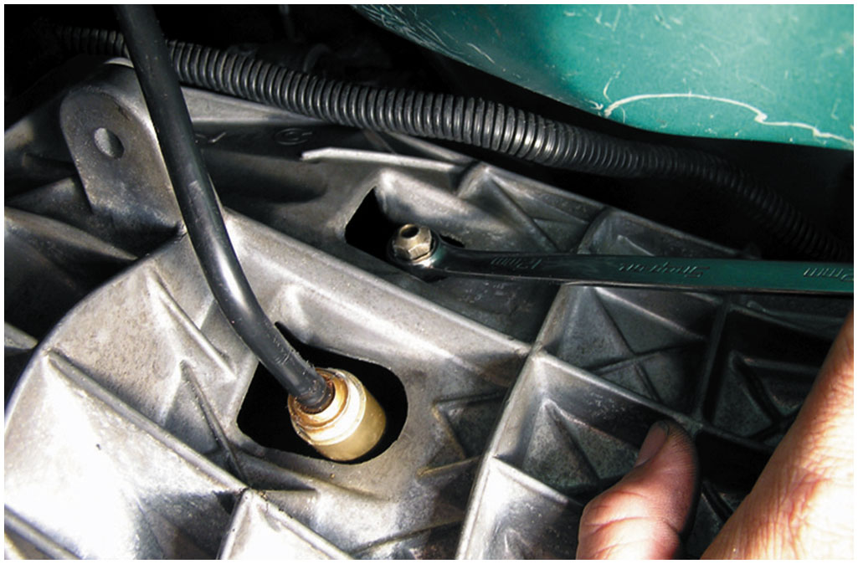
17. Bleeding the air from the hydraulic clutch circuit

Slide 48
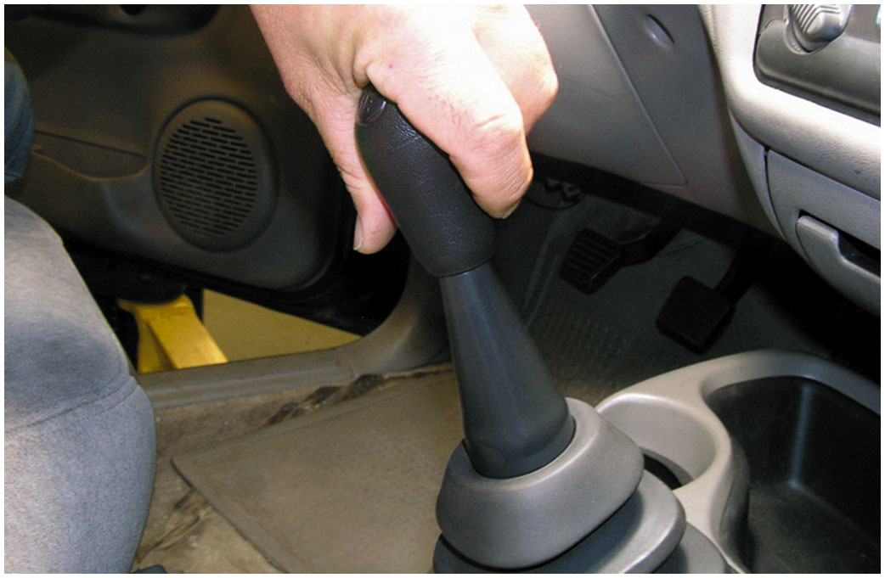
18. Finish the clutch replacement by reinstalling all components removed and check for proper operation

Slide 49
F W D Clutch Replacement Photo Sequence

Slide 50
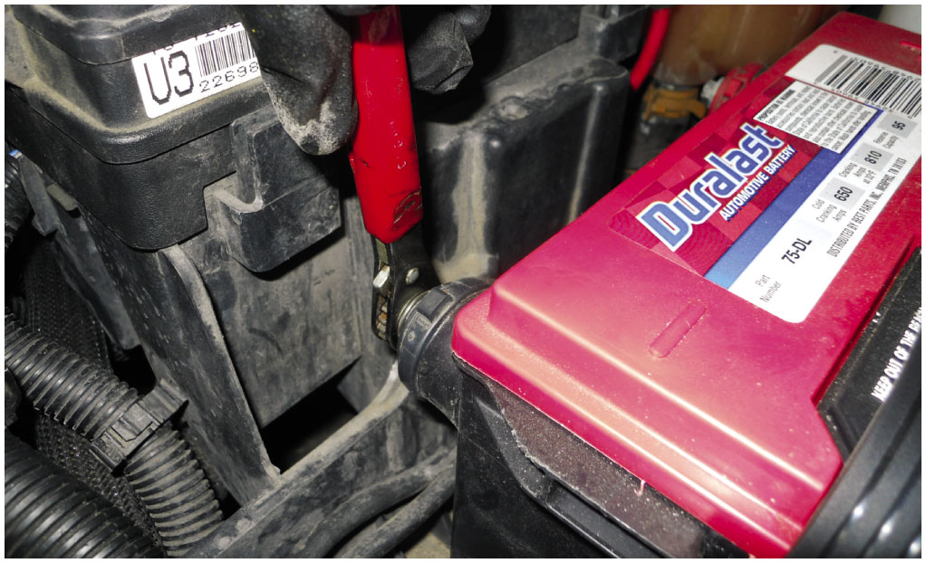
1. The first step in almost all major service work is to disconnect the negative battery cable from the battery

Slide 51
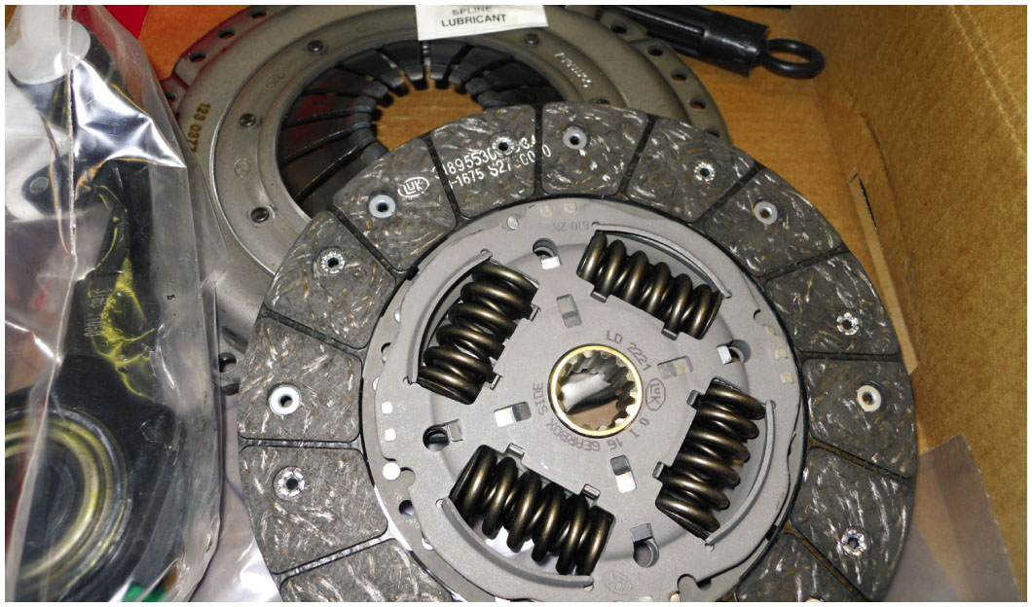
2. A new clutch kit, including the pressure plate, release bearing, and clutch disc, was purchased making sure that all of the needed information was compiled before ordering to help insure that the correct parts were purchased

Slide 52
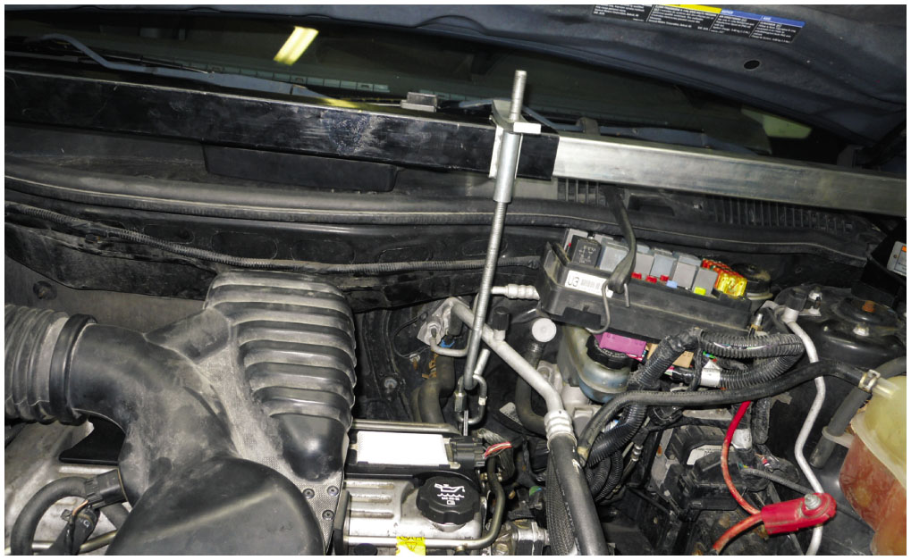
3. A holding fixture was attached to support the engine when the transaxle was removed from underneath the vehicle.

Slide 53
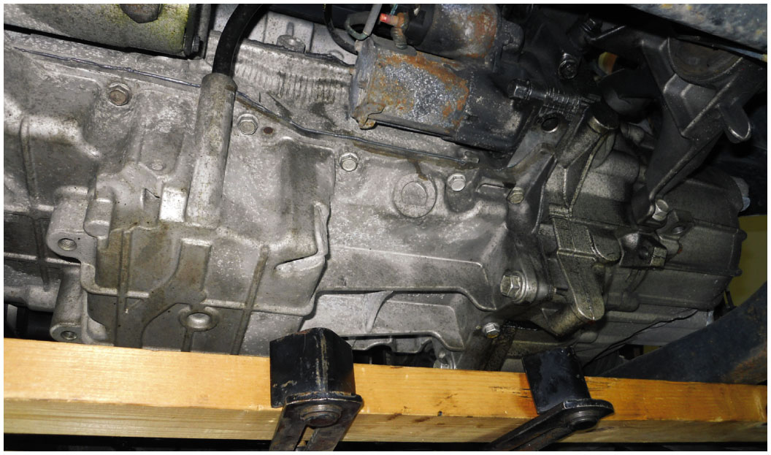
4. The “K” (lower support) member was removed to get access to the transaxle

Slide 54
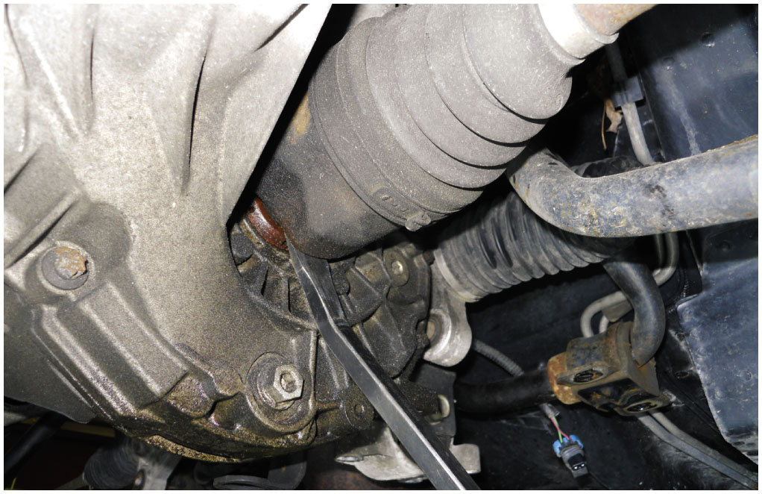
5. Both drive axle shafts (half shafts) were removed

Slide 55
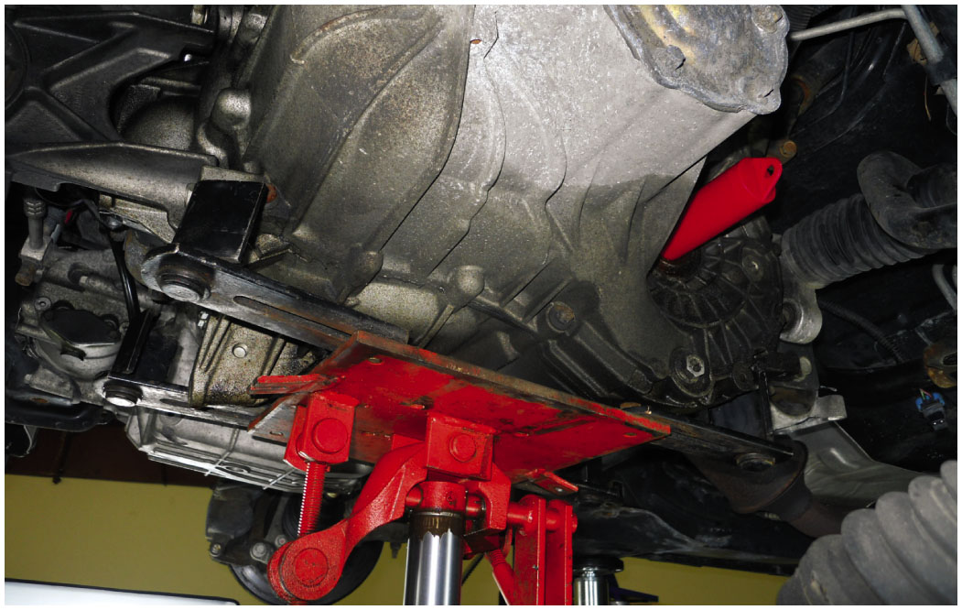
6. The transaxle is supported by a transmission jack as it is being removed from underneath the vehicle

Slide 56
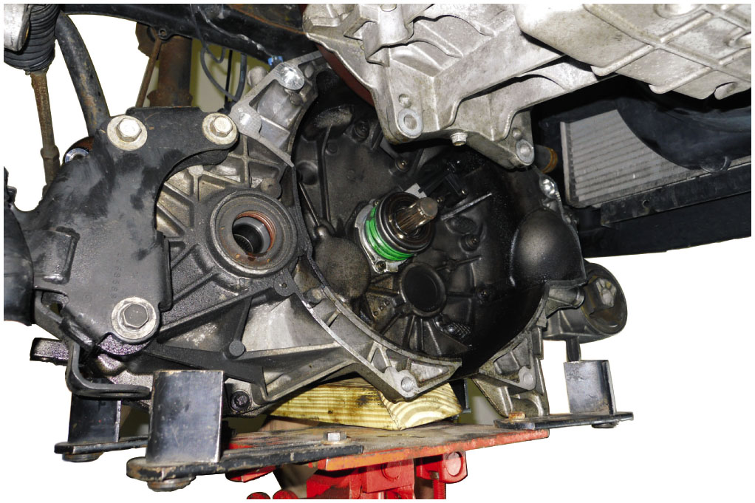
7. The transaxle assembly is lowered from underneath the vehicle

Slide 57
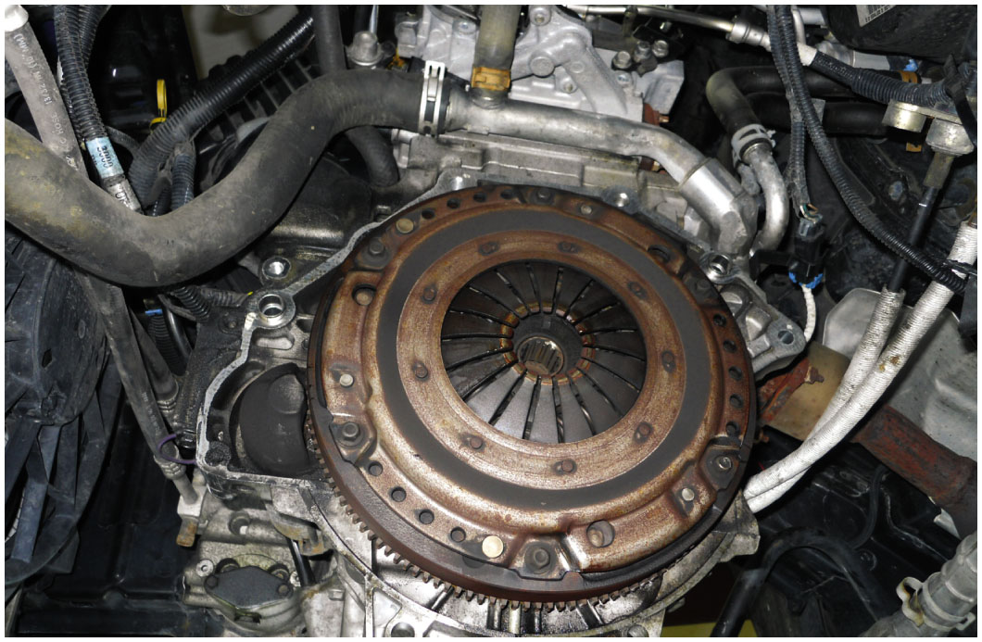
8. The original pressure plate shows normal wear. The problem with this clutch was a leaking actuator cylinder/release bearing assembly

Slide 58
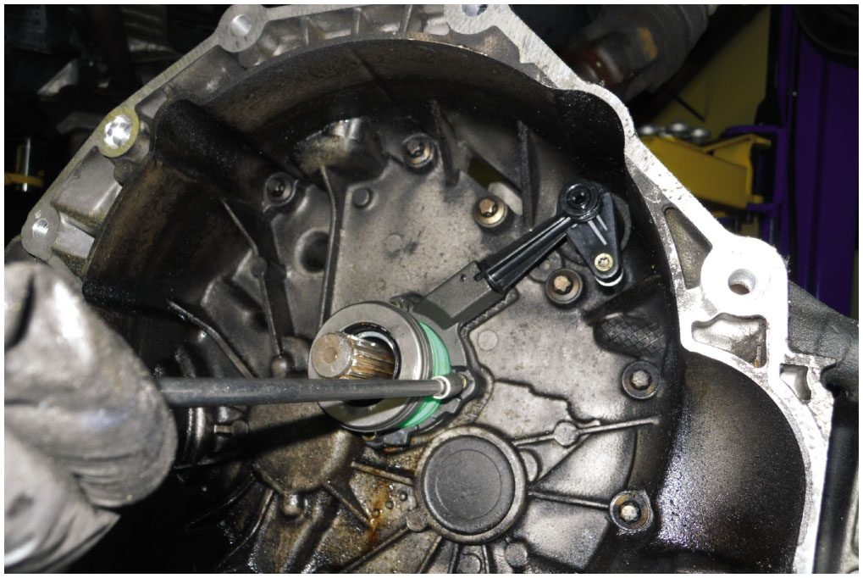
9. The new actuator cylinder/release bearing assembly is being installed

Slide 59
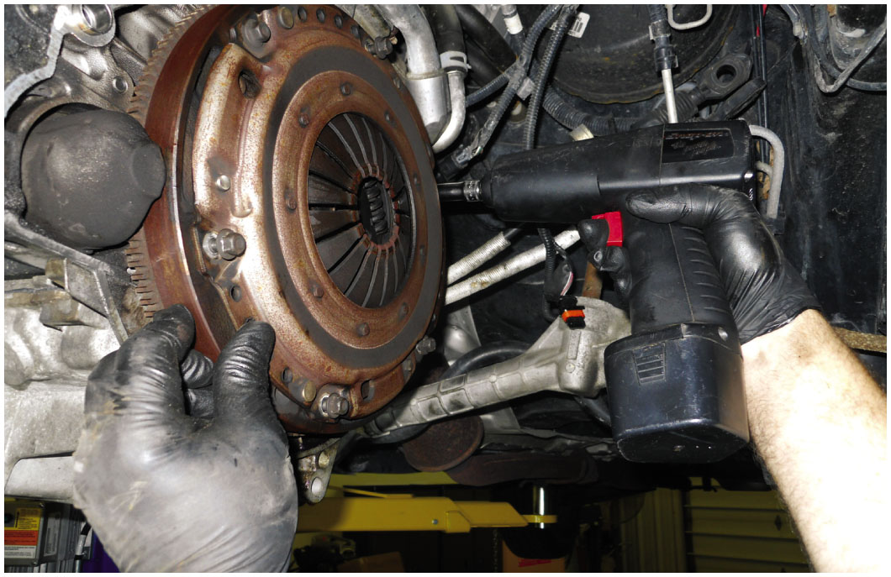
10. The pressure plate is being removed from flywheel

Slide 60
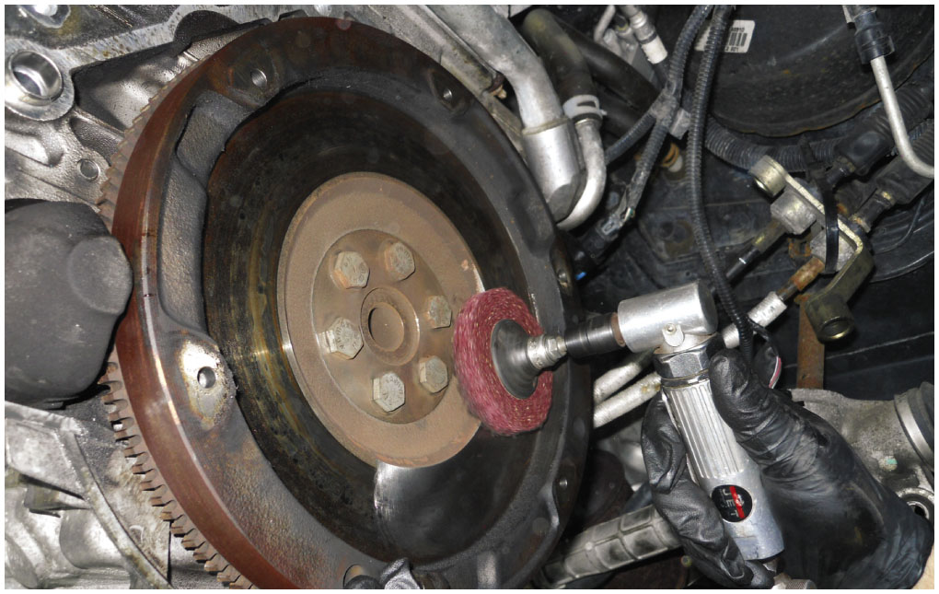
11. The flywheel is cleaned using an abrasive pad to remove glaze on the surface

Slide 61
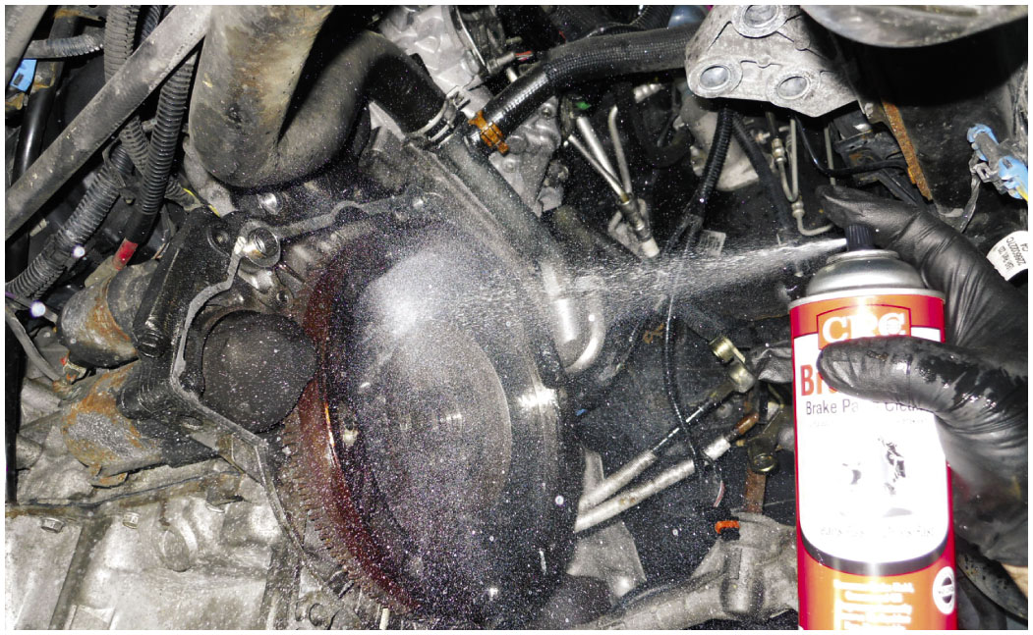
12. The flywheel was thoroughly cleaned after being deglazed

Slide 62
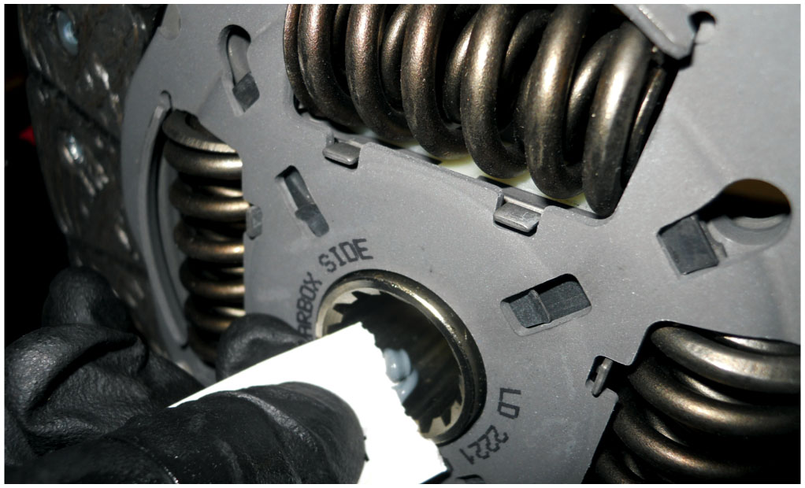
13. The spline grease that was included with the clutch kit is being applied to the splines of the clutch disc

Slide 63
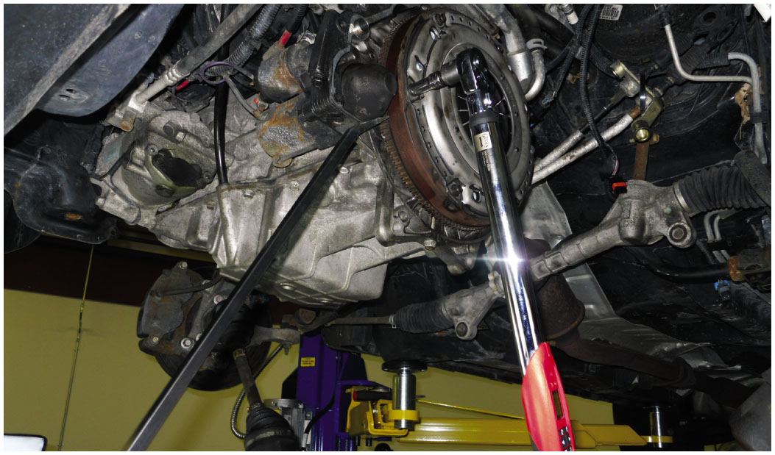
14. The pressure plate retaining bolts are torqued to factory specifications. A flywheel holder can be used instead of pry bar to hold flywheel from turning.

Slide 64
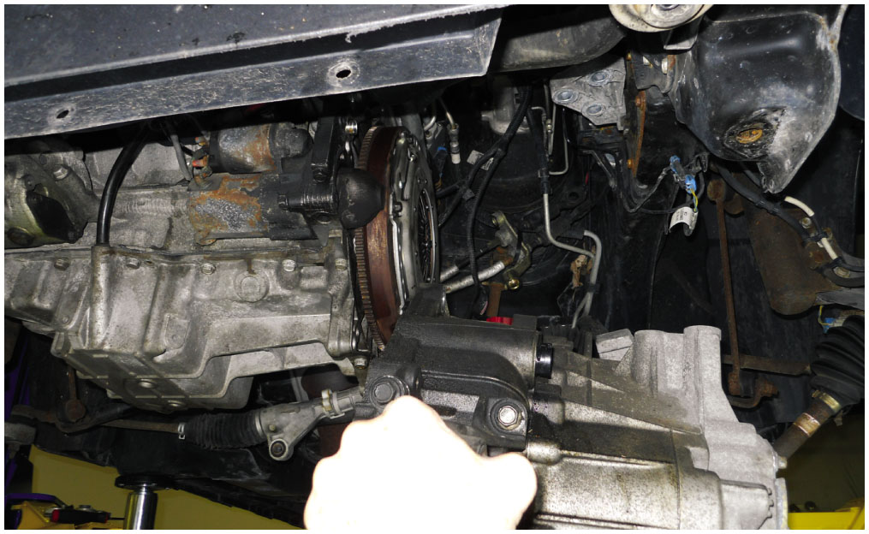
15. The transaxle is then reinstalled from underneath the vehicle

Slide 65
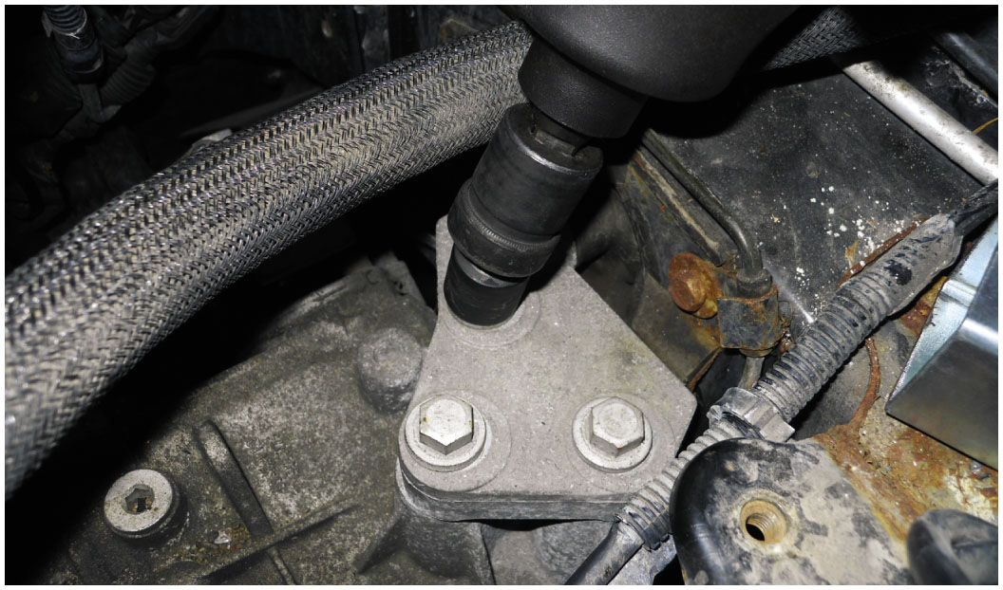
16. The engine and transaxle mounts are reattached and the half shafts reinstalled

Slide 66
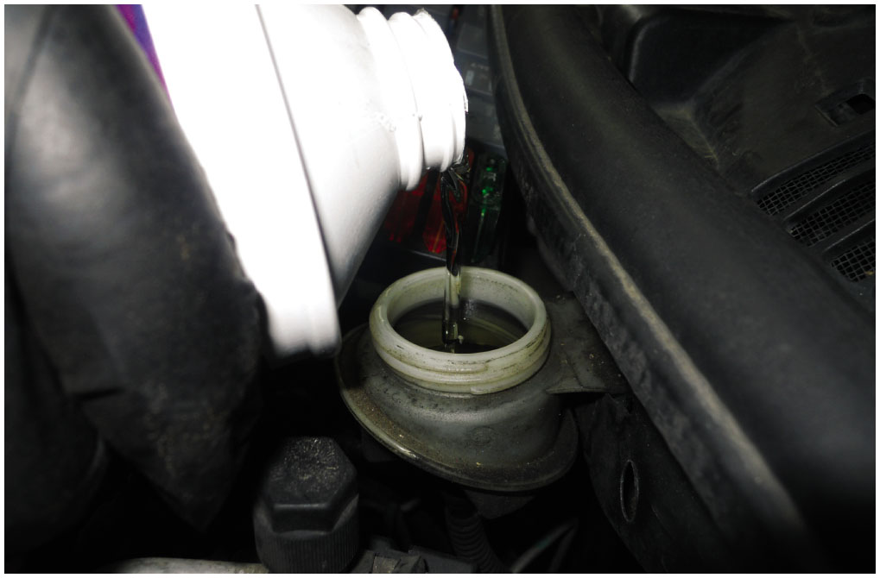
17. The hydraulic clutch master cylinder is filled with DOT 3 brake fluid and allowed to gravity bleed

Slide 67
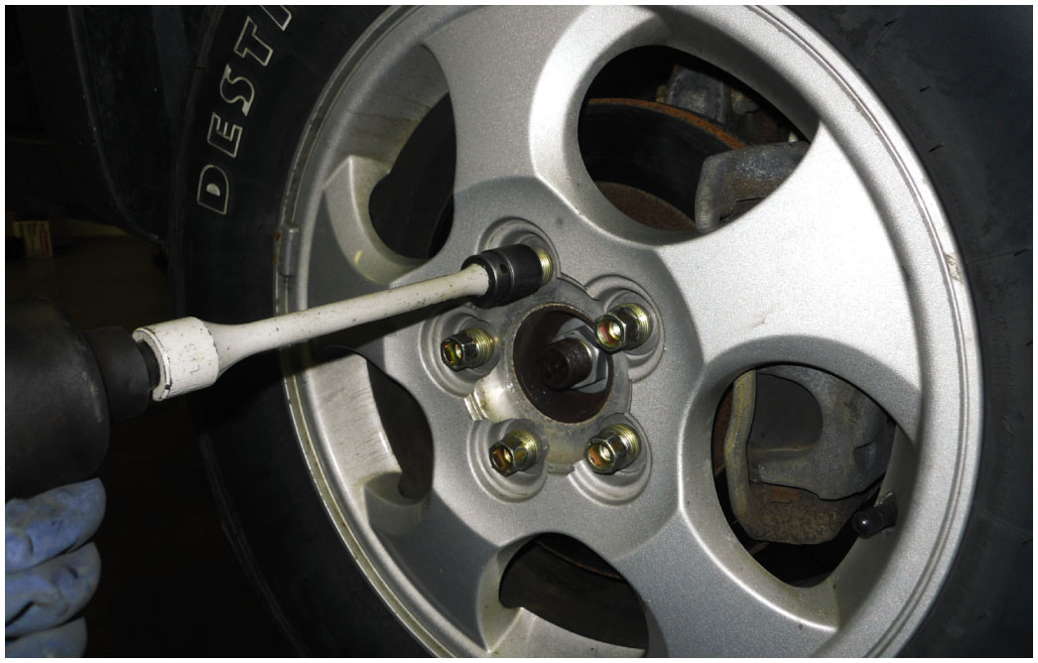
18. All fasteners were torqued to factory specification and the vehicle was test driven to confirm proper operation

Slide 68
Automotive Fundamentals Videos and Animations
Videos Link: (A3) Manual Drive Train Axles Videos
Animations Link: (A3) Manual Drive Train Axles Animations

Slide 69
Copyright
This work is protected by United States copyright laws and is provided solely for the use of instructors in teaching their courses and assessing student learning. Dissemination or sale of any part of this work (including on the World Wide Web) will destroy the integrity of the work and is not permitted. The work and materials from it should never be made available to students except by instructors using the accompanying text in their classes. All recipients of this work are expected to abide by these restrictions and to honor the intended pedagogical purposes and the needs of other instructors who rely on these materials.

