Slide 1
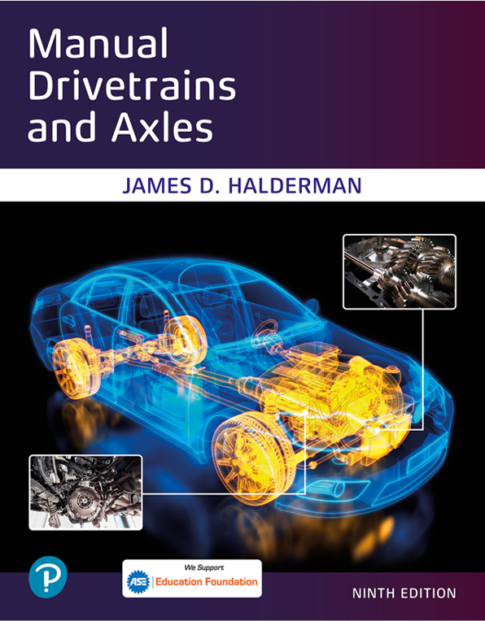
Manual Drivetrains and Axles
Ninth Edition
Chapter 3
Clutch Components and Operation
Copyright © 2024, 2018, 2015 Pearson Education, Inc. All Rights Reserved
Notes:
If this PowerPoint presentation contains mathematical equations, you may need to check that your computer has the following installed:
1) Math Type Plugin
2) Math Player (free versions available)
3) NVDA Reader (free versions available)
INSTRUCTOR NOTE: This presentation includes text explanation notes, you can use to teach the course. When in SLIDE SHOW mode, you RIGHT CLICK and select SHOW PRESENTER VIEW, to use the notes.

Slide 2
Learning Objectives
3.1 List the major parts that are included in the clutch system and describe how the clutch works.
3.2 Describe how the clutch works.
3.3 Explain how a dual mass flywheel works.
3.4 Describe how a hydraulic clutch system works.

Slide 3
Clutch Purpose & Function
Clutch located between engine & transmission/transaxle.
Disconnect engine power from transmission/transaxle
Permit engine to remain running vehicle is stopped in gear
Permit transmission/transaxle to be shifted.
Dampen and absorb engine power impulses & drive train vibration
Provide a smooth engagement and disengagement of torque
Notes:
Clutch assembly is located between the engine & transmission/transaxle.
To disconnect engine power from the transmission/transaxle to permit the engine to remain running when vehicle is stopped with the transmission in gear and to permit the transmission/transaxle to be shifted.
Connect and transmit engine torque to the transmission/transaxle
Dampen and absorb engine power impulses and drive train vibration
Provide a smooth engagement and disengagement of torque between the engine and the transmission/transaxle.

Slide 4
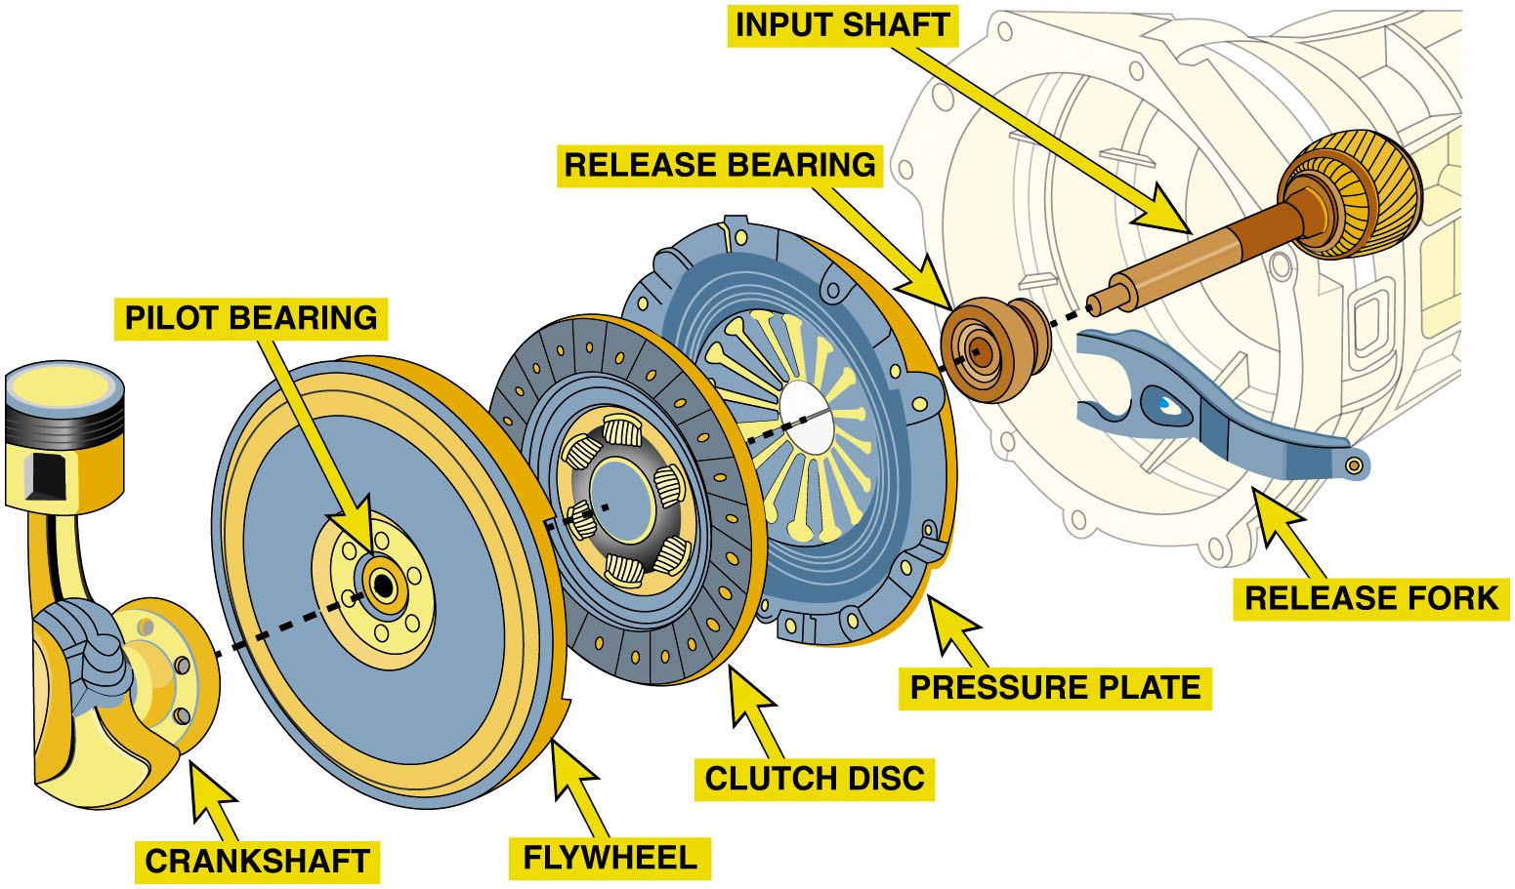
Figure 3.1
Clutch Assembly
Clutch disc splined to input shaft of transmission/transaxle
Depress clutch pedal, release bearing, forced against diaphragm spring
Release Clutch
Typical automotive clutch assembly showing all related parts.
Notes:
A clutch assembly consists of a clutch disc that is splined to the input shaft of the transmission/transaxle. When the
driver depresses the clutch pedal, a release bearing, also called a throwout bearing, is forced against the diaphragm
spring , part of the clutch cover assembly. This lifts the pressure plate releasing the clutch disc. The clutch cover assembly
is bolted to and rotates with the flywheel. ● Figure 3.1
Purpose & Function
Disconnect engine power from the transmission/transaxle to permit engine to remain running when vehicle is stopped with transmission in gear and to permit the transmission/transaxle to be shifted.
Connect and transmit engine torque to the transmission/transaxle
Dampen and absorb engine power impulses and drive train vibration
Provide a smooth engagement and disengagement of torque between the engine and the transmission/transaxle.
Long Description:
The illustration has a crankshaft on the left. On its right is a disc with a flywheel on its circumference and a pilot bearing on its center. On its right is a clutch disc. Next to it is a pressure plate. On its right is a release bearing. Next to it is a release fork. On its right is an input shaft.

Slide 5
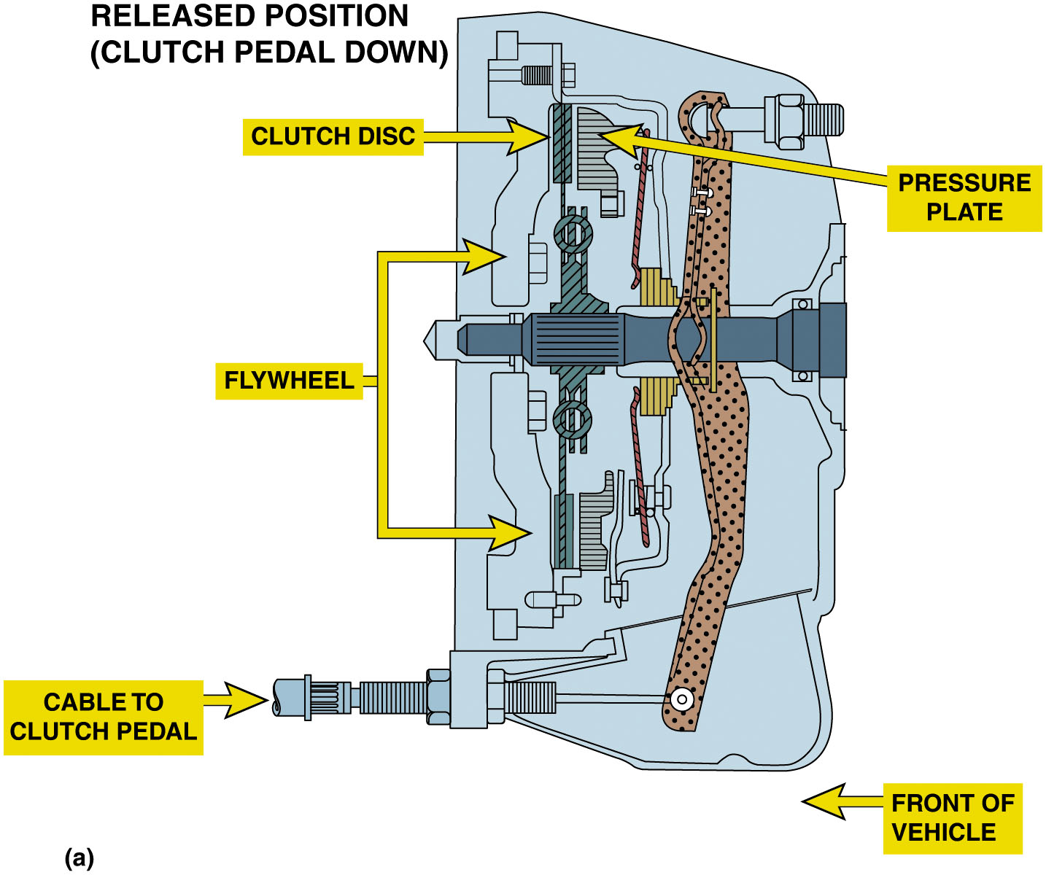
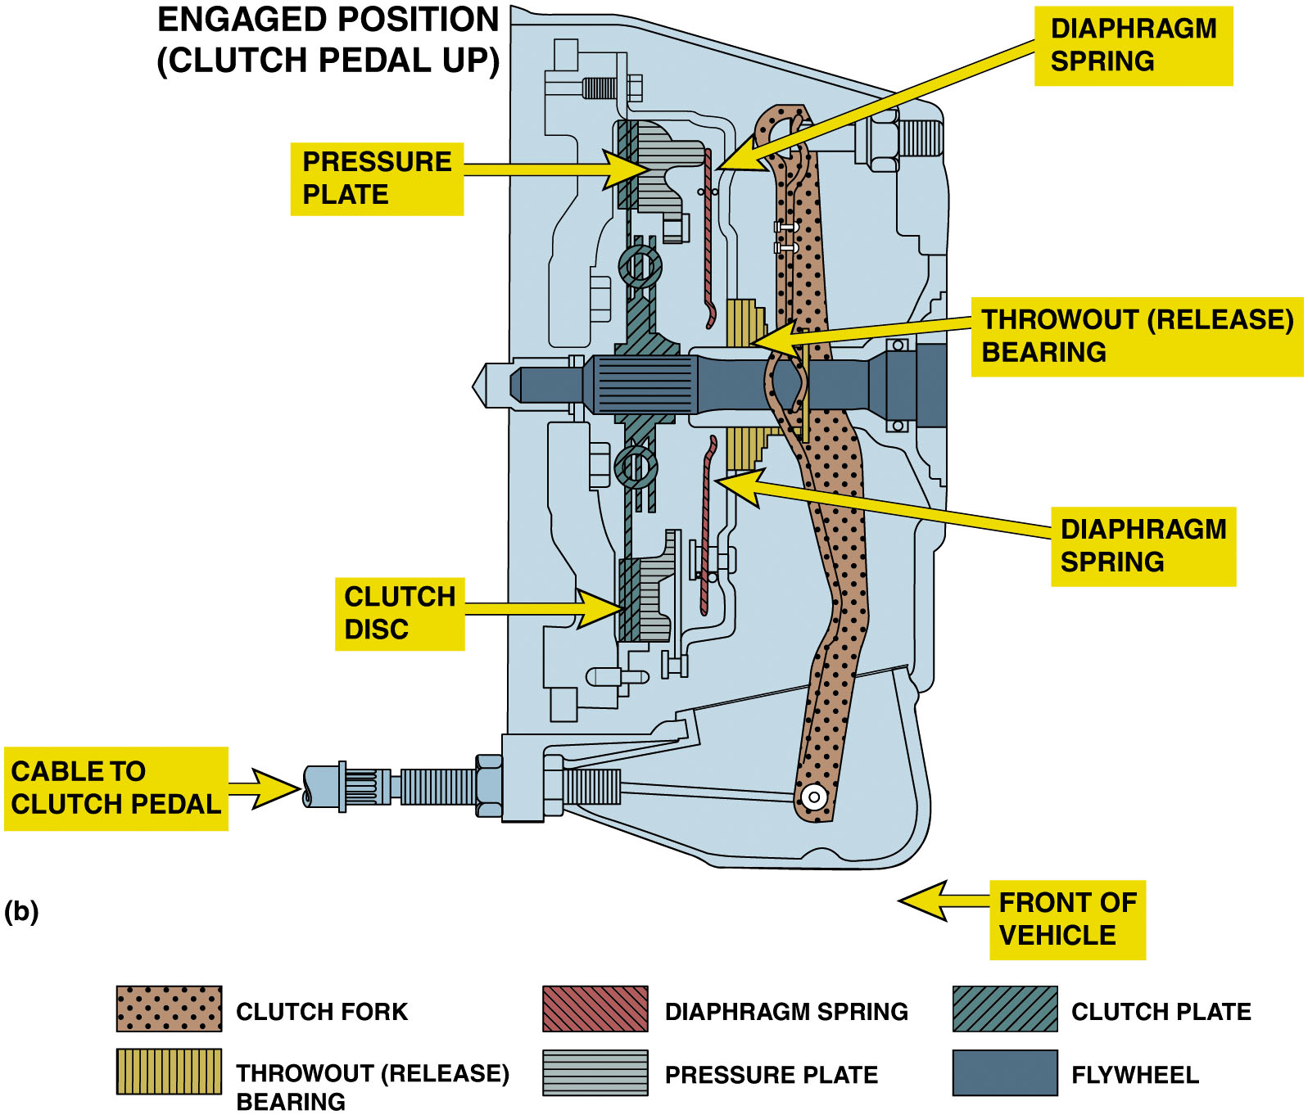
Figure 3.2
Clutch Operation
(a) When the clutch is in the released position (clutch pedal depressed), the clutch fork is applying a force to the throwout (release) bearing, which pushes on the diaphragm spring, releasing the pressure on the friction disc. (b) When the clutch is in the engaged position (clutch pedal up), the diaphragm spring exerts force on the clutch disc, holding it between the flywheel and the pressure plate.
Notes:
When force is exerted on the center of the diaphragm spring by the release bearing, the applied force is released from the clutch disc that had been squeezed between the engine flywheel and the pressure plate.
With the pressure removed from the clutch disc, engine can be operated without transferring torque to transmission/transaxle. Using a clutch also permits transmission/transaxle to be shifted easily because a shift cannot be made easily if the transmission/transaxle is transferring engine torque.
When the driver releases force on the clutch pedal, pedal return spring and the diaphragm spring combine to return the clutch pedal to its at-rest position (clutch engaged position).
When the clutch pedal moves up, the pressure on the release bearing is released and the force against the pressure plate diaphragm spring is released allowing the spring force of the pressure plate to clamp the Clutch disc tightly between the flywheel and pressure plate. ● Figure 3.2.
Long Description 1:
The illustration has a rectangular clutch. It has a long clutch disc on the left. On its left is a flywheel. At the right of the clutch disc, at a minimal distance, is a pressure plate. The cable to the clutch pedal is located on the bottom left.
Long Description 2:
The illustration has a rectangular clutch. It has a long clutch disc on the left. On its right is a pressure plate that touches the clutch disc. On the right of the pressure plate is a diaphragm spring. On its right is a throwout bearing in a release position. The cable to the clutch pedal is located on the bottom left.

Slide 6
Animation: Clutch Operation (Animation will automatically start)

Slide 7
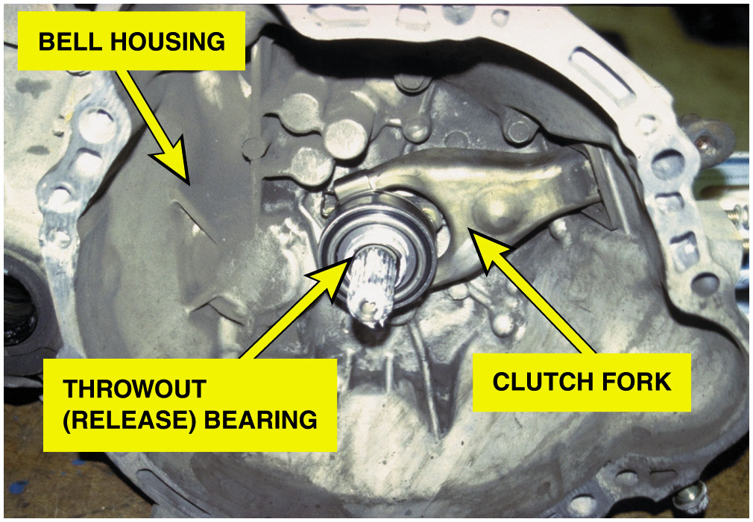
Figure 3.3
Transaxle Removed
The transmission has just been removed. Note that this type of transmission incorporates the bell housing, which was removed at the same time as the transmission. The clutch fork and throwout (release) bearing also came off together. All that remained attached to the engine was the flywheel, clutch disc, and pressure plate.

Slide 8
Clutch Discs
Clutch discs transfer engine torque
From flywheel to input shaft of transmission/transaxle.
Connects flywheel and pressure plate when clutch is engaged…
Pressure plate spring exerts spring pressure
Against disc and forces it against flywheel.
How do you assemble the hub and dampener?
Notes:
Clutch Facing Material
The clutch friction material must be able to withstand the heat generated by the friction during engagement and disengagement. Older clutch friction discs used a mixture of either molded or woven asbestos with various filler and binder materials. Asbestos is nearly ideal friction material for brake lining and clutch facing because it has a very good coefficient of friction, excellent heat characteristics, and low cost. However, the possibility of technicians getting cancer from inhaling asbestos fibers has greatly reduced its use. Asbestos was replaced with fiberglass, aramid nonmetallic compounds and/or metallic materials to obtain the desired friction and wear characteristics. Some of the materials used include:
Powdered iron
Copper
Graphite
Ceramics

Slide 9
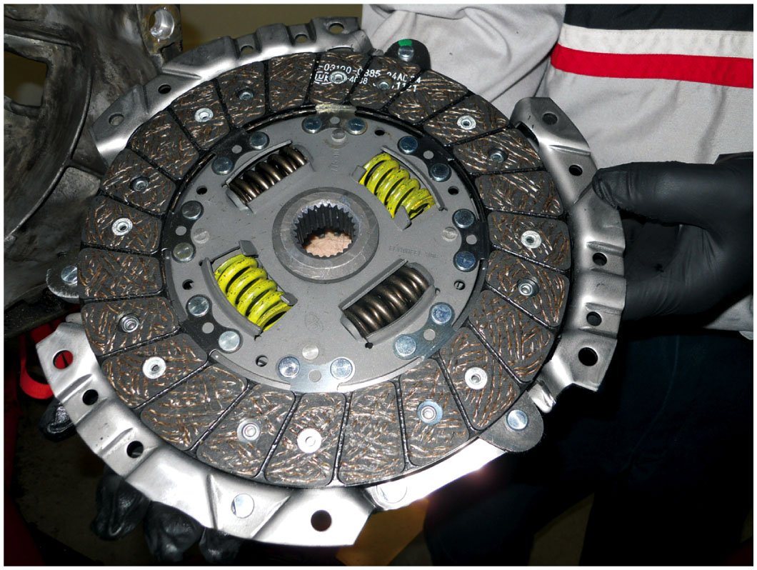
Figure 3.4
Clutch Disc
Overheating Effects
Torque Lowered
Slippage
Binding failure
Surface Grooves
Wipe Dust
Keep cool
Prevent sticking
A replacement clutch is designed to meet the same friction specifications of the original so the new clutch will operate like new.
Notes:
The wear rate and coefficient of friction of nonmetallic facings is greatly affected by temperature, Figure 3.4.
If facing is overheated, its capacity to transmit torque is lowered, and this will probably cause slippage and more heat.
As temperature increases, binders holding facing material together will lose their strength, greatly increasing the clutch disc wear rate.
Surface Grooves
Most nonmetallic facings have a series of radial grooves cut across their surface.
Wipe dust and dirt from the surfaces of the flywheel and pressure plate
Allow airflow to help cool the friction surfaces
Prevent a vacuum that might cause the friction surfaces to stick together during disengagement. Sticking during disengagement will cause clutch drag.
■ Some metallic discs have a series of radial slots cut
across the facing which allows the disc to expand
without warping when it gets hot.

Slide 10
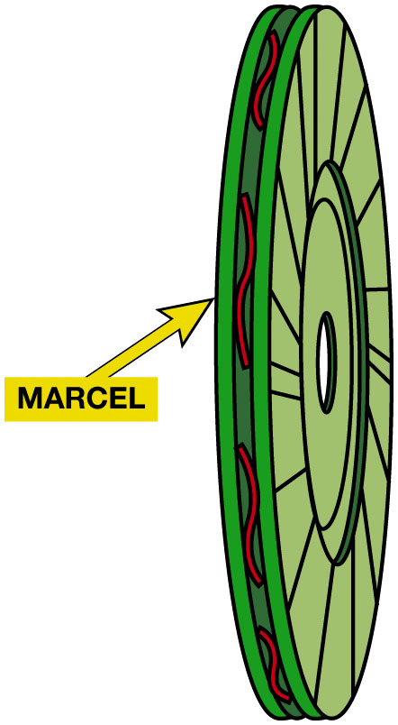
Figure 3.5
Marcel Springs
Marcel Spring
Space between friction surfaces
Wavy cushion spring
Absorb initial shock of rapid engagement
Prove Smooth Engagement
A marcel is a wavy spring that is placed between the two friction surfaces to cushion the clutch engagement.

Slide 11
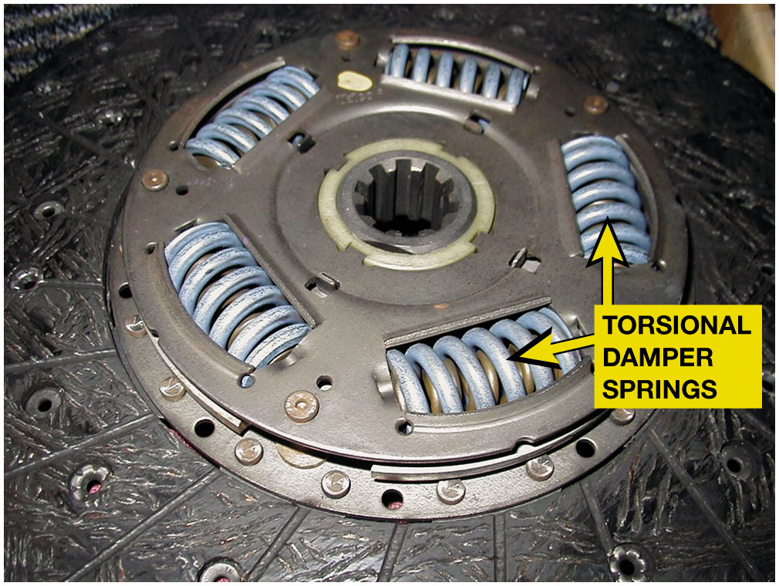
Figure 3.6
Hub & Torsional Damper
Torsional Damper Springs
Reduce vibrations
Reduce gear rattle
Reduce noise
A typical stock clutch friction disc that uses coil spring torsional dampers.
Notes:
Hub & Dampener Assembly
The clutch hub has internal splines (from 10 to 26 teeth) that slide on the external
splines of the transmission input/clutch shaft. Each time clutch is engaged, the disc must slide forward slightly to contact the flywheel, and it must slide back to prevent drag on the flywheel when the clutch is disengaged. Around the center hub of the clutch disc are torsional dampers that are coil springs or rubber plugs that help dampen engine firing pulses from being transmitted into and
through the transmission/transaxle. ● Figure 3.6.
An engine produces uneven power impulses that cause torsional vibration. The torsional damper reduces the torsional vibrations that result from the uneven engine power impulses from the rest of the drivetrain.
As an engine goes through its power cycle, crankshaft will speed up and slow down during each revolution.
If these slight speed fluctuations are not removed by the damper, they could cause “gear rattle,” vibration, noise, and increased wear.
The damper assembly is composed of the hub with 4-8 openings, with one or more springs for each extension, a spring washer, and a friction washer. These parts are fitted between the web of the disc and a metal retainer and are held together by a series of rivets called stop pins, which also keep the hub from revolving too far, usually about 0.037 inch (9.5 m m). The damper springs are positioned by a
series of windows in the web and retainer. The torque must pass through the damper springs on its way from the engine to the transmission, and any power impulses that tend to speed up the clutch hub will compress the springs. The springs will re-extend when there is a torque lag.

Slide 12
Pressure Plates
Exerts force on clutch disc
Torque transmitted from engine to transmission/ transaxle.
Strong clamping force provided by pressure plate spring(s).
What are different styles of pressure plates?
What are advantages of a diaphragm-type clutch?
What is a: pressure plate ring?
Cover (hat)?
Release lever?
Double disc clutch?
Notes:
COMPONENT PARTS The pressure plate assembly is a combination of:
Cover (also called a hat),
Pressure springs or diaphragm spring,
Release levers (also called fingers) on coil spring types, and
Cast iron pressure ring (driving plate) that contacts the friction disc.
PRESSURE PLATE STYLES
A coil spring pressure plate uses coil springs and 3 or 4 release levers. A coil-spring-style pressure plate is also
called the lever style because it uses levers to compress oil springs. This type of pressure plate is often called a
“three-finger” pressure plate. ● SEE FIGURE 3.7.
Two styles of coil-spring style are the following:
Borg and Beck: uses a round closed cover with 3 wide stamped-steel release levers and up to 12 springs with six evenly spaced mounting holes.
Long: uses a triangle-shaped cover with three narrow, forged-steel release levers, which extend through the cover and often have weights on them. This style also use 9 springs and has mounting bolt holes in three groups of two.

Slide 13
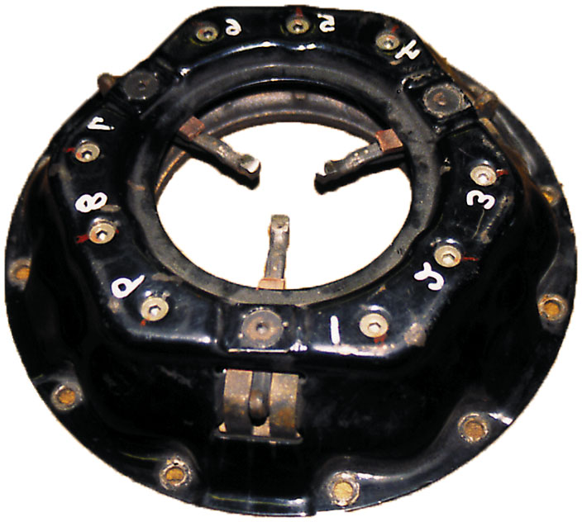
Figure 3.7
Coil-Type Pressure Plate
A coil spring (lever style) clutch pressure plate.

Slide 14
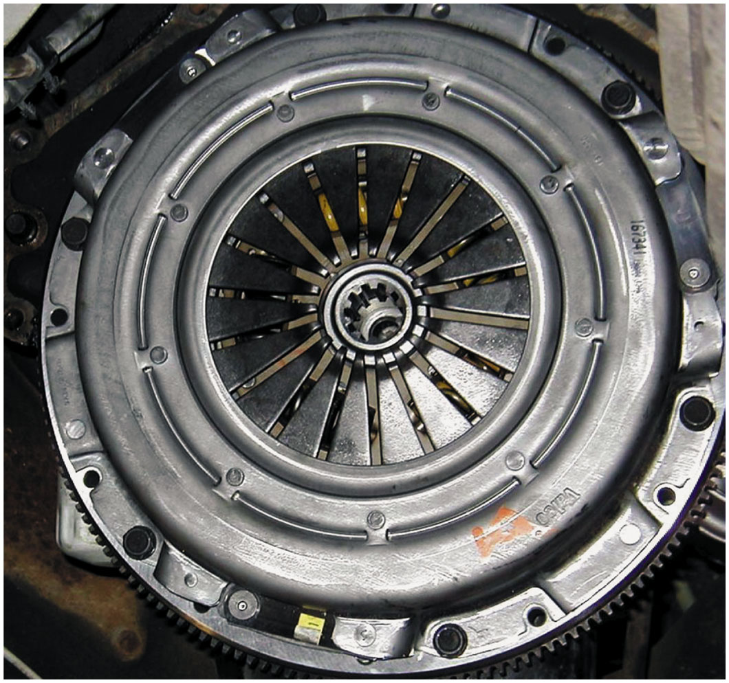
Figure 3.8
Diaphragm Spring Style
Diaphragm Pressure Plate
Most Common
Belleville Spring
Advantages
Smaller lighter
Reduced pedal pressure
Typical diaphragm-style pressure plate that uses a Belleville spring.
Notes:
A diaphragm spring style is the most commonly used pressure plate design. It uses one large, round, spring, called
a Belleville spring, to apply an even force on the clutch disc. The relatively low height of the diaphragm design is highly
favored for transverse engine vehicles where engine and transaxle lengths are critical. ● SEE FIGURE 3.8.
Advantages:
Smaller assemblies, weigh less, and have fewer parts than coil spring assemblies. The one-piece diaphragm spring does the job of all the release levers and coil springs in a coil spring clutch.
Push harder on the clutch pedal to disengage a coil spring clutch than to disengage a comparable diaphragm spring design. The pedal effort for a coil spring clutch increases the farther down the pedal is pushed.
Decreased pedal effort for a diaphragm spring clutch decreases during the second half of pedal travel. As the friction disc wears, coil springs expand and lose some of their clamping force. In contrast, the design of the diaphragm spring tends to increase its clamping force as the friction disc wears to half its original thickness. Then, as the friction disc continues to wear, the clamping force of the spring gradually returns to its original level. This happens without any obvious change in clutch pedal effort.

Slide 15
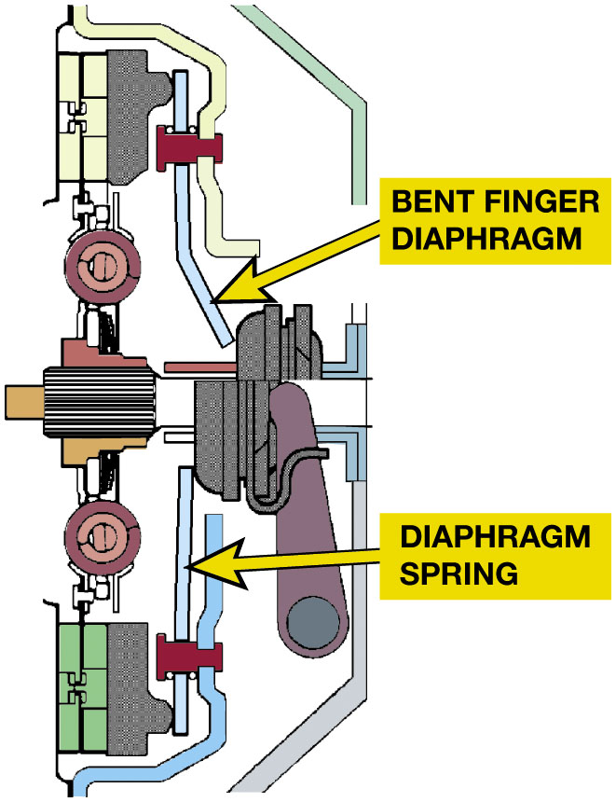
Figure 3.9
Bent-Finger Diaphragm
A bent finger diaphragm clutch. The shape of the fingers keeps the fingers and release bearing from going past center during clutch release.
Notes:
Long Description:
An illustration of a diaphragm clutch is as follows. The illustration has a bent metal structure labeled bent-finger diaphragm at the top. A metal rod labeled diaphragm spring is below it.

Slide 16
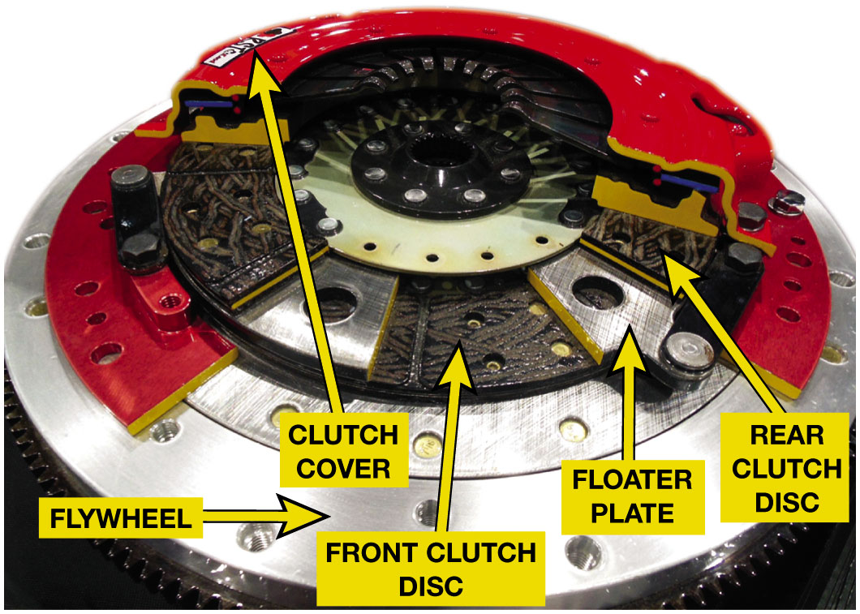
Figure 3.10
Double Disc Clutch
A Double disc clutch that uses a floater plate between the two discs. The second disc doubles the clutch torque capacity.
Notes:
DOUBLE DISC CLUTCHES
A relatively inexpensive method of increasing clutch torque capacity is to use two or more
clutch discs. All that is required is another disc (much like the first), a floater plate, also known as intermediate plate,
is located between the two friction discs and a lengthened pressure plate cover with provision for the floater plate.
● SEE FIGURE 3.10.
The floater plate must be able to move forward to squeeze the front disc against the flywheel and rearward during
release to provide air gaps. The pressure plate provides the clamping force for both discs and has enough movement
to provide air gaps at both discs when released.
Long Description:
A double disc clutch with labeled components is as follows. At the top is a clutch cover. Underneath is a rear clutch disc, and underneath the disc is a floater plate. Beneath the floater plate is a front clutch disc. Below the front clutch disc is a flywheel.

Slide 17
Flywheels
Characteristics
Smooth out or dampens engine power pulses.
Absorbs some of heat created by clutch operation.
Provides connection point for starter motor to rotate engine.
Provides friction surface for clutch friction disc.
What is inertia?
What are stepped flywheels?
Notes:
Stepped Flywheel
Some manufacturers use a stepped flywheel. These are combined with a pressure plate that has either a flat or almost flat cover. Stepped flywheels have more of the mass at the outer edge, which increases the rotational inertia. ● SEE FIGURE 3.13.
Inertia
Newtons First Law of Motion: An object in motion, tends to stay in motion and an object at rest tends to say at rest.

Slide 18
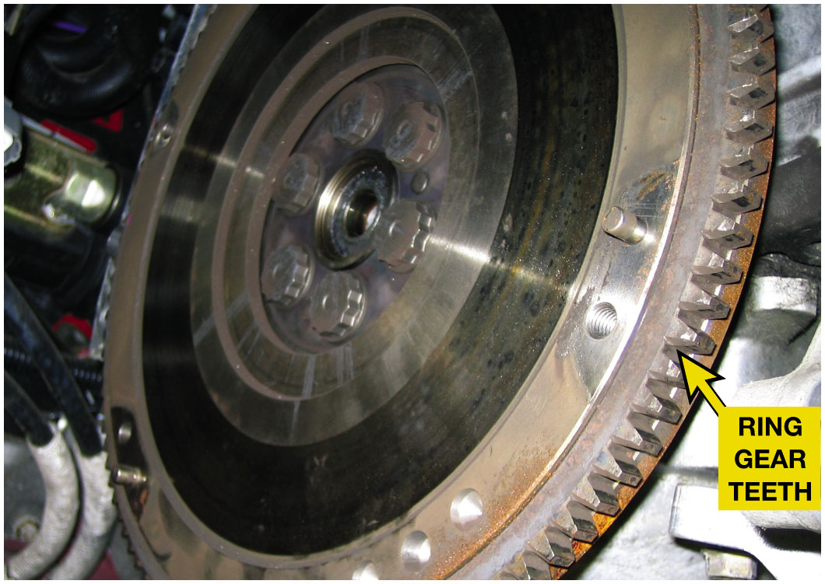
Figure 3.11
Ring Gear
The ring gear, which is attached to the outer rim of the flywheel, provides the teeth needed to mesh with the starter pinion gear.

Slide 19
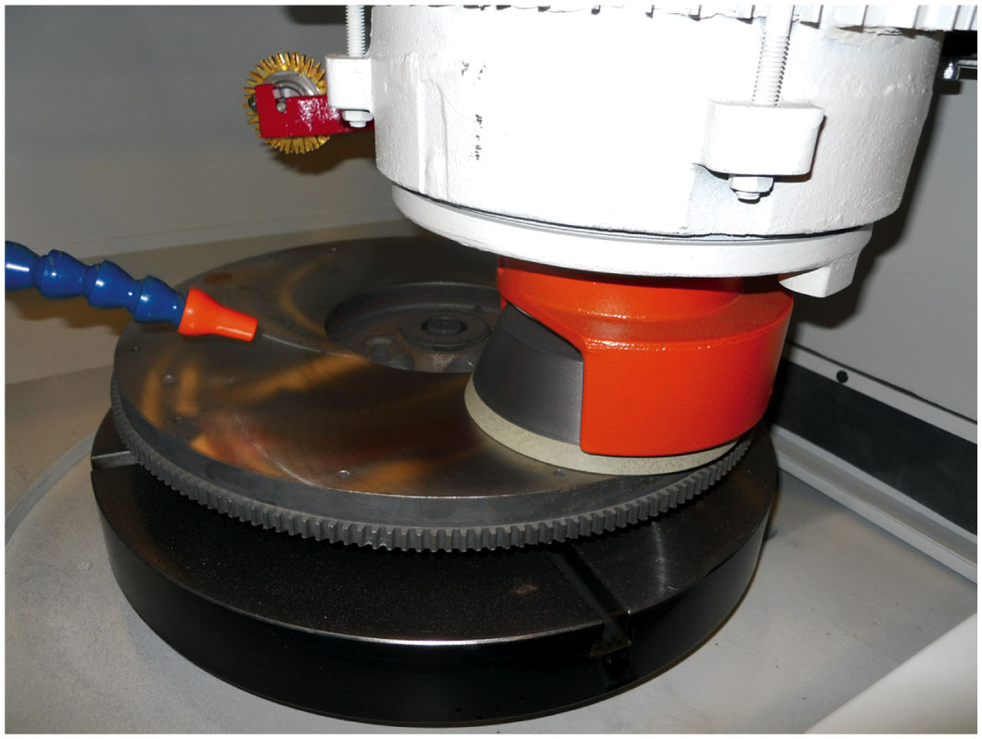
Figure 3.12
Flywheel Resurface
A flywheel being machined (ground) to provide the correct surface finish for the replacement clutch disc.
Notes:
Construction
The flywheel is constructed of cast iron and attaches to the end of the engine crankshaft. The carbon
content of the cast iron (about 3%) provides a suitable surface for the clutch disc. The carbon, in the form of graphite, acts as a lubricant to help provide a smooth engagement of the clutch. The face on the transmission side of the flywheel has a smooth, machined
area that creates the application surface for the clutch friction disc. This surface must be properly finished to allow adequate
slippage as the clutch engages and disengages, and to prevent slippage when the clutch is engaged. Being made from
cast iron makes resurfacing easy. ● figure 3.12

Slide 20
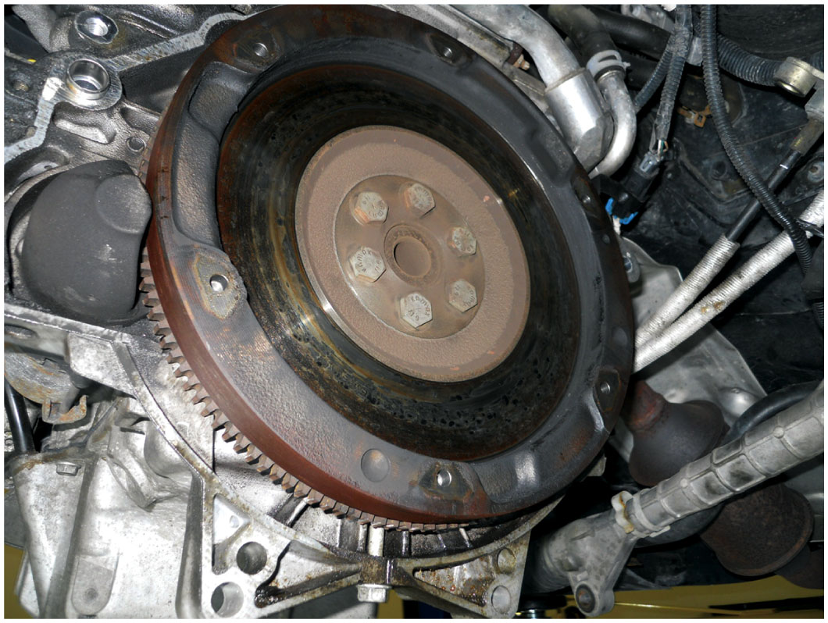
Figure 3.13
Stepped Flywheel
A stepped flywheel has more mass on the outer edge which helps smooth out impulses from a four-cylinder engine especially at idle speed.

Slide 21
Dual-Mass Flywheel
Starter ring gear mounts on the primary flywheel.
Power from starter motor does not have to flow through damper assembly
To reach engine crankshaft.
Pilot bearing is also attached to primary flywheel.
Clutch friction surface is usually on secondary flywheel.
Notes:
Some vehicles, especially high-performance vehicles and vehicles equipped with diesel engines, use a dual-mass flywheel. The purpose of a dual-mass flywheel is to dampen engine vibrations and keep them from being transmitted to the passenger compartment
through the transmission and shift linkage.
NOTE: If the dual-mass flywheel fails, the symptom is the same as a slipping clutch. The torque-limiting
friction material connecting the primary and secondary flywheels can fail. This failure requires the replacement
of the flywheel assembly.

Slide 22
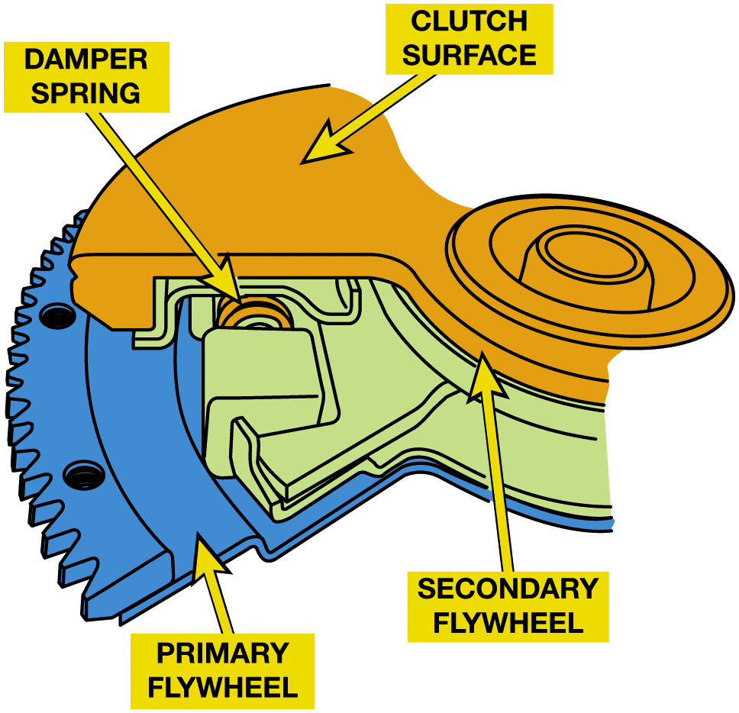
Figure 3.14
Dual-Mass Flywheel
A dual-mass wheel consists of two flywheels connected with a spring between them to help absorb engine pulsations.
Notes:
Long Description:
The illustration has an irregular clutch surface on the top. Below the clutch surface, there is a primary flywheel with small triangular edges. The secondary flywheel is in between the clutch surface and the primary wheel, and a small spring is between the primary flywheel and the secondary flywheel.

Slide 23
Pilot Bearings
Engine end of a transmission input (clutch) shaft
Supported by pilot bearing pressed into end of crankshaft.
Need for pilot bearing
Construction: How can pilot bearings be constructed?
How do pilot bearings operate?
Notes:
Purpose & Function
The engine end of a transmission input (clutch) shaft is supported by a pilot bearing that is
Pressed into the end of the crankshaft.
Pilot Bearing
The transmission input shaft goes all the way from the transmission, through the clutch assembly, to the engine. Transmission bearings support the transmission end of the shaft. The pilot bearing or bushing supports it at the engine end. F W D vehicle has a transaxle with an input shaft supported by a pair of bearings and a short input shaft which may not reach all the way to the flywheel. This design does not need a pilot bushing or bearing to support the engine end of the input shaft.
Construction
Pilot bearings can be constructed using:
Sintered Bronze Oilite Bushing
Needle Bearing
Ball Bearing.

Slide 24
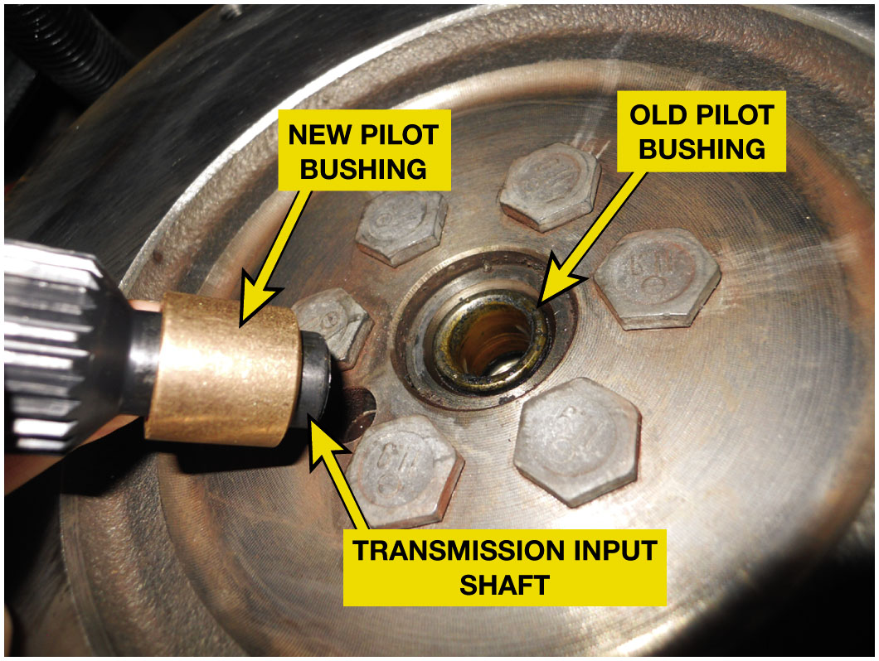
Figure 3.15
Pilot Bearing Installation
A pilot bearing or bushing, such as one being used on the rear-wheel-drive pickup truck, is pressed into the end of the engine crankshaft and supports the input shaft of the transmission.
Notes:
Long Description:
A disc-like crankshaft has an old pilot bushing in the center. A new pilot bushing inserted into the mouth of the transmission input shaft is near the old pilot bushing.

Slide 25
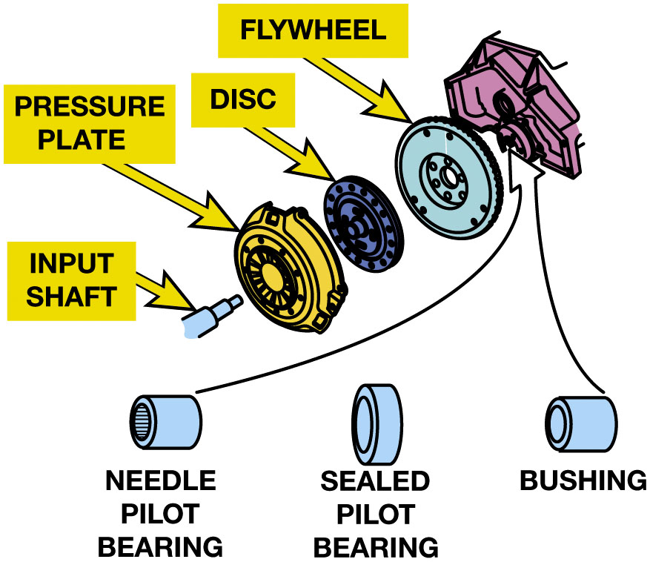
Figure 3.16
Pilot Bearing
Pilot bearings (bushings) are made in several different designs depending on the application.
Notes:
Long Description:
The illustration has seven different types of pilot bearings and other mechanical parts. From the bottom to the top, they are as follows. A cylindrical input shaft, a circular pressure plate, a circular disc, a circular flywheel, and an uneven mechanical component are to be fitted with a needle pilot bearing, sealed pilot bearing, and bushing. The needle pilot bearing, sealed pilot bearing, and bushing are all cylindrical.

Slide 26
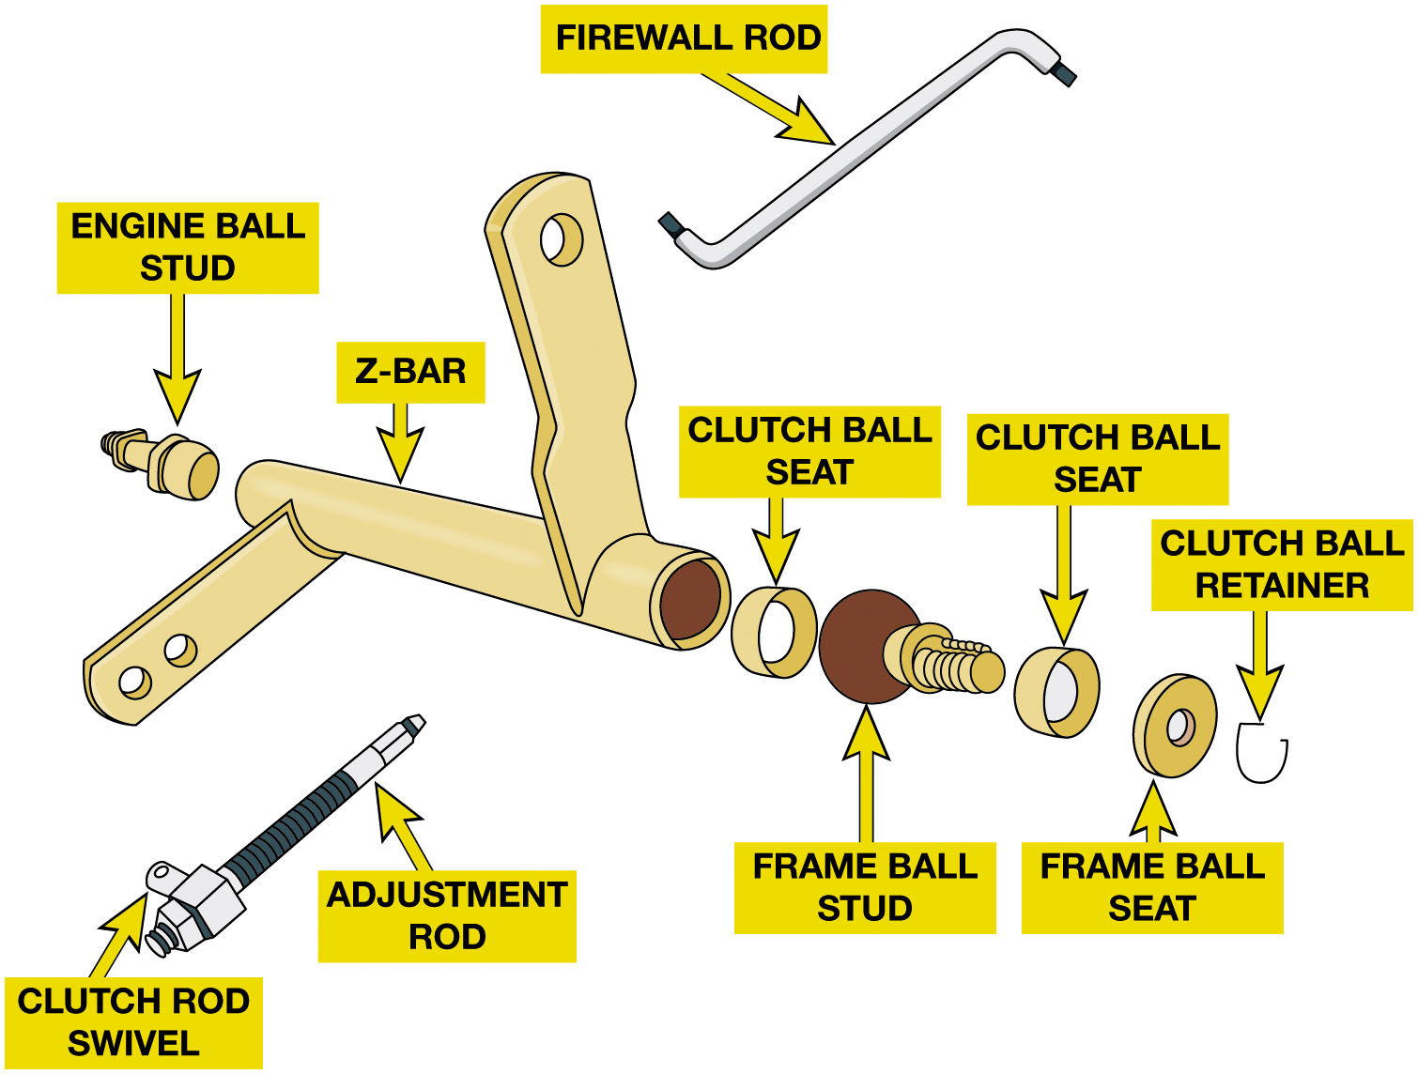
Figure 3.17
Clutch Pedal Linkage
Transfers force driver exerts on clutch pedal to release bearing.
What are types of clutch linkage?
The Z-bar is used on rods and lever-type clutch linkage to change the direction of the movement. It spans between the engines (ball stud) and the frame of the vehicle.
Notes:
Clutch Linkage
3 methods of transferring the force of driver’s foot to the release (throwout) bearing; they are the following:
Levers and rods. Mechanical linkage uses a series of levers and rods, to move the release fork against the throwout bearing. This method was commonly used in older vehicles. If a change in direction is needed, bell cranks, commonly called an equalizer bar (also known as a Z-bar) are mounted on pivot shafts to reverse the direction of the force. ● Figures 3.17, 3.18
Cable operation. A cable is used similar to a brake cable used on a bicycle. Cable linkage consists of a steel cable attached to the clutch pedal. The clutch cable is routed to the engine/bell housing, where it can pull on the clutch fork/lever. Much of the cable is enclosed in a housing or conduit so that it can be routed around corners or obstacles. Although simple and inexpensive, cables have a drawback in that they develop internal friction through time, which makes them harder to operate. ● Figure 3.19.
Hydraulic. A small clutch cylinder is located on the bulkhead and operated by the clutch pedal and an actuator cylinder located near the release (throwout) bearing is a very common method of connecting the clutch pedal to the release fork on vehicles equipped with a manual transmission. ● SEE FIGURE 3.20.
Long Description:
The illustration has nine different components. From the left to right, they are as follows. An engine ball stud is on the left. To the right of the stud, there is a cylindrical z-bar with two rectangular handles on the left and bottom right. Beside the bar, there is a small cylindrical clutch ball seat. On the right of the ball seat, there are a frame ball stud, clutch ball seat, and frame ball seat. On the rightmost, there is a U-shaped thin clutch ball retainer. On the top of the z-bar, there is an inverted Z-shaped firewall rod. On the bottom of the z-bar, there is a cylindrical adjustment rod with a clutch rod swivel on the head.

Slide 27
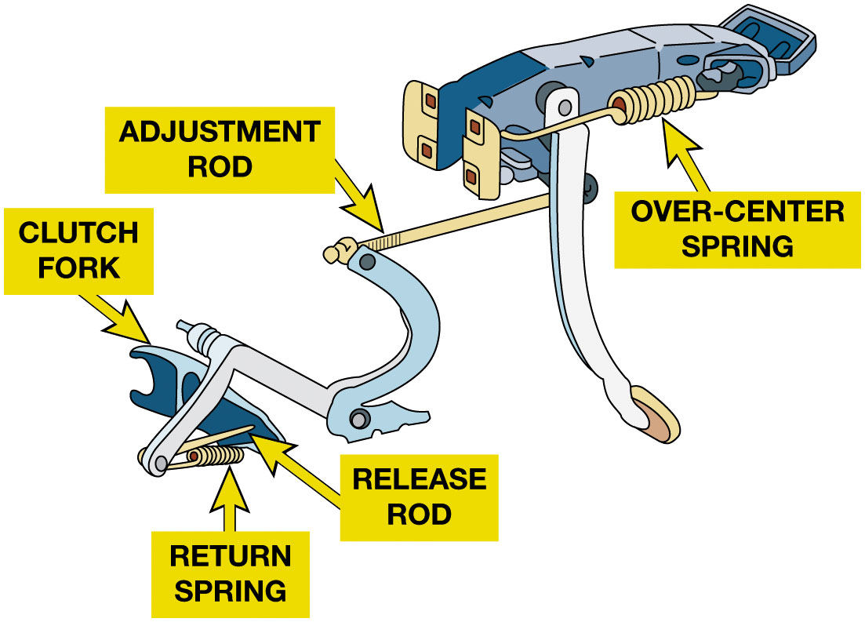
Figure 3.18
Over-Center Spring
The over-center spring is mounted to pull the pedal upward during the first half of pedal travel and downward during the second half. This last action reduces pedal effort and helps release the clutch. This can be demonstrated by carefully pushing on the clutch pedal with the linkage disconnected.
Notes:
Long Description:
The clutch pedal consists of an over-center spring on the left of the pedal. Below the pedal and attached to it, is a long cylindrical adjustment rod. On the left end of the adjustment rod, there is an inverted C-shaped linkage structure. From the end of the inverted C-shaped structure, there extends a cylindrical rod with its bottom part connected to the return spring and release rod. The return spring and release rod touch the clutch fork below the cylindrical rod from the inverted C-shaped linkage structure.

Slide 28
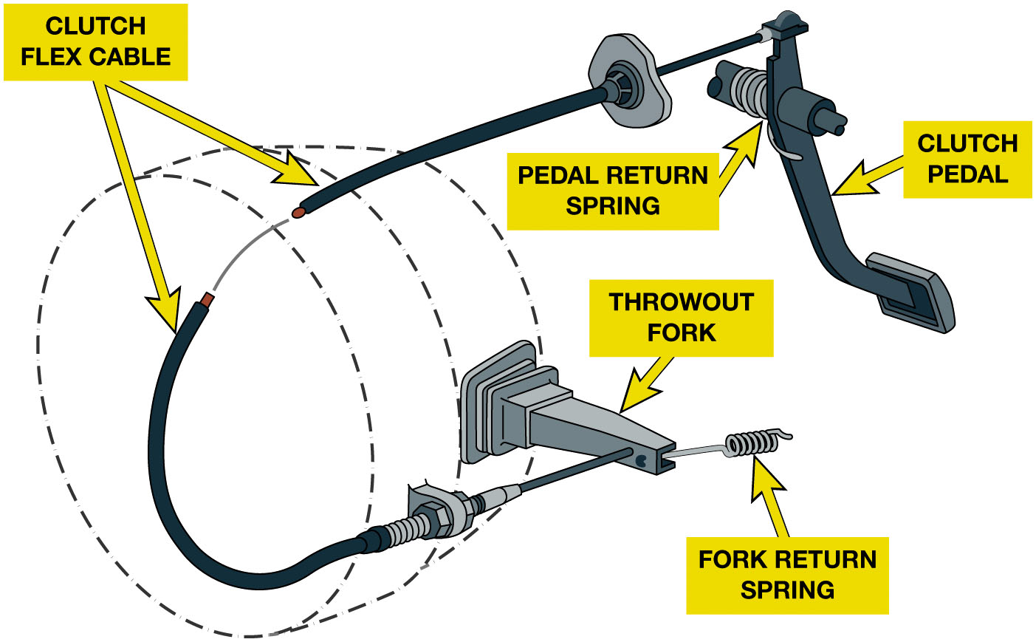
Figure 3.19
Clutch Cable Type
A typical cable operated clutch mechanism uses two springs. One at the pedal assembly is used to return the clutch pedal after it is depressed and the other is located at the fork to return the throwout bearing fork to thee clutch applied (pedal up) position.
Notes:
Long Description:
The illustration consists of a U-shaped clutch flex cable over the shaft. The clutch flex cable is connected on the top with the suspended clutch pedal. The clutch pedal has a pedal return spring on the top. The bottom part of the clutch flex cable is connected to a triangular throwout fork. A fork return spring extends from the mouth of the throwout fork.

Slide 29
Animation: Cable Clutch Operation (Animation will automatically start)

Slide 30
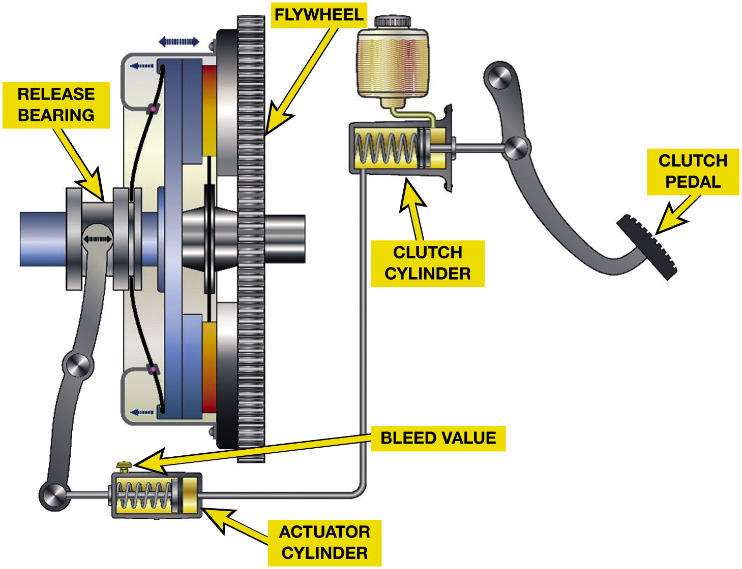
Figure 3.20
Hydraulic Clutch
Hydraulic fluid is used to transmit force and motion from the clutch pedal to the clutch actuator cylinder.
Notes:
Hydraulic Clutch Operation
A hydraulic system transmits force using a fluid and is the most commonly used clutch operating system. Liquids cannot
be compressed, and if a force is put on liquid at one end of a passage, liquid at the other end of
the passage will exert the same force. In a hydraulic clutch system, the input piston is located in the clutch cylinder and is connected to the clutch pedal. The output piston is located in the actuator cylinder, and operates the release bearing directly or through a clutch fork/lever. The clutch cylinder and actuator cylinder pistons are connected by
metal, reinforced rubber, or plastic tubing.
When the clutch pedal is depressed, the clutch cylinder piston forces fluid through the tubing to actuator cylinder, where the pressure forces the actuator cylinder piston to move the clutch fork/lever.
When the clutch pedal is up, the pressure plate forces the actuator cylinder piston to return fluid to master cylinder.
When the clutch pedal is up, a compensating port in the clutch cylinder is opened up between the cylinder bore and the fluid reservoir.
Port allows for fluid expansion or contraction due to temperature changes, for any air to leave the fluid, and in many cases, for self-adjustment for disc wear.
Because air can be compressed, any air trapped in a hydraulic system will cause mushy, spongy pedal, or incomplete operation. DOT 3 brake fluid is generally used in clutch hydraulic systems.
Many systems use an actuator cylinder that is concentric to the bearing retainer and has the release bearing connected directly to it. Some vehicles use an actuator cylinder that is mounted on the exterior of the bell housing. SEE FIGURE 3.21.
Long Description:
The illustration consists of a release bearing between two disc-like structures on the left. Attached to this disc-like structure on the right is a shaft with a flywheel. The release bearing has a suspended linkage structure that is connected to a rectangular actuator cylinder on the bottom. The actuator cylinder has a bleed valve on the top left. A thin rod extends from the actuator cylinder and is connected to the rectangular clutch cylinder on the right of the flywheel. The clutch cylinder is further connected to a suspended linkage structure that has a clutch pedal on the bottom.

Slide 31
Animation: Clutch Hydraulic Operation (Animation will automatically start)

Slide 32
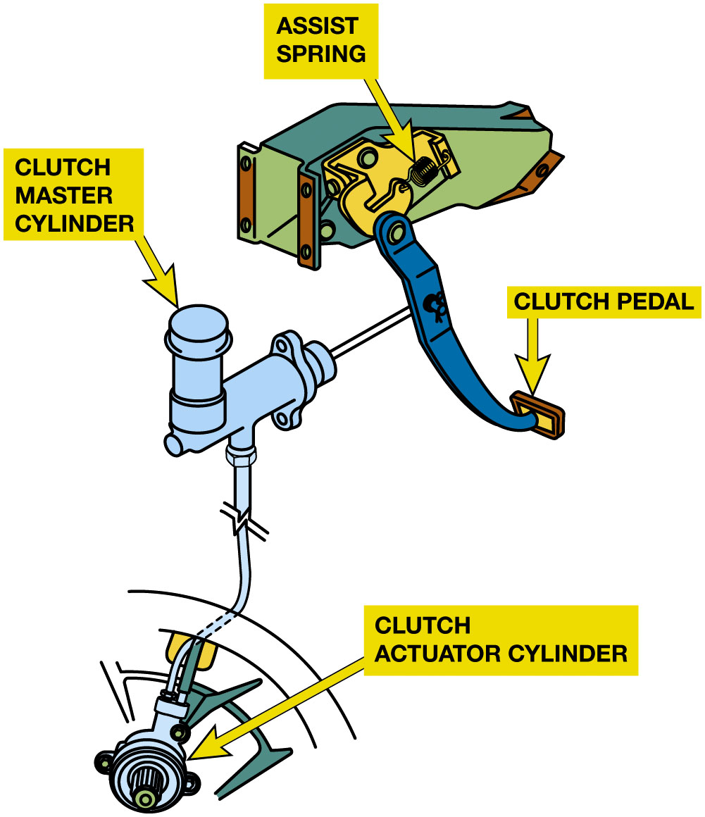
Figure 3.21
Actuating Cylinder
The actuator cylinder of some systems is concentric to the transmission input bearing retainer. When the clutch pedal is depressed, pressurized fluid is forced from the clutch cylinder to the actuator cylinder to release the clutch.
Notes:
Long Description:
The illustration consists of the transmission input bearing retainer on the top. The clutch pedal is on the bottom of the suspended linkage structure from the bearing retainer connected by an assist spring. A thin cylindrical rod from the suspended linkage structure is connected to the tap-like clutch master cylinder. The clutch master cylinder is connected to a spherical clutch actuator cylinder on the bottom via a rod. The liquid flows from the clutch master cylinder to the clutch actuator cylinder via the rod.

Slide 33
Release (Throwout) Bearings
Release Bearing Operation :
Presses against diaphragm spring fingers or coil spring levers
Takes spring force off pressure plate
No longer clamps friction disc against flywheel
Constant-running:
Release bearing outer race constantly turns at crankshaft speed
What are the types of release bearings?
See Figure 3.22

Slide 34
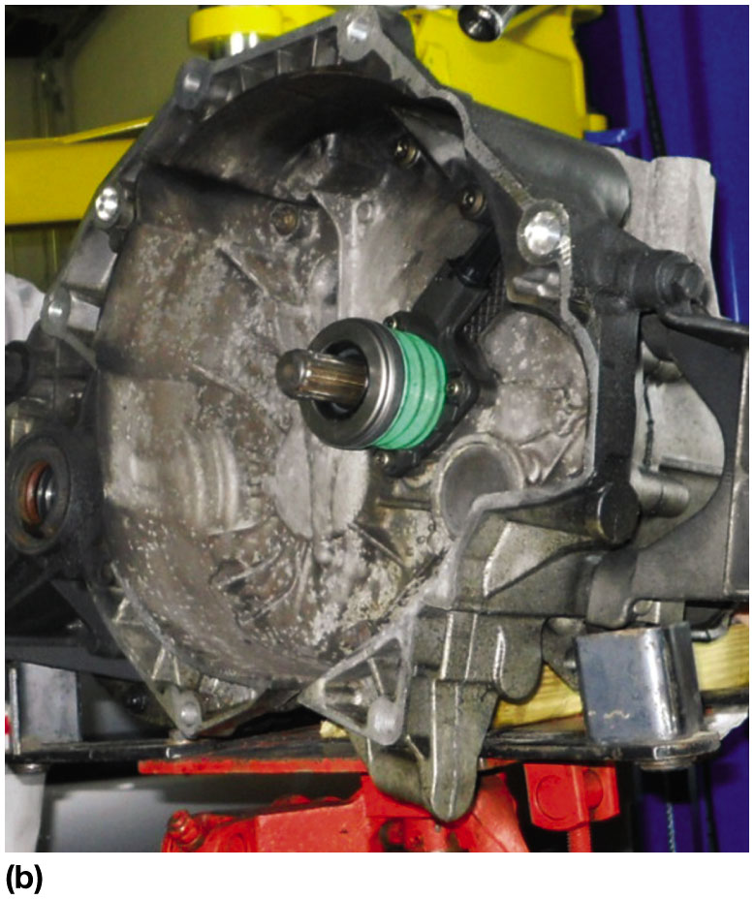
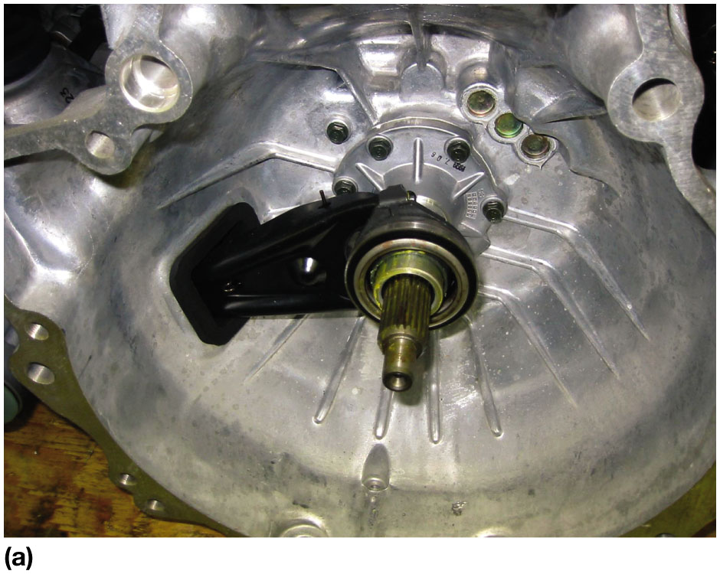
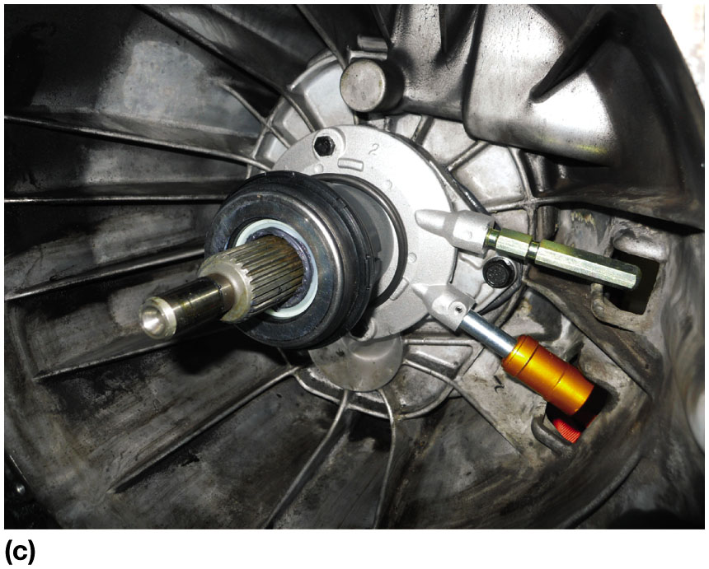
Figure 3.22
Release Bearing Types
(a) A release (throwout) bearing on a transmission that uses a clutch fork and a mechanical or cable-operated linkage. (b) A style of release bearing that includes the actuator cylinder, sometimes called a concentric actuator cylinder. (c) A combination release bearing and actuator cylinder showing the two hydraulic lines. The lower line is from the master clutch cylinder and the upper line is used to bleed air from the hydraulic system.
Notes:
The release bearing sleeve slides on the outer surface of this tube, which is also commonly called (slang):
Quill
Quill Shaft
Candlestick
Long Description:
A close-up view of a throwout bearing in a released position with an actuator cylinder in the center of the clutch disc. The bearing has two hydraulic lines near it.

Slide 35
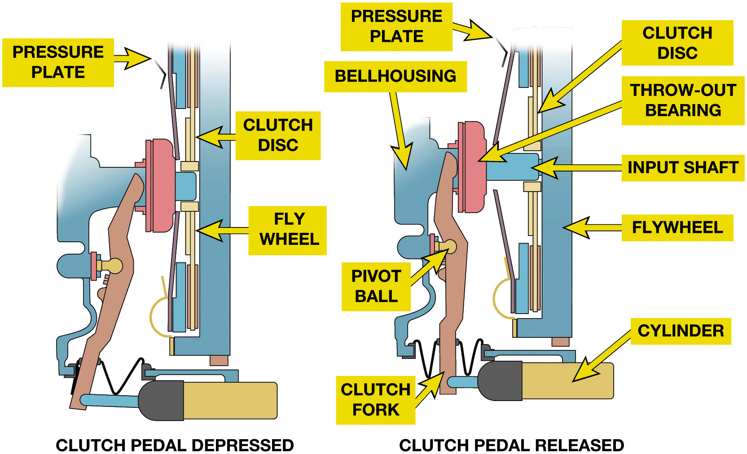
Figure 3.23
Hydraulic Clutch
(a) When the clutch pedal is depressed, the throwout (release) bearing depresses the diaphragm spring which releases the pressure being applied squeezing the pressure plate against the flywheel. (b) When the clutch pedal is released (pedal up), the clutch is engaged and transmits engine torque to the input shaft of the transmission/transaxle.
Notes:
Release Bearings
If the clutch operating system is self-adjusting, then there is no clearance between the release bearing outer race and the diaphragm spring fingers or coil spring levers.
The release bearing outer race constantly turns at engine crankshaft speed. This is called a constant- running release bearing. In some self-adjusting systems, a snap ring holds the outer race to the spring fingers. This design is typical of pull-type clutch operating systems that move away from the flywheel to disengage the clutch.
If the clutch operating system does not self-adjust, then there must be some clearance between the release bearing outer race and the spring fingers when the clutch is engaged. The outer race does not contact the spring fingers and so it does not turn. As the driver depresses the clutch pedal, the release bearing moves into contact with the fingers and the outer race begins to rotate with them. This type of release bearing is not designed to rotate constantly. If the clutch is not adjusted properly and there is no clearance, the release bearing spins constantly and wears out quickly. SEE FIGURE 3.23.
Long Description:
The two illustrations label the following components, There is the bell housing and a pivot ball on the left with a clutch fork and throw-out bearing on the right. The throw-out bearing is inserted into the input shaft. There are two pressure plates above and below the input shaft. On the right of the pressure plates are the clutch discs attached to the flywheel. The illustration on the left consists of the clutch pedal in the depressed position with a sloping clutch fork at some distance from the bell housing. The clutch fork pushes right the throw-out bearing with the two pressure plates pushed right, and a smaller portion of the input shaft is visible. With the clutch pedal depressed, the clutch fork and the cylinder at the bottom are a little far from each other. The illustration on the right consists of the clutch pedal in the released position with a straight clutch fork attached just right of the bell housing. The clutch fork has the throw-out bearing near it with the two pressure plates in a sloping position on the right of the throw-out bearing, and a large portion of the input shaft is visible. With the clutch pedal released, the clutch fork and the cylinder at the bottom are near each other at the bottom.

Slide 36
Frequently Asked Question: What is a Pull-Type Release Bearing?
? Frequently Asked Question
What is a Pull-Type Release Bearing? The pressure plate used on a few F W D vehicles is bolted directly onto the engine’s crankshaft, and the flywheel is bolted onto the pressure plate. This allows the release bearing to be placed inside the pressure plate and operated by a pull rod through the transmission input shaft. It is often called a pull-type clutch. The mounting of diaphragm spring is moved in cover and at the pressure ring so a pulling force is used to release the clutch instead of the normal pushing force. This change produces an improvement in clutch system efficiency and a lower clutch pedal effort.

Slide 37
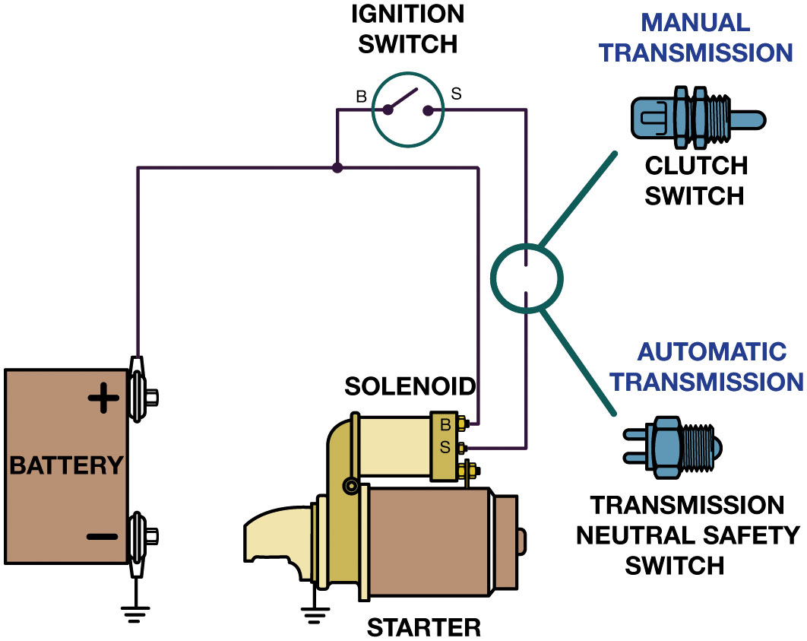
Figure 3.24
Clutch Pedal Switch
Clutch Pedal Switch…
Signals starter circuit that clutch is released which prevents starter operation unless clutch pedal is depressed
To prevent the engine from cranking, an electrical switch is usually installed to open the circuit between the ignition switch and the starter solenoid. When the clutch pedal is depressed, the switch closes and completes the circuit to the starter.
Notes:
Long Description:
The diagram consists of a battery on the bottom left. The positive end of the battery is connected to the ignition switch on the top center. The ignition switch is in an on position. On the center-right, the circuit has the manual transmission feature with the clutch switch and an automatic transmission feature with the transmission neutral safety switch. The ignition switch and the transmission components are connected to the solenoid starter on the bottom right.

Slide 38
Question 1
Which part does not rotate when the engine is running and the clutch pedal is depressed?
A. Pilot bearing (bushing)
B. Pressure plate
C. Input shaft
D. Flywheel

Slide 39
Answer 1
Which part does not rotate when the engine is running and the clutch pedal is depressed?
C. Input shaft

Slide 40
Summary
Purpose and function of a clutch and clutch disc.
Clutch assembly includes
Flywheel, clutch disc, release bearing, pressure plate.
Four basic purposes of the engine flywheel services.
Clutch pedal linkage transfers force the driver
Exerts on clutch pedal to the release bearing.

Slide 41
Automotive Fundamentals Videos and Animations
Videos Link: (A3) Manual Drive Train Axles Videos
Animations Link: (A3) Manual Drive Train Axles Animations

Slide 42
Copyright
This work is protected by United States copyright laws and is provided solely for the use of instructors in teaching their courses and assessing student learning. Dissemination or sale of any part of this work (including on the World Wide Web) will destroy the integrity of the work and is not permitted. The work and materials from it should never be made available to students except by instructors using the accompanying text in their classes. All recipients of this work are expected to abide by these restrictions and to honor the intended pedagogical purposes and the needs of other instructors who rely on these materials.

