Slide 1
Automatic Transmissions and Transaxles
Eighth Edition
Chapter 19
Transmission/Transaxle Assembly and Installation
Copyright © 2024, 2018, 2015 Pearson Education, Inc. All Rights Reserved
Notes:
If this PowerPoint presentation contains mathematical equations, you may need to check that your computer has the following installed:
1) Math Type Plugin
2) Math Player (free versions available)
3) NVDA Reader (free versions available)
INSTRUCTOR NOTE: This presentation includes text explanation notes, you can use to teach the course. When in SLIDE SHOW mode, you RIGHT CLICK and select SHOW PRESENTER VIEW, to use the notes.

Slide 2
Learning Objectives (1 of 2)
19.1 Identify the different methods of component cleaning.
19.2 Explain bushing, bearing, and thrust washer service.
19.3 Discuss friction material service.
19.4 Explain internal seal and ring service.
19.5 Describe the procedure for performing case and pump service.

Slide 3
Learning Objectives (2 of 2)
19.6 Explain the procedure for clutch disassembly and assembly.
19.7 Discuss gear set service and air testing.
19.8 Explain the procedure to perform a final transmission assembly.
19.9 List the steps involved in installing a transmission/transaxle.

Slide 4
Component Cleaning
Methods
Hot spray wash
Solvent wash
Water (aqueous) solution wash
Microbe cleaning
Notes:
Warning: The petroleum solvent–air mixture from drying the parts is highly flammable. Never use cleaning solvent around an open flame, spark, or source of ignition.

Slide 5
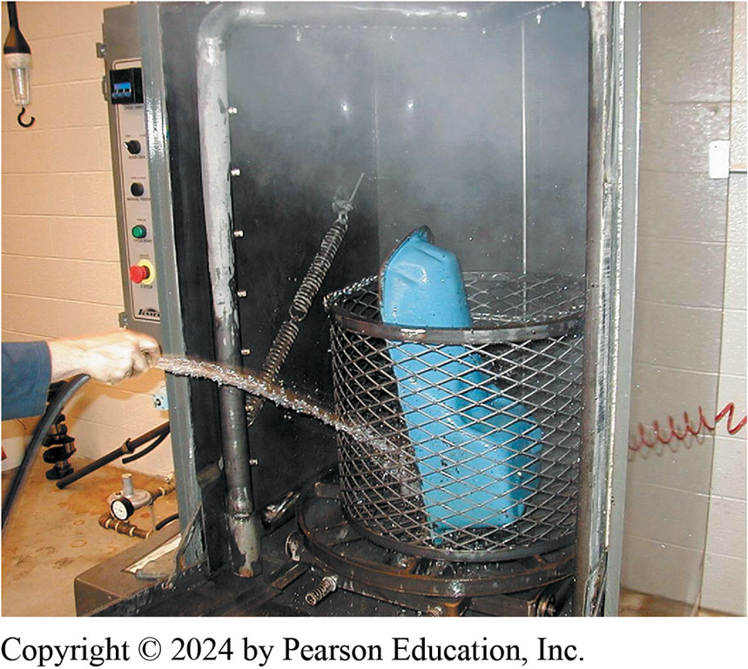
Figure 19.1
Pressure Jet Washer
Pressure jet washer is similar to a large industrial-sized dishwasher. This type of cleaning unit can be used for most automotive components including engines and transmissions. Each part is then rinsed with water to remove chemicals or debris that may remain there while it is still in the tank.

Slide 6
Bushing, Bearing, and Thrust Washer Service
Bushings and bearings are used to support rotating shafts.
Thrust washers are used to separate rotating parts from each other or from stationary parts.

Slide 7
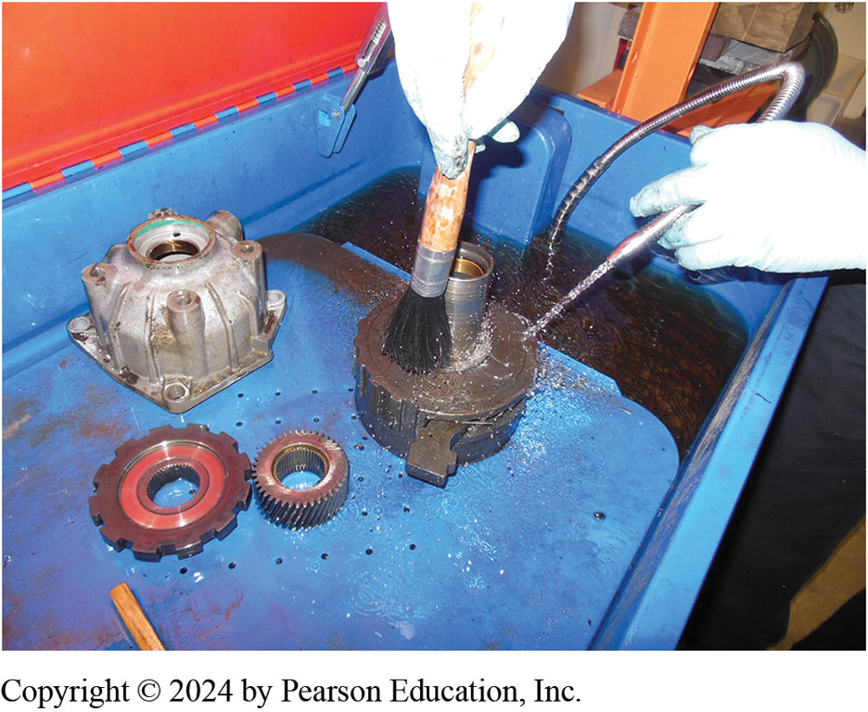
Figure 19.2
Transmission parts being cleaned in a water based solvent cleaning tank.
Notes:
Water-based Chemical Cleaning Because of environmental concerns, most chemical cleaning is now performed using water-based solutions (also called aqueous-based solutions). Most aqueous-type chemicals are silicate based and are mixed with water. Aqueous-based solutions can be used in one of two ways.
■ Sprayed on
■ Used in a tank for soaking parts ● See Figure 19.2.

Slide 8
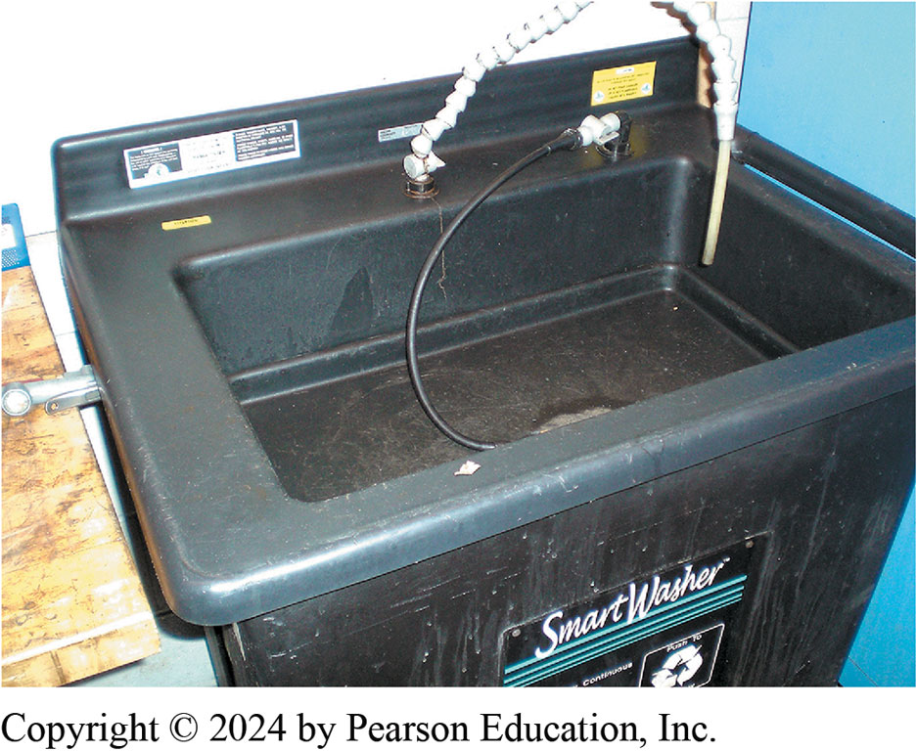
Figure 19.3
Microbial cleaning tank uses microbes to clean grease and oil from parts.

Slide 9
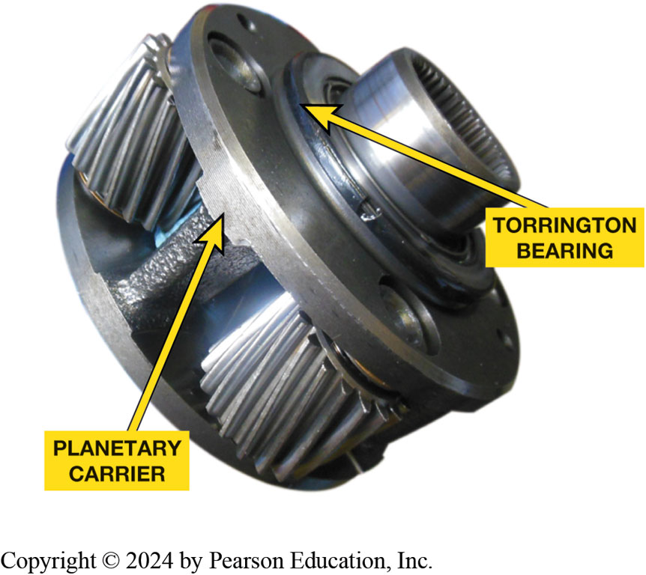
Figure 19.4
Torrington bearing used to absorb thrust loads on a planetary gear set.

Slide 10
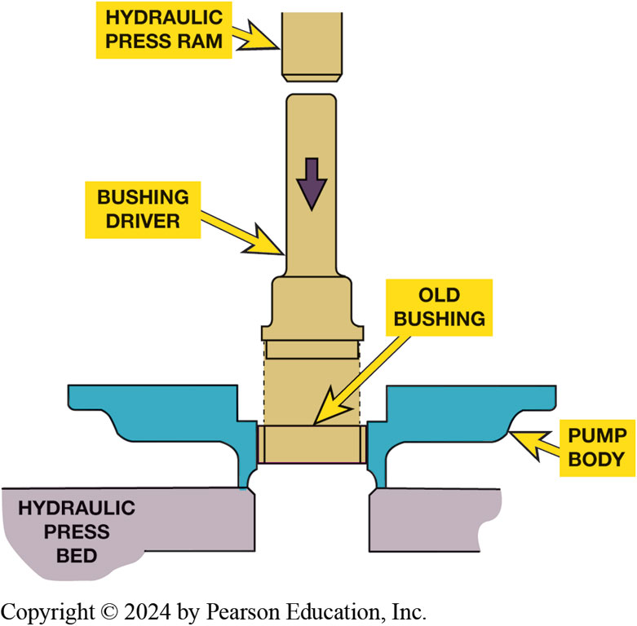
Figure 19.5
Worn pump bushings can be removed using a hydraulic press and a tool that applies force only to bushing.

Slide 11
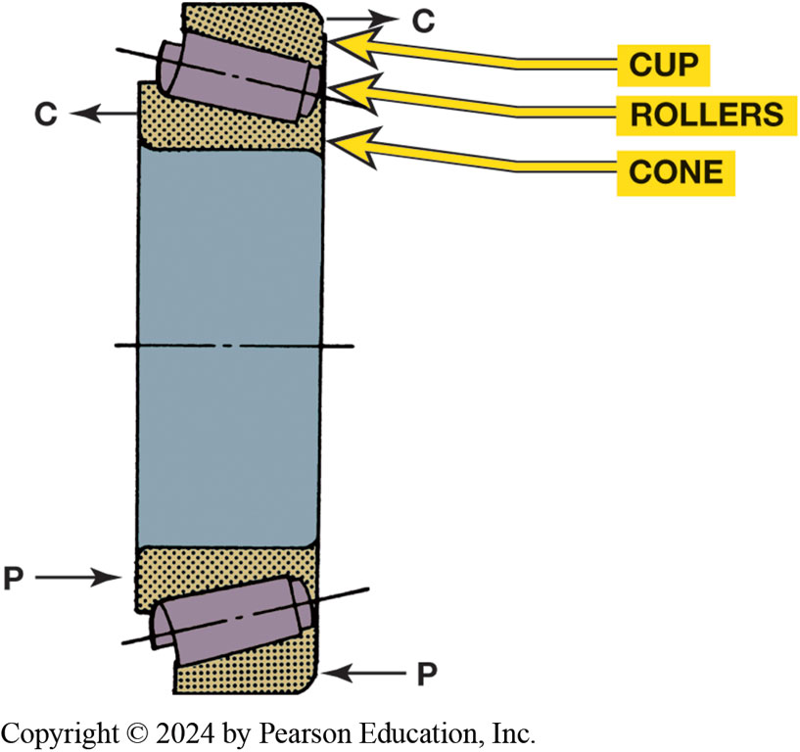
Figure 19.6
Roller Bearing
The cup, rollers, and cone of a tapered roller bearing are machined at an angle as shown. This allows them to resist a thrust in the direction indicated by the P arrows. The bearing is preloaded in this direction; any clearance at sides of the bearing (C arrows) is called free play.
Notes:
Long Description:
C arrows representing clearance point away from the bearing on the top left and right. P arrows representing preloading point toward the bearing on the bottom left and right.

Slide 12
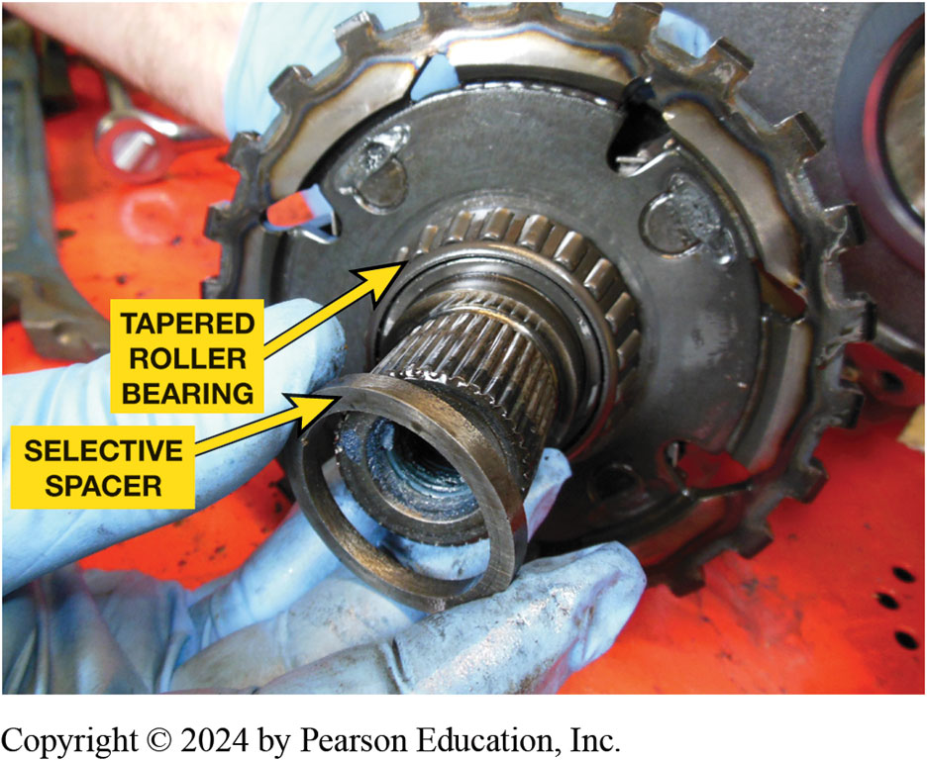
Figure 19.7
Final Drive Bearing
The selective spacer used at the final drive on a Chrysler 41T E. This unit uses two tapered roller bearings facing each other to support the final drive.

Slide 13
Friction Material Service
Lined Plate Service
Reusing lined plates
Steel Plate Service
Reusing steel plates
Band Service
Reusing bands

Slide 14
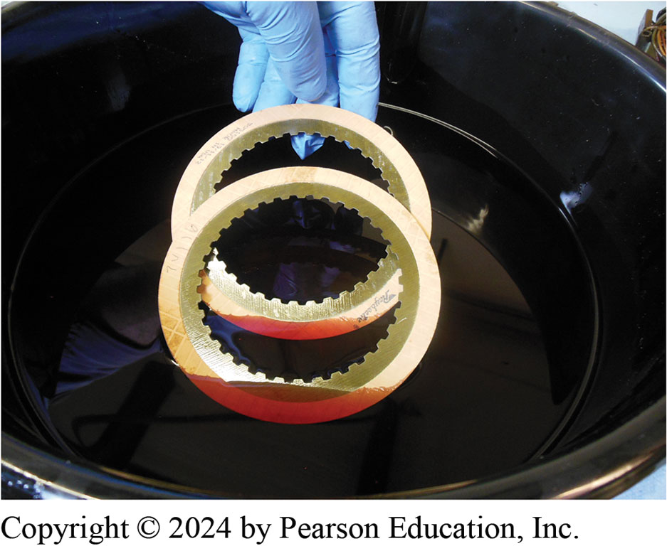
Figure 19.8
Lined Plates
All lined friction material should be submerged in a shallow pan of A T F and allowed to soak before being installed in the automatic transmission/transaxle.

Slide 15
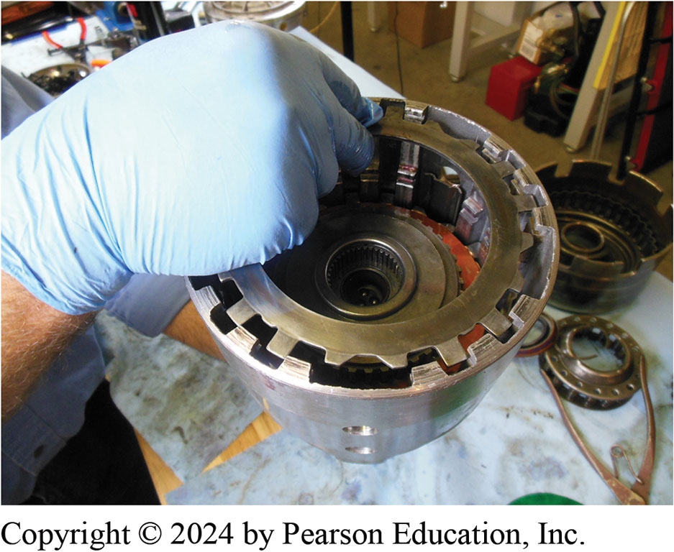
Figure 19.9
Steel plates can usually be reused if no faults are found during a visual inspection.

Slide 16
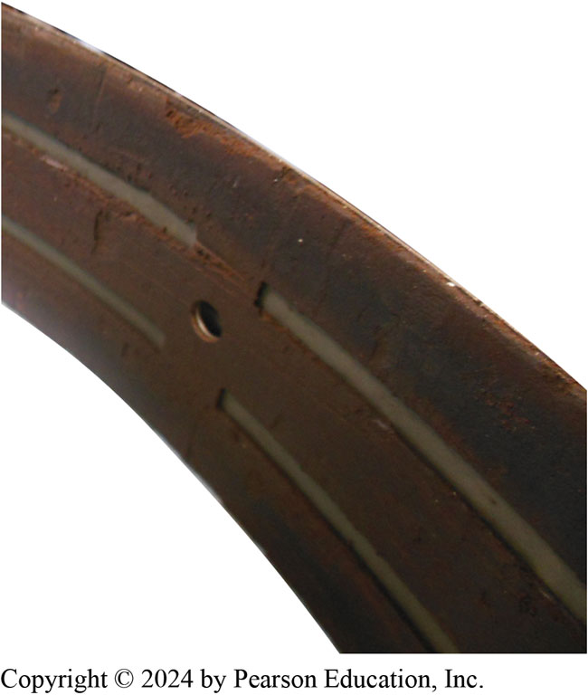
Figure 19.10
A badly chipped and pitted band. This band requires replacement.

Slide 17
Internal Seal and Ring Service (1 of 2)
Rubber Seals
O-ring seal (round or square-cut) is first checked by placing it in bore by itself.
Installing Pistons with Lip Seals
Clutch piston should be inspected before seal installation.

Slide 18
Internal Seal and Ring Service (2 of 2)
Fitting Sealing Rings
Sealing ring has to make a seal on one of its sides and at the outer diameter.
Installing Teflon Sealing Rings
Scarf-cut, Teflon sealing rings are installed by placing them in the groove with ends lapped in correct direction.

Slide 19
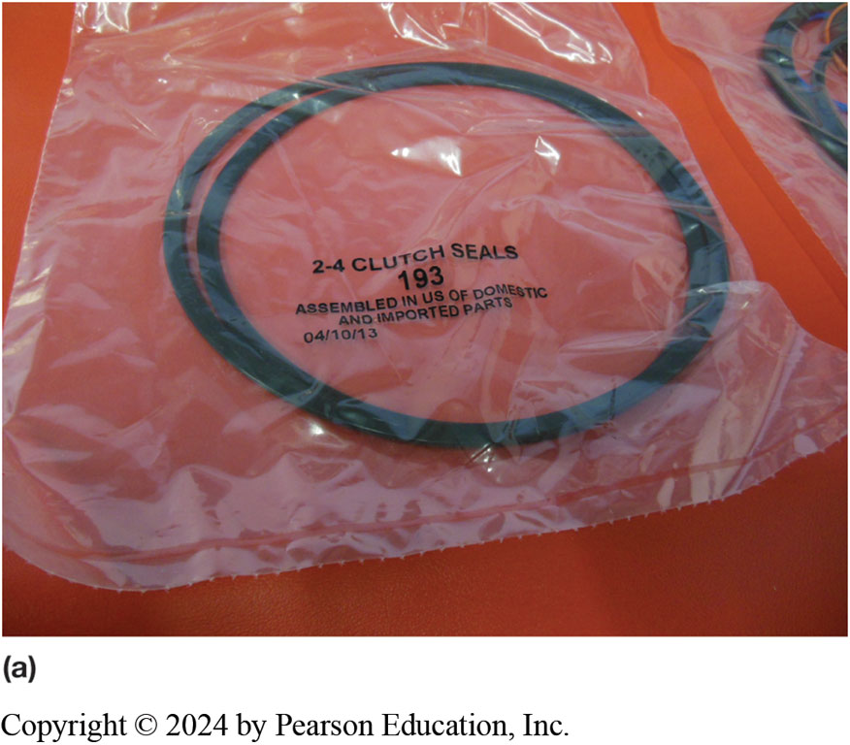
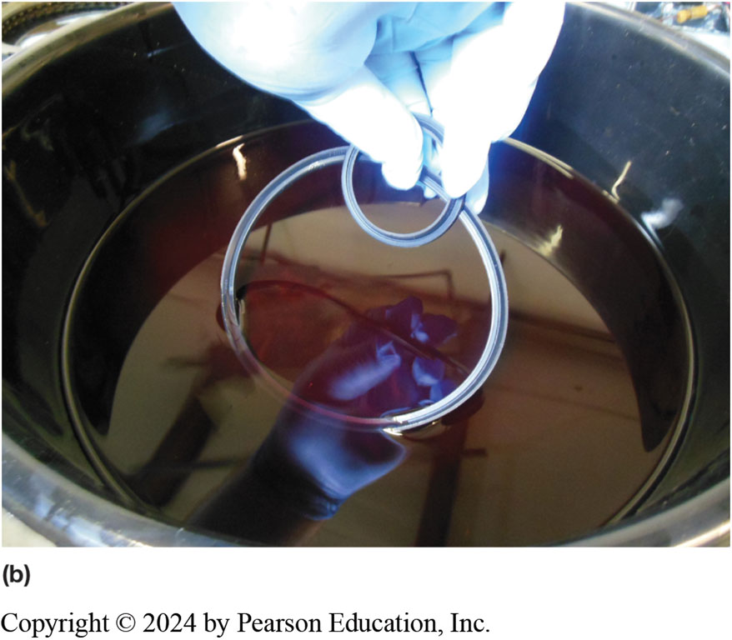
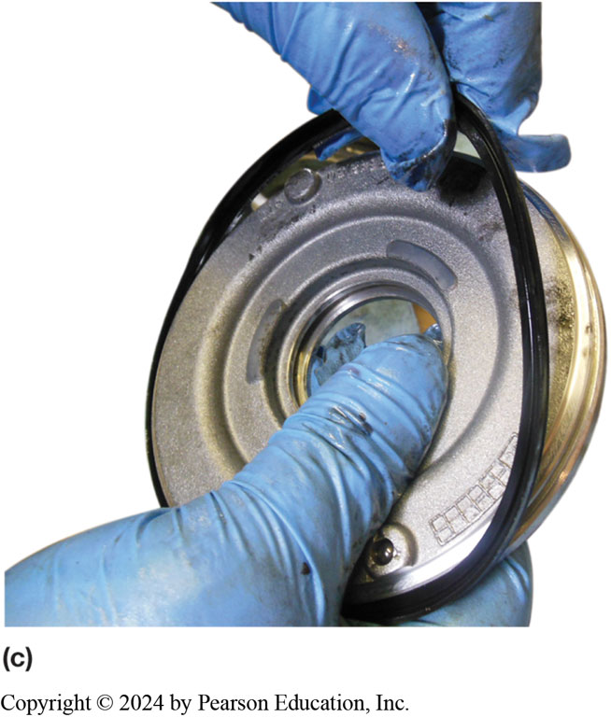
Figure 19.11
Piston Seals
Notes:
Figure 19.11 (a) Piston seals as supplied in an overhaul (O H) kit. (b) These seals are being lubricated in A T F before installation. (c) Installing a lip seal.

Slide 20
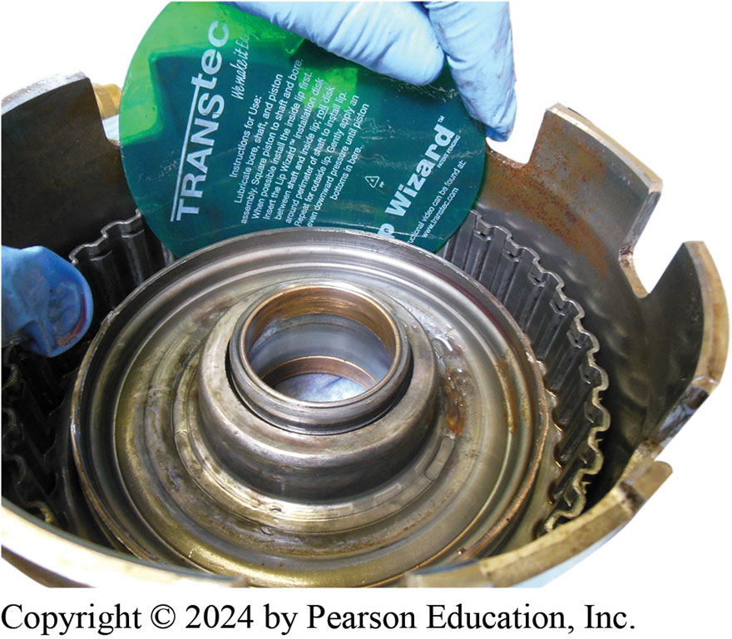
Figure 19.12
Piston Install Tool
A round flat plastic ring is often included in overhaul kits and makes seal installation easier.

Slide 21
Animation: Measure Clutch Plate Clearance, Feeler Gauge (Animation will automatically start)

Slide 22
Subassemblies
Subassemblies include:
Clutch packs
Pump
Valve body

Slide 23
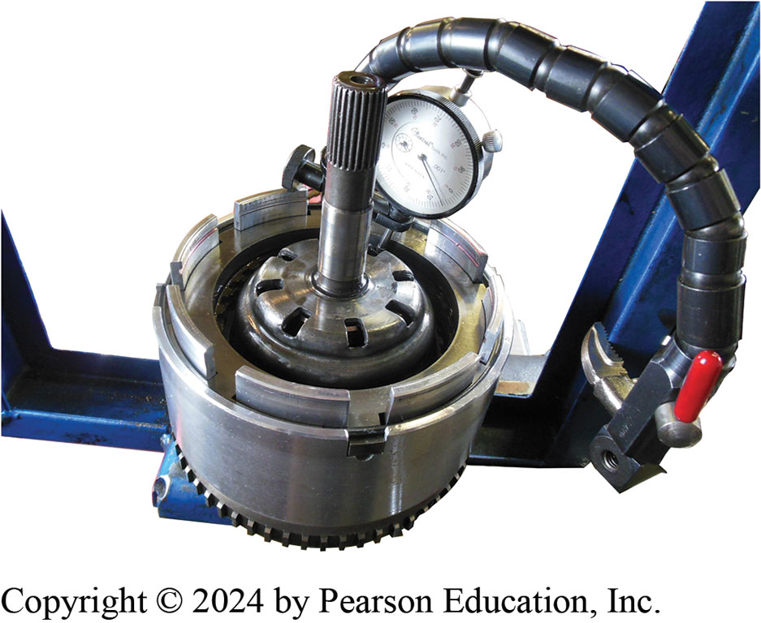
Figure 19.13
Dial indicator is set up to measure clutch pack clearance and then it is air checked to verify proper operation.

Slide 24
Animation: Measures Clutch Plate Clearance, Dial Indicator (Animation will automatically start)

Slide 25
Animation: Air Check Clutch (Animation will automatically start)

Slide 26
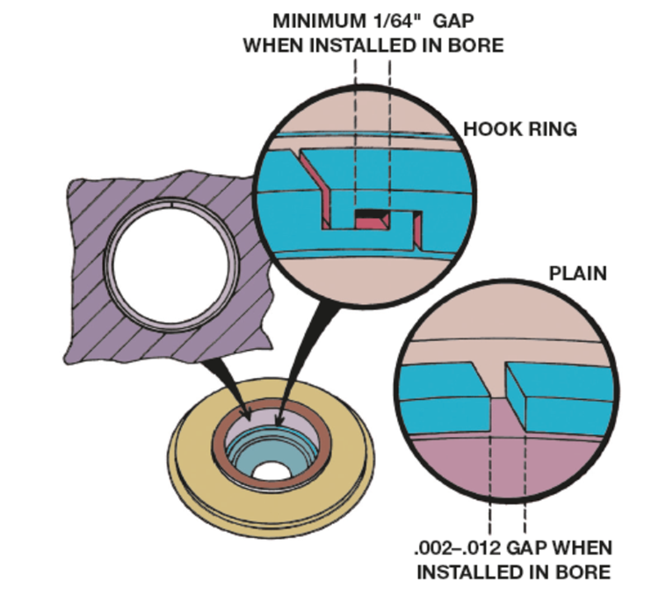
Figure 19.14
Hooked Sealing Ring
A metal sealing ring has been hooked and placed into its bore. It should enter with a slight pressure and make full contact with the bore. There should be a slight gap at the ends of the ring as shown.
Notes:
Long Description:
For hook ring sealing, there is a minimum gap at the ends and a rectangle gap in the middle representing a minimum 1 over 64 inch gap when installed in bore. For open-end rings, there should be .002 to .012 gap when installed in bore.

Slide 27
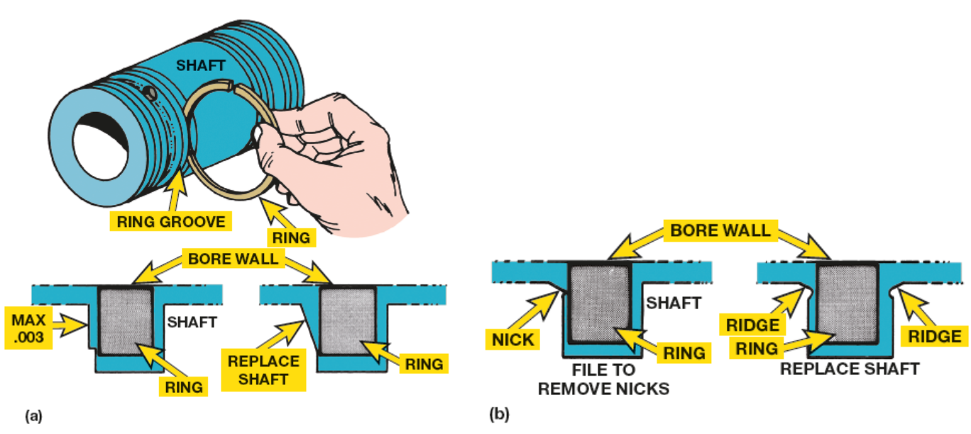
Figure 19.15
Ring Side Clearance
(a) Side clearance of a metal sealing ring is checked by placing the ring into the groove and measuring clearance using a feeler gauge.
(b) While making this check, look for damage to the seal groove.
Notes:
Long Description:
The illustration shows the installation of the metal sealing ring with a shaft. Part (a) shows the ring depicted as a square within the bore wall with a maximum groove wear of .003 with smooth and straight sides and then the ring with imperfect side labeled replace shaft. Part (a) shows the ring within the bore wall with nicks labeled file to remove nicks and then the ring with a ridge along one side labeled replace shaft.

Slide 28
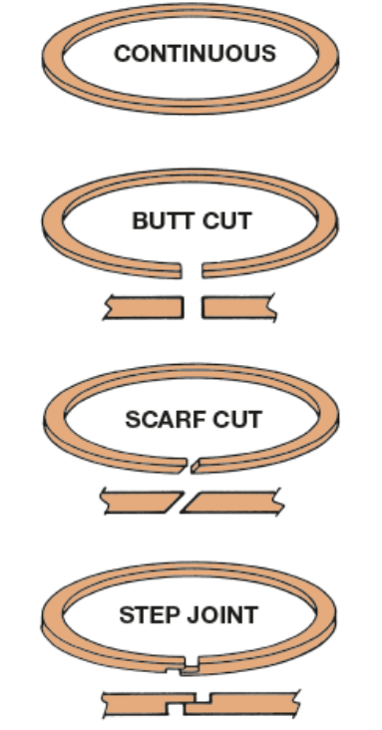
Figure 19.16
Teflon Ring Types
Four styles of Teflon rings; the uncut, continuous ring requires special tools for installation. The other styles are placed into the groove with overlapping ends positioned properly.
Notes:
Long Description:
The continuous style shows an uncut, continuous ring. The butt cut style shows a small gap with square cut edges that can be joined together. The scarf cut style shows a small gap with slant cut edges that can be joined together. The step joint shows a joint connecting the edges of opposite L-shaped cuts together.

Slide 29
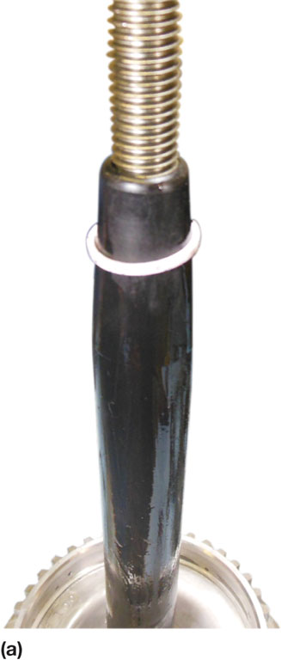
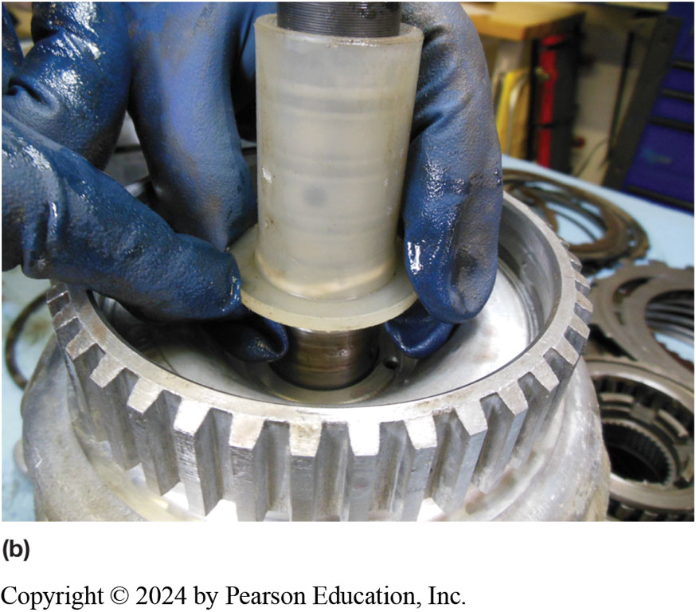
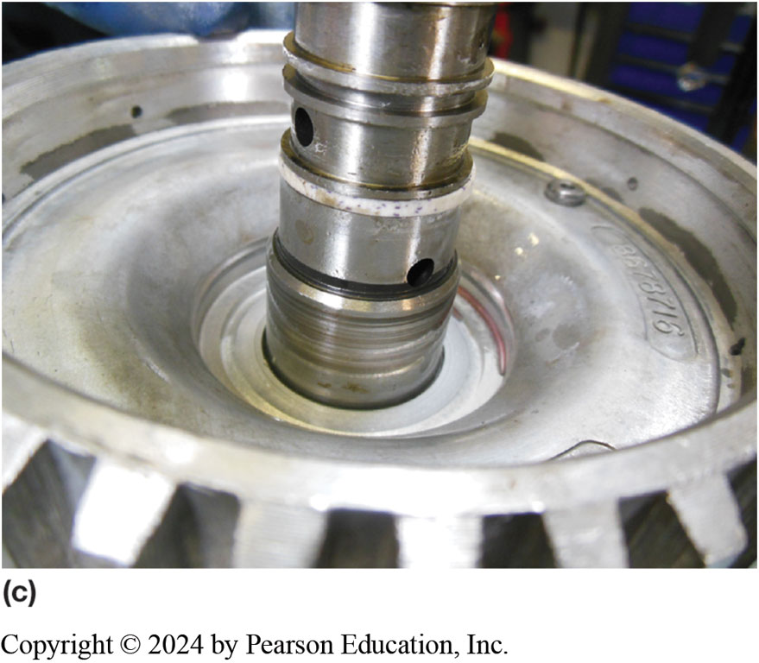
Figure 19.17
Seal Installation Tool
(a) Using a seal installation tool allows seal to slide down over shaft without harming the seal.
(b) After seal has been placed in groove, use a sizing tool to reduce size of seal.
(c) The seal after it has been sized.

Slide 30
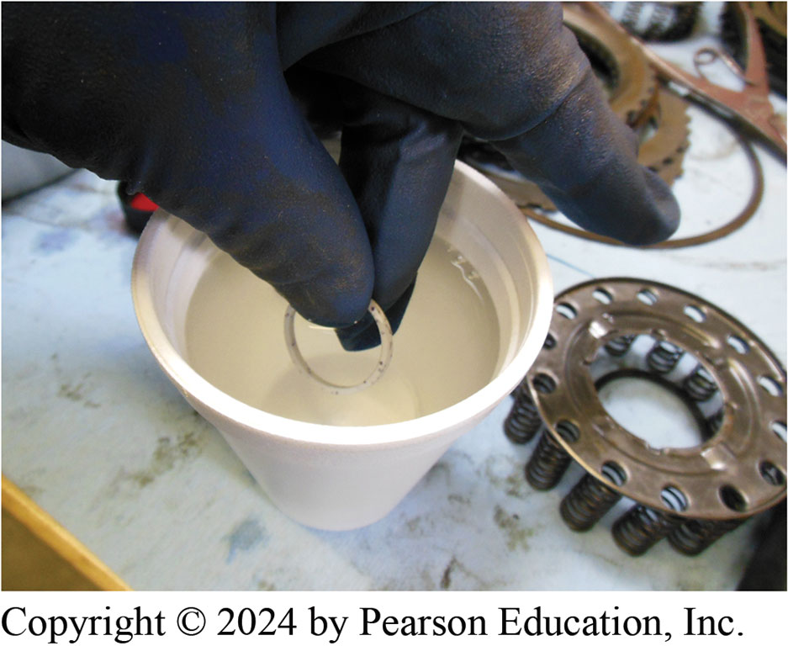
Figure 19.18
Using water that has been heated in a microwave to help soften a Teflon sealing ring before installing it on the shaft.
Notes:
Tech Tip: Sealing Ring Tip
Warming the ring in hot water will soften the material and make installation and resizing easier.
It is helpful to leave the seal-resizing tool on the seal until ready to install the shaft. ● Figure 19.18.

Slide 31
Case Service (1 of 2)
Several areas of case should be checked or serviced after it has been cleaned. These include
Bushings
All fluid passages
Valve body worm tracks (grooves for valve body fluid flow)
All bolt threads
Clutch plate lugs
Governor bore, if equipped

Slide 32
Case Service (2 of 2)
Check for warpage in worm track area.
Check all bores in case.
It is good practice to check all bolt threads visually
To make sure they are in good shape.

Slide 33
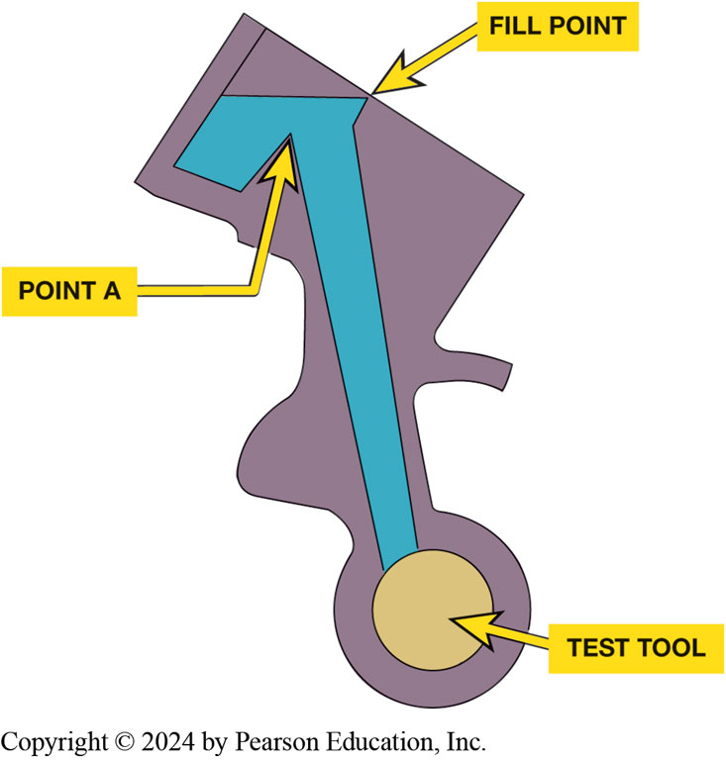
Figure 19.19
Test Tool
Notes:
Figure 19.19 Filling the passage with A T F and then seeing how long it takes for the fluid to leak down to point A. A test tool instead of the component can be used to check for leakage around a bore if available.
Accumulator bore size can be checked by placing the accumulator into its bore and filling the passages with A T F. The bore should be repaired if the fluid leaks out too quickly (to point A in less than 30 sec.). ● SEE FIGURE 19.19. Some accumulator bores tend to wear because of repeated accumulator piston oscillation. This produces leakage at the accumulator piston and will ruin the case. A repair sleeve can be installed into the accumulator bore, and this sleeve along with a matching piston will allow the case to be reused.

Slide 34
Pump Service (1 of 2)
Servicing most pumps involves following operations:
Disassembly
Inspection of the pumping members, stator support shaft, front bushing, clutch support surface, and sealing ring grooves
Checking of all valves
Cleaning of all fluid passages, including the drain back hole
Replacement of the front seal and bushing
Reassembly

Slide 35
Pump Service (2 of 2)
Visual Inspection
Front Seal Installation
Assembling the Pump

Slide 36
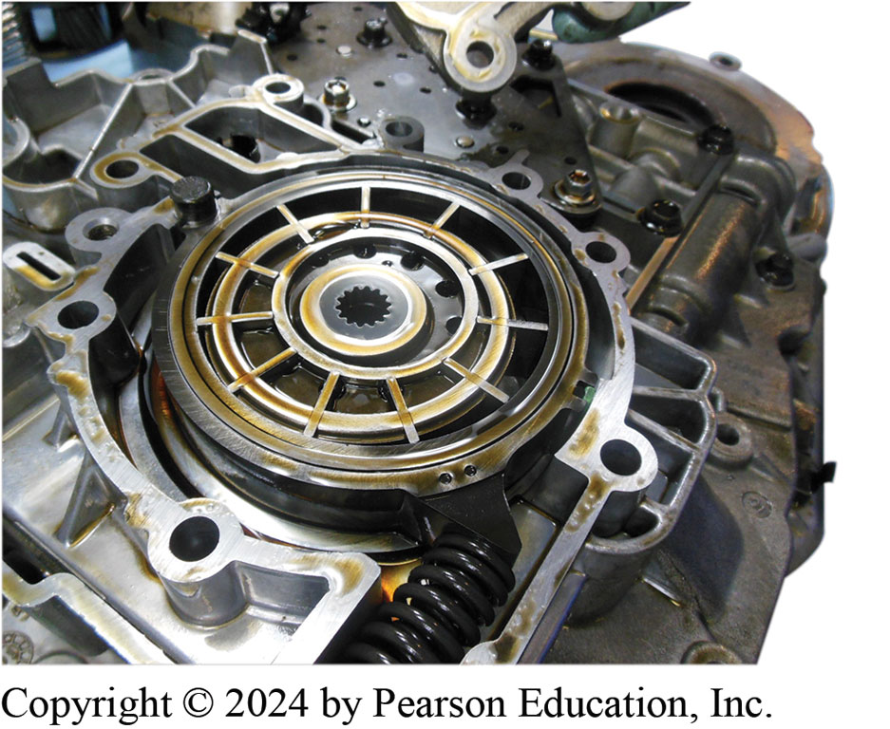
Figure 19.20
A pump assembly after the cover has been removed.

Slide 37
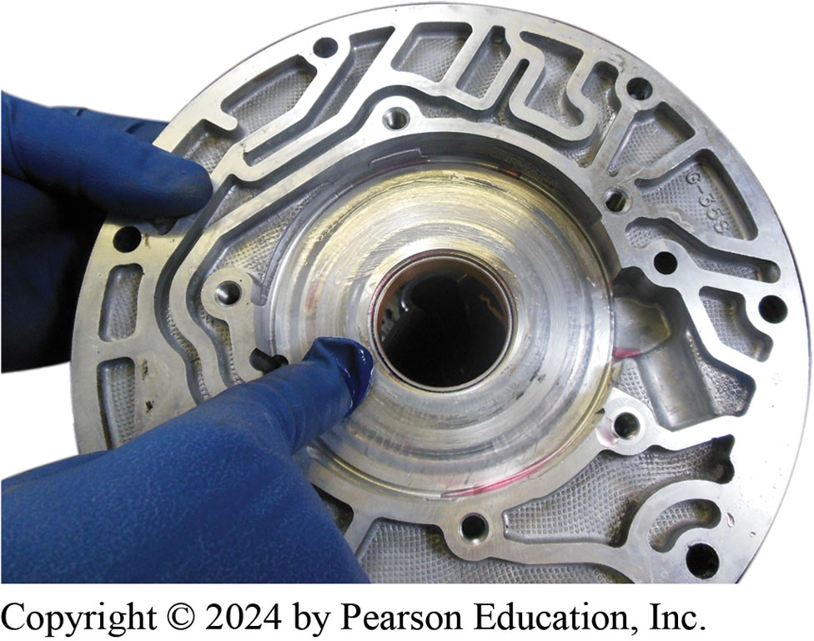
Figure 19.21
Inspecting Pump
The pump housing should be inspected for wear and replaced if grooved or damaged.

Slide 38
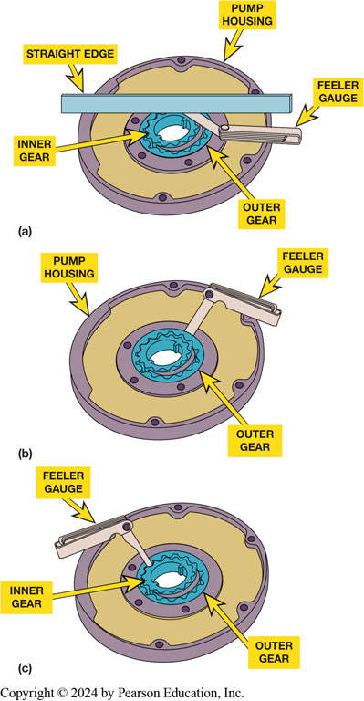
Figure 19.22
Pump Measuring
Clearance checks of the pump gears include (a) end clearance, (b) gear-to-housing clearance, and (c) gear-tooth clearance.
Notes:
Long Description:
Part (a) shows the handle and bar of the gauge at the end of the inner gear. The bar is labeled straight edge. The other labels are pump housing, inner gear, and outer gear. In part (b), the straight end of the gauge is at the end of the inner gear and the bent end over the pump housing on the right. In part (c), the straight end of the gauge is at the tooth of the inner gear and the bent end over the pump housing on the left.

Slide 39
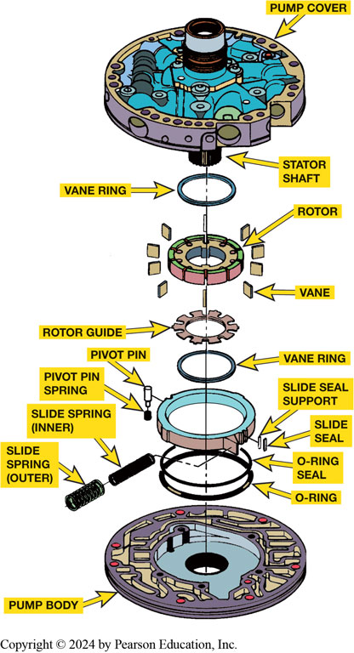
Figure 19.23
Pump
An exploded view of a vane-type pump. Wear checks include the rotor, vanes, slide, pump body, and pump cover
Notes:
Long Description:
The top to bottom parts are labeled as follows: circular lid-like structure: pump cover; a shaft protruding from the middle: stator shaft; a solid ring: vane ring; a bangle-like structure with cuts along the outer and top surfaces: rotor; square-shaped flat blades surrounding the rotor: vane; a bangle-like structure with the sawtooth rim: rotor guide; vane ring; a bangle-like structure to which a open vertical rectangle and a solid vertical rectangle are connected on the right: slide seal support and slide seal; the same structure to which a filament and a solid square are connected on the left: pivot pin and pivot pin spring; the first large ring: O-ring seal; the second large ring: O-ring; a cylinder connected to the O-ring seal: slide spring (inner); another cylinder below: slide spring outer; a flat circular structure: pump body.

Slide 40
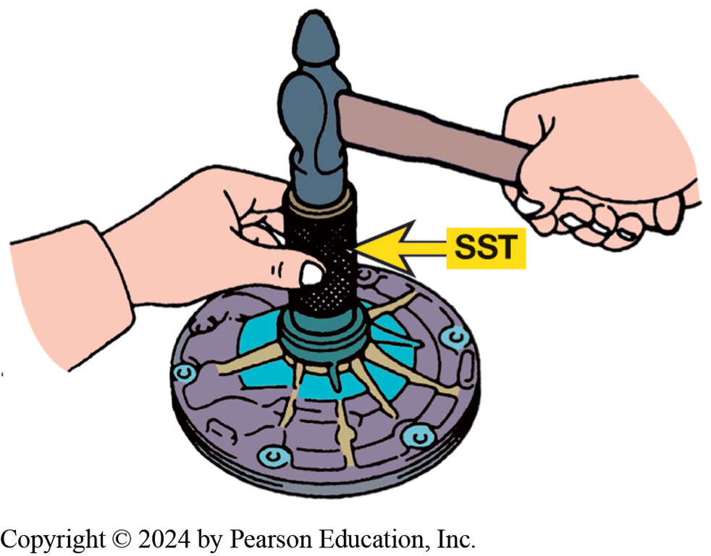
Figure 19.24
A new front seal is being installed using a seal driver which is a special service tool (S S T).
Notes:
FIGURE 19.24

Slide 41
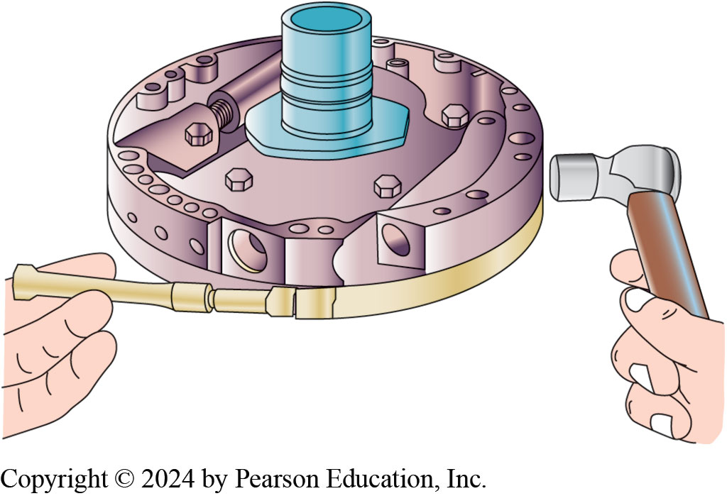
Figure 19.25
Pump Alignment
Using an alignment band to assemble both pump halves. To ensure proper alignment, many experts recommend lightly tapping the outer edges of the pump while tightening the clamp.

Slide 42
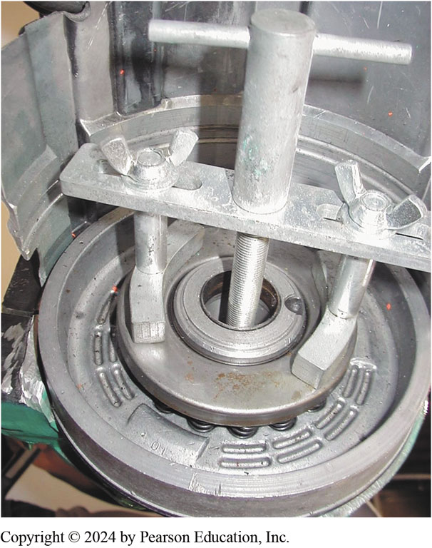
Figure 19.26
Compressor Tool
A compressor tool is usually necessary to compress the springs of the clutch piston to remove and install the snap ring

Slide 43
Clutch Service (1 of 3)
Service procedure for most clutch assemblies:
Remove clutch plates and disassemble return spring(s) and piston using specified clutch compressor.
Thoroughly clean the parts.
Inspect drum, piston, and check ball, also and bushing seal ring area.

Slide 44
Clutch Service (2 of 3)
Install new seals on the piston.
Install the piston and return spring(s).
Soak all new friction plates in A T F.
Install the clutch plates.
Check the clutch clearance.

Slide 45
Clutch Service (3 of 3)
Clutch plate removal first requires taking the snap ring out of its groove using a screwdriver or a seal pick.
Pressure and clutch plates are removed next
A spring compressor is usually required to remove the piston return spring(s) and retainer.
The clutch check ball should be captured in its cage but still be free to rattle when shaken.

Slide 46
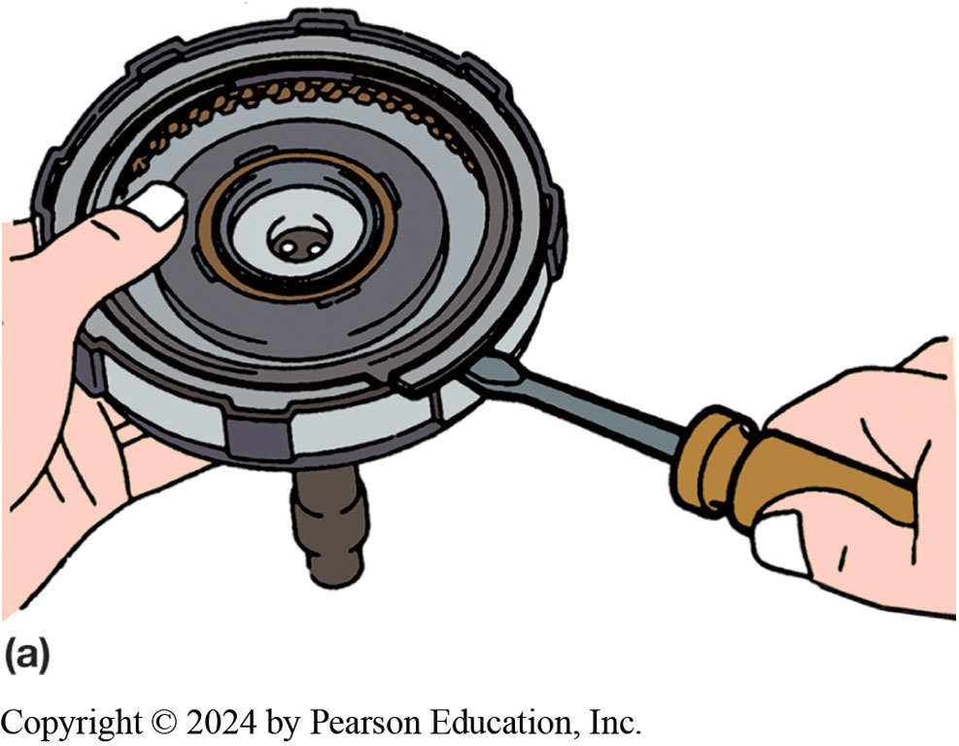
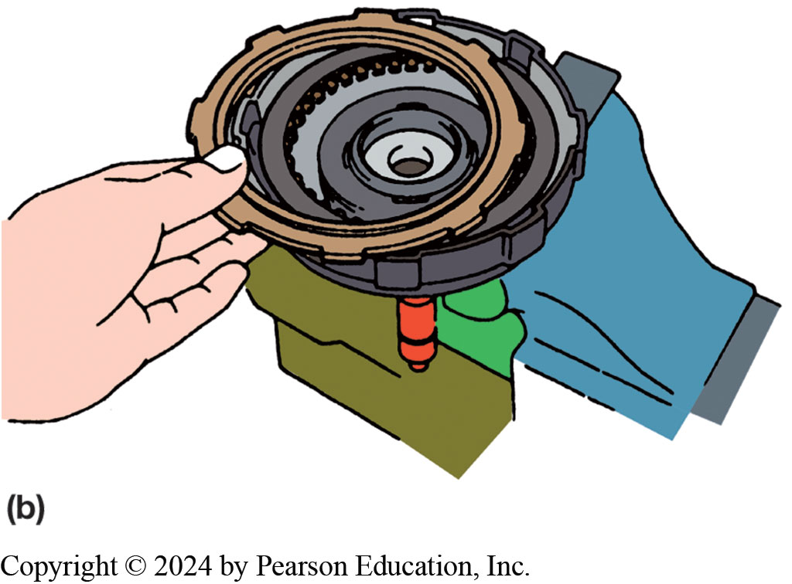
Figure 19.27
Removing Snap Rings
(a)The large snap ring can usually be removed using a screwdriver or a seal pick, and then (b) the pressure plate and clutch plates can be removed.
Be careful when compressing the spring(s), removing the retainer, and allowing the spring(s) to extend. Some springs store quite a bit of energy and if they fly loose, can cause personal injury.

Slide 47
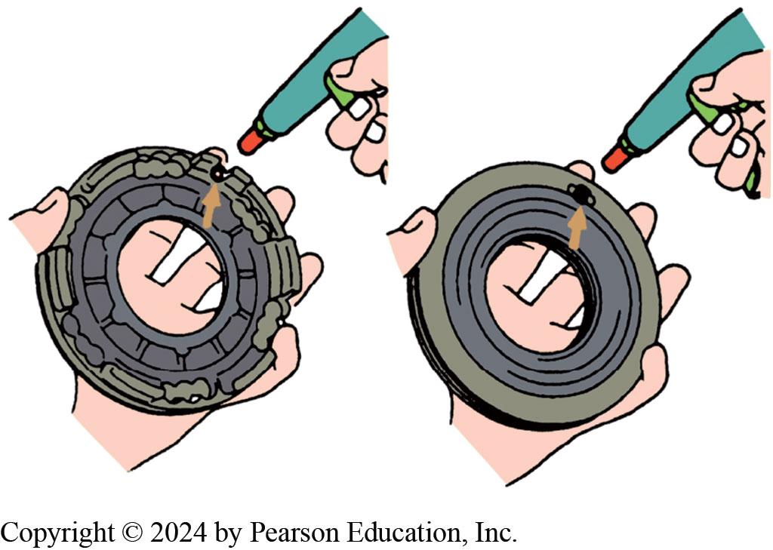
Figure 19.28
Check ball should be free to move inside its cage. It should also seal low-pressure airflow in one direction (left) and leak in the other (right).

Slide 48
Figure 19.29
All new friction plates should be soaked in A T F for at least 20 minutes or until bubbles no longer rise to the surface of the shallow pan of A T F.

Slide 49
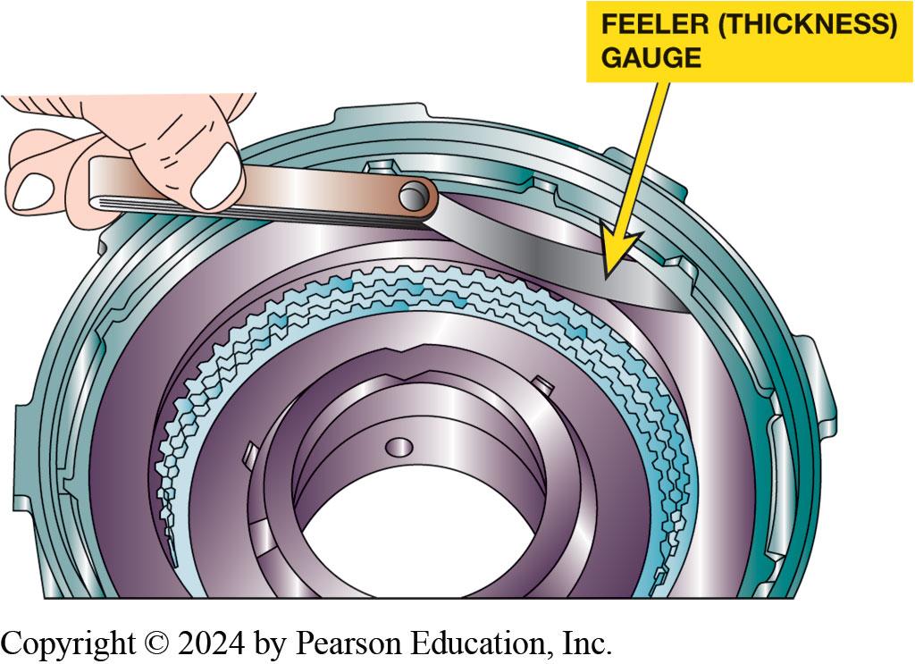
Figure 19.30
Clutch Plate Clearance
All clutch packs should be checked for proper clearance. Here, a feeler (thickness) gauge is used to check the clearance to make sure it is within factory specifications

Slide 50
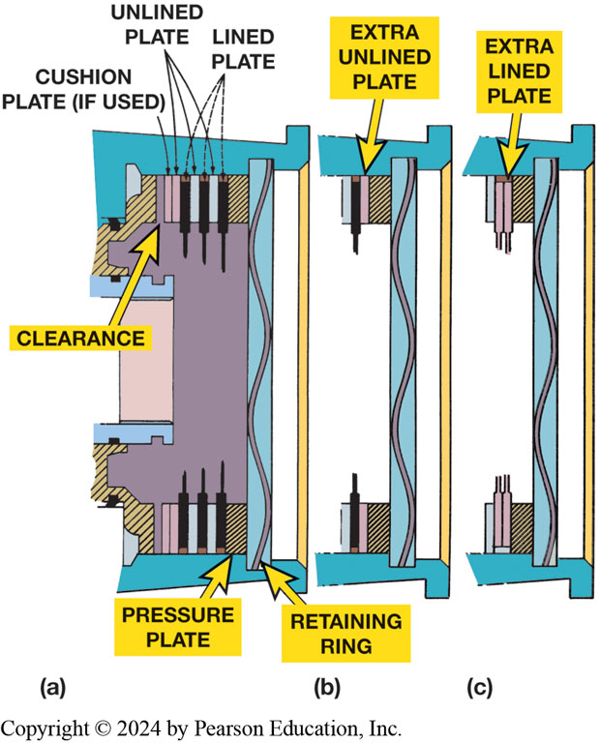
Figure 19.31
Clutch Clearance
(a) and (b) Clutch clearance can be reduced by adding an extra unlined plate, or (c) lined plate. If two lined plates are next to each other as in (c), clearance can be increased by shaving lining off one or both adjacent sides of the two lined plates.
Notes:
Long Description:
In part (a), there is a handpump-shaped boring area and L-shaped and inverted L-shaped areas for placing clutch plates. On top are narrow rectangular plates labeled cushion plate (if used), rectangular plates labeled unlined plates, and solid rectangles with projected lines below labeled lined plates. A small rectangular gap in bore on top is labeled clearance. A small rectangle on bottom below the boring area is labeled pressure plate. A bar beneath the boring area contains a wavy line labeled retaining ring. In parts (b) and (c), the boring area is not shown.

Slide 51
One-Way Clutch Service
One-way clutches (O W C s) are visually inspected
During transmission disassembly and reassembly
Commonly encountered problems are
Severe wear from poor lubrication
Metal fragments peeling from a failed part or wear or
Scoring of the race(s), rollers, or sprags

Slide 52
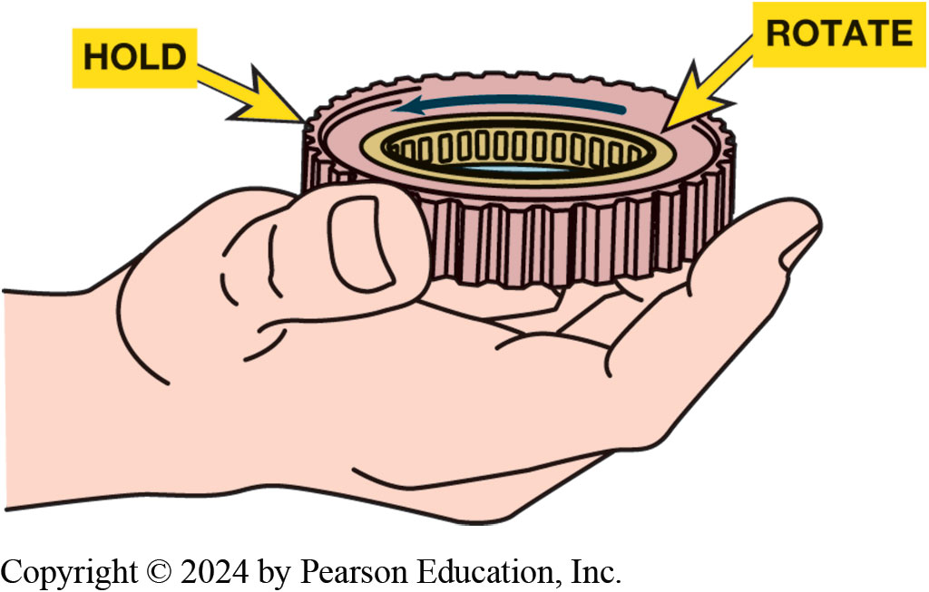
Figure 19.32
One-Way Clutch Check
Service information states that this one-way roller clutch should be installed as shown. Check by holding the outer race so that the inner race is free to rotate counterclockwise as shown.

Slide 53
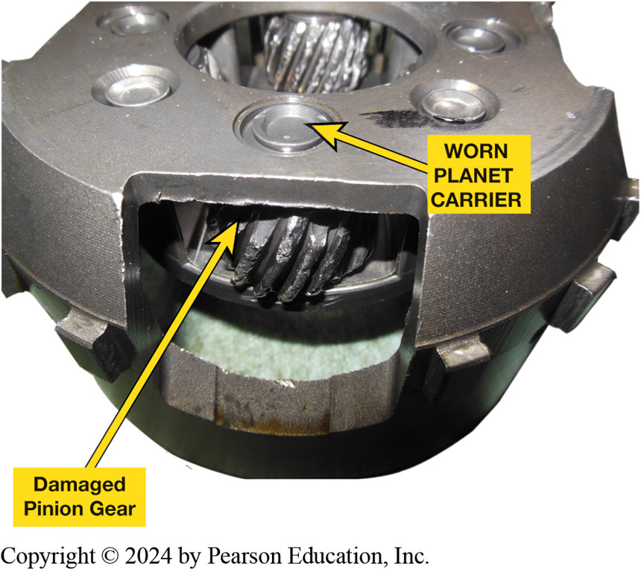
Figure 19.33
Inspecting Carrier
This planetary gear set is excessively worn and wear metal from this failure has likely contaminated many other parts in the transmission.

Slide 54
Gear Set Service
Visual Inspection
Servicing gear sets is
Primarily a visual inspection of various gears
Side play and rotation check of planet gears.
In some cases there is also an end-play check of
Assembled gear train to ensure the thrust washers are not worn excessively

Slide 55
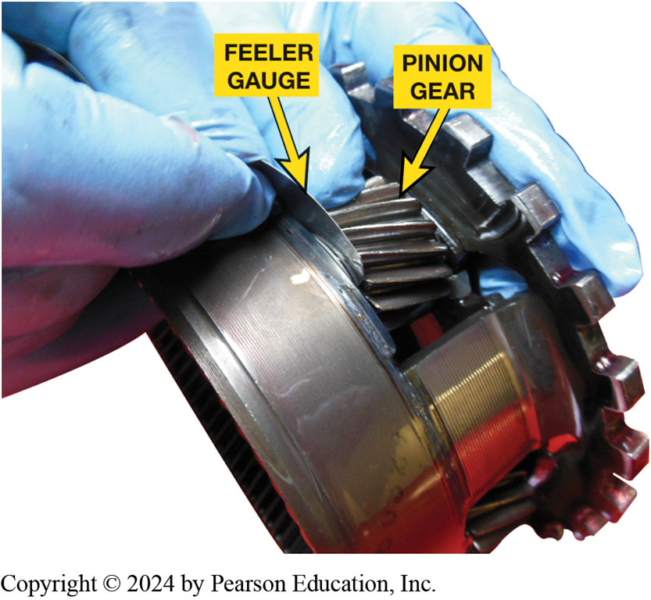
Figure 19.34
Using a feeler gauge to measure the pinion gear side clearance.
Notes:
FIGURE 19.34.

Slide 56
Air Testing
Air testing is a valuable diagnostic tool
Final quality-control check during transmission assembly.
Air tests are used to tell if a clutch or band servo operates
Passages are properly sealed.

Slide 57
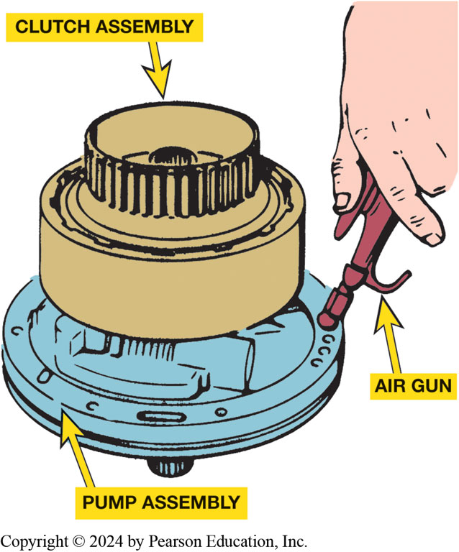
Figure 19.35
Air Testing Clutch
Air testing a clutch pack before installing it into an automatic transmission or transaxle.

Slide 58
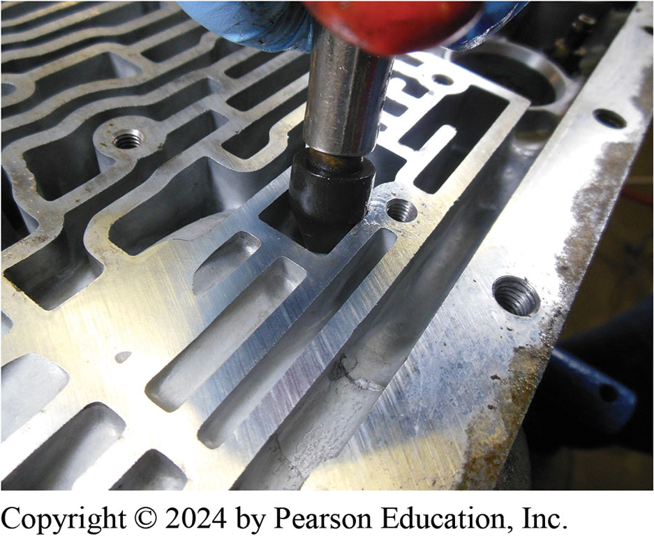
Figure 19.36
Using a rubber-tipped air nozzle in a passage to check the operation of a clutch or band.

Slide 59
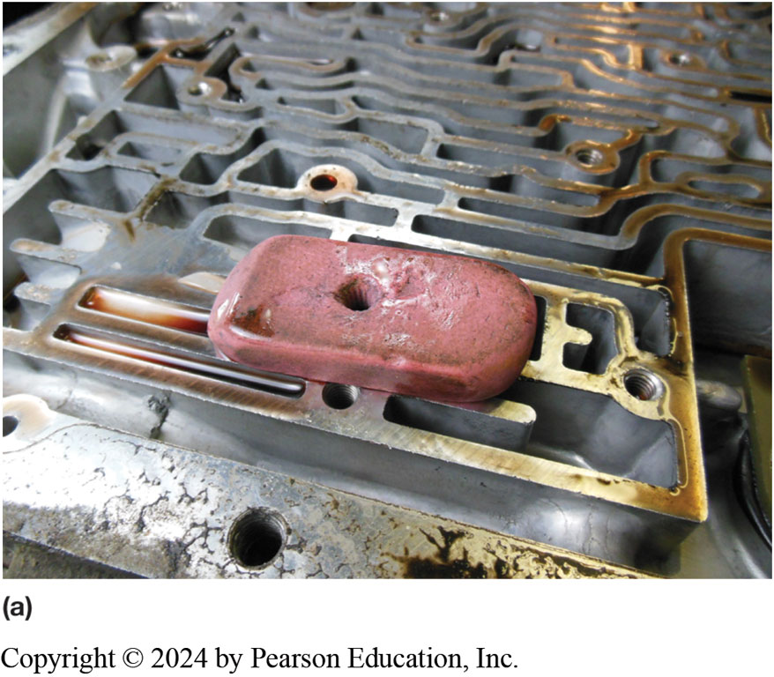
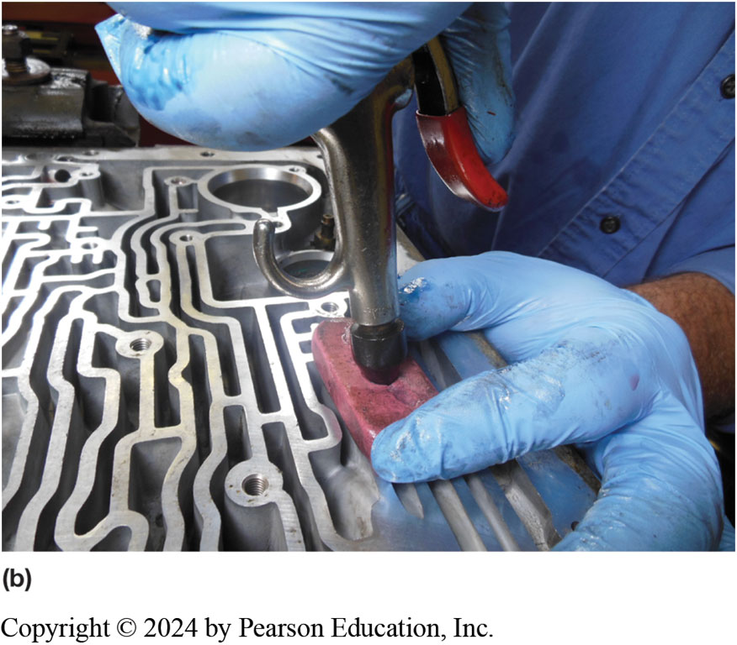
Figure 19.37
Tech Tip
(a) An eraser with a hole drilled through it used to seal passages during an air test. (b) Using an air nozzle and the eraser to test hydraulic circuits at the valve body.
Notes:
Tech Tip Air Testing Tricks
Some technicians use an air gun that is modified with a piece of rubber tubing for hard-to-reach
locations. An eraser with a hole drilled through the center can be used to seal passages. This
makes air testing at the valve body easy. ● See Figure 19.37.

Slide 60
Final Assembly (1 of 4)
Following parts are installed into the case according to prescribed procedure found in service information:
Planetary gear sets
Clutch packs
Bands

Slide 61
Final Assembly (2 of 4)
Pump Installation
End Play Check
Transaxle Differentials/Chains
Valve Body, Filter, and Pan Installation

Slide 62
Final Assembly (3 of 4)
Final Components Installation
Turbine shaft seal
Accumulators and transmission range switch
Solenoid blocks
Internal wiring harness
Speed sensors

Slide 63
Final Assembly (4 of 4)
Carefully install torque converter onto the input shaft, being sure to fully engage following:
Pump gear
Stator splines
Turbine splines
Conduct visual check to make sure that all fasteners are properly tightened.

Slide 64
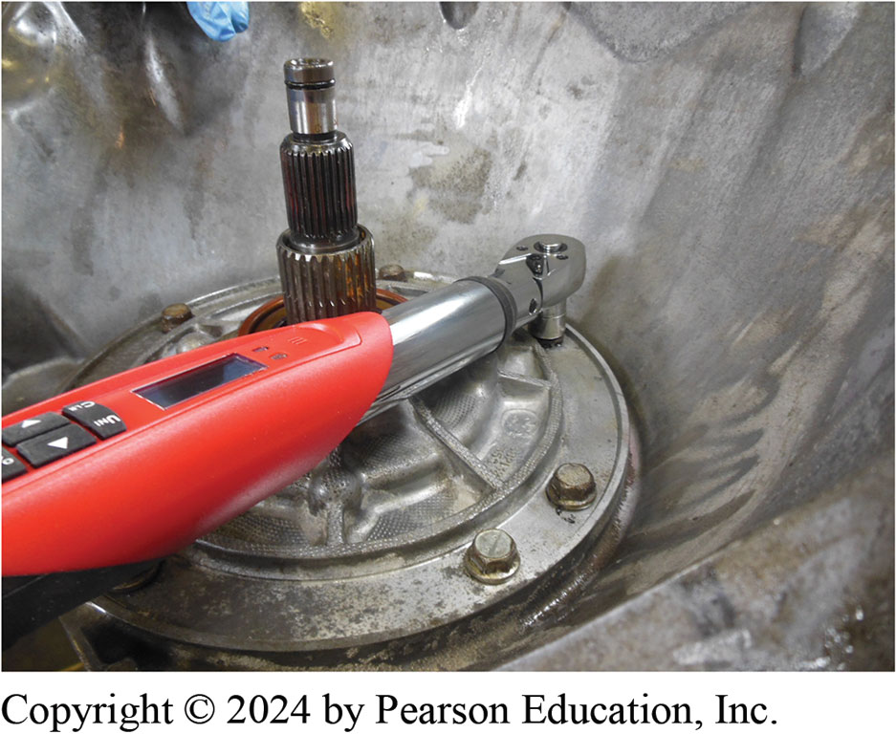
Figure 19.38
Using an electronic torque wrench to tighten the pump retaining bolts to factory specifications.

Slide 65
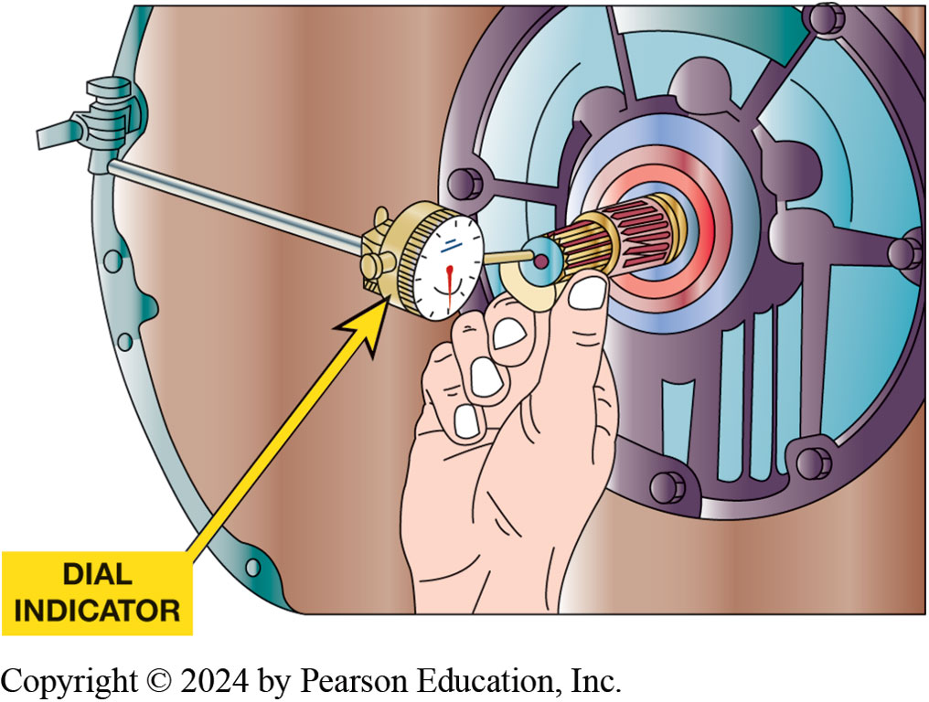
Figure 19.39
Input Shaft End Play
A dial indicator being used to measure the end play of an input shaft. If the end play is not within factory specifications, the unit may not have been assembled correctly

Slide 66
Animation: Check Transmission End Play (Animation will automatically start)

Slide 67
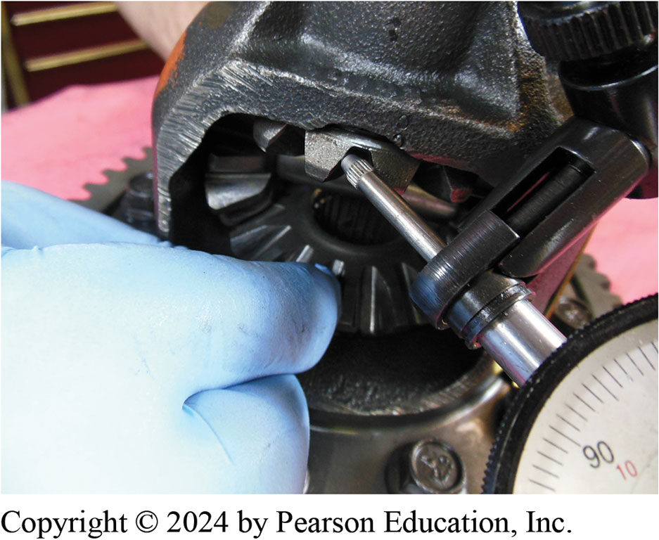
Figure 19.40
Checking gear clearance using a dial indicator on a final drive assembly on a Chrysler 41T E transaxle

Slide 68
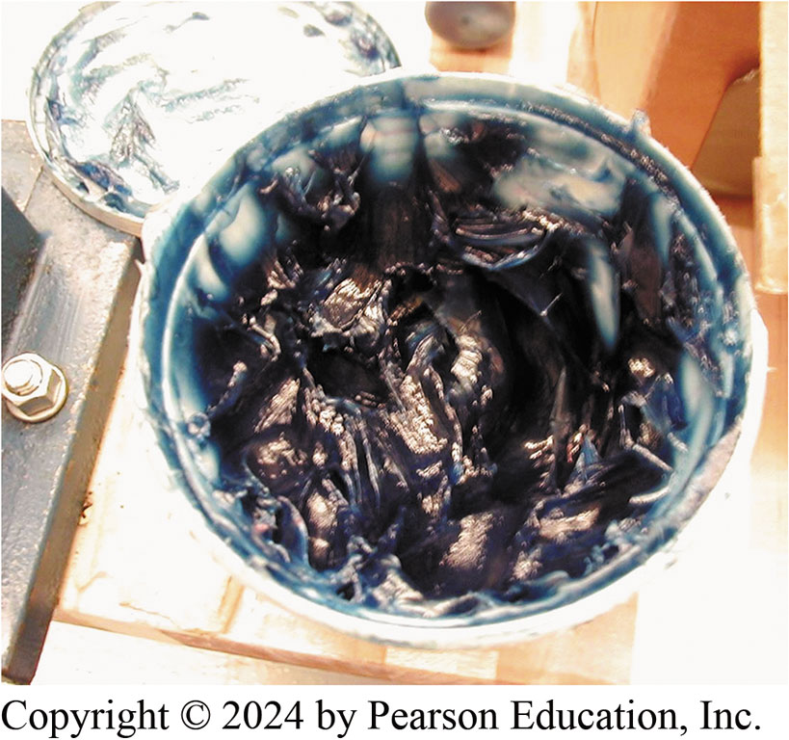
Figure 19.41
Blue assembly lube.
Notes:
Tech Tip: Avoid Using Red Assembly Lube
Assembly lube is used during the reassembly of automatic transmissions. If red assembly lube is
used on seals, it may look like an automatic transmission fluid leak when the transmission
gets hot and the lube melts. If you use blue, green, brown, or clear assembly lube, then the color
will immediately identify it as assembly lube. ● See Figure 19.41.
Many transmissions have been disassembled because the service technician thought that the red
liquid dripping from parts of the transmission was automatic transmission fluid when, in fact,
it was only assembly lube that melted and ran when the transmission reached normal operating
temperature.

Slide 69
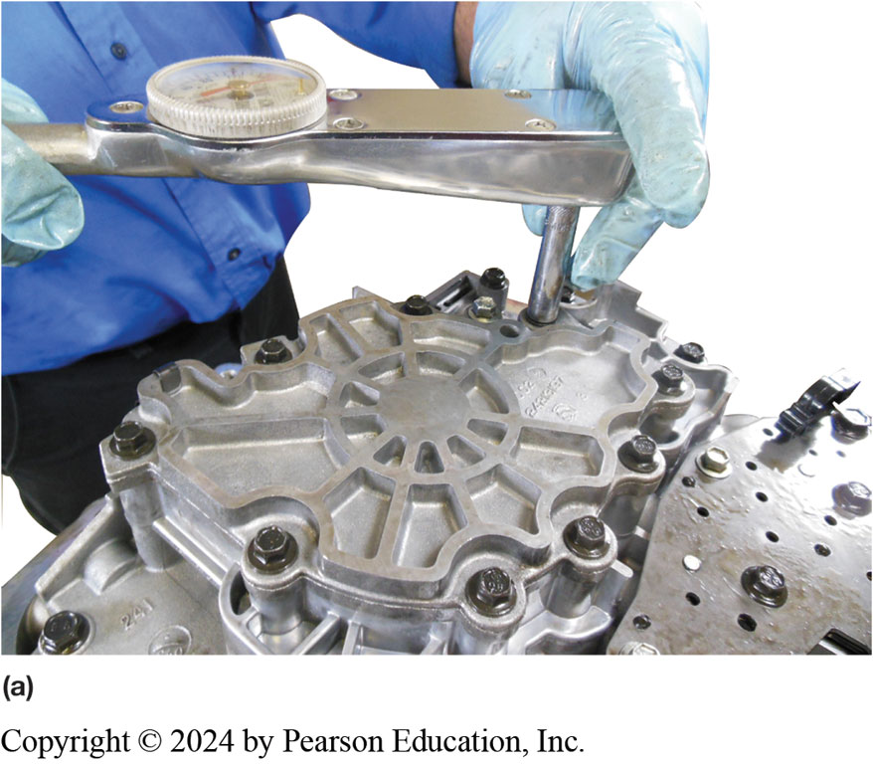
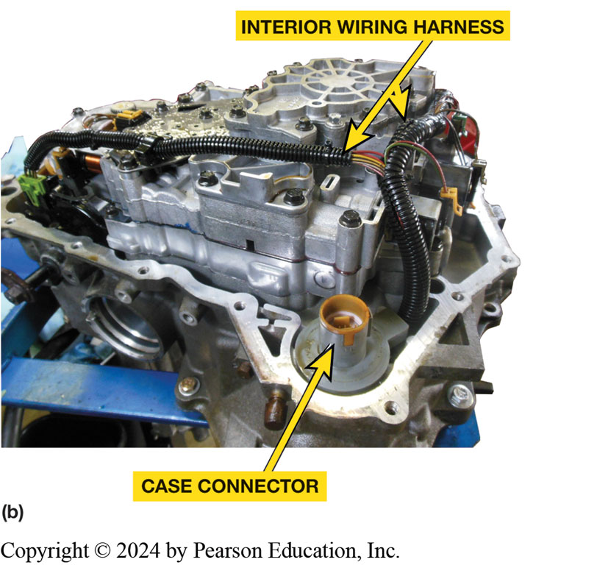
Figure 19.42
(a) The valve body retaining bolts being torqued to factory specifications. (b) After the valve body has been installed, the interior wiring harness and case connector are installed. This unit is ready for the filter and pan to be installed.

Slide 70
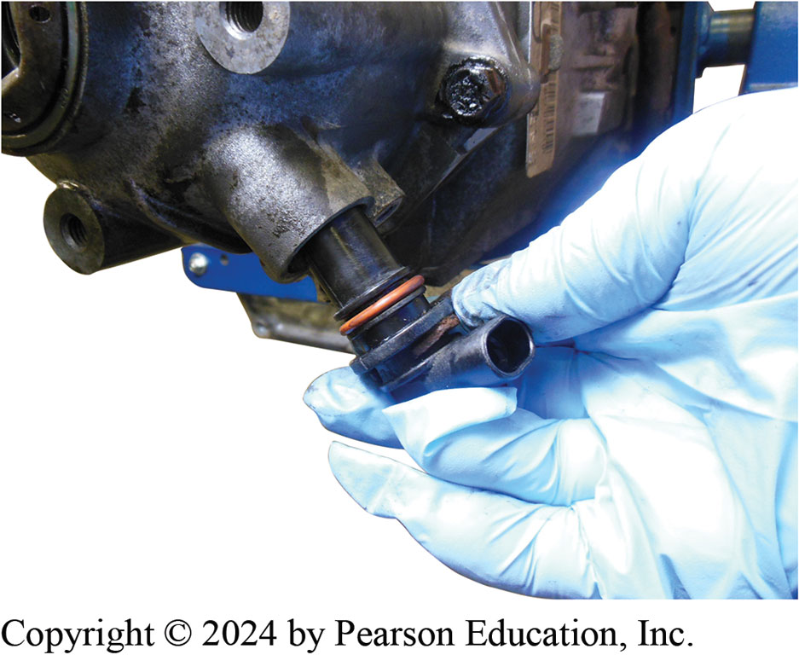
Figure 19.43
Installing an output speed sensor that has been equipped with a new O-ring seal.

Slide 71
Dynamometer Testing
A rebuilt automatic transmission/transaxle can be tested for proper operation on dynamometer powered by:
Electric motor
Gasoline engine

Slide 72
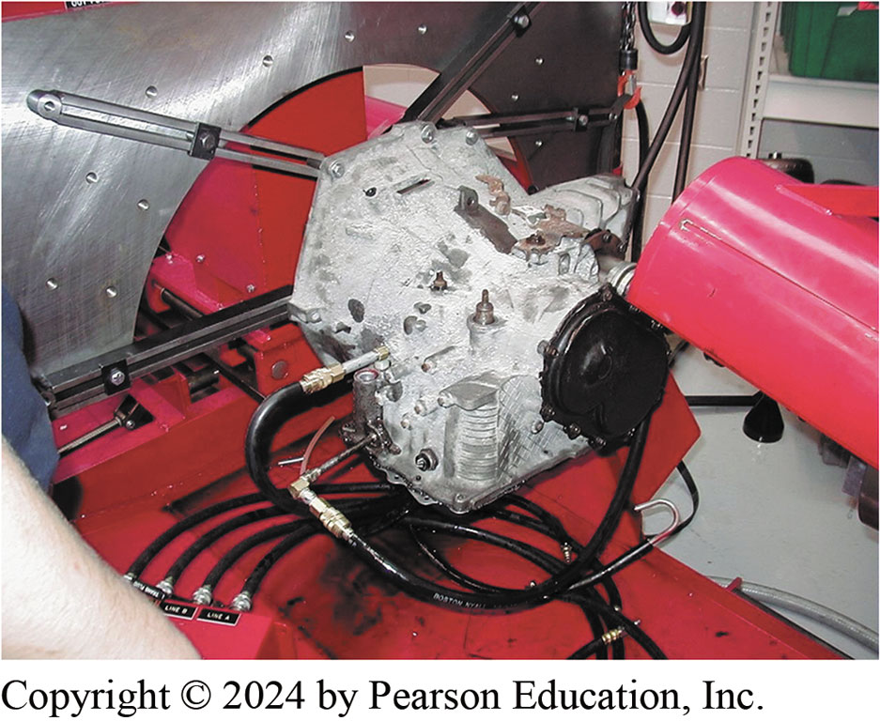
Figure 19.44
Dyno Check
An electric motor-driven dynamometer being used to check the operation of a 41T E transaxle.

Slide 73
Figure 19.45
Gasoline-Powered Dynamometer
A gasoline-powered dynamometer being used to test a rear-wheel-drive automatic transmission

Slide 74
Transmission Installation (1 of 2)
Steps Involved
STEP 1 Make sure that transmission alignment dowels
Wiring harness in place and all of connectors properly connected.
STEP 2 Raise transmission into position
Slide it to place it against engine.
STEP 3 Install transmission-to-engine bolts
Tighten them to correct torque.
Notes:
Case Study: The Case of the Broken Flex Plate
The 5.7-L engine in a Chevrolet Suburban was replaced at 185,000 miles with a reputable remanufactured engine. After 7,000 miles, it came back with a knock. Inspection revealed a broken flex plate, which was replaced. It returned again after another 7,000 miles with a knock, and another broken flex plate. A new GM flex plate was installed. It returned a third time with same problem. After the transmission was removed, it was discovered that the replacement engine did not come with the alignment dowels, and this omission was overlooked three times. Installation of the alignment dowels and a new flex plate solved this problem.
Summary:
Complaint—Customer complained about a knocking sound.
Cause—The replacement engine block did not have alignment dowels installed.
Correction—The installation of the alignment dowels and a new flex plate solved this problem.

Slide 75
Transmission Installation (2 of 2)
STEP 4 Place transmission supports into position
Lower transmission onto mounts
Tighten the mounting bolts to correct torque.
STEP 5 Slide the converter forward to align with the flex plate
Install the bolts and tighten them to the correct torque.
STEP 6 Connect cooler lines and tighten them to correct torque.
STEP 7 Replace driveshaft(s) and tighten any retaining bolts to correct torque.
STEP 8 Reconnect all linkage and wire connections disconnected, making sure they are routed properly.

Slide 76
Animation: Automatic Transmission, Remove & Replace (Animation will automatically start)

Slide 77
Figure 19.46
Linkage Adjustment
Check the linkage for proper adjustment so that the shift interlock works correctly and the P R N D L is aligned with the transmission range switch.

Slide 78
Figure 19.47
A screen shot on a Snap-on Solus scan tool showing where to clear the adaptives prior to test driving the vehicle after an overhaul.
Notes:
Perform Fast Learn
■ Use a scan tool capable of performing the fast-learn procedure. ● See Figure 19.47.
■ Transmission fluid temperature (T F T) should be 158°F to 230°F (70° to 110°C). Move the selector in/out of gear three times.
■ Select the fast learn process from the scan tool menu.
■ Place the transmission in “drive” with the vehicle stationary. T C M will individually apply clutches and calculate clutch volume.
■ Place the transmission in “reverse” with the vehicle stationary. T C M will individually apply clutches and calculate clutch volume.
■ Shut off the engine for at least 30 seconds.
Road Test Procedure Carefully drive the vehicle checking for proper operation and shift points. Hoist the vehicle and check for any possible A T F leaks before returning to the customer.

Slide 79
Assembling a 4T65-E Transaxle Photo Sequence

Slide 80
1. After cleaning all parts, read, understand, and follow instructions that come with overhaul kit.

Slide 81
2. A new seal is installed.

Slide 82
3. All bearings and thrust washers should be lubricated with assembly lube during assembly.

Slide 83
4. The band is installed after soaking in A T F.

Slide 84
5. All seals being laid out and compared before being installed. They too should be covered with A T F or assembly lube before being installed.

Slide 85
6. All friction discs should be soaked in A T F for at least 20 minutes or until the bubbles stop.

Slide 86
7. All piston seals replaced as part of overhaul procedure. Piston is then installed using a lip seal plastic disc to help prevent seal lip from curling over during installation.

Slide 87
8. Assembling a clutch pack with soaked frictions and then steel plates.

Slide 88
9. The return springs have to be compressed before installing the retaining ring.

Slide 89
10. The drive chain being installed after checking that the black link is up the same way it was when it was disassembled.

Slide 90
11. Before assembling valve body, always check valve body gasket labeled “V” & gasket that goes against case, label “C” to make sure they match the ones removed.

Slide 91
12. All fasteners should be tightened to factory specifications using a torque wrench.

Slide 92
Question 1
Air testing is used to Fill in the blank .
A. check the operation of the pump
B. test valve body valve operation
C. test clutches and bands for proper operation and to detect possible leaks
D. operate the speed sensors

Slide 93
Answer 1
Air testing is used to Fill in the blank .
C. test clutches and bands for proper operation and to detect possible leaks

Slide 94
Summary (1 of 2)
Transmission parts cleaning methods that are commonly used include:
Hot spray wash
Solvent wash
Water (aqueous) solution wash
Microbe cleaning
Bushings and bearings are carefully checked and replaced as necessary.
The pump is disassembled and inspected. The bushings and seals are replaced before reassembly.

Slide 95
Summary (2 of 2)
Sealing rings must be replaced and the surfaces they seal against must be carefully inspected and serviced as needed. An O-ring should produce some drag and a square-cut seal is normal if it produces a barely noticeable drag.
Air testing is a valuable diagnostic tool and is also used as a final quality-control check during transmission assembly.

Slide 96
Automatic Transmissions and Transaxles Videos and Animations
Videos Link: (A2) Automatic Transmissions and Transaxles Videos
Animations Link: (A2) Automatic Transmissions and Transaxles Animations

Slide 97
Copyright
This work is protected by United States copyright laws and is provided solely for the use of instructors in teaching their courses and assessing student learning. Dissemination or sale of any part of this work (including on the World Wide Web) will destroy the integrity of the work and is not permitted. The work and materials from it should never be made available to students except by instructors using the accompanying text in their classes. All recipients of this work are expected to abide by these restrictions and to honor the intended pedagogical purposes and the needs of other instructors who rely on these materials.

