Slide 1
Automatic Transmissions and Transaxles
Eighth Edition
Chapter 18
Valve Body Service
Copyright © 2024, 2018, 2015 Pearson Education, Inc. All Rights Reserved
Notes:
If this PowerPoint presentation contains mathematical equations, you may need to check that your computer has the following installed:
1) Math Type Plugin
2) Math Player (free versions available)
3) NVDA Reader (free versions available)
INSTRUCTOR NOTE: This presentation includes text explanation notes, you can use to teach the course. When in SLIDE SHOW mode, you RIGHT CLICK and select SHOW PRESENTER VIEW, to use the notes.

Slide 2
Learning Objectives
18.1 Describe the purpose and function of the valve body.
18.2 Describe the parts and operations of a valve body.
18.3 Discuss valve body service and replacement procedures.

Slide 3
Valve Body Service (1 of 3)
Service and Replacement Procedures
Biggest enemies of valve body
Dirt
Overheated fluid
Failed solenoids attract iron and steel particles, which restrict flow and prevent them from working
Filter screens should be replaced

Slide 4
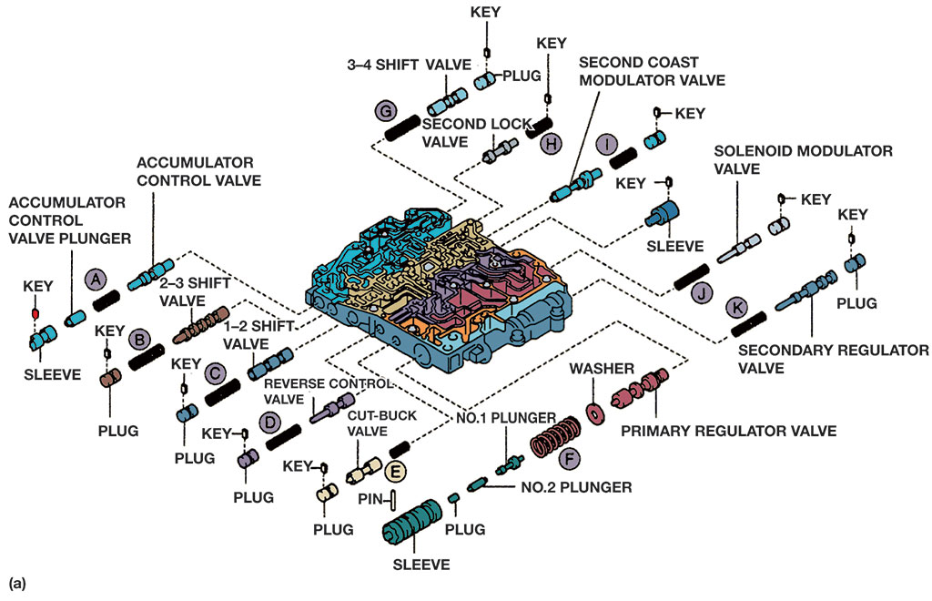
Figure 18.1a
Valve Body
An exploded view of valve body from a four-speed transaxle. Note the various valve groups and how they are retained in their bore.
Notes:
Long Description:
The valve body is shown in the middle with the list of plugs and keys that go into the openings on the side panel. The inserted elements of the first opening of the left panel from outer to inner are a key with a sleeve, an accumulator control valve plunger, a solid rod labeled A, and an accumulator control valve. For the second opening, the elements are a key with a plug, a solid rod labeled B, and a 2 hyphen 3 shift valve. For the third opening, the elements are a key with a plug, a solid rod labeled C, and 1 hyphen 2 shift valve. For the fourth opening, the elements are a key with a plug, a solid rod labeled D, and a reverse control valve. For the fifth opening, the elements are a key with a plug, a cut hyphen buck valve, and a solid rod labeled E. A pin is found near the cut hyphen buck valve. For the sixth opening, the elements are a sleeve, plug, no.2 plunger, no. 1 plunger, a coil labeled F, a washer, and a primary regulator valve. The inserted elements of the first opening of the right panel from outer to inner are a key with a plug, a 3 hyphen 4 shift valve, and a solid rod labeled G. For the second opening, the elements are a key with a solid rod labeled H and a second lock valve. For the third opening, the elements are a key with a plug, a solid rod labeled I, and a second coast modulator valve. For the fourth opening, the element is a key with a sleeve. For the fifth opening, the elements are a key with a plug, a solenoid modulator valve, and a solid rod labeled J. for the sixth opening, the elements are a key with a plug, a secondary regulator valve, and a solid rod labeled K.

Slide 5
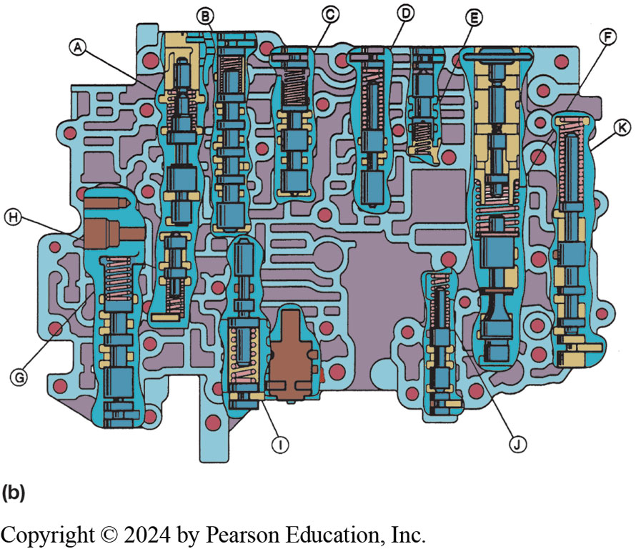
Figure 18.1b
Valve Body Cutaway
Cutaway view of the valve body from a four-speed transaxle. Note the various valve groups and how they are retained in their bore.
Notes:
Long Description:
The top openings from left to right are as follows. A, B, C, D, and E. The left openings are H and G. The right openings are F and K. The openings at the bottom are I and J. For each opening, steel valves are present. There are round circles and long ridges on the floor of the valve body.

Slide 6
Valve Body Service (2 of 3)
Valve Retaining Methods
Valve Body Checks and Tips
Free fall test
Testing shift solenoids
Valve body repair kits
Testing Shift Solenoids
Valve Body Repair Kits

Slide 7
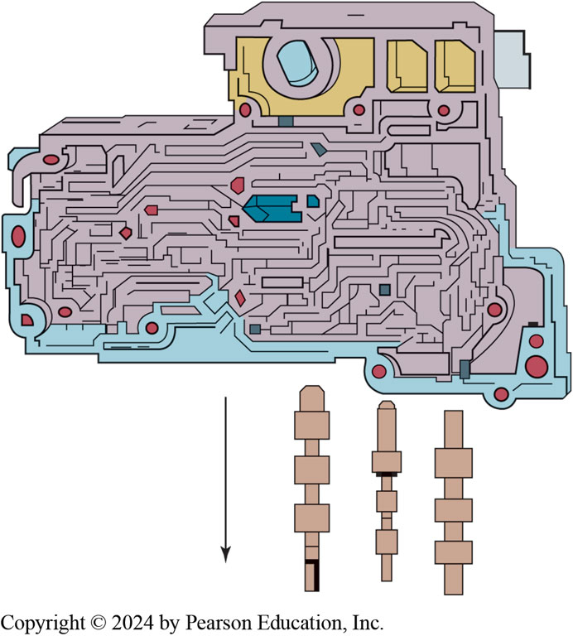
Figure 18.2
If the valve body is moved to a vertical position, steel valves should slide freely from the bore. Be prepared to catch the valves when making this check.

Slide 8
Animation: Air Test Transmission (Animation will automatically start)

Slide 9
Animation: Air Test Transmission, No Test Plate (Animation will automatically start)

Slide 10
Animation: Assemble Valve Body (Animation will automatically start)

Slide 11
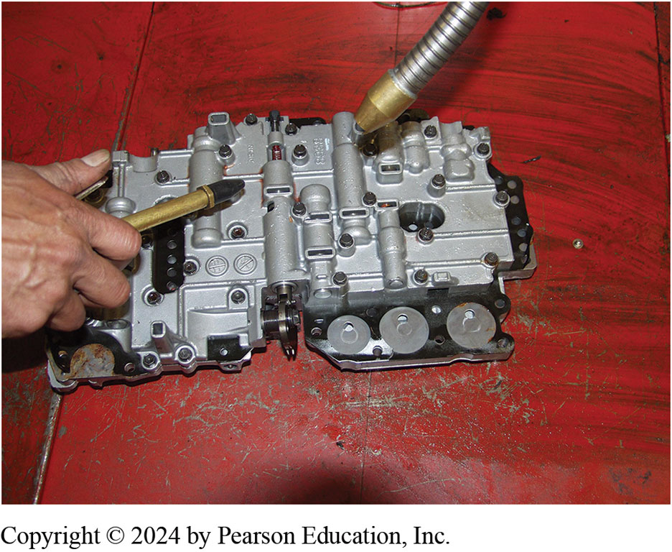
Figure 18.3
A valve body being washed and air dried in a parts washer. It will be cleaned again when the two major parts are separated.

Slide 12
Frequently Asked Question: How Is a Solenoid Tested That Has a Diode across the Leads?
? Frequently Asked Question
How Is a Solenoid Tested That Has a Diode across the Leads? Some solenoids include a diode to eliminate voltage spikes that might occur when the solenoid is de-energized. As the solenoid is tested, diode is also checked to see if it allows a flow in one direction but not in the other. Measure the solenoid coil resistance with analog (needle-type) ohmmeter, the reading should be about
depending on coil temperature. If the reading is
coil or
diode is shorted. If the reading is
or infinite, there is an open or broken
circuit. In either case, the solenoid is faulty. To check the diode, reverse the meter leads. The meter reading should now be lower than it was before, usually
about
If the reading does not change, the diode is open or shorted,
and the solenoid is faulty

Slide 13
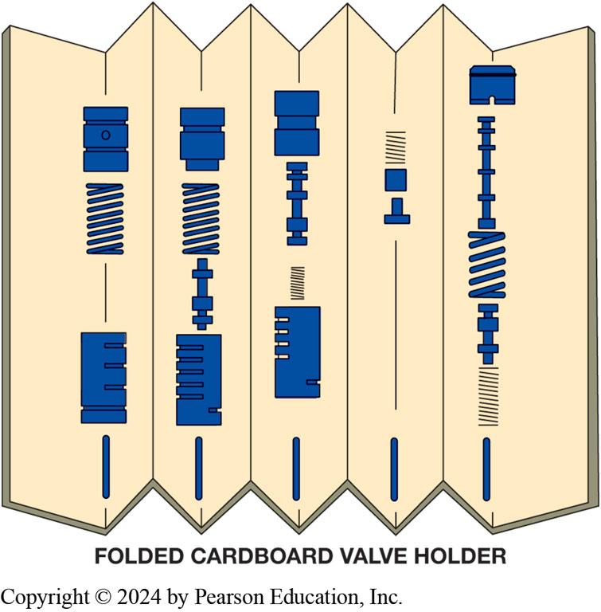
Figure 18.4
A sheet of stiff paper has been folded to create this simple valve holder. Note that a valve group can be placed in order and be labeled.
Notes:
Tech Tip: Technician-Made Valve Body Organizer: Some technicians make a valve organizer by folding a piece of cardboard into an accordion shape. The biggest problem during valve body repair is getting it back together with everything in the right order and location and using something like this helps with the organization. ● See Figure 18.4.
Tech Tip: Do Not Use a Magnet on Check Balls It is easy to use a magnet to retrieve the steel check balls out of the pockets in the valve body. However, using a magnet or placing the steel check balls in a magnetic tray may cause them to become magnetized.
If the balls become magnetized, they may be attracted to the steel separator plate and not be free to move to block passages as designed

Slide 14
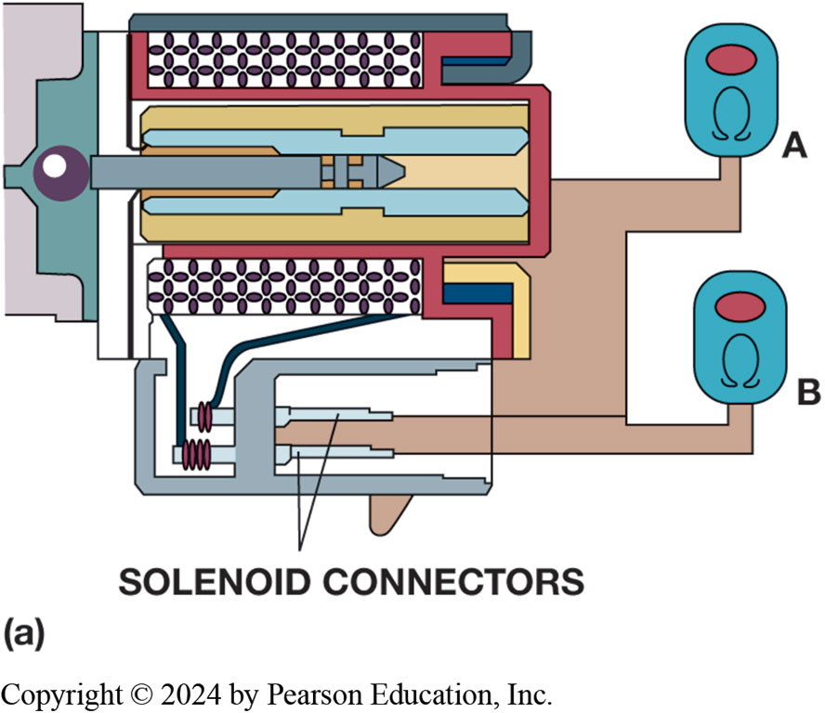
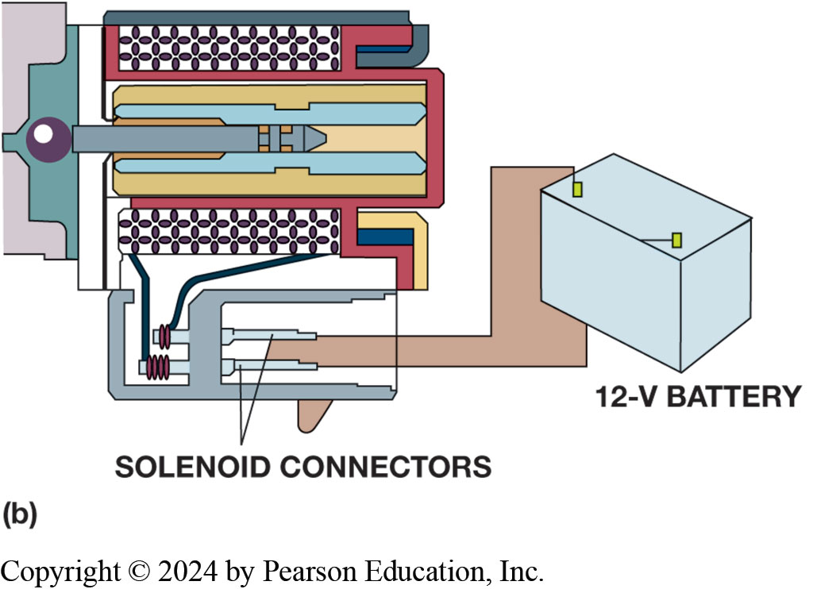
Figure 18.5
Shift Solenoid Testing
(a) Ohmmeter A is checking for a grounded solenoid coil; the reading should be infinite. Ohmmeter B is measuring the coil resistance; it should be within specifications for this solenoid. (b) Connecting a solenoid to a 12-V battery should cause it to operate. Make sure the battery is connected using the correct polarity in case the solenoid has an internal diode.
Notes:
Long Description 1:
The image shows a ball next to a shaft. The shaft is flanked by bands on either side. Each of these bands is flanked by a strip of squares. Two solenoid connectors come out of the bottom strip of squares and are joined to two ohmmeters. The top ohmmeter is labeled as A and the bottom ohmmeter is labeled as B.
Long description 2:
The image shows a ball next to a shaft. The shaft is flanked by bands on either side. Each of these bands is flanked by a strip of squares. Two solenoid connectors come out of the bottom strip of squares and are joined to 12 hyphen V battery.

Slide 15
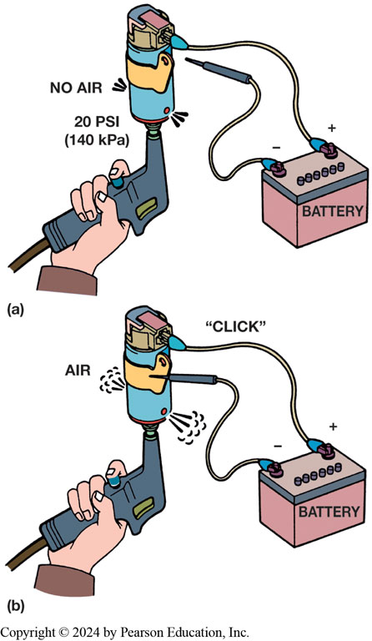
Figure 18.6
Air Check
Air should not be able to flow through this solenoid if it is not activated. If it is connected to a 12-V battery, it should make a “click,” and air should be able to flow through it.
Notes:
Long Description:
In the first image, a person is holding a solenoid in his hand. The solenoid is shaped like a gun. Two wires come out of a battery and one wire is attached to the solenoid. No air is seen and the pressure is 20 Pound-force per square inch or 140 kilopascals. In the second image, a person is holding a solenoid in his hand. The solenoid is shaped like a gun. Two wires come out of a battery and both are attached to the solenoid. Air is seen and a click sound is heard.

Slide 16
Valve Body Service (3 of 3)
Reassembly
After all valves, springs, and valve body are cleaned
Valves move freely in their bores, valve body can be reassembled
Check springs
Dip valves in A T F
Ensure check balls and filter screens are replaced
Tighten fasteners to correct torque

Slide 17
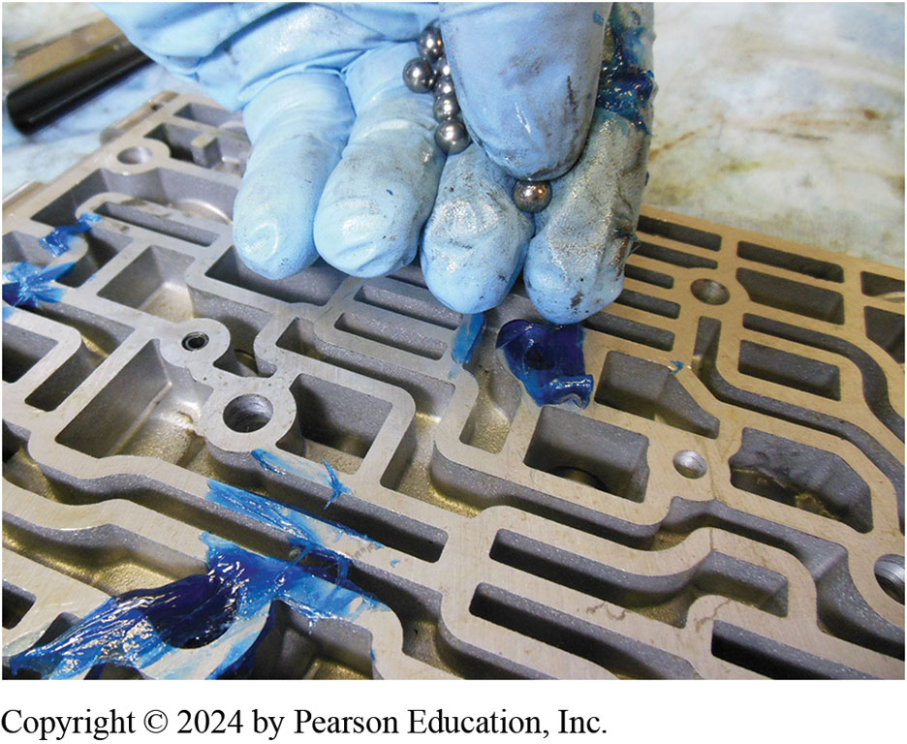
Figure 18.7
Using assembly lube is a great way to keep check balls in place during the reassembly of the valve body.

Slide 18
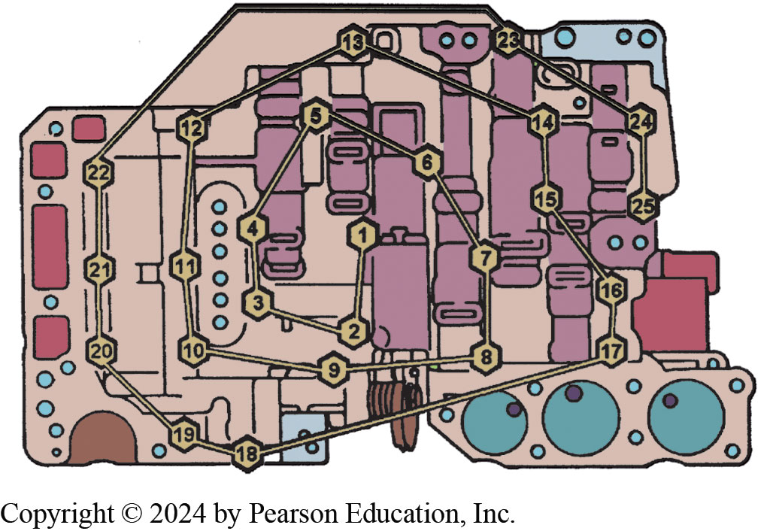
Figure 18.8
The valve body bolts should be tightened in order, starting from the center and working in an outward spiral.
Notes:
Long Description:
A valve body is shown. The bolts are numbered 1 to 25. The bolt number 1 is present in the middle of the valve body. It is connected to bolt number 2 which is connected to bolt number 3 which is connected to bolt number 4 which is connected to bolt number 5 which is connected to bolt number 6 which is connected to bolt number 7 which is connected to bolt number 8 which is connected to bolt number 9 which is connected to bolt number 10 which is connected to bolt number 11 which is connected to bolt number 12 which is connected to bolt number 13 which is connected to bolt number 14 which is connected to bolt number 15 which is connected to bolt number 16 which is connected to bolt number 17 which is connected to bolt number 18 which is connected to bolt number 19 which is connected to bolt number 20 which is connected to bolt number 21 which is connected to bolt number 22 which is connected to bolt number 23 which is connected to bolt number 24 which is connected to bolt number 25. The bolts are present in the order of an outward spiral.

Slide 19
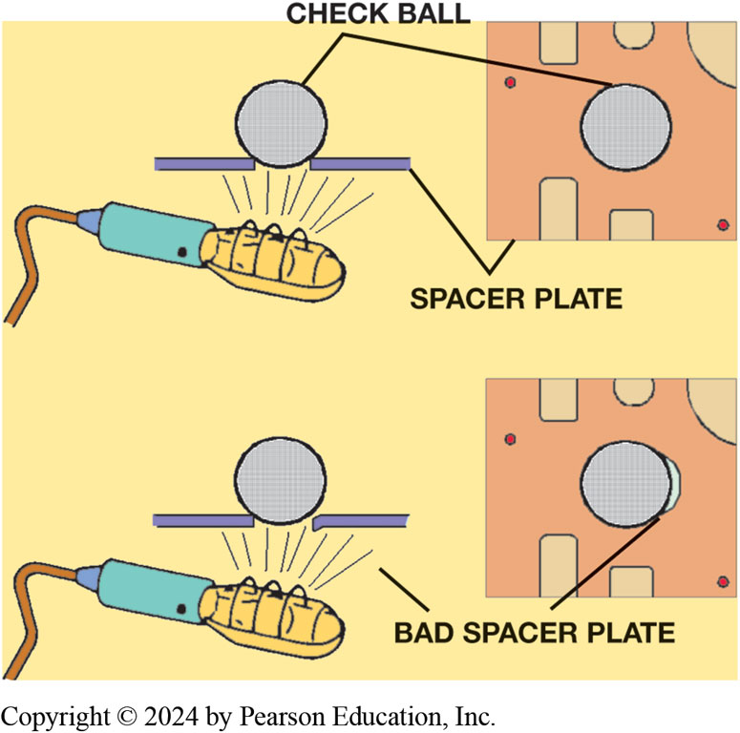
Figure 18.9
Check ball should seal off light from coming through the spacer plate. A problem is indicated if light shines through an opening alongside of check ball.
Notes:
Tech Tip: The Shop Light Trick: If a faulty check ball–transfer plate seat is suspected, place the ball on its seat and hold a flashlight behind the transfer plate. Light shining between the ball and the transfer plate indicates a problem. ● SEE FIGURE 18.9.
Long Description:
In the first image, the check ball is placed on the gap in the spacer plate. A flashlight is held under the spacer plate. A square-shaped plate shows the check ball in the middle. The square-shaped plate is labeled the spacer plate. In the second image, the check ball is placed on the gap in the spacer plate. A flashlight is held under the spacer plate. A square-shaped plate shows the check ball in the middle along with some extra light at the side. The square-shaped plate is labeled the bad spacer plate.

Slide 20
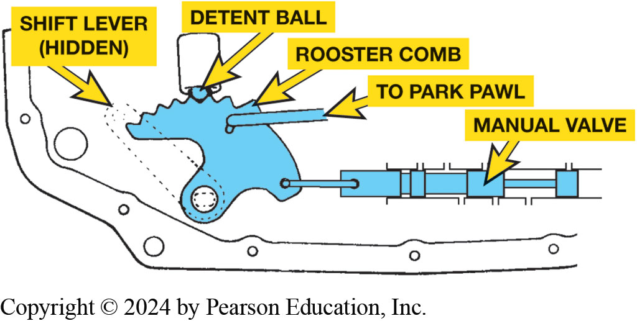
Figure 18.10
The manual valve is moved by the shift lever and held in position by the detent lever (cam).
Notes:
Tech Tip: Check Manual Valve Operation: Whenever servicing the valve body, carefully check the operation of the manual valve and it linkages to the shift lever and parking paw. If there is any misalignment or binding in this mechanism, transmission will not operate as designed. ● See Figure 18.10.
Long Description:
It has a detent ball attached to the ridges on its surface. One pipe goes from the rooster comb to the park pawl. The shift lever is shown as a dotted tube to the left of the rooster comb. It is marked as hidden. The bottom part of the rooster comb is seen attached to the manual valve.

Slide 21
Animation: Manual Valve (Animation will automatically start)

Slide 22
Summary
Most valve body service operations consist of: disassembly, cleaning, checking for free movement, replacing defective solenoids, replacing all filter screens, reassembly.
All solenoids used electronically automatic transmissions and transaxles should be tested for proper operation during valve body service.

Slide 23
Question 1
What can be used to make sure that a check ball is properly seated to a spacer plate?
A. A magnet
B. A light
C. Low pressure air from an air nozzle
D. A T F from a squirt can

Slide 24
Answer 1
What can be used to make sure that a check ball is properly seated to a spacer plate?
C. Low pressure air from an air nozzle

Slide 25
Animation: Inspect Valve Body Vacuum Test (Animation will automatically start)

Slide 26
Automatic Transmissions and Transaxles Videos and Animations
Videos Link: (A2) Automatic Transmissions and Transaxles Videos
Animations Link: (A2) Automatic Transmissions and Transaxles Animations

Slide 27
Copyright
This work is protected by United States copyright laws and is provided solely for the use of instructors in teaching their courses and assessing student learning. Dissemination or sale of any part of this work (including on the World Wide Web) will destroy the integrity of the work and is not permitted. The work and materials from it should never be made available to students except by instructors using the accompanying text in their classes. All recipients of this work are expected to abide by these restrictions and to honor the intended pedagogical purposes and the needs of other instructors who rely on these materials.

