Slide 1
Automatic Transmissions and Transaxles
Eighth Edition
Chapter 17
Transmission/Transaxle Removal and Disassembly
Copyright © 2024, 2018, 2015 Pearson Education, Inc. All Rights Reserved
Notes:
If this PowerPoint presentation contains mathematical equations, you may need to check that your computer has the following installed:
1) Math Type Plugin
2) Math Player (free versions available)
3) NVDA Reader (free versions available)
INSTRUCTOR NOTE: This presentation includes text explanation notes, you can use to teach the course. When in SLIDE SHOW mode, you RIGHT CLICK and select SHOW PRESENTER VIEW, to use the notes.

Slide 2
Learning Objectives
17.1 Describe automatic transmission repair options.
17.2 Describe the automatic transmission/transaxle inspection process.
17.3 List the steps needed to be followed to remove an automatic transmission/transaxle.
17.4 Explain the procedure for disassembling a transmission/transaxle.

Slide 3
Repair Options (1 of 2)
Repair is an operation that replaces faulty parts and performs needed labor to correct transmission fault.
Replacement
May be new, remanufactured, or wrecking (recycling) yard unit.
Remanufactured transmission/transaxle has been disassembled
Cleaned, inspected, and reassembled using new or like-new parts.

Slide 4
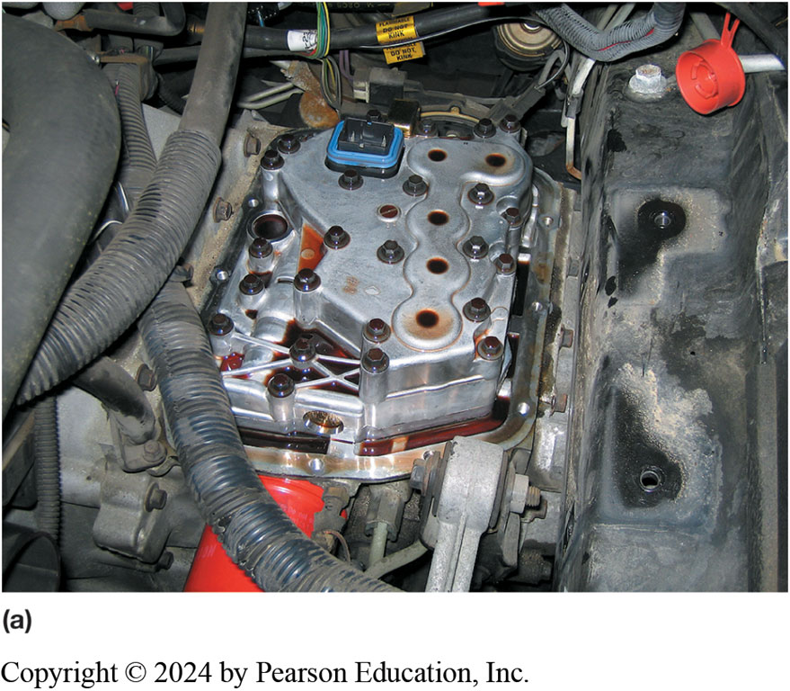
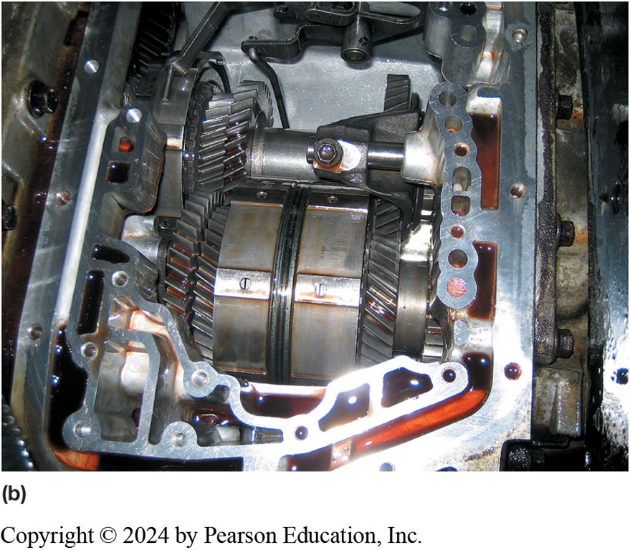
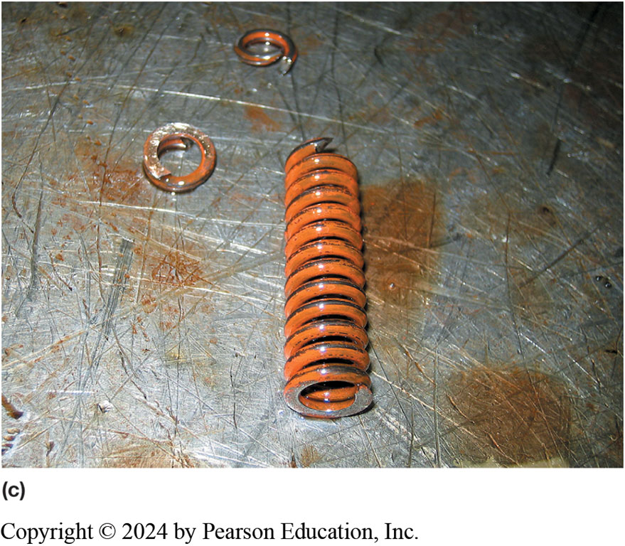
Figure 17.1
Improper Shifts
(a) This Saturn did not shift correctly and one technician was ready to replace the unit. However, another technician thought that the problem could be due to a fault in the valve body. (b) Removing the valve body shows the non-planetary gears used in the Saturn automatic transaxle. (c) The valve body was disassembled and a broken pressure regulator spring was found to be the cause of the customer concern.

Slide 5
Repair Options (2 of 2)
Complete Overhaul Includes
Disassembling entire transmission/transaxle
Replacing all needed parts, gaskets and seals
Restore transmission to perform like a new unit

Slide 6
Verify Need for Unit Repair (1 of 3)
Verify Fault
Use resources to verify fault inside, not outside, unit.
Knowledgeable technician
Hotline service provider, such as Identifix

Slide 7
Verify Need for Unit Repair (2 of 3)
In-Vehicle Repair
Parts and components that may be replaced with transmission/transaxle still in vehicle include:
Pressure switches
Transmission range switch
Turbine and output speed sensors
Extension housing gasket
Drive axle seals
Valve body replacement

Slide 8
Verify Need for Unit Repair (3 of 3)
Identify Unit
Final drive ratio in transaxles can vary depending on application.
Internal gear ratios can vary depending on exact application of unit.
Sometimes V I N needed to obtain correct parts.
More often transmission/transaxle identification number
Identification needed to ordering and receiving proper parts.

Slide 9
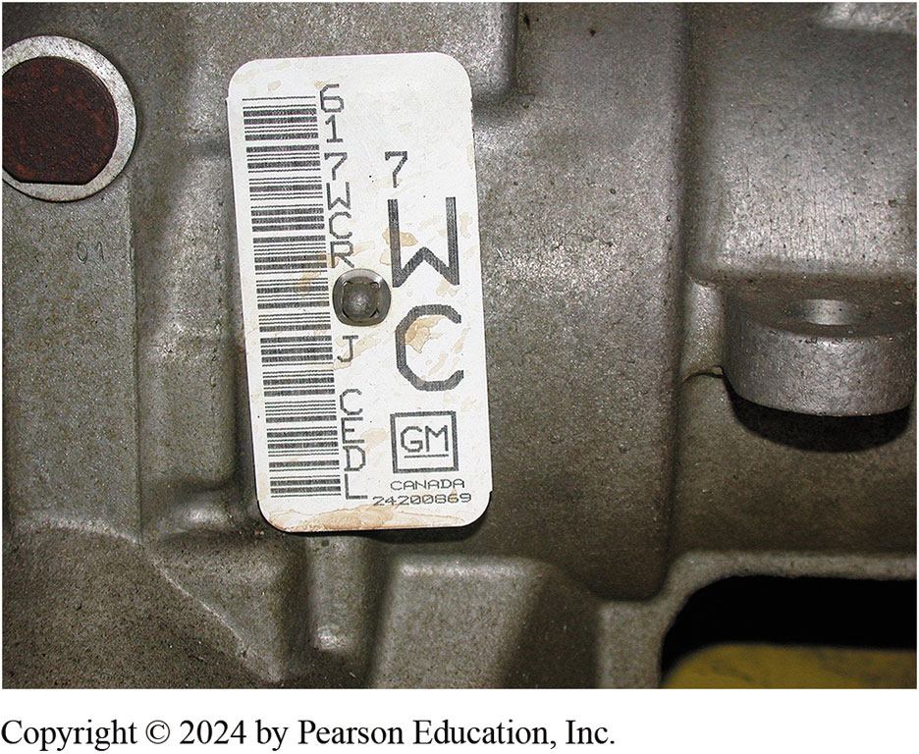
Figure 17.2
Identification Plate
A transmission identification number on the side of the unit. The information on this tag is needed when ordering parts, as there are often several versions of the same transmission used in similar vehicles and the differences could affect the parts needed.

Slide 10
Removing the Automatic Transmission/Transaxle (1 of 3)
Transmissions removed to make repairs, overhaul, or replacement.
Removal & replacement procedures similar for most transmissions/transaxles.
Always check service information before removing automatic transmission.

Slide 11
Removing the Automatic Transmission/Transaxle (2 of 3)
Steps Involved:
STEP 1 Disconnect negative
battery cable
STEP 2 Hoist vehicle safely and drain the fluid
STEP 3 Disconnect driveshaft or drive axle shafts.
STEP 4 Disconnect all cooler lines, linkage, and electrical connections.
Label each to ensure proper reinstallation
STEP 5 Disconnect torque converter from flex (drive) plate of engine.

Slide 12
Removing the Automatic Transmission/Transaxle (3 of 3)
STEP 6 Support engine before
Disconnecting automatic transmission/transaxle
STEP 7 Remove transmission/transaxle mounting fasteners.
STEP 8 Support transmission/transaxle on a jack
Remove attaching bolts at bell housing of engine.
STEP 9 Remove transmission/transaxle from vehicle.

Slide 13
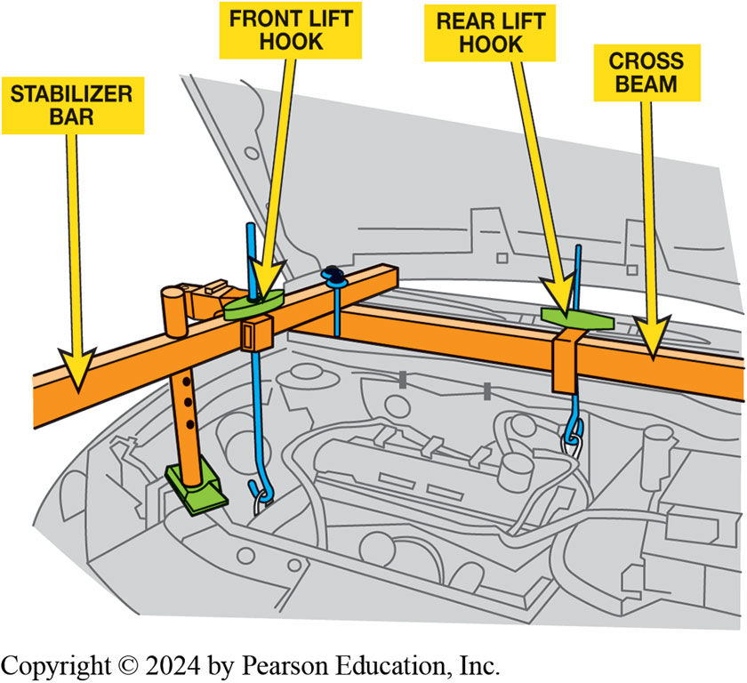
Figure 17.3
Engine Holding Fixture
A holding fixture being used on this F W D vehicle to support the engine when transaxle is removed.
Notes:
Long Description:
The bar supporting the front is labeled stabilizer bar, and the corresponding hook is labeled front lift hook. The bar supporting the rear is labeled rear lift hook, and the corresponding hook is labeled cross beam.

Slide 14
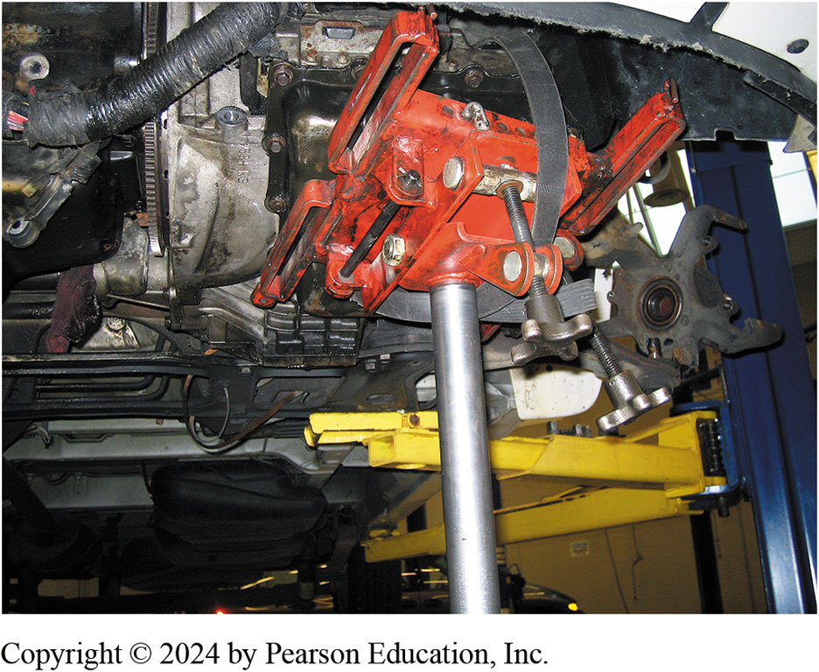
Figure 17.4
Transmission Jack
A transaxle being supported by a transmission jack prior to removal of the unit from underneath the vehicle.

Slide 15
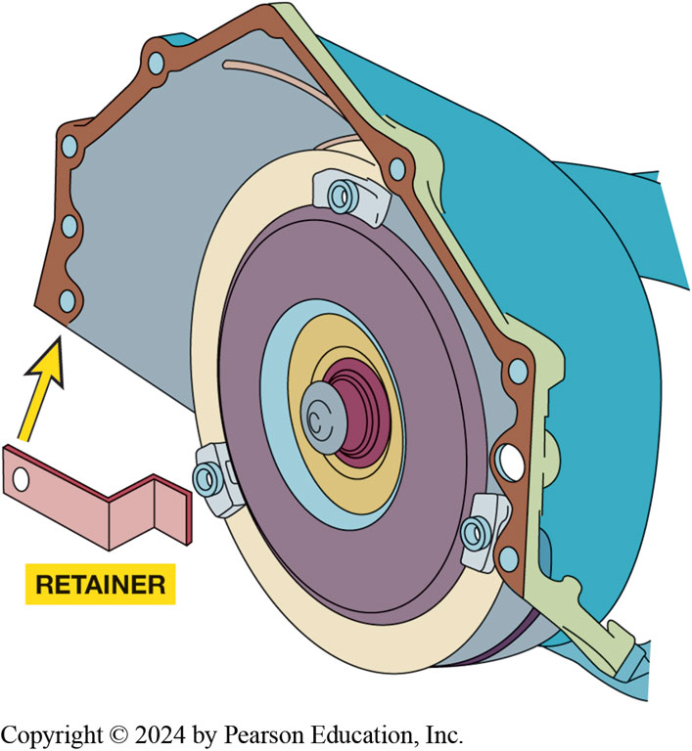
Figure 17.5
Transmission/transaxle is being removed from the vehicle, either remove the torque converter or install a retaining bracket to keep it from falling off the splines.
Notes:
CAUTION: There is a possibility that the converter can slide off its splines and fall as the
transmission is being removed. It is heavy and can cause injury or damage if it falls. Some
manufacturers recommend install ng a converter retaining bracket. ● SEE FIGURE 17–5.

Slide 16
Animation: Automatic Transmission, Remove & Replace (Animation will automatically start)

Slide 17
Automatic Transition Parts (1 of 2)
Hard parts
Soft parts
Kits
Banner kit
Bearing kit
Compliance kit
Deluxe or super kit
Filter kit
Notes:
Hard Parts Major transmission components, such as pumps, clutch drums, or gear sets are called hard parts. New hard parts are generally available only from the manufacturer or an aftermarket supplier of automatic transmission parts. Some aftermarket companies specialize in used or rebuilt hard parts.
Soft Parts On the other hand, soft parts are those parts that are normally replaced during an overhaul. These include the gaskets, seals, and friction material. The parts needed to overhaul a transmission are avail- able from various sources. The vehicle
manufacturer can supply all parts needed to repair or overhaul a transmission. Soft parts can be purchased from aftermarket sources (a supplier other than the vehicle manufacturer). These parts are usually available as individual components or as part of a kit. Kits are available in several forms.

Slide 18
Automatic Transition Parts (2 of 2)
Master kit
Overhaul kit
Sealing ring kit
Solenoid kit
Valve body kit

Slide 19
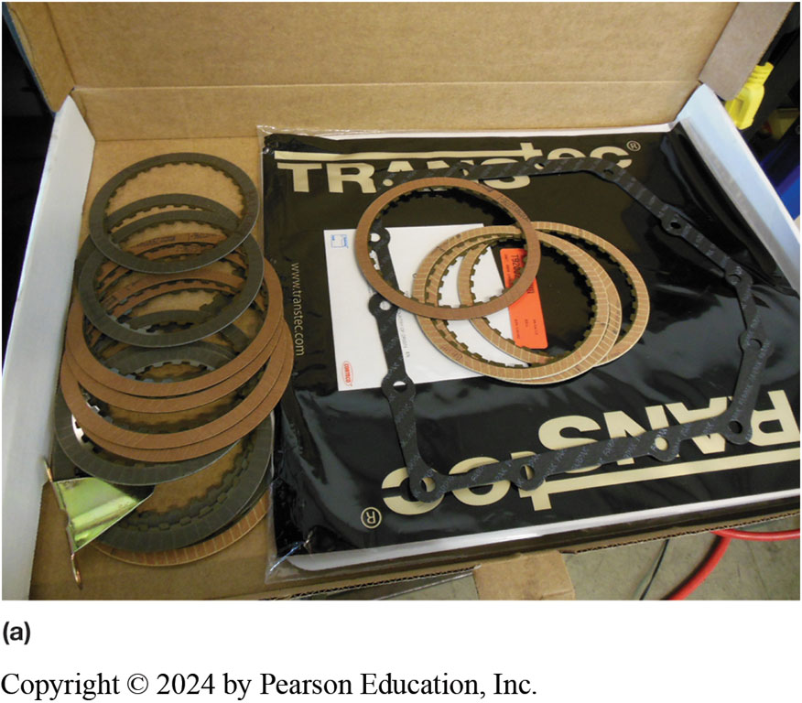
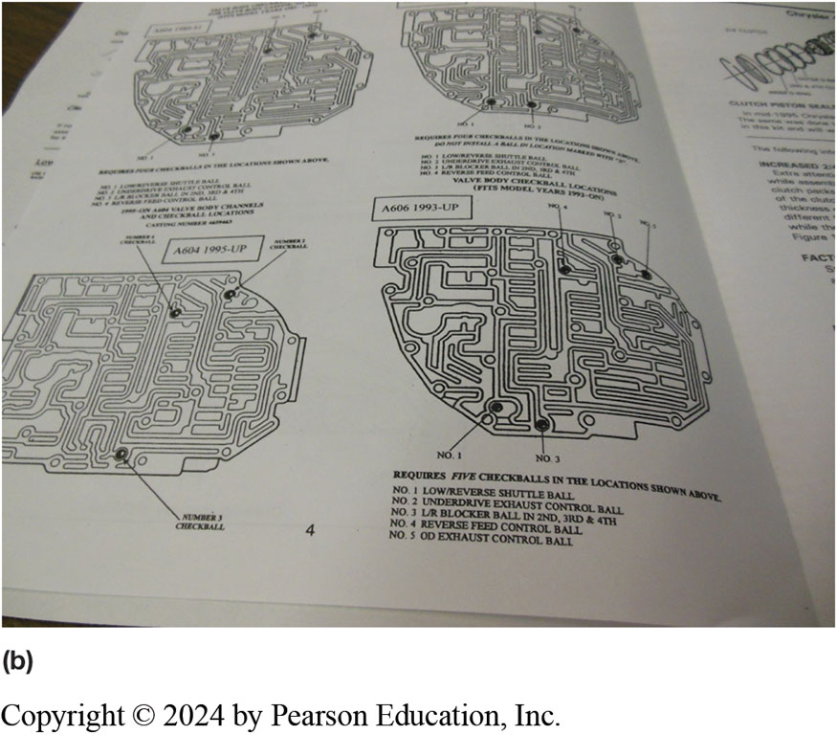
Figure 17.6
Kits
(a) A Typical automatic transaxle overhaul kit for a Chrysler 41T E. (b) The kit includes instructions and diagrams to help identify the unit being overhauled so that the correct parts are used from the kit

Slide 20
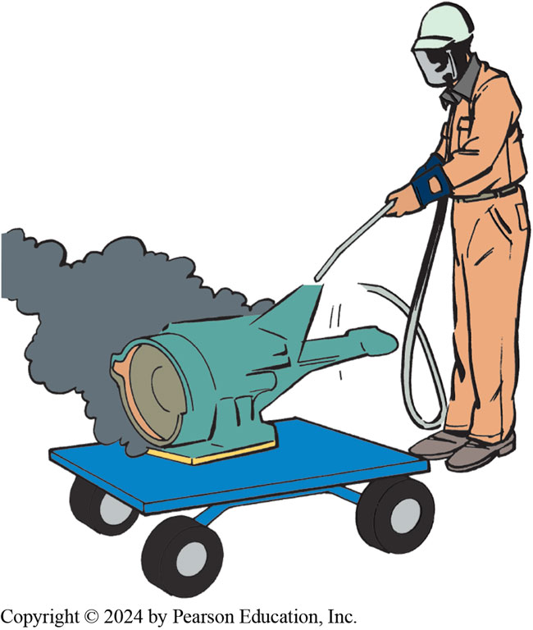
Figure 17.7
A power washer being used to remove the road grime from the unit before it is disassembled.

Slide 21
Transmission/Transaxle Disassembly (1 of 4)
Pre-disassembly Cleanup
Cleanliness is a must during a transmission overhaul.
Teardown Bench and Holding Fixtures
Many shops use a teardown bench
Steel top designed to catch fluid and drain it into a catch pan.

Slide 22
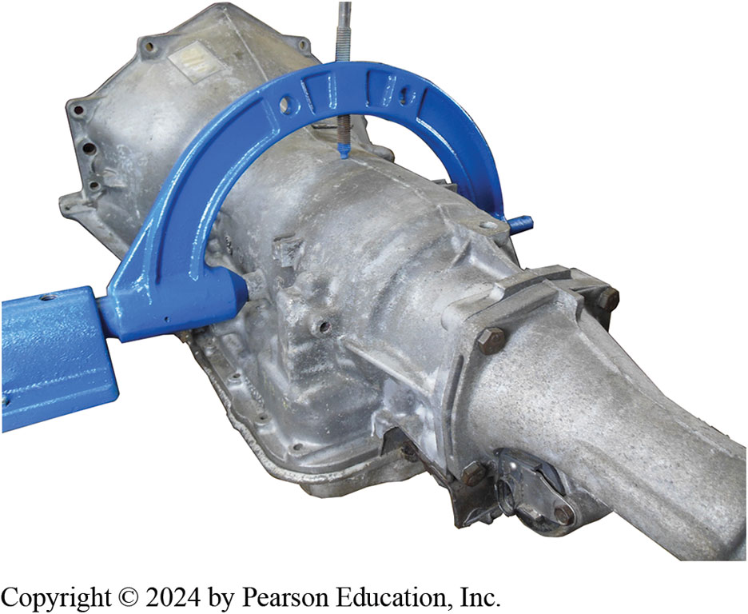
Figure 17.8
Holding Fixture
Using a holding fixture is the preferred method to use when disassembling and assembling an automatic transmission/transaxle. It allows the unit to be tilted and rotated as needed to get access to the internal and external components.

Slide 23
Transmission/Transaxle Disassembly (2 of 4)
First teardown step is to remove the oil pan, filter, and valve body.
Inspect for check balls as the valve body is removed, and note their location.
Retaining rings are used to hold many parts in the proper position.

Slide 24
Transmission/Transaxle Disassembly (3 of 4)
It is standard practice to measure input shaft end play before removing pump.
Pump assembly is front cover that holds gear train inside case on R W D transmissions.
Removal allows disassembly of rest of internal parts

Slide 25
Transmission/Transaxle Disassembly (4 of 4)
Some transaxles use a chain and sprockets for gear train input.
Removal of these parts provides access to driven sprocket support
supports input end of gear train
Case Disassembly

Slide 26
Figure 17.9
The valve body can be removed after the pan has been removed.

Slide 27
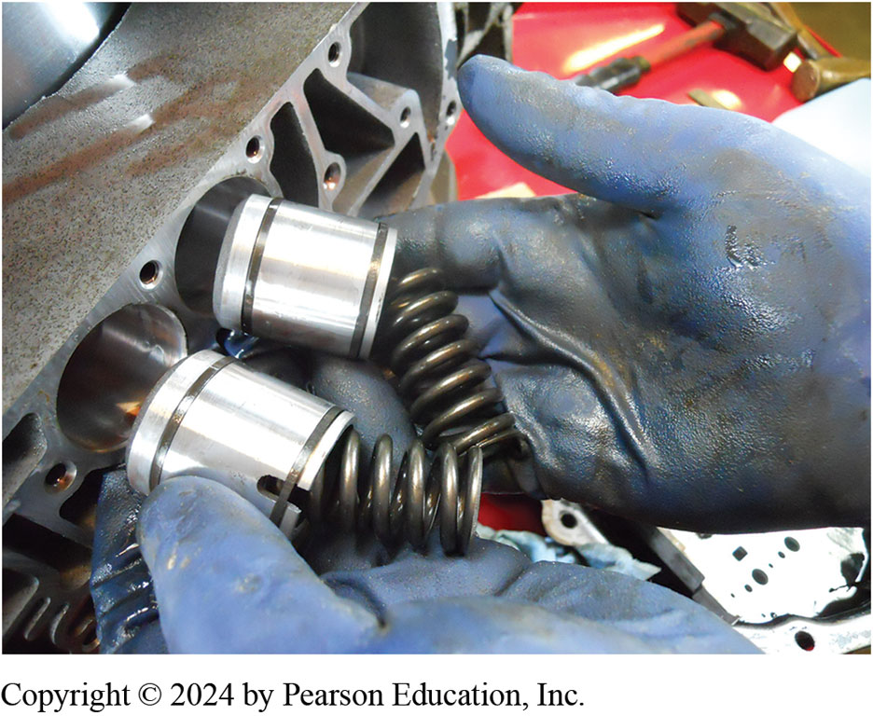
Figure 17.10
The accumulators used in a Chrysler 4 1 T E look the same but use different springs.

Slide 28
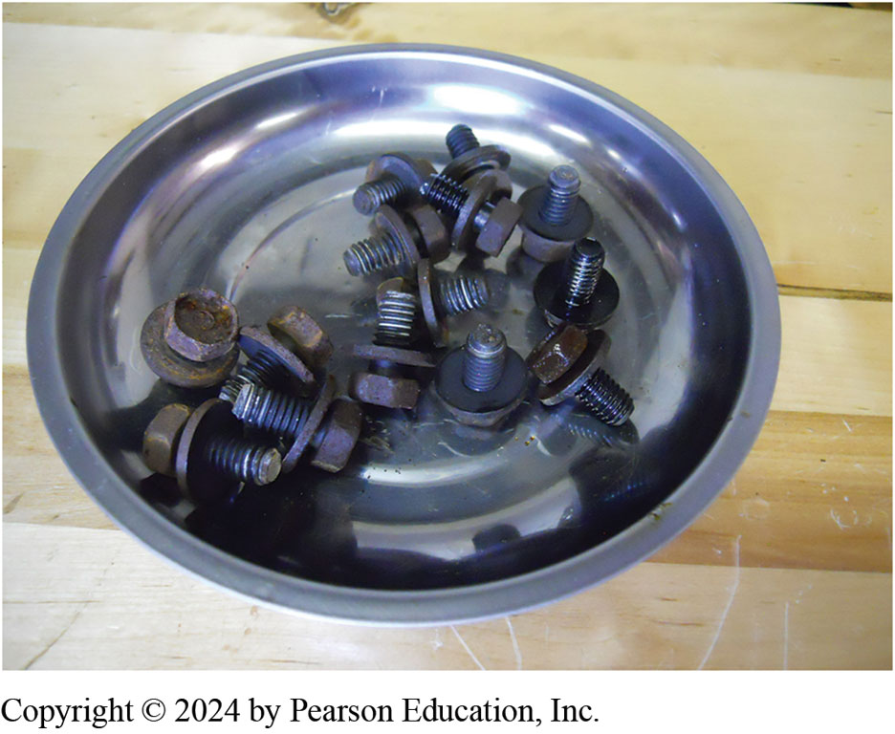
Figure 17.12
Magnetic Tray
Notes:
Figure 17.12 Magnetic trays are an excellent tool to help keep fasteners organized so they do not get misplaced. Some technicians use a separate tray for the fasteners from each major component such as the valve body bolts
Tech Tip: Magnetic Trays
Many shops use magnetic trays to help keep bolts and nuts organized. For example, one tray can
be used just for the oil pan bolts and another for valve body bolts. When not being used, they
should be stored attached to a metal workbench or tool box. If a magnetic tray is stored on a
wooden workbench, the magnet can lose some of its holding power. Figure 7.12.

Slide 29
Figure 17.13
The most common types of retaining rings are (a) external pin type, (b) internal pin type, (c) plain external, (d) plain internal, and (e) E-clip.
Notes:
The correct type and size of snap-ring pliers must be used. Once removed, it is recommended that the retaining ring be
replaced with a new one. ● See Figure 17.13.
Long Description:
All rings have a gap at their ends. Part (a) is almost a circle with two holes at its square ends. Part (b) is a small circle with a large gap having holes at its ends. Part (c) has a small gap at its ends without holes. Part (d) has a small gap at its ends without holes but with cut ends. Part (e) is a headset-like structure with cupped ends and a trapezium protrusion in the middle.

Slide 30
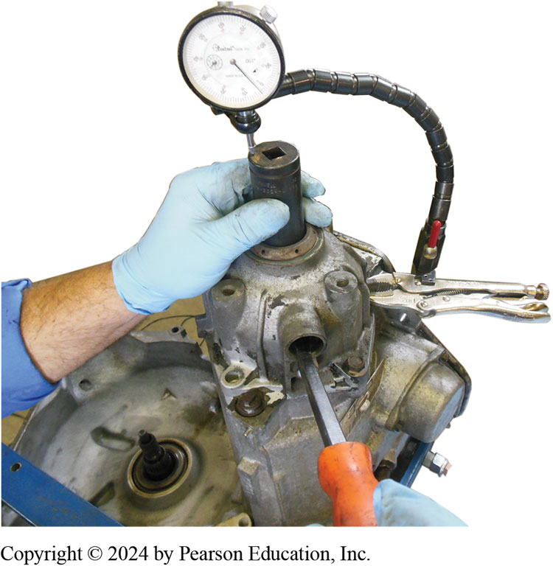
Figure 17.14
Using a dial indicator to check the end play before the transmission is disassembled.
Notes:
End-play Check It is standard practice to measure input shaft end play before removing pump. End play is in-and-out movement of shaft.
If there is no end play, there will be drag and a possible binding of internal components.
Too much end play allows misalignment of internal parts which could cause damage from excess movement.
If end play is correct, internal thrust washers are probably in good shape. If end play is excessive, there is internal wear, which must be corrected during the rebuild. End play is normally measured using a dial indicator.
To measure input or output shaft end play, the usual includes following steps:
STEP 1 Place the transmission in a vertical position with the input shaft pointing up. Some transmissions require that a special fixture be used to hold the output shaft during end-play checks.
STEP 2 Attach a dial indicator onto the case or front pump, and position the measuring stylus
against the end of the input shaft.
STEP 3 Pull the shaft slightly upward and then push it inward as far as it goes. Now adjust indicator to read zero. ● See Figure 17.14.
NOTE: On some transmissions, input shaft is not attached and can be easily pulled out of transmission. On these units, end play is checked by measuring distance from end of stator support to end of turbine shaft. End play on some of these units can be measured by prying upward on gear train or specifying that tail shaft (output) be lifted up and allowed to fall when checking total end play. This allows the entire stacked unit to be checked.
STEP 4 On most transmissions, pull up on the shaft and read the movement on the dial indicator. This is the amount of shaft end play.
STEP 5 Repeat steps 3 and 4 until you get consistent, reliable readings. Then make three more measurements and, if there is a slight difference, average them.
STEP 6 Record your reading and compare it to the specification.

Slide 31
Animation: Check Transmission End Play (Animation will automatically start)

Slide 32
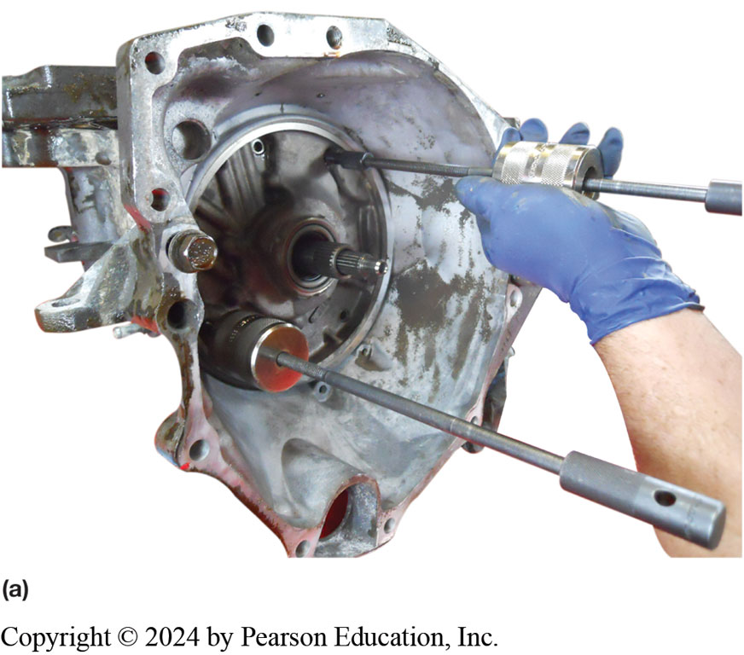
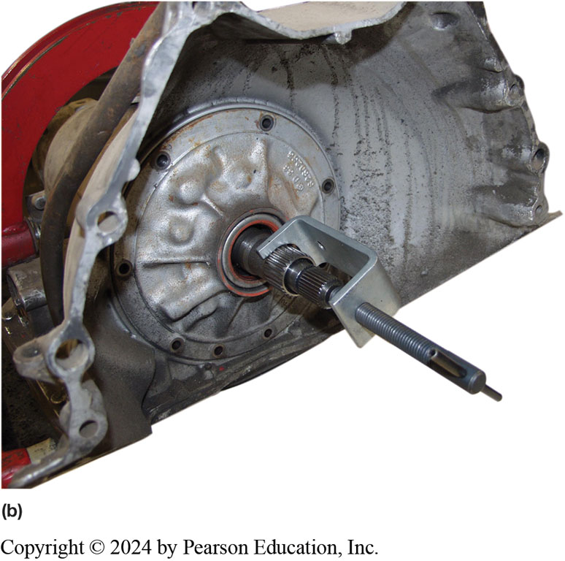
Figure 17.15
Removing Front Pump
Notes:
Figure 17.15 (a) Two slide hammers are used to removed the pump in some transmissions/transaxles. (b) A special puller being used to remove the pump.

Slide 33
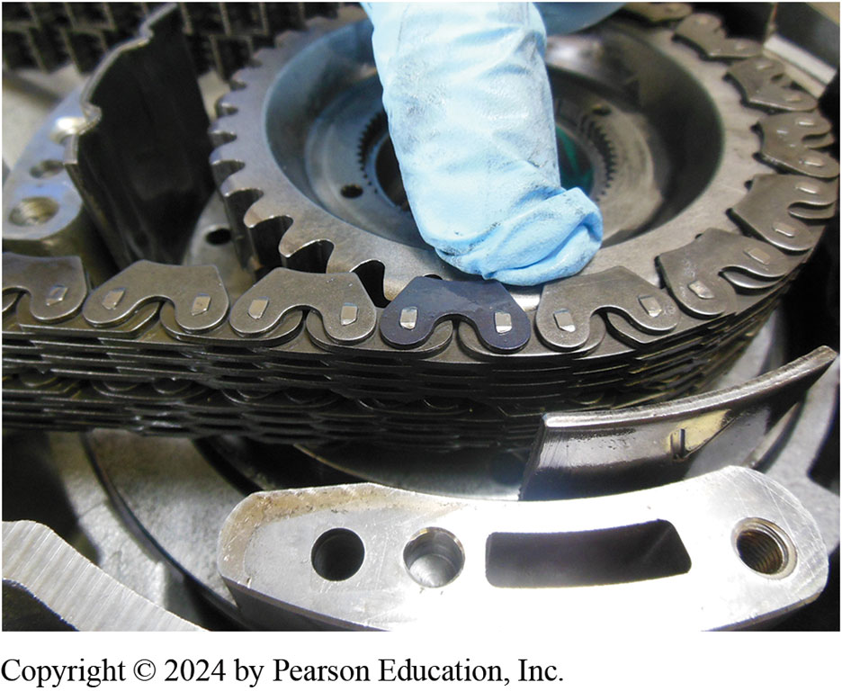
Figure 17.16
Chain Master Link
The master link in this G M 4 T 6 5-E is facing upward and is colored black.

Slide 34
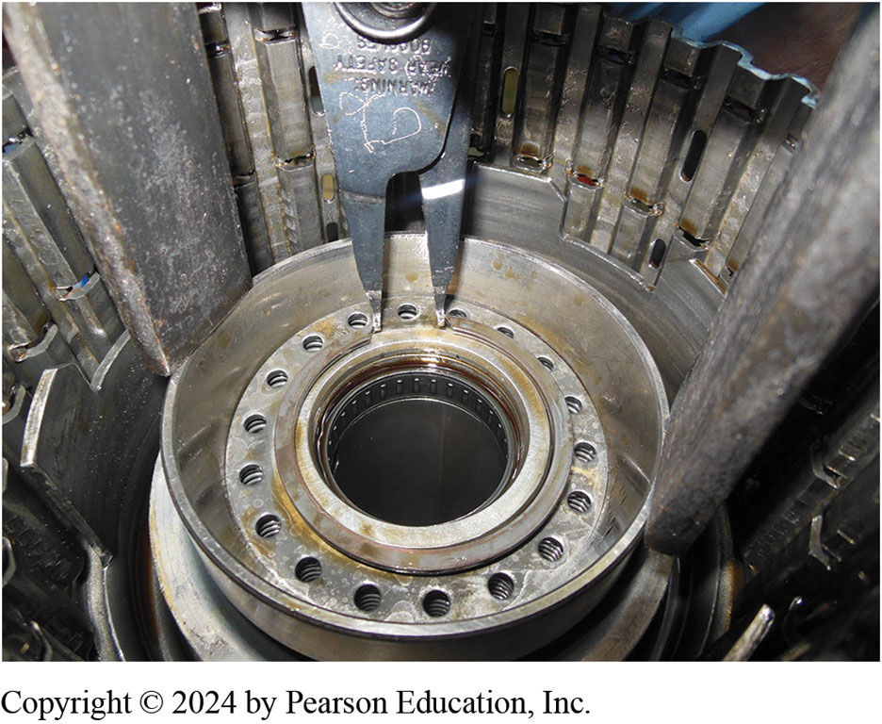
Figure 17.17
A snap ring being removed after the clutch piston has been compressed to allow access to the snap ring on this G M 4 T 6 5-E transaxle.

Slide 35
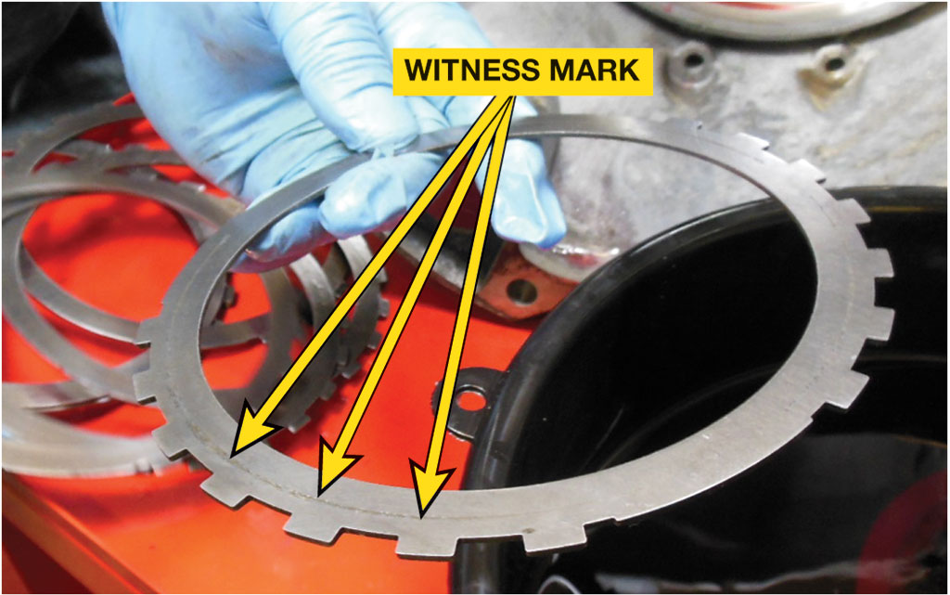
Figure 17.18
Witness marks are sometimes hard to see but there is often wear when two parts operate together, and should be reinstalled in the same position.
Notes:
Tech Tip: Look for Witness Marks
Many transmissions use a drive shell that is connected to a clutch through a set of lugs, and a
wear pattern will be established between them. These wear patterns are commonly referred to as
witness marks. While reassembling, it is important to assemble them in the original position. While
disassembling, it is a good practice to place index marks on both parts.

Slide 36
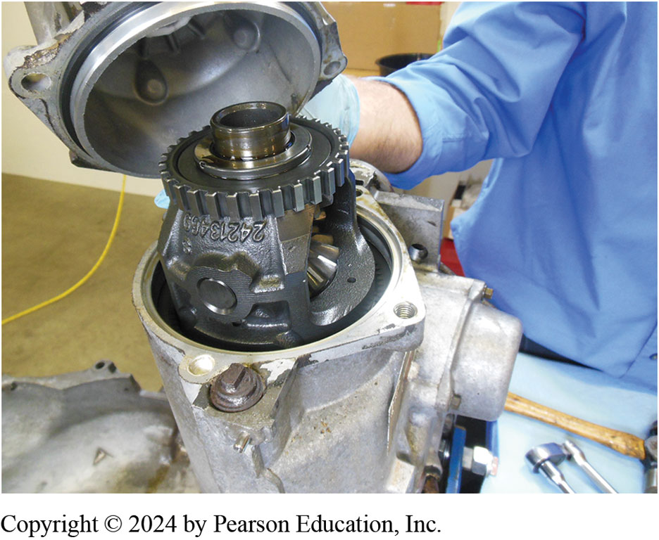
Figure 17.19
The final drive assembly on a G M 4 T 6 5-E.

Slide 37
Transaxle Removal Photo Sequence

Slide 38
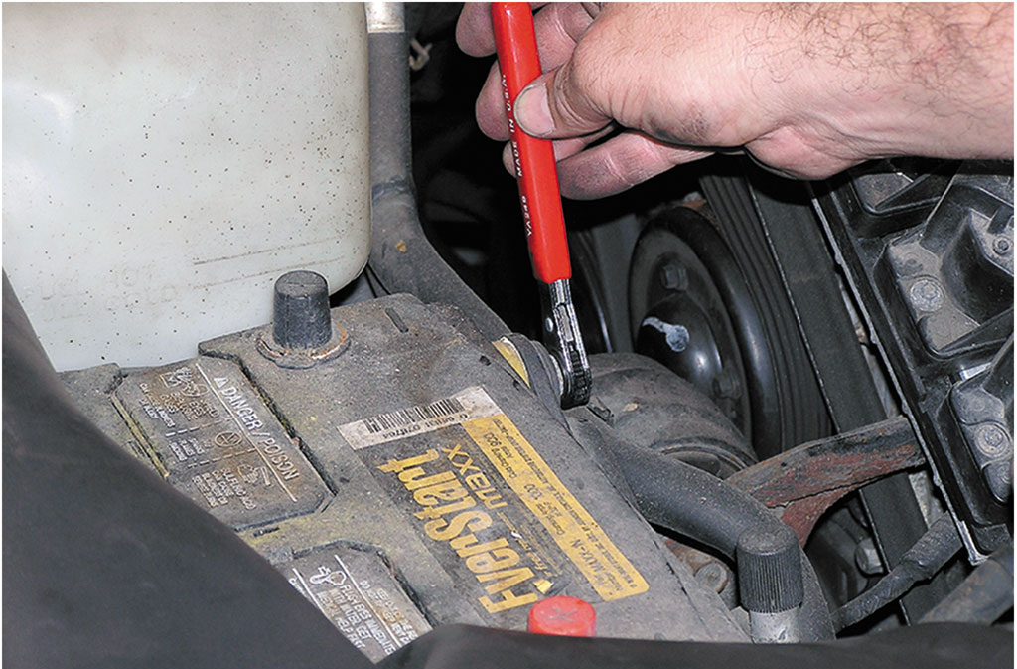
1. For safety purposes, remove the negative battery cable before starting the transaxle removal procedure.

Slide 39
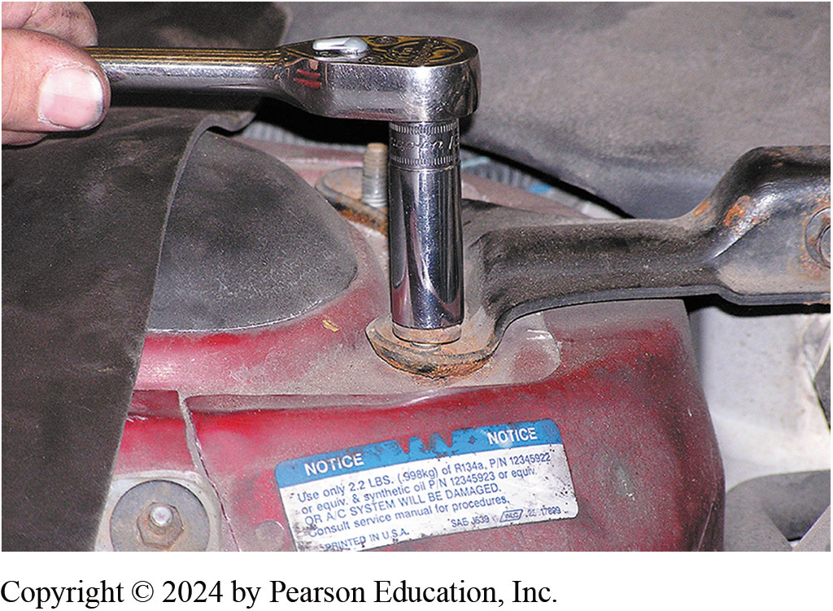
2. Remove engine bay cross members that may interfere with access to the transaxle fasteners.

Slide 40
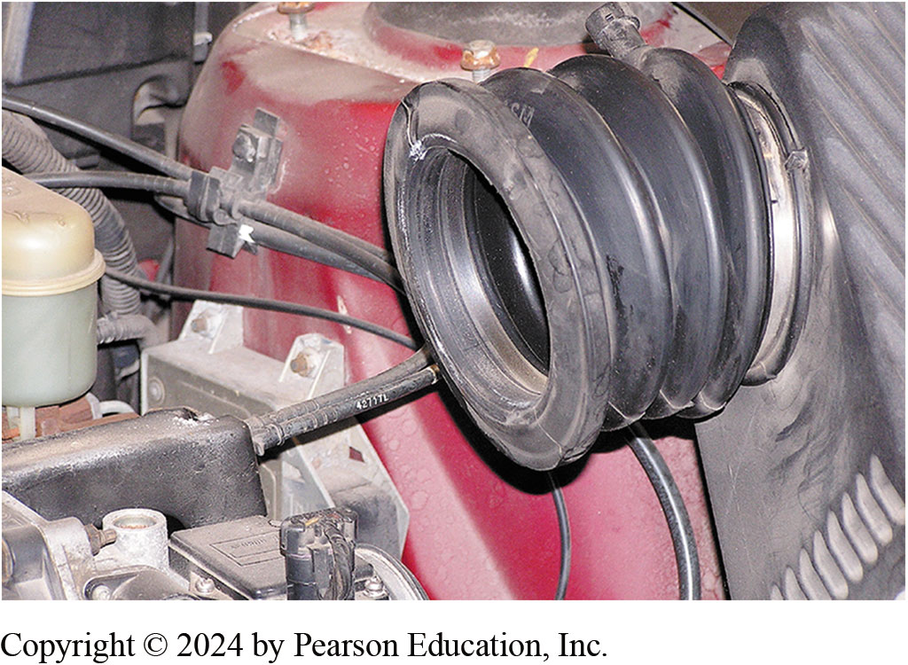
3. Remove the air intake and air filter assembly, which is covering the transaxle in this vehicle.

Slide 41
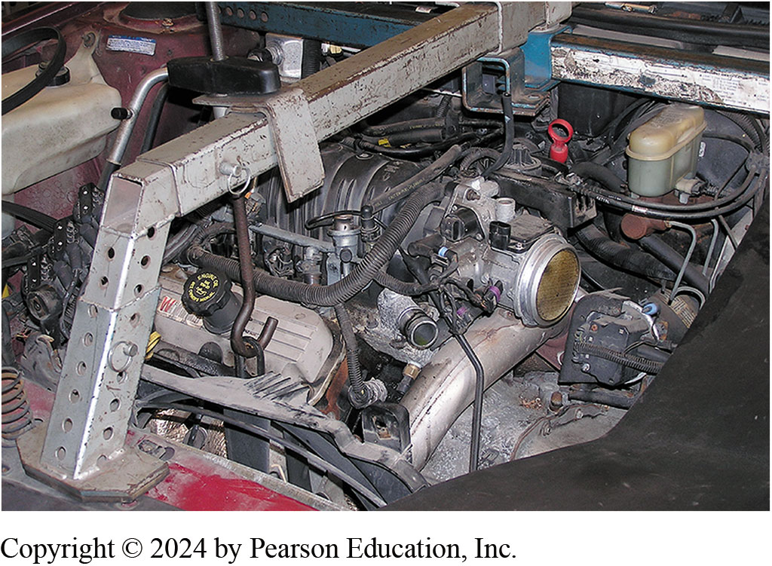
4. Install a support for the engine.

Slide 42
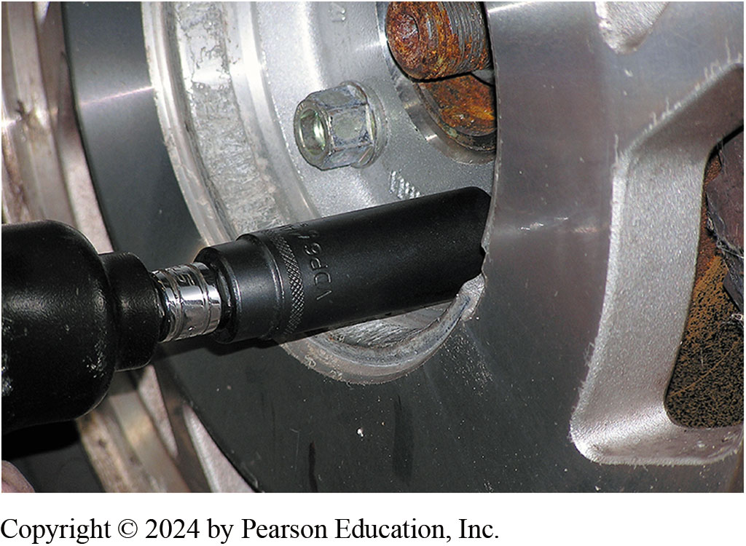
5. Safely hoist the vehicle and remove the wheels.

Slide 43
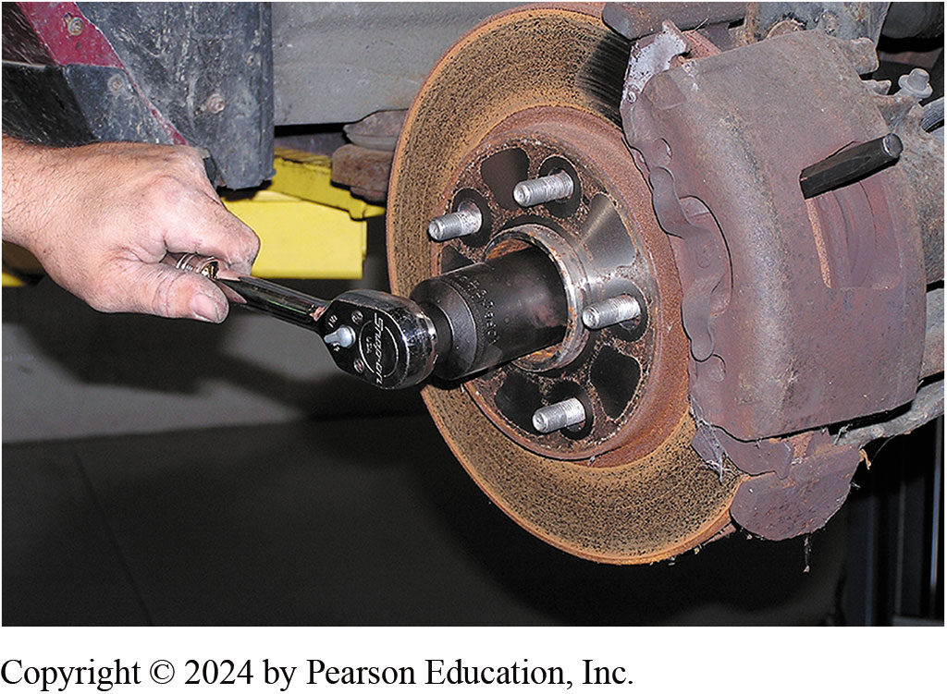
6. Remove the retaining nut from the drive axle shaft.

Slide 44
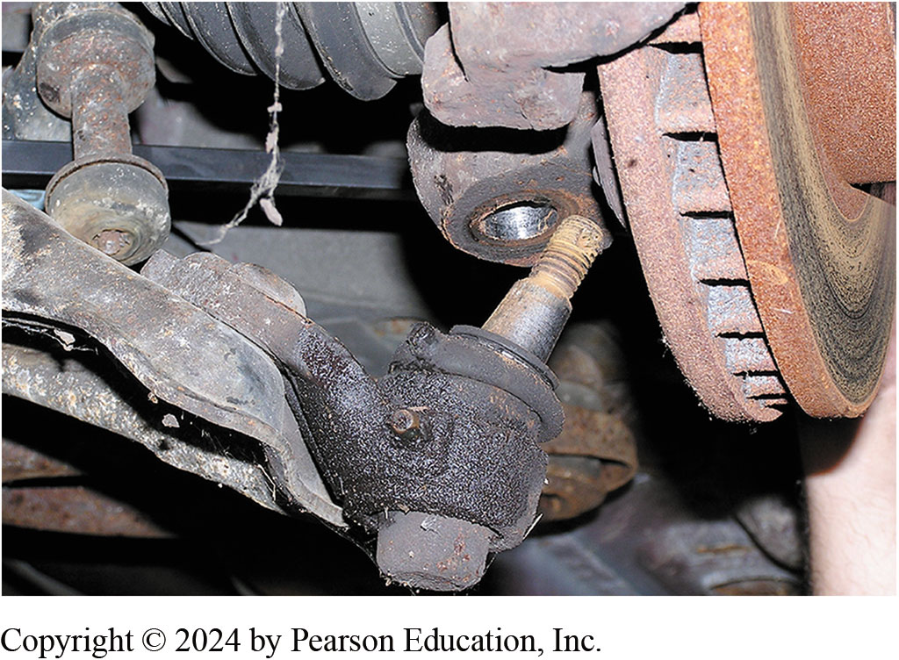
7. Disconnect the lower ball joint on the front-wheel-drive vehicle to allow removal of the drive axle shaft.

Slide 45
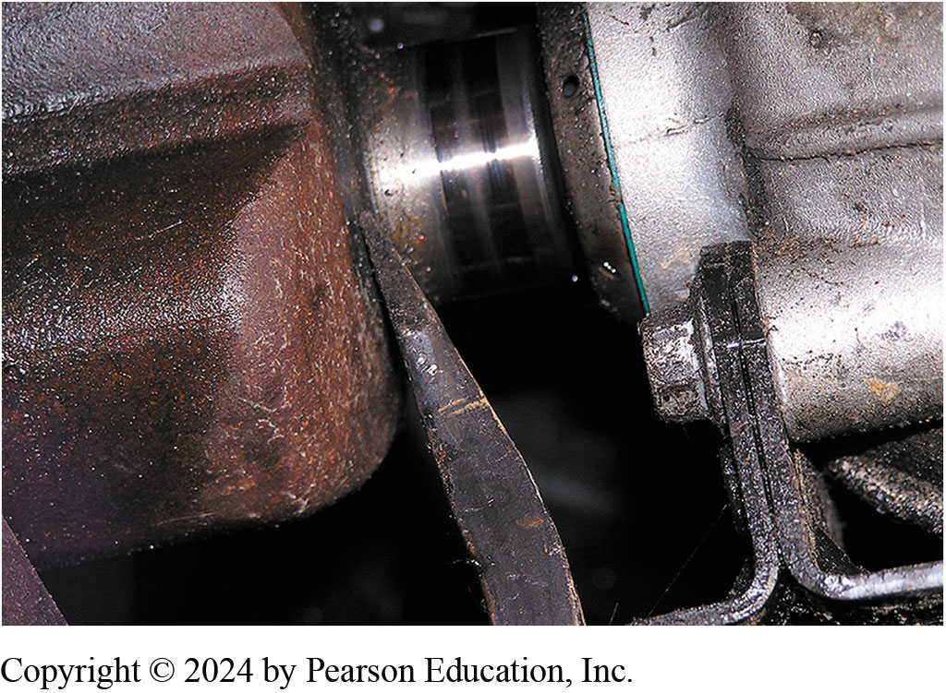
8. Remove the drive axle shaft from the transaxle using a pry bar.

Slide 46
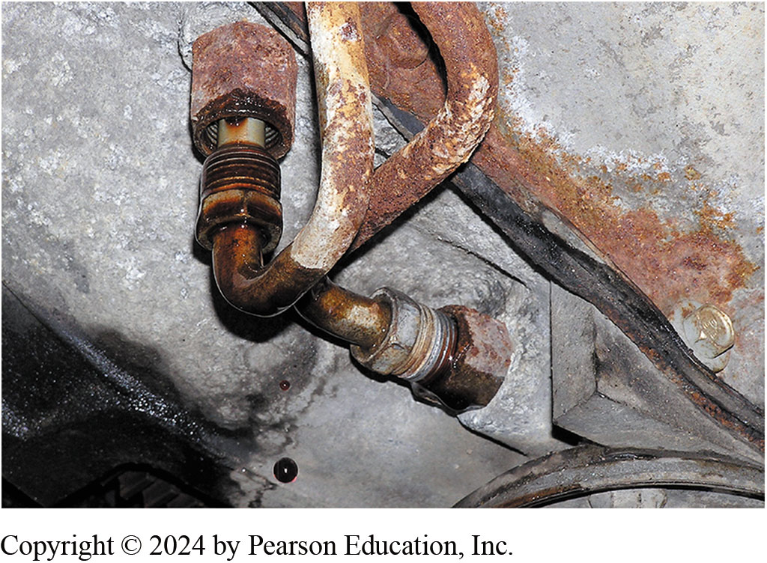
9. Disconnect the cooler lines from the transaxle using a line wrench.

Slide 47
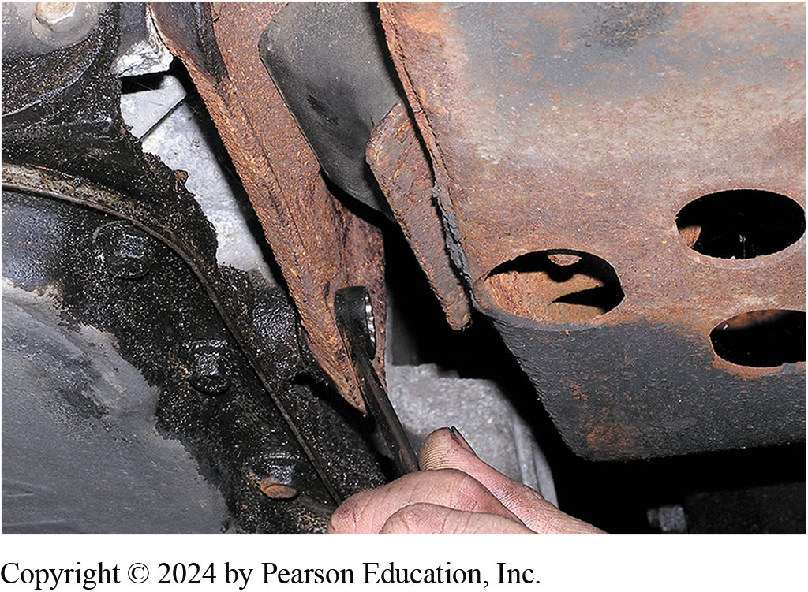
10. Unbolt the torque converter from the flexplate, then remove the transaxle mounts.

Slide 48
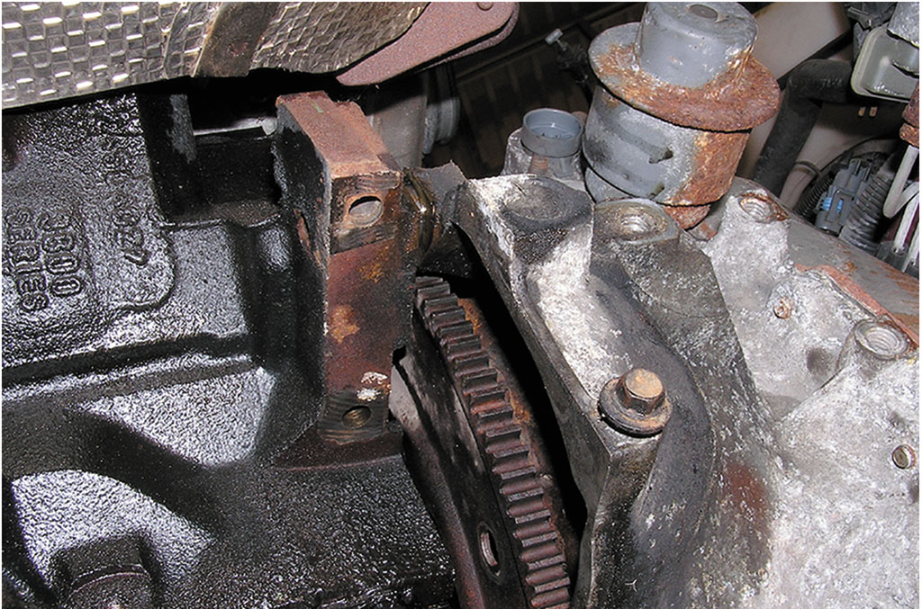
11. With the transaxle supported on a transmission jack, remove the retaining bolts from the bell housing.

Slide 49
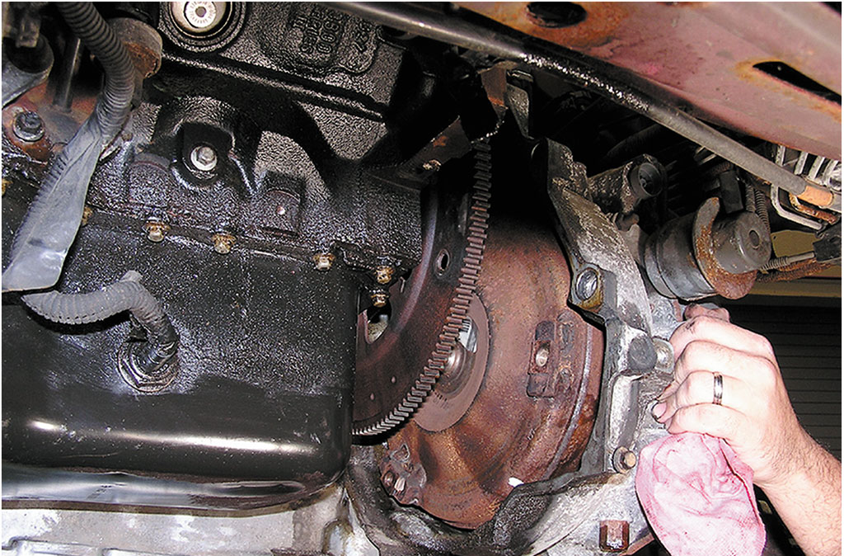
12. Carefully remove the transaxle from the vehicle.

Slide 50
4 1 T E Disassembly Photo Sequence

Slide 51
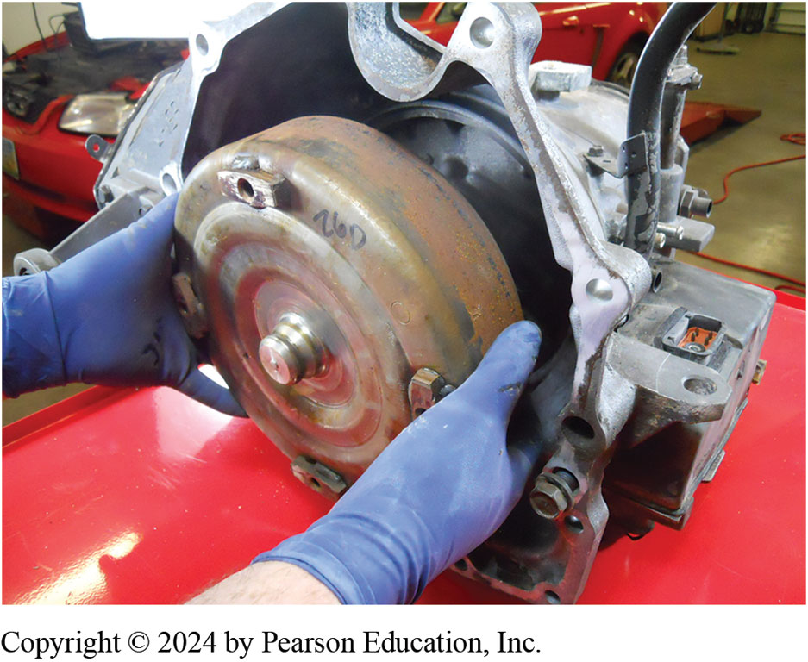
1. The torque converter is removed.

Slide 52
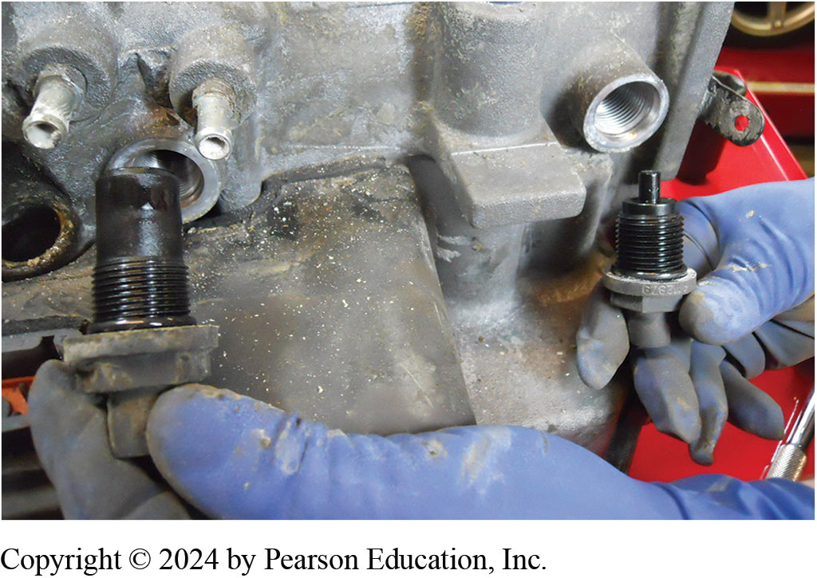
2. Input (left) & output (right) speed sensors are being removed. They are different sizes so they can't be mixed up.

Slide 53
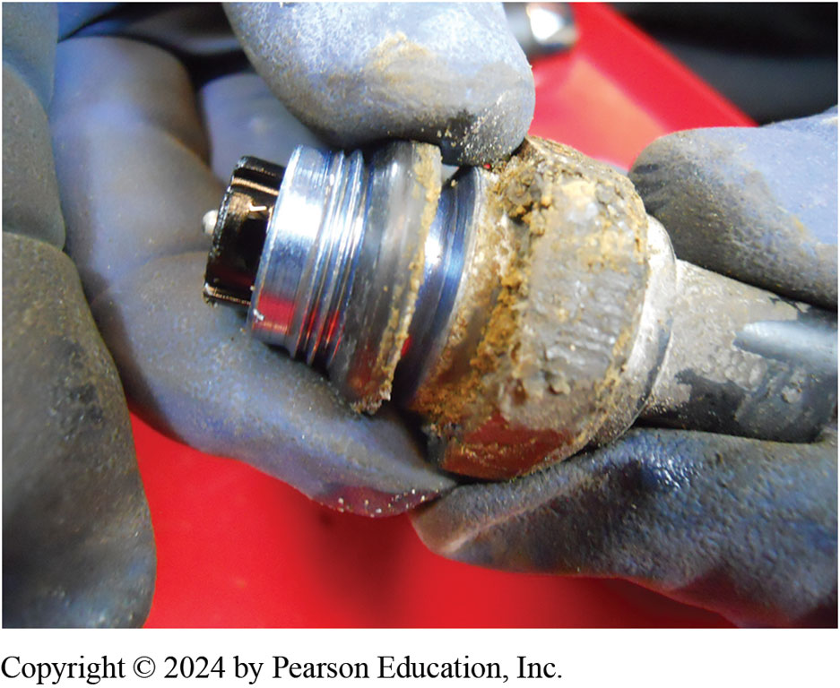
3. A pressure sensor sealing ring being removed.

Slide 54
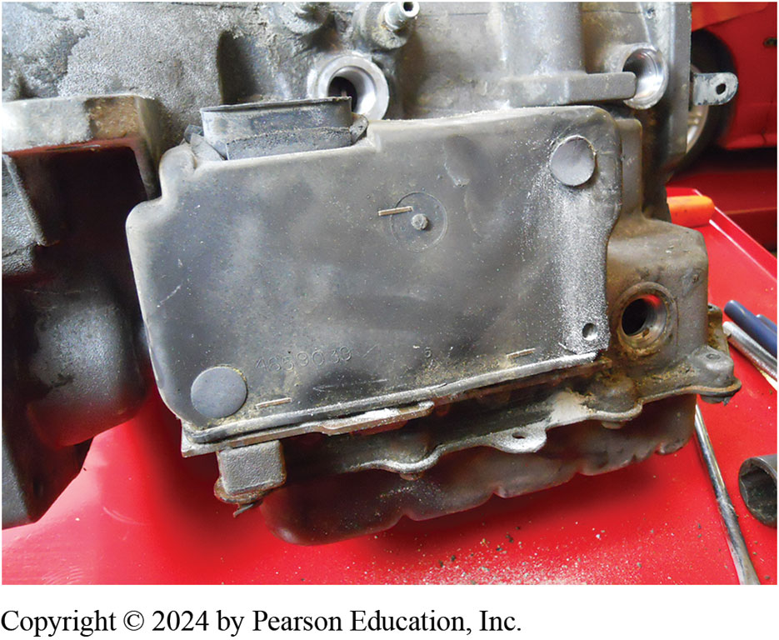
4. Cover for T C M is made of rubber and is attached to the case using plastic “Christmas tree”-type clips.

Slide 55
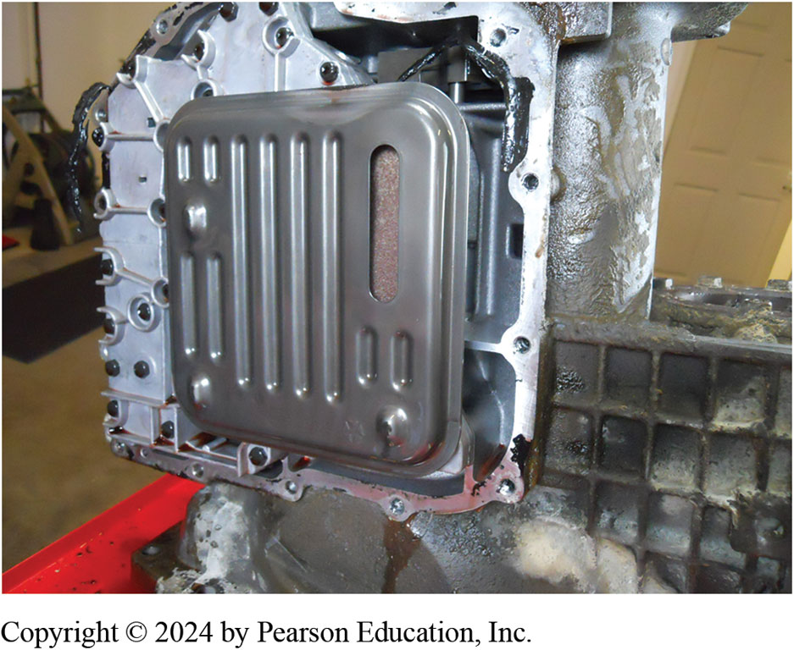
5. After the pan has been removed, the filter can be accessed and then removed before removing the valve body assembly.

Slide 56
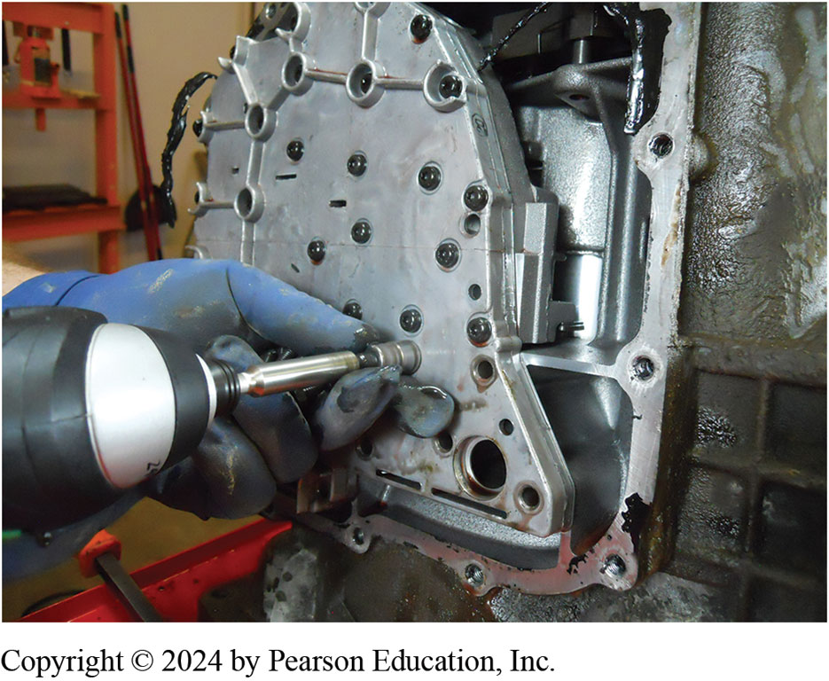
6. Removing the valve body.

Slide 57
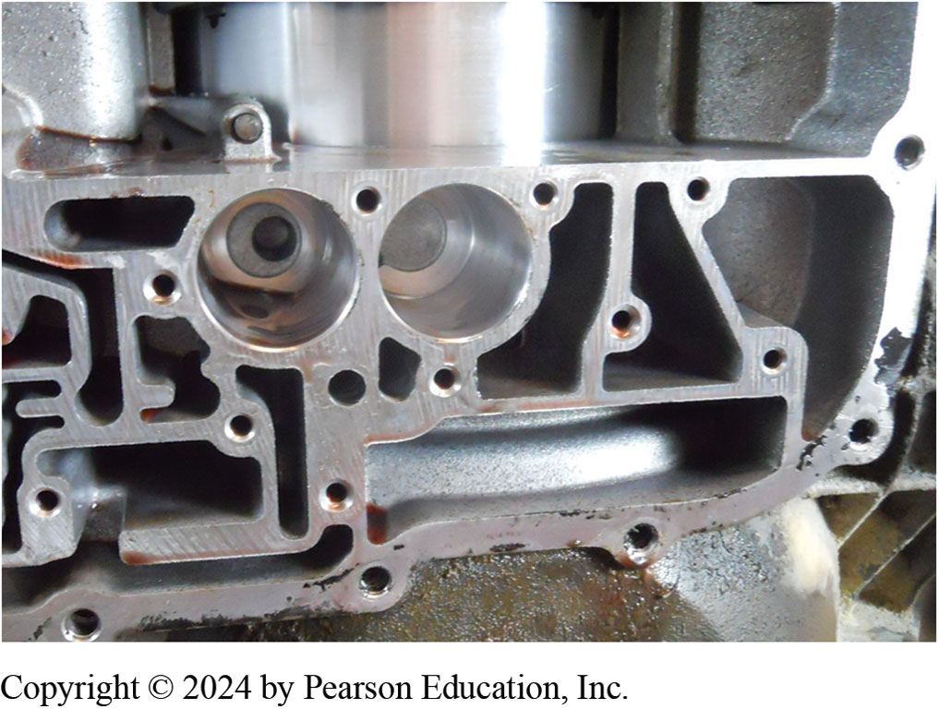
7. The accumulator bores are checked for wear after removing the accumulator pistons.

Slide 58
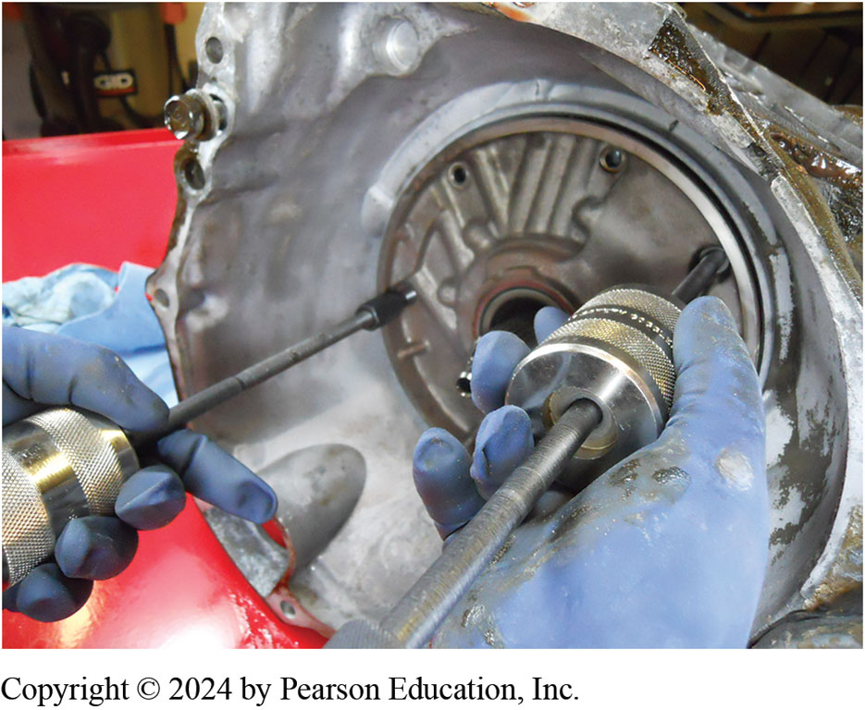
8. The pump is being removed using two slide hammers.

Slide 59
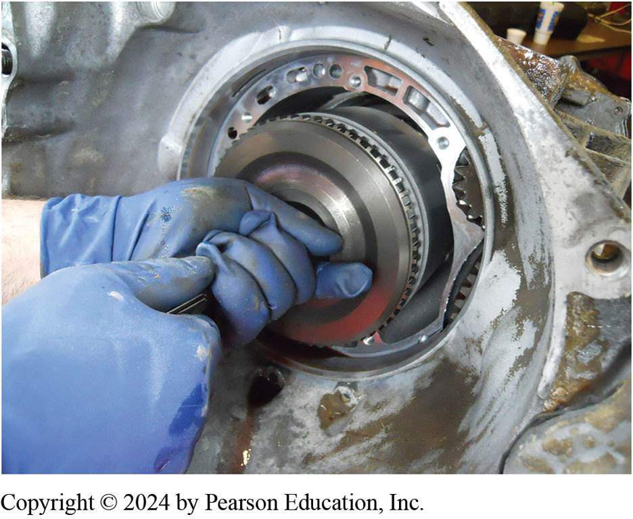
9. The input clutch assembly is being removed.

Slide 60
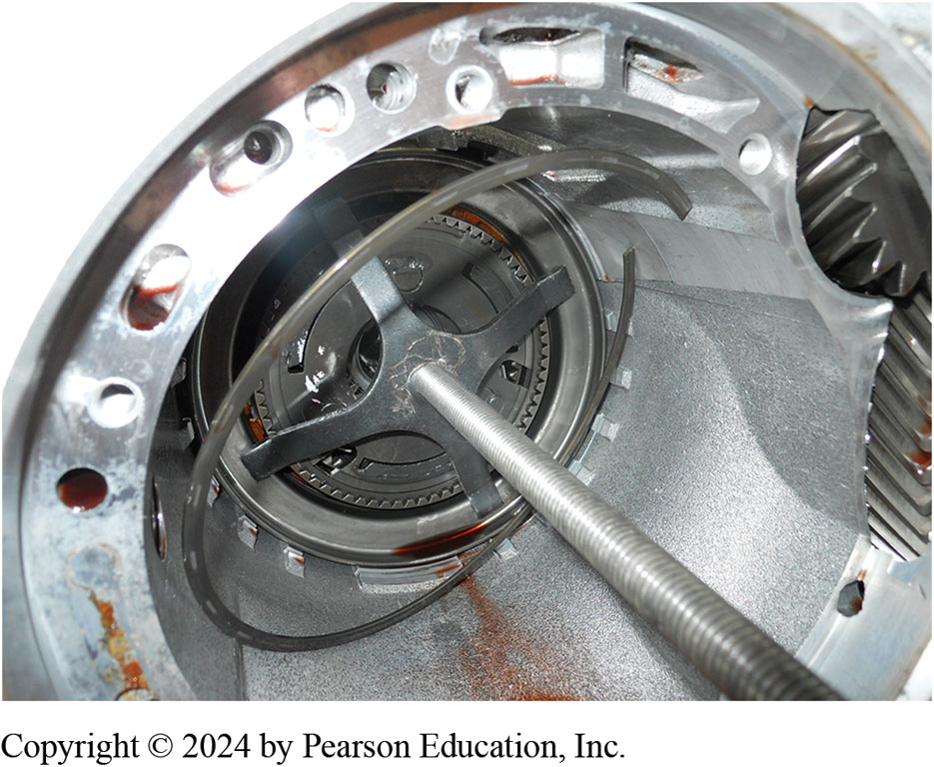
10. The 2 over 4 clutch return spring is being compressed so the retaining ring can be removed.

Slide 61
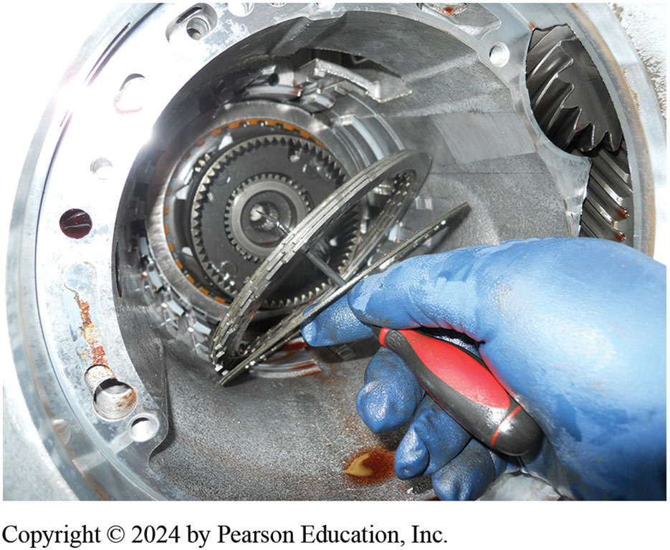
11. Removing the 2 over 4 clutch pack assembly.

Slide 62
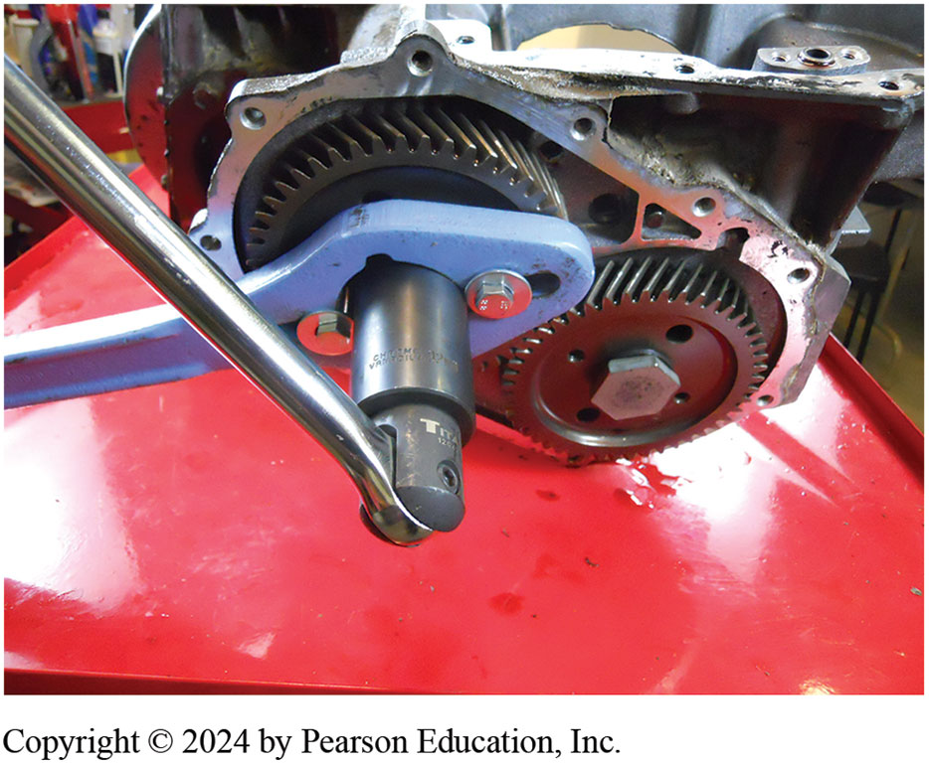
12. The rear carrier assembly is removed after the retaining bolts are removed.

Slide 63
4 L 6 0-E Disassembly Photo Sequence

Slide 64
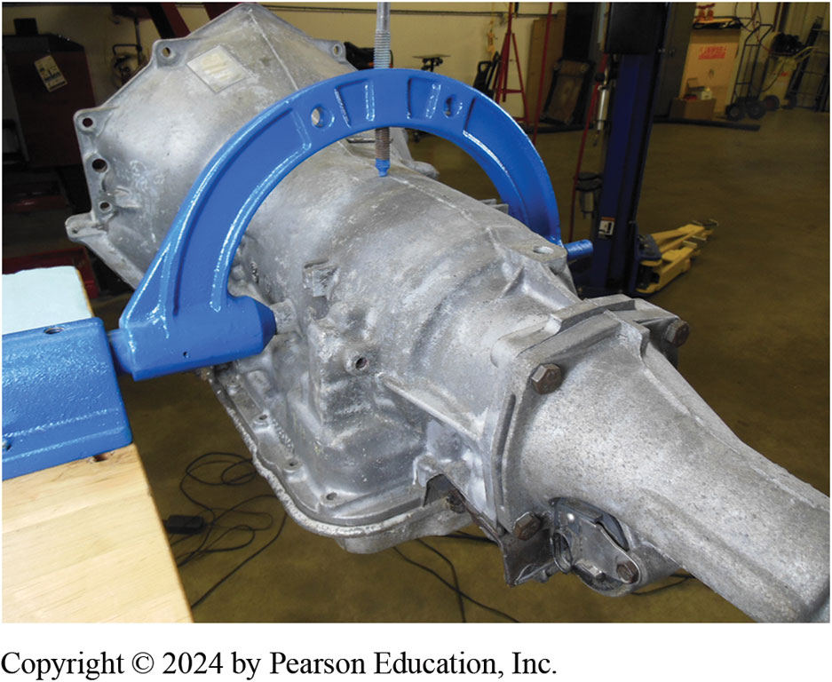
1. Before disassembling, it is preferred that the unit be mounted on a holding fixture.

Slide 65
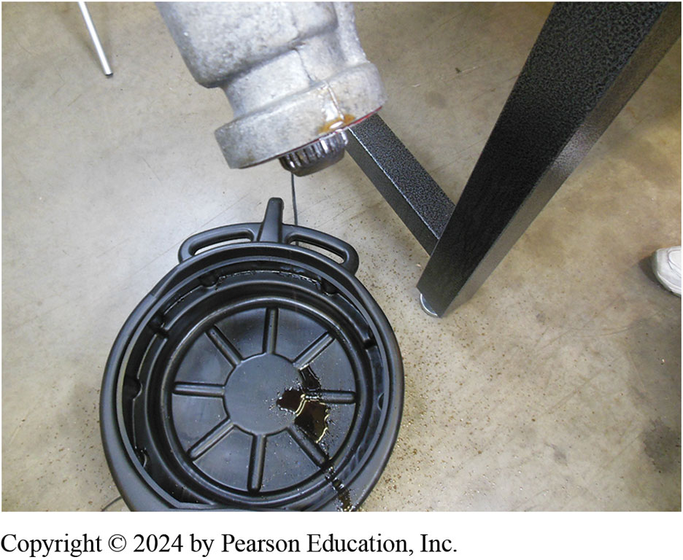
2. The unit is tipped and fluid drained. The fluid looked burned and watery.

Slide 66
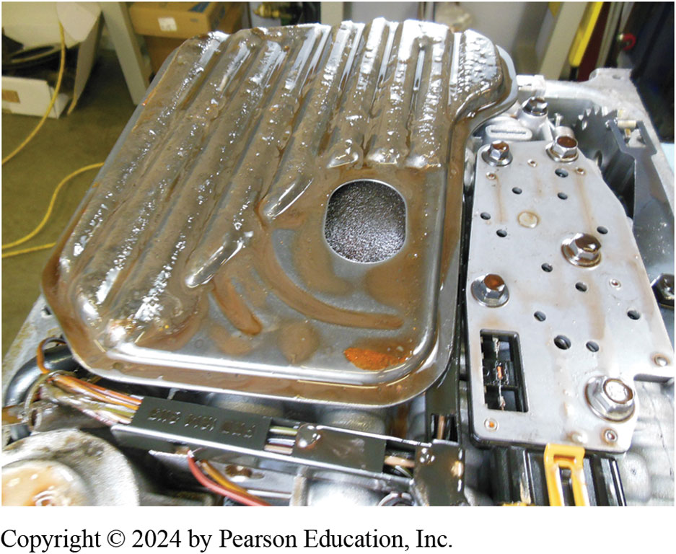
3. After removing the pan, the filter is removed.

Slide 67
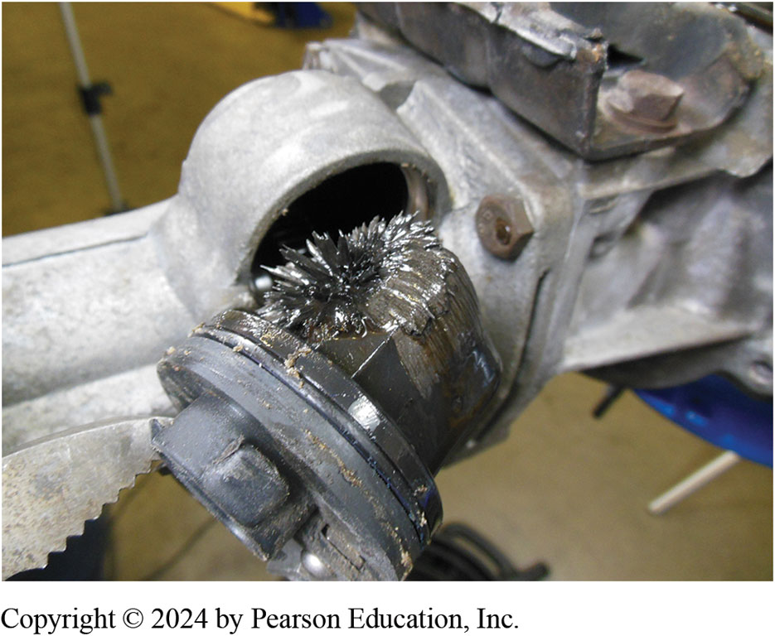
4. When magnetic vehicle speed sensor was removed, it showed lots of metal filings which indicates something is worn or damaged inside unit.

Slide 68
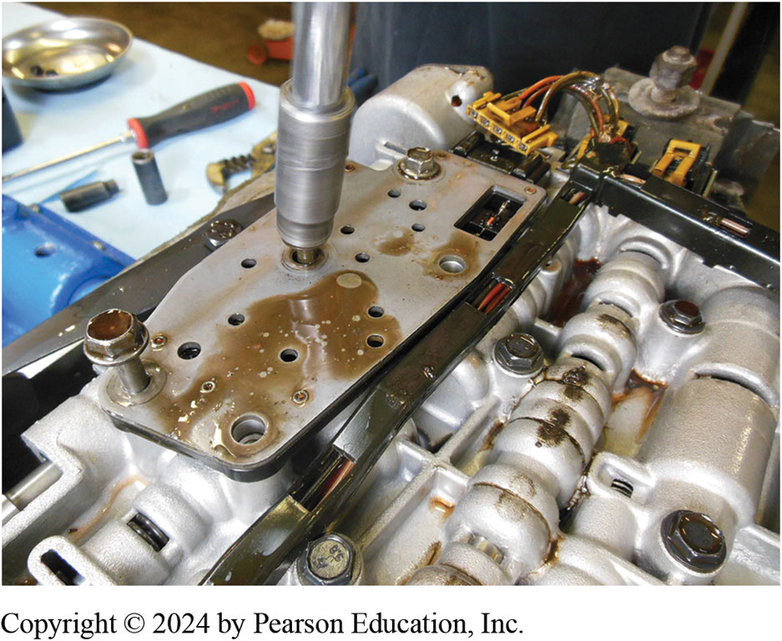
5. The pressure switch manifold being removed prior to removing the valve body.

Slide 69
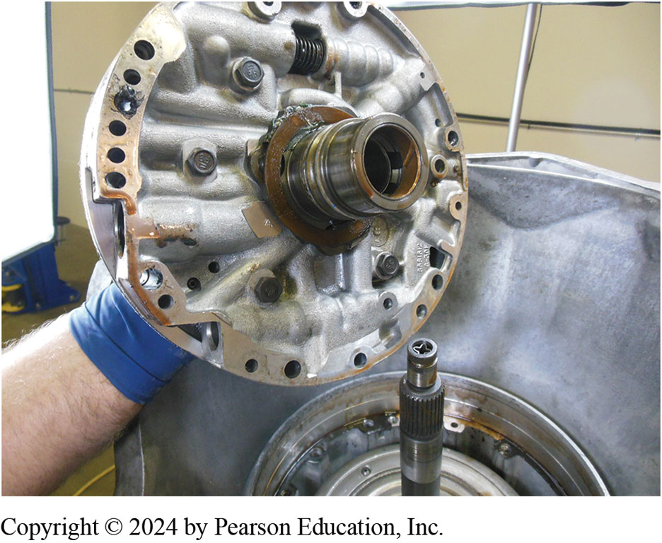
6. The pump assembly is being removed from the unit.

Slide 70
7. Removing the input housing and shaft assembly.

Slide 71
8. The cause of the metal shavings was found to be an excessively worn planet carrier.

Slide 72
9. The reaction carrier and shaft with internal bushing being removed.

Slide 73
10. Removing a snap ring used to retain the low-reverse clutch assembly.

Slide 74
11. Removing the second gear apply piston assembly from side of case.

Slide 75
12. Visual inspection of fluid in this unit shows that it has been overheated and, of course, there are hard parts needed to return this unit to useful service.

Slide 76
Question 1
What is the preferred tool to use when removing a pump?
A. A chain
B. Slide hammers
C. Special screw-type puller
D. Either b or c

Slide 77
Answer 1
What is the preferred tool to use when removing a pump?
D. Either b or c

Slide 78
Summary
Transmissions are removed to make repairs, for overhaul, or for replacement.
Removal procedures are similar for most transmissions/transaxles.
Always check the service information before removing an automatic transmission/transaxle as per the required tools and procedures that are specified.

Slide 79
Automatic Transmissions and Transaxles Videos and Animations
Videos Link: (A2) Automatic Transmissions and Transaxles Videos
Animations Link: (A2) Automatic Transmissions and Transaxles Animations

Slide 80
Copyright
This work is protected by United States copyright laws and is provided solely for the use of instructors in teaching their courses and assessing student learning. Dissemination or sale of any part of this work (including on the World Wide Web) will destroy the integrity of the work and is not permitted. The work and materials from it should never be made available to students except by instructors using the accompanying text in their classes. All recipients of this work are expected to abide by these restrictions and to honor the intended pedagogical purposes and the needs of other instructors who rely on these materials.

