Slide 1
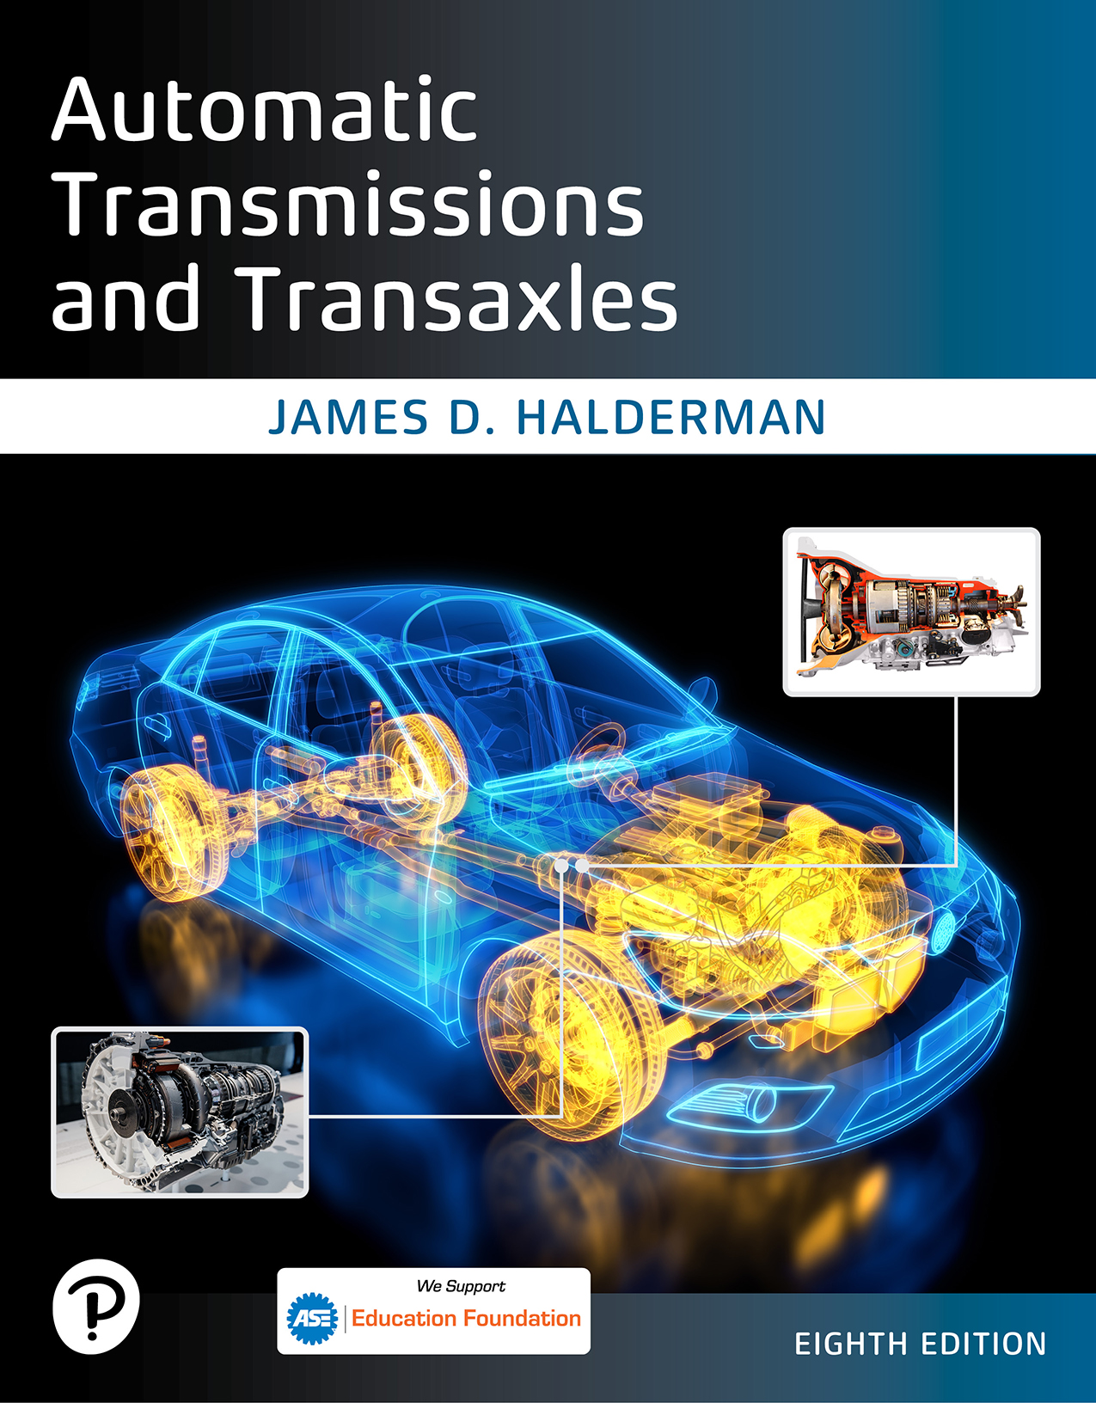
Automatic Transmissions and Transaxles
Eighth Edition
Chapter 16
In-Vehicle Transmission Transaxle Service
Copyright © 2024, 2018, 2015 Pearson Education, Inc. All Rights Reserved
Notes:
If this PowerPoint presentation contains mathematical equations, you may need to check that your computer has the following installed:
1) Math Type Plugin
2) Math Player (free versions available)
3) NVDA Reader (free versions available)
INSTRUCTOR NOTE: This presentation includes text explanation notes, you can use to teach the course. When in SLIDE SHOW mode, you RIGHT CLICK and select SHOW PRESENTER VIEW, to use the notes.

Slide 2
Learning Objectives (1 of 2)
16.1 Discuss fluid replacement.
16.2 Describe the procedure to follow when replacing seals.
16.3 Perform linkage adjustments in automatic transmissions.
16.4 Describe the correct procedure for replacing powertrain mounts and performing band adjustments.

Slide 3
In-Vehicle Service Items
Automatic transmissions/transaxles
Can operate properly for many miles.
Several surveys of transmission shops have shown
Over 80% of transmission failures were result of neglecting to change fluid
Notes:
Tech Tip: Test Drive Before and After Every Service
The wise technician test drives any vehicle being serviced, especially one where a routine automatic transmission service is being requested. Sometimes, a vehicle owner will ask that a service be performed hoping that it will fix an issue that has been noticed. To help avoid misunderstandings and to insure good customer relations, test drive the vehicle and let the customer know if any transmission-related issues are discovered before performing a routine transmission service. Then, of course, test drive vehicle after the service has been performed to verify that everything is normal and operating properly.

Slide 4
Fluid Changes (1 of 2)
Manufacturers recommend fluid changes
Every 100,000 miles (160,000 k m)
Under normal driving conditions
Some recommend a fluid change at
50,000 miles (80,000 k m)

Slide 5
Fluid Changes (2 of 2)
Severe driving conditions described as:
Frequent trailer pulling
Heavy city traffic, in areas where temperature exceeds
Very hilly or mountainous conditions
Commercial use such as taxi or delivery service
Police or ambulance usage

Slide 6
Chart 16.1
Fluid Life/Temperature
Fluid Life (miles/k m) | Temperature (F/C)
100, 000/160, 000 | 175 degrees Fahrenheit or 80 degrees Celsius.
50, 000/80, 000 | 195 degrees Fahrenheit or 90 degrees Celsius.
25, 000/40, 000 | 215 degrees Fahrenheit or 100 degrees Celsius.
12,550/20, 000 | 235 degrees Fahrenheit or 113 degrees Celsius.
6, 250/10, 000 | 255 degrees Fahrenheit or 124 degrees Celsius.
3,125/5, 000 | 275 degrees Fahrenheit or 1350 degrees Celsius.
1,560/2,500 | 295 degrees Fahrenheit or 146 degrees Celsius.
780/1, 250 | 315 degrees Fahrenheit or 157 degrees Celsius.
Notes:
The higher the A T F temperature, the shorter the life expectancy of the fluid.

Slide 7
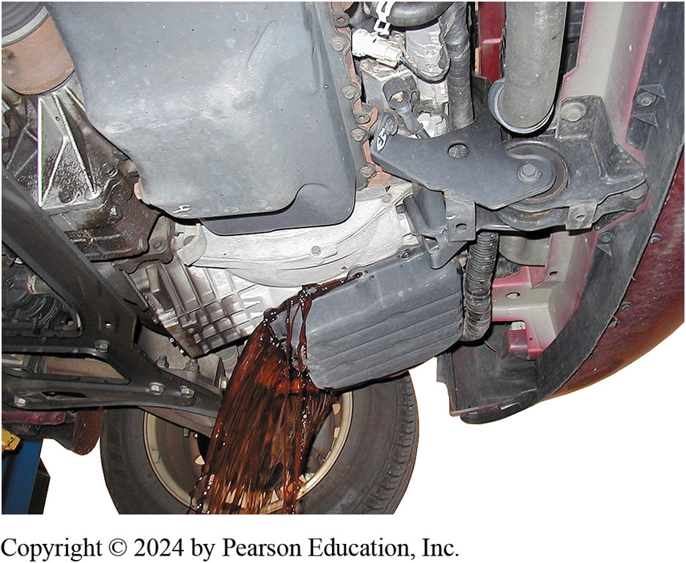
Figure 16.1
Draining Fluid
Draining the fluid from an automatic transaxle by allowing the fluid to flow into a container after most of the retaining bolts have been removed.

Slide 8
Fluid Changing, Dropping the Pan (1 of 4)
STEP 1 Safely hoist vehicle.
STEP 2 Select best direction for fluid to spill from the pan.
STEP 3 When pan lowers to an angle of about
to
support it by hand
Remove remaining two bolts and finish draining pan.

Slide 9
Fluid Changing, Dropping the Pan (2 of 4)
STEP 4 Remove filter, attached to valve body
Watch for any small parts that may come loose
Set aside old filter for comparison with new filter
STEP 5 Inspect pan, filter, and pan magnet
For debris and varnish buildup
STEP 6 Install new filter using new gasket or O-ring
Tighten the mounting bolts to the correct torque

Slide 10
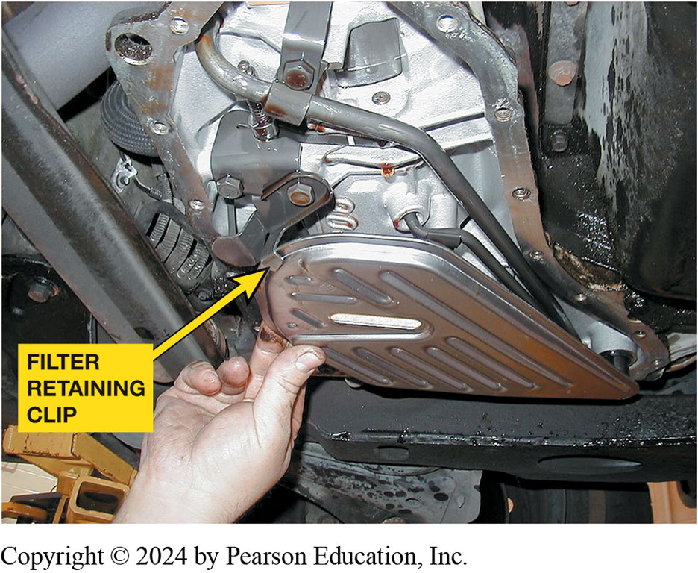
Figure 16.2
Removing Filter
Always check that the filter is secured by a clip or other fastener to keep it from dropping out of its position.

Slide 11
Fluid Changing, Dropping the Pan (3 of 4)
STEP 7 Clean oil pan and check
Straighten if needed any bends at pan bolt holes.
STEP 8 Install new gasket on pan
Install pan on transmission
STEP 9 Bolts should be tightened in a back-and-forth
Across-the-pan sequence to specified torque
Notes:
Case Study: The Case of the Bent Pan: A Nissan minivan van (147,000 mi) would go into neutral under varying conditions. During a test drive, it operated normally in all gears until accelerating from a stop but then it went to neutral and after a short period of time, back into gear. The fluid appeared and smelled normal. The transmission electrical connections were checked, and these were clean and tight. The pan was checked—it was bent upward, apparently blocking flow to the filter. The pan was removed, bent back to the proper shape, and was reinstalled. This repair fixed the problem.
Summary:
Complaint—Customer complained that the trans- axle would go into neutral when accelerating.
Cause—The pan was bent upward apparently blocking fluid flow to the filter.
Correction—The pan was straightened which corrected the customer concern.

Slide 12
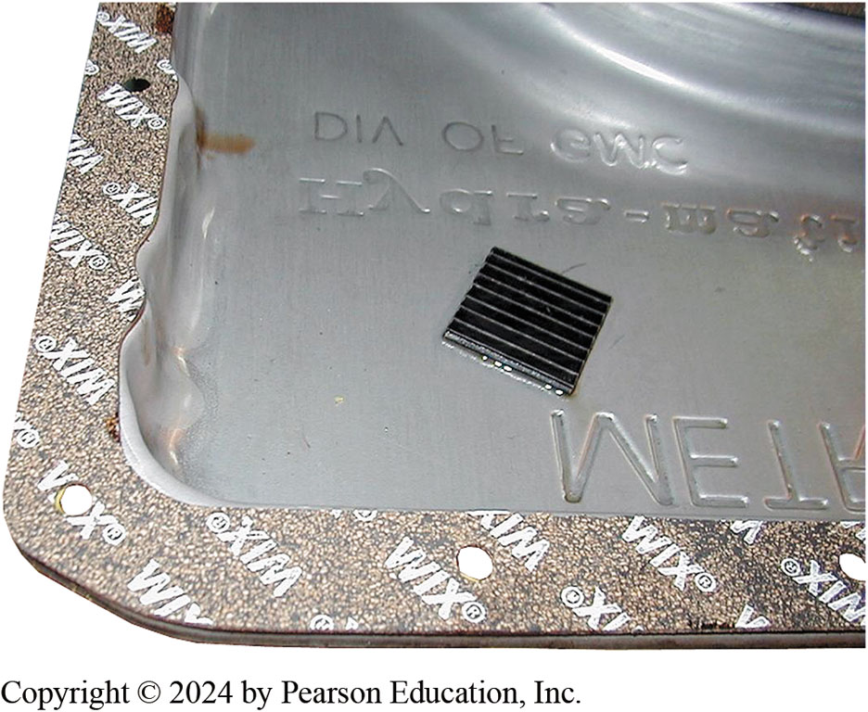
Figure 16.3
Pan Gasket and Magnet
In this case, the cork-rubber gasket is glued to the pan and is ready to be installed. The retaining bolts need to be tightened in sequence, but be aware that overtightening will cause a leak. Also, some manufacturers recommend using only an R T V sealer, but never use an R T V sealer and a gasket together.

Slide 13
Fluid Changing, Dropping the Pan (4 of 4)
STEP 10 Lower vehicle, and add proper amount of fluid.
STEP 11 Dispose of old transmission fluid according to
Federal, State, and local laws and regulations.
Notes:
NOTE: This procedure only changes the fluid in the pan, which is about one-quarter to one-third (1/4 to 1/3) of the total fluid capacity still in the transmission. The remaining fluid stays in torque converter, clutches and band servos, accumulators, cooler, and fluid passages.

Slide 14
Fluid Exchange and Flush Units
Fluid flushing typically uses chemical to
Dissolve varnish and other deposits
Fluid exchange usually means taking out old fluid
Replacing it with new fluid of the correct type.
Typical Procedure
Notes:
Case Study: T S B to the Rescue: A Dodge Durango came in to shop with a customer complaint of delayed engagement into reverse after sitting for a while. A check of a T S B (21-016-05) described filters with defective check valves. Replacement of filter cured problem.
Summary:
Complaint—Customer complained of a delayed engagement into reverse after the vehicle sat for a while.
Cause—The original filter had a defective check valve.
Correction—A replacement filter fixed the concern.

Slide 15
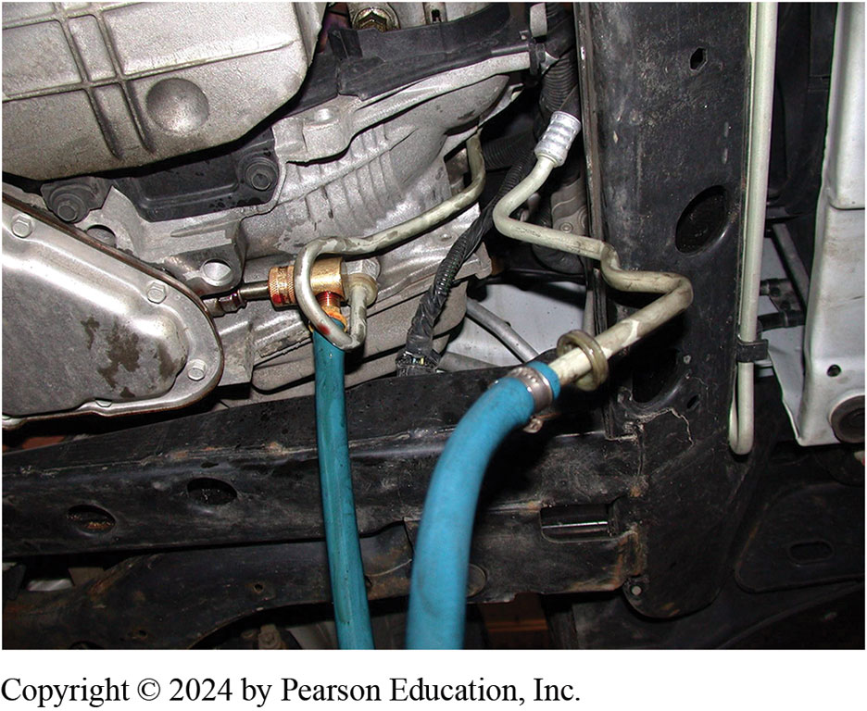
Figure 16.4
Fluid Exchange
The lines from the fluid exchange machine can often be connected to the cooling lines from underneath the vehicle as on this front-wheel-drive General Motors vehicle.

Slide 16
Seal Replacement
Standard metal-backed lip seal must seal
Against two different surfaces
Dynamic seal with moveable shaft at inner bore
Static seal where it fits into its bore
General Replacement Procedure
Extension Housing Seal

Slide 17
Animation: Transmission Fluid Exchange (Animation will automatically start)

Slide 18
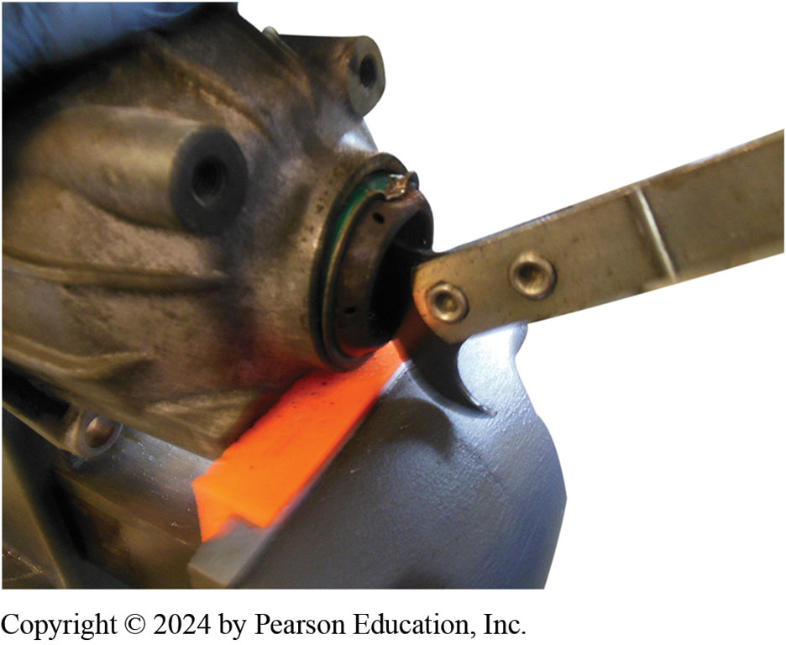
Figure 16.5
This seal is being removed using a seal puller.

Slide 19
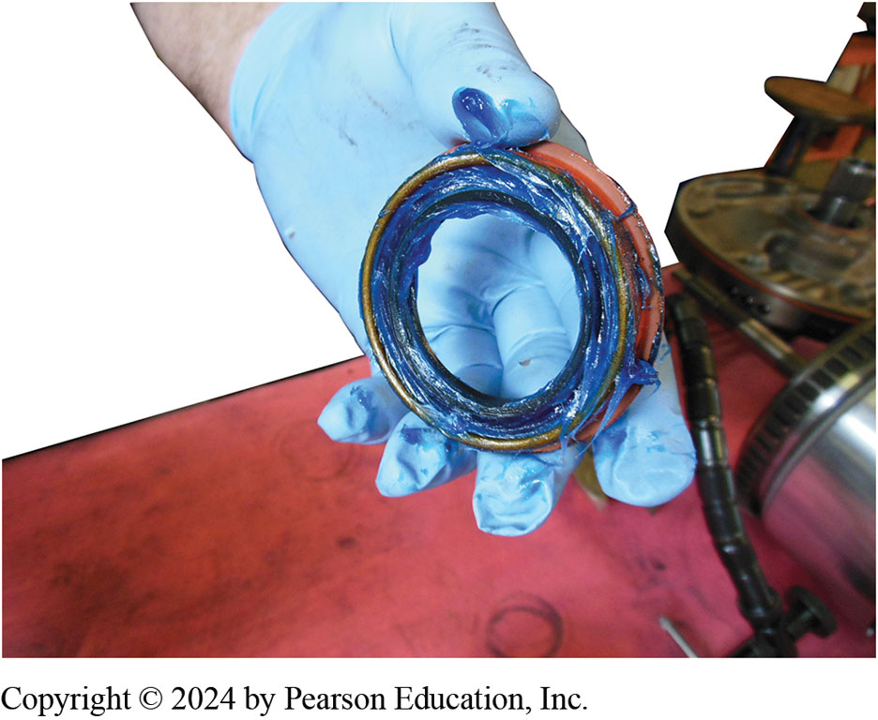
Figure 16.6
Seal Lip with Lube
The lip of the seal around the garter spring is packed with assembly lube to help keep the spring from falling out when it is driven into the transmission housing.

Slide 20
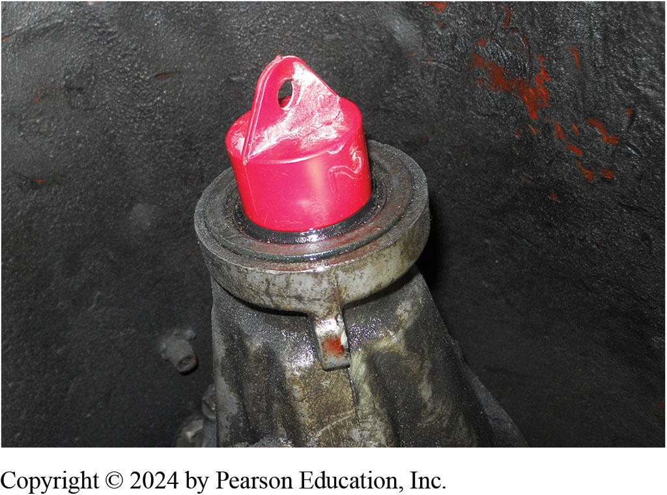
Figure 16.7
Plug to Prevent Fluid Loss
Using a plug helps prevent fluid loss when the driveshaft is removed.

Slide 21
Manual Linkage Checks (1 of 2)
Manual linkage adjustable on most automatic
Ensures manual valve is positioned correctly
Relative to gear selector
Linkage position should be checked periodically.
Misadjusted linkage can cause manual valve to
Leak oil pressure into wrong passage

Slide 22
Manual Linkage Checks (2 of 2)
Manual Linkage Adjustment
Manual linkage should be adjusted if starter engagements occur in wrong position
Transmission detents do not align correctly relative to gear range pointer
Shift Interlock Mechanism
Locks shifter in park position when ignition key is removed

Slide 23
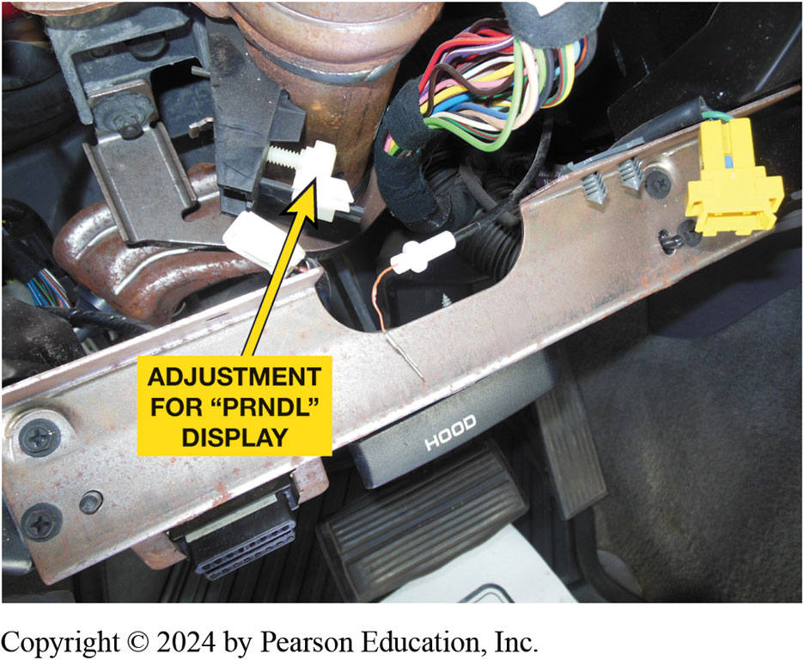
Figure 16.8
P R N D L Display Pointer
The position for the pointer ("P R N D L" display) on this Dodge truck is adjustable.

Slide 24
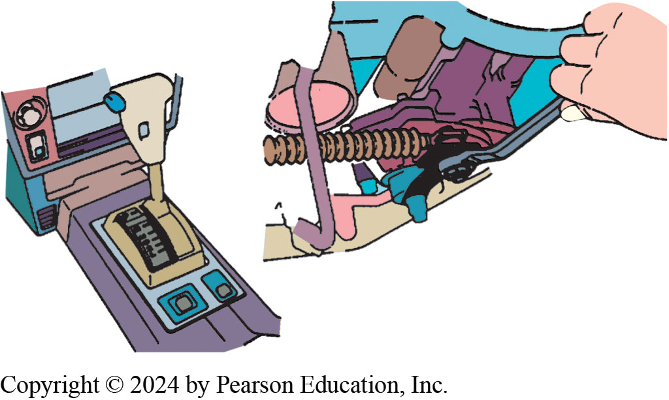
Figure 16.9
Linkage Adjustment
The manual shift lever is in park. The linkage is being tightened to lock the adjustment in after making sure that the transmission is in park.

Slide 25
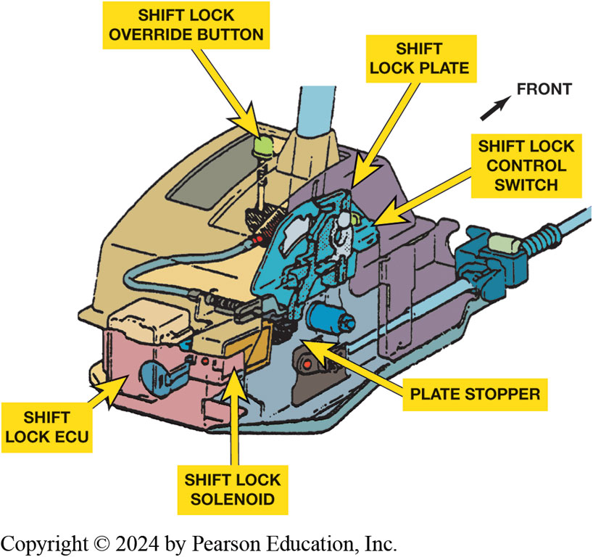
Figure 16.10
Shift Lock Mechanism
This shift lock mechanism includes a solenoid that can mechanically hold the shift lock plate. Note the shift lock override button that can be used to release the shift lock.
Notes:
Long Description:
The internal parts, in anti-clockwise direction, are as follows: shift lock E C U, shift lock solenoid, plate stopper, shift lock control switch, shift lock plate, and shift lock override button. The front side is indicated posterior to the shift lock plate.

Slide 26
Powertrain Mounts
Lift engine and/or transmission slightly to remove weight
Then remove mounting bolts
Old mount is then removed and new mount is installed

Slide 27
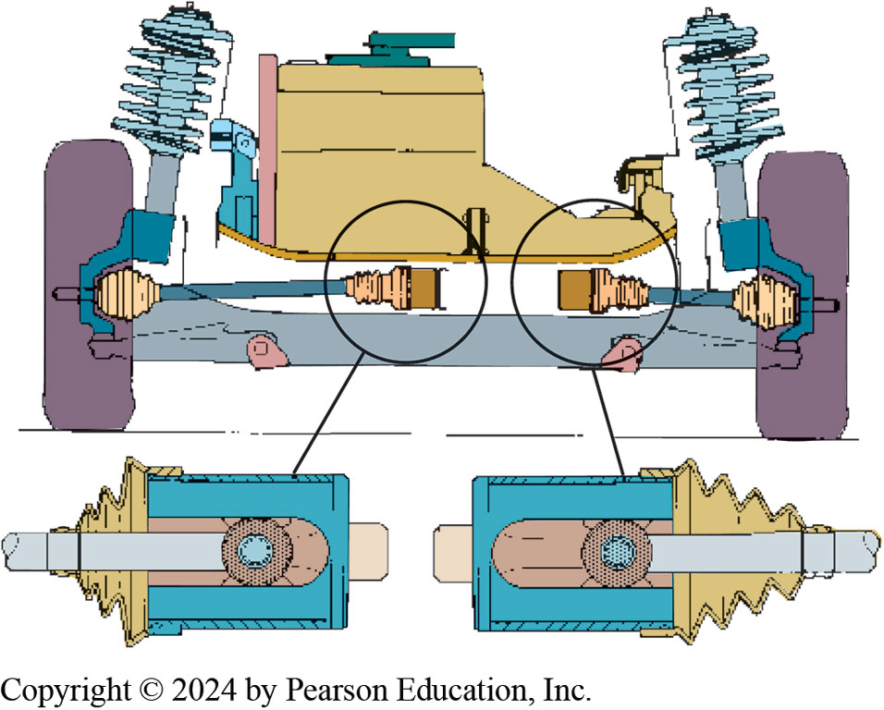
Figure 16.11
Cradle Alignment
Enlarged views of the inner C V joints show that the engine and transaxle are misaligned; they should be moved toward the right.

Slide 28
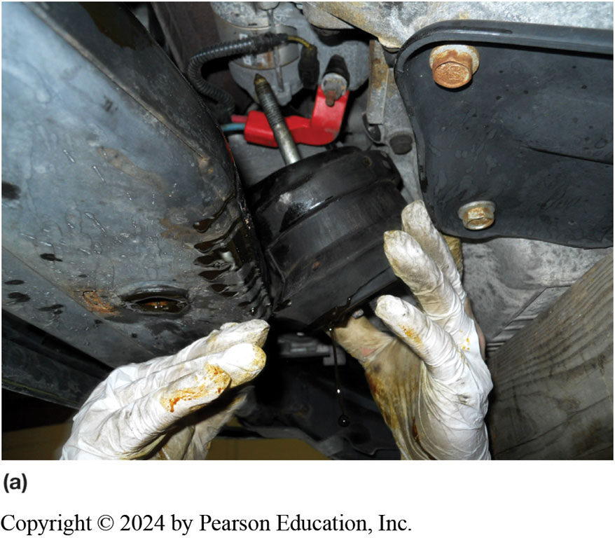
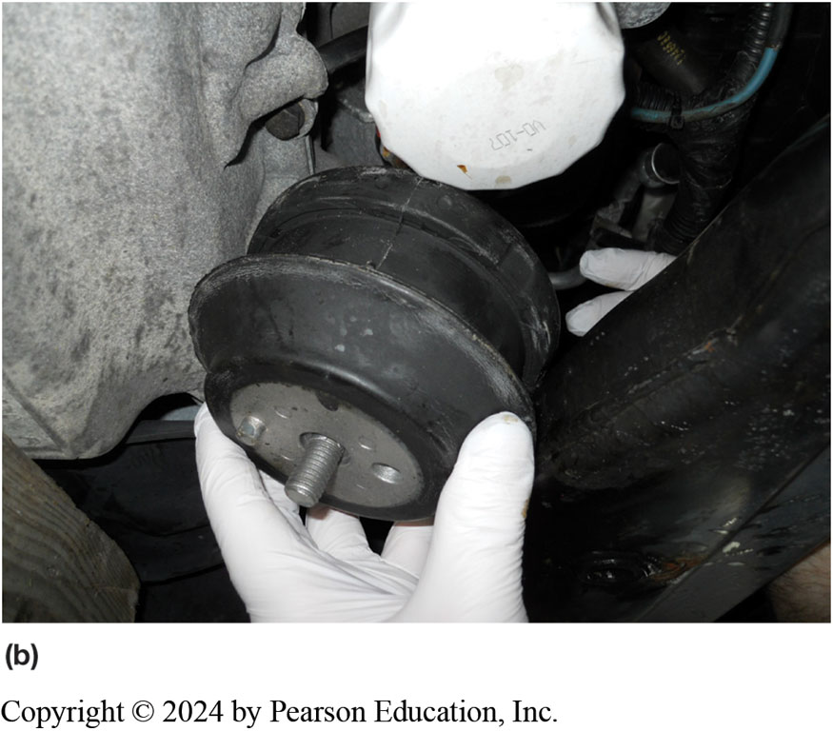
Figure 16.12
Leaking Mount
Notes:
Figure 16.12 a) The old front engine mount contained hydraulic fluid. The oil was leaking from the split in the mount. (b) The new original equipment (O E) mount ready to be installed.

Slide 29
Band Adjustments
At one time
Common transmission maintenance procedure
Readjust band clearance
Wear of the friction material would increase
Clearance to the point
Engagement would not be complete
Slippage would occur

Slide 30
Animation: AT Band & Servo Operation (Animation will automatically start)

Slide 31
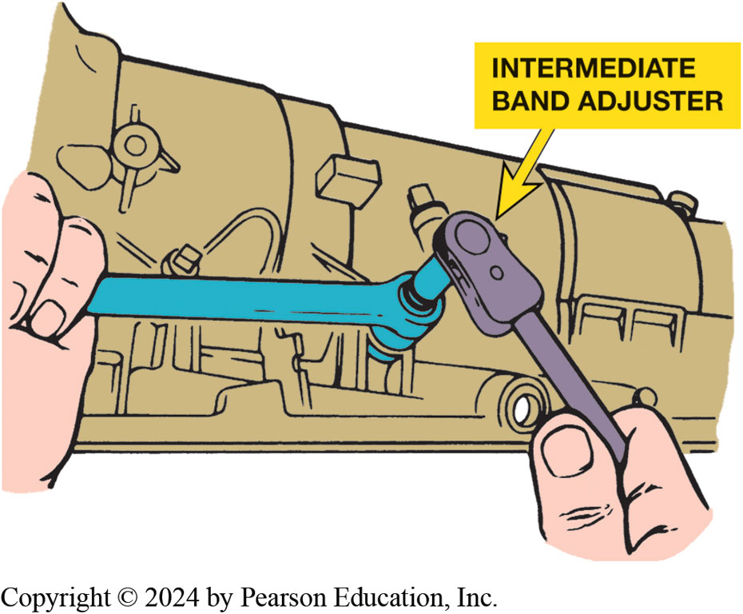
Figure 16.13
Adjusting the intermediate band on a Ford A4L D transmission.

Slide 32
Transmission Pan Replacement Photo Sequence

Slide 33
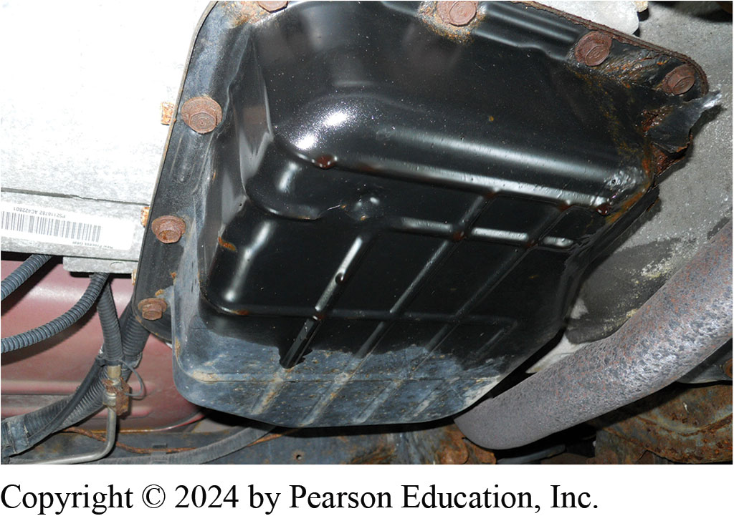
1. The owner of this Dodge pickup complained that automatic transmission fluid was leaking from pan gasket.

Slide 34
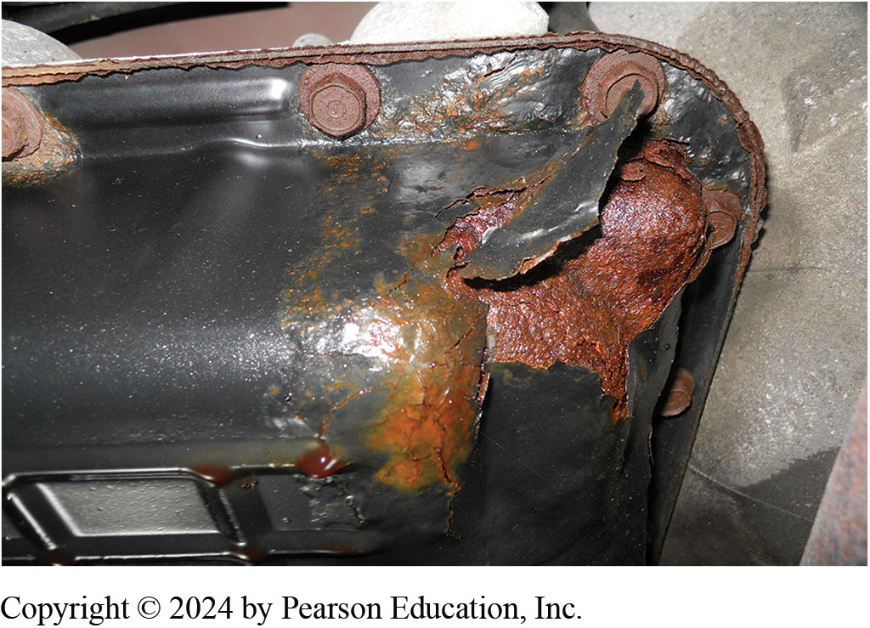
2. The transmission fluid leak is found to be from small holes that had rusted through the steel pan.

Slide 35
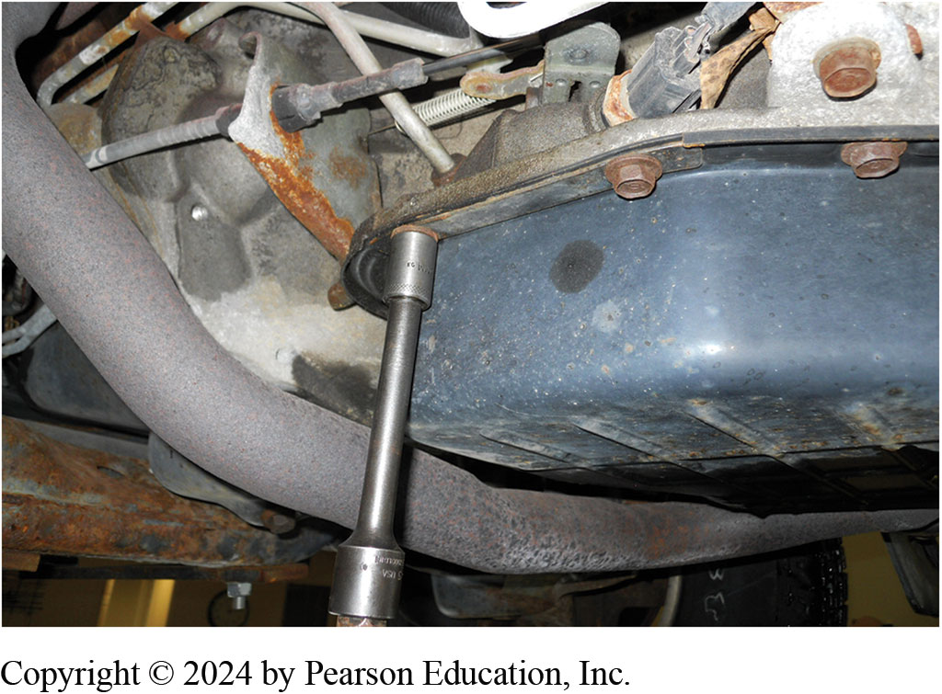
3. The retaining bolts being removed from the pan.

Slide 36
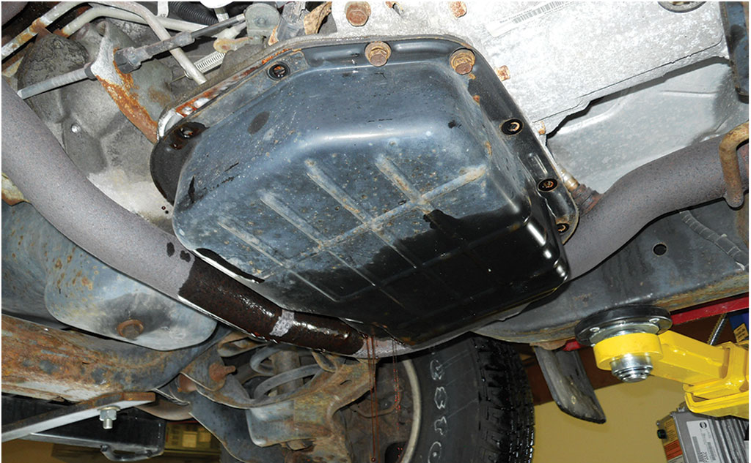
4. Retaining bolts on one side are kept attached and then loosened to allow fluid to drain from one side of the pan.

Slide 37
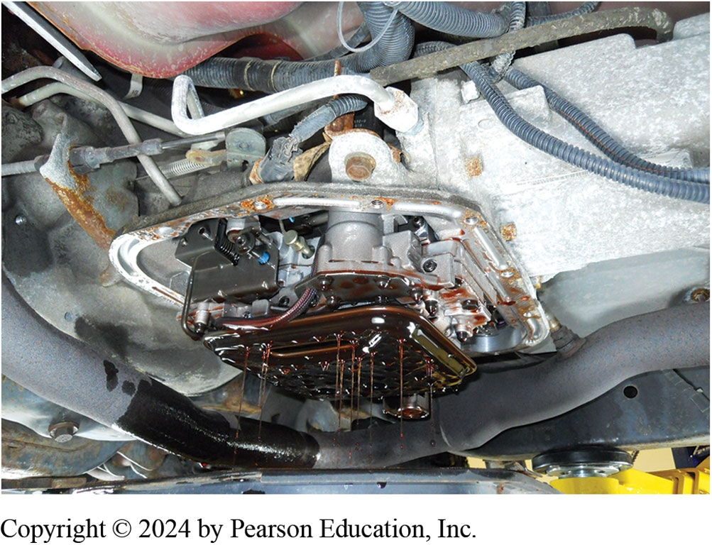
5. The pan is then gently lowered and the A T F is caught dripping from the valve body.

Slide 38
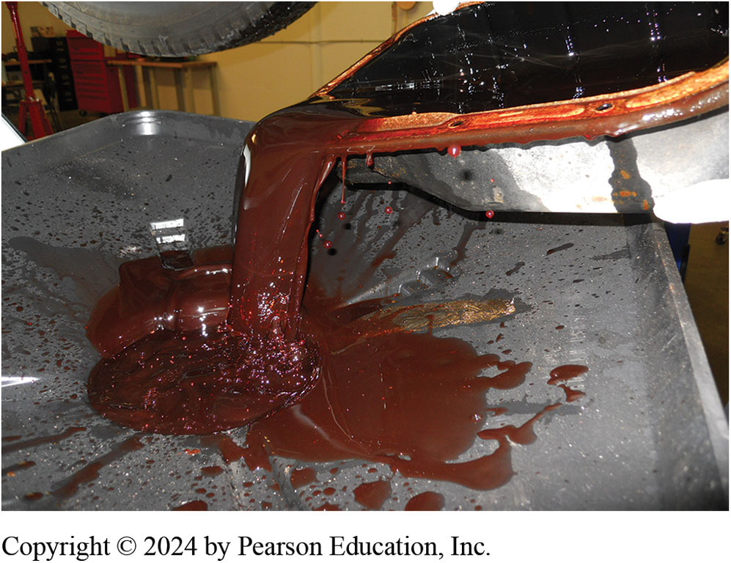
6. The pan is then emptied into an oil drain unit.

Slide 39
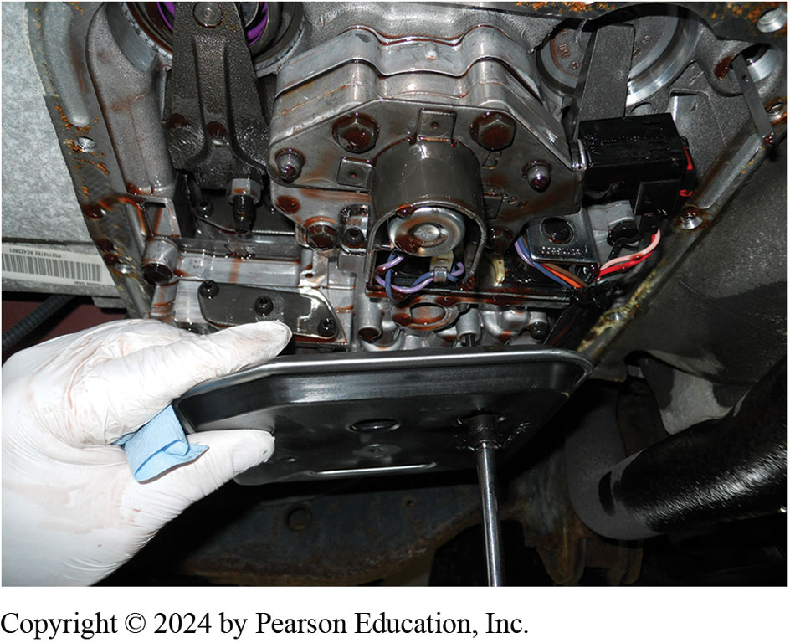
7. The old filter is removed.

Slide 40
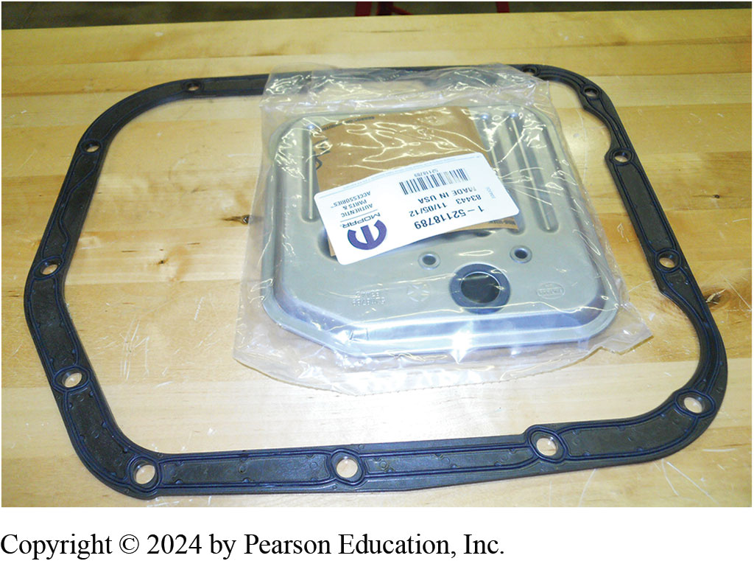
8. The shop purchased a new original equipment filter and a new, improved transmission pan gasket.

Slide 41
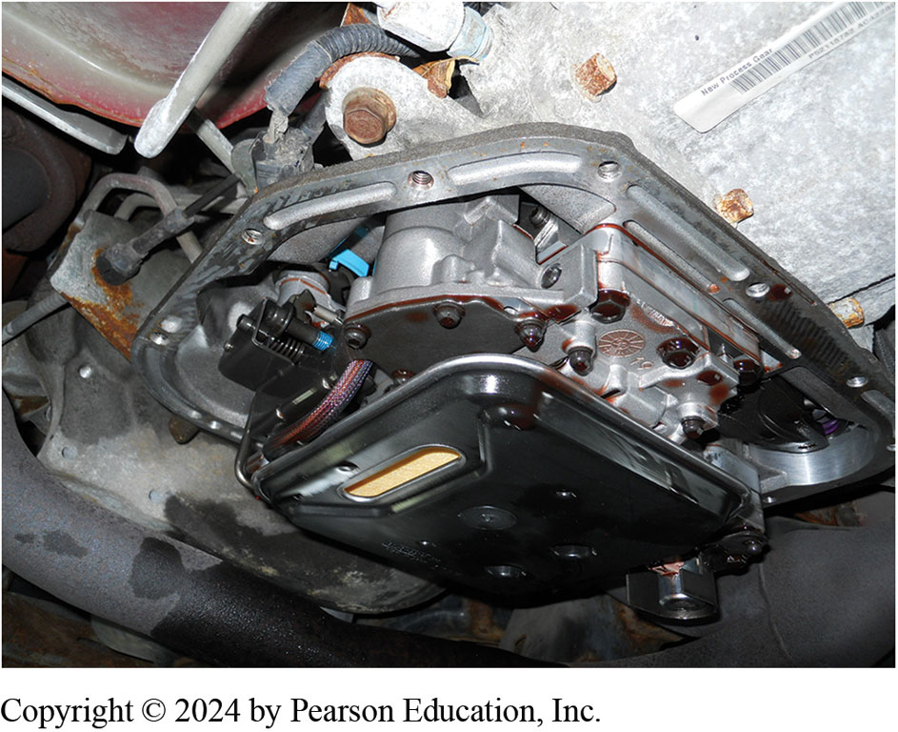
9. The new filter is installed.

Slide 42
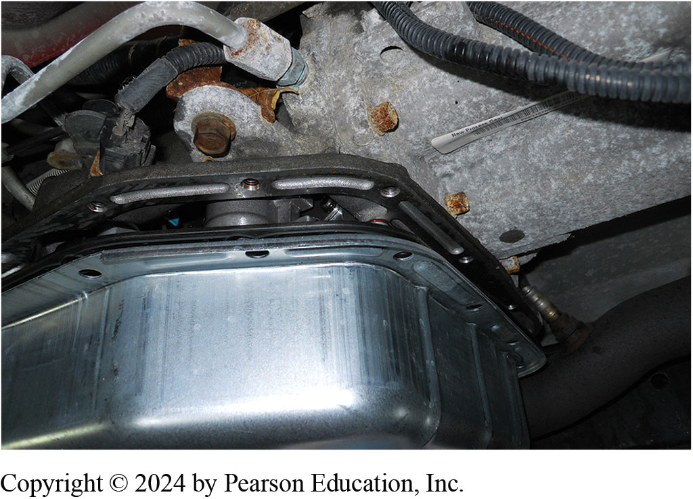
10. Replacement pan installed and fasteners tightened to factory specifications. New pan galvanized steel compared to painted steel.

Slide 43
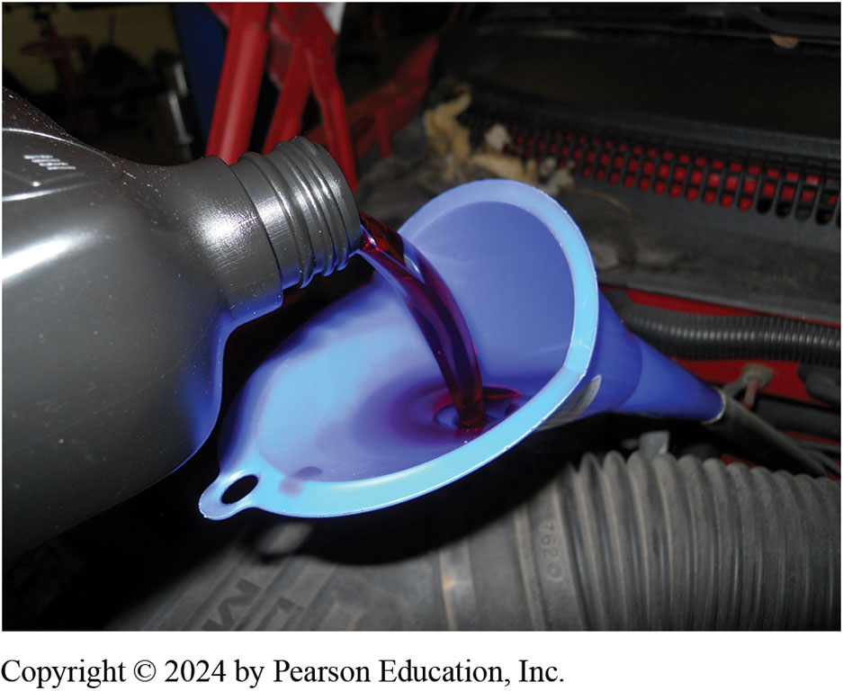
11. The specified A T F is installed.

Slide 44
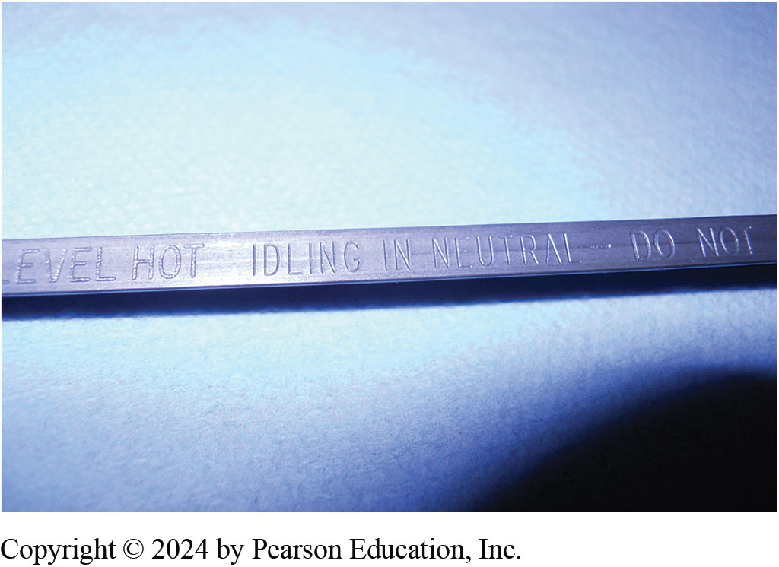
12. The level is checked with the engine running and gear selector in neutral as per the instructions on the dipstick.

Slide 45
Question 1
Severe service includes Fill in the blanks .
A. extensive highway driving
B. commercial use, such as police or taxi use
C. a combination of city and highway driving
D. driving in temperatures below freezing

Slide 46
Answer 1
Severe service includes Fill in the blanks .
B. commercial use, such as police or taxi use

Slide 47
Summary (1 of 2)
Manufacturers recommend fluid changes every 100,000 miles (160,000 k m)
Under normal driving conditions
The manual linkage should be adjusted if
Starter engagement occurs in the wrong position or
Transmission detents do not align correctly relative to the gear range pointer.

Slide 48
Summary (2 of 2)
A chisel, slide hammer, or seal puller can be used
To remove a seal after shaft has been removed.
Replace defective powertrain mounts
by lifting engine and/or transmission slightly to remove te weight
Then removing mounting bolts
Old mount is then removed and new mount is installed.

Slide 49
Automatic Transmissions and Transaxles Videos and Animations
Videos Link: (A2) Automatic Transmissions and Transaxles Videos
Animations Link: (A2) Automatic Transmissions and Transaxles Animations

Slide 50
Copyright
This work is protected by United States copyright laws and is provided solely for the use of instructors in teaching their courses and assessing student learning. Dissemination or sale of any part of this work (including on the World Wide Web) will destroy the integrity of the work and is not permitted. The work and materials from it should never be made available to students except by instructors using the accompanying text in their classes. All recipients of this work are expected to abide by these restrictions and to honor the intended pedagogical purposes and the needs of other instructors who rely on these materials.

