Slide 1
Automatic Transmissions and Transaxles
Eighth Edition
Chapter 15
Transmission Condition Diagnosis
Copyright © 2024, 2018, 2015 Pearson Education, Inc. All Rights Reserved
Notes:
If this PowerPoint presentation contains mathematical equations, you may need to check that your computer has the following installed:
1) Math Type Plugin
2) Math Player (free versions available)
3) NVDA Reader (free versions available)
INSTRUCTOR NOTE: This presentation includes text explanation notes, you can use to teach the course. When in SLIDE SHOW mode, you RIGHT CLICK and select SHOW PRESENTER VIEW, to use the notes.

Slide 2
Learning Objectives (1 of 2)
15.1 Outline the procedures involved in the first step of the automatic transmission diagnostic process—verifying customer concern.
15.2 Outline the procedures involved in the second step of the automatic transmission diagnostic process—fluid level and condition.
15.3 Outline the procedures involved in the third and fourth steps of the automatic transmission diagnostic process—retrieving diagnostic trouble codes and checking for technical service bulletins.

Slide 3
Learning Objectives (2 of 2)
15.4 Outline the procedures involved in the fifth step of the automatic transmission diagnostic process—scan tool testing.
15.5 Outline the procedures involved in the sixth step of the automatic transmission diagnostic process—visual inspections.
15.6 Outline the procedures involved in the seventh step of the automatic transmission diagnostic process—finding the root cause

Slide 4
The Diagnostic Process (1 of 2)
STEP 1 Verify the customer complaint.
STEP 2 Check fluid level and condition.
STEP 3 Check for diagnostic trouble codes (D T Cs).
STEP 4 Check for technical service bulletins (T S Bs).
STEP 5 Check scan tool data including checking the adaptive values.

Slide 5
The Diagnostic Process (2 of 2)
STEP 6 Visual inspections,
STEP 7 Locate root cause of problem.
STEP 8 Replace all components that do not meet factory specifications.
STEP 9 Perform an adaptive relearn
Drive vehicle to verify that repairs corrected customer concern.

Slide 6
Animation: 8-Step Diagnostic Procedure (Animation will automatically start)

Slide 7
Step 1 Verify the Customer Concern (1 of 5)
Road Test
Items to Check
Quality of the garage shifts (neutral–drive and neutral– reverse)
Engagement time for the garage shifts
Quality of each upshift and downshift at various loads

Slide 8
Step 1 Verify the Customer Concern (2 of 5)
Timing of each upshift and downshift at various loads
Any hunting between gear ranges
Operation of the torque converter and torque converter clutch (T C C)
Slipping in any gear range
Binding or tie-up in any gear range
Noise or vibration in any gear range

Slide 9
Step 1 Verify the Customer Concern (3 of 5)
Engine (compression) braking during deceleration in drive and manual gear ranges
Speedometer operation (shows output from vehicle speed (V S) sensor)
Proper engine operation

Slide 10
Step 1 Verify the Customer Concern (4 of 5)
Throttle Position Versus Shift Points
Minimum—least throttle opening that produces acceleration
Light—when throttle is about one-fourth open
Medium—when throttle is about one-half open
Heavy—when throttle is about three-fourths open

Slide 11
Step 1 Verify the Customer Concern (5 of 5)
Wide-open throttle (W O T)—fully opened throttle without downshift
Closed—a complete release of the throttle, which results in coasting
Engine braking—a closed-throttle manual downshift to Produce a condition where engine compression slows vehicle

Slide 12
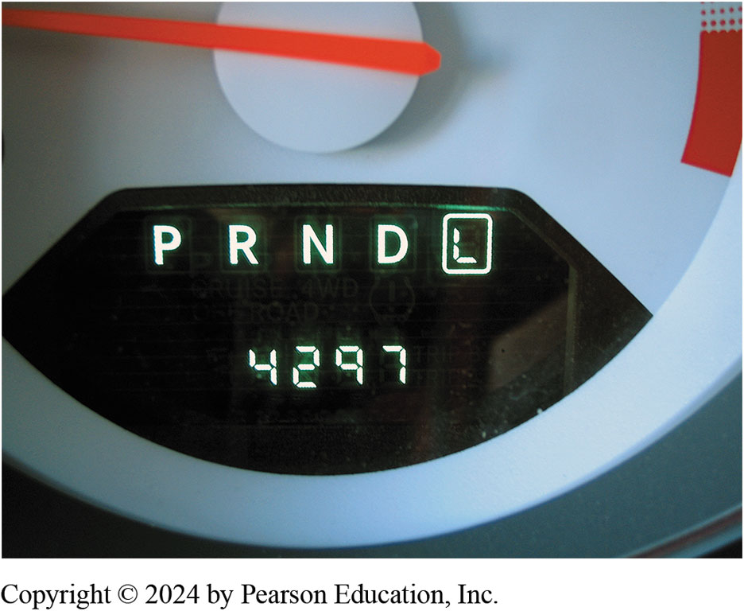
Figure 15.1
Selecting Shift Modes
Selecting all of the shift modes of an automatic transmission/transaxle helps pinpoint the area where the fault is located.

Slide 13
Step 2-Fluid Level and Condition (1 of 2)
Overfilled or Underfilled
An underfill is below the low, cold level on dipstick sometimes marked "Do not drive”
Overfilling can cause slippage and mushy operation because of air in foamy fluid
An overfill condition can bring the fluid level up to the point where it contacts the spinning gear sets
Notes:
The driver of a vehicle should periodically check the fluid level in an automatic transmission. A good time to check this is at every engine oil change. If the level is low, fluid of the correct type should be added. It usually takes 1 pint (0.5 L) to move the fluid level from low to the full mark on the dipstick. Most transmission dipsticks are marked for both cold and hot fluid temperatures. ● See Figure 15.2.
The most obvious markings are for the hot level, which is the normal operating temperature, about 150°F to 170°F (66°C to 77°C). Room temperature of about 65°F to 85°F (18°C to 29°C) is considered cold for transmission fluid. If the fluid at the end of the dipstick
is too hot to hold, then the fluid is hot. When the fluid is cold, use the cold markings on the dipstick. Some transaxles use a thermostatic valve to raise the fluid level in the upper valve body pan as the transaxle warms up. These units have a lower hot level and a higher
cold level. The exact procedure for checking the fluid level can be found in the vehicle owner’s manual, or occasionally it is printed on the dipstick

Slide 14
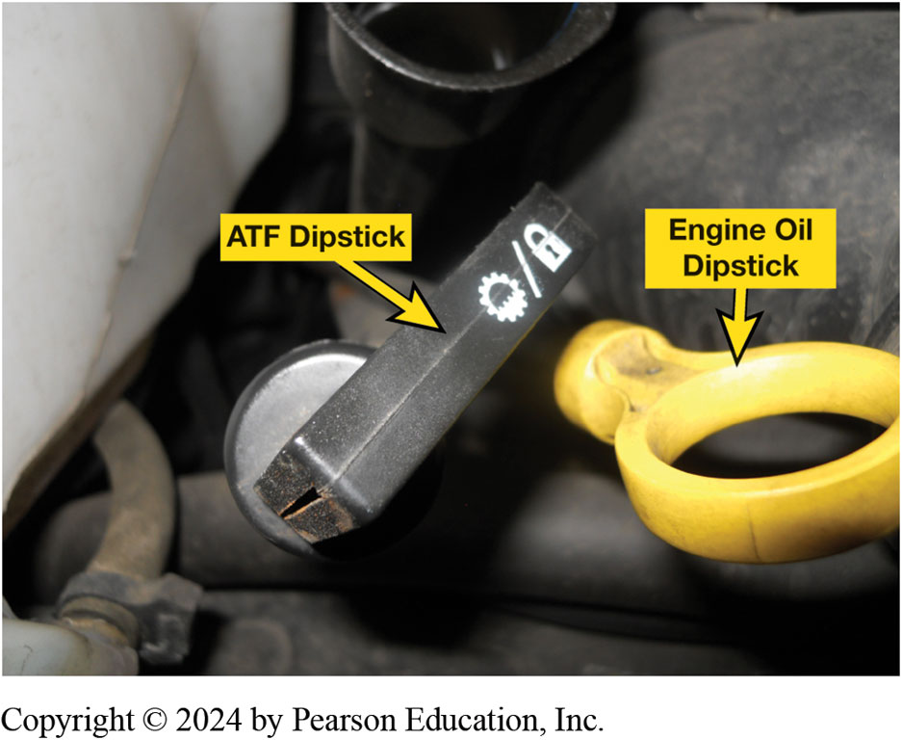
Figure 15.2
Dipstick
A automatic transmission dipstick (fluid level indicator). Many use a clip to keep it from being forced upward due to pressure changes inside the automatic transmission. A firm seal also helps keep water from getting into the fluid, which can cause severe damage to the clutches and bands.
Notes:
Case Study: The Slipping Dodge Truck
A Dodge Durango (89,000 m i) transmission slips when taking off and during the 1–2 shift when cold.
The fluid level was okay when it was checked with the transmission in park. However, the
fluid level has to be checked in neutral, not park, and was found to be 1.5 quarts low. Adding the
correct amount of fluid fixed this problem.
Summary:
Complaint—Owner complained that transmission slipped when cold.
Cause—The transmission fluid was low because it had been checked in park instead in neutral.
Correction—The transmission fluid was restored to the proper level which corrected the customer complaint.
Long Description:
One is labeled an A T F dipstick while the other is labeled an engine oil dipstick. The A T F dipstick has a lock symbol and one flower symbol which is half-filled. It is shaped like a rectangular box. The engine dipstick is a type of ring attached to the plugin.

Slide 15
Step 2-Fluid Level and Condition (2 of 2)
Checking Fluid Level with Dipstick
Checking Fluid Level without Dipstick
Fluid condition should always be checked
When checking fluid level
A transmission technician will normally smell fluid
Check color for unusual characteristics

Slide 16
Figure 15.3
Dipstick Level
The “add” mark on most automatic transmission dipsticks indicates the level is down 0.5 quart (0.5 L). Always follow the instructions stamped or printed on the dipstick.
Notes:
Long Description:
It has a tapering end at one end and is shaped like a pencil. The middle part of the dipstick has a crisscross design. On the left of the crisscross design, a point is labeled as add and to the right of the crisscross design, a point is labeled as full hot.

Slide 17
Animation: Check Fluid Level, No Dipstick (Animation will automatically start)

Slide 18
Chart 15.1
Fault Descriptions
Term | Meaning
Binding | A very noticeable drag that causes the engine to slow down and labor.
Bump | A sudden, harsh application of a clutch or band.
Chuggle | A bucking or jerking condition, similar to the sensation of clutch chatter or acceleration in too high of a gear with a standard transmission (could be engine related).
Delayed or late shift | The shift occurs some time after normally expected.
Double bump | Two sudden, harsh applications of a clutch or band, also called “double feel.”
Dropout | An unexpected shift to neutral or a lower gear, also called “fallout.”
Early | The operation occurs before normally expected. An early shift results in a laboring engine, poor acceleration, and sometimes a chuggle.
End bump | A shift feel that becomes noticeably firmer as it is completed, also called “end feel” or “slip bump.”
Firm shift | A quick, easily felt shift that is not harsh or rough.
Flare | A rapid increase in engine speed, usually caused by slippage.
Harsh or rough shift | An unpleasantly firm band or clutch application.
Hunting | A repeated up-and-then-down shifting sequence that produces noticeable repeated engine RPM changes.
Shudder | A more severe form of chuggle.
Slipping | A noticeable loss of power transfer that results in an increase in engine RPM.
Soft shift | A very slow shift that is barely noticeable.
Stacked shifts | An upshift that occurs immediately after a prior upshift.
Notes:
There are many shift quality and timing problems that can occur. The common terms used to describe abnormal shifts are described in ● Chart 15.1. Typical automatic transmission/transaxle fault descriptions and their meaning

Slide 19
Chart 15.2
Shift Points
Minimum throttle | Speed M P H (k m/h) | Part throttle | Speed M P H (km/h) | W O T | Speed M P H (km/h)
1–2 | 5–10 (8–16) | 1–2 | 15–30 (24–48) | 1–2 | 35–45 (56–72)
2–3 | 15–25 (24–40) | 2–3 | 25–45 (40–72) | 2–3 | 55–65 (89–105)
3–4 | 30–45 (48–72) | 3–4 | 40–55 (64–90) | 3–4 | Above 60/100
4–3 | 30–40 (48–64) | 4–3 | 35–45 (56–72) | 4–3 | Above 60/100
3–2 | 10–15 (16–24) | 3–2 | 30–40 (48–64) | 3–2 | 55–65 (89–105)
3–1 | 5–10 (8–16) | 2–1 | 10–20 (16–32) | 2–1 | 25–40 (40–64)
Typical shift points for a four-speed automatic transmission/transaxle. Always observe all speed limits and traffic regulations during a road test.
Notes:
Manufacturers publish shift points. These are the vehicle speeds at which upshifts and downshifts should occur relative to the different throttle openings. To check the shift points, accelerate the vehicle using different throttle openings, and watch the tachometer or listen for the engine speed change that indicates a shift. Have an assistant record the speed for comparison with the specifications. If no specifications are available, the approximate shift points are shown in ● Chart 15.2.

Slide 20
Step 3—Retrieve Diagnostic Trouble Codes
When problem has been detected
P C M will generate a diagnostic trouble code (D T C)
May also place transmission in limp-home mode depending on what sort of problem has been detected

Slide 21
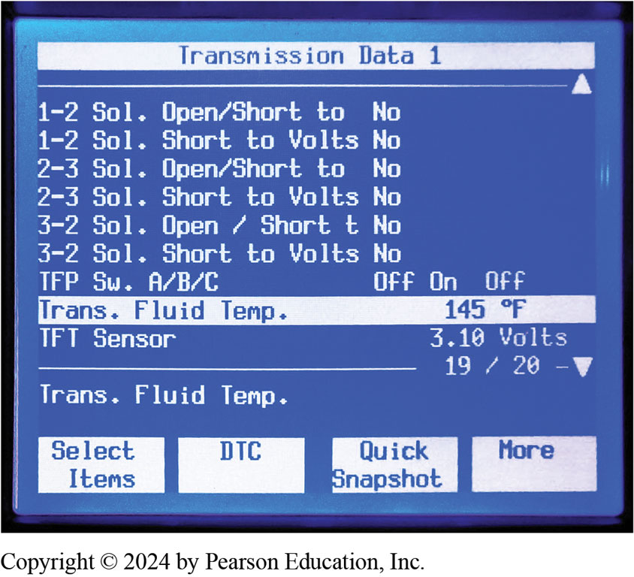
Figure 15.4
Transmission Data
Temperature of automatic transmission fluid is displayed on a factory or factory-level scan tool. It may require that vehicle be driven under a load for the fluid to reach the specified temperature and can often not be achieved by simply allowing engine to idle
Notes:
Long Description:
The first heading is transmission data 1. There is an upward arrow at one corner below this heading. The entries below this are as follows. 1 hyphen 2 sol. Open slash short to no; 1 hyphen 2 sol. Short to volts no; 2 hyphen 3 sol. Open slash short to no; 2 hyphen 3 sol. Short to volts no; 3 hyphen 2 sol. open slash short to no; and 3 hyphen 2 sol. Short to volts no. The next line is T F P sw. A slash B slash C, off, on, and off. The next heading is trans. Fluid temp. 145 degrees Fahrenheit. The entry under this heading is T F T sensor 3.10 volts. A line is shown with 19 slash 20 minus the downward arrow. The next line is trans. Fluid temp. The four options given in squares are select items, D T C, quick snapshot, and more.

Slide 22
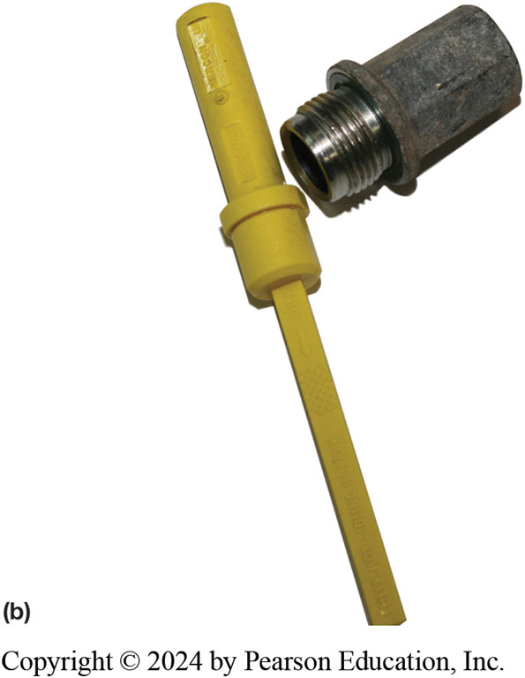
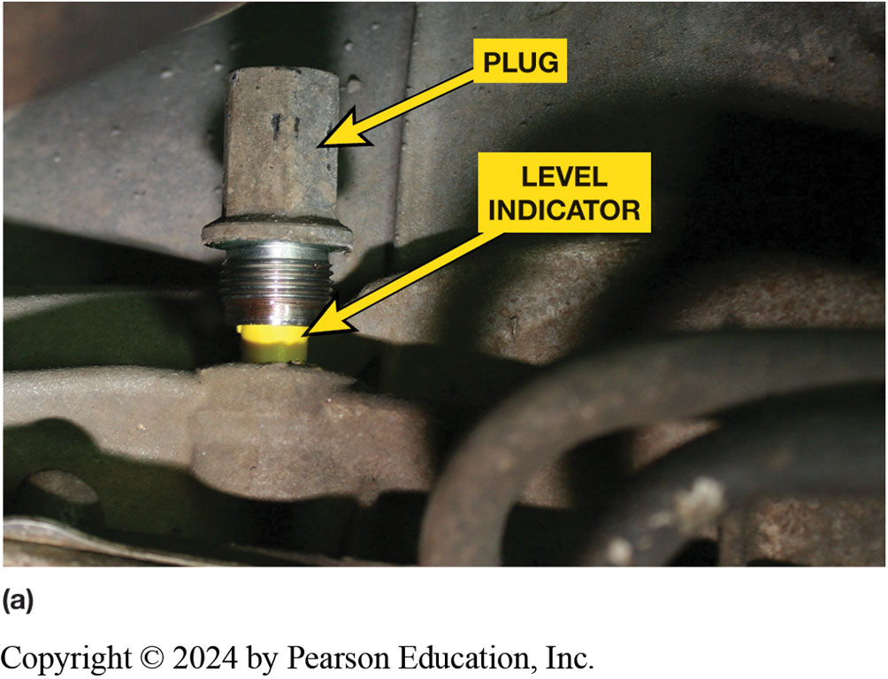
Figure 15.5
No Dipstick
Notes:
(a) The fluid level indicator is reached from under the vehicle on this Ford 6R80 rear-wheel-drive transmission.
(b) The level indicator can be removed after removing the plug, and then the fluid level can be read on the stick.

Slide 23
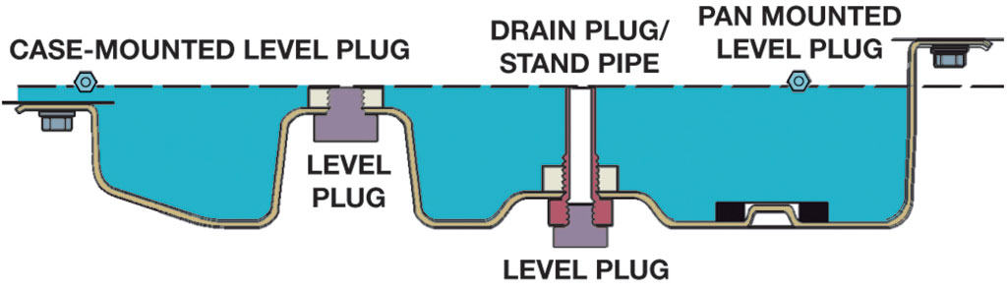
Figure 15.6
Fluid Level Sealed Units
Fluid level on sealed units (without a dipstick) is checked by removing the level plug, which can be mounted in the bottom or side of the pan or in the case. It is normal for some fluid to drip from this type of level indicator because normal operation of the transmission causes fluid to fill stand pipe.
Notes:
Long Description:
Two sealed units are shown. A dotted line marks the surface of the tanks filled with liquid. At the left end, a case hyphen mounted level plug is present. At the right end, a pan mounted level plug is present. A level plug is present between both tanks. A level plug is present at the bottom of the second tank. It is attached to a vertical drain plug or standpipe.

Slide 24
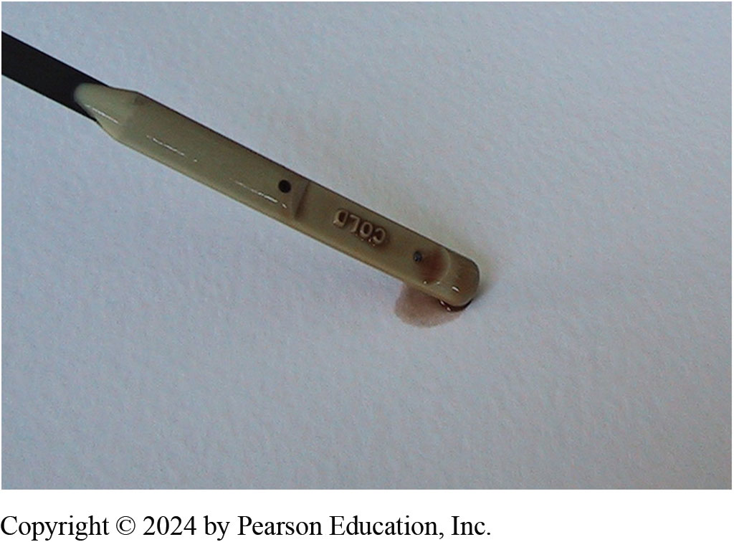
Figure 15.7
Fluid condition can be checked by placing a sample on clean, white, absorbent paper. Clean fluid will spread out and leave only a wet stain. Dirty fluid will leave deposits of foreign material.
Notes:
Case Study: The Automatic V W
A shop drained the dirty transmission fluid and replaced the filter in the V W Passat and then noticed that there was no dipstick to check the fluid level. The problem was how to properly adjust the fluid level. On this vehicle, the recommended fluid level is to install 2 quarts of the proper fluid, start the engine, and monitor the transmission fluid temperature. At 96°F (35°C), fluid should flow from fluid level port. If no fluid flows, the level is low and more should be added. The exact procedure published by the manufacturer for each transmission should be followed.
Summary:
Complaint—The shop discovered that the transaxle did not have a dipstick.
Cause—Service information was used to find the recommended procedure.
Correction—The specified refill procedure was followed.

Slide 25
What Is Wrong When the A T F Looks Like a Strawberry Milkshake?
? Frequently Asked Question
What Is Wrong When the A T F Looks Like a Strawberry Milkshake? If water or coolant gets into the automatic transmission fluid, it makes the A T F look like strawberry milkshake. Common reasons for this condition include the following: A leak in the A F T cooler inside the radiator. Water getting into the transmission/transaxle through the vent at the top of unit. This could be caused by driving through high water or due to a flood where the vehicle is under water or partially under water. The transmission/transaxle will require a complete overhaul because the clutch and band friction material are held to the steel backing using water-soluble glue. The water that is mixed with the A T F will loosen this glue and cause the friction material to be become detached from the steel backing making the transmission unable to transmit engine torque. Figure 15.8

Slide 26
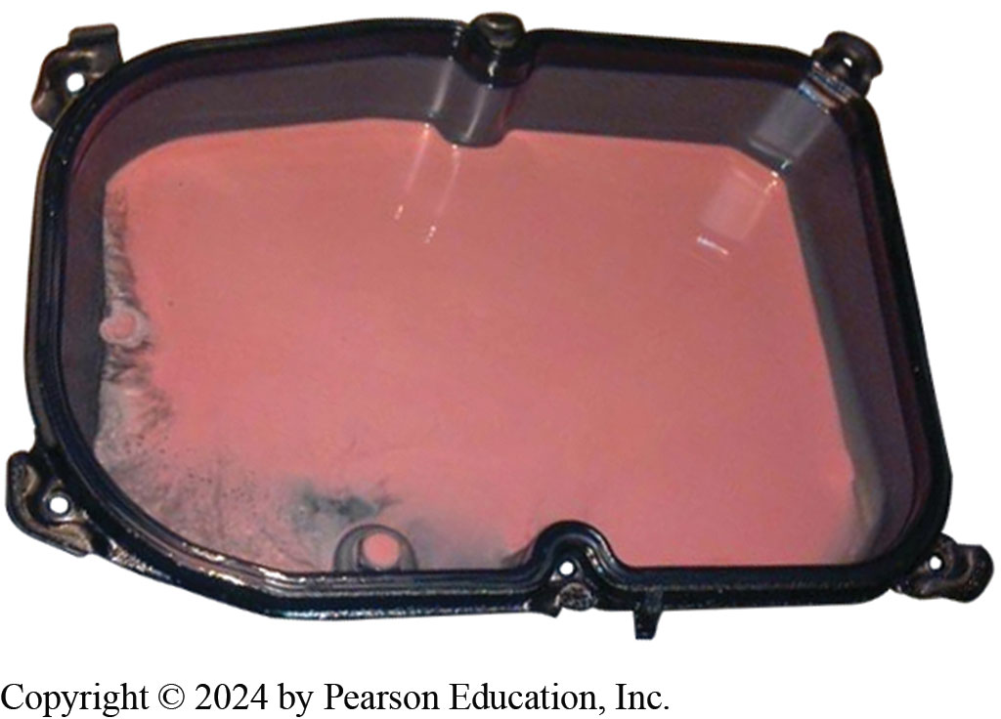
Figure 15.8
If A T F looks like a strawberry milkshake, then transmission/transaxle will require to be overhauled and source of coolant or water found and corrected.
Notes:
What Is Wrong When the A T F Looks Like a Strawberry Milkshake? If water or coolant gets into the automatic transmission fluid, it makes the A T F look like strawberry milkshake. Common reasons for this condition include the following: A leak in the A F T cooler inside the radiator. Water getting into the transmission/transaxle through the vent at the top of unit. This could be caused by driving through high water or due to a flood where the vehicle is under water or partially under water. The transmission/transaxle will require a complete overhaul because the clutch and band friction material are held to the steel backing using water-soluble glue. The water that is mixed with the A T F will loosen this glue and cause the friction material to be become detached from the steel backing making the transmission unable to transmit engine torque. Figure 15.8

Slide 27
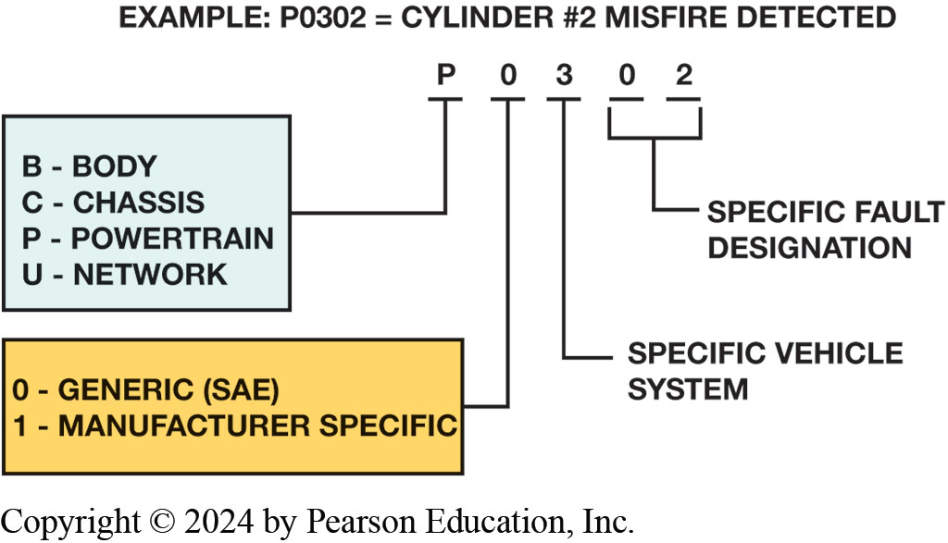
Figure 15.9
D T C
O B D-
D T C identification format.
Notes:
Long Description:
The top of the format shows the sequence of P, 0, 3, 0, and 2. The components related to P are shown as an acronym B C P U with B for body, C for chassis, P for powertrain, and U for the network. The components related to the next 0 are 0 and 1 with 0 standing for generic (S A E) and 1 standing for manufacturer specific. The component related to 3 is a specific vehicle system. The component related to 0 and 2 is specific fault designation.

Slide 28
Chart 15.3
D T C s
Transmission-Related D T C s
P0703 Brake switch input circuit |  | P0740 Torque converter clutch system problem
P0705 Transmission range sensor circuit problem (PRNDL input) |  | P0741 Torque converter clutch system performance or stuck off
P0706 Transmission range sensor circuit range or performance |  | P0742 Torque converter clutch system stuck on
P0707 Transmission range sensor circuit low input |  | P0743 Torque converter clutch system electrical
P0708 Transmission range sensor circuit high input |  | P0745 Pressure control solenoid problem
P0710 Transmission fluid temperature sensor problem |  | P0746 Pressure control solenoid performance or stuck off
P0711 Transmission fluid temperature sensor range |  | P0747 Pressure control solenoid stuck on
P0712 Transmission fluid temperature sensor low input |  | P0748 Pressure control solenoid electrical
P0713 Transmission fluid temperature sensor high input |  | P0750 Shift solenoid A problem
P0715 Input or turbine speed sensor circuit problem |  | P0751 Shift solenoid A performance or stuck off
P0716 Input or turbine speed sensor circuit range or performance |  | P0752 Shift solenoid A stuck on
P0717 Input or turbine speed sensor circuit no signal |  | P0753 Shift solenoid A electrical
P0720 Output speed sensor circuit problem |  | P0755 Shift solenoid B problem
P0721 Output speed sensor circuit range or performance |  | P0756 Shift solenoid B performance or stuck off
P0722 Output speed sensor circuit no signal |  | P0757 Shift solenoid B stuck on
P0725 Engine speed input circuit problem |  | P0758 Shift solenoid B electrical
P0726 Engine speed input circuit range or performance |  | P0760 Shift solenoid C problem
P0727 Engine speed input circuit no signal |  | P0761 Shift solenoid C performance or stuck off
P0728 Gear 6 incorrect ratio |  | P0762 Shift solenoid C stuck on
P0730 Incorrect gear ratio |  | P0763 Shift solenoid C electrical
P0731 Gear 1 incorrect ratio |  | P0765 Shift solenoid D problem
P0732 Gear 2 incorrect ratio |  | P0766 Shift solenoid D performance or stuck off
P0733 Gear 3 incorrect ratio |  | P0767 Shift solenoid D stuck on
P0734 Gear 4 incorrect ratio |  | P0768 Shift solenoid D electrical
P0735 Gear 5 incorrect ratio |  | P0770 Shift solenoid E problem
P0736 Reverse incorrect ratio |  | P0771 Shift solenoid E performance or stuck off
 |  | P0772 Shift solenoid E stuck on
 |  | P0773 Shift solenoid E electrical
Notes:
Chart 15.3
Transmission/transaxle-related diagnostic trouble codes (D T C s). For transmission-related diagnostic trouble codes for vehicles older than 1996, check service information on how to retrieve and read the codes.

Slide 29
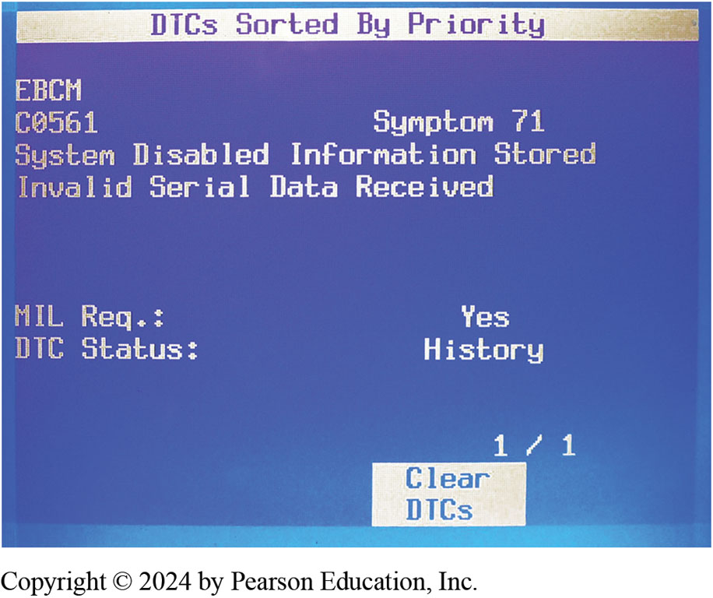
Figure 15.10
“C” diagnostic trouble code stored along with note “symptom 71” which gives additional information about possible cause of this serial data fault code being set.
Notes:
Tech Tip: Look for D T C s in “Body” and “Chassis” Whenever diagnosing a customer concern with a transmission, transfer case, or other driveline components, check for diagnostic trouble codes (D T C s) under chassis and body systems and do not just look under engines. Engine or emission control type codes are “P” codes, whereas module communications are “U” codes. These are most often found when looking for D T C s under chassis or body systems. Chassis-related codes are labeled “C” and body system-related codes are labeled “B” codes and these can cause drivetrain issues if they affect a sensor that is also used by the H V A C system, for example.
● See Figure 15.10.
Long Description:
The heading is mentioned as D T C s sorted by priority. The entry in the next line is E B C M. The entry in the second line is C0561 and symptom 71. The next line mentions the sentence as system disabled information stored. It is followed by the following line: invalid serial data received. The M I L. Req. is yes blank and the D T C status is history. The right bottom corner shows 1 over 1. A square is present with the text clear D T C s.

Slide 30
Step 4—Check for Technical Service Bulletins
Check for corrections or repair procedures in technical service bulletins (T S B s) that match the symptoms.
Bulletins often include information on solving problems that involve a stored diagnostic trouble code.

Slide 31
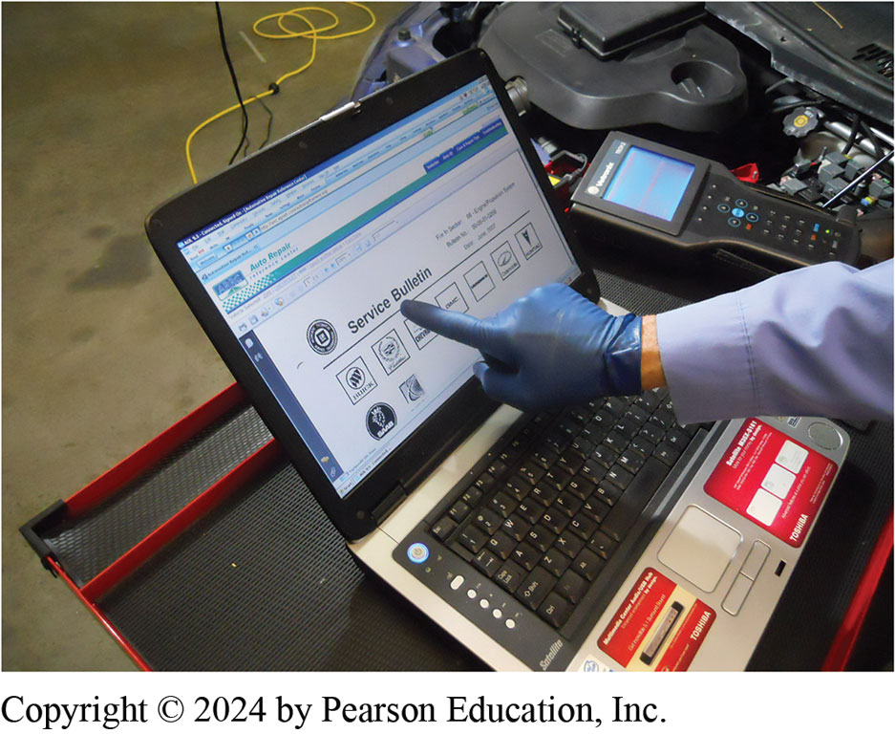
Figure 15.11
T S B
After checking for stored diagnostic trouble codes (D T C s), the wise technician checks service information for any technical service bulletins (T S B s) that may relate to the vehicle being serviced.

Slide 32
Frequently Asked Question: What Is Meant by Flashing a Module?
? Frequently Asked Question
What Is Meant by Flashing a Module? Flashing a module is updating programming of P C M or T C M to solve an issue. Flashing P C M/T C M, also called programming, can be done to correct possible software problems. Occasionally there is a concern that a transmission has improper shift points, delayed shifts, or just does not work right, and a thorough diagnosis fails to locate any problems. T C M s use an electronically erasable programmable read- only memory (E E P R O M) that determines operating parameters of T C M. T C M determines when transmission upshifts or downshifts, when T C C applies or releases, hydraulic system pressures in some transmissions. Memory function can be changed by connecting a computer interface to T C M that will erase the old instructions and send new instructions to the vehicle T C M. Flashing will remove adaptive learned values. S A E J2534 compliant module is available that, with a computer and update program, can flash all vehicles. With some makes of vehicles, this will include all or most of E C M/P C M s, while other makes limit flashing to modules. Recalibration is often necessary when a new T C M is installed. The process must be performed exactly as directed by the manufacturer. T C M can be recalibrated outside of the vehicle in some cases. The T C M in some vehicles has a learn strategy that can compensate for some transmission faults such as low line pressure. These units should be recalibrated after a major repair or overhaul. Figure 15.12.

Slide 33
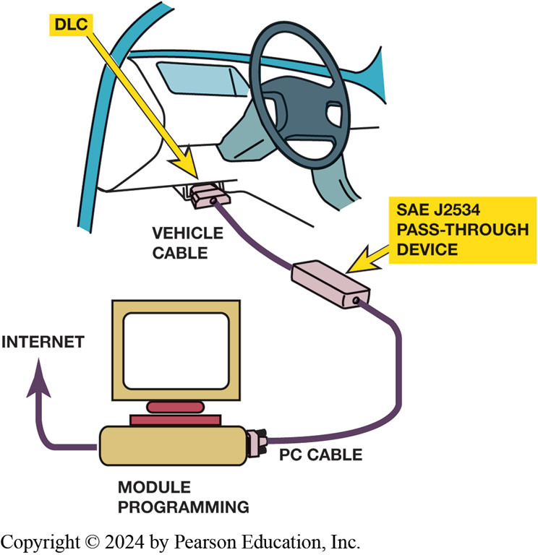
Figure 15.12
J2534 pass-through reprogramming system does not need a scan tool to flash the P C M on most 2004 and newer vehicles.
Notes:
What Is Meant by Flashing a Module? Flashing a module is updating of programming of module such as P C M or T C M to solve an issue. Flashing P C M/T C M, also called programming, reprogramming, and calibrating, can be done to correct possible software problems. Occasionally there is a concern that a transmission has improper shift points, delayed shifts, or just does
not work right, and a thorough diagnosis fails to locate any problems. T C M s use an electronically erasable programmable read- only memory (E E P R O M) that determines operating parameters of T C M. T C M determines when transmission upshifts or downshifts, when T C C applies or releases, hydraulic system pressures in some transmissions. Memory function can be changed by connecting
a computer interface to T C M that will erase the old instructions and send new instructions to the vehicle T C M. Flashing will remove adaptive learned values. S A E J2534 compliant module is available that, with a computer and update program, can flash all vehicles. With some makes of vehicles, this will include all or most of E C M/P C M s, while other makes limit flashing to modules. Recalibration is often necessary when a new T C M is installed. The process must be performed exactly as directed by the manufacturer. The T C M
can be recalibrated outside of the vehicle in some cases. The T C M in some vehicles has a learn strategy that can compensate for some
transmission faults such as low line pressure. These units should be recalibrated after a major repair or overhaul. Figure 5.12.
Long Description:
The outline of a computer desktop is shown. It is labeled as module programming. An arrow goes left to the internet and the P C cable is attached to the right. The P C cable goes through the S A E J2534 pass hyphen through device to connect to the vehicle. The cable that connects to the vehicle is called the vehicle cable. The D L C is the plug that connects to the vehicle.

Slide 34
Step 5—Scan Tool Testing (1 of 3)
Types of Scan Tools
Factory scan tools
Aftermarket scan tools
Global scan tools

Slide 35
Step 5—Scan Tool Testing (2 of 3)
Sensor Values
A properly operating engine should display the following readings with the engine at idle and operating in closed loop.
Engine coolant temperature (E C T)
Throttle position (T P) sensor
Accelerator pedal position sensor (A P P S)
Fuel injector pulse width

Slide 36
Step 5—Scan Tool Testing (3 of 3)
Upstream oxygen sensor (O2S)
Air–fuel ratio sensor(s)
Transmission fluid temperature (T F T)
Brake switch
Manifold absolute pressure (M A P) sensor
Mass airflow sensor (M A F)
Vehicle speed (V S) sensor
Idle speed
Shift solenoids
Clutch Volume Index

Slide 37
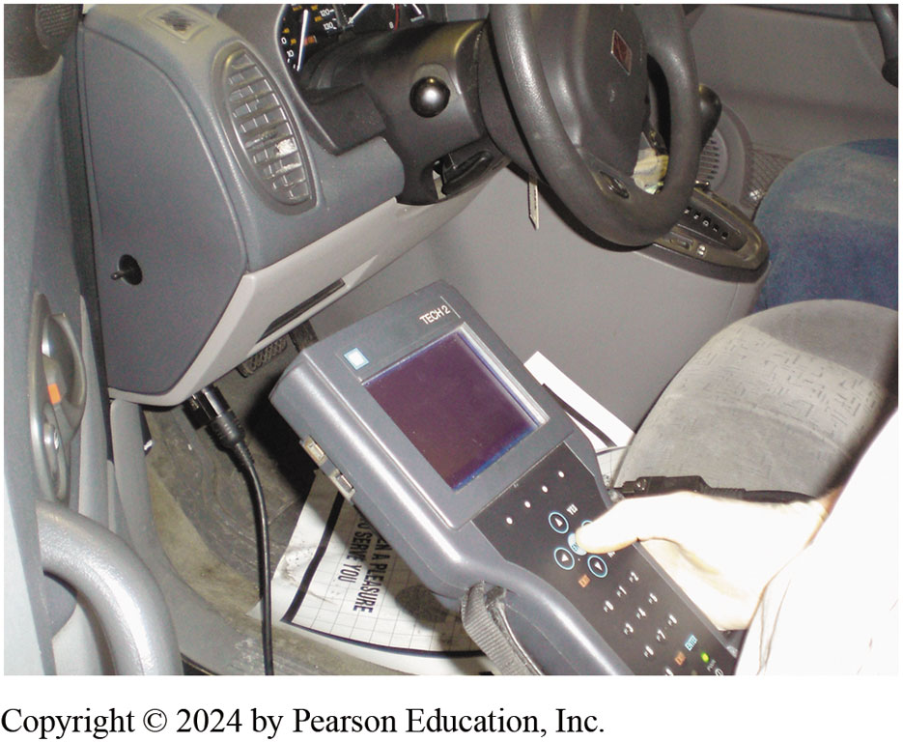
Figure 15.13
Scan Tool
TECH 2 scan tool is the factory scan tool used on G M vehicles.

Slide 38
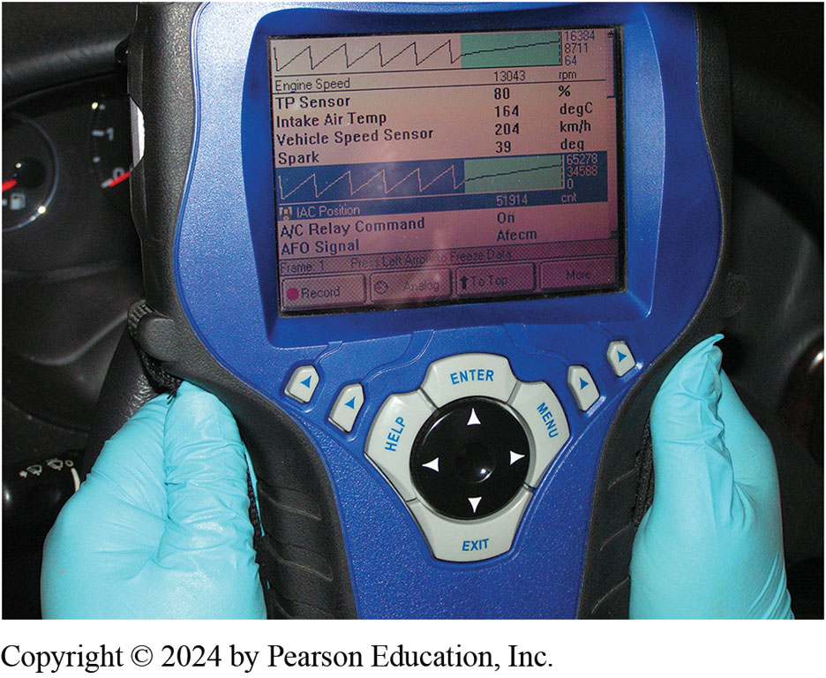
Figure 15.14
Genisys Scan Tool
OTC Genisys being used to troubleshoot a vehicle. This scan tool can be used on most makes and models of vehicles and is capable of diagnosing other computer systems in the vehicles such as automatic transmissions.
Notes:
Long Description:
A person is shown holding an O T C Genisys with a gloved hand on either side of the instrument. The instrument shows a four-direction round switch. The top is enter, the bottom is the exit, the left is help, and the right is the menu. On either side, two arrows are pointing upwards. On the display screen, a graph is seen at the top. The line in the graph is zig zag and the values written at the end of the graph are 16384, 8711, and 64. The entries on the display screen are as follows. Engine speed 13043 rpm, T P sensor 80 percent, intake air temp 164 degrees centigrade, vehicle speed sensor 204 kilometers per hour, and spark 39 degrees. Another graph is seen below this text. The line in the graph is zig zag and the values written at the end of the graph are 65278, 34588, and 0. Below this graph, there are three entries. I A C position 51914 cnt, A slash C relay command as on, and A F O signal as Afecm. The remaining text is as follows from left to right. Frame 1, press the left arrow to freeze data. The next line includes a red circular button labeled record, a circular structure labeled analog, and an upward arrow labeled to top.

Slide 39
Figure 15.15
A Snap-on scan tool is able to shift the transmission and display pressure control (P C) solenoid current (amperes).
Notes:
Observe the operation of the command for the shift solenoids and the T C C solenoid while driving the vehicle. This information confirms that the P C M is commanding the operation and it does not mean that the solenoids are working correctly. Therefore, if the scan data indicate that a particular solenoid is being commanded on and nothing occurs, then the problem could be caused by a defect with the following:
1. Hydraulic component (clutch, band, etc.)
2. Solenoid
3. Fault in the wiring to the solenoid or from the solenoid to the P C M or T C M See Figure 5.15.
Long Description:
There are six options on the screen. They are as follows. 1 hyphen 2 shift solenoid (on or off), 2 hyphen 3 shift solenoid (on or off), 3 hyphen 2 downshift solenoid (on or off), P C solenoid amps, shift transmission, and T C C control solenoid (on or off). The shift transmission has been selected.

Slide 40
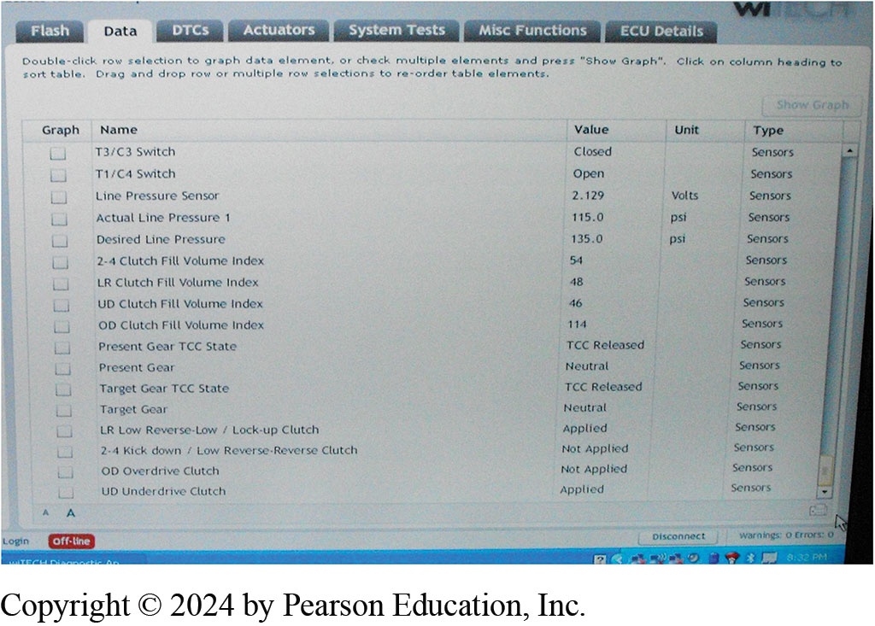
Figure 15.16
The clutch fill volume index as is displayed on a Chrysler wiTECH scan tool.
Notes:
Volume Index: Some vehicles include a code for clutch volume index (C V I), also called transmission adapt pressure (T A P) or clutch fill volume index. The index monitors the time needed to fill a clutch as it applies. Each clutch should fill and stroke the clutch in a specified time. This time period usually increases with normal wear. The T C M determines C V I from the speed differential between the input and output speed sensors. The T C M can determine the actual ratio and how long it takes to complete a shift from the speed differential of the two speed sensors. A high C V I usually indicates a clutch with excessive slippage. See Figure 15.16.
Long Description:
Seven tabs are shown on the screen and are given as follows. Flash, data, D T C s, actuators, system tests, misc functions, and E C U details. The data tab has been selected. The instructions given are double hyphen click row selection to graph data element or check multiple elements and press open quotes show graph close quotes. Click on the column heading to sort the table. Drag and drop row or multiple row selections to re hyphen order table elements. Five columns are given: graph, name, value, unit, and type. The graph column consists of checkboxes. For the T3 slash C3 switch, the value is closed and the type is sensors. For the T1 slash C4 switch, the value is open and the type is sensors. For the line pressure sensor, the value is 2.129, units are volts, and the type is sensors. For actual line pressure 1, the value is 115.0, units are pound hyphen force per square inch, and the type is sensors. For desired line pressure, the value is 135.0, units are pound hyphen force per square inch, and the type is sensors. For 2 hyphen 4 clutch fill volume index, the value is 54, and the type is sensors. For the LR clutch fill volume index, the value is 48, and the type is sensors. For the U D clutch fill volume index, the value is 46, and the type is sensors. For the O D clutch fill volume index, the value is 114, and the type is sensors. For the present gear T C C state, the value is T C C released, and the type is sensors. For the present gear, the value is neutral, and the type is sensors. For the target gear T C C state, the value is T C C released, and the type is sensors. For target gear, the value is neutral, and the type is sensors. For L R low reverse hyphen low slash lock hyphen up clutch, the value is applied, and the type is sensors. For 2 hyphen 4 kick down slash low reverse hyphen reverse clutch, the value is not applied, and the type is sensors. For O D overdrive clutch, the value is not applied, and the type is sensors. For U D underdrive clutch, the value is applied, and the type is sensors. The bottom of the screen has the following text. Login, off hyphen line, disconnect, warnings 0, and errors 0.

Slide 41
Animation: Scan Tools, Automatic Transmission (Animation will automatically start)

Slide 42
Step 6—Visual Inspections (1 of 5)
Many technicians begin their diagnosis by making visual check of battery and wiring
Three most common sources of transmission noise are
Bearings
Gears
Hydraulic system
Notes:
Case Study: The Starbucks Syndrome: B M W 520i (122,000 miles) came in with only second gear, limp-in mode. The customer said car would operate normally one day and have only second gear the next day. The fluid level is correct and appears in good condition. The shop checked for fault codes and found two:
1. Gear position switch
2. Speed sensor
Testing revealed faults in the gear position switch and speed sensor circuits (called Starbucks syndrome). Starbucks syndrome
is a name given to the results of coffee and food spills onto the center console control switches.
Corrosion caused by the spills increases resistance at the wire connections. Replacement of these 2 components fixed problem.
Summary:
Complaint—Customer complained that the transmission stuck in second gear at times.
Cause—Corrosion found at the electrical connections for two components.
Correction—The gear position and speed sensors were replaced.

Slide 43
Step 6—Visual Inspections (2 of 5)
When troubleshooting noise problems, it helps to determine how noise fits into following:
Speed relation
Gear range
Pitch/frequency
Load sensitive
Direction

Slide 44
Step 6—Visual Inspections (3 of 5)
Locating Source of Noise
STEP 1 Raise vehicle so you have access to transmission mounts.
Visually check their condition
STEP 2 Start engine and shift transmission through its gear ranges
While observing for any mount problems.

Slide 45
Step 6—Visual Inspections (4 of 5)
Locating Source of Noise
STEP 3 With engine running gear selector in P or N, listen for noise.
Shift into D, and with brake firmly applied, listen for noise
STEP 4 With engine running, shift from N to R while listening for noise.
Hydraulic problem indicated if noise increases when shifted into R

Slide 46
Step 6—Visual Inspections (5 of 5)
Locating Source of Noise
STEP 5 Perform road test and listen for noise changes as transmission shifts through the gear ranges.
STEP 6 Repeat step 5 and listen for noise increases as vehicle speed increases.
Vibration Checks
Notes:
VIBRATION CHECKS Torque converter problems cause an engine-speed-related vibration problem. Output shaft vibration problems are vehicle-speed related. These are often accompanied by driveline clunk. F W D output shaft problems will usually be most noticeable on turns because of the increased differential and C V joint action.
Engine-speed-related vibrations occur during particular engine speed ranges and these vibrations change when the transmission shifts gears. There are several causes leading to this, for example, belt-driven accessories such as the fan, alternator, air-conditioning compressor, or internal engine unbalance. Belt-driven problems can be identified by running the engine with the belt removed. If the vibration is gone, then the source of the vibration is one of the units being driven by the accessory drive belt.
Identifying a torque converter problem begins with removing the converter cover and carefully inspecting the torque converter and flex plate. Look for a wobble (runout) of the converter during engine rotation. Torque converter runout can be caused by the following:
Improper tightening of the torque-converter-to-flex plate bolts.
A damaged flex plate. ● See Figure 15.18.

Slide 47
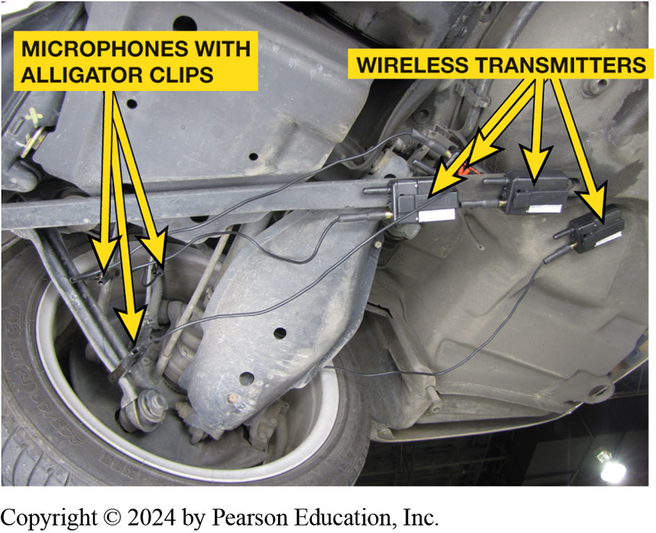
Figure 15.17
Chassis Ears
Chassis ear microphones attached to various under-vehicle components using the integral clamps. The sound is transmitted wirelessly to the receiver inside the vehicle where an assistant technician can listen for noises while the vehicle is being driven.

Slide 48
Chart 15.4
Noise Diagnosis
Noise | Probable Cause
Chain noise | A whine or growl that increases in frequency and amplitude with vehicle speed. Most noticeable under light acceleration. Input chain noise can be heard in park and neutral.
Final drive | A hum related to vehicle speed. Usually torque sensitive.
Gear noise | A whine or growl related to vehicle speed. Usually torque and gear-range sensitive.
Pump noise | A high-pitched whine that increases in amplitude with engine speed. Most noticeable in park or neutral with cold transmission fluid.
Notes:
Chart 15-4 Typical noise problem descriptions.
Case Study: The Case of the Noisy Dodge Grand Caravan
A Dodge Grand Caravan (87,000 m i) had a bad, tinny rattle noise coming from torque converter area. The noise occurs whenever the engine is running. Visual inspection through the inspection cover area does not show a problem. A cracked flexplate is suspected. Removal of the transaxle allowed inspection of the torque converter and flexplate. Visual inspection showed that a balance weight had come loose. Replacement of torque converter fixed this noise problem.
Summary:
Complaint—Customer complained about a rattle noise.
Cause—A balance weight on the torque converter was loose.
Correction—The torque converter was replaced.

Slide 49
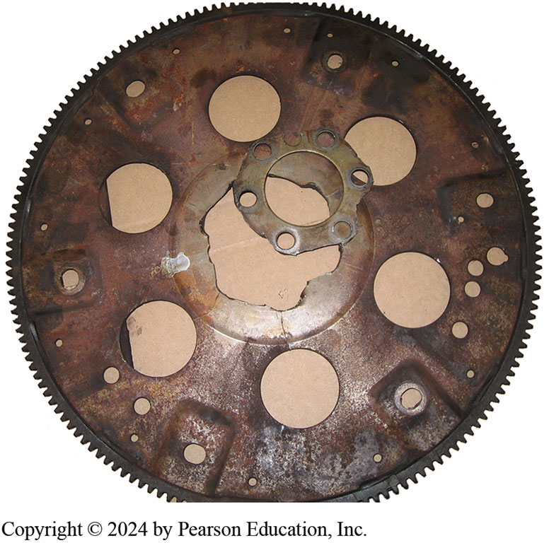
Figure 15.18
Broken Flexplate
A broken flexplate that made a lot of noise and then the engine would not crank when it finally broke.

Slide 50
Step 7—Find the Root Cause (1 of 3)
If something wrong with transmission/transaxle, drain oil and remove pan for inspection
A technician will check B+ voltage at the battery and then at T C M and transmission power relay if there is one

Slide 51
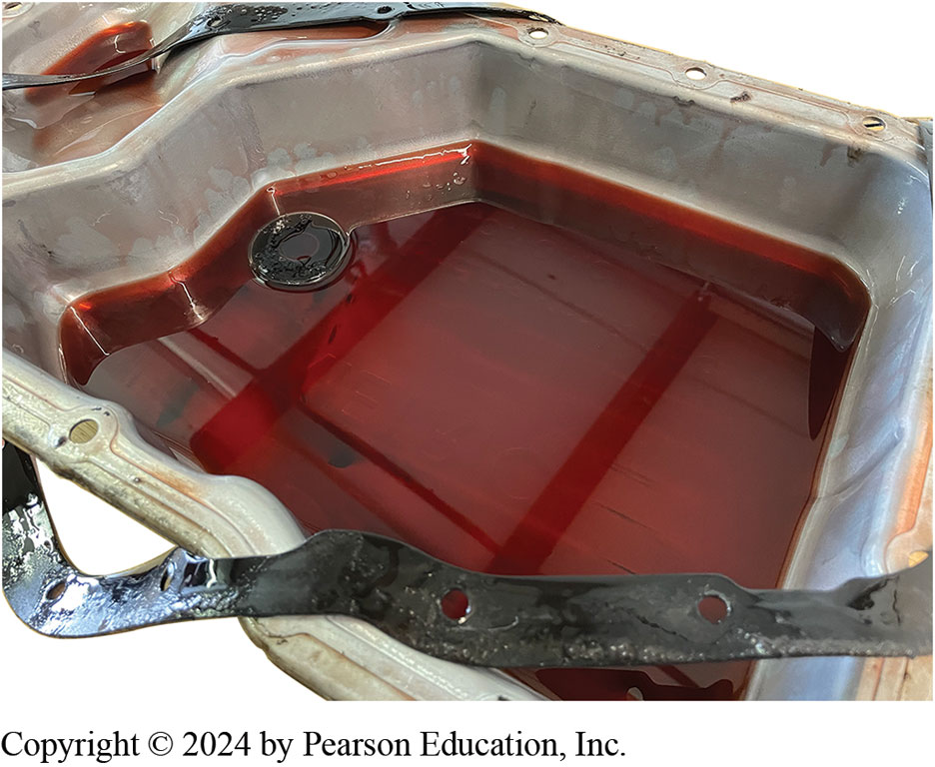
Figure 15.19
This is a normal amount of wear material in the bottom of an automatic transmission pan.
Notes:
A small amount of debris with a blackish oil film is normal. A small amount of metal can be attributed to the wear that occurs during break-in and normal operation. Figure 5.19.

Slide 52
Step 7—Find the Root Cause (2 of 3)
Technician uses pressure gauge to check
Condition of hydraulic system.
Analog hydraulic pressure gauge is normally dampened
So minor pressure fluctuations are lost
Technician compares pressure readings to specifications
To determine if system is operating correctly

Slide 53
Step 7—Find the Root Cause (3 of 3)
Test ports for individual apply circuits as well as
Line determined by comparing its pressure with line pressure
Manufacturers provide hydraulic schematics/fluid diagrams
Of the fluid passages and valves.

Slide 54
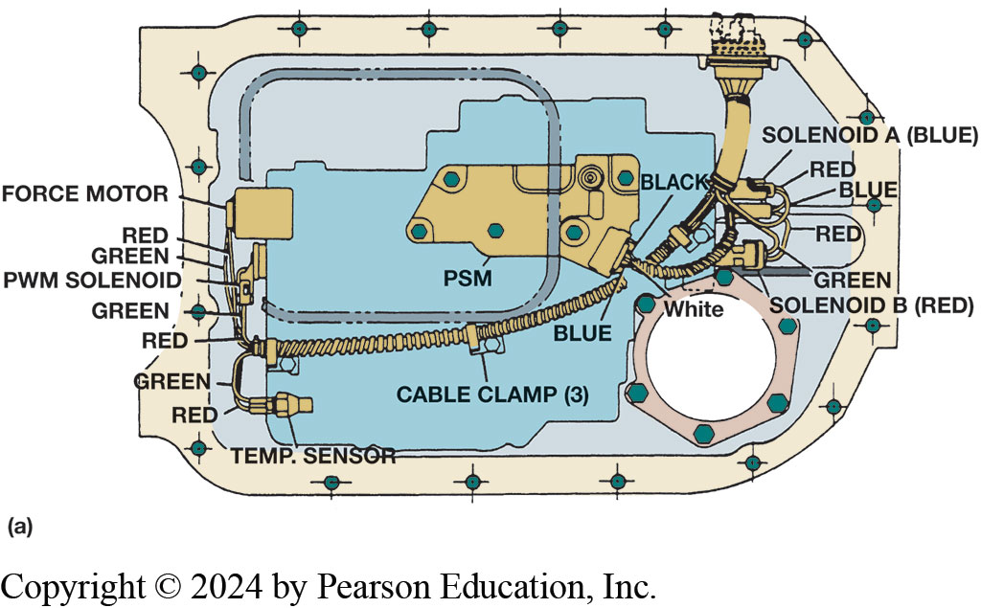
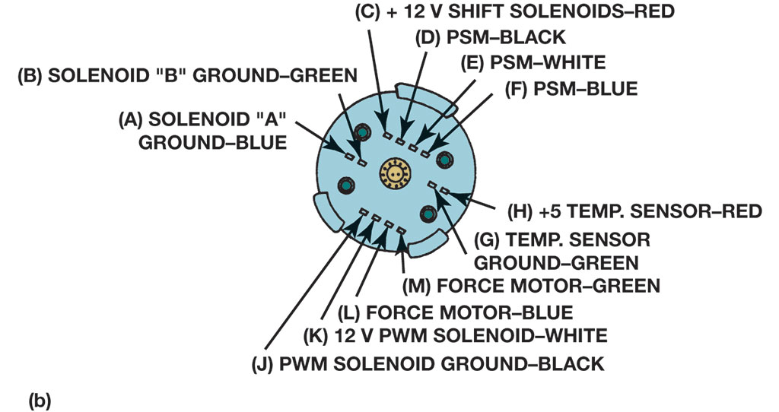
Figure 15.20
Visual Inspection
A visual inspection of the transmission electrical connector ensures that the terminals are clean and in good condition as well as being completely engaged.
Notes:
Long Description 1:
A square outline is present on the left of the connector. A force motor is present at the left border of the square. Red and green wires come out of the force motor. A chip is present in the middle of the connector. The P W M solenoid is attached to the side of the chip. A temperature sensor is also attached to the chip. Green and red wires from the force motor, P W M solenoid, and temperature sensor join together to form a cable. This cable then goes up to connect with a funnel-shaped structure. A P S M is present in the middle of the connector. Black, blue, and white wires go from the P S M and join the cable going to the funnel. A circular structure is present at the lower right of the connector. A solenoid A (blue) and a solenoid B (red) are present at the right border of the chip. The green, red, and blue wires from these solenoids join the cable going to the funnel.
Long Description 2:
A round structure is shown with three clamps at different positions around the border. Four small circles are present on the structure. The top and bottom part has four small squares and the left and right have two small squares. The middle of the structure also shows a circular structure. The left squares are labeled as (A) solenoid A ground hyphen blue and (B) solenoid B ground hyphen green. The top four squares are labeled as follows. (C) plus 12 volts shift solenoids hyphen red, (D) P S M hyphen black, (E) P S hyphen white, and (F) P S M hyphen blue. The right squares are labeled as (H) plus 5 temperature sensor hyphen red and (G) temperature sensor ground hyphen green. The bottom four squares are labeled as follows. (J) P W M solenoid ground hyphen black, (K) 12 volts P W M solenoid hyphen white, (L) force motor hyphen blue, and (M) force motor hyphen green.

Slide 55
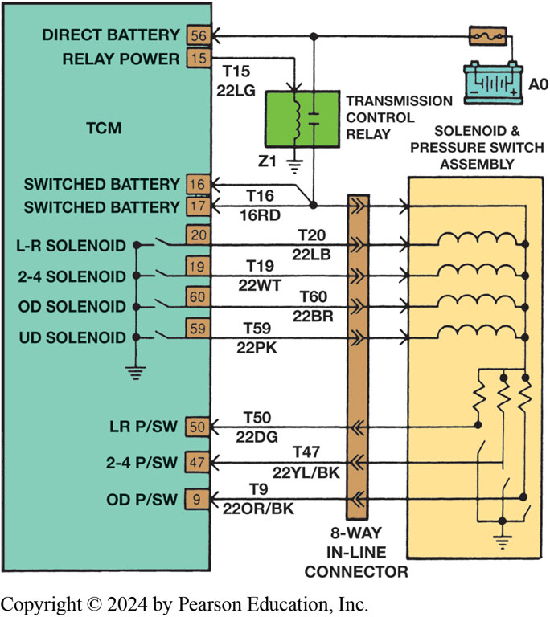
Figure 15.21
Electrical Terminals
T C M terminals 16 and 17 receive B+ when transmission relay is energized.
Notes:
Long Description:
The T C M is represented as a vertical rectangle. From top to bottom, the text is as follows. Direct battery 56, relay power 15, switched battery 16, switched battery 17, L hyphen R solenoid 20, 2 hyphen 4 solenoid 19, O D solenoid 60, U D solenoid 59, L R P slash S W 50, 2 hyphen 4 P slash S W 47, O D P slash SW 9. All four solenoids are connected by a vertical line which is connected to the earth ground symbol. A solenoid and pressure switch assembly is shown parallel to the T C M. An 8 hyphen way in hyphen line connector is present in between the T C M and the solenoid and pressure switch assembly. The A O is present above the solenoid and pressure switch assembly. A wire from A O goes through another horizontal instrument and joins the T C M terminal 56 which is labeled direct battery. A transmission control relay box is present above the 8 hyphen way in hyphen line connector. One wire joins the line going to terminal 56. Another line is connected to the arrow going to terminal 17 and then goes to connect to terminal 16. The T C M terminal 15 which is labeled relay power has an arrow that goes to the transmission control relay box which is labeled T15, 22LG. The arrow goes through the transmission control relay box to join the earth ground symbol labeled Z1. The T C M terminal 17 has an incoming arrow labeled T16 above it and 16RD labeled below it. The other end of the arrow shows a double arrowhead in the 8 hyphen way in hyphen line connector and enters the solenoid and pressure switch assembly as a horizontal line and bends to form a vertical line. The arrow from T C M terminal 20 is labeled T20 above and 22LB below. The arrow shows a double arrowhead facing right in the 8 hyphen way in hyphen line connector and enters the solenoid and pressure switch assembly as a curved arrow. The arrow from T C M terminal 19 is labeled T19 above and 22WT below. The arrow shows a double arrowhead facing right in the 8 hyphen way in hyphen line connector and enters the solenoid and pressure switch assembly as a curved arrow. The arrow from T C M terminal 60 is labeled T60 above and 22BR below. The arrow shows a double arrowhead facing right in the 8 hyphen way in hyphen line connector and enters the solenoid and pressure switch assembly as a curved arrow. The arrow from T C M terminal 59 is labeled T59 above and 22PK below. The arrow shows a double arrowhead facing right in the 8 hyphen way in hyphen line connector and enters the solenoid and pressure switch assembly as a curved arrow. All the curved arrows from terminals 20, 19, 60, and 59 join the straight line from terminal 17. The line then breaks into three zig-zag lines that are joined by arrows from the remaining three terminals. The T C M terminal 50 has an incoming arrow labeled T50 above it and 22DG labeled below it. The other end of the arrow shows a double arrowhead facing left in the 8 hyphen way in hyphen line connector that enters the solenoid and pressure switch assembly and joins the first zig-zag line. The T C M terminal 47 has an incoming arrow labeled T47 above it and 22YL slash BK labeled below it. The other end of the arrow shows a double arrowhead facing left in the 8 hyphen way in hyphen line connector that enters the solenoid and pressure switch assembly and joins the second zig-zag line. The T C M terminal 9 has an incoming arrow labeled T9 above it and 22OR slash B K labeled below it. The other end of the arrow shows a double arrowhead facing left in the 8 hyphen way in hyphen line connector that enters the solenoid and pressure switch assembly and joins the third zig-zag line. All these three zig-zag lines combine to join a single line that is attached to the earth ground symbol.

Slide 56
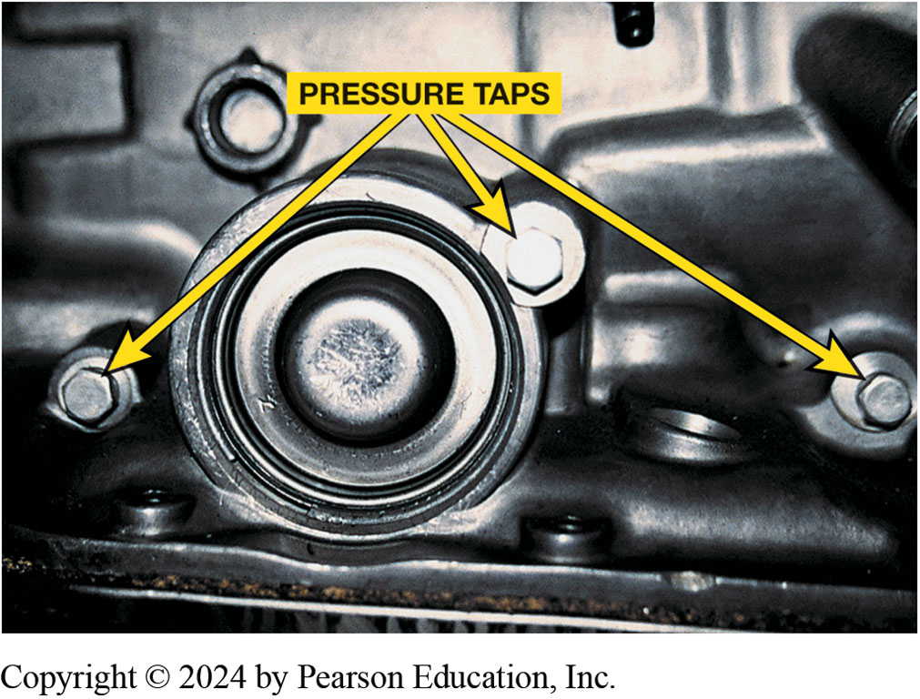
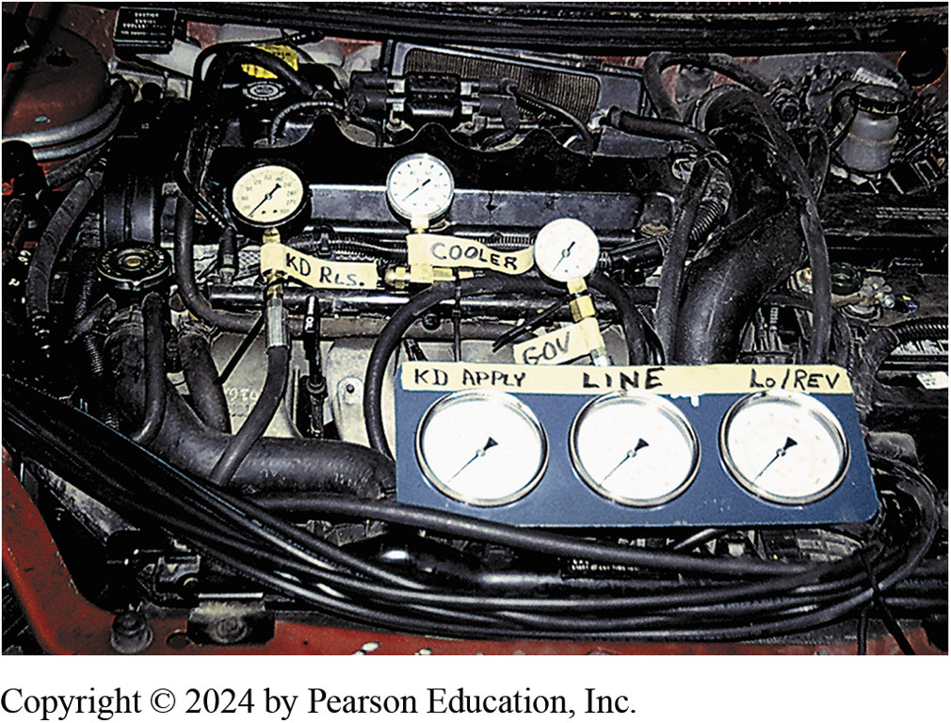
Pressure Testing
Figure 15.22 Locations (taps) for connecting pressure gauge to measure pressure of various hydraulic circuits are usually found on side of automatic transmission/transaxle. Check service information for exact locations for vehicle being tested.
Figure 15.23 Six pressure gauges are installed on this vehicle to show students how pressures vary and how gauges can be used to find faults or possible problem areas before unit is removed and disassembled

Slide 57
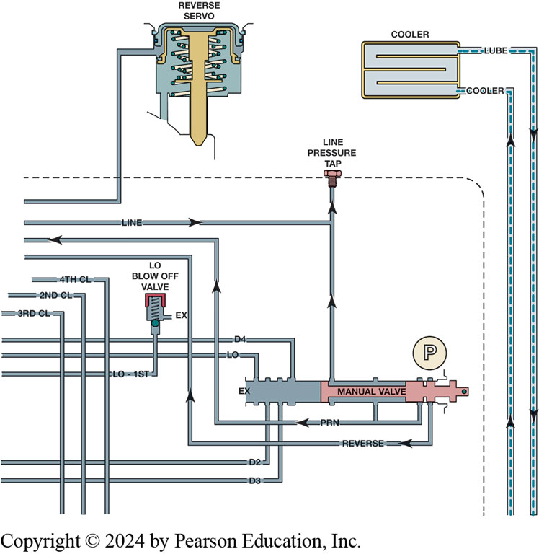
Figure 15.24
Portion of a typical hydraulic schematic showing part of hydraulic system and pressure tap.
Notes:
Long Description:
A tube from the left joins the reverse servo. Another tube comes in from the left and joins a vertical tube to the line pressure tap. Another tube labeled L O hyphen 1st comes in from the left and joins the L O blow off valve. The valve has an exit labeled as ex. Three tubes are seen which come from the left and turn vertically down. They are labeled as 4th C L, 2nd C l, and 3rd C L. A dotted line comes in from the left, touches the line pressure tap, and then turns vertically down. A cooler is present close to the reverse servo. A pipe goes out from the cooler which is labeled lube. Another tube comes into the cooler and is labeled cooler. A manual valve is present below the line pressure tap. A pipe goes up from the manual valve and joins the line pressure tap. Two pipes labeled P R N and reverse go out of the manual valve and to the left. Two more pipes labeled D2 and D3 go out of the manual valve and to the left. Two other pipes labeled L O and D4 go out of the manual valve and to the left. An outlet of the manual valve is labeled as ex. A circle with a P inside is present close to the manual valve.

Slide 58
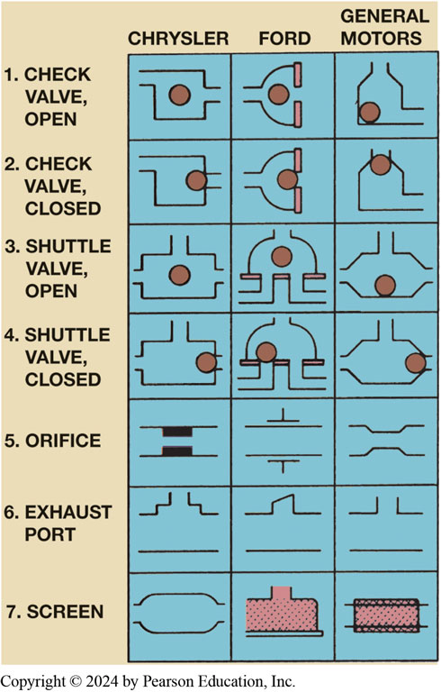
Figure 15.25
Hydraulic symbols used by domestic vehicle manufacturers
Notes:
Long Description:
Seven symbols are shown for Chrysler, Ford, and General Motors. For the check valve, open, in Chrysler, the symbol is a square with a solid circle in the middle. The square has one opening at the upper left and another opening at the middle right. In Ford, a horizontal pipe forms a semicircle and connects to two terminals. A solid circle is present in the middle of the half circle. In General Motors, the shape is like a beaker with an outlet at the bottom. A solid circle is present in the left lower part of the container. For the check valve, closed, in Chrysler, the symbol is a square. The square has one opening at the upper left and another opening at the middle right. A solid circle is present at the middle right opening. In Ford, a horizontal pipe forms a semicircle and connects to two terminals. A solid circle is present in the gap between the two terminals. In General Motors, the shape is like a beaker with an outlet at the bottom. A solid circle is present at the inner opening of the beaker. For the shuttle valve, open, in Chrysler, the symbol is a square. The square has one opening at the top middle, one opening in the middle left, and another opening at the middle right. A solid circle is present in the middle of the square. In Ford, a horizontal pipe joins a dome-like structure. The dome has two outlets, one that goes left and one that goes right. The solid circle is present in the middle of the dome. In General Motors, a pentagon is shown. An outlet is shown at the top middle, left middle, and right middle. The solid circle is present in the middle of the pentagon touching the lower line. For the shuttle valve, closed, in Chrysler, the symbol is a square. The square has one opening at the top middle, one opening in the middle left, and another opening in the middle right. A solid circle is present in the right opening. In Ford, a horizontal pipe joins a dome-like structure. The dome has two outlets, one that goes left and one that goes right. The solid circle is present in the left opening. In General Motors, a pentagon is shown. An outlet is shown at the top middle, left middle, and right middle. The solid circle is present in the right opening. For the orifice, in Chrysler, two horizontal lines are shown with a clasp on each, parallel to each other. The clasps are on the inner side and face each other. In Ford, two horizontal lines are present. A smaller horizontal line is present with a vertical line attached in the middle. This arrangement is seen above the top line and below the top line. In General Motors, a horizontal pipe is shown with both sides open and the middle part narrowed. For the exhaust port, in Chrysler, a horizontal line is shown. Above it, an outlet is present that shows zig-zag steps on either side. In Ford, a horizontal line is shown. Another horizontal line is present above it that has a close outlet in its middle. In General Motors, a horizontal line is shown. Above it, another horizontal line is present with an outlet. For the screen, in Chrysler, a vertical oval is shown. An outlet is shown on the left and right. In Ford, a baseplate is shown. A rectangular structure is present with an outlet at the top middle. The rectangle shows dots inside. In General Motors, a rectangle is filled with dots. Two horizontal lines are present parallel to the horizontal lines of the rectangle. The ends of these lines are seen on either end of the rectangle.

Slide 59
Question 1
A factory or factory-level scan tool can . F ill in the blanks
A. read D T C s
B. read T S B s
C. command shifts
D. Both a and c

Slide 60
Answer 1
A factory or factory-level scan tool can . F ill in the blanks
A. read D T C s

Slide 61
Animation: Transmission Pressure Test (Animation will automatically start)

Slide 62
Animation: Transmission Pressure Test, Electronic Controls (Animation will automatically start)

Slide 63
Summary (1 of 2)
Diagnostic process includes following steps:
Verify customer complaint.
Check fluid level and condition.
Check for stored diagnostic trouble codes (DTCs).
Check for related technical service bulletins (T S B s).
Check scan tool data including the adaptive values.

Slide 64
Summary (2 of 2)
Visual inspections.
Locate root cause of problem.
Replace all components that do not meet factory specifications.
Clear all codes and reset all adaptive factors.
Test drive vehicle to verify that repairs corrected concern.
Check transmission fluid with a dipstick.
Check the procedure stamped on dipstick.

Slide 65
Automatic Transmissions and Transaxles Videos and Animations
Videos Link: (A2) Automatic Transmissions and Transaxles Videos
Animations Link: (A2) Automatic Transmissions and Transaxles Animations

Slide 66
Copyright
This work is protected by United States copyright laws and is provided solely for the use of instructors in teaching their courses and assessing student learning. Dissemination or sale of any part of this work (including on the World Wide Web) will destroy the integrity of the work and is not permitted. The work and materials from it should never be made available to students except by instructors using the accompanying text in their classes. All recipients of this work are expected to abide by these restrictions and to honor the intended pedagogical purposes and the needs of other instructors who rely on these materials.

