Slide 1
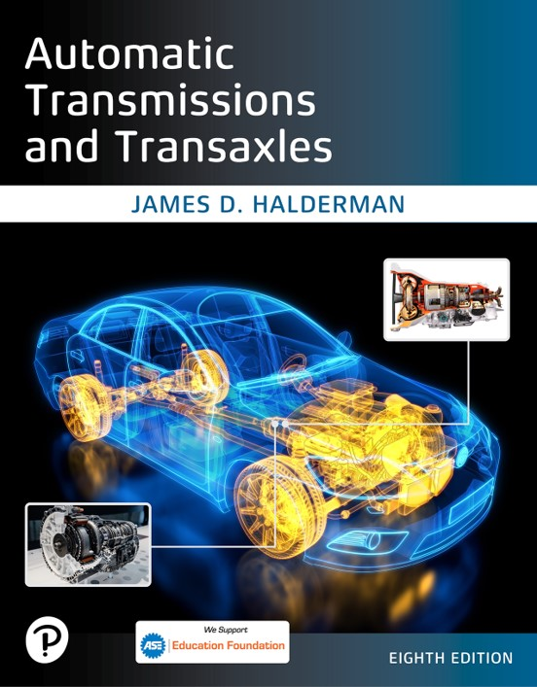
Automatic Transmissions and Transaxles
Eighth Edition
Chapter 13
Continuously Variable Transmissions
Copyright © 2024, 2018, 2015 Pearson Education, Inc. All Rights Reserved
Notes:
If this PowerPoint presentation contains mathematical equations, you may need to check that your computer has the following installed:
1) Math Type Plugin
2) Math Player (free versions available)
3) NVDA Reader (free versions available)
INSTRUCTOR NOTE: This presentation includes text explanation notes, you can use to teach the course. When in SLIDE SHOW mode, you RIGHT CLICK and select SHOW PRESENTER VIEW, to use the notes.

Slide 2
Learning Objectives
13.1 Describe the construction of a continuously variable transmission and discuss its advantages and disadvantages.
13.2 Discuss the electronic controls and operation of a C V T.
13.3 Explain the diagnosis of a C V T, including pressure testing and C V T fluid and noise issues.

Slide 3
Continuously Variable Transmission (C V T) (1 of 2)
C V T offers following advantages over planetary-gear transmission.
Compact, very short
Lighter weight
Constant, stepless acceleration
Engine staying at R P M for maximum power
Efficient fuel use and emissions
Cruise with engine staying at R P M for maximum efficiency
Lower internal power loss
Notes:
C V T offers the following advantages over planetary-gear automatic transmission.
■ Compact, very short
■ Lighter weight
■ Constant, stepless acceleration with engine staying at the R P M for maximum power
■ Efficient fuel use and emissions, cruise with engine staying at the R P M for maximum efficiency
■ Lower internal power loss
Disadvantages of a C V T compared to conventional automatic transmission include the following:
■ High and constant engine speed when accelerating rapidly
■ Requires special fluid that may not be readily available
■ Often not repaired but instead replaced as an assembly if the unit fails

Slide 4
Continuously Variable Transmission (C V T) (2 of 2)
Each pulley has a movable face and a fixed face
C V T improves efficiency by changing ratios
From underdrive/reduction to overdrive in a gradual, continuous manner
Each pulley, also called a sheave, has two sides
One is fixed so it cannot move
The other can float sideways to change pulley width
Push belt and pull chain

Slide 5
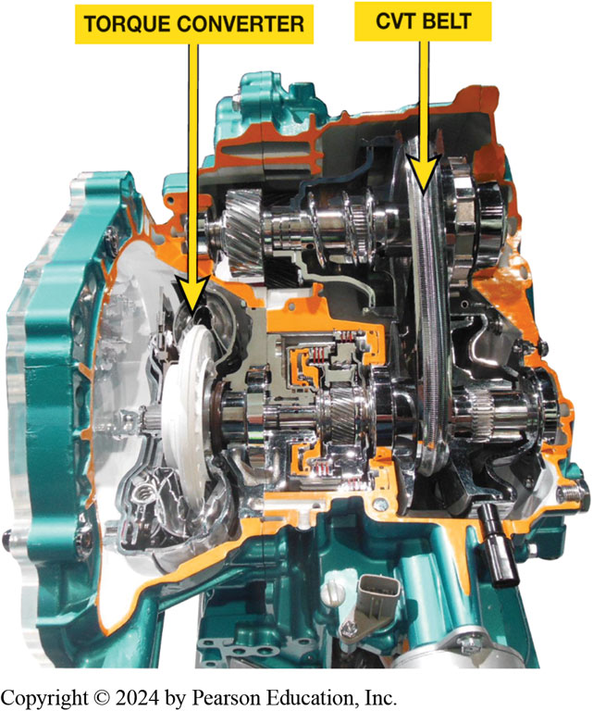
Figure 13.1
C V T Cutaway
A typical C V T transaxle cutaway showing the torque converter and C V T belt.

Slide 6
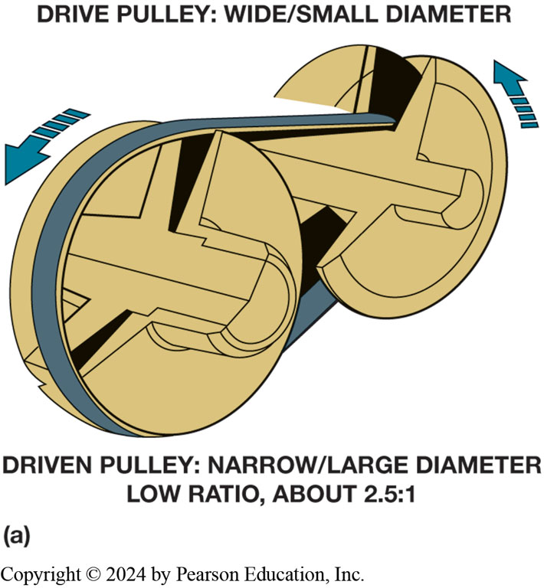
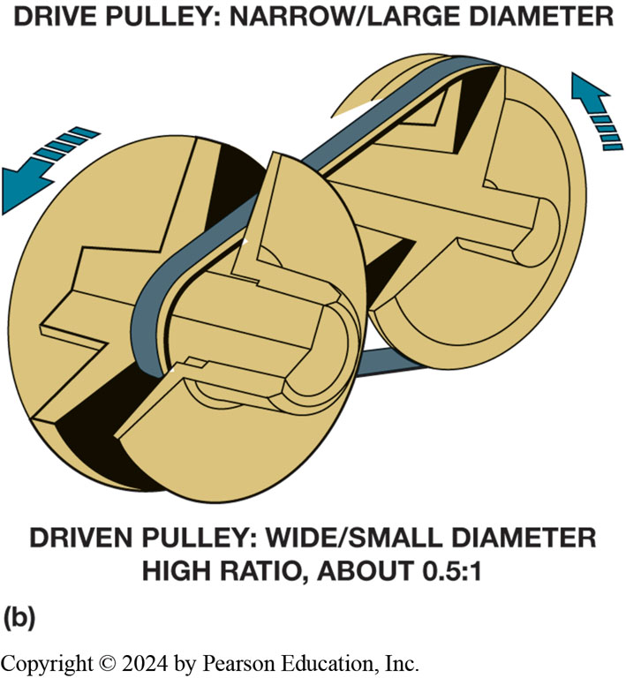
Figure 13.2
Belt and pulley C V T uses variable width pulleys to provide an infinite number of speed ratios.
Notes:
Gear Ratios
As the speed increases, the diameter of the driving pulley increases as the sides of the pulley move together. While this happens, the driven pulley is made wider, and therefore, smaller in diameter. At cruising speeds, the driving pulley is larger than the driven pulley, which produces an overdrive ratio. The pulleys change size smoothly and evenly, which produces a somewhat odd sensation when the vehicle accelerates from a stop. When the throttle is depressed, the engine speed increases to the point of good torque output and the gear ratio selected by the C V T causes the engine to stay at this R P M while the vehicle accelerates. The pulleys move to higher ratios as vehicle speed increases. This is a different sensation than the familiar engine speed increase in each gear and engine speed decrease after an upshift. ● Figures 13.2 and 13.3.
Long Description 1:
The image shows a pulley between two wheels. The larger wheel has the pulley strap on the border. The drive pulley is wide with a small diameter. The driven pulley is narrow with a large diameter and a low ratio of about 2.5 to 1. One arrow near the small wheel and one arrow near the large wheel show the direction of movement.
Long Description 2:
The image shows a pulley between two wheels. The smaller wheel has the pulley strap on the border. The drive pulley is narrow with a large diameter. The driven pulley is wide with a small diameter and a high ratio of about 0.5 to 1. One arrow near the small wheel and one arrow near the large wheel show the direction of movement.

Slide 7
Animation: CVT Operation (Animation will automatically start)

Slide 8
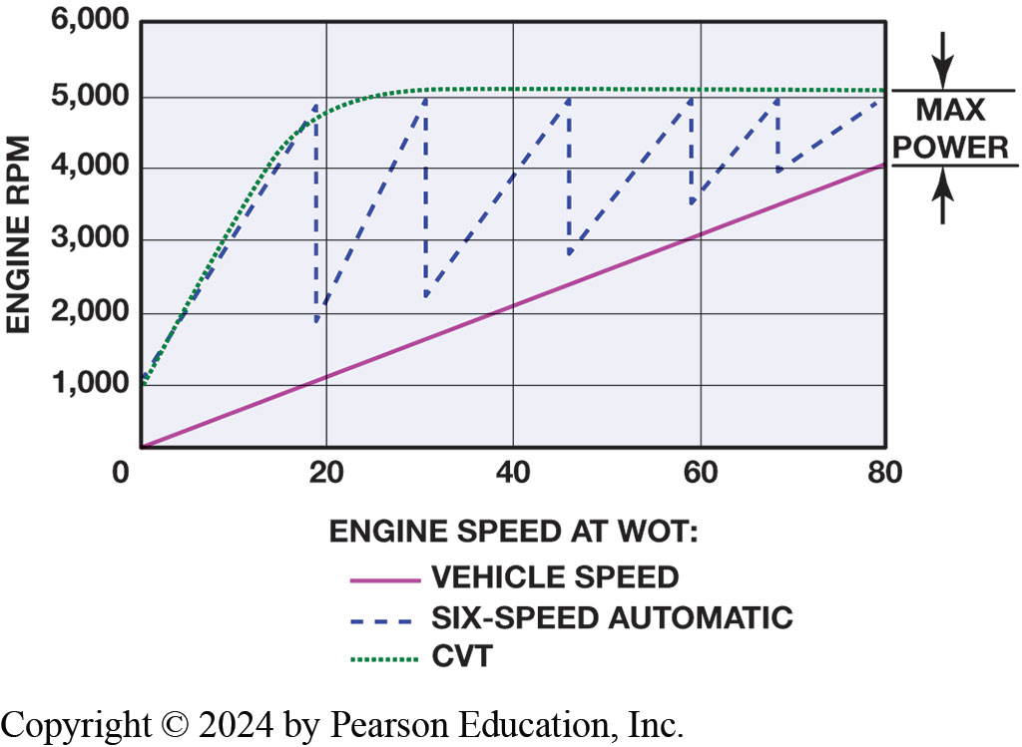
Figure 13.3
Engine speed and vehicle speed of a C V T transaxle compared to a typical six-speed Conventional automatic transaxle.
Notes:
Long Description:
The x-axis is titled engine speed at W O T with values ranging from 0 to 80, in intervals of 20. The y-axis is titled engine rpm with values ranging from 0 to 6000 in intervals of 1000. There are three lines on the graph. The first is a dotted line starting at the intersection of 0, 1000 on the y-axis and goes up in a slope with the approximate values of 5, 2000; 10, 3000; 15, 4000; and 20, 4800. From the y-axis value of 5000, the line becomes horizontal and is the same for all the x-axis values from 22 to 80. The second line is a line of dashes that starts at the intersection of 0, 1000 on the y-axis and goes up in a slope with the approximate values of 5, 2000; 10, 3000; 15, 4000; and 20, 5000. The line then comes down to the intersection point of 20, 2000. The line goes up again and touches the intersection point of 30, 5000. It comes down to the intersection point of 30, 2200. The line goes up to 48, 5000 and comes down to the point of 48, 2900. The line goes up again to the point of 59, 5000 and comes down to the point of 59, 3800. The line goes up again to the point of 68, 5000 and comes down to the point of 68, 4000. The line then finally reaches the last point of 80, 5000. The third line is a solid line that starts at 0, 0. The other intersection points are approximate and are given as follows. 20, 1000; 30, 1800; 40, 2000; 50, 2600; 60, 3000; 70, 3500; and 80, 4000. The legend is given as follows. The bold line corresponds to vehicle speed, the line of dashes corresponds to six hyphen speed automatic, and the dotted line corresponds to C V T.

Slide 9
Frequently Asked Question: What Is It Like to Drive a Vehicle Equipped with C V T?
? Frequently Asked Question
What Is It Like to Drive a Vehicle Equipped with C V T? For most people, driving a vehicle equipped with a C V T is same as driving vehicle equipped with a conventional automatic transmission/transaxle. The vehicle creeps slightly when brake is released and accelerates normally when throttle is opened. Because no shifts occur, first thing driver and passenger notice is that it is very smooth. If vehicle is equipped with a tachometer, driver may notice that engine speed increases when first accelerating and often remains higher until vehicle speed increases. During periods of rapid acceleration, engine speed may be close to its maximum and thereby creates noise and vibration often not experienced in a similar vehicle. Because vehicle speed slowly catches up to engine speed, this effect is often referred to as “rubber band effect” and is most noticeable only during periods of rapid acceleration. However, the fuel economy improvement of a C V T compared to a conventional automatic transmission makes slight difference a reasonable trade-off.

Slide 10
Construction
Variators
Pulleys used in C V T design can vary their width
Varying hydraulic pressure applied to them.
Drive Belt
Push belt
Pull chain
Notes:
Instead of using three or more gears, a C V T uses two variable-width pulleys, sometimes called variators, to change the gear ratio.
The pulleys used in C V T design can vary their width by varying the hydraulic pressure applied to them. Each pulley has a movable face and a fixed face.
The movable face for each pulley is attached to a piston that has hydraulic control pressure applied to it.
Higher application pressure on the movable face causes the pulley to become narrow and this makes the steel belt ride closer to the outside diameter of the pulley. A lower application pressure will allow the pulley to become wider and the belt will ride closer to the pulley axis. If a low hydraulic pressure is applied to the drive pulley and a high hydraulic pressure is applied to the driven pulley, a low speed ratio is achieved.
C V T (continuously variable transmission) has an infinite number of gear ratios between its lowest ratio (about 3.7:1) and highest ratio, which is a 0.27:1 overdrive.
C V T improves efficiency by changing ratios from underdrive/reduction to overdrive in a gradual, continuous manner. The primary/drive pulley is attached to the input shaft. The secondary/driven pulley is on the output shaft and drives the final drive gears. Each pulley, also called a sheave, has two sides:
1. One is fixed so it cannot move.
2. The other can float sideways to change pulley width.

Slide 11
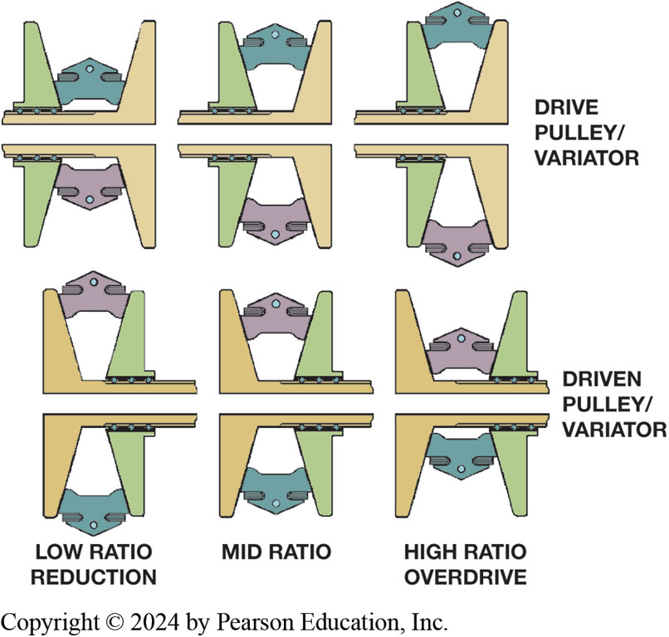
Figure 13.4
Drive pulley is wide while driven pulley is narrow for a low ratio vehicle start (left). Ratio changes by making drive pulley narrow and driven pulley wider.
Notes:
When the vehicle is at rest, the primary pulley is wide so the belt sits low on the pulley, and the secondary pulley is narrow so the belt sits high. This produces the lowest under-drive ratio. ● See Figure 13.4.
The secondary pulley is spring loaded to force it to a narrow position. The primary pulley is adjusted to control the gear ratio, and the secondary pulley is adjusted to maintain tension on the belt. The belt must never be loose between the pulleys.
At start, pulley halves/discs on the input (primary) shaft are spread apart, and the pair of pulley halves on the output (secondary) shaft are pushed together. This produces a small pulley driving a large pulley, which produces the lowest drive ratio.
As vehicle moves, the floating side of the primary pulley moves inward, making pulley narrower and forcing belt to move out to a wider diameter. This produces a higher gear ratio.
Both pulleys must maintain enough pressure on drive belt to transfer required torque. Fluid pressure is used to force drive piston/pulley to a narrower position and driven pulley to a wider position. The secondary pulley is spring loaded to force it to a narrow position. The primary pulley is adjusted to control the gear ratio, and the secondary pulley is adjusted to maintain tension on the belt. The belt must never be loose between the pulleys. A reverse gear set, controlled by a multi-plate clutch pack, is used to produce reverse.
Long Description:
There are three ratios: low ratio reduction, mid ratio, and high ratio overdrive. For the low ratio reduction, the drive pulley slash variator is broad and the driven pulley slash variator is narrow. For the mid ratio, the drive pulley slash variator is medium and the driven pulley slash variator is medium. For the high ratio overdrive, the drive pulley slash variator is narrow and the driven pulley slash variator is broad.

Slide 12
Animation: CVT Ratio Control (Animation will automatically start)

Slide 13
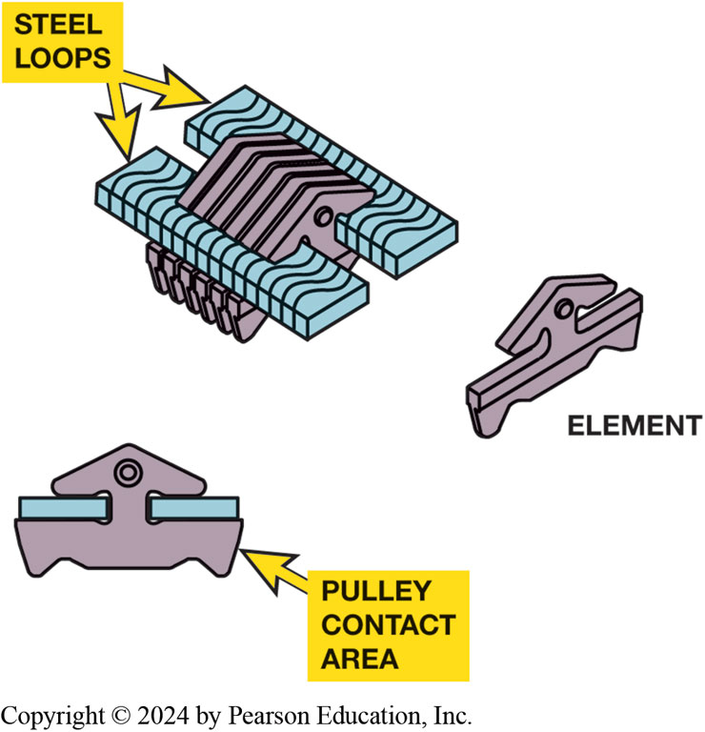
Figure 13.5
A Typical push-type C V T belt construction.
Notes:
Long Description:
There are three subparts in the image. The first subpart is labeled as an element. It is shaped like a long horizontal bar with a tree-shaped attachment on the top. The second subpart shows one element along with the steel loops on either side. These steel loops are inserted in the space between the bar and the tree-shaped attachment of the element. The lower part of the element is labeled as the pulley contact area. The third subpart shows many parallel elements with many steel loops on either end.

Slide 14
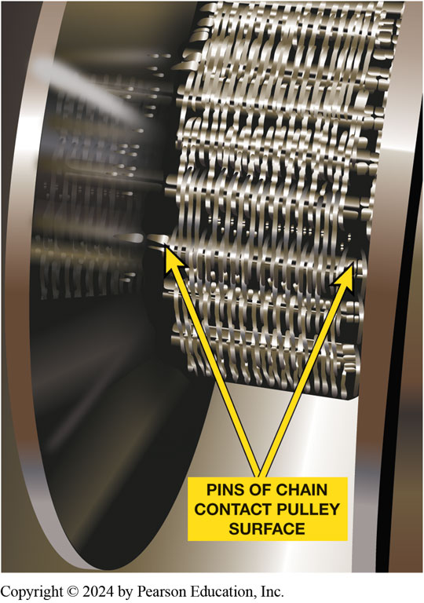
Figure 13.6
The pull chain looks similar to a silent chain

Slide 15
Chart 13.1
C V T Transaxle Types
Vehicles that use a push-type C V T (belt-type) | Vehicles that use a pull-type C V T (chain-type)
Honda (Accord, Civic, Civic hybrid, Insight hybrid) | Audi (A 4, S 4, R S 4)
Dodge Caliber | Ford (500, Freestar, Freestyle)
Jeep (Compass, Patriot) | Mercury (Montego, Monterey
Mini Cooper | Subaru Lineartronic (Legacy, Forester, Impreza, Outback)
Mitsubishi (Lancer, Outlander) | Blank
Nissan (Altima, Cube, Maxima, Murano, Rogue, Sentra, Versa) | Blank
Saturn (Aura, Ion, Vue) Subaru Justy | Blank
Suzuki S X 4 | Blank
Toyota Corolla | Blank
Notes:
Vehicles that use a C V T transaxle, separated by type: either push-type (belt) or pull-type (chain). Check service information for the exact years and types of transmissions used for each model.

Slide 16
C V T Electronic Controls (1 of 3)
Inputs: (Page 186-189)
Transmission Range Sensor
Input Speed Sensor
Output Speed Sensor
Primary Pressure Sensor
Secondary Pressure Sensor
Transmission Temperature Sensor

Slide 17
C V T Electronic Controls (2 of 3)
Indirect inputs from C A N bus include: (Page 186-189)
P C M requests
Engine output torque
Brake switch
A B S status signals
Charging system voltage
Engine R P M
Engine coolant temperature

Slide 18
C V T Electronic Controls (3 of 3)
Accelerator pedal position
Vehicle speed
A/C system requests
Outputs
Radio control motor
Stepper motor
Line pressure solenoid
Secondary pressure solenoid
T C C lockup solenoid

Slide 19
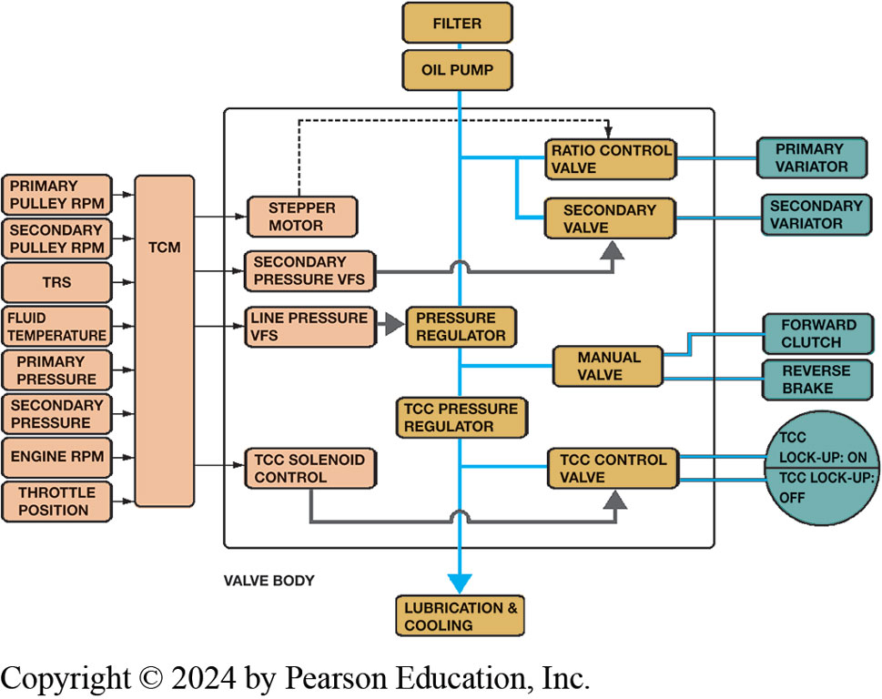
Figure 13.7
Block Diagram
Block diagram showing the relationship between the T C M, electrical actuators, valve body, and hydraulic actuators for a C V T transmission
Notes:
Long Description:
The top block is the filter and the next below it is the oil pump. The arrow from the oil pump goes straight through the pressure regulator and T C C pressure regulator in the valve body down to lubrication and cooling. The right side of the valve body shows many blocks which are as follows from top to bottom. Primary variator, secondary variator, forward clutch, reverse brake, and a circle with T C C lock hyphen up on and lock hyphen up off. The primary variator joins the ratio control valve which joins the main line from the oil pump. The secondary variator joins the secondary valve which joins the line from the ratio control valve to the oil pump line. The next two blocks are the forward clutch and reverse brake which joins the manual valve which joins the oil pump line. The circle with the T C C lock on and off joins the T C C control valve which joins the oil pump line. The ratio control valve, secondary valve, manual valve, T C C control valve, pressure regulator, and T C C pressure regulator are inside the valve body. The left side of the valve body shows many blocks which are as follows from top to bottom. Primary pulley rpm, secondary pulley rpm, T R S, fluid temperature, primary pressure, secondary pressure, engine rpm, and throttle position. All these eight blocks join a single long block labeled T C M. Four arrows go out from the T C M block to four different blocks labeled stepper motor, secondary pressure V F S, line pressure V F S, and T C C solenoid control which are inside the valve body. A dotted arrow goes from the stepper motor to the ratio control valve. An arrow goes from the secondary pressure V F S to the secondary valve through the main line from the oil pump. The line pressure V F S goes to the pressure regulator. The T C C solenoid control goes to the T C C control valve through the main line from the oil pump.

Slide 20
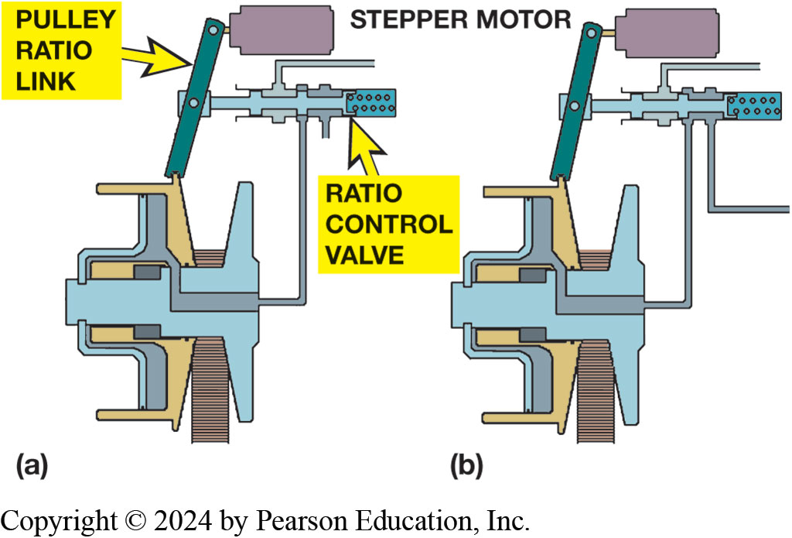
Figure 13.8
Stepper Motor
(a) stepper motor and pulley ratio link with the C V T in low ratio. (b) The stepper motor has extended, moving the ratio link and ratio control valve; this should cause the primary pulley to become narrower to produce a higher ratio.
Notes:
Long Description:
The first image shows a pulley attached to a pulley ratio link. The pulley ratio link is shown as a rod that is attached at one end to the pulley and the other end to the stepper motor. The stepper motor is shown as a rectangle that is fixed to the pulley ratio link by a screw. Below the stepper motor, the ratio control valve is present which is also connected to the pulley and the rod of the pulley ratio link. The second image shows a pulley attached to a pulley ratio link. The pulley ratio link is shown as a rod that is attached at one end to the pulley and the other end to the stepper motor. The stepper motor is shown as a rectangle that is fixed to the pulley ratio link by a screw. Below the stepper motor, the ratio control valve is present which is also connected to the pulley and the rod of the pulley ratio link. The stepper motor is shown to be extended. This causes the movement of both the pulley ratio link and the ratio control valve.

Slide 21
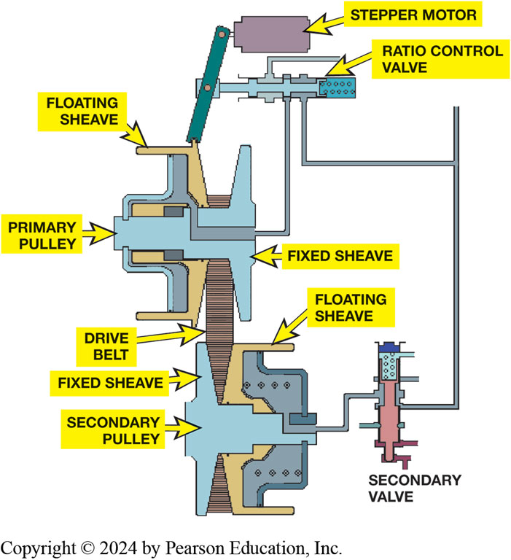
Figure 13.9
Movement
Movement of either stepper motor or primary floating sheave will move the ratio control valve to add or remove fluid from the primary pulley. The secondary valve maintains the necessary pulley pressure on the drive belt
Notes:
Long Description:
The image shows a pulley attached to a pulley ratio link. The pulley ratio link is shown as a rod that is attached at one end to the pulley and the other end to the stepper motor. The stepper motor is shown as a rectangle that is fixed to the pulley ratio link by a screw. Below the stepper motor, the ratio control valve is present which is also connected to the pulley and the rod of the pulley ratio link. The floating sheave is present at the junction of the attachment of the pulley ratio link to the primary pulley. The primary pulley has a fixed sheave at the side which attaches to the ratio control valve. A drive belt is shown at the lower end of the primary pulley. This drive belt connects the primary pulley to the secondary pulley. The drive belt attaches to a point where the fixed sheave and the floating sheave of the second pulley meet. Below the fixed sheave, the secondary pulley is present. The secondary valve connects to the secondary pulley and also connects to the ratio control valve.

Slide 22
C V T Operation
Describe what happens during
Starting
Reverse
Forward

Slide 23
Animation: CVT Forward and Reverse (Animation will automatically start)

Slide 24
C V T Torque Converter
Most C V T transmissions use a low-profile elliptical torque converter with a lockup clutch
Since C V T S are infinitely variable torque converter not needed once the vehicle is moving.

Slide 25
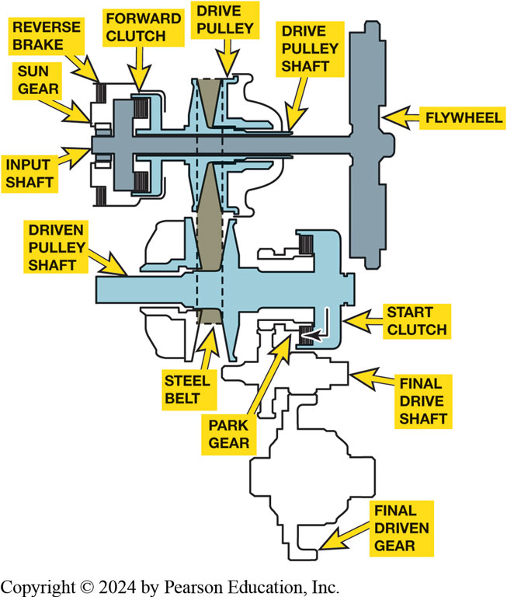
Figure 13.10
Honda C V T power flow in park (P) and neutral (N).
Operation
Forward clutch
Reverse brake
Start clutch
Servicing A Honda C V T Pages (189-190)
Notes:
Long Description:
Two shafts are seen, the top is the drive pulley shaft and the bottom is the driven pulley shaft. The drive pulley shaft is attached to the flywheel on the right. The drive pulley is located in the middle of the drive pulley shaft which connects to the steel belt of the driven pulley shaft. The forward clutch is present next to the drive pulley of the drive pulley shaft. A vertical bar is present in the shaft to the left of the forward shift. On the left of the vertical bar, the end of the shaft is seen. The end of the shaft is labeled as the input shaft. The sun gear and the reverse brake are present above the input shaft. A steel belt is present in the middle of the driven pulley shaft. A start clutch is present at the front of the driven pulley shaft. The clutch is present as a vertical bar at the end of the horizontal shaft. A curved arrow is shown inside the clutch that turns inward into the park gear. The park gear is connected to the final drive shaft below it. The final drive shaft is connected to the final driven gear below it.

Slide 26
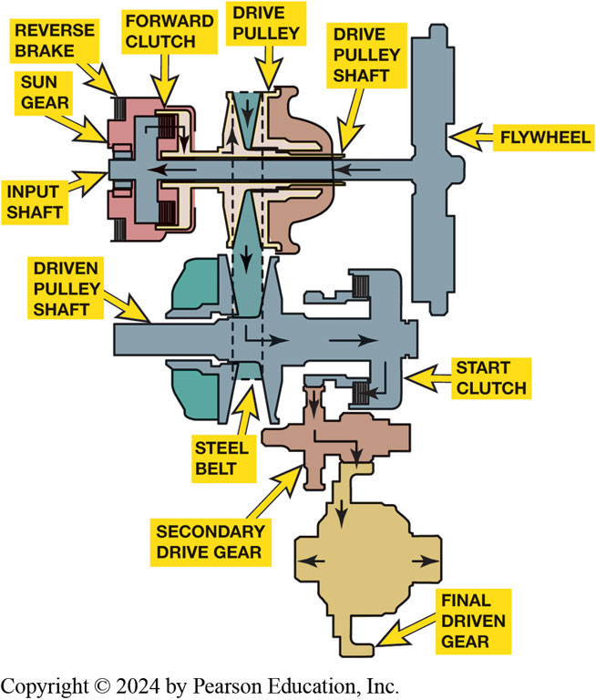
Figure 13.11
Honda C V T operation in drive (D) or low (L).
Notes:
The forward clutch and the start clutch are in operation whenever the transmission is placed in a forward gear position (D or L). ● See Figure 13.11. For the reverse function, a planetary gear set is used in conjunction with the reverse brake. When the reverse brake is applied, the planet carrier is held and the sun gear (splined to the input shaft) causes the ring gear to turn backward. The ring gear is attached to the drive pulley through forward clutch drum, so the drive pulley also turns backward. This torque is sent through the start clutch and the vehicle moves in reverse.
Long Description:
Two shafts are seen, the top is the drive pulley shaft and the bottom is the driven pulley shaft. The drive pulley shaft is attached to the flywheel on the right. The drive pulley is located in the middle of the drive pulley shaft which connects to the steel belt of the driven pulley shaft. The forward clutch is present next to the drive pulley of the drive pulley shaft. A vertical bar is present in the shaft to the left of the forward shift. On the left of the vertical bar, the end of the shaft is seen. The end of the shaft is labeled as the input shaft. The sun gear and the reverse brake are present above the input shaft. A steel belt is present in the middle of the driven pulley shaft. A start clutch is present at the front of the driven pulley shaft. The clutch is present as a vertical bar at the end of the horizontal shaft. A curved arrow is shown inside the clutch that turns inward into the secondary drive gear. The secondary drive gear is connected to the final driven gear below it. Arrows are shown inside the drive pulley shaft from the flywheel to the input shaft. Arrows also go down inside the drive pulley of the drive pulley shaft and go into the steel belt and turn right into the start clutch. The arrows then turn again and into the secondary drive gear. The arrows enter the final driven gear. An arrow is shown in the left and right parts of the final driven gear.

Slide 27
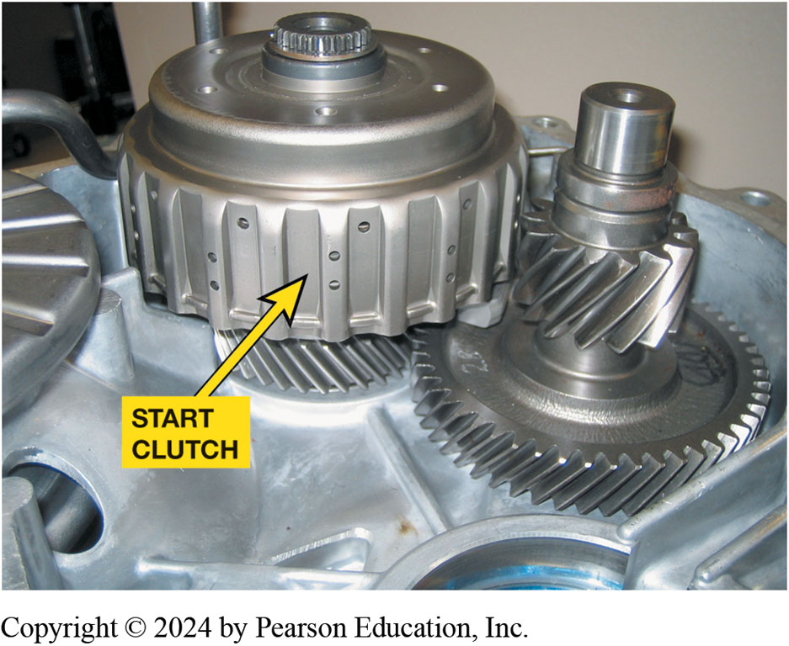
Figure 13.12
Location of the Honda C V T start clutch. The start clutch has been eliminated and replaced by a torque converter in newer models
Notes:
Start clutch has multiple responsibilities, including the following:
The start clutch is engaged whenever the vehicle is moving, in either forward or reverse.
It helps the vehicle accelerate from a standstill by slipping and then fully engaging once the vehicle is moving, similar to a manually operated clutch. ● See Figure 13.12.
The Honda C V T, like any other automatic transmission, uses hydraulic pressure to perform its various functions. The belt drive, the multiple-disc clutches, and the control system will all stop functioning without hydraulic pressure. This pressure is supplied by a chain-driven pump that is driven by transmission input shaft.

Slide 28
Pressure Testing C V T
Pressure Testing
Typical pressures:
Mainline pressure 70 to 900 P S I (485 to 6,200 k P a)
Primary pressure 15 to 900 P S I (100 to 6,200 k P a)
Secondary pressure 15 to 900 P S I (100 to 6,200 k P a)
Notes:
Measuring the C V T oil pressures is
similar to performing pressure testing on conventional automatic transmissions/transaxles. Always check service information for the exact procedures to follow and the location of the pressure tap. ● See Figure 13.13.

Slide 29
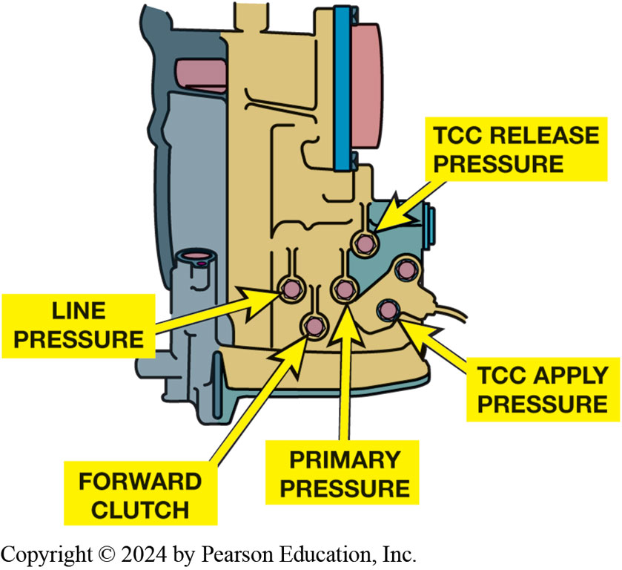
Figure 13.13
Pressure Taps
The pressure tap locations as found on a Dodge Caliber C V T transaxle
Notes:
Warning: The pressure can exceed 1,000 P S I (6,900 k P a) and a leak from the tester could cause personal injury.
Always uses a high-pressure gauge and follow the vehicle manufacturer’s recommended procedures.

Slide 30
C V T Fluid
Checking C V T fluid level
Replacing C V T Fluid
C V T Fluid Options
Option 1
Option 2

Slide 31
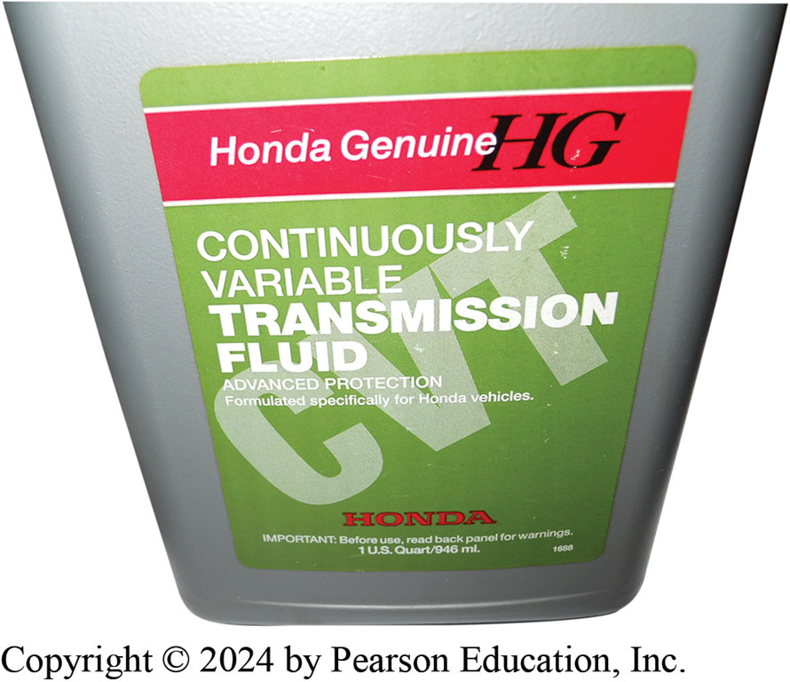
Figure 13.14
C V T Fluid
Using exact fluid recommended by the vehicle manufacturer is the preferred choice when servicing a C V T transaxles.

Slide 32
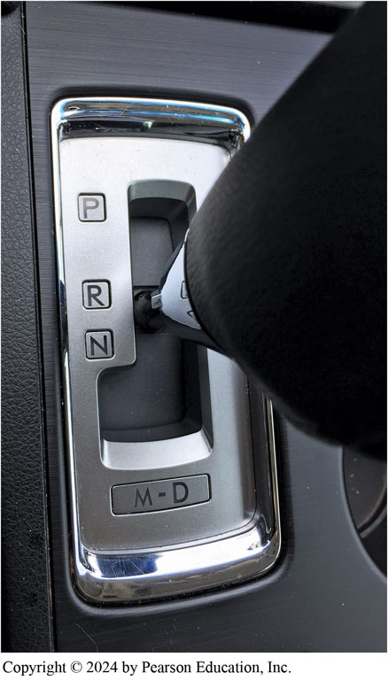
Figure 13.15
The “fix” to the customer concern was to perform a relearn procedure using the gear selector following the instructions found in a T S B.
Notes:
Case Study The Case of the Delayed Shift Subaru
The owner of a Subaru Legacy complained that the C V T (T R 5 8 0) transmission was slow to engage from park to reverse and from drive to reverse. The technician assigned to the vehicle was able to verify that it required as long as four seconds to shift from drive to reverse or from neutral to reverse. After performing a through visual inspection, including a fluid level check, and not finding any issues, a scan tool was used to see if there were any transmission related diagnostic trouble codes. There were none so the technician checked for any T S B s and found one (#16-97-15) that did address customer complaint. In the T S B, there was a procedure to follow to relearn the T C M, which stated that this should be performed if there is a lag time greater than 1.5 seconds. The technician performed the relearn control procedure that included the following steps:
• Shift into “N” for 5 second, then shift into “R” for 3 seconds, and then shift back into “N” Repeat 10 times.
• Stay in “N” for 5 seconds, then shift into “D” for 3 seconds, and then shift back into “N” Repeat 10 times.
After 10 times, perform the “time lag test” again to confirm if this procedure corrected customer complain.
The technician was pleased that the relearn procedure did result in a delay time of less than a second. The customer was very pleased too because it did not require an expensive repair.
Summary:
Complaint—Customer complained of excessive time into a drive gear.
Cause—The transmission needed to be relearned.
Correction—The relearn procedure as found in a T S B was used to relearn the shifting of the C V T.
● Figure 13.15.

Slide 33
C V T Noise Issues
Describe what the following sounds mean
(Pages 191-192)
“Growl”
“Whine”
“Ticking”

Slide 34
C V T-Related Diagnostic Trouble Codes
Diagnostic Trouble Code (D T C) | Description
P0219 | Engine speed excessive—check for speed sensor or transmission slip codes
P0571 | Brake switch fault detected
P0707; P0708 | TCM detects improper signal from transmission range switch (P0707— signal low; P0708—signal high)
P0711; | Transmission temperature sensor
P0712; | (T S S) fault detected (P0711—circuit
P0713 | performance; P0711—signal low;
 | P0713— signal high)
P0716; P0717 | Transmission input speed sensor (I S S) fault detected (P0716—circuit performance; P0717—no signal)
P0721; P0722 | Transmission output speed sensor (O S S) fault detected (P0721—circuit performance; P0722—no signal)
P0730 | Incorrect gear ratio detected (transmission slip)
P0746 | Line pressure sensor performance issue detected
P0776; P0777 | Secondary pressure sensor (S P S) fault detected (P0776—performance fault; P0777—stuck on)
P0842; P0843 | Primary oil pressure (P O P) sensor fault detected (P0842—sensor circuit low; P0843—sensor circuit high)
P0847; P0848 | Secondary oil pressure (S O P) sensor fault detected (P0847—sensor circuit low; P0848—sensor circuit high)
Notes:
Typical continuously variable transmission (C V T) diagnostic trouble codes (D T C s) and code description. Transmission-related D T Cs are usually P 0 7 X X or P 0 8 X X, where X X represents the specific fault code.

Slide 35
Question 1
How is a variable ratio achieved in a C V T?
A. By using multiple gears
B. By using a steel belt with two variable-width pulleys
C. By using a start clutch assembly
D. By using a variable-torque converter

Slide 36
Answer 1
How is a variable ratio achieved in a C V T?
B. By using a steel belt with two variable-width pulleys

Slide 37
Summary (1 of 2)
C V T varies gear ratio in a continuous manner instead of in a series of steps or fixed gear ratios.
A pair of hydraulically controlled variable-size pulleys is used with a steel-link drive belt or chain.
Two styles of fixed-length steel belts are used
Push belt or a pull chain is used

Slide 38
Summary (2 of 2)
T C M of a C V T uses direct and indirect inputs
Monitor transmission and engine operation
Stepper motor is a linear position motor.
Changes position of the upper end of the pulley ratio link
Measuring oil pressure is similar to pressure testing
Conventional automatic transmissions/transaxles

Slide 39
Automatic Transmissions and Transaxles Videos and Animations
Videos Link: (A2) Automatic Transmissions and Transaxles Videos
Animations Link: (A2) Automatic Transmissions and Transaxles Animations

Slide 40
Copyright
This work is protected by United States copyright laws and is provided solely for the use of instructors in teaching their courses and assessing student learning. Dissemination or sale of any part of this work (including on the World Wide Web) will destroy the integrity of the work and is not permitted. The work and materials from it should never be made available to students except by instructors using the accompanying text in their classes. All recipients of this work are expected to abide by these restrictions and to honor the intended pedagogical purposes and the needs of other instructors who rely on these materials.

