Slide 1
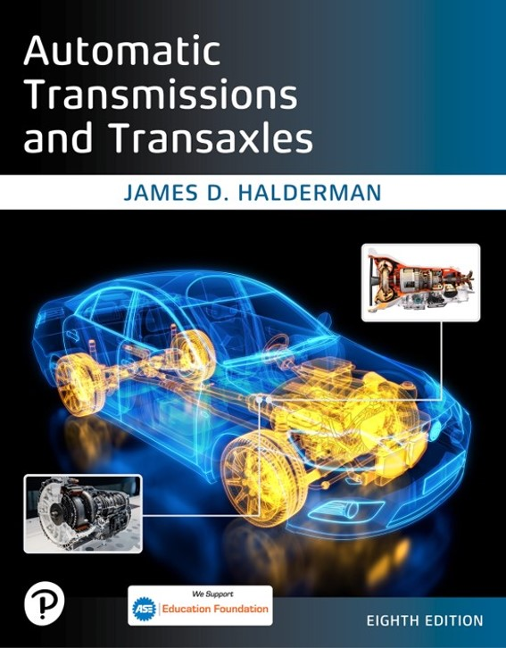
Automatic Transmissions and Transaxles
Eighth Edition
Chapter 12
E V and H E V Transmissions
Copyright © 2024, 2018, 2015 Pearson Education, Inc. All Rights Reserved
Notes:
If this PowerPoint presentation contains mathematical equations, you may need to check that your computer has the following installed:
1) Math Type Plugin
2) Math Player (free versions available)
3) NVDA Reader (free versions available)
INSTRUCTOR NOTE: This presentation includes text explanation notes, you can use to teach the course. When in SLIDE SHOW mode, you RIGHT CLICK and select SHOW PRESENTER VIEW, to use the notes.

Slide 2
Learning Objectives (1 of 2)
12.1 Describe the function of a hybrid electric vehicle (H E V) transmission.
12.2 Understand the relationship required between the I C E and electric motor(s).
12.3 Explain the purpose of an auxiliary electric pump or hydraulic impulse storage generator.
12.4 Describe the difference between a power-split system and an e C V T in a hybrid vehicle.

Slide 3
Learning Objectives (2 of 2)
12.5 Discuss the operation of a transmission in a fully electric vehicle.
12.6 Explain the operation of a two-speed gearing in an electric vehicle

Slide 4
Transmissions and Transaxles (1 of 2)
Series Hybrid
Sole propulsion is by battery-powered electric motor.
Electric energy for batteries comes from another on-board energy source, such as internal combustion engine.
Parallel Hybrid
Multiple propulsion sources can be combined,
One energy sources alone can drive vehicle.
Battery & engine are both connected to transmission.
Notes:
In R W D applications, it is most common to use a transmission along with driveshaft and differential at the rear axle to transmit torque to the drive wheels. The Lexus G S 4 5 0 h and L S 6 0 0 h are both examples of R W D hybrid electric vehicles. The Ford Mustang Mach-E standard configuration is an example of a rear-wheel-drive electric vehicle. In a F W D vehicle, a transaxle assembly is used with half-shafts to transmit torque to the drive wheels. A transaxle is the combination of a transmission, differential, and final drive gears built together as one assembly. A Toyota Prius and Hyundai Sonata hybrid are examples of F W D hybrid vehicles. The Chevrolet Bolt is an
example of a F W D electric vehicle. Figure 12.1.
In a 4 W D or A W D vehicle, a transfer case or rear electric motor is used to distribute power to all four wheels. The
Toyota Highlander/Lexus R X 4 5 0 h uses a transaxle on the front of the vehicle and an electric motor to drive the rear wheels in the 4 W D model. The 4 W D version of the Ford Escape hybrid uses a separate power take-off (P T O) from the transaxle to mechanically drive the rear axle.

Slide 5
Transmissions and Transaxles (2 of 2)
Series–Parallel Hybrid
Toyota and Ford hybrids can operate using electric motor power alone
Assistance of the I C E
Series–parallel hybrids combine both series & parallel design

Slide 6
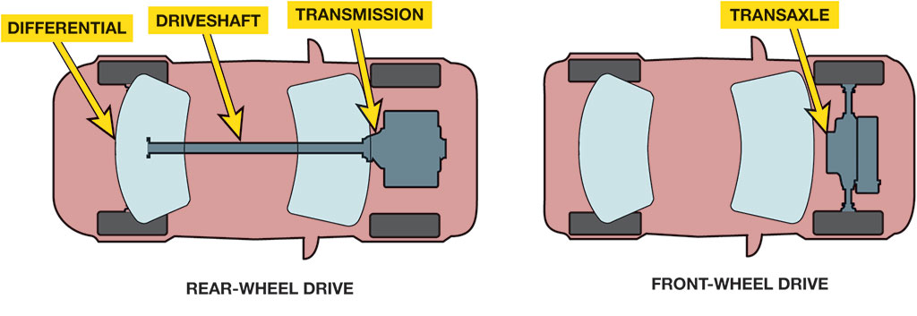
Drive Configuration
Notes:
Figure 12.1 Rear-wheel-drive (R W D) vehicles use transmissions to send torque to the rear differential and final drive. Front-wheel-drive (F W D) vehicles use a transaxle, which incorporates the differential and final drive into the transaxle case.
Long Description:
In the first part, an arc-shaped drive is labeled differential and a shaft labeled driveshaft emerges from a vertical cylindrical drive labeled transmission to the differential drive. The second part shows the absence of the driveshaft and the transmission drive being replaced with two vertical cylinders with a handle-like structure labeled transaxle fixed to front wheels of a vehicle.

Slide 7
Animation: Hybrid Vehicle (Animation will automatically start)

Slide 8
Animation: Hybrid Operating Modes (Animation will automatically start)

Slide 9
Animation: Honda Integrated Motor Assist, IMA System (Animation will automatically start)

Slide 10
Vehicle Transmission Configurations
Vehicle | F W D/R W D/A W D | Configuration
Toyota Prius 2001–2009 | F W D | E C V T 2 Motors/1 Planetary
Chevrolet Volt 2011–2015 | F W D | E C V T 2 Motors/1 Planetary/Clutches
Toyota Prius 2010–2015 | F W D | E C V T 2 motors/2 Planetary
Toyota Prius 2016–2021 | F W D/A W D | E C V T 2 Motors/2 Planetary/One-way clutch
General Motors 2 Mode 2009 | R W D/A W D | E C V T 2 Motors/3 Planetary/Clutches
Honda Accord Hybrid 2015 | F W D | E C V T 2 Motors/2 Clutches
Nissan Leaf 2011 | F W D | Electric Motor with gear reduction unit
Chevrolet Bolt 2017–2022 | F W D | Electric Motor with gear reduction unit
Notes:
Example Vehicle Transmission Configurations

Slide 11
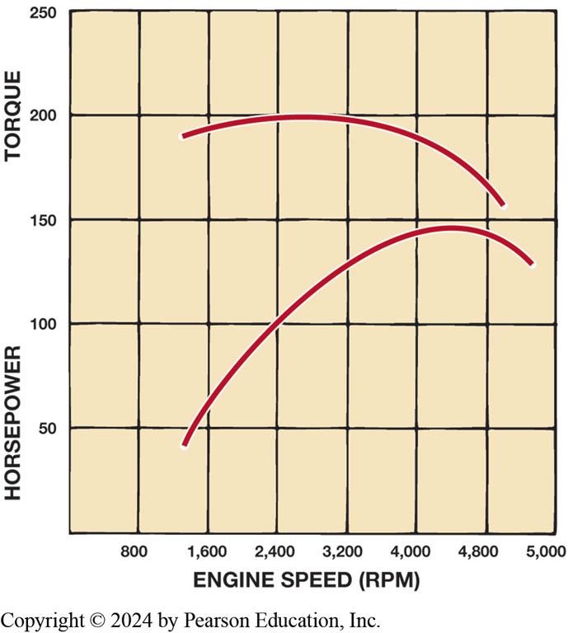
Figure 12.2
Torque versus H P
Graph showing engine torque versus horsepower output for typical internal combustion engine. I C E s produce maximum torque at a high R P M, whereas electric motors produce maximum torque at low R P M.
Notes:
To move a vehicle, torque must be applied to the drive wheels. Torque is twisting force. Torque is applied to the drive wheels to make the vehicle accelerate. The vehicle transmission is responsible for increasing engine torque in the lower speed ranges when acceleration is required, and then reducing engine speed for the best fuel economy when the vehicle is cruising. I C E s are
very different from electric motors in that they only produce torque in a relatively narrow RPM range. ● Figure 12–2. An I C E is most efficient when it is operating near its torque peak. This is the R P M when the engine is breathing most efficiently, and is typically where the engine can deliver
Long Description:
The horizontal axis ranges from 800 to 4,800 in increments of 800 and shows the last value 5,000. The vertical axis ranges from 50 to 250 in increments of 50. Two graphs are drawn against horsepower and torque. The values for horsepower ranges from 50 to 150 in increments of 50, while the values for torque ranges from 150 to 250 in increments of 50. The curve for horsepower is concave down increasing and passes through the following points: (1,300, 40), (2,400, 100), (4,800, 140), and (4,050, 125). The curve for torque is concave down decreasing and passes through the following points: (1,200, 180), (2,400, 200), (3,200, 198), (4,000, 175), and (4,820, 160).

Slide 12
Principles Involved
To move vehicle, torque must be applied to drive wheels.
I C E s produce maximum torque at high R P M
Electric motors produce maximum torque at low R P M
Keep I C E in most efficient range
Increase R P M range where engine produces torque
(“flattening” torque curve)
Increasing number of gear ratios
Easier to match vehicle road speed with most efficient engine R P M.
Notes:
Torque is applied to the drive wheels to make the vehicle accelerate. The vehicle transmission is responsible for increasing engine torque in the lower speed ranges when acceleration is required, and then reducing engine speed for the best fuel economy when the vehicle is cruising. I C E s are very different from electric motors in that they only produce torque in a relatively narrow R P M range. ● See Figure 12.2. An I C E is most efficient when it is operating near its torque peak. This is the R P M when the engine is breathing most efficiently, and is typically where the engine can deliver the best fuel economy. However, it is difficult to keep the engine in this range during all phases of vehicle operation. Automotive engineers overcome this difficulty in two ways:
1. By increasing the R P M range where the engine produces torque (“flattening” the torque curve)
2. By increasing the number of gear ratios in the transmission With more transmission ratios, it is easier to match the vehicle road speed with the most efficient engine R P M. Therefore, any torque increase is generated at the expense of speed. In other words,
when torque is increased in a transmission, output speed is decreased. Figure 12.3.

Slide 13
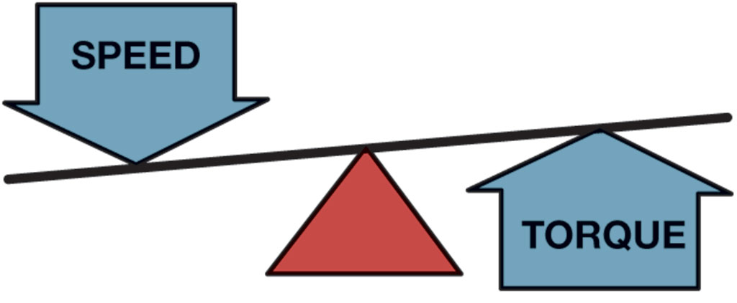
Figure 12.3
R P M Versus Torque
When output speed decreases in a transmission, output torque will increase.
Notes:
Years ago, it was common for vehicles with automatic transmissions to have only 2, 3, or 4 gear ratios. Currently, 5-, 6-, 7-, 8-, and 10-speed automatic transmissions are becoming common. With more emphasis being placed on fuel economy and lower emissions, the continuously variable transmission (C V T) is becoming more popular as it provides infinite gear ratios and best opportunity to maximize engine efficiency.

Slide 14
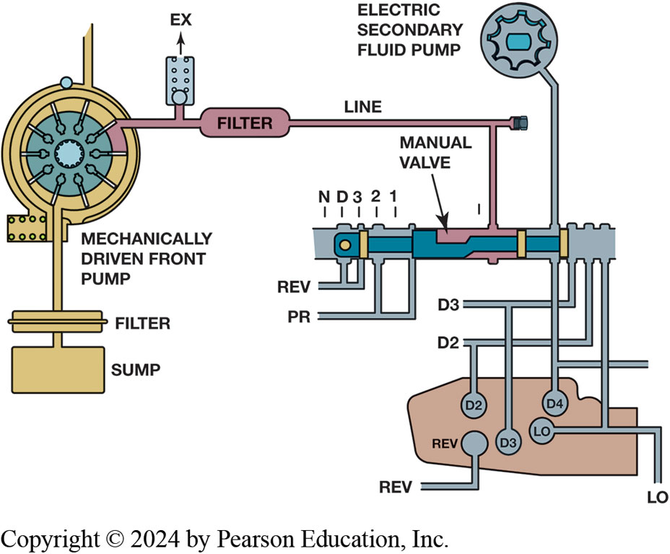
Figure 12.4
Hydraulic circuit diagram for this G M transmission includes a mechanical pump and an electric secondary fluid pump.
Electric Auxiliary Pump
Maintain fluid pressure during I C E idle-stop.
Sends pressure to regulator valve, manual valve
Directed to appropriate clutches
Prevents transmission from shifting into “neutral” @ idle-stop
Notes:
H E V transmissions are different based on the level of the hybrid vehicle in which they are installed. A mild hybrid with stop–start
system typically contains a transmission with a single electric motor. A full hybrid generally contains a transmission with two electric
motors.
Electric Auxiliary Pump In order to adapt a conventional automatic transmission to a hybrid powertrain, an electric auxiliary pump is used to maintain fluid pressure in the transmission during I C E idle-stop. This pump is powered by a D C brushless (A C synchronous) motor, which requires a special controller to provide the correct operating frequency and pulse width. When the auxiliary pump
is operating, it sends hydraulic pressure to the transmission regulator valve, and on to the manual valve where it is directed to the appropriate clutches. This prevents the transmission from shifting into “neutral” when the I C E is in idle-stop. Once the I C E restarts, the auxiliary pump is turned off and hydraulic pressure is again supplied by the mechanically driven transmission fluid pump. ● See Figure 12.4.
Long Description:
The mechanically driven front pump is in the form of a pulley with a filter and a sump. A line containing the outlet ex and a filter leads to a manual valve and an electric secondary fluid pump. The input ports of the valve are N, D, 3, 2, and 1. The input logic terminals are REV and P R. The output logic terminals are D 3, D 2, D 4, and L O. There is a case beneath the valve to which D 2, D 3, and D 4 terminals of the valve are connected to its corresponding terminals. The output terminal REV of the case is connected to the input terminal of the case. Similarly, the output terminal L O of the case is connected to the input terminal of the case.

Slide 15
Figure 12.5
H E V Transmissions
Hydraulic Impulse Storage Accumulator
Provides fluid pressure as
I C E restarts after idle-stop mode
Provides initial hydraulic pressure
Ensures there is no delay in acceleration
When the solenoid is energized, the accumulator releases the fluid creating the initial pressure needed at restart.
Notes:
Hydraulic Impulse Storage Accumulator is used to provide fluid pressure as the I C E restarts after
the idle-stop mode. During normal engine operation, the mechanical transmission pump provides the
hydraulic pressure and charges the accumulator. When the engine restarts, the accumulator provides
the initial hydraulic pressure and the mechanical pump provides the continuation of the pressure.
The pressure release from the accumulator ensures there is no delay in acceleration, and it
eliminates the need for an electric auxiliary pump. Figure 12.5.
Long Description:
It resembles a hand pump leftward containing a U-shaped and a cylindrical structure. There is a spring along the outer surface. There is a square-shaped component followed by a bottle-like structure in which fluid is filled up to an outlet in the bottom center.

Slide 16
G M Parallel Hybrid Truck (1 of 2)
Transmission gear selector lever can be placed in seven positions, as follows:
P—Park
R—Reverse
N—Neutral
D—Drive
3—Manual third
Notes:
The transmission in the 2004–2008 Chevrolet Silverado/G M C Sierra parallel hybrid truck (P H T) is based on the 4 L 6 0 E electronically controlled automatic transmission design with minor modification to adjust for its new role in a hybrid powertrain. It has four forward speeds and one reverse, with the fourth speed being an overdrive. It is designed primarily for medium- and large- displacement engines and is used extensively in G M pickups and S U V s. The specific model used in the hybrid pickup is known as the M 3 3.

Slide 17
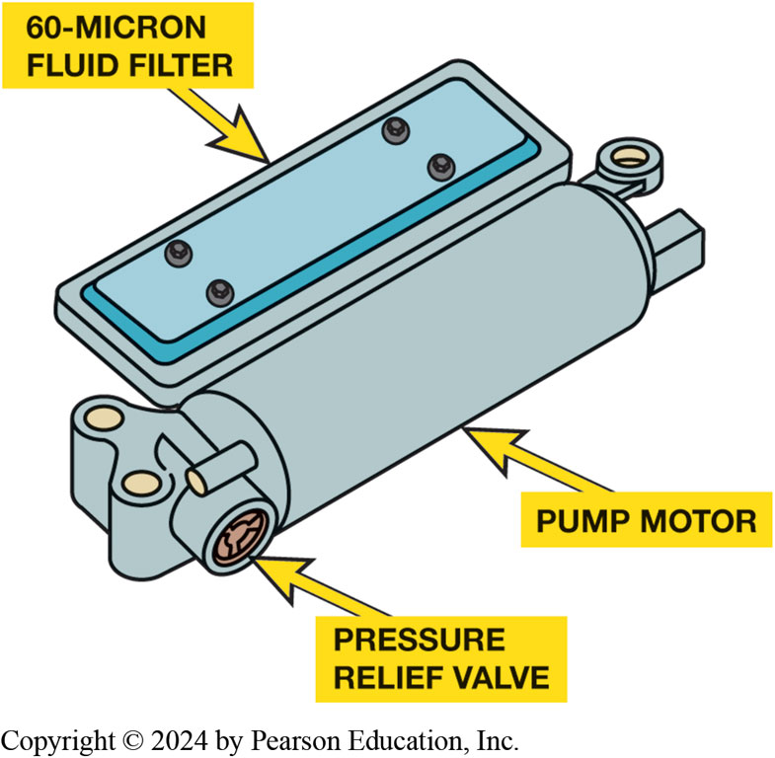
G M Parallel Hybrid Truck (2 of 2)
Construction
Operation
Service: Page 165
Figure 12.6 Electric secondary fluid pump from a 4 L 6 0 E transmission in a G M hybrid pickup.
Notes:
In idle-stop mode the engine stops, which will in turn stop the transmission oil pump and cause the transmission to go to “neutral.” To prevent this, an electric secondary fluid pump is installed on the valve body inside the transmission oil pan. Whenever the engine goes into idle-stop, the electric fluid pump is turned on to maintain oil pressure on the transmission forward clutch, and keep the drivetrain connected to the engine. This results in a smoother transition between idle-stop and engine restarting
as the vehicle resumes operation. ● See Figure 12.6.
The conventional 4 L 6 0 E transmission is made to allow the vehicle to coast or brake without any interference from the engine. To enable regenerative braking, the hybrid version of the 4 L 6 0 E transmission is made to apply the overrun clutch during coast or braking in the D 4 range and either third or second gear. This allows power to be transmitted back through the torque converter, which can then be used to generate electric current for recharging the 42-volt battery pack.

Slide 18
GM Two-Mode Hybrid Transmission (1 of 2)
Components
Three simple planetary gear sets with four multiplate clutches
Has four fixed gear ratios with two E V ratios
Components of the two-mode transmission include:
Two 60-k W electric motor/generators
Three planetary gear sets
Four wet plate clutches

Slide 19
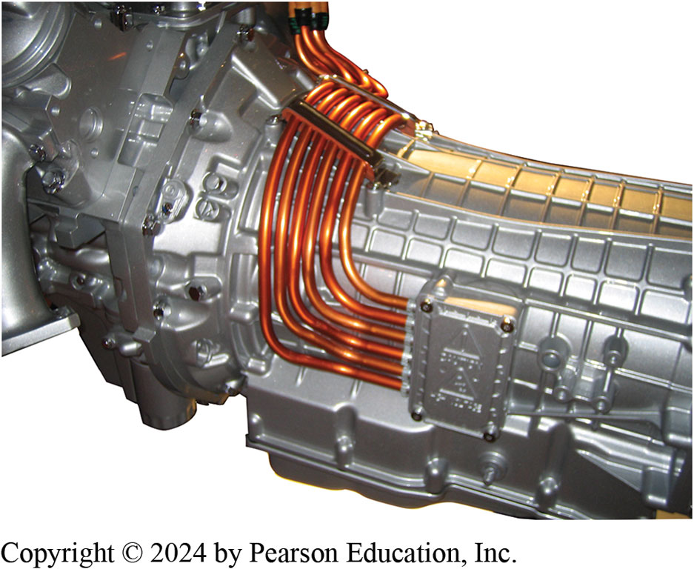
Figure 12.7
Two-mode transmission has orange high-voltage cable entering unit to carry electric energy from high-voltage battery pack to propel vehicle and also to charge the battery during deceleration.

Slide 20
GM Two-Mode Hybrid Transmission (2 of 2)
Operation
First mode is for accelerating from standstill to second gear
Second mode takes vehicle from second gear through to overdrive
Two-mode service
Notes:
First mode is for accelerating from standstill to second gear. At low speed and light load, the vehicle can be propelled by:
■ Either electric motor alone
■ I C E alone
■ Or a combination of the two (electric motor and/or I C E)
In this mode, the engine (if running) can be shut off under certain conditions and everything will continue to operate on electric power alone. The hybrid system can restart the I C E at any time as needed. One of the motor/generators operates as a generator to charge the high-voltage battery, and the other works as a motor to assist in propelling the vehicle.
The second mode takes the vehicle from second gear through to overdrive.
At higher loads and speeds, the I C E always runs. In the second mode, the motor/generators and
planetary gear sets are used to keep torque and horsepower at a maximum. As the vehicle speed
increases, various combinations of the four fixed ratio planetary gears engage and/or disengage to
multiply engine torque, and allowing one or the other of the motor/generators to perform as a
generator to charge the high-voltage battery. ● SEE FIGURE 12.8.
TWO-MODE SERVICE Routine service is all that is needed or required of the two-mode transmission.
Fluid-level check and visual inspection should be all that is required until the first scheduled
fluid change. Always use Dexron VI. Faults in the system will often set a diagnostic trouble code.
Unit repair of the unit requires an engine hoist or the lift arm of a vehicle lift to remove the
motor assembly. ● SEE FIGURE 12.9 A AND B.

Slide 21
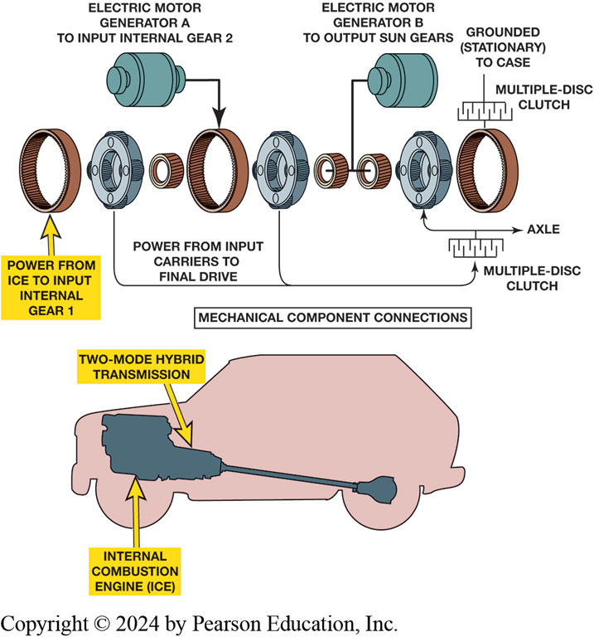
Figure 12.8
Two-Mode Parts
Using two planetary gear sets, I C E can be maintained in most efficient speed of about 2,000 R P M under most operating conditions
Notes:
Long Description:
All gears are bangle shaped, clutches are wheel shaped with holes, and electric motor generators are spool shaped. The last bangle-shaped component is a multiple-disk clutch. The planetary gear components labeled from left to right are as follows: power from I C E to internal gear 1, power from input carriers to final drive, electric motor generator A to input internal gear 2, electric motor generator B to output sun gears, axle (on the four ends of clutches), grounded (stationary) to case, and multiple-disk clutch. The planetary gear components are together labeled mechanical component connections. The internal combustion engine is a shoe-shaped component with a rod and a half-bottle-shaped component. The foot of the shoe-shaped component is labeled two-mode hybrid transmission.

Slide 22
Animation: Two-Mode Transmission Operation (Animation will automatically start)

Slide 23
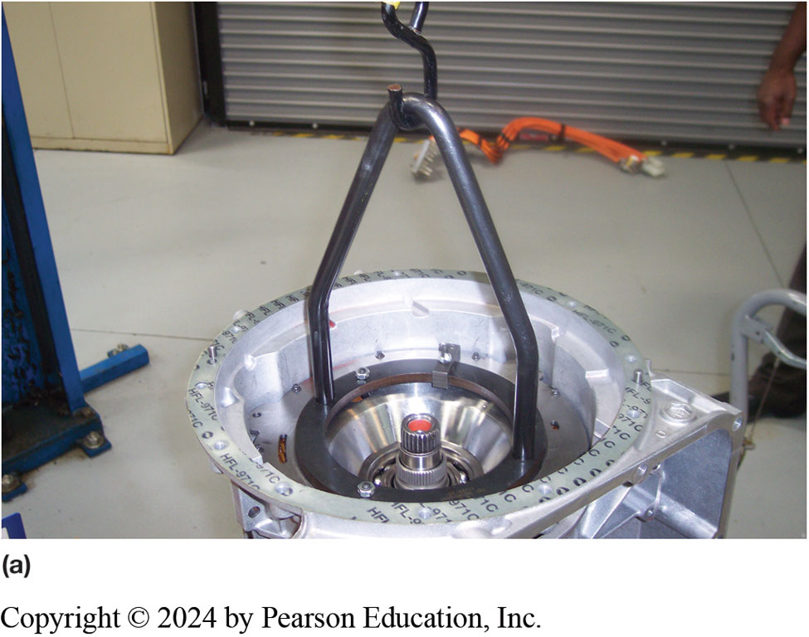
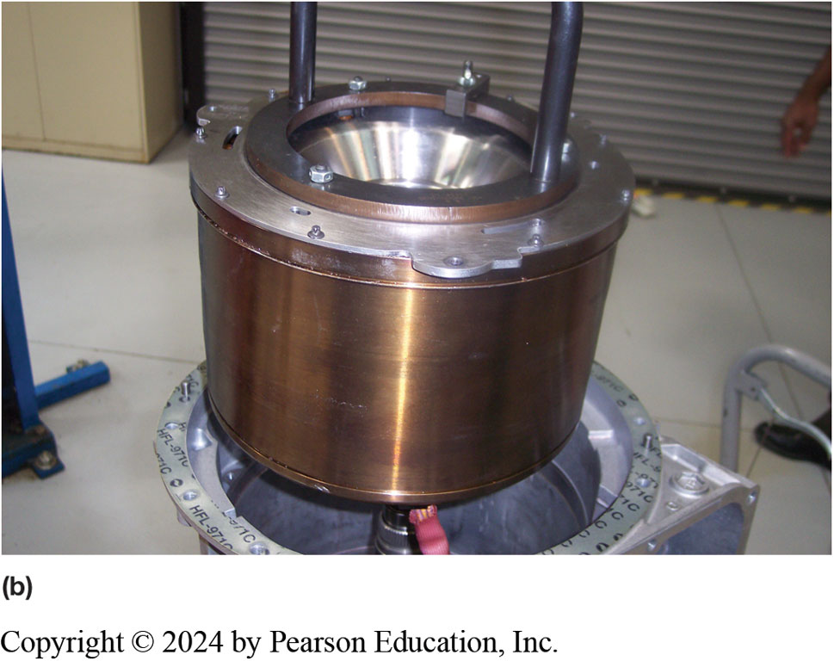
Figure 12.9
G M 2 M L 7 0 Service
(a) Disassembly of the 2 M L 7 0 transmission requires the use of a special tool and a lift or engine hoist to remove the motor assembly. (b) The motor assembly after being removed from the transmission

Slide 24
Ford/Lincoln 1 0 R 8 0 M H T (1 of 2)
10-speed hybrid transmission 2020 Explorer/Aviator
Plug-in hybrid
Still uses a torque converter
Electric motor and disconnect clutch are placed between engine and converter
Electric motor provides low-speed torque and additional power
6 inches longer non-hybrid model 10R80
Shares 90% of the same components
Notes:
10R80 M H T is a modular 10-speed hybrid transmission that was introduced in the 2020 Explorer
and the 2020 Lincoln Aviator plug-in hybrid. The transmission is unique because unlike most
hybrid transmissions, it still uses a torque converter. The continued use of the torque converter
improves towing and hauling capabilities. An electric motor and disconnect clutch are placed
between the engine and the torque converter. In addition to providing stop–start capabilities, the
electric motor provides low-speed torque and additional power. The M T H transmission is six inches
longer than the non-hybrid model (1 0 R 8 0) and shares 90% of the same components. Figure 12.10 A and B

Slide 25
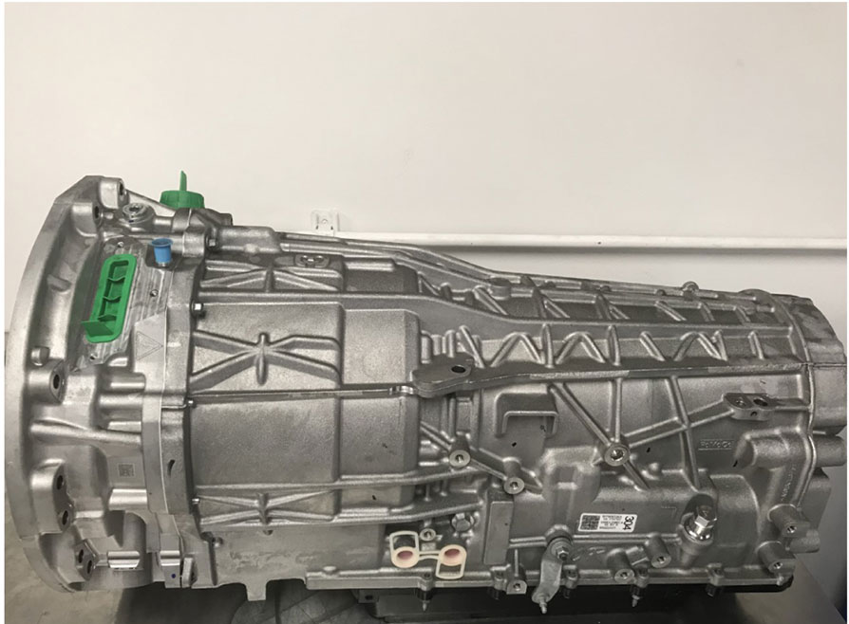
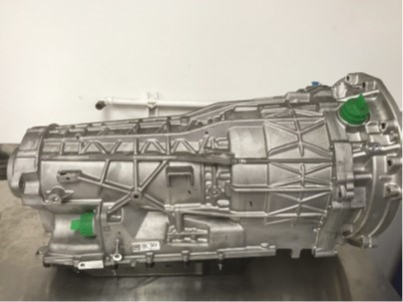
Ford/Lincoln 1 0 R 8 0 M H T (2 of 2)
(a)
(b)
Notes:
Figure 12.10 (a) The driver side of the transmission contains the high-voltage connections and the shift level assembly. The hybrid portion of the transmission is forward of the gasket. (b) The passenger side of the transmission contains the low-voltage connections.

Slide 26
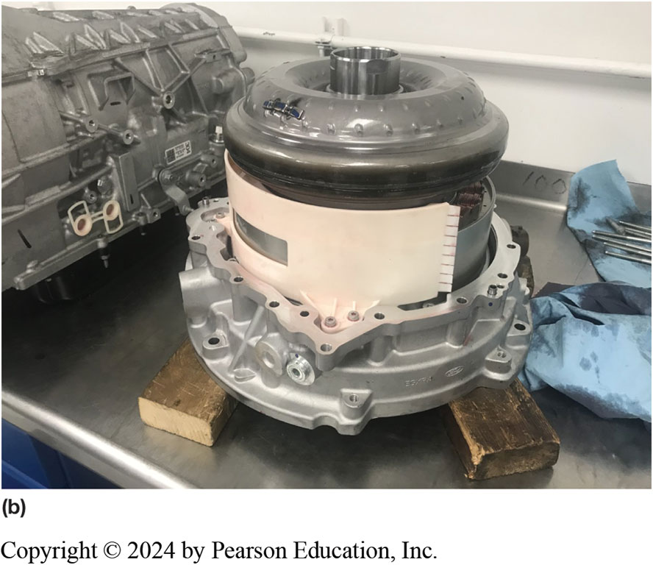
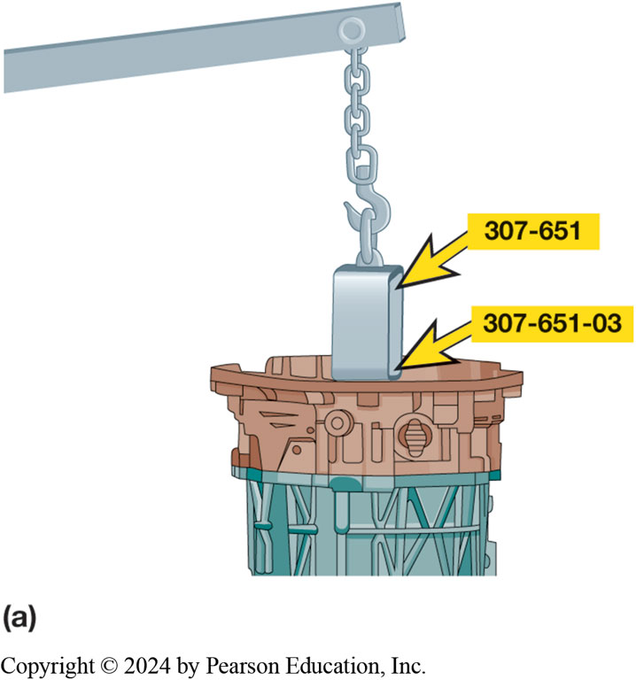
Figure 12.11
Removing Hybrid
Figure 12.11 (a) An engine hoist and adapter are used to remove the hybrid portion of the transmission. (b) The hybrid portion of the transmission resting on two wooden blocks after being removed from the transmission
Notes:
The components of the hybrid drive unit of the transmission are as follows:
■ Electric motor
■ Resolver (speed sensor)
■ High-voltage connection
■ Low-voltage connection
The hybrid drive unit is removed from the transmission as a unit. An engine hoist and special adapter are recommended when completing this task because of the weight of the unit. ● See Figure 12.11 A & B.
The electric motor is a permanent magnet three-phase motor that generates 33 kW of power. ● See Figure 12.12 A A & B.

Slide 27
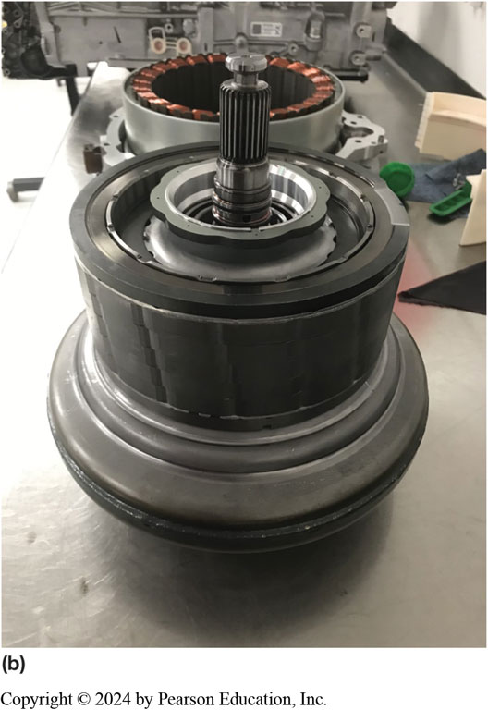
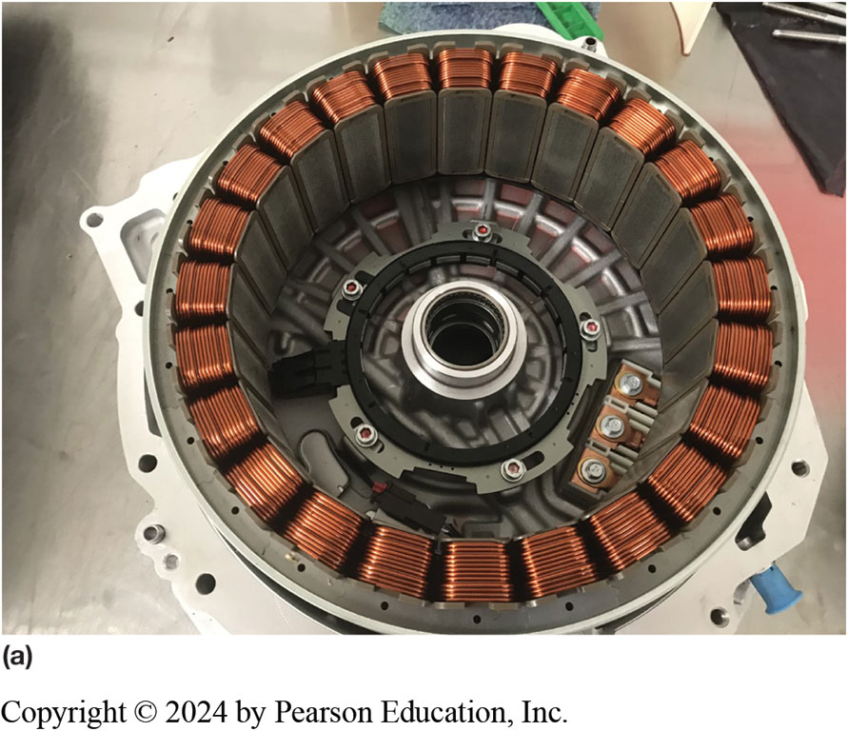
Figure 12.12
Motor Windings
(a) The motor windings attached to the housing after the rotor has been removed. (b) The rotor and torque converter assembly after being separated from the winding.

Slide 28
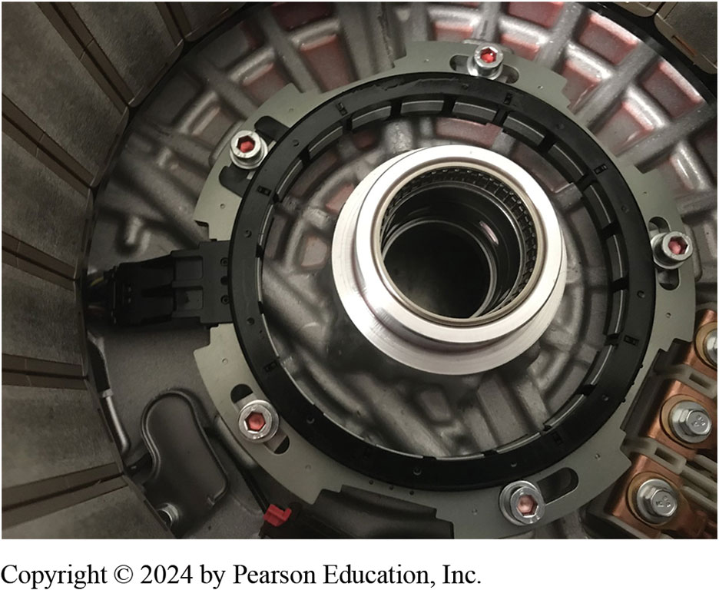
Figure 12.13
Resolver is the black and gray electrical sensor bolted to the housing at the bottom of the motor housing
Notes:
The resolver (speed sensor) provides the P C M with the speed, location, and direction of rotation of the electric motor. See Figure 12.13.

Slide 29
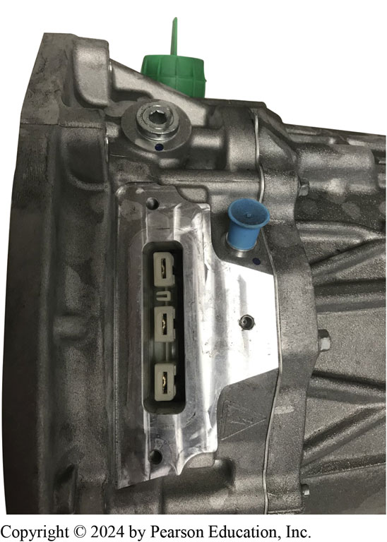
Figure 12.14
The three large flat connectors allow the electric motor to be connected to the I S C via the high-voltage cables.
Notes:
The high-voltage connector at the transmission allows the electric motor in the hybrid section of the transmission to be connected to the Inverter System Controller (I S C) via the orange- colored high-voltage insulated wiring. ● See Figure 12.14.

Slide 30
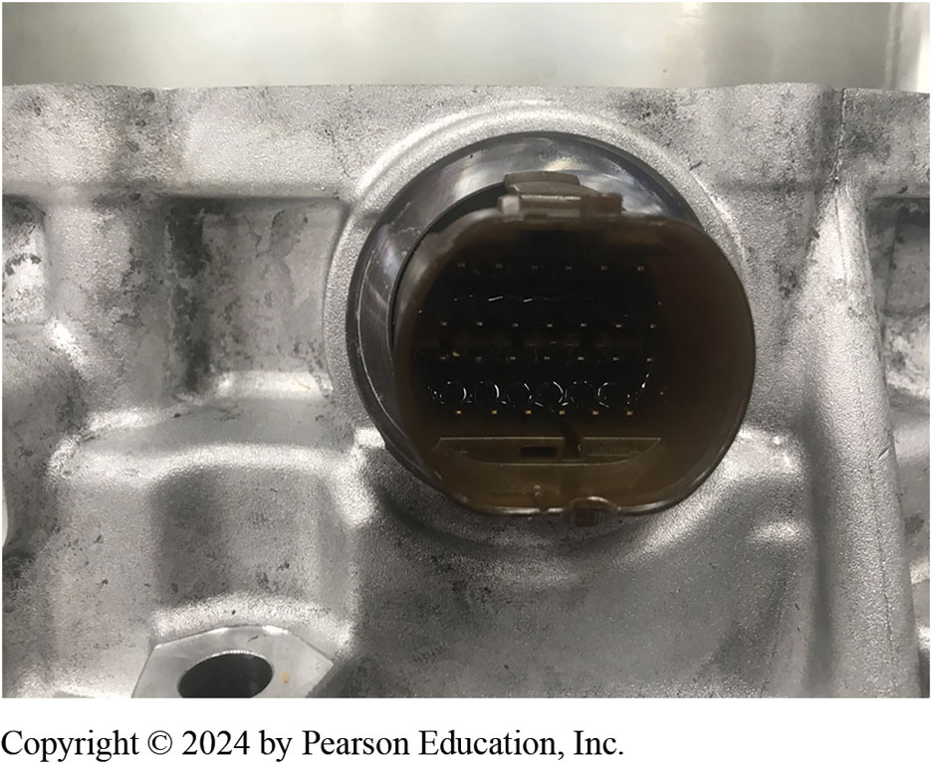
Figure 12.15
The low-voltage connector is for transmission control and monitoring.
Notes:
The low-voltage connectors at the transmission provide for traditional transmission control and monitoring by the powertrain control module. Figure 12.15.

Slide 31
Toyota/Lexus Power-Split System
Toyota/Lexus Power-Split System Operation:
Vehicle Stopped
Light Acceleration
Normal Driving
Full-Throttle Acceleration and High-Speed Cruise
Deceleration and Braking
Reverse
Notes:
Toyota/Lexus Power-split System
he power-split transaxle is a series-parallel hybrid technology. During most phases of vehicle operation, the system is operating as both series and parallel at the same time. While the control system is complex, the basic transaxle is very simple in design as it is built around a single planetary gear set (power-split device) and two electric motor/generators, called M G 1 and M G 2. ● SEE FIGURE 12.16.
A planetary gear set is composed of three main components:
1. Ring gear
2. Planet carrier
3. Sun gear

Slide 32
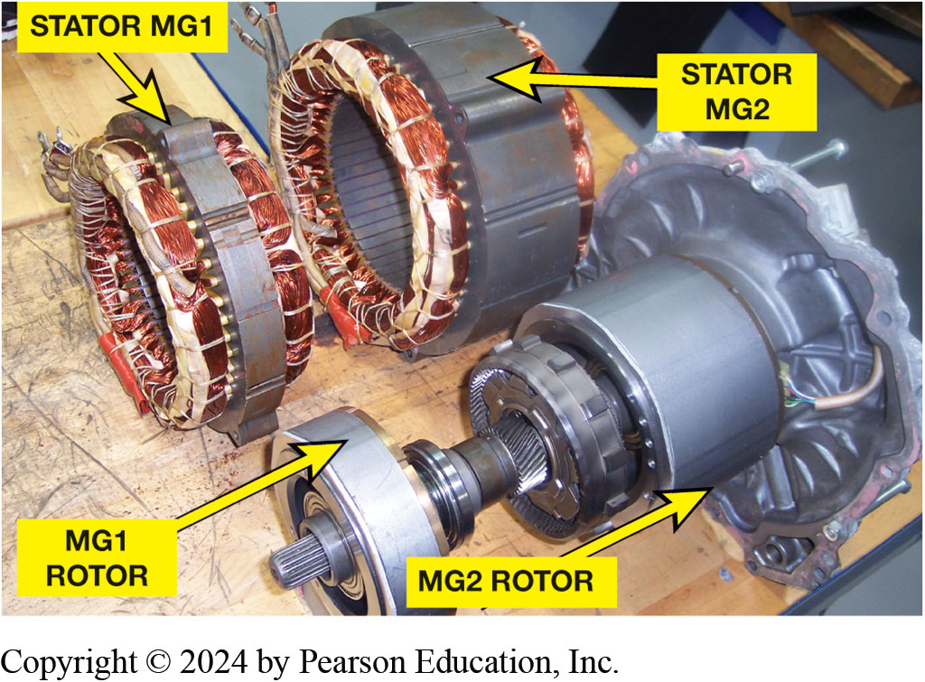
Figure 12.16
Toyota M G 1/M G 2
Toyota Hybrid System uses two electric motor/generators (M G 1 and M G 2) and an I C E, all connected together by a power-split device, which is a simple planetary gear set.

Slide 33
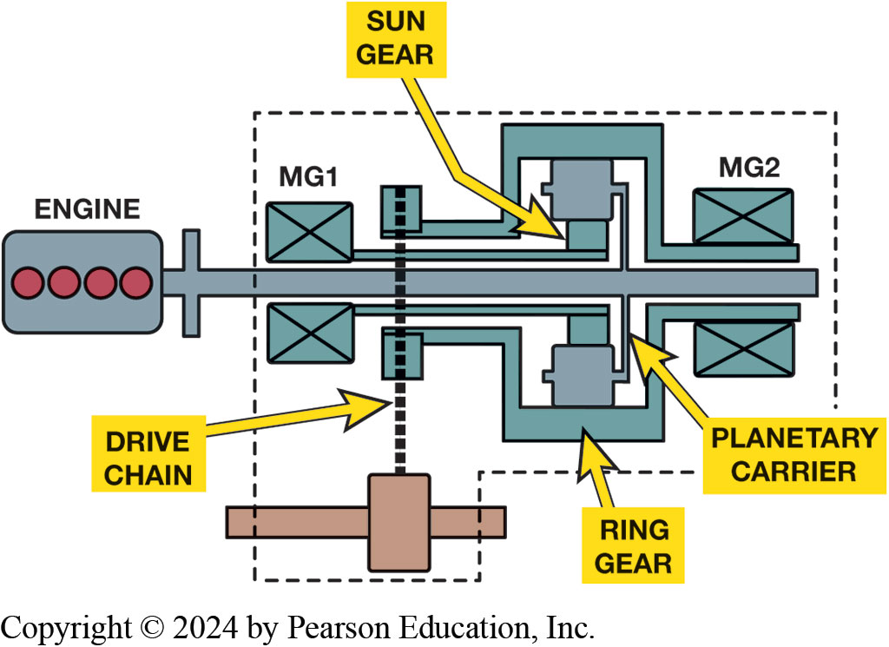
Figure 12.17
The power-split device from the Toyota Hybrid System. Note the vehicle will only move when M G 2 (and the ring gear) is turning.
Notes:
In the power-split transaxle, a large electric motor/generator (M G 2) is directly attached to transaxle final drive and to the planetary ring gear. The ICE is connected to planet carrier, and the small electric motor/generator (M G 1) is connected to the sun gear. ● See
Figure 12.17. The planetary ring gear always turns in the same direction as the drive wheels and its speed is directly proportional to vehicle speed. In other words, if the ring gear is not moving, the vehicle is not moving. The power-split device is so named because the I C E (attached to the planet carrier) splits its torque output between the sun gear (M G 1) and the ring gear (M G 2 and drive wheels).
Long Description:
There are the blocks of I C E, M G 1, and M G 2. There is a bar from the engine over which pair blocks of M G 1 and M G 2 are placed above and below and in between cylindrical blocks with square wave lines above and below. A square connected to the cylindrical block is labeled sun gear. A line connected between the cylindrical blocks is labeled planetary carrier. The square wave block is labeled ring gear. A chain next to M G 1 running across the squares of the left ends of the ring gears is labeled drive chain.

Slide 34
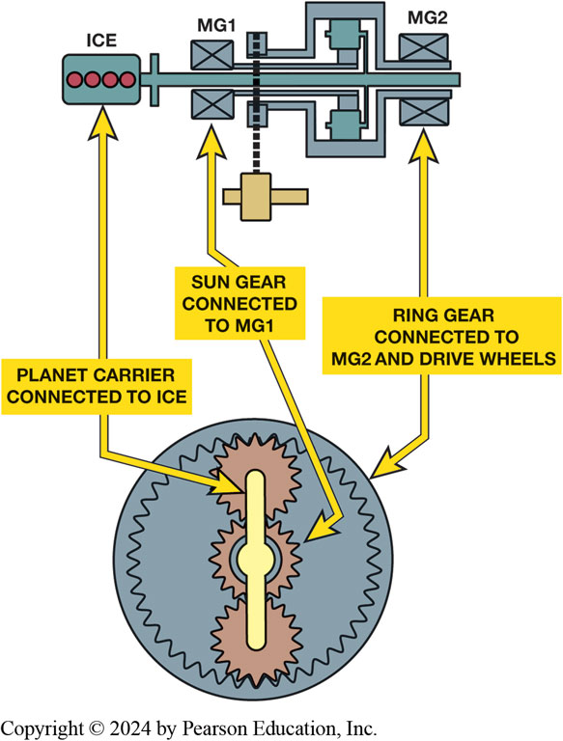
Figure 12.18
Planet Carrier
The planetary gear set used in the Toyota Hybrid System has 2.6 times number of teeth in its ring gear as it has in its sun gear. This means that the I C E (attached to the planet carrier) will send 72% of its torque to the ring gear (drive wheels) and 28% of its torque to the sun gear (M G 1).
Notes:
Long Description:
The illustration shows a wheel containing gears vertically held by a carrier in form of a bar in the middle. Above the wheel are blocks of I C E, M G 1, and M G 2. There is a bar from I C E over which pair blocks of M G 1 and M G 2 are placed above and below and in between cylindrical blocks with square wave lines above and below. Two-headed arrows with labels are between the following components: I C E to the carrier: planet carrier connected to I C E, M G 1 to the sun gear (the middle gear): sun gear connected to M G 1, and M G 2 to the wheel: ring gear connected to M G 2 and drive wheels.

Slide 35
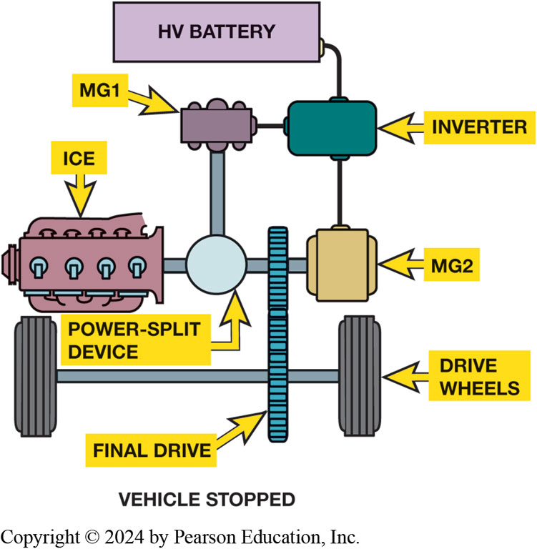
Figure 12.19
When the vehicle is stopped, the I C E is shut off along with both motor/generators.
Notes:
Vehicle Stopped. When the vehicle is stopped, nothing is happening within the vehicle drive system. The I C E is shut off, and both electric motor/generators are shut off as well. There are circuits within the vehicle that will use electrical energy from the auxiliary battery, but the drive system itself is effectively inert. The Toyota hybrid system does not use an auxiliary starter, but instead uses the M G 1 for starting under all conditions. ● Figure 12.19.
Long Description:
A vertical bar labeled final drive is in between the drive wheels. A horizontal bar from the final drive leads to a cylindrical block with extended shields labeled I C E, a spherical shaped component labeled power-split device on the left and a square block labeled M G 2 on the right. The power-split device is connected to M G 1. M G 1 and M G 2 are connected to an inverter. An H V battery is connected to the inverted and M G 2.

Slide 36
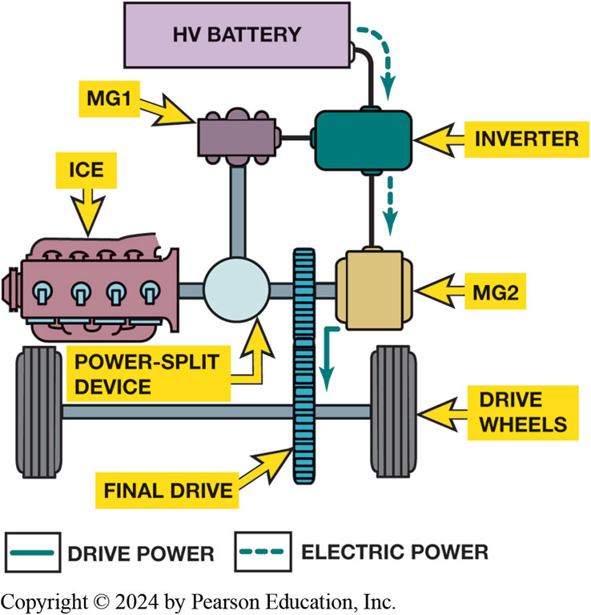
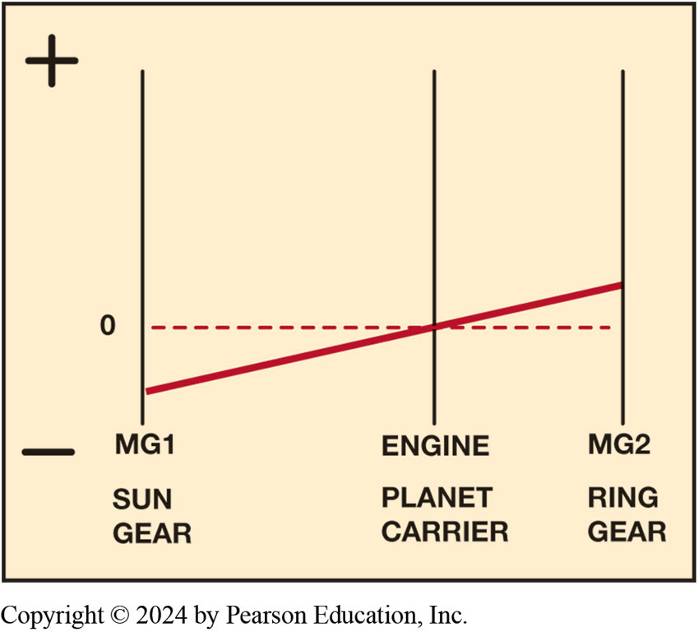
Light Acceleration
Figure 12.20 Under light acceleration, power is sent to M G 2 to move the vehicle.
Figure 12.21 Under light acceleration, the engine is stopped (0 R P M), M G 2 is turning forward (+), and M G 1 is turning backward (−).
Notes:
Long Description 1:
A vertical bar labeled final drive is in between the drive wheels. A horizontal bar from the final drive leads to a cylindrical block with extended shields labeled I C E, a spherical shaped component labeled power-split device on the left and a square block labeled M G 2 on the right. The power-split device is connected to M G 1. M G 1 and M G 2 are connected to an inverter. An H V battery is connected to the inverted and M G 2. In the diagram, dashed arrows indicate electric power and a solid arrow indicates drive power. A dashed arrow points from the H V battery to the inverter and one from the inverter to M G 2. A solid arrow points from M G 2 to the final drive.
Long Description 2:
The graph shows three vertical axes, on the left, in the middle, and on the right, with the left one having plus and minus at its ends. The horizontal axis shows three labels M G 1: sun gear, engine: planet carrier, and M G 2: ring gear corresponding to the three vertical axes. An upward line starts from a negative point on the left vertical axis corresponding to M G 1: sun gear, passes through the origin at engine: planet carrier, and ends at a positive point on the right vertical axis corresponding to M G 2: ring gear.

Slide 37
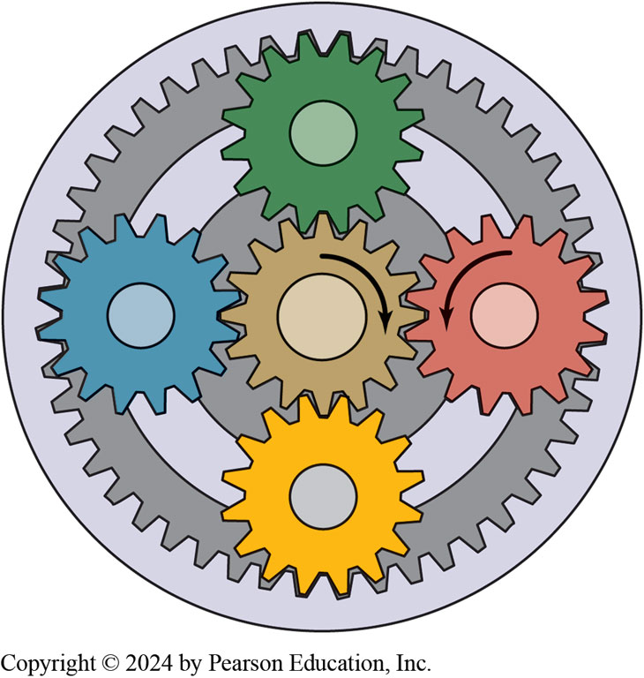
Figure 12.22
To start the I C E, M G 1 (sun) acts as a motor and turns clockwise (C W), causing the planet carrier (attached to the I C E) to also turn C W.
Notes:
Normal Driving. When higher vehicle speeds are required, the I C E must be started so that its output can be combined with that of M G 2. The ring gear is already turning clockwise as the vehicle travels in a forward direction. Since the planet carrier (attached to the I C E) is stationary, the sun gear (driven by M G 1) is used to drive the planet carrier clockwise and start the I C E. Current from the H V battery is directed through the inverter and operates M G 1 as a motor, turning clockwise and spinning the I C E up to 1, 000 R P M for starting. Figure 12.22.

Slide 38
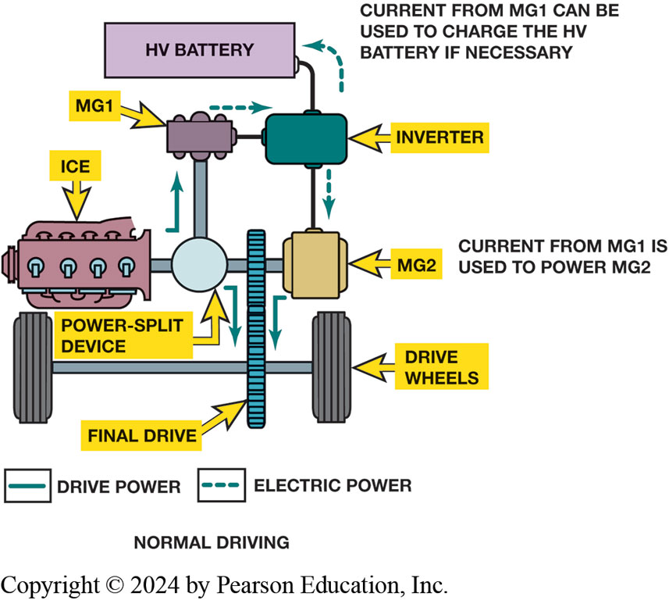
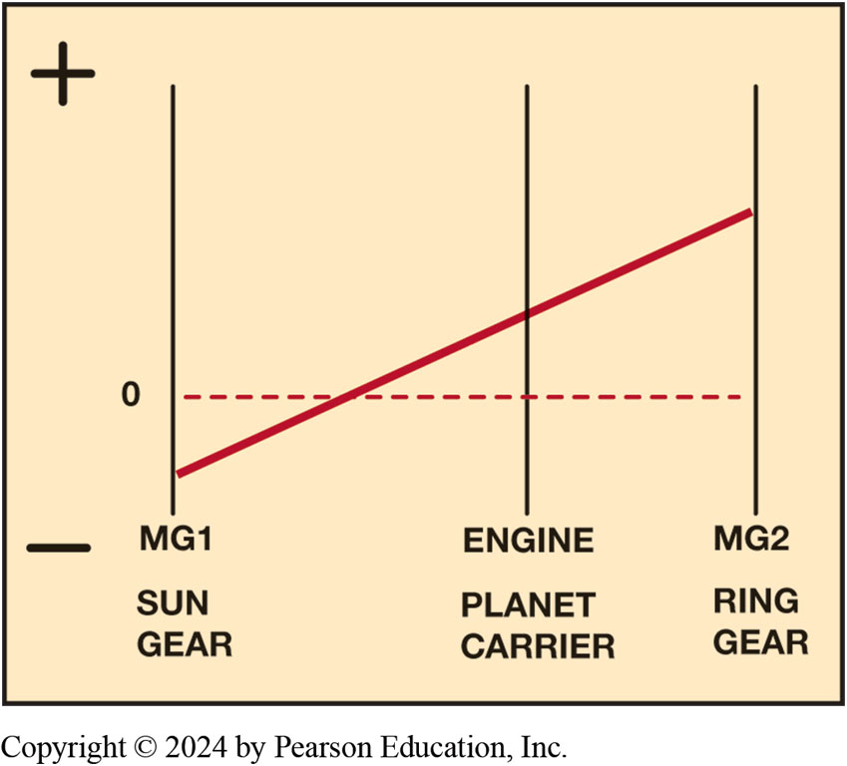
Generator Action
Figure 12.23 Normal driving—I C E is now running and some of its torque is used to drive M G 1. Electricity generated by M G 1 is used to power M G 2 or recharge the H V battery.
Figure 12.24 Normal driving—the engine is running, M G 2 is turning forward (+), and M G 1 is turning backward (−).
Notes:
Long Description 1:
A vertical bar labeled final drive is in between the drive wheels. A horizontal bar from the final drive leads to a cylindrical block with extended shields labeled I C E, a spherical shaped component labeled power-split device on the left and a square block labeled M G 2 on the right. The power-split device is connected to M G 1. M G 1 and M G 2 are connected to an inverter. An H V battery is connected to the inverted and M G 2. In the diagram, dashed arrows indicate electric power and a solid arrow indicates drive power. Dashed arrows flow between the following components: from M G 1 to the inverter, from the inverter to the H V battery, and from the inverter to M G 2. Solid arrows flow between the following components: I C E to M G 1, the power-split device to the final drive, and from M G 2 to the final drive. Text corresponding to the H V battery reads, Current from M G 1 can be used to charge the H V battery if necessary. Text corresponding to M G 2 reads, Current from M G 1 is used to power M G 2.
Long Description 2:
The graph shows three vertical axes, on the left, in the middle, and on the right, with the left one having plus and minus at its ends. The horizontal axis shows three labels M G 1: sun gear, engine: planet carrier, and M G 2: ring gear corresponding to the three vertical axes. An upward line starts from a negative point on the left vertical axis corresponding to M G 1: sun gear, passes through a positive point on the middle vertical axis corresponding to engine: planet carrier, and ends at a positive point on the right vertical axis corresponding to M G 2: ring gear.

Slide 39
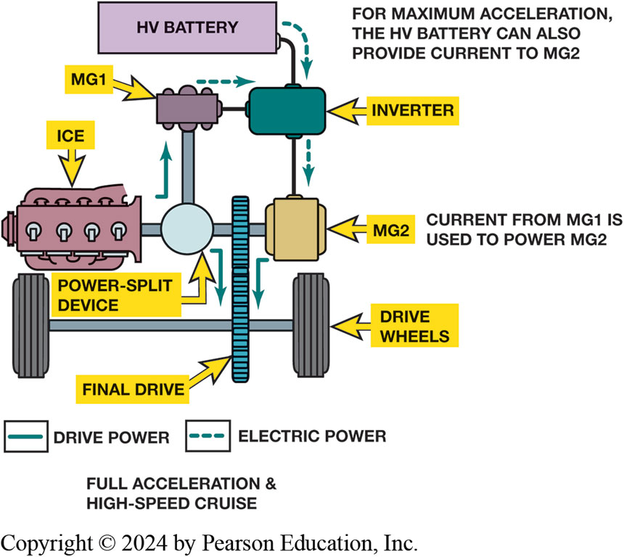
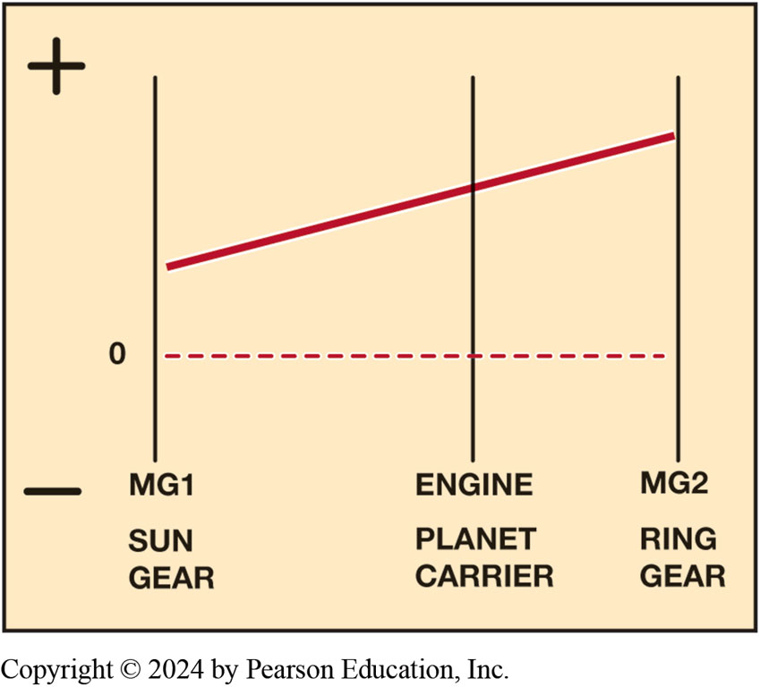
Acceleration
Figure 12.25 Full-throttle acceleration and high-speed cruise—with greater demand for acceleration, power from M G 1 is combined with power from the H V battery to generate higher output from M G 2. It is also possible to configure M G 2 as a generator and send its power to M G 1 (then acts as a motor).
Figure 12.26 Full-throttle acceleration and high-speed cruise—this graph shows M G 1 acting as a motor using power from M G 2. This increases the speed of the I C E, allowing it to produce higher output.
Notes:
Long Description 1:
A vertical bar labeled final drive is in between the drive wheels. A horizontal bar from the final drive leads to a cylindrical block with extended shields labeled I C E, a spherical shaped component labeled power-split device on the left and a square block labeled M G 2 on the right. The power-split device is connected to M G 1. M G 1 and M G 2 are connected to an inverter. An H V battery is connected to the inverted and M G 2. In the diagram, dashed arrows indicate electric power and a solid arrow indicates drive power. Dashed arrows flow between the following components: from M G 1 to the inverter, from the H V battery to the inverter, and from the inverter to M G 2. Solid arrows flow between the following components: I C E to M G 1, the power-split device to the final drive, and from M G 2 to the final drive. Text corresponding to the H V battery reads, For maximum acceleration, the H V battery can also provide current to M G 2. Text corresponding to M G 2 reads, Current from M G 1 is used to power M G 2.
Long Description 2:
The graph shows three vertical axes, on the left, in the middle, and on the right, with the left one having plus and minus at its ends. The horizontal axis shows three labels M G 1: sun gear, engine: planet carrier, and M G 2: ring gear corresponding to the three vertical axes. An upward line starts from a positive point on the left vertical axis near M G 1: sun gear, passes through a positive point on the middle vertical axis corresponding to engine: planet carrier, and ends at a positive point on the right vertical axis corresponding to M G 2: ring gear.

Slide 40
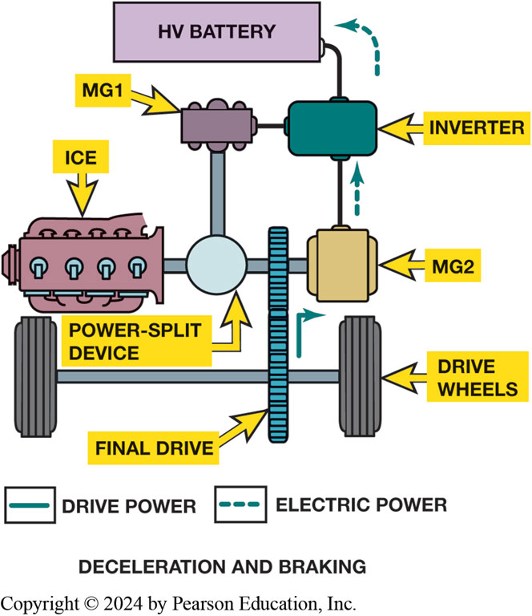
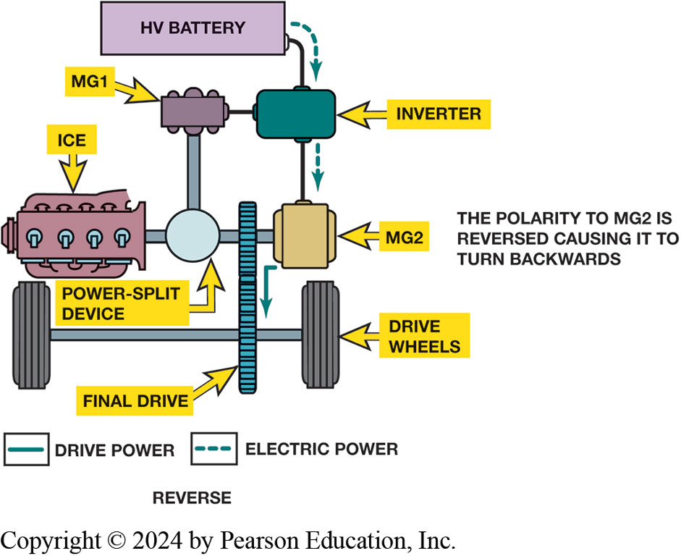
Deceleration and Reverse
Figure 12.28 Reverse—M G 2 alone is used to move the car in reverse. This is accomplished by reversing the direction of M G 2.
Figure 12.27 Deceleration and braking—M G 2 is configured as a generator and recharges H V battery.
Notes:
Long Description 1:
A vertical bar labeled final drive is in between the drive wheels. A horizontal bar from the final drive leads to a cylindrical block with extended shields labeled I C E, a spherical shaped component labeled power-split device on the left and a square block labeled M G 2 on the right. The power-split device is connected to M G 1. M G 1 and M G 2 are connected to an inverter. An H V battery is connected to the inverted and M G 2. In the diagram, dashed arrows indicate electric power and a solid arrow indicates drive power. Dashed arrows flow between the following components: from M G 2 to the inverter and from the inverter to the H V battery. Solid arrows flow from the final drive to M G 2.
Long Description 2:
A vertical bar labeled final drive is in between the drive wheels. A horizontal bar from the final drive leads to a cylindrical block with extended shields labeled I C E, a spherical shaped component labeled power-split device on the left and a square block labeled M G 2 on the right. The power-split device is connected to M G 1. M G 1 and M G 2 are connected to an inverter. An H V battery is connected to the inverted and M G 2. In the diagram, dashed arrows indicate electric power and a solid arrow indicates drive power. Dashed arrows flow between the following components: from the H V battery to the inverter and from the inverter to M G 2. A solid arrow flows from M G 2 to the final drive. Text corresponding to M G 2 reads, The polarity to M G 2 is reversed causing it to turn backwards.

Slide 41
Animation: Toyota Hybrid System Operation (Animation will automatically start)

Slide 42
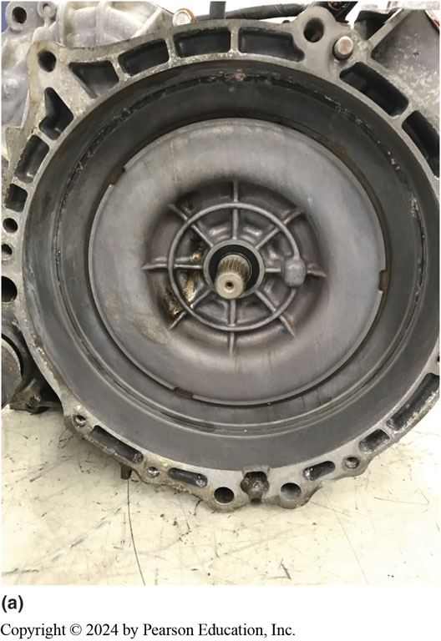
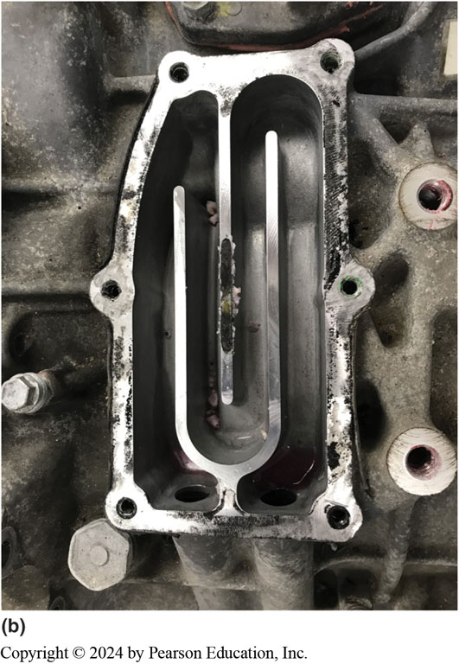
Figure 12.29
Cooling Water Jackets
Notes:
Figure 12.29 (a) Coolant is circulated under the ring in the bellhousing area to remove heat generated by M G 1. (b) Coolant is circulated in the passages near the rear of the transmission to remove heat generated by M G 2.
Each of these major assemblies has its own water jacket for cooling the motor/generator windings in the housing. There are two water jacket unions installed in each major assembly, and these send coolant to the motors from the separate inverter cooling system. ● See Figure 12.29 A & B.

Slide 43
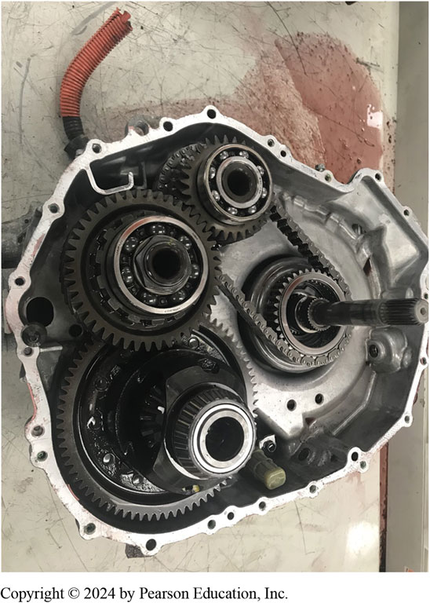
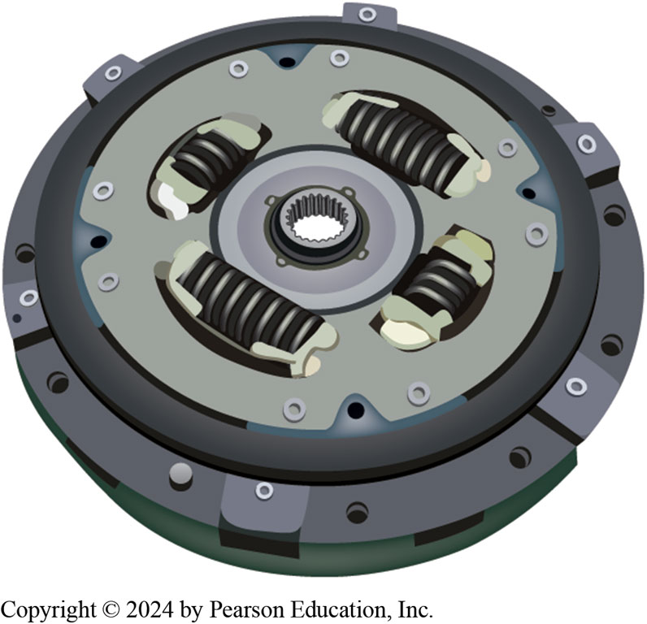
Final Drive and Damper Disc
Figure 12.30 The view of the configuration of the final drive assembly after the front cover has been removed.
Figure 12.31 The flywheel and clutch assembly serve as the dampener between the engine and transmission.

Slide 44
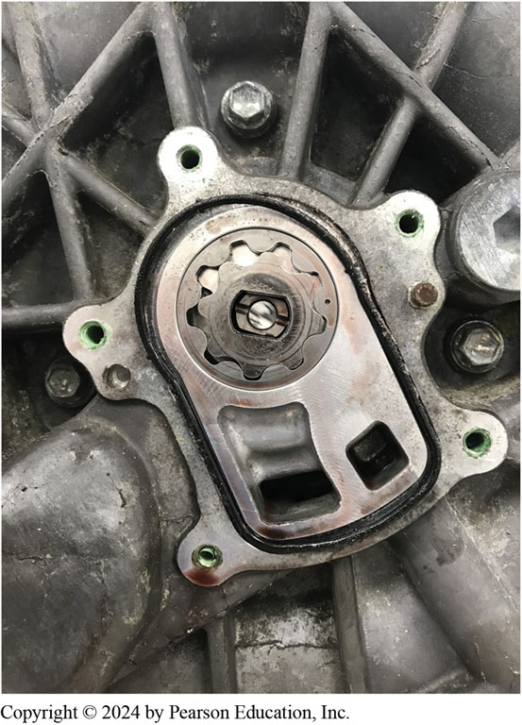
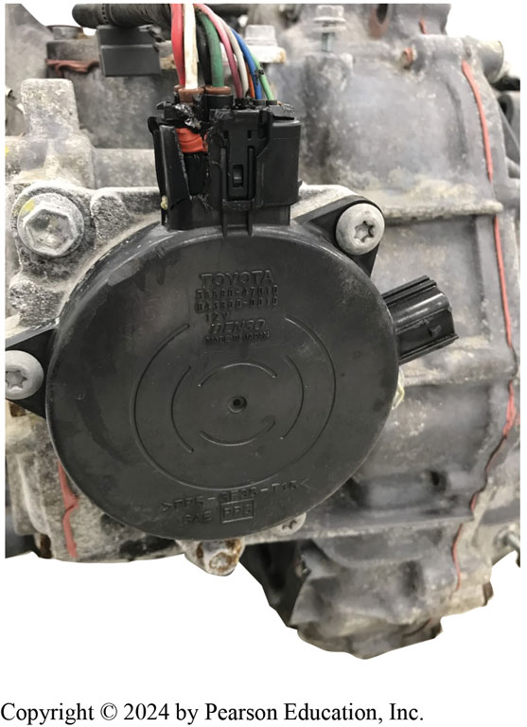
Oil Pump and Parking Lock
Figure 12.32 With the cover removed, transmission oil pump is visible on rear of transmission.
Figure 12.33 The electronic actuated park lock mechanism is mounted externally beginning with the 2004 model year.

Slide 45
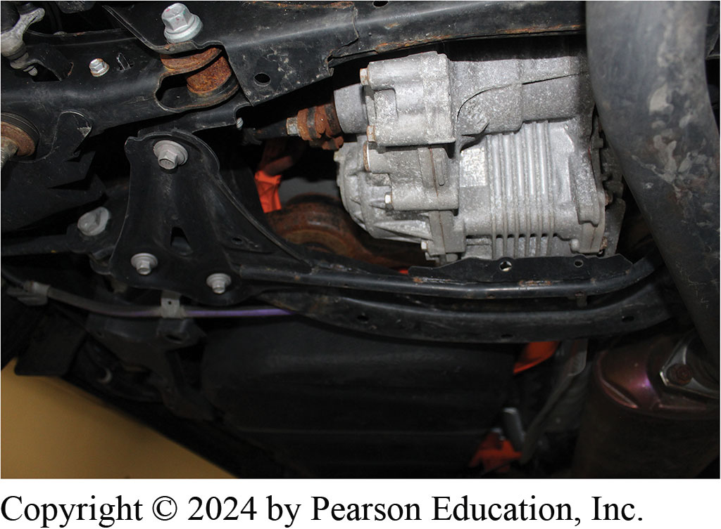
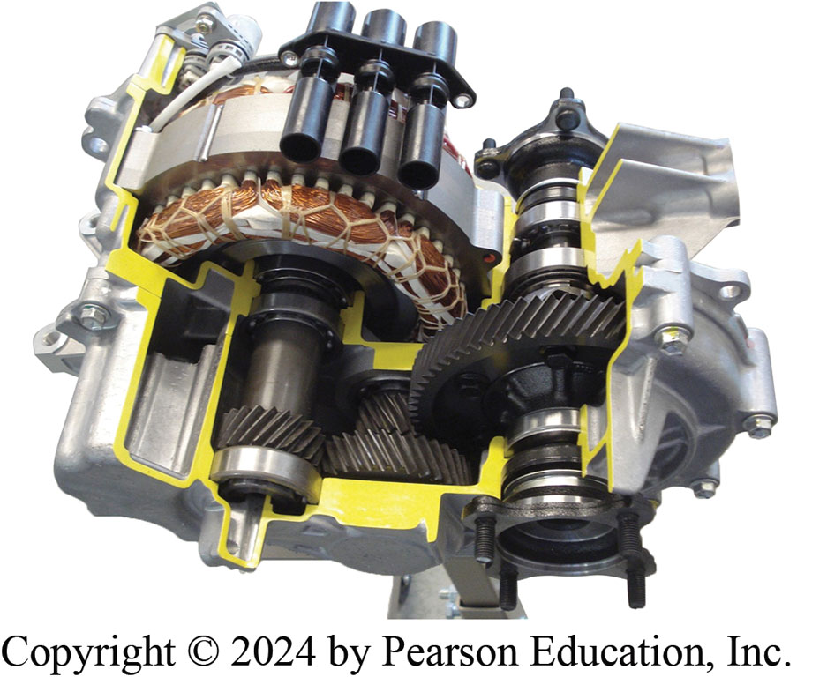
Hybrid Electric Rear Axle
Figure 12.35 The cutaway of the rear axle assembly shows the arrangement of the electric motor and the transfer gears.
Figure 12.36 A rear motor unit in a Toyota R A V 4 Hybrid, an all-wheel-drive H E V.

Slide 46
Hybrid Transmission Diagnosis
Eight Step Process
STEP 1 Verify the customer complaint.
STEP 2 Check fluid level and condition.
STEP 3 Check for D T C s.
STEP 4 Check for T S B s.
STEP 5 Check scan tool data Figure 12.37.
STEP 6 Perform visual inspections.
STEP 7 Perform bidirectional control of transmission.
STEP 8 Locate and correct root cause of problem.
Notes:
Diagnosing a H E V transmission concerns, perform the following steps:
STEP 1 The first step is to verify the customer complaint.
STEP 2 Check the fluid level and condition.
STEP 3 Check for stored diagnostic trouble codes (D T C s).
STEP 4 Check for any related technical service bulletins (T S B s).
STEP 5 Check scan tool data including checking the adaptive values. ● SEE FIGURE 12.37.
STEP 6 Perform visual inspections, including checking for recent accident damage, previous repairs, or other issues.
STEP 7 Perform bidirectional control of the transmission using a factory or an enhanced aftermarket scan tool to check operation. This helps to establish if the issue is inside or outside of the transmission/transaxle.
STEP 8 Locate and correct the root cause of the problem.

Slide 47
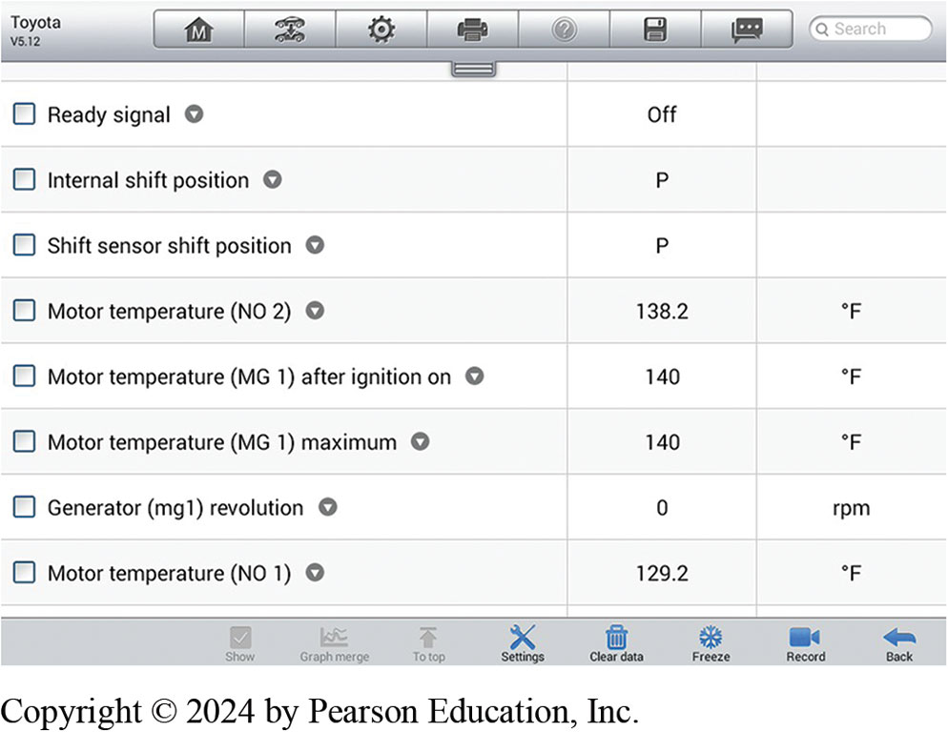
Figure 12.37
The data display of the transmission control module shows live values of various sensors and switches.
Notes:
Long Description:
The data are as follows: Row 1: ready signal; off; blank. Row 2: internal shift position; P; blank. Row 3: shift sensor shift position; P; blank. Row 4: motor temperature (N O 2); 138.2; degrees Fahrenheit. Row 5: motor temperature (M G 1) after ignition on; 140; degrees Fahrenheit. Row 6: motor temperature (M G 1) maximum; 140; degrees Fahrenheit. Row 7: generator (m g 1) revolution; 0; r p m. Row 8: motor temperature (N O 1); 129.2; degrees Fahrenheit.

Slide 48
Electric Vehicle Transmissions (1 of 4)
Acceleration Vs Top Speed
Most electric vehicles use single-speed transmission
E V manufactures usually design their system
For optimum low-end acceleration NOT top speeds

Slide 49
Electric Vehicle Transmissions (2 of 4)
Ford Mustang Mach-E
BorgWarner is producing Integrated Drive Module (i D M) being used in Ford Mustang Mach-E.
i D M consists within one compact assembly including:
Electric traction motor
Single-speed gearbox
Thermal-management system (liquid cooling)
Motor and power electronics

Slide 50
Electric Vehicle Transmissions (3 of 4)
Chevrolet Bolt
Chevrolet Bolt drive unit consists of an electric motor
Final drive assembly
Electric motor is rated at 150 k W
Maximum rotation speed of 8,810 R P M

Slide 51
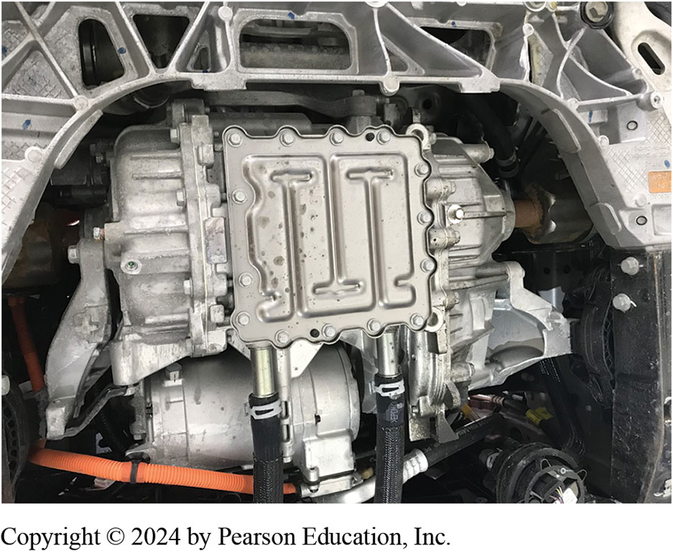
Figure 12.38
Bolt Electric Motor and Final Drive
The electric motor and final drive assembly installed in a Chevrolet Bolt.

Slide 52
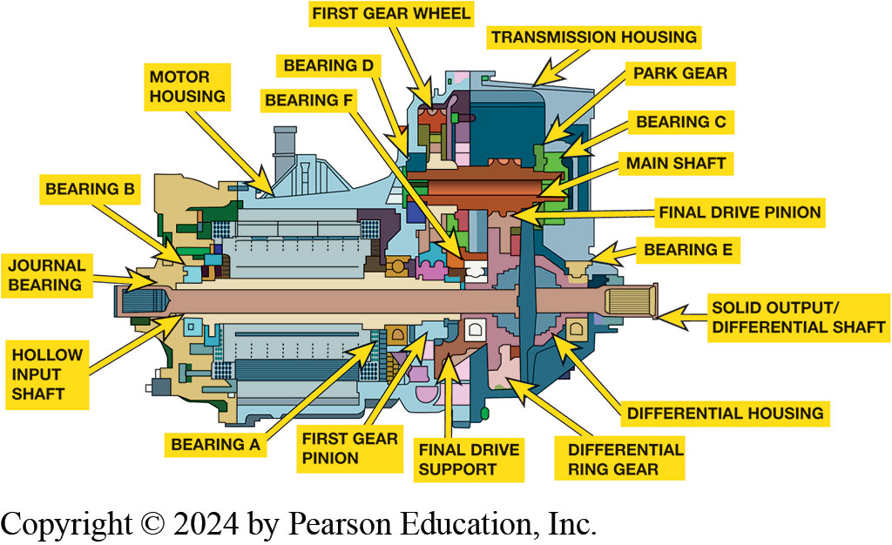
Figure 12.39
A C A TIA drafting of a Chevrolet Bolt electric motor and final drive assembly.
Notes:
Illustration of a Chevrolet Bolt drive unit with the parts labeled as follows: First gear wheel, bearing D, bearing F, motor housing, bearing B, journal bearing, hollow input shaft, bearing A, first gear pinion, final drive support, differential ring gear, differential housing, transmission housing, park gear, bearing C, main shaft, final drive pinion, bearing E, solid output/differential shaft.
The electric motor is a permanent-magnet synchronous A C motor. It is rated at 150 k W and has a maximum rotation speed of 8,810 R P M (2022 model year specifications). The final drive section of the drive unit consists of the drive gear on the output end of the electric motor, the main shaft, and the ring gear which is mounted on the differential assembly. Figure 12.39.
Long Description:
The labeled parts, from left to right, are as follows: hollow input shaft, journal bearing, bearing B, motor housing, bearing F, bearing D, first gear wheel, transmission housing, park gear, bearing C, main shaft, final drive pinion, bearing E, solid output/differential shaft, differential housing, differential ring gear, final drive support, first gear pinion, and bearing A.

Slide 53
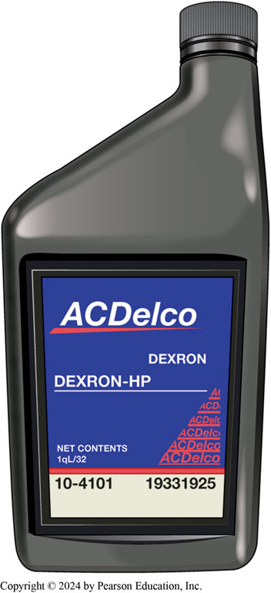
Figure 12.40
Dexron H P
Dexron H P synthetic transmission fluid is specified for Bolt final drive assembly.

Slide 54
Electric Vehicle Transmissions (4 of 4)
Nissan Leaf
Three-phase A C electric motor that produces 80 kilowatts of power
LEAF incorporates a reducer that transfers torque from traction motor to drive wheels
Two-Speed Gearing
Original Tesla Roadster featured two-speed transmission
Currently a two-speed unit is used in Porsche Taycan

Slide 55
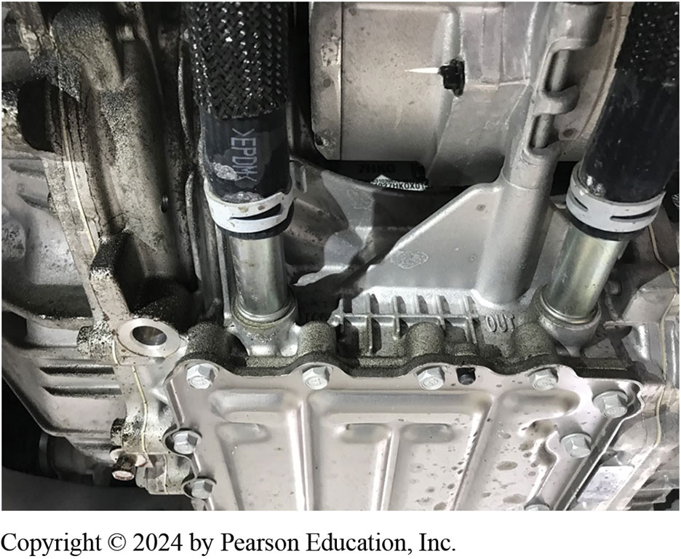
Figure 12.41
Bolt Coolant Lines
Coolant enters through the hose on the left, travels through the passageway absorbing heat, and exits to the radiator through the hose on the right.
Notes:
The final drive assembly provides a gear reduction of 7.05:1 between the electric motor and the drive wheels. The drive unit is internally lubricated and cooled using Dexron H P transmission fluid. The heat is transferred out of the transmission to an external radiator using engine coolant. See Figure 12.41.

Slide 56
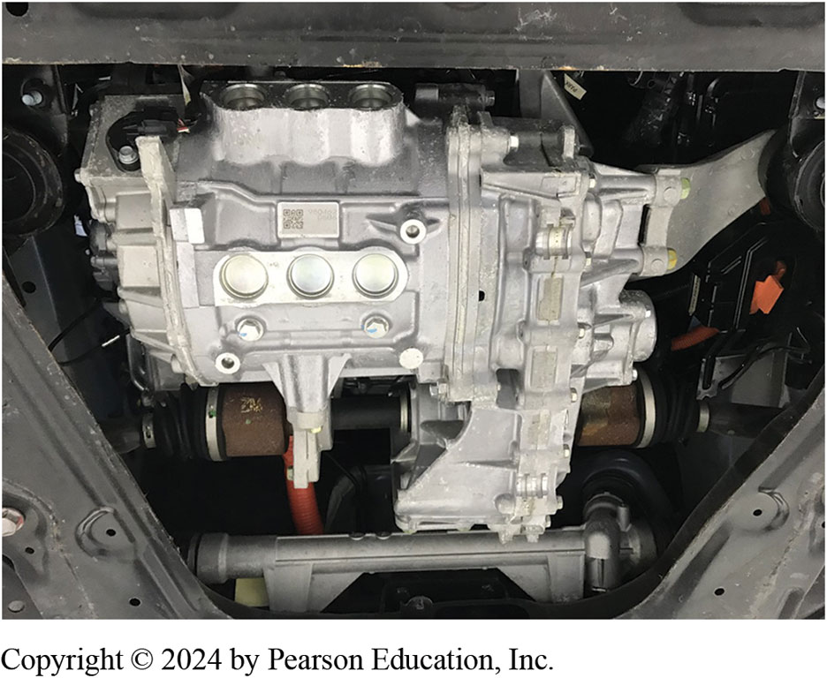
Figure 12.42
Leaf A C Motor
The electric motor assembly and reducer installed in a 2011 Nissan Leaf.
Notes:
At the heart of LEAF’s powertrain is its three-phase A C electric motor. It produces 80 kilowatts of power and can produce maximum torque within 0.1 seconds. This motor has a permanent magnet rotor core with high-density stator winding. It produces 206.5 pound-feet of torque and weighs 129 pounds. ● See Figure 12.42.

Slide 57
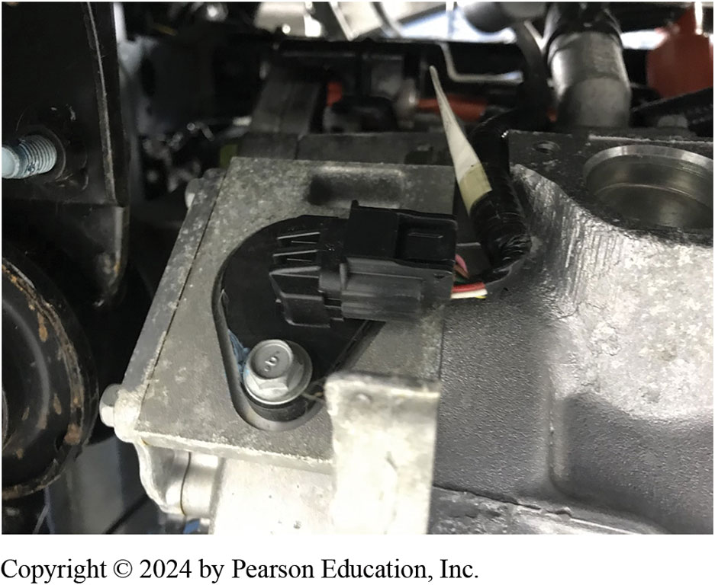
Figure 12.43
The external connection for the resolver
Notes:
A resolver is incorporated to input rotor position and speed to the Vehicle Control Module (V C M). Resolver calibration data to correct for variations in manufacturing is encoded on the traction motor housing. ● See Figure 12.43.

Slide 58
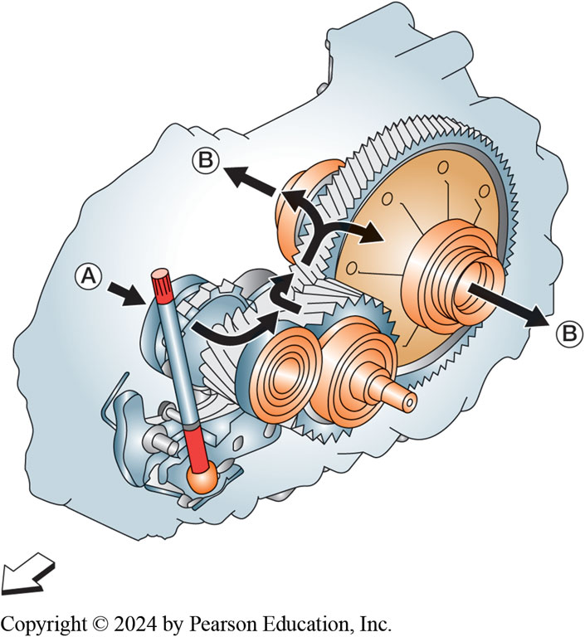
Figure 12.44
Power through Reducer
Power flow through the reducer.
Notes:
The reducer is connected to the electric drive motor. The output gear of a speed reducer has more teeth than the input gear. So, while the output gear might rotate more slowly, by reducing the speed of the input, the torque is increased. With an input power source, the torque can be increased, while decreasing the speed.

Slide 59
Frequently Asked Question: What Happens When You Shift to Neutral?
? Frequently Asked Question
What Happens When You Shift to Neutral? When neutral is selected, does it just disconnect the power connections? Or is the motor free to spin? In neutral, there is no power being supplied to the electric traction motor. The motor is never disconnected.

Slide 60
Question 1
What is the first step when diagnosing a hybrid vehicle transmission?
A. Check the fluid level
B. Verify the customer concern
C. Check for trouble codes
D. Check for Technical Service Bulletins (T S B s)

Slide 61
Answer 1
What is the first step when diagnosing a hybrid vehicle transmission?
B. Verify the customer concern

Slide 62
Summary (1 of 2)
H E V automatic transmissions use electric auxiliary pump to provide transmission fluid pressure at engine idle stop.
Power-split transaxle utilizes two electric motor/generators
Planetary gear set to create infinite speed ratios
Each of motor/generators perform two functions:
M G 1—crank I C E and generate current to charge high-voltage battery.
M G 2—propel vehicle and to charge battery during deceleration.

Slide 63
Summary (2 of 2)
e C V T transmission does not use a belt or chain
Uses parallel gear design.
Some E V s use a single speed transmission/transaxle.
Multispeed transmission in electric vehicle provides:
Same benefits of gasoline-powered vehicle with improved low-speed
Increased efficiency by lowering rotating speed of the electric motor at high speeds

Slide 64
Automatic Transmissions and Transaxles Videos and Animations
Videos Link: (L3) Light Duty Hybrid Electric Videos
Animations Link: (L3) Light Duty Hybrid Electric Animations
Videos Link: (A2) Automatic Transmissions and Transaxles Videos
Animations Link: (A2) Automatic Transmissions and Transaxles Animations

Slide 65
Copyright
This work is protected by United States copyright laws and is provided solely for the use of instructors in teaching their courses and assessing student learning. Dissemination or sale of any part of this work (including on the World Wide Web) will destroy the integrity of the work and is not permitted. The work and materials from it should never be made available to students except by instructors using the accompanying text in their classes. All recipients of this work are expected to abide by these restrictions and to honor the intended pedagogical purposes and the needs of other instructors who rely on these materials.

