Slide 1
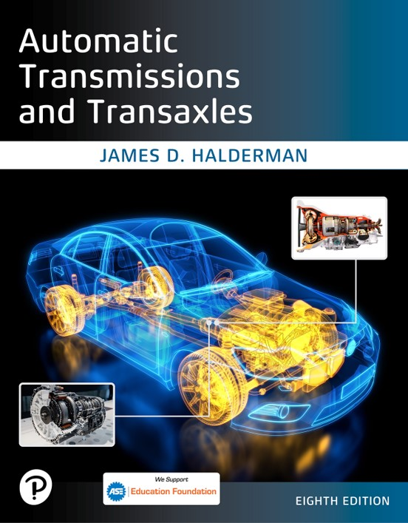
Automatic Transmissions and Transaxles
Eighth Edition
Chapter 11
Eight-,Nine-,and Ten-Speed Automatic Transmissions/Transaxles
Copyright © 2024, 2018, 2015 Pearson Education, Inc. All Rights Reserved
Notes:
If this PowerPoint presentation contains mathematical equations, you may need to check that your computer has the following installed:
1) Math Type Plugin
2) Math Player (free versions available)
3) NVDA Reader (free versions available)
INSTRUCTOR NOTE: This presentation includes text explanation notes, you can use to teach the course. When in SLIDE SHOW mode, you RIGHT CLICK and select SHOW PRESENTER VIEW, to use the notes.

Slide 2
Learning Objectives
11.1 Describe the power flow and operation of an 8-speed automatic transmission.
11.2 Describe the power flow and operation of a 9-speed automatic transaxle.
11.3 Describe the power flow and operation of a 10-speed automatic transmission.

Slide 3
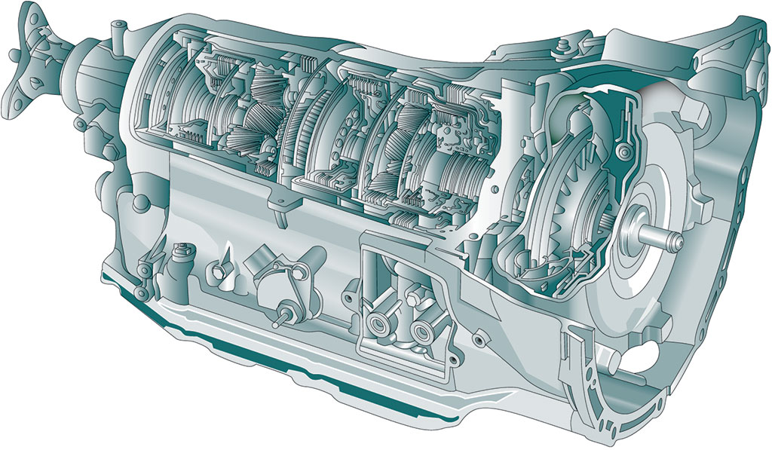
Figure 11.1
An open view of the G M 8L90 transmission showing most of its internal parts.

Slide 4
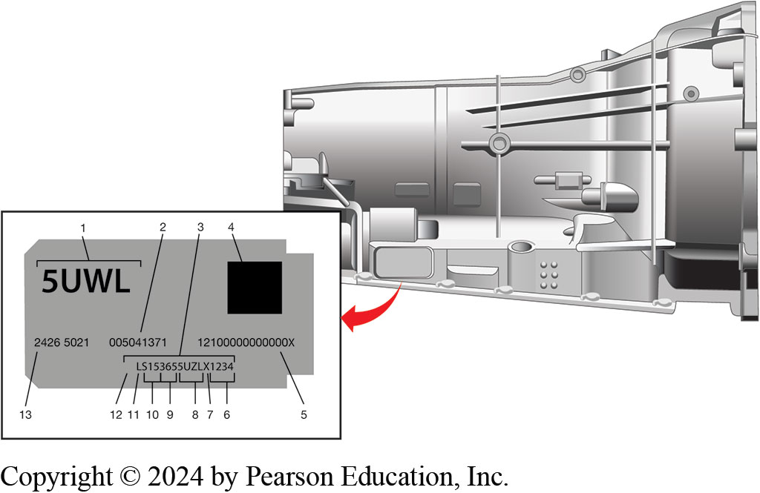
Figure 11.2
G M 8-speed transmission includes an identification label on the side that includes the following
Notes:
1. Broadcast Code
2. Source D U N S Number
3. Transmission Unique Number (T U N)
4. 2D Machine Readable Matrix
5. V P P S Code
6. Part Sequence Number
7. Site I D
8. Broadcast Code
9. Julian Date
10. Year of Build
11. Shift I D
12. Line Plant I D
13. G M Part Number
Long Description:
The label reads as follows: top left: 5 U W L; top right: a solid square; center left: 2426 5021; center of the center: 005041371; center right: 12100000000000 X; bottom center to bottom right: L S 153655 U Z L X 1234. Labels 1 to 12 are as follows: 1. broadcast code: 5 U W L; 2. source D U N S number: 005041371; 3. transmission unique number (T U N): L S 153655 U Z L X 1234; 4. 2 D machine readable matrix: the solid square; 5. V P P S code: 12100000000000 X; 6. part sequence number: the last four digits of T U N, 1234; 7. site I D: letter X before the last four digits of T U N; 8. broadcast code: the four digits before the site id, 5 U Z L; 9. Julian date: the three digits before the broadcast code, 365; 10. year of build: the two digits before the Julian date, 15; 11. shift id: S; 12. line plant I D: L; 13. G M part number: 2426 5021.

Slide 5
Frequently Asked Question: Are There Multiple Versions of the 8- and 10-Speed R W D Transmissions?
? Frequently Asked Question
Are There Multiple Versions of the 8- and 10-Speed R W D Transmissions? Yes, G M builds an 8-speed R W D automatic transmission and so does Z F (Zahnradfabrik Friedrichshafen A G), a German company that builds automatic transmissions and transaxles for Mercedes, B M W, Volvo, V W, Audi, Jaguar, Chrysler, Bentley, and Maserati. Neither G M nor Ford uses 8-speed Z F unit.

Slide 6
8L45/8L90 Operation and Power Flow
G M offers two models: light-duty 8L45 and heavy-duty 8L90.
2016, G M has added start–stop accumulator assembly to 8L90 that required an additional solenoid and two more check balls to valve body, making total of 12.
Pump is a dual-chamber vane-type assembly with rotor and a gasket
Between cover & valve body casting.
Plastic baffle used to limit cavitation.
8L90 has internal mode switch that is part of shift mechanism.
Three R P M speed sensors
Notes:
G M offers two models of eight-speed transmissions, the light-duty 8L45 and the heavy-duty 8L90.
NOTE: Beginning in 2016, G M has added a start–stop accumulator assembly to the 8L90 that required
an additional solenoid and two more check balls to the valve body, making a total of 12.
The pump is a dual-chamber vane-type assembly with rotor and a gasket between the cover and valve body casting. There is a plastic baffle used to limit cavitation.
The 8L90 has an internal mode switch (I M S) that is part of the shift mechanism. There are three R P M speed sensors including the input speed sensor (I S S) at the front of the transmission and intermediate and output speed sensor (O S S) at the rear next to each
other.

Slide 7
Frequently Asked Question: What Is an Automatic Transmission Stick Diagram?
? Frequently Asked Question
What Is an Automatic Transmission Stick Diagram? An automatic transmission stick diagram is like a schematic used in electrical circuits and is used as an interface between symbolic circuit and the actual layout. Like an electrical schematic, the stick diagram shows the parts and their relation to each other. Figure 11.3

Slide 8
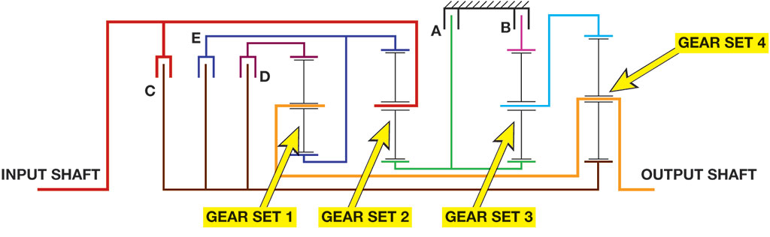
Stick Diagram
Figure 11.3
Notes:
Figure 11.3 The stick diagram of the G M 8-speed automatic transmission showing the four gear sets and the input and output shafts. The symbol that is similar to a ground symbol used in an electrical schematic above “A” and “B” indicates that it is connected to the case of the transmission.
What Is an Automatic Transmission Stick Diagram? An automatic transmission stick diagram is like a schematic used in electrical circuits and is used as an interface between symbolic circuit and the actual layout. Like an electrical schematic, the stick diagram shows the parts and their relation to each other. Figure 11-3
First—4.56:1, Second—2.97:1, Third—2.08:1, Fourth—1.69:1, Fifth—1.27:1, Sixth—1.00:1, Seventh—0.85:1
Eighth—0.65:1, Reverse—3.82:1
First Gear: Instructor Note: See Page 150 for 2nd through 8th Speeds
Fluid pressure is directed to the 1–3–5–6–7 clutch assembly. The manual valve is moved to drive position and allows line fluid pressure to enter the drive fluid circuit. Drive fluid is then routed to the default override valve. Drive fluid is directed through orifice #59 into the 45678R C L D R F D fluid circuit which seats the #2 ball check valve against the reverse circuit allowing fluid to enter the 45678R clutch feed circuit. The 1-3-5-6-7 control solenoid is energized allowing line fluid to enter the S3 V F S S I G fluid circuit which applies fluid pressure against the S3 V F S S I G accumulator spring force and against the 13567-control valve spring force. This allows 13567 C L/23468 C L F D fluid to enter the 13567 clutch fluid circuit.
Long Description:
Clutches C, E, and D are connected in parallel. Clutch D is connected in parallel to a series of three gears together labeled gear set 1, which is again connected in parallel to a series of three gears together labeled gear set 2. The input shaft is connected to clutch c and the second gear of gear set 2. gear set 2 is then connected in parallel to clutches A and B. Clutch B is connected in series to three gears together labeled gear set 3. The second gear of gear set 3 is connected in parallel to a series of three gears labeled gear set 4. The output shaft is connected to the second gear of gear set 4 and the second gear of gear set 1.

Slide 9
Chart 11.1
G M 8L90 Range Chart
Range | Gear | 1-3-5-6-7 Clutch | 4-5-6-7-8 Reverse Clutch | 2-3-4-6-8 Clutch | 1-2-7-8 Reverse Clutch | 1-2-3-4-5 Reverse Clutch
Park | P | Blank | Blank | Blank | Applied** | Applied**
Reverse | R | Blank | Applied | Blank | Applied | Applied
Neutral | N | Blank | Blank | Blank | Applied** | Applied**
Drive | 1st | Applied | Blank | Blank | Applied | Applied
Blank | 2nd | Blank | Blank | Applied | Applied | Applied
Blank | 3rd | Applied | Blank | Applied | Blank | Applied
Blank | 4th | Blank | Applied | Applied | Blank | Applied
Blank | 5th | Applied | Applied | Blank | Blank | Applied
Blank | 6th | Applied | Applied | Applied | Blank | Blank
Blank | 7th | Applied | Applied | Blank | Applied | Blank
Blank | 8th | Blank | Applied | Applied | Applied | Blank
Notes:
Case Study: The Case of the 8L90
A Cadillac A T S equipped with an 8L90 automatic transmission exhibits a funny shudder feel on the highway coming up from the floorboards. The transmission shudders frequently. Also, the shifts are very harsh between first to second, and then second down to first, especially when accelerating and transmission is upshifting or decelerating and the transmission is downshifting. The service
technician checked for any related technical service bulletins (T S B s) and found one that addressed the issue. In the T S B, it recommended the use of a different A T F to be used to correct the issue. The new fluid corrected the shudder and the customer concern.
Summary:
Concern—Shudder feel on the highway and shifting issues
Cause—Problem with the A T F (Automatic Transmission Fluid), a T S B search found T S B #18-N A-355 dated August, 2019.
Correction—Replace fluid with a new type of Mobil 1 automatic transmission fluid for the trouble- some transmissions. The vehicle should have the appropriate fluid exchange procedure completed, not just the fluid in the pan, and the unit must be
flushed.

Slide 10
Z F 8-Speed Transmission
8H P45 is built by Z F in Germany.
845R E is based on Z F-designed 8H P45,
Built by Chrysler in Kokomo, Indiana.
Some internal components share part numbers
Most internal components will not be interchangeable
While clutch packs look very similar, they are not interchangeable
In 845R E clutch pack, D clutch has an extra pair of
Separator and friction plates
Notes:
8H P45 AND 845RE The 8H P45 is built by Z F in Germany. The 845RE is based on the Z F-designed 8H P45,
but it is built by Chrysler in Kokomo, Indiana. While some internal components will share part
numbers, most internal components will not be interchangeable between the 8H P45 and the 845R E.
While the clutch packs look very similar, they are not interchangeable. For example, in the 845R E
clutch pack, the D clutch has an extra pair of separator and friction plates for improved vehicle
performance. ● See Figure 11.4. ● See Chart 11.2.

Slide 11
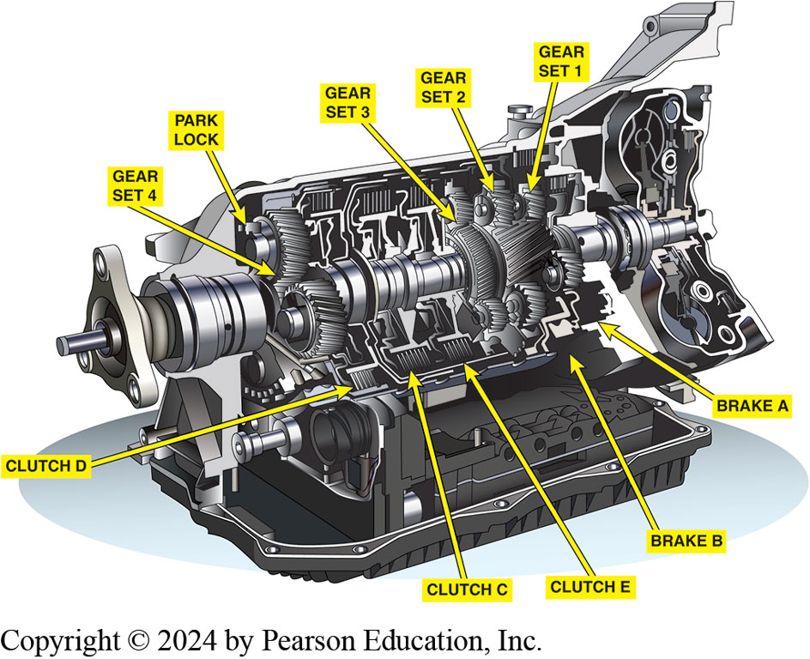
Figure 11.4
Z F 8-speed rear wheel drive automatic transmission cutaway showing all of its internal parts.
Notes:
Variety Of Applications The 8H P transmission is designed for longitudinal installation of rear- or
all-wheel-drive vehicles. The 8H P transmissions were built for many vehicle manufacturers including
Aston Martin, B M W, Chrysler, Jaguar Land Rover, and the Volkswagen/Audi Group.
Long Description:
The structure shows interconnected shafts through the center over which are circular objects with cuts labeled gear set 1, gear set 2, and gear set 3 on the right and gear set 4 on the left. A small knob-like object near the bearing, a projected circular object from the center, of gear set 4 is labeled park lock. Underneath the shafts, rectangles with cuts between two parallel plates, from left to right, are labeled clutch D, clutch C, and clutch E. Projected pads under gear sets 1 and 2, from left to right, are labeled brake B and break A.

Slide 12
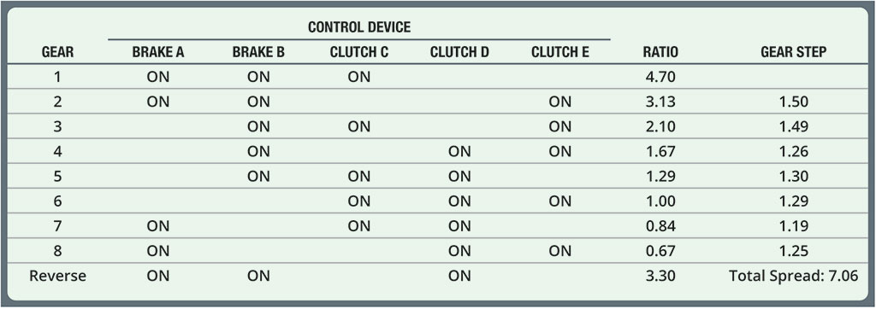
Chart 11.2
Z F 8-Speed Range Chart
Notes:
Clutch and brake application with gear ratios, steps, and spread for the Z F H P8 transmission.
Long Description:
The table shows 8 columns. The column headers are gear, brake A, brake B, clutch C, clutch D, clutch E, ratio, and gear step. The columns brake A, brake B, clutch C, clutch D, and clutch E are categorized under control device. The data are as follows: Row 1: 1; on; on; on; blank; blank; 4.70; blank. Row 2: 2; on; on; blank; blank; on; 3.13; 1.50. Row 3: 3; blank; on; on; blank; on; 2.10; 1.49. Row 4: 4; blank; on; blank; on; on; 1.67; 1.26. Row 5: Row 5: 5; blank; on; on; on; blank; 1.29; 1.30. Row 6: 6; blank; blank; on; on; on; 1.00; 1.29. Row 7: 7; on; blank; on; on; blank; 0.84; 1.19. Row 8: 8; on; blank; blank; on; on; 0.67; 1.25. Row 9: reverse; on; on; blank; on; blank; 3.30; total spread: 7.06.

Slide 13
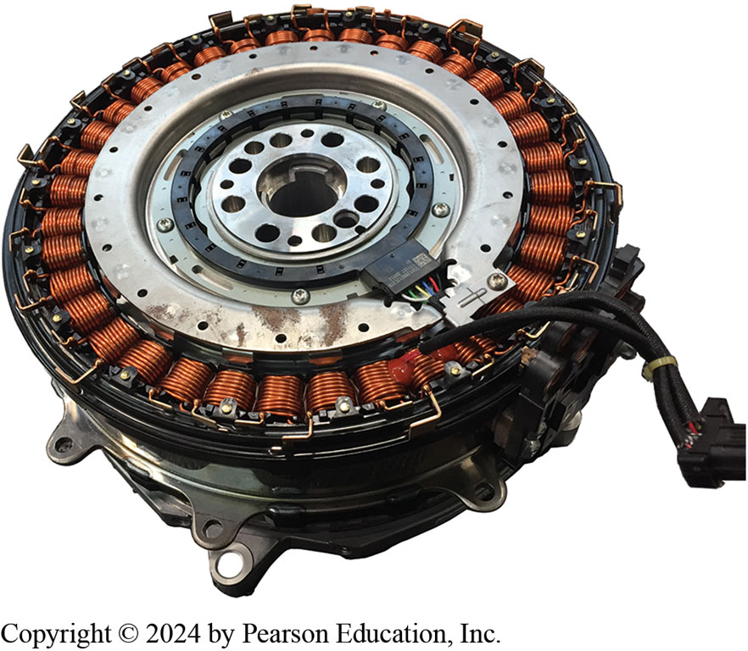
Figure 11.5
The torque converter is replaced with an electric motor to provide electric propulsion and still provide eight forward speeds for performance.
Notes:
An electric motor can replace the torque converter for hybrid electric vehicles (H E V) with minimal changes to the
drivetrain. ● See Figure 11.5.
8HP transmission is designed for longitudinal installation of rear- or all-wheel-drive vehicles. The 8H P transmissions were built for many vehicle manufacturers including Aston Martin, B M W, Chrysler, Jaguar Land Rover, and the Volkswagen/Audi Group.

Slide 14
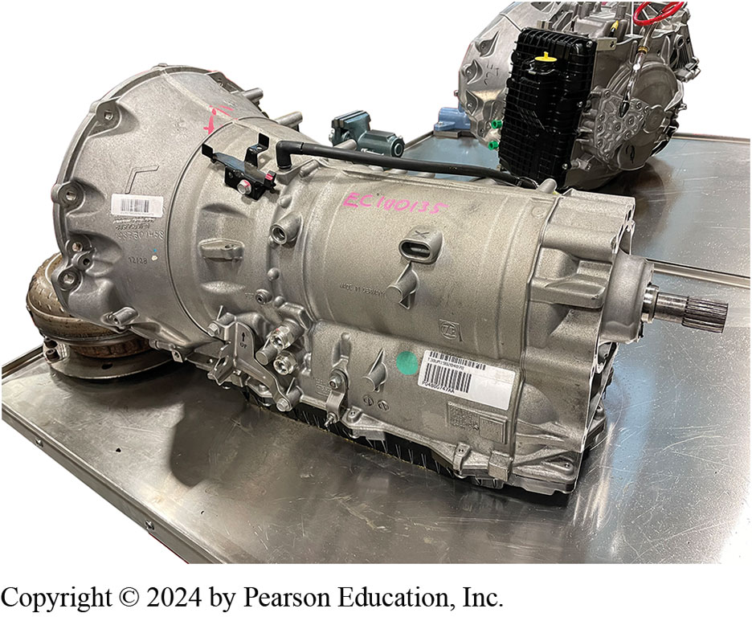
Figure 11.6
The Z F-built 8-speed automatic transmissions used in many R W D vehicles including Ram pickup trucks.
Notes:
Instructor Note: See Page 153 for an explanation of the ranges
Z F (Zahnradfabrik Friedrichshafen A G) builds an 8-speed transmission number 8H P70/8H P90. It is an 8-speed automatic transmission using a lock-up torque converter and planetary gear- sets for R W D applications. It can shift in a non-sequential
manner such as going from eight to second gear. ● See Figure 11.6.
It comes in two torque versions:
1. 8HP70 with a torque limit of 516 pound-feet (700 N-m).
2. 8HP90 has a torque limit of 664 pound-feet (900 N-m) using a Torsen center differential for use in Dodge Charger.

Slide 15
Frequently Asked Question: Who Builds Automatic Transmissions for Toyota?
? Frequently Asked Question
Who Builds Automatic Transmissions for Toyota? Toyota vehicles often use transmissions using their partner Aisin A W, formally known as Aisin- Warner. Figure 11.7.

Slide 16
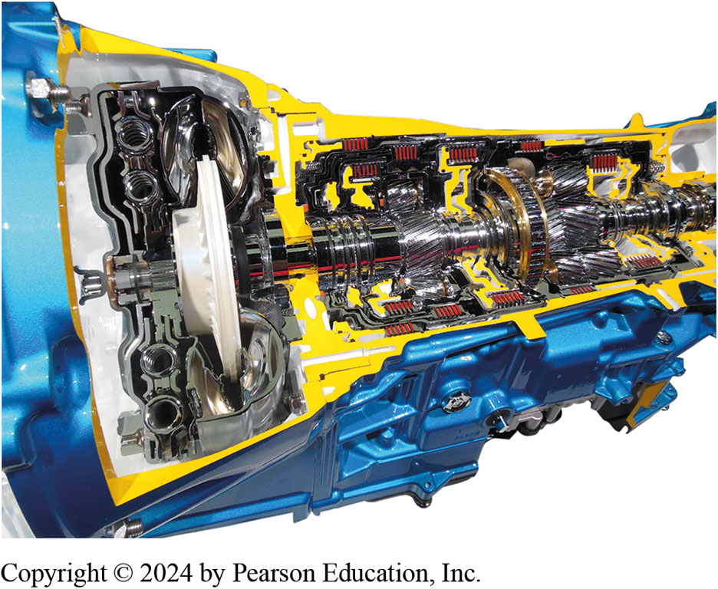
Figure 11.7
A rear wheel drive 8-speed automatic transmission cutaway as used in the Lexus rear wheel drive vehicles.

Slide 17
G M/Ford 9-Speed Transaxle
G M and Ford Jointly Developed
Four models of G M 9-speed transaxle include: 9T45, 9T50, 9T60, 9T65
During stop–start operation, mainline pressure is achieved with spring-loaded accumulator instead of electric motor/pump
Designation means:
9 denotes nine forward gears
T denotes transverse placement
Final
(such as 50) denotes robustness
Notes:
G M and Ford have worked together to develop the 9-speed front wheel drive transaxles. The G M versions include the 9T45, 9T50, 9T60, and the 9T65 and the use of Dexron® V I fluid. The Ford versions are called the 8F35, 8F40, and 8F57 and use Mercon® U L V.
The G M nine speeds are based on the 6-speed 6T41. During the stop–start operation, mainline pressure is achieved using a spring-loaded accumulator instead of an electric motor/pump as is used on many other automatic transmissions. The designation means the following:
■ 9 denotes nine forward gears
■ T denotes transverse placement within the vehicle’s powertrain system
■ The final XX (such as 50) denotes the unit’s robustness, with a higher figure, such as

Slide 18
Chart 11.3
9-Speed Range Chart
9T50 Power Flow Ratios & Components
Gear | Ratio | 9T Clutch Items | 9T Planet Items | 6T Gear Compare
1st | 4.69 | O W C/1-6 Brake | O D Planet/Output Sun | 1st
2nd | 3.31 | 1-6/2 & 9 Brakes | Output Sun/O D Sun L g | ----
3rd | 3 point 01 | 1-6/3 & 8 Brakes | Output Sun/O D Sun S m | 2nd
4th | 2.45 | 1-6/4th Clutch | Output Sun/O D Sun L g | ----
5th | 1.92 | 1-6/5 -7/R e v Clutch | Output Sun/O D Sun S m | 3rd
6th | 1.45 | 1-6/6 -9 Clutch | Output Sun/O D Planet | 4th
7th | 1 point 00 | 6 -9/5 -7/R e v Clutches | OD Planet/O D Sun S m | 5th
8th | 0.75 | 6 -9/3 & 8 Brake | O D Planet/O D Sun S m | 6th
9th | 0.62 | 6 -9/2 & 9 Brake | O D Planet/O D Sun L g
Rev | 2.96 | O W C/5 -7/R e v Clutch | O D Planet/O D Sun S m | R e v
Notes:
The range chart showing what is applied when in G M 9T50.

Slide 19
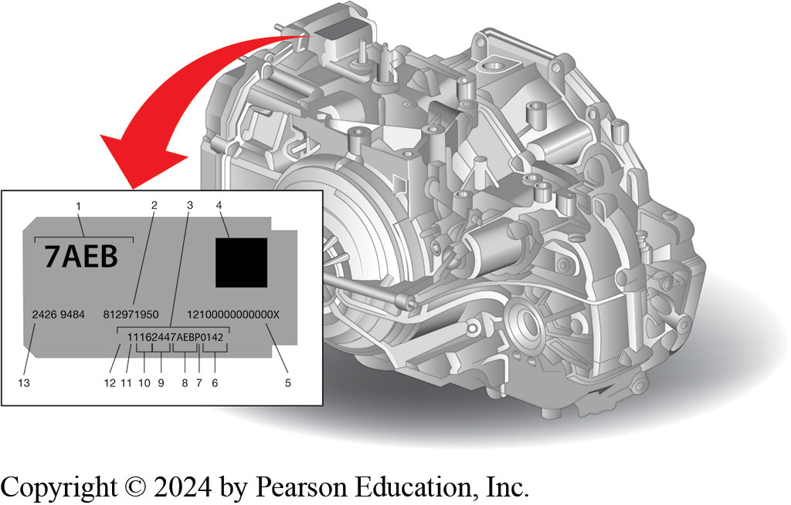
Figure 11.8
The I D tag is located on the top of the transaxle.
Notes:
Identification of GM 9T50 includes the following:
1. Broadcast Code
2. Source D U N S Number
3. Transmission Unique Number (T U N)
4. 2D Machine Readable Matrix
5. V P PS Code
6. Part Sequence Number
7. Site I D
8. Broadcast Code
9. Julian Date
10. Year of Build
11. Shift I D
12. Line Plant I D
13. GM Part Number
Torque converter uses a spring-loaded mass damper to control engine vibrations under certain driving conditions when the T C C is locked. When the converter is locked, P C M commands short periods of unlocking to eliminate vibrations at engine speeds where the mass damper does not work.
This transaxle has 12 individual solenoids installed at the lower control valve body assembly and case
Long Description:
The tag reads as follows: top left: 7 A E B; top right: a solid square (labeled 4); center left: 2426 9484 (labeled 13); center of the center: 812971950; center right: 12100000000000 X; bottom center to bottom right: 11162447 A E B P 0142. Labels 1 to 12 are as follows: 1: 7 A E B; 2: 812971950; 3: 11162447 A E B P 0142; 5: 12100000000000 X; 6: 0142; 7: P; 8: 7 A E B; 9: 6244; 10: 162; 11: 1 before 162; 12: 1, the first digit.

Slide 20
Z F 9-Speed Transaxle
Z F 9H P, 948T E, 928T E used for stop–start, hybrid and
A W D applications.
Gear spread is 9.34
Means it can provide good acceleration from a start and fuel economy
Chrysler (Stellantis) builds the transmissions
9T50 is a fully automatic, 9-speed transaxle, transverse mounted, electronic-controlled transmission using a
Torque converter, compound planetary gear set
Friction and mechanical clutches, and a hydraulic pressurization and control system
Notes:
First introduced in 2013, the Z F 9H P, 948T E, 928T E are designed for stop–start, hybrid
and all-wheel-drive applications. The gear ratios include the following:
■ First—4.71:1
■ Second—2.84:1
■ Third—1.91:1
■ Fourth—1.38:1
■ Fifth—1.00:1
■ Sixth—0.81:1
■ Seventh—0.70:1
■ Eighth—0.58:1
■ Ninth—0.48:1
The gear spread is 9.34 which means it can provide good acceleration from a start and prove good
highway fuel economy. Chrysler (Stellantis) builds the transmissions in Kokomo and Tipton, Indiana.
The 9T50 is a fully automatic, 9-speed transaxle, transverse mounted, electronic-controlled transmission using a torque converter, compound planetary gear set, friction and mechanical clutches, and a hydraulic pressurization
The T C C pressure plate, when applied, provides a mechanical direct drive coupling of the engine to the transmission. The planetary gear sets provide nine forward gear ratios and one reverse.
Changing gear ratios is done through the use of a T C M.
The multiple disc clutches combine with one-way clutch to deliver 10 different gear ratios, nine forward and one reverse. The gear sets then transfer the torque through the transfer drive gear, transfer driven gear, and differential assembly. ● See Figure 11.9.
Four gear sets and six shifting elements are used to provide the nine speeds. SEE Chart 11.4.

Slide 21
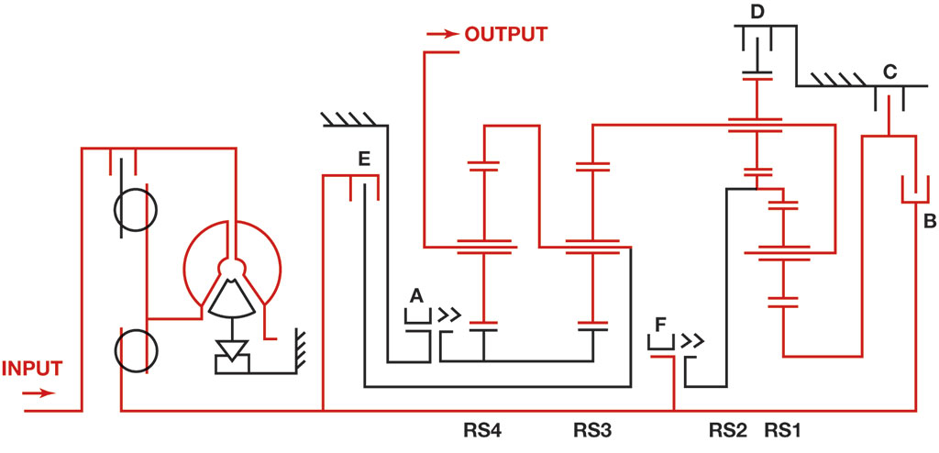
Figure 11.9
A stick diagram of the Z F 9-speed transaxle.
Notes:
Safety Tip Stop–Start Potential Issue
A driver comes to a stop in their driveway or a parking lot and forgets to place the vehicle in park. In this case the engine could start, causing the vehicle to move. Normally when the brake pedal is released, the engine starts and the vehicle could move while in drive or reverse. However, most recent vehicles are equipped with an electronic park actuator. This means that as soon as the driver releases the seat belt and opens the driver’s door, the transmission automatically goes into park.
Long Description:
The input shaft is connected to the engine, which is connected to two T S S pressure plates. The second plate is connected to clutch E, which in turn is connected to brake F and clutch B. Brake A is connected in parallel to two gear sets having three gears, R S 4 and R S 3. The output shaft is connected to the second gear of R S 4. A shaft from the first gear of R S 4 is connected to the second gear of R S 3. The second gear of R S 3 is connected to clutch E. The first gear of R S 3 is connected to the second gear of gear set R S 2. The second gear of R S 2 is connected to the second gear of gear set R S 1. The third gear of R S 2 is connected to the first gear of gear set R S 1 and to brake F. The third gear of R S 1 is connected to clutches C and B one over the other. Clutch C is connected to clutch D, which in turn is connected to the first gear of R S 2.

Slide 22
Chart 11.4
Z F 9-Speed Transaxle
The engagement of clutches, internal brakes, and dog clutches are used to provide the nine forward speeds and reverse for the Z F nine-speed. This transmission can skip gears too.
Gear | A (Dog) | B (Clutch) | C (Clutch) | D (Brake) | E (Clutch) | F (Dog)
First | On | Off | Off | On | Off | On
Second | On | Off | On | Off | Off | On
Third | On | On | Off | Off | Off | On
Fourth | On | Off | Off | Off | On | On
Fifth | On | On | Off | Off | On | Off
Sixth | On | On | On | Off | On | Off
Seventh | On | Off | Off | On | On | Off
Eighth | Off | Off | On | On | On | Off
Ninth | Off | On | Off | On | On | Off
Reverse | Off | On | Off | On | Blank | On

Slide 23
G M and Ford 10-Speed Transmission
Joint venture between Ford Motor Company and G M
Design two transmissions, a R W D 10-speed transmission
FWD/AWD 9-speed transaxle
G M/Ford each build their own unique version
Four planetary gear sets, two brake clutches, four rotating clutches
Triple-clutch assembly on dedicated intermediate shaft
Placed in middle of power flow
Replaces two ordinary clutches and is key for packaging 10-speed
Unit into same space as 8-speed transmission
Notes:
The 10-speed automatic transmission was part of a joint venture between Ford Motor Company and G M to design 2 transmissions, a R W D 10-speed transmission and a Front Wheel Drive/All- Wheel Drive (F W D/A W D) 9-speed transaxle. G M and Ford each build their own unique version of these transmissions but the design is the same. The 10-speed uses a triple-clutch assembly on a dedicated intermediate shaft, placed in the middle of the power flow. This replaces two ordinary clutches and is the key for packaging the 10-speed
unit into the same space as the 8-speed transmission.
NOTE: Alison also builds a 10-speed R W D transmission, which is used by G M behind the Duramax 6600 diesel engine and by Stellantis in the Ram with the 6.7L Cummins diesel, starting in 2022. Alison, which was part of G M prior to 2007 does not build this 10L1000. It is built by G M but uses the Alison name.
10 speeds are developed with 4 planetary gear sets, 2 brake clutches, and 4 rotating clutches. The transmission uses a squashed converter, an off-axis pump, and 4 close- coupled gear sets. The four rotating clutches are located forward of the gear sets to attenuate the length of oil feeds which provides for enhanced shift response. To improve efficiency, the shifts do not require unlocking of the torque converter. The 10-speed uses a triple-clutch assembly on a dedicated intermediate shaft, placed in middle of the power flow. This replaces two ordinary clutches and is the key for packaging the 10-speed unit into the same space as the 8-speed transmission. The transmission uses a pump drive design that enables for off-axis packaging very low within the transmission. The 4-element
convertor contains a pump, a turbine, converter clutch (T C C) pressure plate splined to the turbine, and a stator assembly. See Figure 11.11.

Slide 24
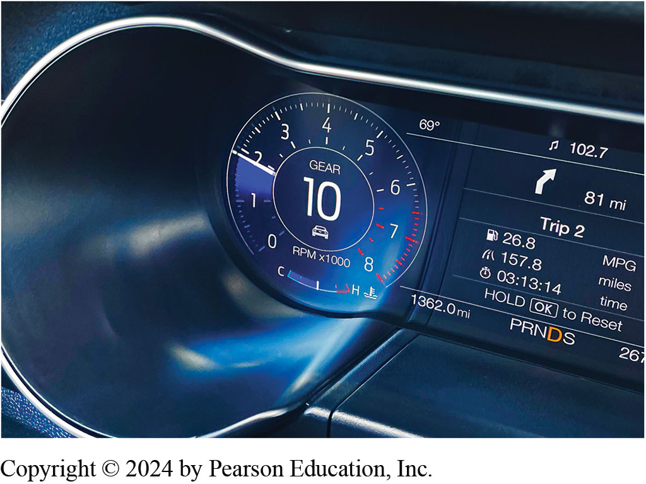
Figure 11.10
Dash display on a Ford Mustang showing gear display. The transmission is so smooth that driver would not have any idea what gear transmission is operating in with the digital display.
Notes:
The 10-speed transmission is a rear-wheel drive, electronic-controlled transmission. ● See Figure 11.10.
Long Description:
The gear speed in a circle reads, 1.9 r pm times 1000. The miles run is 1362.0 mi. The fuel economy is 26.8 for 157.8 miles.

Slide 25
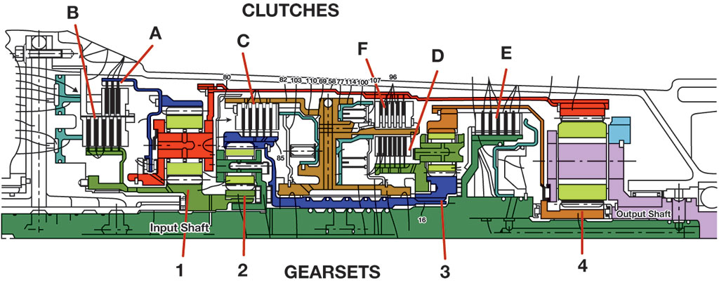
Figure 11.11
A cross-sectional view showing the location of the clutches (A through F) and gear sets (1 through 4).
Notes:
A cross-sectional view showing the location of the clutches (A through F) and gear sets (1 through 4).
Long Description:
Clutches are represented as small vertical bars between two parallel plates on top of the diagram and gears as pipelines on bottom. The connections from left to right are as follows: clutches B and A are connected to gear set 1, clutch C to gear set 2, clutches F and D to the front end of gear set 3 and clutch E to the rear end of gear set 3. The input shaft passes through gear sets 1 to 3. The output of gear set 1 on top is connected to the output of gear set 4 on bottom. The output shaft passes through the gears of gear set 4.

Slide 26
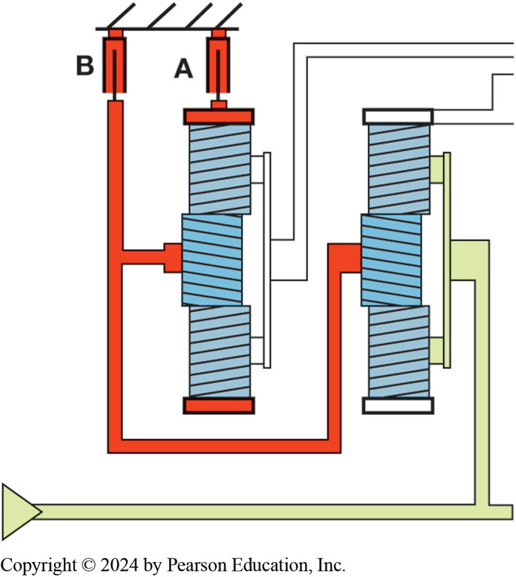
Figure 11.12
Clutches A and B.
Notes:
Four clutches are applied at the same time. Three are needed for that gear and the fourth prepares for an upshift. When clutches A and B are applied, they are brakes. Clutch A will hold the ring gear of gear set
Clutch B will hold the sun gears of gear sets 1 and 2. ● See Figure 11.12. When applied, clutch E connects gear set 3 ring gear and gear set 4 sun gear to the input shaft. Clutch F connects gear set 1 carrier and gear set 4 sun gear to clutches C and /or D. ● See Figure 11.13. ● See Chart 11.5.
Long Description:
Clutches A and B are represented as small vertical cylinders with a line in the middle and gear sets 1 and 2 as vertical rectangles with cross lines. Clutch A is connected to the ring gear of gear set 1 and clutch B, placed to the left of clutch A, to the sun gears of gear sets 1 and 2.

Slide 27
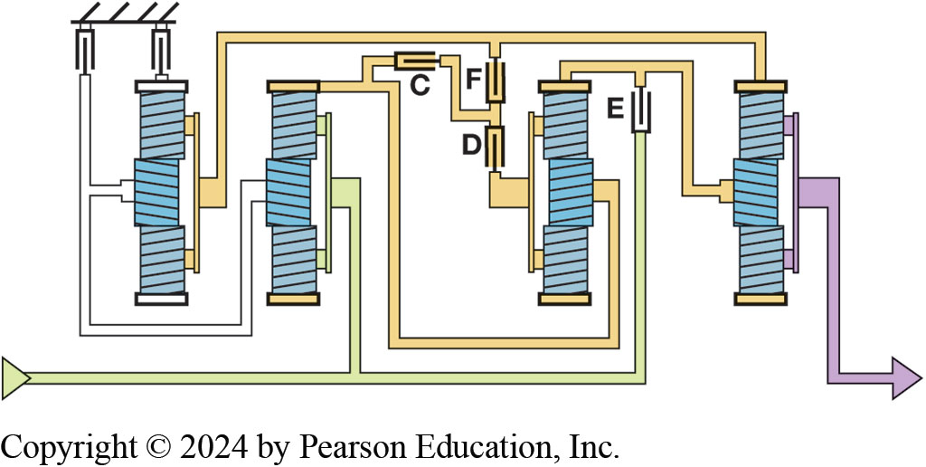
Figure 11.13
Clutches E and F.
Notes:
Four clutches are applied at the same time. Three are needed for that gear and the fourth prepares for an upshift. When clutches A and B are applied, they are brakes. Clutch A will hold the ring gear of gear set
Clutch B will hold the sun gears of gear sets 1 and 2. ● See Figure 11.12. When applied, clutch E connects gear set 3 ring gear and gear set 4 sun gear to the input shaft. Clutch F connects gear set 1 carrier and gear set 4 sun gear to clutches C and /or D. ● See Figure 11.13. ● See Chart 11.5.
Long Description:
The clutches are represented as small vertical cylinders with a line in the middle and the gear sets as vertical rectangles with cross lines. Clutch C is from the ring gear of gear set 2 and is connected in parallel to clutches F and D. Clutch F connects the carrier of gear set 1 and the sun gear of gear set 3 to clutches C and D. Clutch E connects the ring gear of gear set 3 and the sun gear of gear set 4 to the input shaft.

Slide 28
Chart 11.5
10-Speed Clutch/Ratios
Gear | Clutch | Gear Ratio | Reduction/Overdrive
1 | A B D E | 4.07 is to 1. | Reduction
2 | A B C D | 2.98 is to 1. | Reduction
3 | A C D E | 2.15 is to 1. | Reduction
4 | A C D F | 1.80 is to 1. | Reduction
5 | A C E F | 1.52 is to 1. | Reduction
6 | A D E F | 1.28 is to 1. | Reduction
7 | C D E F | 1 is to 1. | –
8 | B D E F | 0.85 is to 1. | Overdrive
9 | B C E F | 0.69 is to 1. | Overdrive
10 | B C D F | 0.64 is to 1. | Overdrive
Reverse | A B D F | 4.87 is to 1. | Reduction
Notes:
The clutch and gear ratios all in one chart.

Slide 29
Ford/G M 10R80/10L90 Speed Sensor Functions
Four internally mounted 2-wire Hall-Effect speed sensors
One of them slightly different from other three
9-volt supply from T C M is supplied to all or any four sensors
Signal from each sensor returns directly back to T C M
I S S is also called T S S
Monitors a reluctor ring has 40 evenly spaced magnets
Reluctor ring riveted to input planet carrier
Notes:
There are four internally mounted 2-wire Hall-Effect speed sensors used in the 10-speed unit. Although all 4-speed sensors work the same way, one of them is slightly different from the other three. A 9-volt supply from the T C M is supplied to all or any 4 sensors and the signal from each sensor returns directly back to the T C M. The input speed sensor (I S S) is also called the turbine speed sensor (T S S). This sensor monitors a reluctor ring that has 40 evenly spaced magnets bonded in rubber. The reluctor ring is riveted to the input planet carrier splined to the transmission’s input shaft. The input carrier assembly is found just inside the front section of the transfer shell. ● See Figures 11.14 and 11.15.

Slide 30
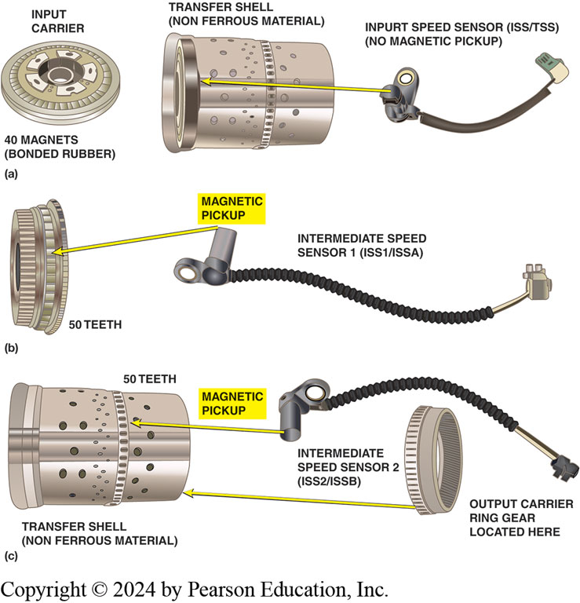
Figure 11.14
10-Speed Sensors
Notes:
Figure 11.14 (A) The transfer shell is created with a nonferrous material allowing the sensor to observe the magnets through the wall of the shell. (B) The intermediate speed sensor 1 (I S S1) is additionally noted because of the automatic drive intermediate speed sensor A (S S A). The intermediate speed sensor 2 (I S S2) is also stated because of the transmission intermediate speed sensor B (I S S B). (C) The magnetic pickup during this sensor monitors a 50-tooth steel reluctor ring attached (pressed) onto the nonferrous transfer shell.
Long Description:
In part (a), the input speed sensor (I S S or T S S) monitors the input carrier of the ring reluctor with 40 magnets bonded in rubber. The reluctor ring is attached to the transfer shell made of nonferrous material. In part (b), the intermediate speed sensor 1 (I S S 1 or I S S A) is an automatic drive sensor. It shows magnetic pickup and 50 teeth. In part (c), the intermediate speed sensor 2 (I S S 1 or I S S A) monitors the reluctor ring, which has 50 teeth in the middle. The output carrier ring gear is on the outer surface of the ring. The transfer shell is of nonferrous material.

Slide 31
Figure 11.15
The output speed sensor monitors a steel 68-tooth reluctor wheel that is riveted to output planet carrier. The reluctor ring and planetary component tooth count on both the Ford and G M transmissions.

Slide 32
Honda 10-Speed Automatic Transaxle (10A T)
Honda’s first automatic transmission to use planetary gear sets
10-speed automatic transaxle with four planetary gear sets
Special two-way clutch allows
Ratchet-type mechanical clutch to either lock in both directions
Allow gear set to freewheel in one direction
Eight linear clutch pressure control solenoids (C P C)
Four shift solenoids, six pressure sensors
Three solenoids, two stroke sensors, fluid temperature sensor
Notes:
First Planetary Honda Transmissions Honda’s first automatic transmission to use planetary gear sets is a 10-speed automatic transaxle with 4planetary gear sets and a special two-way clutch. This allows a ratchet-type mechanical clutch to either lock in both directions or allow the gear set to freewheel in one direction.
The top of the valve body includes the following:
Eight linear clutch pressure control solenoids (C P C)
Four shift solenoids
Six pressure sensors
The underside of the valve body contains the following:
Three solenoids
Two stroke sensors
A transmission fluid temperature sensor
The Honda 10-speed automatic transmission features Shift- By-Wire (S B W) and Paddle Shifters. The
gear ratios include the following:
First: 5.246
Second: 3.271
Third: 2.185
Fourth: 1.597
Fifth: 1.304
Sixth: 1.000
Seventh: 0.782
Eighth: 0.653
Ninth: 0.581
Tenth: 0.517
Reverse: 3.974
Final Drive: 3.610
● See Figure 11.16.

Slide 33
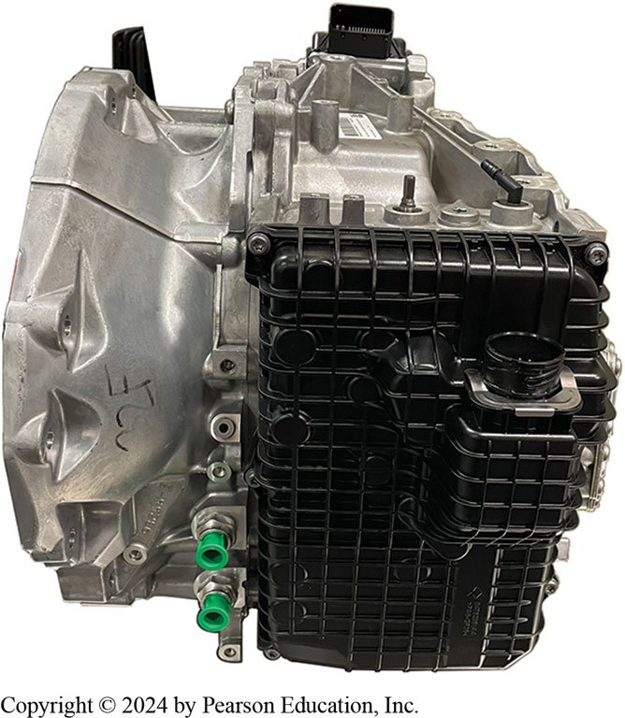
Figure 11.16
The Honda 10A T is the first automatic transmission to use planetary gear sets.

Slide 34
Question 1
What kind of A T F (Automatic Transmission Fluid) is required in the G M 8-speed transmission?
A. Mobil 1
B. Dexron
C. Dexron
D. Rotelle

Slide 35
Answer 1
What kind of A T F (Automatic Transmission Fluid) is required in the G M 8-speed transmission?
A. Mobil 1

Slide 36
Summary (1 of 2)
8-speed R W D is a fully automatic, 8-speed, R W D,
Electronic-controlled transmission using four planetary gear sets-,
Two brake clutches, and three rotating clutches
G M, Z F, and Aisin-Warner 8-speed transmissions
10-speed transmission is R W D electronic-controlled transmission
Four planetary gear sets, two brake clutches, and two rotating clutches
Off-axis pump, and four close coupled gear sets
G M and Ford build 10-speed transmissions
Notes:
The 8-speed R W D is a fully automatic, 8-speed, R W D, electronic-controlled transmission using 4 planetary gear sets, 2 brake clutches, and 3 rotating clutches. The 3 rotating clutches are located forward of the gear sets to reduce the length of oil feeds which provides for enhanced shift response: G M, Z F, and Aisin-Warner 8-speed transmissions.
The 10-speed transmission is a rear-wheel drive, electronic-controlled transmission. The 10 speeds are developed with 4 planetary gear sets, two brake clutches, and four rotating clutches. The trans- mission uses a torque converter, an off-axis pump, and four close coupled gear sets. The 4 rotating clutches are located forward of the gear sets to attenuate the length of oil feeds which provides for enhanced shift response. There are different applications of the transmission, all supported torque capacity. Architecture is common between the various applications, and component differences are associated with size. G M and Ford build 10-speed transmissions.
The 9T50 is a fully automatic, 9-speed transaxle, transverse mounted, electronic-controlled transmission using a torque converter, compound planetary gear set, friction and mechanical clutches, and a hydraulic pressurization and control system. The torque converter contains a pump, a turbine, a torque converter clutch (T C C) pressure plate splined to the turbine, and a stator assembly. The hydraulic system uses a chain-driven pump, a control valve body assembly, and case. The planetary gear sets provide nine forward gear ratios and one reverse. The transaxle uses a chain-driven pump that maintains the working pressures. The unit uses 7 multiple disc clutches. The multiple disc clutches combine with one away clutch to deliver 10 different gear ratios, nine forward and one reverse. G M and Z F build a 9-speed transaxle.
The 8- and 10-speed transmission use an off-axis chain-driven binary vane-type pump located within the valve body. The pump maintains the pressures needed to move the clutch pistons that apply or release the friction clutches. Normally the fluid pump is driven in line with the shaft flow of the transmission.

Slide 37
Summary (2 of 2)
9T50 is a fully automatic, 9-speed transaxle, transverse mounted
Electronic-controlled transmission using a torque converter
Compound planetary gear set, friction and mechanical clutches
Torque converter contains a pump, a turbine, a T C C
Chain-driven pump, a control valve body assembly, and case
Nine forward gear ratios and one reverse.
Seven multiple disc clutches
G M and Z F build 9-speed transaxle
Notes:
The 8-speed R W D is a fully automatic, 8-speed, R W D, electronic-controlled transmission using 4 planetary gear sets, 2 brake clutches, and 3 rotating clutches. The 3 rotating clutches are located forward of the gear sets to reduce the length of oil feeds which provides for enhanced shift response: G M, Z F, and Aisin-Warner 8-speed transmissions.
The 10-speed transmission is a rear-wheel drive, electronic-controlled transmission. The 10 speeds are developed with 4 planetary gear sets, two brake clutches, and four rotating clutches. The trans- mission uses a torque converter, an off-axis pump, and four close coupled gear sets. The 4 rotating clutches are located forward of the gear sets to attenuate the length of oil feeds which provides for enhanced shift response. There are different applications of the transmission, all supported torque capacity. Architecture is common between the various applications, and component differences are associated with size. G M and Ford build 10-speed transmissions.
The 9T50 is a fully automatic, 9-speed transaxle, transverse mounted, electronic-controlled transmission using a torque converter, compound planetary gear set, friction and mechanical clutches, and a hydraulic pressurization and control system. The torque converter contains a pump, a turbine, a torque converter clutch (T C C) pressure plate splined to the turbine, and a stator assembly. The hydraulic system uses a chain-driven pump, a control valve body assembly, and case. The planetary gear sets provide nine forward gear ratios and one reverse. The transaxle uses a chain-driven pump that maintains the working pressures. The unit uses 7 multiple disc clutches. The multiple disc clutches combine with one away clutch to deliver 10 different gear ratios, nine forward and one reverse. G M and Z F build a 9-speed transaxle.
The 8- and 10-speed transmission use an off-axis chain-driven binary vane-type pump located within the valve body. The pump maintains the pressures needed to move the clutch pistons that apply or release the friction clutches. Normally the fluid pump is driven in line with the shaft flow of the transmission.

Slide 38
Automatic Transmissions and Transaxles Videos and Animations
Videos Link: (A2) Automatic Transmissions and Transaxles Videos
Animations Link: (A2) Automatic Transmissions and Transaxles Animations

Slide 39
Copyright
This work is protected by United States copyright laws and is provided solely for the use of instructors in teaching their courses and assessing student learning. Dissemination or sale of any part of this work (including on the World Wide Web) will destroy the integrity of the work and is not permitted. The work and materials from it should never be made available to students except by instructors using the accompanying text in their classes. All recipients of this work are expected to abide by these restrictions and to honor the intended pedagogical purposes and the needs of other instructors who rely on these materials.

