Slide 1
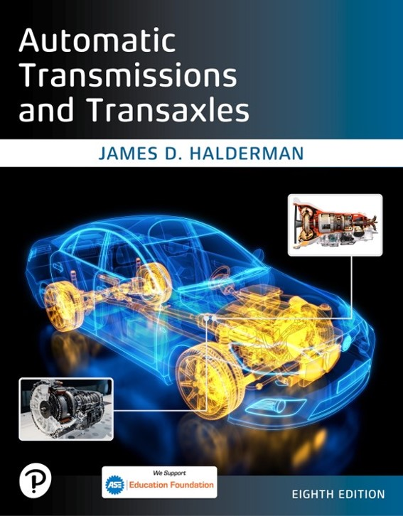
Automatic Transmissions and Transaxles
Eighth Edition
Chapter 9
Drivetrain Electricity and Electronics
Copyright © 2024, 2018, 2015 Pearson Education, Inc. All Rights Reserved
Notes:
If this PowerPoint presentation contains mathematical equations, you may need to check that your computer has the following installed:
1) Math Type Plugin
2) Math Player (free versions available)
3) NVDA Reader (free versions available)
INSTRUCTOR NOTE: This presentation includes text explanation notes, you can use to teach the course. When in SLIDE SHOW mode, you RIGHT CLICK and select SHOW PRESENTER VIEW, to use the notes.

Slide 2
Learning Objectives (1 of 2)
9.1 Explain the characteristics of electricity.
9.2 Differentiate between conductors, insulators, and semiconductors.
9.3 Explain the units of electrical measurement.
9.4 List the parts of a complete circuit.
9.5 Discuss the types of electrical circuit faults.
9.6 Explain how to detect and measure electrical voltage, current, and resistance.

Slide 3
Learning Objectives (2 of 2)
9.7 Discuss the purpose of terminals, connectors, relays, and switches.
9.8 Explain the operation of speed sensors and throttle position (T P) sensors.
9.9 State the need for networks and discuss network classifications.

Slide 4
Introduction
Electricity may be difficult for some people to learn for the following reasons:
It cannot be seen
Only the results of electricity can be seen
It has to be detected and measured

Slide 5
Electricity (1 of 2)
Electricity: movement of electrons from one atom to another.
Nucleus
Protons, neutrons, and electrons
Automotive electricity uses conventional theory
Electricity flows from positive to negative
Magnets and electrical charge
Electron orbits

Slide 6
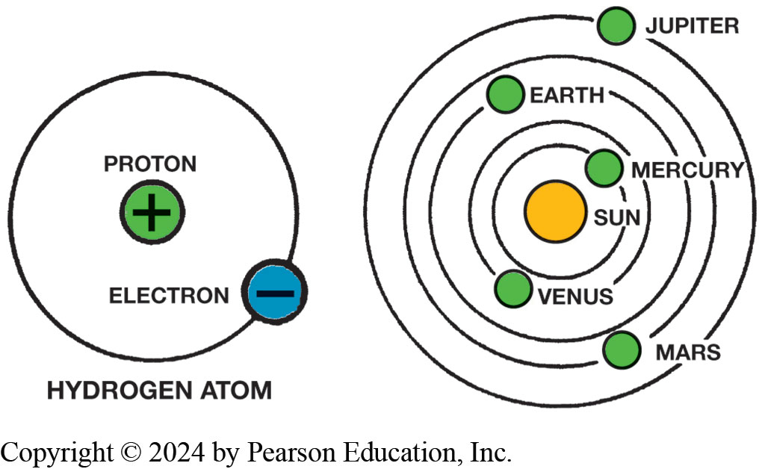
Figure 9.1
In an atom (left), electrons orbit protons in the nucleus just as planets orbit the sun in our solar system (right).
Notes:
The parts of an atom have different charges. The orbiting electrons are negatively charged, while protons are positively charged. Positive charges are indicated by the “plus” sign (+), and negative charges by the “minus” sign (−). These same + and − signs are used to identify parts of an electrical circuit. Neutrons have no charge at all. They are neutral. In a normal or balanced atom, the number of negative particles equals the number of positive particles. That is, there are as many electrons as there are protons.

Slide 7
Electricity (2 of 2)
Conductors
Conductors are materials with fewer than four electrons in their atom’s outer orbit.
Insulators
Insulators are materials with more than four electrons in their atom’s outer orbit.
Semiconductors
Materials with exactly four electrons in outer orbit are called semiconductors.

Slide 8
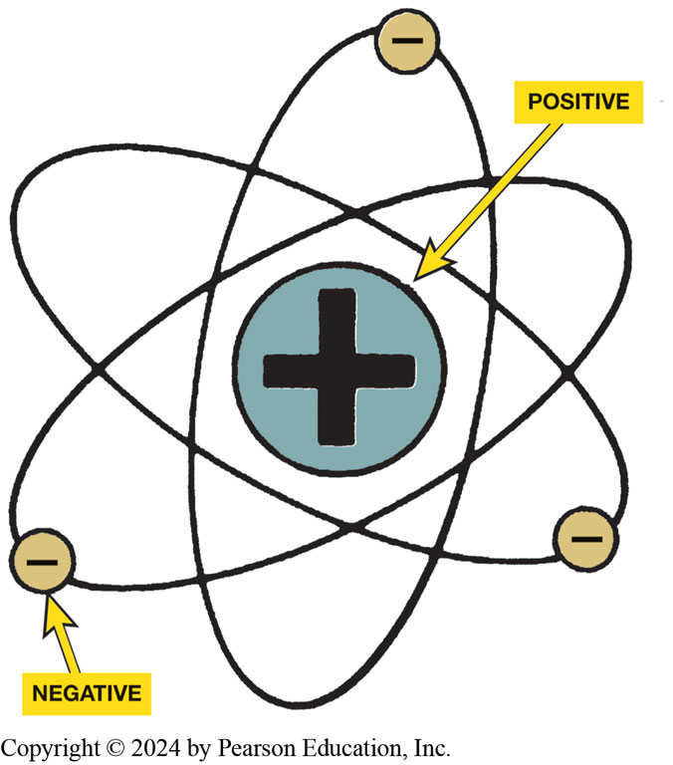
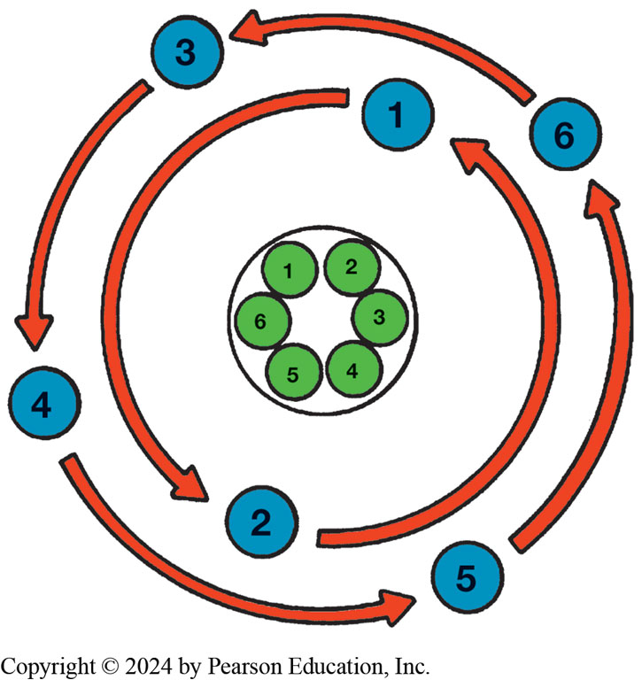
Atom Nucleus & Balanced Atom
Figure 9.2 Nucleus of an atom has a positive (+) charge and the surrounding electrons have a
Figure 9.3 Figure shows a balanced atom. The number of electrons is the same as the number of protons in the nucleus.
negative
charge

Slide 9
Figure 9.4
Unlike charges attract and like charges repel.

Slide 10
Animation: Magnets (Animation will automatically start)

Slide 11
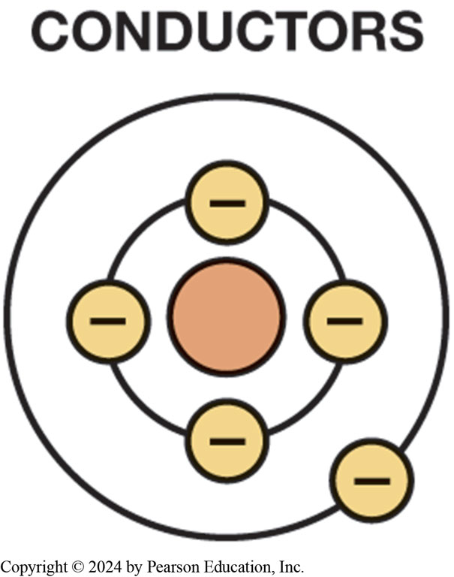
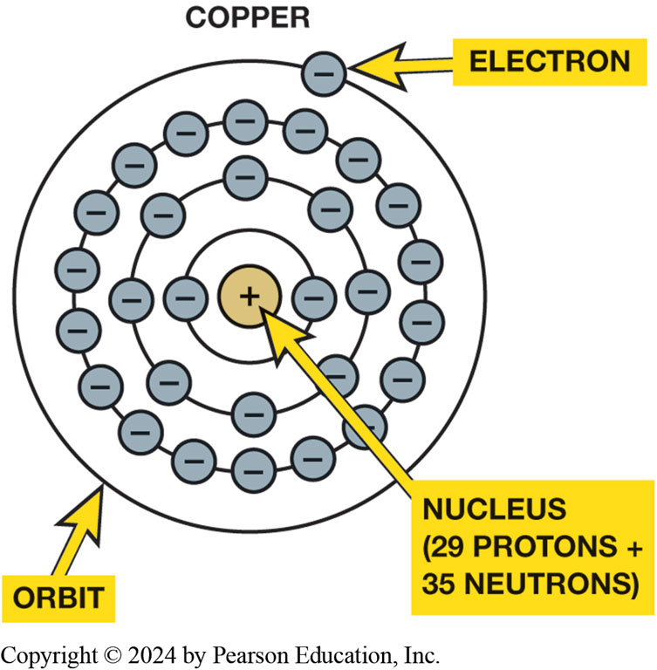
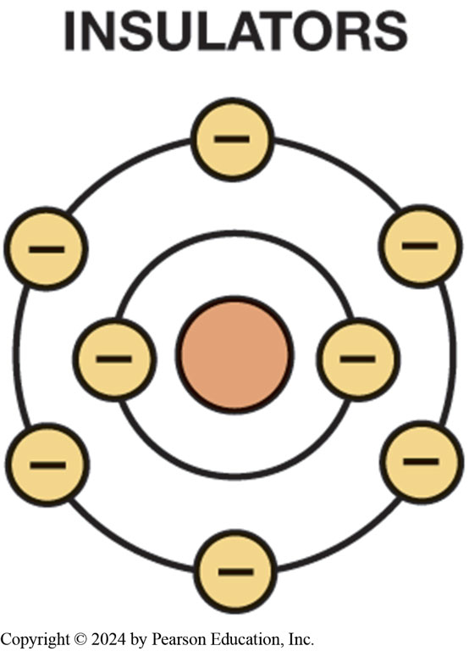
Conductors/Insulators
Figure 9.5 Conductor is any element that has one to three electrons in its outer orbit.
Figure 9.6 Copper is excellent conductor, with just one electron in its outer orbit, making it easy to be knocked out of its orbit and flow to other nearby atoms. This causes electron flow, which is definition of electricity.
Figure 9.7 Insulators are elements with five to eight electrons in the outer orbit.
Notes:
Copper is an excellent conductor because it has only one electron in its outer orbit. This orbit is far enough away from the nucleus of the copper atom that the pull or force holding the outermost electron in orbit is relatively weak.
Copper is the conductor most used in vehicles because the price of copper is reasonable compared to relative cost of other conductors with similar properties. Examples of commonly used conductors include the following materials:
■ Silver
■ Copper
■ Gold
■ Aluminum
■ Steel
■ Cast Iron

Slide 12
Animation: Copper Atom (Animation will automatically start)

Slide 13
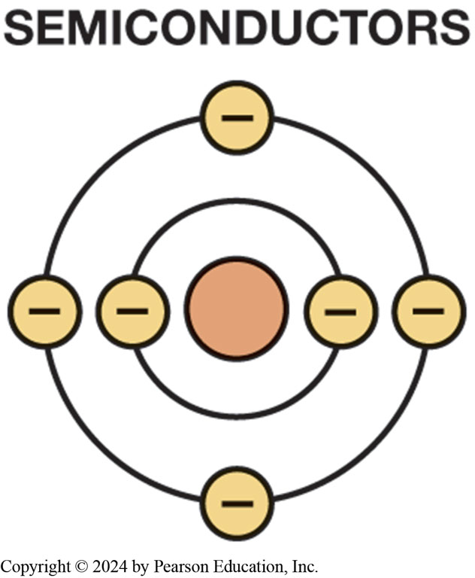
Figure 9.8
Semiconductor
Semiconductor elements contain exactly four electrons in the outer orbit.

Slide 14
Figure 9.9
Current Flow
Current Flow
What is difference between conventional theory and electron theory?
Current electricity is the movement of electrons through a conductor.
Notes:
Current Flow The following events occur if a source of power, such as a battery, is connected to the ends of a conductor—a positive charge (lack of electrons) is placed on one end of the conductor and a negative charge (excess of electrons) is placed on the opposite end of the conductor. For current to flow, there must be an imbalance of excess electrons at one end of the circuit and a
deficiency of electrons at the opposite end. ● SEE FIGURE 9.9.
CONVENTIONAL THEORY VERSUS ELECTRON THEORY
Conventional theory. It was once thought that electricity had only one charge and moved from positive to negative. This theory of the flow conventional theory of current flow. Most automotive applications use the conventional theory. FIGURE 14.10.
Electron theory. The discovery of the electron and its negative charge led to the electron theory, which states that there is electron flow from negative to positive.

Slide 15
Animation: Electron Flow (Animation will automatically start)

Slide 16
Figure 9.11
Units of Electricity
Three fundamentals of electricity-related units include the ampere, volt, and ohm.
Ampere is measure of amount of current flow.
Voltage is unit of electrical pressure.
Ohm is unit of electrical resistance
One ampere is the movement of 1 coulomb (6.28 billion billion electrons) past a point in 1 second.

Slide 17
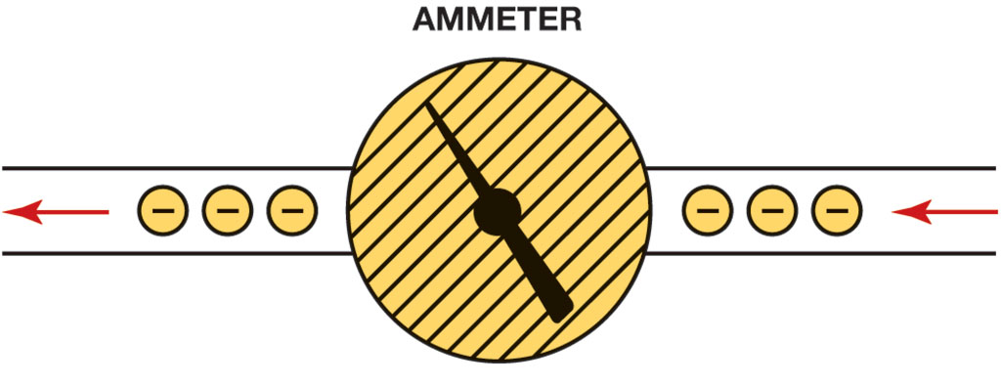
Figure 9.12
Ammeter
Ammeter is installed in the path of the electrons similar to a water meter used to measure the flow of water in gallons per minute. The ammeter displays current flow in amperes.

Slide 18
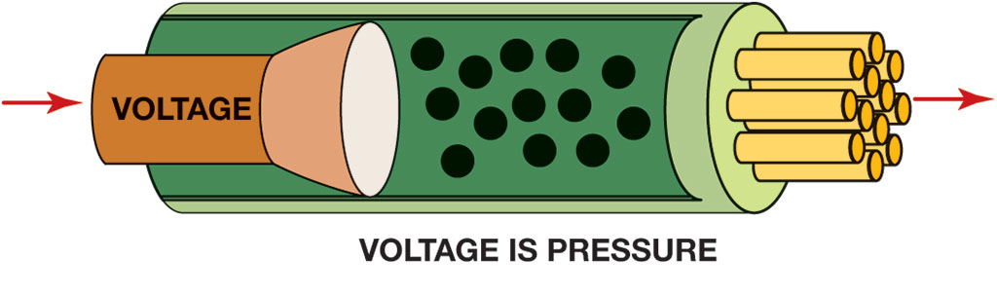
Figure 9.13
Units of Electricity
Voltage is the electrical pressure that causes the electrons to flow through a conductor.

Slide 19
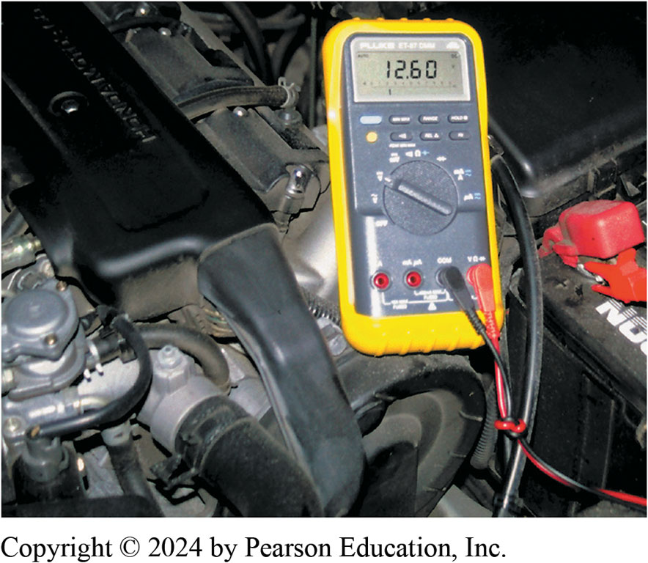
Figure 9.14
Digital multimeter set to read D C volts is being used to test voltage of vehicle battery. Multimeters can also measure resistance (ohms) and current flow (amperes).

Slide 20
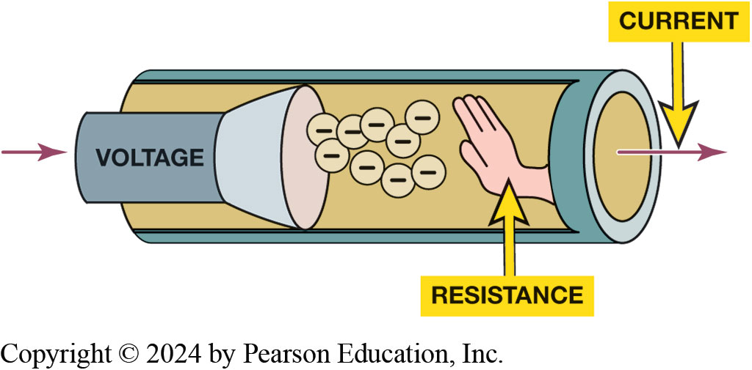
Figure 9.15
Resistance
Resistance to the flow of electrons through a conductor is measured in ohms.

Slide 21
Animation: Voltage and Resistance (Animation will automatically start)

Slide 22
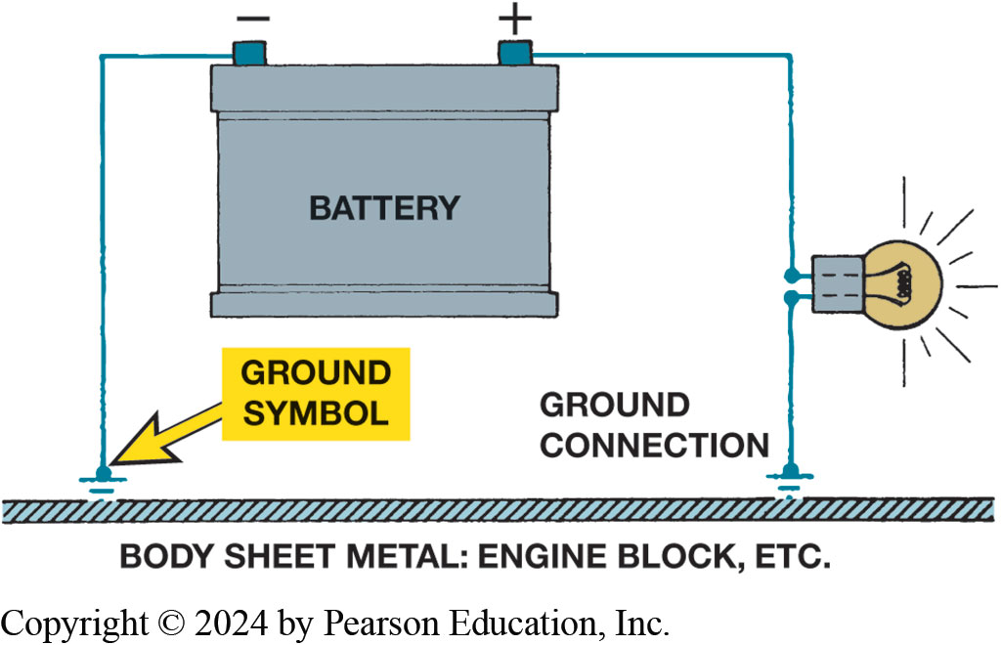
Electrical Circuits
Complete Electrical Circuits:
Power source, circuit protection device, power-side wire or path, electrical load, a ground return path, & switch or a control device.
Circuit testers include test lights, fused jumper leads.
Figure 9.16 The return path back to the battery can be any electrical conductor, such as a copper wire or the metal frame or body of the vehicle.

Slide 23
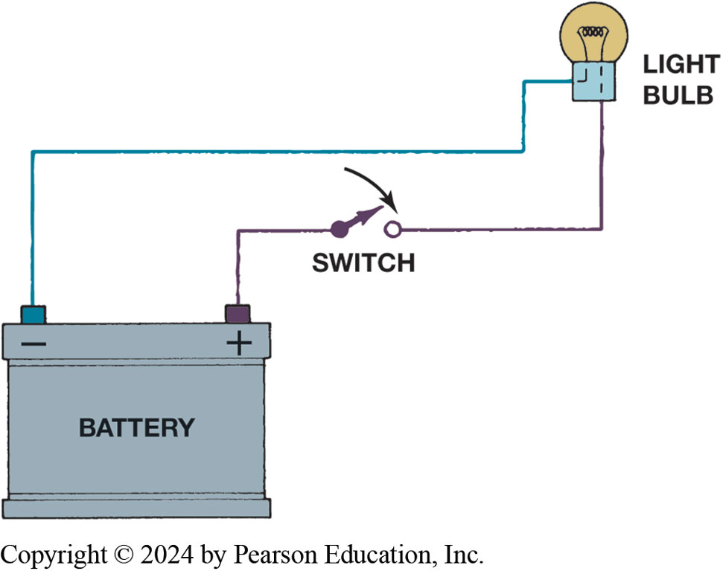
Figure 9.17
Switch
Return path (ground) for electrical current from load back to power source so that there is a complete circuit.
Switches and controls turn circuit on and off.
An electrical switch opens the circuit and no current flows. The switch could also be on the return (ground) path wire.

Slide 24
Animation: Battery Charge & Discharge (Animation will automatically start)

Slide 25
Electrical Schematics (1 of 3)
All circuit schematics or diagrams include:
Power-side wiring of the circuit
All splices
Connectors
Wire size
Wire color
Trace color (if any)
Circuit number
Electrical components
Ground return paths
Fuses and switches

Slide 26
Electrical Schematics (2 of 3)
Circuit Information
Wire size
Open circuits
Short-to-voltage
Short-to-ground
High resistance

Slide 27
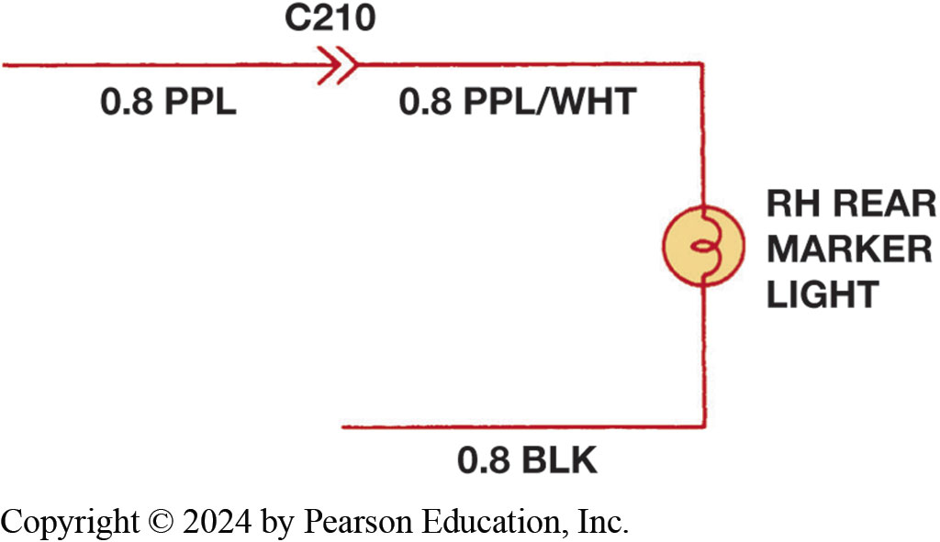
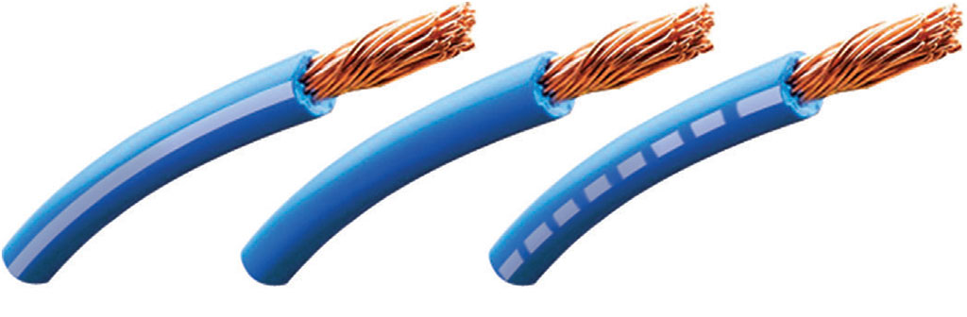
Electrical Schematics (3 of 3)
Figure 9.18 Center wire is a solid color wire, meaning that wire has no other identifying tracer or stripe color. Two end wires could be labeled “B L U/W H T,” indicating a blue wire with a white tracer or stripe.
Figure 9.19 Section of a wiring diagram. Notice that the wire color changed at connection C210. The “0.8” is metric wire size in square millimeters.
Notes:
Wire size is shown on all schematics. For example, ● FIGURE 9.19 illustrates a rear side-marker bulb circuit diagram where “.8” indicates the metric wire gauge size in square millimeters (mm 2) and “P P L” indicates a solid purple wire. The wire diagram also shows that the color of the wire changes at the number C210. This stands for
“connector #210” and is used for reference purposes. The symbol for the connection can vary
depending on the manufacturer. The color change from purple (P P L) to purple with a white tracer
(P P L/W H T). The ground circuit is the “.8 B L K” wire.
FIGURE 9.20 shows many of the electrical and electronic symbols that are used in wiring and circuit grams.
.

Slide 28
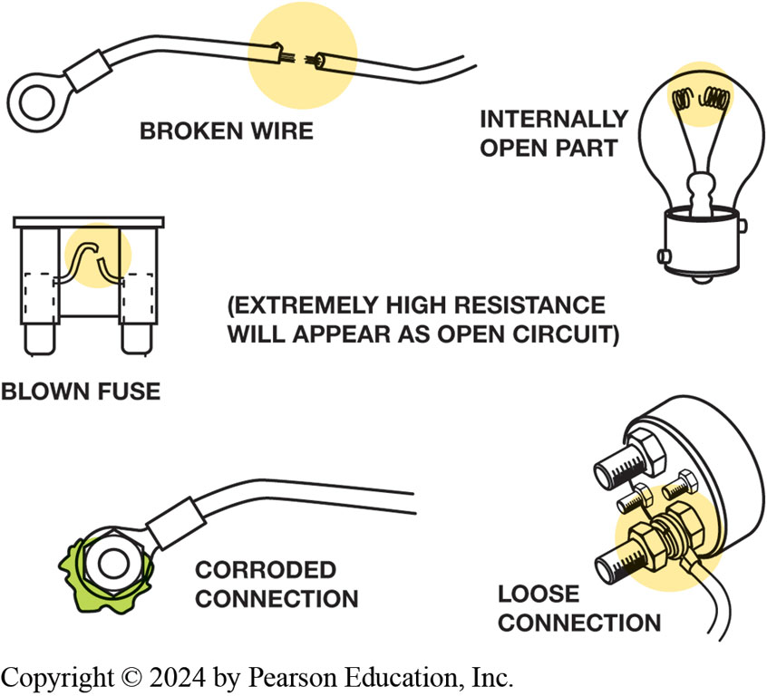
Figure 9.21
Examples of common causes of open circuits. Some of these are often difficult to find.
Open Circuit
Circuit that is not complete, or lacks continuity
Such as a broken wire
Short-to-Voltage
Occurs when power side of one circuit is electrically connected to power side of another circuit
Notes:
Open circuit is any circuit that is not complete, or that lacks continuity, such as a broken wire.
Open circuits have the following features:
No current will flow through an open circuit.
An open circuit may be created by a break in the circuit or by a switch that opens (turns off) the circuit and prevents the flow of current.
In any circuit containing a power load and ground, an opening anywhere in the circuit will cause circuit not to work.
A light switch in a home and the headlight switch in a vehicle are examples of devices that open a circuit to control its operation.
NOTE: A blown fuse opens the circuit to prevent damage to the components or wiring in the circuit in the event of an overload caused by a fault in the circuit.

Slide 29
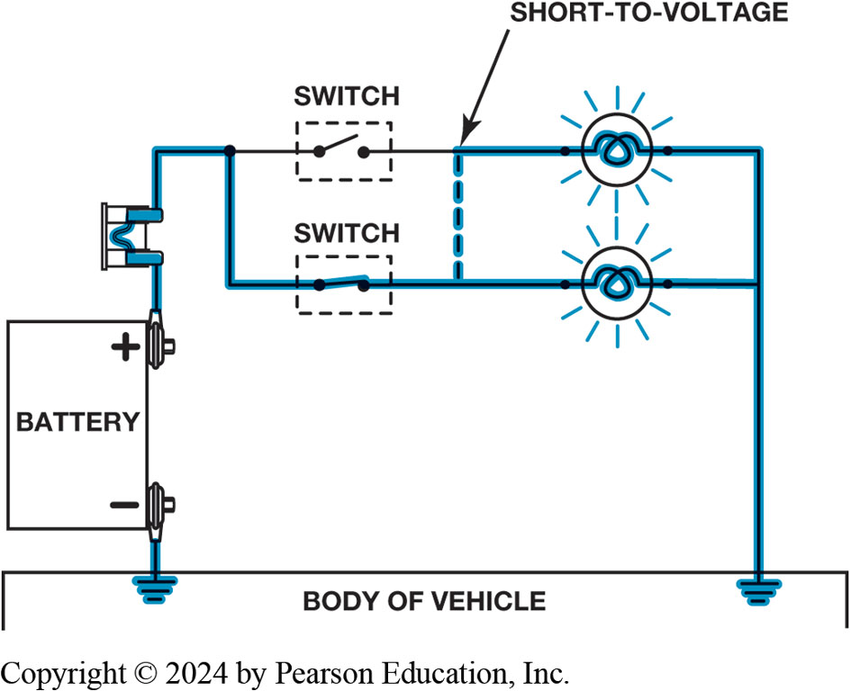
Figure 9.22
Short circuit permits electrical current to bypass some or all of the resistance in the circuit.
Notes:
Short-to-Voltage If a wire (conductor) or component is shorted to voltage, it is commonly referred to as being
shorted. A short-to-voltage occurs when the power side of one circuit is electrically connected to
the power side of another circuit.
A short circuit has the following features:
1. It is a complete circuit in which the current usually bypasses some or all of the resistance in the circuit.
2. It involves the power side of the circuit.
3. It involves a copper-to-copper connection (two power side wires touching together).
4. It is also called a short-to-voltage.
5. It usually affects more than one circuit. In this case, if one circuit is electrically connected to another circuit, one of the circuits may operate when it is not supposed to because it is being supplied power from another circuit.
6. It may or may not blow a fuse.
Long Description:
Two glowing bulbs in parallel connection are connected to two switches at one end and to the ground at the other. One switch is on and the other is off. The switches are connected to the positive terminal of the battery; its negative terminal is grounded to the body of the vehicle. There is a short-to voltage between the two connections, which bypasses the switch that is off and thus illuminates the bulb.

Slide 30
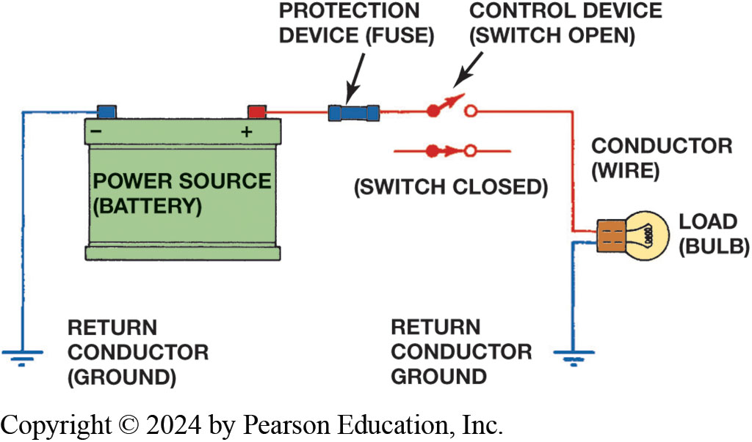
Figure 9.23
Fuse or circuit breaker opens circuit to prevent damage in the event of a short circuit.
Notes:
Long Description:
A load (light bulb) is connected to a control device (open switch) by a conductor (wire) on one end and to the return conductor ground on the other. The switch is connected to the protection device (fuse) which is connected to the positive terminal of the power source (battery). The negative terminal of the battery is connected to the return conductor ground. A closed switch is also seen.

Slide 31
Animation: Working with Wiring Diagrams (Animation will automatically start)

Slide 32
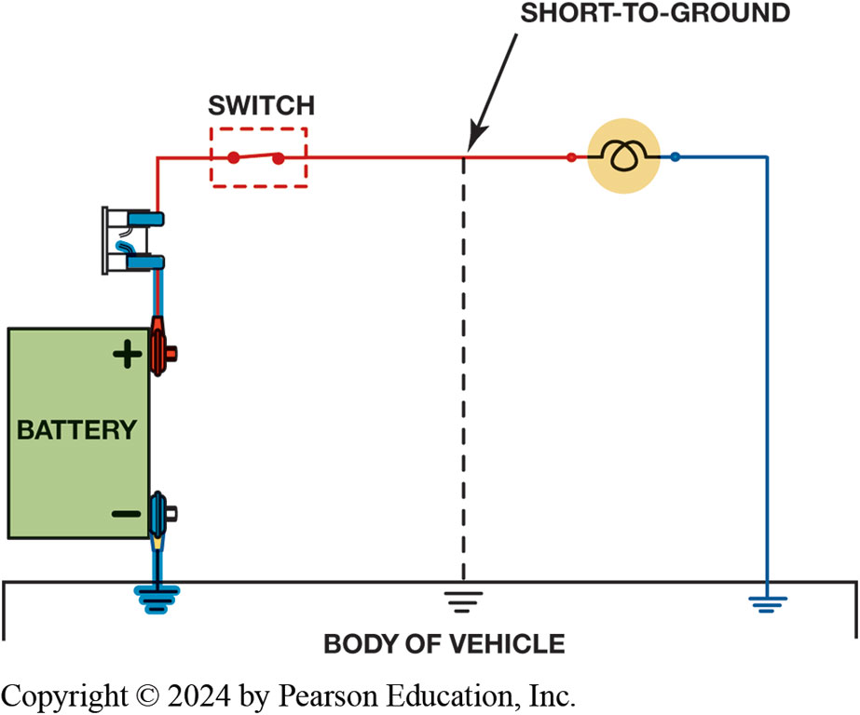
Figure 9.24
Short-to-Ground
Short-to-ground affects power side of circuit. Current flows directly to ground return, bypassing some or all of electrical loads in circuit. No current in circuit past short. Short-to-ground will cause fuse to blow.
Notes:
A short-to-ground is a type of short circuit that occurs when the current bypasses part of the nor-
mal circuit and flows directly to ground. A short-to-ground has the following features:
Because the ground return circuit is metal (vehicle frame, engine, or body), it is often identified as having current flowing from copper to steel.
A short-to-ground can occur at any place where a power path wire accidentally touches a return path wire or conductor. ● SEE Figure 9.24.
A defective component or circuit that is shorted to ground is commonly called grounded.
A short-to-ground almost always results in a blown fuse, damaged connectors, or melted wires.
High resistance is resistance higher than normal circuit resistance usually caused by following:
■ Corroded connections or sockets
■ Loose terminals in a connector
■ Loose ground connections
If there is high resistance anywhere in a circuit, it may cause the following problems:
1. Slow operation of a motor-driven unit, such as when the transfer case makes a range change.
2. Dim lights
3. “Clicking” of relays or solenoids
4. No operation of a circuit or electrical component
Long Description:
A glowing bulb is connected to a closed switch by a conductor on one end which connected to the positive terminal of a battery. The other end of the bulb and the negative terminal of a battery are grounded at the body of the vehicle. A short to ground marked by dotted lines is connected from the conductor to the body of the vehicle where it is grounded.

Slide 33
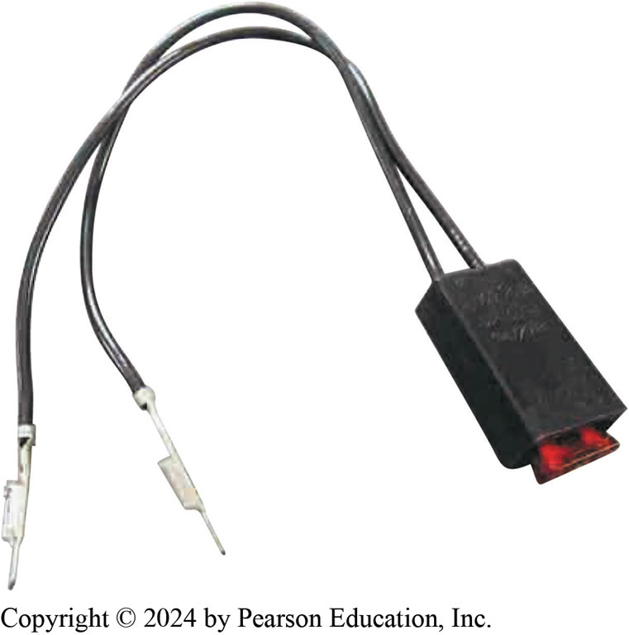
Fused Jumper Wire
Purpose and function
Fuse
Alligator clip ends
Good-quality insulated wire
Figure 9.25 Technician-made fused jumper lead, which is equipped with a red 10-ampere fuse. This fused jumper wire uses terminals for testing circuits at a connector instead of alligator clips

Slide 34
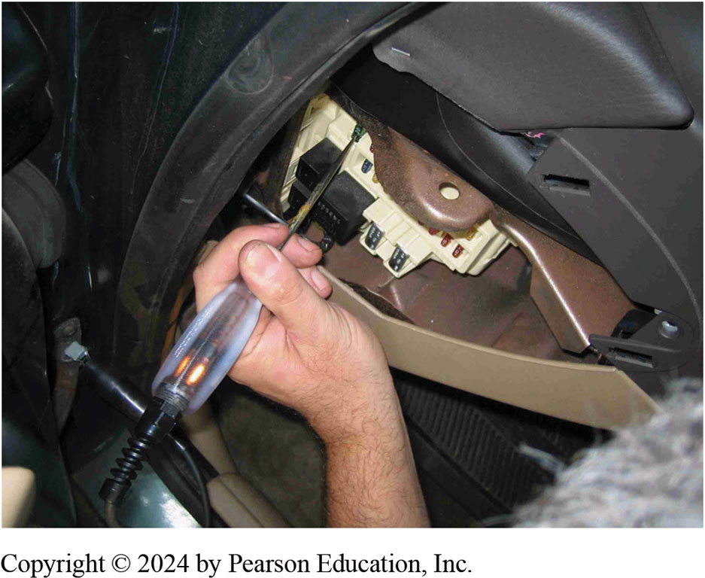
Figure 9.26
Testing a fuse with a test light. If the fuse is good, the test light should light on both sides (power side and load side) of the fuse.
Non-powered Test Light
Use of a 12-volt test light
Electrical power
Grounds

Slide 35
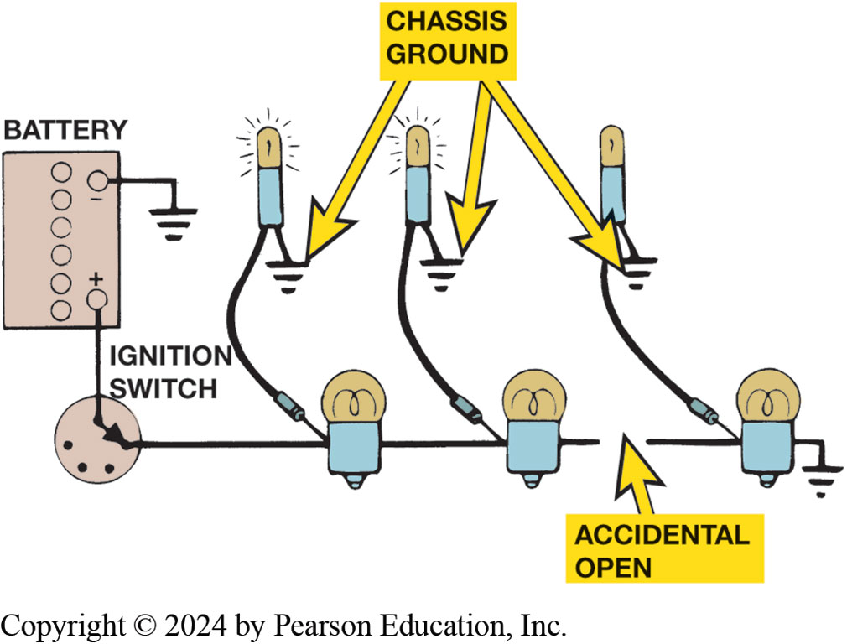
Figure 9.27
Test Light Use
A test light can be used to locate an open in a circuit. Note that the test light is grounded at a different location than the circuit itself.
Notes:
Long Description:
Three bulbs are connected in series to an ignition switch at one end and to the ground at the other. There is an accidental open in the connection in between the second and the third bulb from the left. The switch is connected to the positive terminal of the battery which is grounded at its negative terminal. Three testers are connected to each bulb at one end and to a chassis ground at the other. The two testers to the left of the open glow while the tester to the right of the open does not, indicating a break in the circuit.

Slide 36
Animation: Circuit Test, Test Light (Animation will automatically start)

Slide 37
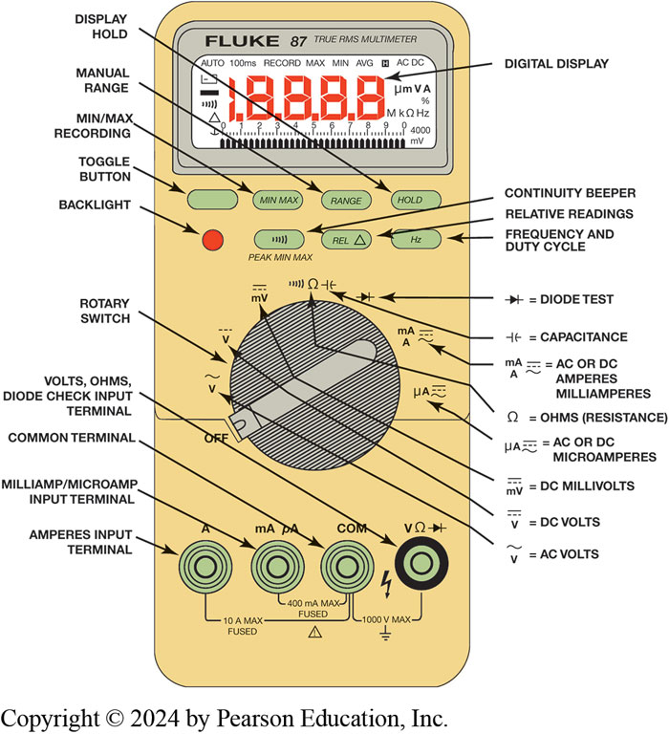
Digital Multimeter (D M M)
Voltmeter measures pressure or potential of electricity in volts.
Ohmmeter measures resistance in ohms of a component or circuit section when no current is flowing
Ammeter measures flow of current through a complete circuit in amperes or milliamperes.
Figure 9.28 Digital multimeter. Black meter lead placed in C O M terminal. Red meter test lead should be in volt-ohm terminal except when measuring current in amperes.
Notes:
Long Description:
The parts are labelled as follows. The top part of the multimeter shows the digital display and buttons for display hold, toggle button, min/max recording, manual range, backlight, continuity beeper, relative readings, frequency and duty cycle. A knob at the center known as the rotary switch has symbols for the diode test, capacitance, A C or D C Amperes and Milliamperes, Ohms (resistance), A C or D C microamperes, D C millivolts, D C Volts, A C Volts. Blow the knob there are four terminals: amperes input terminal, milliamp/microamp input terminal, volts, ohms, common terminal, and volts, ohms, diode check input terminal. The amperes input terminal and the common terminal are 10 amperes max fused with an alert symbol, the milliamp/microamp input terminal and the common terminal are 400 milliamps max fused, and the common terminal, and volts, ohms, diode check input terminal are 1000 volts max grounded.

Slide 38
Chart 9.1
Common symbols and abbreviations used on D M M
Symbol | Meaning
A C | Alternating current or voltage
D C | Direct current or voltage
V | Volts
m V | Millivolts (1/1, 000 volts)
A | Ampere (amps), current
m A | Milliamperes (1/1, 000 amps)
% | Percent (for duty cycle readings only)
Ohm. | Ohms, resistance
Kilo ohm. | Kilohm (1, 000 ohms), resistance
Mega ohm. | Megohm (1, 000, 000 ohms), resistance
H z | Hertz (cycles per second), frequency
k H z | Kilohertz (1, 000 cycles/second), frequency
M s | Milliseconds (1/1, 000 second) for pulse width measurements

Slide 39
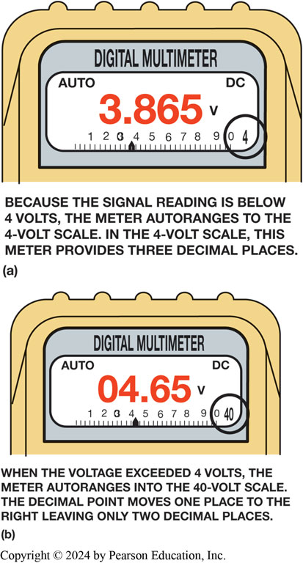
Figure 9.30
D M M Autoranging
A typical autoranging digital multimeter automatically selects the proper scale to read the voltage being tested. The scale selected is usually displayed on the meter face. (a) Note that the display indicates “4,” meaning that this range can read up to 4 volts. (b) The range is now set to the 40-volt scale, meaning that the meter can read up to 40 volts on the scale. Any reading above this level will cause the meter to reset to a higher scale. If not set on autoranging, the meter display would indicate OL if a reading exceeds the limit of the scale selected.
Notes:
Figure 9.30 A typical autoranging digital multimeter automatically selects the proper scale to read the voltage being tested. The scale selected is usually displayed on the meter face. (a) Note that the display indicates “4,” meaning that this range can read up to 4 volts. (b) The range is now set to the 40 volt scale, meaning that the meter can read up to 40 volts on the scale. Any reading above this level will cause the meter to reset to a higher scale. If not set on autoranging, the meter display would indicate O L if a reading exceeds the limit of the scale selected.
D C volts (D C V). This setting is the most common for automotive use. Use this setting to measure
battery voltage and voltage to all lighting and accessory circuits.
A C volts (A C V). This setting is used to check some computer sensors and to check for unwanted A C
voltage from alternators.
Range. The range is automatically set for most meters but can be manually adjusted if needed.
THINK OF MONEY Digital meter displays can often be confusing. The display for a battery measured as 12 1/2 volts would be 12.50 V just as $12.50 is 12 dollars and 50 cents. A 1/2 volt reading on a digital meter will be displayed as 0.50 V, just as $0.50 is half of a dollar. It is more confusing when low values are displayed. E.G. if a voltage reading is 0.063 volt, an auto-ranging meter will display 63 millivolts (63 m V), or 63/1, 000 of a volt, or $63 of $1, 000. (It takes 1,000 m V to equal 1 volt.) Think of millivolts as
one-tenth of a cent, with 1 volt being $1.00. Therefore, 630 millivolts are equal to $0.63 of $1.00 (630 tenths of a cent, or 63 cents). To avoid confusion, try to manually range the meter to read base units (whole volts). If the meter is ranged to base unit volts, 63 millivolts would be displayed as 0.063 or maybe just 0.06, depending ay capabilities of the meter.
Long Description:
The display screen of a digital multimeter has the words auto and D C and the number 4 at the top left, top right, and bottom right corners respectively. The number 4 is circled. A ruler has values from 0 to 10, a pointer points at around 3.8, and the reading shows the value 3.865 Volts. Text reads: Because the signal reading is below 4 volts, the meter autoranges to the 4-volt scale. In the 4-volt scale, this meter provides three decimal places.

Slide 40
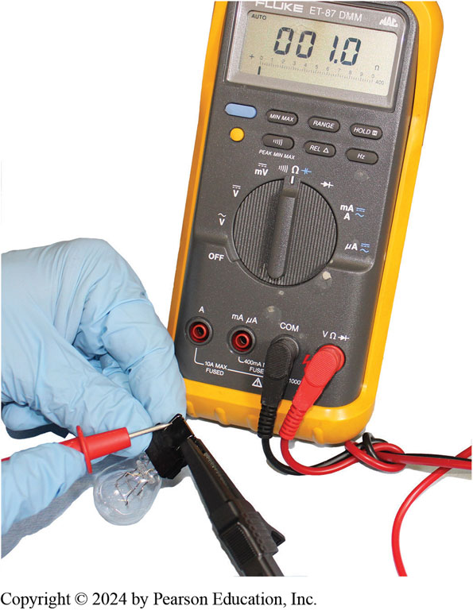
Figure 9.31
Using a digital multimeter set to read ohms
to test this
light bulb. The meter reads the resistance of the filament
Notes:
Measuring Resistance
An ohmmeter measures resistance in ohms of a component or circuit section when no current is flowing through the
circuit. An ohmmeter contains a battery (or other power source) and is connected in series with the
component or wire being measured.
Zero ohms on the scale means that there is no resistance between the test leads, thus indicating continuity or a continuous path for the current to flow in a closed circuit.
Infinity means no connection, as in an open circuit.
Ohmmeters have no required polarity even though red and black test leads are used for resistance measurement. Different meters have different ways of indicating infinity resistance, or a reading higher than the scale allows. Examples of an over-limit display
include the following:
O L, meaning over limit or overload
Flashing or solid number 1
Flashing or solid number 3 on the left side of the display Check the meter instructions for the exact display used to indicate an open circuit or over-range reading.
To summarize, open and zero readings are as follows:
0.00 Ω = Zero resistance (component or circuit has continuity)
O L = An open circuit (no current flows) or the reading is higher than the scale selected.

Slide 41
Animation: Test Bulb (Animation will automatically start)

Slide 42
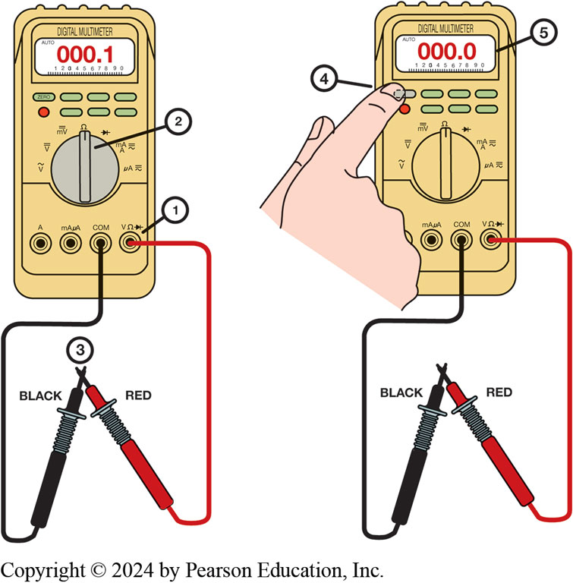
Figure 9.32
Testing Leads
Many digital multimeters can have the display indicate zero to
compensate for test lead resistance. (1) Connect leads in the V
and COM meter terminals. (2) Select the
scale. (3) Touch the
two meter leads together. (4) Push the “zero” or “relative” button on the meter. (5) The meter display will now indicate zero ohms of resistance.
Notes:
Figure 9.32 Many digital multimeters can have the display indicate zero to compensate for test lead resistance.
Connect leads in the V Ω and C O M meter terminals.
Select the Ω scale.
Touch the two meter leads together.
(4) Push the “zero” or “relative” button on the meter.
(5) The meter display will now indicate zero ohms of resistance.
Long Description:
The black and red leads are connected to the common terminal and volts, ohms, diode check input terminal respectively. The rotary switch is set to show the resistance. The two meter leads ate placed in contact with each other. The display indicates 000.1 Ohms of resistance. zero ohms of resistance Upon pushing the “zero” or “relative” button on the meter the display indicates zero ohms of resistance.

Slide 43
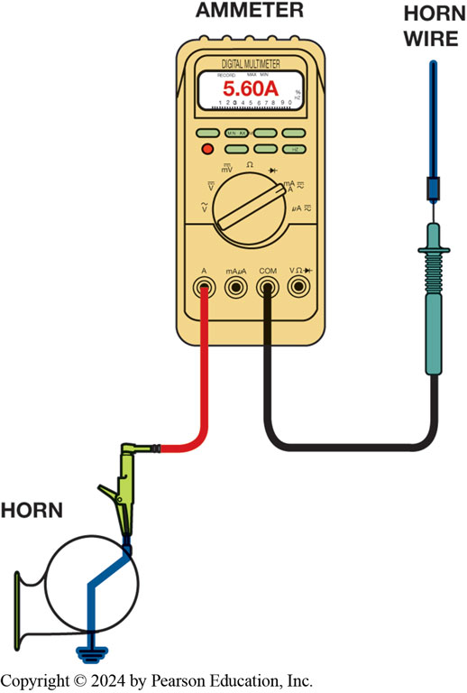
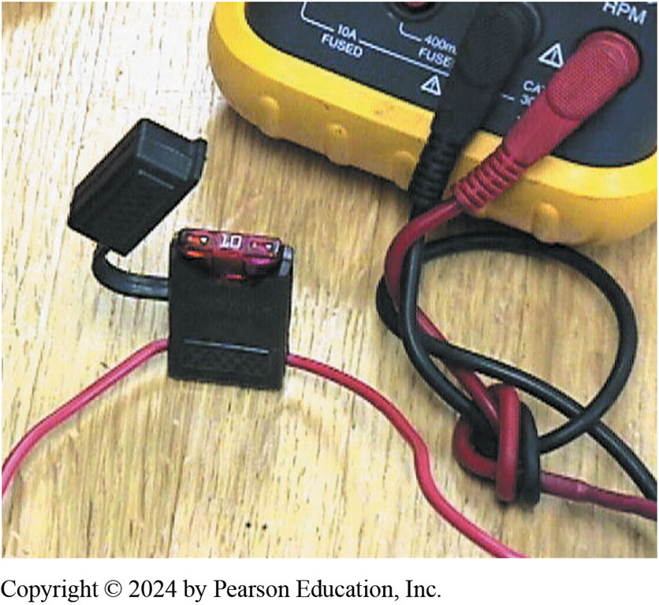
Testing for Current
Figure 9.34 Blade-type fuse holder soldered in series with one of meter leads. 10-ampere fuse protects internal meter fuse and meter itself from damage that may result from excessive current flow if accidentally used incorrectly.
Figure 9.33 Measuring current flow required by a horn requires that ammeter be connected in series and button be depressed

Slide 44
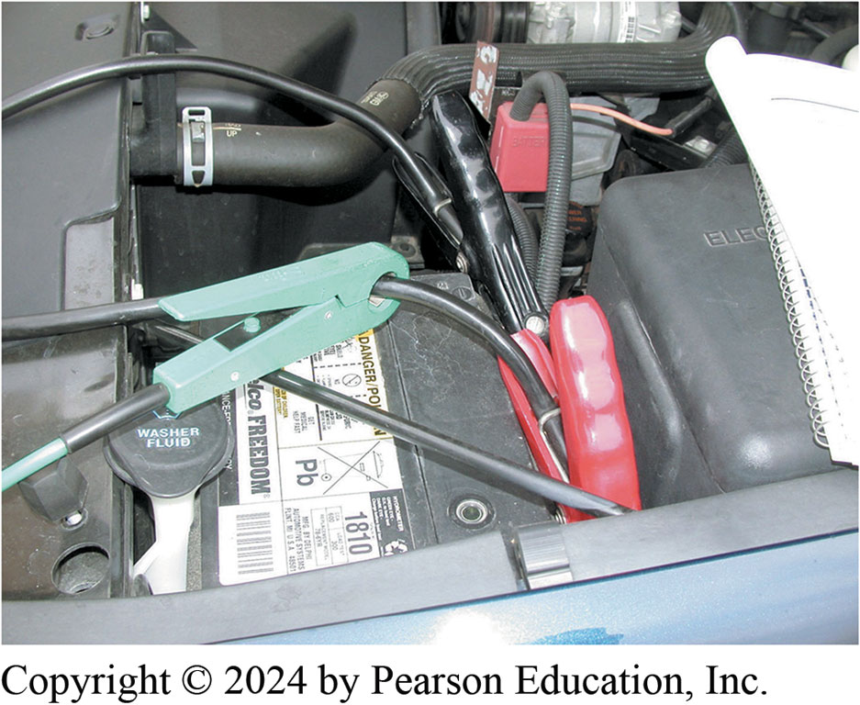
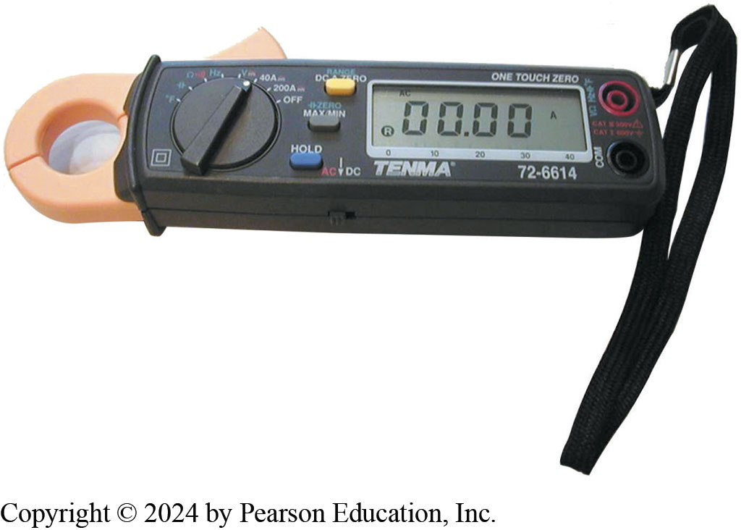
Induction Ammeters
Figure 9.36 Typical mini clamp-on-type digital multimeter. Meter is capable of measuring A C & D C without requiring that circuit be disconnected to install meter in series. The jaws are simply placed over the wire and current flow through the circuit is displayed
Figure 9.35 An inductive ammeter clamp is used with all starting and charging testers to measure the current flow through the battery cables.

Slide 45
Animation: Battery Drain Test, Clamp Meter (Animation will automatically start)

Slide 46
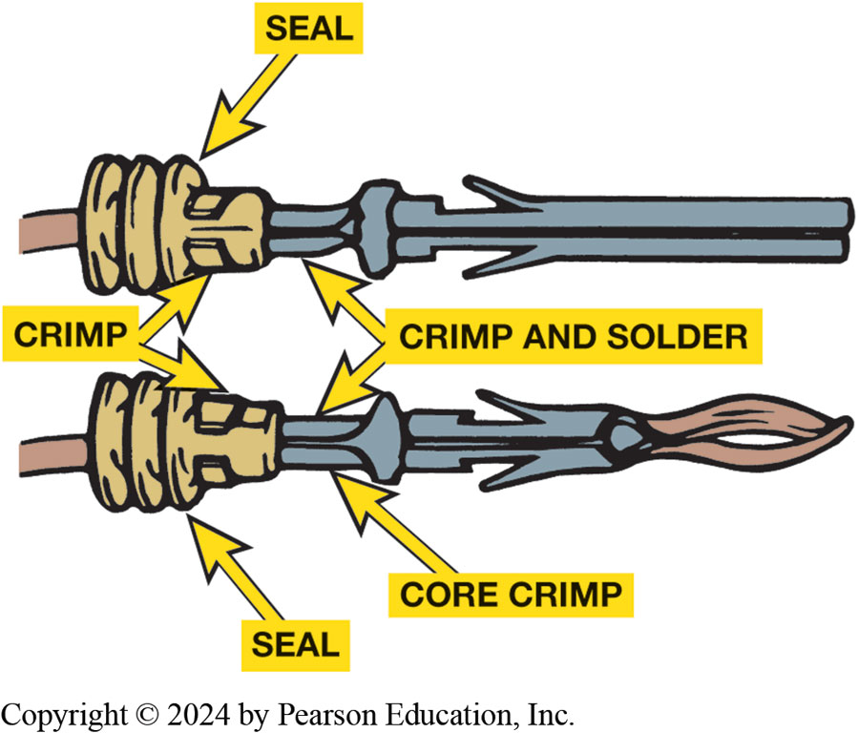
Terminals and Connectors
Terminal
Metal fastener attached
to end of wire which makes electrical connection
Connector
plastic portion that snaps or connects together
Electrical connectors exposed to environment use weather-tight seal.
Figure 9.37 Some terminals have seals attached to help seal the electrical connections

Slide 47
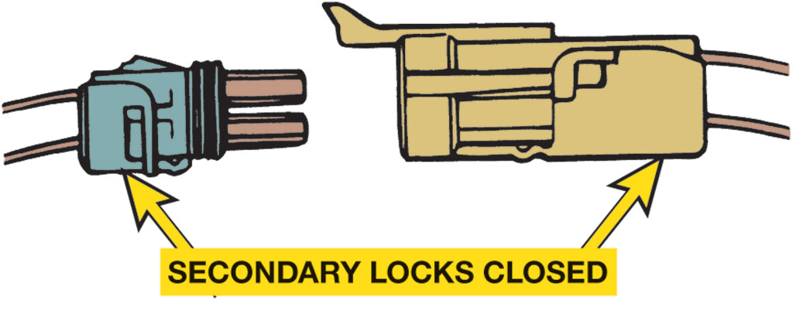
Figure 9.38
Separate a connector by opening the lock and pulling the two apart.

Slide 48
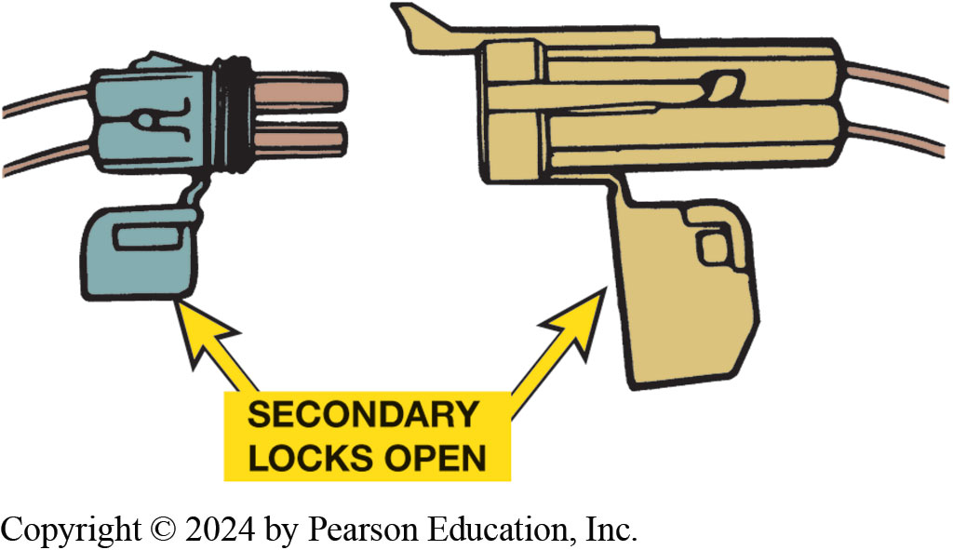
Figure 9.39
Secondary locks help retain the terminals in the connector.

Slide 49
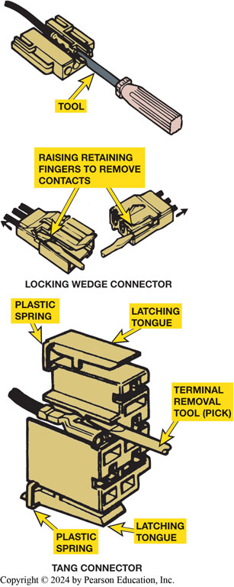
Figure 9.40
Use a small removal tool, sometimes called a pick, to release terminals from the connector.
Notes:
Long Description:
in the locking wedge connector, a terminal removal tool is passed through the device which shows raising retaining fingers to remove contacts. in the T A N G connector, the terminal removal tool (pick) is attached to two latching tongues that are connected to the body by plastic springs.

Slide 50
Wire Repair
Soldering
Many manufacturers recommend that all wiring repairs be soldered.
Why?
What is the soldering procedure?
Crimping terminals
Heat shrink tubing
Crimp-and-seal connectors
Notes:
Many manufacturers recommend that all wiring repairs be soldered. Solder is an alloy of tin and lead used to make a good electrical contact between two wires or connections in an electrical circuit. However, a flux must be used to help clean the area and to
help make the solder flow. Therefore, solder is made with a resin (rosin) contained in the center, called rosin-core solder.
CAUTION: Never use acid-core solder to repair electrical wiring as the acid will cause corrosion. Figure 9.41.
Solder is available with various percentages of tin and lead in the alloy. Ratios are used to
identify these various types of solder, with the first number denoting the percent- age of tin in
the alloy and the second number giving the percentage of lead. The most commonly used solder is
50/50, which means that 50% of the solder is tin and the other 50% is lead. The percentages of each
alloy primarily determine the melting point of the solder.
■ 60/40 solder (60% tin/40% lead) melts at 361°F (183°C).
■ 50/50 solder (50% tin/50% lead) melts at 421°F (216°C).
■ 40/60 solder (40% tin/60% lead) melts at 460°F (238°C).

Slide 51
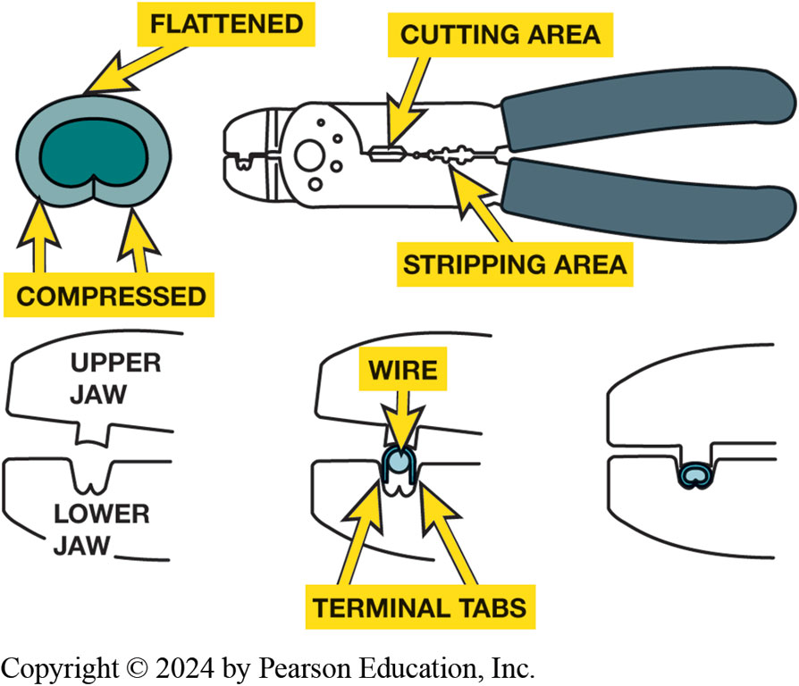
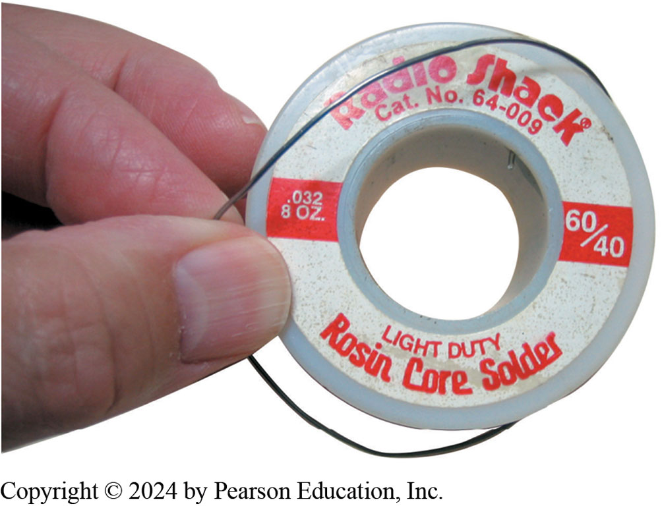
Soldering & Crimping Terminals
Figure 9.41
Figure 9.42
Notes:
Figure 9.41 Always use rosin-core solder. Use small-diameter solder for small soldering irons. Use large-diameter solder only for large-diameter (large-gauge) wire and higher-wattage soldering irons (guns).
Figure 9.42 Notice that to create a good crimp, the open part of the terminal is placed in jaws of crimping tool toward the anvil or the W-shape part.

Slide 52
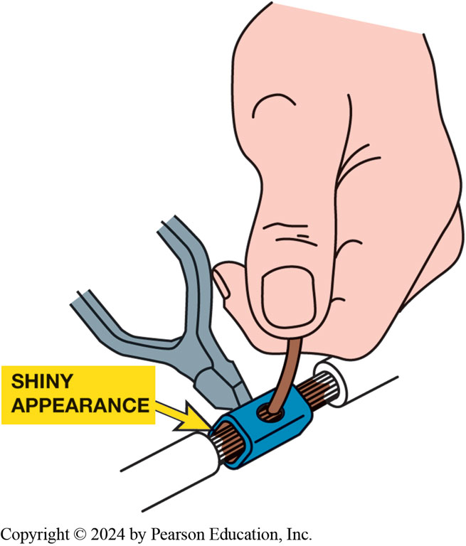
Figure 9.43
All hand-crimped splices or terminals should be soldered to be assured of a good electrical connection.

Slide 53
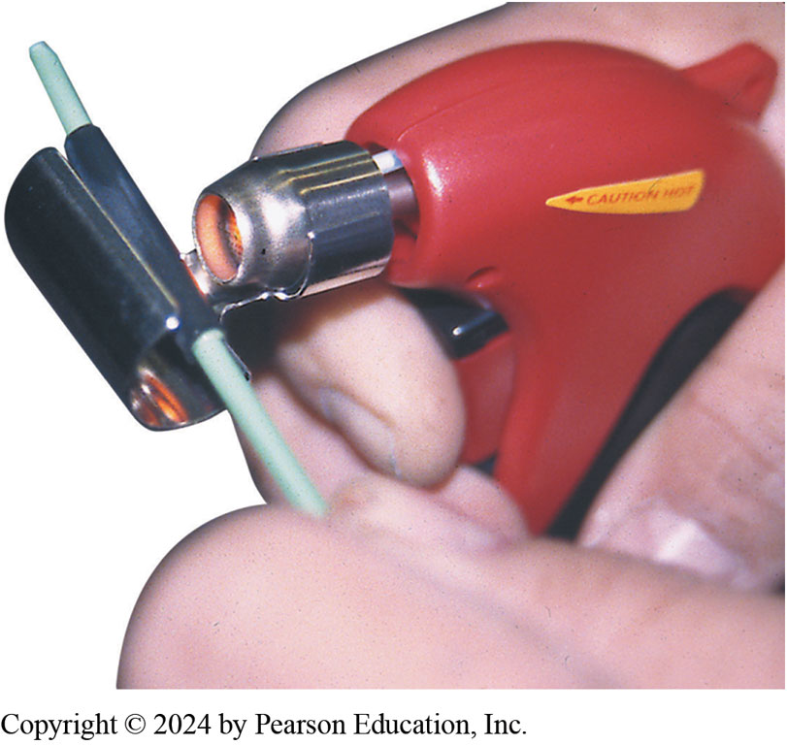
Figure 9.44
A butane torch especially designed for use on heat shrink applies heat without an open flame, which could cause damage

Slide 54
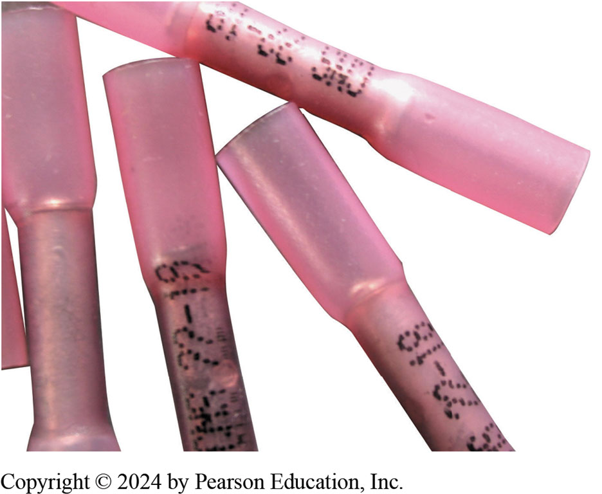
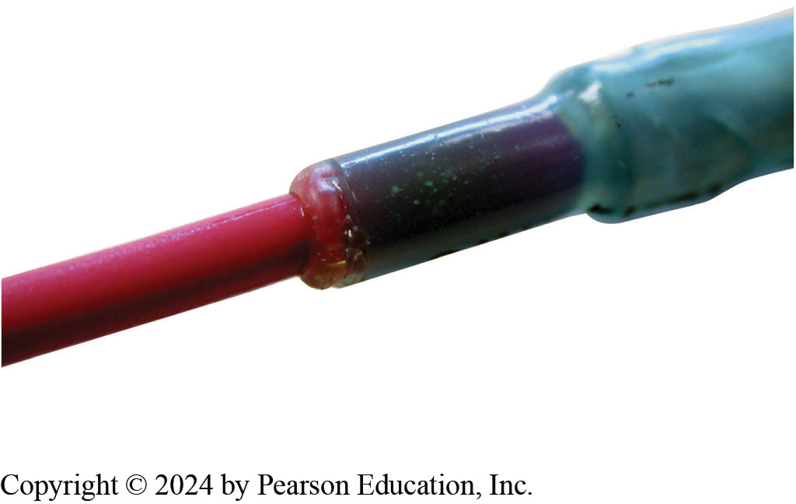
Crimp-and-Seal Connector
Figure 9.45 This type of connector is first lightly crimped to retain ends of wires and then it is heated. The tubing shrinks around wire splice, and thermoplastic glue melts on inside to provide an effective weather-resistant seal.
Figure 9.46 Heating the crimp-and-seal connector melts the glue and forms an effective seal against moisture.

Slide 55
Animation: Electrical Wire Repair (Animation will automatically start)

Slide 56
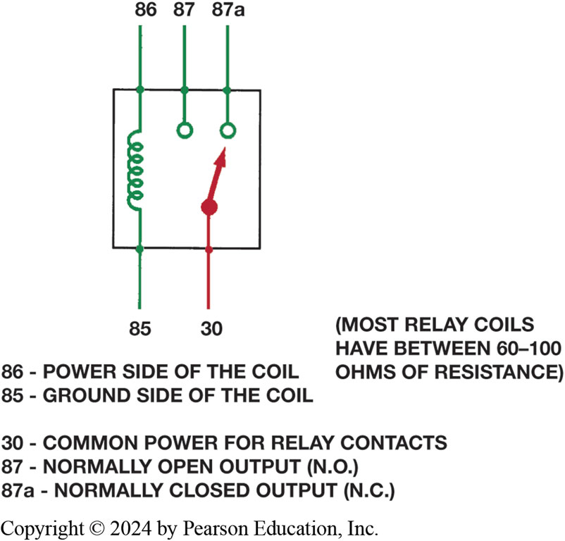
Figure 9.47 (1 of 2)
Relays
Magnetic Switch
Uses movable armature to control high-amperage circuit by using a low-amperage switch
Terminal Identification
Coil
Other terminals used to control the load current
A relay uses a movable arm to complete a circuit whenever there is a power at terminal 86 and a ground at terminal 85. A typical relay only requires about 1/10 ampere through the relay coil. The movable arm then closes the contacts (#30 to #87) and can often handle 30 amperes or more
Notes:
Long Description:
A relay coil has terminal 85 representing the power side and terminal 86 representing the ground side. Two unconnected terminals 87 and 87a represent normally open output (N O) and normally closed output (N C) respectively. A conductor with terminal 30 representing common power for relay contacts has a needle pointing towards the normally closed output. Text reads most relay coils have between 60 to 100 ohms of resistance.

Slide 57
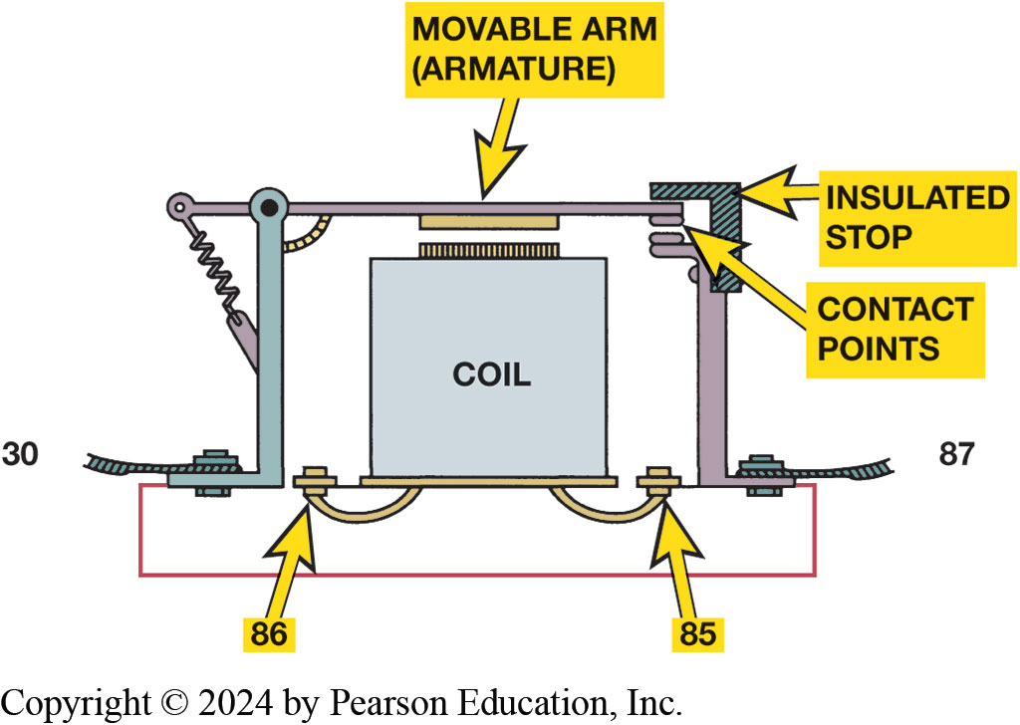
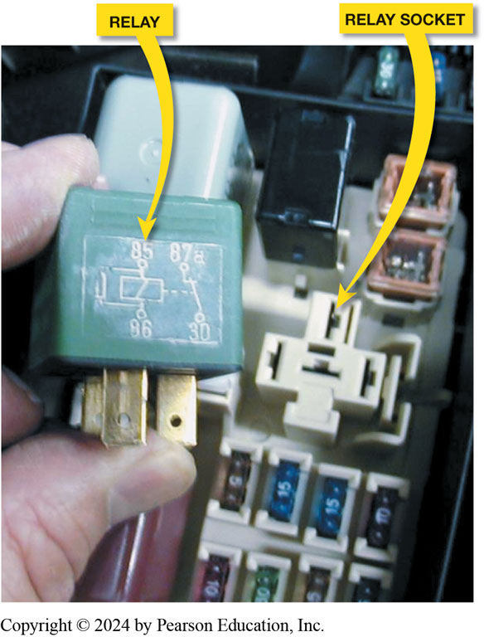
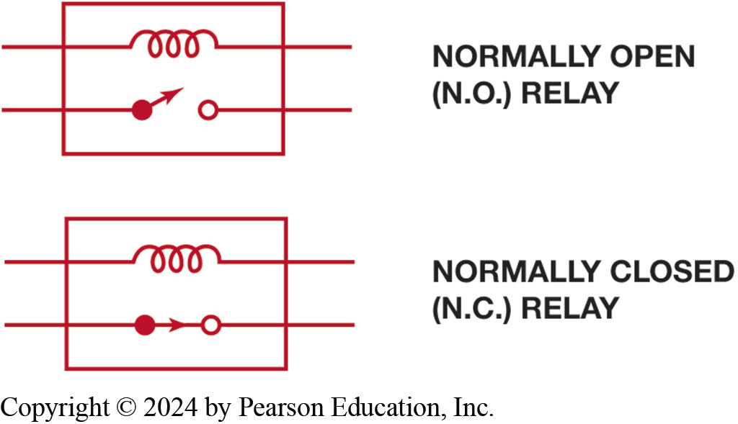
Figure 9.47 (2 of 2)
Figure 9.48
Figure 9.49
Figure 9.50
Notes:
Figure 9.48 cross-sectional view of a typical four-terminal relay. Current flowing through the coil (terminals 86 and 85) causes the movable arm (armature) to be drawn toward the coil magnet. The contact points complete the electrical circuit connected to terminals 30 and 87.
Figure 9.49 A typical relay showing the schematic of the wiring in the relay.
Figure 9.50 All schematics are shown in their normal, non-energized position.
Tech Tip: Divide the Circuit in Half
When diagnosing any circuit that has a relay, start testing at relay and divide circuit in half.
High current portion: Remove the relay and check that there are 12 volts at the terminal 30 socket. If there is, then the power side is okay. Use an ohmmeter and check between terminal 87 socket and ground. If the load circuit has continuity, there should be some resistance. If O L, the circuit is electrically open.
Control circuit (low current): With the relay removed from the socket, check that there is 12 volts to terminal 86 with the ignition on and the control switch on. If not, check service information to see if power should be applied to terminal 86, then continue troubleshooting the switch power and related circuit.
Check the relay itself: Use an ohmmeter and measure for continuity and resistance.
Between terminals 85 and 86 (coil), there should be 60 to 100 ohms. If not, replace the relay.
Between terminals 30 and 87 (high-amperage switch controls), there should be continuity (low ohms) when there is power applied to terminal 85 and a ground applied to terminal 86 that operates the relay. If “O L” is displayed on the meter set to read ohms, the circuit is open which requires that the reply be replaced.
• Between terminals 30 and 87a (if equipped), with the relay turned off, there should be low resistance (less than 5 ohms).
Long Description:
A relay coil has two terminals 85 and 86. Terminal 85 is connected to a movable arm (armature) through insulated stops covering the contact points. The arms connect to terminals 30 and 87 thus completing the electrical circuit.

Slide 58
Animation: Relay (Animation will automatically start)

Slide 59
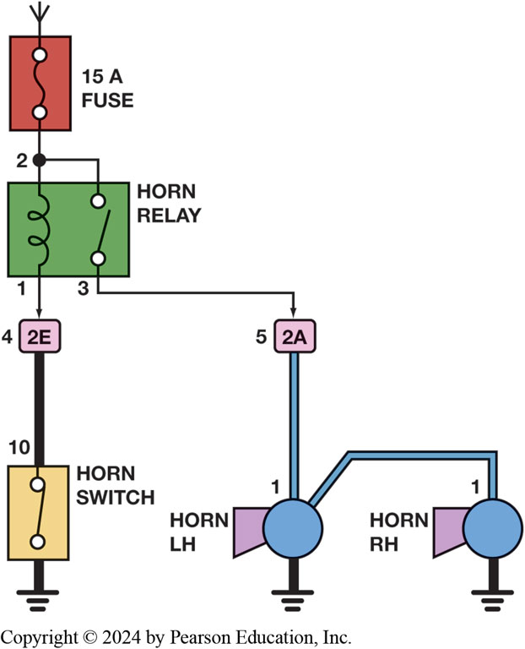
Figure 9.51
Horn Circuit
A typical horn circuit. Note that the relay contacts supply the heavy current to operate the horn when the horn switch simply completes a low-current circuit to ground, causing the relay contacts to close.
Notes:
Long Description:
The diagram shows a 15 A fuse connected to a horn relay at terminal 2. From terminal 2, an inductor of the horn relay is connected at terminal 1 to 2E lead of a horn switch at terminal 10. The other end of the horn switch is grounded. Terminal 3 of an open switch of the horn relay is connected to 2A lead of horn switch L H at terminal 1. Horn switch L H is connected to horn switch R H at terminal 1. The other ends of both switches are grounded.

Slide 60
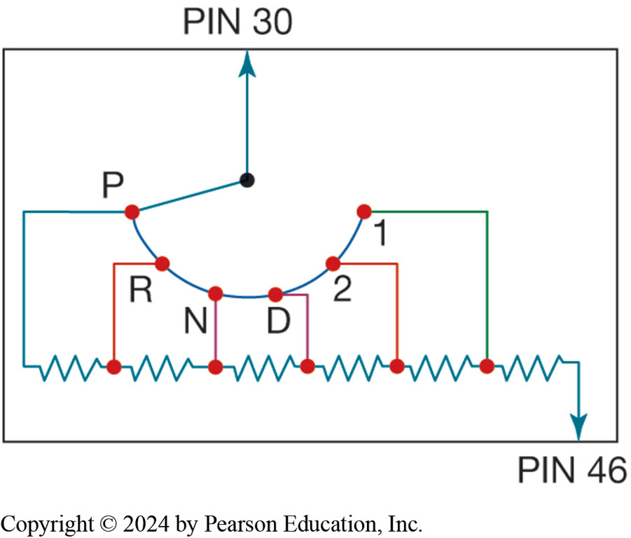
Switches
Electrical Switch
Opens the circuit and no current flows
Switch can be on return (ground) path wire
Ohmmeter Checks
Voltmeter Checks
Figure 9.52 A typical transmission range switch is also similar to the circuit used for electronic transfer case switches. In this example, power, usually 12 volts, is applied at pin 30 and pin 46 is an input to the P C M. The change in voltage at pin 46 indicates how much resistance the circuit has, which is used to detect the gear selected
Notes:
Long Description:
Pin 42 and Pin 30 are inputs to the P C M with and without resistance respectively. P is the primary live wire, R, N, D, and 2 are the secondary live wires, and 1 is the grounding wire. There are resistances between P, R, N, D, 2, 1, and Pin 46.

Slide 61
Speed Sensors
A magnetic sensor consists of a notched wheel and a coil consisting of an iron core wrapped with fine wire
The notched wheel causes the magnetic strength changes, enough to create usable varying A C voltage signal
Speed Sensor Tests: Page 127

Slide 62
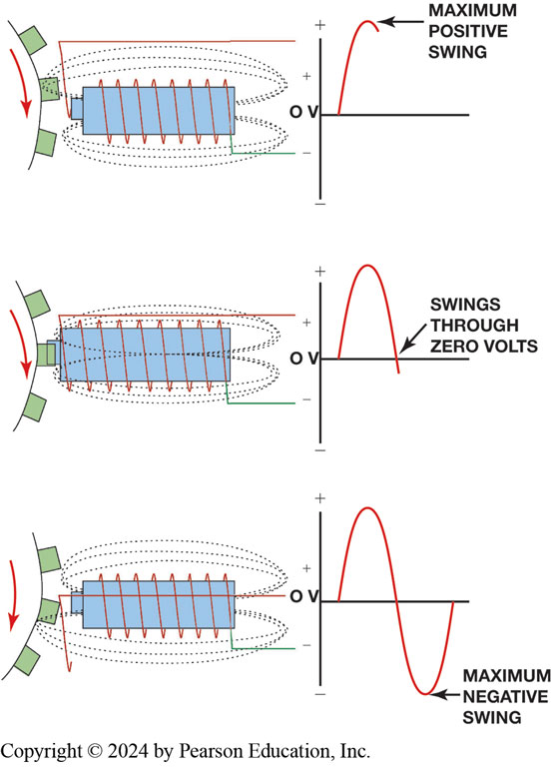
Figure 9.53
Magnetic Sensor
Magnetic sensor uses permanent magnet surrounded by coil of wire. The notches on rotating shaft create a variable magnetic field strength around the coil. When a metallic section is close to sensor, the magnetic field is stronger because metal is a better conductor of magnetic lines of force than air.
Notes:
Long Description:
A clockwise moving trigger wheel has a battery surrounded by a coil of wire and a magnetic field around it. When the spokes of the wheel are not in contact with the battery, the positive terminal of the battery shows maximum positive swing represented by a rise with the curve reaching its peak in the positive direction. When a spoke of the wheel is in contact with the battery, the positive terminal of the battery shows swings through 0 volts represented by a drop with the curve reaching zero. When the spokes of the wheel disengage from the battery, the positive terminal of the battery shows maximum negative swing, represented by a rise with the curve reaching the peak in the opposite direction. The voltage remains at 0 volts at all stages.

Slide 63
Animation: MRE Speed Sensor (Animation will automatically start)

Slide 64
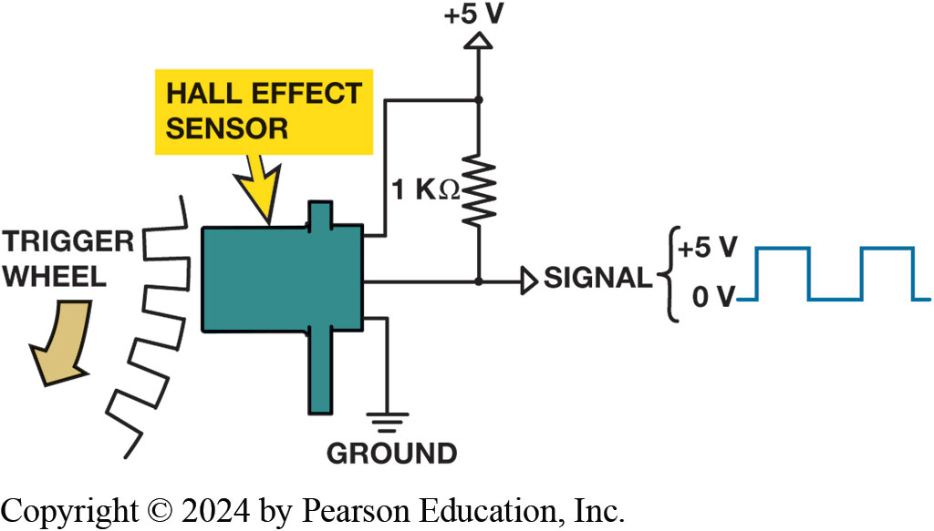
Figure 9.54
A Hall-Effect sensor produces an on-off voltage signal whether it is used with a blade or a notched wheel.

Slide 65
Animation: Hall-effect Sensor (Animation will automatically start)

Slide 66
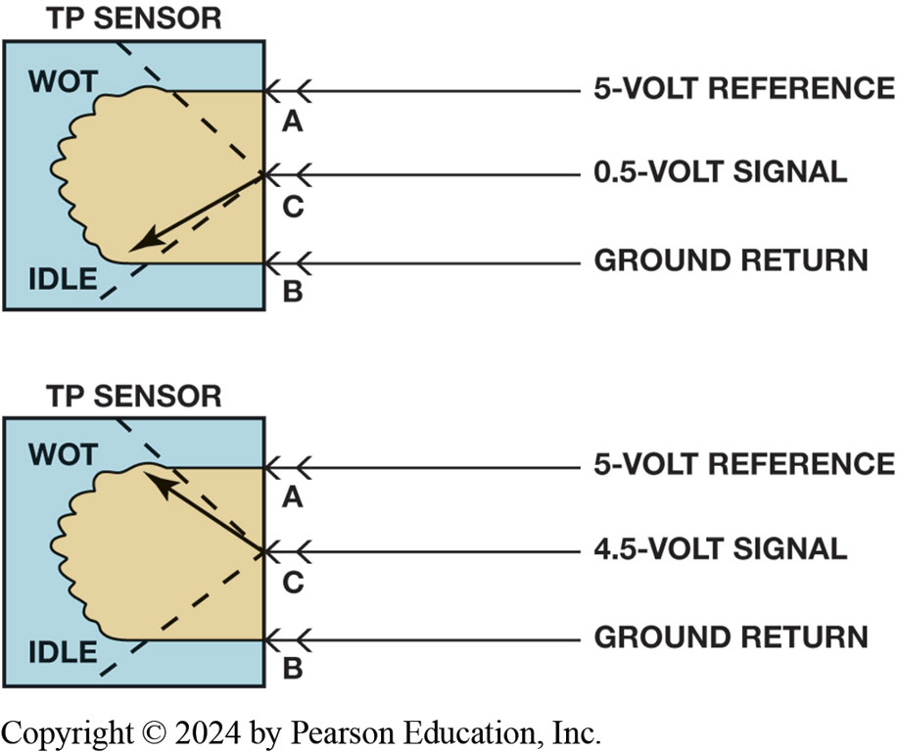
Throttle Position (T P) Sensor
T P Sensor Input
Determine amount of throttle opening and rate of change
Determine shift points
Parts/Operation
Page 127
Testing T P Sensor
Page 127
Figure 9.55 Signal voltage from a throttle position increases as the throttle is opened because the wiper arm is closer to the 5-volt reference. At idle, the resistance of the sensor winding effectively reduces the signal voltage output to the P C M.
Notes:
Long Description:
In the T P sensor, at the wide open throttle position, the wiper arm is at the 5-volt reference point A. At idle throttle position, the wiper arm is at the ground return point C. The midpoint C is at 0.5-volt signal in the W O T and at 4.5-volt signal at idle position.

Slide 67
Animation: Throttle Position Sensor (Animation will automatically start)

Slide 68
Animation: TP Sensor Volt Check, Reference Signal (Animation will automatically start)

Slide 69
Networks
Need for Network
Modules communicate with each other over data lines or hard wiring
Use of a network for module communications
Reduces number of wires and connections needed.
Types of Communication
Differential
Parallel
Serial data
Multiplexing

Slide 70
Figure 9.57
Module Communications
Notes:
Since 1990s, vehicles have used modules to control the operation of most electrical components.
A typical vehicle will have 10 or more modules and they communicate with each other over data lines or hard
wiring, depending on the application.
Long Description:
The conventional wiring between components: A battery is grounded at one end and is connected to a fuse at the other. The fuse is connected to four devices in parallel: a motor, a light, a heater, and a solenoid, each of which has a switch at one end and is grounded at the other. Module communications between components: A battery is grounded at one end and is connected to a fuse at the other. The fuse is connected to two E C Us, both of which are connected by an M P X communication line. The E C U on the left is connected to the fuse by switches and the E C U on the right is connected to the four devices: a motor, a light, a heater, and a solenoid, all of which are grounded at their free end. Each device shows discrete signals.

Slide 71
Figure 9.58
A network allows all modules to communicate with other modules.
Robert Bosch
Developed C A N protocol
Called C A N 1.2, in 1993.
What is C A N?

Slide 72
Figure 9.59
A typical (generic) system showing how the C A N B U S is connected to various electrical accessories and systems in the vehicle.
S A E communication classifications for vehicle communications system
Class A
Class B
Class C
Notes:
The Society of Automotive Engineers (S A E) standards include the following three categories of in-vehicle network
communications:
■ Class A. Low-speed networks, meaning less than 10,000 bits per second (bps, or 10 Kbs), are generally
used for trip computers, entertainment, and other convenience features.
■ Class B. Medium-speed networks, meaning 10,000 bps to 125,000 bps (10 Kbs to 125 Kbs), are generally
used for information transfer among modules, such as instrument clusters, temperature sensor data, and other general uses.
Class C. High-speed networks, meaning 125,000 bps to 1,000,000 bps, are generally used for real-time powertrain and vehicle dynamic control. High-speed BUS communication systems now use a controller area
network (C A N). ● See Figure 9.58.
Long Description:
The BUS has i6 pins in two rows of 8 each. Pin 1 connects to the low-speed G M L A N network that connects to the radio, V C I module, the heads-up display (H U D), and the body control module (B C M) gateway. Pin 2 connects to a Class 2 network that connects to H V A C control module, instrument panel cluster, 4 door modules, sensing diagnostic module (S D M), memory seat module, navigation radio, and the body control module (B C M) gateway. Pins 6 and 14 connect to high-speed G M L A N network that connect to transmission control module (T C M), electronic brake/ traction control module (E B T C M), vehicle communications interface module (V C I M), powertrain control module (P C M), and the body control module (B C M) gateway. The P C M is connected to the throttle actuator by U A R T 1 and 2.

Slide 73
Animation: Controller Area Network, CAN (Animation will automatically start)

Slide 74
Figure 9.60
G M L A N (C A N)
Notes:
Figure 9.59 Schematic of a Chevrolet Equinox shows that the vehicle uses a G M L A N BUS (D L C pins 6 and 14), plus a Class 2 (pin 2). A scan tool can therefore communicate to the transmission control module (T C M) through the high-speed network. Pin 1 connects to the low-speed G M L A N network
Long Description:
The BUS has i6 pins in two rows of 8 each. Pin 1 connects to the low-speed G M L A N network that connects to the radio, V C I module, the heads-up display (H U D), and the body control module (B C M) gateway. Pin 2 connects to a Class 2 network that connects to H V A C control module, instrument panel cluster, 4 door modules, sensing diagnostic module (S D M), memory seat module, navigation radio, and the body control module (B C M) gateway. Pins 6 and 14 connect to high-speed G M L A N network that connect to transmission control module (T C M), electronic brake/ traction control module (E B T C M), vehicle communications interface module (V C I M), powertrain control module (P C M), and the body control module (B C M) gateway. The P C M is connected to the throttle actuator by UART 1 and 2.

Slide 75
Animation: CAN Signal (Animation will automatically start)

Slide 76
Animation: CAN Circuit Check (Animation will automatically start)

Slide 77
Frequently Asked Question: What Are U Codes?
? Frequently Asked Question
What Are U Codes? The “U” diagnostic trouble codes were at first “undefined” but are now network-related codes. Use the network codes to help pinpoint the circuit or module that is not working correctly. Some powertrain-related faults are due to network communications errors and therefore can be detected by looking for “U” diagnostic trouble codes (D T Cs).

Slide 78
Question 1
A high-speed C A N BUS communicates with a scan tool through which terminal(s)?
A. 6 and 14
B. 2
C. 7 and 15
D. 4 and 16

Slide 79
Answer 1
A high-speed C A N BUS communicates with a scan tool through which terminal(s)?
A. 6 and 14

Slide 80
Summary (1 of 2)
Electricity is movement of electrons from one atom to another.
Automotive electricity uses conventional theory
Electricity flows from + to -
Ampere is the measure of amount of current flow.
Voltage is the unit of electrical pressure
Ohm is unit of electrical resistance
Complete circuit: power source, a circuit protection device, path, load, ground return path, and a switch or a control device.

Slide 81
Summary (2 of 2)
Circuit testers include test lights and fused jumper leads.
A terminal is the metal end of a wire
A connector is the plastic housing for the terminal.
The use of a network for module communications
Reduces number of wires and connections needed.
S A E communication classifications for vehicle communications system:
Class A (low speed)
Class B (medium speed)
Class C (high speed)

Slide 82
Automatic Transmissions and Transaxles Videos and Animations
Videos Link: (A6) Electrical/Electronic Systems Videos
Animations Link: (A6) Electrical/Electronic Systems Animations
Videos Link: (A2) Automatic Transmissions and Transaxles Videos
Animations Link: (A2) Automatic Transmissions and Transaxles Animations

Slide 83
Copyright
This work is protected by United States copyright laws and is provided solely for the use of instructors in teaching their courses and assessing student learning. Dissemination or sale of any part of this work (including on the World Wide Web) will destroy the integrity of the work and is not permitted. The work and materials from it should never be made available to students except by instructors using the accompanying text in their classes. All recipients of this work are expected to abide by these restrictions and to honor the intended pedagogical purposes and the needs of other instructors who rely on these materials.

