Slide 1
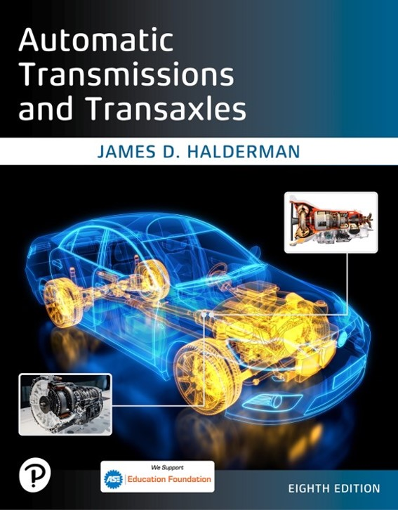
Automatic Transmissions and Transaxles
Eighth Edition
Chapter 8
Clutches and Bands
Copyright © 2024, 2018, 2015 Pearson Education, Inc. All Rights Reserved
Notes:
If this PowerPoint presentation contains mathematical equations, you may need to check that your computer has the following installed:
1) Math Type Plugin
2) Math Player (free versions available)
3) NVDA Reader (free versions available)
INSTRUCTOR NOTE: This presentation includes text explanation notes, you can use to teach the course. When in SLIDE SHOW mode, you RIGHT CLICK and select SHOW PRESENTER VIEW, to use the notes.

Slide 2
Learning Objectives
8.1 Identify the components of a multiple-disc driving clutch and describe its operation.
8.2 Identify the components of a one-way driving clutch and describe its operation.
8.3 Discuss holding clutches and bands.
8.4 Explain shift quality.

Slide 3
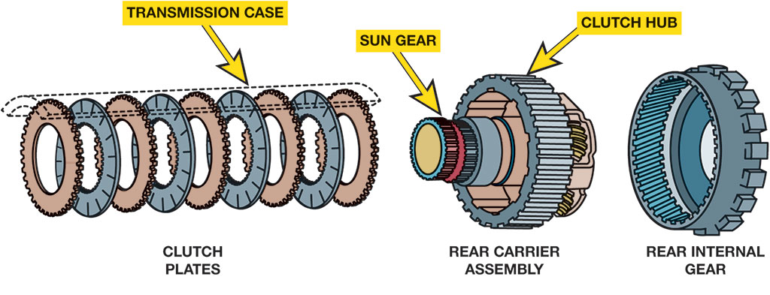
Figure 8.1
A multiple-disc clutch can hold, or drive a member of a gear set.
Notes:
There are several paths for power to flow through an automatic transmission, and each path provides a different gear ratio. These power paths are controlled by clutches and bands, also called driving and reaction members. The driving devices connect the turbine shaft from the torque converter to the elements of the planetary gear train. The reaction devices connect (lock) a member
of the gear train to the transmission case. Figure 8.1.
Long Description:
The clutch plates show nine rings with the transmission case on top of them. The clutch plates consist of two types of discs. One disc has gear teeth on its outside border while the other type of disc has gear teeth on its inside border. The rear carriage assembly consists of the sun gear protruding out of the structure. The sun gear is surrounded by a circular clutch hub that has grooves on its surface. The rear internal gear shows large gear teeth on the outer border and small gear teeth on the inner border. The inner border has grooves that will fit the grooves of the clutch hub.

Slide 4
Driving Devices
Driving devices are usually multiple-plate disc clutches.
Chrysler Corporation calls first clutch the front clutch.
Ford Motor Company calls it a high-reverse clutch.
General Motors Corporation and Toyota call it a direct clutch.
Toyota commonly calls it C 2.
Synchronizing Shifts
Notes:
Synchronizing Shifts
Automatic shifts must be timed to happen quickly without the possibility of being in two gears at the same time. A gear set will lock up if it has two ratios at the same time. In order to prevent this from happening, transmission manufacturers adopt the following two strategies:
The first strategy is synchronous, overlap, or clutch-to-clutch shifting. This requires that one apply device be timed or synchronized with the application of the apply device for the next gear range.
The second strategy is called nonsynchronous, asynchronous, or freewheel shifts. Nonsynchronous shifts use one or more one-way clutches as driving or reaction devices. A one-way clutch will self-release during a shift as soon as the next clutch applies, eliminating the need to synchronize the shifts.

Slide 5
Multiple-Disc Driving Clutch (1 of 2)
Components
Drum
Hub
Lined plates (discs)
Unlined discs (steels)
Pressure plate
Apply piston
Piston return springs

Slide 6
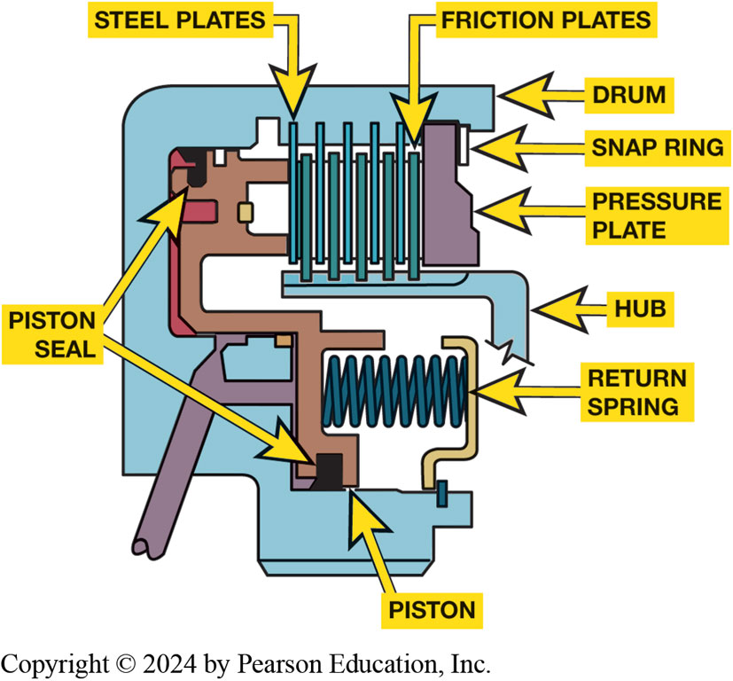
Multiple-Disc Driving Clutch (2 of 2)
Clutch plates
Lining surface
Friction lining materials
Paper
Aramid (Kevlar)
Figure 8.2 A sectioned view of a multiple-disc clutch. Note the piston to apply the clutch and the spring(s) to release it.
Notes:
The drum, also called the housing, has internal splines that mate with external splines on the steel plates for the externally lugged discs, usually the unlined discs (steels). The inner diameter of the drum is machined for the apply piston and its inner and outer seals. The drum of the forward clutch is usually built as part of or splined to the input or turbine shaft. A clutch can be built as a single unit or combined with another drum or hub of a second clutch assembly. Figures 8.2, and 8.3.
Long Description:
The top part of the image is labeled as a drum and is shaped like the upper part of a C. The top horizontal part has a snap ring at the end. A pressure plate is attached to the left of the snap ring. Friction plates and steel plates alternate and attach to the top horizontal part of the drum. These plates are attached to a hub on its bottom. The lower part of the structure has a piston and a piston seal. A return spring is present between two vertical bars. One of the vertical bars goes up along the border of the drum and divides into two bars near the alternating friction and steel plates. Another piston seal is present attached to the top horizontal bar of the drum. A lever is present which is attached to the vertical and horizontal bars near the return spring.

Slide 7
Clutch Operation
Clutch Pack Apply: Pages 98–100
Pressure Balanced Release: Pages 98–100
Clutch Pack Release: Pages 98–100
Double & Single-Sided Friction Plates Pages: 98–100
Forces Involved Pages 98–100
Static and Dynamic Friction Pages 98–100
Garage Shifts Pages 98–100

Slide 8
Animation: Automatic Transmission Clutch Operation (Animation will automatically start)

Slide 9
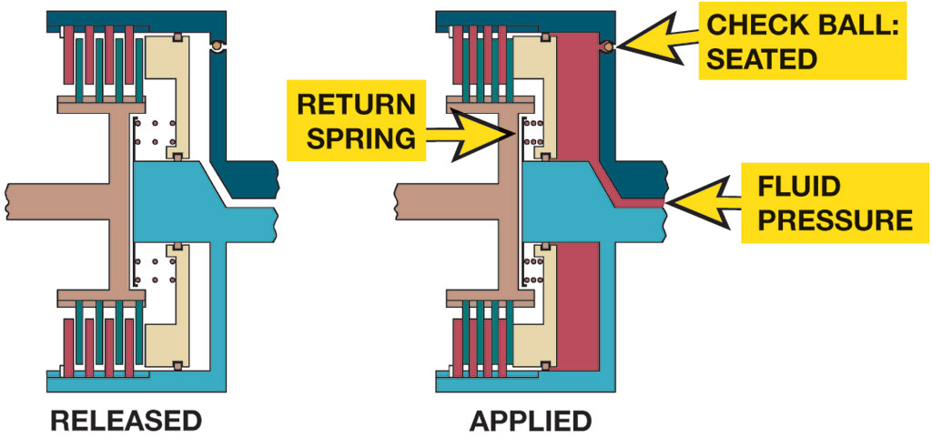
Figure 8.3
The apply piston is released (left) by the coil springs. Fluid pressure moves the piston to apply the clutch (right).
Notes:
The unlined plates are called steels, or separator plates. They are flat pieces of steel stamped Into the desired shape. A steel plate is usually about 0.070 to 0.100 inch (1.78 to 2.54 m m) thick. After being stamped, the plate is carefully flattened. An out-of-flat plate will take up clutch clearance and cause drag while released. An unlined steel plate usually has lugs on its outer diameter to engage with the clutch drum/housing or transmission case. The steel plates used in current automatic transmissions are very smooth and often have a polished appearance with a surface roughness of 12 to 15 microinches. Steel plates have a secondary purpose of serving as heat sinks to help remove heat from the lined friction plates.
Plates lined with friction material are called friction plates, friction disc, or simply frictions. These plates are also made from stamped steel with lining material bonded to each side. The engagement lugs are usually on the inner diameter. A friction plate is about 0.063 to 0.086 inch (1.6 to 2.2 m m) thick, and the friction material is about 0.030 inch (0.4 to 0.8 m m) thick.
Long Description:
The image has two parts. The first part is titled released. The apply piston is present as a horizontal bar that attaches to a vertical bar. The vertical bar has a set of alternating bars on either end. Return springs are present adjacent to this vertical bar. A horizontal rod from the top of the alternating bars bends as a vertical bar to join the center of the structure. The horizontal rod from the bottom set of alternating bars bends as a vertical bar and joins the vertical bar attached to the apply piston. A gap is present between the rods from the alternating bars. The second part is titled applied. The apply piston is present as a horizontal bar that attaches to a vertical bar. The vertical bar has a set of alternating bars on either end. Return springs are present adjacent to this vertical bar and are compressed. A check ball is seated in the rod from the top set of alternating bars. The apply piston has been depressed. A vertical band of fluid is seen adjacent to the two vertical rods from the alternating bars. The gap between the rods from the alternating bars is also filled with fluid and is labeled as fluid pressure.

Slide 10
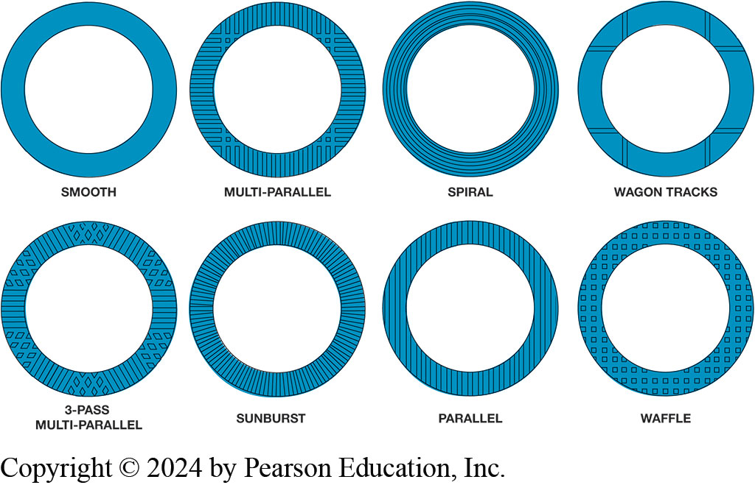
Figure 8.4
Groove Pattern
Friction plates often have a groove pattern to help wipe fluid away, dissipate heat, eliminate clutch noise, and change friction qualities during apply and release. A smooth plate is the coolest and slowest to apply and the waffle plate will apply the fastest.
Notes:
Figure 8.4 Friction plates often have a groove pattern to help wipe fluid away, dissipate heat, eliminate clutch noise, and change friction qualities during apply and release. A smooth plate is the coolest and slowest to apply and the waffle plate will apply the fastest.
Long Description:
There are eight rings shown. The first is the smooth ring with no grooves. The second is the multi hyphen parallel ring which has vertical groove lines and horizontal groove lines. These vertical and horizontal groove lines cross to form squares at four points around the circle. The third is the spiral ring. The ring has circular grooves. The fourth is the wagon tracks ring. Two horizontal groove lines and two vertical groove lines pass perpendicularly. The fifth is the 3 hyphen pass multi hyphen parallel ring. The grooves present a repeating design of about seven straight groove lines followed by a group of diamond-shaped grooves. The sixth is the sunburst ring which has vertical groove lines that move from the inner border to the outer border of the ring all over the ring. The seventh is the parallel ring that has many straight groove lines from top to bottom. The eighth is the waffle ring that has small square grooves all over the ring.

Slide 11
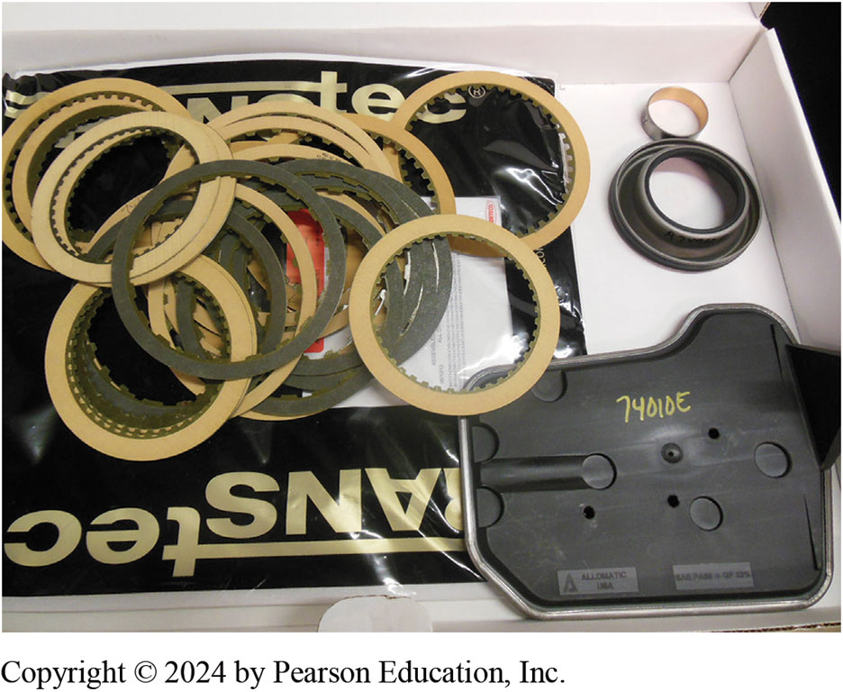
Figure 8.5
Overhaul Kit
Most clutches included in overhaul kits use paper as the basis for the lining material.
Notes:
Figure 8.5 Most clutches included in overhaul kits use paper as the basis for the lining material.

Slide 12
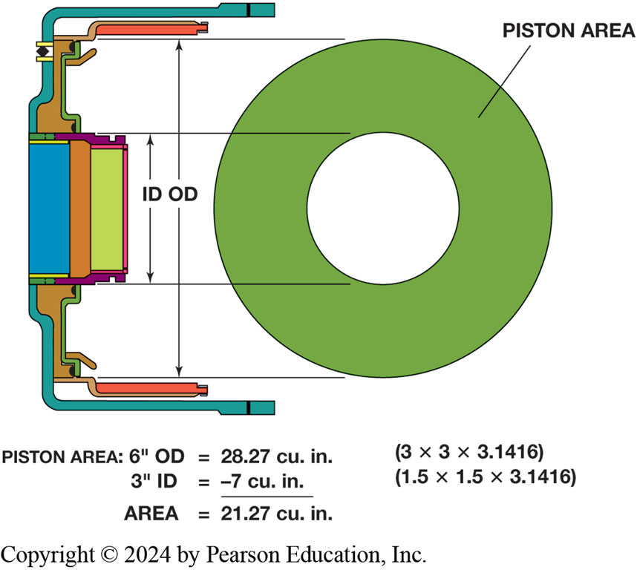
Figure 8.6
Typical Clutch Piston
A typical clutch piston area is determined by subtracting the area of the inner diameter from the area of the outer-circle diameter.
Notes:
Long Description:
The image has two parts. The right image shows a circle inside a circle. These circles are matched with the actual measurements of the piston on the left. The distance between the border of the outer circle and the border of the inner circle is labeled as the piston area. The length from the top border of the outer circle to the bottom border of the outer circle is labeled as O D. The length from the top border of the inner circle to the bottom border of the inner circle is labeled as I D. The calculation of the piston area is as follows. 6 inches O D is equal to 28.27 cubic inches (3 times 3 times 3.1416) and 3 inches I D is equal to minus 7 cubic inches (1.5 times 1.5 times 3.1416). The area equals 21.27 cubic inches.

Slide 13
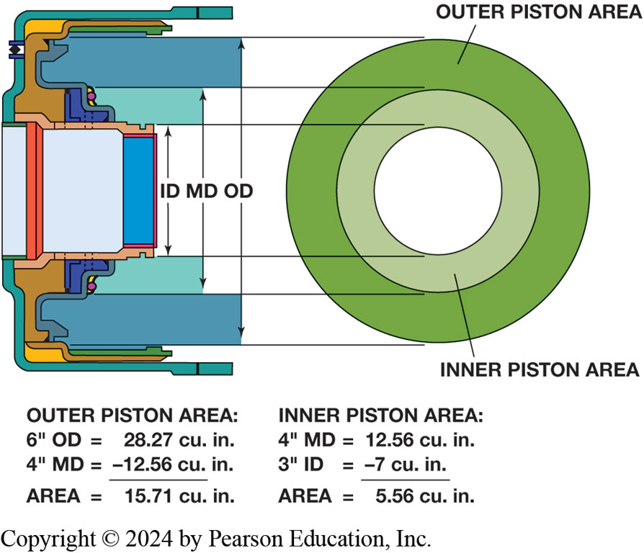
Figure 8.7
Piston with Two Working Areas
Some clutch pistons use middle seal so piston will have two working areas
Notes:
Long Description:
There are two parts to the image. In the right part, three circles are drawn. One is a large circle that contains another circle inside it and a small circle in the center. The large ring is labeled as the outer piston area and the second ring is labeled as the inner piston area. These rings are matched with the actual parts on a piston. The piston is shown as a C-shaped structure. The length from the top border of the outer ring to the bottom border of the outer ring is labeled as O D. The length from the top border of the inner ring to the bottom border of the inner ring is labeled as M D. The length of the small circle is labeled as ID. The calculation is given as follows. Outer piston area is calculated as 6 inches O D is equal to 28.27 cubic inches and 4 inches M D is equal to minus 12.56 cubic inches. The total area is 15.71 cubic inches. The inner piston area is calculated as 4 inches M D is equal to 12.56 cubic inches and 3 inches I D is equal to minus 7 cubic inches. The total area is 5.56 cubic inches.

Slide 14
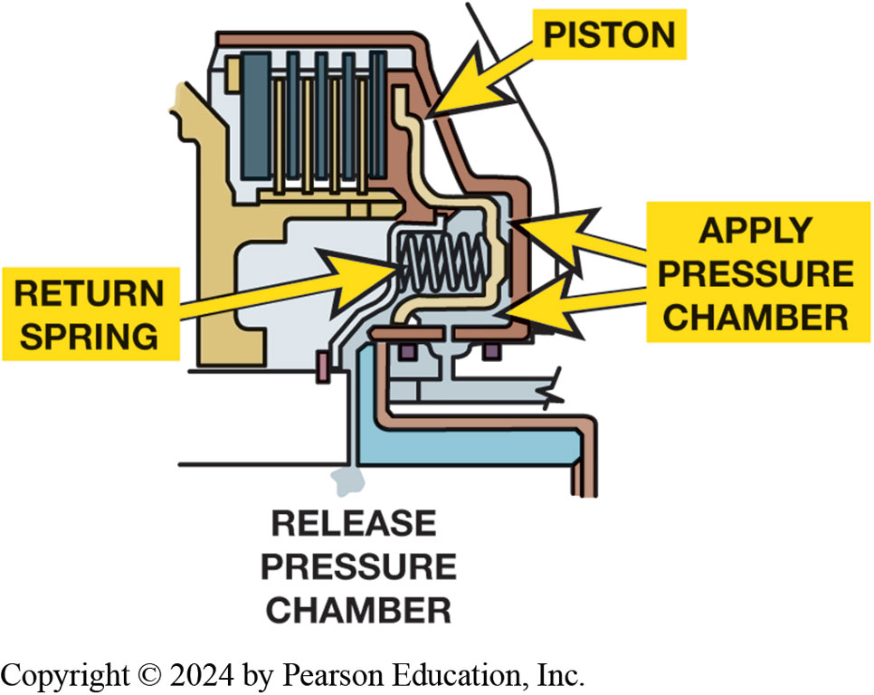
Figure 8.8
Chamber for Release
The baffle that supports the return springs also forms a chamber for release pressure. The clutch is released when fluid pressure enters this chamber as pressure is released from the apply side of the piston.
Notes:
Long Description:
The image is a close-up image of the piston which is shown as a sequence of bars that alternate with each other. Below the piston is the return spring which is present inside a chamber. The chamber is labeled as an apply pressure chamber.

Slide 15
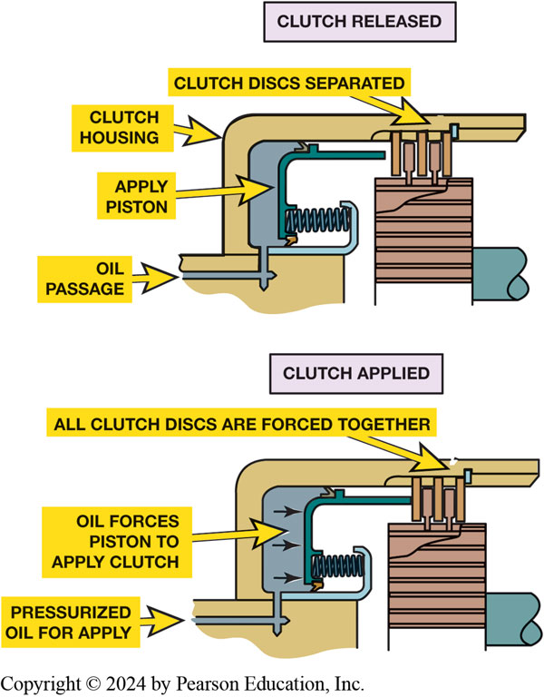
Figure 8.9
Applying Clutch
Pressurized oil is sent to the apply side of the piston to force the clutch discs together.
Notes:
Long Description:
The first part of the image is titled clutch released. The structure shows a base on which the piston is fixed. The piston is supported by a clutch housing that has a horizontal bar that is connected to all the clutch discs. The clutch discs are labeled as separated. The piston has an oil passage under the base. The piston is labeled as apply piston and has a spring and a long bar attached to the spring. The output shaft is also seen in the lower right of the image. The second part of the image is titled clutch applied. The structure shows a base on which the piston is fixed. The piston is supported by a clutch housing that has a horizontal bar that is connected to all the clutch discs. The piston has an oil passage under the base and the label is pressurized oil for apply. The piston has a spring and a long bar. Horizontal arrows are shown near the piston and the label is oil forces piston to apply clutch. The long bar attached to the spring goes and pushes the clutch discs together. The label is: all clutch discs are forced together. The output shaft is also seen in the lower right of the image.

Slide 16
Animation: Electronic Clutch Control (Animation will automatically start)

Slide 17
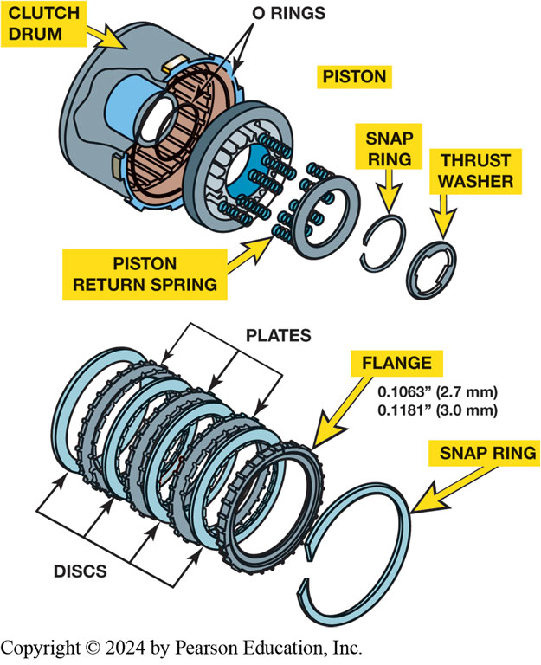
Figure 8.10
Clutch stack clearance is adjusted using either large or small flange (backing plate). Some use a selective snap ring.
Notes:
Long Description:
In the first image, the elements from left to right are as follows. Clutch drum, two O-rings, piston consisting of piston return spring, snap ring, and thrust washer. The clutch drum is shown as a drum while the O-rings are shown as thin rings at the opening of the clutch drum. The piston is shown as a circular structure with springs that fits into another circular structure consisting of the piston return spring. The snap ring is shown as a ring that is broken at one point. The thrust washer looks like a ring that has ridges at three points on the structure. In the second image, there are seven rings shown parallel to each other. These seven rings consist of plates and discs that alternate with each other. The plates have gear teeth on their outer border while the discs have gear teeth on their inner border. The consecutive rings are the flange and the snap ring. The flange has gear teeth on the outer border and the measurements written are 0.10063 inches or 2.7 millimeters and 0.1181 inches or 3.0 millimeters. The snap ring is a circle that is broken at one point and the ends are cut.

Slide 18
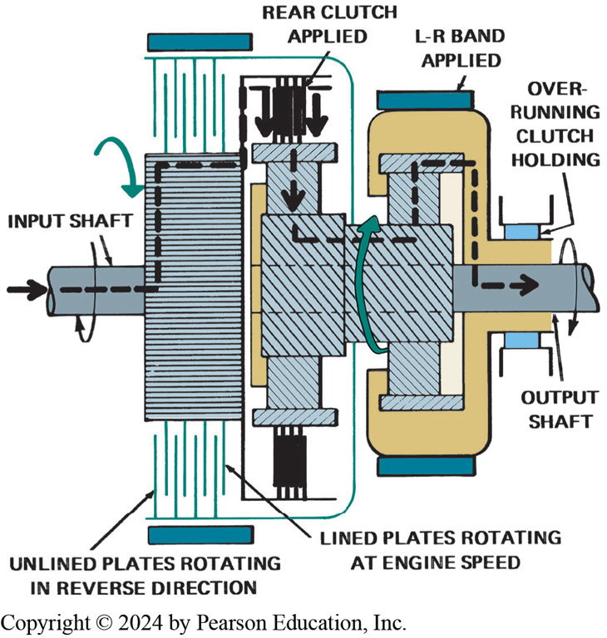
Figure 8.11
First Gear
When this transmission is in first gear, the sun gear and unlined plates of the front clutch rotate counterclock wise while hub and lined plates of this clutch rotate clockwise. Any drag will produce heat that can cause clutch burnout.
Notes:
When a clutch is applied, the plates are squeezed together and torque is transferred from the friction plates to the steel plates. The amount of torque that can be transferred is determined by the following factors: diameter and width of the friction surfaces, number of friction surfaces (two per lined plate), and amount of force being applied (hydraulic pressure times the piston area). The greater the plate area, number of plates, piston size, or hydraulic pressure, the greater the torque capacity. When a clutch is released, there must be clearance between the plates. There is often a considerable speed differential between the friction and steel plates. For example, during first gear in a Simpson gear train, the sun gear revolves at a 2.5:1 ratio in reverse (counterclockwise). Imagine the speed difference between a released high-gear clutch with the input shaft, clutch hub, and lined plates revolving at an engine speed of 3000 R P M in a clockwise direction and the drum and the unlined plates turning at 7500 R P M in a counterclockwise direction. Without sufficient clearance and lubrication, these plates would drag, create friction, and overheat. The oil flow through the groove and between the plates helps cool the friction surfaces. See Figure 8.11.
Long Description:
The input shaft is shown in the left part of the image. The direction of the input shaft is clockwise. A vertical rectangle is adjacent to the input shaft. The rectangle is flanked by unlined plates rotating in the reverse direction which alternate with lined plates rotating at engine speed on either end. A curved downward arrow is shown next to the vertical rectangle. The next element is a band with a vertical rectangle in the middle. It has bars on either end. A square is present on these bars. The top square is labeled as the rear clutch applied. The next element is another band with a square in the middle. An arrow is shown from the bottom of the square to the top of the square. The second element is surrounded by a structure that leads to the output shaft. The output shaft shows clockwise movement. The horizontal portion of the output shaft is flanked by a clutch labeled as overrunning clutch holding. The L hyphen R band applied is seen on top of the second band. An arrow enters in through the input shaft and goes to the rear clutch applied. Another arrow is shown from the rear clutch, into the second band, and then into the output shaft. The direction is shown by small dashes.

Slide 19
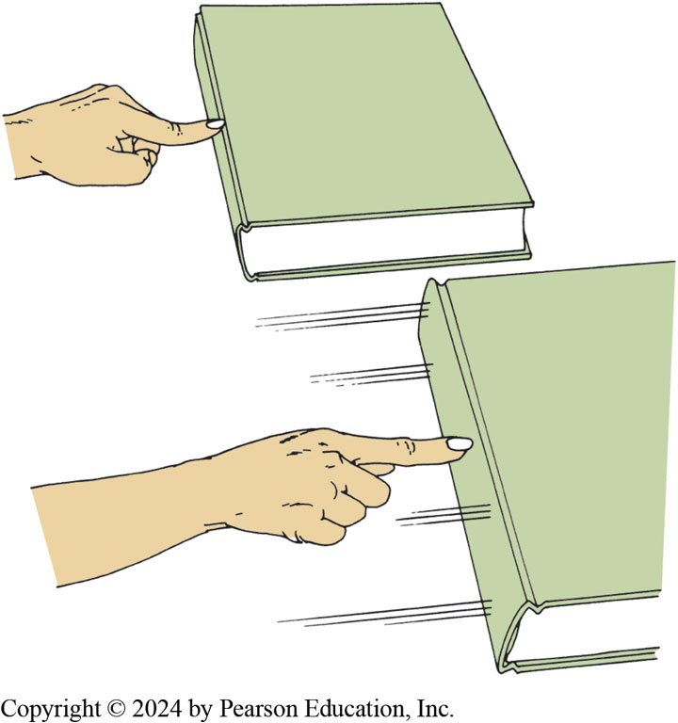
Figure 8.12
When pushing against a stationary book, the static friction resists motion. Pushing against same book while it is sliding is easier because dynamic friction is less.
Notes:
Dynamic Friction
A transmission engineer is concerned with three different friction conditions in a clutch:
While the clutch is released, there should be no friction or drag.
While applied, there should be sufficient static friction to transfer torque without slippage.
While applying, there should be the proper dynamic friction to get a good, smooth shift. The amount of friction between two objects or surfaces is commonly expressed as a value called the coefficient of friction and is represented by the Greek letter μ (mu). The coefficient of friction, also referred to as the friction coefficient, is determined by dividing tensile force by weight force. The tensile force is the pulling force required to slide one of the surfaces across the other. The weight force is the force pushing down on the object being pulled. Figure 8.12.

Slide 20
Frequently Asked Question: What Is Wet Friction?
? Frequently Asked Question
What Is Wet Friction? Wet friction occurs because A T F fills the space between the clutch plates. This A T F film transmits torque between the clutch plates as the clutch is being applied. The action of the film of fluid is called fluid shear. As the clutch is applied, the clutch plate clearance is reduced as the fluid is squeezed from between the plates, leaving a film of fluid. This hydrodynamic film begins transferring torque. Fluid shear, which is the resistance to motion, is the primary torque transmitting force at start of a shift. As the plate clearance is reduced, fluid viscosity increases and its resistance to shear increases. The clutch plates make physical contact at the end of application. Since there is no movement between the plates at this time, friction lining wear is minimized.

Slide 21
One-Way Driving Clutch
Roller Clutch: Pages 100 –102
Sprag Clutches
Mechanical Diode
One-way clutch can be placed as an input to a gear set.
Will overrun as transmission shifts into next higher gear

Slide 22
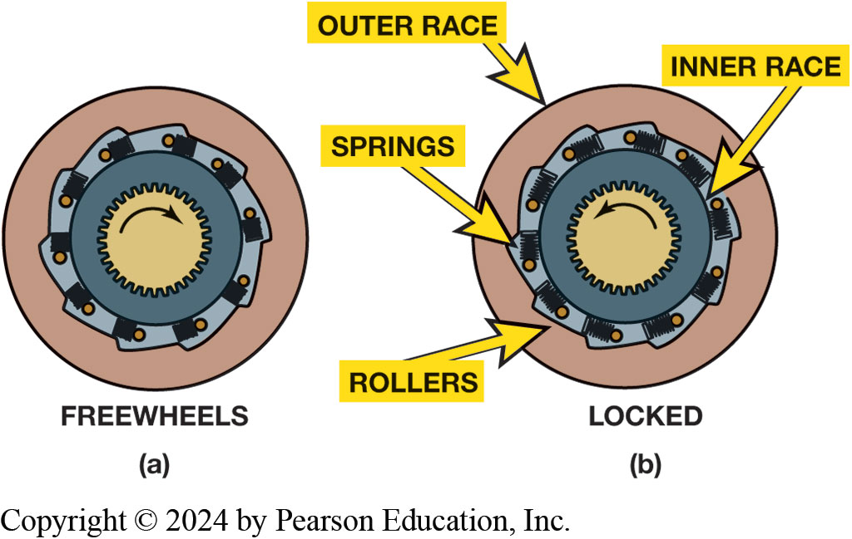
Figure 8.13
Roller Clutch
(a) Roller one-way clutch in released (free) position. When the inner roller clutch race rotates faster than the outer support, the rollers move out of the wedge and are free to rotate, thereby unlocking the one-way clutch. (b) Roller one-way clutch in the locked (held) position. Note how the rollers are wedged into the ramp that is machined into the outer support.
Notes:
A roller clutch is made up of a smooth inner race, a ramped outer race, a series of rollers and
energizing springs, and a cage or guide to contain the springs. Some roller clutches are made with
a ramped inner race and a smooth outer race. Each roller fits in the ramp or cam section of the
race. An energizing spring pushes the roller so there is a light contact between the roller, the
ramp, and the smooth race. Counterclockwise rotation of the hub will wedge the rollers so they
become locked between the inner and outer races. When locked, they will block any further rotation
in that direction. Clockwise rotation will unwedge the rollers, and each roller will simply rotate,
much like a roller bearing. The inner hub will rotate freely or overrun in a clockwise direction.
Long Description:
The first image is titled freewheels. A circle is shown with a center smaller circle with gear wheels on the inner border. The direction of movement is clockwise. The smaller circle is surrounded by rollers. The shape of the roller looks like a solid square with a small circle on top. The second image is titled locked. A circle is shown with a center smaller circle with gear wheels on the inner border. The outer circle is labeled as the outer race and the inner circle is labeled as the inner race. The direction of movement is anti-clockwise. The smaller circle is surrounded by rollers. The shape of the roller looks like a solid square with a small circle on top. The solid square is labeled as springs. In the second image, the rollers are wedged into the ramp.

Slide 23
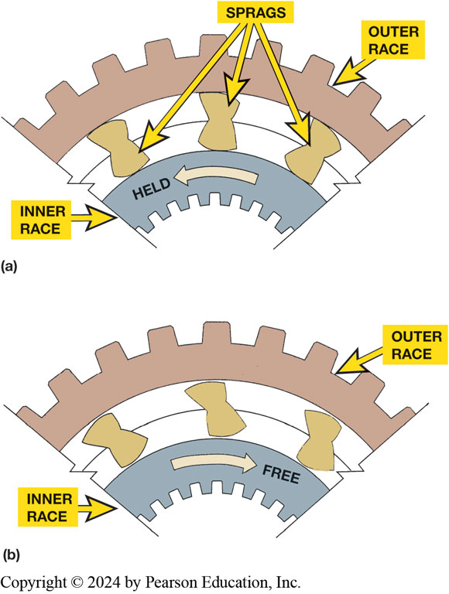
Figure 8.14
Sprag Clutch
(a) Sprag in holding (locked) position. Note how the long portion of the sprag is wedged between the inner and outer race. (b) The sprag in the released position. The inner race is free to rotate faster than outer race
Notes:
Long Description:
There are two parts to the image. In the first part, the outer race is shown as an arc with gear teeth on its outer border. The inner race is also shown as an arc with an arrow from right to left labeled as held. Between the outer race and the inner race, three sprags are present on a line and are wedged between the outer and inner races. In the second part, the outer race is shown as an arc with gear teeth on its outer border. The inner race is also shown as an arc with an arrow from right to left labeled as held. Between the outer race and the inner race, three sprags are present on a line. These sprags are not wedged and are in the free position.

Slide 24
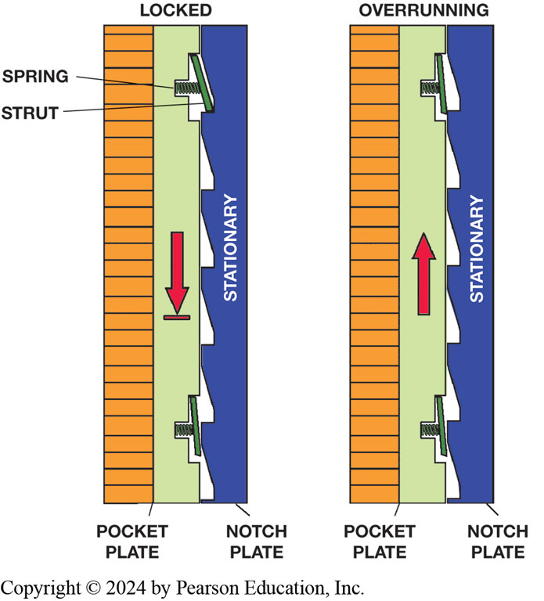
Figure 8.15
Mechanical Diode
A mechanical diode. The struts can move out of the pocket plate to engage the notch plate, and this will lock the pocket plate. The pocket plate can overrun in the opposite direction
Notes:
Long Description:
The two states of locked and overrunning are shown. In the locked state, two vertical plates are shown. The pocket plate is present between two vertical bars. One bar has longitudinal lines from top to bottom. The second bar shows a downward arrow and has grooves for the spring which is attached to the strut. The adjoining plate is the stationary notch plate. In the overrunning state, two vertical plates are shown. The pocket plate is present between two vertical bars. One bar has longitudinal lines from top to bottom. The second bar shows an upward arrow and has grooves for the spring which is attached to the strut. The adjoining plate is the stationary notch plate.

Slide 25
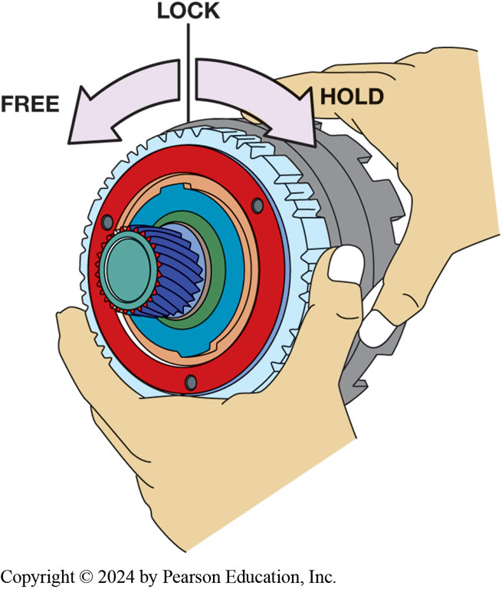
Figure 8.16
One-Way Clutch
This clutch hub and sprag clutch should rotate freely in a counterclockwise direction but should lock up in the opposite direction.
Notes:
Long Description:
The image shows the sprag clutch around the shaft. The clutch hub joins the sprag clutch. A person is seen holding the sprag clutch in the left hand and the clutch hub in the right hand. A vertical line is shown with an arrow turning to the left and an arrow turning to the right. The left arrow is labeled as free and the right arrow is labeled as a hold.

Slide 26
Holding/Reaction Devices
A holding member acts as a brake to hold a planetary gear set member in reaction.
Three types of holding devices are used:
Multiple-disc clutches
Bands
One-way clutches

Slide 27
Frequently Asked Question: What Is Selectable One-Way Clutch?
? Frequently Asked Question
What Is Selectable One-Way Clutch? A hydraulically operated, selectable one-way clutch (SOWC) is a one-way clutch that is designed to do following:
Acts like a conventional one-way clutch that locks in one direction and free wheels in the other direction.
Can be locked in both directions.
S O W C s are used in several automatic transmissions including the General Motors 9T50 and Ford 8F35 as well as in the Honda 10 A T. The S O W C can be used to provide a one-way clutch for first gear as well as being used as a low/reverse brake when in reverse. The strut-based one-way clutch is used to reduce friction, with lower weight in a smaller overall package. See FIGURE 8.17.

Slide 28
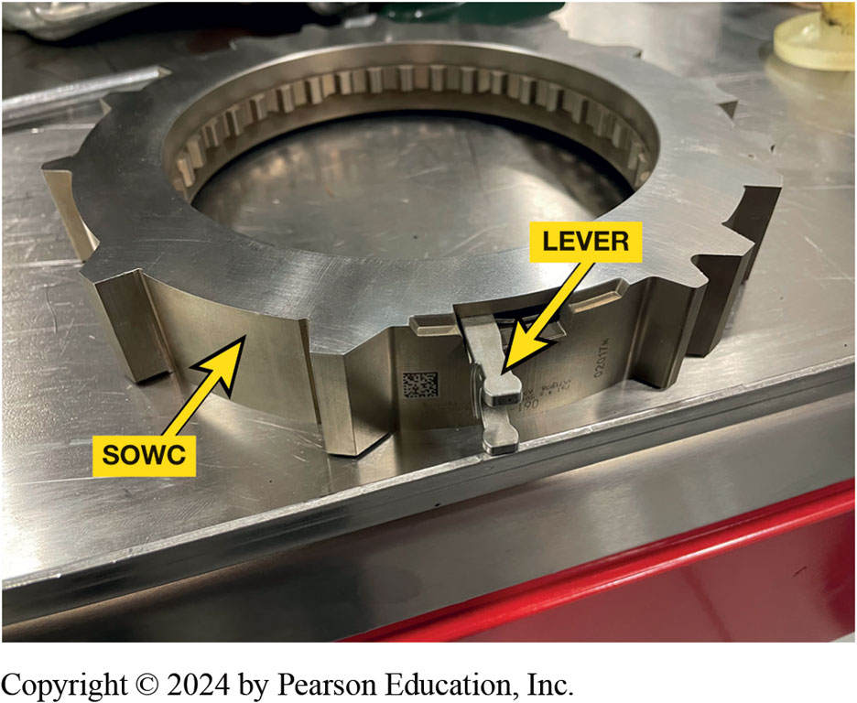
Figure 8.17
Lever on side of selectable one-way clutch (S O W C) used to switch clutch from holding in one direction to freewheeling in other position.

Slide 29
Frequently Asked Question: What Is Clutch-to-Clutch Type Transmission?
? Frequently Asked Question
What Is a Clutch-to-Clutch Type Transmission? A clutch-to-clutch transmission or transaxle is a unit that does not use one-way clutches and instead just uses multiple-plate clutches for all clamping functions. Chrysler 4 1 T E transaxle is an example of a clutch-to-clutch automatic transmission. Primary reason for not using one-way clutches is that the metal particles that are detached from these assemblies are attracted to magnetic solenoids. These particles can clog screens and reduce flow of fluid through solenoid valves. This leads to many types of transmission or transaxle failures that are prevented by not using steel-on-steel units such as roller clutches or mechanical diodes.

Slide 30
Holding Clutches
Multiple-disc holding clutch quite similar to a driving clutch
The difference is that the transmission case
Clutch drum, and clutch plates splined to it, do not rotate
Lugs on outside of unlined plates fit into slots built into the case

Slide 31
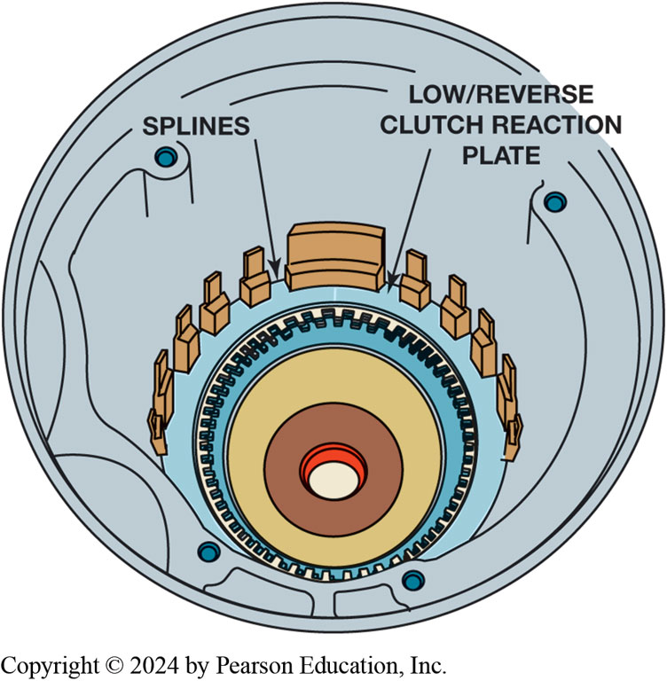
Figure 8.18
Holding Clutch
4 1 T E transaxle low/reverse clutch is a holding clutch. Note the splines in the case for the clutch plates.
Notes:
Long Description:
A circular structure is shown. Near the rim of the structure, we see the openings for four screws. The center of the structure shows a hole. It is surrounded by three layers. The third layer from bottom to top has gear teeth around its edge. The next element is the low slash reverse clutch reaction plate. Splines are present as a part of the clutch and arrange around the border of the clutch.

Slide 32
Bands (1 of 3)
Purpose of a band is to prevent rotation of drum it is wrapped around
Drum can be a member of the planetary gear train.
Types
Rigid band
Flex band
Double-wrap

Slide 33
Bands (2 of 3)
Servo components
Cylinder
Piston
Piston rod/pin
Return spring
Friction material used on a band is similar to that used on clutch plates.

Slide 34
Bands (3 of 3)
The anchor for band can be a fixed or adjustable point in transmission case.
When band releases, servo piston backs off, and springy,
elastic nature of band causes it to move away from drum.

Slide 35
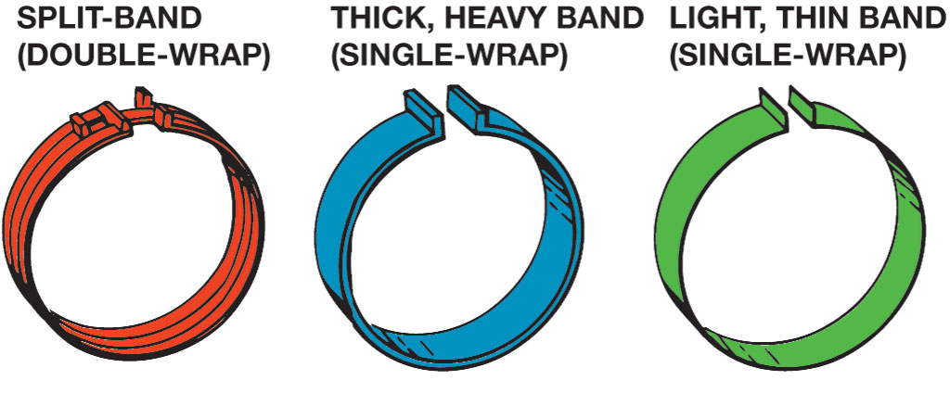
Figure 8.19
Band Designs
Transmission bands come in several designs and thicknesses.
Notes:
A band is a circular strip of metal that has lining bonded to the inner surface. It wraps around the smooth surface of a drum. There are three types of bands:
1. A single thick, heavy band, also called a rigid band.
2. A single thin, light band, also Called A Flexible Or Flex Band.
3. A Split, Double-wrap, Heavy Band. ● See Figure 8.19.
A rigid band is strong and provides a good heat sink to absorb some of the friction heat during application. The dis- advantage with a rigid band is that it is relatively expensive and does not always conform to the shape of the drum. A flex band is less expensive and, because of its flexibility, can easily conform to the shape of the drum. Double-wrap bands give more holding power, and are often used for reverse or manual first gears. Each band type has end lugs so it can be attached to the anchor and the servo.
Long Description:
The first band is labeled split hyphen band or double hyphen wrap. The outer left and outer right parts of the band are split at one point and bent a little. The middle part of the band is not split. The second band is labeled thick, heavy band, or single hyphen wrap. At one point on the band, the bands are fully cut and bent upward. The third is labeled light, thin band, or single hyphen wrap. This band is the same as the thick band but only thinner.

Slide 36
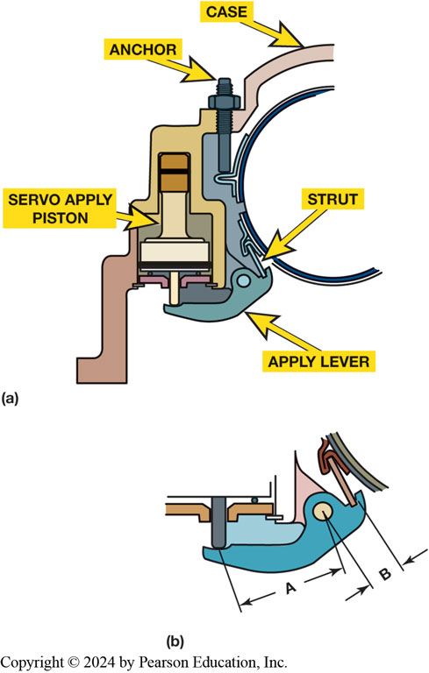
Figure 8.20
Band Adjustable Anchor
(a) This band uses an adjustable anchor that allows the clearance to be easily adjusted. (b) Note that the apply lever will increase apply force.
Notes:
A small link, commonly called a strut, is often used to connect the lugs of the band to the anchor or the servo piston rod. Figure 8.20.
Long Description:
There are two parts to the image. In the first image, a circular case is shown. The bottom left of the circular case is attached to a strut which is attached to an apply lever. The lever is connected to the servo apply piston. The lever is also connected to the structure by a screw. At the top left of the circular case, an anchor is attached. In the second image, a close-up of the apply lever is shown. The distance between the lower edge of the servo apply piston and the screw is labeled as A. the distance between the screw and the strut is labeled as B.

Slide 37
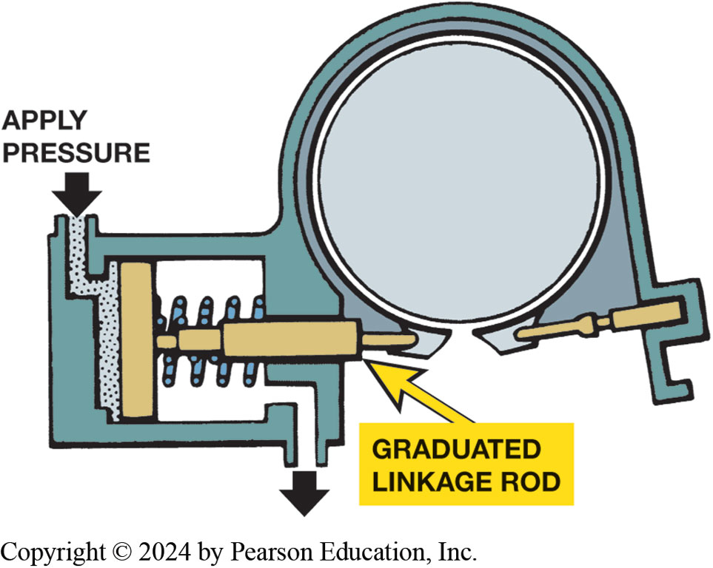
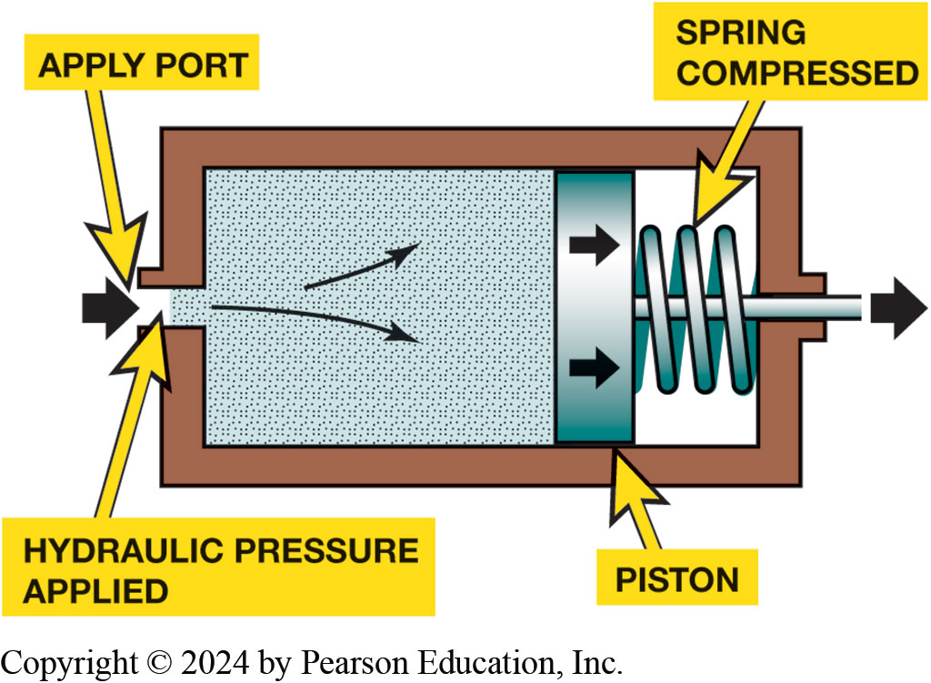
Servos
Figure 8.21 A servo uses hydraulic pressure to move a piston, which applies a band
Figure 8.22 One end of a band is held stationary and the other end is attached to the servo
Notes:
The servo is the hydraulic assembly that applies the band. Its main components include a
■ Cylinder
■ Piston
■ Piston Rod/Pin
■ Return Spring. ● See Figure 8.21.
The piston rod pushes directly on the end of the band on most servos. Some servo pistons are connected to the band through a lever or linkage attached to the band strut. A band lever provides a force increase because of the lever ratio. The ratio will require more piston travel to apply the band and increases the application force acting on the end of the band. Some manufacturers incorporate a band
adjustment screw in the apply lever. Other manufacturers use selective-size servo piston rods for band adjustment.
● See Figure 8.22.
Adjustment The anchor for the band can be a fixed or adjustable point in the transmission case. Some bands have an adjustable anchor, which provides a method of adjusting the clearance between the band and the drum. The bands that are adjustable are usually the rigid bands that have thick lining. Most bands use thin linings and are not adjustable. There must be enough clearance to
ensure there is no band-to-drum contact with the band released, but too much clearance might cause slippage if the band does not completely. A band that is too loose or too tight has an adverse effect on shift timing.
Long Description 1:
A rectangle-shaped structure with one inlet at the left of the structure and an outlet at the right of the structure. The inlet is labeled as the apply port. An arrow is shown entering the inlet. At the entrance of the inlet, hydraulic pressure is applied. Inside the structure, two slightly curved arrows show the distribution of pressure. A vertical band is present which is labeled the piston. Two horizontal forward arrows are shown on the piston. A compressed spring is present next to the piston. A rod is present in the middle of the spring which is pushed forward out of the servo and an arrow shows the direction.
Long Description 2:
The servo has an inlet where a downward arrow is labeled apply pressure. The inlet is shown as a dotted area. A band is present next to the inlet which is attached to a graduated linkage rod. A spring is present behind this rod. An outlet is shown which shows a downward arrow. The lower part of the circular structure has the graduated linkage rod at one end and another rod at the other end.

Slide 38
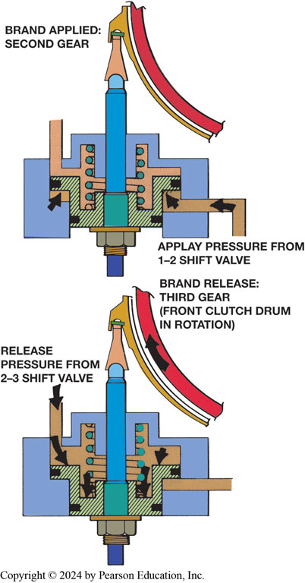
Figure 8.23
Band Applied
In this example, the band is applied when 1–2 shift valve pressure pushes upward on servo piston (top). It will release when 2–3 shift valve pressure pushes the piston downward (bottom). Note the larger area above the piston.
Notes:
When the shift has to be made to neutral, the release speed is not important. Normally, servos use only a release spring.
During an upshift, the band release must be fast and carefully timed. The release of many bands is done by using fluid pressure from the clutch being applied. For example, in a Simpson gear train transmission during a 2–3 shift, the fluid pressure to apply the third-gear clutch is also used to release the second-gear band.
During a downshift, band apply must be quick and firm. ● See Figure 8.23.
Long Description:
The first part of the image shows a vertical shaft with surrounding machinery and valves. The shaft has a pointed end on which the band is applied. The band is shaped like an arc with a hook at the top. It is labeled as band applied: second gear. The hook sits on the pointed end of the shaft. The lower end of the shaft has a base plate. To the lower right of the shaft, an opening is shown that is labeled apply pressure from 1 hyphen 2 shift valve. Arrows are shown entering the opening. An arrow is also shown on the lower left side of the shaft. To the upper right of the shaft, another opening is present. The second part of the image shows a vertical shaft with surrounding machinery and valves. The shaft has a pointed end on which the band is applied. The band is shaped like an arc with a hook at the top. It is labeled as band release: third gear (front clutch drum in rotation). The hook sits on the pointed end of the shaft. An upward arrow is marked on the band. The lower end of the shaft has a base plate. To the lower right of the shaft, an opening is shown. To the upper right of the shaft, another opening is present. Arrows are shown entering the opening. It is labeled as release pressure from 2 hyphen 3 shift valve. Arrows are also shown on the upper left of the shaft.

Slide 39
Animation: AT Band & Servo Operation (Animation will automatically start)

Slide 40
Shift Quality (1 of 2)
Smoothness of shift is referred to as shift quality or shift feel.
Accumulator is tied hydraulically to the clutch or band servo
Absorbs fluid during pressure buildup stage when a clutch or band applies.

Slide 41
Shift Quality (2 of 2)
Wave plate is an unlined plate that is wavy, not flat.
Belleville plate, like Belleville spring, is also not flat.
These are often called cushion plates.
One-way clutch is an ideal driving or reaction member for automatic shifts
When throttle is released while in a gear that uses a one-way clutch, transmission will go into neutral as the one-way clutch overruns

Slide 42
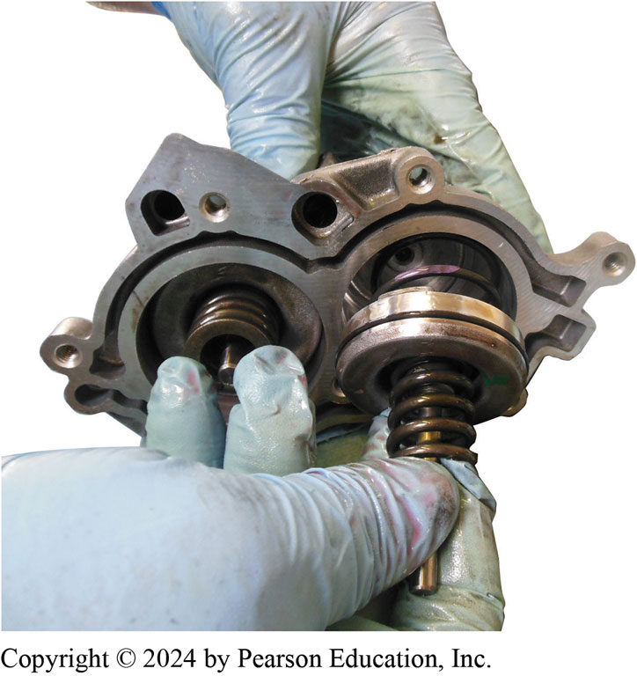
Figure 8.24
Accumulators
A band accumulator piston and spring being removed from G M 4T65-E.
Notes:
A shift should be smooth without any unusual noises. In order for this to occur, the clutches and
bands must apply smoothly and quietly. The timing of the band releasing from second gear and the
clutch applying for third gear must be precise. Any improper noises such as squeaks, squawks,
shrieks or operations such as engine R P M flare, jerks, bumps, or harsh application are considered
faults that need to be corrected.
Accumulator is tied hydraulically to the clutch or band servo, and absorbs fluid during the pressure buildup stage when a clutch or band applies. This has the effect of slowing the Pressure Increase And Lengthening The Time It Takes For The Friction Device To Lock Up. See Figure 8.24.

Slide 43
Animation: Accumulator (Animation will automatically start)

Slide 44
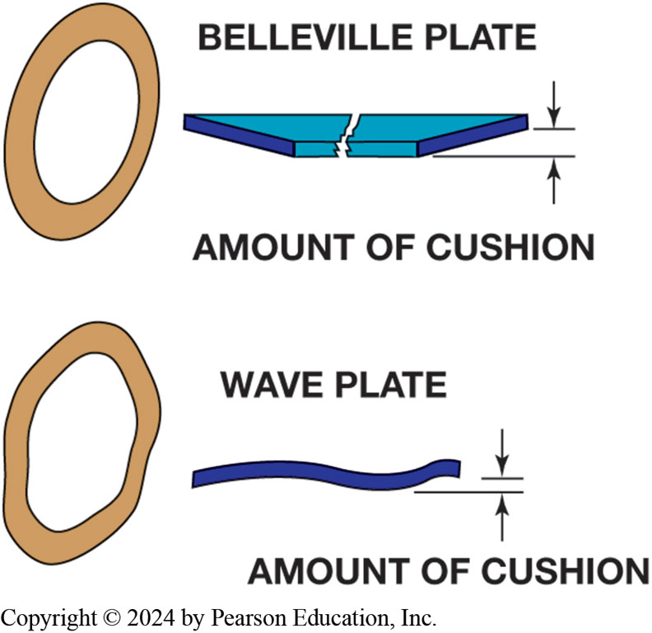
Figure 8.25
Wave Plate
Two cushion plates: The Belleville plate has a coned shape; the wave plate has a wavy shape. Both of them will flatten slightly as the clutch is applied
Notes:
Long Description:
The Belleville plate is shown as an oval ring while the wave plate is shown as a wavy oval ring. The amount of cushion is thicker in the Belleville plate when compared to the wave plate. The Belleville plate is shown as two pieces of a four-sided structure. The wave plate is shown as a thick string.

Slide 45
Question 1
Which of these is an example of a one-way clutch?
A. Multi-clutch pack
B. Band
C. Roller clutch
D. Accumulator

Slide 46
Answer 1
Which of these is an example of a one-way clutch?
C. Roller clutch

Slide 47
Summary (1 of 2)
Power flow through a gear set is controlled by driving and reaction devices.
Driving and reaction devices are multiple-disc clutches, one-way clutches, and bands.
Multiple-disc clutches are primary driving devices and are also used to hold planetary members in reaction.

Slide 48
Summary (2 of 2)
One-way clutches are primarily used to hold planetary members in reaction, but can be used with a multiple-disc clutch as a driving device.
Bands are used to hold a planetary member in reaction.
Timing of apply devices has a direct effect on shift quality.

Slide 49
Animation: Check One-Way Clutch (Animation will automatically start)

Slide 50
Animation: Sprag Clutch (Animation will automatically start)

Slide 51
Automatic Transmissions and Transaxles Videos and Animations
Videos Link: (A2) Automatic Transmissions and Transaxles Videos
Animations Link: (A2) Automatic Transmissions and Transaxles Animations

Slide 52
Copyright
This work is protected by United States copyright laws and is provided solely for the use of instructors in teaching their courses and assessing student learning. Dissemination or sale of any part of this work (including on the World Wide Web) will destroy the integrity of the work and is not permitted. The work and materials from it should never be made available to students except by instructors using the accompanying text in their classes. All recipients of this work are expected to abide by these restrictions and to honor the intended pedagogical purposes and the needs of other instructors who rely on these materials.

