Slide 1
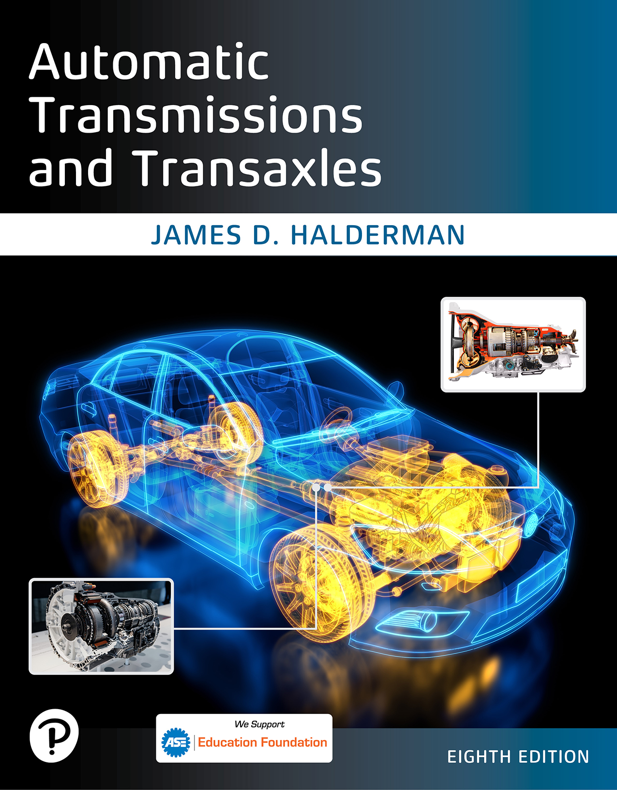
Automatic Transmissions and Transaxle
Eighth Edition
Chapter 6
Torque Converters
Copyright © 2024, 2018, 2015 Pearson Education, Inc. All Rights Reserved
Notes:
If this PowerPoint presentation contains mathematical equations, you may need to check that your computer has the following installed:
1) Math Type Plugin
2) Math Player (free versions available)
3) NVDA Reader (free versions available)
INSTRUCTOR NOTE: This presentation includes text explanation notes, you can use to teach the course. When in SLIDE SHOW mode, you RIGHT CLICK and select SHOW PRESENTER VIEW, to use the notes.

Slide 2
Learning Objectives
6.1 Identify and describe the components of a torque converter.
6.2 Explain torque converter operation.
6.3 Discuss the parts and operation of torque converter clutches.
6.4 Describe the purpose and procedure of a stall test.
6.5 Discuss the service of torque converters.

Slide 3
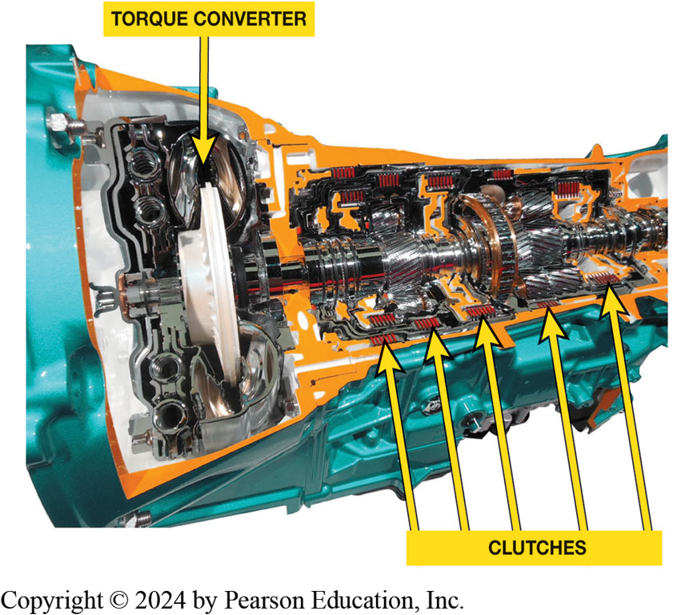
Figure 6.1
A cutaway of an eight speed automatic transmission showing torque converter and clutches needed to engage all eight forward speeds, plus reverse.

Slide 4
Torque Converter Terminology
Three major parts of torque converter are turbine, impeller, and stator.
Torque converter contains stator mounted on one-way clutch
Stator is the reaction member of torque converter
Impeller is the driving member and rotates with engine
It is Located on the transmission side of converter
Turbine is located on engine side of converter.
Impeller vanes pick up fluid in converter housing
Direct it toward turbine

Slide 5
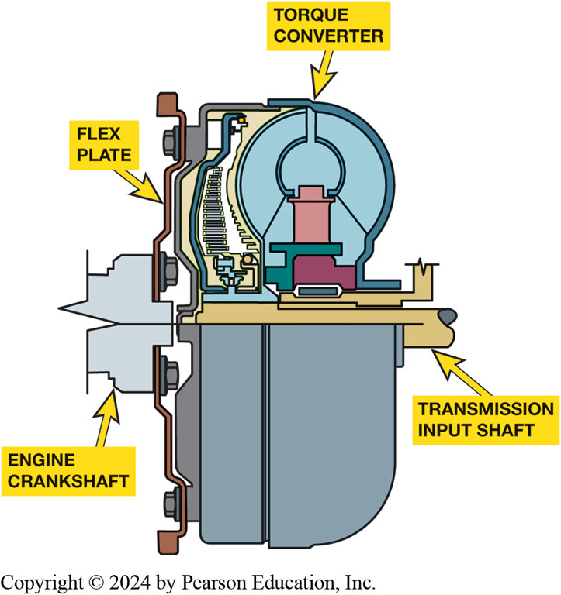
Figure 6.2
Torque Converter
Torque converter bolts to the flexplate which is attached to the engine crankshaft and rotates at engine speed.
Notes:
The flexplate replaces the heavy flywheel used with a manual transmission. An important function of a flywheel is to smooth out engine pulsations and dampen vibrations. An automatic transmission does not require a conventional fly- wheel because weight of the torque converter provides enough mass to dampen engine vibrations. An external ring gear generally attaches to the outer rim of the flexplate, while on some applications the ring gear may be welded to the out- side of the torque converter cover. This ring gear engages the st rter motor pinion gear to turn the engine during starting. Figure 6–2.
Long Description:
A torque converter is shown with a flex plate attached on the left. The flex plate is attached to the engine crankshaft which is present just below the flex plate. The torque converter sits on the transmission input shaft which has an unnamed structure below it.

Slide 6
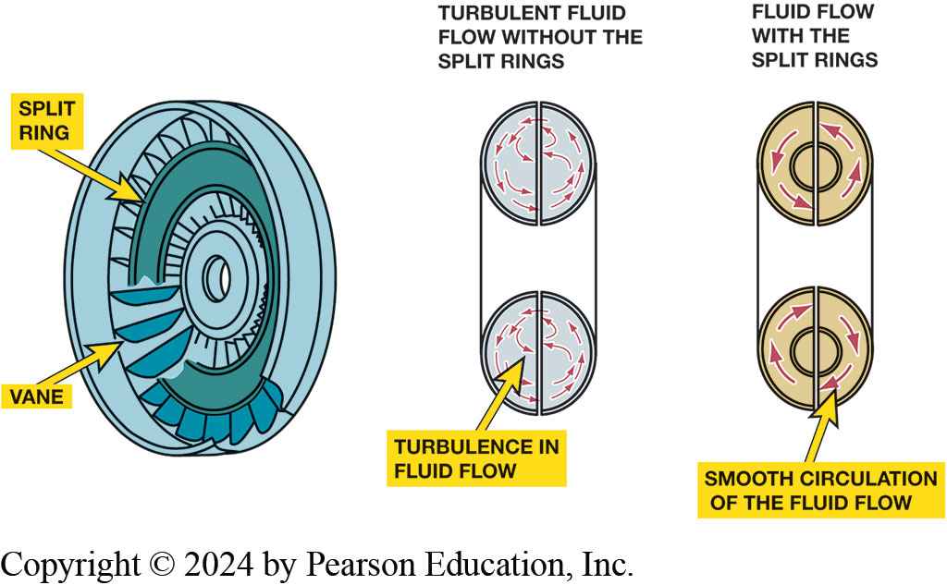
Figure 6.3
Split Rings
Split rings in the impeller and turbine help to direct the flow of fluid and improve the efficiency of the torque converter by reducing turbulence.
Notes:
Long Description:
Three images are shown. In the first image, the impeller of the torque converter is shown which has a split ring surrounded by vanes. A few of the vanes are magnified and shown. There is a small hole in the middle of the impeller. In the second image, a turbine is shown without split rings. Turbulence is seen in the flow of fluid. In the third image, a turbine is shown with split rings. Smooth circulation of fluid is seen.

Slide 7
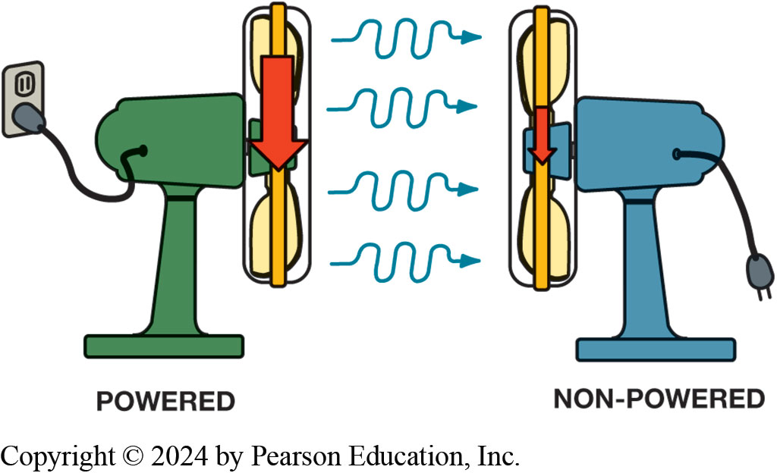
Figure 6.4
Two Fans
Two fans can be used to show how fluid, or air in the case of fans instead of automatic transmission fluid, can be used to transfer energy. If one fan is operating, which represents the impeller, and the blades of a second fan (turbine) will be rotated by the flow of air past the fan that is unplugged, causing the blades to rotate
Notes:
Long Description:
One fan is attached to a power supply and is labeled as powered. The other fan is not attached to a power supply and is labeled as non hyphen powered. Four wriggly arrows are seen from the powered fan to the non hyphen powered fan.

Slide 8
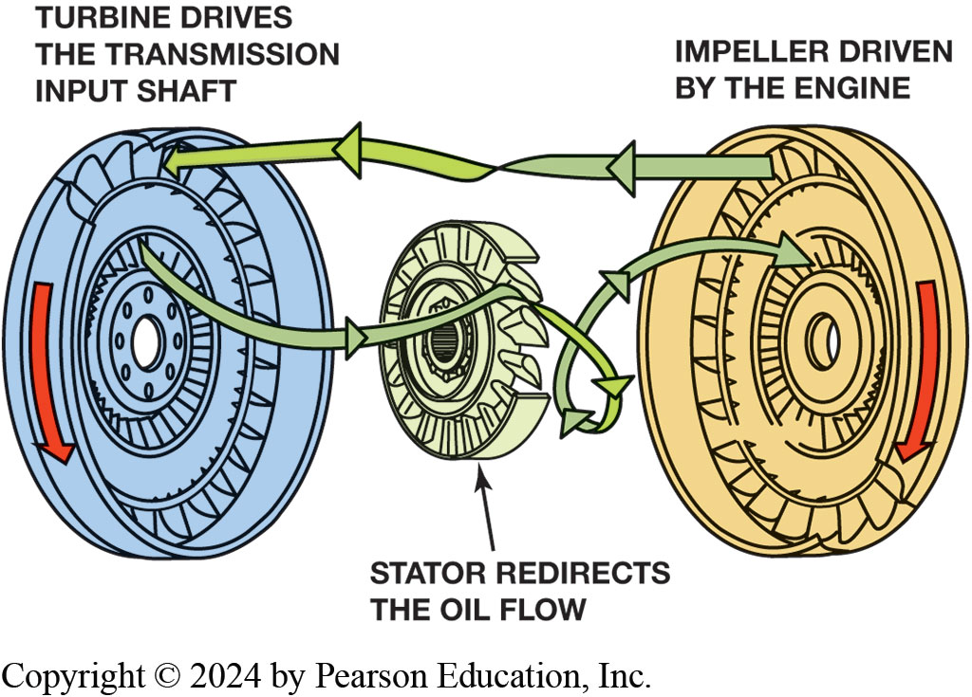
Figure 6.5
Converter Components
Notes:
Figure 6–5 A torque converter is made from three parts: The impeller is located at the transmission end, attached to the housing, and is driven by the engine. The turbine is located at the engine side and is driven by the fluid flow from the impeller and drives the input shaft of the transmission. The stator redirects the flow to improve efficiency and multiply torque.
Turbine. The turbine is located on the engine side of the converter. The impeller vanes pick up fluid in the converter housing and direct it toward the turbine. Fluid flow drives the turbine, and when the flow between the impeller and the turbine is adequate, the turbine rotates and turns the transmission input shaft. The turbine is the converter’s output member. The center hub of the turbine is splined to the transmission input shaft. The turbine is positioned in the front, engine end, of the converter housing so the turbine vanes face the impeller vanes. ● See Figure 6–5.
Stator. A Torque converter also contains stator, or reactor, which is mounted on a one-way clutch. Stator is reaction member of torque converter. The stator assembly is about ½ diameter of impeller or turbine. Outer edge of stator vanes forms inner edge of three-piece fluid guide ring that is also part of impeller and turbine vanes. Stator is mounted on a one-way clutch that is attached to stationary reaction shaft splines. Reaction shaft is made as part of transmission front pump housing and is fixed and does not rotate. The one-way clutch allows the stator to rotate clockwise but blocks counterclockwise rotation. ● See Figure 6–5.
Long Description:
The turbine drives the transmission input shaft. A downward arrow is shown on the turbine. The stator redirects the oil flow. The impeller is driven by the engine. A downward arrow is shown on the impeller. A ribbon is shown attached between the turbine and the impeller. Arrows are drawn from the impeller to the turbine. Another ribbon is shown attached between the turbine and the impeller, but the arrow gets twisted near the stator. Arrows are drawn from the turbine to the impeller.

Slide 9
Torque Converter Operation
Torque Converter is a Hydrodynamic Unit.
Transfers power through dynamic motion of fluid.
Other hydraulic units transfer power through static pressure of fluid.
Torque multiplication
Coupling phase

Slide 10
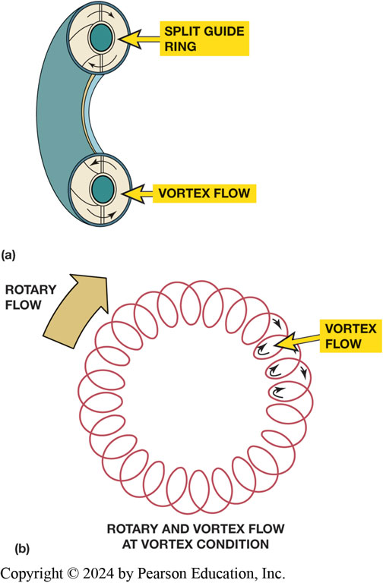
Figure 6.6
Rotary/Vortex Flow
(a)Fluid flowing around the guide ring is called vortex flow.
(b) Fluid flow around the converter is called rotary flow.
Notes:
Vortex Flow: The rotating fluid in the impeller tries to turn the turbine in a clockwise direction. If turbine is stationary or turning at a speed substantially slower than the impeller, only part of energy leaves the fluid to drive the turbine. Most of the fluid energy is lost as fluid bounces off the turbine vanes. The fluid moves toward the center of the tur- bine, driven there by continuous flow of fluid from the impeller. As energy leaves the fluid, the flow slows down and returns to the center of the impeller vanes, where the impeller will pick it up and keep it circulating. This flow is called a vortex flow. The vortex flow is a continuous circulation of fluid outward from the impeller, around the guide ring, inward into the turbine, through the stator, and back into the impeller. The guide ring directs vortex flow, creating a smooth, turbulence-free flow. Clockwise flow of fluid leaving impeller, in direction of engine rotation, is called Rotary Flow. When impeller is rotating substantially faster than turbine, fluid tends to bounce off turbine vanes and change the rotary flow to counterclockwise direction. The fluid flow still has quite a bit of energy. It can be compared with a tennis ball thrown against a wall. The ball bounces back and travels in a different direction, but it still has most of its energy of motion. A strong counterclockwise fluid flow from the turbine would tend to work against the clockwise rotation of the impeller. See Figure 6–6.
Long Description:
In the first image, a small part of a tube is shown. The cross section shows the split guide ring in the middle of the tube. The top part of the tube shows arrows indicating the clockwise movement of fluid. The lower part of the tube shows arrows indicating the anti hyphen clockwise movement of fluid. The vortex flow is labeled. In the second image, a circular spring is shown. A curved arrow in the clockwise direction shows the direction of rotary flow. In each twist of the spring, the direction of the flow of fluid is shown to be in clockwise direction. It is labeled as vortex flow. The overall title is rotary and vortex flow at vortex condition.

Slide 11
Frequently Asked Question: What Is an Air-Cooled Torque Converter?
? Frequently Asked Question
What Is an Air-Cooled Torque Converter? Some early torque converters used with smaller engines were air cooled. They had a shroud with fins attached to the rear of the converter cover, to force cooling airflow past the converter. Torque converters must be cooled because of the heat they generate during torque multiplication.

Slide 12
Figure 6.7
Fluid Flow Direction
The fluid flow from the turbine is turned in the same direction as the impeller by the stator vanes.
Notes:
Torque Multiplication: The stator redirects the fluid flow in the torque converter. It returns the fluid from turbine back to the impeller in a clockwise direction. This action helps recover any energy remaining in the fluid. The curved shape of the stator vanes and a one-way clutch make this possible. Fluid leaving the turbine in a counterclockwise direction tries to turn the stator counterclockwise. This causes the stator one-way clutch to lock up and hold the stator stationary. The smooth, curved shape of the stator vanes redirects the fluid flow in a clockwise direction. ● See Figure 6–7.

Slide 13
Animation: Torque Converter Fluid Flows (Animation will automatically start)

Slide 14
Animation: Torque Converter Power Flow (Animation will automatically start)

Slide 15
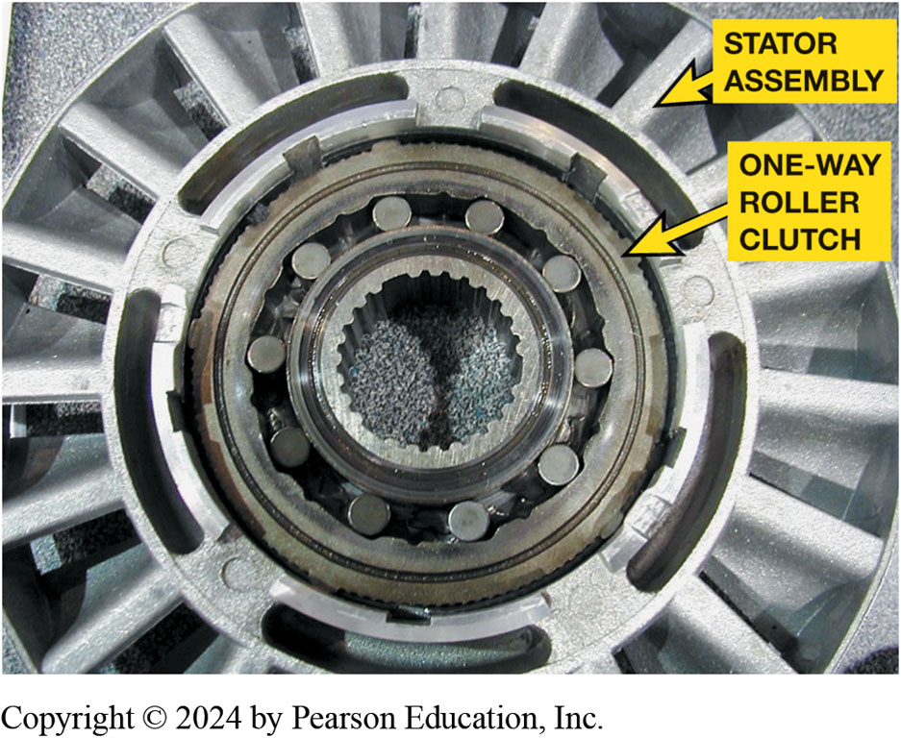
Figure 6.8
Stator One-Way Clutch
A stator contains a one-way roller clutch which locks it from rotating in one direction and allows it to rotate freely in the opposite direction.
Notes:
Torque Multiplication occurs because the stator redirects fluid flow. This occurs only when impeller is rotating faster than turbine. As turbine speed increases, the direction of flow becomes more rotary. The stator clutch overruns and converter becomes more of a coupling, transferring power from the engine to the transmission. ● See Figure 6–8. An engineering term used for torque converters is the Stall Torque Ratio (S T R), which is the torque converter’s ability to multiply torque. Most passenger vehicle torque converters have a S T R between 1.68:1 and 2.1:1. For most converters, this means that the torque converter is able to double the torque of the engine at the stall speed of the converter.
Coupling Phase: When the turbine speed reaches 90% to 95% of impeller speed, coupling occurs. The coupling phase occurs when the speeds of the impeller and turbine are nearly equal. Centrifugal force acting on fluid in the spinning turbine is high enough to stop the vortex flow. At this point, there is no torque multiplication. It should be noted that this coupling speed is a relative point between the speeds of the impeller and turbine. Therefore, the coupling phase occurs at various vehicle speeds depending on throttle position and speed. Some slippage occurs during the coupling phase. If power and load demands require, the converter can return to the torque multiplication phase. In a non lock-up converter, the turbine almost never turns at the same speed as the engine and impeller, a condition commonly referred to as converter slippage. The converter’s efficiency steadily improves during torque multiplication and
the coupling phases to about 90% to 95%.
Stall Speed is the fastest R P M that an engine can reach while the turbine is held stationary. Stall is when the turbine is held stationary while the converter housing and impeller are spinning. This is done by shifting the transmission into gear and applying brakes to hold the drive wheels stationary. The importance of stall speed is that an engine must be able to reach an RPM where enough torque is available to accelerate the vehicle, but not running so fast that there is poor fuel economy and excessive noise. Stall occurs to some degree
each time a vehicle starts moving, either forward or backward, and each time a vehicle stops at a stop sign.
Creep When the transmission selector is moved from park (P) or neutral (N) into a drive gear, some engine torque is input shaft of the transmission or transaxle. The vehicle will move slightly if the brakes are released. This slight movement of the vehicle when the engine is at idle speed and the brakes are released, is called creep. Therefore, a slight movement is normal for a vehicle equipped with an automatic transmission. NOTE: Vehicle creep is more noticeable when the engine is cold due to the higher idle speed.

Slide 16
Torque Converter Clutches
Torque converter clutch (T C C) applied to eliminate slippage
During coupling phase, which improves fuel economy
Converter clutch is a large clutch disc
Called a pressure plate or clutch disc
It has friction material and a damper assembly
Attached to it and it is splined to the turbine

Slide 17
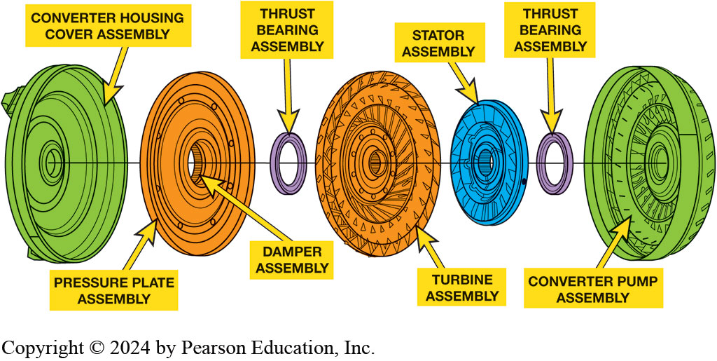
Figure 6.9
Torque Converter Clutch
An expanded view of a typical torque converter assembly showing the torque converter clutch (T C C).
Notes:
Long Description:
The order from left to right is as follows. Converter housing cover assembly, pressure plate assembly with a damper assembly in its center, thrust bearing assembly, turbine assembly, stator assembly, thrust bearing assembly, and converter pump assembly. A straight line passes through all these elements.

Slide 18
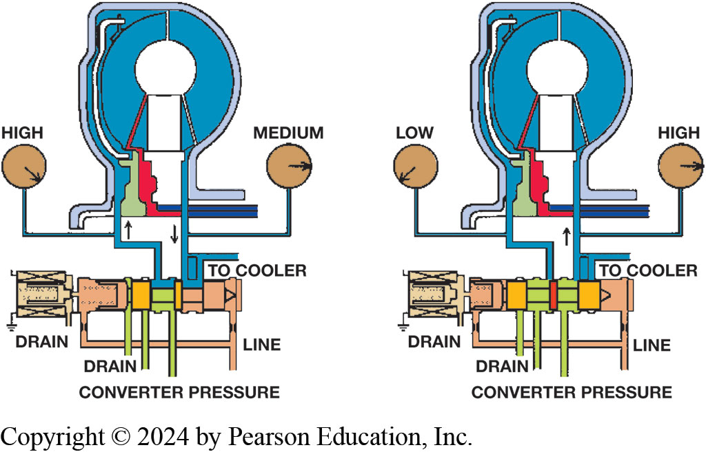
Figure 6.10
T C C Operation
T C C releases fluid flows through the center of the turbine shaft to the front of the clutch disc (left). Pressure to apply the clutch enters between the converter hub and the stator support (right).
Notes:
Long Description:
The first image shows the release of fluid by the T C C. The fluid flows through the center of the turbine to the front of the clutch disc. There is an upward and a downward arrow showing the direction of the fluid. Left and right gauges are present. The left gauge shows high and the right gauge shows medium. The clutch disc has four outlets. One is labeled drain, one is unnamed, one is labeled converter pressure, and one is labeled line. The end of the clutch disc is labeled as the drain. The front of the clutch disc is extended to the border. An outlet above the clutch disc is labeled as to cooler. The second image shows the left gauge as low and the right gauge as high. There is an upward arrow showing the direction of the fluid. The front of the clutch disc is not extended to the border. In this image, the fluid is not seen near the clutch plate.

Slide 19
Animation: TCC Operation (Animation will automatically start)

Slide 20
Stall Test (1 of 3)
Stall test used to check the stator one-way clutch
Strength of apply devices inside transmission/ transaxle.
Stall test can severely damage transmission if done incorrectly.
Notes:
A stall test is used to check the stator one-way clutch inside the torque converter and the strength of the apply devices inside the transmission/transaxle. A stall test measures stall speed of the torque converter in each of the gear positions. It is an important diagnostic test to determine transmission and torque converter condition.

Slide 21
Stall Test (2 of 3)
Procedure
STEP 1 Connect scan tool to monitor engine speed (R P M).
STEP 2 Position vehicle with all 4 wheels firm on ground
Place blocks at front and back of drive wheels.
STEP 3 Start engine and note R P M reading

Slide 22
Stall Test (3 of 3)
STEP 4 Apply brakes firmly, move gear selector to reverse
Move throttle to wide open, and watch
STEP 5 Shift to neutral, run engine at fast idle for 30 to 60 seconds
To cool converter
STEP 6 Repeat steps 4, 5 with gear selector in drive
STEP 7 Repeat steps 4, 5 with gear selector in low
Notes:
If all of the stall speeds were equal but low. The engine is weak, out of tune, or the stator one-way clutch is slipping. Checking engine performance should indicate which is at fault.
If the stall speeds are normal, but the vehicle has normal acceleration and has reduced performance at higher speeds. The stator one-way clutch could be seized in a locked-up condition.
If the stall speed is high in one or two of the gear ranges. One or more of the apply devices is slipping. Consult a clutch and band application chart to determine which apply devices are at fault.

Slide 23
Animation: Stall Test (Animation will automatically start)

Slide 24
Torque Converter Service (1 of 2)
Torque converter is part of transmission
Serviced/replaced when a transmission is overhauled.
Visual inspection
Stator one-way clutch operation

Slide 25
Torque Converter Service (2 of 2)
Turbine end play
Internal interference
Lock-up clutch operation
External leakage

Slide 26
Frequently Asked Question: What Controls Torque Converter Clutch?
? Frequently Asked Question
What Is Used to Control the Torque Converter Clutch? The torque converter clutch (T C C) is a P C M controlled fluid exhaust valve. When solenoid is deenergized (no current flowing through solenoid electrical coil), it allows A T F to exhaust. When solenoid is energized by the P C M, it causes the fluid to stop exhausting, increasing fluid pressure, therefore shifting converter clutch apply valve. The P C M determines when the T C C is to be applied based on sensor information, such as throttle position (T P), engine load (M A P), and engine temperature. T C C can applied in almost any gear, depending on the transmission/transaxle design, and can be monitored using a scan tool. SEE Figure 6.11

Slide 27
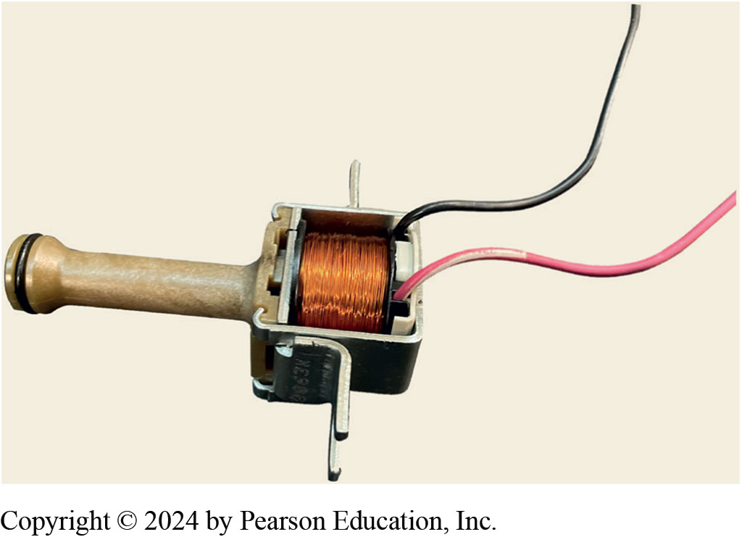
Figure 6.11
T C C Solenoid
A typical T C C solenoid used on many G M automatic transmissions showing the solenoid coil and the O-ring seal used to provide a tight seal when installed in the transmission.

Slide 28
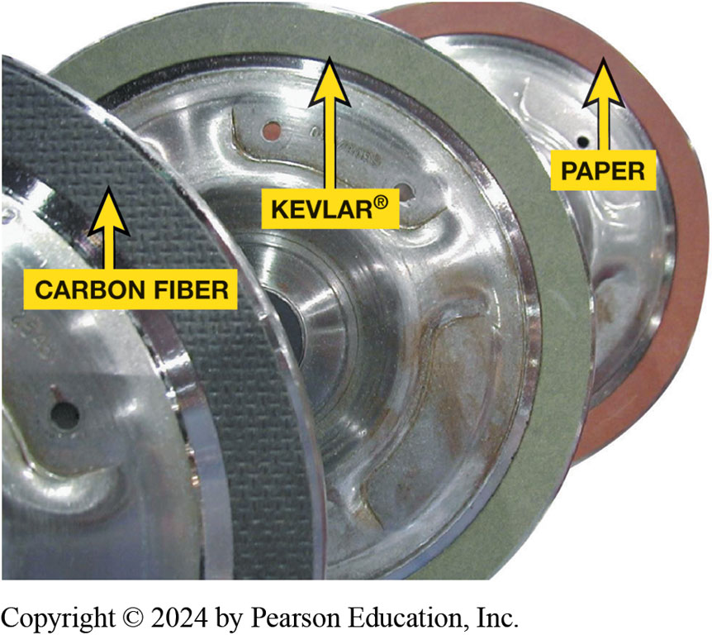
Figure 6.12
T C C Friction Material

Slide 29
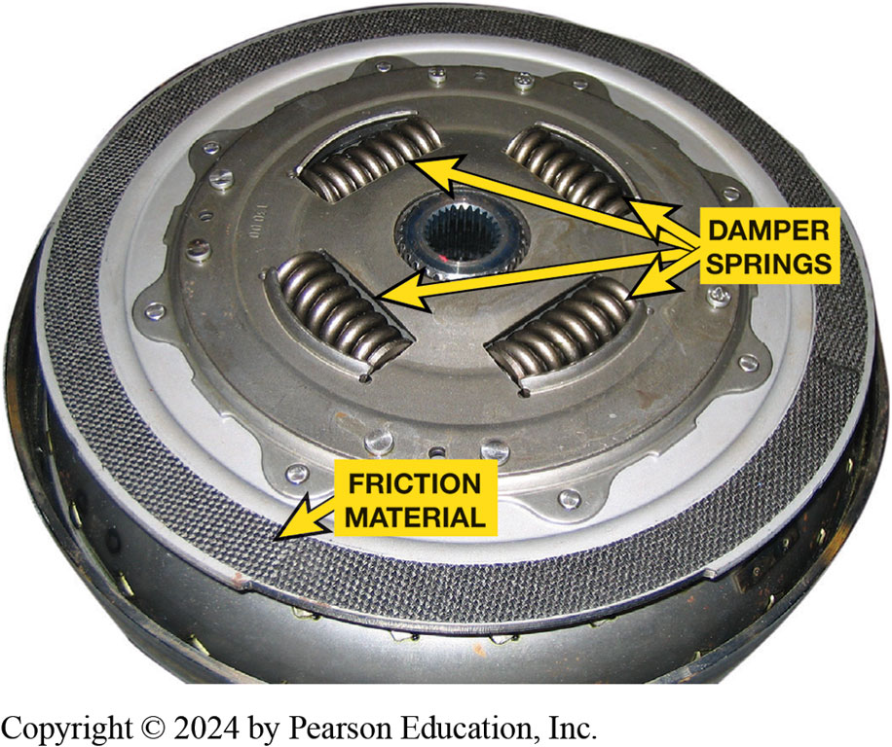
Figure 6.13
Damper Springs
The damper springs used in many torque converter clutches are similar to the damper springs used in clutch discs used with a manual transmission.
Notes:
Clutch discs include a damper assembly that transfers the power through a group of coil springs. In most converters, the damper springs are grouped at the center; in others they are grouped around the outer edge. These springs are used to dampen torsional vibrations from the engine. All automotive engines produce torsional vibration at some operating speed. Torsional vibrations are small speed increases and slowdowns as the crank- shaft revolves between engine cylinder firing pulses. These vibrations can produce gear noise in the transmission and drivetrain as well as a noticeable vibration and harshness in vehicle.

Slide 30
Frequently Asked Question: What Is a “Squashed Converter”?
? Frequently Asked Question
What Is a “ Squashed Converter”?The cross-sectional area of the impeller, turbine, and stator of most torque converters is round to give an efficient flow. The converter used with many newer transaxles has an elliptical cross- sectional shape that reduces the width of the converter. A shorter, low-profile converter, often called a squashed converter, makes the engine and transaxle shorter and easier to fit transversely in a vehicle. SEE FIGURE 6.14

Slide 31
Figure 6.14
Squashed Converter
Most torque converters have a round cross section (bottom). Some new transmissions use a shorter, elliptical, squashed converter (top) that is about 13% shorter than a round style.
Notes:
Long Description 1:
The cross-section has a round shape with the turbine on the left and the impeller on the right. The broad stator is present between the turbine and the impeller. A double headed headed arrow is present horizontally from one end of the structure to another.
Long Description 2:
The cross-section has a pear shape with the turbine on the left and the impeller on the right. The narrow stator is present between the turbine and the impeller. A double hyphen headed arrow is present horizontally from one end of the structure to another.

Slide 32
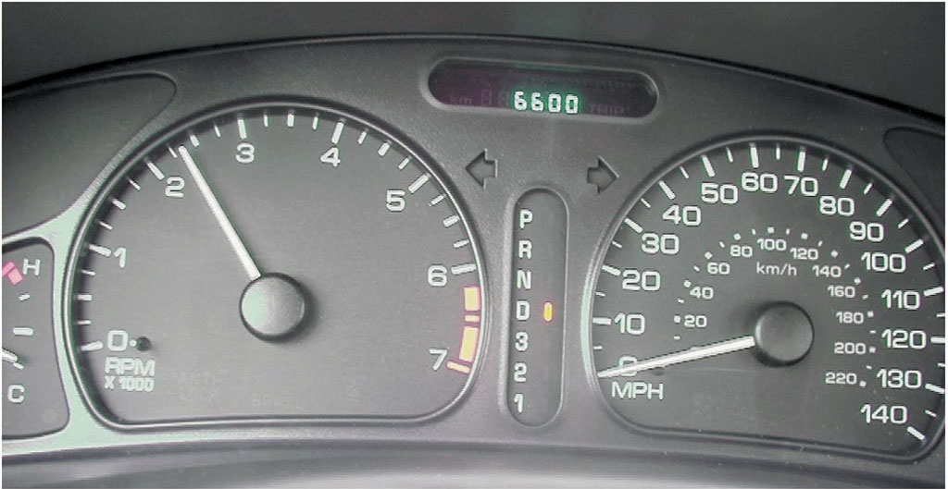
Figure 6.15
This 4-cylinder G M vehicle has a stall speed of about 2350 R P M. Notice that the gear selector is in drive and the speedometer is reading zero.
Notes:
Long Description:
The reading on the screen shows 6600. The speedometer shows a dial with a range from 0 mph to 140 in intervals of 10. There is a smaller dial that shows in km slash hour. This smaller dial shows a range from 0 to 220 in intervals of 20. The speedometer reading shows 0. Another dial is present with numbers ranging from 0 to 7. A vertical indicator shows the letters P, R, N, D, 3, 2, and 1. The light indicator near the letter D is on. This vertical indicator is present between the two big dials.

Slide 33
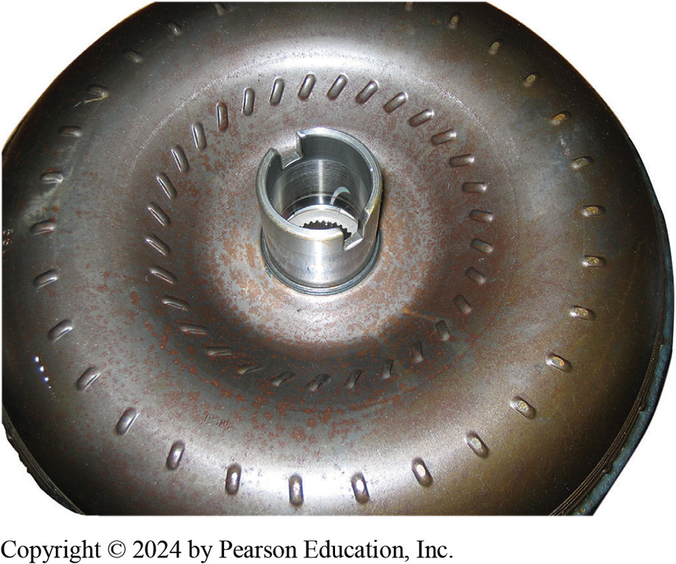
Figure 6.16
Pump Drive Notches
Visually check the pump drive notches or tangs for damage and the hub sealing surface for wear.

Slide 34
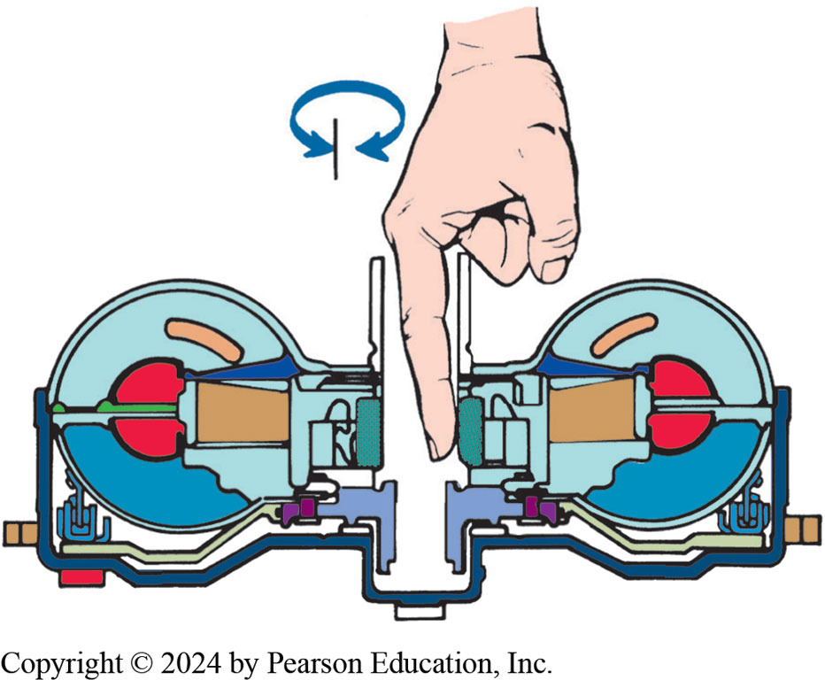
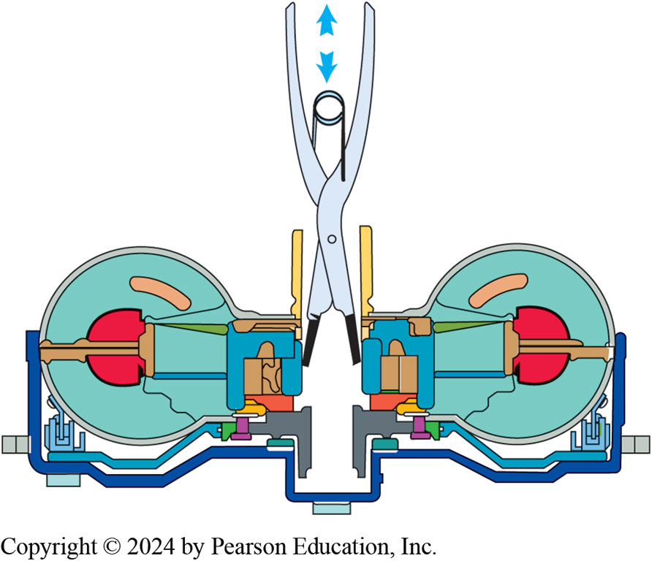
Torque Converter Checks
Figure 6.17 stator clutch can be checked by reaching into the hub so a finger contacts the splines. The splines should rotate in one direction but not in the other.
Figure 6.18 A quick end-play check can be made by gripping the turbine or stator splines and trying to move the turbine or stator in and out.
Notes:
Long Description 1:
Two circular structures are connected with a space called a hub. Each circle has a half circle inside it attached to the spline mechanism. The splines are present on the inner surface of the hub. A person’s finger is put into the hub touching the spline. The direction of rotation of splines is shown as an arrow in the clockwise direction.
Long Description 2:
Two circular structures are connected with a space called a hub. Each circle has a half circle inside it attached to the spline mechanism. The splines are present on the inner surface of the hub. An instrument is used to grip the splines. The direction of the instrument is shown to be up and down.

Slide 35
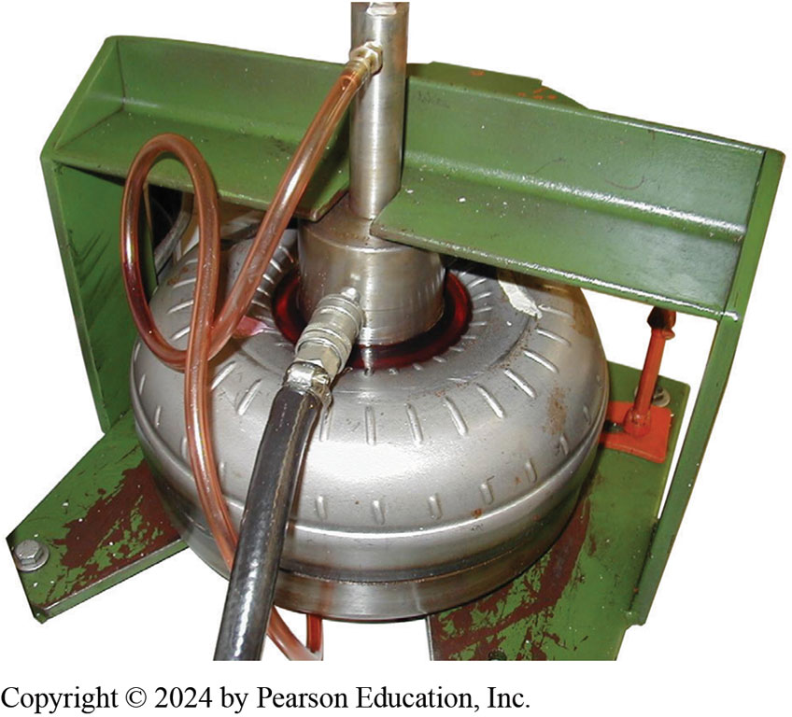
Figure 6.19
Leaking Checking
A leak-test fixture has been placed on the torque converter. It will be filled with A T F and then inspected for leaks.
Notes:
Case Study The Case of the Blue Torque Converter
An Acura (85,000 mi) runs good in park and neutral, but the engine dies as soon as it is shifted into gear. Tests reveal no problems outside of the transaxle. When the transaxle was removed, the torque converter was found to be blue from overheating and
seized up internally. It had also sent metal particles throughout the transaxle. The root cause of the problem was never discovered but rebuilding the transaxle along with a replacement torque converter fixed this transaxle.
Summary:
Complaint—Vehicle owner complained that engine would die as soon as it was shifted into gear.
Cause—Root cause is unknown but an internal transaxle failure had occurred.
Correction—A new torque and rebuilding transaxle fixed the customer concern.
Tech Tip: Converter Drain-Back Test: If the fluid leaves the torque converter when the engine is off, the vehicle will not move when the
engine is restarted until the torque converter is refilled by the pump, which causes a delay. If torque converter drain back is suspected,
operate the vehicle until it is at normal operating temperature, and drive the vehicle through several full-shift cycles. Check and adjust the fluid level if it is low, and shut off the engine. Allow the vehicle to sit for 30 to 60 minutes, then recheck the fluid level and mark it on the dipstick. Allow the vehicle to sit for 24 hours and then recheck the fluid level. If the level has risen by 1 inch (25 mm) or more, converter drain back has occurred. This means that the sealing rings around the torque converter are not able to seal properly and this means that transmission or transaxle has to be removed to correct this condition.
Long description:
The top of the converter has a special tool that has a circular base and a cylinder on top. A small pipe is attached to the cylinder hyphen shaped portion of the tool. A thicker pipe is attached to the circular base of the tool. The iron base has a groove to keep this tool in place.

Slide 36
Frequently Asked Question: What Is High-Stall Speed Converter?
? Frequently Asked Question
What Is High-Stall Speed Converter? A high-stall speed converter called a loose converter. A low-stall speed converter called a tight converter. When vehicle is still, turbine is not rotating. As vehicle accelerates, engine R P M increases to torque capacity of converter (stall speed) and then it stabilizes. As turbine speed increases, engine speed also increases. A loose converter allows a higher engine R P M relative to turbine R P M. Stall speed of converter is determined by: torque, diameter, angle of impeller vanes, & angle of stator vanes. High-torque engine has ability to turn impeller faster against a stalled turbine than small or weak engine. Low-torque engine is normally equipped with a looser converter. If converter is too tight, engine R P M cannot increase to point of usable power and vehicle would lose acceleration and performance. A converter that is too loose will cause engine to operate at excessive speed. The result will be poor fuel economy, noise, and reduced performance because of the excessive slippage. In production, the torque converter capacity/ stall speed is matched to the engine size and vehicle weight to produce the best vehicle performance and fuel economy. Depending on the engine, different converters are used with a transmission model.

Slide 37
Installing A Higher Stall Speed Torque Converter - Photo Sequence

Slide 38
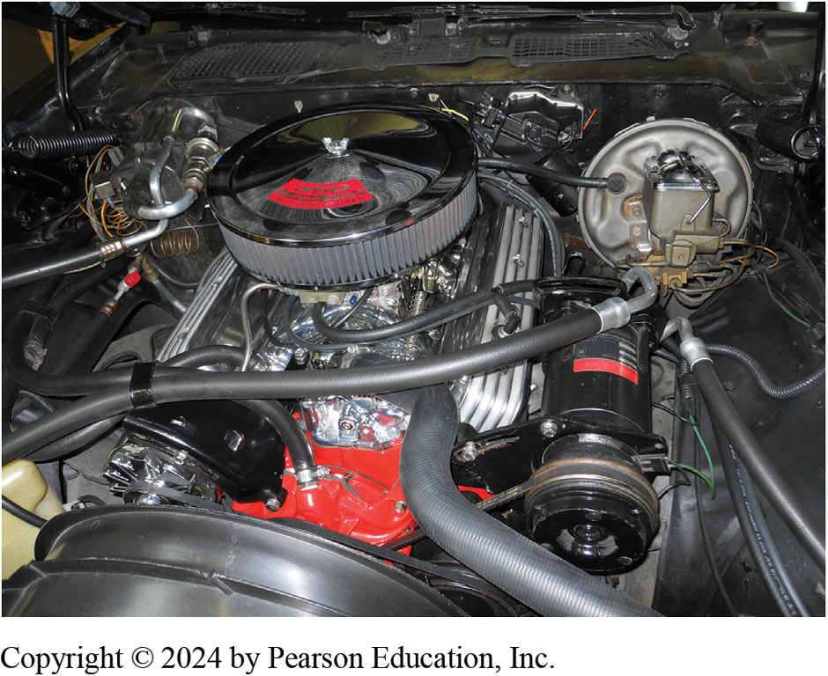
1. Restored 1971 Chevrolet Camaro has an aftermarket high-lift camshaft and does not idle correctly in drive with the stock torque converter.

Slide 39
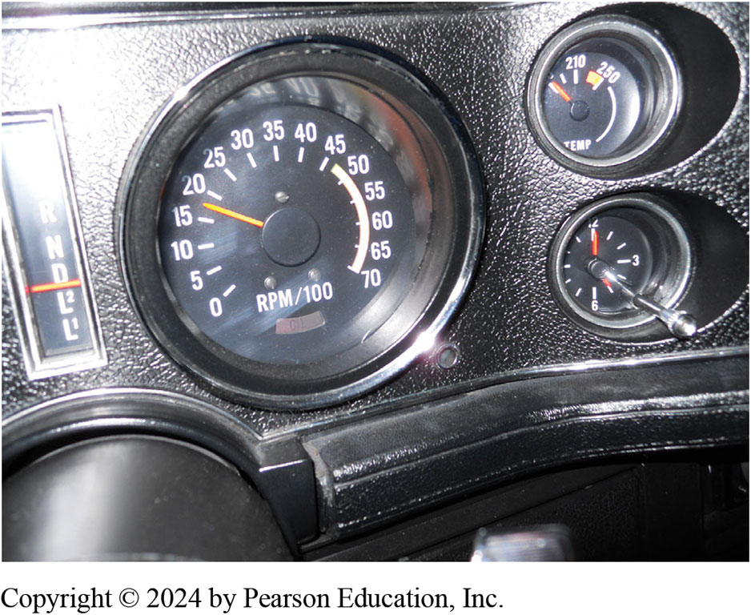
2. Stall speed of stock torque converter was tested at 1850 R P M , which is normal for stock engine but not for an engine equipped with a high-performance camshaft.
Notes:
Long Description:
There is one large dial and two smaller dials. The large dial has numbers from 0 to 70 in intervals of 5. The large dial measures in rpm slash 100. The indicator is seen as 18. The small dial on the top shows two numbers 210 and 250. The indicator shows a value before 210 which is not seen. The small dial on the bottom shows the top middle number as 12 and the right middle number as 3. The value opposite to 12 is 6. The indicator shows one hand at 5 and one hand at 12.

Slide 40
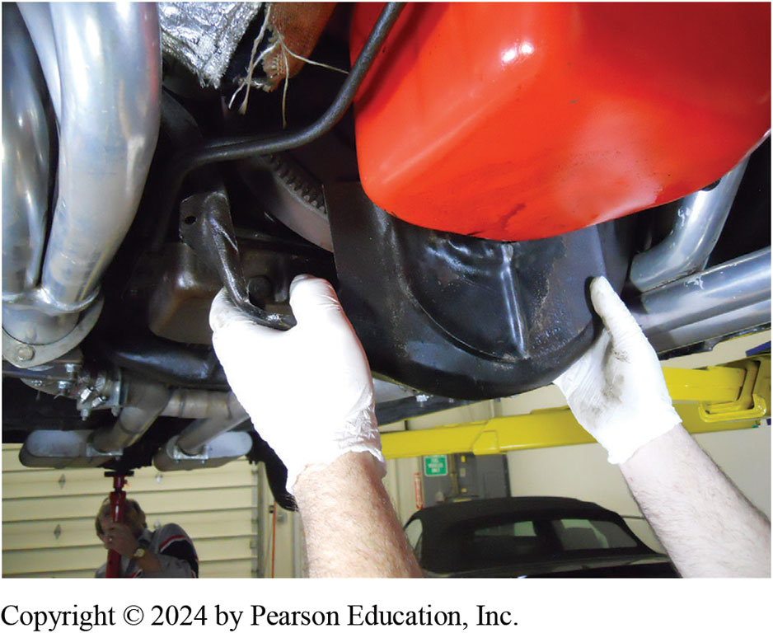
3. The inspection cover is removed.

Slide 41
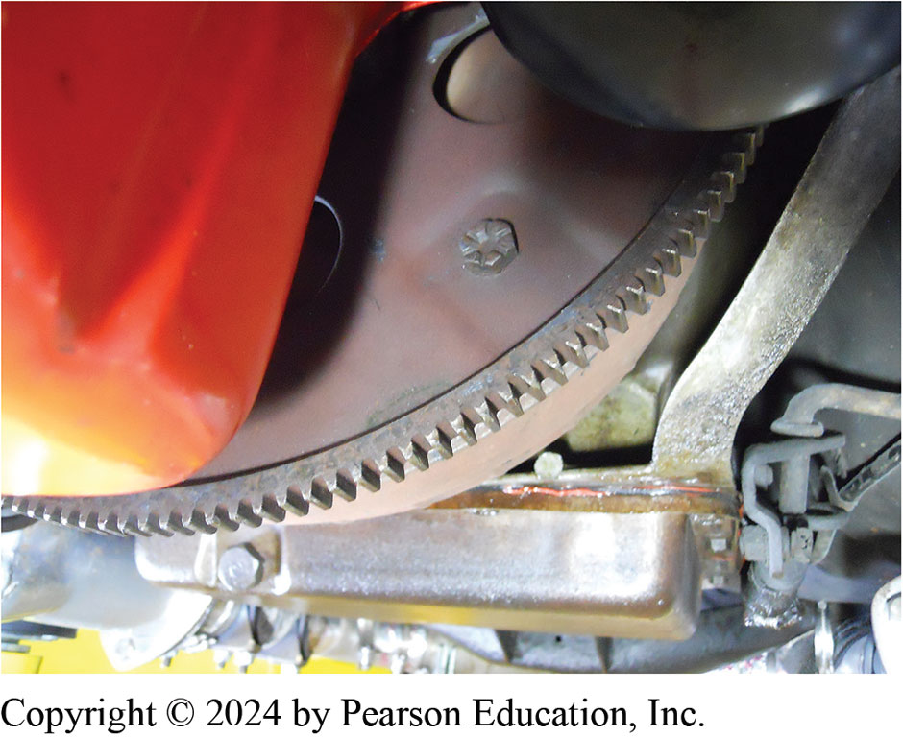
4. The torque converter retaining bolts are removed requiring the engine be rotated using a flywheel turning tool.

Slide 42
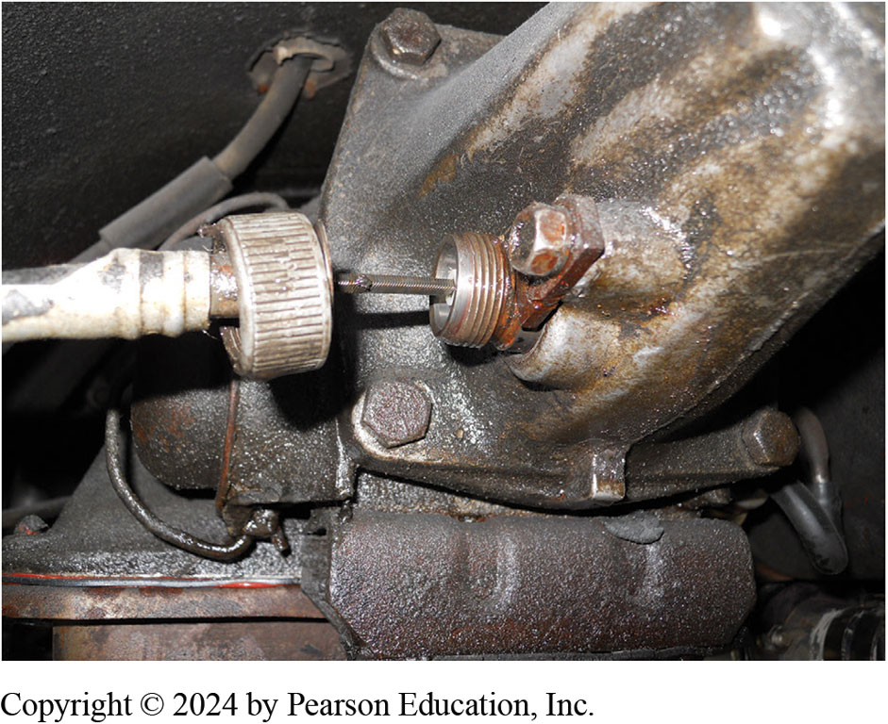
5. The speedometer cable was removed.

Slide 43
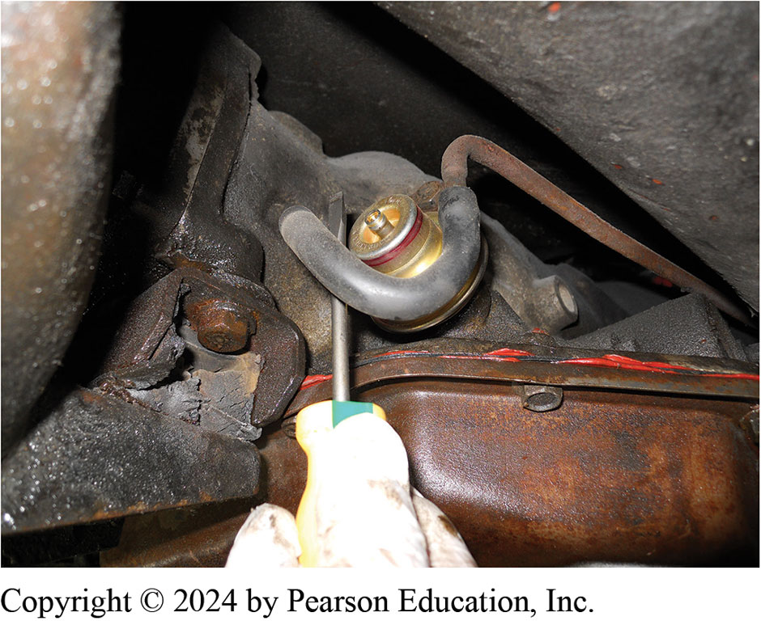
6. The vacuum hose to the modulator valve was removed.

Slide 44
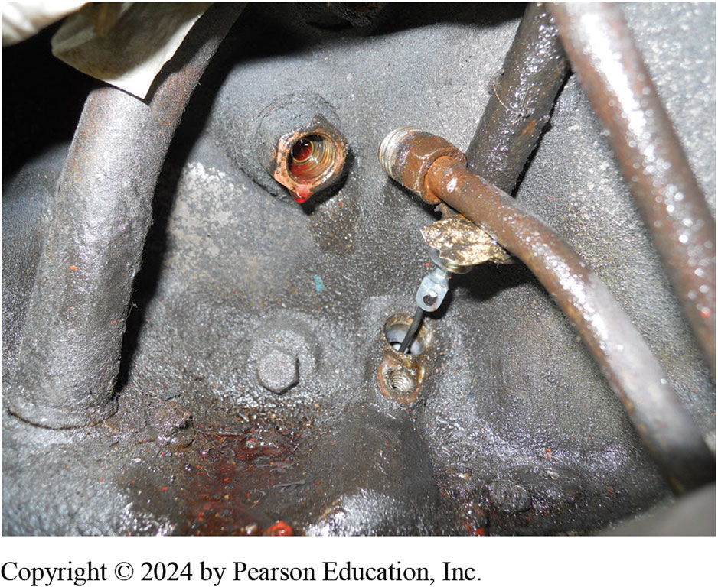
7. The cooling lines and the dip stick tube are removed.

Slide 45
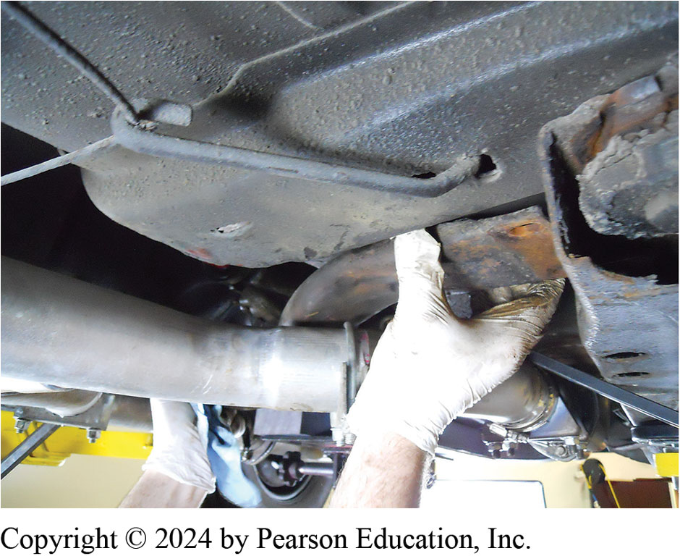
8. After removing driveshaft, cross member was unbolted and removed after supporting the transmission using a transmission jack.

Slide 46
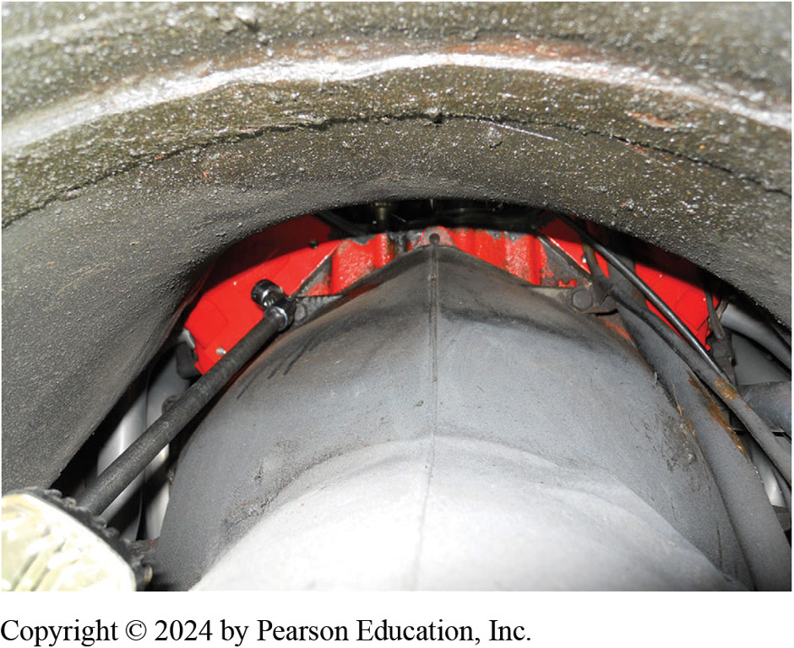
9. The bell housing bolts were removed using a long extension and a swivel socket.

Slide 47
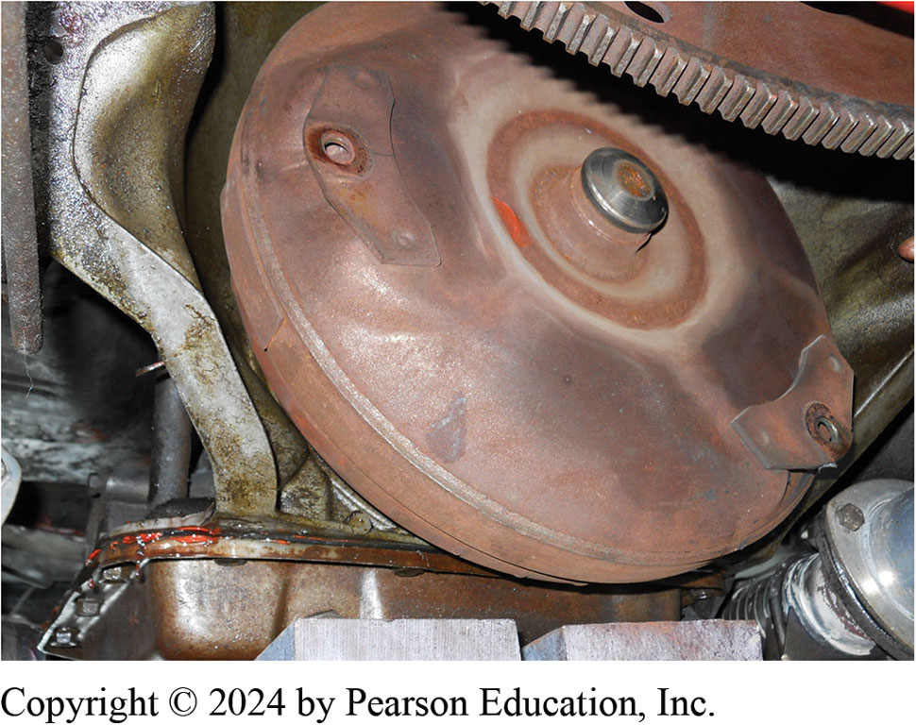
10. The transmission is removed from the engine with the torque converter still in place.

Slide 48
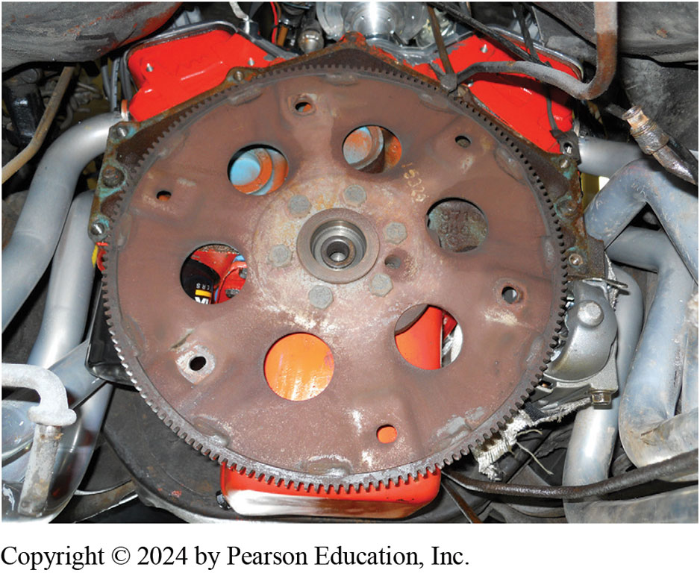
11. The flexplate was inspected for cracks or worn ring gear teeth and found to be normal.

Slide 49
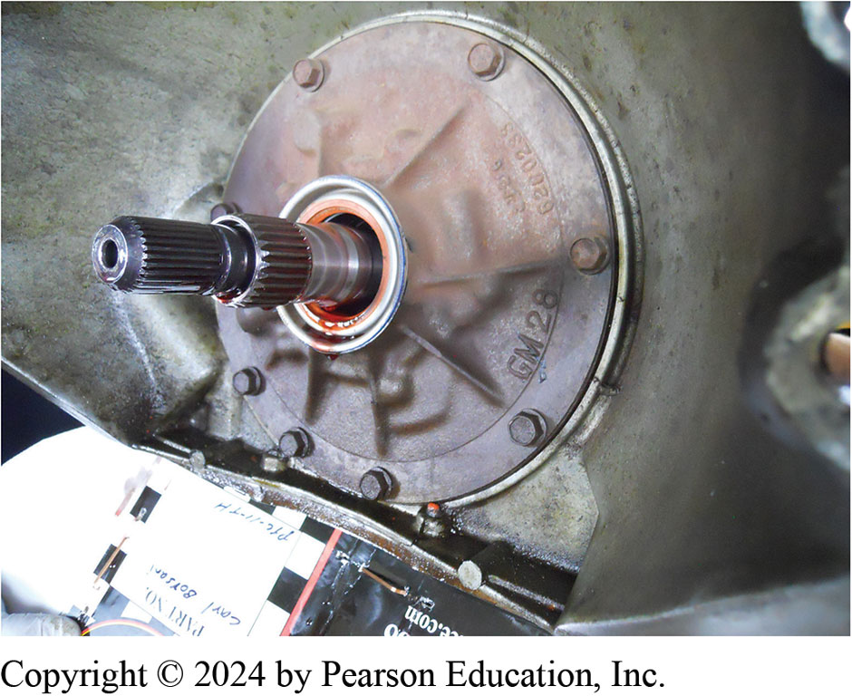
12. Torque converter was removed & front seal found to be leaking. All seals were replaced before it was returned to the customer.

Slide 50
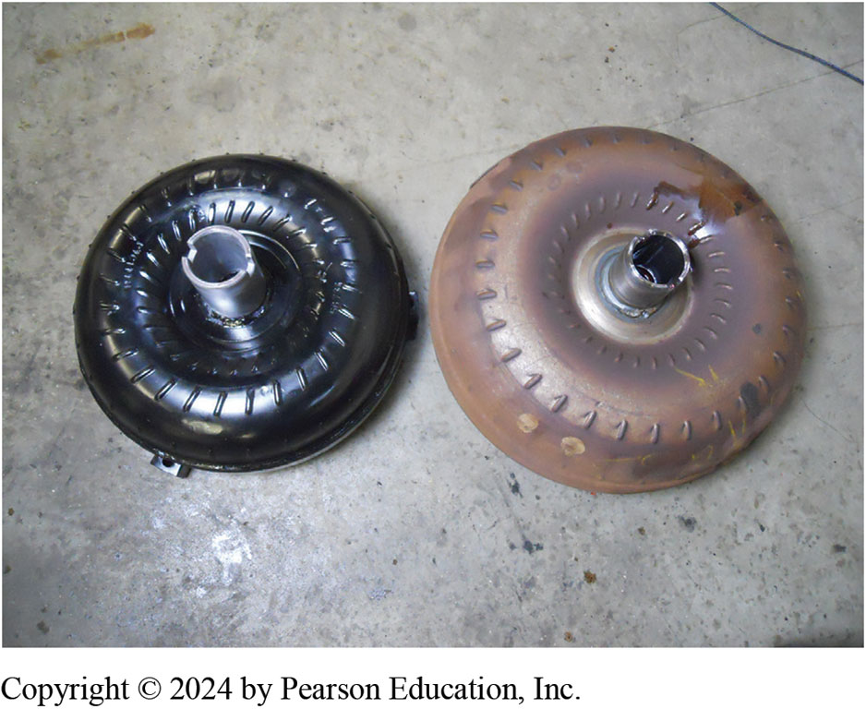
13. New replacement higher stall speed converter is on left, is noticeably smaller in diameter than stock converter.

Slide 51
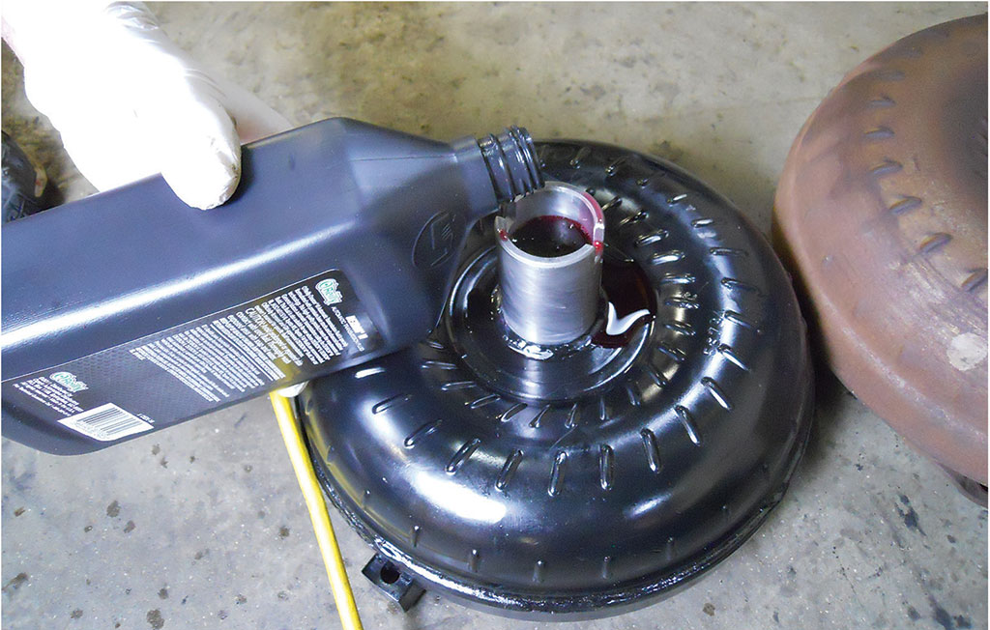
14. The new torque converter is filled with A T F before being installed.

Slide 52
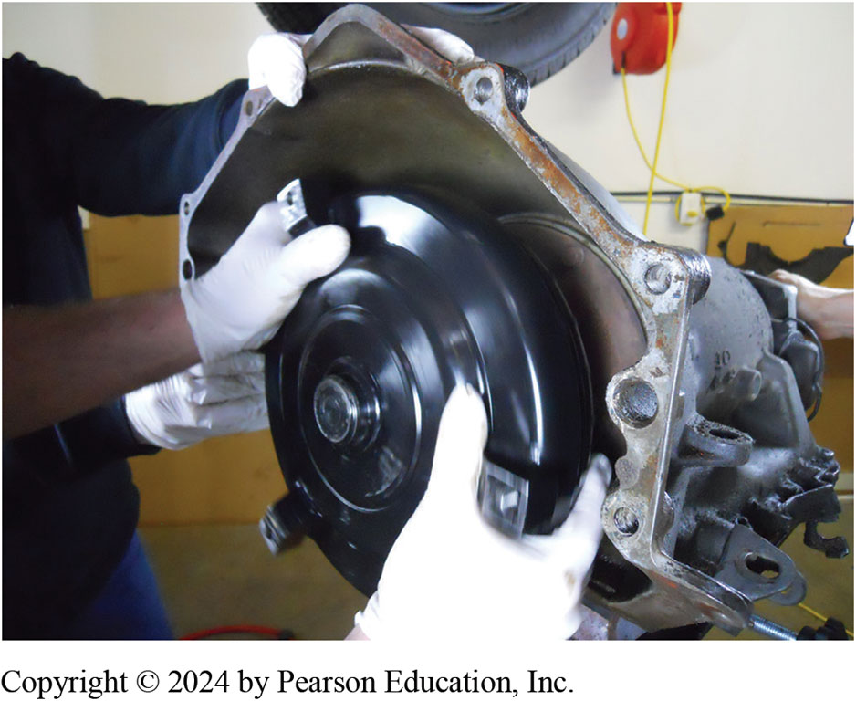
15. The torque converter is wiggled back and forth to ensure that all of the splines are engaged.

Slide 53
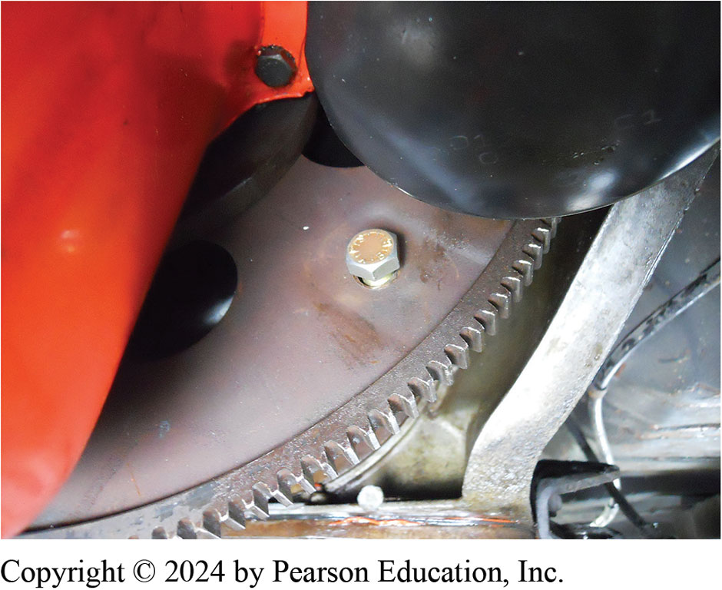
16. The holes in the flexplate were enlarged so that the new larger torque converter bolts would fit.

Slide 54
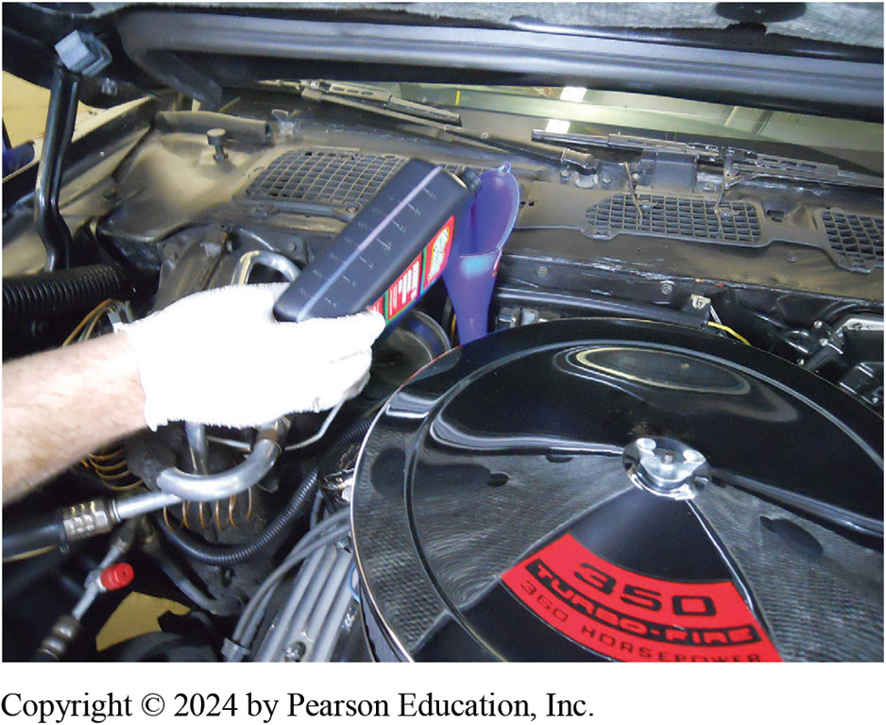
17. Transmission was installed and all parts reconnected, then filled to proper level with specified A T F.

Slide 55
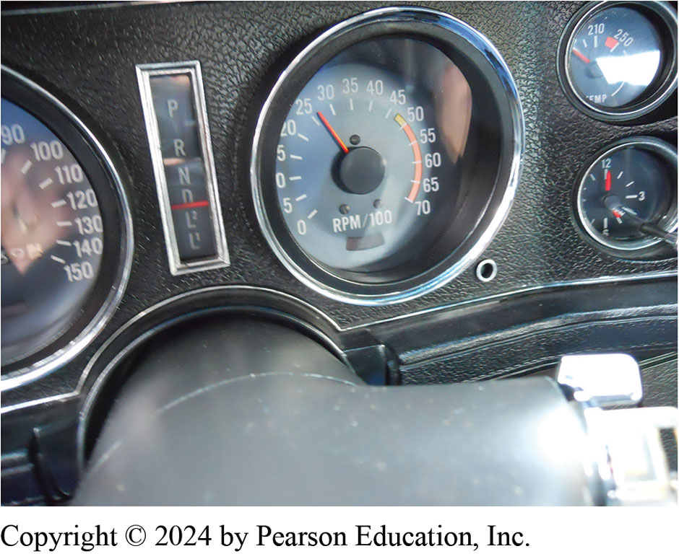
18. Stall speed retested and new converter is 2350 R P M , which worked well for this engine. The customer was very happy.
Notes:
Long Description:
There is one large dial and two smaller dials. The large dial has numbers from 0 to 70 in intervals of 5. The large dial measures in rpm slash 100. The indicator is seen as 18. The small dial on the top shows two numbers 210 and 250. The indicator shows a value before 210 which is not seen. The small dial on the bottom shows the top middle number as 12 and the right middle number as 3. The value opposite to 12 is 6. The indicator shows one hand at 5 and one hand at 12. There is a vertical indicator with the letters P, R, N, D, L2, and L1. The D option has been highlighted. There is another dial which is partially seen in the image.

Slide 56
Question 1
A stall test is used to check the Fill in the blank .
A. stator
B. impeller
C. turbine
D. torque converter clutch

Slide 57
Answer 1
A stall test is used to check the Fill in the blank .
A. stator

Slide 58
Summary (1 of 2)
Torque converter is located between the engine and transmission/transaxle.
Three major parts of torque converter are turbine, impeller, and stator.
A torque converter is a hydrodynamic unit.
Transfers power through dynamic motion of fluid.
Flow of fluid inside a torque converter is both rotary and vortex flow.

Slide 59
Summary (2 of 2)
Stall test is used to check stator one-way clutch and the strength of apply devices inside transmission/ transaxle.
Torque converter is considered to be part of transmission
Should be serviced or replaced when a transmission is overhauled.
Notes:
Installing a higher stall speed torque converter 18 Step by step ON Pages 66 to 69

Slide 60
Automatic Transmissions and Transaxles Videos and Animations
Videos Link: (A2) Automatic Transmissions and Transaxles Videos
Animations Link: (A2) Automatic Transmissions and Transaxles Animations

Slide 61
Copyright
This work is protected by United States copyright laws and is provided solely for the use of instructors in teaching their courses and assessing student learning. Dissemination or sale of any part of this work (including on the World Wide Web) will destroy the integrity of the work and is not permitted. The work and materials from it should never be made available to students except by instructors using the accompanying text in their classes. All recipients of this work are expected to abide by these restrictions and to honor the intended pedagogical purposes and the needs of other instructors who rely on these materials.

