Slide 1
Automatic Transmissions and Transaxles
Eighth Edition
Chapter 5
Hydraulic Control Valves and Solenoids
Copyright © 2024, 2018, 2015 Pearson Education, Inc. All Rights Reserved
Notes:
If this PowerPoint presentation contains mathematical equations, you may need to check that your computer has the following installed:
1) Math Type Plugin
2) Math Player (free versions available)
3) NVDA Reader (free versions available)
INSTRUCTOR NOTE: This presentation includes text explanation notes, you can use to teach the course. When in SLIDE SHOW mode, you RIGHT CLICK and select SHOW PRESENTER VIEW, to use the notes.

Slide 2
Learning Objectives
5.1 Describe the types and operation of automatic transmission/transaxle valves.
5.2 Discuss accumulators and orifices as used in an automatic transmission/transaxle hydraulic system.
5.3 Explain the operation of automatic transmission solenoids.
5.4 Describe how a pressure control solenoid (P C S) controls fluid pressure.

Slide 3
Hydraulically-Controlled Transmissions
Non-computerized hydraulically-controlled transmissions, until the late 1980s used the hydraulic system components to determine when to shift.
A governor to detect vehicle speed.
A throttle cable and valve or a vacuum modulator to determine the load on the engine.
Engine load input
Throttle valve
Vacuum modulator

Slide 4
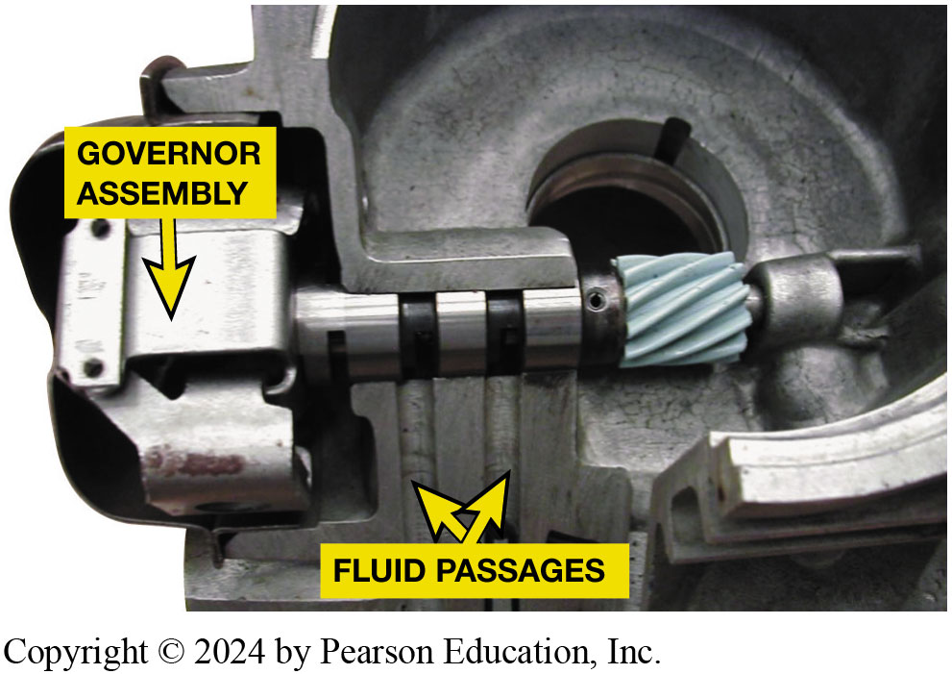
Figure 5.1
Governor
A governor assembly is used on older hydraulically controlled automatic transmissions/transaxles to control shift points based on vehicle speed.
Notes:
Long Description:
A shaft is seen in the middle of the image. The left part of the shaft is connected to the governor assembly. Two fluid passages are marked near the governor assembly. The shaft is joined to another part by a spring. This shaft is present near a circular part of the machinery.

Slide 5
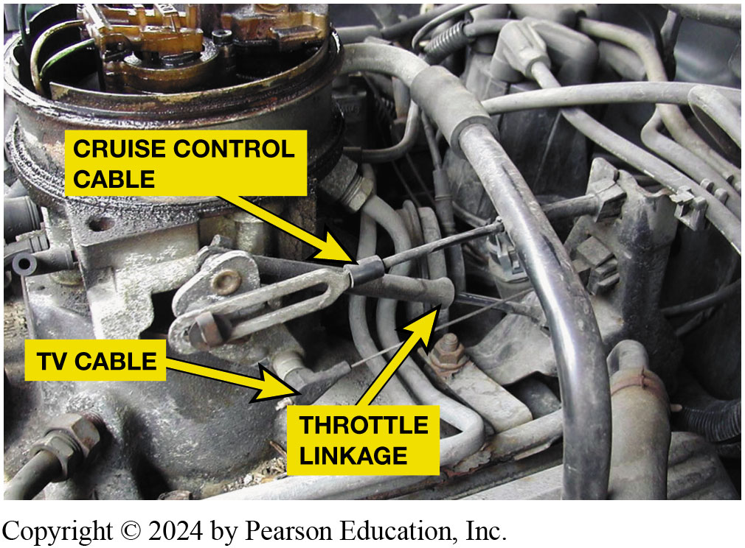
Figure 5.2
Throttle valve (T V) cable on a 4L60 transmission.
Notes:
Long Description:
In the middle of the image, a cruise control cable is labeled. A T V cable is present close to it. A throttle linkage is present on another part of the transmission. There are many pipes in the transmission. The left upper part of the image contains a circular structure.

Slide 6
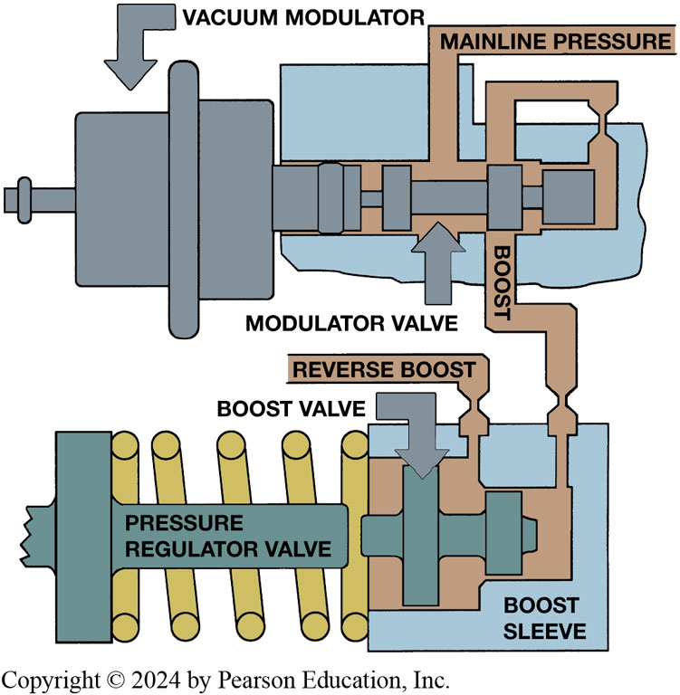
Figure 5.3
Vacuum Modulator
Vacuum modulator moves modulator valve depending on vacuum of the engine. A heavy load on engine causes the vacuum to be lower than when engine is operating under a light load. The spool valve applies mainline pressure to the boost sleeve of pressure regulator valve, which causes mainline pressure to increase.
Notes:
Long Description:
The lower part of the image has a vertical bar with a horizontal bar labeled as a pressure regulator valve. A spring is present behind the pressure regulator valve and is attached to the boost sleeve. Inside the boost sleeve, there are two vertical bars, one half the size of the other, and one horizontal bar. The first long vertical bar is labeled as a boost valve. These three bars are surrounded by a structure that opens into two pipes. The first is the reverse boost pipe and the second is the boost pipe. The structure has three openings on the top and two at the bottom. The left opening at the top goes to mainline pressure, the middle opening joins the right opening. The left bottom opening is called the modulator valve and the right bottom opening joins the boost pipe. A shaft is present in the middle of the structure. It has many vertical bars on its surface. The shaft has a broad rectangular end and is attached to a vacuum modulator. The vacuum modulator is a rectangular structure with a small shaft and bolt at the end. A vertical bar is present between the vacuum modulator and the shaft.

Slide 7
Animation: Vacuum Modulator Valve (Animation will automatically start)

Slide 8
Shift Valves
An upshift or downshift occurs when shift valves move.
Shift valves are placed in one of two positions
Moved to desired position by increase/decrease of fluid pressure at one end.
What happens at rest or at slow speeds? Page 46
What does governor pressure do? (Page 46)

Slide 9
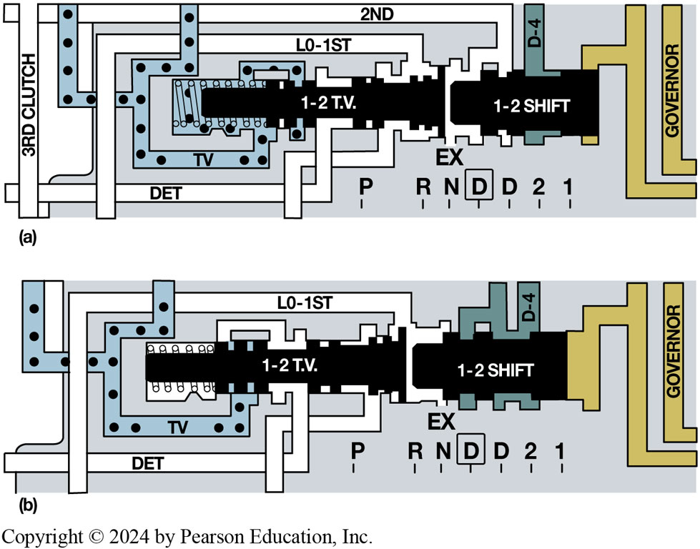
Figure 5.4
Shift Valve
(a) As the speed increases, governor pressure increases and is applied to the 1–2 shift valve. (b) When the 1–2 shift valve moves, the fluid is directed to 2nd clutch and the shift is completed
Notes:
Long Description:
The image has two parts. In the first part, the openings around 1 hyphen 2 T.V. shaft are as follows. The shaft of 1 hyphen 2 T.V. is surrounded by a visible spring at the left end. The top horizontal bar is labeled as 2nd. From this bar, two inlets come and join the area around the spring. These two inlets are shown with dots inside. A pipe labeled L O hyphen 1st comes out at the right end of 1 hyphen 2 T.V., goes horizontally left, and then goes down. Two openings come out from the bottom of 1 hyphen 2 T.V. shaft. They are a D E T bar and one unnamed bar. The D E T bar goes to the extreme left of the image. It crosses with a vertical bar labeled the 3rd clutch. The 1 hyphen 2 shift shaft is present to the right of the 1 hyphen 2 T.V. shaft. The 2nd bar joins this shaft. Another opening is labeled as a D hyphen 4. The 1 hyphen 2 shift shaft fully joins with the governor structure on the right. The junction between 1 hyphen 2 shift shaft and 1 hyphen 2 T.V. shaft has an ex written under it. Below the ex, the letters written are R, N, D, D, 2, and 1. The first D is surrounded by a small box. The letter P is written some distance away under the shaft of 1 hyphen 2 T.V. In the second part, the shaft of 1 hyphen 2 T.V. is extended fully to cover the spring. The 1 hyphen 2 shift shaft shows a partial shift away from the governor structure.

Slide 10
Animation: 1-2 Upshift: Minimum Throttle (Animation will automatically start)

Slide 11
Shift Quality
Fluid pressure must be high enough to apply clutch or band.
Tightly enough to prevent slippage.
Shift overlap
Need for shift modifiers
Light-throttle shift
Heavy throttle
Too slow shift
Too fast shift
Accumulators

Slide 12
Figure 5.5
Accumulator Cushioning
(a) When clutch applies, fluid pressure rises gradually until circuit is filled and piston strokes to take up clearance; then there is a rapid increase to line pressure. (b) Accumulator can be placed into circuit to slow this pressure rise and soften clutch application.
Notes:
Long Description 1:
In graph A, the line in the graph shows a slope which is labeled as pressure rise to fill the clutch circuit. The slope then becomes a small plateau which is labeled as the stroke of the clutch piston. The line then goes vertically up as a long line and then goes horizontally to the end of the graph. The area covered by the line graph is shaded on the right side. The beginning of the horizontal line is labeled as full line pressure with clutch applied while the end of the horizontal line is labeled as apply pressure.
Long Description 2:
In graph B, the line in the graph shows a slope which is labeled as pressure rise to fill clutch circuit. The slope then becomes a small plateau which is labeled as the stroke of the clutch piston. The line then goes vertically up as a short line and then turns into a long slope which is labeled as the stroke of the accumulator piston. The line then goes horizontally to the end of the graph. The horizontal line is labeled as full line pressure with a clutch applied.

Slide 13
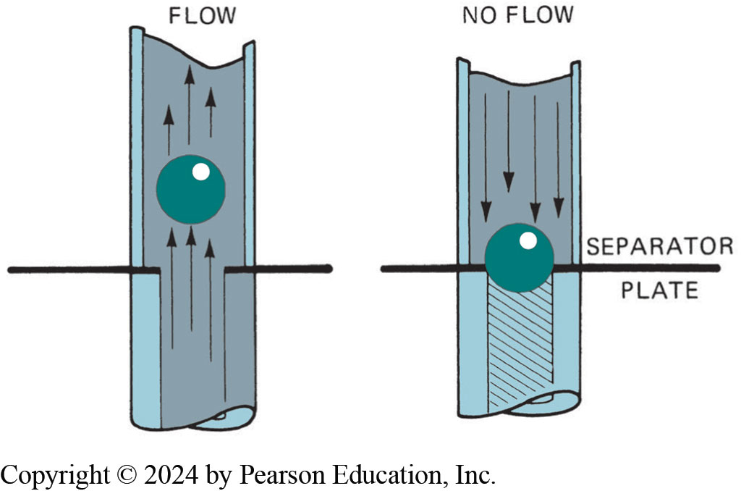
Figure 5.6
One-Way Check Ball
A check valve is opened by fluid flow in one direction (left) and closes when the fluid tries to flow in reverse direction.
Notes:
Long Description:
In the first image, the front portion of the pipe is partially cut to show the inner flow of the pipe. When the flow is upward, a ball is seen going up with the flow. The separator plate is open in this image. In the second image, the separator plate is present with the ball in the middle. This setup does not allow the flow of fluid in the opposite direction. Arrows are shown in both images to indicate the direction of the fluid.

Slide 14
Controlling Fluid Flow (1 of 2)
Check Balls
Fluid flow from pressure regulator to manual valve
Into control circuit called mainline, line, or control pressure
Flow to and from a transmission hydraulic actuator
Controlled by one or more valves
Spool valves sliding in a round bore are used for this purpose

Slide 15
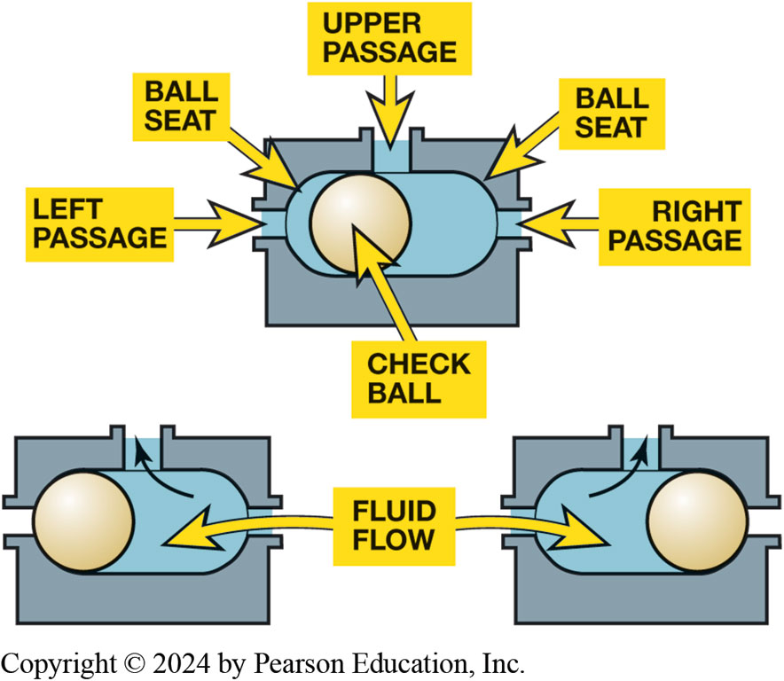
Figure 5.7
Steel Check Balls
Check balls are used in the valve body to allow hydraulic circuits to share a common passage.
Notes:
Long Description:
The first image shows a rectangular structure with three openings, one on the top, one on the left, and one on the right. The top passage is labeled the upper passage, the left opening is labeled the left passage, and the right opening is labeled the right passage. The interior of the rectangle contains a ball seat which is an enclosure for the check ball. In the second image, the check ball is present at the left passage. The flow of fluid is shown to be from the right passage into the structure. The fluid then leaves by the upper passage. In the third image, the check ball is present at the right passage. The flow of fluid is shown to be from the left passage into the structure. The fluid then leaves by the upper passage.

Slide 16
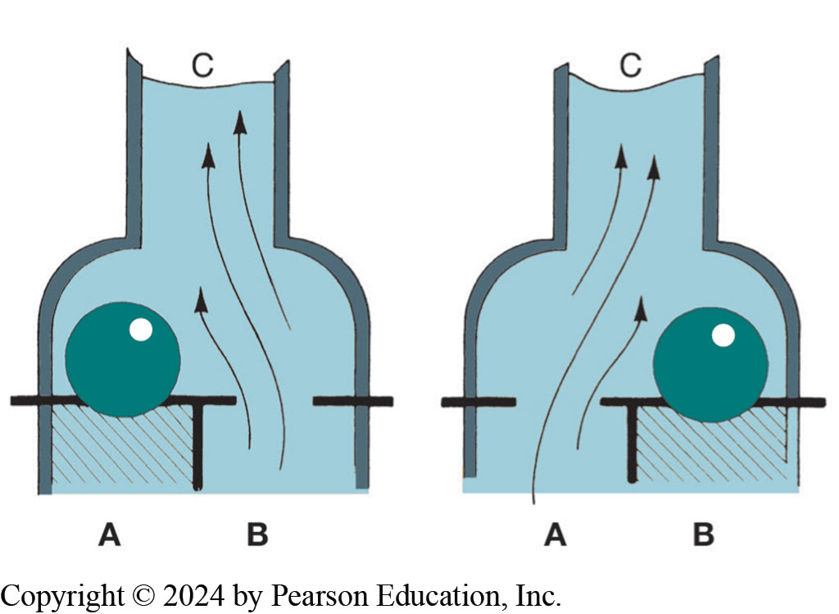
Figure 5.8
When fluid flows through this shuttle valve from port B to port C, check ball moves over to close port A (left). Fluid flow from port A will close port B (right).
Notes:
Check balls are easier on seats and they cannot be magnetized. Some transmissions use a two-way check valve, also called a shuttle valve. The ball is positioned above two side-by-side holes with another flow passage extending upward or to the side. Upward flow through one of the holes in plate causes the ball to move over and seal the other hole. Fluid flow upward through the second hole causes the ball to move over and seal the first hole. Figure 5.8.
Long Description:
In the first image, a container is shown with the top part narrow and the bottom part broad like a bottle. Inside the bottle, there are two enclosures, A and B. A is having a grill and a ball on top while B is open for the fluid to pass through. The opening of the container is marked as C. In the second image, the A enclosure is open for the fluid to pass through and B has a grill with a ball on top.

Slide 17
Controlling Fluid Flow (2 of 2)
Orifices
Fluid pressure in an automatic transmission is controlled
By a variable pressure regulator valve.
An additional passage from pump enters the valve at one valley
Passage leading back to pump inlet is located at an adjacent valley

Slide 18
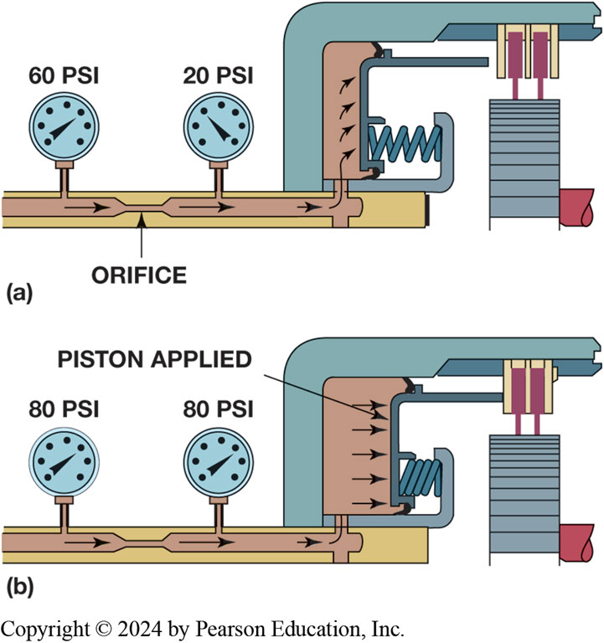
Figure 5.9
Orifice
(a) An orifice will cause a pressure drop as fluid flows through; (b) When flow stops, pressure on both sides of orifice will be same.
Notes:
Long Description:
The image consists of two parts. The first part consists of a flat base with two pressure gauges attached. The two pressure gauges are connected under the base plate and to a structure containing a piston and a spring. The first gauge shows 60 P S I pressure and the second gauge shows 20 P S I. The tubes connecting the pressure gauges have a narrow part in the middle that contains the orifice. The fluid flows in the direction of the spring and the piston. The spring is relaxed and the piston is not applied. Curved arrows are shown to indicate the direction of the fluid. In the second part, the pressure in both gauges is 80 P S I. The fluid puts pressure on the piston. The piston is applied and the spring is contracted. Straight arrows are shown to indicate the direction of the fluid.

Slide 19
Animation: Orifice (Animation will automatically start)

Slide 20
Animation: Orifice with Check Valve (Animation will automatically start)

Slide 21
Animation: Pressure Balanced Clutch (Animation will automatically start)

Slide 22
Chart 5.1
Hydraulic Variables
Variable | Change | Effect
Line pressure | Increase | Firmer shift
Flow rate | Increase | Firmer shift
Orifice size | Increase | Faster flow rate
Accumulator rate | Increase | Firmer shift
Accumulator spring | Softer | Faster accumulator rate
Accumulator back pressure | Reduce | Faster accumulator rate
Notes:
Chart 5.1 hydraulic variables and how they are controlled in a hydraulically-controlled automatic transmission.
The firmness of a shift is controlled by the orifice size and the accumulator. In electronically-controlled automatic transmissions and transaxles, all of this is controlled by software.

Slide 23
Chart 5.2
Sub-Circuit
Name of Circuit | Purpose
Supply | Provides fluid to pressure regulator valve and transmission.
Main control pressure | Supplies fluid at a controlled pressure to transmission and converter when the engine is running.
Converter and cooler | Regulates converter pressure; provides gear train lubrication and cooling of the fluid.
Drive | Applies forward clutch and supplies control systems in forward-gear ranges.
Reverse | Increases control pressure.
Governor | Provides a pressure proportional to road speed for upshifts
Throttle valve (T V) | Provides a pressure proportional to engine load and vacuum for shift timing and quality.
Accumulator | Cushions shift by softening or band apply.
Notes:
Hydraulic Sub-Circuits
The hydraulic system is easier to understand if it is divided into sub-circuits. A flow control valve is the dividing point as supply pressure enters the different circuits. Also note that each circuit serves a particular purpose. See Chart 5.2.

Slide 24
Transmission Solenoids (1 of 2)
Electromagnetism
Creating an electromagnet
Solenoid operation
On-off solenoids
Apply
Venting
Pulse-width modulated solenoids
Notes:
Scientists did not discover that current carrying conductors also are surrounded by a magnetic field until 1820. These fields may be
made many times stronger than those surrounding conventional magnets. Also, the magnetic field strength around a conductor may be controlled by changing the current.
As current increases, more flux lines are created and magnetic field expands.
As current decreases, magnetic field contracts.
Magnetic field collapses when current is shut off.
Interaction and relationship between magnetism and electricity is known as electromagnetism.

Slide 25
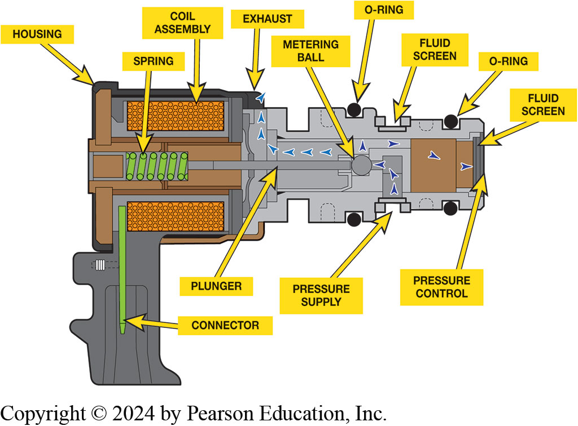
Transmission Solenoids (2 of 2)
Linear Solenoids
Electronic Pressure Regulation
Solenoid Location
Figure 5.10 A typical automatic transmission solenoid showing the coil assembly where the magnetic field and the metering ball and plunger that works against the force of the spring.
Notes:
Long Description:
The structure is shaped like a gun. The lower vertical part has a thin stick-like structure called the connector. The broad horizontal part of the structure has many parts. The extreme left part of the horizontal part is covered by the housing. The housing contains a spring in between two coil assemblies. The lower coil assembly is attached to the connector. The spring is attached to a horizontal rod called the plunger which is fixed to a metering ball. The exhaust is present next to the upper coil assembly. The part of the structure not covered by the housing has eight grooves, six are shallow and two are deep grooves. Out of the four grooves on the top, the first and third one is empty. The third groove is labeled as the fluid screen. The other two are filled with an O-ring. The same arrangement is seen on the bottom side too. The third groove is labeled as a pressure supply. Perpendicular to the plunger and in the extreme right portion, a flat surface is present which is labeled as the fluid screen. It is also labeled as pressure control. From the pressure supply, arrows go to the metering ball, from where they go left to the exhaust and right to the pressure control fluid screen.

Slide 26
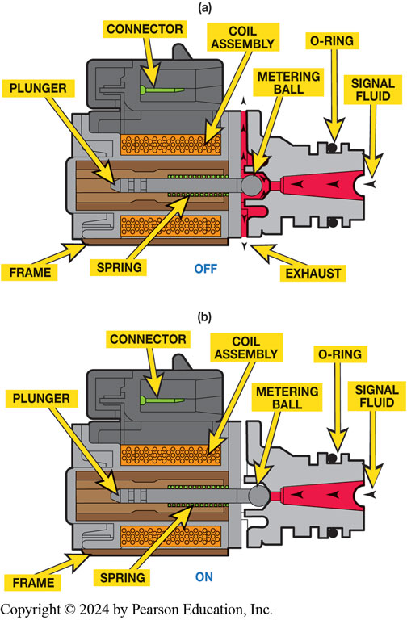
Figure 5.11
Solenoid
(a) In this example, solenoid is commanded off, metering ball is off its seat and allows fluid to flow. (b) When the solenoid is on, metering ball is seated preventing fluid flow.
Notes:
Long Description:
The image has two parts, the first is labeled as off and the second is labeled as on. In the first image, the middle of the structure has a plunger which is attached to a metering ball. A coil assembly is present on either side of the plunger. A spring is below the plunger near the metering ball. The outer frame is also marked at the bottom. Above the upper coil assembly, the connector is present in the middle of a flap-like structure. In the extreme right, an opening is present for signal fluid which moves along to the metering ball and then moves downwards to the exhaust and upwards out of the structure. An O-ring is present in a groove on either side of the opening for the signal fluid. In the second image, the signal fluid doesn’t flow past the metering ball. The flow of fluid is stopped at the metering ball.

Slide 27
Animation: Shift Solenoid Operation (Animation will automatically start)

Slide 28
Animation: Normally Closed Solenoid (Animation will automatically start)

Slide 29
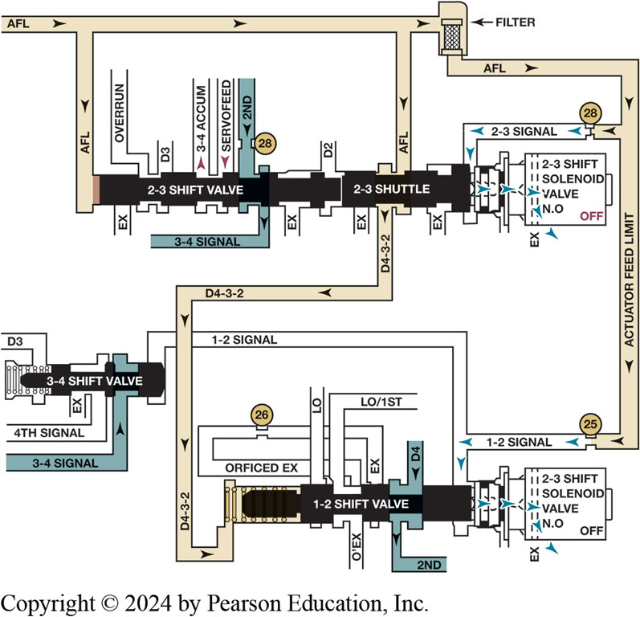
Figure 5.12
Shift solenoids are commanded on and off by P C M/T C M as needed to make a shift
Notes:
Shift solenoids control the pressure force which in turn controls the position of the shift valve. ● See Figure 5.12.
They are commanded on or off by the P C M/T C M.
The resistance of most on–off type shift solenoids is 10 to 15 ohms.
Pulse-width Modulated Solenoids Some automatic transmission solenoids are pulse-width modulated
(P W M), which means that they are energized at a fixed rate (frequency) the amount of time it is “on” is controlled by the P C M/T C M. The ratio of on/off time is called the duty cycle and ranges from 0% (completely de-energized) to 100% (fully energized). A typical application of P W M solenoids is the torque converter clutch-apply circuit such as in the G M 4T60-E.
When the pulse width is high, the apply pressure to the T C C is at a minimum.
When the pulse width is low, full line pressure flows through the solenoid to allow maximum converter apply pressure.
P W M solenoids have a low resistance, usually 4–6 ohms.
Long Description:
The incoming horizontal pipe is labeled as A F L. The first branch of the pipe goes vertically downwards to the 2 hyphen 3 shift valve. The second branch goes vertically downwards to the 2 hyphen 3 shuttle. The horizontal pipe goes through a filter and down into two inlets. The pipe is now labeled as actuator feed limit. The first inlet has a narrow opening labeled as 28 that goes into a pipe labeled as 2 hyphen 3 signal which goes near the 2 hyphen 3 shuttle and into the 2 hyphen 3 shift solenoid valve n.o. The word off is mentioned inside the solenoid and an ex is mentioned near it. The second inlet also has a narrow opening labeled 25 that goes into a pipe labeled 1 hyphen 2 signal which divides into two segments. One pipe goes near the 1 hyphen 2 shift valve and into the 2 hyphen 3 solenoid valve n.o. The word off is mentioned inside the solenoid and an ex is mentioned near it. The other pipe joins the 3 hyphen 4 shift valve. The openings near 2 hyphen 3 shift valve are as follows. On the top side, overrun, D3, the outlet of 3 hyphen 4 accum, the inlet of servofeed, and the inlet of 2nd. The pipe labeled 2nd has a narrow opening labeled as 28. The openings on the lower side are one opening for ex and one outlet for 3 hyphen 4 signal. The openings near 2 hyphen 3 shuttle are as follows. On the top side, D2, on the bottom, two openings for ex and one pipe labeled D4 hyphen 3 hyphen 2. This pipe joins the 1 hyphen 2 shift valve by passing through a spring. The openings near 1 hyphen 2 shift valve are as follows. On the top side, orficed ex, ex, L O, L O over 1st, and the inlet of D4. On the bottom, the outlet of 2nd, and o’ex. The pipe of orficed ex and ex are joined together and have a narrow region labeled 26. The openings near 3 hyphen 4 shift valve are as follows. On the top side, D3 is the opening. At the bottom, the three openings are ex, 4th signal, and an inlet of 3 hyphen 4 signal.

Slide 30
Frequently Asked Question: What is a “Pintle Hump”?
? Frequently Asked Question
What is a “Pintle Hump”? Observing the operation of an on-off type shift solenoid using a digital storage oscilloscope, (D S O), there usually appears to be dip in the waveform about half or two thirds of the way up the ramp as current is flowing through the windings of the solenoid. This “hump” is created by the action of the plunger (pintle) inside the solenoid as it moves and provides the service technician proof that the solenoid did, in fact, move. SEE FIGURE 5.13, page 52. Some experienced automatic transmission diagnostic technician use a D S O to check all of the solenoids while the transmission/transaxle is still in the vehicle using the following: Scan tool to command the solenoids on. An Inductive amp clamp connected to the feed wire to the solenoid or around the wire being controlled by the P C M/T C M. A digital storage oscilloscope (DSO).

Slide 31
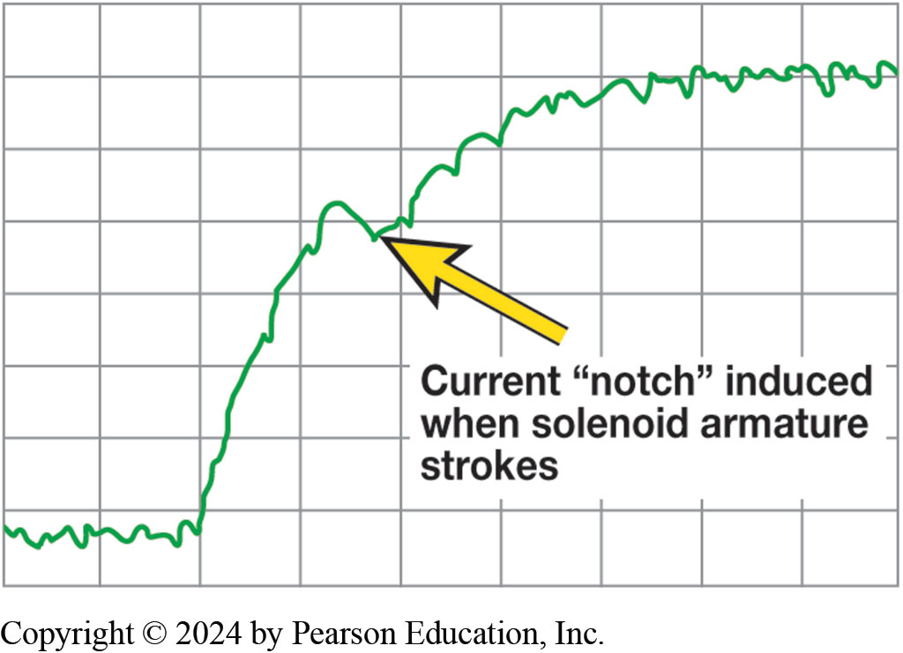
Figure 5.13
Pintle Hump
A scope waveform showing the opening of a solenoid using a current clamp around solenoid feed wire. The hump is created when the core of the solenoid moves which creates a slight counter electromotive force (E M F) causing the slight hump in the current waveform.
Notes:
Long Description:
There are nine squares on the x-axis and eight squares on the y-axis. A scope waveform starts at the lower left of the grid and continues for two squares, then climbs up vertically for a distance of four squares. Then, a slight hump is seen in the current waveform in the fourth square from the left. After that, a gradual slope is seen over a distance of two squares. Then the waveform stabilizes and continues at the same height for three squares. The hump is labeled as current open quotes notch close quotes induced when solenoid armature strokes. The waveform of the graph is wriggly with multiple small humps and dents.

Slide 32
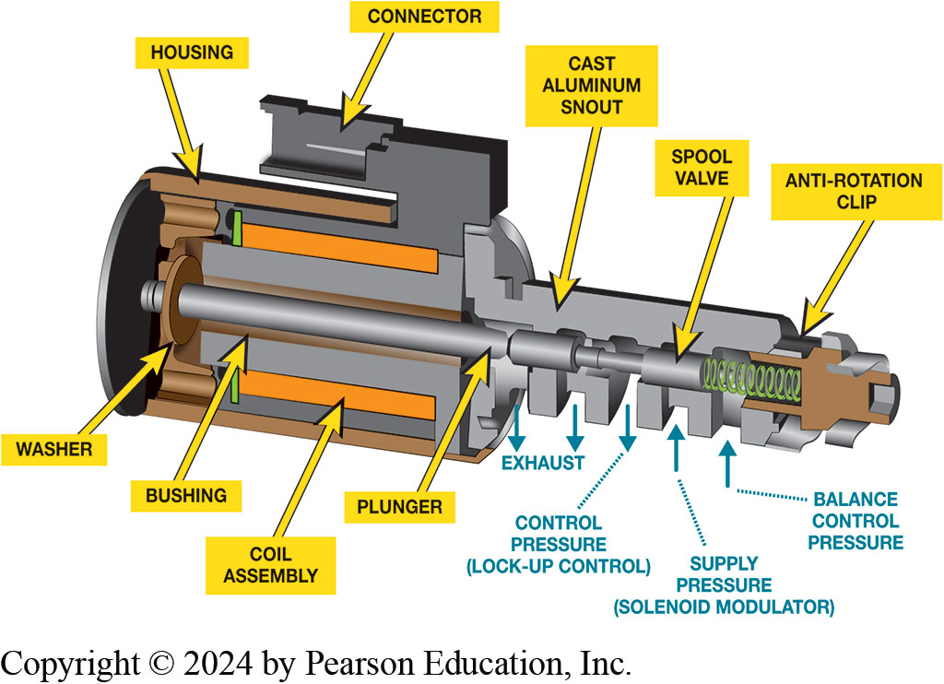
Figure 5.14
Linear solenoid is pulse-width modulated plus spool valve moves in proportion to the pulse-width signal form the P C M/T C M.
Notes:
Linear Solenoids operate using a P W M control to cause the plunger inside the solenoid to move in or out depending on the amount of the applied cur- rent. The typical operation of a linear solenoid includes:
P C M/T C M sends a pulse-width modulated signal at a fixed frequency with a varying duty cycle (on-off time).
Current through the coil of the solenoid creates an electromagnetic force that is applied to the internal plunger which moves against a spool valve and spring force in the snout part of the solenoid.
The higher the pulse-width of the signal applied from the P C M/T C M, the greater the movement of the plunger.
Linear solenoids have a low resistance, usually 4–6 ohms. Figure 5.14.
Long Description:
It is a tapering structure shaped like a nail. A circular disc is present at one end which is connected to a washer which connects to the plunger. The plunger is surrounded by a bushing. A coil assembly is present near the bushing on either side. The coil assembly is then connected to the structure that holds the connector. The structure is covered with housing. The plunger is connected to the spool valve which is attached to a spring. An anti-rotation clip is adjacent to the spring. The lower half has a cast aluminum snout with five openings on the lower side. From left to right, the first two openings are labeled as exhaust with downward arrows. The third opening is labeled as control pressure (lock hyphen up control). The fourth opening is labeled as supply pressure (solenoid modulator). The fifth opening is labeled as balance control pressure.

Slide 33
Chart 5.3
Solenoid Ohmic Values
Type of Solenoid | Typical Resistance
On-off type shift solenoids | 10–15 Ohms
Pulse-width modulated (P W M) shift or T C C solenoids | 4–6 Ohms
Linear (P W M) solenoids | 4–6 Ohms
Notes:
Typical automatic transmission/transaxles solenoid coil winding resistance. Always check service
information for the exact resistance specifications for the unit being serviced.

Slide 34
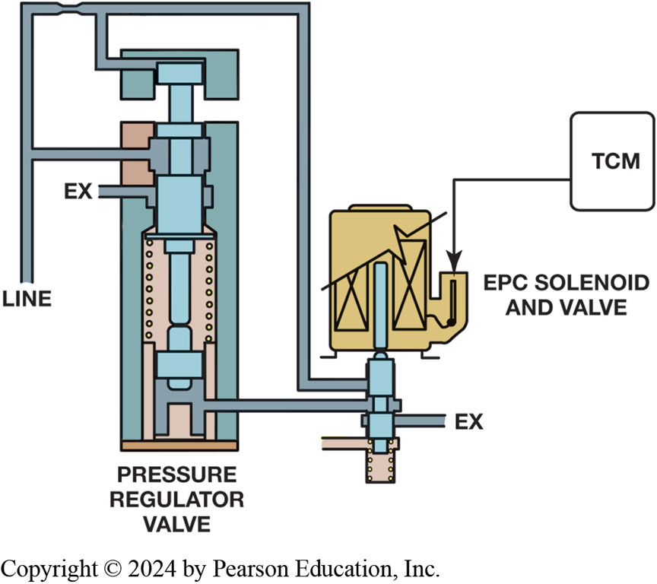
Figure 5.15
T C M controls the E P C solenoid to change pressure regulator valve to adjust line pressure.
Notes:
Electronic Pressure Regulation
Electronic auto- matic transmissions/transaxles regulate hydraulic system pressure using a pressure control solenoid (P C S) that may also be called any of the following:
■ Electronic pressure control (E P C)
■ Pressure control (P C)
■ Variable force solenoid (V F S)
■ Force motor
The powertrain control module (P C M) or the transmission control module (T C M) switches solenoids on and off very quickly using pulse-width modulation (P W M). ● Figure 5.15.
These pressure control solenoids usually have a low resistance of one to four ohms and operate at high frequency with varying duty cycles. Most electronic pressure control solenoids draw 1–2 amperes which has an inverse relation- ship to the fluid pressure:
■ Higher amperage = lower fluid pressure
■ Lower amperage = higher fluid pressure
Long Description:
The right part of the figure has a vertical tube labeled as a line. It divides into two branches. The lower branch joins the pressure regulator valve. The upper branch again divides into two, out of which one joins the pressure regulator valve and the other joins the shaft near the E P C solenoid and valve. The pressure regulator valve has an opening labeled as ex. The E P C solenoid and valve are shaped like a rectangle with a spout through which T C M is added. A shaft below the E P C solenoid comes into the solenoid. The shaft has one opening labeled as ex. A tube from the shaft joins the lower part of the pressure regulator valve. Another opening is unlabeled and present at the bottom.

Slide 35
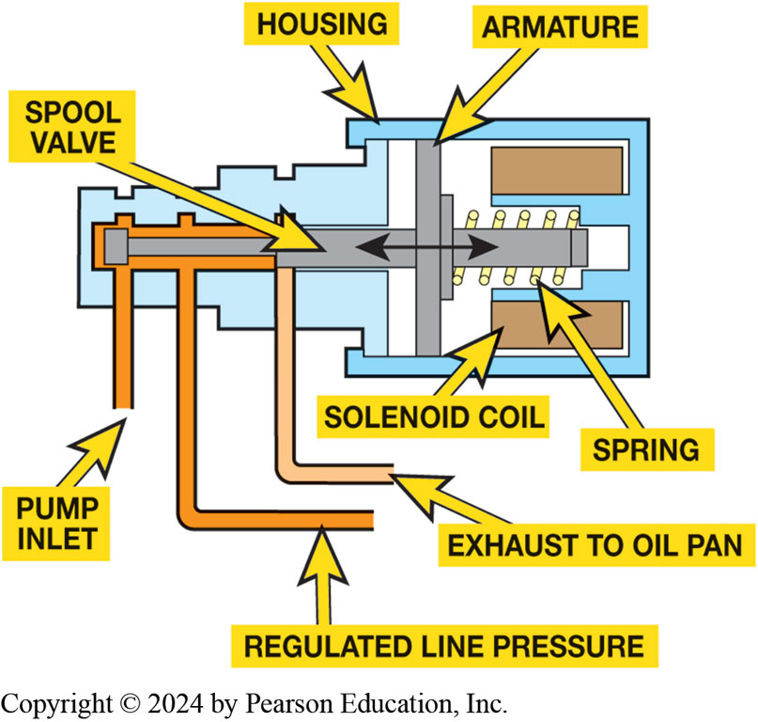
Figure 5.16
Pressure Control Solenoid
Pressure control solenoid controls mainline pressure, which is in turn controlled by the powertrain control module (P C M) or transmission control module (T C M), by applying pressure to spring side of pressure regulator valve
Notes:
Long Description:
The structure is in the shape of a key. The outer covering is called the housing. In the broader part of the structure, a solenoid coil is present on the upper and bottom parts. In between the solenoid coils, a spring is present in a horizontal manner that is connected to the armature perpendicularly. The armature is then connected to the spool valve. The spool valve is then connected and extends to the end of the structure. The right part of the structure has one pipe labeled as pump inlet, another pipe labeled as regulated line pressure, and the third pipe labeled as exhaust to the oil pan.

Slide 36
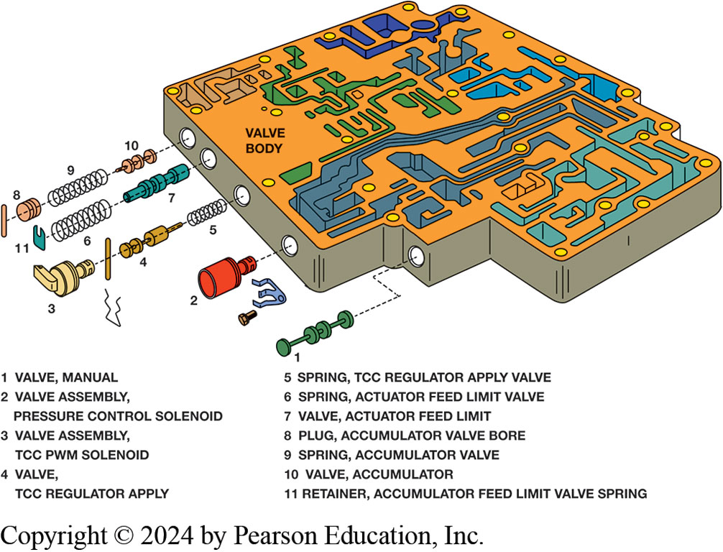
Figure 5.17
Valve Body
A typical valve body showing some of the valves and solenoids as well as the clips and pins used to retain the parts in the valve body.
Notes:
Long Description:
The surface of the valve body has some ridges and holes. The valve body has five openings on the side. The list of valves and solenoids is as follows. 1 valve, manual; 2 valve assembly, pressure control solenoid; 3 valve assembly, T C C P W M solenoid; 4 valve, T C C regulator apply; 5 spring, T C C regulator apply valve; 6 spring, actuator feed limit valve; 7 valve, actuator feed limit; 8 plug, accumulator valve bore; 9 spring, accumulator valve; 10 valve, accumulator; and 11 retainer, accumulator feed limit valve spring. The first opening is for the valve labeled 1. It is shown as small circular discs connected by small bars. The second opening is for the valve labeled 2. It is shown as a spherical cap with a shaft attached. A screw is there nearby along with a clip of three prongs. The third opening is for the solenoid labeled 3 and valves labeled 4 and 5. They are shown as a lever attached to a round structure; a vertical line connected to round discs; and a spring. A bent pin is present nearby. The fourth opening is for the retainer labeled 11, the spring labeled 6, and the valve labeled 7. They are shown as a tag; spring; and a structure of pipes and rings. The fifth opening is for the plug labeled 8, the spring labeled 9, and the valve labeled 10. They are shown as a series of discs; a spring; and a structure of three discs with bars in between.

Slide 37
Animation: Inspect Valve Body (Animation will automatically start)

Slide 38
Animation: Assemble Valve Body (Animation will automatically start)

Slide 39
Animation: Air Test Transmission, No Test Plate (Animation will automatically start)

Slide 40
Animation: Air Test Transmission (Plate) (Animation will automatically start)

Slide 41
Question 1
A duty cycle of 100% means Fill in the Blanks .
A. the solenoid is completely off
B. the solenoid is fully energized on
C. can be either on or off depending on application
D. the solenoid is not being controlled

Slide 42
Answer 1
A duty cycle of 100% means Fill in the Blanks .
B. the solenoid is fully energized on

Slide 43
Summary (1 of 2)
Non-computerized hydraulically-controlled transmissions until the mid to late 1980s used hydraulic system components to determine when to shift.
governor to detect vehicle speed.
throttle cable and valve or vacuum modulator to determine load
Accumulator connected hydraulically absorbs fluid during pressure build- up.
Slowing pressure increase and lengthening time it takes for the friction device to complete the shift
Solenoid electromagnetic switch with movable core.
Used to control flow of A T F through hydraulic circuits.

Slide 44
Summary (2 of 2)
Solenoids used in electronically controlled automatic:
Normally open to allow fluid flow or normally closed to block fluid flow
Shift solenoids control pressure force controls position of shift valve
Commanded on or off by P C M/T C M
Electronics automatic transmission/transaxle regulates hydraulic system pressure using computer-controlled solenoids:
Pressure control solenoid (P C S)
Electronic pressure control (E P C)
Pressure control (P C)
Variable force solenoid (V F S)
Force Motor

Slide 45
Animation: 2-3 Shift Valve (Animation will automatically start)

Slide 46
Animation: 2-3 Shift Valve, Light Throttle Upshift (Animation will automatically start)

Slide 47
Animation: 2-3 Shift Valve, Wide Open Throttle Upshift (Animation will automatically start)

Slide 48
Animation: 2-3 Shift Valve, Coast Downshift (Animation will automatically start)

Slide 49
Animation: 2-3 Shift Valve, Light Throttle Downshift (Animation will automatically start)

Slide 50
Animation: 2-3 Shift Valve, Full Throttle Downshift (Animation will automatically start)

Slide 51
Automatic Transmissions and Transaxles Videos and Animations
Videos Link: (A2) Automatic Transmissions and Transaxles Videos
Animations Link: (A2) Automatic Transmissions and Transaxles Animations

Slide 52
Copyright
This work is protected by United States copyright laws and is provided solely for the use of instructors in teaching their courses and assessing student learning. Dissemination or sale of any part of this work (including on the World Wide Web) will destroy the integrity of the work and is not permitted. The work and materials from it should never be made available to students except by instructors using the accompanying text in their classes. All recipients of this work are expected to abide by these restrictions and to honor the intended pedagogical purposes and the needs of other instructors who rely on these materials.

