Slide 1
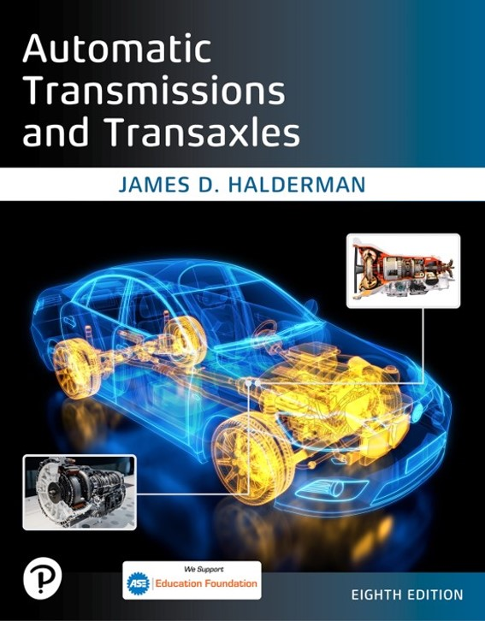
Automatic Transmissions and Transaxles
Eighth Edition
Chapter 4
Automatic Transmission/Transaxle Hydraulic System
Copyright © 2024, 2018, 2015 Pearson Education, Inc. All Rights Reserved
Notes:
If this PowerPoint presentation contains mathematical equations, you may need to check that your computer has the following installed:
1) Math Type Plugin
2) Math Player (free versions available)
3) NVDA Reader (free versions available)
INSTRUCTOR NOTE: This presentation includes text explanation notes, you can use to teach the course. When in SLIDE SHOW mode, you RIGHT CLICK and select SHOW PRESENTER VIEW, to use the notes.

Slide 2
Learning Objectives
4.1 Discuss hydraulic principles and Pascal’s Law.
4.2 Describe the types and operation of automatic transmission/transaxle pumps.
4.3 Explain the different methods for controlling fluid flow and regulating pressure.
4.4 Identify the types of hydraulic seals.

Slide 3
The Hydraulic System
Purpose and Function
Applies clutches, bands to control power flow
Transmits sufficient force and motion
Completely apply control units to prevent slippage
Maintains fluid flow through torque converter for its proper operation
Maintains fluid flow to lubricate and cool moving parts of gear train
Hydraulics; fluid power

Slide 4
Hydraulic Principles (1 of 2)
Pascal’s Law
“When force is applied to a liquid confined in a container or an enclosure, the pressure is transmitted equally and undiminished in every direction.”

Slide 5
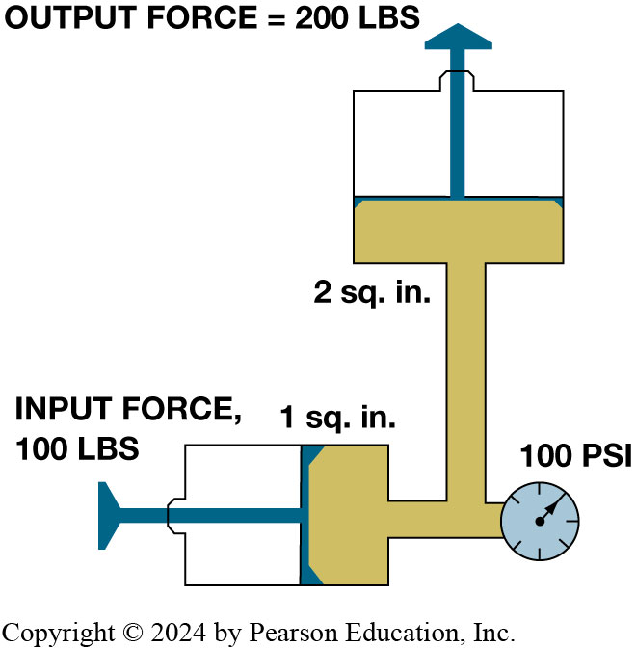
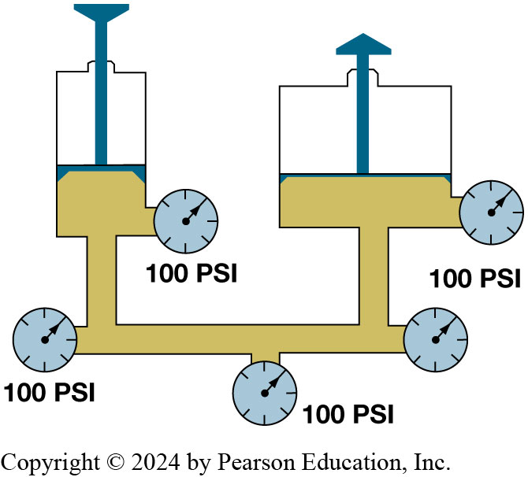
Pascal’s Law
Figure 4.2 A 100 l b force applied on an input piston that has area of 1 s q. i n. will produce a force of 200 L B S when applied to a 2 s q. i n. piston.
Figure 4.1 Fluid pressure is transmitted undiminished in all directions. Note that the pressure is equal throughout the system.
Notes:
Pascal’s Law, formulated by Blaise Pascal (1623–1662), a French mathematician, states: “When force is applied to a liquid confined in a container or an enclosure, the pressure is transmitted equally and undiminished in every direction.” To help understand this principle, assume that a force of 10 l b s is exerted on a piston with a surface area of 1 square inch (s q. in.). Since this force, measured in l b or
Newton (N), is applied to a piston with an area measured in square inches (s q. in.), the pressure is the force divided by the area, that is, “10 pounds per square inch (P S I).” It is this “pressure” that is transmitted, without loss, throughout the hydraulic system. The pressure in a hydraulic system becomes a force to produce work, and the amount of force can be determined by multiplying the area of the output piston by the system pressure. A force of 100 pounds pushing on a piston that has an area of two square inches produces a force of 200 pounds (100 p s i × 2 s q. in.).
Long Description 1:
A narrow container is present with liquid and a piston on top. It has a pressure gauge attached. A broad container is also present with some liquid, a piston, and a pressure gauge. Both containers are joined by a tube that has three pressure gauges: one in the middle and one at each end. All the pressure gauges show a pressure of 100 P S I.
Long Description 2:
A broad container is shown with liquid with a piston of area 2 square inches. It is connected to a narrow container at a perpendicular angle. The piston of the narrow container has an area of 1 square inch. Both containers are connected to a single pressure gauge. The pressure gauge shows a pressure of 100 P S I. The input force in the narrow container is 100 L B S and the output force in the broad container is 200 L B S.

Slide 6
Hydraulic Principles (2 of 2)
Pascal’s Law Formula
(force is equal to pressure x area)
(pressure is equal to force divided by area)
(area is equal to force divided by pressure)
F = force (l b) or (Newton),
P = pressure in pounds per s q. in.
A = area in sq. in. or (s q.c m)

Slide 7
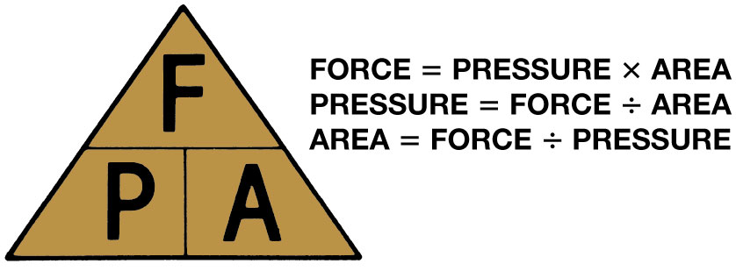
Figure 4.3
A simple memory triangle can be used to help remember the commonly used hydraulic formulas
Notes:
Long Description:
F is written on the top division and P and A on the lower two divisions. Force is equal to pressure times area. Pressure is equal to force divided by area. The area is equal to force divided by pressure.

Slide 8
Pumps (1 of 2)
Pumps produce fluid flow
Restriction to flow results in system pressure
Internal-external gear
Gerotor pump
Vane pump
Figure 4.4 (a) Gear-type pump. (b) Gerotor-type pump. (c) Vane-type pump.
Notes:
Long Description 1:
An opening is shown in the middle of a large disc. The opening has a smaller disc with nine blunt spokes. The spokes fit in the surrounding metal. The middle disc is surrounded by seven holes for screws. The rest of the disc also has some holes for screws and some ridges.
Long Description 2:
A disc has five plates of different sizes in the middle which appear to close an opening. A spring is present close to the middle plates and is called the priming spring. The rest of the disc has ten screws that are bolted down and some ridges.

Slide 9
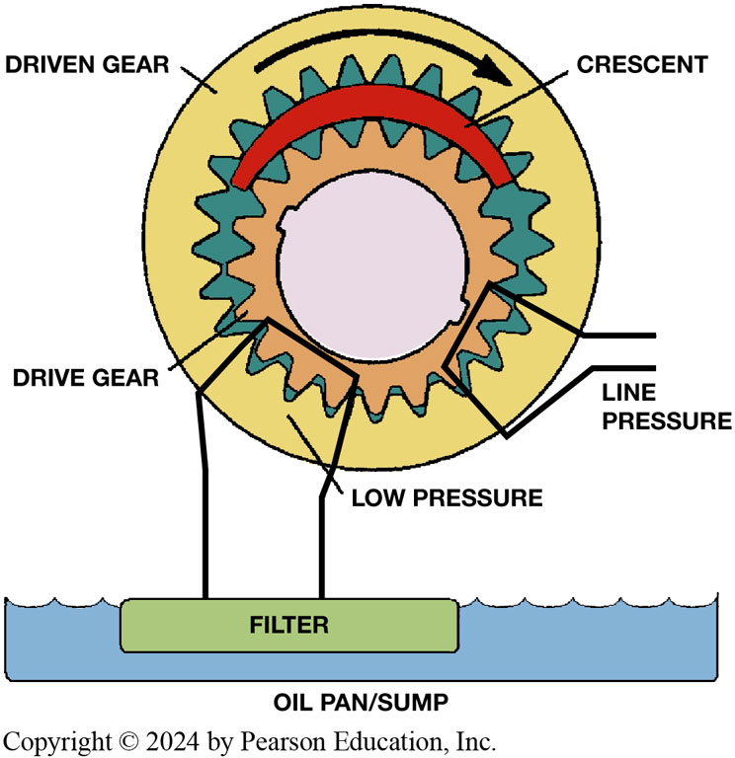
Figure 4.5
Pump Operation
As a pump rotates, a low pressure (vacuum) is created as the pumping members move apart in one area, and atmospheric pressure will force fluid into this area. Pressure created where pumping members move together.
Notes:
Long Description:
A circle is shown with a smaller circle inside in the middle. The inner circle is surrounded by two rounds of drive gear teeth. Above the gear teeth, an arc is present which is labeled as a crescent. An arrow shows the direction of the gears to be clockwise. A folded hook is inserted near the gear teeth and is labeled as line pressure. A blunt hook is inserted at another area near the gear teeth and is attached to a filter present in an oil pan or sump. The area close to the blunt hook is labeled as low pressure.

Slide 10
Animation: Internal-External Gear Pump with Crescent (Animation will automatically start)

Slide 11
Animation: Gerotor Pump (Animation will automatically start)

Slide 12
Pumps (2 of 2)
Fixed Displacement Pumps
Variable Displacement Pumps
Dual-Stage Pumps
Chain-Driven Pumps

Slide 13
Frequently Asked Question: What Is a Front Pump?
? Frequently Asked Question
What Is a Front Pump? The pumps used in automatic transmissions are driven by the torque converter and are located at the front of the transmissions. In the early days of automatic transmissions, manufacturers equipped transmission with a pump that was driven from output shaft and was called the rear pump. The purpose of this pump was to supply fluid under pressure to the governor and fluid circuit when the vehicle was coasting down a hill with the engine at idle speed. It also made it possible to push start the vehicle. When a unit was equipped with a rear pump, it was common terminology to refer to the pump at the front as the “front pump.” This term is still heard today long after the rear pump has been deleted from automatic transmissions.

Slide 14
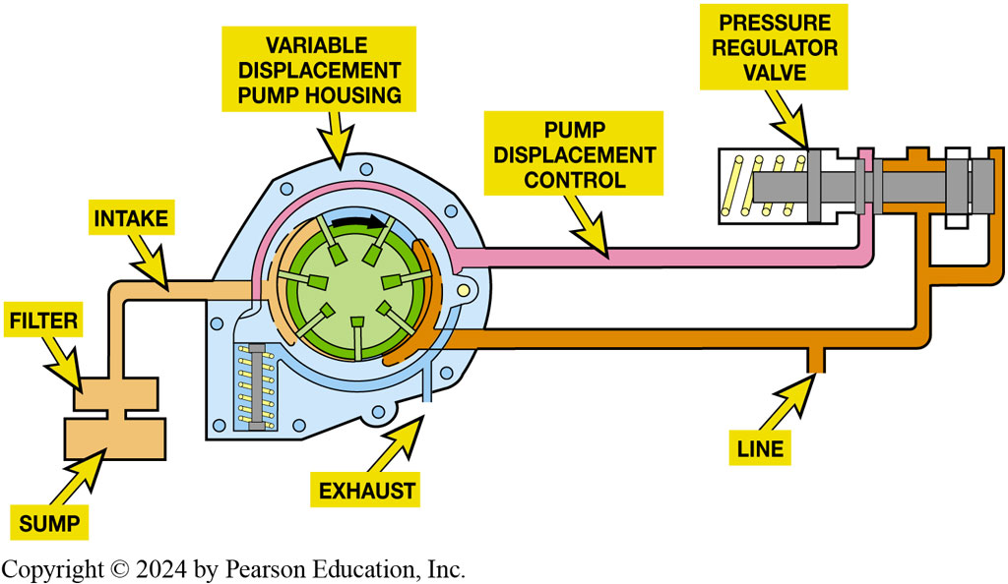
Figure 4.6
Variable displacement vane-type pump. Slide moved to high output position by a spring and decreased pressure comes from the pressure regulator valve
Notes:
Fixed Displacement Pumps
Many automatic transmissions use a fixed-size positive displacement pump. Every revolution of the pump will move the same volume of fluid. The faster the pump turns, the more fluid will be pumped during a given time period. Both the gear pump and the rotor pump are positive displacement pumps.
Variable Displacement Pumps Variable displacement pumps are also positive displacement in that they will pump a certain volume on each revolution, but the displacement, and therefore the fluid volume, can be changed. This is done by moving the vane housing to reduce the size of the pumping chambers. ● Figure 4.6. Variable displacement pumps allow a large output to produce the fluid volume needed for shifts and lubrication and a reduced output when it is not needed. A pressure ds fluid to move the pump slide, and this reduces the offset between the rotor and the pump displacement.
Dual-Stage Pumps Some transmissions use a dual-stage gear pump, which is a combination of two positive displacement pumps. Both pumps supply fluid when demands are high. The output of the second stage pump is released or vented when the primary stage can supply the needed flow and pressure. This system provides the volume of a large displacement pump at low speeds plus the
economy of a small displacement pump at higher, cruising speeds. ● Figure 4.7.
Chain-Driven Pumps Some automatic transaxles, such as the G M 6 T 7 5 and the Ford 6 F 5 0/6 F 55 units use a chain-driven pump. The purpose of using a chain-driven pump is to reduce the overall length of the transaxle. Instead of the pump being driven by the torque converter, the pump is located beside the torque converter and driven by a chain. Figure 4.8.
Long Description:
The variable displacement pump housing is attached to the pump displacement control which is then attached to the pressure regulator valve. An exhaust pipe cones out of the pump housing. Another pipe comes from the pump housing and joins the pressure regulator valve. It leads to another outlet labeled the line. The other end of the pump housing is attached to the intake pipe. The input from the sump crosses a filter to enter the intake pipe.

Slide 15
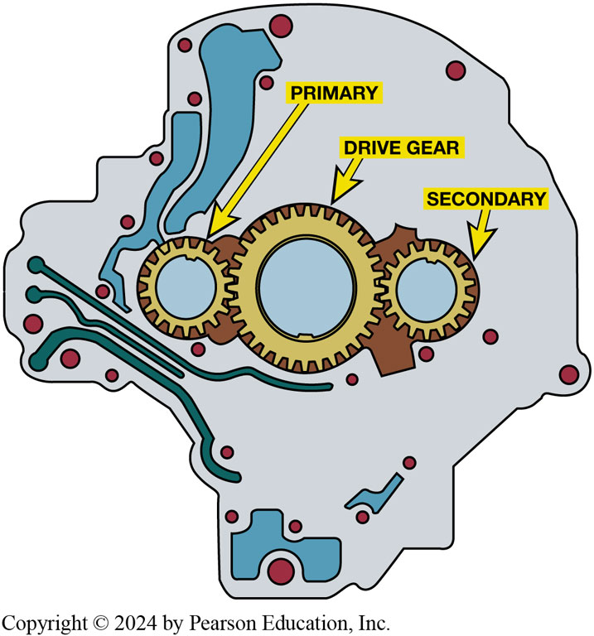
Figure 4.7
Dual-Stage Pump
Dual-stage, external gear pump. Both stages are used at low engine speeds to produce enough fluid for the transmission’s needs. At higher engine speeds, output of the secondary stage is vented.

Slide 16
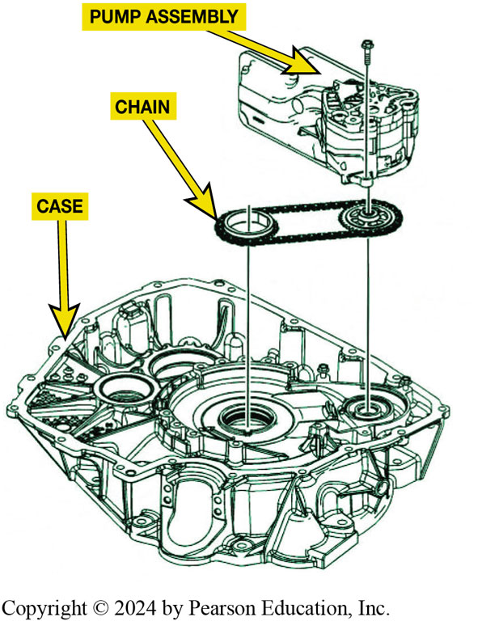
Figure 4.8
Chain-Driven Pump
Chain-driven pump allows transaxle to be shorter compared to a conventional pump that is driven by the torque converter.
Notes:
Long Description:
The case is shown with the pump machinery. The pump assembly is shown on top ready to be attached inside the case. The chain is shown under the pump assembly and is present around two circular discs that fit exactly into the grooves of the machinery inside the case.

Slide 17
Hydraulic Valves
Spool valves
Valve Construction
Valve Hydraulic Forces
The valve area is determined using the formula for the
area of a circle,
Valve Categories
Switch valve
Servo valve
Regulator valve

Slide 18
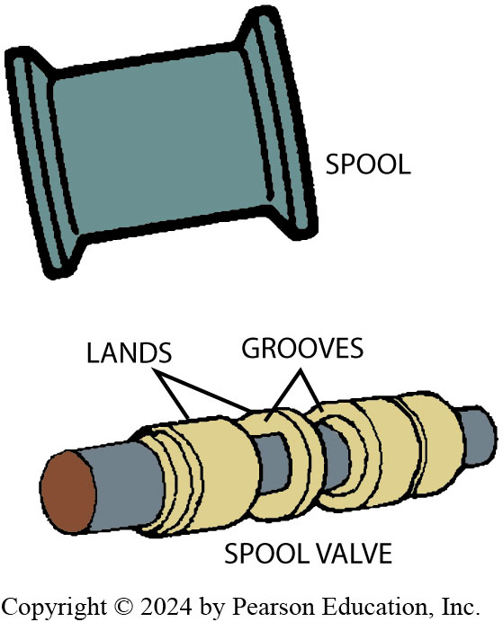
Figure 4.9
A spool valve resembles a spool for thread (top).

Slide 19
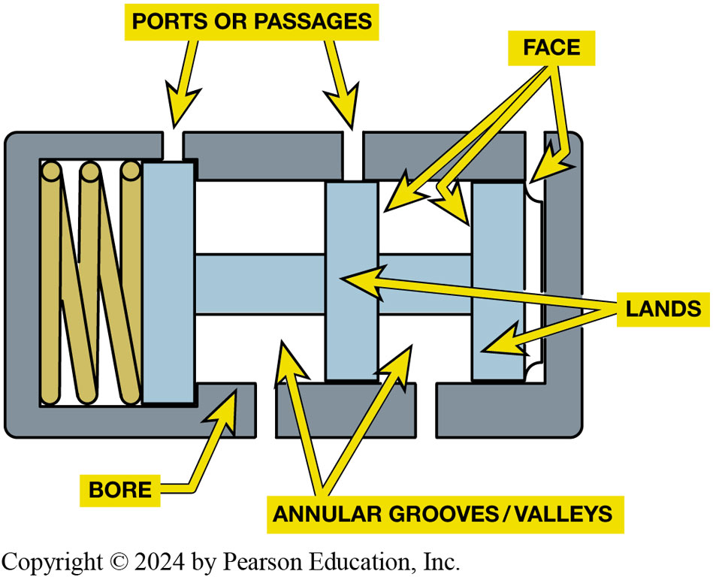
Figure 4.10
A spool valve and its bore. Note the names of the various parts
Notes:
Long Description:
A rectangular structure is shown with three ports on the top and two ports at the bottom. The ports are also called passages. The left part of the image consists of a squeezed spring. There are three parallel bars that represent lands. A horizontal bar is present below the three bars. The bottom gaps between the horizontal and vertical bars are called annular grooves or valleys. The bore is present near the port on the bottom. The two edges of the right top gap are labeled as a face. The narrow space between the border of the structure and the land bar is labeled as a face.

Slide 20
Animation: Shift Valve (Animation will automatically start)

Slide 21
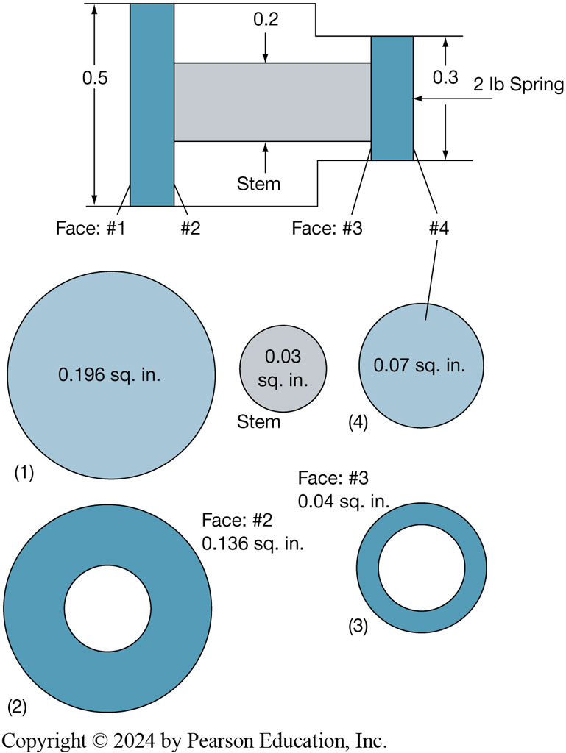
Figure 4.11
Reaction Faces
This valve spool has four possible hydraulic reaction faces. The areas are calculated like those of any other circular surface
using the formula
Notes:
Long Description:
The first part of the image shows the structure of the valve spool. The left part of the valve spool is wide and the right part is narrow. One vertical bar is present in the wide part and one vertical bar is present in the narrow part. The left and right sides of the vertical bar in the wide part are numbered as face hash 1 and hash 2. The left and right sides of the vertical bar in the narrow part are numbered as face hash 3 and hash 4. The width of the wide part is 0.5. The width of the narrow part is 0.3. An arrow labeled 2 l b spring is present pointing towards the vertical bar in the narrow part. Two horizontal lines are present in the middle of the structure. The top line is labeled as 0.2 and the bottom line is labeled as the stem. The second part of the image shows five circles. Two circles of the same diameter are shown and labeled as 1 and 2. The first circle has 0.196 square inches written inside. The second circle has a small empty circle in the middle. Face hash 2 is 0.136 square inches. A small circle is shown which is labeled as the stem. It has 0.03 square inches written inside. Two other medium circles are shown and labeled 3 and 4. One circle is connected to the face hash 4 of the top structure. 0.07 square inches is written inside. The other circle has a smaller empty circle inside it. Face hash 3 is 0.04 square inches.

Slide 22
Valve Body (1 of 2)
Location of Valve Bodies
Functions of a Valve Body
Control fluid pressures
Schedule shifts to optimize engine performance
Safely shift into reverse when requested
Provide driver control of the operating ranges
Provide for proper shift timing

Slide 23
Valve Body (2 of 2)
Provide engine braking to help control vehicle speed on downgrades
Lock or unlock the torque converter clutch
Valve Body Parts
Case side
Separator plate
Valve body side
Valves and circuits

Slide 24
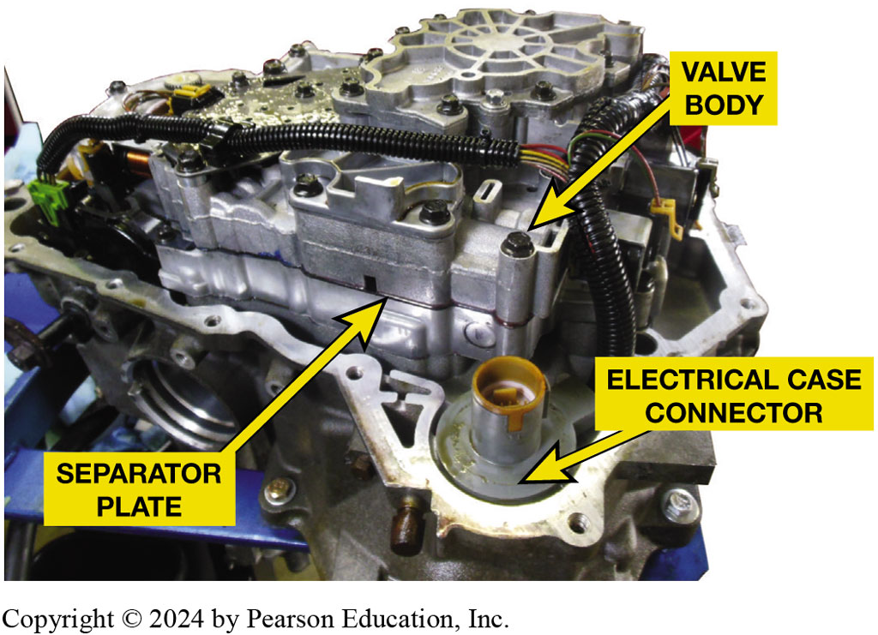
Figure 4.12
Typical Valve Body
A typical valve body as installed on a G M 4T65-E transaxle
Notes:
Long Description:
The electrical case connector is present at the corner of the assembly. The valve body is present close to the electrical case connector. The separator plate is present near the valve body. A bunch of wires is encased in a protective case and runs all around the assembly.

Slide 25
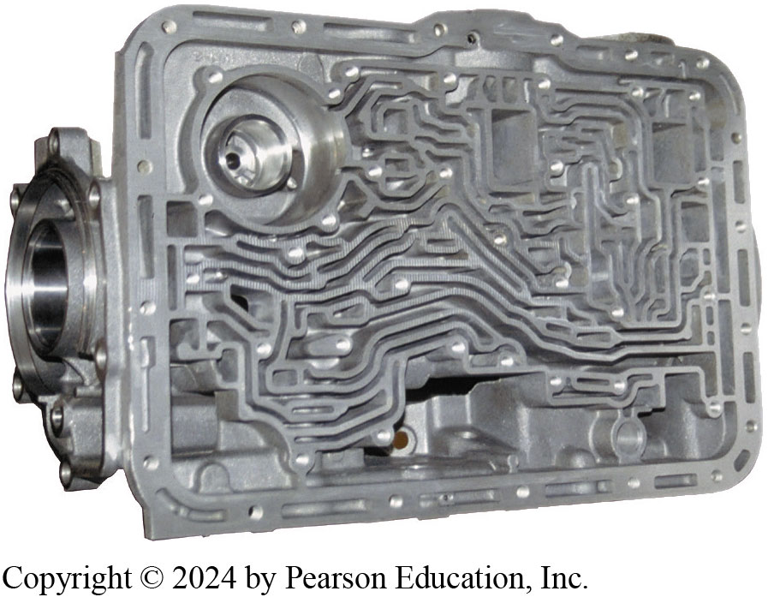
Figure 4.13
Valve Body Passages
A typical upper valve body showing the fluid passages (“worm holes”).

Slide 26
Animation: Inspect Valve Body (Animation will automatically start)

Slide 27
Pressure Regulation
Pressure Regulator Valve, Figure 4.14
Exhaust
Pressure relief valve
Typical Pressures
Normal line pressure
Wide open throttle
Reverse or manual low
Notes:
The term exhaust refers to fluid flow back to the pan to empty or drain a circuit. The exhaust port provides a low-pressure path to the transmission oil pan (sump) where excess A T F is stored. Excess pressurized fluid flowing through this port reduces system pressure. When hydraulic pressure drops below spring pressure, the regulator valve closes the port and pressure begins to build up again. In operation, the opening and closing of the exhaust port occurs many times per second. This sequence of events achieves a steady pressure as the valve balances both the spring pressure and the hydraulic pressure. Because of this action, this type of valve is sometimes called a balance valve.

Slide 28
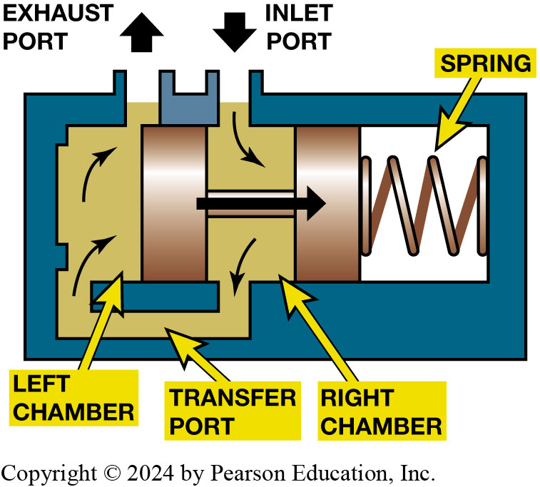
Figure 4.14
Pressure Regulator
Then pressure on the face of the pressure regulator valve overcomes spring force, the valve moves to open the exhaust port.
Notes:
Long Description:
A rectangular structure is shown with two ports or openings on the top of the structure. The left is the exhaust port and the right is the inlet port. A spring is present inside the structure on the right. Two vertical bars are present inside the structure. One bar is present between the ports and the other is adjacent to the spring. The first bar is situated on a base plate and partially divides the space into the left chamber and right chamber. The lower part of the chamber is not divided and is called the transfer port. The left chamber has two upward curving arrows. A horizontal bar is present with connects the two vertical bars. An arrow is present from the left bar to the right bar towards the spring.

Slide 29
Figure 4.15
Typical pressure relief valves as found in the pump circuit.
Notes:
In addition to the pressure regulator, some transmissions use a pressure relief valve to release excess pressure that might occur under certain operating conditions. Figure 4.15.
Long Description:
A torque converter assembly is shown at the top at one end. Two pipes come out of the torque converter assembly. Both pipes are shaped like the letter C. one is labeled as T C QTcB release and the other is labeled as T C C apply. Both these pipes show dots inside. The T C C release pipe also has another opening into the release blow-off. The release blow-off contains a spring and a round solid structure. A pressure relief valve is present on the top part of the blow-off and leads to the exhaust. A cooler is shown below the torque converter assembly. A circular opening is seen on the top of the cooler. The cooler also has openings for cooler F D and lube. The cooler F D pipe is also shaped like the letter C. Both the cooler F D and lube pipes show dots inside. The line overpressure blow-off is present parallel to the release blow-off. It gets input from a pipe that is shaded in solid color and has small arrowheads that show the direction of the flow of liquid. The line pipe comes from the fluid pump. The line pipe is divided into two before coming into the line overpressure blow-off. The line overpressure blow-off contains a spring and a round solid structure. A pressure relief valve is present on the top part of the blow-off and leads to the exhaust. The fluid pump has a central circle with six spokes surrounding a central small circle. A small arrow is present on the right side of the inner small circle. The rim of the outer circle is divided into two parts. One has solid color and the other is filled with cross lines. The solid color part is connected to the line pipe which connects to the line overpressure blow-off. The part with cross lines connects to a pipe labeled suction. This pipe comes from the sump through a filter and into the fluid pump. There are small arrowheads that indicate the direction of fluid inside this pipe. Around the outer circle, there is another circular structure that is connected to a spring. Outside the spring, another circular pipe is present which is labeled as decrease. The pipe divides into one opening close to the fluid pump which is labeled exhaust. The pipe then continues and divides into two parts. One part goes to another exhaust and the other is labeled decrease and goes right. This pipe is filled with cross lines. The title of the image is fluid pressures and the legend shows that dotted filling of pipes refers to converter and lube, and cross lines inside pipes refer to suction.

Slide 30
Frequently Asked Question: Start-Stop Operation
? Frequently Asked Question
How Is Pressure Maintained in the Automatic Transmission During Stop-Start Operation? Many newer non-hybrid vehicles are equipped with a stop-start system. In these vehicles, engine stops running when vehicle is stopped and restarts when driver releases the brake. Most of these vehicles use a an enhanced starter motor that is engineered to provide over 50,000 starts compared to a normal starter motor that is designed to provide only 5,000 engine starts during its life. When the engine stops, the hydraulic pump inside the transmission/transaxle also stops and pressure would drop preventing the clutches from holding. Some non-hybrid automatic transmissions/transaxles, such as the G M 4T45-E use an auxiliary electric driven pump to maintain line pressure when the engine stops during a stop-start event. SEE Figure 4.16

Slide 31
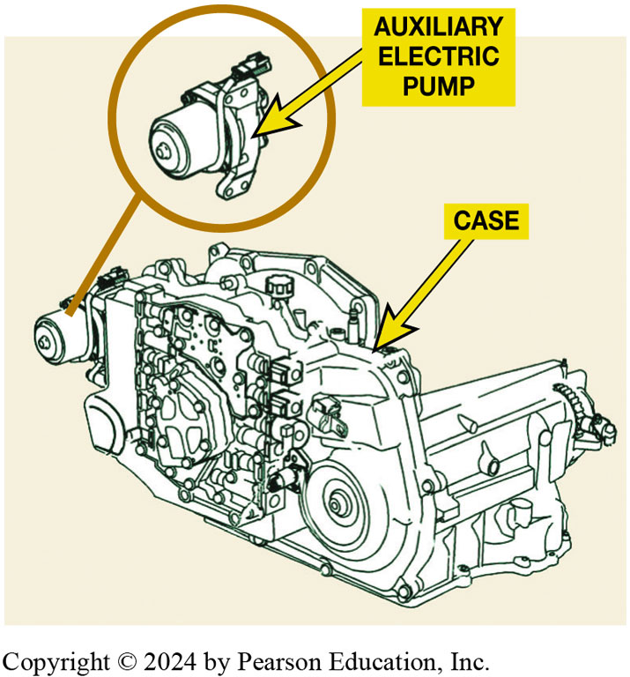
Figure 4.16
Electric Pump
A G M 4T45-E uses an auxiliary electric pump to maintain hydraulic pressure when engine stops during a stop-start event.
Notes:
How Is Pressure Maintained in the Automatic Transmission During Stop-Start Operation? Many newer non-hybrid vehicles are equipped with a stop-start system. In these vehicles, the engine stops running when the vehicle is stopped and restarts when the driver releases the brake. Most of these vehicles use a an enhanced starter motor that is engineered to provide over 50,000 starts compared to a normal starter motor that is designed to provide only 5,000 engine starts during its life. When the engine stops, the hydraulic pump inside the transmission/transaxle also stops and pressure would drop preventing the clutches from holding. Some non-hybrid automatic transmissions/transaxles, such as the G M 4 T 4 5-E use an auxiliary electric driven pump to maintain line pressure when the engine stops during a stop-start event. See Figure 4.16
Long Description:
The corner of the engine is labeled as an auxiliary electric pump. The case of the engine is labeled. The auxiliary pump is shown in a close-up picture. The front portion of the pump protrudes and has a circular opening. The back portion of the pump is covered with a strip. It also has a small tube connected to a small part on the top of the pump.

Slide 32
Manual Valve
Operation
Rooster comb
What is a Shift-By-Wire System?

Slide 33
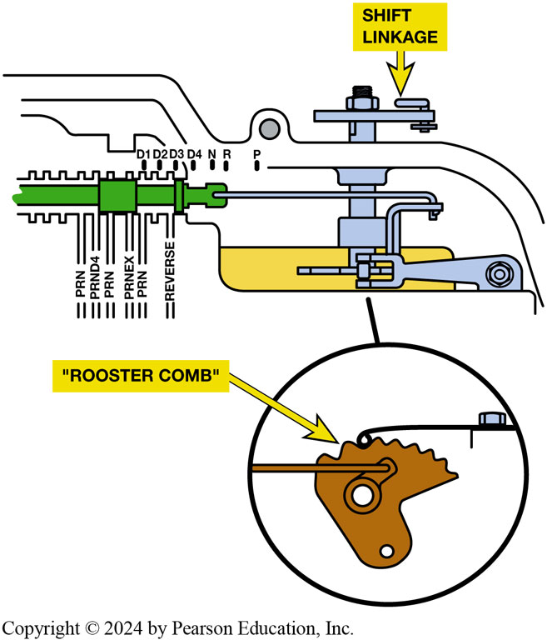
Figure 4.17
Rooster Comb
Rooster comb is detent that helps retain the manual positions in valve body.
Notes:
Long Description:
There are two parts to the image. The first part contains the valve body. A long shaft is present on the left side of the valve body. It has a square-shaped slider on the top along with a vertical narrow strip on the top. The shaft is surrounded by a line with dents. The dents are labeled as P R N, P R N D 4, P R N, P R N E X, P R N, and reverse. The shaft is connected to a narrow tube that connects to the valve mechanism. The outer surface of the machine has a shaft with a crossbar and a bolt. It is labeled as shift linkage. The rooster comb is shown in a close-up photo. The rooster comb has about 8 protruding ridges on the top. The comb is shaped like a foot with a hole in the middle. The hole is surrounded by a bolt that is connected to a tube.

Slide 34
Animation: Manual Valve (Animation will automatically start)

Slide 35
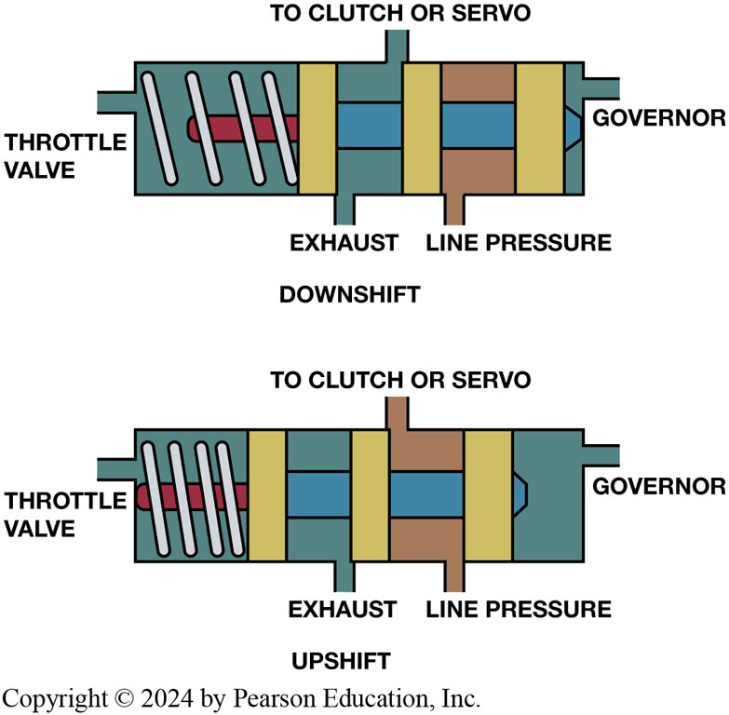
Figure 4.18
Shift Valve
A typical shift valve has a spring to move the valve to a downshift position where the throttle pressure works with this spring. When governor pressure gets high enough, the valve will move to an upshift position.
Notes:
Long Description:
In the downshift position, a rectangular structure is shown, with two openings on the bottom, one on the top, one on the left, and one on the right. The left opening is labeled as the throttle valve. The right opening is labeled as governor. The top opening is labeled as to clutch or servo. The bottom left opening is labeled as exhaust and the bottom right opening is labeled as line pressure. Three vertical bars are present, one on the left of the exhaust outlet, one on the left of the line pressure outlet, and one near the governor outlet. A spring is present between the first bar and the border of the structure. A narrow horizontal bar extends from the left middle of the vertical bar halfway to the throttle valve. A broad horizontal bar extends from the other side of the vertical bar all the way to the governor outlet. In the upshift position, the narrow horizontal bar extends all the way to the throttle valve. The broader horizontal bar extends halfway to the governor outlet. The positions of the vertical bars are different from the downshift position. The first bar is closer to the throttle valve, the second bar is on the right of the exhaust outlet, and the third is on the right of the line pressure outlet.

Slide 36
Frequently Asked Question: What Is a Shift-By-Wire System?
? Frequently Asked Question
What is a Shift-By-Wire System? Many newer vehicles now use an electronic shifter that controls manual valve using an electronic actuator or by using electric motor to drive gears to rotate manual valve instead of a lever control with mechanical linkage to transmission. SEE FIGURE 4.19. This design, called shift-by-wire, allows for effortless shifting between drive, park, neutral and reverse, completely eliminates any wear-and- tear that used to occur in mechanical connection between shifter and transmission. The control uses one of the following to control shifter: Push buttons, Rotary knob, SEE FIGURE 4.20. Smaller than normal (mini) shifter. Electric knob or dial and electronic controller are used to control actuator in or on transmission/transaxle. The knob-control electronic module is about size of a fist rather than shoe-box-size space required for a lever control assembly. This space saving allows room for more storage space in the interior console.

Slide 37
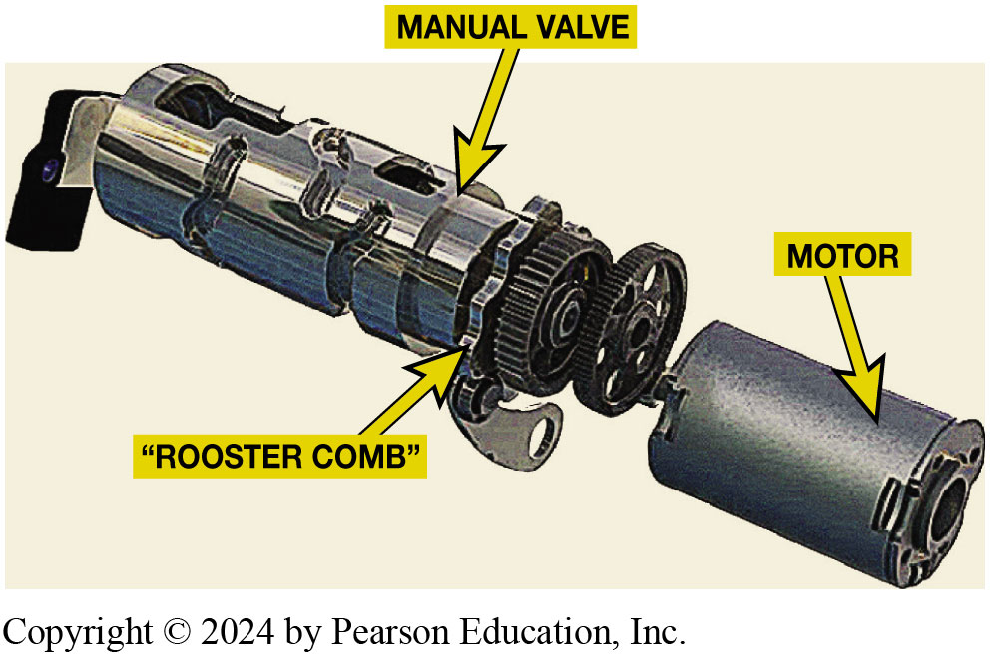
Figure 4.19
P R N D L Actuator
Some transmissions, such as this V W/Audi unit use an electric motor to move the manual valve inside the transaxles itself. Other vehicles use an external actuator to move manual valve. Check service information for the exact method used on vehicle being serviced.
Notes:
Long Description:
A manual valve is present with a rooster comb at one end. It has a circular mechanism at one end which matches the circular extension of the motor. The manual value and motor are seen parallel to each other. The motor has a circular groove in the middle and a smooth surface. The surface of the manual valve has many ridges.

Slide 38
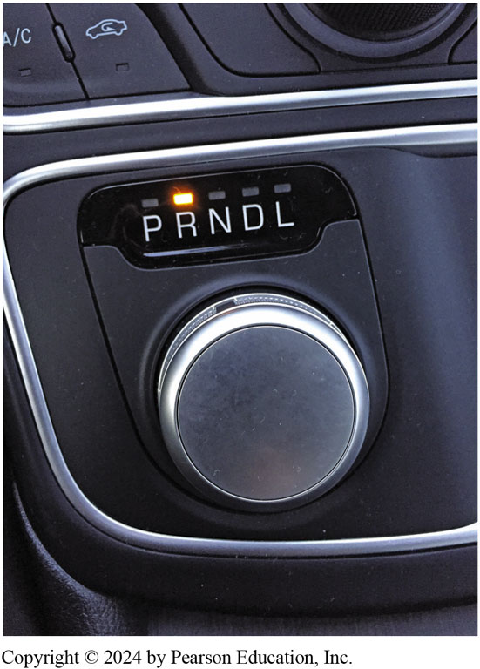
Figure 4.20
P R N D L Knob A rotary knob type electronic shifter used on a Chrysler 200
Notes:
Long Description:
A circular knob is shown with the words P, R, N, D, and L above it on the dashboard. Each of these letters has a small light above them. The light above the letter R is shown to be switched on. In a panel above the knob, a small inbuilt switch is present with the words A slash C on the left side and an outline of a car on the right side. Inside the car, there is a curved arrow which is in the form of the letter C. There is a single light indicator for both of these options.

Slide 39
Hydraulic Seals
Seals are used to confine the fluid to the appropriate passages.
Static and dynamic
Sealing rings
Used to seal fluid passages where fluid
Leaves stationary member and transfers to a rotating member

Slide 40
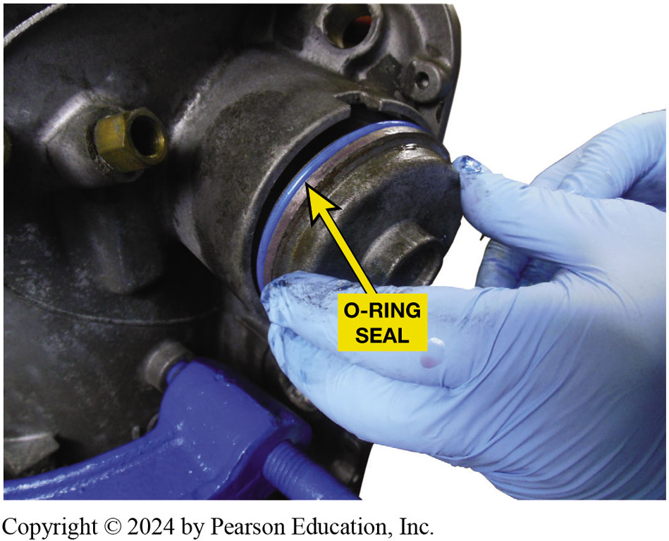
Figure 4.21
O-Ring Seal
A new O-ring seal being installed on a cover.

Slide 41
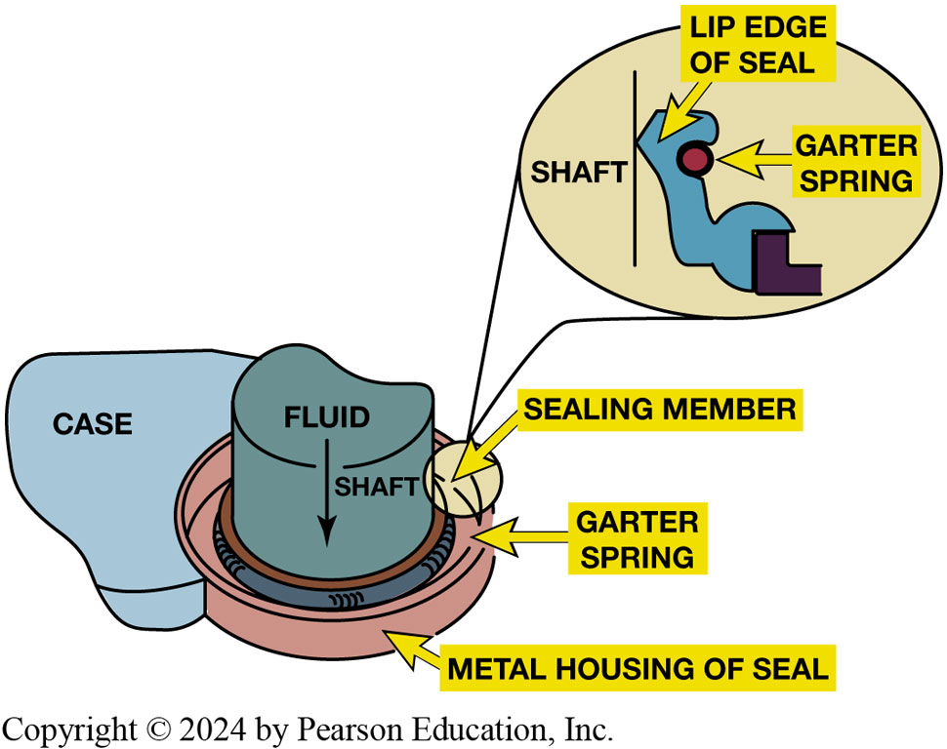
Figure 4.22
Lip Seal
Sealing member of metal-clad lip seal makes a dynamic seal with the rotating shaft while the metal case forms a static seal with the transmission case.
Notes:
Long Description:
The metal housing of the seal is shown at the bottom. The case is attached to it on one side. The garter spring is present inside the metal housing. The sealing member is present on top of the garter spring. The shaft is present on top of the sealing member. On top of the shaft, the word fluid is written with a downward arrow. A close-up picture reveals that the lip edge of the seal is in contact with the shaft. The garter spring is shown as a small round opposite the shaft.

Slide 42
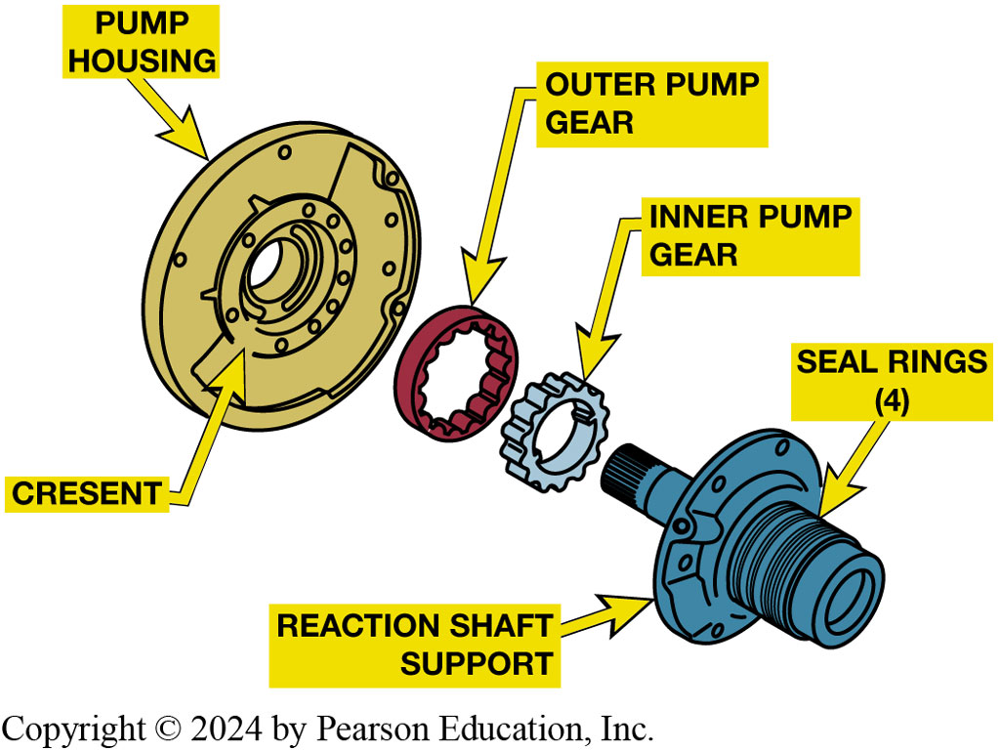
Figure 4.23
Rotating Sealing Rings
Sealing rings are used to seal the passages between stationary and rotating members. For example, the seal rings at the right keep the fluid flow from the pump to the front clutch from escaping.
Notes:
Sealing Rings
Another type of seal are sealing rings used to seal the fluid passages where fluid leaves a stationary member and transfers to a rotating member. ● See Figure 4.23. This seal is a metal, plastic, or Teflon ring that fits tight in its bore to make a seal while the side seals against the side of its groove. ● See Figure 4.24. A seal with a small leak is sometimes desirable to lubricate a bearing area close to the sealing ring. Metal and plastic sealing rings can be a full-circle, hook ring, or a butt-cut ring with a small gap. Teflon rings can be scarf cut (have the ends cut at an angle so they overlap), butt cut, or uncut. ● See Figure 4.25.
Long Description:
The pump housing is present with a crescent in the center. The outer pump gear is present next to the pump housing. The inner pump gear is present next to the outer pump gear. The reaction shaft is present adjacent to the inner pump gear. The reaction shaft has a reaction shaft support and also has four seal rings. The four elements are present parallel to each other.

Slide 43
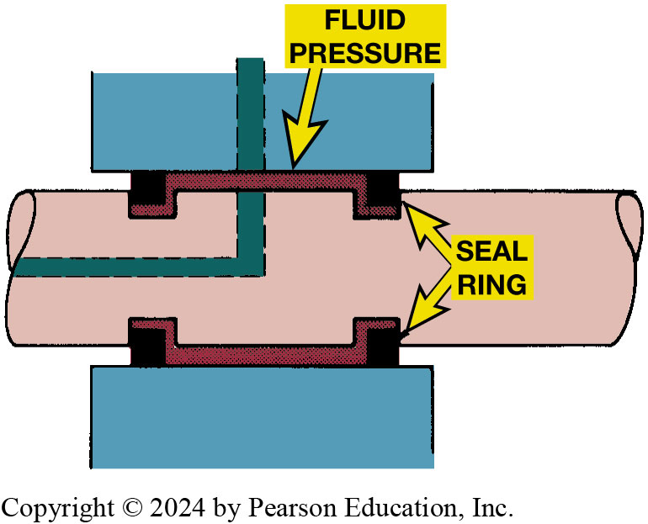
Figure 4.24
Fluid Pressure
Fluid pressure forces a sealing ring outward in both directions to make firm contact with the side of the groove and outer diameter of the bore.
Notes:
Long Description:
The bore has four grooves, two on each side. Each side of the bore has one seal ring. The seal rings are present inside the grooves of the bore. Fluid is present in a container on both sides of the bore adjacent to the seal. A long bar starts from the top fluid container and turns leftward into the bore to the edge of the bore.

Slide 44
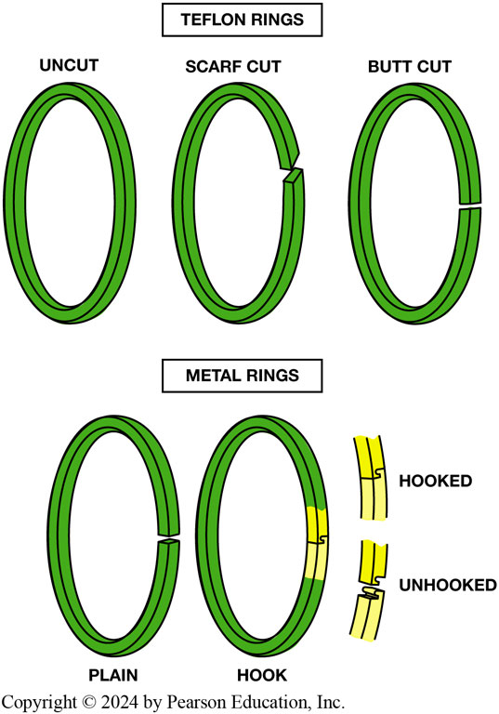
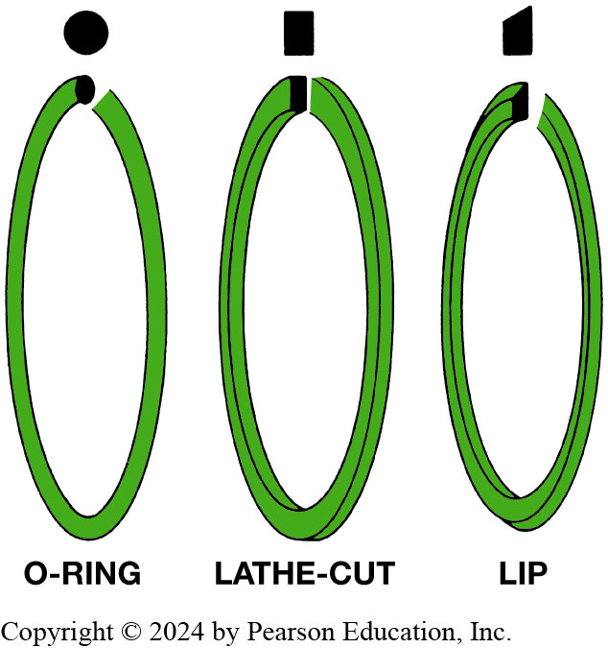
Sealing Rings
Figure 4.25 Metal seal rings (bottom) have plain or hooked ends. Teflon rings (top) are either uncut, scarf cut, or butt cut.
Figure 4.26 Clutch and servo piston seals are usually O-rings, lathe-cut rings, or lip seals
Notes:
Long Description 1:
The first ring is uncut, the second ring is scarf cut where the ends are cut at an angle, and the third ring is butt cut where a small gap is created with the cut. Under metal rings, the first is plain which has a gap larger than the butt cut. The second is the hook type where the ends are cut in a particular pattern and can be hooked to each other again. The difference between hooked and unhooked is shown in the adjoining picture. When the ends are hooked, the ring appears to be complete. When the ends are unhooked, the two edges show the grooves needed for hooking.
Long Description 2:
The first is the O-ring where the cut face of the ring shows a circle. The second is the lathe-cut type where the cut face of the ring shows a rectangle. The third is the lip-type where the cut face of the ring shows a rectangle with a slanting top line.

Slide 45
Question 1
Fluid pressure is maintained in a transmission using the Stop-Start system using which of these?
A. Gear driven pump
B. Chain driven pump
C. Electric pump
D. Rear pump assembly

Slide 46
Answer 1
Fluid pressure is maintained in a transmission using the Stop-Start system using which of these?
C. Electric pump

Slide 47
Summary (1 of 2)
Hydraulic system applies the band and clutches
Transmits force and motion, maintains fluid flow
Provides lubrication and cooling to the moving parts of transmission.
Pumps produce fluid flow in a transmission
Restriction to the flow results in the system pressure.

Slide 48
Summary (2 of 2)
Mainline pressure is controlled by a variable pressure regulator.
Seals are used to confine the fluid to the appropriate passages.
Only the specified fluid should be used.

Slide 49
Automatic Transmissions and Transaxles Videos and Animations
Videos Link: (A2) Automatic Transmissions and Transaxles Videos
Animations Link: (A2) Automatic Transmissions and Transaxles Animations

Slide 50
Copyright
This work is protected by United States copyright laws and is provided solely for the use of instructors in teaching their courses and assessing student learning. Dissemination or sale of any part of this work (including on the World Wide Web) will destroy the integrity of the work and is not permitted. The work and materials from it should never be made available to students except by instructors using the accompanying text in their classes. All recipients of this work are expected to abide by these restrictions and to honor the intended pedagogical purposes and the needs of other instructors who rely on these materials.

