Slide 1
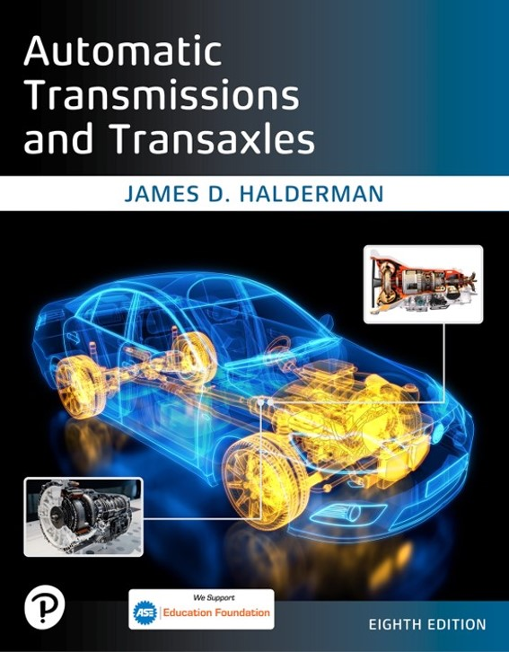
Automatic Transmissions and Transaxles
Eighth Edition
Chapter 3
Automatic Transmission Fluid, Filters, and Coolers
Copyright © 2024, 2018, 2015 Pearson Education, Inc. All Rights Reserved
Notes:
If this PowerPoint presentation contains mathematical equations, you may need to check that your computer has the following installed:
1) Math Type Plugin
2) Math Player (free versions available)
3) NVDA Reader (free versions available)
INSTRUCTOR NOTE: This presentation includes text explanation notes, you can use to teach the course. When in SLIDE SHOW mode, you RIGHT CLICK and select SHOW PRESENTER VIEW, to use the notes.

Slide 2
Learning Objectives
3.1 Discuss the specifications and types of automatic transmission fluids (A T F s).
3.2 Discuss A T F filters, heaters, and coolers

Slide 3
Automatic Transmission Fluid (1 of 4)
A T F is one of most complex fluids used. It has to:
Transfers power in torque converters
Provides hydraulic pressure in clutches and band servos
Lubricates bearings, bushings, and gears
Transfers heat to cool transmission parts

Slide 4
Automatic Transmission Fluid (2 of 4)
Provides correct friction for clutch and band application
Acts as medium to control transmission shifting
Acting on valves, and being directed by solenoids
Background
Additives
Detergents-dispersants
Oxidation inhibitors

Slide 5
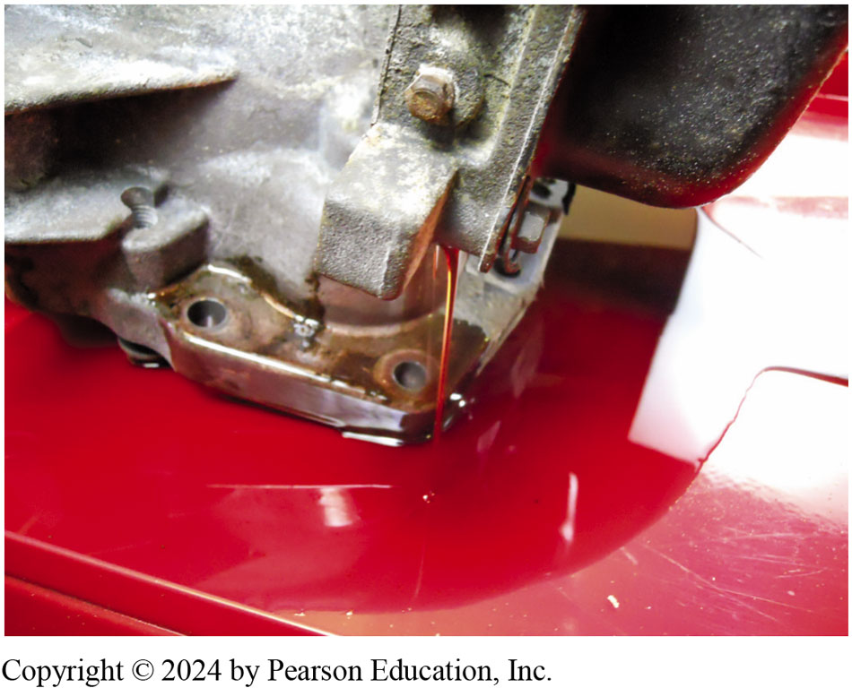
Figure 3.1
Draining Transmission
A T F being drained from a recycling center automatic transmission in this unit being used for training.
Notes:
Additives Transmission fluid is formulated with various additives to produce favorable operating
characteristics. Automatic transmission fluid contains about 10% to 15% additives. These additives
are chemical compounds, and the reasons for their use are as follows:
■ Detergents-dispersants. Keep the transmission clean and the valves free from sticking by keeping
foreign items in suspension until they are removed by the filter or by draining.
■ Oxidation inhibitors. Reduce oxidation and decomposition of the fluid, which can produce varnish
and sludge.
■ Viscosity index improvers. Changes viscosity with change in temperature so that fluid thickness and shift characteristics remain stable during a range of changing temperatures.
■ Friction modifiers. Changes the fluid’s coefficient of friction.
■ Foam inhibitors. Prevent formation of air bubbles and foam in the fluid.
■ Seal swelling agents. Produce a slight swelling of the elastomers (seals) to compensate for any wear that occurs.
■ Anti-wear agents. Reduce friction and prevent scoring and seizure of metal parts against each other.
■ Rust inhibitors. Prevent rust from forming on the iron and steel parts.
■ Corrosion inhibitors. Prevent corrosion of the nonferrous parts.
■ Metal deactivators. Form a protective film to inhibit oxidation of metal surfaces.
■ Dye. Dye is added to make A T F red. ● See Figure 3.1.
American Petroleum Institute, oils are classified into the following groups:
Group I—Solvent refined mineral oil with few, if any, additives. Not used in current formulations of A T F.
Group II—Mineral oil with quality additive packages; includes most friction-modified fluids.
Group III—Hydrogenated (hydroisomerized) synthetic compounds, commonly referred to as hydrowaxes
or hydrocracked oil and is considered to be synthetic. Most “fill-for life” A T F is made from Group
III base stock.
Group IV—Synthetic oils made from monomolecular oil are called polyalpholefin (P O A) and include Mobil 1 A T F.
Group V—Synthetic oils made from non-mineral sources such as alcohol from corn, called diesters or polyolesters and includes Red Line and Royal Purple A T F.
Groups III, IV, and V are considered to be synthetic because the molecular structure of finished product does not occur naturally, but is man-made through chemical processes.

Slide 6
Animation: Transmission Fluid Exchange (Animation will automatically start)

Slide 7
Automatic Transmission Fluid (3 of 4)
Viscosity index improvers
Friction modifiers.
Foam inhibitors
Seal swelling agents
Anti-wear agents
Rust inhibitors
Corrosion inhibitors
Metal deactivators
Dye

Slide 8
Automatic Transmission Fluid (4 of 4)
Types
Non-friction modified
Friction modified
Highly friction modified
Synthetic A T F
Group

Slide 9
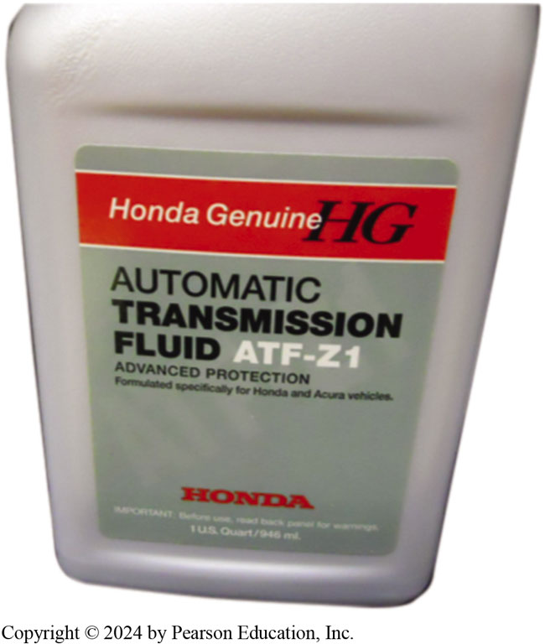
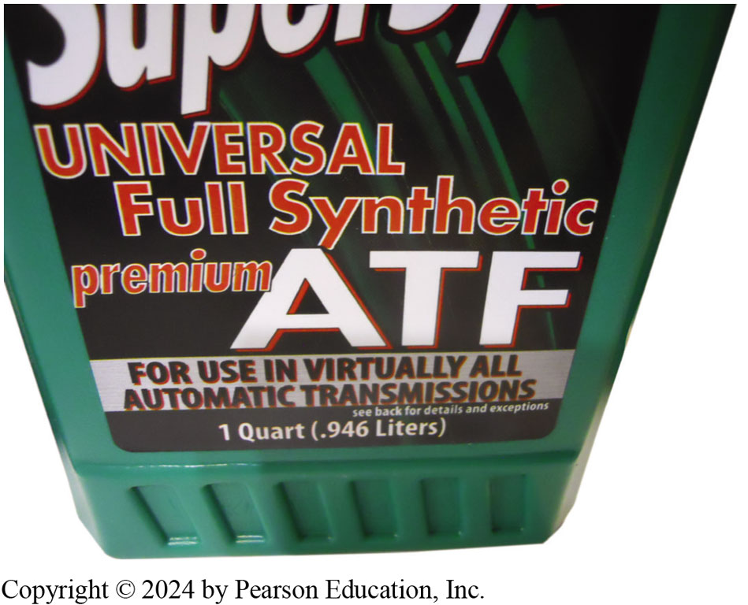
Automatic Transmission Fluid (A T F)
Figure 3.3 Multi-vehicle, or universal fluid, is designed to meet specifications of many types of fluids, making it popular with independent shops that service many makes and models of vehicles
Figure 3.2 Use of factory-specific fluid is the recommend fluid to insure the best possible shifting and operation
Notes:
Long Description:
The name of the company is Honda Genuine with the logo as capital H G. The details on the can are advanced protection, formulated specifically for Honda and Acura vehicles. The logo of Honda is written at the bottom of the front of the can.

Slide 10
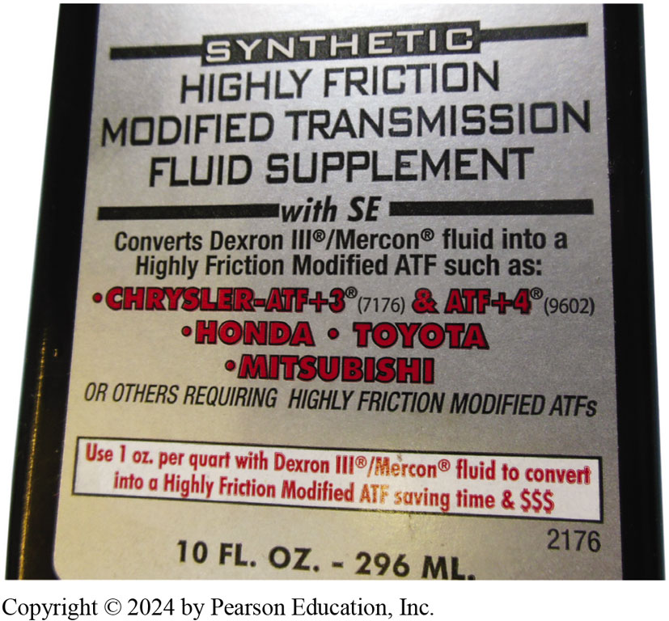
Figure 3.4
Friction-Modified A T F
Aftermarket additives are available that can convert friction-modified A T F into highly friction-modified A T F.
Notes:
Long Description:
The text reads as synthetic highly friction modified transmission fluid supplement with S E. Converts Dexron III slash Mercon fluid into a highly friction modified AT F such as Chrysler-A T F + 3 (7176) ampersand A T F +4 (9602), Honda, Toyota, Mitsubishi, or others requiring highly friction modified ATFs. Use 1 o z. per quart with Dexron III slash Mercon fluid to convert into a highly friction modified A T F saving time and dollars. 10 f l. O z. hyphen 296 milliliters.

Slide 11
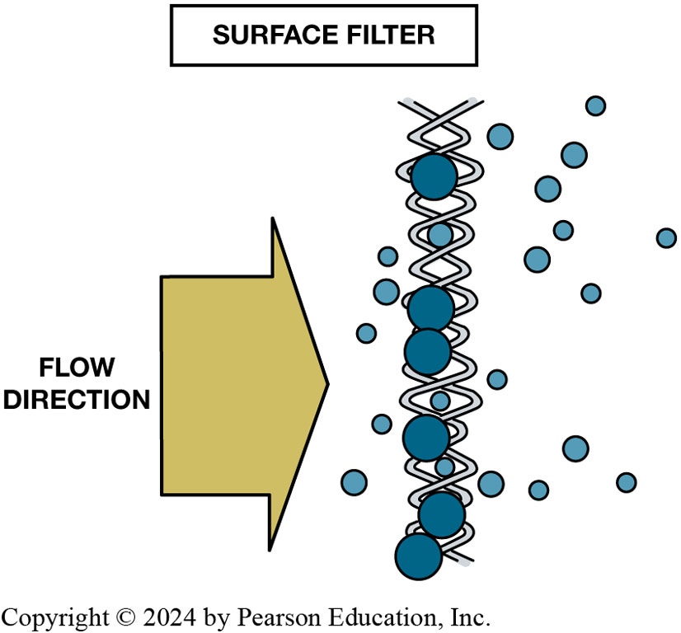
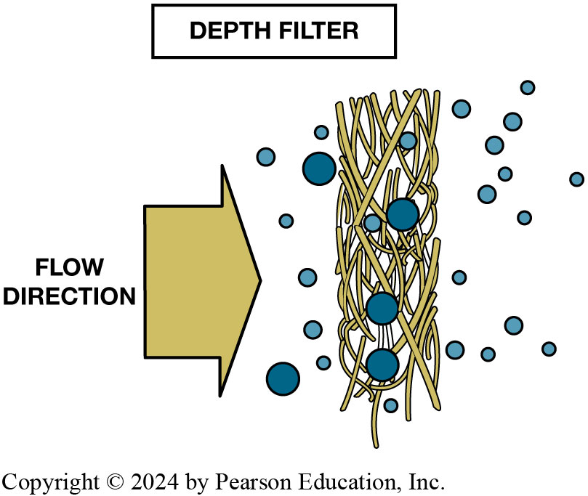
Filters: Surface & Depth Types
Figure 3.5 A surface filter traps particles that are too big to pass through the openings in the screen.
Figure 3.7 Depth filter is group of woven fibers of certain thickness. Foreign particles are trapped at different levels as they try to flow through.

Slide 12
A T F Heaters and Coolers (1 of 2)
Transmissions are expected to perform over a wide range of temperatures.
Excess heat significantly shortens life of A T F
Cooler oil flow begins as soon as pump begins to rotate.
Fluid leaving torque converter is routed out of the transmission case and through a steel line to transmission cooler.

Slide 13
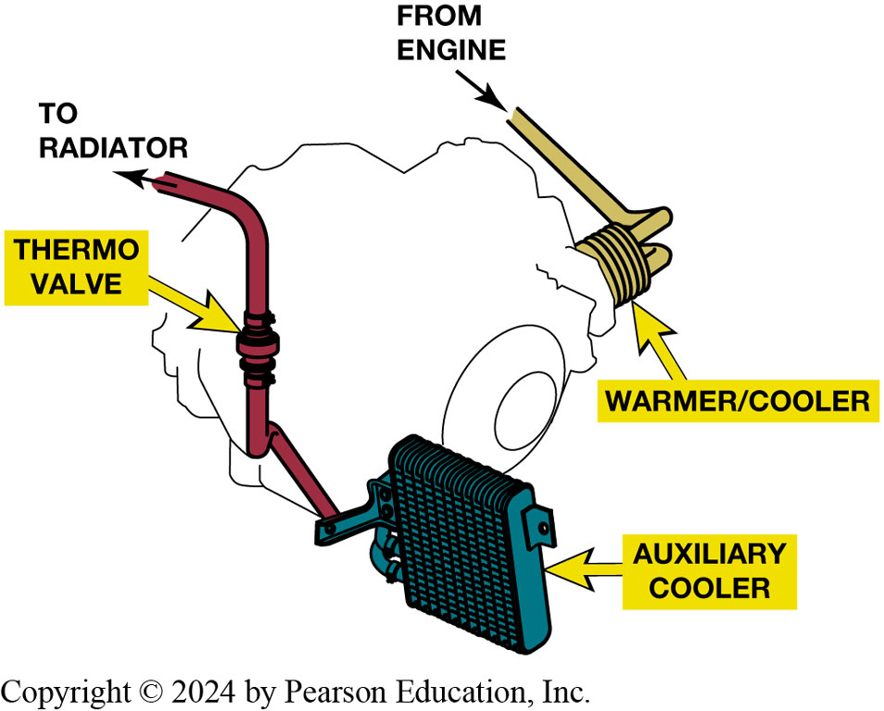
Figure 3.8
Transmission Cooler
Notes:
Figure 3.8 Engine coolant from the engine block flows through the passages in the warmer/cooler,
and then out through the thermostatic valve to the upper radiator tank. The thermostatic valve uses a wax element–type valve to control the flow of engine coolant through the case-mounted cooler/warmer. The thermostatic valve improves the A T F warm-up times and maintains A T F temperature within the optimum operating range between 170°F and 180°F (77°C and 82°C).

Slide 14
A T F Heaters and Coolers (2 of 2)
Cooler Flow
Supplementary Coolers
Option 1 and Option 2
Auxiliary Filters
Lubrication Flow

Slide 15
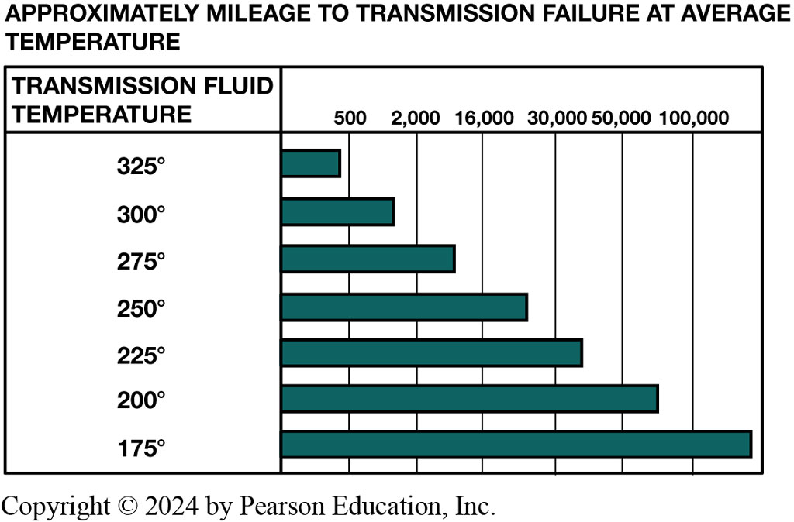
Figure 3.9
Temperature Increase
The life of automatic transmission fluid drops drastically when the temperature increases above normal.
Notes:
Long Description:
The first column is labeled transmission fluid temperature and the second column contains the mileage as 500, 2000, 16,000, 30,000, 50, 000 and 100, 000. For 325 degrees, the mileage is 400; for 300 degrees, the mileage is 1300; for 275 degrees, the mileage is 10, 000; for 250 degrees, the mileage is 24, 000; for 225 degrees, the mileage is 39, 000; for 200 degrees, the mileage is 75, 000; and for 175 degrees, the mileage is above 100, 000.

Slide 16
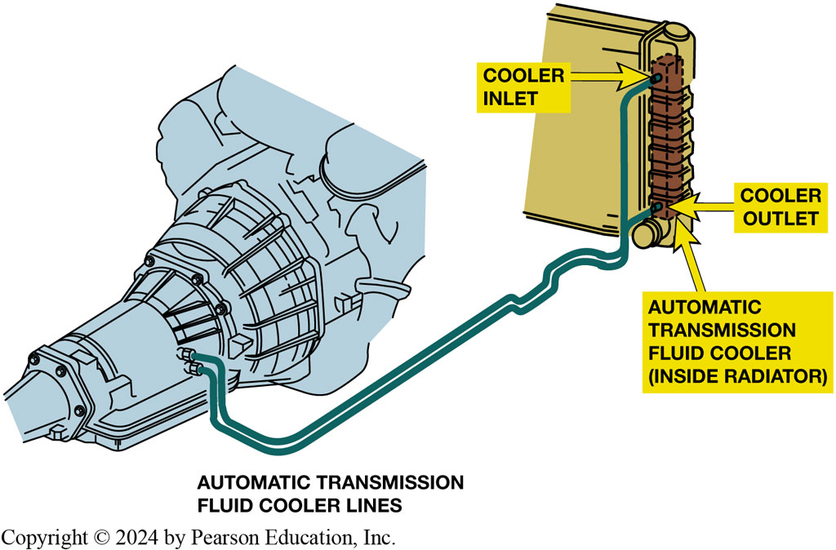
Figure 3.10
Oil Cooler
Automatic transmission fluid is routed from the torque converter, where most of the heat is generated, to the radiator where it is cooled. The fluid then returns to the transmission/transaxle to lubricate the bearings and bushings
Notes:
Long Description:
There are two automatic transmission fluid cooler lines that go to the automatic transmission fluid cooler (inside the radiator). One line joins the cooler inlet and the other line joins the cooler outlet. The inlet is at the top and the outlet is at the bottom.

Slide 17
Frequently Asked Question: What is a “Turbulator”?
? Frequently Asked Question
What is a “Turbulator”? A plain-tube cooler is not very effective for cooling fluid because fluid tends to increase its viscosity and slow down as it cools. The cooler oil then tends to become stationary on outer, cooler areas of the cooler while hotter, thinner-viscosity fluid flows through the center. Turbulator in well-designed oil coolers continuously mixes fluid. A T F in contact with the outer part of cooler tubes is in contact with the relatively cool coolant in radiator tank. Screen-like turbulator causes turbulence in the fluid flow to ensure constant mixing and thorough cooling of all the fluid. SEE Figure 3.11

Slide 18
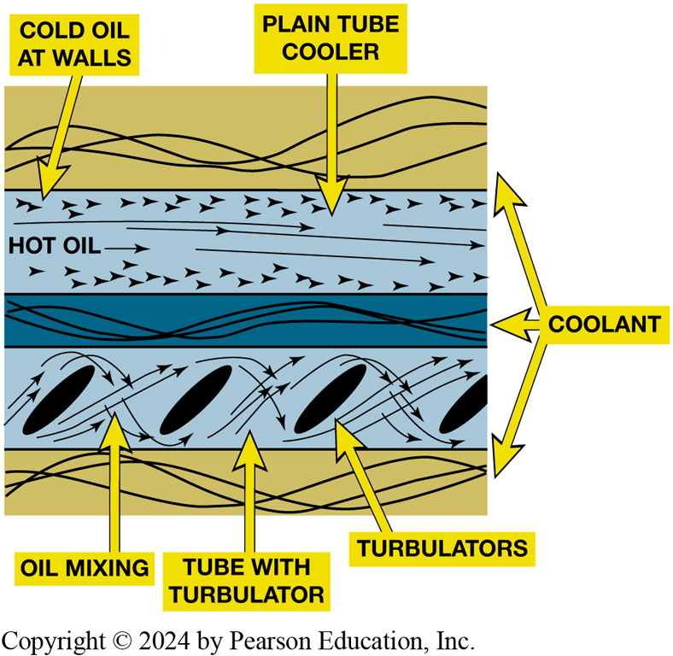
Figure 3.11
Turbulator
Cold fluid tends to stick to the walls of a plain tube cooler (top). The turbulator causes fluid turbulence to promote mixing so all of the fluid cools (bottom).
Notes:
Long Description:
The top of the arrangement has a layer of coolant. It is followed by a plain tube cooler which has cold oil on the walls and hot oil in the middle. This tube cooler is followed by a layer of coolant. This second layer of coolant is followed by a tube with turbulator. There are four turbulators in the pipe which result in the mixing of oil. This pipe is again followed by a layer of coolant.

Slide 19
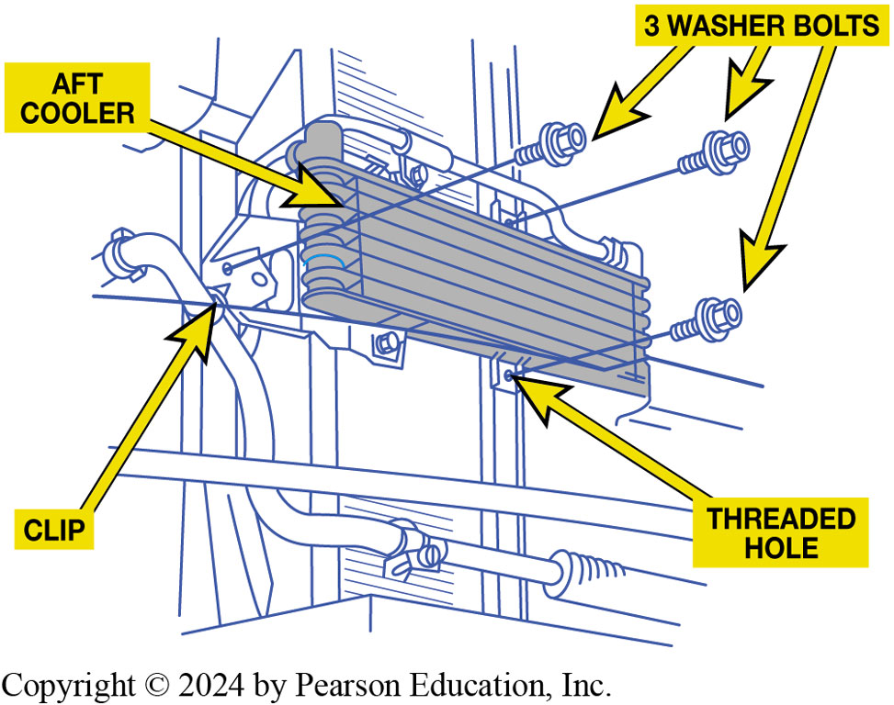
Figure 3.12
Auxiliary Cooler
If the vehicle is being used for towing and it is not equipped with a supplemental cooler, an aftermarket cooler can be installed.

Slide 20
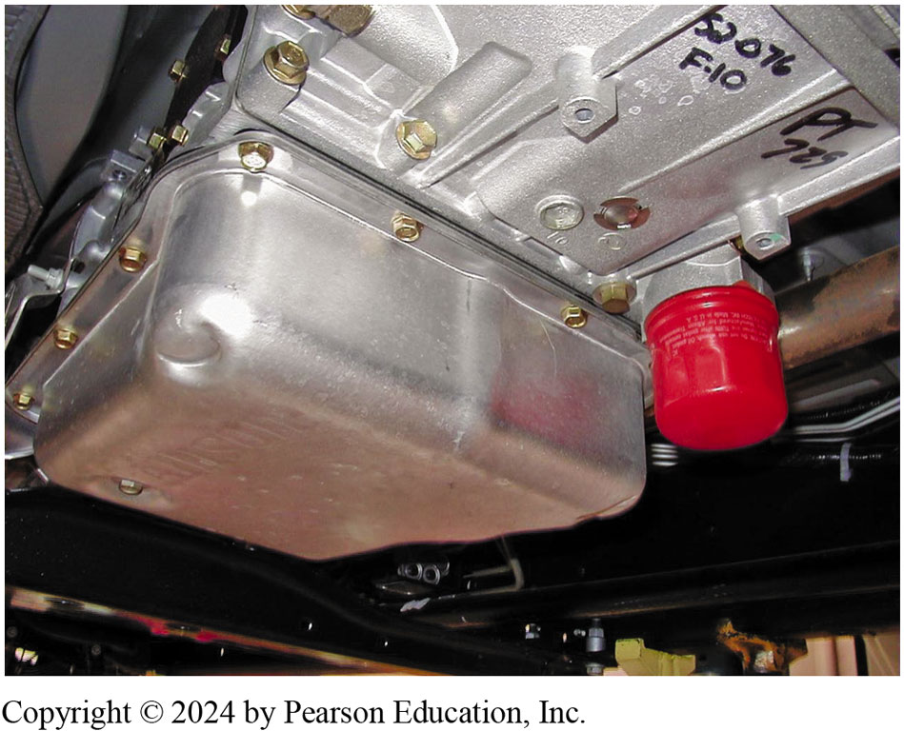
Figure 3.13
Spin-On Filter
Many filters contain a magnet
Remove iron particles
Filter gets plugged
Flow will be restricted
Supplementary filters include a bypass valve
Maintain fluid flow
While most automatic transmissions use an internal filter only, this Allison transmission uses a spin-on- type filter that is designed to be replaced as part of routine service. There is another filter inside that is designed to be replaced only if the unit is overhauled or repaired.

Slide 21
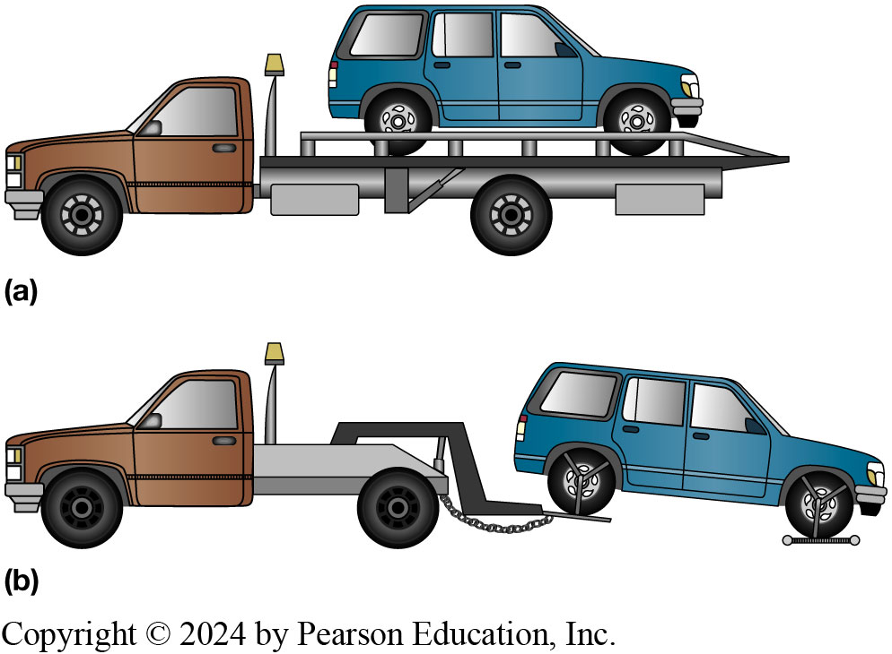
Figure 3.14
Towing Vehicle
If an all-wheel-drive vehicle must be towed, it should be either on (a) flatbed truck or (b) a dolly.

Slide 22
Question 1
Why should a vehicle be towed with the drive wheels off the ground?
A. To reduce the number of miles registered on the odometer
B. To prevent transmission damage due to a lack of lubrication
C. To help keep the temperature of the A T F from increasing to dangerous levels
D. To reduce driveline (U-Joints and C V joint) wear

Slide 23
Answer 1
Why should a vehicle be towed with the drive wheels off the ground?
B. To prevent transmission damage due to a lack of lubrication

Slide 24
Summary (1 of 2)
Automatic transmission fluid is the lifeblood of an automatic transmission
Only specified fluid should be used
Pumps produce fluid flow in a transmission and restriction to flow
Results in system pressure

Slide 25
Summary (2 of 2)
Technicians can select one of three possible fluids.
Filter is at pump inlet to trap dirt, metal, and foreign particles.
Fluid returning from torque converter and cooler lubricates transmission.

Slide 26
Automatic Transmissions and Transaxles Videos and Animations
Videos Link: (A2) Automatic Transmissions and Transaxles Videos
Animations Link: (A2) Automatic Transmissions and Transaxles Animations

Slide 27
Copyright
This work is protected by United States copyright laws and is provided solely for the use of instructors in teaching their courses and assessing student learning. Dissemination or sale of any part of this work (including on the World Wide Web) will destroy the integrity of the work and is not permitted. The work and materials from it should never be made available to students except by instructors using the accompanying text in their classes. All recipients of this work are expected to abide by these restrictions and to honor the intended pedagogical purposes and the needs of other instructors who rely on these materials.

