Slide 1
Automatic Transmissions and Transaxles
Eighth Edition
Chapter 2
Introduction to Drivetrains
Copyright © 2024, 2018, 2015 Pearson Education, Inc. All Rights Reserved
Notes:
If this PowerPoint presentation contains mathematical equations, you may need to check that your computer has the following installed:
1) Math Type Plugin
2) Math Player (free versions available)
3) NVDA Reader (free versions available)
INSTRUCTOR NOTE: This presentation includes text explanation notes, you can use to teach the course. When in SLIDE SHOW mode, you RIGHT CLICK and select SHOW PRESENTER VIEW, to use the notes.

Slide 2
Learning Objectives (1 of 1)
2.1 Define torque, and explain the relationship between torque and horsepower.
2.2 Describe the various gear types and their effect on speed, torque, and direction of rotation.
2.3 Explain gear ratios and their effect on vehicle operation.
2.4 Discuss the types of manual transmissions and transaxles that are currently in use.

Slide 3
Learning Objectives (2 of 2)
2.5 Discuss automatic transmissions and the planetary gear sets used for automatic transmissions.
2.6 Compare rear-wheel drive, front-wheel drive, four-wheel drive, and all-wheel drive systems.
2.7 Explain the characteristics of drive shafts and drive axle assemblies.

Slide 4
Drivetrains
Vehicle Drivetrain/Powertrain
Transfer power from engine to drive wheels
Serves following functions:
Allows driver to control power flow
Multiplies engine torque
Controls engine speed

Slide 5
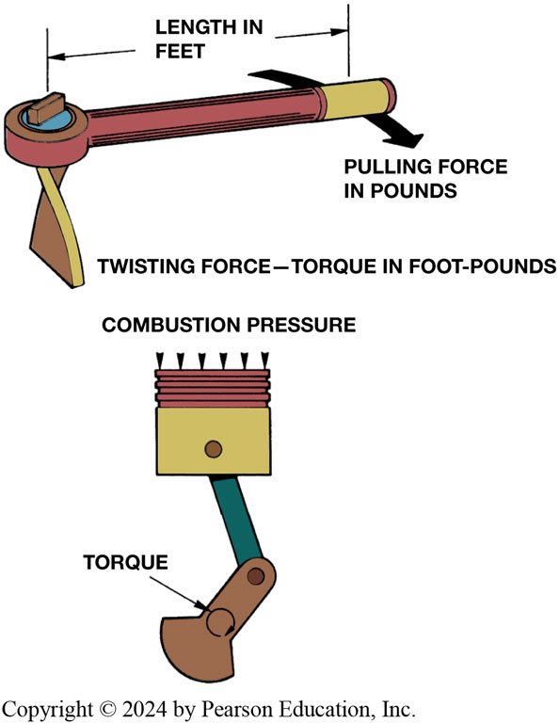
Figure 2.1
Torque
Definition
Rotating or twisting force that may or may not result in motion
Engines develop torque & drivetrains modify that torque to move vehicle
Torque, a twisting force, is produced when you pull on a wrench. An engine produces torque at the crankshaft as combustion pressure pushes the piston downward
Notes:
Engine torque is developed when combustion pressure pushes a piston downward to rotate the crankshaft. ● SEE FIGURE 2–1.
Vehicle moves because of the torque the drive axle exerts on the wheels and tires to make them rotate. Being a form of mechanical energy, torque cannot be created or destroyed—it is converted from one form of energy to another form of energy.
Long description:
In the first instance, the movement, force, and torque of a wrench are shown. The twisting force torque is in foot hyphen pounds. The length of the wrench is measured in feet. The pulling force at the end of the wrench is measured in pounds. In the second instance, an engine is shown with a crankshaft and a piston. The torque produced on the piston is shown by a circular arrow. The down arrows on top indicated combustion pressure.

Slide 6
Frequently Asked Question: Is It L b-F t or F t-L b of Torque?
? Frequently Asked Question
Is It L b-F t or F t-L b of Torque? The unit for torque is expressed as a force times the distance (leverage) from the object. Therefore, the official unit for torque is l b-f t (pound-feet) or Newton-meters (a force times a distance). However, it is commonly expressed in f t-l b and most torque wrenches are labeled with this unit

Slide 7
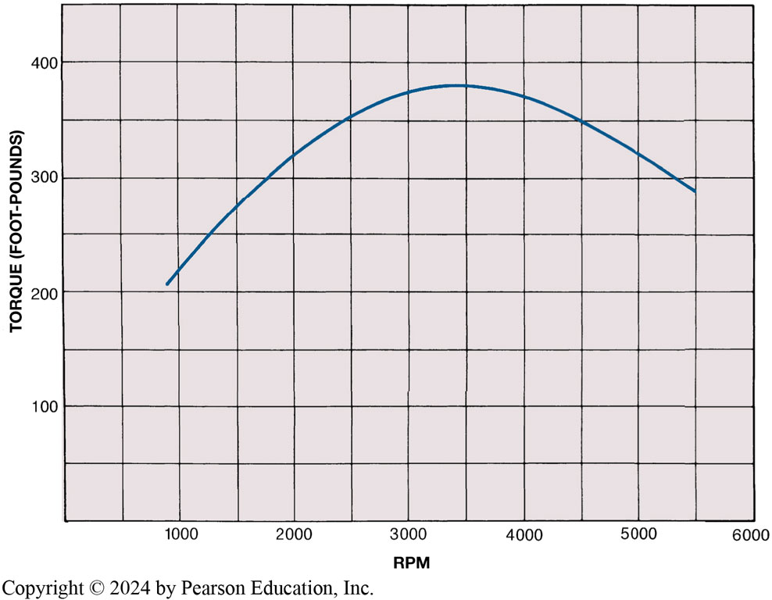
Figure 2.2
Torque
Units of Torque
The torque produced by a 5.7 L engine as plotted on a graph. Note that the engine begins producing usable torque at 1000 to 1200 R P M and a maximum torque (381 f t-l b) at 3500 R P M. The torque produced by the engine decreases at higher R P M due to a decrease in volumetric efficiency.
Notes:
The amount of torque produced will vary depending on the size and design of the engine and the throttle opening.
Torque is measured in pounds-feet (lb-ft) or Newton-meters (N-m). One Newton-meter of torque is equal to 0.737 lb-ft.
A factor that greatly affects drivetrain design is that very little or no torque is developed at engine speeds below
1000 RPM (revolutions per minute). An engine begins producing usable torque at about 1200 RPM and peak torque at
about 2500 to 4000 RPM, with an upper usable speed limit of 5000 to 7000 RPM. The gear ratios in the transmission and
drive axle are used to match the engine speed and torque output to the vehicle speed and torque requirements. SEE FIGURE 2–2.
Long description:
The y-axis shows values from 0 to 400 in intervals of 100 and is labeled torque (foot hyphen pounds). The x-axis shows values from 0 to 6000 in intervals of 1000 and is labeled RPM. The curve starts at the intersection of 200 on the y-axis and 900 on the x-axis. The curve shows a concave downward shape and ends at the intersection of 299 on the y-axis and 5500 on the x-axis. The points in between are 1500, 270; 2000, 320; 2500, 350; 3000, 380; 3500, 380; 4000, 360; 4500, 350; and 5000, 320.

Slide 8
Animation: Math Formula, Ib ft to Ib in, Torque (Animation will automatically start)

Slide 9
Animation: Math Formula, Ib in to Lb ft, Torque (Animation will automatically start)

Slide 10
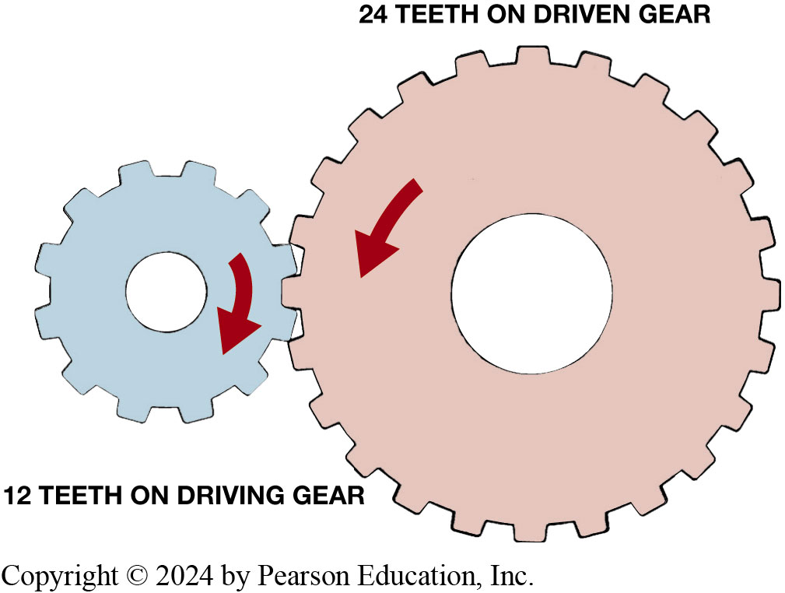
Figure 2.3
Drive versus Driven Gears
Torque varies on:
Design of engine and throttle opening
Two gears meshed together transmit torque & rotational motion.
Gear teeth cut proportional to gear diameter.
Each tooth like a lever,
Fulcrum center of gear.
Gear ratio determined by dividing number of teeth of driven (output) gear (24 teeth) by the number of teeth on driving (input)
gear (12 teeth). Ratio is
Notes:
Driven vs Drive Gears
The drive gear is the gear that is the source of the engine torque and rotation. The driven gear is the gear that is driven or rotated by the drive gear. Two gears meshed together are used to transmit torque and rotational motion. The driven gear can then rotate yet another gear. In this case, the second gear becomes the drive gear and the third gear is the driven gear.
Torque Multiplication
The gear teeth are cut proportional to the diameter of the gear. If one of two mating gears were twice as large as the other, it would have twice as many teeth. For example, if the smaller gear has 10 teeth, a gear twice as large will have 20 teeth. If the teeth of these
gears are intermeshed, 10 teeth of each gear will come into contact when the smaller gear rotates one revolution. This will require one revolution of the small gear and one-half revolution of the larger gear. It will take two revolutions of the small gear to produce one revolution of the larger gear. This is a gear ratio of 2:1, assuming that the small gear is the drive gear. To determine a gear ratio, divide the driven gear by the driving gear. ● Figure 2–3.
Gears Are Levers Torque is increased because of the length of the gear lever, as measured from the center of the
gear. Think of each tooth as a lever, with the fulcrum being the center of the gear. Physics does not allow energy to become lost in a gear set, other than what is lost as heat in overcoming friction. Therefore, whatever power that comes in one shaft, goes out through another.
■ If speed is reduced, torque will increase by same amount.
■ If speed is increased, torque will decrease by same amount.

Slide 11
Animation: External Gears 2:1 (Animation will automatically start)

Slide 12
Horsepower (1 of 2)
Power: Rate of doing work.
Power equals work divided by time
Work is done when a certain amount of mass (weight)
is moved a certain distance by a force

Slide 13
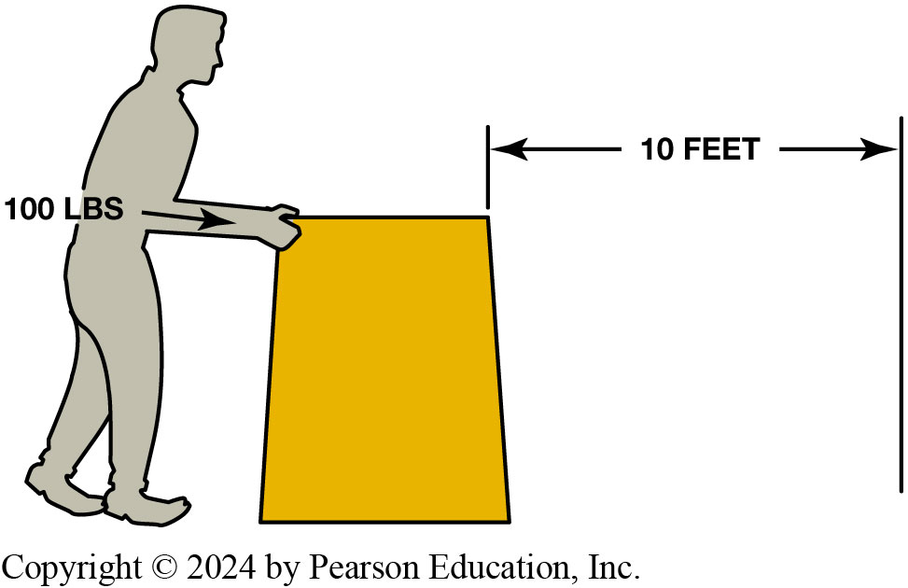
Figure 2.4
Work
Work is calculated by multiplying force times distance. If you push 100 pounds 10 feet, you have done 1,000 foot-pounds of work.
Notes:
Work is done when a certain amount of mass (weight) is moved a certain distance by a force. Whether the object is moved in 10 seconds or 10 minutes does not make a difference in the amount of work accomplished, but it does affect the amount of power
needed. ● SEE FIGURE 2–4.

Slide 14
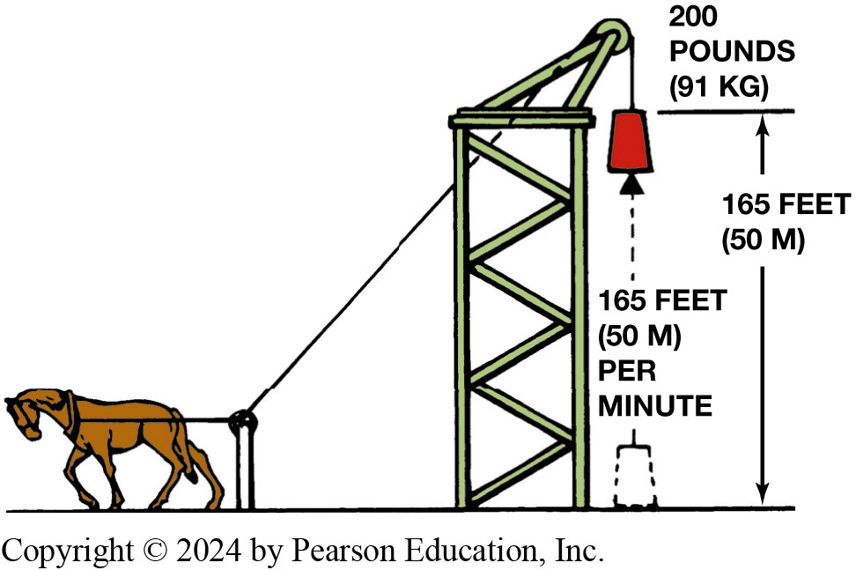
Figure 2.5
Horsepower
One horsepower is equal to 33,000 footpounds
of work per minute
Notes:
Power is expressed in units of foot-pounds per minute. One horsepower is the power required to move
550 pounds one foot in one second, or 33,000 pounds one foot in one minute (550 lb × 60 sec = 33,000 lb). This is expressed as 550 foot-pounds (ft-lb) per second or 33,000 foot-pounds per minute. ● Figure 2–5.
Long description:
A horse is tied to a rod by a rope and the rope is attached to a pulley weighting 200 pounds (91 kg). The distance between the weight and the ground is 165 feet (50 M). Under the weight, a dotted arrow is shown with the words 165 feet (50 M) per minute.

Slide 15
Horsepower (2 of 2)
Power equals work divided by time.
Torque and horsepower:
Torque increased using gears
Gear set can increase torque, but decrease speed by same amount
Figure 2.5 One horsepower is equal to 33,000 footpounds
of work per minute
Notes:
Long description:
A horse is tied to a rod by a rope and the rope is attached to a pulley weighting 200 pounds (91 kg). The distance between the weight and the ground is 165 feet (50 M). Under the weight, a dotted arrow is shown with the words 165 feet (50 M) per minute.

Slide 16
Animation: Math Formula: Horsepower (Animation will automatically start)

Slide 17
Question 1
Horsepower is which of these?
A. Rate of doing work
B. Same as torque
C. Determines vehicle speed
D. R P M times 5252

Slide 18
Answer 1
Horsepower is which of these?
A. Rate of doing work

Slide 19
Gears (1 of 2)
Used to increase torque
Types
Spur gears
Helical gear
Bevel gears
Spiral bevel gears
Hypoid gear
Worm gear (used in speed sensor drives)
Notes:
GEARS
The torque from an engine can be increased or decreased through the use of gears, belts, and chains. Gears, belts, or chains cannot increase horsepower; they can only modify its effect. A gear set can increase torque, but it will decrease speed by the same amount.

Slide 20
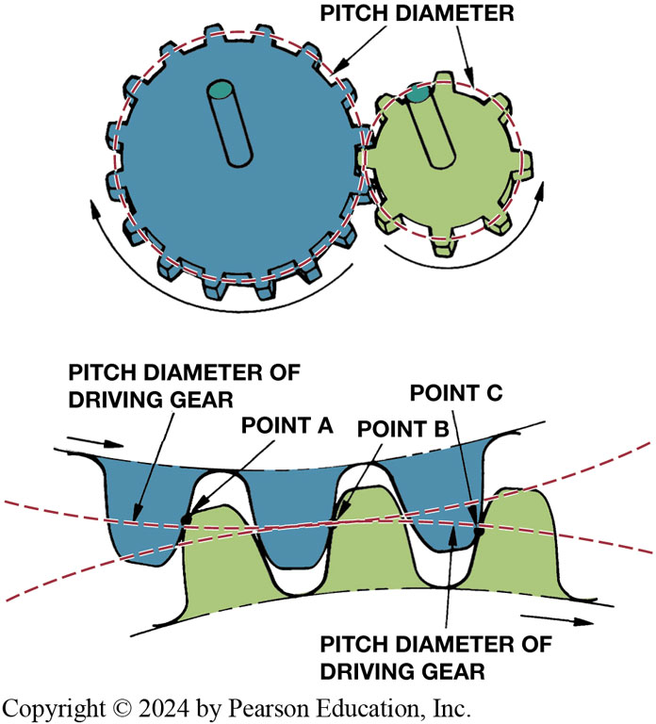
Figure 2.6
Gear Pitch
The pitch diameter is the effective diameter of the gear. Note how the contact points slide on the gear teeth as they move in and out of contact
Notes:
GEARS TERMINOLOGY The effective diameter of a gear is the pitch diameter (or pitch line). ● SEE FIGURE 2–6.
The pitch diameter is the diameter of the gear at the point where the teeth of the two gears meet and transfer power. The gear teeth are shaped to be able to slide in and out of mesh with a minimum amount of friction and wear.
Major points include the following:
Driven and driving gears will rotate in opposite directions
External gears will always reverse shaft motion.
If same-direction motion is required, the power will be routed through two gear sets.
When power goes through a series of gears, an even number of gears (2, 4, 6, and 8) will cause a reversal in direction and an odd number of gears (3, 5, 7, and 9) will produce same-direction of rotation.
● SEE FIGURE 2–7.
Long description:
The first part shows two gear wheels interlocked at a particular point. The two gear wheels are different in size and are moving in opposite directions. The left gear wheel is moving in the clockwise direction while the right gear wheel is moving in the anti-clockwise direction. The gap between the teeth of the gear wheel is labeled as pitch diameter. The second part shows a close-up view of the gear teeth. The pitch diameter of the driving gear is labeled. Three points are labeled point A, point B, and point C. These points show the point of contact between the teeth of the gear wheels.

Slide 21
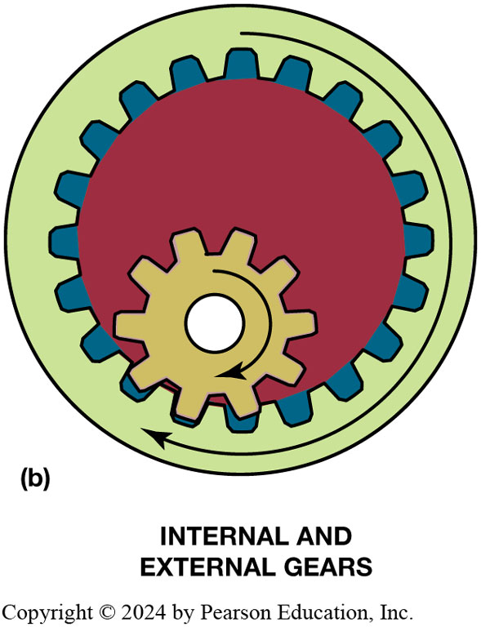
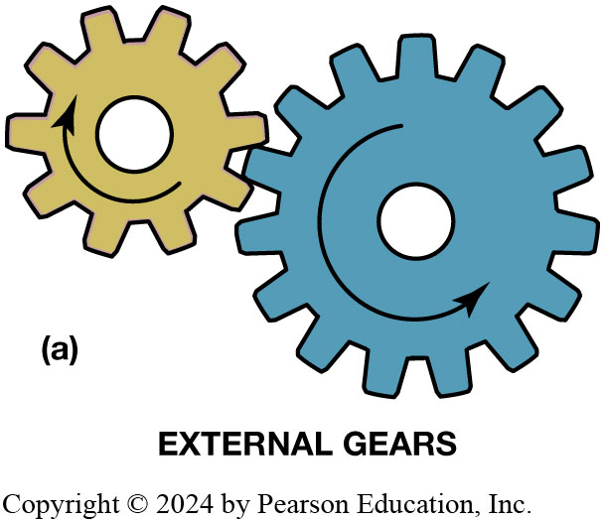
Figure 2.7 (1 of 2)
External Internal Gears
(a) When one external gear drives another, the direction of rotation is always reversed. (b) When an external gear drives an internal gear, the two gears will rotate in the same direction.
Notes:
Long description 1:
The first part shows two gear wheels interlocked in one position. One gear wheel is smaller than the other and is shown to be moving in the clockwise direction. The other gear wheel is larger than the other and is shown to be moving in the anti-clockwise direction. The label is given as external gears.
Long description 2:
The second part shows internal and external gears. A larger gear wheel has a smaller gear wheel inside it. Three teeth of the smaller gear wheel fit into the three teeth of the larger gear wheel. Both wheels are present inside a circle. The direction of both the gear wheels is clockwise.

Slide 22
Animation: Internal & External Gear (Animation will automatically start)

Slide 23
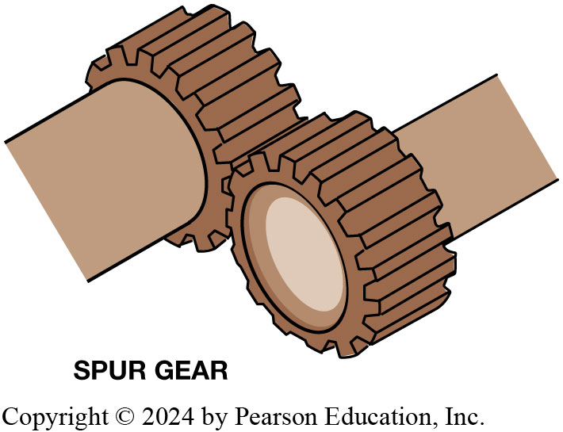
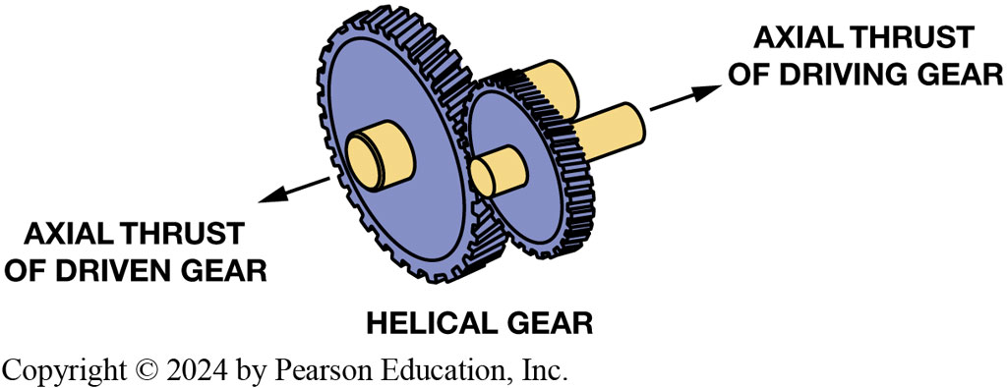
Gears (2 of 2)
Gear Types
Spur
Straight teeth
Helical
Teeth cut spiral
Notes:
Gear Types
Gears come in different types depending on the cut and relationship of the teeth to the shafts.
Spur gears—Spur gears, the simplest gears, are on parallel shafts with teeth cut straight or parallel to the shaft. FIGURE 2–9.
Helical gear—Helical gears are the most used gear type in transmissions. These gears have teeth cut in a spiral or helix shape. FIGURE 2–10.
Helical gears are quieter than spur gears, but generate axial or end thrust under a load. A helical gear is stronger than a comparable-sized spur gear and has an almost continuous power flow because of the angled teeth. SEE FIGURE 2–10.
NOTE: pinion gear is the smaller gear of a pair.

Slide 24
Figure 2.7 (2 of 2)
External Internal Gears
The teeth of a spur gear are cut parallel to the shaft, and this produces a straight pressure between the driving and the driven gear teeth.

Slide 25
Figure 2.10
Helical Gears
The teeth of a helical gear are cut on a slant, and this produces an axial or side thrust.

Slide 26
Frequently Asked Question: What Is a “Rock Crusher” Transmission?
? Frequently Asked Question
What Is a “Rock Crusher” Transmission? A manual Muncie (M22) four-speed manual transmission in the muscle car era, was called the rock crusher because it used straight cut spur gears. It was designed as a racing transmission because by using spur gear, end thrust loads were reduced. However, spur gears are noisy and sounded like rocks being chewed up, hence the slang term “rock crusher” for this once popular transmission.

Slide 27
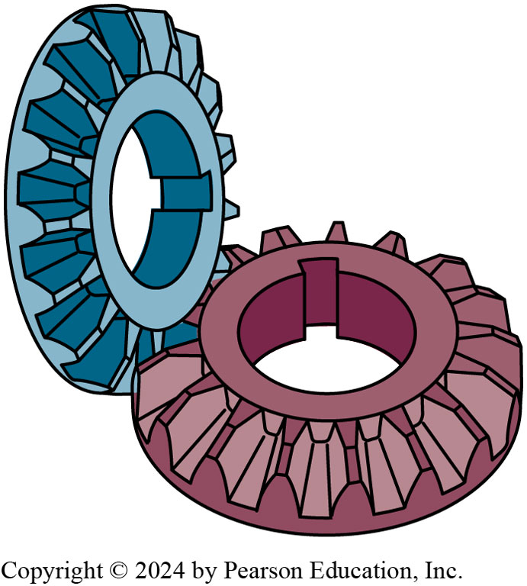
Figure 2.11
Bevel Gears
Bevel gears are commonly used in differentials.
Notes:
Bevel Gears
Bevel gears are used on nonparallel shafts. The outer edge of the gear must be cut on the angle that bisects the angle of the two shafts. In other words, if the two shafts meet at an angle of 90 degrees and the two gears are the same size, the outer edge of the gears will be cut at 45 degrees. The simplest bevel gears have teeth cut straight and are called spur bevel gears. They are inexpensive but noisy. ● Figure 2–11.

Slide 28
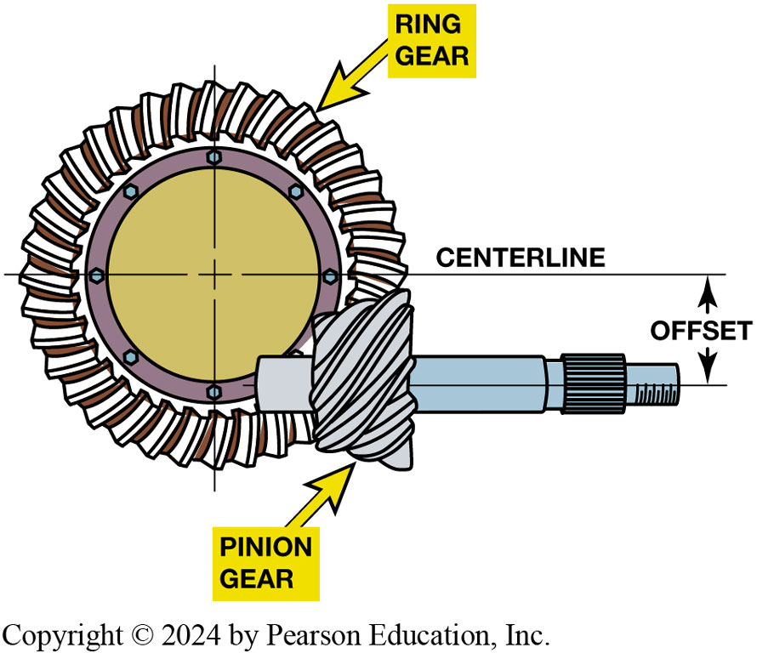
Figure 2.12
Hypoid Gearset
A hypoid gear set uses a pinion gear that is located below the centerline of the ring gear and is commonly used in drive axles.
Notes:
Spiral bevel gears —Spiral bevel gears, like helical gears, have curved teeth for quieter operation.
Hypoid gear — A variation of the spiral bevel gear is the hypoid gear, also called an offset-bevel gear. Hypoid gears are used in most drive axles and transaxles that have longitudinal mounted engines. The hypoid gear design places the drive pinion gear lower in the housing (below the centerline) of the ring gear and axle shafts. Figure 2–12.

Slide 29
Animation: Hypoid Ring & Pinion Gear Set (Animation will automatically start)

Slide 30
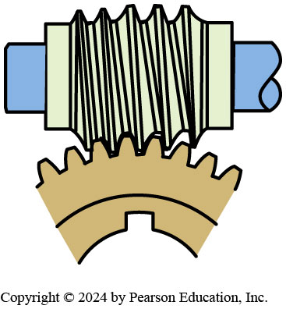
Figure 2.13
Worm Gear
A worm gear set is also used to transmit power between angled shafts.
Notes:
Worm Gear
A gear set used with shafts that cross each other but do not intersect is the worm gear. The worm gear or drive pinion is cut in a rather severe helix, much like a bolt thread, and the ring gear or wheel is cut almost like a spur gear. Worm gears are used in vehicle speed sensor drives. To determine the ratio of a worm gear, divide the number of teeth on the wheel by the pitch of the worm gear. For example, a single-pitch worm gear tooth driving a 20-tooth ring gear will have a ratio of 20:1, a very low ratio, and the wheel does not have to be 20 times larger than the worm gear. A 20:1 ratio in most gear sets requires the driven gear to be 20 times larger than the driving gear. ● Figure 2–13.

Slide 31
Gear Ratios (1of 3)
Gear ratio = Driven gear/drive gear
Gear ratio determined by dividing number of driven gear teeth by number of teeth on driving gear.
Driving gear turns 4 times
For each revolution of driven gear.
Results in a speed reduction and torque increase.

Slide 32
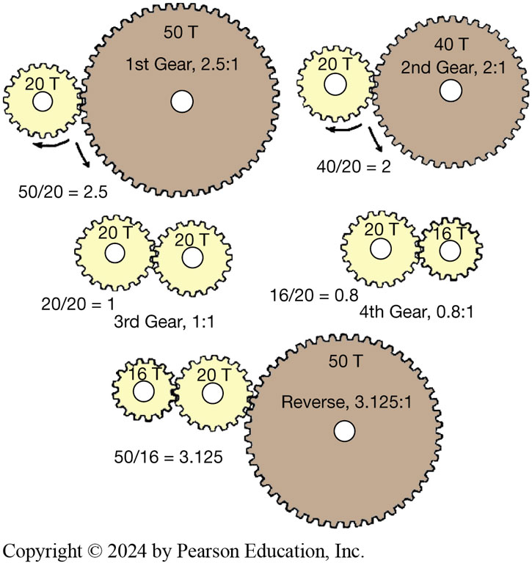
Figure 2.14
Gear Ratios
The gear ratio is determined by dividing the number of teeth on the driven (output) gear by the number of teeth on the driving (input) gear.
Notes:
Most of the time, the ratio will not end up as whole numbers. It will be something like an 11-tooth driving gear
and a 19-tooth driven gear, which results in a ratio of 19 divided by 11, which equals 1.7272727 and can be rounded
off to 1.73.
Long description:
In the first instance, a small and a large gear wheel are shown to be interlocked. The large gear wheel is 50 T, first gear, 2.5 is to 1. The small wheel is labeled as 20 T. The calculation is 50 over 20 is equal to 2.5. The direction of movement of the large wheel is anticlockwise and the small wheel is clockwise. In the second instance, a small and a medium gear wheel are shown to be interlocked. The large gear wheel is 40 T, second gear, 2 is to 1. The small wheel is labeled as 20 T. The calculation is 40 over 20 is equal to 2. The direction of movement of the large wheel is anticlockwise and the small wheel is clockwise. In the third instance, two small gear wheels are shown to be interlocked. Both wheels are labeled 20 T. The calculation is 20 over 20 is equal to 1. The details are third gear, 1 is to 1. In the fourth instance, two small gear wheels are shown to be interlocked. One of the wheels is slightly smaller than the other. One is labeled 20 T and the other 16 T. The calculation is 16 over 20 is equal to 0.8. The details are fourth gear, 0.8 is to 1. In the fifth instance, three gear wheels are present, one large and two small wheels. One wheel is 16 T, the other is 20 T and the third is 50 T. The details are reverse, 3.125 is to 1. The calculation is 50 over 16 which is equal to 3.125.

Slide 33
Gear Ratios (2 of 3)
Commonly used ratios
Rounds off gear ratios to 2 decimal points;
or
Even ratio, like
repeats same gear tooth contact
ratio called a hunting gear set
Gear tooth contacts all of the other gear teeth
Produces quieter operation.
Notes:
Commonly Used Ratios
The automotive industry commonly rounds off gear ratios to two decimal points. Drivetrain engineers usually do not use even ratios like 3:1. or 4:1 but instead use ratios that are at least 10% greater or less than even numbers. An even ratio, like 3:1, repeats the same gear tooth contacts every third revolution. If there is a damaged tooth, a noise will be repeated continuously, and most drivers will not like the noise. A gear set with a ratio such as 3.23:1 is called a hunting gear set, and a tooth of one gear contacts all of the other gear teeth, which produces quieter operation.
Calculating Overall Ratios
When power goes through more than one gear set, two or more ratios are involved. In most cases, the simplest way to handle this is to
figure the ratio of each set and then multiply the ratios. An example of this is a vehicle with a first-gear ratio of 2.68:1 and a rear axle ratio of 3.45:1. The overall ratio in first gear is 2.68 × 3.45 or 9.246:1.
At the same time there will be 9.246 times as much torque at the rear wheels than the engine produced.
The engine will rotate at a speed that is 9.246 times faster than the rear axle shafts. The overall ratios for the other transmission gears would be figured in the same manner

Slide 34
Frequently Asked Question: Speed and Gear Ratio
? Frequently Asked Question
What Is the Relationship between Speed and Gear Ratio? The following formulas can be used to determine the vehicle speed based on the gear ratio and engine speed, or the engine speed based on the gear ratio and miles per hour
NOTE: The constant 336 is used to convert the units from inches (tire diameter) to feet and MPH to feet per hour.
Notes:
Long Description:
Left parenthesis M P H right parenthesis is to M P H equals left parenthesis R P M times tire diameter right parenthesis over left parenthesis gear ratio times 336 right parenthesis. Engine R P M equals left parenthesis M P H times gear ratio times 336 right parenthesis over gear diameter.

Slide 35
Gear Ratios (3 of 3)
Overdrive
Driving gear has more teeth (20) than driven gear (5)
Increase in speed & reduction in torque
Dividing 5 by
so the ratio is
Driving gear turns
revolution for each turn of the
driven gear
Notes:
Overdrive
If the driving gear has more teeth (20) than the driven gear (5), there will be an increase in speed and a reduction
in torque. This is called an overdrive. The ratio is computed by dividing 5 by 20, 5 ÷ 20 = 0.25, so the ratio would be
expressed as 0.25:1. The driving gear will turn 0.25 or one fourth of a revolution for each turn of the driven gear. Note that
a gear ratio is always written with the number 1 to the right of the colon. This represents one turn of the output gear, while the
number to the left represents the revolutions of the input gear.

Slide 36
Animation: Math Formula: Gear Ratio (Animation will automatically start)

Slide 37
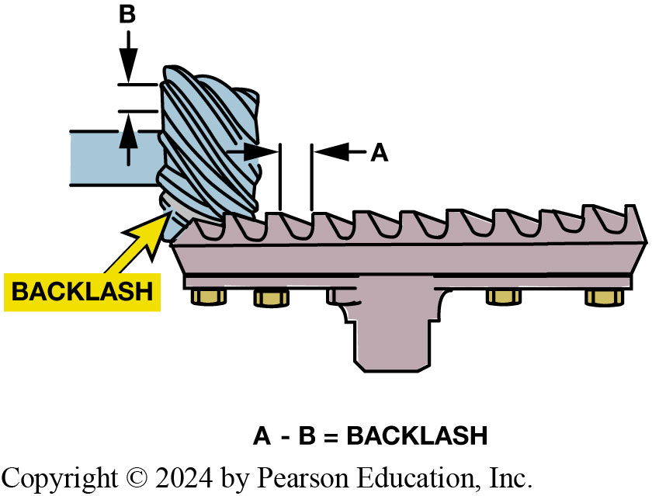
Figure 2.15
Gear Backlash
Backlash is the clearance between the teeth of two meshing gears. There has to be some clearance (backlash) to prevent the gears from getting into a bind condition when they are transmitting torque.
Notes:
Gear Summary
Two mated external gears will always rotate in opposite directions.
Gear sets will multiply torque but at a reduced speed.
An idler gear allows the drive and driven gears to rotate in the same direction.
To find the ratio, divide the driven gear by the drive gear.
When power transfers through an even number (two or four) of gears, input and output gears rotate in opposite directions.
When power transfers through an uneven number (one, three, or five) of gears, input and output gears will rotate in same direction.
To find overall ratio of multiple gear sets, multiply ratios of gear sets.
2 gears transferring power push away from each other in an action called gear separation. The gear separation force (thrust) is proportional to the torque being transferred.
The smaller gear(s) in a gear set may also be called a pinion gear.
All gear sets must have backlash to prevent binding. FIGURE 2–15.
Long description:
Backlash is present between the teeth of the gears. The gap between the teeth of the lower gear is labeled as A. The gap between the teeth of the second gear wheel is labeled as B. The equation given below the figure is A minus B is equal to backlash.

Slide 38
Question 2
Which of these is determined by dividing the number of teeth on the driven (output) gear by the number of teeth on the driving (input) gear?
Torque
Gear ratio
Horsepower
Work

Slide 39
Answer 2
Which of these is determined by dividing the number of teeth on the driven (output) gear by the number of teeth on the driving (input) gear?
Gear ratio

Slide 40
Transmissions
Transmission facts
Low/first gear provides torque to get vehicle moving.
High gear should provide an engine speed for fuel-efficient operation
Intermediate ratios provide adequate acceleration
Minimizing overrevving the engine before shift
Lugging engine after shift
Notes:
Note Trends: Up to 1970s used 3-speed transmissions
Some added an overdrive unit for a fourth gear ratio
Lower engine RPM at cruise speeds.

Slide 41
Manual Transmission (1 of 2)
Manual transmissions use clutch.
Most vehicles use foot-pedal-operated single-plate clutch assembly.
Notes:
Purpose and Function:
A manual transmission, also called a standard transmission, is constructed with a group of paths through which power can flow with each path used being a different gear ratio. ● Figure 2–16. Synchronizer assemblies or sliding gears and the shift linkage are used to control or engage the power paths.

Slide 42
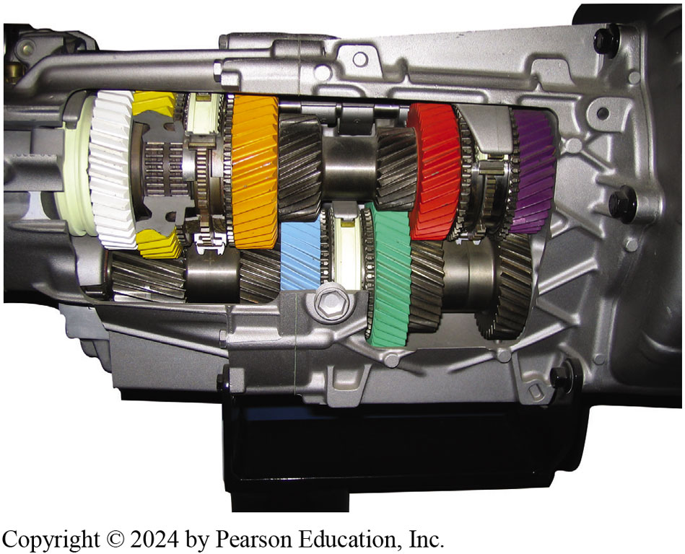
Figure 2.16
Manual Transmission
A manual transmission provides several gear ratios and a method to shift them.

Slide 43
Frequently Asked Question: Close Ratio Transmission
? Frequently Asked Question
What Is a “Close-Ratio” Transmission? Gear ratio spread (G R S), is the difference between the lowest and highest ratios or, in other words, the overall range of the transmission gear ratios. In transmissions, it is
fairly easy to visualize difference between a
first gear and a
fifth gear. Gear ratio spread is determined by dividing the low
gear ratio by the high gear ratio. The G R S for the gear transmission is
R P M change/drop is fairly easy to determine:
Subtract higher ratio from lower ratio and divide product by lower ratio. A close-ratio Muncie four-speed has ratios spaced fairly close together (25% or less), closer than the wide-ratio version. SEE FIGURE 2–17.

Slide 44
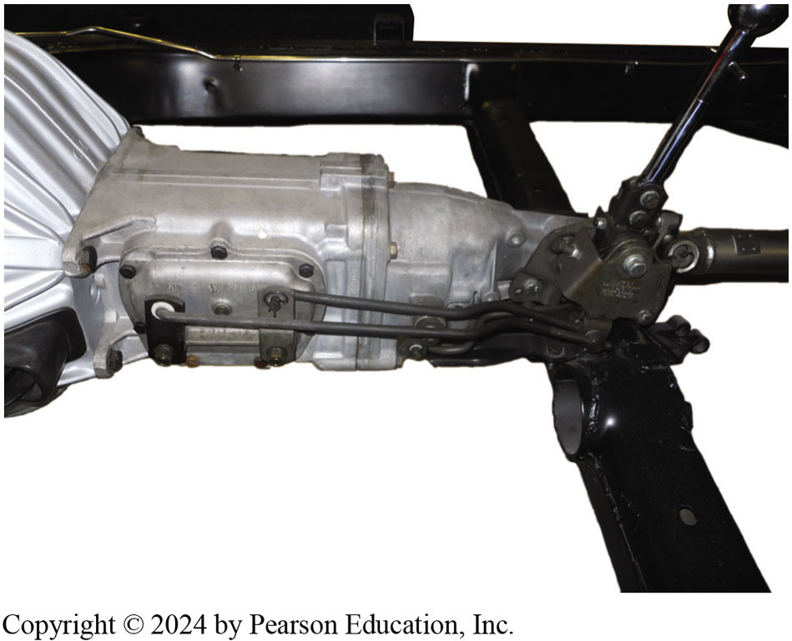
Figure 2.17
A Muncie four-speed manual transmission on a restored muscle car is an example of a close-ratio manual transmission.

Slide 45
Manual Transmission (2 of 2)
Clutch
Stop power flow to allow transmission to be shifted
Slight slippage as the clutch engages allows
Engine speed to stay up where it produces usable torque
Foot-pedal-operated single-plate clutch assembly
Pedal pushed down, power flow is disengaged
Pedal is released, power flow engaged
Notes:
CLUTCH
Engine power must be stopped when making a shift in a manual transmission. The clutch is used to stop the power flow to allow the transmission to be shifted. It is also used to ease the engagement of the power flow when the vehicle starts from a standstill. The slight slippage as the clutch engages allows the engine speed to stay up where it produces usable torque as the vehicle begins moving.
Most vehicles use a foot-pedal-operated single-plate clutch assembly that is mounted on the engine flywheel. When the pedal is pushed down, the power flow is disengaged and when the pedal is released, power can flow from the engine to the transmission through the engaged clutch. FIGURE 2–18.

Slide 46
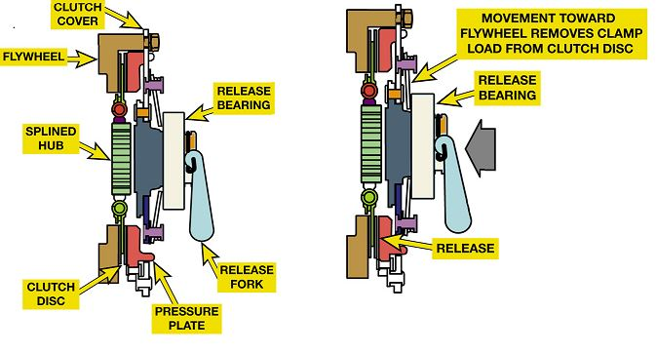
Figure 2.18
Clutch
A clutch cover (pressure plate assembly) is bolted onto the flywheel with the clutch disc between them. The release bearing and fork provide a method to release (disengage) the clutch. (a) When the clutch is engaged, the disc is squeezed against the flywheel by the pressure plate. (b) Releasing the clutch separates the disc from the flywheel and pressure plate.
Notes:
Long description:
The first image is labeled as A. The top part of the image has a flywheel that is attached to a splined hub which is then attached to the clutch disc. A clutch cover is bolted on the flywheel. The release bearing and release fork is present adjacent to the splined hub. The clutch disc is adjacent to the pressure plate. The second image is labeled as B. The top part of the image has a flywheel that is attached to a splined hub which is then attached to the clutch disc. A clutch cover is bolted on the flywheel. The release bearing and release fork is present adjacent to the splined hub. The clutch disc is adjacent to the pressure plate. The movement toward the flywheel removes the clamp load from the clutch disc. The clutch is released. There is an arrow shown near the release fork.

Slide 47
Automatic Transmissions
Automatic transmissions use a torque converter.
Provides forward & reverse gear ratios needed
Not requiring driver to change in gearing as with manual transmission.
Most automatic transmissions use planetary gear sets:
sun gear, ring gear, planet carrier.
What Is an Automated Manual Transmission?

Slide 48
Frequently Asked Question: What Is an Automated Manual Transmission?
? Frequently Asked Question
What Is an Automated Manual Transmission? An automated manual transmission is a type of automatic transmission/transaxle that uses two clutches and a manual transmission-type gears and is shifted hydraulically by computer-controlled solenoids. This type of transmission is commonly called a dual clutch or an electronically controlled manual transmission.

Slide 49
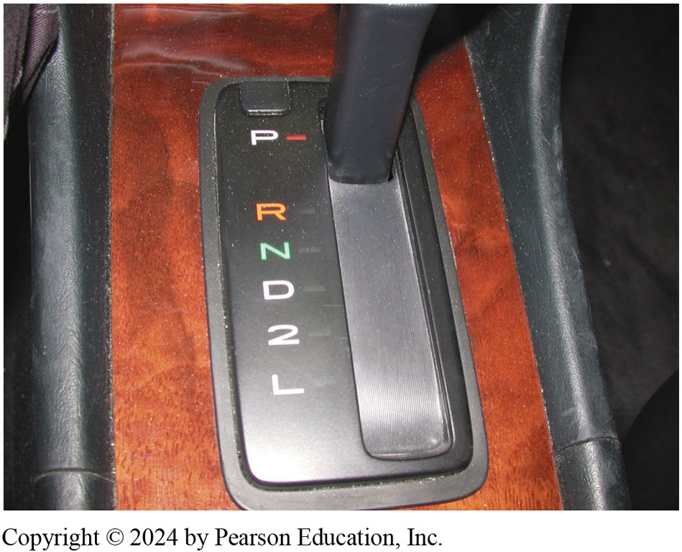
Figure 2.19
Shifter
Shift modes: Park, Reverse, Neutral, Overdrive, Drive, Third, Second, First
The gear selector is often called the “P R N D L,” pronounced “prindle,” regardless of the actual letters or numbers used
Notes:
Shift Modes transmission provides various gear ratios for forward and reverse operations as well as 2
methods for the engine to run without moving the vehicle. Most automatic transmissions and transaxles include the following shift modes. Figure 2–19.
Park. output shaft is locked to case of transmission/transaxle which keeps vehicle from moving. In the park position
Engine can be started by driver. Move the shifter out of the park position on a late model vehicle, the brake pedal must be depressed to release the transmission shift interlock.
Reverse. Move the vehicle in reverse. Reverse usually uses a gear ratio similar to first gear.
Neutral. No torque is being transmitted through the automatic transmission/ transaxle. Engine can be started by the driver.
Overdrive (OD). Normal position Allows transmission/transaxle to shift through all forward gears as needed. The overdrive button on many automatic transmissions is used to turn off overdrive and is used while towing or when in driving in city traffic to prevent the transmission from shifting in and out of overdrive
Drive (D). D position includes the overdrive ratios provide all forward gears
Third (3). In the third position, the transmission/transaxle will upshift normally to third gear
Second (2). The second position is used for slowing the vehicle while descending long grades.
First (1 or Low). The first (or low) position is used for slowing the vehicle while descending steep grades.

Slide 50
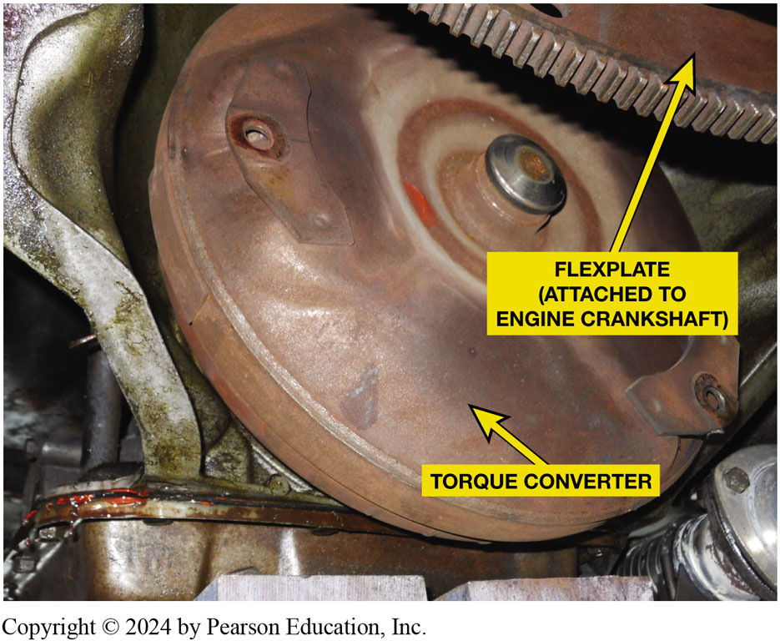
Figure 2.20
Torque Converter
A torque converter is attached to the engine crankshaft and the other end is splined to the input shaft of the automatic transmission. The torque converter is used to transmit engine torque to the transmission yet slip when the engine is at idle speed.
Notes:
A torque converter replaces manual transmission clutch. It is a type of fluid coupling that can release the power flow at slow engine speeds and also multiply the engine torque during acceleration. Torque converters in newer vehicles include a friction clutch that locks up to eliminate slippage at cruising speeds, improving fuel economy. SEE FIGURE 2–20.

Slide 51
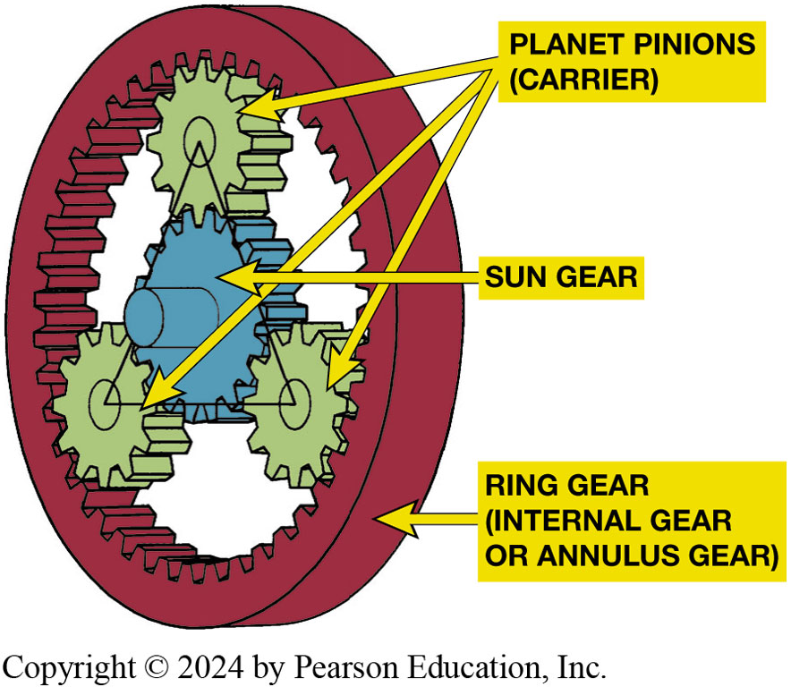
Figure 2.21
Planetary Gear Set
A typical planetary gear set showing the terms that are used to describe each member.
Notes:
PLANETARY GEAR SETS
Combination of gears. When the gear set is assembled, the sun gear is in the center and meshed with the planet gears, which are located around it, somewhat like planets in solar system. The ring gear is meshed around outside of te planet gears. The 3
main members of planetary gear set include:
1. Sun gear—gear in the center.
2. Ring gear—annulus gear or internal gear.
3. Planet carrier—holds planet gears (also called pinions) in position. FIGURE 2–21.
Long description:
The ring gear is also known as internal gear or annulus gear. Inside the ring gear, there are three planet pinions (carrier) gear wheels which are interlocked on the inner side of the ring gear. The sun gear is present in the middle of the three planet pinions and interlocks with all three wheels.

Slide 52
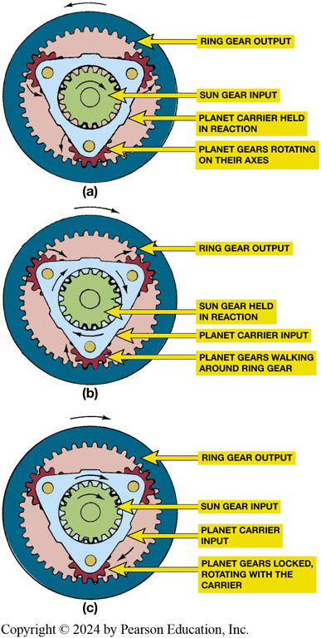
Figure 2.22
Planetary Gearset
(a) If planet carrier is held with sun gear rotating, planet gears simply rotate in the carrier and act as idler gears between sun and ring gears. (b) If sun or ring is held, planet gears will walk around that stationary gear; they rotate on their shafts as carrier rotates. (c) If two parts are driven and no parts are held, planet gears are stationary on their shafts, and whole assembly rotates as a unit.
Notes:
Planetary Gear Set Operation
Planetary gear sets are arranged that power enters through one of the members and leaves through one of the other members while the third member is held stationary in reaction. Power flow through a planetary gear set is controlled by clutches, bands, and one-way clutches. One or more clutches will control the power coming to a planetary member and one or more reaction members can hold a gear set member stationary. The third planetary member will be the output. Figure 2–22.
Long Description:
In the first scenario, the sun gear shows rotation in the clockwise direction. The sun gear input is labeled. The planet carrier is held in reaction. The ring gear output is shown to move in the anti-clockwise direction. The planet gears are rotating on their axes in the anti-clockwise direction. In the second scenario, the sun gear is held in reaction. The ring gear output is shown to move in the clockwise direction. The planet gears are walking around the ring gear in a clockwise direction. The planet carrier input is labeled. In the third scenario, the ring gear output is shown to move in the clockwise direction. The sun gear shows rotation in the clockwise direction. The sun gear input is labeled. The planet carrier input is labeled. The planet gears are locked and are rotating with the carrier.

Slide 53
Animation: PGS 1, Reduction (Animation will automatically start)

Slide 54
Animation: PGS 2, Rev. Red. (Animation will automatically start)

Slide 55
Animation: PGS 3,Reduction (Animation will automatically start)

Slide 56
Animation: PGS 4, Rev. OD (Animation will automatically start)

Slide 57
Animation: PGS 5, OD (Animation will automatically start)

Slide 58
Animation: PGS 6, OD (Animation will automatically start)

Slide 59
Animation: PGS 7, Direct Drive (Animation will automatically start)

Slide 60
Frequently Asked Question: What do Letters & Numbers Mean
? Frequently Asked Question
What Do All the Letters and Numbers Mean in Transmission Designations? Numbers and letters mean: Number of forward speeds. Number of forward speeds may include 4, 5, or 6 such as G M 4T60-E 4-speed unit and the Z F 5H P24 five-speed unit. F W D or R W D. Letter T usually means transverse (F W D transaxle) such as the Chrysler 41-T E; L means longitudinal (rear-wheel-drive transmission) such as the G M 6L80; and R means R W D such as Ford 5R55E. Electronically controlled. The letter E is often used to indicate that the unit is electronically controlled, and M or H is used to designate older mechanically (hydraulically) controlled units. Most automatic transmissions built since the early 1990s are electronically controlled and therefore the E is often included in designation of newer designs. Torque rating. The torque rating is usually designated by a number where the higher the number, the higher the amount of torque load the unit is designed to handle. In a G M 6L80-E, the torque rating is 80.

Slide 61
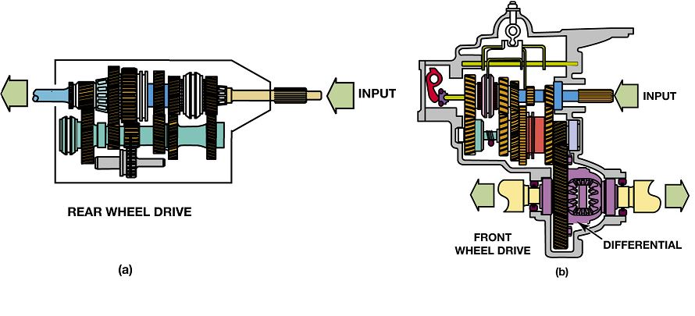
Figure 2.23
Rear-wheel Drive versus. Front-wheel Drive
Rear Wheel Drive (R W D)
Front Wheel Drive (F W D)
Many vehicles use transaxle to drive front wheels, called F W D
Half shafts: drive front wheels
Notes:
Figure 2-23 RWD drivetrain uses a transmission to provide the necessary gear ratio and a single driveshaft to transfer power to the rear axle (a). A FWD drivetrain uses a transaxle that combines the transmission’s final drive, and differential (b). A driveshaft is used for each front drive wheel
Most vehicles had the transmission mounted behind the engine and used a driveshaft to transfer power to the rear axle and driving wheels. This drivetrain is called rear-wheel drive (RWD).
Many vehicles use a transaxle to drive the front wheels, called front-wheel drive (FWD). Most FWD vehicles have the engine mounted in a transverse position, crosswise in the vehicle. Some are longitudinally mounted, in a lengthwise position as in RWD vehicles.
Two short driveshafts, called half shafts, are used to connect the transaxle to the front wheels. Driving only two wheels is adequate for most driving conditions. When the roads are slippery or driving off road, driving all four wheels provides better vehicle control. SEE FIGURE 2–23.
Long Description:
In the rear-wheel-drive drivetrain, the transmission consists of many gear sets and a single driveshaft. The input is indicated by an arrow. Another arrow is present on the other side of the transmission moving outward. The transaxle is present. In the front-wheel-drive drivetrain, the transmission is much bigger than the rear wheel drive. It is also vertical rather than horizontal. The input is given in the right upper part of the transmission. In the right and left lower parts of the transmission, a single arrow is present moving outward. The differential is present near the bottom of the transmission.

Slide 62
Transaxle Differential
Compact combination of a transmission
Final drive gear reduction, and differential.
It can be either a manual, automatic, or continuously variable transaxle.
How does it operate?
Differential– What is it?
Notes:
Transaxle Operation
A transmission normally has one output shaft that couples to the rear axle through the driveshaft. A transaxle has two output shafts that couple to the two front wheels through a pair of driveshafts. The differential used in transaxles or drive axles is a torque-splitting device
that allows the two axle shafts to operate at different speeds so that a vehicle can turn corners. When a vehicle turns a
corner, the wheel on the outer side of the turning radius must travel farther than the inner wheel, but it must do this in the same period of time. Therefore, it must rotate faster while turning. Most differentials are composed of a group of four or more gears. One gear is coupled to each axle and two are mounted on the differential pinion shaft.
Long Description:
In the rear-wheel-drive drivetrain, the transmission consists of many gear sets and a single driveshaft. The input is indicated by an arrow. Another arrow is present on the other side of the transmission moving outward. The transaxle is present. In the front-wheel-drive drivetrain, the transmission is much bigger than the rear wheel drive. It is also vertical rather than horizontal. The input is given in the right upper part of the transmission. In the right and left lower parts of the transmission, a single arrow is present moving outward. The differential is present near the bottom of the transmission.

Slide 63
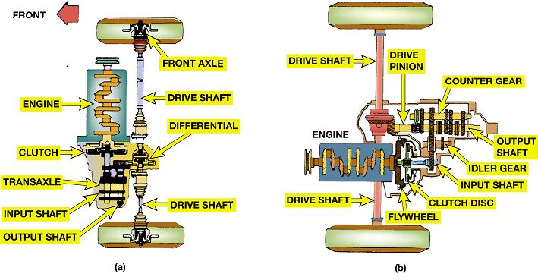
Figure 2.24
Transaxle
Transverse (a) and longitudinal (b) mounted front-wheel-drive (F W D) drivetrains.
Notes:
A transaxle is a compact combination of a transmission, the final drive gear reduction, and the differential.
It can be either a manual, automatic, or continuously variable transaxle. Transaxles are used in nearly all front-
wheel-drive vehicles, some mid-engine vehicles, rear engine, and even a few rear-wheel-drive vehicles. ● Figure 2–24.
Long Description:
In the transverse part, the front of the drivetrain is marked. The top of the drivetrain consists of the front axle connected to the drive shaft which is then connected to the differential. The differential then connects to the drive shaft of the other axle. The engine is present to the left of the drivetrain. The clutch is present adjacent to the engine. The clutch is joined to the transaxle, input shaft, and output shaft. This assembly of clutch, transaxle, input shaft, and the output shaft is connected to the differential. In the longitudinal part, the drive shaft is marked at both ends. The assembly in the middle of the drivetrain consists of the engine, flywheel, clutch disc, input shaft, idler gear, output shaft, counter gear, and drive pinion.

Slide 64
Animation: FWD Drivetrain (Animation will automatically start)

Slide 65
Driveshafts
Driveshafts
Driveshafts, also called propeller shaft or prop shaft
Transfer power from one component to another
Drive axle supports weight of rear of vehicle
Contains final drive reduction gears
Contains differential
Allows power to turn 90 degrees

Slide 66
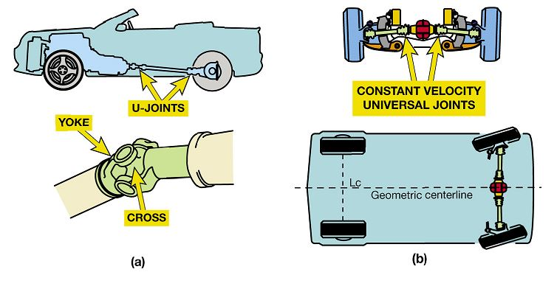
Figure 2.26
R W D & F W D
(a) A rear-wheel-drive (R W D) driveshaft uses a pair of universal joints to allow the rear axle to move up and down. (b) A front-wheel-drive (F W D) driveshaft uses a pair of constant-velocity joints to allow the front wheels to move up and down and steer.
Notes:
Long Description:
In the rear-wheel-drive, the figure of a car is shown. The car shows the transmission connected to the rear wheel by a shaft. Two u-joints are present on either end of the shaft. The close-up view of the u-joint is given. The joint consists of a cross and a yoke. In the front-wheel-drive, the transmission is present between two wheels. The driveshaft has constant two velocity universal joints. The image of the car is shown and the transmission is present between the rear wheels. The two front wheels have a dotted line between them which is labeled as Lc. A dotted line is present in the middle through the length of the car. This dotted line passes through the transmission. It is labeled as a geometric centerline. The rear wheels are present at a tilted angle.

Slide 67
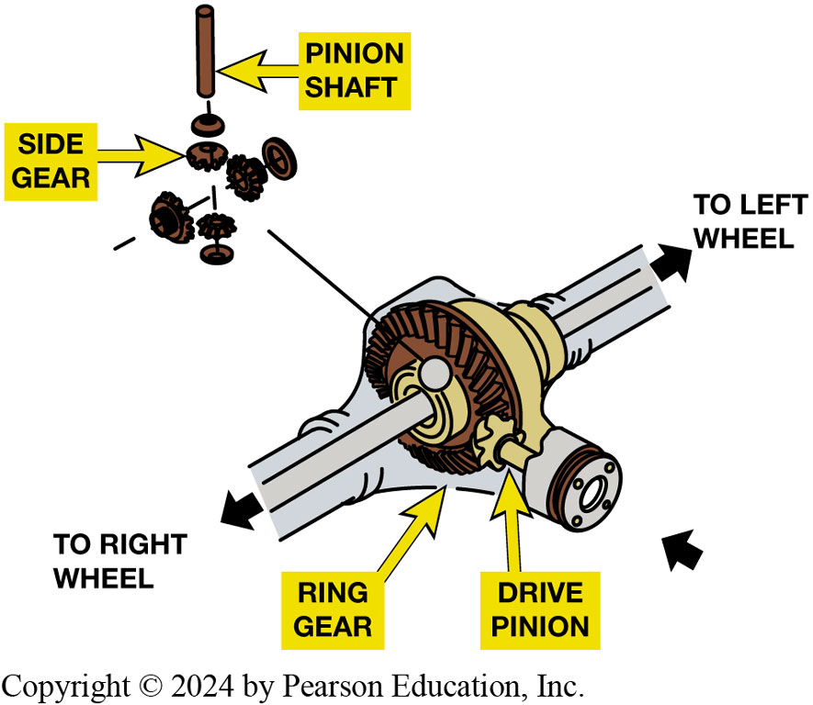
Figure 2.27
Drive Axle Assemblies
Drive axle includes a ring and pinion gear to produce a lower gear ratio as it turns power flow 90 degrees and differential (differential pinion, side gears) to allow drive wheels to rotate at different speeds.
Notes:
Rear-wheel-drive vehicles use a drive axle assembly at the rear. A drive axle performs four functions:
Supports the weight of the rear of the vehicle.
Contains the final drive reduction gears.
Contains differential, which transfers torque to both drive wheels and allows the wheels to rotate at different speeds when cornering.
Allows the power to turn 90 degrees.
Most axle assemblies use strong axle shafts to transfer torque from the differential gears to the wheels and tires.
A bearing at the outer end of the axle housing serves to transfer vehicle weight to the axle and then to the wheels and tires while allowing the shaft to rotate.
The term final drive refers to the last set of reduction gears in a gear train. The torque that is applied to the drive wheels, and cruising speed engine RPM, is determined by the reduction gears and the drive wheel
Long Description:
The ring gear and drive pinion are present in the middle of the drive axle. The shaft is attached to the left and right wheels. The close-up view of the pinion shaft and gear is shown. The pinion shaft is in a vertical position and is surrounded by the side gear. Some gears are present at a perpendicular angle.

Slide 68
Animation: FWD Driveshaft Operation (Animation will automatically start)

Slide 69
Frequently Asked Question: What Must Powertrain Overcome to Move Vehicle?
? Frequently Asked Question
What Must Powertrain Overcome to Move Vehicle? To propel vehicle, engine and drivetrain must overcome following:
Rolling friction, which is the drag of the tires on the road, and bearing friction. These frictions increase at a constant rate, doubling as the speed is doubled.
Aerodynamic drag, which is the wind resistance of air moving over the size and shape of the vehicle. It increases at a rapid rate, roughly four times as the speed is doubled (actually, velocity squared).
Grade resistance, which is equal to
times the vehicle weight
times the angle of the grade in percent.

Slide 70
Towing Capability
Drivetrain requirements
What are the features needed to tow a heavy load?
S A E J2807 standard
Climbing test
Acceleration test
Launching
Notes:
SAE J2807 Standard for Towing Starting in 2013, standard includes three vehicle performance standards
including:
Climbing test. During the climbing test, the vehicle with the loaded trailer (at the specified rating that the vehicle manufacturer states is the capacity of the vehicle) has to climb a hill that rises 3,000 feet (900 m) over a length of 11.4 miles (18 km) without dropping below 40 MPH (64 km/h). This test is based on the Davis Dam grade, a stretch of road in Arizona southeast of Las Vegas.
Acceleration test. During this test, the vehicle with loaded trailer must accelerate from 0 to 30 MPH (48 km/h) in 12 seconds and less than 30 seconds to reach 60 MPH (100 km/h).
Launching. This test is used to test the vehicle and loaded trailer in both forward and reverse. The test places the vehicle at the base of a long hill with a 12% grade. The vehicle must be able to climb the grade 16 feet (5 m) from a stop five times within five minutes.
These tests not only test the power of the vehicle but also that the engine and transmission can be kept at the proper temperature, meaning that the engine and transmission (if automatic) be equipped with a cooler.

Slide 71
Four-Wheel Drive
Four-wheel drive (4WD) designated as
Vehicle that has four driven wheels.
All-wheel-drive (A W D), called full-time four-wheel drive
Four-wheel-drive vehicles equipped with center (inner-axle) differential
Operated on pavement in four-wheel drive.
Notes:
Four-wheel drive (4WD) is often designated 4 × 4” and refers to a vehicle that has 4 driven wheels.
■ The first 4 indicates that the vehicle has four wheels.
■ The second 4 indicates that all four wheels are driven.
A vehicle will have more pulling power and traction if all of its wheels are driven. This requires a drive axle at each end of the vehicle, another driveshaft, and a transfer case or power transfer unit to drive the additional driveshaft and drive axle. The transfer case is normally attached to the rear of the transmission. It has a single input shaft from the transmission and two output shafts, one to the front drive axle and one to the rear drive axle. Some transfer cases are two-speed and include a set of reduction gears for lower-speed, higher torque operation. Four-wheel drive can be built into
Front-engine rear-wheel drive
Front-engine front-wheel drive
Rear-engine rear-wheel drive ● SEE FIGURE 2–27.
ALL-WHEEL DRIVE (AWD), also called full-time four-wheel drive, vehicles are four-wheel-drive vehicles equipped with a center (inner-axle) differential so they can be operated on pavement in four-wheel drive. Full-time four-wheel drive is another name for all-wheel drive. All-wheel-drive vehicles are designed for improved on-road handling. There will be one differential in each drive axle assembly plus a differential between the two drive axles. The inter-axle differential allows the front-to-rear wheel speed differential. Because all wheels are driven, these vehicles are excellent for use in rain and snow where added control is needed.

Slide 72
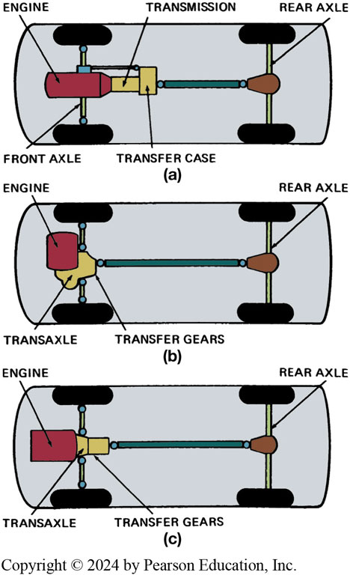
Figure 2.28
4W D Configurations
Three major 4W D configurations. The traditional form (a) uses a transfer case to split the torque for the front and rear drive axles. Both (b) and (c) are typical A W D configurations.
Notes:
Rear-wheel-drive vehicles use a drive axle assembly at the rear. A drive axle performs four functions:
Supports the weight of the rear of the vehicle.
Contains the final drive reduction gears.
Contains differential, which transfers torque to both drive wheels and allows the wheels to rotate at different speeds when cornering.
Allows the power to turn 90 degrees.
Most axle assemblies use strong axle shafts to transfer torque from the differential gears to the wheels and tires.
A bearing at the outer end of the axle housing serves to transfer vehicle weight to the axle and then to the wheels and tires while allowing the shaft to rotate.
The term final drive refers to the last set of reduction gears in a gear train. The torque that is applied to the drive wheels, and cruising speed engine RPM, is determined by the reduction gears and the drive wheel
Long Description:
In the first configuration, the outline of a car is shown. The engine is present near the front axle. The transmission is present adjacent to the engine. The transfer case is present adjacent to the transmission. This assembly is connected to the rear axle by a shaft. In the second configuration, the transaxle is present on the shaft between the front wheels. The engine is present on top of the transaxle. The transfer gears are present adjacent to the transaxle. This assembly is connected to the rear axle by a shaft. In the third configuration, the transaxle is present on the shaft between the front wheels. The transfer gears are present adjacent to the transaxle. The engine is present near the transaxle. This assembly is connected to the rear axle by a shaft.

Slide 73
Animation: 4WD Drivetrain FWD Based (Animation will automatically start)
4WD Drivetrain FWD Based

Slide 74
Summary (1 of 2)
Vehicles are built as rear-wheel drive, front-wheel drive, and four- or all-wheel drive.
Engines develop torque and the drivetrains modify that torque to move the vehicle.
A variety of gears are used to modify torque.
The gear ratio is determined by dividing the number of driven gear teeth by the number of teeth on the driving gear.

Slide 75
Summary (2 of 2)
Manual transmissions use a clutch and automatic transmissions use a torque converter.
Driveshafts and the drive axle complete the drivetrain.
Four-wheel-drive and all-wheel-drive vehicles have a transfer case or transfer gears and a second drive axle.

Slide 76
Automatic Transmissions and Transaxles Videos and Animations
Videos Link: (A2) Automatic Transmissions and Transaxles Videos
Animations Link: (A2) Automatic Transmissions and Transaxles Animations

Slide 77
Copyright
This work is protected by United States copyright laws and is provided solely for the use of instructors in teaching their courses and assessing student learning. Dissemination or sale of any part of this work (including on the World Wide Web) will destroy the integrity of the work and is not permitted. The work and materials from it should never be made available to students except by instructors using the accompanying text in their classes. All recipients of this work are expected to abide by these restrictions and to honor the intended pedagogical purposes and the needs of other instructors who rely on these materials.

