Slide 1
Automatic Transmissions and Transaxles
Eighth Edition
Chapter 1
Service Information, Work Orders, and Vehicle Identification
Copyright © 2024, 2018, 2015 Pearson Education, Inc. All Rights Reserved
Notes:
If this PowerPoint presentation contains mathematical equations, you may need to check that your computer has the following installed:
1) Math Type Plugin
2) Math Player (free versions available)
3) NVDA Reader (free versions available)
INSTRUCTOR NOTE: This presentation includes text explanation notes, you can use to teach the course. When in SLIDE SHOW mode, you RIGHT CLICK and select SHOW PRESENTER VIEW, to use the notes.

Slide 2
Learning Objectives (1 of 2)
1.1 Discuss the importance of vehicle owner’s manuals, service records, and service information.
1.2 Explain the different types of service information.
1.3 Describe vehicle recalls and campaigns.
1.4 Discuss the importance of the work order.

Slide 3
Learning Objectives (2 of 2)
1.5 Explain why service records are important.
1.6 Discuss the parts of a vehicle, and differentiate between front-wheel drive and rear-wheel drive.
1.7 Explain vehicle identification, vehicle safety certification label, and the V E C I label.

Slide 4
Owner’s Manual
Most owners’ manuals contain following:
Meaning of instrument panel warning symbols
How to reset maintenance reminder light
Specifications
Maintenance schedule
Warnings about improper operation
Explanation of various gear ranges
Notes:
Content
The owner’s manual is the instructional booklet that comes with every new vehicle and includes important
information. Most owners’ manuals contain all or most of the following information:
Meaning of instrument panel warning symbols
How to reset the maintenance reminder light
Specifications, including viscosity of oil needed and number of quarts (liters)
Maintenance schedule for all fluids, including coolant, brake fluid, automatic transmission fluid, and differential fluid
Warnings about improper operation, such as towing in overdrive
The explanation of various gear ranges

Slide 5
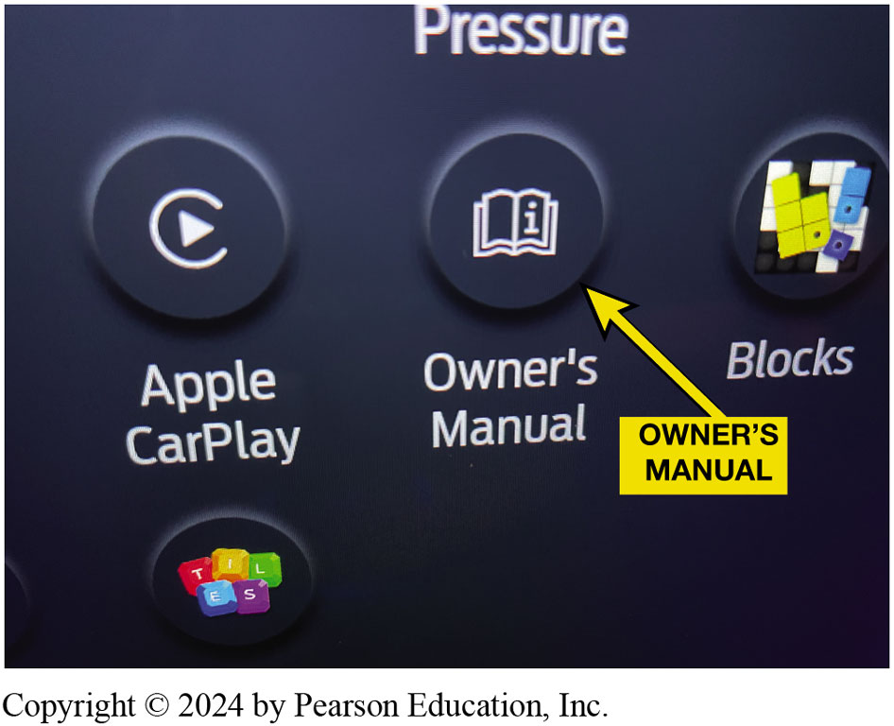
Figure 1.1
Owners Manual
The owner’s manual can be a paper manual or electronic accessed through the vehicle display.
Notes:
Long Description:
The switches are grouped under the heading “pressure”. One switch is labeled as “Apple CarPlay” with the play symbol inside the letter C. Another switch is labeled as “Owner’s Manual” with the letter of small “i” inside the icon of an open book. A yellow arrow points to this icon. The next switch is labeled as “Blocks” with the icon of building blocks. The next switch has an icon with the letters, t, i, l, e, and s.

Slide 6
Service Information (1 of 2)
Purpose of Service Information
Correctly service or repair vehicles
Factory Service Information
Until 1990s service information found in service or shop manuals, now digital
Most accurate service information is from vehicle manufacturer.
Notes:
Purpose of Service Information
Service information is needed to correctly service or repair vehicles because it contains all of the specifications, as well as the specified procedures to follow when servicing or repairing a vehicle.
Factory Service Information
Until the 1990s, most service information was found in paper manuals called service manuals or shop manuals.
More recently, the manufacturer provides this information in a digital format.
The most comprehensive and accurate service information is the service information from the vehicle manufacturer.
Tech Tip: Print It Out
It is often a benefit to have the written instructions or schematics (wiring diagrams) at the vehicle while diagnosing or performing a repair. The advantage of electronic service information is that the material can be printed out and taken to the vehicle for easy
access. This also allows the service technician to write or draw on the printed copy, which can be a big help when performing tests, such as electrical system measurements. The schematic can be color-coded to show where there should be voltage and where a ground should be detected. These notes can then be used to document the test results on the work order.

Slide 7
Service Information (2 of 2)
Aftermarket Service Information
Cover multiple years and/or models in one manual.
Paper service manuals disadvantages:
Required storage space
Difficult to use at vehicle or to make copies
Replaced with electronic service information
C D s then D V D s, before becoming available on Internet.
Notes:
Aftermarket Service Information
While factory service manuals cover just one year and one or more models of the same vehicle, most aftermarket service manuals cover multiple years and/or models in one manual.
Paper service manuals had the following disadvantages:
Required a lot of storage space
The pages would become dirty from handling
Difficult to use at the vehicle or to make copies from the thick manuals
Paper service manuals were replaced with electronic service information that came on C D s and then D V D s, before becoming available on the Internet.

Slide 8
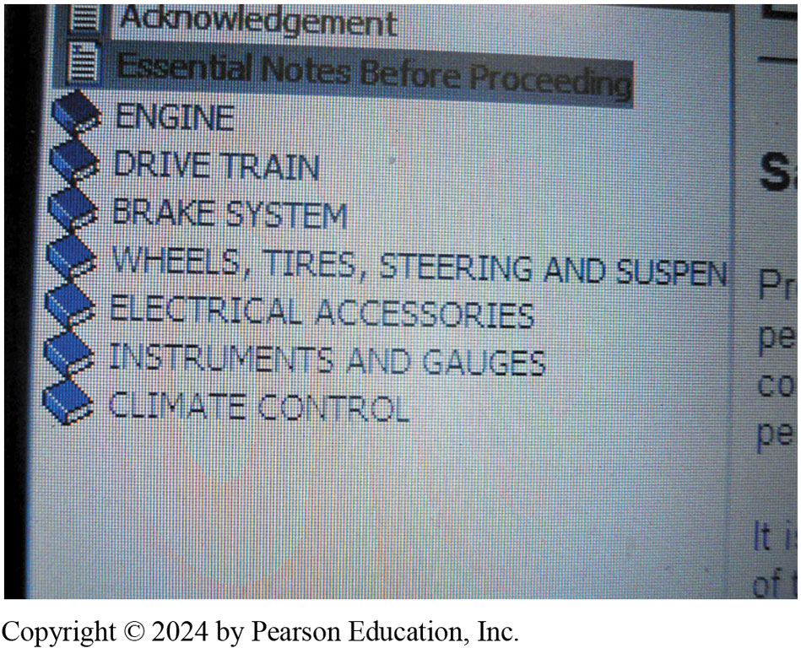
Figure 1.2
Service Info Menu
A main menu showing the major systems of the vehicle. Clicking on one of these major topics opens up another menu showing more detailed information.
Notes:
Long Description:
The icon of a page is shown followed by the word “acknowledgment.” Another icon of a page is followed by the words “essential notes before proceeding.” The next seven headings have the icon of a closed book. The titles of the seven are engine; drive train; brake system; wheels, tires, steering, and suspension; electrical accessories, instruments, and gauges, and climate control.

Slide 9
Technical Service Bulletins
Technical Service Bulletins
T S B issued by vehicle manufacturer
Notify of problem or other critical information.
Diagnostic procedures/necessary corrective action.
Not an authorization for repair
For dealership technicians
Notes:
Technical Service Bulletins
A technical service bulletin (T S B) is issued by the vehicle manufacturer to notify service technicians of a potential problem or other critical information.
The T S B may include diagnostic procedures and the necessary corrective action.
T S B s are not an authorization for repair or a guarantee to correct a concern.
T S B s are designed for dealership technicians, but are republished by aftermarket companies and made available along with other service information to shops and vehicle repair facilities.
Recalls and Campaigns
A campaign is typically issued when a manufacturer wants to improve a product’s performance or increase the customer’s satisfaction.
If the campaign involves a safety or emissions concern, it is considered a recall.
A recall can occur when either the manufacturer or the National Highway Traffic Safety Administration (N H T S A) determines there is a concern.
N H T S A WEB SITE FOR RECALLS: Check for Recalls: Vehicle, Car Seat, Tire, Equipment | N H T S A

Slide 10
Recalls and Campaigns
Recalls and Campaigns
Campaign issued when a manufacturer wants to improve performance or increase satisfaction.
Safety or emissions concern, it is considered a recall.
Recall occurs when either manufacturer or N H T S A determines there is a concern.
Notes:
Technical Service Bulletins
A technical service bulletin (T S B) is issued by the vehicle manufacturer to notify service technicians of a potential problem or other critical information.
The T S B may include diagnostic procedures and the necessary corrective action.
T S B s are not an authorization for repair or a guarantee to correct a concern.
T S B s are designed for dealership technicians, but are republished by aftermarket companies and made available along with other service information to shops and vehicle repair facilities.
Recalls and Campaigns
A campaign is typically issued when a manufacturer wants to improve a product’s performance or increase the customer’s satisfaction.
If the campaign involves a safety or emissions concern, it is considered a recall.
A recall can occur when either the manufacturer or the National Highway Traffic Safety Administration (N H T S A) determines there is a concern.
N H T S A WEB SITE FOR RECALLS: Check for Recalls: Vehicle, Car Seat, Tire, Equipment | N H T S A

Slide 11
Work Order (1 of 3)
Service Advisor Documentation
Work order or repair order (R O), is a legal document
Signed by vehicle owner or his/her representative.
Service advisor completes R O info:
Make, model, year color and V I N
Contact information
Date of service and person who wrote it
Estimate amount and list of requested work
Notes:
Service Advisor Documentation
The work order or repair order (R O), is a legal document that is signed by the vehicle owner or his/her representative.
The service advisor or the person designated to complete the work order has to include the following information:
Make, model, and year and other identifying information, such as color and vehicle identification number (V I N)
Name and address of the owner with contact information, such as the cell phone number and email address
Date of service and the name of the person who wrote the service invoice
The miles shown on the odometer
Estimate amount and list of requested work
All professional service facilities and shops use a form that is designed for their purposes and include all of the required information, as specified by the local area and state.

Slide 12
Work Order (2 of 3)
Service Technician Documentation
Technician perform services and repairs
Document work order for accuracy
Service tools were used such as:
Verified customer concern by what means
Looked for stored D T C & note it
Performed a visual inspection of components
Notes:
Service Technician Documentation
The role of the service technician is to not only perform the services and repairs as requested by the vehicle owner, but also to document the work order so that an accurate record of what was performed and the parts used on the work order.
The technician should document the work order by stating not only what was done, but what service tools were used such as:
Verified the customer concern of a rough running engine and the “check engine light” was on by visual inspection.
Looked for stored diagnostic trouble codes using a factory scan tool and noted that a P0300 (random misfire detected) was set.
Performed a visual inspection of the secondary ignition system components.
Found evidence of a coil boot that arced to the cylinder head on cylinders 2 and 3

Slide 13
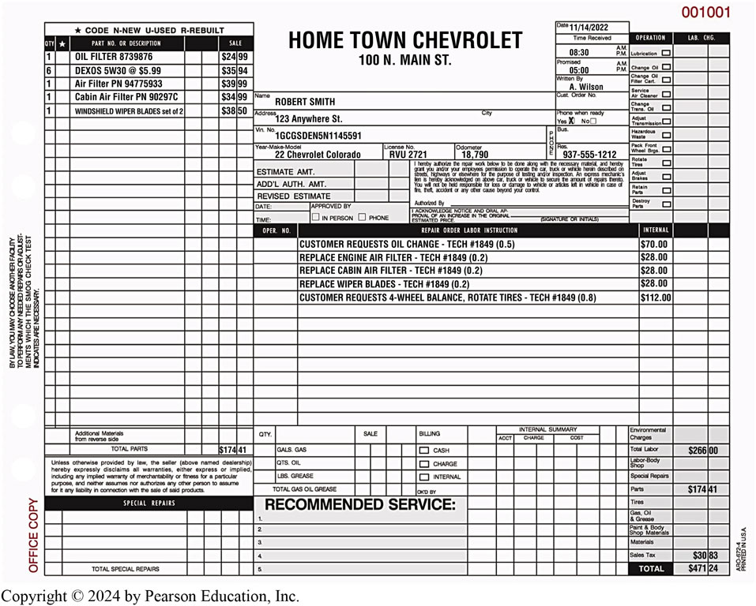
Figure 1.3
A typical work order showing the customer concern and what was done to correct the issue. Electronic work orders include all of the same required information.
Notes:
Long Description:
Text in the top left corner is a box with the following text: Customer’s Description of Problem or Repair; This accurately describes the problem or symptom I am experiencing with my motor vehicle. Customer’s Initials blank space. Below this is a table with column headings such as cost, quantity, part number or description, and price. The text at the lower part of this table reads as SUBLET REPAIRS. On the top right corner is number 8993 and below this is a table with column headings as TECH ID number slash INIT and LABOR CHARGE. Row headings are CHANGE OIL, CHANGE OIL FILTER CART, and CHANGE TRANS. OIL and so on with checkboxes. In the center are details of name, address, date received and completion date, city, state, zip, mileage in and out, VIN, ENGINE Number, MAKE, type of model, year, license number, phone when ready yes or no, terms, order accepted by and phone. Below this is another table that lists operation numbers and instructions. The bottom part is divided into three sections, first tilted estimate, second titled ALL PARTS ARE NEW UNLESS SPECIFIED OTHERWISE, and third is a table. Text in the first section reads as follows; (UNDER OHIO LAW) YOU HAVE THE RIGHT TO AN ESTIMATE IF THE EXPECTED COST OF RE-PAIRS OR SEVENTY-FIVE DOLLARS. INITIAL YOUR CHOICE. WRITTEN ORAL Blank ESTIMATE blank ESTIMATE I DO NOT REQUEST blank AN ESTIMATE. WARRANTY STATEMENT AND DISCLAIMER: THE DEALER HEREBY DISCLAIMS ALL WARRANTIES EXPRESS OR IMPLIED, INCLUDING ANY IMPLIED WARRANTIES OF MERCHANTABILITY OR FITNESS FOR A PARTICULAR PURPOSE, AND NEITHER ASSUMES NOR AUTHORIZES ANY OTHER PERSON TO ASSUME FOR IT ANY LIABILITY IN CONNECTION WITH THE SALE OF SAID PARTS OR THIS REPAIR. THIS DISCLAIMER IN NO WAY AFFECTS THE PROVISIONS OF ANY MANUFACTURER OR OTHER SUPPLIER WARRANTIES. IF DEALER PROVIDES A WRITTEN WARRANTY, ANY IMPLIED WARRANTIES ARE EXPRESSLY LIMITED TO THE TERM OF THE WRITTEN WARRANTY. ORIGINAL ESTIMATE dollar blank, CUSTOMERS ACCEPTANCE INITIAL HERE, space to fill DATE, TIME, BY. AUTHORIZED ADDITIONS dollar blank. In the event that you, the customer, authorize commencement but do not authorize completion of a repair or service, a charge will be imposed for disassembly, reassembly or partially completed work. Such charge will be directly related to the actual amount of labor or parts involved in the inspection, repair or service. Text in second section reads as follows: This Facility charges blank % of the Total Blank Charges, up to a Maximum of blank dollars, for Shop Materials. WE WILL OFFER TO RETURN TO YOU ALL REPLACED PARTS, AS REQUIRED BY LAW, UNLESS THEY ARE TO BE REBUILT, SOLD, OR RETURNED TO THE MANUFACTURER. I hereby authorize the repair work herein set forth to be done by you, together with the furnishing by you of the necessary parts and other material for such repair, and agree: that you are not responsible for any delays caused by unavailability or delayed availability of parts or material for any reason; that you neither assume nor authorize any other person to assume for you any liability in connection with such repair; that you shall not be responsible for loss of or damage to the above vehicle, or articles left therein, in case of fire, theft or other cause beyond your control; that an express mechanic’s lien is hereby acknowledged on the above vehicle to secure the amount of repairs thereto; that your employees may operate the above vehicle on streets, highways or elsewhere for the purpose of testing and/or inspecting such vehicle. I HEREBY ACKNOWLEDGE RECEIPT OF A COPY HEREOF. X blank line. Table in third section shows details of sales for TOTAL LABOR, TOTAL PARTS GAS, OIL & GREASE and SUBLET REPAIRS. Total Tax at bottom.

Slide 14
Work Order (3 of 3)
Parts Documentation
Parts used to make repair
Part number(s) and the costs are documented
Notes:
Parts Documentation
Parts are those items used to repair a vehicle or to restore it to useful service.
The part number(s) and the costs are usually documented on the work order by the parts department personnel in larger shops, or the shop owner or service manager in smaller shops.

Slide 15
Work Order Chart 1.1
Tenths of an Hour | Number of Minutes
0.1 | 6
0.2 | 12
0.3 | 18
0.4 | 24
0.5 | 30
0.6 | 36
0.7 | 42
0.8 | 48
0.9 | 54
1 point 0 | 60
Labor Time Documentation
Labor time, called flat rate, is found in labor guides
Service procedures & time complete task.
Basis for estimates
Pay technicians.
Some T S B s include time
The time that is published for repair and service operations are expressed in tenths of an hour.
Notes:
Labor Time Documentation
The labor time, called flat rate, is found in labor guides, and lists vehicle service procedures and the time it should take an average technician to complete the task.
This flat-rate time is the basis for estimates and the pay for the technicians.
Some T S B s include the time needed to accomplish the task.
Long Description:
The description and labor time for each procedure is given. The first procedure is brake burnish which has a time of 0.2 hours. The second procedure is the replacement of pads, front disc, and brake. The third procedure is R & R or replacing pads, and rear disc brake. For both the second and third procedures the comment given is to use published labor operation time.

Slide 16
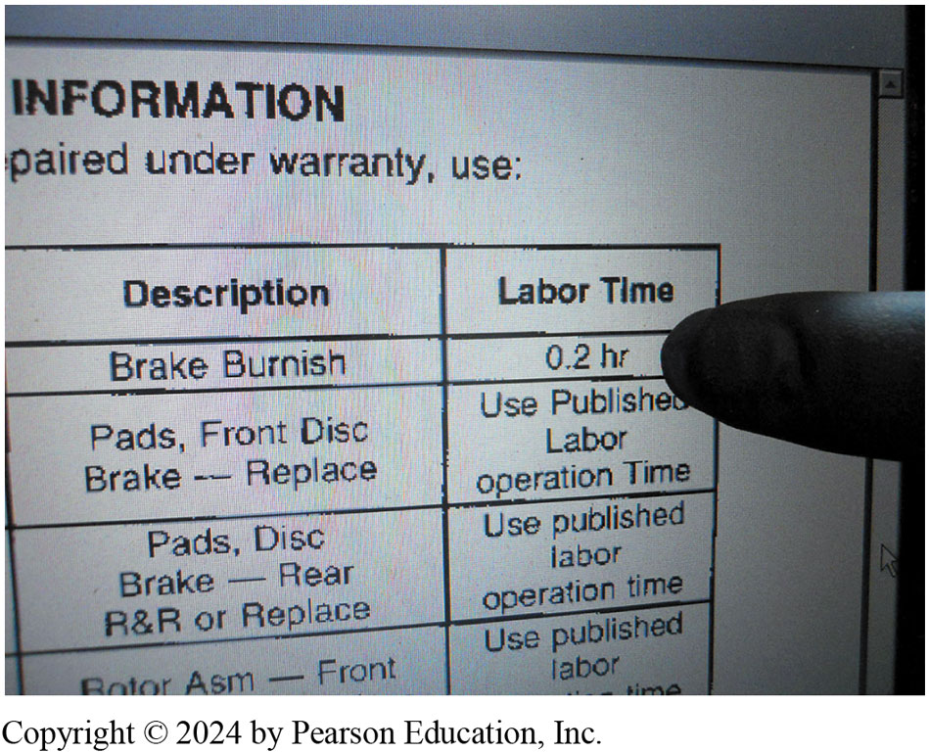
Figure 1.4
T S B s
Some technical service bulletins also include the designated flat-rate time when specifying a repair procedure.
Notes:
Long Description:
The description and labor time for each procedure is given. The first procedure is brake burnish which has a time of 0.2 hours. The second procedure is the replacement of pads, front disc, and brake. The third procedure is R & R or replacing pads, and rear disc brake. For both the second and third procedures the comment given is to use published labor operation time.

Slide 17
Animation: Work Order Estimate (Animation will automatically start)

Slide 18
Animation: Work Order Customer Copy (Animation will automatically start)

Slide 19
Animation: Work Order Technician Copy (Animation will automatically start)

Slide 20
Animation: Work Order Total Costs (Animation will automatically start)

Slide 21
Question 1
All of these are required on a Work Order: EXCEPT:
A. Customer concern
B. Vehicle mileage
C. V I N
D. Engine number

Slide 22
Answer 1
All of these are required on a Work Order: EXCEPT:
D. Engine Number

Slide 23
Service Records
Purpose
History of service work performed on vehicle
indicate reason for current problem or circuit
Previous collision repair
History of failure in same area as concern
Notes:
Purpose
The purpose of service records is to provide a history of the service work that has been performed on the vehicle in the past.
Often, a previous repair may indicate the reason for the current problem or it could be related to the same circuit or components.
Example #1—A collision could have caused hidden damage that can affect the operation of the vehicle.
Example #2—If the current issue is an error code for an engine misfire and the history of the service work on the vehicle does not show an oil change for several years, this might help the technician to find the root cause

Slide 24
Parts of a Vehicle
Parts of vehicle based on location & purpose of component.
Left side of the vehicle—Right side of a vehicle
Front and rear
Front-wheel drive versus rear-wheel drive
Notes:
Parts of Vehicle
The names of the parts of a vehicle are based on the location and purpose of the component.
Left Side of the Vehicle—Right Side of a Vehicle
Both of these terms refer to the left and right as if the driver is sitting behind the steering wheel.
Front and Rear
The proper term for the back portion of any vehicle is rear (e.g., left rear tire).
Front-Wheel Drive Versus Rear-Wheel Drive
Front-wheel drive (F W D) means that the front wheels are being driven by the engine, as well as turned by the steering wheel.
Rear-wheel drive (R W D) means that the rear wheels are driven by the engine.
If the engine is in the front, it can be either front- or rear-wheel drive. In many cases, a front engine vehicle can also drive all four wheels, called four wheel drive (4 W D) or all-wheel drive (A W D).
If the engine is located at the rear of the vehicle, it can be rear-wheel drive or four-wheel drive.

Slide 25
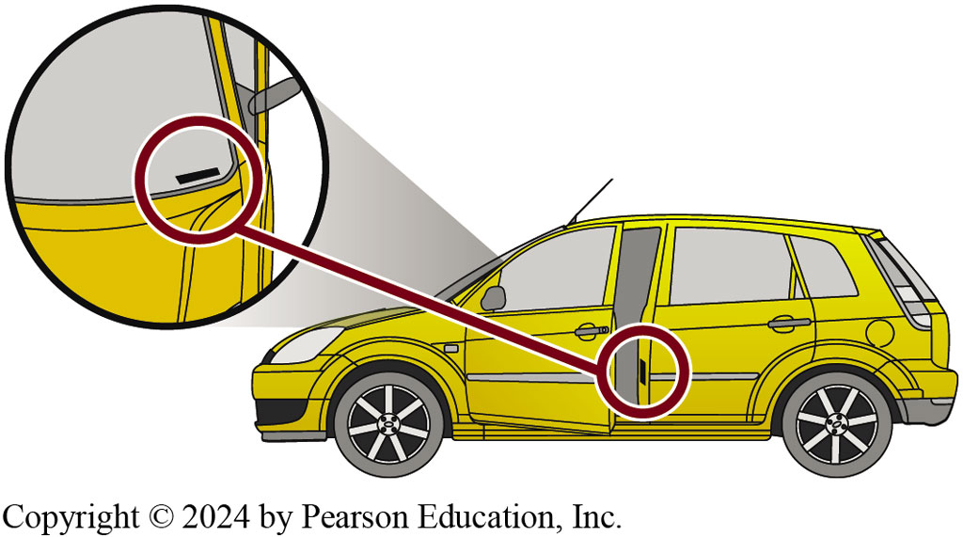
Figure 1.5
Vehicle Identification
Vehicle, engine and accessories, be properly identified.
Make, model, and year of the vehicle.
New model year (abbreviated M Y)
Why V I N is important?
The vehicle identification number (V I N) is visible through the base of the windshield and on a decal inside the driver’s door.
Notes:
All service work requires that the vehicle, including the engine and accessories, be properly identified.
The most common identification is the make, model, and year of the vehicle.
Make: e.g., Chevrolet
Model: e.g., Cruze
Year: e.g., 2014
The year of the vehicle is often difficult to determine exactly.
A model may be introduced as the next year’s model as soon as January of the previous year.
Typically, a new model year (abbreviated M Y) starts in September or October of the year prior to the actual new year, but not always.
This is why the vehicle identification number, usually abbreviated V I N, is so important

Slide 26
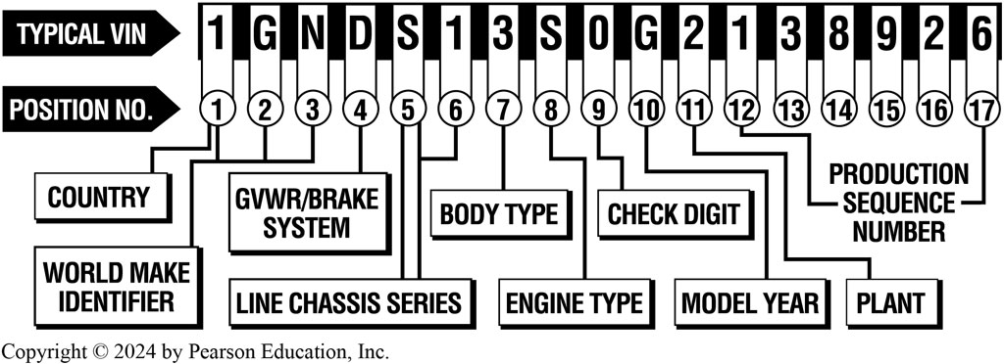
Figure 1.6
V I N
Vehicle Identification
Since 1981, 17 characters
Some constants:
number/letter designates
Country of origin
A Typical V I N showing the information that is represented.
Notes:
Vehicle Identification
Since 1981, all vehicle manufacturers have used a V I N that is 17 characters long.
Although every vehicle manufacturer assigns various letters or numbers within these 17 characters, there are some constants, including:
The first number or letter designates the country of origin
Long Description:
The first character designates the country of origin. The first, second, and third characters indicate the world make identifier. The fourth character indicates the G V W R/brake system. The fifth and sixth characters indicate the line chassis series. The seventh character indicates body type. The eighth character indicates engine type. The ninth character indicates to check the digit. The tenth character indicates the model year. The eleventh character indicates a plant. The twelfth to seventeenth characters are the production sequence number.

Slide 27
Chart 1.2
Country of Origin
1 = United States J = Japan U = Romania
2 = Canada K = Korea V = France
3 = Mexico L = China W = Germany
4 = United States M = India X = Russia
5 = United States N = Turkey Y = Sweden
6 = Australia P = Philippines Z = Italy
7 = United States R = Taiwan
8 = Argentina S = England
9 = Brazil T = Czechoslovakia
The first number or letter designates the country of origin.
Notes:
Vehicle Identification
The first number or letter designates the country of origin. ● SEE CHART 1.2.
The model of the vehicle is commonly the fourth and/or fifth character.
The eighth character is often the engine code. (Some engines cannot be determined by the V I N.)
The tenth character represents the model year (M Y) on all vehicles

Slide 28
Chart 1.3
Vehicle Year
A | = 1980/2010 | L | = 1990/2020 | Y = 2000/2030
B | = 1981/2011 | M | = 1991/2021 | 1 = 2001/2031
C | = 1982/2012 | N | = 1992/2022 | 2 = 2002/2032
D | = 1983/2013 | P | = 1993/2023 | 3 = 2003/2033
E | = 1984/2014 | R | = 1994/2024 | 4 = 2004/2034
F | = 1985/2015 | S | = 1995/2025 | 5 = 2005/2035
G | = 1986/2016 | T | = 1996/2026 | 6 = 2006/2036
H | = 1987/2017 | V | = 1997/2027 | 7 = 2007/2037
J | = 1988/2018 | W | = 1998/2028 | 8 = 2008/2038
K | = 1989/2019 | X | = 1999/2029 | 9 = 2009/2039
V I N year chart. (The pattern repeats every 30 years.)
Notes:
Vehicle Identification
The tenth character represents the model year (M Y) on all vehicles. ● SEE CHART 1.3.

Slide 29
Animation: Vehicle Identification Number, VIN (Animation will automatically start)

Slide 30
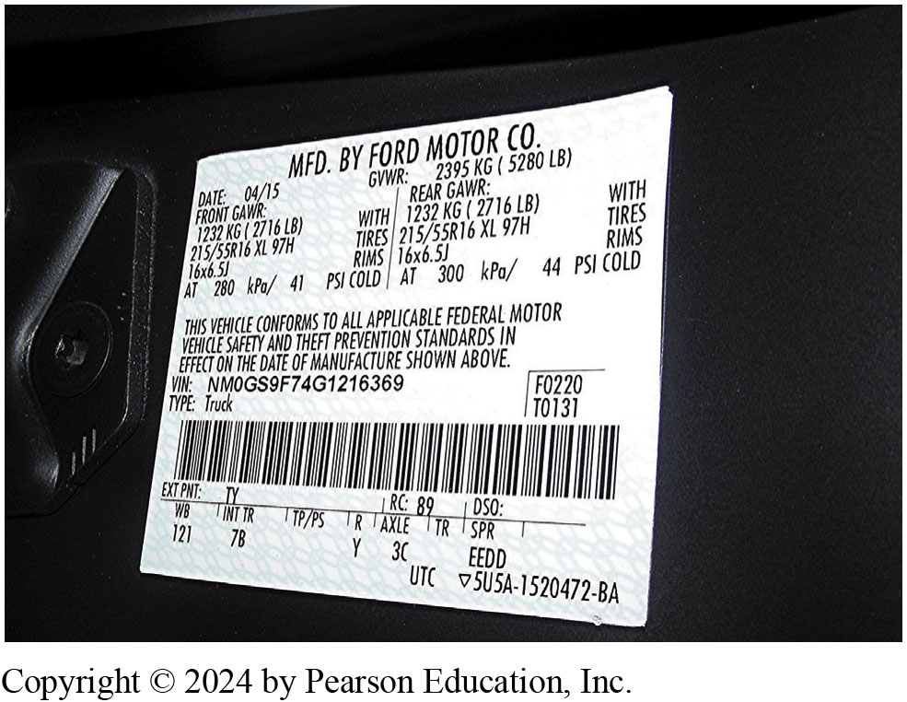
Figure 1.8
Vehicle Safety Certification Label
Left side pillar post on rearward-facing section of left front door.
Month/year of manufacture, V I N, G V W R & G A W R.
A typical vehicle safety certification label which shows the gross vehicle weight, gross axles weight rating, as well as the size and inflation pressure of the tires.
Notes:
A Vehicle Safety Certification Label is attached to the left side pillar post on the rearward-facing section of the left front door.
This label indicates the month and year of manufacture, the (V I N), as well as the G V W R and G A W R.
Gross vehicle weight rating (G V W R)—The maximum (upper limit) weight of a vehicle as specified by the vehicle manufacturer.
This is important to know if hauling a heavy load, such as in a truck or S U V.
Gross axle weight rating (G A W R)—The maximum weight that an axle can support is usually followed by “F R” for front axle and “R Cruse” for rear axle.
Long Description:
The text reads as follows: Date: 04 slash 15; G V W R: 2395 kilograms (5280 pounds). Details of Front G A W R are as follows: 1232 kilograms (2716 pounds) with; 215 slash 55 R 16 X L 97 H, Tires; 16 by 6.5 joules R I M S; at 280 kilo Pascal slash 41 P S I cold. Details of Rear G A W R are as follows: 1232 kilograms (2716 pounds) with; 215 slash 55 R 16 X L 97 H, Tires; 16 by 6.5 joules R I M S; at 300 kilo Pascal slash 44 P S I cold. This vehicle conforms to all applicable federal motor vehicle safety and theft prevention standards in effect on the date of manufacture shown above. Below are details of V I N; type (truck), a bar code, and other details.

Slide 31
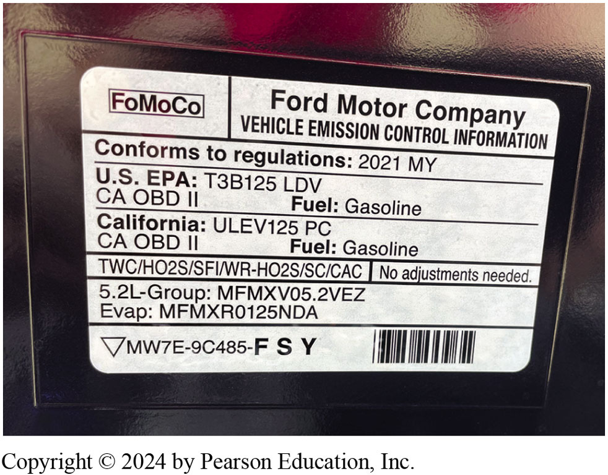
Figure 1.9
Vehicle Emissions Control Information (V E C I) label
Under hood
Settings & emission hose routing information.
Bottom side of hood, radiator fan shroud, radiator core support, or strut towers.
Vehicle emission control information (V E C I) decal indicates this vehicle meets both national E P A Tier3 Bin 125 (T3B125) and California U L E V 125 P C (passenger car) standard.
Notes:
Vehicle Emissions Control Information
The vehicle emissions control information (V E C I) label under the hood of the vehicle shows informative settings and emission hose routing information.
The V E C I label (sticker) can be located on the bottom side of the hood, the radiator fan shroud, the radiator core support, or the strut towers.
Long Description:
The logo of the Ford Motor Company is present at the top right corner of the decal. The name of the company is given along with the words” vehicle emission control information.” The next words in the decal are “conforms to regulations 2021 M Y.” The words “U.S. E P A: T 3 B 1 2 5 L D V” is given. Under that, “C A O B D II, fuel: gasoline” is given. The next words are “California: U L E V 1 2 5 P C. Under that “C A O B D II, fuel: gasoline” is given. There are other numbers given in the decal.

Slide 32
Summary (1 of 2)
Service information needed to correctly service vehicles.
Contains all of specifications, & specified procedures
T S B to notify of potential problem/critical information.
Campaign issued to improve a performance or increase customer satisfaction.
If the campaign involves safety or emissions, it is recall.
Recall can occur from manufacturer or N H T S A

Slide 33
Summary (2 of 2)
Work order, or repair order (R O), is a legal document
Signed by vehicle owner or his/her representative.
Service records is to provide a history of service work
New model year (M Y) starts in September/October of year
V E C I label under the hood of the vehicle
Informative settings/emission hose routing information

Slide 34
Automotive Fundamentals Videos and Animations
Videos Link: (A0) Automotive Fundamentals Videos
Animations Link: (A0) Automotive Fundamentals Animations

Slide 35
Copyright
This work is protected by United States copyright laws and is provided solely for the use of instructors in teaching their courses and assessing student learning. Dissemination or sale of any part of this work (including on the World Wide Web) will destroy the integrity of the work and is not permitted. The work and materials from it should never be made available to students except by instructors using the accompanying text in their classes. All recipients of this work are expected to abide by these restrictions and to honor the intended pedagogical purposes and the needs of other instructors who rely on these materials.

