Slide 1
Automotive Technology: Principles, Diagnosis, and Service
Seventh Edition
Chapter 97
Wheel Bearings and Service
Copyright © 2023 Pearson Education, Inc. All Rights Reserved
Notes:
INSTRUCTOR NOTE: This presentation includes text explanation notes, you can use to teach the course. When in SLIDE SHOW mode, you RIGHT CLICK and select SHOW PRESENTER VIEW, to use the notes.

Slide 2
Learning Objectives (1 of 2)
97.1 Describe the types of antifriction bearings.
97.2 Discuss bearing greases.
97.3 Discuss types of seals.
97.4 Explain the diagnosis of defective wheel bearings.
97.5 Describe wheel bearing service.

Slide 3
Learning Objectives (2 of 2)
97.6 Describe sealed bearing service.
97.7 Discuss rear drive axle classifications.
97.8 Describe rear axle bearing and seal replacement.
97.9 State the reasons for bearing failure.

Slide 4
Antifriction Bearings (1 of 3)
Purpose and Function
Bearings allow the wheels of a vehicle to rotate and still support the weight of the entire vehicle.
Ball Bearings
Ball bearings use hardened steel balls between the inner and outer race to reduce friction.
While ball bearings cannot support the same weight as roller bearings, there is less friction in ball bearings and they generally operate at higher speeds.

Slide 5
Antifriction Bearings (2 of 3)
Roller Bearings
Roller bearings use rollers between the inner and outer race to reduce friction.
A roller bearing having a greater (longer) contact area can support heavier loads than a ball bearing.
Tapered Roller Bearing
By design, this type of bearing can withstand radial loads (up and down) as well as axial loads (thrust) in one direction.

Slide 6
Antifriction Bearings (3 of 3)
Inner and Outer Wheel Bearings
Many vehicles use an inner and outer wheel bearing.
The inner wheel bearing is always the larger bearing because it is designed to carry most of the vehicle weight and transmit the weight to the suspension through to the spindle.
Standard Bearing Sizes
The standardization of bearing sizes helps interchangeability.
Sealed Front Wheel Drive Bearings
A most common nonadjustable bearing.

Slide 7
Figure 97.1 Rolling Contact Bearings
Rolling contact bearings include (left to right) ball, roller, needle, and tapered roller

Slide 8
Figure 97.2 Ball Bearing
Ball bearing point contact

Slide 9
Figure 97.3 Radial Load
Radial load is the vehicle weight pressing on the wheels. The thrust load occurs as the chassis components exert a side force during cornering

Slide 10
Figure 97.4 Roller Bearing
Roller bearing line contact

Slide 11
Figure 97.5 Tapered Roller Bearing
A tapered roller bearing will support a radial load and an axial load in only one direction

Slide 12
Figure 97.6 Front Wheel Bearing
A cross-sectional view of a typical front wheel bearing showing the larger tapered roller bearing with grease seal on the right and the smaller outer tapered roller bearing on the left.

Slide 13
Figure 97.7 Non-Drive Hub
Non-drive-wheel hub with inner and outer tapered roller bearings. By angling the inner and outer in opposite directions, axial (thrust) loads are supported in both directions

Slide 14
Figure 97.8a Sealed Ball Bearing
(a) Non-drive-wheel hub with inner and outer tapered roller bearings. By angling the inner and outer in opposite directions, axial (thrust) loads are supported in both directions

Slide 15
Figure 97.8 (b) Tapered Roller
(b) A type using tapered roller bearings

Slide 16
Figure 97.9 Serviced as a Unit
Sealed bearing and hub assemblies are serviced as a complete unit as shown. This hub assembly includes the wheel speed sensor

Slide 17
Frequently Asked Question: What Do Different Grease Colors Mean?
? Frequently Asked Question
What Do Different Grease Colors Mean? Nothing. According to grease manufacturers, grease is colored for identification, marketing, and for consistency of color reasons. Identification. The color is often used to distinguish one type of grease from another within same company. The blue grease from one company may be totally different from the blue grease produced or marketed by another company. Marketing. According to grease manufacturers, customers tend to be attracted to a particular color of grease and associate that color with quality. Consistency of color. All greases are produced in batches, and the color of the finished product often varies from one batch to another. By adding color to the grease, the color can be made consistent. Always use the grease recommended for the service being performed.

Slide 18
Question 1: ?
What are the three most common types of antifriction bearings?

Slide 19
Answer 1
Ball, roller, and tapered-roller.

Slide 20
Bearing Greases (1 of 3)
Definition of Grease
Grease is oil with a thickening agent to allow it to be installed in places where a liquid lubricant would not stay.
Grease Additives
Antioxidants
Antiwear agents
Rust inhibitors
Extreme pressure (E P) additives such as sulfurized fatty oil or chlorine

Slide 21
Bearing Greases (2 of 3)
N L G I Classification
National Lubricating Grease Institute (N L G I)
Uses penetration test as a guide to assign grease a number.
Low numbers are very fluid and higher numbers are more firm or hard.
Number 2 grease most commonly used.

Slide 22
Bearing Greases (3 of 3)
Grease is also classified according to quality.
G A—mild duty
G B—moderate duty
G C—severe duty, high temperature
Chassis grease, such as is used to lubricate steering and suspension components, includes the following classifications:
L A—mild duty (frequent relubrication)
L B—high loads (infrequent relubrication)

Slide 23
Question 2: ?
What are the two ways wheel bearing grease is classified?

Slide 24
Answer 2
Hardness and quality.

Slide 25
Seals
Purpose and Function
Seals are used in all vehicles to keep lubricant
Such as grease, from leaking out and to prevent dirt, dust, or water from getting into bearing or lubricant.
Types of Seals
Static seals used between 2 surfaces that do not move.
Dynamic seals are used to seal between 2 surfaces that move.

Slide 26
Figure 97.10 Lip Seal
Typical lip seal with a garter spring

Slide 27
Figure 97.11 Garter Spring
A garter spring helps hold the sharp lip edge of the seal tight against the shaft

Slide 28
Question 3: ?
What are the two types of seals?

Slide 29
Answer 3
Static and dynamic.

Slide 30
Bearing Diagnosis (1 of 2)
Symptoms of Defective Bearing
Hum, rumbling, or growling noise that increases with vehicle speed
Roughness felt in steering wheel that changes with speed or cornering
Looseness or excessive play in steering wheel, especially while driving over rough road surfaces
Loud grinding noise in severe cases, indicating a defective front wheel bearing
Pulling during braking
Notes:
WARNING: Smoking Can Kill You: Some greases contain polymers such as Teflon® that turn to a deadly gas when burned. Always wash your hands thoroughly after handling grease that contains these ingredients before smoking. If some of the grease is on the cigarette paper and is burned, these polymers turn into nitrofluoric acid—a deadly toxin.

Slide 31
Bearing Diagnosis (2 of 2)
Determining Bearing Noise from Tire Noise
Drive vehicle over a variety of road surfaces
If noise remains same, then cause is a defective wheel bearing
Try temporarily overinflating tires. If noise changes, then the tires are the cause.
Testing Wheel Bearing
With vehicle off the ground, rotate wheel by hand, listening and feeling carefully for bearing roughness.
Grasp tire top and bottom, wiggle and check for looseness.
Notes:
TECH TIP: Easy Wheel Bearing Looseness Test
Looseness in a front wheel bearing can allow the rotor to move whenever the front wheel hits a bump, forcing the caliper piston in, which causes the brake pedal to kick back and creates the feeling that the brakes are locking up. Loose wheel bearings are easily diagnosed by removing the cover of the master cylinder reservoir and watching the brake fluid as the front wheels are turned left and right with the steering wheel. If the brake fluid moves while the front wheels are being turned, caliper piston(s) are moving in and out, caused by loose wheel bearing(s). If everything is OK, the brake fluid should not move. Loose wheel bearings can also cause the brake pedal to sink due to movement of the rotor, causing the caliper piston to move. This sinking brake pedal is usually caused by a defective master cylinder. Before replacing a master cylinder, check the wheel bearings.

Slide 32
Wheel Bearing Service (1 of 2)
Steps in non-drive-wheel bearing inspection include:
Hoist vehicle safely and remove wheel.
Remove brake Caliper assembly and remove bearing dust cap.
Remove and discard cotter key.
Remove spindle nut, washer, and outside bearing.
Remove bearing hub, and remove inside bearing.
Clean both bearings and inspect for damage.

Slide 33
Wheel Bearing Service (2 of 2)
Non-drive-wheel bearing inspection continued…
Pack cleaned or new bearing thoroughly with clean, new, approved wheel bearing grease.
Place thin layer of grease on outer race.
Apply thin layer of grease to spindle
Install a new grease seal
Install hub, the outer bearing, washer and nut
Torque bearings to specifications and install new cotter key.
Install dust cap and brake Caliper.

Slide 34
Figure 97.12 Removing Grease Cap
Removing the grease cap with grease cap pliers

Slide 35
Chart 97.1 Bearing Diagnosis
Wheel bearing inspection chart. Replace the bearing if it has any of the faults shown. See Page 1134

Slide 36
Figure 97.13 Removing Seal
Using a seal puller to remove the grease seal

Slide 37
Figure 97.14 Cleaning Bearing
Cleaning a wheel bearing with a parts brush and solvent

Slide 38
Figure 97.15 Race Puller
A wheel bearing race puller

Slide 39
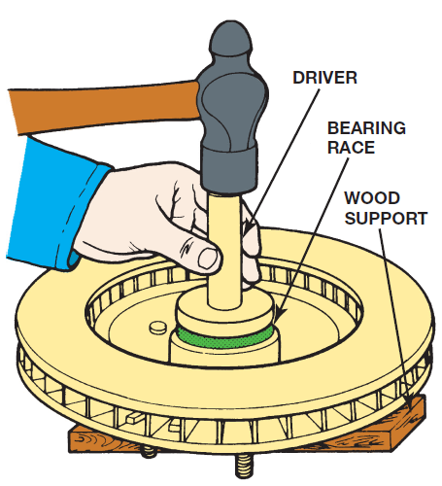
Figure 102.16

Slide 40
Figure 97.16 Installing Bearing Race
Installing a bearing race with a driver

Slide 41
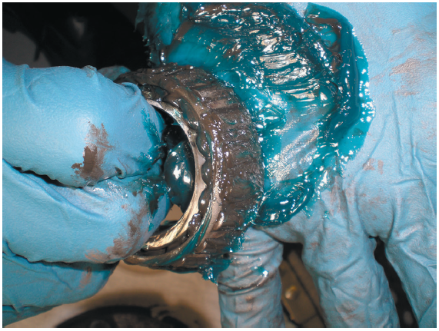
Figure 102.17

Slide 42
Figure 97.17 Packing Grease
Notice the new blue grease has been forced through the bearing

Slide 43
Figure 97.18 Wheel Bearing Packer
A commonly used hand-operated bearing packer

Slide 44
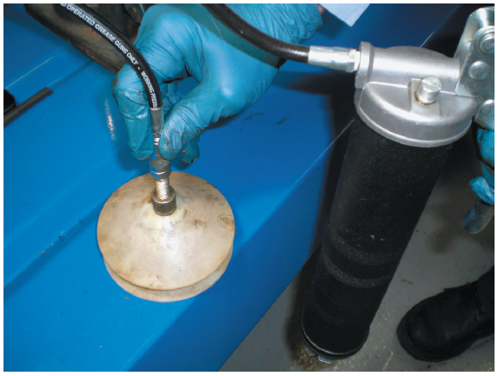
Figure 102.19

Slide 45
Figure 97.19 Packing the Bearing
The wheel bearing is placed between two nylon cones and then a grease gun is used to inject grease into the center of the bearing

Slide 46
Sealed Bearing Replacement
Some front-wheel-drive vehicles use a sealed bearing assembly that is bolted to the steering knuckle and supports the drive axle.
Many front-wheel-drive vehicles use a bearing that must be pressed off the steering knuckle.
Special aftermarket tools are also available to remove many of the bearings without removing the knuckle from the vehicle.

Slide 47
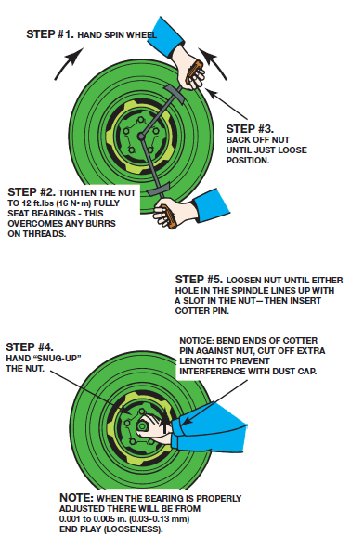
Figure 102.20

Slide 48
Figure 97.20 Bearing Adjustment
The wheel bearing adjustment procedure as specified for rear-wheel-drive vehicles. Always check service information for the specified procedure to follow

Slide 49
Figure 97.21 Cotter Pin Installation
A properly secured wheel bearing adjust nut

Slide 50
Figure 97.22 Sealed Wheel Bearing
A rear wheel sealed bearing hub assembly

Slide 51
Figure 97.23 Drive Axle Nut
Removing drive axle shaft hub nut. This nut is usually very tight and drift punch wedged into cooling fins of brake rotor keeps hub from revolving when nut is loosened. Never use an air impact wrench to loosen or tighten the drive axle shaft nut because the hammering action will damage the bearings.

Slide 52
Figure 97.24 Bearing Puller
A special puller makes the job of removing the hub bearing from the knuckle easy without damaging any component.

Slide 53
Rear Drive Axle Classifications (1 of 2)
Full-Floating Axle
The wheel mounts onto the hub, and lug bolts or nuts retain it. In this design, the axle shafts “float” in the axle housing and drive the wheels without supporting their weight.
¾ -Floating Axle
The bearings in a three-quarter-floating axle are mounted and retained in the brake drum or rotor hub, which mounts onto the axle housing.

Slide 54
Rear Drive Axle Classifications (2 of 2)
Semi-Floating Axle
The wheel bearings in a semi-floating axle either press onto the axle shaft or are installed in the outer end of the axle housing.
The outboard end of the shaft retains the wheel and transmits the weight of the wheel to the housing.

Slide 55
Figure 97.25 Full-Floating Rear Axle
A typical full-floating rear axle assembly

Slide 56
Figure 97.26 ¾ Floating Rear Axle
A three-quarter-floating rear axle

Slide 57
Figure 97.27 Semi-Floating Axle
A semi-floating rear axle housing is the most commonly used in light rear-wheel-drive vehicles

Slide 58
Rear Axle Bearing and Seal Replacement (1 of 2)
The rear axle must be removed from the vehicle to replace the rear axle bearing.
There are two basic types of axle retaining methods:
Retainer plate-type
C-lock

Slide 59
Rear Axle Bearing and Seal Replacement (2 of 2)
Retainer Plate-Type Rear Axles
Retainer plate-type rear axle uses 4 fasteners that retain axle in axle housing.
To remove axle shaft and rear axle bearing and seal, retainer bolts or nuts must be removed.
C-Lock-Type Axles
C-lock-type rear axle retaining method requires that differential cover plate be removed.
After removal of cover, differential pinion shaft has to be removed before C-lock that retains the axle can be removed.

Slide 60
Figure 97.28 Retainer Plate
A retainer plate-type rear axle bearing. Access to the fasteners is through a hole in the axle flange

Slide 61
Figure 97.29 Slide Hammer Removal
A slide-hammer-type axle puller can be used to remove an axle

Slide 62
Figure 97.30 Using the Brake Drum
To remove axle from this vehicle equipped with a retainer-plate rear axle, brake drum was placed back onto axle studs backward so that drum itself can be used as a slide hammer to pull the axle out of the axle housing. A couple of pulls and the rear axle is pulled out of the axle housing
Notes:
TECH TIP: The Brake Drum Slide Hammer Trick
To remove the axle from a vehicle equipped with a retainer plate-type rear axle, simply use the
brake drum as a slide hammer to remove the axle from the axle housing. ● SEE FIGURE 97–30. If the brake drum does not provide enough force, a slide hammer can also be used to remove the axle shaft.

Slide 63
Figure 97.31 C-Lock Removal
To remove the C-lock (clip), the lock bolt must be removed before the pinion shaft is taken out

Slide 64
Figure 97.32 C-Lock Removed
The axle must be pushed inward slightly to allow the C-lock to be removed. After the C-lock has been removed, the axle can be easily pulled out of the axle housing

Slide 65
Figure 97.33 Hydraulic Press
Using a hydraulic press to press an axle bearing from the axle. When pressing a new bearing back onto the axle, pressure should only be on the inner bearing race to prevent damaging the bearing

Slide 66
Figure 97.34 Removing Axle Seal
Removing an axle seal using the axle shaft as the tool. While this procedure is done in some shops, the preferred and specified procedure is to use a seal puller

Slide 67
Bearing Failure Analysis
A wheel bearing may also fail for reasons that include the following:
Metal Fatigue
Electrical Arcing
Shock Loading

Slide 68
Figure 97.35 Bent Cage
This bearing has a bent cage and must be replaced
Notes:
TECH TIP: “Bearing Overload”
It is not uncommon for vehicles to be overloaded. This is particularly common with pickup trucks
and vans. Whenever there is a heavy load, the axle bearings must support the entire weight of the vehicle, including its cargo. If a bump is hit while driving with a heavy load, the balls of a ball bearing
or the rollers of a roller bearing can make an indent in the race of the bearing. This dent or
imprint is called brinelling, named after Johann A. Brinell, a Swedish engineer who developed
a process of testing for surface hardness by pressing a hard ball with a standard force into a
sample material to be tested. Once this imprint is made, the bearing will make noise whenever the roller or ball rolls over the indent. Continued use causes wear to occur on all of the balls or rollers and eventual failure.
While this may take months to fail, the cause of the bearing failure is often overloading of the vehicle. Avoid shock loads and overloading for safety and for longer vehicle life.

Slide 69
Figure 97.36 Detection Using Spring
To detect a possible defective wheel bearing, grasp the coil spring and then rotate the wheel. If there is roughness in the bearing, a vibration will be felt in the spring
Notes:
TECH TIP: Touch the Spring When Checking for Bearing Noise
Wheel bearing noises are often hard to pin down because the noise can be transmitted throughout the vehicle. Whenever diagnosing a possible defective wheel bearing, use one hand to grasp the spring while using the other hand to rotate the wheel. The roughness of a defective wheel bearing is easily detected by feeling a vibration in the coil spring. FIGURE 97–36.

Slide 70
Figure 97.37 ABS Reluctor
A bearing/hub assembly that shows the reluctor (tone wheel) teeth used by the wheel speed sensor
Notes:
TECH TIP: Double-Check the Bearing Part Number
Most wheel bearing/hub assemblies include the tone wheel (reluctor ring), which is used by the
wheel speed sensor for use by the electronic brake control unit for electronic stability control
and antilock brake operation. The number of notches or teeth on the bearing hub can and do vary. If the incorrect bearing is installed, it can cause the amber ABS warning lamp to come on and a wheel speed sensor diagnostic trouble code to be set. FIGURE 97–37.
CASE STUDY: The Noisy Toyota
A customer complained that a noise was heard from the rear of a Toyota Highlander SUV. During a
test drive, the service technician did notice a slight noise and thought it might be due to a tire.
Driving over various types of road surfaces did not change the level or the pitch (frequency) of
the noise indicating that the noise was due to a bearing rather than a tire. As a double check that
a tire was not the issue, the technician rotated tires placing the front tires in the rear and the
rear tires on the front. Another test drive resulted in the same results. The technician then recommended that the right rear wheel bearing (bearing hub assembly) be replaced and the customer agreed to the estimate. When the hub bearing was removed and checked for any roughness, the technician did not feel or hear any noise from the old bearing. However, once the new bearing was replaced, the noise was gone during a test drive.
Summary:
Complaint—Customer complained of a noise from the right rear of the SUV.
Cause—Defective wheel bearing.
Correction—Replacing the right rear bearing/hub assembly fixed the noise concern.

Slide 71
Rear Axle Bearing Service

Slide 72
1. Raise Vehicle Remove Drums
1. After safely hoisting the vehicle, remove the rear wheels and brake drums

Slide 73
2. Remove Differential Cover
2. Remove the rear differential cover and inspect the magnet for metal particles that would indicate serious wear or damage

Slide 74
3. Remove Pinion Retainer
3. Remove the retaining bolt and allow the pinion shaft to be removed

Slide 75
4. Push Axle Inward Toward Center
4. Push the axle inward toward the center of the vehicle to free the axle clip

Slide 76
5. Remove Axle
5. After removing the clip, the axle can then be removed. Note that the backing plate is wet, indicating that the axle seal has been leaking

Slide 77
6. Remove Axle Seal
6. A seal removal tool being used to remove the axle seal

Slide 78
7. Retainer Type Axle
7. If a retainer-type axle is being serviced, the bearing and seal need to be pressed off of the axle

Slide 79
8. Inserting C-Lock Axle
8. After installing a new bearing and seal, insert the axle and install the clip, then the pinion shaft

Slide 80
9. Install Gasket and Cover
9. Clean the differential housing before installing the cover gasket and cover. Refill the differential with the specified fluid

Slide 81
Animation: Wheel Bearing Assembly (Animation will automatically start)

Slide 82
Animation: Wheel Bearing & Hub Replacement (Animation will automatically start)

Slide 83
Animation: Remove and Replace Axle Shaft, Bearing Retained (Animation will automatically start)

Slide 84
Animation: Adjust Carrier, Threaded Adjusters (Animation will automatically start)

Slide 85
Animation: Seal Driver (Animation will automatically start)

Slide 86
Brakes Videos and Animations
Videos Link: (A5) Brakes Videos
Animations Link: (A5) Brakes Animations

Slide 87
Copyright
This work is protected by United States copyright laws and is provided solely for the use of instructors in teaching their courses and assessing student learning. Dissemination or sale of any part of this work (including on the World Wide Web) will destroy the integrity of the work and is not permitted. The work and materials from it should never be made available to students except by instructors using the accompanying text in their classes. All recipients of this work are expected to abide by these restrictions and to honor the intended pedagogical purposes and the needs of other instructors who rely on these materials.

