Slide 1
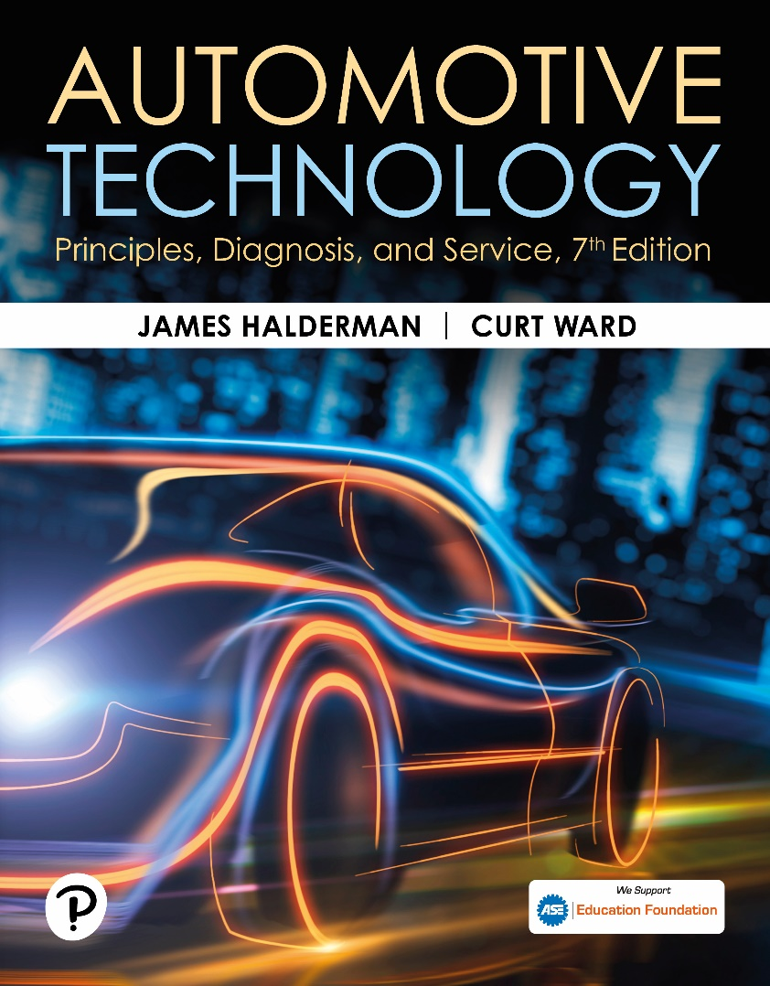
Automotive Technology: Principles, Diagnosis, and Service
Seventh Edition
Chapter 94
Braking System Principles and Friction Materials
Copyright © 2023 Pearson Education, Inc. All Rights Reserved
Notes:
INSTRUCTOR NOTE: This presentation includes text explanation notes, you can use to teach the course. When in SLIDE SHOW mode, you RIGHT CLICK and select SHOW PRESENTER VIEW, to use the notes.

Slide 2
Learning Objectives (1 of 2)
94.1 Discuss the energy principles that apply to brakes.
94.2 Discuss the friction principles that apply to brakes.
94.3 Discuss inertia as it applies to brakes.
94.4 Discuss the friction principles that apply to brakes.
94.5 Describe how brakes can fade due to excessive heat.
94.6 Describe how deceleration rates are measured.
94.7 Describe brake friction materials.

Slide 3
Learning Objectives (2 of 2)
94.8 Discuss asbestos as it applies to brakes.
94.9 Describe semimetallic friction materials.
94.10 Discuss non-asbestos/ceramic friction materials.
94.11 Explain brake pad environmental concerns.
94.12 Discuss the use of edge codes on friction materials.

Slide 4
Energy and Work
Energy
Energy is the ability to do work.
Work
Work is the transfer of energy from one physical system to another.
Kinetic Energy
It is the energy of mass in motion.

Slide 5
Figure 94.1 Energy
Energy, which is the ability to perform work, exists in many forms

Slide 6
Figure 94.2 Kinetic Energy
Kinetic energy increases in direct proportion to the weight of the vehicle

Slide 7
Figure 94.3 Kinetic Energy Squared
Kinetic energy increases as the square of any increase in vehicle speed

Slide 8
Question 1: ?
What is kinetic energy?

Slide 9
Answer 1
The energy of a mass in motion.

Slide 10
Inertia (1 of 2)
Definition
Inertia is a property of matter by virtue of which a body at rest tends to remain at rest, and a body in motion tends to remain in motion in a straight line unless acted upon by an outside force.
Weight Transfer
When the brakes are applied at the wheel assembly, only the wheels and tires begin to slow immediately.
The rest of the vehicle, all of the weight carried by the suspension, attempts to remain in forward motion.

Slide 11
Inertia (2 of 2)
Weight Bias
The total weight of the vehicle does not change during a brake application, only the amount supported by each axle.
Front-wheel-drive (F W D) vehicles, in particular, have a forward weight bias.
To deal with the extra load, the front brakes are much more powerful than the rear brakes.

Slide 12
Figure 94.4 Inertia
Inertia creates weight transfer that requires the front brakes to provide most of the braking force

Slide 13
Animation: Inertia (Animation will automatically start)

Slide 14
Figure 94.5 Inertia FWD
Front-wheel-drive vehicles have most of their weight over the front wheels

Slide 15
Coefficient of Friction
Definition
The amount of friction between two objects or surfaces is commonly expressed as a value called the coefficient of friction.
Static and Kinetic Friction
Static value is the coefficient of friction with two friction surfaces at rest.
Kinetic value is the coefficient of friction while the two surfaces are sliding against one another.

Slide 16
Figure 94.6 Coefficient of Friction
The static coefficient of friction of an object at rest is higher than the kinetic (dynamic) friction coefficient once in motion

Slide 17
Animation: Coefficient of Friction (Animation will automatically start)

Slide 18
Chart 94.1 Braking Materials
CONTACTING SURFACES | STATIC COEFFICIENT OF FRICTION | KINETIC COEFFICIENT OF FRICTION
Steel on steel (dry) | 0.6 | 0.4
Steel on steel (greasy) | 0.1 | 0.05
Teflon on steel | 0.04 | 0.04
Brass on steel (dry) | 0.5 | 0.4
Brake lining on cast iron | 0.4 | 0.3
Rubber tires on smooth pavement (dry) | 0.9 | 0.8
Every combination of materials has different static and kinetic friction coefficients.

Slide 19
Question 2: ?
What is coefficient of friction?

Slide 20
Answer 2
The amount of friction between two surfaces.

Slide 21
Brake Fade (1 of 2)
Definition
If repeated hard stops are performed, the brake system components can overheat and lose effectiveness, or possibly fail altogether.
Mechanical Fade
Mechanical fade occurs when a brake drum overheats and expands away from the brake lining.
Lining Fade
The friction material overheats to the point where its coefficient of friction drops off.

Slide 22
Brake Fade (2 of 2)
Gas Fade
Under very hard braking, when a thin layer of hot gases and dust particles builds up between the brake drum or rotor and linings
Water Fade
Water fade occurs when water gets between the brake drum and the linings.

Slide 23
Figure 94.7 Heat Graph
Some heat increases the coefficient of friction, but too much heat can cause it to drop off sharply

Slide 24
Figure 94.8 Brake Fade
One cause of brake fade occurs when the phenolic resin, a part of the friction material, gets so hot that it vaporizes. The vaporized gas from the disc brake pads gets between the rotor (disc) and the friction pad. Because the friction pad is no longer in contact with the rotor, no additional braking force is possible

Slide 25
Figure 94.9 PRNDL Tech Tip
The gear selector is often called the “PRNDL,” pronounced “prindle,” regardless of the actual letters or numbers used
Notes:
TECH TIP: How to Reduce Possible Brake Fade?
To help prevent possible brake fade while descending long hills, place the gear selector into a
lower drive range, such as “2,” or even “1,” if going slowly enough.
This action allows for additional engine braking and takes the load off of the wheel brakes. ● SEE
FIGURE 94–9.

Slide 26
Deceleration Rates
Terminology
Deceleration rates are measured in units of “feet per second per second.”
Typical Deceleration Rates
Comfortable deceleration is about 8.5 ft/sec² (3 m/sec²).
Loose items in the vehicle “fly” above 11 ft/sec² (3.5 m/sec²).
Brake temperature
1,300°F (700°C) or higher during normal driving

Slide 27
Figure 94.10 Rapid Braking
Rapid braking causes the brake friction material to wear more compared to gentle, less aggressive, braking

Slide 28
Brake Friction Materials
Brake friction materials are composed of relatively soft but tough and heat-resistant material to provide the friction between the moveable part (drum or rotor) and the stationary part of the braking system.

Slide 29
Asbestos (1 of 2)
Definition
Asbestos is a term used to describe naturally occurring silicate minerals that consist of long fibers.
Asbestos Hazards
Exposure to asbestos can cause the formation of scar tissue in the lungs. This condition is called asbestosis.

Slide 30
Asbestos (2 of 2)
The use of asbestos for brake linings was never abandoned completely.

Slide 31
Chart 94.2 Asbestos Compositions
INGREDIENT | TYPICAL FORMULA RANGE
Phenolic resin (binder) | 9% to 15%
Asbestos fiber | 30% to 50%
Organic friction modifiers (rubber scrap) | 8% to 19%
Inorganic friction modifiers (barites, talc, whiting) | 12% to 26%
Abrasive particles (alumina) | 4% to 20%
Carbon | 4% to 20%
Typical brake compositions for asbestos (organic) lining.
Notes:
TECH TIP: Competitively Priced Brakes
The term “competitively priced” means lower cost. Most brake manufacturers offer “premium” as well as lower-price linings to remain competitive with other manufacturers, or with importers of brake lining material produced overseas by U.S. or foreign companies. Organic asbestos brake lining
is inexpensive to manufacture. In fact, according to warehouse distributors and importers, the box often costs more than the brake lining inside. Professional brake service technicians should only install brake linings and pads that give braking performance equal to that of the original factory brakes. For best results, always purchase high-quality brake parts from a known brand-name manufacturer.

Slide 32
Semimetalic Friction Materials
Definition
The term semimetallic refers to the brake lining material that uses metal rather than asbestos in its formulation.

Slide 33
Chart 94.3 Semi-Metallic Material
INGREDIENT | FORMULA RANGE
Phenolic resin | 15% to 40%
Graphite or carbon particles | 15% to 40%
Steel fibers | 0% to 25%
Ceramic powders | 2% to 10%
Steel, copper, brass metal powders | 15% to 40%
Other modifiers (rubber scrap) | 0% to 20%
Typical brake compositions for semimetallic disc brake pads.

Slide 34
Non-Asbestos/Ceramic Friction Materials
Terminology
Brake pads and linings that use synthetic material, such as aramid fibers, instead of steel

Slide 35
Carbon Fiber Friction Materials
Terminology
Carbon fiber material is often called C F R C (carbon fiber-reinforced carbon). It is composed of a carbon mix into which reinforcing carbon fibers are embedded.
C F R C brakes provide constant friction coefficient, whether cold or hot, low wear rates, and low noise development.

Slide 36
Brake Pads and Environmental Concerns
Copper is used in brake pads for heat transfer, strength, and to reduce fade.
Copper is considered a pollutant.
Legislation to reduce/eliminate copper in various states.
Washington State legislation mandates that all brake pads and shoes manufactured after January 1, 2015, are required to have a leaf mark icon indicating the level of compliance with state friction material content legislation.

Slide 37
Chart 94.4 Ceramic Materials
INGREDIENT | FORMULA RANGE
Phenolic resin | 15% to 40%
Graphite or carbon | 20% to 30%
Copper | 0% to 22% (Being phased out)
Ceramic powders | 5% to 30%
Aluminum, barium, calcium, iron, potassium, magnesium, sodium | Each <2%
Fillers (barium sulfate, | 5% to 10%
aramid fibers, ceramic
fibers, other mined
mineral powders)
Typical compositions for NAO/ceramic friction materials.

Slide 38
Frequently Asked Question: Frequently Asked Question What Are Ceramic Pads Exactly?
? Frequently Asked Question
What Are Ceramic Pads Exactly? NAO/Ceramic friction materials contain some ceramic powders or fibers. They are not “ceramic matrix composites,” but rather they are an organic matrix composite molded using a phenolic resin. NAO materials typically exhibit low friction and/or high wear rates at high temperatures. To counteract this behavior, they sometimes contain many other raw materials (such as abrasives and metal sulfides) to maintain thermal stability. Metal sulfides generally provide lubrication and reduce noise created by these friction materials. Ceramic compounds provide much quieter braking because the ceramic compound helps dampen noise by generating a frequency beyond the human hearing range. MORE INFO IN NOTES
Notes:
Frequently Asked Question What Are Ceramic Pads Exactly?
NAO/Ceramic friction materials contain some ceramic powders or fibers. They are not “ceramic matrix composites,” but rather they are an organic matrix composite molded using a phenolic resin. NAO materials typically exhibit low friction and/or high wear rates at high temperatures. To counteract this behavior, they sometimes contain many other raw materials (such as abrasives and metal sulfides) to maintain thermal stability. Metal sulfides generally provide lubrication and reduce noise created by these friction materials. Ceramic compounds provide much quieter braking because the ceramic compound helps dampen noise by generating a frequency beyond the human hearing range.
Another characteristic that makes ceramic materials attractive is the absence of noticeable dust. All brake pads produce dust as they wear. The ingredients in ceramic compounds produce a light- colored dust that is much less noticeable and less likely to stick to the wheels. Ceramic pads meet or
exceed all original equipment standards for durability, stopping distance, and noise.
This is quite an improvement over organic and semimetallic brake materials that typically sacrifice
pad life to reduce noise, or vice versa.

Slide 39
Frequently Asked Question: What Do D3EA and BEEP Mean?
? Frequently Asked Question
What Do D³EA and BEEP Mean? OEM brake pads and shoes are required to comply with FMVSS 135, which specifies maximum stopping distances. There is also a requirement for fade resistance, but no standard for noise or wear. Aftermarket brake pads and shoes are not required to meet the FMVSS standard. However, several manufacturers of replacement brake pads and shoes are using a standardized test that closely matches FMVSS standard and is called the “Dual Dynamometer Differential Effectiveness Analysis” or D3EA. This test is currently voluntary and linings that pass the test can have a “D3EA certified” seal placed on the product package. BEEP stands for “Brake Effectiveness Evaluation Procedure” and is a series of tests on aftermarket brake components that is similar to the FMVSS tests and SAE J2430 standards.
Notes:
Frequently Asked Question: What Do D3EA and BEEP Mean?
Original equipment brake pads and shoes are required to comply with the Federal Motor Vehicle
Safety Standard (FMVSS) 135, which specifies maximum stopping distances. There is also a
requirement for fade resistance, but no standard for noise or wear.
Aftermarket (replacement) brake pads and shoes are not required to meet the FMVSS standard.
However, several manufacturers of replacement brake pads and shoes are using a standardized test
that closely matches the FMVSS standard and is called the “Dual Dynamometer Differential
Effectiveness Analysis” or D3EA. This test is currently voluntary and linings that pass the test
can have a “D3EA certified” seal placed on the product package. BEEP stands for “Brake
Effectiveness Evaluation Procedure” and is a series of tests on aftermarket brake components that
is similar to the FMVSS tests and SAE J2430 standards.

Slide 40
Figure 94.11 Leaf Mark
All boxes of brake linings and pads should be labeled with the leaf mark, which gives a visual clue as to the standard under which the brake friction materials meet certain state laws regarding the amount of copper

Slide 41
Question 3: ?
Why is copper being removed from brake pads?

Slide 42
Answer 3
It is considered a pollutant.

Slide 43
Edge Codes (1 of 2)
Purpose
Starting in 1964, brake linings have been using a standardized way to identify the brake lining materials.
Edge Code Information
Company code
Pad number
Formulation code
Vendor number
Friction code
Week number that the brakes were made
Environmental code (A, B, or N)
Year of manufacture

Slide 44
Edge Codes (2 of 2)
Coefficient of Friction Edge Code

Slide 45
Figure 94.12 Edge Codes
The edge codes include a lot of information about the brake friction material

Slide 46
Figure 94.13 Code on Pad Backing
The “edge codes” are now printed on the backing of the brake pad because there is so much required information that it often does not fit on the edge of the brake pad or shoe.

Slide 47
Figure 94.14 Drum Brake Codes
Typical drum brake lining edge codes, showing the coefficient of friction codes for cold and hot circled

Slide 48
Chart 94.5 Lining Edge Codes
CODE LETTER | COEFFICIENT OF FRICTION RANGE
Code C | 0.00–0.15
Code D | 0.15–0.25
Code E | 0.25–0.35
Code F | 0.35–0.45
Code G | 0.45–0.55
Code H | 0.55 and above
Code Z | Ungraded
Edge code letters represent a range of coefficient of friction of the linings.

Slide 49
Brakes Videos and Animations
Videos Link: (A5) Brakes Videos
Animations Link: (A5) Brakes Animations

Slide 50
Copyright
This work is protected by United States copyright laws and is provided solely for the use of instructors in teaching their courses and assessing student learning. Dissemination or sale of any part of this work (including on the World Wide Web) will destroy the integrity of the work and is not permitted. The work and materials from it should never be made available to students except by instructors using the accompanying text in their classes. All recipients of this work are expected to abide by these restrictions and to honor the intended pedagogical purposes and the needs of other instructors who rely on these materials.

