Slide 1
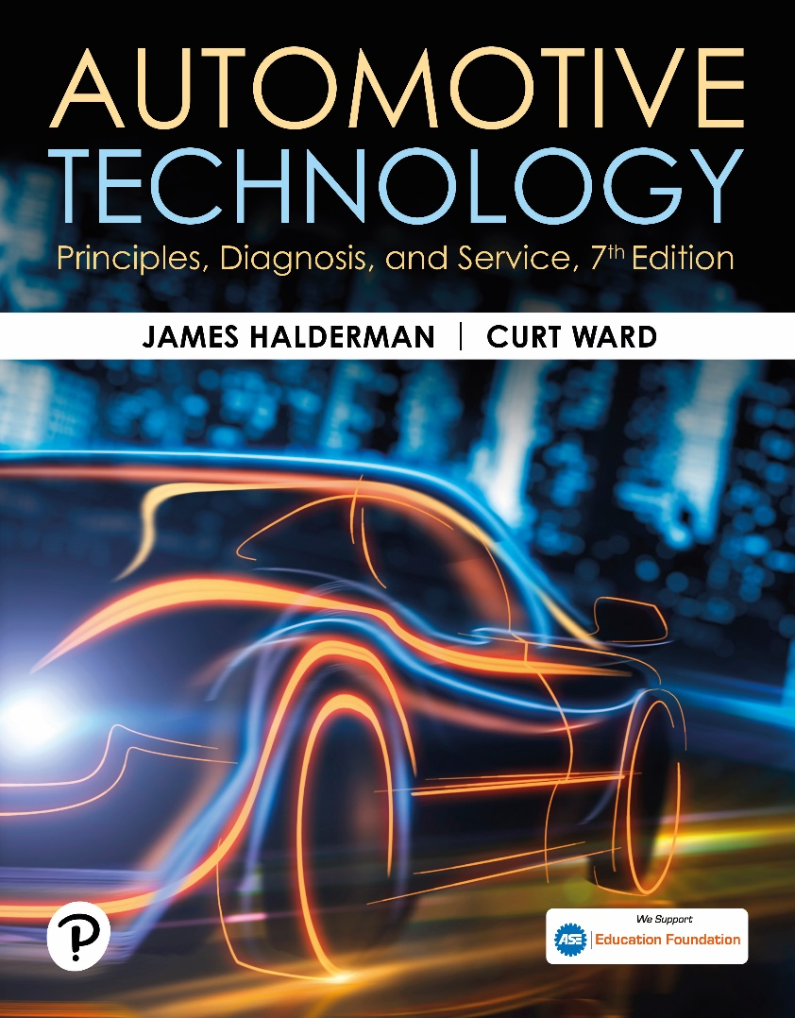
Automotive Technology: Principles, Diagnosis, and Service
Seventh Edition
Chapter 93
Braking System Parts and Performance Standards
Copyright © 2023 Pearson Education, Inc. All Rights Reserved
Notes:
INSTRUCTOR NOTE: This presentation includes text explanation notes, you can use to teach the course. When in SLIDE SHOW mode, you RIGHT CLICK and select SHOW PRESENTER VIEW, to use the notes.

Slide 2
Learning Objectives
93.1 Describe the fundamentals of brake systems.
93.2 List the six brake system categories.
93.3 State the purpose of an antilock brake system.
93.4 Discuss federal brake standards.
93.5 Discuss legal aspects of brake repair..

Slide 3
Fundamentals of Brake Systems
Brakes are an energy-absorbing mechanism that converts vehicle movement into heat while stopping rotation of wheels.
Hydraulic pressure to each wheel cylinder or caliper is used to force friction materials against the brake drum or rotor.
The friction between the stationary friction material and the rotating drum or rotor (disc) causes the rotating part to slow and eventually stop.

Slide 4
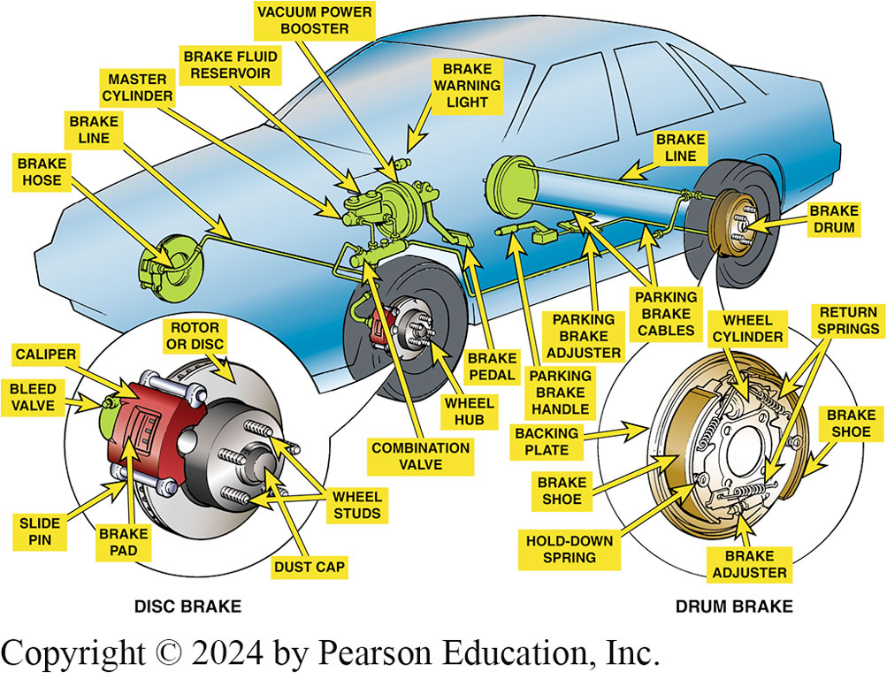
Figure 93.1 Typical Brake System
Typical vehicle brake system showing all typical components

Slide 5
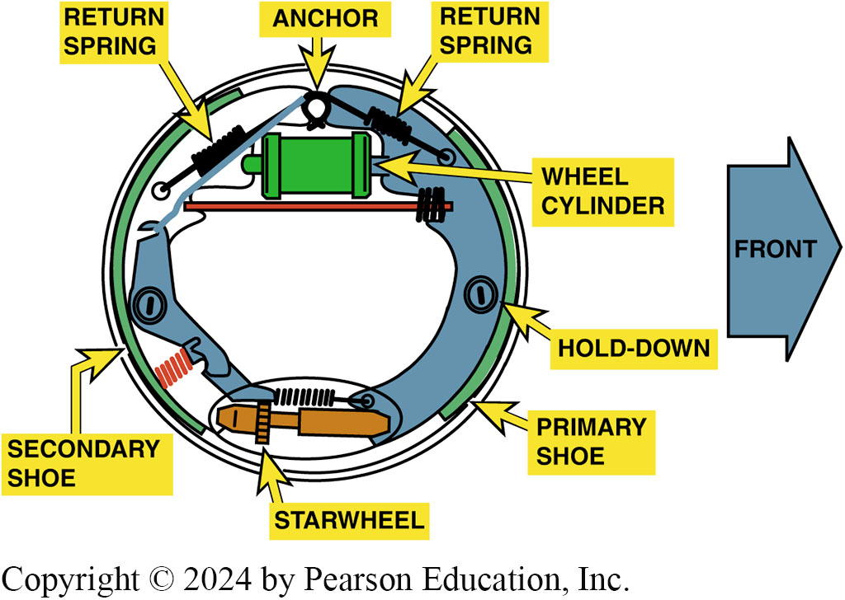
Figure 93.2 Brake Drum Assembly
Typical drum brake assembly

Slide 6
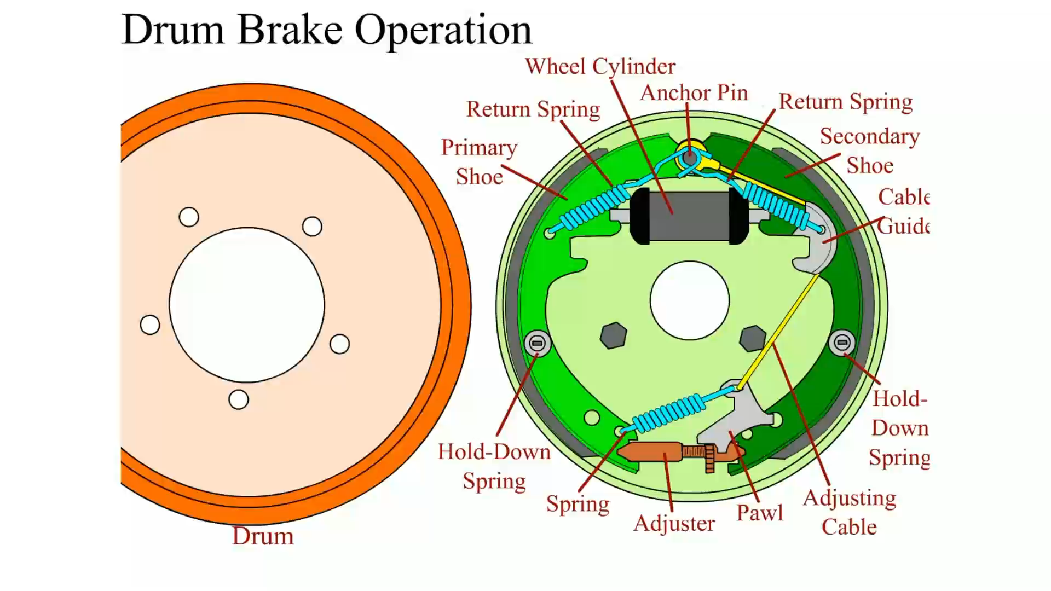
Animation: Drum Brake Operation (Animation will automatically start)

Slide 7
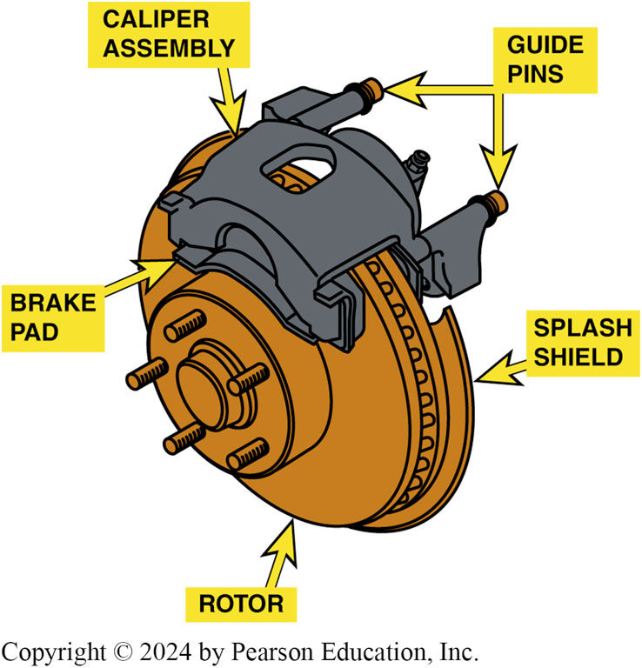
Figure 93.3 Disc Brake Assembly
Typical disc brake assembly

Slide 8
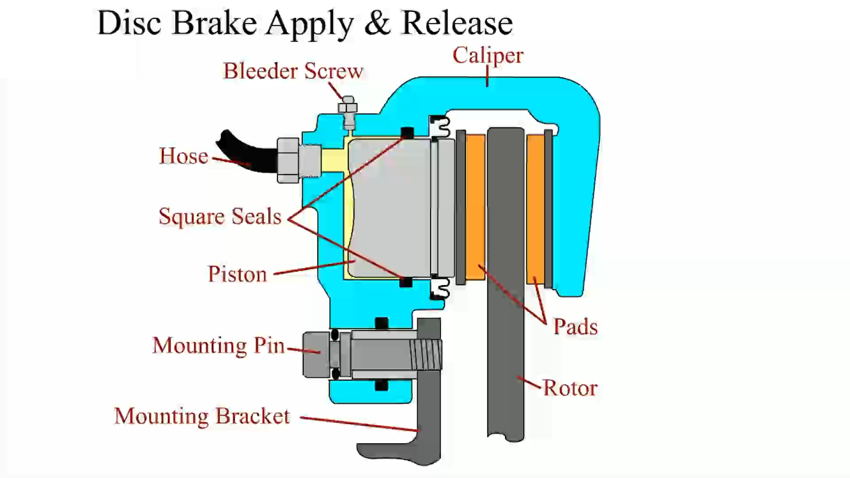
Animation: Disc Brake Apply and Release (Animation will automatically start)

Slide 9
Brake Design Requirements (1 of 2)
All braking forces must provide:
Equal forces must be applied to both left and right sides of vehicle to assure straight stops.
Hydraulic systems must be properly engineered and serviced to provide for changes as vehicle weight shifts forward during braking.
Hydraulic system must use a fluid that does not evaporate or freeze.
Friction material (lining or pads) designed to provide adequate friction between stationary axles and rotating drum or rotor.

Slide 10
Brake Design Requirements (2 of 2)
All braking forces must provide:
Design of the braking system should secure brake lining solidly to prevent movement of friction material during braking.
Incorporate a power-assist unit that reduces the driver’s effort but does not reduce stopping distance.

Slide 11
Brake System Categories
Brake system components can be classified and placed into six subsystem categories, depending on their function.
Apply system
Boost system
Hydraulic system
Wheel brakes
Brake balance control systems
Brake warning lights

Slide 12
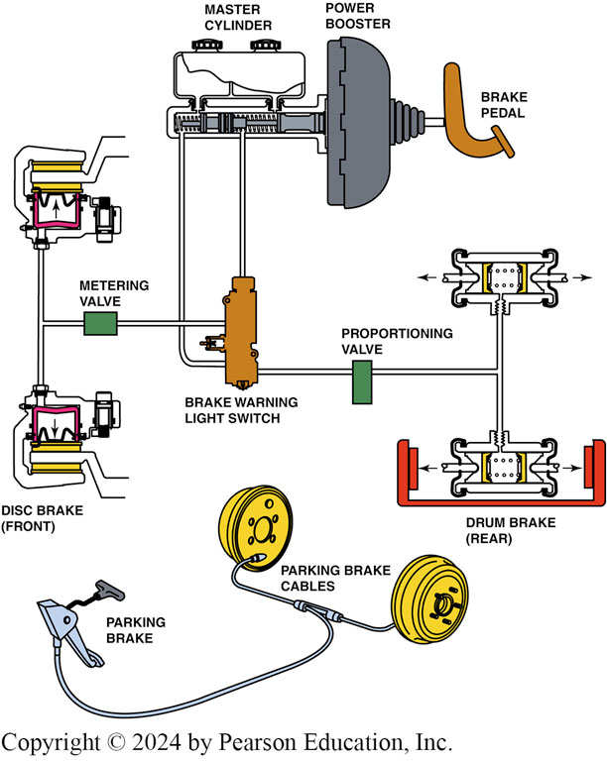
Figure 93.4 System Components
Typical brake system components

Slide 13
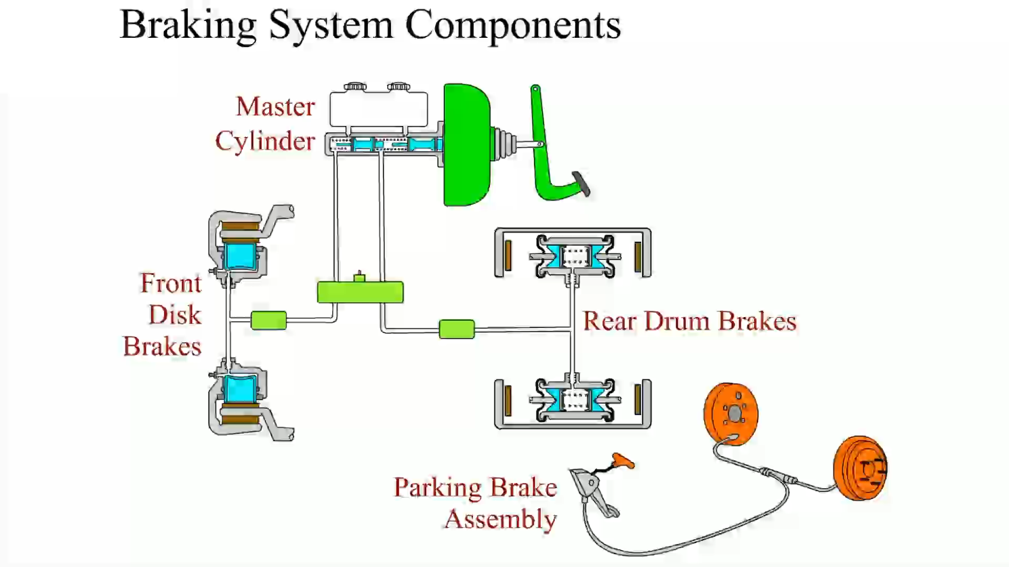
Animation: Braking System Components (Animation will automatically start)

Slide 14
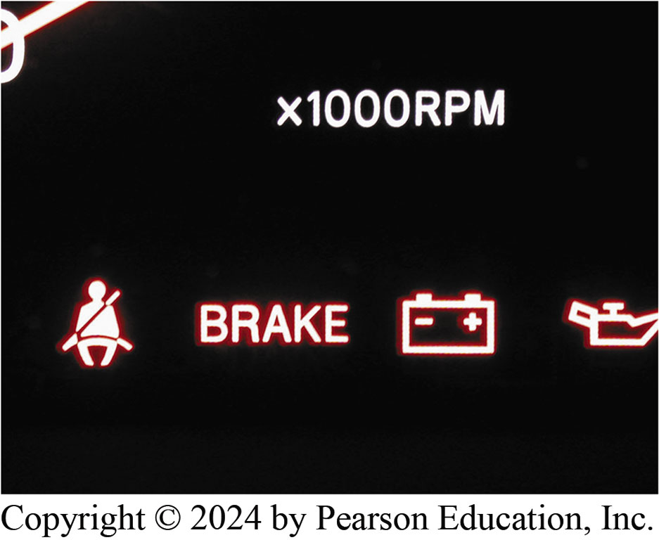
Figure 93.5 Red Brake Warning Light
The red brake warning light remains on after a bulb test if there is a fault with the hydraulic part of the brake system or low brake fluid level has been detected

Slide 15

Figure 93.6 Amber ABS Light
ABS warning light is amber

Slide 16
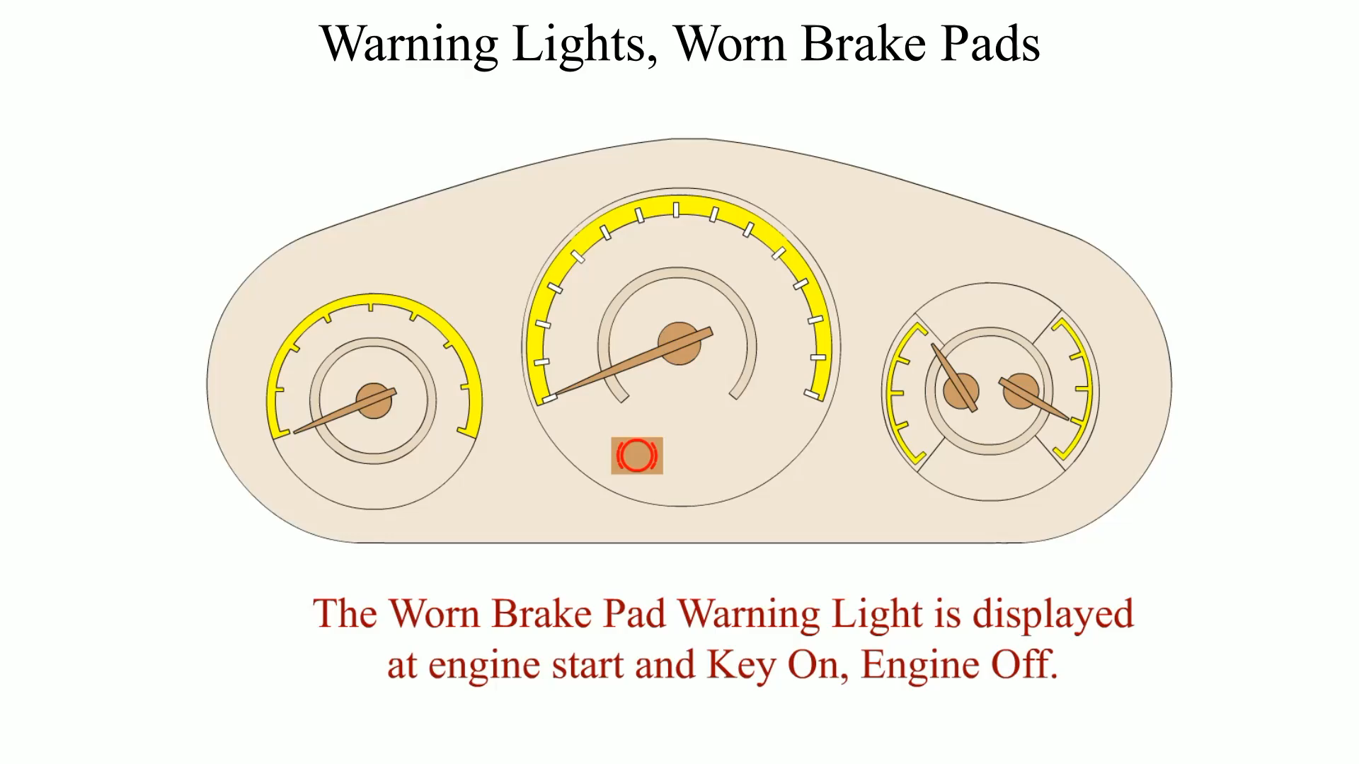
Animation: Warning Lights, Worn Brake Pads (Animation will automatically start)

Slide 17
Question 1: ?
What are the six brake subsystem categories?

Slide 18
Answer 1
Apply system
Boost system
Hydraulic system
Wheel brakes
Brake balance control systems
Brake warning lights

Slide 19
Frequently Asked Question: How Do Adjustable Pedals Work?
? Frequently Asked Question
How Do Adjustable Pedals Work? Adjustable pedals, also called electric adjustable pedals (EAP), place the brake pedal and the accelerator pedal on movable brackets that are motor operated. A typical adjustable pedal system includes the following components: Adjustable pedal position switch, which allows the driver to position the pedals, Adjustable pedal assembly, which includes the motor, threaded adjustment rods, and a pedal position sensor. ● SEE FIGURE 93–7. The position of the pedals, as well as the position of the seat system, is usually included as part of the memory seat function and can be set for two or more drivers.

Slide 20
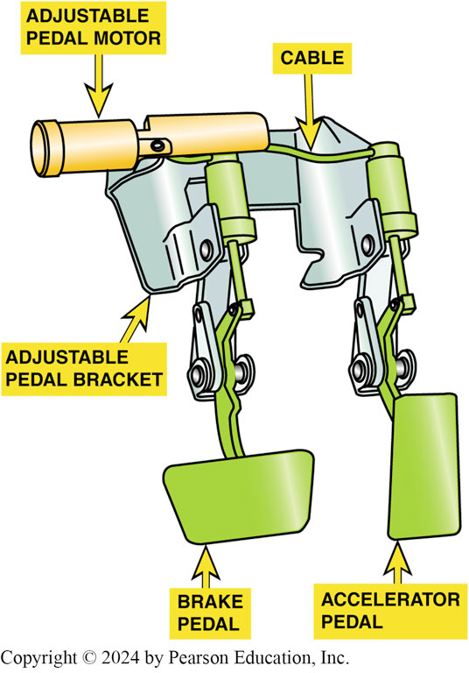
Figure 93.7 Adjustable Pedals
Adjustable pedal assembly. Both the accelerator and the brake pedal can be moved forward and rearward by using the adjustable pedal position switch

Slide 21
Antilock Brake System Overview
Purpose of A B S is to prevent the wheels from locking during braking, especially on low-friction surfaces, such as wet, icy, or snowy roads.
A B S uses sensors at wheels to measure wheel speed.
A B S will pulse the brakes on and off to maintain directional stability with maximum braking force.

Slide 22
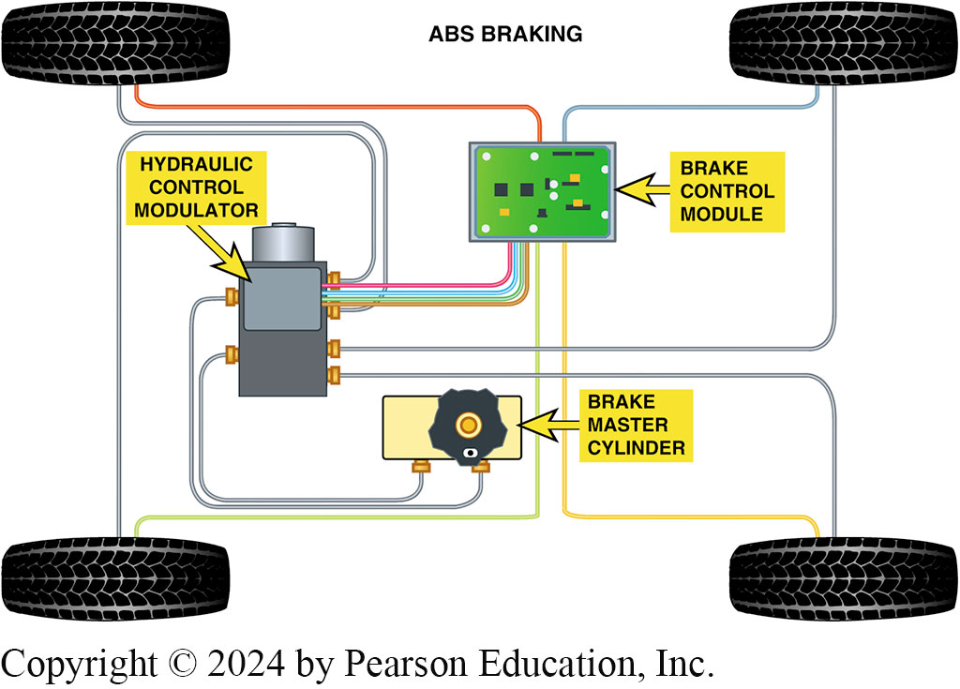
Figure 93.8 ABS System
Typical components of an antilock brake system (ABS) used on a rear-wheel-drive vehicle

Slide 23
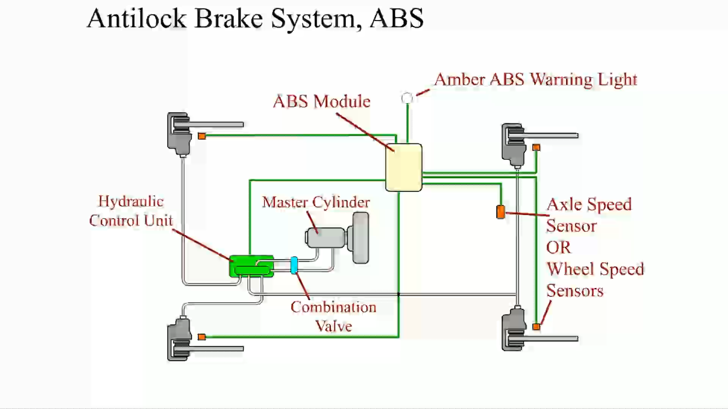
Animation: Antilock Brake System, ABS (Animation will automatically start)

Slide 24
Federal Brake Standards
The statutes pertaining to automotive brake systems are part of the Federal Motor Vehicle Safety Standards (F M V S S) established by Department of Transportation (D O T).
F M V S S 135 Brake Test
F M V S S 135 brake test procedure consists of up to 24 steps, depending on the vehicle’s configuration and braking system.
Test is a minimum standard of performance.

Slide 25
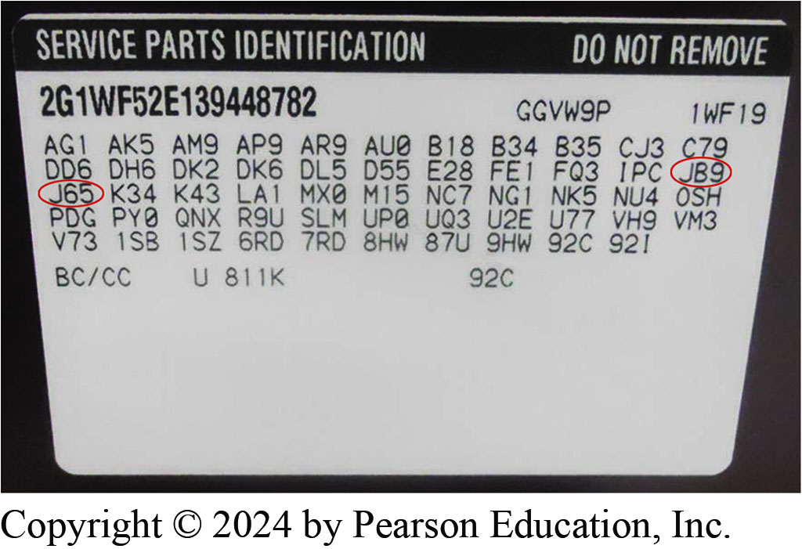
Figure 93.9 RPO Sticker
A typical service parts identification (RPO) sticker is located on the inside of the trunk lid of GM vehicle

Slide 26
Frequently Asked Question: What Is a GM RPO Code?
? Frequently Asked Question
What Is a GM RPO Code? The GM regular production code (RPO) is the code used when the vehicle was built, including all optional equipment listed, which includes letters and/or numbers. Most General Motors vehicles have the RPO sticker, also called the Service Parts Identification label, in the trunk, most often on the spare tire cover. Trucks usually have the RPO sticker in the glove box. ● SEE FIGURE 93–9 with more detail in NOTES section
Notes:
Frequently Asked Question: What Is a GM RPO Code?
The GM regular production code (RPO) is the code used when the vehicle was built, including all optional equipment listed, which includes letters and/or numbers. Most General Motors vehicles have the RPO sticker, also called the Service Parts Identification label, in the trunk, most often on the spare tire cover. Trucks usually have the RPO sticker in the glove box. ^{● SEE}
FIGURE 93–9.
Before ordering parts, take a photo of the vehicle identification number (VIN) and the RPO sticker.
Having these available to answer any questions at the parts counter saves a lot of time and makes sure that the correct part is being ordered for the vehicle. The brake-related RPO codes start with the letter “J” and include the type or rating of the brake system. Some sample brake system–related RPO codes include
J41 BRAKE SYSTEM, PWR, FRT DISC, RR DRUM, CAST IRON
J42 BRAKE SYSTEM, PWR, FRT DISC, RR DRUM, ALUMINUM
J65 BRAKE SYSTEM, PWR, FRT & RR DISC J85 BRAKE SYSTEM, PWR, FRT & RR DISC JA1 BRAKE, LIGHT WEIGHT DISC DRUM JA2 BRAKE, HEAVY WEIGHT DISC DRUM JA8 BRAKE, MEDIUM WEIGHT DISC DRUM
JB3 BRAKE, POWER, DISC/DRUM, 4,600 LBS JB5 BRAKE, POWER, DISC/DRUM, 6,400 LBS JB6 BRAKE, POWER, DISC, DRUM 7,200 LBS JB7 BRAKE, POWER, DISC, DRUM 8,400 L85 JB8 BRAKE, POWER, DISC, DRUM 10,000 LBS JB9 BRAKE, LIGHT WEIGHT, DISC/DISC
JC4 BRAKE, POWER, DISC, DRUM 5,600 LBS
JC5 BRAKE, VAC POWER, 4-WHEEL DISC, 7,200 LBS JD3 BRAKE, HYD POWER, DISC/DRUM
JE5 BRAKE, SYSTEM, PWR, ANTILOCK, FRT & RR WHL JF9 BRAKE, HYD POWER, 4 WHEEL DISC
JH5 BRAKE, HYD POWER, 4-WHEEL DISC, 7,200 LBS JH6 BRAKE, HYD POWER, 4-WHEEL DISC, 9,900 LBS JL8 FRONT & REAR DISC BRAKES
JM5 BOOSTER, BRAKE, 200MM TANDEM, HIGH FLOW JM8 BRAKE SYSTEM PWR, FRT DISC RR DRUM,
ALUMINUM.

Slide 27
Frequently Asked Question: Do the FMVSS 135 Standards Apply to Replacement Brake Performance?
? Frequently Asked Question
Do the FMVSS 135 Standards Apply to Replacement Brake Performance? No. Federal Motor Vehicle Safety Standard 135 applies to new vehicles. Replacement parts used during a brake repair or replacement may or may not permit the vehicle to achieve the same standards as when new. To help ensure like-new braking performance, the service technician should always use quality brake parts from a known manufacturer.

Slide 28
Brake Repair and the Law
Responsibility for maintaining the designed-in level of braking performance falls on the owner of the vehicle.
Technician always liable for damages or injuries resulting from repairs performed in an unprofessional or un-workman-like manner.
Purpose of any repair is to restore like-new performance.

Slide 29
Question 2: ?
What is the purpose of a brake repair?

Slide 30
Answer 2
To restore like-new performance.

Slide 31
Brakes Videos and Animations
Videos Link: (A5) Brakes Videos
Animations Link: (A5) Brakes Animations

Slide 32

Copyright
This work is protected by United States copyright laws and is provided solely for the use of instructors in teaching their courses and assessing student learning. Dissemination or sale of any part of this work (including on the World Wide Web) will destroy the integrity of the work and is not permitted. The work and materials from it should never be made available to students except by instructors using the accompanying text in their classes. All recipients of this work are expected to abide by these restrictions and to honor the intended pedagogical purposes and the needs of other instructors who rely on these materials.

