Slide 1
Automotive Technology: Principles, Diagnosis, and Service
Seventh Edition
Chapter 92
Fuel Cells and Advanced Technologies
Copyright © 2023 Pearson Education, Inc. All Rights Reserved
Notes:
INSTRUCTOR NOTE: This presentation includes text explanation notes, you can use to teach the course. When in SLIDE SHOW mode, you RIGHT CLICK and select SHOW PRESENTER VIEW, to use the notes.

Slide 2
Learning Objectives
92.1 Explain how a fuel cell generates electricity and the types of fuel cells.
92.2 Discuss hydrogen refueling.
92.3 Discuss fuel cell vehicle systems.
92.4 Explain the purpose and function of fuel cell hybrid vehicles.
92.5 Explain the purpose and function of hydrogen storage.
92.6 Explain how ultracapacitors work in fuel-cell hybrid vehicles.
92.7 Describe the HCCI combustion process.

Slide 3
Fuel Cell Technology (1 of 7)
Background
A fuel cell is an electrochemical device in which the chemical energy of hydrogen and oxygen is converted into electrical energy.
In the 1950s, national Aeronautics and Space Administration (N A S A) put this principle to work in building devices for powering space exploration vehicles.
Fuel cells are being developed to power homes and vehicles while producing low or zero emissions.

Slide 4
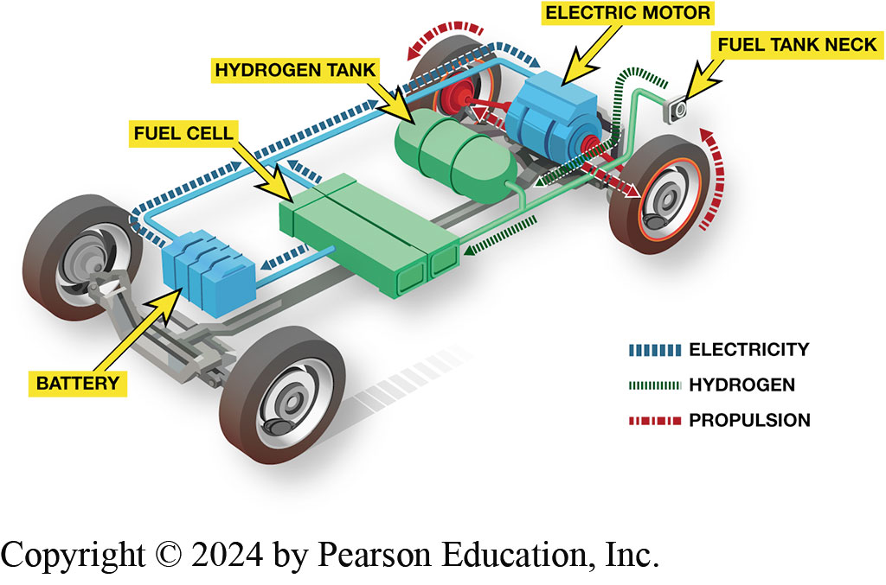
Figure 92.1 Fuel Cell Vehicle
A fuel cell vehicle uses a fuel cell and a high-voltage battery to provide electrical power to the electric drive motor.

Slide 5
Animation: Fuel Cell Vehicle (Animation will automatically start)

Slide 6
Fuel Cell Technology (2 of 7)
Parts and Operation
Chemical reaction in a fuel cell is the opposite of electrolysis.
Energy is required to bring about electrolysis and this same energy can be retrieved by allowing hydrogen and oxygen to reunite in a fuel cell.

Slide 7
Fuel Cell Technology (3 of 7)
Hydrogen-Powered Battery
A fuel cell is a hydrogen-powered battery.
Hydrogen is an excellent fuel because it has a very high specific energy when compared to an equivalent amount of fossil fuel.
Hydrogen Sources
Hydrogen is a low-carbon, non-toxic fuel that is domestically produced from local resources.
Hydrogen is also found in many other compounds, such as natural gas or crude oil.

Slide 8
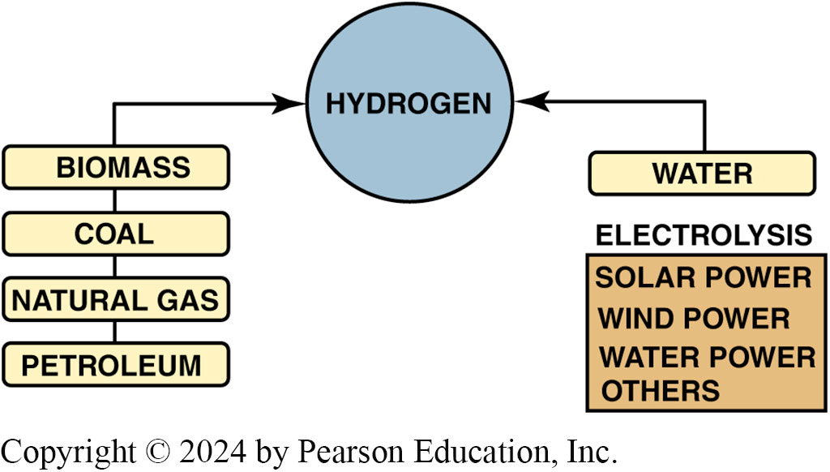
Figure 92.2
Hydrogen does not exist by itself in nature. Energy must be expended to separate it from other, more complex materials.

Slide 9
Fuel Cell Technology (4 of 7)
Advantages of a Fuel Cell
Only emissions are water vapor and heat.
More energy-efficient than a typical internal combustion engine (I C E).
Very few moving parts and have the potential to be very reliable.

Slide 10
Fuel Cell Technology (5 of 7)
Disadvantages of Fuel Cells
High cost
Lack of refueling infrastructure
Safety perception
Insufficient vehicle range
Lack of durability
Cold weather starting problems
Insufficient power density

Slide 11
Fuel Cell Technology (6 of 7)
Fuel Cell Types
Differentiated by type of electrolyte that is used in design.
Cell best suited for automotive applications is the Proton Exchange Membrane (P E M).
P E M Fuel Cell Operation
P E M fuel cell can start quickly and produce full power without an extensive warm-up period. The P E M is a design based on a membrane that is coated on both sides with a catalyst, such as platinum or palladium.

Slide 12
Chart 92.1 Fuel Cell Types
PEM (POLYMER ELECTROLYTE MEMBRANE) |  | PAFC (PHOSPHORIC ACID FUEL CELL) | MCFC (MOLTEN CARBONATE FUEL CELL) | SOFC (SOLID OXIDE FUEL CELL)
Electrolyte | Sulfonic acid in polymer | Orthophosphoric acid | Li and K carbonates | Yttrium-stabilized zirconia
Fuel | Natural gas, hydrogen, methanol | Natural gas, hydrogen | Natural gas, synthetic gas | Natural gas, synthetic gas
Operating Temp. (°F) (°C) | 176 – 212°F 80 –100°C | 360 – 410°F 180 – 210°C | 1100 –1300°F 600 – 700°C | 1200 – 3300°F 650 –1800°C
Electric Efficiency | 30% to 40% | 40% | 43% to 44% | 50% to 60%
Manufacturers | Avista, Ballard, Energy | ONSI Corp. | Fuel Cell Energy, IHI, | Honeywell, Siemens-
 | Partners, |  | Hitachi, Siemens | Westinghouse, Ceramic
 | H-Power, International,
 | Plug Power
Applications | Vehicles, portable power units, small stationary power units | Stationary power units | Industrial and institutional power units | Stationary power units, military vehicles
Types and details of fuel cells, including those most suitable to stationary power generation rather than for use in a vehicle.
Notes:
NOTE: The column headers are PEM (Polymer electrolyte membrane), PAFC (Phosphoric acid fuel cell), MCFC (Molten carbonate fuel cell), and SOFC (Solid oxide fuel cell). The row entries are as follows. Row 1. Electrolyte: PEM: Sulfonic acid in polymer. PAFC: Orthophosphoric acid. MCFC: Li and K carbonates. SOFC: Yttrium-stabilized zirconia. Row 2. Fuel: PEM: Natural gas, hydrogen, methanol. PAFC: Natural gas, hydrogen. MCFC: Natural gas, synthetic gas. SOFC: Natural gas, synthetic gas. Row 3. Operating Temperature (°F) (°C): PEM: 176–212°F, 80–100°C. PAFC: 360–410°F, 180–210°C. MCFC: 1100–1300°F, 600–700°C. SOFC: 1200–3300°F, 650–1800°C. Row 4. Electric Efficiency: PEM: 30% to 40%. PAFC: 40%. MCFC: 43% to 44%. SOFC: 50% to 60%. Row 5. Manufacturers: PEM: Avista, Ballard, Energy Partners, H-Power, International, Plug Power. PAFC: ONSI Corporation. MCFC: Fuel Cell Energy, IHI, Hitachi, Siemens. SOFC: Honeywell, Siemens-Westinghouse, Ceramic. Row 6. Applications: PEM: Vehicles, portable power units, small stationary power units. PAFC: Stationary power units. MCFC: Industrial and institutional power units. SOFC: Stationary power units, military vehicles.

Slide 13
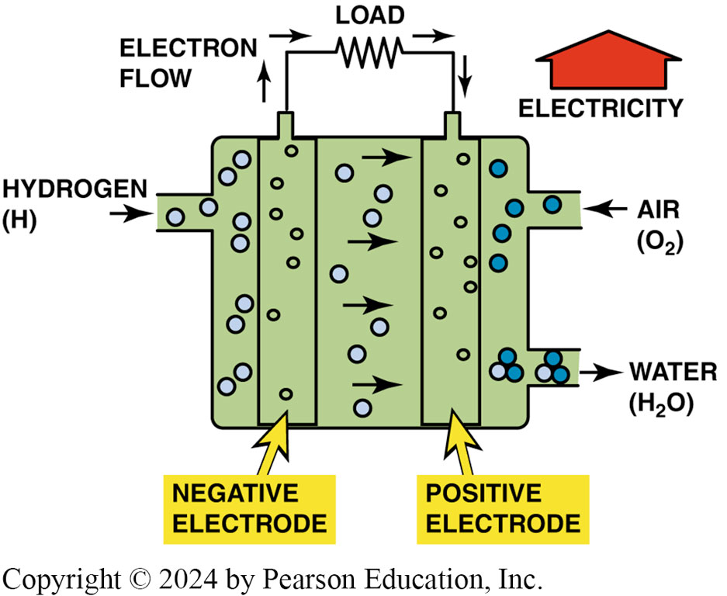
Figure 92.4 PEM Cell
The polymer electrolyte membrane only allows H+ ions (protons) to pass through it. This means that electrons must follow the external circuit and pass through the load to perform work.
Notes:
Water acts at the anode to form oxygen and positively charged hydrogen ions (protons). The electrons flow through an external circuit and hydrogen ions selectively move across the PEM to the cathode.
TECH TIP: CO Poisons the PEM Fuel-Cell Catalyst: Purity of the fuel gas is critical with PEM fuel cells.
If more than 10 parts per million (PPM) of carbon monoxide is present in the hydrogen stream being fed to the PEM anode, the catalyst is gradually poisoned and the fuel cell is eventually disabled. This means that the purity must be “five nines” (99.999% pure). This is a major concern in vehicles where hydrogen is generated by reforming hydrocarbons, such as gasoline, because it is difficult to remove all CO from the hydrogen during the reforming process. In these applications, some means of hydrogen purification
must be used to prevent CO poisoning of the catalyst.

Slide 14
Fuel Cell Technology (7 of 7)
Fuel Cell Stacks
A single fuel cell by itself is not particularly useful, as it generates less than 1 volt of electrical potential.
It is more common for hundreds of fuel cells to be built together in a fuel cell stack.

Slide 15
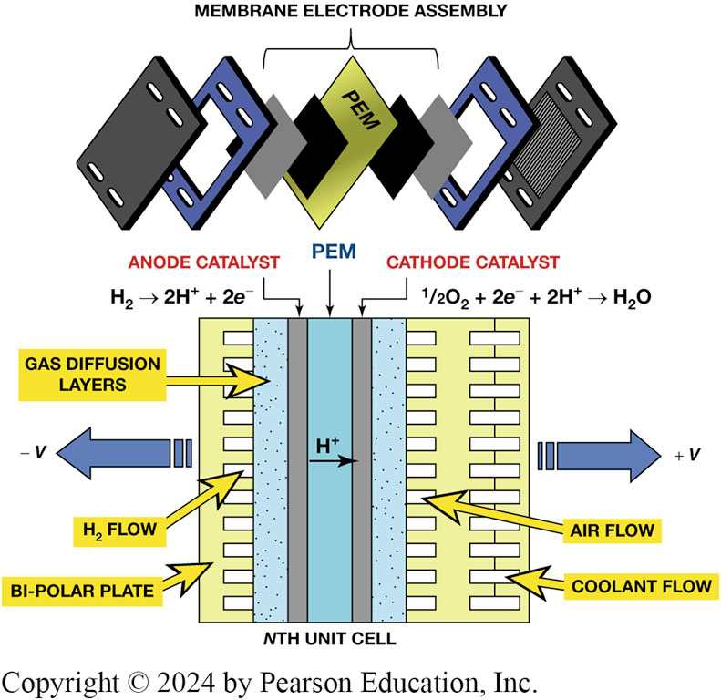
Figure 92.5 Fuel Cell Stack
A fuel cell stack is made up of hundreds of individual cells connected in series.
Notes:
Long Description:
At the top, the electrodes assembly contains the stack of proton exchange membranes, catalyst and flat plate electrode, and elctrolyzers. At the bottom, the stack includes several plates, a fuel electrode, an oxygen electrode, and an electrolyte matrix. The bipolar plate connects the cells in a sequence and also supplies gas for the electrodes. The individual fuel cells are typically combined in a series into a fuel cell stack. Hydrogen rich fuel enters the fuel cell stack and produces electric current by an electrochemical reaction. Anode catalyst: H2 breakdown into H plus and 2 e minus. Cathode catalyst: 1/2 O 2, 2 e minus, and 2 H plus gives H 2 O.

Slide 16
Refueling with Hydrogen (1 of 2)
Fueling Procedure
Hydrogen is a compressed gas that is stored aboveground at the station.
Most hydrogen stations have fuel delivered by a tanker truck, although some stations make their fuel onsite.
Filling up with hydrogen is very similar to putting propane in a barbeque tank.

Slide 17
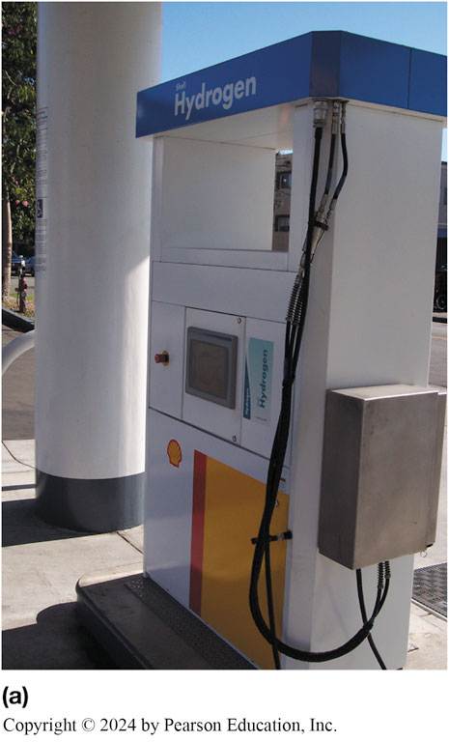
Figure 92.6 (a) Fueling Station
A hydrogen fueling station located at a Shell gasoline station in Los Angeles, C A.

Slide 18
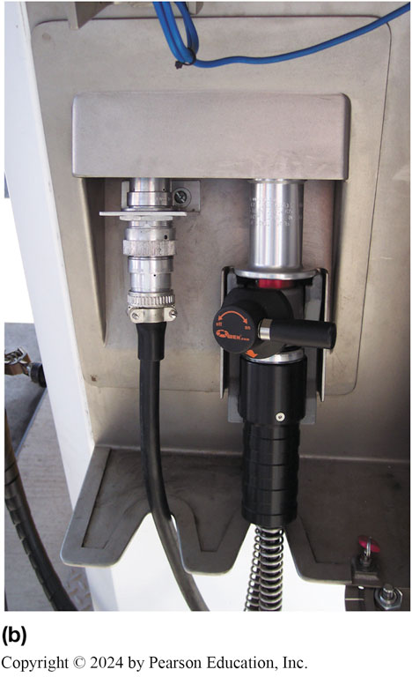
Figure 19.6 (b) Hydrogen Fill Nozzle
The door on the side is opened to show the fill nozzle with shut-off valve.

Slide 19
Refueling with Hydrogen (2 of 2)
Pressures Used
The two most commonly used pressures at hydrogen filling stations include:
H35 = 35 M P a (5,000 P S I)
H70 = 70 M P a (10,000 P S I)
S A E J2601
S A E International-created standard J2601 is the standard for hydrogen-fueling protocol of hydrogen fuel cell electric vehicles (F C E V s).
A H70-T40 fueling dispenser enables fueling the fuel-cell vehicle in usually less than 3 minutes.

Slide 20
Fuel Cell Vehicle Systems (1 of 2)
Fuel Cell Humidifiers
Water management inside a P E M fuel cell is critical.
Too much water can prevent oxygen from making contact with the positive electrode; too little water can allow the electrolyte to dry out
Fuel Cell Cooling Systems
Heat is generated by the fuel cell during normal operation.
A liquid cooling system must be utilized to remove waste heat.

Slide 21
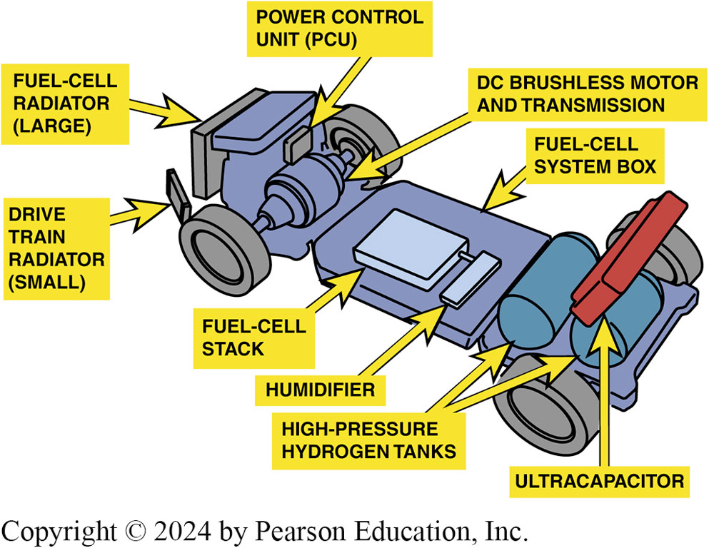
Figure 19.7 Humidifier
Powertrain layout in a Honda FCX fuel-cell vehicle. Note the use of a humidifier behind the fuel-cell stack to maintain moisture levels in the membrane electrode assemblies.
Notes:
FUEL CELL HUMIDIFIERS
Water management inside a PEM fuel cell is critical. Too much water can prevent oxygen from making contact with the positive electrode; too little water can allow the electrolyte to dry out and lower its conductivity. The amount of water and where it resides in the fuel cell is also critical in determining at how low a temperature the fuel cell starts because water freezing in the fuel cell can prevent it from starting. The role of the humidifier is to achieve a balance where it is providing sufficient moisture to the fuel cell by recycling water that is evaporating at the cathode. The humidifier is located in the air line leading to the cathode of the fuel-cell stack. SEE FIGURE 92-7. Some newer PEM designs manage the water in the cells
in such a way that there is no need to pre-humidify the incoming reactant gases. This eliminates the need for the humidifier assembly and makes the system simpler overall.

Slide 22
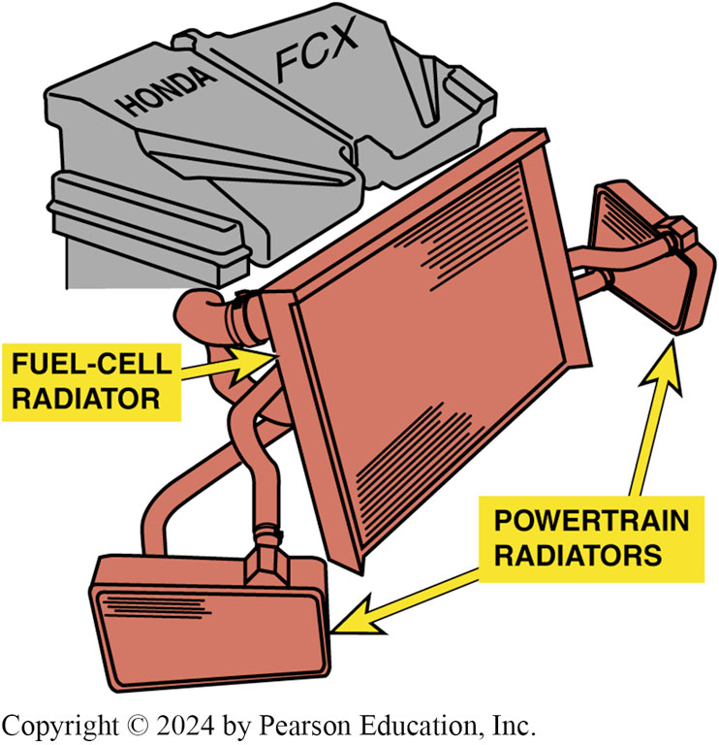
Figure 92.8 Large Radiator
The Honda FCX uses one large radiator for cooling the fuel cell, and two smaller ones on either side for cooling drivetrain components.

Slide 23
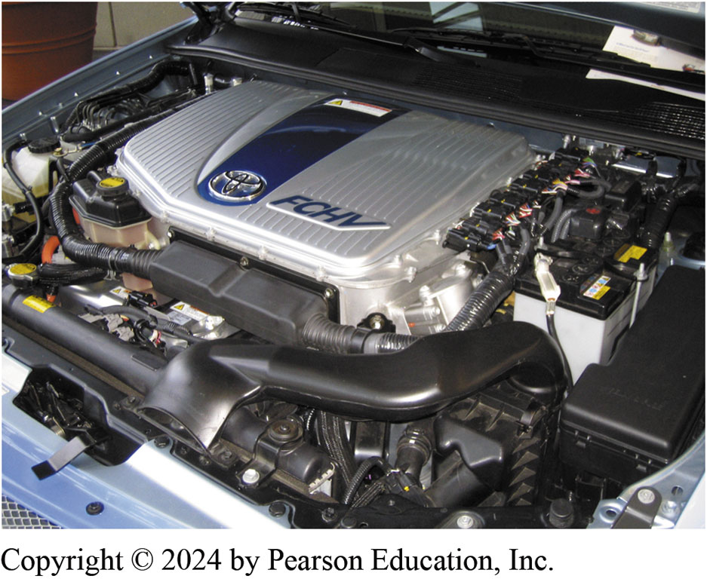
Figure 92.9 Aux Heat Exchanger
Space is limited at the front of the Toyota F C H V engine compartment, so an auxiliary heat exchanger is located under the vehicle to help cool the fuel cell stack.

Slide 24
Fuel Cell Vehicle Systems (2 of 2)
Air Supply Pumps
Air must be supplied to the fuel cell stack at the proper pressure and flow rate to enable proper performance.
This pump is often driven by a high-voltage electric drive motor.

Slide 25
Fuel Cell Hybrid Vehicles
Purpose and Function
The fuel cell hybrid vehicle relies on both the fuel cell and an electrical storage device for motive power.
Secondary Batteries
In most F C H V designs, a high-voltage nickel-metal hydride (N i M H) battery pack is used as a secondary battery.
This is most often located near the back of the vehicle, either under or behind the rear passenger seat.

Slide 26
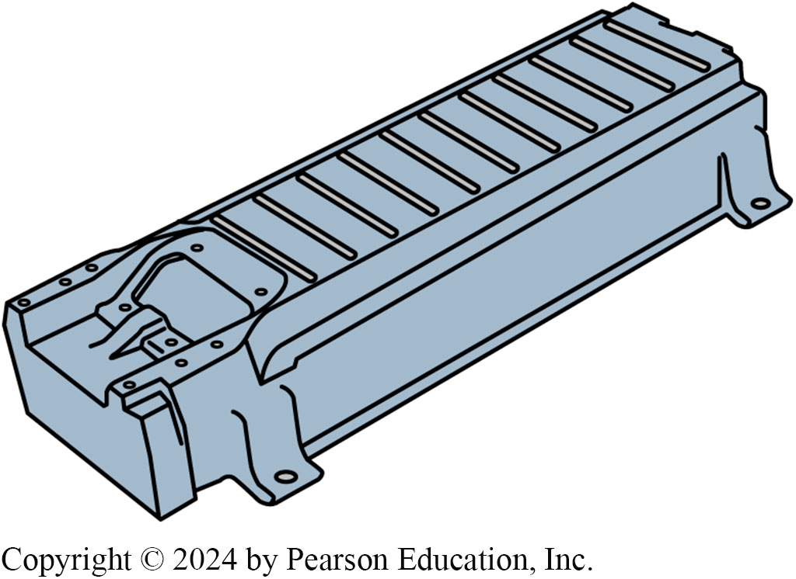
Figure 92.10 Secondary Battery
Secondary battery in a fuel cell hybrid vehicle is made up of many individual cells connected in series, much like a fuel cell stack.

Slide 27
Question 1: ?
What are the advantages of a fuel cell?

Slide 28
Answer 1
The only emissions are water vapor and heat.
More energy-efficient than a typical internal combustion engine (I C E).
Fuel cells have very few moving parts and have the potential to be very reliable.

Slide 29
Hydrogen Storage (1 of 3)
Purpose and Function
One of the issues with fuel cell hybrid vehicles is how to store sufficient hydrogen onboard to allow for reasonable vehicle range.
Hydrogen has very high energy content on a pound-for-pound basis, but its energy density is less than that of conventional liquid fuels.

Slide 30
Hydrogen Storage (2 of 3)
High-Pressure Compressed Gas
Most current fuel cell hybrid vehicles use compressed hydrogen that is stored in tanks as a high-pressure gas.
Multiple small storage tanks are often used rather than one large tank.
Liquid Hydrogen
Hydrogen can be liquefied in an effort to increase its energy density, but this requires that it be stored in cryogenic tanks at -423°F (-253°C)

Slide 31
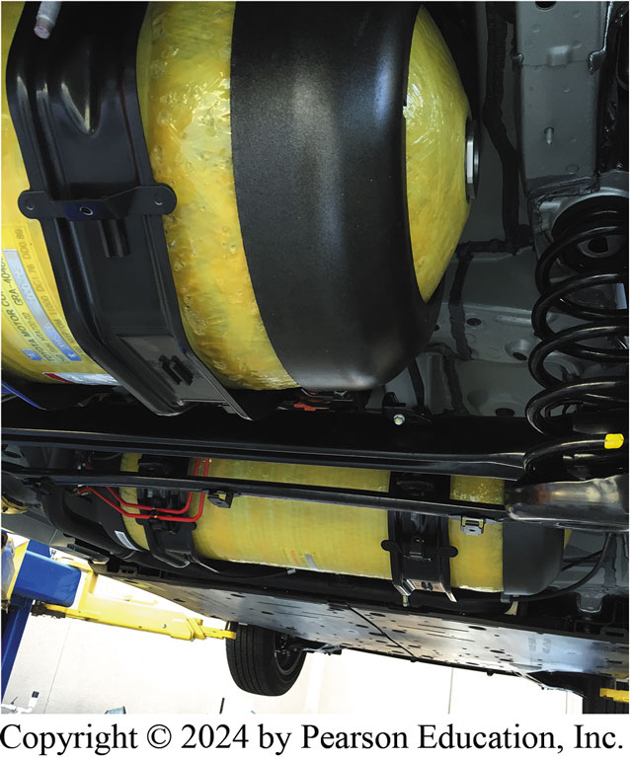
Figure 92.11 H Storage Tank
A photo showing the hydrogen storage tanks underneath a Toyota Mirai fuel cell vehicle. This vehicle uses two carbon-fiber-reinforced fuel tanks.

Slide 32
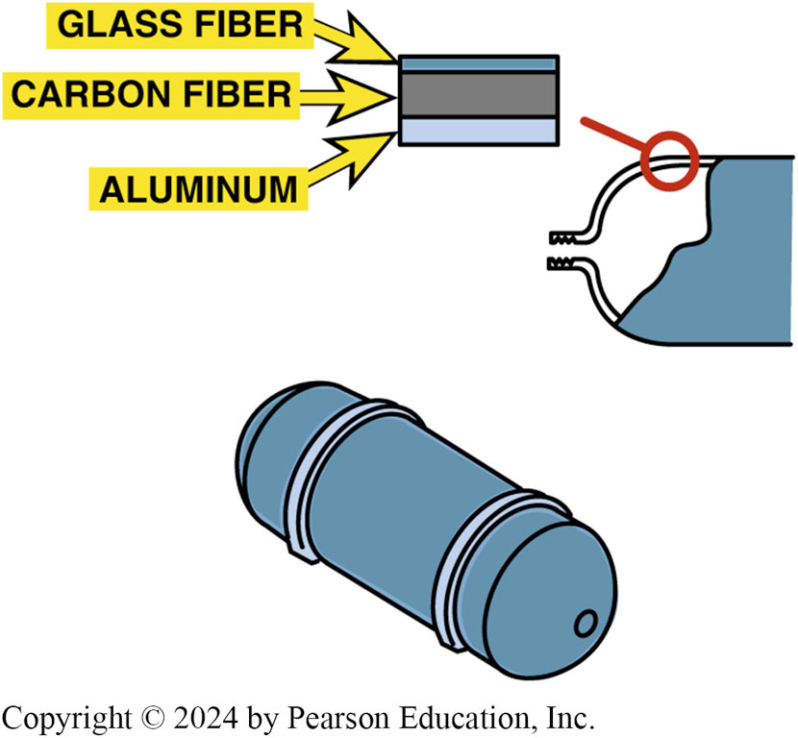
Figure 92.12 Storage Tank
The Toyota F C H V uses high-pressure storage tanks that are rated at 350 bar. This is the equivalent of 5,000 pounds per square inch.

Slide 33
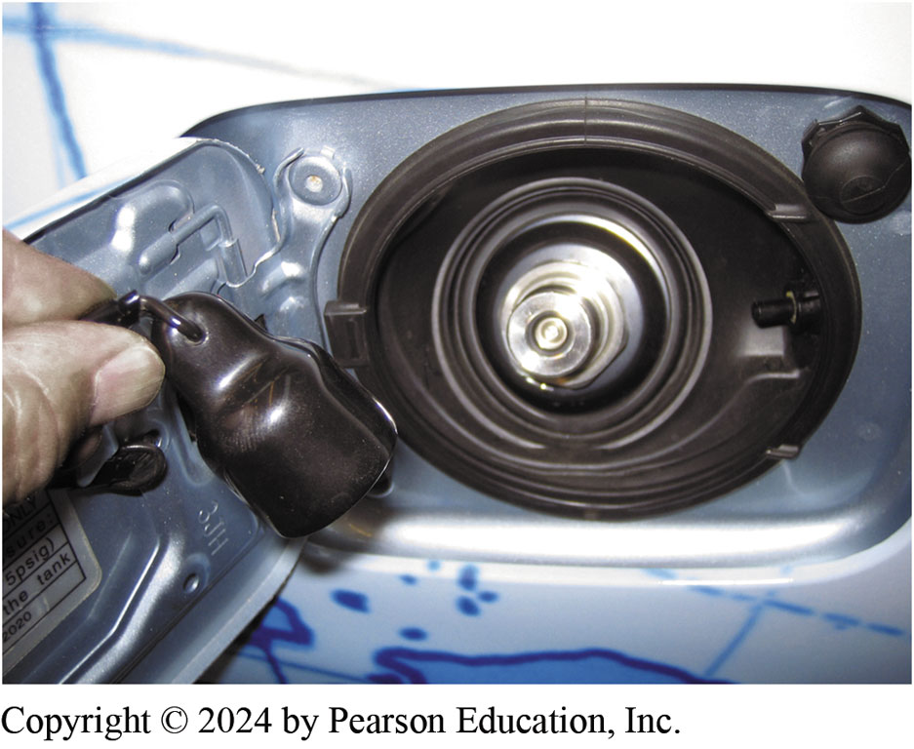
Figure 92.13 High Pressure Fitting
High-pressure fitting used to refuel a fuel cell hybrid vehicle.

Slide 34
Figure 92.14 Tank Replacement
Note that high-pressure hydrogen storage tanks must be replaced in 2031.

Slide 35
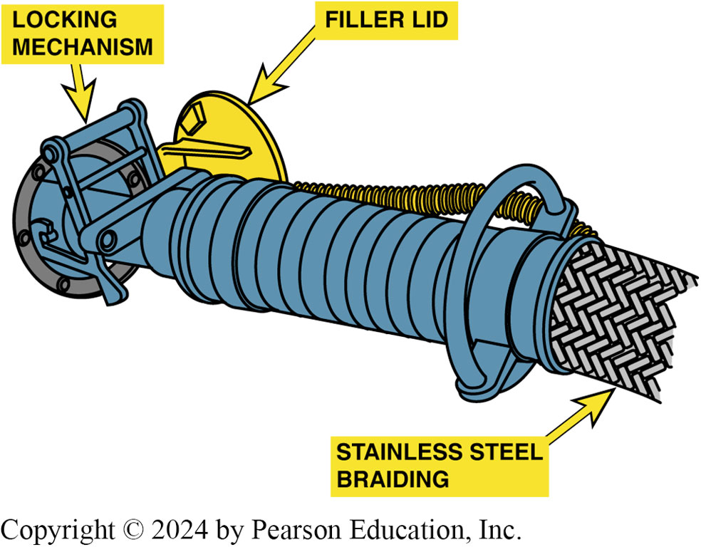
Figure 92.15 Refueling
Refueling a vehicle with liquid hydrogen.

Slide 36
Hydrogen Storage (3 of 3)
Solid Storage of Hydrogen
One method discovered to store hydrogen in solid form is as a metal hydride, similar to how a N i M H battery works.

Slide 37
Question 2: ?
What are the three ways to store hydrogen?

Slide 38
Answer 2
High-pressure gas, liquid, and solid.

Slide 39
Ultracapacitors
Purpose and Function
An alternative to storing electrical energy in batteries is to use ultracapacitors.
Parts and Operation
Ultracapacitor cells are based on double-layer technology, in which two activated carbon electrodes are immersed in an organic electrolyte.
Advantages: Page 1069
Disadvantages: Page 1069
Notes:
ADVANTAGES Ultracapacitors have excellent cycle life, mean- ing that they can be fully charged and discharged many times without degrading their performance. They are also able to operate over a wide temperature range and are not affected by low temperatures to the same degree as many battery technologies.
DISADVANTAGES The one major downside of ultracapacitors is a lack of specific energy, which means that they are best suited for sudden bursts of energy, as opposed to prolonged discharge
cycles. Research is being conducted to improve this and other
ultracapacitor performance.

Slide 40
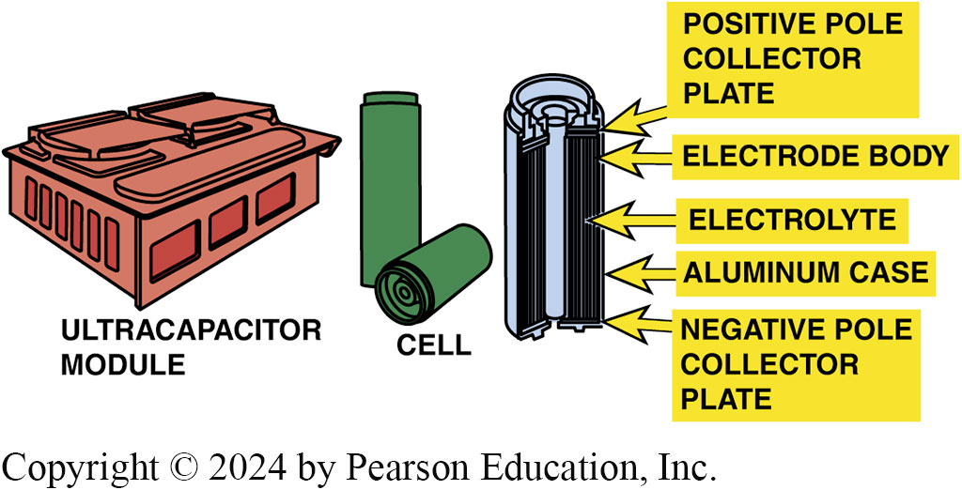
Figure 92.16 Ultracapacitor Module
Honda ultracapacitor module and construction of the individual cells.
Notes:
Long Description:
The double-side coated electrodes are made from graphite carbon in the form of activated conductive carbon, carbon nanotubes or carbon gels. A porous paper membrane called a separator keeps the electrodes apart, but allows positive ions to pass through while blocking larger electrons.

Slide 41
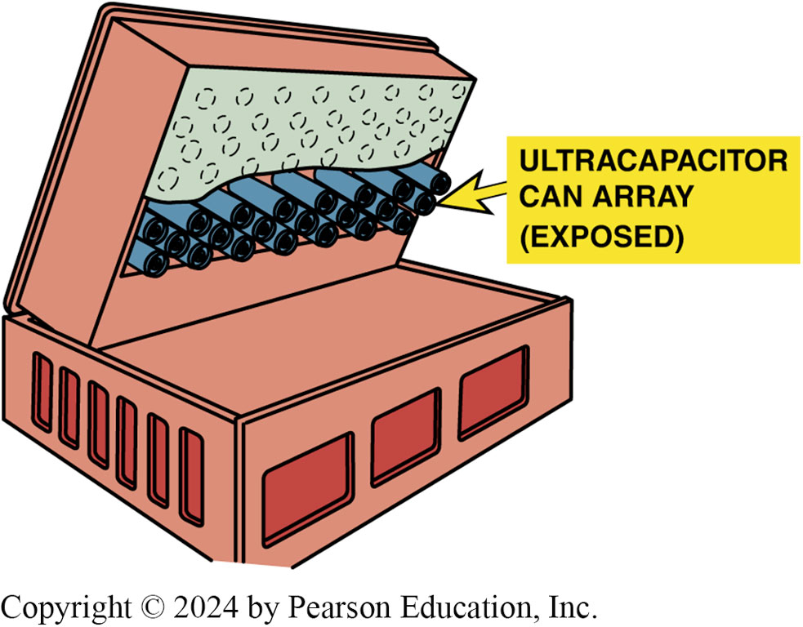
Figure 92.17 Ultracapacitor Battery
An ultracapacitor can be used in place of a high-voltage battery in a hybrid electric vehicle. This example is from the Honda F C X fuel cell hybrid vehicle.

Slide 42
H C C I
Terminology
Homogeneous Charge Compression Ignition (H C C I)
Is a combustion process.
H C C I is the combustion of a very lean gasoline air–fuel mixture without the use of a spark ignition.
Future of H C C I
Engineers need to improve transition in and out of H C C I mode.
Work is also being done on piston and combustion chamber shape to reduce combustion noise.

Slide 43
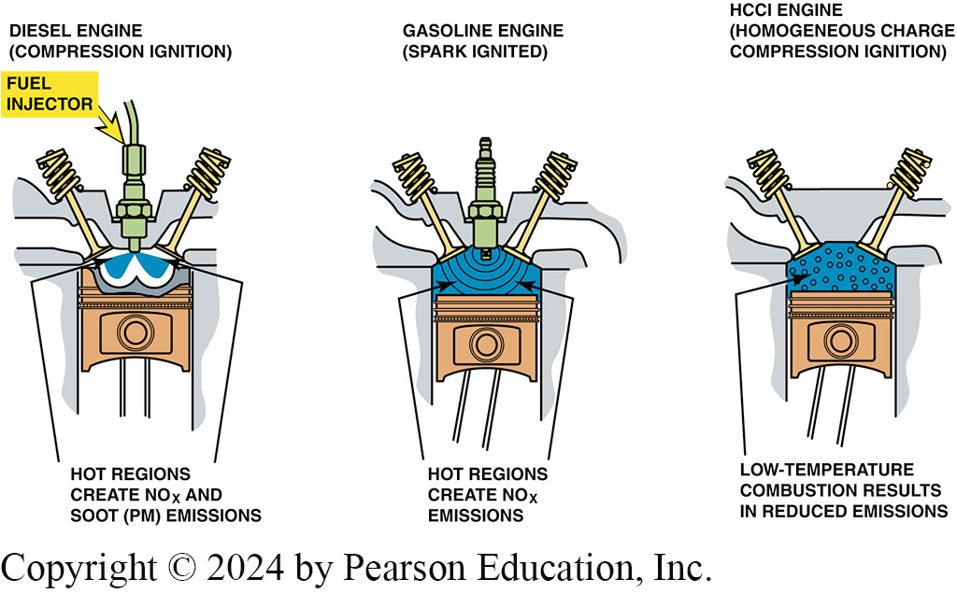
Figure 92.18 HCCI Emissions
Both diesel and conventional gasoline engines create exhaust emissions due to high peak temperatures created in the combustion chamber. The lower combustion temperatures during H C C I operation result in high efficiency with reduced emissions.
Notes:
In a spark ignition engine, the fuel is mixed with air and then inducted into the cylinder during the intake process. After the piston compresses the fuel-air mixture, the spark ignites it, causing combustion. The expansion of the combustion gases pushes the piston during the power stroke.

Slide 44
Hybrid and Fuel Cell Vehicles Videos and Animations
Videos Link: (L3) Light Duty Hybrid Electric Videos
Animations Link: (L3) Light Duty Hybrid Electric Animations

Slide 45
Copyright
This work is protected by United States copyright laws and is provided solely for the use of instructors in teaching their courses and assessing student learning. Dissemination or sale of any part of this work (including on the World Wide Web) will destroy the integrity of the work and is not permitted. The work and materials from it should never be made available to students except by instructors using the accompanying text in their classes. All recipients of this work are expected to abide by these restrictions and to honor the intended pedagogical purposes and the needs of other instructors who rely on these materials.

