Slide 1
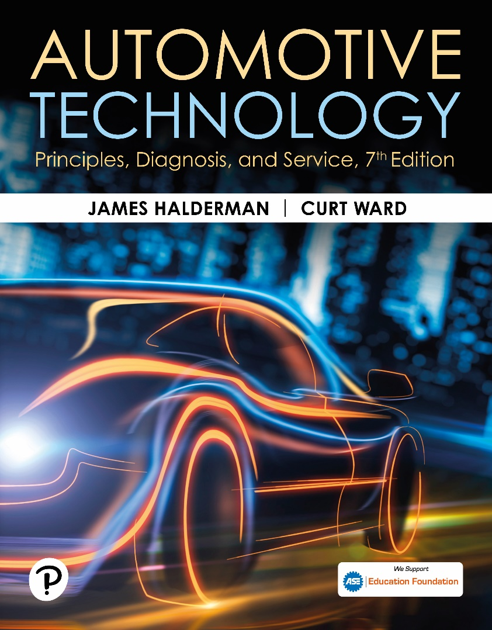
Automotive Technology: Principles, Diagnosis, and Service
Seventh Edition
Chapter 91
Regenerative Brakes
Copyright © 2023 Pearson Education, Inc. All Rights Reserved
Notes:
INSTRUCTOR NOTE: This presentation includes text explanation notes, you can use to teach the course. When in SLIDE SHOW mode, you RIGHT CLICK and select SHOW PRESENTER VIEW, to use the notes.

Slide 2
Learning Objectives
91.1 Describe the principles and operation of regenerative brake systems.
91.2 Discuss the different types of regenerative brake systems, including the components of the system.
91.3 Discuss one-pedal driving.
91.4 Discuss deceleration rates.
91.5 Describe the servicing precautions involved with regenerative brakes. .

Slide 3
Regenerative Braking in Vehicles (1 of 4)
Inertia, Force, and Mass
If a moving object has a mass, it has inertia.
Inertia is resistance of an object to change its state of motion.
E V or H E V can reclaim energy by converting energy of a moving object, called kinetic energy, into electric energy.

Slide 4
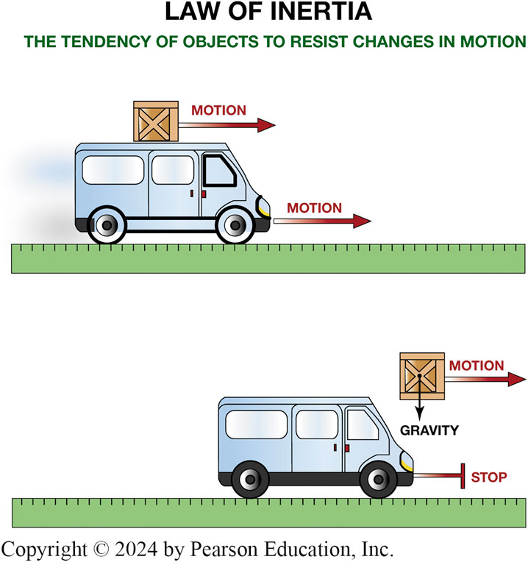
Figure 91.1 Inertia
Any object tends to stay in motion unless acted on by an outside force.

Slide 5
Animation: Inertia Law (Animation will automatically start)

Slide 6
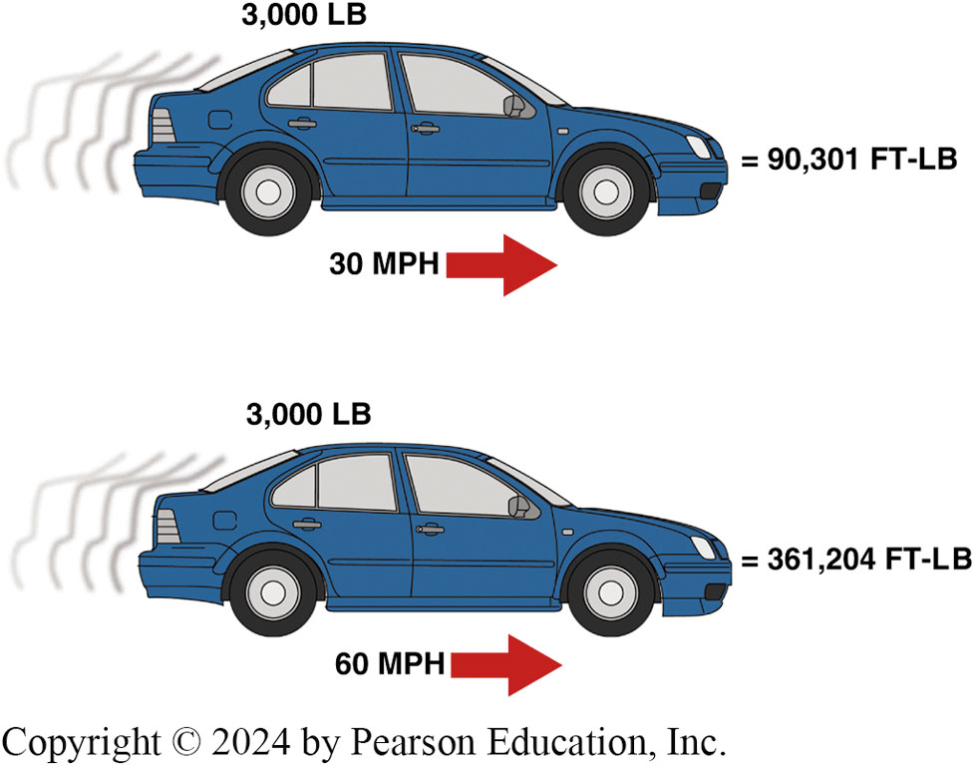
Figure 91.2 Kinetic Energy
Kinetic energy increases as the square of any increase in vehicle speed.

Slide 7
Frequently Asked Question: What Is the Difference between Mass and Weight?
? Frequently Asked Question
What Is the Difference between Mass and Weight? Mass is the amount of matter in an object. One of the properties of mass is inertia. Inertia is the resistance of an object to being put in motion, and the tendency to remain in motion once it is set in motion. The weight of an object is the force of gravity on the object and may be defined as the mass times the acceleration of gravity. Therefore, mass means the property of an object and weight is a force.

Slide 8
Regenerative Braking in Vehicles (2 of 4)
Transferring Energy Back to the Motor
Instead of using 100% friction brakes (base brakes), braking torque is transferred from wheels back into the motor shaft.
Magnets on the rotor move past the electric coils on the stator, passing the magnetic fields of the magnets through the coils, producing electricity.
Electrical energy directed to and recharges the high-voltage battery.
Process called regeneration.

Slide 9
Animation: Regenerative Braking (Animation will automatically start)

Slide 10
Frequently Asked Question: Are the Friction Brakes Used during Regenerative Braking?
? Frequently Asked Question
Are Friction Brakes Used during Regenerative Braking? Yes. Most hybrid vehicles make use of base (friction) brakes during stopping. The amount of regenerative braking compared to amount of friction braking is determined by electronic brake controller. It is important that the base brakes be used regularly to keep the rotors free from rust and ready to be used to stop the vehicle. A typical curve showing the relative proportion of brake usage is shown in FIGURE 91–3.

Slide 11
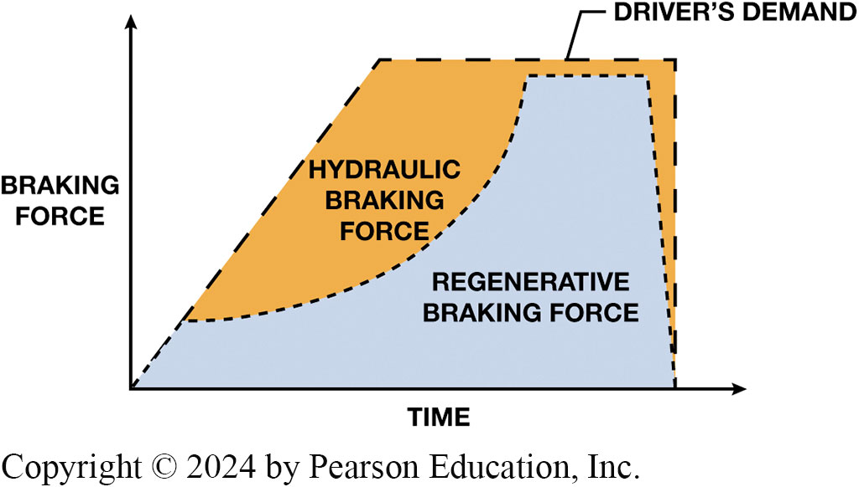
Figure 91.3 Braking Force
Regenerative braking system works with mechanical and hydraulic brake system to provide the necessary braking force to slow and stop the vehicle. Regenerative brakes seldom work at speeds below 10 M P H (16 km/h).
Notes:
Long Description:
The horizontal axis of the graph represents time. The vertical axis represents braking force. A part in blue color reads regenerative braking force and the orange -colored part reads hydraulic braking force. The both parts are surrounded by a dotted boundary. The text at the top reads drivers demand.

Slide 12
Frequently Asked Question: When Does Regenerative Braking Not Work?
? Frequently Asked Question
When Does Regenerative Braking Not Work? There is one situation where regenerative braking will not occur. What happens if, for example, vehicle is at top of a long hill and battery charge level is high? In this situation, controller can only overcharge batteries. Overcharging is not good for batteries, so controller will disable regenerative braking and use base brakes only. This is why SOC of the batteries is kept below 80% so regenerative braking can occur.

Slide 13
Regenerative Braking in Vehicles (3 of 4)
Limitations of Regenerative Brakes
It only acts on driven wheels.
The system has to be designed to allow for proper use of antilock braking system (A B S).
Batteries are commanded to be kept at a maximum of about 60%, plus or minus 20%, which is best for long battery life and to allow for energy to be stored.

Slide 14
Regenerative Braking in Vehicles (4 of 4)
Benefits of Regenerative Braking Systems
Reduces drawdown of battery charge.
Extends overall life of battery pack.
Reduces fuel consumption.
All production E V s and H E V s use regenerative braking as a method to improve vehicle efficiency, and this feature alone provides the most fuel economy savings.

Slide 15
Types of Regenerative Brake Systems (1 of 2)
Series Regeneration
In series regenerative braking systems, the amount of regeneration is proportional to the brake pedal position.
Parallel Regeneration
Parallel regenerative braking system is less complex.
Controller for regenerative braking system determines the amount of regeneration.

Slide 16
Types of Regenerative Brake Systems (2 of 2)
Regenerative Brake Components
A B S E C U handles regenerative braking, and A B S functions, sending a signal to EV/HEV E C U how much regeneration to impose.
System uses pressure measuring sensors to detect master cylinder pressure.
Some systems use a brake pedal position (B P P) sensor.

Slide 17
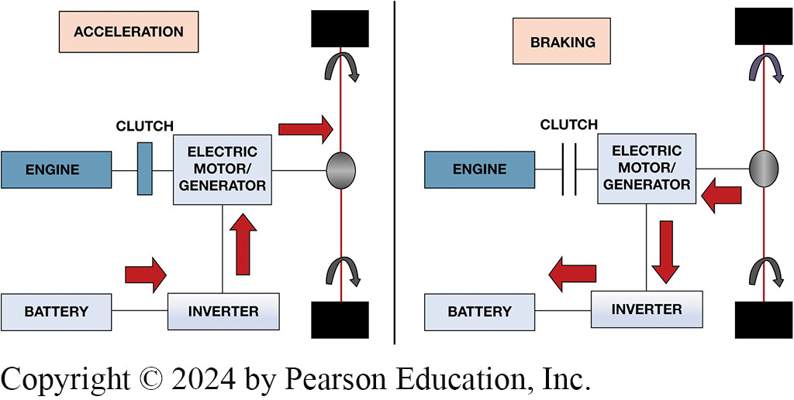
Figure 91.4 Battery Charging
During acceleration, I C E and motor/generator are used to propel the vehicle. During deceleration, energy is returned to H V battery through the inverter that changes the A C crated in motor/generator to D C to charge battery.
Notes:
Long Description:
Two figures are given. The left side reads as acceleration, and right side reads braking. In acceleration the engine is connected to the clutch and the clutch is connected to the electric motor or generator. The electric generator or motor is connected to inverter, and the inverter is connected to the battery. In breaking the engine is connected to the clutch and the clutch is connected to the electric motor or generator. The electric generator or motor is connected to inverter, and the inverter is connected to the battery.

Slide 18
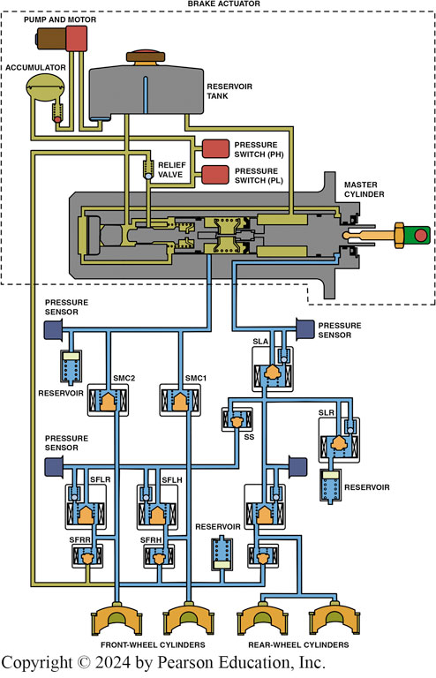
Figure 91.5
Toyota Prius regenerative braking system component showing the master cylinder and pressure switches.
Notes:
Long Description:
Two front wheel and two rear wheel cylinders. The two front wheel cylinders are connected to SMC1 and SMC2. and they are also interconnected to SFRR and SFRH. Four pressure sensors two on the right side and two on the left side. The left upper pressure sensor is connected to the master cylinder and the reservoir. The left lower sensor is connected to SFLR and SS. The right upper pressure sensor is connected to the master cylinder and SLA. The right lower pressure sensor is connected to the SLA. The upper side reads brake actuator. The pump and motor are connected to a reservoir and an accumulator. The accumulator is connected to the two pressure switches and a relief valve. The pressure switch PH and PL are connected to relief valve and the accumulator.

Slide 19
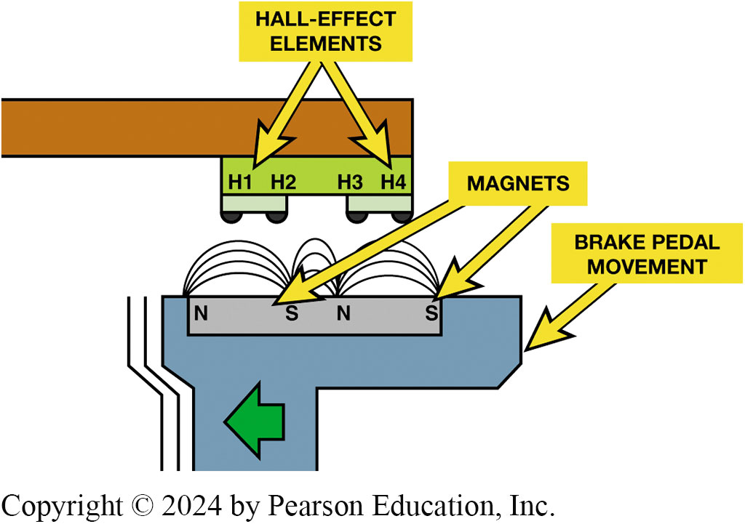
Figure 91.6 Brake Pedal Position
A contactless B P P sensor uses two Hall-effect elements and magnets to determine not only the position of the brake pedal, but also the speed that the driver is depressing the brake pedal.
Notes:
Long Description:
The upper part of the sensor has hall effect elements named H 1, H 2, H 3, H 4. The lower part has a brake pedal with two magnets in it.

Slide 20
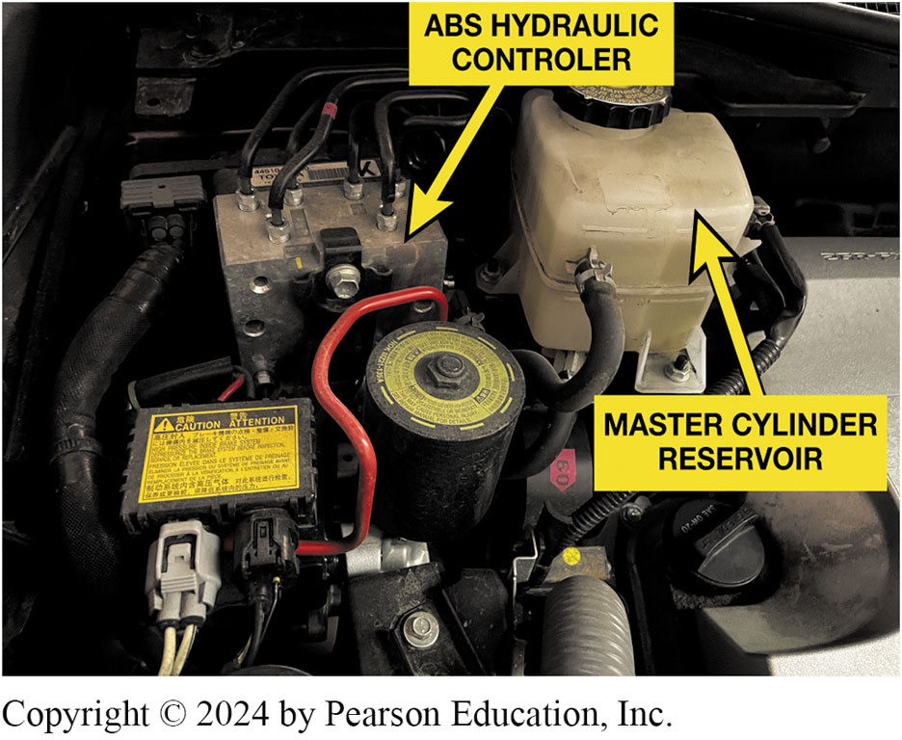
Figure 91.7 Braking Components
The components under the hood of a Toyota Highlander hybrid electric vehicle showing the master cylinder reservoir and the A B S controller.

Slide 21
Frequently Asked Question: What Do Regenerative Brakes Look Like?
? Frequently Asked Question
What Do Regenerative Brakes Look Like? Regenerative brakes use the rotation of the wheels applied to the electric traction (drive) motor to create electricity. Therefore, the brakes themselves look the same as conventional brakes because the hydraulic brakes are still in place and work the same as conventional brakes. The major difference is that the standard wheel brakes work mostly at low vehicle speeds, whereas conventional brakes work at all speeds. As a result, the brakes on a hybrid electric vehicle should last many times longer than the brakes on a conventional vehicle. FIGURE 91–8.

Slide 22
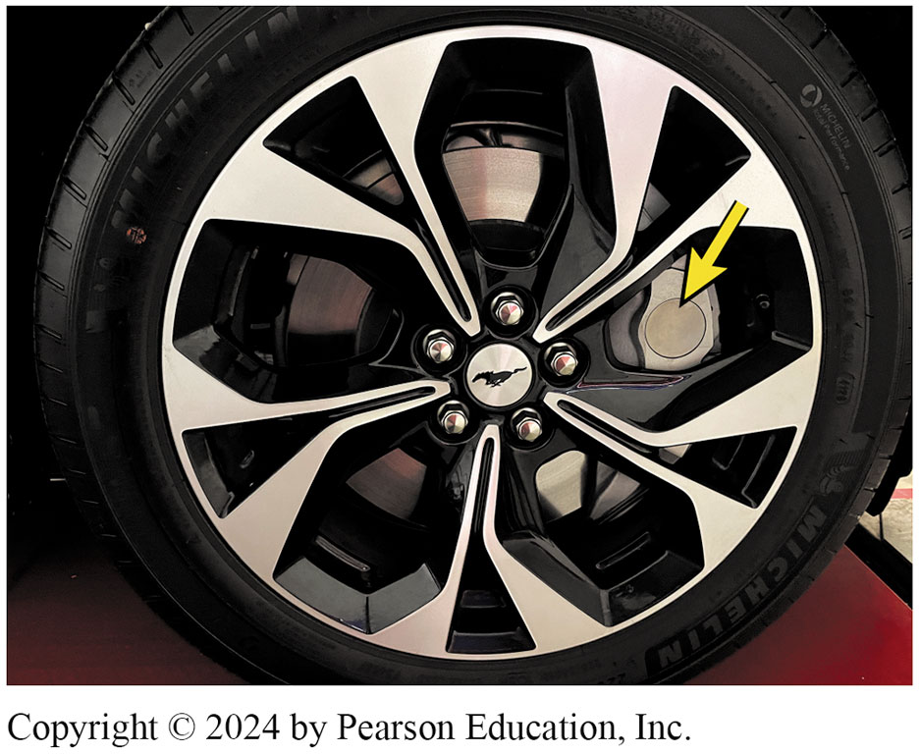
Figure 91.8 Mach E Brakes
Front disc brakes on a Mustang Mach E electric vehicle look like most multi-piston front disc brakes used on conventional vehicles.

Slide 23
Frequently Asked Question: Can an On-Vehicle Brake Lathe Be Used on a Hybrid Electric Vehicle?
? Frequently Asked Question
Can On-Vehicle Brake Lathe Be Used on HEV? Yes. When a brake rotor needs to be machined on a HEV, rotor is being rotated. On most hybrids, front wheels are also connected to the traction motor that can propel the vehicle and generate electricity during deceleration and braking. When drive wheels are being rotated, motor/generator is producing electricity. However, unless the high-voltage circuit wiring has been disconnected, no harm will occur.

Slide 24
One-Pedal Driving
Definition
One-pedal driving means that for normal driving, the driver only needs to use accelerator pedal to accelerate and decelerate.
To accelerate, driver depresses accelerator pedal.
To decelerate (slow down), driver releases the accelerator pedal, and vehicle speed slows.

Slide 25
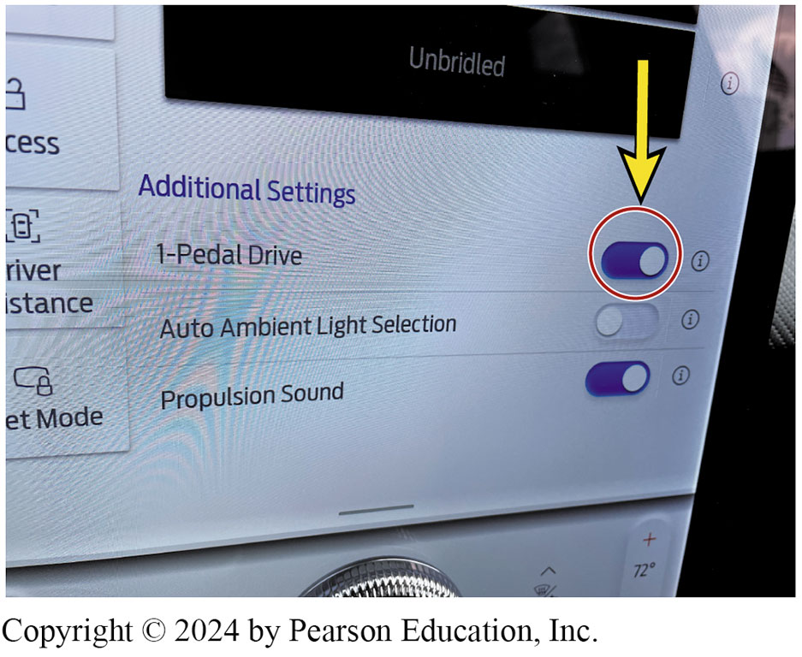
Figure 91.9 Dash Indicator 1-Pedal
Display on the dash display of an electric vehicle shows where the one pedal feature can be turned on or off.

Slide 26
Frequently Asked Question: Is One-Pedal Driving an Advantage?
? Frequently Asked Question
Is One-Pedal Driving an Advantage? Some dealers are recommending that their customers do not use one-pedal driving to maximized range. Some electric vehicle manufactures also limit regenerative braking and allow vehicle to coast, thereby maintaining inertia. Regenerative braking is not 100% efficient. If you are coasting at 60 MPH, regen slows you down to 50, and then accelerates to 60 again, you will lose more energy than if the speed was kept at a steady 60 MPH. Regenerative braking is only useful if used for braking. The most efficient driving mode is the one that is smoothest. That means no hard acceleration or deceleration.

Slide 27
Deceleration Rates
Measured in feet per second, per second ft/sec²
Comfortable deceleration is 8.5 ft/ sec² (3 m/s² ).
Deceleration is also expressed in units called a g. One g is the acceleration of gravity, which is 32 feet per second, per second
Loose items will “fly” above 11 ft/sec² (3.5 m/s² ).
Maximum deceleration rates for most vehicles and light trucks range: 16 to 32 ft/sec² (5 to 10 m/s² ).
Notes:
Deceleration rates are measured in units of “feet per second, per second.” What this means is that the vehicle will change in velocity during a certain time interval divided by the time interval.
Deceleration is abbreviated “ft/sec2 ” (pronounced “feet per second, per second” or “feet per second squared”) or meters per sec2 (m/s2 ) in the metric system.
EXAMPLES Typical deceleration rates include the following:
■ Comfortable deceleration is about 8.5 ft/ sec2 (3 m/s2 ).
■ Loose items in the vehicle will “fly” above 11 ft/sec2 (3.5 m/s2 ).
■ Maximum deceleration rates for most vehicles and light trucks range from 16 to 32 ft/sec2 (5 to
10 m/s2 ).
An average deceleration rate of 15 ft/sec2 (FPSPS) (3 m/s2 ) can stop a vehicle traveling at 55 mph
(88 km/h) in about 200 ft (61m) and in less than 4 seconds. Deceleration is also expressed in units
called a g. One g is the acceleration of gravity, which is 32 feet per second, per second. With a
conventional hydraulic braking system, the driver can brake extremely gently, thereby only
imperceptibly slowing the vehicle. A typical hybrid using regenerative braking will normally
indicate a 0.1g (about 3 ft/sec2 ) deceleration rate when the throttle is released and the brake pedal has not been applied. This rate is what a driver would normally expect to occur when the accelerator pedal is released. This slight deceleration feels comfortable to
the driver, as well as the passengers, because this is what occurs in a non-hybrid vehicle that
does not incorporate regenerative braking. When the brake pedal is pressed, the deceleration
increases to a greater value than 0.1 g, which gives the driver the same feeling of deceleration
that would occur in a conventional vehicle. Maximum deceleration rates are usually greater than
0.8 g and could exceed 1g in most vehicles. ● SEE FIGURE 91–10.

Slide 28
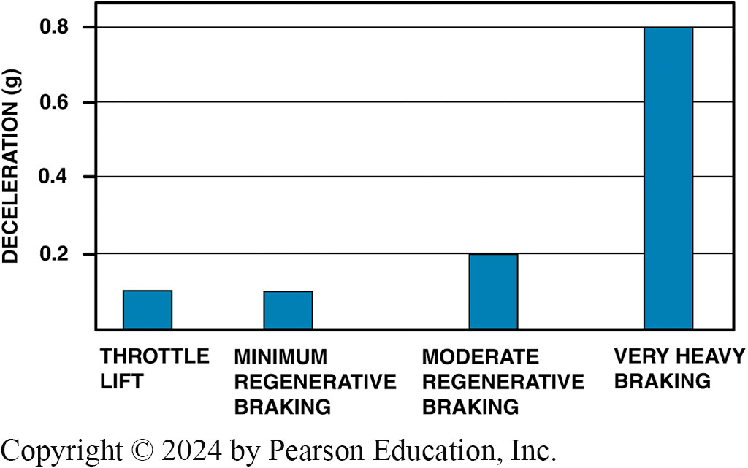
Figure 91.10 Deceleration Graph
Graph compares figures: at the far left, a throttle lift typically giving about 0.1 g deceleration; on the far right, a hard emergency stop resulting in braking of (at least) 0.8 g, which uses both the regenerative braking system and the base hydraulic brake system.
Notes:
Long Description:
The vertical axis represents declaration (g) and it ranges from 0.2 to 0.8 in increments of 0.2. Following are the data from the graph. Throttle lift, 0.1. Minimum regenerative braking, 0.1. Moderate regenerative braking, 0.2. Very heavy braking, 0.8.

Slide 29
Servicing Regenerative Brakes (1 of 2)
Master Cylinders
Many hybrid electric vehicles use unique master cylinders.
Late model G M E V s and P H E V s use an electromechanical brake booster combined with the A B S unit that allows the use of a more conventional master cylinder.

Slide 30
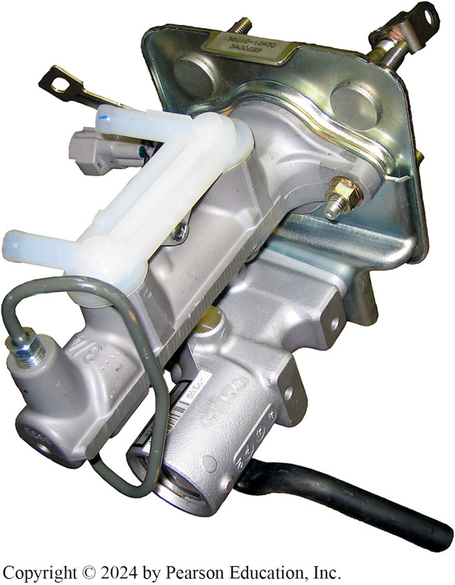
Figure 91.11 Master Cylinder
A master cylinder from a Toyota Highlander hybrid electric vehicle.

Slide 31
Servicing Regenerative Brakes (2 of 2)
Ford Escape Precautions
On the Ford Escape hybrid system, the regenerative braking system checks the integrity of the brake system as a self-test.
This is performed when a door is opened as part of the wake-up feature of the system.
In order to change the brake pads, it is necessary to enter the “Pad Service Mode” on a scan tool and disable the self-test.

Slide 32
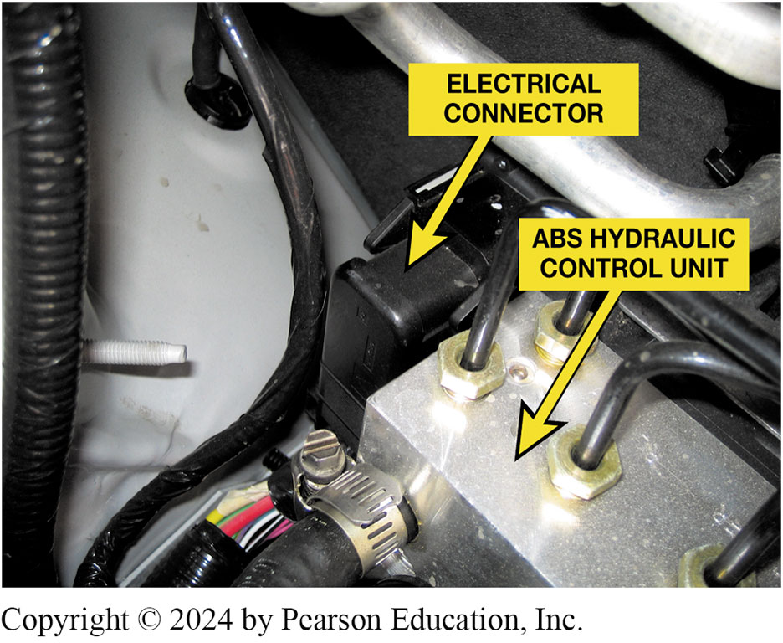
Figure 91.12 Brake Connector
When working on the brakes on a Ford Escape or Mercury Mariner hybrid vehicle, disconnect the black electrical connector on the A B S hydraulic control unit located on the passenger side under the hood.

Slide 33
Figure 92.13 Degraded Regen Brakes
A notice displayed on dash informing driver that regenerative brakes are degraded or temporarily reduced. When this occurs, brake pedal feel will change because the system will use more of the base brakes, which may require a higher pedal effort.
Notes:
CASE STUDY: Regenerative Brake Warning Message
The owner of an electric vehicle complained to the service department about a message on the dash that stated that the regenerative braking system is degraded. This can be considered normal in cold weather because lithium-ion batteries have no trouble discharging when cold, but do not accept a charge easily when cold. Regenerative braking relies on using the motors as generators, and the battery as the place to store that power. Cold batteries mean limited or no regenerative braking. Once the vehicle was driven and the high-voltage batteries increased in temperature, the regenerative braking system worked normally and the message was no longer displayed on the dash. SEE FIGURE 91-13.
Summary:
Complaint—Vehicle owner saw a message on the dash warning that the braking system was degraded.
Cause—The high-voltage batteries were cold and could not accept a charge from the regenerative brake system.
Correction—Once the high-voltage batteries increased in temperature, the message was not displayed and is considered to be normal operation at very cold temperatures.

Slide 34
Question ?
Kinetic energy is .
Energy that the driver exerts on the brake pedal
Energy needed from the batteries to propel a vehicle
Energy in any moving object
Energy that the motor produces to propel the vehicle

Slide 35
Answer
Kinetic energy is .
Energy that the driver exerts on the brake pedal
Energy needed from the batteries to propel a vehicle
Energy in any moving object X
Energy that the motor produces to propel the vehicle

Slide 36
Hybrid and Fuel Cell Vehicles Videos and Animations
Videos Link: (L3) Light Duty Hybrid Electric Videos
Animations Link: (L3) Light Duty Hybrid Electric Animations

Slide 37
Copyright
This work is protected by United States copyright laws and is provided solely for the use of instructors in teaching their courses and assessing student learning. Dissemination or sale of any part of this work (including on the World Wide Web) will destroy the integrity of the work and is not permitted. The work and materials from it should never be made available to students except by instructors using the accompanying text in their classes. All recipients of this work are expected to abide by these restrictions and to honor the intended pedagogical purposes and the needs of other instructors who rely on these materials.

