Slide 1
Automotive Technology: Principles, Diagnosis, and Service
Seventh Edition
Chapter 90
EV and PHEV Charging
Copyright © 2023 Pearson Education, Inc. All Rights Reserved
Notes:
INSTRUCTOR NOTE: This presentation includes text explanation notes, you can use to teach the course. When in SLIDE SHOW mode, you RIGHT CLICK and select SHOW PRESENTER VIEW, to use the notes.

Slide 2
Learning Objectives
90.1 Describe plug-in hybrid electric vehicles (PHEVs).
90.2 Explain how the high-voltage batteries are recharged in an electric vehicle (EV), including battery capacity, and range correlation.
90.3 Discuss Level 1 charging.
90.4 Discuss Level 2 charging.
90.5 Discuss Level 3 charging.
90.6 Discuss owning and charging an electric vehicle (EV).

Slide 3
Plug-In Hybrid Electric Vehicles (1 of 3)
Terminology
A plug-in hybrid electric vehicle (P H E V) is a vehicle that is designed to be plugged into an electrical outlet to charge the batteries.
Identifying a P H E V
Different badges (usually stating that it is a P H E V, sometimes including P H E V on the badge).
An access door for the charging cable in addition to the normal I C E fueling door.
A different instrument panel cluster.

Slide 4
Plug-In Hybrid Electric Vehicles (2 of 3)
P H E V Battery Capacity
The size or capacity of the battery pack used determines how far that the vehicle can travel without using the I C E, commonly called the E V range.
P H E V Examples
A standard Toyota Prius has a 1.3 k W h battery pack, whereas the plug-in version has a larger 4.4 k W h battery, allowing electric-only travel of about 10 miles.
A Chevrolet Volt has a larger 16 k W h battery pack and, as a result, can travel about 40 miles on electric power alone.

Slide 5
Plug-In Hybrid Electric Vehicles (3 of 3)
Charging a P H E V
To fully charge the high-voltage battery pack in a plug-in hybrid electric vehicle, it should be plugged in.

Slide 6
Figure 90.1 ID PHEV Prius
(a) About the only way to tell a plug-in Prius from a regular Prius is from the badge on the sides or (b) by the charge port door on the passenger side at the rear.

Slide 7
Animation: Plug-In Hybrid Vehicle (Animation will automatically start)

Slide 8
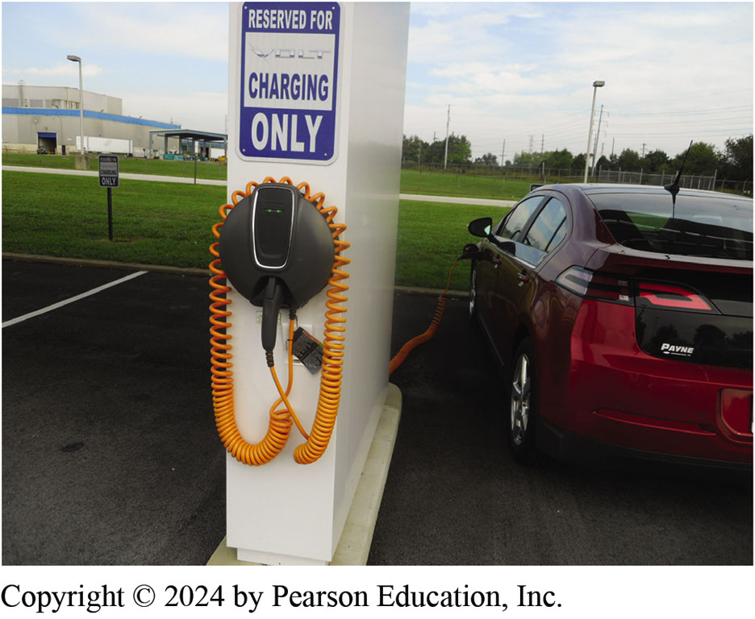
Figure 90.2 EREV
Chevrolet Volt extended range electric vehicle (E R E V), also called a plug-in hybrid electric vehicle (P H E V), being charged at a row of charging stations.

Slide 9
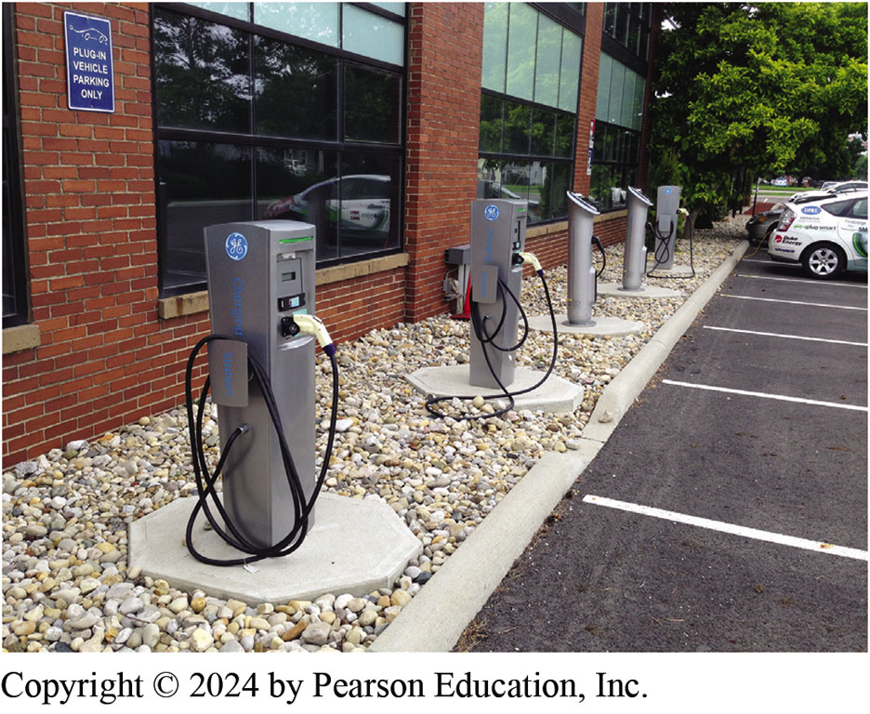
Figure 90.3 Charging Stations
Charging stations that are equipped with S A E J1772 chargers are often found at large companies, colleges, universities, and shopping malls in many parts of country.

Slide 10
Electric Vehicles (1 of 3)
E V Battery Capacity
An electric vehicle (E V), also called a battery electric vehicle (B E V), uses a high-voltage battery pack to supply electrical energy to an electric motor(s).
Electric vehicles called zero-emission vehicles (Z E V).
The capacity of the battery pack, in kilowatt-hours, determines the range of the vehicle.

Slide 11
Electric Vehicles (2 of 3)
Cold-Weather Concerns
Cold temperatures reduce battery efficiency.
Additional electrical power from the batteries is needed to heat the batteries.
Hot-Weather Concerns
Batteries do not function well at high temperatures.
Some type of battery cooling must be added to the vehicle.

Slide 12
Electric Vehicles (3 of 3)
Range
How far an electric vehicle can travel on a full battery charge is called range.
Typical range for an electric vehicle is in excess of 200 miles.
Cost of Charging
National average for electricity is about $0.11 per kilowatt-hour.
Kilowatts per 100 Miles
Shortened to k W h/100 m i.

Slide 13
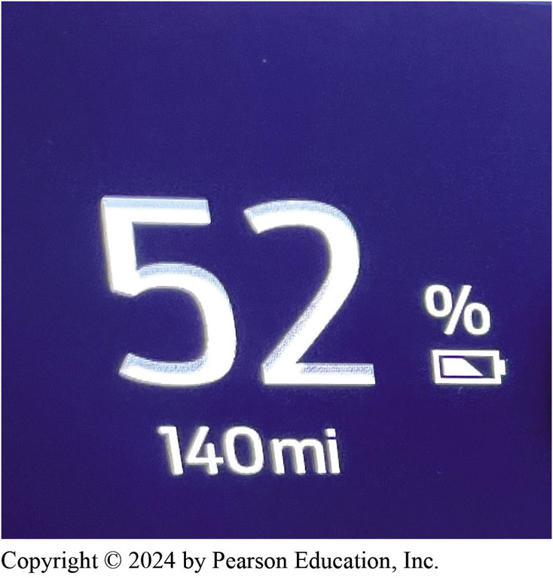
Figure 90.4 Miles Range
The “gas gauge” on an electric vehicle is the miles remaining and the state-of-charge. According to those who have owned an electric vehicle, range anxiety lasts only about 10 days after they see that their travel distance can be easily achieved after being charged.
Notes:
TECH TIP: Use Phone App to Turn on Seat and Steering Wheel Heaters
If not plugged into a charging station on a cold day, most experts recommend that just the steering wheel and seat warmers be turned on to help conserve electrical power. Heating the seats and steering wheel will give the driver a sense of warmth without draining the HV batteries in an effort to heat the air in the entire passenger compartment.

Slide 14
Animation: Chevrolet Volt Range (Animation will automatically start)

Slide 15
Animation: Fuel Mileage and Range, Gasoline (Animation will automatically start)

Slide 16
Animation: Fuel Mileage and Range, Hybrid (Animation will automatically start)

Slide 17
Animation: Fuel Mileage and Range, Electric (Animation will automatically start)

Slide 18
Animation: Fuel Mileage and Range, EREV (Animation will automatically start)

Slide 19
Frequently Asked Question: What Is Range Anxiety?
? Frequently Asked Question
What Is Range Anxiety? Range anxiety is a feeling that many drivers experience when driving an electric vehicle because they fear running out of electric battery energy before they reach their destination. This condition is very common, but according to studies, this feeling lasts about two weeks after first getting an electric vehicle. Within those first two weeks, the driver develops experience regarding how far the vehicle can travel on a full charge and knows that their regular trip can be completed without any issues.

Slide 20
Question 1: ?
What factors effect the range of an electric vehicle?

Slide 21
Answer 1
Vehicle weight, battery energy storage capacity, outside temperature, terrain, and use of electrical devices.

Slide 22
Level 1 Charging
20 Ampere Circuit
Level 1 charging uses a 110/120-volt standard electric outlet (20-ampere circuit).
Maximum power with Level 1 charging is 1.9 k W.
Level 1 charging results in 2 to 5 miles of range for each hour of charging.
Precautions Using Level 1 Charging
Plug charging cord directly into a dedicated 110/120- volt, 20-ampere outlet. Do not use an extension cord.
Notes:
TECH TIP: Tip on Using Some Generators
If trying to use a gasoline-powered generator to charge an electric vehicle, the neutral and ground have to be tied together or the charger errors out. For example, an owner of a Honda EU 2000i generator got a plug with the two lead (neutral and ground) tied together that it can be plugged into the other socket if needed to charge the vehicle. The electric vehicle needs to see 120 volts on the hot lead and 0 volt on neutral when referenced to ground. Some generators will show 60 volts and 60 volts, and then the vehicle may display a ground fault error.
NOTE: The neutral and ground must be electrically isolated. This is also true for any remote panel and all receptacles. The only place they can be connected together is in the main panel where the service ground (ground rod) is located. Some early generators combined them, which led to a whole host of problems, especially with household electronic equipment

Slide 23
Figure 90.5 Level 1 120 Volt Charge
(a) A Chevrolet Volt being charged using the supplied 120-volt charger. (b) Always lay out the entire length of charging cord before plugging the vehicle into the outlet. If cord is not kept straight, the current flow can not only create a coil, but the flow of current can overheat the wires and, in some cases, can actually cause the insulation to melt.

Slide 24
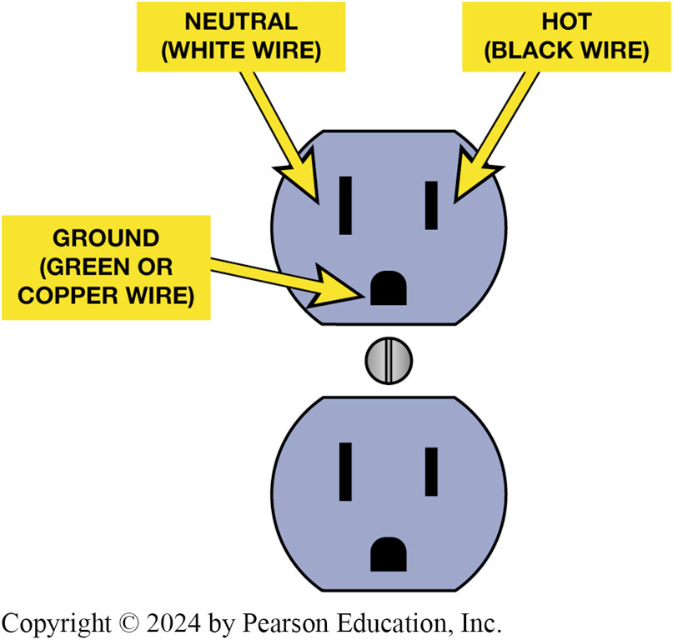
Figure 90.6 Electrical Outlet
The electrical outlet must be wired correctly to the house wiring to avoid the possibility of an electrical shock and for proper charging of the vehicle.
Notes:
CASE STUDY The Case of the Older House
The owner of a Chevrolet Bolt was visiting a relative who lives in an older home. When visiting, the owner thought that they might as well charge their car even though it was at Level 1 (110/120-volt outlet). At least this could add some range added during the visit.
Unfortunately, the house was so old that the electrical outlets did not have a separate ground wire and instead used just a neutral and power (hot) wire. The car knew that the connection did not have a proper ground and the connection was not completed. In this case, the car was smarter than the house.
Summary:
Complaint—A Chevrolet Bolt would not charge when connected to a 110-volt outlet.
Cause—The outlet did not have a ground terminal.
Correction—The vehicle did not allow charging because of the missing ground terminal. This is normal
operation and a safety feature of electric vehicles and no correction was needed.

Slide 25
Animation: Type 1 EV Charging (Animation will automatically start)

Slide 26
Level 2 Charging
Higher Voltage Equals Faster Charging
Level 2 chargers uses 208/240 volts to charge.
Level 2 charging adds about 25 miles of range per hour (R P H).
On-Board Chargers
Level 1 & 2 A C charging is done by on-board charger.

Slide 27
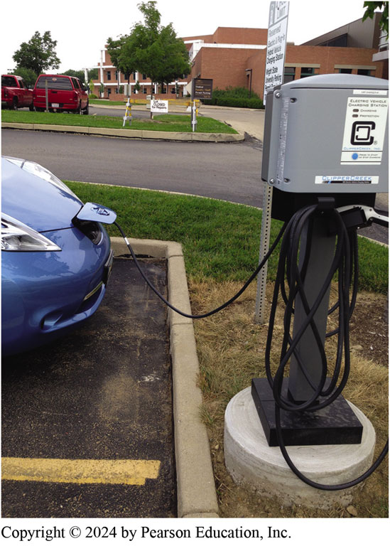
Figure 90.7 Level 2 Charging
Nissan Leaf plugged into a Level 2 charging station at a college.

Slide 28
Animation: Level 2 E.V. Charge (Animation will automatically start)

Slide 29
Frequently Asked Question: What Is That Sound?
? Frequently Asked Question
What Is That Sound? Many electric vehicle owners say that they hear their vehicle making humming sounds while parked in the garage like the climate control fans running. Checking the smartphone app indicated that the climate control was off. While this can cause some concerns to first time owner of electric vehicle, the noise is usually caused by one of the following: The fan, which keeps the battery cool, will run especially if charging or having just finished driving. A Chevrolet Volt, for example, often makes gurgling noises due to the A/C running to help cool the battery down in the garage on a hot sunny day. Because these systems are working when the vehicle is stopped and not operating, many experts recommend that the vehicle is plugged in all the time when it is at home. This is what is often referred to as Always Be Charging (ABC).

Slide 30
Level 3 Charging (1 of 2)
D C Fast Charging
Level 3 charging stations use 440/480 volts A C input and outputs D C to charge most electric vehicles to 80% charge in less than 30 minutes.
Level 3 chargers called D C F C (D C Fast Charge).

Slide 31
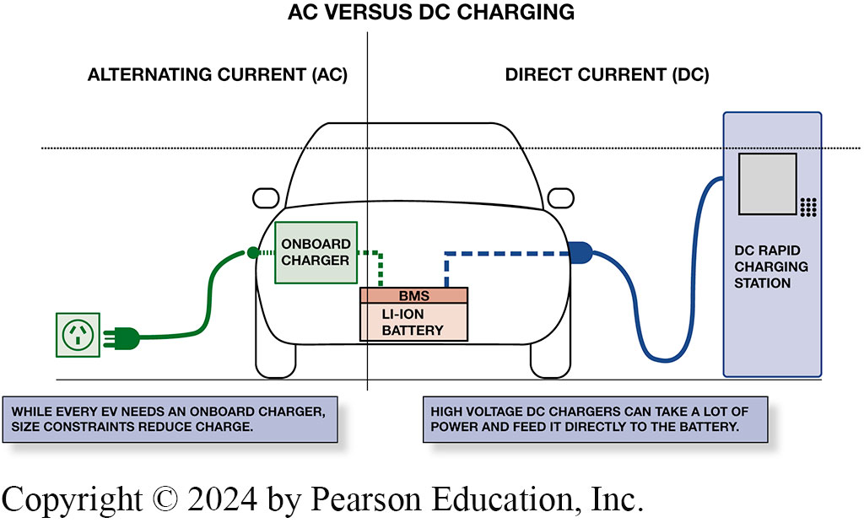
Figure 90.8 Level 3 Charging
Difference between Levels 1, 2, & 3 charging is that by using A C (Levels 1 and 2) onboard charger has to convert A C to D C in order to charge high-voltage battery; using direct current (Level 3) this conversion is not needed so that D C can be used directly to charge the battery.
Notes:
Long Description:
The text on the left side reads alternating current A C, onboard charger and while every E V needs an onboard charger, size constraints reduce charge. The text on right side reads direct current D C, B M S L I -I O N battery, dc rapid charging station and high voltage D C chargers can take a lot of power and feed it directly to the battery.

Slide 32
Level 3 Charging (2 of 2)
Level 3 Electrical Connectors
There are 4 different D C F C connectors currently being used by electric vehicle manufacturers all over the world.
C H AdeM O—Nissan and other Japanese companies such as Mitsubishi.
S A E Combo Charging System (C Adeem S)—(B M W, Ford, G M, V W, and other vehicle makers).
Tesla Supercharger—Tesla standard connector.
Guobiao standard (G B or G B / T)—The Chinese national standard.

Slide 33
Animation: EV DC Fast Charge (Animation will automatically start)

Slide 34
Question 2: ?
What are the differences between level 1, level 2, and level 3 chargers?

Slide 35
Answer 2
The voltage level and the amount of time it takes to charge the battery.

Slide 36
Figure 90.9 DC vs % SOC
Chart showing typical charging rate, which is decreased once state-of-charge reaches about 70%.

Slide 37
Animation: HV Battery State of Charge, SOC (Animation will automatically start)

Slide 38
Figure 90.10 CHAdeMO Level 3 Plug
A close-up view of C H A de M O Level 3 charging plug.
Notes:
TECH TIP: Speak the Language of Electricity
Most people understand units like inches and feet, meters and kilometers, cups and gallons, milliliters and liters, kilobytes and megabytes and gigabytes, but never learned the basic units of electricity.
Many home appliances, such as hair dryers and microwave ovens, have the wattage printed right on the front. There are some people who think electricity is just too complicated. So, when it comes to EVs, manufacturers and charging station operators try to help by stating the miles of range you can get per minute or hour of charging instead of the actual power rating of a charging station. Also, vehicle manufacturers tend to mention just the range that the vehicle can achieve instead of the kWh capacity
of the battery. The first battery electric vehicles were equipped with chargers rated at 3.3 kW. They could only accept a maximum of 3.3 kW of electricity each hour they were connected to a 240-volt, or Level 2,
power supply. A watt is the basic unit of electricity, and a kilowatt is 1,000 watts. A charging station that could send only 1 kilowatt of electricity to the battery pack in an hour would be a 1 kilowatt-hour (kWh) device. The basic charging capacity of a Tesla, for instance, is 10 kWh, and buyers can order a second onboard charger that doubles the charging speed to 20 kWh. To compute how much electrical current will be delivered to a plugged-in vehicle through any properly installed EVSE, multiply the amperes by the volts and divide by 1,000. Typically, most EVs on a Level 2 charging station can achieve about 25 miles per charging hour.

Slide 39
Figure 90.11 SAE Combo System
The S A E Combo Charging System (C C S) is a D C F C connector standard used by B M W, Ford, G M, V W, and other vehicle makers.

Slide 40
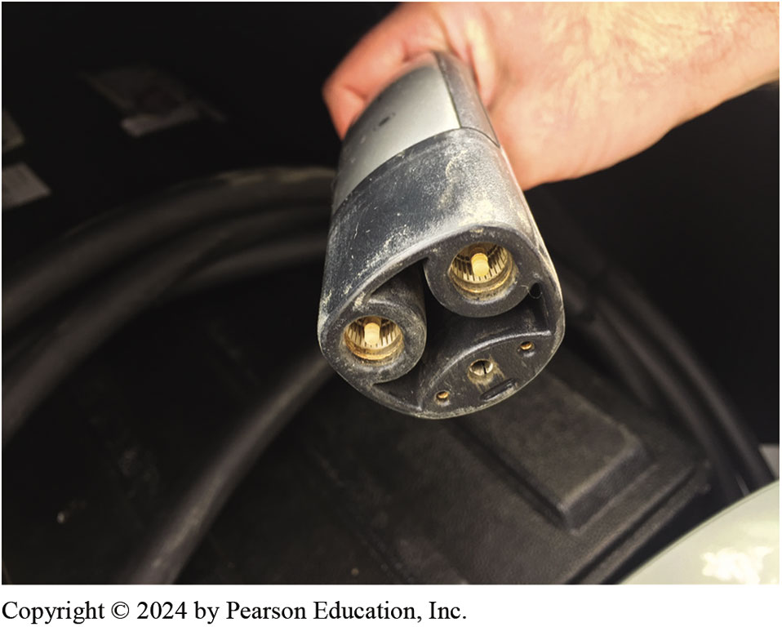
Figure 90.12 Tesla Connector
Tesla vehicles use a unique changing connector that is only used by Tesla.

Slide 41
Frequently Asked Question: What Is Plug & Charge?
? Frequently Asked Question
What Is Plug & Charge? “Plug & Charge” uses ISO 15118 international standard, which specifies secured communication protocol that EV and charging stations should use. Plug & charge improves the public charging experience for electric vehicle owners. Until now, networked public EV charging stations required the use of RFID card, a smartphone app, and credit card. Some find using a public charging station a frustrating experience. This is because station often fails to communicate properly and session either takes a couple of attempts to initiate. Using plug & charge will simplify public charging and is available for use by many EV makes and models, except Tesla that have their own network.

Slide 42
Frequently Asked Question: Why Doesn’t My EV Charge at the Rated Out- put of the Charging Station?
? Frequently Asked Question
Why Doesn’t My EV Charge at the Rated Out- put of the Charging Station? Bolt owner’s manual states to use at least 80 kW to get a full charge in 30 minutes. However, trying to locate a DCFC unit that does in fact supply 80 kW may be a challenge. For example, one Bolt owner was able to locate a DCFC rated at 50 kW, but when using it, the charger was only supplying 35 kW. Other EV owners report the same situation where the rated charger output is not what is actually being supplied to the vehicle. The reasons for this apparent reduced charger include that the vehicle battery may be limiting the amount of current that is be used to charge the battery. This could be the result of the SOC, battery temperature, or other parameters. As a result of the many factors involved, it is difficult to know what the charging rate will be. Use smartphone app for the vehicle, which will provide the information on charging status.

Slide 43
Frequently Asked Question: Can a Solar Panel on Roof Charge My EV?
? Frequently Asked Question
Can a Solar Panel on the Roof Charge My EV? While this sounds like a neat idea, it is not practical. If a vehicle’s surface was covered with solar panels, they might be able to produce 50-watt hours of electricity. A standard 110/120-volt electrical outlet that takes 8 hours to charge a Chevrolet Volt by supplying about 1,400 watts per hour. A full solar charge would roughly take 350 hours. To answer the question . . . , probably not.

Slide 44
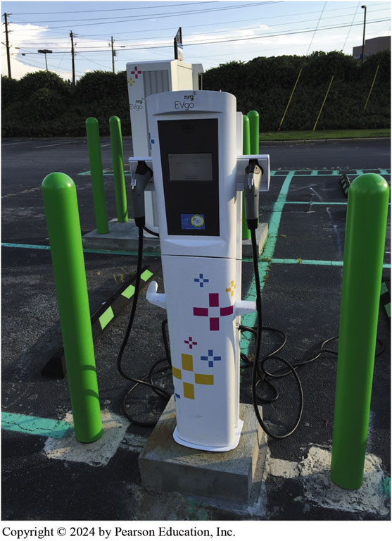
Figure 90.13 Commercial Charging
Commercial charging stations are often located in shopping areas and while most charge a fee, either by the minute of the kWh, some, such as some businesses and schools, are free to use.
Notes:
TECH TIP: Charge to 80% Unless Traveling
Batteries do not have a long service life if the state- of-charge (SOC) is above 80% or below 20%. To help protect the high-voltage battery and extend its life, use the menu in the vehicle display main screen to charge to 80% and input the charging stations at work or a free charger used frequently. Usually at 80% SOC, the charging rate drops and then holds steady until 95% where it tapers again. Even when charged to 80%, the display may say fully charged and needs to be manually changed to indicate charge capacity closer to 100%. The only difference will be the number of miles to zero. The two ways that batteries can degrade are as follows:
Over discharging starts eating copper once no more lithium is left to move and this action will destroy the battery.
Heat created by a high-charge level can cause acid to eat the battery more rapidly.
Once the charging station has been inputted, the vehicle will start to precondition the battery in preparation to being charged. Try to charge to trips and charge to 80% for daily runs to help protect the battery life.

Slide 45
Owning and Charging an E V
Time-of-Use
For almost all E V owners, choosing a time-of-use (T O U) electric rate plan is needed to achieve the largest savings for charging.
Public Charging Stations
Workplace and Destination Charging
Locating a Charging Station
Cost to Charge

Slide 46
Figure 12.14
Commercial charging stations are often located in shopping areas and while most charge a fee, either by the minute of the k W h, some, such as some businesses and schools, are free to use.

Slide 47
Commercial High-speed Charging

Slide 48
1. 66 Miles Left
1. A Mustang Mach E electric SUV is showing 66 miles (27%) of charge remaining.

Slide 49
2. Located Level 3
2. Using a smartphone app, Plug Share in this case, the driver located a Level 3 charging station.

Slide 50
3. SAE CCS Charge Plug
3. After using a credit card to gain access, the driver removed the SAE CCS charge plug from the charging station

Slide 51
4. Plug Location
4. The charge post on the Mustang Mach E is located on the left front fender.

Slide 52
5. Receptacle Lights
5. During charging, the Mach E lights a series of lights around the charge receptacle to let the driver know the level of charge. When all lights are on, the vehicle has been fully charged.

Slide 53
6. Charging Station SOC
6. The charging station also shows the state-of-change on the display. Most experts recommend only charging to 80% unless traveling when the extra range is required to help protect the HV battery.

Slide 54
Additional Related Animations

Slide 55
Animation: Wireless Phone Charging (Animation will automatically start)

Slide 56
Animation: Wireless/Plugless E.V. Charging (Animation will automatically start)

Slide 57
Hybrid and Fuel Cell Vehicles Videos and Animations
Videos Link: (L3) Light Duty Hybrid Electric Videos
Animations Link: (L3) Light Duty Hybrid Electric Animations

Slide 58
Copyright
This work is protected by United States copyright laws and is provided solely for the use of instructors in teaching their courses and assessing student learning. Dissemination or sale of any part of this work (including on the World Wide Web) will destroy the integrity of the work and is not permitted. The work and materials from it should never be made available to students except by instructors using the accompanying text in their classes. All recipients of this work are expected to abide by these restrictions and to honor the intended pedagogical purposes and the needs of other instructors who rely on these materials.

