Slide 1
Automotive Technology: Principles, Diagnosis, and Service
Seventh Edition
Chapter 89
EV and HEV Vehicle High-Voltage Batteries
Copyright © 2023 Pearson Education, Inc. All Rights Reserved
Notes:
INSTRUCTOR NOTE: This presentation includes text explanation notes, you can use to teach the course. When in SLIDE SHOW mode, you RIGHT CLICK and select SHOW PRESENTER VIEW, to use the notes.

Slide 2
Learning Objectives (1 of 2)
89.1 Discuss hybrid and electric vehicle high-voltage batteries.
89.2 Describe nickel-metal hydride batteries and designs used in hybrid electric vehicles.
89.3 Explain the operation of lithium-ion high-voltage batteries including the various types and designs.
89.4 Describe the designs of lithium-ion cells.
89.5 Describe the types of lithium-ion batteries.
89.6 Explain HEV/EV electronics cooling.
89.7 Explain high-voltage battery cooling and heating.

Slide 3
Learning Objectives (2 of 2)
89.8 Discuss battery capacity versus vehicle range.
89.9 Discuss the high-voltage battery control components.
89.10 Discuss the factory authorized lithium-ion battery repair procedure.
89.11 Describe battery degradation and balancing

Slide 4
Hybrid and Electric Vehicle High-Voltage Batteries (1 of 2)
Purpose and Function
Hybrid electric vehicles (H E V s) use a dual-voltage electrical system.
The high-voltage (H V) system is used to power the electric drive (traction) motor.
A conventional 12-volt system is used to power all other aspects of vehicle operation.

Slide 5
Hybrid and Electric Vehicle High-Voltage Batteries (2 of 2)
Electric Motor Requirements
E V s and H E V s use high-output electric motors to drive and assist vehicle movement.
Motors can also be made much smaller and more powerful when they are designed to operate on higher voltages.

Slide 6
Nickel-Metal Hydride Batteries (1 of 4)
Uses
Most current production H E V s use nickel-metal hydride (N i M H) battery technology for the high-voltage battery.
Description and Operation
N i M H batteries have a positive electrode made of nickel hydroxide.
The negative electrode is a hydrogen-absorbing alloy, also known as a metal hydride.

Slide 7
Nickel-Metal Hydride Batteries (2 of 4)
Electrolyte
N i M H batteries are known as alkaline batteries due to the alkaline (p H greater than 7) nature of the electrolyte.
The electrolyte is aqueous potassium hydroxide.
Operation During Charging
Operation During Discharging
Advantages and Disadvantages

Slide 8
Figure 10.2
An N i M H cell. The unique element in a nickel metal hydride cell is the negative electrode which is a hydrogen-absorbing alloy.

Slide 9
Animation: Nickel-Metal Hydride (NIMH) Battery (Animation will automatically start)

Slide 10
Frequently Asked Question: Why Do Higher Voltage Motors Draw Less Current?
? Frequently Asked Question
Why Do Higher Voltage Motors Draw Less Current? Electric motor is powered by wattage. Every motor is rated according to amount of power (watts) it consumes. Power is calculated using following formula: P = I × E or Power in watts = Current (in amperes) × Voltage (in volts) A motor rated at 144 watts will consume 12 amperes at 12 volts of applied voltage (12 volts × 12 amperes = 144 watts). If this same motor was powered with 6 volts, it would draw 24 amperes to achieve same power output. This increase in current draw would require a much bigger cable to efficiently transmit electric current and minimize voltage drop. Motor windings would also have to be much heavier to handle this increased current. Imagine that we power this same motor with a 144-volt battery. SEE NOTES FRO MORE INFO
Notes:
Frequently Asked Question: Why Do Higher Voltage Motors Draw Less Current?
Keep in mind that an electric motor is powered by wattage. Every electric motor is rated according to the amount of power (in watts) it consumes. Power is calculated using the following formula: P = I × E or Power in watts = Current (in amperes) × Voltage (in volts) An electric motor rated at 144 watts will consume 12 amperes at 12 volts of applied voltage (12 volts × 12 amperes = 144 watts). If this same motor was powered with 6 volts, it would draw 24 amperes to achieve the same power output. This increase in current draw would require a much bigger cable to efficiently transmit the electric current and minimize voltage drop. The motor windings would also have to be much heavier to handle this increased current. Imagine that we power this same motor with a 144-volt battery. Now we require only 1 ampere of electrical current to operate the motor (144 volts × 1 ampere = 144 watts). The cable required to transmit this current could be sized much smaller and it will now be much easier to run the cables over the length of the car without significant power loss. Also, the electric motor can be made much smaller and more efficient when less current is needed to power it. Some hybrid systems have motors that operate at up to 650 volts in an effort to increase system efficiency.

Slide 11
Figure 10.3
Chemical reactions inside an N i M H cell. Charging and discharging both involve an exchange of hydrogen ions (protons) between the two electrodes.

Slide 12
Nickel-Metal Hydride Batteries (3 of 4)
N i M H Battery Designs
Cylindrical type. The cylindrical type has the active materials made in long ribbons and arranged in a spiral fashion inside a steel cylinder (case).
Prismatic type. The prismatic type is a rectangular or boxlike design with the active materials formed into flat plates, much like a conventional lead–acid battery.

Slide 13
Frequently Asked Question: How Is an Alkaline Battery Different from a Lead–Acid Battery?
? Frequently Asked Question
How Is an Alkaline Battery Different from a Lead–Acid Battery? Lead–acid batteries use sulfuric acid as the electrolyte, which acts as the medium between the battery’s positive and negative electrodes. Acids have a Ph that is below 7, and pure water has a pH of exactly 7. If electrolyte from a lead–acid battery is spilled, it can be neutralized using a solution of baking soda and water (an alkaline solution). Alkaline batteries use an electrolyte such as potassium hydroxide, which has a pH greater than 7. This means that the electrolyte solution is basic, which is the opposite of acidic. If an alkaline battery electrolyte is spilled, it can be neutralized using a solution of vinegar and water (vinegar is acidic). Both nickel-cadmium (Ni-Cd) and nickel-metal hydride (NiMH) batteries are alkaline battery designs.

Slide 14
Figure 89.4 Cylindrical-Type NiMH
Cylindrical-type NiMH batteries are made with a stainless-steel housing.

Slide 15
Figure 89.5
Prismatic Ni MH cell. Prismatic cells are built with flat plates and separators similar to conventional lead–acid batteries.

Slide 16
Nickel-Metal Hydride Batteries (4 of 4)
Battery Cells Are Connected in Series
In the case of N i M H batteries, each cell is capable of producing only 1.2 volts.
A high-voltage battery based on N i M H technology must be built using multiples of 1.2 volts.
To build a 144-volt battery, 114 individual N i M H cells must be connected together in series

Slide 17
Figure 89.6 Temp Sensor
Each cell has 1.25 volts and a group of six as shown has 7.5 volts. These sections are connected to other sections to create the H V battery pack.

Slide 18
Figure 89.7 NiMH module
Prismatic NiMH module from a Toyota Prius HV pack. The battery posts are located on left and right sides of module. A self-resealing vent is located on the top right for venting hydrogen gas if module overheats.

Slide 19
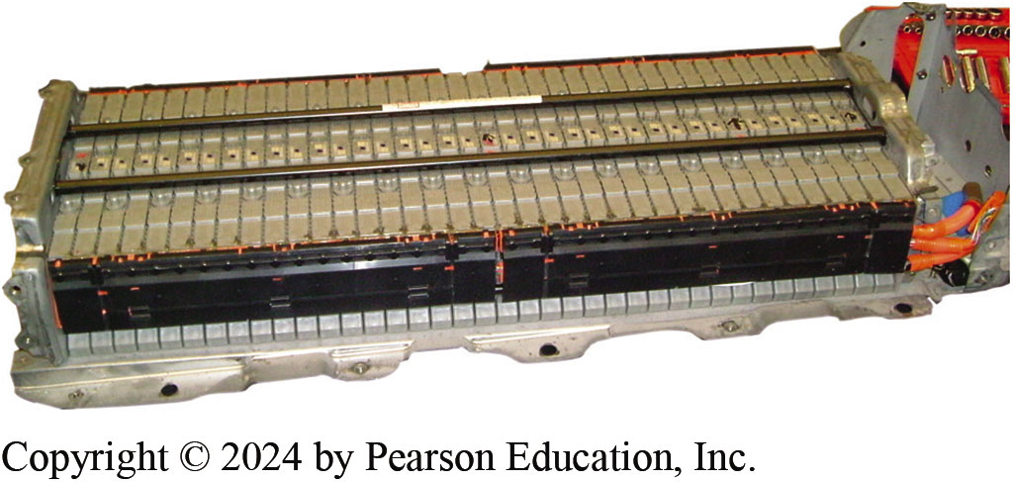
Figure 89.8 HV Battery Pack
A Toyota Camry Hybrid H V battery pack.

Slide 20
Lithium-Ion High-Voltage Batteries (1 of 2)
Uses
Currently used in most electric and plug-in hybrid electric vehicles (P H E V s).
Description
A lithium-ion cell is named because during battery cycling, lithium ions move back and forth between the positive and negative electrodes.

Slide 21
Lithium-Ion High-Voltage Batteries (2 of 2)
Construction
Positive electrode in a conventional lithium-ion battery has lithium cobalt oxide as its main ingredient.
Negative electrode is made from a specialty carbon.
Electrolyte is an organic solvent.
Operation
Advantages and Disadvantages

Slide 22
Designs of Lithium-Ion Cells (1 of 2)
Cylindrical
A cylindrical cell has high specific energy, good mechanical stability, and lends itself to automated manufacturing.
The cylindrical cell design is used by many electric vehicle manufacturers such as Tesla.

Slide 23
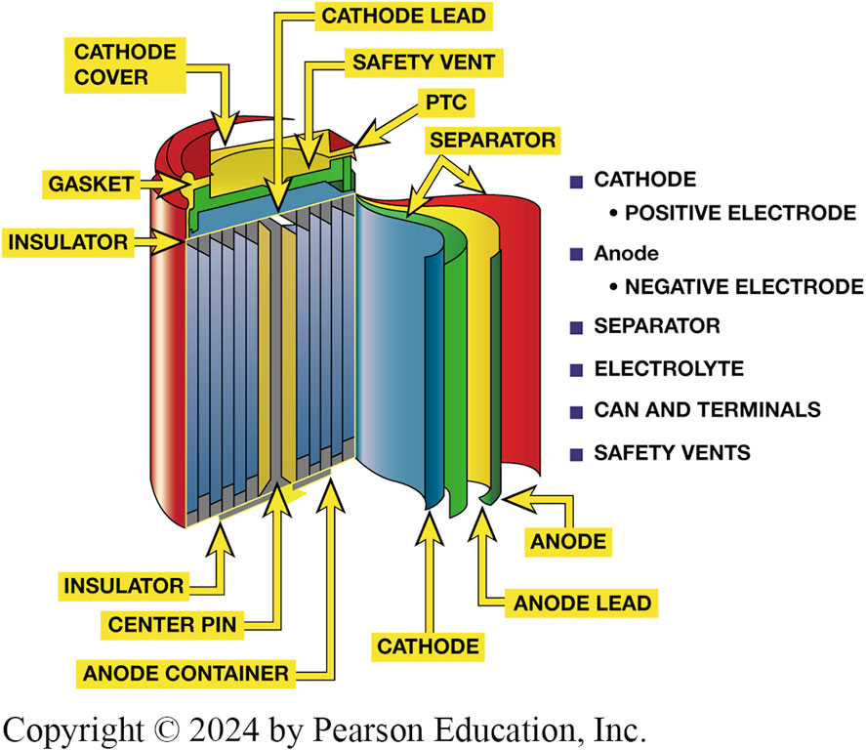
Figure 89.9 Cylindrical Lithium-ion
Construction of a cylindrical lithium-ion cell. Note the pressure relief valve and exhaust gas hole that will relieve internal battery pressure if it gets too hot.
Notes:
Long Description:
The labels on the cylindrical lithium-ion cell are as follows. Gasket, insulator, cathode cover, cathode lead, safety vent, p t c, separator, cathode, positive electrode, anode, negative electrode, separator, electrolyte, can and terminals, safety vents, anode, anode lead, cathode, anode container, and center pin insulator.

Slide 24
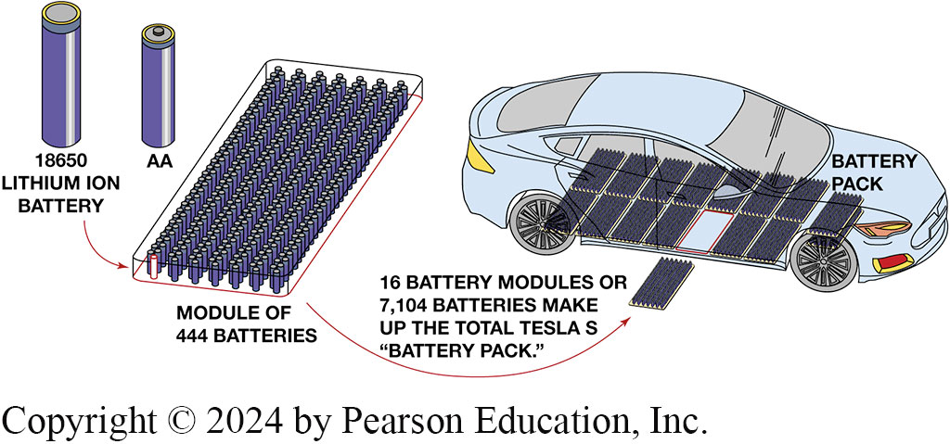
Figure 89.10 Tesla Model S
A Tesla Model S uses 7,104 18650 batteries located under the floor of the vehicle and weighs 1,200 pounds (544 k g).
Notes:
Long Description:
The labels are as follows. 18650 lithium ion E167battery, module of 444 batteries, 16 battery modules or 7,104 batteries make up the total tesla s battery pack, battery pack.

Slide 25
Animation: Tesla Batteries (Animation will automatically start)

Slide 26
Frequently Asked Question: How Much Lithium Is There in a Typical Li-Ion High-Voltage EV Battery?
? Frequently Asked Question
How Much Lithium Is There in a Typical Li-Ion High-Voltage EV Battery? In a typical electric vehicle, such as the Tesla Model S, it is estimated that there is a total of about 15 pounds (7 kg) of lithium used in all of the cells. This is about the weight of a bowling ball.

Slide 27
Designs of Lithium-Ion Cells (2 of 2)
Prismatic—Hard Case
The prismatic type is a rectangular or boxlike design with the active materials formed into flat plates, much like a conventional lead–acid battery.
Prismatic—Pouch Type
Pouch design H V battery uses laminated architecture in a bag referred to as pouch cell.

Slide 28
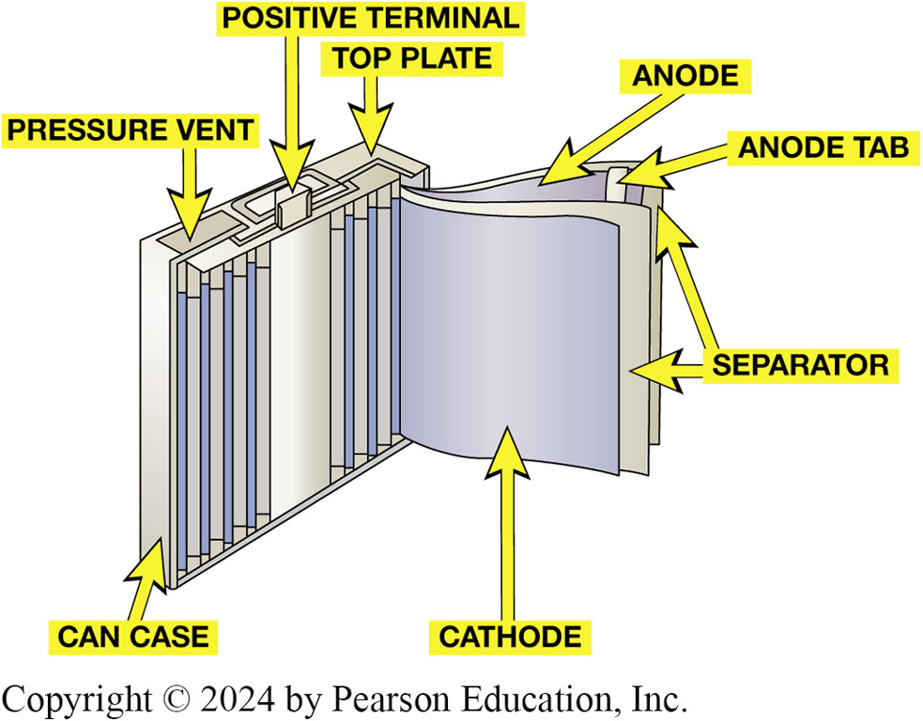
Figure 89.11 Prismatic Type
Prismatic type is rectangular or boxlike design that allows them to be stacked close together to create a H V battery pack.
Notes:
Long Description:
The labels are as follows. Pressure vent, positive terminal, top plate, anode, anode tab, separator, cathode, and can case.

Slide 29
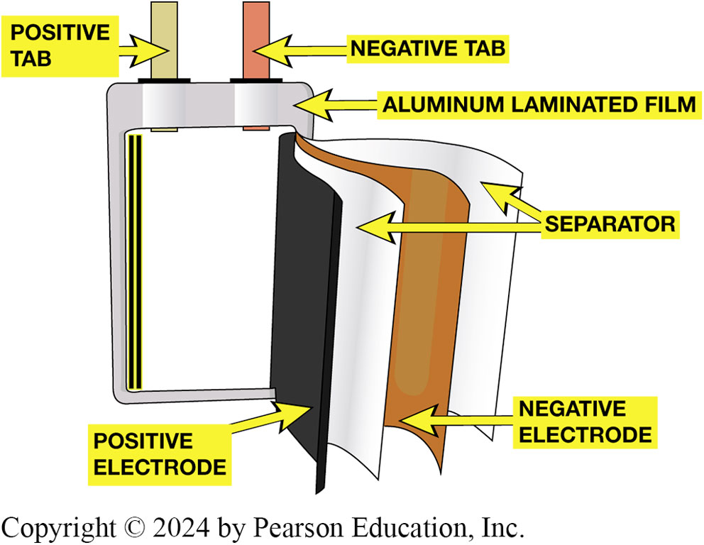
Figure 89.12 Pouch Battery Design
The pouch design uses a flexible outer container that is able to expand when being charged without damaging the battery.

Slide 30
Types of Lithium-Ion Batteries
Numerous Materials
There are numerous types of lithium-ion batteries.
The primary difference between the various designs is the materials used for the positive electrode or cathode.
Cathode Material
Nickel, manganese, and cobalt (N M C)
Nickel, cobalt, and aluminum (N C A)
lithium iron phosphate (L i F e P O4)

Slide 31
Chart 89.1 Common Li-ion Batteries
CHEMICAL NAME | MATERIAL | ABBREVIATION
Lithium Cobalt Oxide | LiCoO2 | LCO
Lithium Nickel Cobalt Oxide | LiNix COyAlz O2 | LNCO
Lithium Nickel Manganese Cobalt Oxide | LiNiMnCoO2 | NMC
Lithium Manganese Oxide | LiMn2O4 | LMO
Lithium Iron Phosphate | LiFePO4 | LFP
Lithium Nickel Cobalt Aluminum Oxide | LiNiCoAlO2 | NCA
Chart of the most commonly used L i-ion batteries.
Notes:
Long Description:
The table has three columns and six rows. From left to right, the columns are labeled chemical name, material, and abbreviation. Row 1. Lithium cobalt oxide, L i C o O sub 2, L C O. Row 2. Lithium nickel cobalt oxide, L i N i sub 1-x C o sub x O sub 2, L N C O. Row 3.Lithium nickel manganese cobalt oxide, L i N i M n C o O sub 2, N M C. Row 4. Lithium manganese oxide. L i M n sub 2 O sub 4, L M O. Row 5. Lithium iron phosphate, L i F e P O sub 4, L F P. Row 6. Lithium nickel cobalt aluminum oxide, L i N i C o A l O sub 2, N C A.

Slide 32
Frequently Asked Question: What Is “Battery Density ”?
? Frequently Asked Question
What Is “Battery Density ”? Battery density refers to the amount of energy in kilowatt-hours (kWh) that a battery can store per kilogram of mass (kWh per kilograms) or volume (kWh per liter) of volume. The higher the number, the higher the energy density of the battery. ● SEE CHART 89–2.

Slide 33
What Is “Battery Density”?
Battery density refers to the amount of energy in kilowatt-hours (k W h) that a battery can store per kilogram of mass (k W h per kilograms) or volume (k W h per liter) of volume.

Slide 34
Chart 89.2 Density
BATTERY TYPE | ENERGY DENSITY (kWh/kg) | ENERGY DENSITY (kWh/L)
Lead–Acid | 0.11–0.14 | 0.22–0.27
Nickel-Metal Hydride | 0.36 | 1.44
Lithium Cobalt Oxide | 0.70 | 2.0
The higher the number, the higher the energy density of the battery. Notice that the lithium-ion battery has the highest energy density compared to lead-acid and nickel-metal hydride batteries.
Notes:
Long Description:
The table has three columns and three rows. From left to right, the columns are labeled battery type, energy density (KWH\KG), energy density (KWH\L). Row 1. Lead acid, 0.11-0.14, 0.22-0.27. Row 2. Nickel metal hydride, 0.36, 1.44. Row 3. Lithium cobalt oxide, 0.70, 2.0.

Slide 35
Frequently Asked Question: What Is a “Solid State” Battery?
? Frequently Asked Question
What Is a “Solid State” Battery? Many manufacturers including Toyota are working on a solid-state battery that does not use a liquid or gel electrolyte. A prototype solid-state battery is said to use a lithium-nickel-manganese-cobalt cathode and a flexible ceramic separator. The lithium ions from the cathode create a metal film on the collector when charging. The advantages of a solid-state battery include a faster charging rate, lower weight, and higher capacity.

Slide 36
H E V/E V Electronics Cooling (1 of 2)
Need for Cooling
Hybrid electric vehicles have electric motors and electronic controls that generate excessive heat during vehicle operation.
Cooling systems are incorporated into hybrid electric vehicles to keep those components at efficient operating temperatures.

Slide 37
H E V/E V Electronics Cooling (2 of 2)
Effects of Heat on the Electrical/Electronic System
Electronic components operate more efficiently as their temperature decreases but can suffer permanent damage if they overheat.
System Construction
Expansion tank and pressure cap
Radiator
Electric water pump

Slide 38
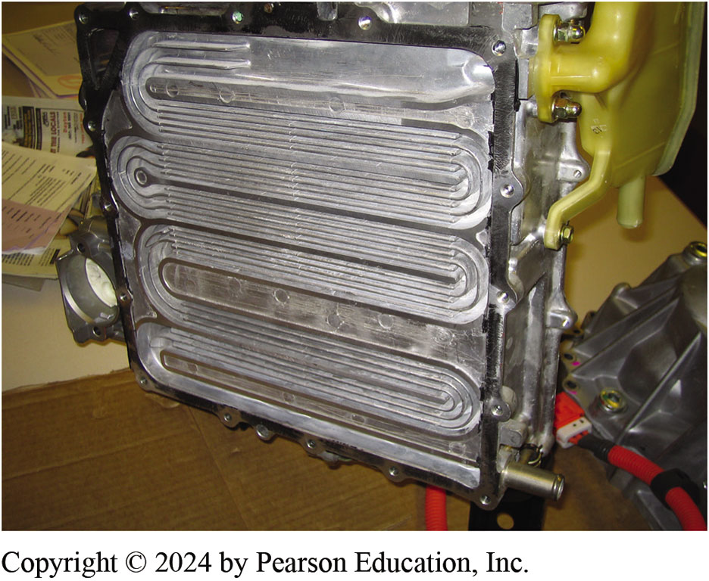
Figure 89.13 Controller Cooling
The underside of the Toyota Prius controller showing the coolant passages used to cool the electronic control unit.

Slide 39
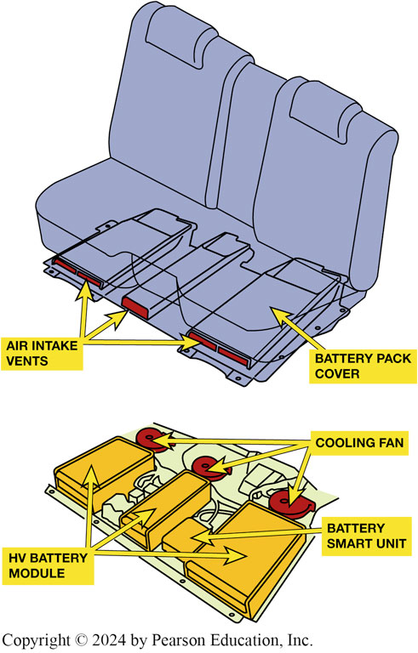
Figure 10.14 Air Cooling
The motor and H V battery electronics on Toyota hybrid S U V.

Slide 40
Frequently Asked Question: Why Isn’t ICE Cooling System Used to Cool HEV Motors & Controls?
? Frequently Asked Question
Why Isn’t the ICE Cooling System Used to Cool HEV Motors and Motor Controls? Most ICE cooling systems operate at over 200 degrees F (93 degrees C). For maximum efficiency, it is important that the ICE operate at close to this temperature at all times. Electric motors and the motor controls, however, tend to operate more efficiently at lower temperatures. The ICE cooling system runs too hot to allow these components to operate at peak efficiency, so a separate low-temperature system is often used.

Slide 41
Figure 89.15 Motor Cooler
The electric motors and the motor controls are cooled using a separate cooling system. This Toyota Hybrid Synergy Drive (HSD) system uses a radiator that is integral with ICE cooling system radiator.

Slide 42
High-Voltage Battery Cooling and Heating (1 of 2)
Need to Heat/Cool H V Batteries
High operating temperatures can lower performance and cause damage to a N i M H or lithium battery pack.
Most current electric vehicles use a liquid cooling system.
Temperature sensors (thermistors) are mounted in various locations in the battery pack housing.

Slide 43
High-Voltage Battery Cooling and Heating (2 of 2)
Service of the System
Air intake inlets must be inspected.
Cooling system level must be checked to ensure there are no leaks and the freeze protection and p H level should be checked.
Coolant should be replaced at the specified service interval.
Electric water pump must be inspected for proper operation.
E V Battery Heater

Slide 44
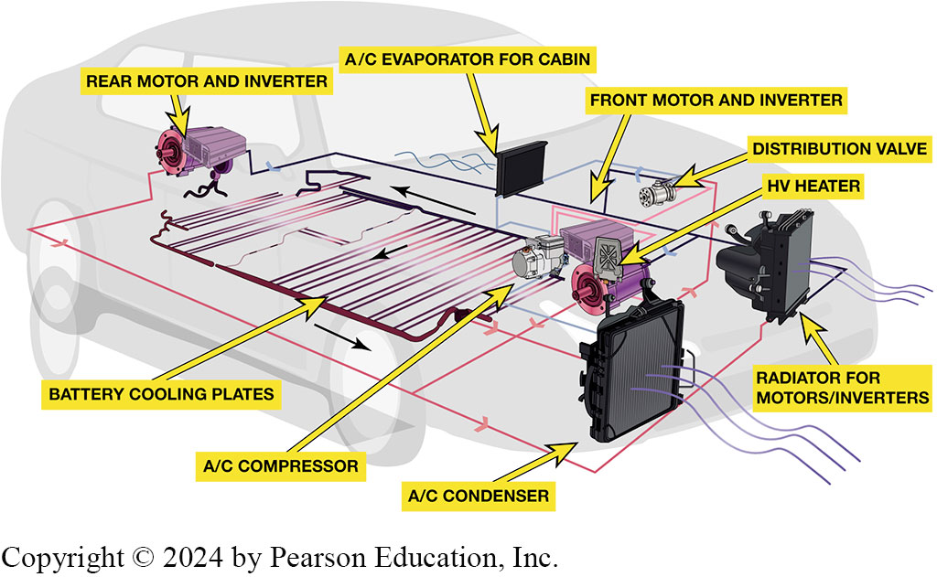
Figure 89.16 Temp Control System
The battery and electronics are included as part of the temperature control system.
Notes:
Radiator for motor or inverters, ac condenser, ac compressor, battery cooling plates, rear motor and inverter, A C evaporation for cabin, front motor and inverter, distribution valve, H V heater.

Slide 45
Figure 89.17 Battery Zone Filter
The HV battery cooling system from a Ford Escape Hybrid. Ford uses outside air to cool the battery pack, then increases cooling with a separate zone in the A/C system when necessary. The was only used on a first generation Ford Escape Hybrid.

Slide 46
Frequently Asked Question: What Is a “Guess-O-Meter”?
? Frequently Asked Question
What Is a “Guess-O-Meter”? The dash display that shows the miles per kWh is often called a Guess-O-Meter (GOM) because it is often not accurate. Good numbers for miles per kWh are 4.3 to 4.9 miles of travel for each kWh consumed. It can be used to help plan a trip. For example, if GOM indicates the battery capacity is 60 kWh in the battery, this usually means the vehicle can travel about 235 miles, so plan on charging at about 200 miles. ● SEE FIGURE 89–18.
Notes:
TECH TIP: The Rule of Thumb Is 3
To help estimate the range of an electric vehicle (EV), multiply the battery capacity in kilowatt-hours (kWh) by three to get a good idea as to the range of the vehicle. For example, a Tesla Model 3 has a battery capacity of 75 kWh and when multiplied by 3 equals 225 miles (75 × 3 = ).

Slide 47
Figure 89.18 “Guess-O-Meter.”
The dash display on a Chevrolet Bolt indicates the miles per kWh, which may or may not be accurate. Because the displayed estimated range varies, it is often referred to as “Guess-O-Meter.”

Slide 48
Battery Capacity V S Vehicle Range (1 of 2)
I C E Vehicle Mileage
In the United States, fuel economy for an internal combustion engine (I C E) vehicle is expressed in miles per gallon (M P G).
E P A V S W L T P
In the United States the Environmental Protection Agency (E P A) estimates electric vehicle range, while in Europe electric vehicle range uses the Worldwide harmonized Light vehicles Test Procedure (W L T P).

Slide 49
Battery Capacity V S Vehicle Range (2 of 2)
E V Equivalent Economy
With an electric vehicle, how far it can travel is measured in miles per kilowatt-hours.
A typical electric vehicle can travel about 3 to 4 miles per kilowatt-hour of battery capacity.

Slide 50
Animation: Chevrolet Volt Range (Animation will automatically start)

Slide 51
High-Voltage Battery Control Components (1 of 3)
Battery Control Module
The battery control module (B C M) is responsible for controlling the operation of the high-voltage battery based on the requests from the hybrid control module.
System Main Relays
System Main Relays (S M R s) are heavy duty relays that control the high-voltage circuit between the battery and the other components.
S M R s are often referred to as contactors.

Slide 52
High-Voltage Battery Control Components (2 of 3)
Current Sensors
Measure the current flowing into the battery during charging and is used to measure current flowing out of the battery when it is discharging.
Voltage Block Monitoring Circuits
Each cell block, which consists of multiple battery cells, is monitored by the B C M for voltage level.
Temperature Sensors
Used to measure the temperature of the battery cells.

Slide 53
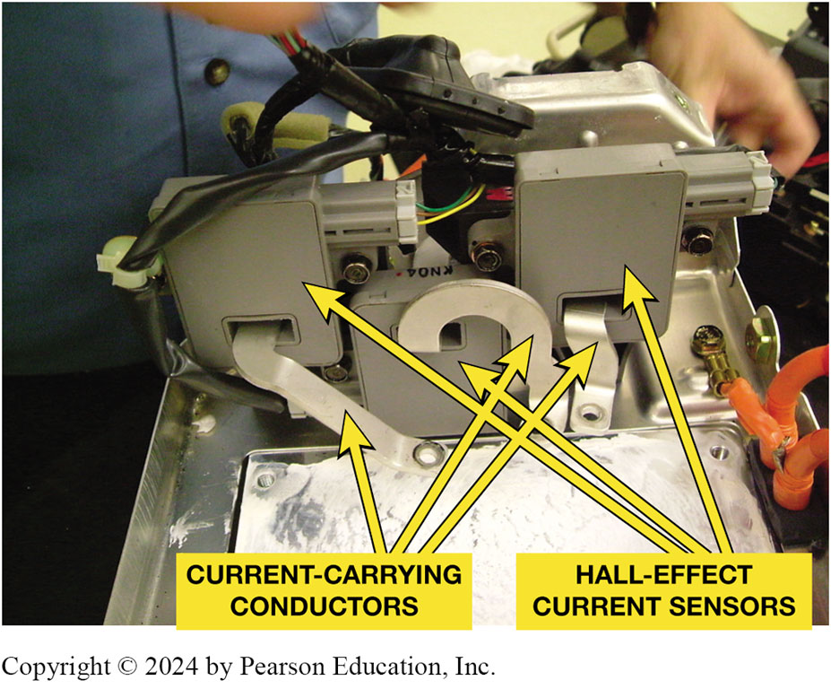
Figure 89.19 Hall-Effect Sensors
Three legs of brushless motor run through 3 Hall-effect-type current sensors. The conductors used in the Honda unit are flat aluminum and attach to the motor controller terminals.

Slide 54
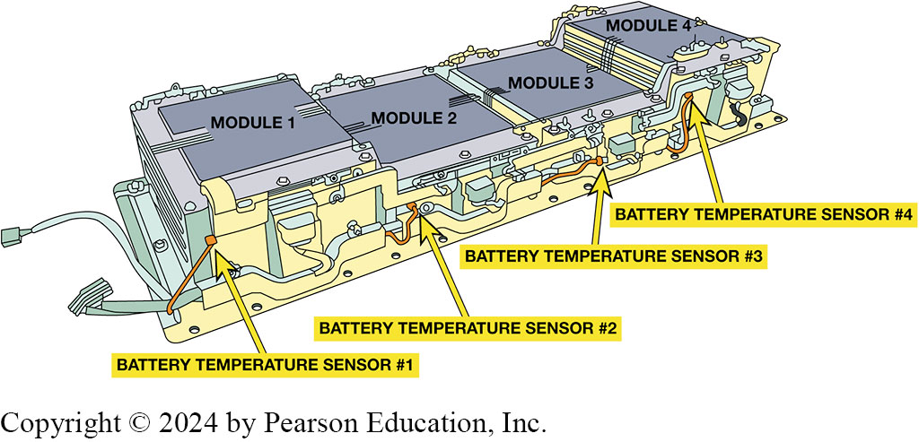
Figure 89.20 Temperature Sensors
Temperature sensors are located throughout a H V battery pack.
Notes:
Long Description:
The labels are as follows. Module 1, module 2, module 3, module 4, battery temperature sensor 1, battery temperature sensor 2, battery temperature sensor 3, battery temperature sensor 4.

Slide 55
High-Voltage Battery Control Components (3 of 3)
H V Disconnect
The purpose of H V battery disconnect switch is to remove power from high-voltage system prior to repairs.
Many H V disconnect switches contain a high-voltage fuse.
Most H V disconnect switches also contain a low-voltage monitoring circuit.

Slide 56
Animation: Toyota Battery Control (Animation will automatically start)

Slide 57
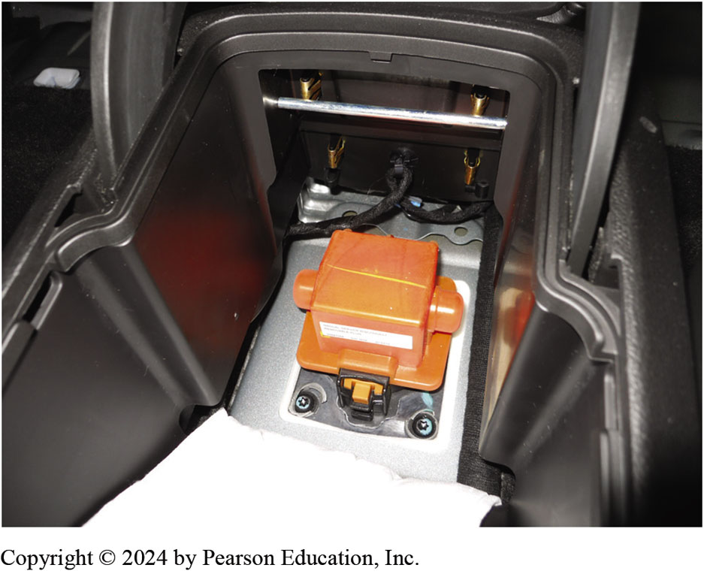
Figure 89.21 Volt Battery Disconnect
The battery disconnect on a Chevrolet Volt is located under the center console.

Slide 58
Electrical Distribution System (E D S) (1 of 2)
Purpose
Isolates the conduction path
Measures current and voltage in high-voltage (H V) line
Provides pre-charge function when energizing H V line
Fuses H V line in case of over-current
Provides manual disconnect of H V line for servicing
Monitors effectiveness of electrical insulation

Slide 59
Figure 10.22
The H V disconnect plug has two small terminals used to signal the H V controller that the safety/service plug has been removed.

Slide 60
Electrical Distribution System (E D S) (2 of 2)
Isolation Testing
The high-voltage system is completely isolated from the vehicle.
A loss of isolation in the high-voltage system will result in a vehicle that will not power-up to the ready mode and set a series of diagnostic trouble codes.
State-of-Charge Management
In most hybrid-electric vehicle applications, a target SOC of 60% is used, and the battery is then cycled so its SOC varies no more than 20% higher or lower than the target.

Slide 61
High Voltage Battery Monitor
State-of-Charge
The H V battery pack controller monitors the state-of-charge.
Scan Date Test Procedure

Slide 62
Figure 89.23 HV Battery SOC
HV battery pack SOC is maintained in a relatively narrow range to prevent overheating and maximize service life.

Slide 63
Animation: HV Battery State of Charge, SOC (Animation will automatically start)

Slide 64
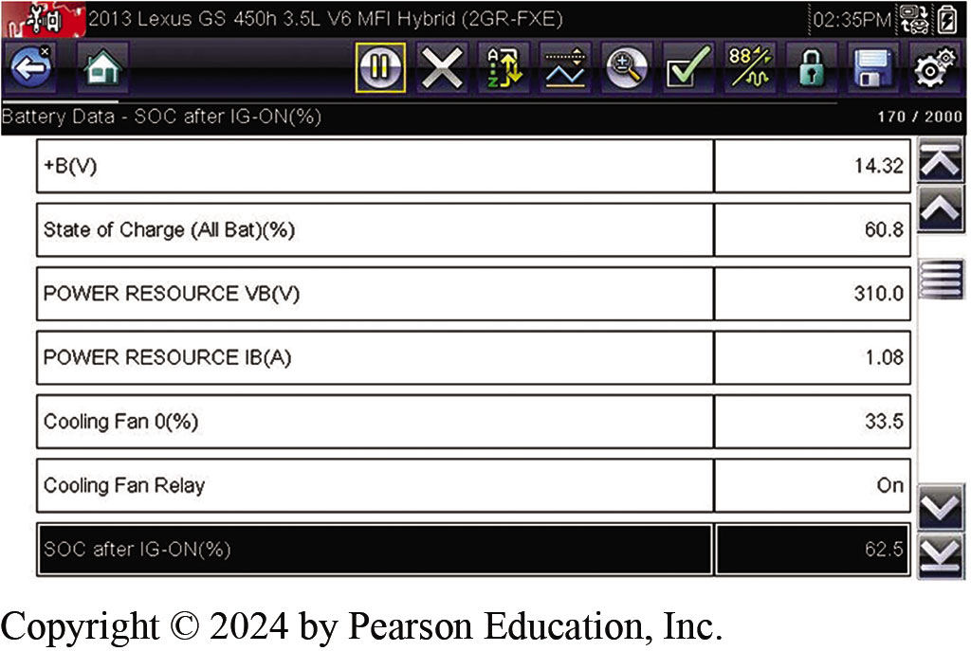
Figure 89.24 Scan Tool SOC
A Snap-on Solus scan tool displays the state-of-charge of the high voltage battery under the heading of “H V E C M”.
Notes:
Long Description:
Following are the data from the tool. Plus B (V), 14.32. State of charge (All battery) (Percentage), 60.8. Power resource V B (V), 310.0. Power resource I B (A), 1.08. Cooling fan 0(percentage), 33.5. Cooling fan relay, on. S O C after I G- ON (percentage), 62.5.

Slide 65
Figure 89.25 Battery Blocks Data
Internal resistances of battery blocks are available on data stream as shown using an aftermarket scan tool. The internal resistance should be between 15 and 40 milliohms (0.015 to 0.040 ohms).
Notes:
Tech Tip: Check State-of-charge First
If a hybrid vehicle owner complains of a lack of power on acceleration, check the state-of-charge (SOC) first. There may be nothing wrong with the traction motor or its controller. It may be simply that the HV battery pack is not within a normal state-of-charge, usually due to a fault
with the battery pack or related electrical connections.

Slide 66
Figure 89.26 Scan Tool Cell Data
The scan tool data indicates that cell #27 was a lot lower than the rest of the cells, which indicates a problem and the reason for the diagnostic trouble code to be set.

Slide 67
Lithium-Ion Battery Repair
Purpose
Some original equipment manufacturers (O E M s) are replacing defective high-voltage battery components rather than replacing the entire battery.
Procedure
Before the battery is removed, it is essential that all the required tools are available.

Slide 68
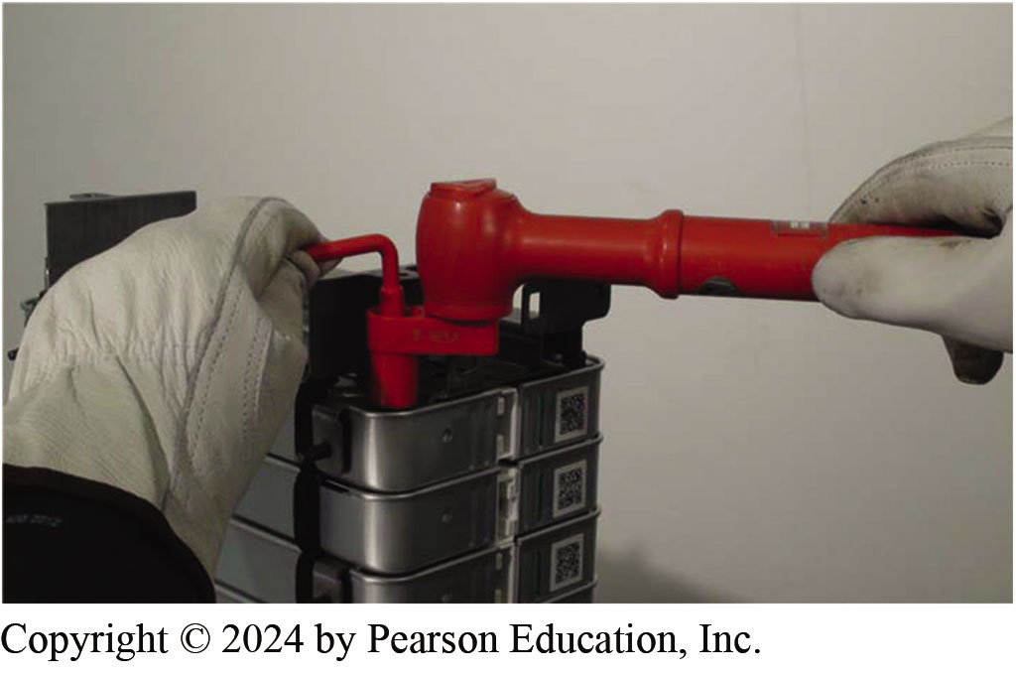
Figure 89.27 Safety Procedures
Whenever working on any potential high-voltage components, always follow recommended safety procedures including using insulated tools and rubber gloves.

Slide 69
H V Battery Pack Service

Slide 70
1. Depower HV Battery
1. To depower the high-voltage system, the ignition is off and the negative battery cable is disconnected from the 12-volt auxiliary battery, then the HV battery safety plug is removed

Slide 71
2. HV Battery Cover Removed
2. After checking that the voltage level is safe, the rear seat and HV battery cover are removed. Always follow the safety procedures specified by the manufacturer for the vehicle being serviced and adhere to all safety warnings and precautions

Slide 72
3. Removing HV Wires
3. The high-voltage wires are removed from the battery pack while wearing H V gloves

Slide 73
4. Removing Battery Pack
4. The HV battery pack is being removed through the rear of the vehicle

Slide 74
5. HV Pack On Workbench
5. The HV battery pack is placed on a workbench that is covered with a thick rubber (insulating) mat. A wood top bench can also be used

Slide 75
6. Visual Inspection
6. A visual inspection shows that many electrical connections between battery modules are corroded

Slide 76
7. Remove Temp Sensors
7. HV battery pack temperature sensors are removed

Slide 77
8. Remove Vent Tubes
8. HV battery vent tubes are removed from the battery pack

Slide 78
9. Removing End Caps
9. The end caps are removed from the battery pack

Slide 79
10. Fasteners
10. The fasteners that hold the battery modules to the base of the battery pack are removed

Slide 80
11. Removing Module
11. The end module is being removed from the battery pack

Slide 81
12. Measuring Voltage
12. The individual modules are measured using a voltmeter and most modules are found to be about 3.6 volts, which is far below the minimum of 5.4 volts that most experts think can be restored by charging

Slide 82
Hybrid and Fuel Cell Vehicles Videos and Animations
Videos Link: (L3) Light Duty Hybrid Electric Videos
Animations Link: (L3) Light Duty Hybrid Electric Animations

Slide 83
Copyright
This work is protected by United States copyright laws and is provided solely for the use of instructors in teaching their courses and assessing student learning. Dissemination or sale of any part of this work (including on the World Wide Web) will destroy the integrity of the work and is not permitted. The work and materials from it should never be made available to students except by instructors using the accompanying text in their classes. All recipients of this work are expected to abide by these restrictions and to honor the intended pedagogical purposes and the needs of other instructors who rely on these materials.

