Slide 1
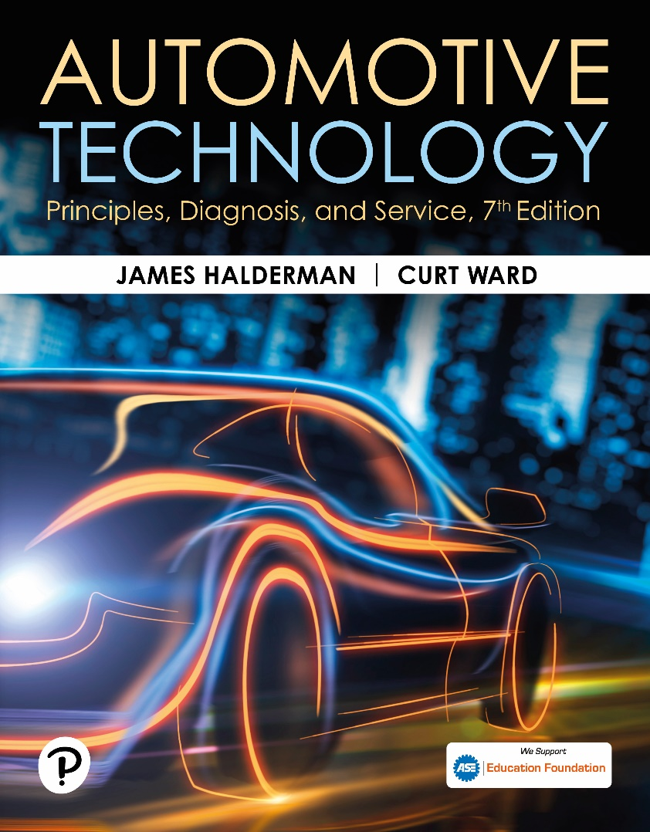
Automotive Technology: Principles, Diagnosis, and Service
Seventh Edition
Chapter 88
Hybrid and Electric Vehicle Maintenance
Copyright © 2023 Pearson Education, Inc. All Rights Reserved
Notes:
INSTRUCTOR NOTE: This presentation includes text explanation notes, you can use to teach the course. When in SLIDE SHOW mode, you RIGHT CLICK and select SHOW PRESENTER VIEW, to use the notes.

Slide 2
Learning Objectives
88.1 Describe routine service procedures for both hybrid and electric vehicles.
88.1 Explain how to place a hybrid vehicle in maintenance mode.
88.1 Describe an oil and filter change and engine maintenance on a hybrid vehicle.
88.1 Explain how to service the base brake system on a hybrid or electric vehicle.
88.1 Discuss related maintenance items: battery, filter, A/C service, tires, auxiliary battery, and steering systems.
88.1 List diagnostic procedures for hybrid and electric vehicles.

Slide 3
Routine Service Procedures
Customer Perception
Customer begins to notice decrease in fuel economy.
Perception is that decrease is a result of a failing high-voltage battery.
Decrease in fuel economy or performance is
Result of a lack of routine maintenance.

Slide 4
Instrument Cluster Messages
Technician must understand what the indicators in the instrument cluster and message center mean.
Failure to understand these symbols may lead to unnecessary or incorrect initial diagnostic assumptions.
Notes:
As part of correctly diagnosing a hybrid or electric vehicle, the technician must understand what the indicators in the instrument cluster and message center mean. These indicators will help to confirm the customer’s concern and provide a clue as to what may be wrong with the vehicle. The failure to understand these symbols may lead to unnecessary or incorrect initial diagnostic assumptions. SEE FIGURE 88-1.

Slide 5
Chart 88.1 Routine Maintenance
HEV/PHEV MAINTENANCE ITEMS | EV MAINTENANCE ITEMS
Oil changes (once or a year or when the OLM indicates) | NA
Engine air filter (every 2–3 years) | NA
Cabin filter (every 2–3 years) | Cabin filter (every 2–3 years)
Tire rotation (every 7,500 miles) | Tire rotation (every 7,500 miles)
Windshield washer fluid (as needed) | Windshield washer fluid (as needed)
Windshield wiper blades (as needed) | Windshield wiper blades (as needed)
Routine maintenance service.

Slide 6
Figure 88.1 DIC Message
An example message screen from a Generation 2 Toyota Prius provides a wealth of information for the driver and the service technician.

Slide 7
Non-High Voltage Components That Impact Fuel Economy
Absence in any of the following components as it may affect the vehicles’ fuel economy:
Low rolling resistance tires
Low-mass wheels
Spoilers
Underbody trays
Aerodynamic assist steps

Slide 8
Placing the Vehicle in Maintenance Mode
Required under conditions that can include the following:
Checking air-conditioning pressures
Bringing the engine to operating temperature
Safety inspection of the exhaust system
The vehicle can be placed in this mode either with a scan tool or through a specific sequence of steps.

Slide 9
Lifting an Electric Vehicle
The high-voltage battery and its covers fill a large portion of the underside of the vehicle.
Some vehicles require special adapters for lifting.

Slide 10
Figure 88.2 Lift Positions
When positioning the lift, make sure the arms and contact points are clear of any high-voltage cables.

Slide 11
Oil and Filter Service
H E Vs require S A E 0W-20, S A E 0W-16, or S A E 5W-20.
Be sure that I C E is off and that “READY” lamp is off.
Be sure that the key fob is at least 15 feet (5 meters) away from the vehicle.

Slide 12
Frequently Asked Question: When Do I Need to Depower the High-Voltage System?
? Frequently Asked Question
When Do I Need to Depower the High-Voltage System? During routine service, there is no need to depower the high-voltage system. The only time when this process is needed is if service repairs or testing is being performed on any circuit that has an orange cable attached. These include: AC compressor if electrically powered, High-voltage battery pack or electronic controllers, Electric power steering system usually operates on 12 volts/42 volts and neither is a shock hazard. However, an arc will be maintained if a 42-volt circuit is opened. Always refer to service information if servicing the electric power steering system,

Slide 13
Figure 88.3 Oil Fill
This Toyota Prius uses SAE 0W-20 as indicated by the oil filler cap
Notes:
CASE STUDY: A No-Start Prius after a Routine Oil Change A technician went to start a Toyota Prius after completing a routine oil and filter service. The technician discovered the engine would crank over briefly and then fail to start. A visual inspection was performed and no components were found to be damaged or disconnected as a result of the oil service. Further diagnosis revealed the engine crankcase was significantly overfilled. When motor generator 1 (MG1) turned over the crankshaft on startup, it was unable to achieve the desired engine RPM as a result of the extra resistance created by the excess oil in the crank case. The fail-safe or limp-in operation was a no-start condition. After the engine oil level was lowered to the
correct level, the vehicle started and operated normally.
Summary:
The vehicle failed to start due to a crankcase overfill condition that caused MG1 to go into a fail-safe or limp-in condition.
Concern—The vehicle would not start.
Cause—An over-full engine crank case was observed.
Correction—Lowered the engine oil to the correct level.

Slide 14
Engine Maintenance
Hybrid vehicles may have specific engine maintenance requirements.
Honda Insight requires the indexing of spark plugs.
Honda engines require mechanical valve lash adjustments.
Atkinson cycle engines may require more frequent throttle body service.

Slide 15
Cooling System Service
Service is similar to service in vehicle equipped with I C E.
There are several items to know when servicing the cooling system on a hybrid and electric vehicle, including there may be 2 or 3 systems that require service.
Use specified coolant and replacement interval.
Some hybrid vehicles use a different pressure cap on the engine as compared to the electronics cooling systems.

Slide 16
Figure 88.4 Pressure Cap
Chevrolet Volt engine cooling system with a 20 P S I rated reservoir cap.

Slide 17
Figure 88.5 Reservoir Cap
Chevrolet Volt electronics cooling system with a 5 P S I rated reservoir cap.

Slide 18
Braking System Service
Check service information for any precautions.
Need scan tools, pressure bleeders, and other required tools.
Base brakes on many hybrid and electric vehicles are often found to be stuck or not functioning correctly because the brakes are not doing much work.

Slide 19
Figure 88.6 Base Brakes
The brake rotor on this Audi Q5 hybrid is rusted and has very little pad contact due to a seized brake caliper pin.

Slide 20
Figure 88-7

Slide 21
Figure 88.7 HV Battery Air Filter
This Toyota Prius has a high-voltage battery air filter that must be replaced at the documented time or mileage to prevent the battery from overheating.
Notes:
Many hybrid vehicles rely on the air that is heated and cooled for the passenger compartment to regulate the temperature of the high-voltage battery. To prevent the intrusion of passenger compartment debris from the entering the high-voltage battery cooling system, a filter is placed in the air-intake system. These filters must be replaced at specific service intervals to ensure proper cooling. SEE FIGURE 88-7.

Slide 22
Air-Conditioning Service
Many hybrid and electric vehicles use an A/C compressor that uses high voltage from high-voltage battery pack to operate compressor.
Make sure high-voltage system has been properly depowered before removing compressor for service.
If system is electrically driven,
Special refrigerant oil, P O E oil, is used.

Slide 23
Figure 88-8 POE Refrigerant Oil
This POE refrigerant oil is specific to FCA brand products.

Slide 24
Tire Service
Always inflate the tires to the pressure indicated on the door jamb sticker.
Follow normal tire inspections and tire rotation intervals as specified by the vehicle manufacturer.
Noise-reducing tires
Noise reduction is accomplished by adding acoustical foam to the inside of a tire.
The acoustical foam must be carefully cut from the area of the puncture and after the repair is complete it must be reattached.

Slide 25
Figure 88.9 Noise Reducing Tires
Blowing across the top of an empty “Coke” bottle creates a noise similar to a vehicle without noise-reducing tires.
Notes:
The purpose of a noise-reducing tire is to eliminate noise in the 130–240 Hz range that would be normally covered up by normal engine noise in a vehicle with an ICE. The noise reduction is accomplished by adding acoustical foam to the inside of a tire. The sound is created within the structure of the tire itself and is not transmitted through the air, but rather through the chassis of the vehicle. The sound is similar to the sound heard when blowing across a partially filled glass Coke bottle. As result, this sound is often referred to a “Coke bottle resonance.” This sound is most noticeable with electric vehicles (EVs) because there is no drivetrain noise to
drown out the resonance. Figure 88-9.

Slide 26
Figure 88.10 Tire Foam
A tire off a Tesla Model 3 with acoustical foam.

Slide 27
Auxiliary Battery Service
Auxiliary 12-volt batteries used in hybrid or electric vehicles are located in one of two general locations
Under the hood
In the passenger or trunk compartment
Some micro hybrids with the stop-start feature will have two 12-volt batteries.

Slide 28
88.11 JIS
Toyota battery is rated using the Japanese Industrial Standard (JIS) rather than cold-cranking amperes.

Slide 29
Steering System Service
Powered by one of two voltages:
12 volts—These systems can be identified by red or black wiring conduit.
42 volts—These systems use a yellow or blue plastic conduit.
When depowering the power steering system to make repairs, it is important to follow the specific wait times to ensure the capacitors are completely discharged.

Slide 30
Figure 88.12 Power Steering Assist
The capacitors in the power steering assist unit provide additional power when needed but must be allowed to discharge before service work begins.

Slide 31
Diagnosis Procedure
Hybrid and electric vehicles should be diagnosed the same as any other type of vehicle.
Follow a diagnostic routine as described in the text.

Slide 32
Question 1?
The purpose of the hybrid vehicle maintenance mode is to_____________.
a. bypass the idle stop feature
b. service the base brake system
c. change the oil and filter
d. service the cooling system

Slide 33
Answer 1
The purpose of the hybrid vehicle maintenance mode is to_____________.
a. bypass the idle stop feature

Slide 34
Hybrid and Fuel Cell Vehicles Videos and Animations
Videos Link: (L3) Light Duty Hybrid Electric Videos
Animations Link: (L3) Light Duty Hybrid Electric Animations

Slide 35
Copyright
This work is protected by United States copyright laws and is provided solely for the use of instructors in teaching their courses and assessing student learning. Dissemination or sale of any part of this work (including on the World Wide Web) will destroy the integrity of the work and is not permitted. The work and materials from it should never be made available to students except by instructors using the accompanying text in their classes. All recipients of this work are expected to abide by these restrictions and to honor the intended pedagogical purposes and the needs of other instructors who rely on these materials.

