Slide 1
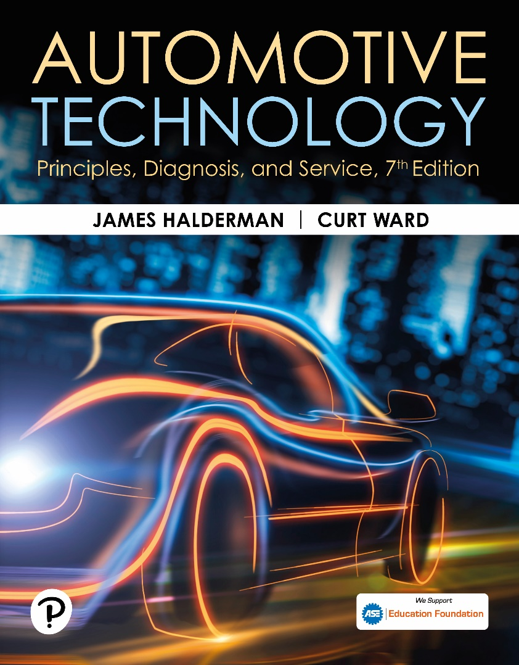
Automotive Technology: Principles, Diagnosis, and Service
Seventh Edition
Chapter 84
Module Programming
Copyright © 2023 Pearson Education, Inc. All Rights Reserved
Notes:
INSTRUCTOR NOTE: This presentation includes text explanation notes, you can use to teach the course. When in SLIDE SHOW mode, you RIGHT CLICK and select SHOW PRESENTER VIEW, to use the notes.

Slide 2
Learning Objectives
84.1 List the benefits of module reprogramming over previous methods of update.
84.2 Describe the regulatory requirements of J2534.
84.3 List the hardware used for programming.
84.4 List the software used for programming.
84.5 Describe the methods of module reprogramming.
84.6 Explain the need for a battery maintainer during reprogramming.
84.7 Describe the concerns of programming in the shop.
84.8 Describe aftermarket reprogramming.

Slide 3
Figure 84.1 Control Module
Toyota engine control module pictured in the figure is an example of a module that must be replaced to update the programming memory.
Notes:
Software programming has been used by the engine control module to meet air quality and emission standards since fuel injection replaced carburetors. The method of updating the software calibration has changed as technology has evolved. On early fuel-injected vehicles, it was necessary to change the computer when the calibration needed to be updated. As shown in Figure 84-1
In the early 1980s, the replacement PROM (programmable read only memory) was introduced. Instead of replacing the entire module, the technician would remove the PROM and install a replacement chip. Several versions of replaceable PROMs were used. FIGURES 84-2 AND 84-2B. In 1990, GM introduced flash reprogramming. This process allowed the technician to download the replacement software calibration from the manufacturer and to install it in the vehicles computer EEPROM (electronically erasable programmable read only memory). This eliminated the need to stock any parts which decreased the cost and the time needed
for the repair.

Slide 4
Figure 84.2A GM PROM ECM
The two GM engine control modules above are examples of two styles of removable PROMs used to update programmable memory.

Slide 5
Figure 84.2B GM ECM PROM
The two GM engine control modules above are examples of two styles of removable PROMs used to update programmable memory

Slide 6
Figure 84.3 Scan Tool Programming
The manufacturer scan tool is being used to reprogram the engine control module via the data link connector.

Slide 7
SAE Standards J2534 & J2534-1/2
SAE J2534: communications between computer and vehicle
EPA/CARB regulations require all automakers
Provide a J2534 service to everyone in US
For reflashing emission-related controllers
4 Versions J2534, J2534-1, J2534-2, and J2534-5
J2534-5 Latest improved DLC Communications
Notes:
SAE created the standard SAE J2534 for communications between a computer and a vehicle. The original standard was introduced in February of 2002, and was identified as version 02.02. The EPA and CARB regulations require all automakers to provide a J2534 service to everyone in the United States for re- flashing emission-related controllers. If the technician has a SAE J2534 pass-through device, they can re-flash and, in some cases, diagnose vehicles with factory functionality. The EPA documentation requires OEMs to comply with SAE J2534 for pass-through reprogramming beginning with model year 2004. Reprogramming information also had to be made available within three months of vehicle introduction for new models. The original version of the standard was found to have some errors.
This original standard was updated in December of 2004. The new standard was identified as version 04.04 or more commonly as SAE J2534-1. The changes in the second version of the standard supported specific requirements of Ford and Chrysler that were not addressed in the first standard that related to J1850 class 2 communication protocols. It also defined specifics for the design of the vehicle communication interface device. The standard was updated again and referred to as SAE
J2534-2. These changes addressed issues related to single wire CAN BUS communication and issues related to the GM UART communication protocol. The new standard also provided a method for manufacturers to add optional features in a uniform way. An example of this is the ability to flash program modules that were not emission related.
The current standard is referred to as SAE J2534 version 5.00. The newest standard includes all the changes required in the previous updates and serves to improve the communication through the J1962 connector. It is important to have the most current equipment to ensure that that the flash reprogramming process will be completed without any malfunctions.

Slide 8
Programming Hardware
OEM pass-through devices
GM MDI and Ford VCI
Generic Devices like CarDAQ-Plus
Notes:
Each manufacturer has developed their own J2534 pass-through device or application programming interface (API) that is specific to the brands the manufacturer sells. A pass-through device or API serves as a connection point that makes all the hardware look the same, and allows the computer with the reprogramming software to communicate with the vehicles control module through the data link connector (DLC). Generally, these tools are not designed with the functionality to support competitive brands. In many cases, these pass-through devices are designed to support the manufacturer scan tool in addition to providing reprogramming capabilities. The GM MDI and Ford VCI are both examples of this type of technology. FIGURE 84-4.
The generic J2534 pass-through device is designed to support multiple manufacturers. These tools typically do not have the same level of scan tool diagnostics as a manufacturer-specific tool. These tools are more often found outside of the dealership environment in the independent repair facilities. The Drew Technologies CarDAQ-Plus series of J2534 pass-through devices is an example of a generic tool..

Slide 9
Figure 84.4 GM MDI Ford VCI
The GM MDI and Ford VCI are examples of manufacturer-specific pass-through devices.

Slide 10
Figure 84.5 Generic Device
The CarDAQ Plus is a generic pass-through device.

Slide 11
Programming Software
NASTF (National Automotive Service Task Force)
Tool industry, OEM ensures access to information, training, and tools needed for diagnosis and repair
NASTF created a portal to access reprogramming information.
Includes where to access information, tools needed, and in many cases a short video on how to complete the task
OEM Dealers have a factory system
Notes:
NASTF (NATIONAL AUTOMOTIVE SERVICE TASK FORCE) he NASTF is a cooperative effort of the automotive service industry, the tool industry, and the original equipment manufacturers to ensure that automotive professionals employed outside of the OEMs have all the information, training, and tools they need to diagnose and repair modern automobiles. The NASTF has created a portal for all automotive service professionals to access manufacturer-specific reprogramming information. This includes where to access the information, the tools needed, and in many cases a short video on how to complete the task. FIGURE 84-5
VEHICLE SECURITY PROFESSIONAL – LOCKSMITH ID Many
times when a module must be reprogrammed or programmed upon replacement, the security codes or key specific information must be re-entered during the process. In order to obtain this information, the shop or service technician must be a registered vehicle security professional and have a locksmith ID number. The National Automotive Service Task Force (NASTF), in conjunction with automotive manufacturers, insurance industry, independent repair, and law enforcement communities, has developed this system to allow the aftermarket repair industry to access to this sensitive data. The forms and instructions needed to apply for this identification number can be found on the NASTF website (www.nasft.org) under Locksmith/Vehicle Security. FIGURE 84-7

Slide 12
Figure 84.6 Locksmith ID
The screenshot from the NASTF website provides the resources for the technician to apply for a locksmith ID.

Slide 13
Figure 84.7 NASTF Website
The screenshot of the NASTF website provides an access point for the aftermarket automotive professional to obtain the needed reprogramming information.

Slide 14
Reprogramming (1 of 2)
Module connected to vehicle during process
Module uses its normal connection points
Provide power, ground, communication links
Involves Scan tool, Computer, Internet, Interface
Notes:
On-board reprogramming of the controller is defined as having the module connected to the vehicle during the process. The module uses its normal connection points to provide the power, ground, communication links, and any other needed support. This is the type of programming that typically occurs in a service facility. SEE FIGURE 84-8.

Slide 15
Figure 84.8 J2534 Device
The J2534 device is being used to program the engine control module through the DLC.

Slide 16
Reprogramming (2 of 2)
Off-board programming of controller
Module Programmed Someplace Other Than In Vehicle
Sometimes done at local parts store
Remote Programming shop simply plugs in equipment and follows the instructions of someone who is at a distant location
Notes:
Off-board programming of the controller is defined as having the module programmed someplace other than in the vehicle. This could be anywhere that there is a computer and the needed power, ground and communication links. The purchase and programming of a module at a local
parts store is an example of off-board programming. SEE FIGURE 84-9
Remote programming is a relatively new process. The servicing facility does not perform the reprogramming of the vehicle. Instead, the shop simply plugs in the equipment and follows the instructions of someone who is at a distant location. This process still requires an Internet connection and equipment. However, it relies on a third party who has the manufacturer subscription for the software. This option has become increasingly popular for shops that perform very few reprogramming events or lack the technical expertise to complete the task. SEE FIGURE 84-10.

Slide 17
Figure 84.9 Off-Board Programming
The engine control module can be programmed at an off-board location.

Slide 18
Figure 84.10 Remote Programmer
The Drew Technologies remote programming tool is an example of a tool that is connected to the vehicle and used remotely.

Slide 19
Battery Voltage
Provide a stable vehicle voltage
Use battery maintainer connected during repair
Hold vehicle at specific voltage for duration of repair.
NO wide fluctuations in voltage or amperage.
Recommended that the maintainer be only used
For voltage stabilization during a reprogramming
Not be used for any other general shop
Notes:
In order to provide a stable vehicle voltage throughout the reprogramming process, it is recommended that a battery maintainer be connected to the vehicle during the repair. A battery maintainer is designed to hold the vehicle at a specific voltage throughout the duration of the repair. A unique feature of the battery maintainer is that it accomplishes this task without wide fluctuations in voltage or amperage. FIGURES 84–11 AND 84–12. Currently there are very few battery
maintainers in the marketplace and they are more expensive than a battery charger. It is recommended that the maintainer be only used for the purpose of voltage stabilization during a reprogramming event, and they not be used for any other general shop use to ensure their proper operation.

Slide 20
Figure 84.11 Battery Maintainer
Midtronics PSC-550 is an example of battery maintainer that meets the voltage and current requirements for reprogramming.

Slide 21
Figure 84.12 DSO Pattern
Scope patterns show stable voltage and current traces.
Notes:
The reprogramming of computers is relatively new to the automotive industry, and, as a result, there are many concerns related to the failure of the process and the damaging of the vehicle’s module. The items listed below are some of the reasons some shops are hesitant to perform this type of repair.

Slide 22
Aftermarket Reprogramming
Tuners increase torque and horsepower or defeat emissions
Take vehicle out of emission compliance
They do not meet EPA/CARB requirements
Illegal for on- or off-road use.
Change in torque and horsepower will lead to physical failures of the powertrain
Changes in software may also lead to a failure at the emission test lane due to monitor failures or omissions
Notes:
There are many aftermarket programmers or “tuners” available in the marketplace today. The primary purpose of the programs is to increase torque and horsepower or to defeat emission control devices. These programs take the vehicle out of emission compliance because they do not meet the EPA/CARB requirements and are therefore illegal for on- or off-road use. It is likely that the change in torque and horsepower will lead to physical failures of the powertrain due to the increased numbers. The changes in software may also lead to a failure at the emission test lane due to monitor failures or omissions. SEE FIGURE 84-13

Slide 23
Figure 84.13 SCT Tuner
The SCT aftermarket tuner is an example of device that takes the vehicle out of compliance when reprogramming the module.

Slide 24
Frequently Asked Question: How Does Over-The-Air Software Update Work?
? Frequently Asked Question
How Does Over-The-Air Software Update Work? Over-the-air (OTA) updates refers to the process of updating the software wirelessly by the manufacturer, eliminating the need to take the vehicle to the dealership. The vehicle is connected to the Internet via onboard cellular equipment (either 4G or 5G) or by Wi-Fi (if the owner allows access to their home Internet). The software is downloaded when the vehicle is updated while parked during a period of non-use. The process allows the manufacturer to update many vehicles in a very short period. See Figure 84–14.

Slide 25
Figure 84.14 Software Message
The vehicle owner receives a message from the manufacturer acknowledging the software update.

Slide 26
Question 1?
Technician A says that reprogramming an engine control module using the J2534 system requires a factory scan tool. Technician B says that reprogramming an engine control module using the J2534 system requires Internet access. Which technician is correct?
a. Technician A only
b. Technician B only
c. Both Technicians A and B
d. Neither Technician A nor B

Slide 27
Answer 1
Technician A says that reprogramming an engine control module using the J2534 system requires a factory scan tool. Technician B says that reprogramming an engine control module using the J2534 system requires Internet access. Which technician is correct?
a. Technician A only
b. Technician B only X
c. Both Technicians A and B
d. Neither Technician A nor B

Slide 28
Engine Performance Videos and Animations
Videos Link: (A8) Engine Performance Videos
Animations Link: (A8) Engine Performance Animations

Slide 29
Copyright
This work is protected by United States copyright laws and is provided solely for the use of instructors in teaching their courses and assessing student learning. Dissemination or sale of any part of this work (including on the World Wide Web) will destroy the integrity of the work and is not permitted. The work and materials from it should never be made available to students except by instructors using the accompanying text in their classes. All recipients of this work are expected to abide by these restrictions and to honor the intended pedagogical purposes and the needs of other instructors who rely on these materials.

