Slide 1
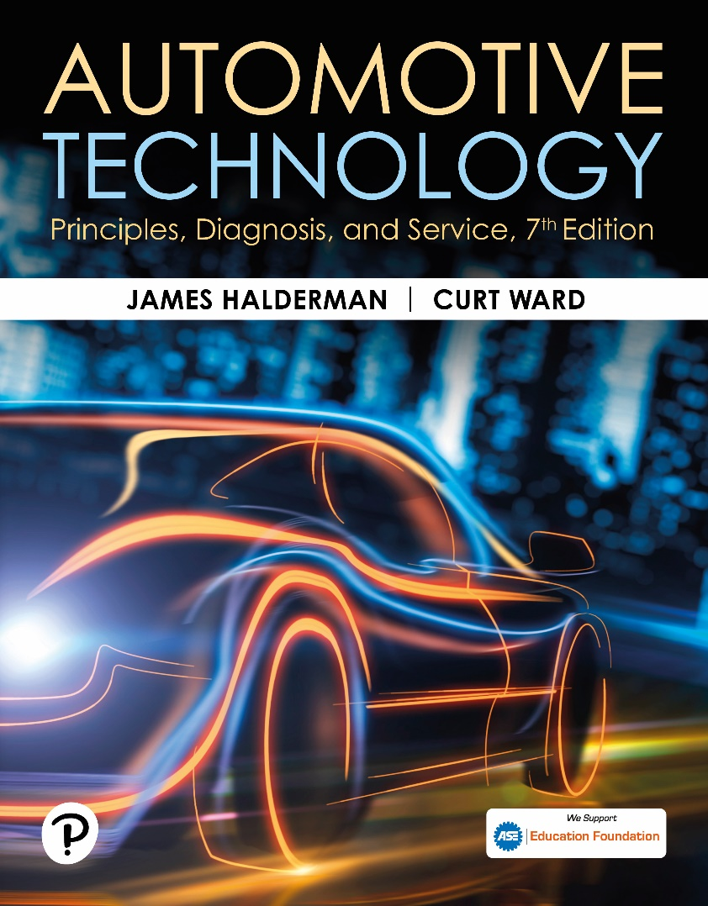
Automotive Technology: Principles, Diagnosis, and Service
Seventh Edition
Chapter 81
PCV and SAI Systems
Copyright © 2023 Pearson Education, Inc. All Rights Reserved
Notes:
INSTRUCTOR NOTE: This presentation includes text explanation notes, you can use to teach the course. When in SLIDE SHOW mode, you RIGHT CLICK and select SHOW PRESENTER VIEW, to use the notes.

Slide 2
Learning Objectives
81.1 Describe the purpose and function of the positive crankcase ventilation (PCV) system.
81.2 Discuss PCV system diagnosis.
81.3 Explain the purpose and function of the secondary air-injection (SAI) system.
81.4 Explain how to diagnose faults in the secondary air-Injection system..

Slide 3
Crankcase Ventilation (1 of 2)
Purpose and Function
P C V systems were developed to ventilate the crankcase and recirculate the vapors to induction system so they can be burned in the cylinders.
P C V Valves
P C V valve in most systems is a one-way valve containing a spring-operated plunger that controls valve flow rate.

Slide 4
Crankcase Ventilation (2 of 2)
Orifice-Controlled Systems
Closed P C V system used on some 4-cylinder engines contains a calibrated orifice instead of a P C V valve.
Separator Systems
Turbocharged and many fuel-injected engines use an oil/vapor or oil/water separator and a calibrated orifice instead of a P C V valve.

Slide 5
Figure 81.1 Vent Type PCV
PCV valve in a cutaway valve cover, showing the baffles that prevent liquid oil from being drawn into the intake manifold
Notes:
CASE STUDY: The Whistling Engine
An older vehicle was being diagnosed for a whistling sound whenever the engine was running, especially at idle. It was finally discovered that the breather in the valve cover was plugged and caused high vacuum in the crankcase. The engine was sucking air from what was likely the rear main seal lip, making the “whistle” noise. After replacing the breather and PCV, the noise stopped.
Summary:
Complaint—The customer stated that the engine made a whistling sound when it was running.
Cause—A clogged PCV breather was found to be the cause of air being drawn into the engine through the rear main seal.
Correction—The PCV breather and check valve were replaced, which corrected the whistling noise concern.

Slide 6
Figure 81.2 PCV Flow
Spring force, crankcase pressure, and intake manifold vacuum work together to regulate the flow rate through the PCV valve

Slide 7
Figure 81.3 Idle
Air flows through the PCV valve during idle, cruising, and light-load conditions

Slide 8
Figure 81.4 Acceleration
Air flows through the PCV valve during acceleration and when the engine is under a heavy load

Slide 9
Figure 81.5 Backfire
PCV valve operation in the event of a backfire

Slide 10
Animation: Positive Crankcase Ventilation (PCV) (Animation will automatically start)

Slide 11
PCV System Diagnosis (1 of 3)
Symptoms
Rough or unstable idle
Excessive oil consumption
Oil in the air filter housing
Oil leaks due to excessive crankcase pressure
P C V System Performance Test
A slight vacuum is created in the crankcase (usually less than 1 in. Hg if measured at the dipstick) and is also applied to other areas of the engine.
Notes:
TECH TIP: Check for Oil Leaks with the Engine Off
The owner of an older vehicle equipped with a V-6
engine complained to their technician that they
smelled burning oil, but only after shutting off the
engine. The technician found that the rocker cover
gaskets were leaking. But why did the owner only
notice the smell of hot oil when the engine was shut
off? Because of the PCV system, engine vacuum tends
to draw oil away from gasket surfaces. When the
engine stops, however, engine vacuum disappears,
and the oil remaining in the upper regions of the
engine tend to flow down and out through any
opening. Therefore, a good technician should check an
engine for oil leaks, not only with the engine running,
but also shortly after shutdown.

Slide 12
PCV System Diagnosis (2 of 3)
Rattle Test
If the P C V valve does not rattle, it is definitely defective and must be replaced.
The 3 × 5 Card Test
Remove the oil-fill cap (where oil is added to the engine) and start the engine.
Hold a 3 × 5 card over the opening (a dollar bill or any other piece of paper can be used for this test):
If the P C V system, including the valve and hoses, is functioning correctly, the card should be held down on the oil-fill opening by the slight vacuum inside the crankcase.

Slide 13
PCV System Diagnosis (3 of 3)
Snap-Back Test
The proper operation of the P C V valve can be checked by placing a finger over the inlet hole in the valve when the engine is running and removing the finger rapidly.
Crankcase Vacuum Test
The P C V system can be checked by testing for a weak vacuum at the oil dipstick tube using an inches-of-water manometer or gauge.
P C V Monitor
Starting with 2004 and newer vehicles, all vehicle P C M s monitor the P C V system for proper operation as part of the O B D-I I system.

Slide 14
Figure 81.6 Vacuum Gauge
Using a gauge that measures vacuum in units of inches of water to test the vacuum at the dipstick tube, being sure that the PCV system is capable of drawing a vacuum on the crankcase (28 inches H₂O = 1 PSI, or about 2 in. Hg of vacuum)

Slide 15
Frequently Asked Question: What Are the Wires for at the PCV Valve?
? Frequently Asked Question
What Are the Wires for at the PCV Valve? Ford uses an electric heater to prevent ice from forming inside the PCV valve and causing blockage. Water is a by-product of combustion, and resulting moisture can freeze when the outside air temperature is low. General Motors and others clip a heater hose to the PCV hose to provide the heat needed to prevent an ice blockage.

Slide 16
Figure 81.7 PCV Fasteners
Most PCV valves used on newer vehicles are secured with fasteners, making it more difficult to disconnect, and thereby less likely to increase emissions

Slide 17
Animation: Positive Crankcase Ventilation System Test (Animation will automatically start)

Slide 18
PCV-Related Diagnostic Trouble Codes
Diagnostic Trouble Code | Description | Possible Causes
P0101 | MAF or airflow circuit range problem | Defective PCV valve or hose/connections or MAF circuit fault
P0505 | Idle control system problem | Defective PCV valve or hose/connections

Slide 19
Question 1: ?
What emissions does a P C V valve control?

Slide 20
Answer 1
Excessive crankcase hydrocarbons (H C).

Slide 21
Secondary Air-Injection System (1 of 3)
Purpose and Function
The secondary air-injection (S A I) system provides the air necessary for the oxidizing process either at the exhaust manifold or inside the catalytic converter.
Parts and Operation
The system pulls fresh air in through an external filter and pumps the air under slight pressure to each exhaust port through connecting hoses or a manifold.

Slide 22
Secondary Air-Injection System (2 of 3)
Air Distribution Manifolds and Nozzles
Air delivered to exhaust system in one of two ways:
An external air manifold, or manifolds, distributes the air through injection tubes with stainless steel nozzles.
An internal air manifold distributes air to exhaust ports near each exhaust valve through passages cast in the cylinder head or the exhaust manifold.

Slide 23
Secondary Air-Injection System (3 of 3)
Exhaust Check Valves
All air-injection systems use one or more one-way check valves to protect the air pump and other components from reverse exhaust flow.
Belt-Driven Air Pumps
Belt-driven air pump uses a centrifugal filter just behind the drive pulley.
Electric Motor-Driven Air Pumps
Generally used only during cold engine operation and is computer controlled.

Slide 24
Figure 81.8 Air Pump
A typical belt-driven air pump. Air enters through the revolving fins behind the drive pulley. The fins act as an air filter because dirt is heavier than air and, therefore, the dirt is deflected off of the fins at the same time air is being drawn into the pump

Slide 25
Figure 81.9 Exhaust Check Valve
The external air manifold and exhaust check valve on a restored muscle car engine

Slide 26
Figure 81.10 AIR Operation
(a) When the engine is cold and before the oxygen sensor is hot enough to achieve closed loop, the airflow from the air pump is directed to the exhaust manifold(s) through the one-way check valves, which keep the exhaust gases from entering the switching solenoids and the pump itself. (b) When the engine achieves closed loop, the air is directed to the catalytic converter.

Slide 27
Animation: Secondary Air-Injection (Animation will automatically start)

Slide 28
Figure 81.11 SAI Pump
A typical electric motor-driven SAI pump. This unit is on a Chevrolet Corvette and works only when the engine is cold

Slide 29
Secondary Air-injection System Diagnosis (1 of 2)
Symptoms
The air pump system should be inspected if an exhaust emissions test failure occurs.

Slide 30
Secondary Air-injection System Diagnosis (2 of 2)
Visual Inspection
Carefully inspect all parts of the S A I system for holes or other physical damage.
Four-Gas Exhaust Analysis
A S A I system can be tested using an exhaust gas analyzer.
Verify O₂ values as the system is enabled and disabled.

Slide 31
S A I-Related Diagnostic Trouble Codes
Diagnostic Trouble Code | Description | Possible Causes
P0410 | S A I solenoid circuit fault | Defective S A I solenoid Loose or corroded electrical connections Loose, missing, or defective rubber hose(s)

Slide 32
Question 2: ?
What is the purpose of the air-injection pump?

Slide 33
Answer 2
The secondary air-injection (S A I) system provides the air necessary for the oxidizing process either at the exhaust manifold or inside the catalytic converter.

Slide 34
Engine Performance Videos and Animations
Videos Link: (A8) Engine Performance Videos
Animations Link: (A8) Engine Performance Animations

Slide 35
Copyright
This work is protected by United States copyright laws and is provided solely for the use of instructors in teaching their courses and assessing student learning. Dissemination or sale of any part of this work (including on the World Wide Web) will destroy the integrity of the work and is not permitted. The work and materials from it should never be made available to students except by instructors using the accompanying text in their classes. All recipients of this work are expected to abide by these restrictions and to honor the intended pedagogical purposes and the needs of other instructors who rely on these materials.

