Slide 1
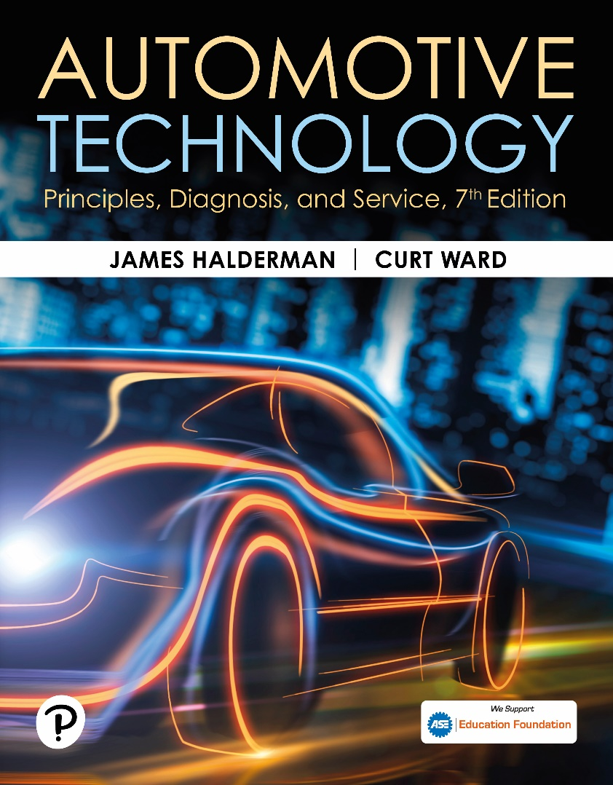
Automotive Technology: Principles, Diagnosis, and Service
Seventh Edition
Chapter 77
Electronic Throttle Control System
Copyright © 2023 Pearson Education, Inc. All Rights Reserved
Notes:
INSTRUCTOR NOTE: This presentation includes text explanation notes, you can use to teach the course. When in SLIDE SHOW mode, you RIGHT CLICK and select SHOW PRESENTER VIEW, to use the notes.

Slide 2
Learning Objectives
77.1 Describe electronic throttle control systems.
77.2 Explain how an electronic throttle control system works.
77.3 Describe the APP sensor.
77.4 Describe the throttle body assembly.
77.5 Describe TP sensors.
77.6 Describe how to diagnose faults in an electronic throttle control system.
77.7 Explain how to service an electronic throttle system.

Slide 3
Electronic Throttle Control (E T C) System
Advantages of E T C
Eliminates mechanical throttle cable
Eliminates need for cruise control actuators and controllers
Helps reduce engine power for traction control (T C) and electronic stability control (E S C) systems
Eliminates need for an idle air control valve
Parts Involved
Accelerator pedal position sensor (A P P S), throttle position sensor (T P S), servo motor, and control unit

Slide 4
Figure 77.1 ETC
The throttle pedal is connected to the accelerator pedal position (APP) sensor. The electronic throttle body includes a throttle position sensor to provide throttle angle feedback to the vehicle computer. Some systems use a throttle actuator control (T A C) module to operate the throttle blade (plate)

Slide 5
Question 1: ?
What parts can be deleted if an engine uses an electronic throttle control (E T C) system instead of a conventional accelerator pedal and cable to operate the throttle valve?

Slide 6
Answer 1
Accelerator cable, cruise actuator, idle air control valve.

Slide 7
Normal Operation of ETC System
These normal conditions include the following:
The engine may not increase above idle speed when depressing the accelerator pedal when the gear selector is in P A R K or NEUTRAL.
While accelerating rapidly, there is often a slight delay before the engine responds.
While at cruise speed, the accelerator pedal may or may not cause the engine speed to increase if the accelerator pedal is moved slightly.

Slide 8
Figure 77.2 Throttle Valve Opening
The opening of the throttle plate can be delayed as long as 30 milliseconds (0.030 sec) to allow time for the amount of fuel needed to catch up to the opening of the throttle plate

Slide 9
Accelerator Pedal Position Sensor
Cable-Operated System
Uses a cable attached to the accelerator pedal to operate the A P P sensor located under the hood
Two Sensors
The accelerator pedal position sensor (on pedal assembly) uses 2 sometimes 3, separate sensors, which act together to give accurate accelerator pedal position information to the controller, but also are used to check that the sensor is working properly.

Slide 10
Figure 77.3 APP Sensor
A typical accelerator pedal position (APP) sensor showing two different output voltage signals that are used by the P C M to determine accelerator pedal position. Two (or three in some applications) are used as a double check because this is a safety-related sensor.

Slide 11
Animation: Electronic Throttle Control (Animation will automatically start)

Slide 12
Throttle Body Assembly
Throttle Plate and Spring
Throttle plate held slightly open by a concentric clock spring.
Electronic Throttle Body Motor
Throttle plate held slightly open by a concentric clock spring.
Throttle plate motor driven by a bidirectional pulse-width modulated (P W M) signal from P C M or electronic throttle control module using H-bridge circuit.

Slide 13
Figure 77.4 Throttle Positions
The default position for the throttle plate is in slightly open position. The servomotor then is used to close it for idle and open it during acceleration

Slide 14
Frequently Asked Question: What Is the “Spring Test”?
? Frequently Asked Question
What Is the “Spring Test”? The spring test is a self-test performed by the PCM whenever the engine is started. The PCM operates the throttle to check if it can react to the command and return to the default (home) position. This self-test is used by the PCM to determine that the spring and motor are working correctly and may be noticed by some vehicle owners by the following factors: A slight delay in the operation of the starter motor. It is when the ignition is turned to the on position that the PCM performs the test. While it takes just a short time to perform the test, it can be sensed by the driver that there could be a fault in the ignition switch or starter motor circuits. A slight “clicking” sound may also be heard coming from under the hood when the ignition is turned on. This is normal and is related to the self-test on the throttle as it opens and closes.

Slide 15
Frequently Asked Question: Why Not Use a Stepper Motor for ETC?
? Frequently Asked Question
Why Not Use a Stepper Motor for ETC? A stepper motor is a type of motor that has multiple windings and is pulsed by a computer to rotate a certain number of degrees when pulsed. The disadvantage is that a stepper motor is too slow to react compared with a conventional DC electric motor and is the reason a stepper motor is not used in ETC systems.

Slide 16
Figure 77.5 H-Bridge Control
(a) An H-bridge circuit is used to control the direction of the DC electric motor of the ETC unit. (b) To reverse the direction of operation, the polarity of the current through the motor is reversed.

Slide 17
Figure 77.6 Schematic
Schematic of a typical electronic throttle control (ETC) system. Note that terminal #5 is always pulse-width modulated and that terminal #3 is always constant, but both power and ground are switched to change the direction of the motor

Slide 18
Throttle Position (T P) Sensor
Two T P sensors are used in the throttle body assembly to provide T P signals to the P C M.
2 sensors are used as fail-safe measure and for diagnosis.
There are 2 types of T P sensors used in electronic throttle control systems:
Potentiometers
Hall-effect

Slide 19
Animation: Throttle Position Sensor (TPS) (Animation will automatically start)

Slide 20
Question 2: ?
What two types of throttle position sensors are used?

Slide 21
Answer 2
Potentiometer and Hall-effect.

Slide 22
Diagnosis of Electronic Throttle Control Systems (1 of 3)
Fault Mode
Limp home mode also called “fail-safe mode” indicates following actions performed by P C M:
Engine speed limited to default speed (1,200-1,600 R P M)
There is slow or no response when accelerator pedal is depressed.
Cruise control system is disabled.
Diagnostic trouble code (D T C) is set.
E T C warning lamp on the dash lights.

Slide 23
Diagnosis of Electronic Throttle Control Systems (2 of 3)
Vacuum Leaks
E T C system simply moves throttle, as needed, to achieve proper idle speed to compensate for leak.
Diagnostic Procedure
If a fault occurs in E T C system, check service information for specified procedure to follow.

Slide 24
Diagnosis of Electronic Throttle Control Systems (3 of 3)
Scan Tool Data
A P P-indicated angle
T P-desired angle
T P-indicated angle
T P sensors 1 and 2

Slide 25
Figure 77.7 TP Sensors
The 2 TP sensors used on the throttle body of an electronic throttle body assembly produce opposite voltage signals as the throttle is opened. The total voltage of both combined at any throttle plate position is 5 volts

Slide 26
Animation: Throttle Position (TP) Sensor (Animation will automatically start)

Slide 27
Animation: TP Sensor Volt Check, Reference Signal (Animation will automatically start)

Slide 28
Figure 77.8 ETC Fault Indicators
(a) A “reduced power” warning light indicates a fault with the ETC system on some General Motors vehicles. (b) A symbol showing an engine with an arrow pointing down is used on some General Motors vehicles to indicate a fault with the ETC system.

Slide 29
Figure 77.9 Ford Wrench Symbol
A wrench symbol warning lamp on a Ford vehicle. The symbol can also be green

Slide 30
Figure 77.10 Chrysler Fault Symbol
A symbol used on a Chrysler vehicle indicating a fault with the electronic throttle control

Slide 31
Frequently Asked Question: How Do You Calibrate a New APP Sensor?
? Frequently Asked Question
How Do You Calibrate a New APP Sensor? Whenever an APP sensor is replaced, it should be calibrated before it will work correctly. Always check service information for the exact procedure to follow after APP sensor replacement. Here is a typical example of the procedure:
STEP 1 Make sure the accelerator pedal is fully released.
STEP 2 Turn the ignition switch on (engine off) and wait at least 2 seconds.
STEP 3 Turn the ignition switch off and wait at least 10 seconds.
STEP 4 Turn the ignition switch on (engine on) and wait at least 2 seconds.
STEP 5 Turn the ignition switch off and wait at least 10 seconds.

Slide 32
Figure 77.11 Stuck Throttle Valve
The throttle plate stayed where it was moved, which indicates that there is a problem with the electronic throttle body control assembly

Slide 33
Figure 77.12 Corroded ETC
A corroded electronic throttle control assembly shown with the cover removed
Notes:
CASE STUDY: The High Idle Toyota
The owner of a Toyota Camry complained that the engine would idle at over 1,200 RPM compared with a normal 600 to 700 RPM. The vehicle would also not
accelerate. Using a scan tool, a check for DTCs showed one code: P2101—“TAC motor circuit low.”
Checking service information led to the inspection of the ETC throttle body assembly. With the ignition key out of the ignition and the inlet air duct off the throttle body, the technician used a screwdriver to see if the throttle plate worked.
Normal operation—The throttle plate should move and then spring back quickly to the default position. Abnormal operation—If the throttle plate stays where it is moved or does not return to the default position,
there is a fault with the throttle body assembly. ^{● SEE}
FIGURE 77–11.
The technician replaced the throttle body assembly with an updated version and proper engine operation was restored. The technician disassembled the old throttle body and found it was corroded inside due to moisture entering the unit through the vent
hose. ^{●SEE FIGURE 77-12.}
Summary:
Complaint—Customer stated that the engine would idle at over 2,000 RPM.
Cause—A stored P2101 DTC was stored indicating a fault with the throttle body assembly.
Correction—The throttle body was replaced with an improved version that placed the vent tube in a different position to help avoid water getting into the assembly.

Slide 34
Figure 77.13 ETC Motor Drive
Notice small motor gear on the left drives a larger plastic gear (black), which then drives the small gear in mesh with the section of a gear attached to the throttle plate. This results in a huge torque increase from the small motor and helps explain why it could be dangerous to insert a finger into the throttle body assembly

Slide 35
ECT Throttle Follower Test
Test can be performed on some Chrysler vehicles.
To perform this test, use the “throttle follower test” procedure as shown on the scan tool. An assistant is needed to check that the throttle plate is moving as the accelerator pedal is depressed.

Slide 36
Servicing Electronic Throttle Systems (1 of 2)
E T C-Related Performance Issues
Lower than normal idle speed
Rough idle
Engine stalls when coming to a stop (called a coast-down stall)
Throttle Body Cleaning Procedure
Remove the air inlet hose from throttle body
Spray throttle body cleaner onto a shop cloth
Use shop cloth to remove varnish and carbon deposits from the throttle body housing and throttle plate

Slide 37
Servicing Electronic Throttle Systems (2 of 2)
Throttle Body Relearn Procedure
A typical throttle body relearn procedure includes:
Turn the ignition on (engine off) for 30 seconds.
Turn the ignition off and wait 30 seconds.
Start the engine and the idle learn procedure should cause the engine to idle at the correct speed.
Other vehicles may require the use of a scan tool.

Slide 38
Question 3: ?
What three E C T performance-related conditions might indicate a need for throttle body cleaning?

Slide 39
Answer 3
Rough idle, lower than normal idle speed, and engine stalling.

Slide 40
Engine Performance Videos and Animations
Videos Link: (A8) Engine Performance Videos
Animations Link: (A8) Engine Performance Animations

Slide 41
Copyright
This work is protected by United States copyright laws and is provided solely for the use of instructors in teaching their courses and assessing student learning. Dissemination or sale of any part of this work (including on the World Wide Web) will destroy the integrity of the work and is not permitted. The work and materials from it should never be made available to students except by instructors using the accompanying text in their classes. All recipients of this work are expected to abide by these restrictions and to honor the intended pedagogical purposes and the needs of other instructors who rely on these materials.

