Slide 1
Automotive Technology: Principles, Diagnosis, and Service
Seventh Edition
Chapter 74
Fuel Pumps, Lines, and Filters
Copyright © 2023 Pearson Education, Inc. All Rights Reserved
Notes:
INSTRUCTOR NOTE: This presentation includes text explanation notes, you can use to teach the course. When in SLIDE SHOW mode, you RIGHT CLICK and select SHOW PRESENTER VIEW, to use the notes.

Slide 2
Learning Objectives
74.1 Discuss the fuel delivery system, including fuel tanks and rollover leak protection.
74.2 Discuss the different types of fuel lines.
74.3 Explain the different types of electric fuel pumps.
74.4 Describe fuel filters.
74.5 Describe how to test fuel pumps.
74.6 Describe how to replace fuel pumps..

Slide 3
Fuel Delivery System
Fuel delivery (and return) systems use many if not all of the following components:
Fuel storage tank, filler neck, and gas cap
Fuel tank pressure sensor
Fuel pump
Fuel filter(s)
Fuel delivery lines and fuel rail
Fuel-pressure regulator
Fuel return line (if equipped with a return-type fuel delivery system)

Slide 4
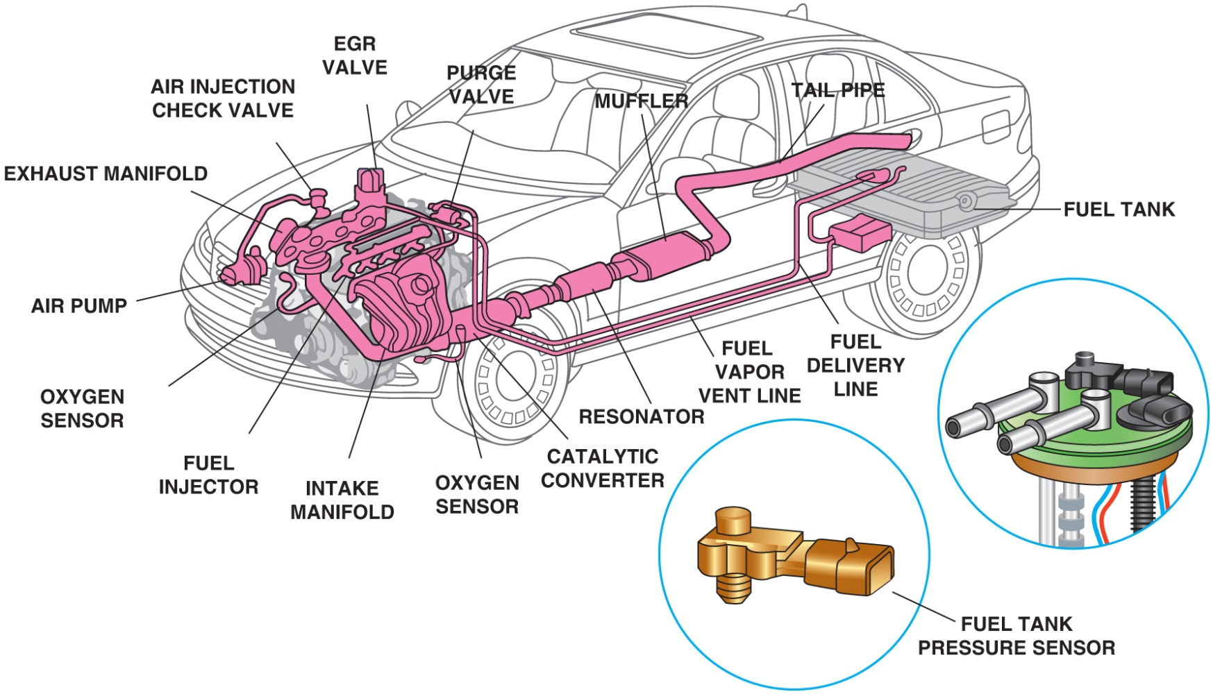
Figure 79.1 The

Slide 5
Figure 74.1 Fuel System
Fuel system includes many separate parts and components, including the fuel tank, fuel pump, and lines, as well as the fuel tank pressure sensor used to measure the pressure inside the fuel tanks, used by the evaporative fuel control system.

Slide 6
Fuel Tanks (1 of 3)
A vehicle fuel tank is made of corrosion-resistant steel or polyethylene plastic.
Regardless of size and shape, all fuel tanks incorporate most, if not all, of the following features:
Inlet or filler tube through which fuel enters the tank
Filler cap with pressure holding and relief features
An outlet to the fuel line leading to the fuel pump or fuel injector
Fuel pump mounted within the tank
Tank vent system
Fuel pickup tube and fuel level sending unit

Slide 7
Fuel Tanks (2 of 3)
Tank Location and Mounting
Most vehicles use a horizontally suspended fuel tank.
Fuel tanks located there so that frame rails and body components protect the tank in the event of a crash.
Filler Tubes
Fuel enters tank through a large tube extending from the tank to an opening on the outside of the vehicle.
Onboard refueling vapor recovery (O R V R) systems were added to the filler neck to reduce evaporative emissions.

Slide 8
Fuel Tanks (3 of 3)
Pressure-Vacuum Filler Cap
Safety cap must seal system and release excess pressure or excess vacuum.
Fuel Pickup Tube
Fuel pickup tube is usually a part of the fuel sender assembly or the electric fuel pump assembly and contains the tank sock.
Tank Venting Requirements
E V A P system vents gasoline vapors from the fuel tank directly to a charcoal-filled vapor storage canister.

Slide 9
Figure 74.2 Fuel Tank
A three-piece filler tube assembly

Slide 10
Figure 74.3 Filler Tube
A view of a typical filler tube with the fuel tank removed. Notice the ground strap used to help prevent the buildup of static electricity as the fuel flows into the plastic tank. The check ball looks exactly like a ping-pong ball

Slide 11
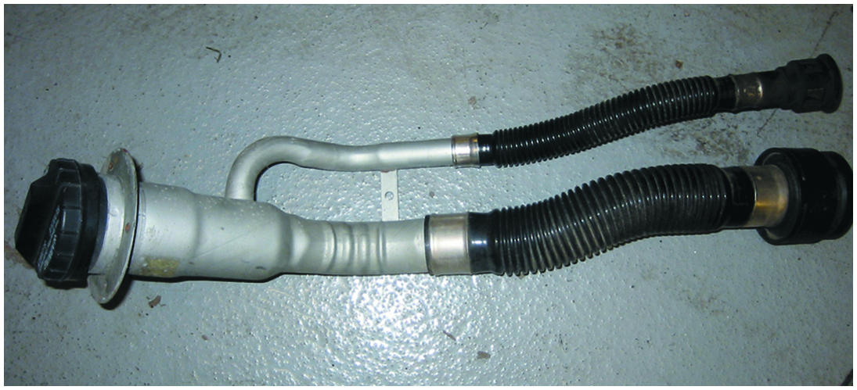
Figure 79.4

Slide 12
Figure 74.4 Vapor Recovery
Vehicles equipped with onboard refueling vapor recovery usually have a reduced-size fill tube

Slide 13
Animation: Evaporation Emission Control System (Animation will automatically start)

Slide 14
Figure 74.5 Fuel Pickup
The fuel pickup tube is part of the fuel sender and pump assembly

Slide 15
Rollover Leak Protection
All vehicles have one or more devices to prevent fuel leaks in case of vehicle rollover or a collision in which fuel may spill.
A basic one-way check valve may be installed in any number of places between the fuel tank and the engine.
Some vehicles use devices to ensure that the fuel pump shuts off when an accident occurs.

Slide 16
Figure 74.6 Ford Inertia Switch
Ford uses an inertia switch to turn off the electric fuel pump in case of an accident

Slide 17
Fuel Lines (1 of 3)
Fuel and vapor lines made of steel, nylon tubing, or fuel-resistant rubber hoses connect the parts of the fuel system.
Depending on their function, fuel and vapor lines may be either rigid or flexible.
The design of the line is dependent on the pressure it must carry.

Slide 18
Fuel Lines (2 of 3)
Rigid Lines
All fuel lines fastened to the body, frame, or engine are made of seamless steel tubing.
Flexible Lines
Most fuel systems use synthetic rubber hose sections where flexibility is needed.
Fuel Line Mounting
Fuel supply lines from the tank to a throttle body or fuel rail are routed to follow the frame along the underbody of the vehicle.

Slide 19
Fuel Lines (3 of 3)
Fuel Injection Lines
Hoses used for fuel-injection systems are made of materials with high resistance to oxidation and deterioration.
Fuel-Injection Fittings and Nylon Lines
Because of their operating pressures, fuel-injection systems often use special kinds of fittings to ensure leak proof connections.
Unlocking the special fittings typically requires special tools.

Slide 20
Figure 74.7 Fuel Lines
Fuel lines are routed along the frame or body and secured with clips

Slide 21
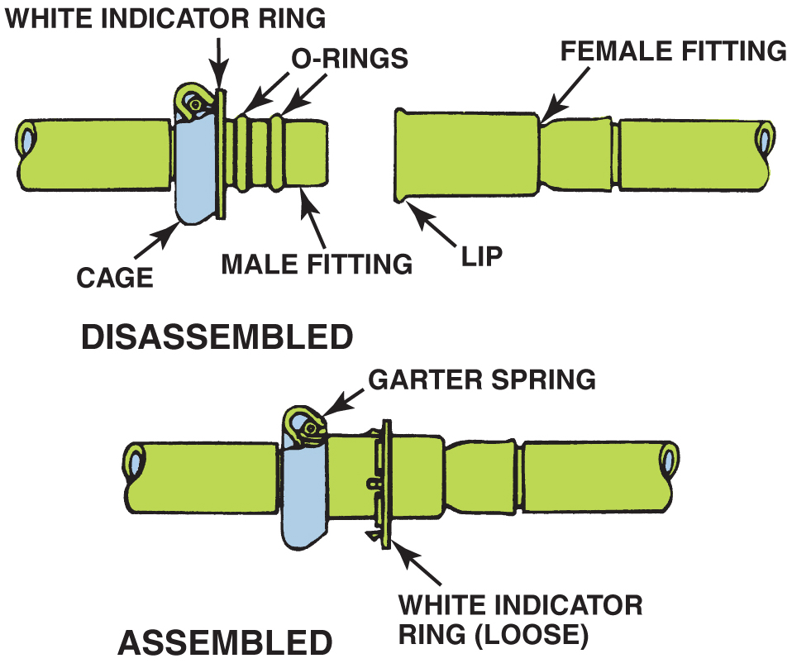
Figure 79.8

Slide 22
Figure 74.8 Spring Lock Connectors
Some Ford metal line connections use spring-locks and O-rings

Slide 23
Figure 74.9 Spring Lock Tool
Ford spring-lock connectors require a special tool for disassembly

Slide 24
Frequently Asked Question: Just How Much Fuel Is Recirculated?
? Frequently Asked Question
Just How Much Fuel Is Recirculated? Approximately 80% of the available fuel-pump volume is released to the fuel tank through the fuel-pressure regulator at idle speed. For example, a passenger vehicle cruising down the road at 60 mph gets 30 mpg. With a typical return-style fuel system pumping about 30 gallons per hour from the tank, it would therefore burn 2 gallons per hour, and return about 28 gallons per hour to the tank!

Slide 25
Frequently Asked Question: How Can an Electric Pump Work Inside a Gas Tank and Not Cause a Fire?
? Frequently Asked Question
How Can an Electric Pump Work Inside a Gas Tank and Not Cause a Fire? Even though fuel fills the entire pump, no burnable mixture exists inside the pump because there is no air and no danger of commutator brush arcing, igniting the fuel.

Slide 26
Figure 74.10 Quick Connector Steps
Typical quick-connect steps

Slide 27
Electric Fuel Pumps (1 of 4)
Positive Displacement Pump
A positive displacement pump is a design that forces everything that enters the pump to leave the pump.
When the maximum volume has been reached, the supply port closes and the discharge opens.
A fuel outlet check valve closes to maintain fuel pressure when the pump shuts off.

Slide 28
Electric Fuel Pumps (2 of 4)
Hydrokinetic Flow Pump Design
This design of pump rapidly moves the fuel to create pressure.
A turbine pump is the most common.
These units use an impeller that accelerates the fuel particles before actually discharging.
A typical electric fuel pump used on a fuel-injection system delivers about 40 to 50 gallons per hour or 0.6 to 0.8 gallons per minute at a pressure of 70 to 90 P S I.

Slide 29
Electric Fuel Pumps (3 of 4)
Modular Fuel Sender Assembly
The modular fuel sender consists of a fuel level sensor, a turbine pump, and a jet pump.
The reservoir dampens fuel slosh to maintain a constant fuel level available to the pump.
Electric Pump Control Circuits
Fuel-pump circuits are typically controlled by the fuel-pump relay.
The pump is energized at key on and then again once a “tach” signal is received.

Slide 30
Electric Fuel Pumps (4 of 4)
Pump Pulsation Dampening
An accumulator in the system to reduce pressure pulses and noise.
Variable Speed Pumps
Pump speed and pressure can be regulated by controlling the voltage supplied to the pump with a resistor switched into the circuit, or by using a separate fuel pump driver module to supply a pulse-width modulated (P W M) voltage to the pump.

Slide 31
Figure 74.11 Roller Pump
A roller cell-type electric fuel pump

Slide 32
Figure 74.12 Rotary Vane Pump
The pumping action of an impeller or rotary vane pump

Slide 33
Figure 74.13 Exploded View
An exploded view of a gerotor electric fuel pump

Slide 34
Figure 74.14 Two Stage Pump
A cutaway view of a typical two-stage turbine electric fuel pump

Slide 35
Figure 74.15 Two-Stage Pump
A cutaway view of a typical two-stage turbine electric fuel pump

Slide 36
Frequently Asked Question: Why Are Many Fuel-Pump Modules Spring-Loaded?
? Frequently Asked Question
Why Are Many Fuel-Pump Modules Spring-Loaded? Fuel modules that contain the fuel pickup sock, fuel pump, and fuel level sensor are often spring-loaded when fitted to a plastic fuel tank. The plastic material shrinks when cold and expands when hot, so having fuel module spring-loaded ensures that the fuel pickup sock will always be the same distance from the bottom of the tank. ● SEE FIGURE 74–15.

Slide 37
Figure 74.16 Circuit
Schematic showing that an inertia switch is connected in series between the fuel-pump relay and the fuel pump

Slide 38
Figure 74.17 Fuel Pulsator
A typical fuel pulsator used mostly with roller vane-type pumps to help even out the pulsation in pressure that can cause noise

Slide 39
Question 1: ?
What are the two most common types of electric fuel pumps?

Slide 40
Answer 1
Positive displacement and hydrokinetic flow.

Slide 41
Fuel Filters
Fuel filters remove dirt, rust, water, and other contamination from the gasoline before it can reach the fuel injectors.
Fuel filters should be replaced according to the vehicle manufacturer’s recommendations.
Returnless-type fuel-injection system usually use filters that are part of the fuel pump assembly and do not have any specified service interval.

Slide 42
Animation: Fuel Filters (Animation will automatically start)

Slide 43
Figure 74.18 Older Fuel Filter
Inline fuel filters are usually attached to the fuel line with screw clamps or threaded connections. The fuel filter must be installed in the proper direction or a restricted fuel flow can result

Slide 44
Animation: Fuel Filter, Remove & Replace (Animation will automatically start)

Slide 45
Question 2: ?
Where are fuel filters typically located in the system?

Slide 46
Answer 2
In the fuel tank and in-line.

Slide 47
Fuel Pump Testing (1 of 2)
Testing Fuel Pump Pressure
To measure fuel-pump pressure, locate the Schrader valve and attach a fuel-pressure gauge.
Cycle the key to on to actuate the fuel pump.
Rest Pressure Test
If the fuel pressure is acceptable, then check the system for leakdown.
The pressure should not drop for 5 minutes.

Slide 48
Fuel Pump Testing (2 of 2)
Dynamic Pressure Test
To test the pressure dynamically, start the engine.
If the pressure is vacuum referenced, then the pressure should change when the throttle is cycled.
Testing Fuel Pump Volume
Sufficient fuel capacity (flow) should be at least 2 pints (1 liter) every 30 seconds or 1 pint in 15 seconds.

Slide 49
Figure 74.19 Dim Headlight
A dim headlight indicates excessive resistance in fuel pump circuit
Notes:
TECH TIP Use a Headlight to Test for Power and Ground
When replacing a fuel pump, always check for proper
power and ground. If the supply voltage is low due
to resistance in the circuit or the ground connection
is poor, the lower available voltage to the pump will
result in lower pump output and could also reduce
the life of the pump. While a voltage drop test can be
preformed, a quick and easy test is to use a headlight
connected to the circuit. If the headlight is bright,
then both the power side and the ground side of the
pump circuit are normal. If the headlight is dim, then
more testing will be needed to find the source of the
resistance in the circuit(s). ● SEE FIGURE 74–19.

Slide 50
Figure 74.20 Pump Running Test
(a) A funnel helps in hearing if the electric fuel pump inside the gas tank is working. (b) If the pump is not running, check the wiring and current flow before going through the process of dropping the fuel tank to remove the pump.

Slide 51
Figure 74.21 Fuel System Tester
A fuel system tester connected in series in the fuel system so all of the fuel used flows through the meter, which displays the rate of flow and the fuel pressure.

Slide 52
Fuel Pump Current Draw Test
This test is most often performed by connecting a digital multimeter set to read DC amperes and test the current draw.
Compare the reading to factory specifications.

Slide 53
Figure 74.23 Relay Test
Hookup for testing fuel-pump current draw on any vehicle equipped with a fuel-pump relay.

Slide 54
Animation: Fuel Pump Pressure Test (Animation will automatically start)

Slide 55
Animation: Locate High-Pressure Fuel Leak (Animation will automatically start)

Slide 56
Question 3: ?
What are three ways to test the fuel pump.

Slide 57
Answer 3
Rest pressure test, dynamic pressure test, and volume test.

Slide 58
Fuel Pump Replacement
The following recommendations should be followed whenever replacing an electric fuel pump:
The fuel-pump strainer (sock) should be replaced with the new pump.
If the original pump had a deflector shield, it should always be reinstalled.
Always check the interior of the fuel tank for evidence of contamination or dirt.
Check that the wiring and electrical connectors are clean and tight.

Slide 59
Figure 74.22 Truck Bed
Removing the bed from a pickup truck makes gaining access to the fuel pump a lot easier.
Notes:
TECH TIP Remove the Bed to Save Time?
The electric fuel pump is easier to replace on many
General Motors pickup trucks if the bed is removed.
Access to the top of the fuel tank, where the access
hole is located, for the removal of the fuel tank sender
unit and pump is restricted by the bottom of the
pickup truck bed. It would take several people (usually
other technicians in the shop) to lift the truck bed from
the frame after removing only a few fasteners. ● SEE
FIGURE 74–22.
CAUTION: Be sure to clean around the fuel pump
opening so that dirt or debris does not enter the tank
when the fuel pump is removed.

Slide 60
Engine Performance Videos and Animations
Videos Link: (A8) Engine Performance Videos
Animations Link: (A8) Engine Performance Animations

Slide 61
Copyright
This work is protected by United States copyright laws and is provided solely for the use of instructors in teaching their courses and assessing student learning. Dissemination or sale of any part of this work (including on the World Wide Web) will destroy the integrity of the work and is not permitted. The work and materials from it should never be made available to students except by instructors using the accompanying text in their classes. All recipients of this work are expected to abide by these restrictions and to honor the intended pedagogical purposes and the needs of other instructors who rely on these materials.

