Slide 1
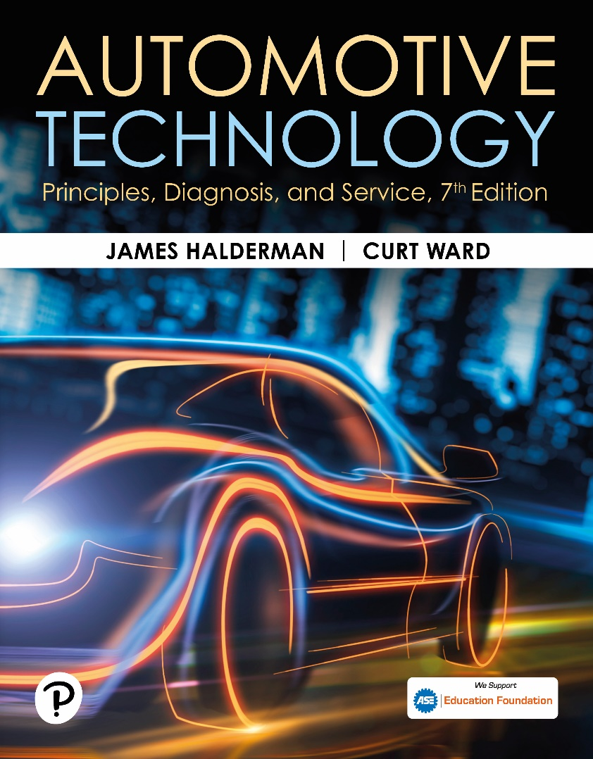
Automotive Technology: Principles, Diagnosis, and Service
Seventh Edition
Chapter 70
Computer Fundamentals
Copyright © 2023 Pearson Education, Inc. All Rights Reserved
Notes:
INSTRUCTOR NOTE: This presentation includes text explanation notes, you can use to teach the course. When in SLIDE SHOW mode, you RIGHT CLICK and select SHOW PRESENTER VIEW, to use the notes.

Slide 2
Learning Objectives
70.1 Explain the purpose and function of onboard computers.
70.2 Explain the parts and characteristics of digital computers.
70.3 List input sensors to an automotive computer.
70.4 List output devices (actuators) controlled by the computer.

Slide 3
Computer Fundamentals
Purpose and Function
Modern automotive control systems consist of a network of electronic sensors, actuators, and computer modules designed to regulate the powertrain and vehicle support systems.
Voltage Signals
Automotive computers use voltage to send and receive information.

Slide 4
Computer Functions (1 of 3)
Basic Functions
Input
Processing
Storage
Output
Input Functions
The computer receives a voltage signal (input) from an input device. This may be a switch or a sensor.

Slide 5
Computer Functions (2 of 3)
Processing
The term “processing” is used to describe how input voltage signals received by a computer are handled through a series of electronic logic circuits.
Storage
Storage is the place where the program instructions for a computer are stored in electronic memory.
Memory includes R O M, E E P R O M, R A M, and K A M.

Slide 6
Computer Functions (3 of 3)
Output Functions
After the computer has processed the input signals, it sends voltage signals or commands to other devices in the system, such as system actuators.
Computer Communication
Computers can communicate with, and control, each other through their output and input functions.
Computers communicate with each other via high- and low-speed networks.

Slide 7
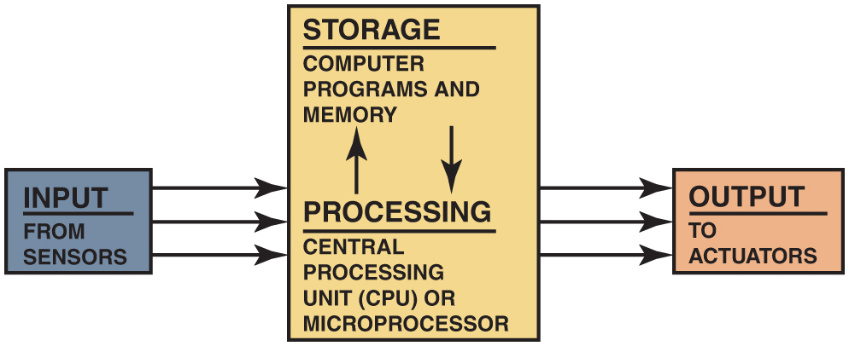
Figure 73.1

Slide 8
Figure 70.1 Computer Systems
All computer systems include inputs, processing, storage, and output

Slide 9
Animation: ECM Output Devices (Animation will automatically start)

Slide 10
Figure 70.2 Potentiometer
Potentiometer uses a movable contact to vary resistance and send an analog voltage right to the PCM

Slide 11
Animation: Potentiometer (Animation will automatically start)

Slide 12
Figure 70.3 AD Converter
An A D converter changes analog (variable) voltage signals into digital signals that the PCM can process

Slide 13
Question 1: ?
What is the purpose of computer communication?

Slide 14
Answer 1
To share information with other modules digitally.

Slide 15
Digital Computers (1 of 2)
Parts of a Computer
Central processing unit (C P U)
Computer memory
Computer programs
Clock Rates and Timing
The computer’s crystal oscillator generates a steady stream of one-bit-long voltage pulses. Both the microprocessor and the memories monitor the clock pulses while they are communicating.

Slide 16
Digital Computers (2 of 2)
Computer Speeds
The speed at which a computer operates is specified by the cycle time, or clock speed, required to perform certain measurements. Cycle time or clock speed is measured in megahertz.
Baud Rate
The speed at which the computer transmits bits of a serial data; measured in bits per second.
Control Module Locations
Mounted on a circuit board in a metal case.

Slide 17
Figure 70.4 Digital Computer
Many electronic components are used to construct a typical vehicle computer, including chips, resistors, and capacitors

Slide 18
Figure 70.5 ICE Map
Typical engine map developed from testing and used by the vehicle computer to provide the optimum ignition timing for all engine speeds and load combinations

Slide 19
Figure 70.6 Clock Generator
The clock generator produces a series of pulses that are used by the microprocessor and other components to stay in step with each other at a steady rate

Slide 20
Figure 70.7 PCM
A powertrain control module (PCM) under the hood where it can be exposed to air for cooling

Slide 21
Computer Input Sensors
The vehicle computer (P C M) uses signals (voltage levels) from the following sensors.
Engine speed (revolutions per minute, or R P M) sensor
Switches or buttons for accessory operation
Manifold absolute pressure (M A P) sensor
Mass airflow (M A F) sensor
Engine coolant temperature (E C T) sensor
Oxygen sensor (O 2 S)
Throttle position (T P) sensor
Vehicle speed (V S) sensor

Slide 22
Computer Outputs (1 of 2)
Computer sends voltage signals or commands to other devices in the system through:
Operating actuators
Network communication
Typical output devices include:
Fuel Injectors
Blower motor control
Transmission shifting
Idle speed control
Evaporative emission control solenoids

Slide 23
Computer Outputs (2 of 2)
Output Drivers
Low-side driver (L S D): provide a path to ground when energized.
High-side driver (H S D): provide a path to voltage when energized.
Pulse-Width Modulation
A method of controlling an output using a digital signal. Instead of just turning devices on or off, the computer can control the amount of on-time.

Slide 24
Animation: Computer System (Animation will automatically start)

Slide 25
Figure 70.8 Output Driver
A typical output driver. In this Case, the PCM applies voltage to the fuel pump relay coil to energize the fuel pump

Slide 26
Figure 70.9 Low Side Driver
A typical low-side driver (LSD), which uses a control module to control the ground side of the relay coil

Slide 27
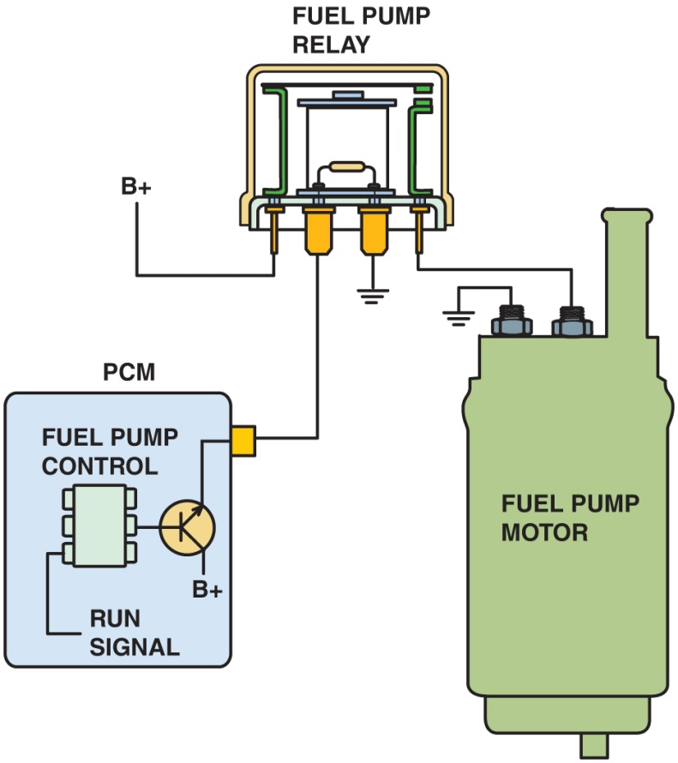
Figure 73.10

Slide 28
Figure 70.10 Module HSD
A typical module-controlled high-side driver (HSD) where the module itself supplies the electrical power to the device. The logic circuit inside the module can detect circuit faults, including continuity of the circuit, and if there is a short-to-ground in the circuit being controlled.

Slide 29
Animation: Output Driver, Fuel Pump Control (Animation will automatically start)

Slide 30
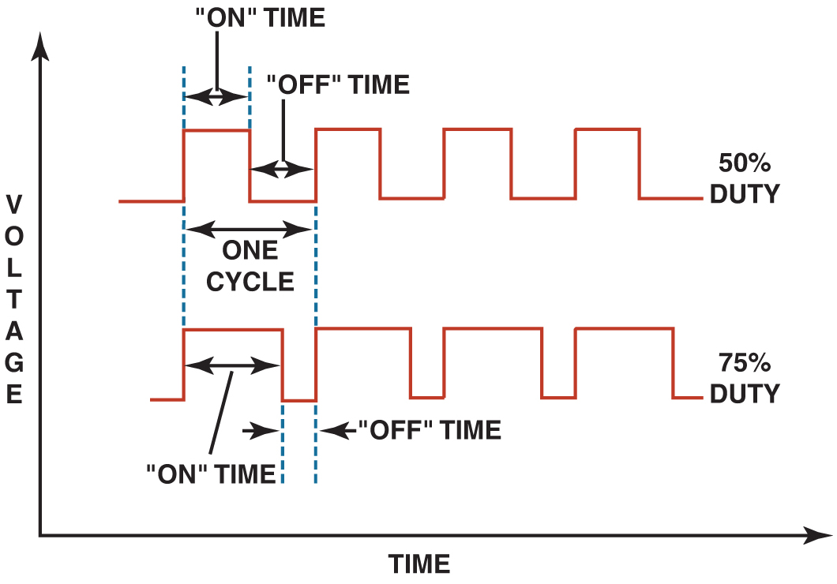
Figure 73.11

Slide 31
Figure 70.11 Duty Cycle
Both the top and bottom pattern have the same frequency. However, the amount of on-time varies. Duty cycle is the percentage of the time during a cycle that the signal is turned on.

Slide 32
Question 2: ?
What is a low-side driver (L S D)?

Slide 33
Answer 2
A digital device that completes a path to ground when energized.

Slide 34
Engine Performance Videos and Animations
Videos Link: (A8) Engine Performance Videos
Animations Link: (A8) Engine Performance Animations

Slide 35
Copyright
This work is protected by United States copyright laws and is provided solely for the use of instructors in teaching their courses and assessing student learning. Dissemination or sale of any part of this work (including on the World Wide Web) will destroy the integrity of the work and is not permitted. The work and materials from it should never be made available to students except by instructors using the accompanying text in their classes. All recipients of this work are expected to abide by these restrictions and to honor the intended pedagogical purposes and the needs of other instructors who rely on these materials.

