Slide 1
Automotive Technology: Principles, Diagnosis, and Service
Seventh Edition
Chapter 62
Air Management System
Copyright © 2023 Pearson Education, Inc. All Rights Reserved
Notes:
INSTRUCTOR NOTE: This presentation includes text explanation notes, you can use to teach the course. When in SLIDE SHOW mode, you RIGHT CLICK and select SHOW PRESENTER VIEW, to use the notes.

Slide 2
Learning Objectives
62.1 Discuss the different components of an air management system.
62.2 Explain airflow control in an A/C system.
62.3 Explain air temperature control in an A/C system.
62.4 Describe air filtration in an A/C system.
62.5 Describe housing and ducts in an A/C system.
62.6 Discuss plenum and control doors.
62.7 Explain nonelectrical and electronic HVAC controls.
62.8 Describe the blower motor..

Slide 3
Introduction (1 of 2)
Terminology
A system that contains the H V A C plenum, ducts, and air doors is called the air management system.
Airflow is controlled by 3 or more doors, which are called flap doors or valves by some manufacturers.
Air inlet door is used to select outside or inside air inlet.
Temperature-blend door is used to adjust air temperature.
Mode door is used to select air discharge location.

Slide 4
Introduction (2 of 2)
The use of these components allows the system to provide airflow under the following conditions:
Fresh outside air or recirculated air
Air conditioning
Defrost
Heat
The control head is connected to various parts through electrical connections, vacuum connections, mechanical cables, or a combination of these.

Slide 5
Figure 62.1 HVAC
HVAC airflow is directed toward windshield, dash or floor vents, or combinations, depending on system settings

Slide 6
Figure 62.2 HVAC Portions
The three major portions of the A/C and heat system are air inlet, plenum, and air distribution. The shaded portions show the paths of the four control doors

Slide 7
Animation: HVAC Functions (Animation will automatically start)

Slide 8
Figure 62.3 Defrost/Defog
In the defog or defrost mode position, the air is directed through the evaporator to remove the moisture from the air before being sent through the heater core to warm the air

Slide 9
Figure 62.4 Control Head
Most HVAC control heads include a control for turning units on and setting the mode of operation, a control for adjusting the temperature, and a control for the fan speed

Slide 10
Frequently Asked Question: What Does the Snowflake Button on the Dash Do?
? Frequently Asked Question
What Does the Snowflake Button on the Dash Do? Some people, such as those who drive vehicles that are equipped with automatic climate control systems, sometimes find it hard to figure out how to engage the A/C compressor on a rental car or a vehicle that they have not driven before. Often the driver will turn the fan to high and the mode selector to the dash vent position, but no cool air is being delivered. For the compressor to function, the button that looks like a snowflake has to be pushed. The snowflake button is actually the air conditioning on/off button. FIGURE 62–5.

Slide 11
Figure 62.5 Snowflake Button
A/C compressor is turned on or off by depressing the “snowflake” button on the dash

Slide 12
Question 1: ?
What are the three main H V A C doors?

Slide 13
Answer 1
Mode, temperature, and air inlet.

Slide 14
Airflow Control
Operation
Amount/volume of H V A C air controlled by blower speed.
Type of doors
Flap door swings about 45° to 90°.
Rotary door has openings at side and edge, and door rotates about 100° to one of 4 different positions.
Sliding mode door, also called a rolling door, is used when space in the instrument panel is small.

Slide 15
Figure 62.6 Air Control Doors
Many air control doors swing on their upper and lower pivots, shown in red

Slide 16
Figure 62.7 Rolling Door
(a) A typical rolling-door type HVAC door that is shown almost fully closed. (b) The same door is shown about half open.

Slide 17
Air Temperature Control
Temperature Control Using Airflow
The air is heated or cooled as it passes through the evaporator and heater core.
Temperature Control Using a Variable Compressor
Compressor displacement is adjusted to cool the evaporator just enough to cool the air to the desired temperature.

Slide 18
Figure 62.8 Blower Motor
The blower motor forces air to flow through the A/C evaporator to remove moisture from the air before it is sent through the heater core where the air is heated before being directed to the defrost and floor vents

Slide 19
Figure 62.9 Cabin Filter
A cabin filter being removed from behind the glove compartment. The dark color is part of the filter and is activated charcoal used to help remove odors.

Slide 20
Animation: Remove & Replace Cabin Filter (Animation will automatically start)

Slide 21
Air Filtration
Terminology
Most H V A C systems include a cabin filter to remove small dust or pollen particles from the incoming airstream.
This filter is also called a/an:
H V A C air filter
Interior ventilation filter
Micron filter
Particulate filter
Pollen filter

Slide 22
Figure 62.10 HVAC Housing
A typical HVAC housing that often has to be removed from the vehicle as an assembly to get access to the heater core and evaporator

Slide 23
Cases and Ducts
Construction
The evaporator and heater housing is molded from reinforced plastic and contains the following components:
Evaporator
Heater core
Blower motor
Most of the air control doors
The housing, called a plenum, is connected to the air inlets and outlets using formed plastic.

Slide 24
Animation: HVAC Functions (Animation will automatically start)

Slide 25
Figure 62.11 HVAC Inlet
The air inlet to the HVAC system is usually at the base of the windshield and covered with a plastic screen (grille) to help keep debris, such as leaves, from entering the system

Slide 26
Plenum and Control Doors (1 of 4)
Air Inlet Control Door
Fresh air door
Recirculation door
Outside air door
Door can be positioned to allow:
Fresh air to enter while shutting off the recirculation opening.
Air to return or recirculate from inside the vehicle while shutting off fresh air
A mix of fresh air and return air.

Slide 27
Plenum and Control Doors (2 of 4)
Temperature-Blend Door
The door used to control interior temperature
Some other names for this door include:
Air-mix door
Temperature door
Blend door
Diverter door
Bypass door

Slide 28
Plenum and Control Doors (3 of 4)
Air Distribution and Outlets
Air from plenum can flow into 1 or 2 of 3 outlet paths:
A/C registers (vents) in the face of instrument panel
defroster registers at the base of windshield
heater outlets at floor under instrument panel.
Airflow to ducts controlled by one or more mode doors
Notes:
TECH TIP: Keep the Air Screen Clean
The outside air inlet screen must be kept in good condition to prevent debris and small animals from entering the HVAC case. Leaves and pine needles can enter, decay, and mold. Mice have been known to enter and build nests and/or die. Any of these conditions can create a bad smell and are very difficult to clean.

Slide 29
Plenum and Control Doors (4 of 4)
Mode/function control sets the doors as follows:
A/C: in-dash registers with outside air inlet
Max A/C: in-dash registers with recirculation
Heat: floor level with outside air inlet
Max Heat: floor level with recirculation
Bi-level: both in-dash and floor discharge
Defrost: windshield registers
Dual-zone air distribution allows the driver and passenger to select different temperature settings.

Slide 30
Figure 62.12 Temp and Mode Doors
(a) The temperature and mode doors swing to direct all of the cool air past the heater core, (b) through the core to become hot, (c) or to blend hot and cool air.

Slide 31
Figure 62.13 Air Blend Door
(a) In a blend-air system, all of the air is cooled. Then some of it is reheated and blended with the cool air to get the right temperature. (b) In a reheat system, all of the air is cooled and then reheated to the correct temperature.

Slide 32
Animation: HVAC Modes: Air Inlet and Discharge (Animation will automatically start)

Slide 33
Animation: HVAC Modes: Temperature Change (Heat) (Animation will automatically start)

Slide 34
Animation: HVAC System (Animation will automatically start)

Slide 35
Animation: HVAC Modes: Temperature Change (Cool) (Animation will automatically start)

Slide 36
Figure 62.14 Air Ducts
Ducts are placed in center console or on the floor under front seats to provide heated and cooled air to rear seat passengers

Slide 37
Nonelectrical H V A C Controls
Cable-Operated Systems
Most early control heads used purely mechanical operation for the doors, and one or more cables connected the function lever to the air inlet and mode doors.
Vacuum-Operated Systems
Many vehicles use vacuum actuators, sometimes called vacuum motors, to operate the air inlet and mode doors.
The doors are controlled by a vacuum valve that is operated by the control head.

Slide 38
Electronic H V A C Controls (1 of 2)
Overview
Most recent vehicles use electrical function switches at the H V A C control head.
The system uses an electric actuator(s) (motor) to operate the air distribution and temperature-blend doors.
Two-Wire Actuators
A typical two-wire actuator rotates when electric impulses are sent to the brushes by the H V A C control head.

Slide 39
Electronic H V A C Controls (2 of 2)
Three-Wire Actuators
A typical three-wire actuator uses a power, ground, and an input signal wire from the H V A C control module.
Five-Wire Actuators
A five-wire actuator uses two wires to power the motor (power and ground) and three wires for a potentiometer that is used to signal the H V A C control module of the motor’s location.
An H V A C actuator may need to be calibrated after the actuator has been replaced.

Slide 40
Figure 62.15 Electric Actuators
Three compact, electric actuators/servomotors operate the doors in this part of the HVAC case.
Notes:
ELECTRONIC HVAC CONTROLS Most recent vehicles use electrical function switches at the HVAC control head. These are often called electromechanical controls. These switches operate electric actuators (motors) to control the air distribution and temperature-blend doors.
TWO-WIRE ACTUATORS A typical two-wire actuator rotates when electric impulses are sent to the brushes by the HVAC control head. The direction of rotation, and therefore the movement of the HVAC door position, is changed by changing the wire that is pulsed with power and the other brush is then connected to ground.

Slide 41
Figure 62.16 Two-Wire Actuators
A two-wire HVAC electronic actuator where the direction of rotation is controlled by the HVAC control head or module, which changes the direction of rotation by changing the polarity of the power and ground connection at the motor.

Slide 42
Figure 62.17 Three-Wire Actuators
Three-wire actuators include a logic chip inside the motor assembly. HVAC control module then sends a 0-volt to 5-volt signal to motor assembly to control direction of rotation

Slide 43
Figure 62.18 Five-Wire Actuators
A typical 5-wire HVAC actuator showing the 2 wires used to power the motor and the three wires used for the motor position potentiometer

Slide 44
Question 2: ?
What is the purpose of the three wire used by a three-wire actuator?

Slide 45
Answer 2
Power, ground, and a signal from the control module.

Slide 46
Blower Motor (1 of 2)
Purpose and Function
Moves air inside the vehicle.
Parts and Operation
Permanent magnet motor that gets its power from the battery and the ground through a variable resistor.
Variable Speed Control
Achieved through a fixed resistor pack or an electronically controlled module.

Slide 47
Blower Motor (2 of 2)
Blower Motor Diagnosis
If it does not operate at any speed:
Defective ground wire or ground wire connection
Defective blower motor (not repairable; must be replaced)
Open circuit in the power-side circuit, including fuse, wiring, or fan switch.
If the blower works on lower speeds, but not on high speed, the problem is usually an in-line fuse or high-speed relay.

Slide 48
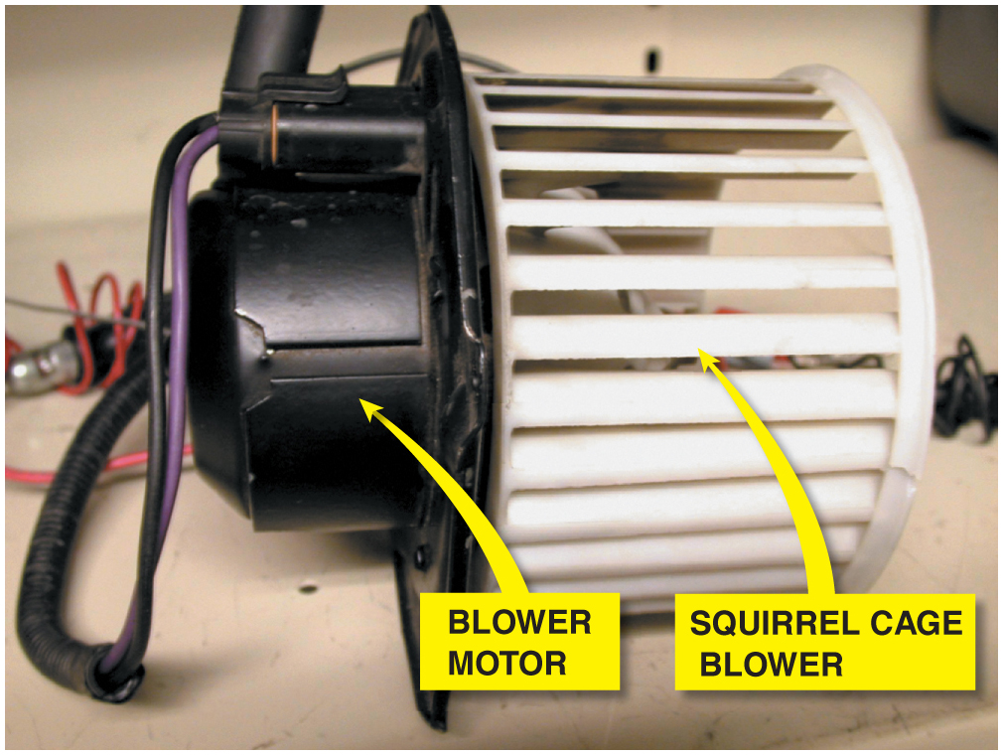
Figure 64.21 A squirrel cage blower motor. A replacement blower motor usually does not come equipped with the squirrel cage blower, so it has to be switched from the old motor

Slide 49
Animation: Blower (Animation will automatically start)

Slide 50
Figure 62.19 Blower Motor Resistor
A blower motor resistor pack used to control blower motor speed. Some Blower motor resistors are flat and look like a credit card and are called “credit card resistors”

Slide 51
Figure 62.20 Brushless Blower
A brushless DC motor that uses the body computer to control the speed

Slide 52
Figure 62.21 Testing Blower Motor
Using a mini AC/DC clamp-on multimeter to measure the current drawn by a blower motor

Slide 53
Animation: Test Blower Motor (Test Light) (Animation will automatically start)

Slide 54
Animation: Test Blower Motor, Clamp Meter (Animation will automatically start)

Slide 55
Animation: Manual Blower Control (Animation will automatically start)

Slide 56
Animation: PWM Blower Control (Animation will automatically start)

Slide 57
Question 3: ?
A blower motor only operates on high speed. What is the most likely cause?

Slide 58
Answer 3
A bad blower motor resistor pack.

Slide 59
Heating and Air Conditioning Videos and Animations
Videos Link: (A7) Heating & Air Conditioning Videos
Animations Link: (A7) Heating & Air Conditioning Animations

Slide 60
Copyright
This work is protected by United States copyright laws and is provided solely for the use of instructors in teaching their courses and assessing student learning. Dissemination or sale of any part of this work (including on the World Wide Web) will destroy the integrity of the work and is not permitted. The work and materials from it should never be made available to students except by instructors using the accompanying text in their classes. All recipients of this work are expected to abide by these restrictions and to honor the intended pedagogical purposes and the needs of other instructors who rely on these materials.

