Slide 1
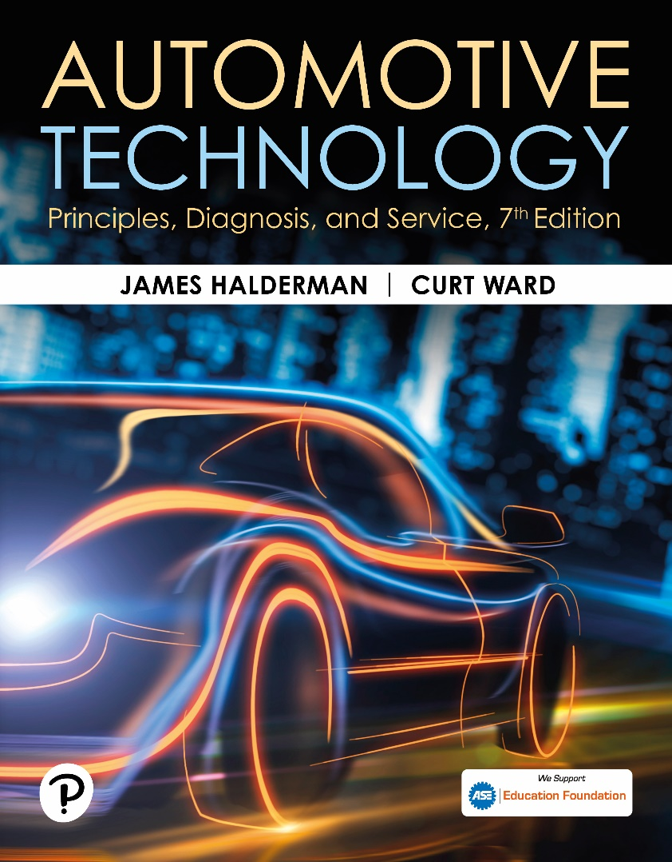
Automotive Technology: Principles, Diagnosis, and Service
Seventh Edition
Chapter 59
Audio System Operation and Diagnosis
Copyright © 2023 Pearson Education, Inc. All Rights Reserved
Notes:
INSTRUCTOR NOTE: This presentation includes text explanation notes, you can use to teach the course. When in SLIDE SHOW mode, you RIGHT CLICK and select SHOW PRESENTER VIEW, to use the notes.

Slide 2
Learning Objectives (1 of 2)
59.1 Discuss audio system fundamentals.
59.2 Describe radios and receivers.
59.3 Describe types of antennas and antenna testing.
59.4 Discuss the purpose and function of speakers.
59.5 Describe types of speakers.
59.6 Explain the decibel scale.
59.7 Discuss voice recognition systems.

Slide 3
Learning Objectives (2 of 2)
59.8 Explain how Bluetooth systems work.
59.9 Explain how satellite radio systems work.

Slide 4
Audio Fundamentals (1 of 5)
Audio systems produce audible sounds and include the following:
Radio (A M, F M, and satellite)
Antenna systems that are used to capture electronic energy broadcast to radios
Speaker systems
Aftermarket enhancement devices that increase the sound energy output of an audio system
Diagnosis of audio-related problems

Slide 5
Audio Fundamentals (2 of 5)
Types of Energy
Electromagnetic energy or radio waves.
Acoustical energy, usually called sound.
Terminology
Radio frequency (R F) is number of times a particular waveform repeats itself in a given amount of time
Hertz (H z). measurement of a waveform. A signal with a frequency of 1 H z is one radio wavelength per second.

Slide 6
Audio Fundamentals (3 of 5)
Modulation
Modulation describes when information is added to a constant frequency.
Amplitude modulation (A M)
Frequency modulation (F M)
Radio Wave Transmission
More than one signal can be carried by a radio wave. This process is called sideband operation.

Slide 7
Audio Fundamentals (4 of 5)
Noise
Radio Frequency Interference (R F I) is one type of electromagnetic interference (E M I) and is the frequency that interferes with radio transmission.
A M Characteristics
Reception can be achieved over long distances from the transmitter because the waves can bounce off the ionosphere.

Slide 8
Audio Fundamentals (5 of 5)
F M Characteristics
Because F M waves have a high R F and a short wavelength, they travel only a short distance.
Multipath
Multipath is caused by reflected, refracted, or line-sight signals reaching an antenna at different times.
From radio receiving 2 signals to process on same frequency.

Slide 9
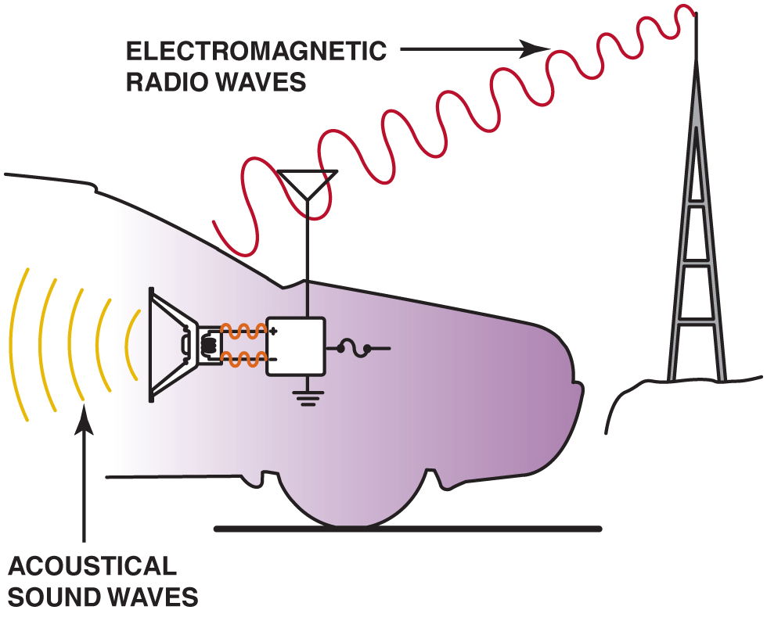
Figure 62.1

Slide 10
Figure 59.1 Electromagnetic Waves
Audio systems use both electromagnetic radio waves and sound waves to reproduce sound inside the vehicle

Slide 11
Figure 59.2 Audio Terms
The relationship among wavelength, frequency, and amplitude
Notes:
Wavelength is the time and distance between two consecutive points, either high or low. Wavelength is measured in meters. Frequency, also known as radio frequency (RF), is the number of times a particular waveform repeats itself in a given amount of time and is measured in hertz (Hz). A signal with a frequency of 1Hz is one radio wavelength per second. Radio frequencies are measured in kilohertz (kHz), thousands of wavelengths per second, and megahertz (MHz), millions of wavelengths per second. ● SEE FIGURE 59–2.
■ The higher the frequency, the shorter the wavelength.
■ The lower the frequency, the longer the wavelength.
A longer wavelength can travel a further distance than a shorter wavelength. Therefore, lower
frequencies provide better reception at further distances.
■ AM radio frequencies range from 530 to 1, 710 kHz.
■ FM radio frequencies range from 87.9 to 107.9 MHz.
Amplitude: the absolute value of the maximum displacement from a zero value during one period of an oscillation.

Slide 12
Figure 59.3 Amplitude
The amplitude changes in AM broadcasting

Slide 13
Frequently Asked Question: What Does a “Capture” Problem Mean?
? Frequently Asked Question
What Does a “Capture” Problem Mean? A capture problem affects only FM reception and means that the receiver is playing more than one station if two stations are broadcasting at the same frequency. Most radios capture the stronger signal and block the weaker signal. However, if the stronger signal is weakened due to being blocked by buildings or mountains, the weaker signal is then used. When this occurs, it sounds as if the radio is changing stations by itself. This is not a fault with the radio, but simply a rare occurrence with FM radio.

Slide 14
Figure 59.4 Frequency
The frequency changes in FM broadcasting and the amplitude remains constant

Slide 15
Figure 59.5 Sidebands
Using upper and lower sidebands allows stereo to be broadcast. The receiver separates the signals to provide left and right channels

Slide 16
Question 1: ?
Why do A M signals travel farther than F M signals?

Slide 17
Answer 1
The A M waves bounce off the ionosphere.

Slide 18
Radios and Receivers
Most late-model radios and receivers use five input/output circuits.
Power
Ground
Serial Data
Antenna Input
Speaker Outputs

Slide 19
Antennas
Types of Antennas
Slot antenna
Rear window defogger grid
Powered mast
Fixed mast antenna
Integrated antenna

Slide 20
Animation: Antenna Locations (Animation will automatically start)

Slide 21
Antenna Diagnosis (1 of 2)
Antenna Height
Most fixed-length antennas are exactly 31 inches (79 cm).
Antenna Testing
An ohmmeter should read infinity between the center antenna lead and the antenna case.
The case of the antenna must be properly grounded to the vehicle body.
The cable should have less than 5 ohms resistance end-to-end.

Slide 22
Antenna Diagnosis (2 of 2)
Power Antenna Testing and Service
Most power antennas use a circuit breaker and a relay to power a reversible, permanent magnet (P M) electric motor that moves a nylon cord attached to the antenna mast.
The power antenna mast is tested in the same way as a fixed-mast antenna.
All power antennas should be kept clean by wiping the mast with a soft cloth and lightly oiling with light oil, such as W D-40 or a similar-grade oil.

Slide 23
Figure 59.6 Antenna
If all ohmmeter readings are satisfactory, the antenna is good.
Notes:
The typical radio electromagnetic energy from the broadcast antenna induces a signal in the antenna that is very small, only about 25 microvolts AC
(0.000025 volt AC), in strength. The radio contains amplifier circuits that increase the received signal strength into usable information.
For example, some types of antennas used on vehicles include the following:
■ Rear window defogger grid. This type of system uses the
heating wires to receive the signals and special circuitry to
separate the RF from the DC heater circuit.
■ Fixed mast antenna. The mast is simply a vertical rod.
Mast antennas are typically located on the fender or rear
quarter panel of the vehicle.
■ Integrated antenna. This type of antenna is sandwiched in
the windshield and an appliqué on the rear window glass.
The antenna in the rear window is the primary antenna and
receives both AM and FM signals. The secondary antenna
is located in the front windshield typically on the passenger
side of the vehicle. This antenna receives only FM signals.
■ Shark-fin antenna. This type of antenna contains multiple
antennas, including radio, GPS, and cellular system antennas.

Slide 24
Animation: Check Antenna (Animation will automatically start)

Slide 25
Speakers
Purpose and Function
The purpose of any speaker is to reproduce the original sound as accurately as possible.
Impedance Matching
All speakers used on the same radio or amplifier should have the same internal coil resistance.
Speaker Wiring
Typical “speaker wire” is about 22 gauge (0.35 mm²).

Slide 26
Speaker Types
Tweeter
A speaker designed to reproduce high-frequency sounds, usually between 4,000 and 20,000 Hz (4 and 20 kHz).
Midrange
A speaker is designed and manufactured to be able to best reproduce sounds in the middle of the human hearing range, from 400 to 5,000 Hz.
Subwoofer
Produces the lowest frequency of sounds, usually 125 Hz.
Notes:
No one speaker is capable of reproducing
sound over such a wide frequency range. Therefore, speakers are available in three basic types:
1. Tweeters are for high-frequency ranges.
2. Midrange are for mid-frequency ranges.
3. Woofers and subwoofers are for low-frequency ranges.

Slide 27
Figure 59.7 Speaker Diagnosis
Between 6 and 7 volts is applied to each speaker terminal, and the audio amplifier then increases the voltage on one terminal and at the same time decreases the voltage on the other terminal, causing the speaker cone to move

Slide 28
Figure 59.8 Speaker Testing
Typical automotive speaker with two terminals. The polarity of the speakers can be identified by looking at the wiring diagram in the service manual or by using a 1.5-volt battery to check. When the battery positive is applied to the positive terminal of the speaker, the cone moves outward. When the battery leads are reversed, the speaker cone moves inward

Slide 29
Animation: Check Speaker (Animation will automatically start)

Slide 30
Sound Levels
Decibel Scale
A decibel (d B) is a measure of sound power.
The d B scale is not linear (straight line) but logarithmic.
A small difference in d B rating means a big difference in the sound volume of the speaker.
Decibel Examples
Quiet, faint 30 d B: whisper, quiet library
Loud 70 d B: vacuum cleaner, city traffic
Hearing loss possible 110 d B: loud rock music
Notes:
WARNING: Hearing loss is possible if exposed to loud sounds.
According to noise experts (audiologists), hearing protection should be used whenever the following occurs:
You must raise your voice to be heard by others next to you.
You cannot hear someone else speaking who is less than 3 feet (1 m) away. Are operating power equipment, such as a lawnmower.

Slide 31
Voice Recognition
Parts and Operation
It allows the driver of a vehicle to perform tasks, such as locate an address in a navigation system by using voice commands rather than buttons.
Diagnosis and Service
Verify the customer concern
Check for aftermarket accessory interference
Check for codes
Follow the troubleshooting procedure

Slide 32
Figure 59.9 Voice Commands
Voice commands can be used to control many functions, including climate control, telephone, and radio.

Slide 33
Figure 59.10 Voice Command Icon
The voice command icon on the steering wheel of a Cadillac.

Slide 34
Bluetooth
Operation
Bluetooth is a (radio frequency) standard for short range communications.
It operates in the I S M (industrial, scientific, and medical) band between 2.4000 and 2.4835 M Hz.
A Bluetooth receiver can be built into the navigation or existing sound system.
A built-in microphone allows the driver to use voice commands to operate vehicle features as well as telephone conversations.

Slide 35
Figure 59.11 Bluetooth
Bluetooth earpiece that contains a microphone and speaker unit that is paired to a cellular phone. The telephone has to be within 33 feet (10 m) of the earpiece.

Slide 36
Frequently Asked Question: Where Did Bluetooth Get Its Name?
? Frequently Asked Question
Where Did Bluetooth Get Its Name? The early adopters of the standard used the term “Bluetooth,” and they named it for Harold Bluetooth, the king of Denmark in the late 900s. The king was able to unite Denmark and part of Norway into a single kingdom.

Slide 37
Frequently Asked Question: Can Two Bluetooth Telephones Be Used in a Vehicle?
? Frequently Asked Question
Can Two Bluetooth Telephones Be Used in a Vehicle? Usually, in order to use two telephones, the second phone needs to be given a name. When both telephones enter the vehicle, check which one is recognized. Say “phone status” and the system tells you to which telephone the system is responding. If it is not the one you want, simply say, “next phone” and it moves to the other one.

Slide 38
Satellite Radio (1 of 2)
Parts and Operation
Satellite radio, also called Satellite Digital Audio Radio Services or S D A R S, is a fee-based system that uses satellites to broadcast high-quality radio.
Sirus/X M Radio
The most common satellite radio service offered.
An optional in most vehicles.
Reception
Reception affected by anything that would block signal.

Slide 39
Satellite Radio (2 of 2)
Antenna
Must be able to receive satellite and repeater signals.
Diagnosis and Service
Ensure the service is current
Check the antenna for damage
Follow manufacturer and provider test procedures

Slide 40
Figure 59.12 SDARS
SDARS uses satellites and repeater stations to broadcast radio

Slide 41
Figure 59.13 XM/OnStar Antenna
A shark-fin-type factory antenna used for both XM and OnStar

Slide 42
Frequently Asked Question: What Does ESN Mean?
? Frequently Asked Question
What Does ESN Mean? ESN means electronic serial number. This is necessary information to know when reviewing satellite radio subscriptions. Each radio has its own unique ESN, often found on a label at the back or bottom of the unit. It is also often shown on scan tools or test equipment designed to help diagnose faults in the units.

Slide 43
Radio Interference
Definition
Caused by variations in voltage in the powerline or may be picked up by the antenna.
Capacitor Usage
Used to eliminate ignition noise in the system.
Radio Choke
A coil of wire used to eliminate ignition noise in the radio.
Braided Ground Wire
Used when electrical noise is a concern.

Slide 44
Figure 59.14 Lightening Damage
The tip of this antenna was struck by lightning.
Notes:
CASE STUDY: Lightning Damage
A radio failed to work in a vehicle that was outside during a thunderstorm. The technician checked the fuses and verified that power was reaching the radio. Then the technician noticed the antenna. It had been struck by lightning. Obviously, the high voltage from the lightning strike traveled to the radio receiver and damaged the circuits. Both the radio and the antenna were replaced to
correct the problem. Figure 59-14.
Summary:
Complaint—Customer stated that the radio did not work.
Cause—Visual inspection showed an antenna that had been stuck by lightning.
Correction—Replacing the radio and the antenna restored proper operation.

Slide 45
Question 2: ?
What can affect the reception of a satellite radio signal?

Slide 46
Answer 2
Anything tall enough to block the signal.

Slide 47
Electrical and Electronic Systems Videos and Animations
Videos Link: (A6) Electrical/Electronic Systems Videos
Animations Link: (A6) Electrical/Electronic Systems Animations

Slide 48
Copyright
This work is protected by United States copyright laws and is provided solely for the use of instructors in teaching their courses and assessing student learning. Dissemination or sale of any part of this work (including on the World Wide Web) will destroy the integrity of the work and is not permitted. The work and materials from it should never be made available to students except by instructors using the accompanying text in their classes. All recipients of this work are expected to abide by these restrictions and to honor the intended pedagogical purposes and the needs of other instructors who rely on these materials.

