Slide 1
Automotive Technology: Principles, Diagnosis, and Service
Seventh Edition
Chapter 57
Electrical Accessory Circuits
Copyright © 2023 Pearson Education, Inc. All Rights Reserved
Notes:
INSTRUCTOR NOTE: This presentation includes text explanation notes, you can use to teach the course. When in SLIDE SHOW mode, you RIGHT CLICK and select SHOW PRESENTER VIEW, to use the notes.

Slide 2
Learning Objectives (1 of 3)
57.1 Describe how the horn operates.
57.2 Diagnose faulty horn operation.
57.3 Explain the testing and diagnosis of windshield wipers.
57.4 Explain the testing and diagnosis of windshield washers.
57.5 Describe how rain-sense wipers operate and are serviced.
57.6 Describe the operation of the blower motor.
57.7 Describe the operation of cruise control.
57.8 Discuss electrically heated rear window defogger systems.

Slide 3
Learning Objectives (2 of 3)
57.9 Explain the operation and testing procedures for power windows.
57.10 Discuss electric power door locks and trunk/lift gate locks.
57.11 Discuss the operation of power sun roofs/moon roofs and sun shades.
57.12 Describe the operation of power seats.
57.13 Describe the operation of electrically heated seats and cooled seats.
57.14 Describe the operation of heated steering wheels.
57.15 Describe the operation of heated mirrors.

Slide 4
Learning Objectives (3 of 3)
57.16 Explain the operation of adjustable pedals and folding outside mirrors.
57.17 Describe the operation and diagnosis of remote keyless entry.
57.18 Describe the operation and diagnosis of garage door openers.
57.19 Discuss remote start systems.
57.20 Explain the diagnosis of body electrical communications systems and describe the process to reprogram electronic modules.

Slide 5
Horns
Purpose and Function
Horns are electric devices that emit a loud sound used to alert other drivers or persons in the area.
Horn Circuits
Horn circuit consists of fused power that is controlled by a relay when the switch is grounded.
Computer - Controlled Horns
B C M controls the horn relay based on an input from the switch.

Slide 6
Figure 57.1 Horns
Two horns are used on this vehicle. Many vehicles use only one horn, often hidden underneath the vehicle

Slide 7
Figure 57.2 Horn Circuit
Horns are generally mounted on the radiator core support by bolts and nuts or sheet metal screws

Slide 8
Horn Diagnosis
Scan Tool Testing
A scan tool can be used to test a horn that is computer controlled.
Horn Circuit Testing
Typically, a digital multimeter (D M M) is used to perform voltage drop and continuity checks to isolate the failure.
Horn replacement
The horns are typically mounted on either side of the radiator support.

Slide 9
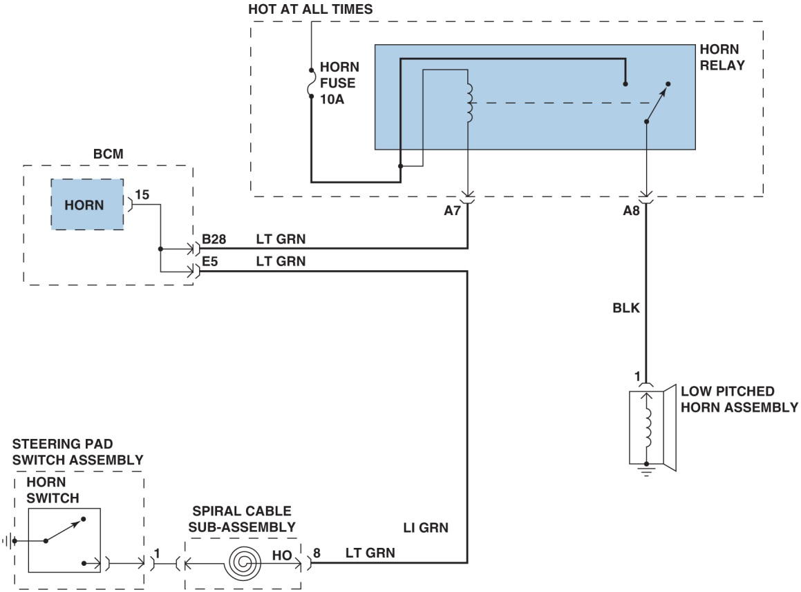
Figure 58.3

Slide 10
Animation: Meter Usage, Measure Amps (Horn) (Animation will automatically start)

Slide 11
Figure 57.3 BCM Horn Schematic
A typical schematic of a horn circuit. Note that the horn relay can be activated by either the horn switch in the steering wheel or by the body control module (BCM)

Slide 12
Question 1: ?
What are the advantages of using the B C M to able to operate the horns?

Slide 13
Answer 1
Improve diagnostics and use for systems such as theft alarm and remote keyless entry.

Slide 14
Windshield Wipers (1 of 5)
Purpose and Function
Windshield wipers keep viewing area of windshield clear of rain.
Computer Controlled Wipers
B C M to control actual operation of wiper based on the input from switch.

Slide 15
Windshield Wipers (2 of 5)
Wiper and Washer Components
Wiper motor(s)
Gearbox
Wiper arms and linkage
Wiper blades
Washer pump
Hoses and jets (nozzles)
Fluid reservoir
Switches, wiring and connectors

Slide 16
Windshield Wipers (3 of 5)
Windshield Wiper Motors
Series-wound field
Shunt field
Wiper Motor Operation
Wiper motors using a permanent magnet motor
Have a low-speed positive brush
High-speed positive brush
Ground (negative) brush
To conduct electricity

Slide 17
Windshield Wipers (4 of 5)
Park Position
Windshield wiper motor park operation is controlled by wiper motor module using an input from park switch within wiper motor assembly.
Variable Wipers
Describes operation of the wipers that operate on an interval that can be delayed when the rain is light.

Slide 18
Windshield Wipers (5 of 5)
Windshield Wiper Diagnosis
Electrical failures can typically be diagnosed with a scan tool and a multimeter.
Electrical failures can include
Defective wiper switch or connections
Failed motors or park switches
Mechanical failures can include
Stripped gears or linkage connections
Loose or separated connection at motor
Loose linkage

Slide 19
Figure 57.4 Motor Linkage
The motor and linkage bolt to the body and connect to the switch with a wiring harness

Slide 20
Figure 57.5 Typical Motor
A typical wiper motor with the housing cover removed. Motor itself has a worm gear on shaft that turns the small intermediate gear, which then rotates the gear and tube assembly
Notes:
CASE STUDY: Wipers Would Stop Working
The owner of a Ford Focus stated that the wipers would stop working randomly in the middle of a sweep. The technician saw that the wiper blades were aftermarket multiple blade type. The wiper motors have a fail-safe over load protection built in. If the body control module (BCM) detects too much current, it will shut the motors down to protect them. The motors communicate over a LIN network between the two motors. The technician replaced the wiper blades with factor original equipment (OE) blades. This corrected the customer concern.
Summary:
Complaint—The wipers would stop working randomly in the middle of a sweep.
Cause—The aftermarket wiper blades created too much of a drag on the wiper motor and caused it to stop working.
Correction—The wiper blades were replaced with the factory original type.

Slide 21
Frequently Asked Question: How Do Wipers Park?
? Frequently Asked Question
How Do Wipers Park? Some vehicles have wiper arms that park lower than the normal operating position, so they are hidden below the hood when not in operation. This is called a depressed park position. When the wiper motor is turned off, the park switch allows the motor to continue to turn until the wiper arms reach the bottom edge of the windshield. Then the park switch reverses the current flow through the wiper motor, which makes a partial revolution in the opposite direction. The wiper linkage pulls the wiper arms down below the level of the hood and the park switch is opened, stopping the wiper motor.

Slide 22
Figure 57.6 Wiring Diagram 2-Speed
A wiring diagram of a two-speed windshield wiper circuit using a three-brush, two-speed motor. The dashed line for the multifunction lever indicates that the circuit shown is only part of the total function of the steering column lever

Slide 23
Figure 57.7 Diagnosis Diagram
A circuit diagram is necessary to troubleshoot a windshield wiper problem
Notes:
CASE STUDY: Intermittent Wipers Inoperative
The owner of a Chevrolet Tahoe LTZ complained the intermittent wipers did not work. On the initial selection of the wiper switch to one of the pulse positions, the wipers made one swipe and stopped working after that. The wipers would just sit in the park position. The low speed, high speed, and park positions worked fine.
This vehicle was equipped with rain-sense wipers. The wipers are not supposed to work in the pulse mode unless there is water on the windshield. In this case, the rain sensor at the top of the windshield was defective. The wipers would not come on because the body control module (BCM) was not being notified that there was a wipe pulse required. The rain sensor was replaced. After replacement of the sensor, with wipers in pulse mode, the windshield was sprayed with a spray bottle and the wipers operated correctly.
Summary:
Complaint—Intermittent wipers inoperative.
Cause—The rain senor on the inside of the windshield was defective.
Correction—The rain sensor was replaced and normal operation of the windshield wipers was restored.

Slide 24
Figure 57.8 Cowl Panel
The wiper motor and linkage mount under the cowl panel on many vehicles

Slide 25
Figure 57.9 CAN BUS Connection
A typical schematic showing how a scan tool connected to the CAN bus could be used to operate the components connected to the bus
Notes:
TECH TIP: Scan Tool Bidirectional Control
Most vehicles built since 2000 can have the lighting and accessory circuits checked using a scan tool. A technician can use the following:
Factory scan tool, such as:
GDS II (General Motors vehicles)
DRB III, Star Scan, Star Mobile, WiTech, or MicroPOD II (Chrysler-Jeep vehicles)
New Generation Star or IDS (Ford)
Honda Diagnostic System (HDS)
TIS Tech Stream (Toyota/Lexus)
An enhanced aftermarket scan tool has body bidirectional control capability, including
Snap-on Modis, Solus, or Verus
OTC Genisys
AutoEnginuity
Using a bidirectional scan tool allows the technician to command the operation of electrical accessories, such as horns, windows, lights, door locks, and wipers. SEE FIGURE 57-9. If the circuit operates correctly when commanded by the scan tool and does not function using the switch(s), follow service information instructions for the exact tests and testing procedures to follow for the vehicle being tested.

Slide 26
Animation: Meter Usage, Check CAN Circuit (Animation will automatically start)

Slide 27
Windshield Washers (1 of 2)
Operation
Used to squirt washer fluid onto the surface of the windshield where wipers are used.
Rear Washers
Used to squirt washer fluid on the rear glass.
Typically a shared reservoir with the front washers.
Headlight Washers
Used to wash the surface of the headlight.
May be equipped with a wiper blade.

Slide 28
Windshield Washers (2 of 2)
Windshield Washer Diagnosis
Make sure reservoir has fluid and is not frozen.
If pump does not operate it is an electrical problem.
If fluid does not reach nozzle it is distribution problem.
Windshield Washer Service
Washer motors are not repairable
Replaced if defective.
Pumps are located on or inside washer reservoir tank or cover.

Slide 29
Figure 57.10 Washer Pump
A typical windshield washer reservoir and pump assembly

Slide 30
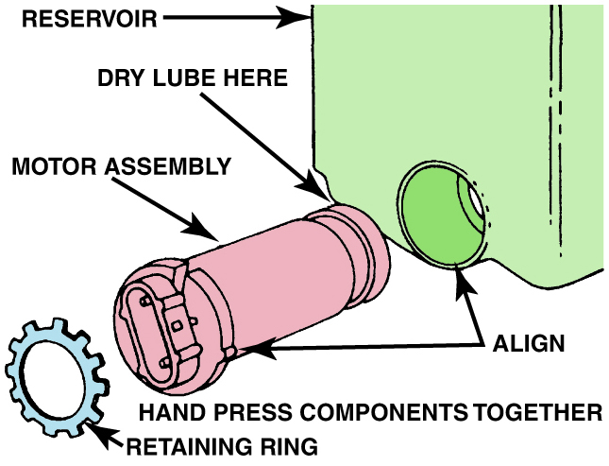
Figure 58.11

Slide 31
Figure 57.12 Washer Pump Location
Washer pumps usually install into the reservoir and are held in place with a retaining ring

Slide 32
Rain-Sense Wipers
Parts and Operation
Rain-sense wiper systems use a sensor located on inside and at top of windshield to detect rain droplets.
Wiper switch can be left on the sense position all the time, and if no rain is sensed, the wipers do not swipe.
Contains 4 infrared (IR) diodes, 2 photocells, and a microprocessor.
Follow vehicle manufacturer’s recommended diagnosis and testing procedures.

Slide 33
Figure 57.13 Rain-Sense Wipers
A typical rain-sensing module located on the inside of the windshield near the inside rearview mirror

Slide 34
Figure 57.14 Rain-Sense Operation
The electronics in the rain-sense wiper module can detect the presence of rain drops under various lighting conditions
Notes:
TECH TIP: Rain Sense and Cruise Control
The rain-sense wiper module communicates with the BCM over the data links and, if the rain is heavy, a signal is sent to deactivate the cruise control. A message is then displayed on the instrument panel warning that the cruise control is not available. This is normal operation and is used to help prevent the vehicle from hydroplaning during heavy rain. Normal cruise control operation resumes when the rain intensity is reduced. This is normal operation and not a fault with the cruise control system.

Slide 35
Animation: Rain Sensing (Animation will automatically start)

Slide 36
Blower Motor
Blower motor moves air inside vehicle for:
Air conditioning
Heat
Defrosting
Defogging
Venting passenger compartment.
Turns a squirrel cage-type fan
Move air without creating a lot of noise
Fan switch controls current to the blower motor.

Slide 37
Figure 57.14 Blower Motor
A squirrel cage blower motor. A replacement blower motor usually does not come equipped with the squirrel cage blower, so it has to be switched from the old motor.

Slide 38
Animation: Blower (Animation will automatically start)

Slide 39
Figure 57.15 Blower Motor Circuit
A blower motor circuit with four speeds controlled Ng resistors. The three lowest fan speeds (low, medium-low, and medium-high) use the blower motor resistors to drop the voltage to the motor and reduce current to the motor

Slide 40
Animation: Manual Blower Control (Animation will automatically start)

Slide 41
Figure 57.16 Resistor
A blower motor resistor pack used to control blower motor speed. Some Blower motor resistors are flat and look like a credit card and are called “credit card resistors

Slide 42
Figure 57.17 Brushless Blower Motor
A brushless DC motor that uses the body computer to control the speed

Slide 43
Figure 57.18 DMM Diagnosis
Using a mini AC/DC clamp-on multimeter to measure the current drawn by a blower motor

Slide 44
Animation: Test Blower Motor, Clamp Meter (Animation will automatically start)

Slide 45
Question 3: ?
A blower motor only operates on high speed. What is the most likely cause?

Slide 46
Answer 3
A bad blower motor resistor pack.

Slide 47
Cruise Control (1 of 2)
Purpose and Function
Maintain pre-set vehicle speed, even up gentle grades.
Cruise Control Operation
Can usually be set only if the vehicle speed is 25 M P H (40 km/h) or more.
Clutch cannot be depressed or the brakes applied.

Slide 48
Cruise Control (2 of 2)
Electronic Throttle Cruise Control
Vehicles equipped with such a system do not use throttle actuators for cruise control, but instead use electronic throttle to control vehicle speed.
Diagnosis and Service
Fault with the accelerator position sensor, the brake switch or the electronic throttle control system will disable the system.

Slide 49
Figure 57.19 Cruise Circuit
Circuit diagram of a typical electronic cruise control system.

Slide 50
Figure 57.20 ETC Cruise Control
The ETC system uses a sensor that measures position and the speed of the driver’s foot on the accelerator pedal. A throttle position sensor measures the throttle angle. An electric motor operates the movement of the throttle plate using commands from the PCM.
Notes:
TECH TIP: Bump Problems
Cruise control problem diagnosis can involve a complex series of checks and tests. The troubleshooting procedures vary among manufacturers (and year), so a technician should always check service information for the exact vehicle being serviced. However, every cruise control system
uses a brake safety switch and, if the vehicle has manual transmission, a clutch safety switch. The purpose of these safety switches is to ensure that the cruise control system is disabled if the brakes or the clutch are applied. Some systems use a redundant brake pedal safety switch. If the cruise control “cuts out” or disengages itself while traveling over bumpy roads, the most common cause is a misadjusted brake (and/or clutch) safety switch(es). Often, a simple readjustment of these safety switches cures the intermittent cruise control disengagement problems.
CAUTION: Always follow the manufacturer’s recommended safety switch adjustment procedures. If the brake safety switch(es) is misadjusted, it could keep pressure applied to the master brake cylinder, resulting in severe damage to the braking system.
TECH TIP: Check the Brake Lights
On many vehicles, the cruise control does not work if the brake lights are not working. This includes the third brake light, commonly called the center high-mounted stop light (CHMSL). Always check for the proper operation of the brake lights first if the cruise control does not work.

Slide 51
Animation: Warning Lights, Cruise Control (Animation will automatically start)

Slide 52
Animation: Radar Cruise Control (Animation will automatically start)

Slide 53
Animation: ADAS Adaptive Cruise Control (Animation will automatically start)

Slide 54
Heated Rear Window Defoggers
Parts and Operation
Uses electrical grid baked on glass that warms glass to about 85°F (29°C) and clears it of fog or frost.
Heated Rear Window Defogger Diagnosis
Troubleshooting a nonfunctioning rear window defogger unit involves using a test light or a voltmeter to check for voltage to the grid.
If a break in grid exceeds 2 inches, most manufacturers recommend replacing the glass.

Slide 55
Figure 57.21 Heated Glass Wiring
A schematic showing that the side view mirrors are heated along with the rear window defogger whenever the rear window switch (lower right) is turned to the on position

Slide 56
Figure 57.22 Defogger Working
A typical image captured using an infrared camera of a rear defogger that is working as designed

Slide 57
Figure 57.23 Testing Defogger
A rear window defogger electrical grid can be tested using a voltmeter to check for a decreasing voltage as the meter lead is moved from the power side toward the ground side

Slide 58
Power Windows (1 of 3)
Switches and Controls
Operated by both a master control switch located beside driver and additional independent switches located at each electric window.
Some power window systems use a lockout/child safety switch located on driver’s controls to prevent operation of power windows from switches.
Designed to operate with the key on and if equipped, in retained accessory power mode, after key is off for a fixed amount of time or until door is opened.

Slide 59
Power Windows (2 of 3)
Power Window Motors
Most use permanent magnet (P M) electric motors.
Reverse direction by reversing polarity of 2 wires going to motor.
Each motor protected by internal positive temperature coefficient (P T C) electronic circuit breaker.
Auto Down/Up Features
Allow window to automatically go down or up after clicking detent position in switch.
Must be equipped with the automatic reversal system.

Slide 60
Power Windows (3 of 3)
Troubleshooting Power Windows
Check for proper operation of all power windows.
Check that child-proof switch is not enabled.
Check for codes with scan tool.
Relearn/reprogram windows after part replacement.

Slide 61
Figure 57.24 Power Windows
A typical power window circuit using PM motors. Control of the direction of window operation is achieved by directing the polarity of the current through the non-grounded motors. The only ground for the entire system is located at the master control (driver’s side) switch assembly.

Slide 62
Animation: Power Windows (Animation will automatically start)

Slide 63
Figure 57.25 Window Regulator
An electric motor and a regulator assembly raise and lower the glass on a power window
Notes:
TECH TIP: Programming Auto Down/Up Power Windows
Many vehicles are equipped with automatic operation that can cause the window to go all the way down (or up) if the switch is depressed beyond a certain point or held for a fraction of a second. Sometimes this feature is lost if the battery in the vehicle has been disconnected. Although this programming procedure can vary depending on the make and model, many times the window(s) can be reprogrammed without using a scan tool by depressing and holding the down button for 10 seconds. If the vehicle is equipped with an auto up feature, repeat the procedure by holding the button up for 10 seconds. Always check exact
service information for the vehicle being serviced.

Slide 64
Electric Power Door Locks
Parts and Operation
Electric power door locks use a permanent magnet (P M) reversible motor
Lock/unlock all door locks from a control switch or switches.
Troubleshooting Power Door Locks
Use a factory or factory-level aftermarket scan tool and try operating the locks using the bidirectional control.
If a single door lock failure
Check electrical connections and binding of mechanisms.

Slide 65
Figure 57.26 Door Lock Wiring
A typical electric power door lock circuit diagram. Note that the control circuit is protected by a fuse, whereas the power circuit is protected by a circuit breaker. Power door locks typically use reversible permanent magnet (P M) non-grounded electric motors

Slide 66
Animation: Power Door Locks (Animation will automatically start)

Slide 67
Figure 57.27 Door Lock
A typical power door lock mechanism showing a DC drive motor used to move the door lock plunger

Slide 68
Animation: Power Door Lock Motor (Animation will automatically start)

Slide 69
Trunk/Lift Gate Locks
Circuit Description
Electric power trunk/lift gate lock
Uses a permanent magnet (P M) reversible motor
To lock or unlock the trunk/lift gate lock
From a control switch or with the remote.

Slide 70
Figure 57.28 Lift Gate Switch
The switch to disable the outside opening of the trunk/lift gate is often in the glove box

Slide 71
Power Sun Roof/ Moon Roof (1 of 2)
Definitions
Sun roof - any kind of panel on the roof of a car that permits light, air, or both to come into a vehicle, but only if the panel is opened.
Moon roof - made of a tinted glass panel that can be either tilted open or completely retracted to operate as an open window in the roof.
Operation
Most moon or sun roof systems use permanent magnet (P M) electric motors to open and close the moveable glass panel.

Slide 72
Power Sun Roof/ Moon Roof (2 of 2)
Diagnosis and Service
Water leaks - water seals around moon roofs “controlling the flow of water” and not necessarily trying to provide a water-proof seal.
Electrical/Mechanical Issues - Electrical or mechanical issues can prevent the moon roof from opening or closing.
Most vehicle manufacturers include a crank or a way to close the roof if the roof fails to close due to an electrical fault.

Slide 73
Figure 57.29 Movable Roof
An exploded view of a typical moveable roof showing the location of the motor and the drain tubes that direct the water to the ground

Slide 74
Sun Shades
Fabric or screen-like material installed on inside of vehicle
Can be raised, lowered, or moved to block the rays of the sun from entering the interior of the vehicle.
Sun shades are vehicle-specific, so check service information for the exact procedures to follow when servicing or repairing a sun shade.

Slide 75
Figure 57.30 Power Sun Shade
The control for the operation of the powered inside sun shade on this Chevrolet Impala is in the overhead control panel

Slide 76
Power Seats (1 of 2)
Parts and Operation
A typical power-operated seat includes a reversible electric motor and a transmission assembly that may have three solenoids or motors, and six drive cables that turn the six seat adjusters.
Power Seat Motor(s)
Power seats use a permanent magnet motor with built-in circuit protection to power the movement of the seat.

Slide 77
Power Seats (2 of 2)
Memory Seat
Memory seats use potentiometer to sense seat position
Position can be programmed into B C M or memory seat module, and stored by position number 1, 2, or 3.
Push desired button or key fob and the seat moves to the stored position.

Slide 78
Figure 57.31 Power Seat Module
A power seat uses electric motors under the seat, which drive cables that extend to operate screw jacks (up and down) or gears to move the seat forward and back

Slide 79
Figure 57.32 Seat Wiring
A typical power seat circuit diagram. The seat control switch can change the direction in which the motor(s) runs by reversing the direction in which the current flows through the motor

Slide 80
Animation: Power Seat Control (Animation will automatically start)

Slide 81
Figure 57.33 Memory Seat Circuit
A typical memory seat module showing the three-wire potentiometer used to determine seat position

Slide 82
Electrically Heated Seats
Parts and Operation
Electric heating elements in seat bottom
Seat back, in many vehicles.
Temperature sensor in seat cushion used to regulate temperature.
Diagnosis and Service
Using service information, check for power and ground at the control module and to the heating element in the seat.

Slide 83
Figure 57.34 Heating Element
The heating element of a heated seat is a replaceable part, but service requires that the upholstery be removed. The yellow part is the seat foam material and the entire white cover is the replaceable heating element. This is then covered by the seat material

Slide 84
Heated and Cooled Seats
Parts and Operation
Use a thermoelectric device (T E D) located under the seat cushion and seat back.
Consists of positive and negative connections between two ceramic plates.
Electrical current flow determines which plate is headed and which is cooled.

Slide 85
Figure 57.35 Peltier Effect Device
A Peltier effect device is capable of heating or cooling, depending on the polarity of the applied current

Slide 86
Figure 57.36 Seat Cooling Fan
A fan is used to move the heated or cooled air to heat or cool the bottom or the back of the seat

Slide 87
Heated Steering Wheel
Operation
A signal is sent to control module and electrical current flows through heating element in rim of steering wheel.
Temperature of steering wheel is usually calibrated to stay at about 90°F (32°C).
Always follow vehicle manufacturer’s recommended diagnosis and testing procedures for heated steering wheel diagnosis and repair.

Slide 88
Figure 57.37 Heated Steering Wheel
The heated steering wheel is controlled by a switch on the steering wheel in this vehicle

Slide 89
Heated Mirrors
Purpose and Function
To heat surface of mirror, which evaporates moisture on surface.
Parts and Operation
Heated outside mirrors are often tied into the same electrical circuit as rear window defogger.
Diagnosis
Check service information for specific procedures.

Slide 90
Adjustable Pedals
Purpose and Function
Ability place the brake pedal and the accelerator pedal at A desired level.
Both are on movable brackets (that operate together) that are motor operated.
Diagnosis and Service
Follow vehicle manufacturer’s recommended troubleshooting procedure.

Slide 91
Figure 57.38 Movable Pedals
A typical adjustable pedal assembly. Both the accelerator and the brake pedal can be moved forward and rearward by using the adjustable pedal position switch

Slide 92
Folding Outside Mirrors
A control inside is used to fold both mirrors inward when needed, such as when entering a garage or a tight parking spot.
For diagnosis and servicing of outside folding mirrors, check service information for details.

Slide 93
Figure 57.39 Electronic Folding
Electrically folded mirror in the folded position

Slide 94
Figure 57.40 Mirror Control
The electric mirror control is located on the driver’s side door panel on this Cadillac Escalade

Slide 95
Keyless Entry (1 of 2)
System Description
Some vehicles use a keypad located on the outside of the door,
Most keyless entry systems use a wireless transmitter built into the key fob or remote.
Rolling Code Reset Procedure
If the transmitter does not work, try to resynchronize the transmitter to the receiver by depressing and holding both the lock and the unlock button for 10 seconds when within range of the receiver.

Slide 96
Keyless Entry (2 of 2)
Passive Keyless Entry System
Passive system uses key fob as a transmitter, which communicates with vehicle as it comes close.
Vehicle is automatically unlocked when a button or sensor on door handle or trunk release is depressed.
Keyless Entry Diagnosis
A small battery powers transmitter, and a weak battery is common cause of remote power locks failing to operate.

Slide 97
Figure 57. 41 Key Fob Remote

Slide 98
Figure 57.42 Keyless Entry Sensors
A typical vehicle showing the location of the various components of the remote keyless entry system

Slide 99
Figure 57.43 Passive Key
(a) If the passive key is within about 15 feet (5 meters) of the vehicle when the door handle is touched, the door unlocks, allowing access to the interior. (b) The engine starts if the smart key is detected being inside the vehicle

Slide 100
Question 3: ?
What is meant by a “rolling code”?

Slide 101
Answer 3
The changing of the coding between the keyless remote and the vehicle every time a button is pushed to prevent theft.

Slide 102
Garage Door Opener
Operation
HomeLink or Car2U is a device installed in many new vehicles that duplicates the radio-frequency code of the original garage door opener.
Programming
Must be programmed using the transmitter for the garage door opener or other device.
Diagnosis
Ensure the garage door opener is compatible.

Slide 103
Figure 57.44 Garage Door Opener
Typical HomeLink garage door opener buttons. Notice that three different units can be controlled from the vehicle using the HomeLink system

Slide 104
Module Communications
Steps to determine module communications:
STEP 1 Connect factory/factory-level scan tool to DLC.
STEP 2 Perform all-module scan to check for DTCs
STEP 3 Command module to take action and observe the response. If component operates OK, this means that there is nothing wrong on output. If an incorrect response is shown, then refer to service information for diagnostic procedure.

Slide 105
Figure 57.45 DLC
The data link connector (DLC) is located under the dash.
Notes:
MODULE COMMUNICATION
The body control module (BCM) and other electronic modules are used to operate the various vehicle systems. The number of these modules and the purpose of them varies among the vehicle manufacturers. All these systems use the different controller area networks (CAN) to connect all these modules together. If there are communication errors on the various networks some or all of these modules may not function. Many communication errors will set a “U” DTC. If this network is active or partially active, a bidirectional factory level scan tool is needed to diagnose the diagnostic trouble code(s). A factory or factory-level aftermarket scan tool is also required to reprogram the current or new BCM with the latest operating software and calibrations.

Slide 106
Animation: Data Link Connector, DLC (Animation will automatically start)

Slide 107
Module Reprogramming
STEP 1 Download latest vehicle software program updates from OEM or subscription website and load these updates onto flash programmer or scan tool.
STEP 2 Power on the flash programming tool, then turn on ignition (KOEO).
STEP 3 Establish flash programming tool communication
STEP 4 Identify vehicle modules that will need to be updated, and use flash programming tool (J2934) or scan tool to perform software updates or reprogramming.

Slide 108
Figure 57.46 Re-Programming
A laptop computer being used to download the latest software from the Internet, which needs to be transferred to a factory or factory-level scan tool that is connected to DLC to perform the file transfer.

Slide 109
Frequently Asked Question: How Do Over the Air (OTA) Module Updates Work?
? Frequently Asked Question
How Do Over the Air (OTA) Module Updates Work? Electronic modules can be updated using over the air (OTA) on many vehicles. Tesla was the first to use OTA to update some of the electronic modules in 2012 on their Model S. Since then, many vehicle manufacturers are able to update the software of many electronic modules using OTA communication. Some use Wi-Fi whereas others use cellular systems to communicate with the vehicle.

Slide 110
Electrical and Electronic Systems Videos and Animations
Videos Link: (A6) Electrical/Electronic Systems Videos
Animations Link: (A6) Electrical/Electronic Systems Animations

Slide 111
Copyright
This work is protected by United States copyright laws and is provided solely for the use of instructors in teaching their courses and assessing student learning. Dissemination or sale of any part of this work (including on the World Wide Web) will destroy the integrity of the work and is not permitted. The work and materials from it should never be made available to students except by instructors using the accompanying text in their classes. All recipients of this work are expected to abide by these restrictions and to honor the intended pedagogical purposes and the needs of other instructors who rely on these materials.

