Slide 1
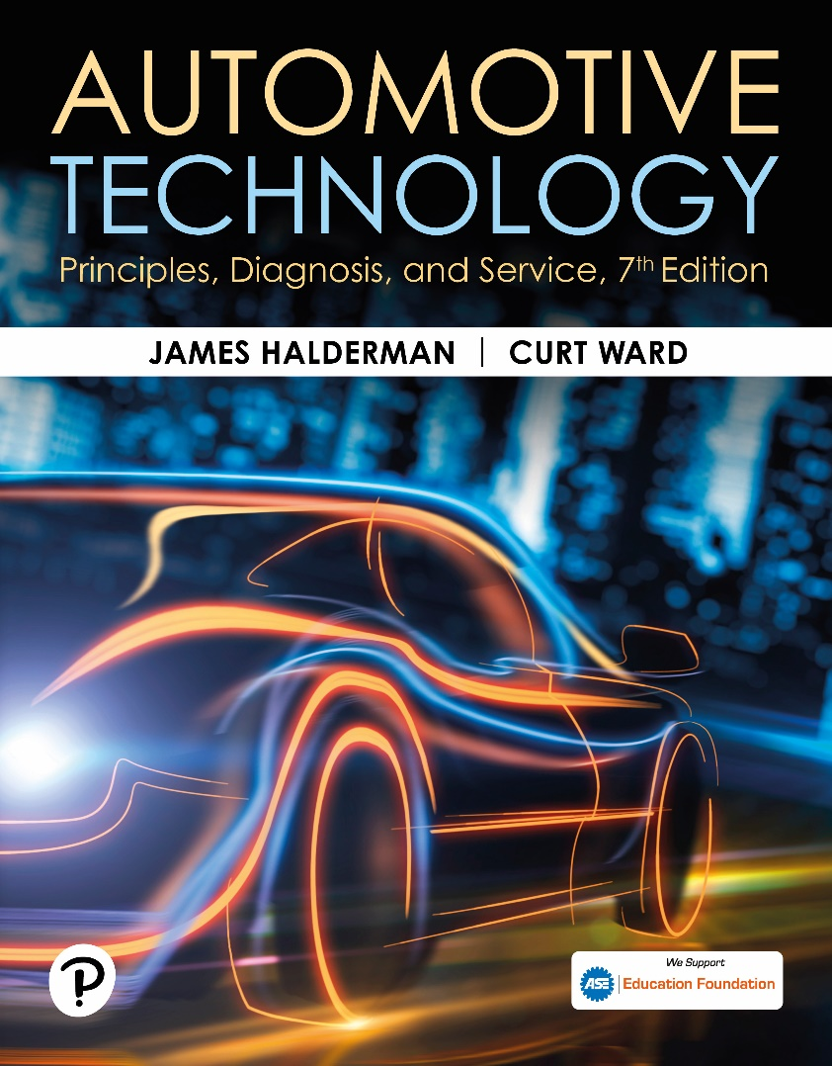
Automotive Technology: Principles, Diagnosis, and Service
Seventh Edition
Chapter 55
Security and Immobilizer Systems
Copyright © 2023 Pearson Education, Inc. All Rights Reserved
Notes:
INSTRUCTOR NOTE: This presentation includes text explanation notes, you can use to teach the course. When in SLIDE SHOW mode, you RIGHT CLICK and select SHOW PRESENTER VIEW, to use the notes.

Slide 2
Learning Objectives (1 of 3)
55.1 Describe the purpose and function of a security system.
55.2 Explain how an immobilizer system works and identify its major components.
55.3 Describe immobilizer systems in Chrysler vehicles.
55.4 Describe the Ford passive antitheft system.
55.5 Describe the General Motors antitheft system.
55.6 Explain how to diagnose a fault with an immobilizer system.

Slide 3
Vehicle Security Systems
Purpose and Function
Purpose and function of a security system on a vehicle is to prevent the unauthorized use (theft) of the vehicle.
This function is accomplished with a lock on the door and a lock on the ignition.

Slide 4
Frequently Asked Question: What Is Content Thief Protection?
? Frequently Asked Question
What Is Content Thief Protection? Content Thief protection is a security system that includes sensors that detect glass breakage or entry into the vehicle and sounds an alarm when these occur. The purpose of the content theft system is to prevent the theft of objects inside the vehicle and sound an alarm when someone enters the vehicle without using the proper remote or key. Most systems use a motion detector for content theft protection, as well as switches in the doorjambs, trunk, and hood that provide an input signal to the control module. Some antitheft systems are more complex and also have electronic sensors that trigger the alarm if glass is broken or a change in battery current draw occurs. These sensors also provide an input signal to the control module, which may be a separate antitheft unit, or may be incorporated into PCM or BCM. Figure 55–1.

Slide 5
Figure 55.1 Shock Sensor
A shock sensor used in alarm and antitheft systems. If the vehicle is moved, the magnet moves relative to the coil, inducing a small voltage that triggers the alarm

Slide 6
Immobilizer Systems (1 of 3)
Normal Operation
The engine cranks and starts and the immobilizer symbol on the dash flashes on and off for about 2 seconds, and then goes off.
Immobilizer System Parts
Key fob – remote keyless entry (R K E)
Transponder key
Transceiver

Slide 7
Immobilizer Systems (2 of 3)
Immobilizer System Operation
The key identification (I D) numbers are stored in a nonvolatile memory of the immobilizer module.
At each start, the module compares the I D number of the transponder key used with those stored in the memory.
The immobilizer module controls the starter circuit and the security light and signals the P C M to activate fuel injection and ignition when the I D number and code word verification have been successful.

Slide 8
Immobilizer Systems (3 of 3)
Security Light Operation
Normal operation of the security light includes a self-test and flashes a few times, then goes out.
If a fault is detected, the security light continues to flash and the engine may not start.
Precautions
Do not drop key
Key the key dry
Do not expose the key to magnetic fields
Do not expose to high temperatures

Slide 9
Figure 55.2 Security System Symbol
The security system symbol used on a Ford. The symbol varies by make, model, and year, so check service information to determine what symbol is used on the vehicle being diagnosed

Slide 10
Figure 55.3 Key
A typical key with the cover removed showing the battery used to power the door lock and the antenna used for the immobilizer system

Slide 11
Figure 55.4 Remote Keyless Entry
The remote keyless entry is used to unlock the doors as well as create the signals to the powertrain control module (P C M) used to control the starter motor and/ or the fuel system and the warning lamp on the instrument panel cluster (I P C)

Slide 12
Figure 55.5 Immobilizer
A typical immobilizer circuit showing the communication between the key and the transceiver. The transceiver then communicates with the immobilizer module over data lines

Slide 13
Animation: Immobilizer System (Animation will automatically start)

Slide 14
Figure 55.6 Key Use
(a) Avoid using a key where the key ring is over the top of the key, which can interfere with the operation of the immobilizer system. (b) Do not angle another key upward from the key being used to help prevent interference with the magnetic field used to energize the key. (c) Do not have the keys from another vehicle near the key being used
Notes:
TECH TIP: Do Not Have Other Keys Near
Whenever diagnosing an immobilizer system, keep other key fobs away from the area. If another key fob were close, it could be transmitting a signal that is not recognized by the vehicle and the security system could prevent proper vehicle operation. Even having other metal objects near the key can affect the strength of the electromagnetic pulses and could interfere with the immobilizer system and prevent it from working as designed. Figure 55-6

Slide 15
Figure 55.7 Exact Wiring Diagram
Check service information for the exact wiring diagram (schematic) for the vehicle being tested. Highlighting the wires and noting their color helps when following the specified testing procedures

Slide 16
Question 1: ?
What faults will an immobilizer system cause?

Slide 17
Answer 1
Cranks-no start, start and die, no-crank.

Slide 18
Question 2: ?
A typical immobilizer system consists of what parts?

Slide 19
Answer 2
Key fob, transponder key, and transceiver.

Slide 20
Chrysler Immobilzer System (1 of 2)
Beginning in 1998, Chrysler started a security system known as the Sentry Key Immobilizer System (S K I S).
The transponder then returns a unique signal back to the S K I M, giving it the okay for the vehicle to start and continue to run.

Slide 21
Chrysler Immobilzer System (2 of 2)
Chrysler Self-Programming Additional Sentry Keys
Purchase blank key and have it cut to fit lock cylinder.
Insert original key #1 into ignition and turn to ON.
Wait 5 seconds and turn key to OFF.
Immediately insert original key #2 into ignition turn ON.
Wait 10 seconds for S K I S indicator in dash to start to flash.
Turn ignition off, insert new blank key, and turn ignition back on.

Slide 22
Ford Pats System
Ford antitheft system: Passive Antitheft System (P A T S).
Ford Programming for additional P A T S Keys
Insert first programmed ignition key into ignition lock cylinder and turn to on.
Within 5 seconds of turning ignition switch to LOCK position, insert the second programmed ignition key into ignition lock cylinder and turn to on.
Within 5 seconds of turning ignition switch to LOCK position, insert a new un-programmed ignition key into the ignition lock cylinder and turn on.

Slide 23
General Motors Antitheft System
The type of antitheft system used on General Motors vehicles has included many different systems.
Vehicle Antitheft system
Passkey I
Passkey I I
Passlock I
Passlock I I

Slide 24
Figure 55.8 GM VATS
A special tool is needed to diagnose a GM VATS security system and special keys that contain a resistor pellet

Slide 25
Figure 55.9 GM PASSLOCK
The PASSLOCK series of general motors security systems uses a conventional key. The magnet is located in the ignition lock cylinder and triggers the Hall-effect sensors

Slide 26
Testing Immobilizer Systems
Diagnostic Steps
Verify the customer concern
Visual Inspection
Check security light status
Check for trouble codes
Check Technical Service Bulletins (T S Bs)
Perform pinpoint tests
Determine the root cause
Verify the repair

Slide 27
Figure 55.10 SCAN TOOL
Scan tools, such as this factory tool being used on a Chrysler, are capable of many diagnostic functions that can help the technician zero in on the root cause of a problem

Slide 28
Figure 55.11 Checking for TSB
After checking for stored diagnostic trouble codes (DTCs), wise technician checks service information for any technical service bulletins (TSBs) that may relate to the vehicle being serviced

Slide 29
Figure 55.12 Coil Detectors
Immobilizer coil detectors can be found online by searching for immobilizer transponder coil detector

Slide 30
Question 3: ?
An antenna coil tester is used to test what part of the immobilizer system?

Slide 31
Answer 3
Electromagnetic pulses

Slide 32
Related Animations

Slide 33
Animation: Antitheft System (Animation will automatically start)

Slide 34
Electrical and Electronic Systems Videos and Animations
Videos Link: (A6) Electrical/Electronic Systems Videos
Animations Link: (A6) Electrical/Electronic Systems Animations

Slide 35
Copyright
This work is protected by United States copyright laws and is provided solely for the use of instructors in teaching their courses and assessing student learning. Dissemination or sale of any part of this work (including on the World Wide Web) will destroy the integrity of the work and is not permitted. The work and materials from it should never be made available to students except by instructors using the accompanying text in their classes. All recipients of this work are expected to abide by these restrictions and to honor the intended pedagogical purposes and the needs of other instructors who rely on these materials.

