Slide 1
Automotive Technology: Principles, Diagnosis, and Service
Seventh Edition
Chapter 54
Driver Information and Navigation Systems
Copyright © 2023 Pearson Education, Inc. All Rights Reserved
Notes:
INSTRUCTOR NOTE: This presentation includes text explanation notes, you can use to teach the course. When in SLIDE SHOW mode, you RIGHT CLICK and select SHOW PRESENTER VIEW, to use the notes.

Slide 2
Learning Objectives (1 of 2)
54.1 Identify the meaning of dash warning symbols.
54.2 Describe steering wheel controls.
54.3 Describe voice activation.
54.4 Describe maintenance indicators.
54.5 Describe analog and digital displays.
54.6 Discuss the operation of a head-up display.
54.7 Discuss the operation of night vision systems.
54.8 Discuss the operation of electronic displays.

Slide 3
Learning Objectives (2 of 2)
54.9 Discuss the operation of virtual displays
54.10 Discuss the operation of touch screens.
54.11 Describe how speedometers and odometers work.
54.12 Discuss the diagnosis of oil pressure lamp, temperature lamp, brake warning lamp, and other analog dash instruments.
54.13 Describe how a navigation system works.
54.14 Explain the operation and diagnosis of Telematics systems.
54.15 Explain the operation of a backup camera.

Slide 4
Dash Warning Symbols (1 of 2)
Purpose and Function
Symbols are used instead of words because they are universal in a global vehicle market.
Bulb Check
All of warning lights come on as part of a self-test, and to help driver or technician spot any warning light that may be burned out or not operating.

Slide 5
Dash Warning Symbols (2 of 2)
Green or White Symbols
Used to notify the driver that certain functions are working
Amber Symbols
A fault or an issue has occurred that may require attention soon.
Red Warning Symbols
Red symbols mean that a serious fault has been detected and that immediate attention is required

Slide 6
Figure 54.1 Green & Blue Symbols
Green and blue symbols are used to inform the driver what is in operation

Slide 7
Figure 54.2 Amber Symbols
Amber warning symbols inform driver of a potential concern

Slide 8
Figure 54.3 RED Dash Symbols
Red dash symbols are used to warn the driver of a fault requiring immediate action

Slide 9
Frequently Asked Question: How to Rest Maintenance Indicators?
? Frequently Asked Question
How to Rest Maintenance Indicators? In most cases, the maintenance required indicators symbols are used only as a reminder that routine maintenance is needed, such as an oil change. For most vehicles, the resetting procedure is often easily done such as: “Depress the accelerator pedal three times to the floor, in less than 10 seconds.” Then when the ignition is turned off, and the light will go out, resetting the indicator. Check service information the owner's manual or perform an Internet search to find the exact procedure to follow for the vehicle being serviced.

Slide 10
Question 1: ?
What do the colors of the dash symbols mean?

Slide 11
Answer 1
Green or blue indicate something is working, amber indicates something will need attention soon and red indicates that attention is needed immediately.

Slide 12
Steering Wheel Controls
Purpose
Allow driver to keep their hands on wheel and their eyes on the road at all times.
Function
Radio controls
Cruise control
Telephone answering and calls
Voice commands

Slide 13
Figure 54.4 Steering Wheel Controls
Steering wheel controls allow the driver to select a function while keeping their hands on the wheel and their eyes on the road

Slide 14
Voice Activation
Purpose
Perform various functions or settings in the vehicle.
Functions
Phone calls
Text messages
Climate-control settings
Source of audio
Navigation system

Slide 15
Maintenance Indicators
Purpose and Function
Inform the driver that routine maintenance is needed.
Reset Maintenance Indicators
Refer to service information or owners manual for procedure.

Slide 16
Figure 54.5 Maintenance Minders
Maintenance reminders are often messages displayed on the instrument panel informing the driver of needed service, such as the need to change engine oil

Slide 17
Analog and Digital Displays
Terminology
Analog display uses a needle to show values.
Digital display uses numbers to indicate values.
Stepper Motor Analog Gauges
Most analog dash displays use a stepper motor to move the needle.
Network Communication
Data is shared digitally with the instrument cluster from various modules.

Slide 18
Figure 54.6 Stepper Motor
Most stepper motors use four wires that are pulsed by the computer to rotate the armature in steps

Slide 19
Figure 54.7 Instrument Display DLC
A typical instrument display uses data from the sensors over serial data lines to the individual gauges

Slide 20
Heads-up Display
Purpose
Supplemental display that projects the vehicle speed and sometimes other data, such as turn-signal information, onto the windshield.
Operation
H U D unit is installed in instrument panel (I P) and uses a mirror to project vehicle information onto the inside surface of the windshield.

Slide 21
Figure 54.8 HUD
A typical head-up display showing zero miles per hour, which is actually projected on the windshield from the head-up display in the dash

Slide 22
Figure 54.9 HUD Control
The dash-mounted control for the head-up display on this Cadillac allows the driver to move the image Up and down on the windshield for best viewing

Slide 23
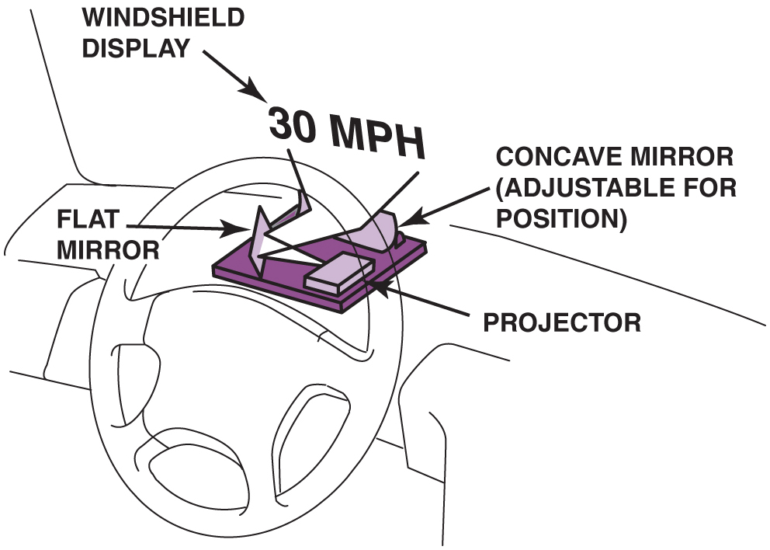
Figure 57.10

Slide 24
Figure 54.10 HUD Display Unit
A typical head-up display (HUD) unit

Slide 25
Night Vision
Purpose and Function
Uses a camera that is capable of observing objects in the dark to assist the driver while driving at night.
Operation
Camera creates pictures based on the heat energy emitted by objects, rather than from light reflected on an object, as in a normal optical camera.
Diagnosis and Service
Follow the manufacturer’s recommended testing and service procedures.

Slide 26
Figure 54.11 Night Vision
A night vision camera behind the grille of a Cadillac

Slide 27
Figure 54.12 Night Vision Image
A view of a person walking in front of a Cadillac equipped with night vision.

Slide 28
Question 2: ?
Night vision is used to detect what type of objects?

Slide 29
Answer 2
People or objects that emit heat energy that cannot be seen in the darkness.

Slide 30
Electronic Displays (1 of 2)
Light-Emitting Diode (L E D)
Light-Emitting Diode (L E D) is a semiconductor that is constructed to release energy in the form of light
Vacuum Tube Fluorescent Displays
V T F display generates its bright light in a manner similar to that of a T V screen, where a chemical-coated light-emitting element called phosphor is hit with high-speed electrons.

Slide 31
Electronic Displays (2 of 2)
Liquid Crystal Displays
L C D construction consists of a special fluid sandwiched between two sheets of polarized glass.
A small voltage is applied to the fluid through a conductive film laminated to the glass plates.
WOW Display
When a vehicle equipped with a digital dash is started, all segments of the electronic display are turned on at full brilliance for 1 or 2 seconds.

Slide 32
Figure 54.13 Navigation System
A typical LCD navigation system display

Slide 33
Frequently Asked Question: What Is the WOW Display?
? Frequently Asked Question
What Is the WOW Display? When a vehicle equipped with a digital dash is started, all segments of the electronic display are turned on at full brilliance for 1 or 2 seconds. This is commonly called the WOW display and is used to show off the brilliance of the display. If numbers are part of the display, the number 8 is shown, because this number uses all segments of a number display. Technicians can also use the WOW display to determine if all segments of the electronic display are functioning correctly.

Slide 34
Virtual Display
Purpose and Function
Virtual display is a dash that allows the driver to select what data is being displayed.
Operation
Dash display is all that is really different because all the data comes to the I P C on the data bus.
Display can be changed to meet the needs of driver.

Slide 35
Figure 54.14 Virtual Dash
A virtual dash being used to show a navigation screen that takes up all of the center dash area. This driver-selectable dash display can show almost any combination of dash instruments to meet the desires of the driver

Slide 36
Touch Screens
Purpose
Allow driver to use a finger to perform functions displayed on the screen.
Operation
Capacitive touchscreen panel reacts to the human touch. The touch location is sent to the controller for processing.
Touch Screen Feedback
Haptic response (beep or vibration) improves the experience by providing feedback.

Slide 37
Figure 54.15 Touchscreen
Schematic of a capacitive touchscreen
Notes:
TECH TIP: Touch Screen Tip
Most vehicle navigation systems use a touch screen for use by the driver (or passenger) to input information or other on-screen prompts. Most touch screens use a change in capacitance at the surface of the screen to determine when and where some action is being performed. Do not push harder on the display if the unit does not respond, or the display unit may be damaged. If no response is detected when lightly touching the screen, rotate the finger to cause the capacitance area to increase so it can be easily detected.

Slide 38
Speedometers/ Odometers
Operation
Dash displays use an electric vehicle speed sensor on the output of the transmission or from the input from the wheel speed sensors (W S S).
Odometers
Odometer is a dash display that indicates the total miles traveled by the vehicle.
Uses either an electrically driven mechanical odometer or a digital display odometer to indicate miles traveled

Slide 39
Figure 54.16 VSS
A vehicle speed sensor located in the extension housing of the transmission. Some vehicles use the wheel speed sensors for vehicle speed information

Slide 40
Figure 54.17 Odometers
(a) Some odometers are mechanical and are operated by a stepper motor (b) Many vehicles are equipped with an electronic odometer.
Notes:
TECH TIP: Keep the Same Overall Tire Diameter
Whenever larger (or smaller) wheels or tires are installed, the speedometer and odometer calibration are thrown off. This can be summarized as follows:
Larger diameter tires. The speed showing on the speedometer is slower than the actual speed. The odometer reading shows fewer miles than actual.
Smaller diameter tires. The speed showing on the speedometer is faster than the actual speed. The odometer reading shows more miles than actual.
To avoid speedometer and odometer issues, select a wheel/tire combination that has the same outside diameter (OD) of the original wheel/tire
combination. Many newer vehicles can use the scan tool to change the tire size (from a select group of sizes) to minimize the effects of tires size change on odometer and speedometer readings. To determine the exact effects of a replacement size wheel or tire, perform an Internet search for a tire
size comparison chart.
CASE STUDY: The Speedometer Works As If It Is A Tachometer: The owner of a Ford F-150 pickup truck complained that all of a sudden the speedometer needle went up and down with engine speed, rather than vehicle speed. In fact, the speedometer needle went up and down with engine speed, even though the gear selector was in “park” and the vehicle was not moving. After hours of troubleshooting, the service technician went back and started checking the basics and discovered that the alternator had a bad diode. The technician measured over 1 volt AC and over 10 ampere AC ripple current using a clamp-on AC/DC ammeter. Replacing the alternator restored the proper operation of the speedometer.
Summary:
Complaint—Customer stated that the speedometer moves in relation to engine speed and not vehicle speed.
Cause—Tests confirmed that the alternator was producing excessive AC voltage due to a bad diode.
Correction—Replacing the alternator restored proper operation of the speedometer.

Slide 41
Dash Gauges (1 of 2)
Fuel Level
Fuel level gauges use a fuel tank sending unit that consists of a float attached to a variable resistor.
As the resistance of the tank unit changes, the dash-mounted gauge also changes to show the level of the fuel in the tank.
Oil Pressure
The oil pressure lamp operates through use of an oil pressure sending unit, which is a switch screwed into the engine block, and grounds the electrical circuit.

Slide 42
Dash Gauges (2 of 2)
Coolant Temperature
Most vehicles use the engine coolant temperature (E C T) sensor for engine temperature gauge operation.
Dash Instrument Diagnosis
Use factory or factory-level scan tool to check for codes.
Use bidirectional control features on scan tool to actuate dash display.
Always follow the specified testing and diagnostic procedures found in service information for the vehicle being tested.

Slide 43
Animation: Warning Lights, Engine Coolant Temperature (Animation will automatically start)

Slide 44
Figure 54.18 Sending Unit
A sending unit socket being used to remove an oil pressure sender unit
Notes:
CASE STUDY: Electronic Devices Cannot Swim
The owner of a Dodge minivan complained that after the vehicle was cleaned inside and outside, the temperature gauge, fuel gauge, and speedometer stopped working. The vehicle speed sensor was checked and found to be supplying a square wave signal that changed with vehicle speed. A scan tool
indicated a speed, yet the speedometer displayed zero all the time. Finally, the service technician checked
the body control module (BCM) to the right of the accelerator pedal and noticed that it had been wet, from the interior cleaning. Drying the BCM did not fix the problem, but a replacement BCM fixed all the problems. The owner discovered that electronic
devices do not like water and that computers cannot swim.
Summary:
Complaint—Customer complained that many gauges stopped working after the vehicle was cleaned.
Cause—The body control module (BCM) was found to be wet from interior cleaning.
Correction—Replacing the BCM fixed all the problems.

Slide 45
Animation: Oil Pressure Sending Unit (Animation will automatically start)

Slide 46
Frequently Asked Question: What Does the Arrow Mean?
? Frequently Asked Question
What Does the Arrow Mean? Many fuel gauges have an arrow next the symbol of a fuel pump. The arrow points to the side where the fill cap is located. This is very helpful if using a rental vehicle as it indicates which side to pull up to a filling station pump. ● Figure 54–19.

Slide 47
Figure 54.19 Fuel Cap Location
The arrow next to the fuel pump symbol shows which side of the vehicle the fuel cap is located

Slide 48
Figure 54.20 Temp Gauge
A temperature gauge showing normal operating temperature between 180°F and 215°F, depending on the specific vehicle and engine

Slide 49
Navigation and G P S
Purpose and Function
The global positioning system (G P S) uses 24 satellites in orbit around the earth to provide signals for navigation devices.
Navigation System Parts and Operation
G P S satellite signals
Y A W sensor
Vehicle speed sensor
Audio input/output

Slide 50
Figure 54.21 GPS
Global positioning systems use 24 satellites in high earth orbit whose signals are picked Up by navigation systems. The navigation system computer then calculates the location based on the position of the satellite overhead

Slide 51
Figure 54.22 GPS Display
A typical GPS display screen showing the location of the vehicle

Slide 52
Frequently Asked Question: What Is Navigation-Enhanced Climate Control?
? Frequently Asked Question
What Is Navigation-Enhanced Climate Control? Some vehicles use data from navigation system to help control the automatic climate control system. Data about the location of the vehicle includes Time and date. This information allows the auto- matic climate control system to determine where sun is located. Direction of travel. The navigation system can also help the climate control system determine the direction of travel. As a result of input from navigation system, the automatic climate control system can control cabin temperature, in addition to various other sensors in the vehicle. E. G. if vehicle is traveling south in the late afternoon in July, the climate control system could assume that the passenger side of the vehicle is warmed more by the sun than the driver’s side, and could increase the airflow to the passenger side to help compensate for the additional solar heating.

Slide 53
Figure 54.23 Navigation Display
A typical navigation display showing various options. Some systems do not allow access to these if the vehicle is in gear and/or moving

Slide 54
Figure 54.24 No GPS Signal
A screen display of a navigation system that is unable to acquire usable signals from GPS satellites

Slide 55
Question 3: ?
How does a navigation system determine the location of the vehicle?

Slide 56
Answer 3
G P S Satellites.

Slide 57
Telematics
What is telematics?
Telematics: interconnected system that combines telecommunications (cellular systems) and G P S navigation satellite system technology.
Parts and Operation
Automatic notification of airbag deployment.
Emergency services.
Stolen vehicle location assistance.
Remote door unlock.
Roadside assistance.

Slide 58
Figure 54.25 OnStar Telematics
3-button OnStar control located on inside rearview mirror. The left button (telephone handset icon) is pushed if a hands-free cellular call is to be made. Center button depressed to contact an OnStar advisor and right emergency button used to request help be sent to vehicle’s location

Slide 59
Backup Camera
Parts and Operation
Used to display area at rear of vehicle in a screen display on dash, or in the inside rear-view mirror when gear selector is placed in reverse.
Rear Camera Image Issues
Dark conditions
Physical damage
Dirt, mud, ice, snow
Excessive temperatures
Glare

Slide 60
Figure 54.26 Back-Up Camera
A typical view displayed on the navigation screen from the backup camera

Slide 61
Figure 54.27 Back-Up Camera
A typical fisheye-type backup camera usually located near the center on the rear of the vehicle near the license plate

Slide 62
Parking Assist
Components
Ultrasonic object sensors
Electromagnetic parking sensors (E P S)
Blind spot monitor
Operation
The system is active from the time the engine is started until the vehicle exceeds a speed of approximately 6 M P H (10 km/h).
Also active when the vehicle is backing up.

Slide 63
Lane Departure Warning
Parts and Operation
Uses cameras to detect if the vehicle is crossing over lane marking lines on the pavement.
Some systems use two cameras, one mounted on each outside rearview mirror.
Some systems use infrared sensors located under the front bumper
Diagnosis and Service
After a visual inspection, follow the vehicle manufacturer’s recommended diagnosis procedures to locate and repair the fault in the system.

Slide 64
Animation: ADAS Lane Departure Warning (Animation will automatically start)

Slide 65
Additional Related Animations

Slide 66
Animation: Warning Lights, Airbag (Animation will automatically start)

Slide 67
Animation: Warning Lights, Brake Light Bulb Failure (Animation will automatically start)

Slide 68
Animation: Warning Lights, Charging System (Animation will automatically start)

Slide 69
Animation: Warning Lights, Cruise Control (Animation will automatically start)

Slide 70
Animation: Warning Lights Door Ajar (Animation will automatically start)

Slide 71
Animation: Warning Lights, Low Traction (Animation will automatically start)

Slide 72
Animation: Warning Lights, Low Fuel (Animation will automatically start)

Slide 73
Animation: Warning Lights, Safety Belt (Animation will automatically start)

Slide 74
Animation: Warning Lights, Tire Pressure (Animation will automatically start)

Slide 75
Animation: Warning Lights, Water in Fuel (Animation will automatically start)

Slide 76
Animation: Warning Lights, Wiper Fluid Low (Animation will automatically start)

Slide 77
Animation: Warning Lights, Worn Brake Pads (Animation will automatically start)

Slide 78
Electrical and Electronic Systems Videos and Animations
Videos Link: (A6) Electrical/Electronic Systems Videos
Animations Link: (A6) Electrical/Electronic Systems Animations

Slide 79
Copyright
This work is protected by United States copyright laws and is provided solely for the use of instructors in teaching their courses and assessing student learning. Dissemination or sale of any part of this work (including on the World Wide Web) will destroy the integrity of the work and is not permitted. The work and materials from it should never be made available to students except by instructors using the accompanying text in their classes. All recipients of this work are expected to abide by these restrictions and to honor the intended pedagogical purposes and the needs of other instructors who rely on these materials.

