Slide 1
Automotive Technology: Principles, Diagnosis, and Service
Seventh Edition
Chapter 51
Charging Systems Parts and Operation
Copyright © 2023 Pearson Education, Inc. All Rights Reserved
Notes:
INSTRUCTOR NOTE: This presentation includes text explanation notes, you can use to teach the course. When in SLIDE SHOW mode, you RIGHT CLICK and select SHOW PRESENTER VIEW, to use the notes.

Slide 2
Learning Objectives (1 of 2)
51.1 Explain why an alternator generates an A C and changes it to D C.
51.2 Describe an alternator’s construction, including overrunning pulleys.
51.3 Describe the components and operation of an alternator.
51.4 Discuss how an alternator works.

Slide 3
Learning Objectives (2 of 2)
51.5 List the factors determining an alternator’s output voltage and current.
51.6 Explain how the voltage of an alternator is regulated.
51.7 Explain how the heat produced by an alternator is regulated.
51.8 Discuss computer-controlled alternators.

Slide 4
Principle of Alternator Operation
Terminology
S A E term for unit that generates electricity is generator.
Alternator is most commonly used
Amount of current generated can be increased by:
Increasing speed of conductors through magnetic field
Increasing number of conductors passing through magnetic field
Increasing strength of magnetic field

Slide 5
Alternator Construction
Housing
An alternator is constructed using a two-piece cast aluminum housing
A front ball bearing is pressed into the front housing, called the drive-end (D E) housing
The rear housing, or the slip-ring-end (S R E) housing, usually contains either a roller bearing or ball bearing

Slide 6
Question 1: ?
How can the amount of current an alternator generates increase?

Slide 7
Answer 1
Increase the speed of the conductors, increase the number of conductors, increase the strength of the magnetic field.

Slide 8
Alternator Overrunning Pulleys
Purpose and Function
The purpose of this pulley is to help eliminate noise and vibration in the accessory drive belt system.
May use a dampener spring inside, plus a one-way clutch.
Manufacturer Specific System Names
Isolating Decoupler Pulley (I D P)
Active Alternator Pulley (A A P)
Alternator Decoupler Pulley (A D P)
Alternator Overrunning Decoupler Pulley

Slide 9
Figure 51.1 Alternator
A typical alternator on a Chevrolet V-8 engine that is driven by the accessory drive belt at the front of the engine
Notes:
TECH TIP: Alternator Horsepower and Engine Operation
Many technicians are asked how much power certain accessories require. A 100 ampere alternator requires about 2 horsepower from the engine.
One horsepower is equal to 746 watts. Watts are calculated by multiplying amperes times volts.
Power in watts = 100 A × 14.5 V = 1, 450 W 1 hp = 746 W
Therefore, 1, 450 watts is about 2 horsepower.
Allowing about 20% for mechanical and electrical losses adds another 0.4 horsepower. Therefore, when someone asks how much power it takes to produce
100 amperes from an alternator, the answer is
2.4 horsepower.
Many alternators delay the electrical load to prevent the engine from stumbling when a heavy electrical load is applied. The voltage regulator or vehicle computer is capable of gradually increasing the output of the alternator over a period of several
minutes. Even though 2 horsepower does not sound like much, a sudden demand for 2 horsepower
from an idling engine can cause the engine to run rough or stall. The difference in part numbers of various alternators is often an indication of the time interval over which the load is applied. Therefore, using the wrong replacement alternator could cause
the engine to stall!

Slide 10
Figure 51.2 Frame
The end frame toward the drive belt is called the drive-end housing and the rear section is called the slip-ring-end housing

Slide 11
Figure 51.3 OAP
An OAP on a Chevrolet Corvette alternator

Slide 12
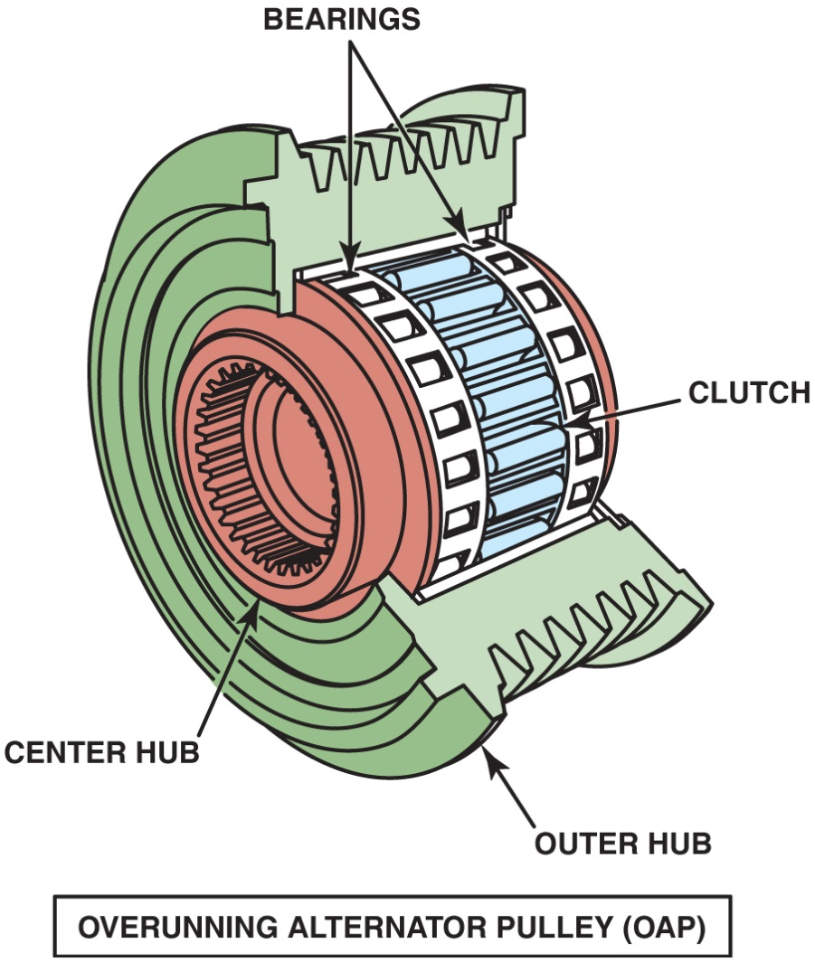
Figure 54.4

Slide 13
Figure 51.4 OAP Exploded View
An exploded view of an overrunning alternator pulley showing all of the internal parts

Slide 14
Figure 51.5 OAD
An overrunning alternator damper (OAD) is not a simple one-way clutch or a solid pulley, but instead is engineered to dampen noises and vibrations in the front accessory drive belt system

Slide 15
Frequently Asked Question: Can I Install an OAP or an OAD to My Alternator?
? Frequently Asked Question
Can I Install an OAP or an OAD to My Alternator? Usually, no. An alternator needs to be equipped with the proper shaft to allow the installation of an OAP or OAD. This also means that a conventional pulley often cannot be used to replace a defective overrunning alternator pulley or dampener. Check service information for the exact procedure to follow.

Slide 16
Question 2: ?
What is the purpose of an O A P or O A D?

Slide 17
Answer 2
Reduce noise and vibration.

Slide 18
Alternator Components and Operation (1 of 2)
Rotor Construction
Rotor constructed of many turns of copper wire coated with a varnish insulation wound over an iron core.
How Rotors Create Magnetic Fields
Current through slip rings causes “fingers” of rotor to become alternating north and south magnetic poles.

Slide 19
Alternator Components and Operation (2 of 2)
Rotor Current
Maximum rated alternator output in amperes depends on the number and gauge of the rotor windings.
Stator Construction
Stator consists of stationary coil windings inside alternator.
Diodes
Semiconductor that operate as a one-way electrical check valve.

Slide 20
Figure 51.6 Cutaway
A cutaway of an alternator, showing the rotor and cooling fan that is used to force air through the unit to remove the heat created when it is charging the battery and supplying electrical power for the vehicle

Slide 21
Figure 51.7 Rotor Flux
Rotor assembly of a typical alternator. Current through the slip rings causes the “fingers” of the rotor to become alternating north and south magnetic poles. As the rotor revolves, these magnetic lines of force induce a current in the stator windings

Slide 22
Figure 51.8 Exploded View
An exploded view of a typical alternator showing all of its internal parts, including the stator windings

Slide 23
Figure 51.9 Rectifier
A rectifier usually includes six diodes in one assembly and is used to rectify A C voltage from the stator windings into DC voltage suitable for use by the battery and electrical devices in the vehicle

Slide 24
How an Alternator Works (1 of 2)
Field Current Is Produced
Magnetic field of rotor generates a current in stator windings by electromagnetic induction.
Current Induced in Stator
Induced current in stator windings is alternating current because of alternating magnetic field of rotor.

Slide 25
How an Alternator Works (2 of 2)
Wye-Connected Stators
Wye-type stator connection, the currents must combine because 2 windings are always connected in series.
Delta-Connected Stators
Current induced in each winding flows to diodes in a parallel circuit.

Slide 26
Figure 51.10 Magnetic Line of Force
Magnetic lines of force cutting across a conductor induce a voltage and current in the conductor

Slide 27
Animation: Alternating Current (Animation will automatically start)

Slide 28
Figure 51.11 Sine Wave
A sine wave (shaped like the letter S on its side) voltage curve is created by one revolution of a winding as it rotates in a magnetic field

Slide 29
Figure 51.12 Three Windings Wave
54.12 When 3 windings (A, B, and C) present in a stator, the resulting current generation is represented by 3 sine waves. The voltages are 120 degrees out of phase. The connection of the individual phases produces a three-phase alternating voltage

Slide 30
Figure 51.13 Wye Stator
Wye-connected stator winding

Slide 31
Figure 51.14 Wye Stator Operation
As magnetic field, created in the rotor, cuts across windings of stator, a current is induced. Notice that current path includes passing through one positive (+) diode on way to battery and one negative (-) diode as a complete circuit is completed through rectifier and stator. It is the flow of current through diodes that converts the AC voltage produced in the stator windings to DC voltage available at the output terminal of the alternator

Slide 32
Figure 51.15 Delta Wound
Delta-connected stator winding

Slide 33
Animation: Three Connector Alternator (Animation will automatically start)

Slide 34
Alternator Output Factors
The output voltage and current of an alternator depend on the following factors.
Speed of rotation
Number of conductors
Strength of the magnetic field

Slide 35
Figure 51.16 Stator Windings
A stator assembly with 6, rather than normal 3 , windings

Slide 36
Alternator Voltage Regulation
Regulator Operation
Control of field current accomplished by opening and closing ground side of field circuit through rotor on most alternators.
Zener diode is a major electronic component that makes voltage regulation possible.
Battery Condition and Charging Voltage
The alternator may supply the needed current but may not reach maximum charging voltage.
Voltage regulators compensate for temperature.

Slide 37
Figure 51.17 Voltage Regulator
Typical voltage regulator range

Slide 38
Figure 51.18 Electronic Regulator
A typical electronic voltage regulator with the cover removed showing the circuits inside

Slide 39
Figure 51.19 GM SI Regulator
Typical GM SI-style alternator with an integral voltage regulator. Voltage present at terminal 2 is used to reverse bias the Zener diode (D2) that controls TR2. The positive brush is fed by the ignition current (terminal 1) plus current from the diode trio

Slide 40
Alternator Cooling
The types of cooling include the following:
External fan
Internal fan(s)
Both an external fan and an internal fan
Coolant cooled

Slide 41
Figure 51.20 Coolant Cooled
A coolant-cooled alternator showing the hose connections where coolant from the engine flows through the rear frame of the alternator

Slide 42
Question 3: ?
How can an alternator be cooled?

Slide 43
Answer 3
How can an alternator be cooled?

Slide 44
Computer-Controlled Alternators
Computers can interface with charging system in 3 ways.
Computer can activate charging system by turning on and off field current to rotor.
Computer can monitor operation of alternator and increase engine speed.
Computer can control alternator by controlling alternator output to match needs of system.

Slide 45
Figure 51.21 Hall-Effect Sensor
A Hall-effect current sensor attached to positive battery cable is used as part of the EPM system

Slide 46
Figure 51.22 Computer Control
The amount of time current is flowing through the field (rotor) determines the alternator output

Slide 47
Animation: Hall-Effect Sensor (Animation will automatically start)

Slide 48
Chart 51.1 Output Voltage
COMMAND DUTY CYCLE | ALTERNATOR OUTPUT VOLTAGE
10% | 11.0 V
20% | 11.6 V
30% | 12.1 V
40% | 12.7 V
50% | 13.3 V
60% | 13.8 V
70% | 14.4 V
80% | 14.9 V
90% | 15.5 V
The output voltage is controlled by varying the duty cycle as controlled by the PCM.

Slide 49
Electrical and Electronic Systems Videos and Animations
Videos Link: (A6) Electrical/Electronic Systems Videos
Animations Link: (A6) Electrical/Electronic Systems Animations

Slide 50
Copyright
This work is protected by United States copyright laws and is provided solely for the use of instructors in teaching their courses and assessing student learning. Dissemination or sale of any part of this work (including on the World Wide Web) will destroy the integrity of the work and is not permitted. The work and materials from it should never be made available to students except by instructors using the accompanying text in their classes. All recipients of this work are expected to abide by these restrictions and to honor the intended pedagogical purposes and the needs of other instructors who rely on these materials.

