Slide 1
Automotive Technology: Principles, Diagnosis, and Service
Seventh Edition
Chapter 50
Starting System Diagnosis and Service
Copyright © 2023 Pearson Education, Inc. All Rights Reserved
Notes:
INSTRUCTOR NOTE: This presentation includes text explanation notes, you can use to teach the course. When in SLIDE SHOW mode, you RIGHT CLICK and select SHOW PRESENTER VIEW, to use the notes.

Slide 2
Learning Objectives (1 of 2)
50.1 Explain the procedure to troubleshoot a starting system problem.
50.2 Discuss how to perform a voltage drop test on the cranking circuit.
50.3 Perform control circuit testing.
50.4 Perform a starter amperage test and determine necessary action.
50.5 Describe the procedure to remove a starter motor.

Slide 3
Learning Objectives (2 of 2)
50.6 Explain starter motor bench testing.
50.7 Describe the procedure to install a starter motor.
50.8 Describe how to troubleshoot starting systems based on their symptoms.

Slide 4
Starting System Troubleshooting Procedure
Overview
Check all system components for proper operation
Steps Involved
Step 1: Verify the customer concern.
Step 2: Visually inspect the battery and battery connections.
Step 3:Test battery condition.
Step 4: Check the control circuit.
Step 5: Check voltage drop of the starter circuit.

Slide 5
Figure 50.1 Theft Deterrent
A theft deterrent indicator lamp of the dash. A flashing lamp usually indicates a fault in the system, and the engine may not start

Slide 6
Voltage Drop Testing
Voltage drop is the drop in voltage that occurs when current is flowing through a resistance.
Test Procedure
Disable the ignition or fuel injection.
Connect voltmeter between battery and starter motor.
Crank the engine and observe the reading while cranking.
Test voltage drop across solenoid.
Check voltage drop on ground side of circuit.

Slide 7
Figure 50.2 Voltage Drop Testing
Voltmeter hookups for voltage drop testing of a solenoid-type cranking circuit
Notes:
TECH TIP: Voltage Drop Is Resistance
Many technicians have asked, “Why measure voltage drop when the resistance can be easily measured using an ohmmeter?” Think of a battery cable with all the strands of the cable broken, except for one strand. If an ohmmeter were used to measure the resistance of the cable, the reading would be very
low, probably less than 1 ohm. However, the cable is not capable of conducting the amount of current necessary to crank the engine. In less severe cases, several strands can be broken, thereby affecting the operation of the starter motor. Although the resistance of the battery cable does not indicate an increase, the restriction to current flow causes heat and a drop of voltage available at the starter. Because resistance is not effective until current flows, measuring the voltage drop (differences in voltage between two points) is the most accurate method of determining the true resistance in a circuit. How much is too much? According to Bosch Corporation, all electrical circuits should have a maximum of 3% loss of the circuit voltage to resistance. Therefore, in a 12 volt circuit, the maximum loss of voltage in cables and connections should be 0.36 volt (12 × 0.03 = 0.36 volt). The remaining 97% of the circuit voltage (11.64 volts) is available to operate the electrical device (load). Just remember:
Low-voltage drop = Low resistance
High-voltage drop = high resistance

Slide 8
Animation: Starter Circuit, Voltage Drop Test (Animation will automatically start)

Slide 9
Figure 50.3 Ford Voltage Drop Testing
Voltmeter hookups for voltage drop testing of a Ford cranking circuit

Slide 10
Figure 50.4 Battery Testing
Place one voltmeter lead on the battery terminal and the other voltmeter lead on the cable end and crank the engine. The voltmeter reads the difference in voltage between the two leads, which should not exceed 0.20 volt (200 millivolts)
Notes:
TECH TIP: A Warm Cable Equals High Resistance
If a cable or connection is warm to the touch, there is electrical resistance in the cable or connection. The resistance changes electrical energy into heat energy. Therefore, if a voltmeter is not available, touch the battery cables and connections while cranking the engine. If any cable or connection is hot to the touch,
it should be cleaned or replaced.

Slide 11
Animation: Meter Usage, Battery Volt Check (Animation will automatically start)

Slide 12
Animation: Measure Battery Voltage Drop (Animation will automatically start)

Slide 13
Animation: Battery Drain Test, Clamp Meter (Animation will automatically start)

Slide 14
Question 1: ?
What is the purpose of the voltage drop testing?

Slide 15
Answer 1
To ensure no unwanted resistance exists in the circuit.

Slide 16
Control Circuit Testing
An open or break anywhere in the control circuit prevents the operation of the starter motor.
Components to be checked
Neutral safety or clutch switch
Blown crank fuse
Open at the ignition switch in the crank position
Starter relay or module, if equipped
Antitheft controls

Slide 17
Starter Amperage Test
Reason for Starter Amperage Test
Slow or no cranking of the engine
Test Preparation
Battery is sufficiently charged (75% or more)
Specifications:
4-cylinder engines = 150 to 185 amperes
6-cylinder engines = 160 to 200 amperes
8-cylinder engines = 185 to 250 amperes

Slide 18
Figure 50.5 Amperage Tester
A starter amperage tester uses an amp probe around the positive or negative battery cables
Notes:
TECH TIP: Watch the Dome Light
When diagnosing any starter-related problem, open the door of the vehicle and observe the brightness of the dome or interior light(s).
The brightness of any electrical lamp is proportional to the voltage of the battery. Normal operation of the starter results in a slight dimming of the dome light.
If the light remains bright, the problem is usually an open in the control circuit. If the light goes out or almost goes out, there could be a problem with the following:
A shorted or grounded armature of field coils inside the starter Loose or corroded battery connections or cables Weak or discharged battery
CASE STUDY: The Case of the No-Crank Camaro
The owner of a Camaro SS equipped with a 6.2 liter V-8 and a six-speed manual transmission had the car towed to a shop for a no crank, no start condition. The technician used a scan tool and was able to retrieve a stored diagnostic trouble code (DTC) P0807. This code indicated a fault with the clutch pedal position (CPP) sensor. The clutch pedal position sensor was removed and it was found to be internally shorted. A new sensor was installed and the technician performed a relearn procedure as specified in service information. The car was then able to crank and start and verified that no codes were present.
Summary:
Complaint—The customer stated that the engine would not crank or start.
Cause—A shorted clutch pedal position (CPP) sensor.
Correction—The clutch pedal position sensor was replaced and a relearn procedure was performed.

Slide 19
Starter Removal
Procedure
Disconnect the negative battery cable.
Hoist the vehicle safely (as needed).
Remove the starter retaining bolts.
Gain access to the wiring.
Disconnect and label the wire(s).
Inspect the flywheel (flexplate) for ring gear damage.

Slide 20
Figure 50.6 Northstar Starter
The starter is located under the intake manifold on this Cadillac Northstar engine

Slide 21
Question 2: ?
What are the steps in removing a typical starter motor?

Slide 22
Answer 2
Disconnect the negative battery cable.
Hoist the vehicle safely (as needed).
Remove the starter retaining bolts.
Gain access to the wiring.
Disconnect and label the wire(s).
Inspect the flywheel (flexplate) for ring gear damage.

Slide 23
Starter Motor Service
Purpose
Most starter motors are replaced as an assembly.
Some older starters can be serviced.
Inspection and Testing
Solenoid
Starter armature
Starter motor field coils
Starter brush inspection

Slide 24
Bench Testing
Every starter should be tested before installation in a vehicle.
Bench testing is the usual method of ensuring starter has been properly repaired.
Clamp the starter in a vise.
Connect heavy-gauge jumper wires (minimum 4 gauge) to both a good battery and the starter.
The starter motor operates within specifications.

Slide 25
Question 3: ?
What is the purpose of bench testing the starter motor?

Slide 26
Answer 3
To ensure it operates properly before it is reinstalled on the vehicle.

Slide 27
Starter Installation
Check service information for the exact wiring connections.
Verify that all electrical connections on the starter-motor are in good condition.
Attach the power and control wires.
Install the starter, and torque all the fasteners to factory specifications.
Perform a starter amperage draw test and check for proper engine cranking.

Slide 28
Starter Drive-to-Flywheel Clearance
Need for Shims
Many starters use shims, which are thin metal strips, between the flywheel and the engine block mounting pad to provide the proper clearance.
Symptoms of Clearance Problems
Clearance too great: A high pitched whine during cranking.
Clearance to small: The starter may bind, crank slowly.

Slide 29
Starting System Symptom Guide
The following list may help to identify possible starting system concerns.
Starter motor whines
Starter rotates slowly
Starter fails to rotate
Starter produces grinding noise
Starter clicks when engaged

Slide 30
Starter Overhaul

Slide 31
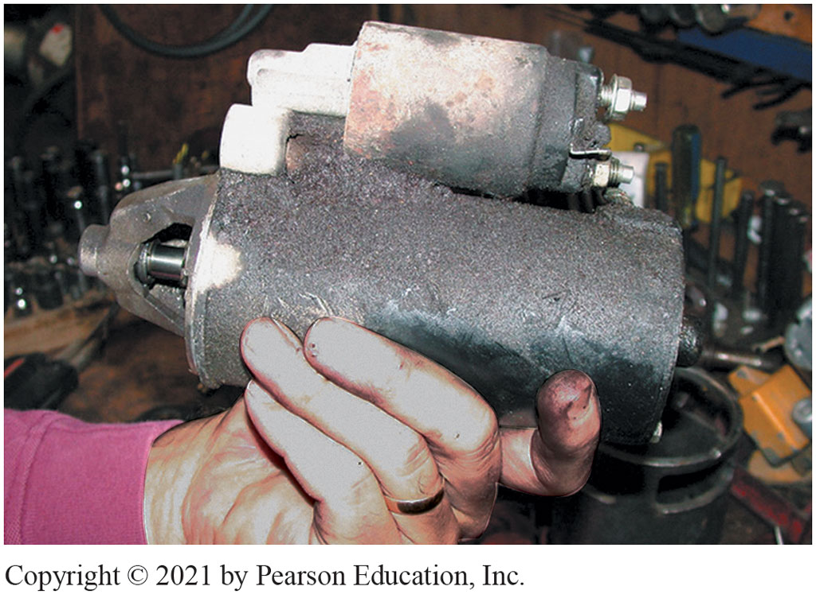
1. Starter can be restored to useful service

Slide 32
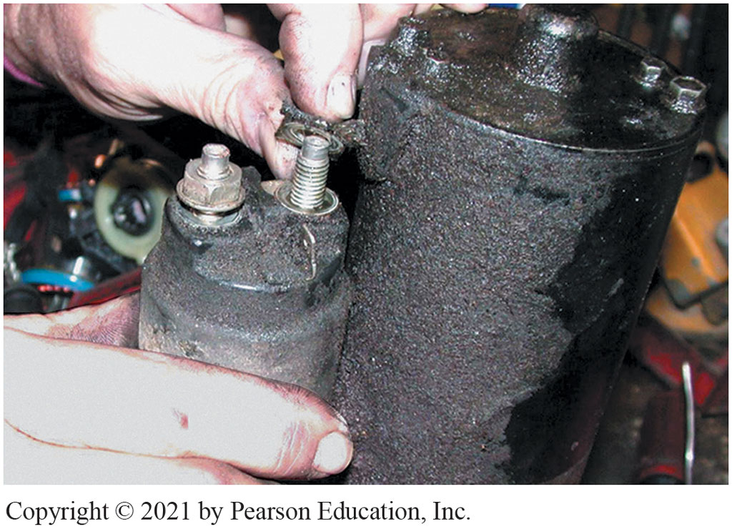
2. The connecting wire between the solenoid and the starter is removed

Slide 33
3. Old Field Housing as a Support
3. An old starter field housing is being used to support the drive-end housing of the starter as it is being disassembled. This rebuilder is using an electric impact wrench to remove the solenoid fasteners

Slide 34
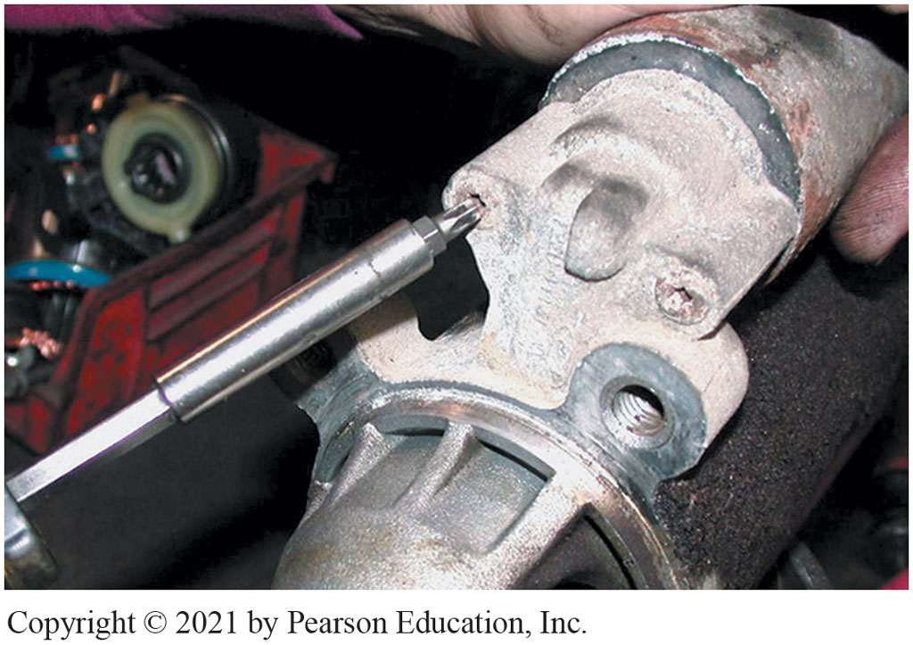
4. Torx driver used to remove solenoid screws

Slide 35
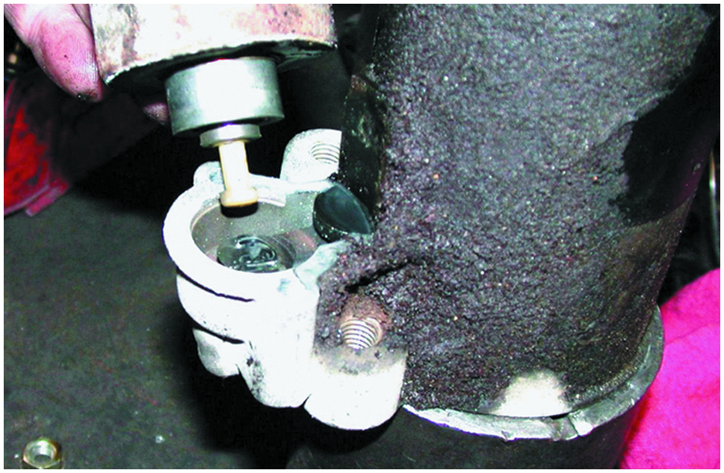
5. After the retaining screws have been removed, the solenoid can be separated from the starter motor. This rebuilder always replaces the solenoid

Slide 36
5. Solenoid Separated from Motor
5. After the retaining screws have been removed, the solenoid can be separated from the starter motor. This rebuilder always replaces the solenoid

Slide 37
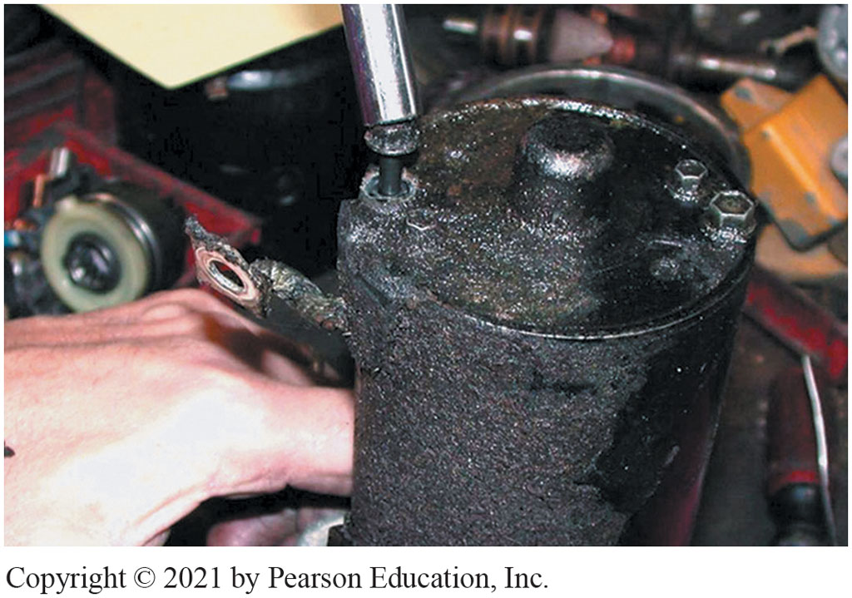
6. Bolts are being removed

Slide 38
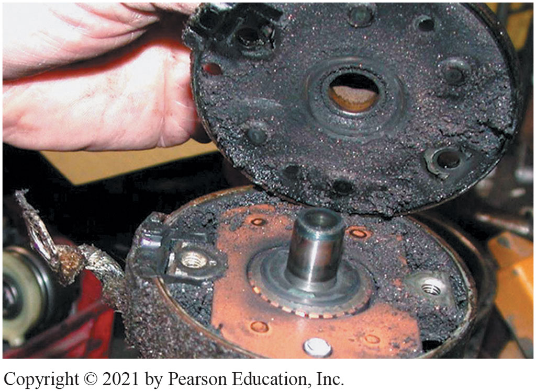
7. Brush end plate is removed

Slide 39
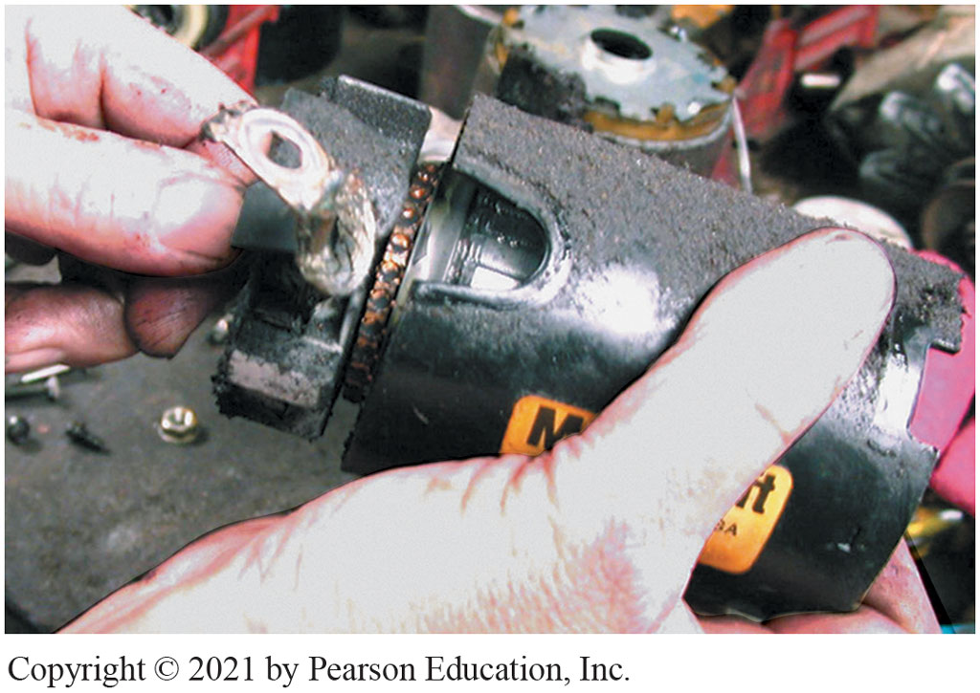
8. Armature removed from field frame

Slide 40
9. Notice Armature Length
9. Notice that the length of a direct-drive starter armature (top) is the same length as the overall length of a gear-reduction armature, except smaller in diameter

Slide 41
10. Dislodge Armature Thrust Ball
10. A light tap with a hammer dislodges the armature thrust ball (in the palm of the hand) from the center of the gear-reduction assembly

Slide 42
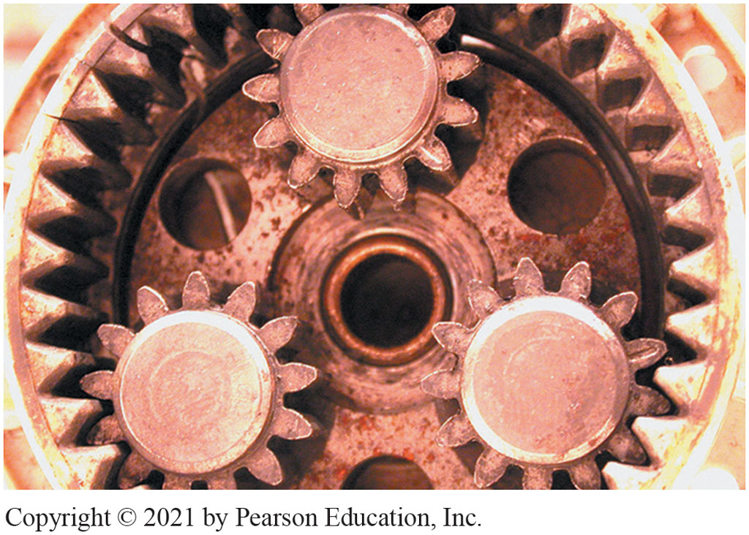
11. Planetary ring gear/pinion gears

Slide 43
12.Planetary Pinion Close-up
12. A close-up of one of the planetary gears, which shows the small needle bearings on the inside

Slide 44
13. Clip Removed
13. The clip is removed from the shaft so the planetary gear assembly can be separated and inspected

Slide 45
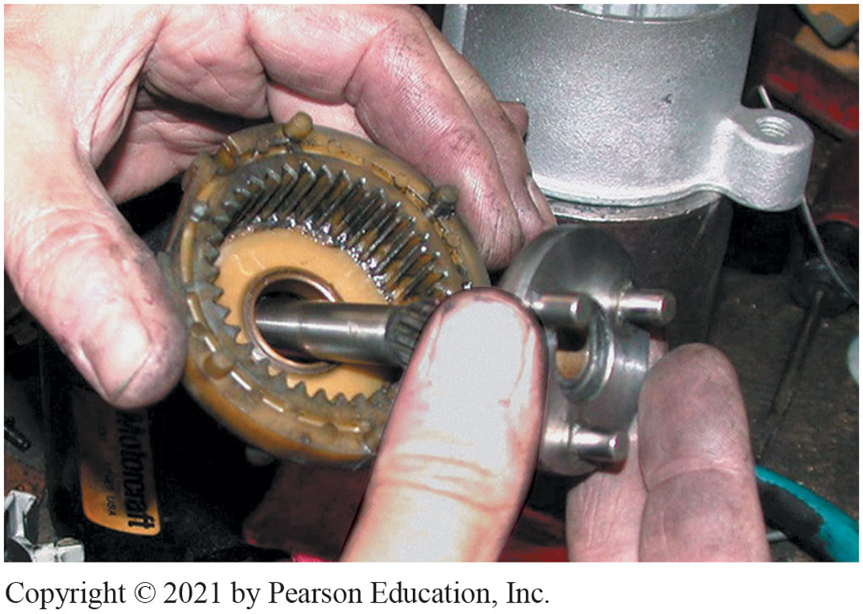
14. Shaft assembly separated from gear assembly

Slide 46
15. Armature Discolored
15. The commutator on the armature is discolored and the brushes may not have been making good contact with the segments

Slide 47
16. Commutator Resurfaced
16. All of the starter components are placed in a tumbler with water-based cleaner. The armature is installed in a lathe and the commutator is resurfaced using emery cloth

Slide 48
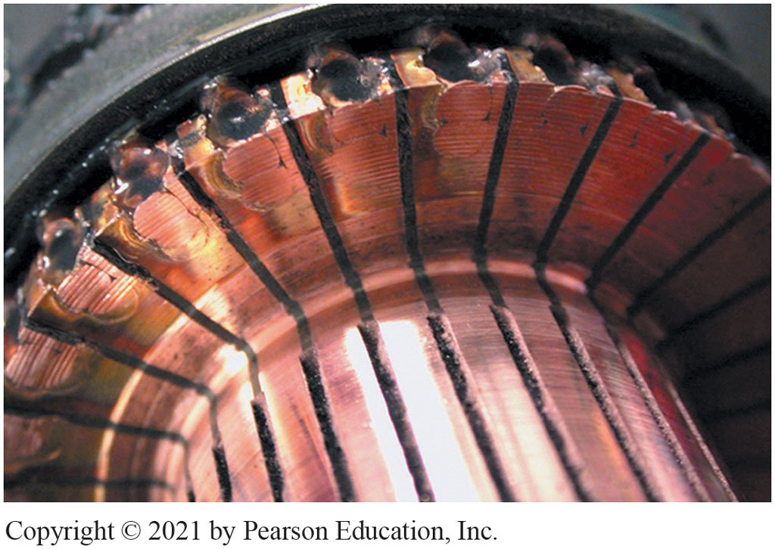
17. Finished commutator

Slide 49
18. Reassembly
18. Starter reassembly begins by installing a new starter drive on the shaft assembly. The stop ring and stop ring retainer are then installed

Slide 50
19. Gear-Reduction Assembly
19. The gear-reduction assembly is positioned along with the shift fork (drive lever) into the cleaned drive-end housing

Slide 51
20. Armature Installed
20. After gear retainer has been installed over the gear reduction assembly, the armature is installed

Slide 52
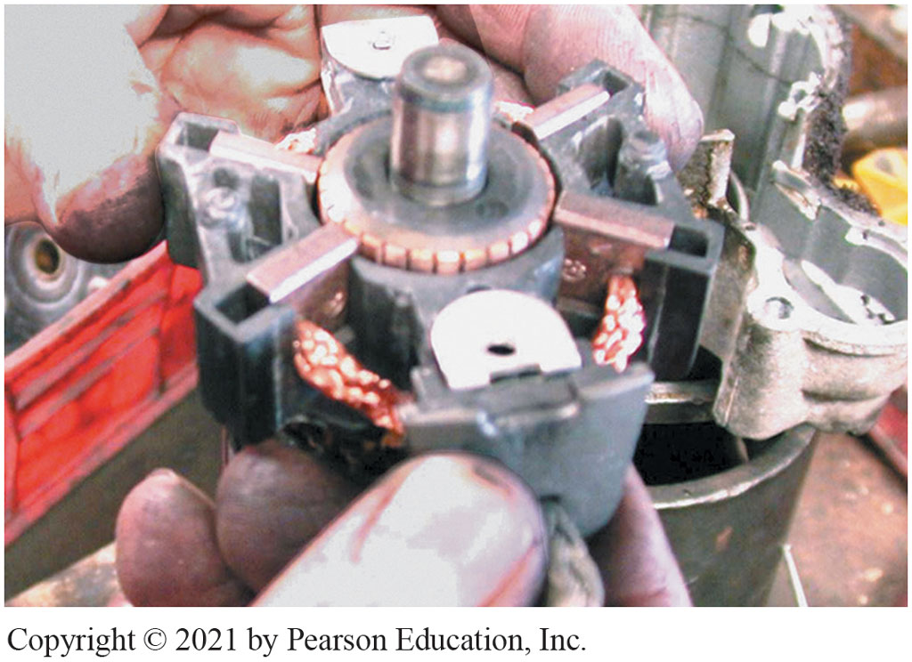
21. New brushes installed into brush holder

Slide 53
22. Plate and Through Bolts
22. The brush end plate and the through bolts are installed, being sure that the ground connection for the brushes is clean and tight

Slide 54
23. Starter Restored
23. This starter was restored to useful service by replacing the solenoid, the brushes, and the starter drive assembly, plus a thorough cleaning and attention to detail in the reassembly

Slide 55
Electrical and Electronic Systems Videos and Animations
Videos Link: (A6) Electrical/Electronic Systems Videos
Animations Link: (A6) Electrical/Electronic Systems Animations

Slide 56
Copyright
This work is protected by United States copyright laws and is provided solely for the use of instructors in teaching their courses and assessing student learning. Dissemination or sale of any part of this work (including on the World Wide Web) will destroy the integrity of the work and is not permitted. The work and materials from it should never be made available to students except by instructors using the accompanying text in their classes. All recipients of this work are expected to abide by these restrictions and to honor the intended pedagogical purposes and the needs of other instructors who rely on these materials.

