Slide 1
Automotive Technology: Principles, Diagnosis, and Service
Seventh Edition
Chapter 49
Starting System Parts and Operation
Copyright © 2023 Pearson Education, Inc. All Rights Reserved
Notes:
INSTRUCTOR NOTE: This presentation includes text explanation notes, you can use to teach the course. When in SLIDE SHOW mode, you RIGHT CLICK and select SHOW PRESENTER VIEW, to use the notes.

Slide 2
Learning Objectives
49.1 Describe the parts and operation of a cranking circuit.
49.2 Explain push button starting.
49.3 Discuss starter motor operation.
49.4 Explain the components of a starter motor.
49.5 Describe gear reduction starters.
49.6 Describe the function of starter drives.
49.7 Describe the function of solenoids.
49.8 Discuss stop-start system operation.

Slide 3
Cranking Circuit
Parts Involved
Starter motor
Battery
Starter solenoid or relay
Starter drive
Ignition switch
Control Circuit Parts and Operation
The ignition switch does not operate the starter unless the automatic transmission is in neutral or park, or the clutch pedal is depressed on manual transmission/transaxle vehicles.

Slide 4
Figure 49.1 Solenoid Starter
A typical solenoid-operated starter

Slide 5
Figure 49.2 Lock Cylinder
The lock cylinder is often a separate part from the electrical ignition switch and operates it directly or uses a link between two components

Slide 6
Figure 49.3 Cranking Control
To prevent engine from cranking, an electrical switch is usually installed to open circuit between ignition switch and the starter solenoid. The control circuit includes small wiring and components needed to control the solenoid. The starter solenoid controls the electrical current flow through large battery cables of power circuit that operates starter motor

Slide 7
Animation: Starter Circuit (Animation will automatically start)

Slide 8
Animation: Starter Circuit, Neutral Safety Switch (Animation will automatically start)

Slide 9
Question 1: ?
What are the parts in a typical cranking circuit?

Slide 10
Answer 1
Starter motor, battery, starter solenoid or relay, starter drive, and ignition switch.

Slide 11
Computer-Controlled Starting
Operation
The ignition switch start position on the push-to-start button is used as an input signal to the powertrain control module (P C M).
Remote Starting
Allows the driver to start the engine of the vehicle from a distance of about 200 ft (65 m).
The doors remain locked to reduce the possibility of theft.

Slide 12
Figure 49.4 Start Button
Instead of using an ignition key to start the engine, some vehicles are using a start button, which is also used to stop the engine, as shown on this Jaguar

Slide 13
Figure 49.5 Remote Start
The top button on this key fob is the remote start button

Slide 14
Starter Motor Operation (1 of 2)
Principles
A starter motor uses electromagnetic principles to convert electrical energy from the battery (up to 300 amperes) to mechanical power (up to 8 horsepower [6 kilowatts]) to crank the engine.
Series Motors
A series motor develops its maximum torque at the initial start (0 R P M) and develops less torque as the speed increases.

Slide 15
Starter Motor Operation (2 of 2)
Shunt Motors
Shunt-type electric motors have the field coils in parallel (or shunt) across the armature.
Permanent Magnet Motors
Permanent magnet starters use gear reduction to multiply starter motor torque.
Compound Motors
Some of the field coils are connected to the armature in series and some are connected directly to the battery in parallel (shunt) with the armature.

Slide 16
Figure 49.6 Series Wound Motor
This series-wound electric motor shows the basic operation with only two brushes: one hot brush and one ground brush. The current flows through both field coils, then through the hot brush and the loop winding of the armature, before reaching ground through the ground brush

Slide 17
Animation: DC Motor, Simple (Animation will automatically start)

Slide 18
Figure 49.7 Magnetic Fields
The interaction of the magnetic fields of the armature loops and field coils creates a stronger magnetic field on the right side of the conductor, causing the armature loop to move toward the left

Slide 19
Figure 49.8 Armature Loops
The armature loops rotate due to the difference in the strength of the magnetic field. The loops move from a strong magnetic field strength toward a weaker magnetic field strength

Slide 20
Figure 49.9 Lines of Force
Magnetic lines of force in a four-pole motor

Slide 21
Figure 49.10 Pole shoe/field winding

Slide 22
Figure 49.11 Series-Wound Motor
This wiring diagram illustrates the construction of a series-wound electric motor. Notice that all current flows through the field coils, then through the armature (in series) before reaching ground

Slide 23
Figure 49.12 Shunt-Type Motor
This wiring diagram illustrates the construction of a shunt-type electric motor and shows the field coils in parallel (or shunt) across the armature

Slide 24
Figure 49.13 Compound Motor
A compound motor is a combination of series and shunt types, using part of the field coils connected electrically in series with the armature and part in parallel (shunt)

Slide 25
How the Starter Motor Works
Parts Involved
Field coils
Armature
Field housing
Starter Brushes
To supply the proper current to the armature, a four-pole motor must have four brushes riding on the commutator.
Permanent Magnet Fields
Used in place of the electromagnetic field coils.

Slide 26
Figure 49.14 Starter Motor
A typical starter motor showing the drive-end housing

Slide 27
Figure 49.15 Pole Shoes
Pole shoes and field windings installed in the housing

Slide 28
Figure 49.16 Armature
A typical starter motor armature. The armature core is made from thin sheet metal sections assembled on the armature shaft, which is used to increase the magnetic field strength

Slide 29
Figure 49.17 Armature Loops
An armature showing how its copper wire loops are connected to the commutator

Slide 30
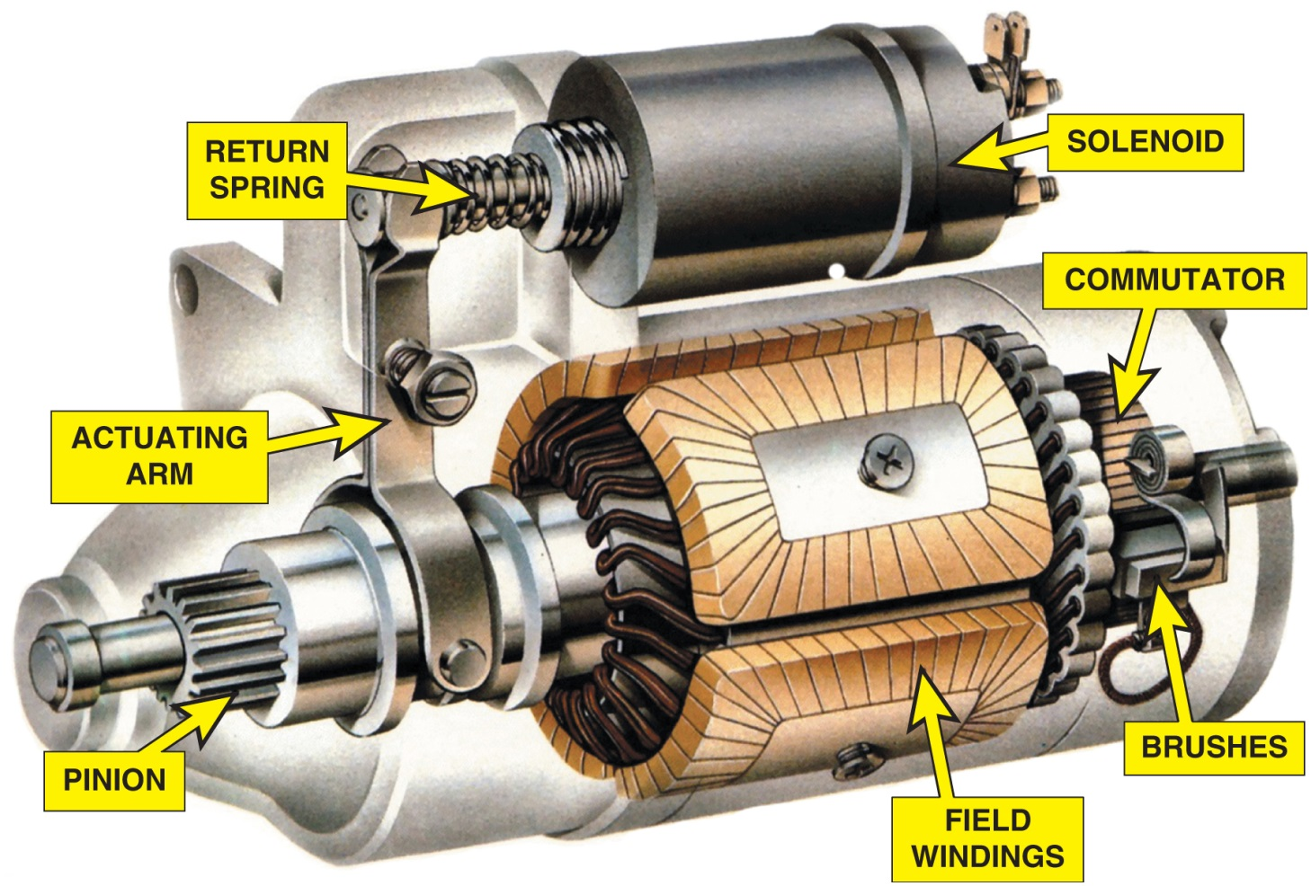
Figure 52.18

Slide 31
Figure 49.18 Starter Cutaway
A cutaway of a typical starter motor showing the commutator, brushes, and brush spring

Slide 32
Animation: Starter Drive Gear (Animation will automatically start)

Slide 33
Figure 49.19 Damaged Magnet
This starter permanent magnet field housing was ruined when someone used a hammer on the field housing in an attempt to “fix” a starter that did not work. A total replacement is the only solution in this case
Notes:
TECH TIP: Don’t Hit That Starter!
In the past, it was common to see service technicians hitting a starter in their effort to diagnose a no-crank condition. Often the shock of the blow to the starter aligned or moved the brushes, armature, and bushings. Many times, the starter functioned after being hit, even if only for a short time.
However, most starters today use permanent magnet fields, and the magnets can be easily broken if hit. A magnet that is broken becomes two weaker magnets. Some early permanent magnet starters used magnets that were glued or bonded to the field housing. If struck with a heavy tool, the magnets could be broken with parts of the magnet falling onto the armature and into the bearing pockets, making the starter impossible to repair or rebuild. ^{● SEE} FIGURE 49–19.

Slide 34
Gear-Reduction Starters
Purpose and Function
Gear reduction purpose (2:1 to 4:1) is to increase starter motor speed and provide torque multiplication necessary to crank an engine.
Produces necessary cranking power with reduced starter amperage requirements.
Uses a planetary gear set to provide necessary torque for starting.

Slide 35
Figure 49.20 Gear-reduction starter

Slide 36
Starter Drives (1 of 2)
Purpose and Function
Includes small pinion gears that mesh with and rotate the larger gear on the engine flywheel or flex plate for starting.
Starter Drive Gear Ratio
The engine ring gear to starter pinion ratio is between 15:1 and 20:1.

Slide 37
Starter Drives (2 of 2)
Starter Drive Operation
Uses a type of one-way clutch that allows the starter to rotate the engine, but then turns freely if the engine speed is greater than the starter motor speed.
Failure Mode
The major wear occurs in the overrunning clutch section of the starter drive unit.
The entire starter drive is replaced as a unit.

Slide 38
Figure 49.21 Starter Drive
A cutaway of a typical starter drive showing all of the internal parts

Slide 39
Figure 49.22 Gear Ratio
The ring gear to pinion gear ratio is usually 15:1 to 20:1

Slide 40
Figure 49.23 Drive Operation
Operation of the overrunning clutch. (a) Starter motor is driving the starter pinion and cranking the engine. The rollers are wedged against spring force into their slots. (b) The engine has started and is rotating faster than the starter armature. Spring force pushes the rollers so they can rotate freely

Slide 41
Frequently Asked Question: What Is a Bendix?
? Frequently Asked Question
What Is a Bendix? Older-model starters often used a Bendix drive mechanism, which used inertia to engage the starter pinion with the engine flywheel gear. Inertia is the tendency of a stationary object to remain stationary, because of its weight, unless forced to move. On these older-model starters, the small starter pinion gear was attached to a shaft with threads, and the weight of this gear caused it to be spun along the threaded shaft and mesh with the flywheel whenever the starter motor spun. If the engine speed was greater than the starter speed, the pinion gear was forced back along the threaded shaft and out of mesh with the flywheel gear. The Bendix drive mechanism has generally not been used since the early 1960s, but some technicians use this term when describing a starter drive.

Slide 42
Question 2: ?
What is the typical engine ring rear to starter pinion ratio?

Slide 43
Answer 2
The typical engine ring rear to starter pinion ratio 15:1 to 20:1.

Slide 44
Starter Solenoids
Solenoid Operation
A starter solenoid is an electromagnetic switch containing two separate, but connected, electromagnetic windings.
Solenoid Windings
The two internal windings contain approximately the same number of turns but are made from different-gauge wire.

Slide 45
Figure 49.24 Solenoid Operation
Wiring diagram of a typical starter solenoid. Notice that both the pull-in winding and the hold-in winding are energized when the ignition switch is first turned to the “start” position. As soon as the solenoid contact disk makes electrical contact with both the B and M terminals, the battery current is conducted to the starter motor and electrically neutralizes the pull-in winding

Slide 46
Frequently Asked Question: How Are Starters Made So Small?
? Frequently Asked Question
How Are Starters Made So Small? Starters and most components in a vehicle are made as small and as light in weight as possible to help increase vehicle performance. A starter can be constructed smaller due to the use of gear reduction and permanent magnets to achieve the same cranking torque as a straight drive starter, but using much smaller components. ● SEE FIGURE 49–25 for an example of an automotive starter armature that is palm size.

Slide 47
Figure 49.25 Palm-size Starter Armature

Slide 48
Start-Stop Systems (1 of 2)
Purpose and Function
Stop-start systems are designed to increase fuel economy and reduce exhaust emissions.
Conditions for Start-Stop to Occur
Accelerator pedal not depressed
Vehicle speed is low or zero
Battery state-of-charge above threshold
Hood is closed

Slide 49
Start-Stop Systems (2 of 2)
Start-Stop System Components
An A G M or E L A battery
Battery sensor
Low engine speed
Hood switch
H V A C control unit
Starter Motor Designs
Advanced engagement (A E) starter
Tandem solenoid (T S) starter

Slide 50
Figure 49.26 Auto-Stop
A Buick Auto Stop system lets the driver know when the engine is stopped

Slide 51
Figure 49.27 Two Solenoids
Using two solenoids allows independent control of the pinion gear and motor energization

Slide 52
Frequently Asked Question: Can a Stop-Start System Be Turned Off?
? Frequently Asked Question
Can a Stop-Start System Be Turned Off? Sometimes. Some vehicles equipped with a stop-start system can be turned off using a button on the dash or center stack. ● Figure 49–28.
.

Slide 53
Figure 49.28 Auto-Stop Off Switch
The stop-start system on this Ford F-150 pickup truck can be turned off using a switch on the dash

Slide 54
Question 3: ?
Can the Stop Start system be turned off on every vehicle equipped with the system?

Slide 55
Answer 3
No, Some vehicles equipped with a stop-start system can be turned off using a button on the dash or console. For example you cannot turn it off on a Chevrolet Cruze, if equipped.

Slide 56
Electrical and Electronic Systems Videos and Animations
Videos Link: (A6) Electrical/Electronic Systems Videos
Animations Link: (A6) Electrical/Electronic Systems Animations

Slide 57
Copyright
This work is protected by United States copyright laws and is provided solely for the use of instructors in teaching their courses and assessing student learning. Dissemination or sale of any part of this work (including on the World Wide Web) will destroy the integrity of the work and is not permitted. The work and materials from it should never be made available to students except by instructors using the accompanying text in their classes. All recipients of this work are expected to abide by these restrictions and to honor the intended pedagogical purposes and the needs of other instructors who rely on these materials.

