Slide 1
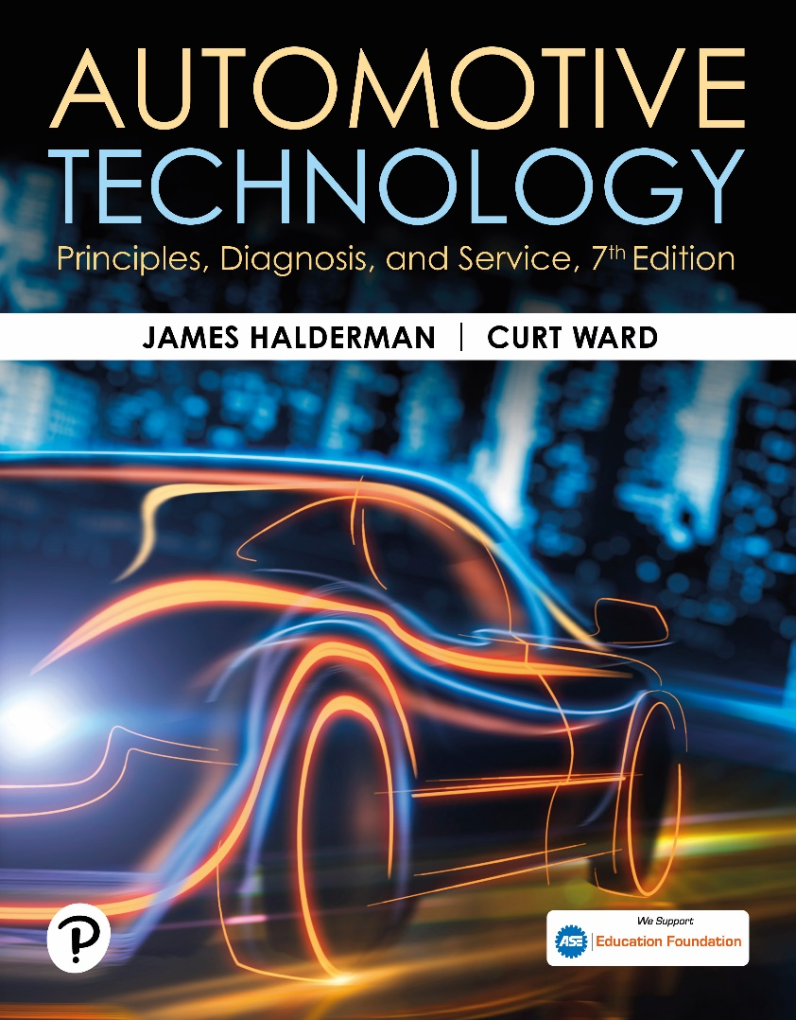
Automotive Technology: Principles, Diagnosis, and Service
Seventh Edition
Chapter 45
Electronic Fundamentals
Copyright © 2023 Pearson Education, Inc. All Rights Reserved
Notes:
INSTRUCTOR NOTE: This presentation includes text explanation notes, you can use to teach the course. When in SLIDE SHOW mode, you RIGHT CLICK and select SHOW PRESENTER VIEW, to use the notes.

Slide 2
Learning Objectives (1 of 3)
45.1 Discuss semiconductors including doping, P-type material, and N-type material.
45.2 Describe diodes, including Zener diodes.
45.3 Discuss high-voltage spike protection.
45.4 Discuss diode ratings.
45.5 Discuss light-emitting diodes.
45.6 Describe photo diodes.
45.7 Describe Photo-resistors.
45.8 Describe silicon-controlled rectifiers.

Slide 3
Learning Objectives (2 of 3)
45.9 Describe thermistors.
45.10 Describe rectifier bridges
45.11 Describe transistors, including field-effect transistors and phototransistors.
45.12 Describe integrated circuits.
45.13 Describe transistor gates.
45.14 Describe operational amplifiers.
45.15 Discuss electronic component failure causes.

Slide 4
Learning Objectives (3 of 3)
45.16 Describe how to test diodes and transistors.
45.17 Discuss converters and inverters and how they are used.
45.18 Explain electrostatic discharge damage and how to avoid it.

Slide 5
Semiconductors (1 of 2)
Definition
  Semiconductors are materials that contain exactly four electrons in the outer orbit of their atom structure and are, therefore, neither good conductors nor good insulators.
Examples of Semiconductors
  Germanium
  Silicone

Slide 6
Semiconductors (2 of 2)
Construction
  When another material is added to a semiconductor material in very small amounts, it is called doping.
N-Type Material
  N-type material is silicon or germanium that is doped with an element such as phosphorus, arsenic, or antimony, each having five electrons in its outer orbit.
P-Type Material
  P-type material is produced by doping silicon or germanium with the element boron or the element indium.

Slide 7
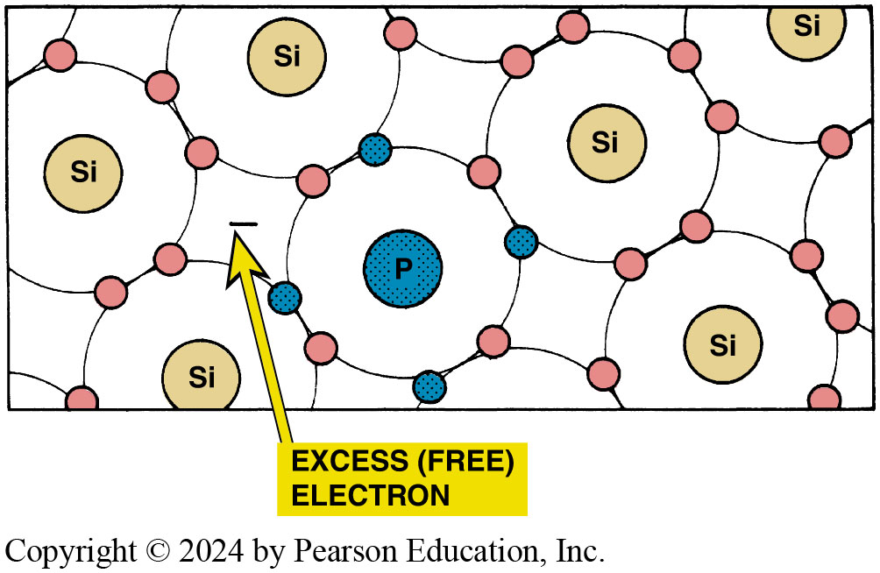
Figure 45.1 N-Type Material
N-type material. Silicon (Si) doped with a material (such as phosphorus) with five electrons in the outer orbit results in an extra free electron

Slide 8
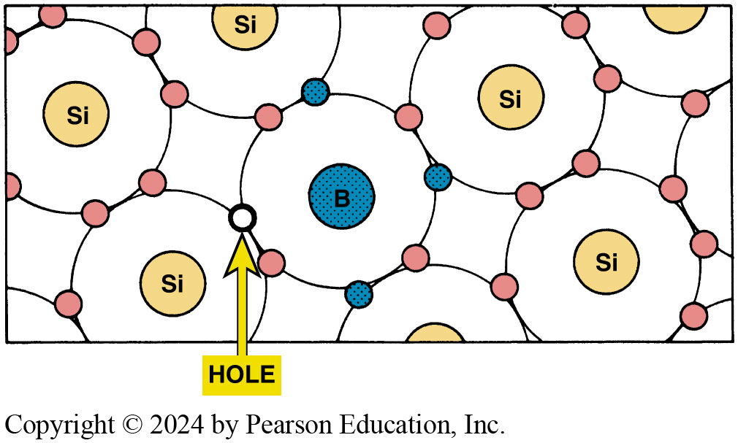
Figure 45.2 P-Type Material
P-type material. Silicon (Si) doped with a material, such as boron (b), with three electrons in the outer orbit results in a hole capable of attracting an electron

Slide 9
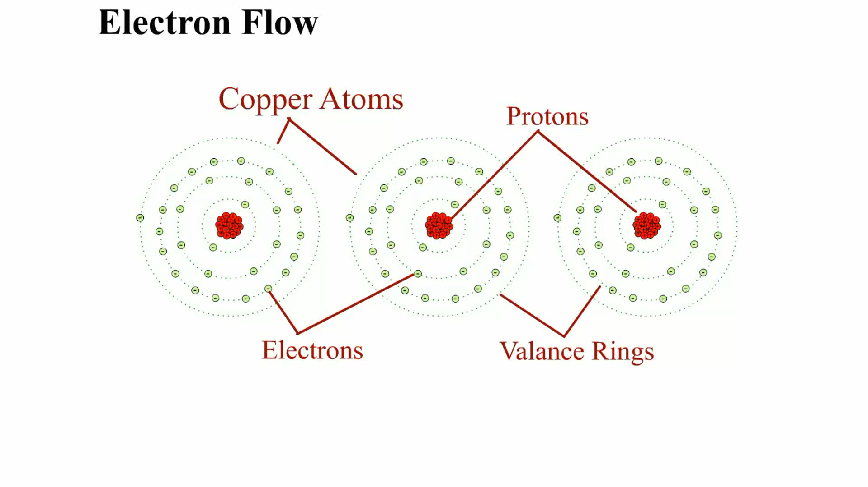
Animation: Electron Flow
(Animation will automatically start)

Slide 10
Frequently Asked Question: What Is the Hole Theory?
? Frequently Asked Question
What Is the Hole Theory? Current flow is expressed as the movement of electrons from one atom to another. In semiconductor and electronic terms, the movement of electrons fills the holes of the P-type material. Therefore, as the holes are filled with electrons, the unfilled holes move opposite to the flow of the electrons. This concept of hole movement is called the hole theory of current flow. The holes move in the direction opposite to that of electron flow. For example, think of an egg carton, where if an egg is moved in one direction, the holes created move in the opposite direction. ● SEE FIGURE 45–3.

Slide 11
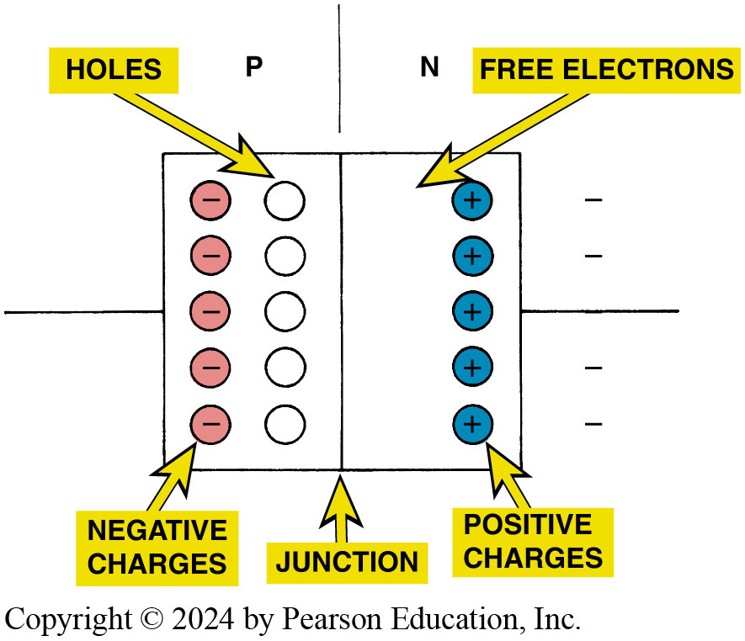
Figure 45.3 Bias
Unlike charges attract and the current carriers (electrons and holes) move toward the junction

Slide 12
Summary of Semiconductors
The two types of semiconductor materials are P type and N type.
In P-type semiconductors, electrical conduction occurs mainly as a result of holes (absence of electrons).
In N-type semiconductors, electrical conduction occurs mainly as a result of electrons (excess of electrons).

Slide 13
Question 1: ?
What is the difference between P-type material and N-type material?

Slide 14
Answer 1
The material used to dope the silicon or germanium.

Slide 15
Diodes
Construction
  Electrical one-way check valve made by combining a P-type material and N-type material.
Operation
The N-type material has one extra electron, which can flow into the P-type material. The P-type material requires electrons to fill its holes.
Diodes allow current flow only when current of the correct polarity is connected to the circuit.

Slide 16
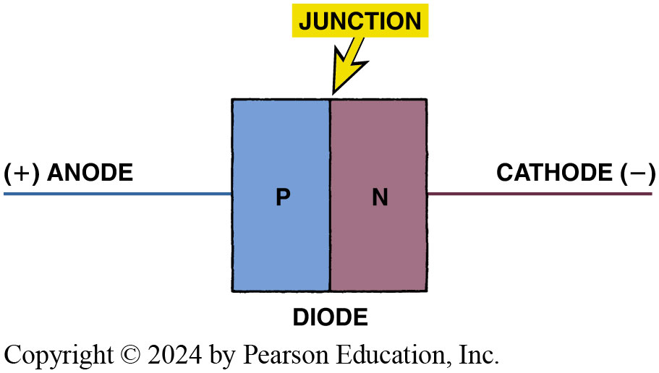
Figure 45.4 Diode
A diode is a component with P-type and N-type materials together. The negative electrode is called the cathode and the positive electrode is called the anode

Slide 17
Frequently Asked Question: What is the difference between Electricity and Electronics?
? Frequently Asked Question
What is the difference between Electricity and Electronics? Electronics usually means that solid-state devices are used in the electrical circuits. Electricity as used in automotive applications usually means electrical current flow through resistance and loads without the use of diodes, transistors, or other electronic devices.

Slide 18
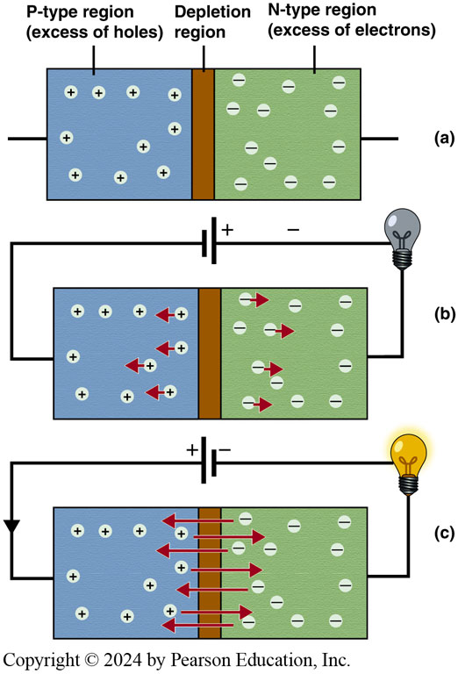
Figure 45.5 Depletion Zone
(a) A diode consist of P-type and N-type materials separated by a depletion region. (b) When connected to a voltage source in the reverse bias situation, no current flows across the depletion region. (c) When the diode is connected in the forward bias direction, the charge carriers are allowed to cross the depletion region and current can flow from the anode (+) to the cathode (-)

Slide 19
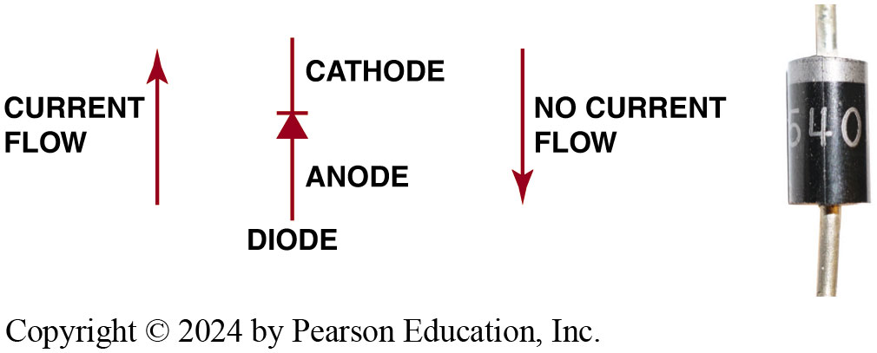
Figure 45.6 Diode Symbol
Diode symbol and electrode names. The stripe on one end of a diode represents the cathode end of the diode

Slide 20
Zener Diodes
Construction
  A zener diode is a specially constructed diode designed to operate with a reverse-bias current.
Operation
  A zener diode acts as any diode in that it blocks reverse-bias current, but only up to a certain voltage.
  Above this certain voltage (called the breakdown voltage or the zener region), a zener diode conducts current in the opposite direction without damage to the diode.

Slide 21
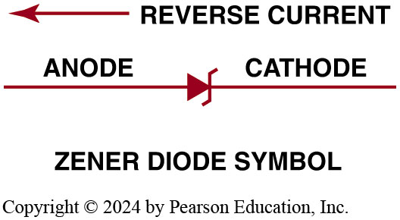
Figure 45.7 Zener Diode
Zener diode blocks current flow until a certain voltage is reached, then it permits current to flow

Slide 22
High-Voltage Spike Protection (1 of 2)
Clamping Diodes
  A diode can be installed across the leads to the coil to redirect the high-voltage spike back into the coil, protecting the rest of the circuit.
Clamping Diode Application
  Air-conditioning clutch coil
  Blower motor
  Relays

Slide 23
High-Voltage Spike Protection (2 of 2)
Despiking Zener Diodes
  Zener diodes are most commonly used in electronic fuel-injection circuits that control the firing of the injectors.
Despiking Resistors
  Instead of a diode installed in parallel with the coil windings, a resistor can be used.

Slide 24
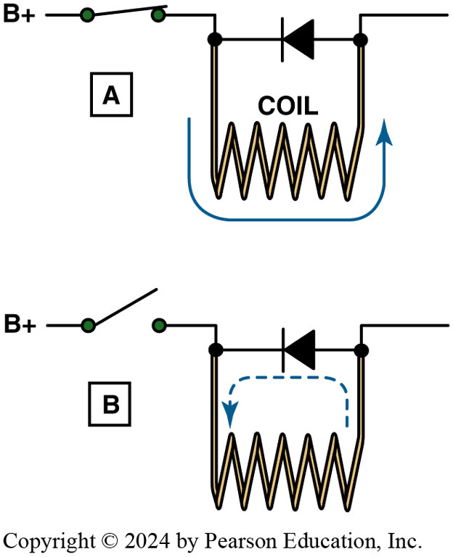
Figure 45.8 Zener Diode Operation
(a) When the coil is energized, the diode is reverse biased and the current is blocked from passing through the diode. (b) When the switch is opened, the magnetic field surrounding the coil collapses, producing a high-voltage surge. This voltage surge forward biases the diode, and the surge is dissipated harmlessly back through the windings of the coil

Slide 25
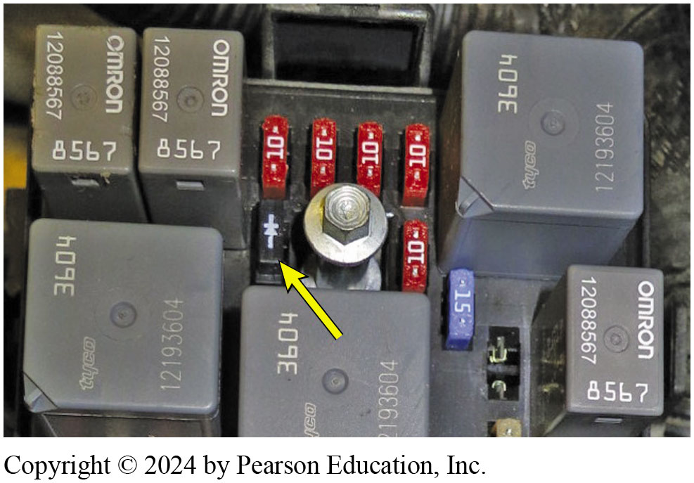
Figure 45.9 A/C Clutch Diode
A diode connected to both terminals of the air-conditioning compressor clutch used to reduce the high-voltage spike that results when a coil (compressor clutch coil) is de-energized

Slide 26
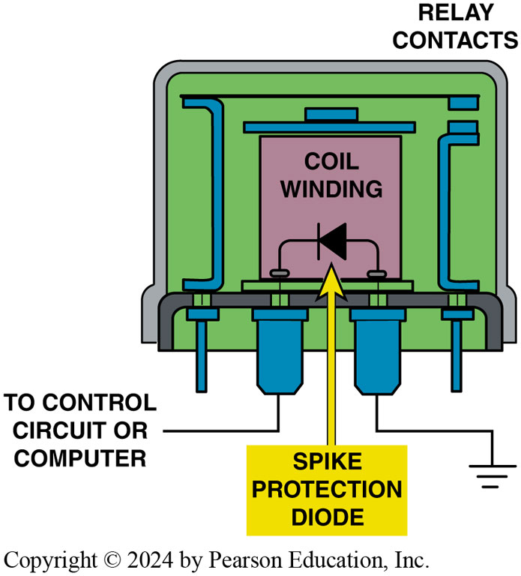
Figure 45.10 Spike Protection
Spike protection diodes are commonly used in computer-controlled circuits to prevent damaging high-voltage surges that occur any time current flowing through a coil is stopped

Slide 27
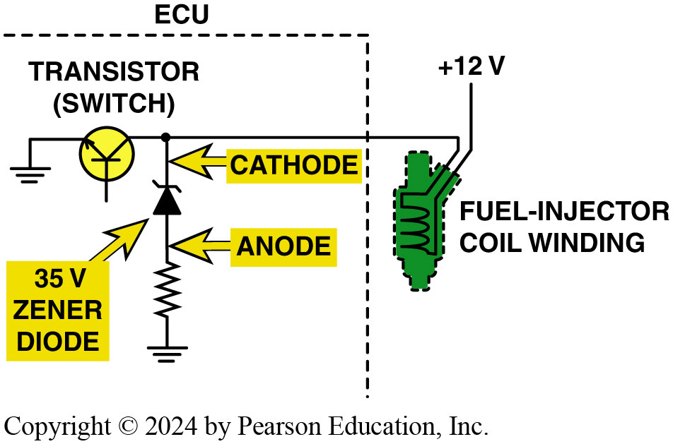
Figure 45.11 Protecting Circuits
Zener diode is commonly used inside automotive computers to protect delicate electronic circuits from high-voltage spikes. A 35-volt Zener diode conducts any voltage spike higher than 35 volts resulting from the discharge of the fuel-injector coil safely to ground through a current-limiting resistor in series with the Zener diode

Slide 28
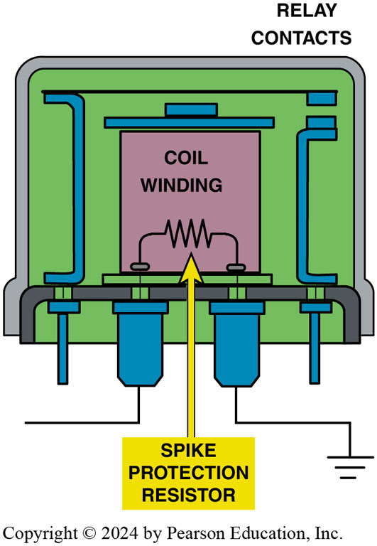
Figure 45.12 Despiking Resistor
A despiking resistor is used in many automotive applications to help prevent harmful high-voltage surges from being created when the magnetic field surrounding a coil collapses when the coil circuit is opened

Slide 29
Diode Ratings
Specifications
  Maximum current flow in the forward-bias direction.
  The rating of resistance to reverse-bias voltage is called the peak inverse voltage (P I V) rating.
Diode Voltage Drop
  The voltage drop across a diode is about the same voltage as that required to forward bias the diode.

Slide 30
Question 2: ?
How can a diode be used to suppress high-voltage surges in automotive components or circuits containing a coil?

Slide 31
Answer 2
A diode can be installed across the leads to the coil to redirect the high-voltage spike back into the coil.

Slide 32
Light-Emitting Diodes
Light-emitting diodes (L E D) radiate light when current flows through the diode in the forward-bias direction.
If an L E D is connected across a 12-volt automotive battery, a resistor must be connected in series to prevent destruction of the P-N junction.

Slide 33
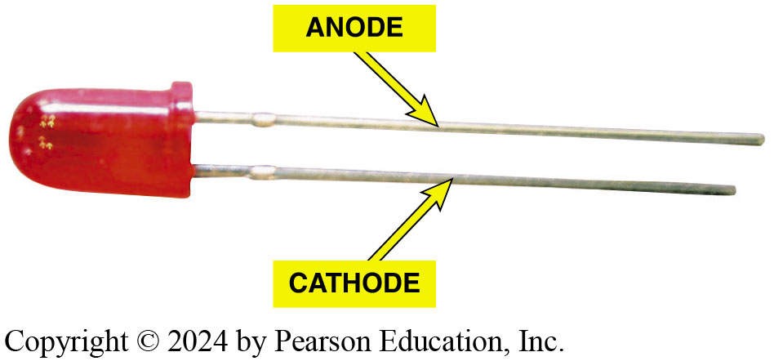
Figure 45.13 LED
A typical light-emitting diode (L E D). This particular L E D is designed with a built-in resistor so that 12-volts D C may be applied directly to the leads without an external resistor. Normally a 300- to 500-ohm, 0.5-watt resistor is required to be attached in
series with the LED, to control current flow to about 0.020 ampere (20 milliamperes), or damage to the P-N junction may occur

Slide 34
Frequently Asked Question: How Does an LED Emit Light?
? Frequently Asked Question
How Does an LED Emit Light? An LED contains a chip that houses P-type and N-type materials. The junction between these regions acts as a barrier to the flow of electrons between the two materials. When a voltage of 1.5 to 2.2 volts is applied to the correct polarity, current flows across the junction. As the electrons enter the P-type material, it combines with the holes in the material and releases energy in the form of light (called photons). The intensity and color the light produces depends on materials used in the manufacture of the semiconductor. LEDs are very efficient compared to conventional incandescent bulbs, which depend on heat to create light. LEDs generate very little heat, with most of the energy consumed converted directly into light. LEDs are reliable and are being used for taillights, brake lights, daytime running lights, and headlights in some vehicles.

Slide 35
Photodiodes
Purpose and Function
  Photodiodes are specially constructed to respond to various wavelengths of light with a “window” built into the housing
Construction
  When light energy strikes the diode, electrons are released and the diode conducts in the forward-bias direction.

Slide 36
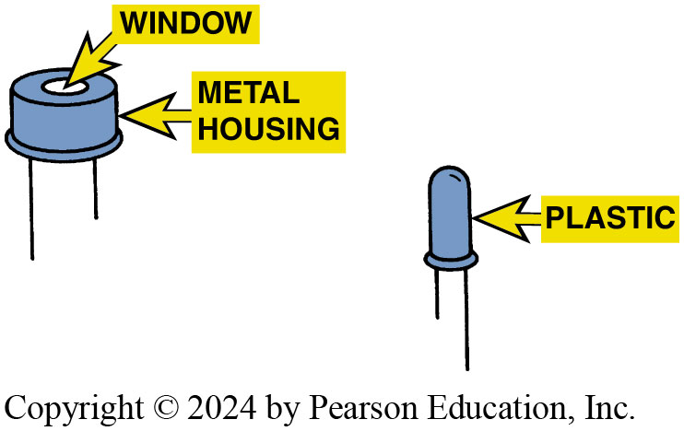
Figure 45.14 Photodiodes
Typical photodiodes. They are usually built into a plastic housing so that the photodiode itself may not be visible

Slide 37
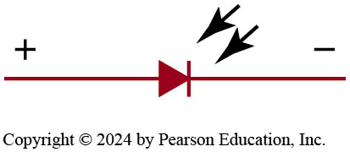
Figure 45.15 Photodiode Symbol
Symbol for a photodiode. The arrows represent light striking the P-N junction of the photodiode

Slide 38
Photoresistors
A photoresistor is a semiconductor material (usually cadmium sulfide) that changes resistance with the presence or absence of light.
  Dark = High resistance
  Light = Low resistance
Can be used to control headlight dimmer relays and automotive headlights.

Slide 39
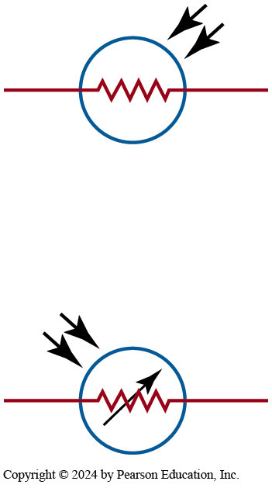
Figure 45.16 Photoresistor
Either symbol may be used to represent a photoresistor

Slide 40
Silicon-Controlled Rectifiers
Construction
  Silicon-Controlled Rectifier (S C R) is a semiconductor device that looks like two diodes connected end to end.
Uses of S C R
  S C R s can be used to construct a circuit for a center high-mounted stoplight (C H M S L).

Slide 41
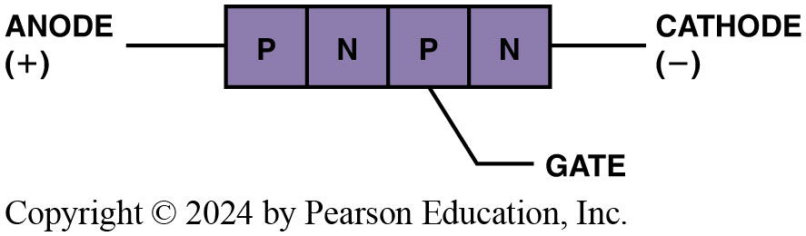
Figure 45.17 SCR
Symbol and terminal identification of an SCR
Notes:
A silicon-controlled rectifier (SCR) is commonly used in the electronic circuits of various automotive applications. An SCR is a semiconductor device that looks like two diodes connected end to end. If the anode is connected to a higher voltage source rather than the cathode in a circuit, no current flows, as occurs with a diode. If, however, a positive voltage source is connected to the gate of the SCR, current can flow from anode to cathode with a typical voltage drop of 1.2 volts (double the voltage drop of a typical diode, at 0.6 volt). Voltage applied to the gate is used to turn the SCR on. However, if the voltage source at the gate is shut off, the current still continues to flow through the SCR until the source current is stopped.

Slide 42
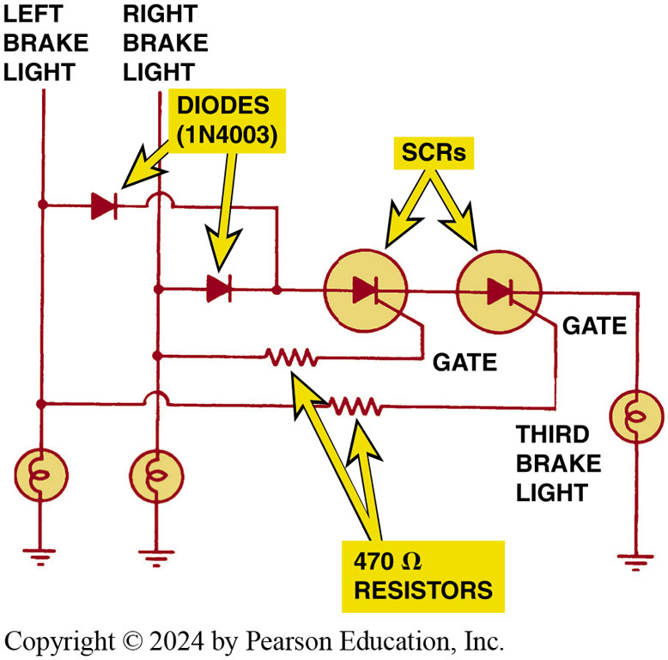
Figure 45.18 SCR Wiring
Wiring diagram for a center high-mounted stoplight (CHMSL) using SCRs
Notes:
SCRs can be used to construct a circuit for a
center high-mounted stoplight (CHMSL). If this third stoplight
is wired into either the left- or the right-side brake light circuit,
the CHMSL also flashes whenever the turn signals are used for
the side that was connected to the CHMSL. When two SCRs are
used, both brake lights must be activated to supply current to
the CHMSL. The current to the CHMSL is shut off when both SCRs
lose their power source (when the brake pedal is released, which
stops the current flow to the brake lights). ● SEE FIGURE 45–18.

Slide 43
Chart 45.1 Resistance Changes
COPPER WIRE |  | NTC THERMISTOR
Cold | Lower resistance | Higher resistance
Hot | Higher resistance | Lower resistance
Notes:
The resistance changes opposite to that of a copper wire with changes in temperature.

Slide 44
Thermistors
Construction
  A thermistor is a semiconductor material, such as silicon, that has been doped to provide a given resistance.
  When the thermistor is heated, the electrons within the crystal gain energy and electrons are released.
  Resistance decreases with heat
Uses of Thermistors
  A thermistor is commonly used as a temperature-sensing device for coolant temperature and intake manifold air temperature.

Slide 45
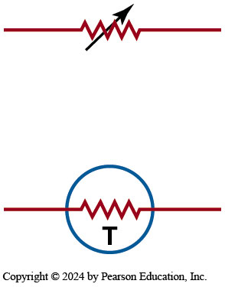
Figure 45.19 Thermistor
Symbols used to represent a thermistor

Slide 46
Rectifier Bridges
Definition
  A rectifier is an electronic device (such as a diode) used to convert a changing voltage into a straight or constant voltage.
  A rectifier bridge is a group of diodes that is used to change an A C circuit into a D C circuit.

Slide 47
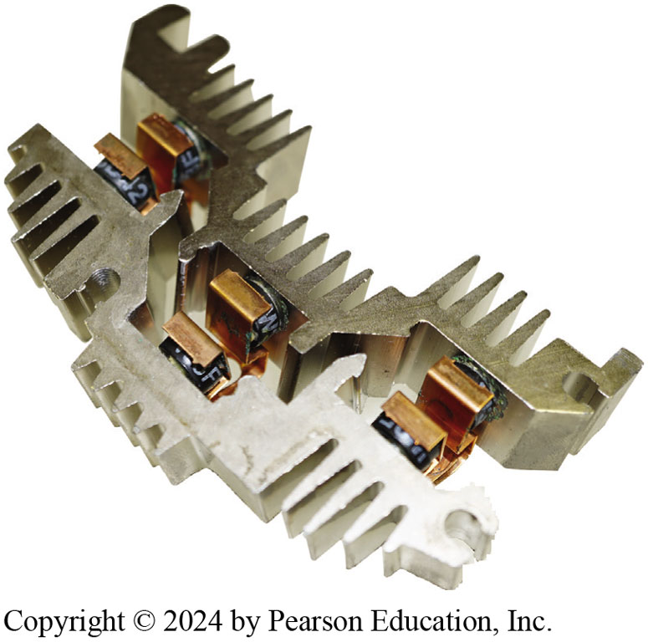
Figure 45.20 Rectifier Bridge
This rectifier bridge contains six diodes; the three on each side are mounted in an aluminum-finned unit to help keep the diode cool during alternator operation

Slide 48
Transistors (1 of 2)
Purpose and Function
  A transistor is a semiconductor device that can perform the following electrical functions.
    Act as an electrical switch in a circuit
    Act as an amplifier of current in a circuit
    Regulate the current in a circuit
Construction
  A transistor that has P-type material on each end with N-type material in the center is called a P N P transistor. Another type, with the exact opposite arrangement, is called an N P N transistor.

Slide 49
Transistors (2 of 2)
Transistor Symbols
  All transistor symbols contain an arrow indicating the emitter part of the transistor. The arrow points in the direction of current flow (conventional theory).
How a Transistor Works
  A transistor allows current flow if the electrical conditions allow it to switch on, in a manner similar to the working of an electromagnetic relay.
  The electrical conditions are determined, or switched, by means of the base.

Slide 50
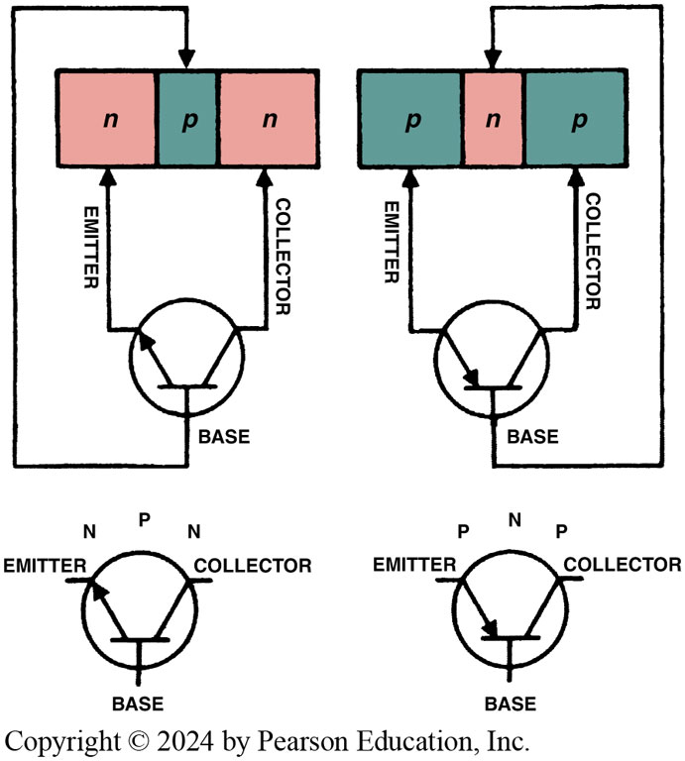
Figure 45.21 Transistor
Basic transistor operation. A small current flowing through the base and emitter of the transistor turns on the transistor and permits a higher amperage current to flow from the collector and the emitter

Slide 51
Frequently Asked Question: Is a Transistor Similar to a Relay?
? Frequently Asked Question
Is a Transistor Similar to a Relay? Yes, in many cases a transistor is similar to a relay. Both use a low current to control a higher current circuit. ● SEE CHART 45–2. A relay can only be on or off. A transistor can provide a variable output if the base is supplied a variable current input.

Slide 52
Chart 45.2 Relay vs Transistor
 | RELAY | TRANSISTOR
High-current circuit | Coil (terminals 85 and 86) | Base and emitter
Low-current circuit | Contacts terminals 30 and 87 | Collector and emitter
Comparison between the control (low-current) and high-current circuits of a transistor compared to a mechanical relay.

Slide 53
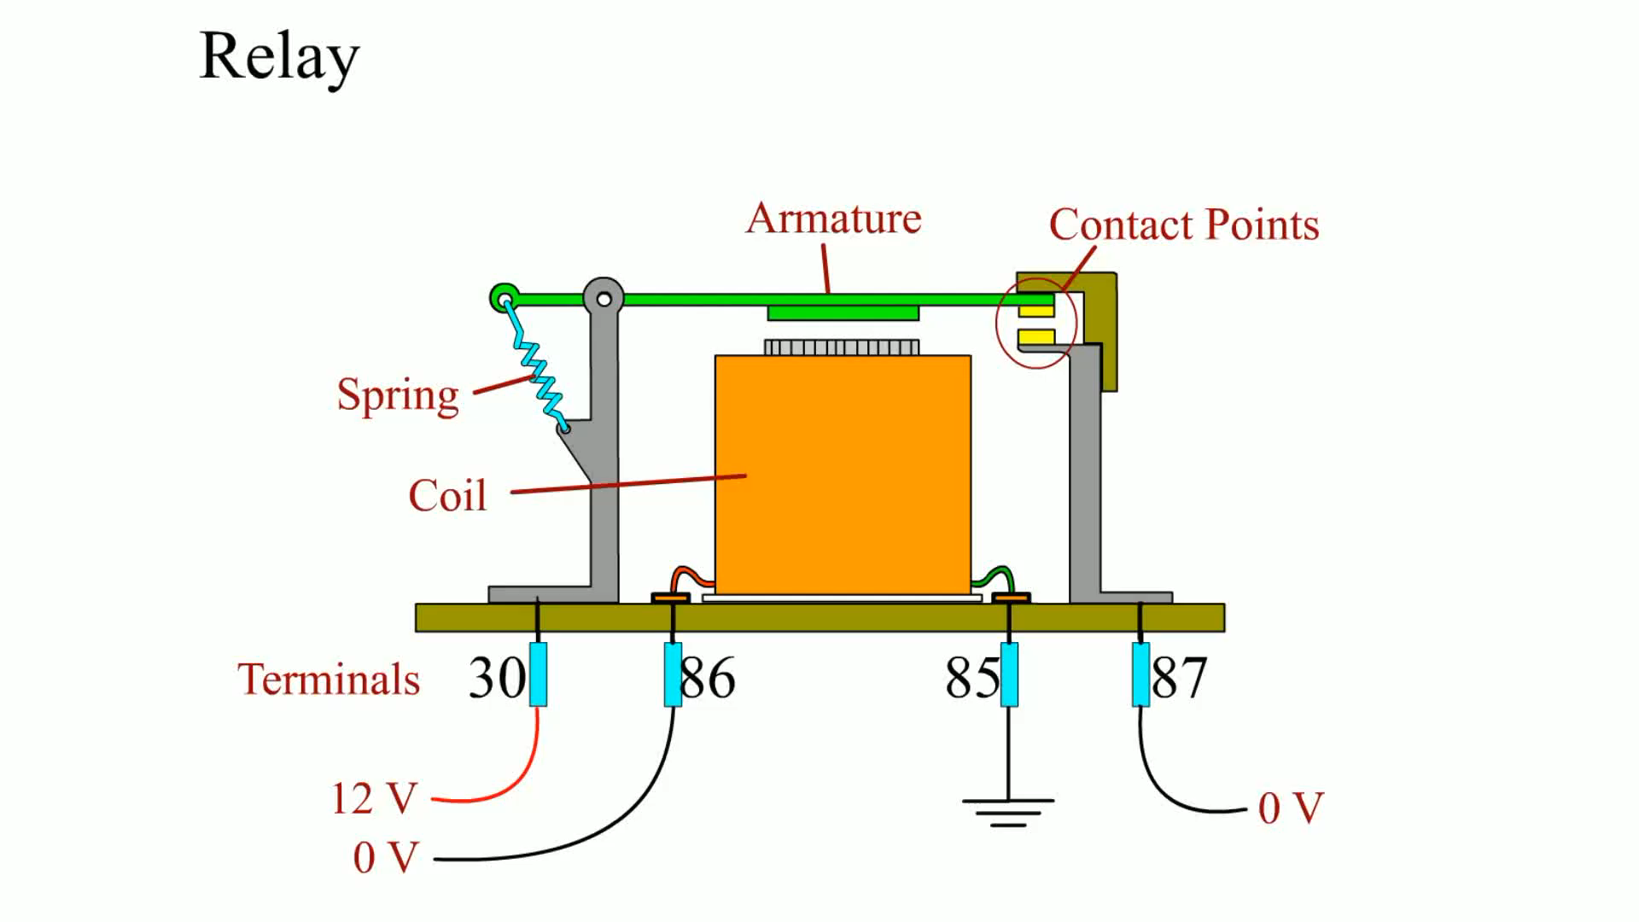
Animation: Relay
(Animation will automatically start)

Slide 54
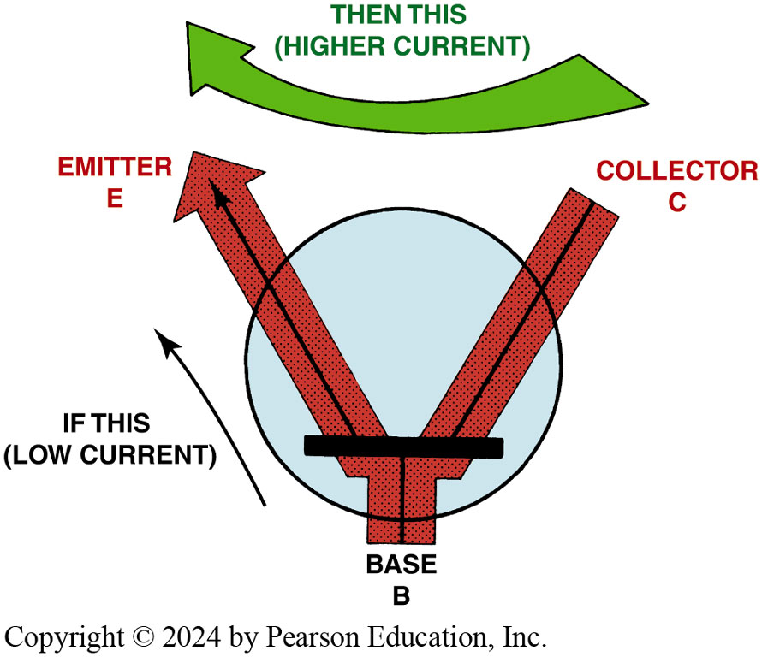
Figure 45.22 Transistor Operation
Basic transistor operation. A small current flowing through the base and emitter of the transistor turns on the transistor and permits a higher amperage current to flow from the collector and the emitter

Slide 55
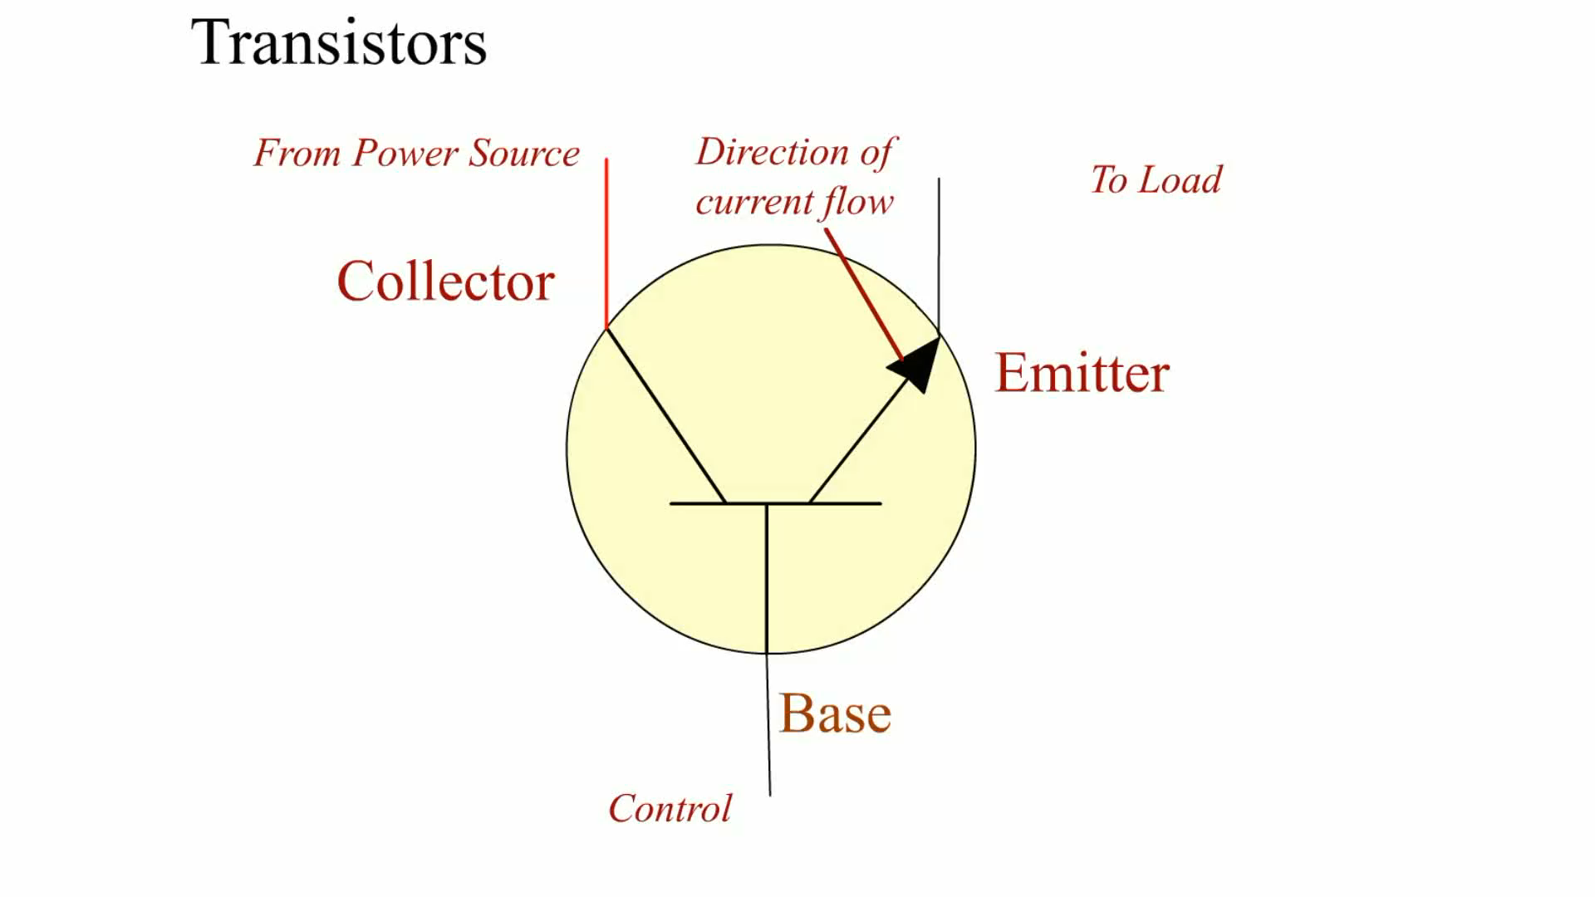
Animation: Transistors
(Animation will automatically start)

Slide 56
Frequently Asked Question: What Does the Arrow Mean on a Transistor Symbol?
? Frequently Asked Question
What Does the Arrow Mean on a Transistor Symbol? The arrow on a transistor symbol is always on the emitter and points toward the N-type material. The arrow on a diode also points toward the N-type material. To know which type of transistor is being shown, note which direction the arrow points.
  PNP: pointing in
  NPN: not pointing in

Slide 57
Field-Effect Transistors
Field-effect transistors (F E T s) have been used in most automotive applications since the mid-1980s.
They use less electrical current and rely mostly on the strength of a small voltage signal to control the output.
Many F E T s are constructed of metal oxide semiconductor (M O S) materials, called M O S F E T s.

Slide 58
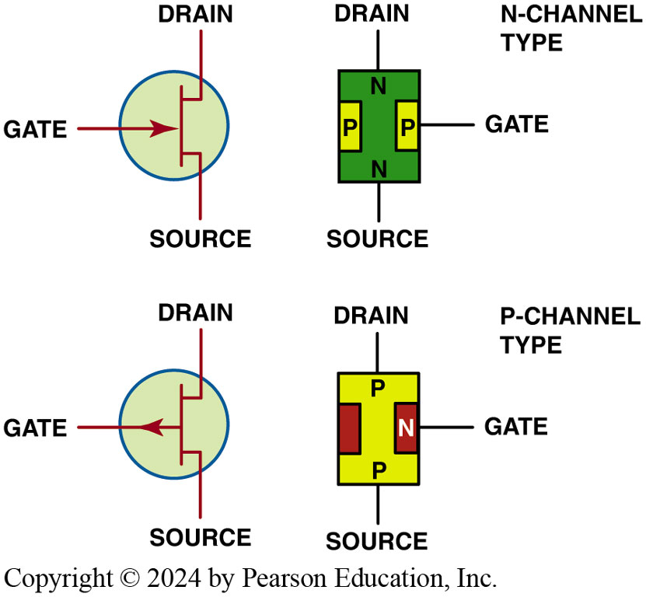
Figure 45.23 FET
The three terminals of a field-effect transistor (FET) are called the source, gate, and drain

Slide 59
Frequently Asked Question: What Is a Darlington Pair?
? Frequently Asked Question
What Is a Darlington Pair? A Darlington pair consists of two transistors wired together. This arrangement permits a very small current flow to control a large current flow. The Darlington pair is named for Sidney Darlington, an American physicist for Bell Laboratories from 1929 to 1971. Darlington amplifier circuits are commonly used in electronic ignition systems, computer engine control circuits, and many other electronic applications. ● SEE FIGURE 45–24.

Slide 60
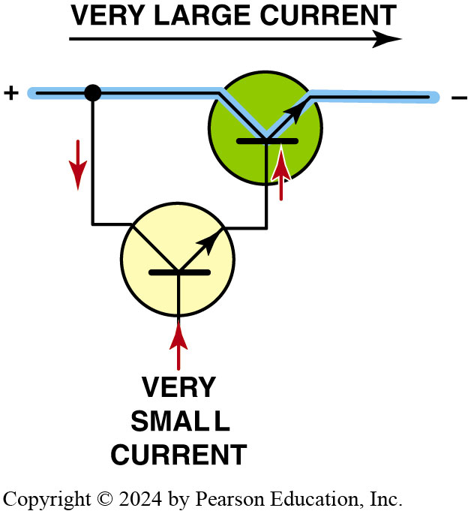
Figure 45.24 Darlington Pair
A Darlington pair consists of two transistors wired together, allowing for a very small current to control a larger current flow circuit

Slide 61
Phototransistors
Similar in operation to a photodiode, a phototransistor uses light energy to turn on the base of a transistor.
A phototransistor may or may not have a base lead.
Phototransistors, along with photo diodes, are frequently used in steering wheel controls.

Slide 62
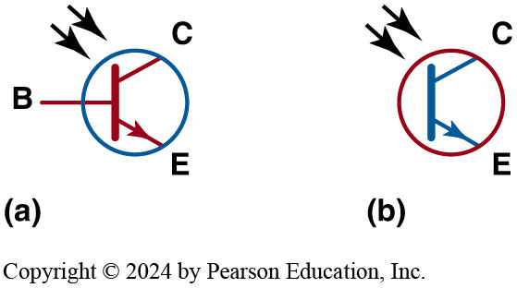
Figure 45.25 Phototransistor
Symbols for a phototransistor. (a) This symbol uses the line for the base; (b) this symbol does not

Slide 63
Integrated Circuits
Purpose and Function
  Individual diodes, transistors, and other semiconductor devices combined (integrated) into one group of circuits.
Construction
  Integrated circuits are usually encased in a plastic housing called a C H I P with two rows of inline pins.
Heat Sink
  Any area around an electronic component that is designed to conduct heat away from electronic parts.

Slide 64
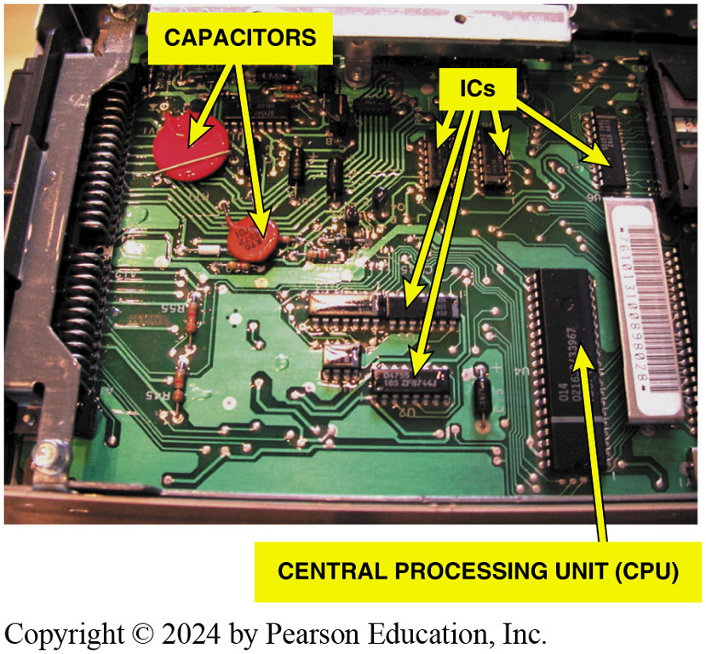
Figure 45.26 Integrated Circuit
A typical automotive computer with the case removed to show all of the various electronic devices and integrated circuits (I C s). The CPU is an example of a D I P chip and the large red and orange devices are ceramic capacitors

Slide 65
Frequently Asked Question: What Causes a Transistor or Diode to Blow?
? Frequently Asked Question
What Causes a Transistor or Diode to Blow? Every automotive diode and transistor is designed to operate within certain voltage and amperage ranges for individual applications. For example, transistors used for switching are designed and constructed differently from transistors used for amplifying signals. Because each electronic component is designed to operate satisfactorily for its particular application, any severe change in operating current (amperes), voltage, or heat can destroy the junction. This failure can cause either an open circuit (no current flows) or a short (current flows through the component all the time when the component should be blocking the current flow).

Slide 66
Transistor Gates
Purpose and Function
  A gate is an electronic circuit whose output depends on the location and voltage of two inputs.
Construction
  For the transistor to turn on, a voltage difference between the base of the transmitter and the emitter should be at least 0.6 volt.
Operation
  Gates represent logic circuits that can be constructed so that the output depends on the voltage of the inputs to the bases of transistors.

Slide 67
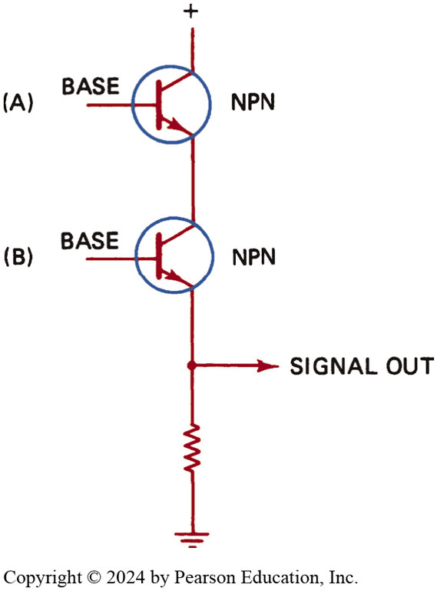
Figure 45.27 AND Gate
Typical AND gate circuit using two transistors. The emitter is always the line with the arrow. Notice that both transistors must be turned on before there is voltage present at the point labeled “signal out”

Slide 68
Operational Amplifiers
Operational amplifiers (op-amps) are used in circuits to control and amplify digital signals.
Op-amps are frequently used for motor control for airflow door operation as part of the climate control system.
Op-amps can provide the proper voltage polarity and current (amperes) to control the direction of permanent magnetic (P M) motors.

Slide 69
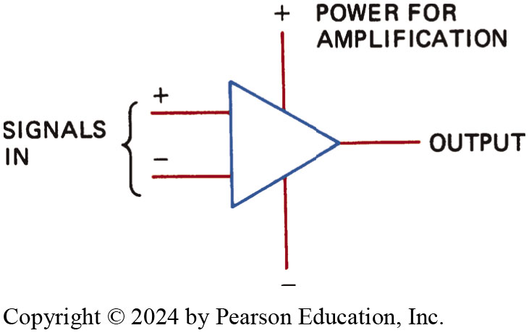
Figure 45.28 Op-Amp
Symbol for an operational amplifier (op-amp)

Slide 70
Frequently Asked Question: What Are Logic Highs and Lows?
? Frequently Asked Question
What Are Logic Highs and Lows? All computer circuits and most electronic circuits (such as gates) use various combinations of high and low voltages. High voltages are typically those above 5 volts, and low is generally considered zero (ground). However, high voltages do not have to begin at 5 volts. High, or the number 1, to a computer is the presence of voltage above a certain level. a circuit could be constructed where any voltage higher than 3.8 volts is considered high. Low, or the number 0, to a computer is the absence of voltage or a voltage lower than a certain value. For example, a voltage of 0.62 volt may be considered low. Various associated names and terms can be summarized. Logic low = Low voltage = Number 0 = Reference low • Logic high = Higher voltage = Number 1 = Reference high

Slide 71
Electronic Component Failure Causes
Frequent causes of premature failure include the following:
  Poor connections
  Heat
  Voltage spikes
  Excessive current

Slide 72
How to Test Diodes/Transistors (1 of 2)
Testers
  Diodes and transistors can be tested with an ohmmeter. The diode or transistor being tested must be disconnected from the circuit.
Diodes
  A good diode should give an over limit (O L) reading with the test leads attached to each lead of the diode in one way, and a voltage reading of 0.400 to 0.600 volt when the leads are reversed.

Slide 73
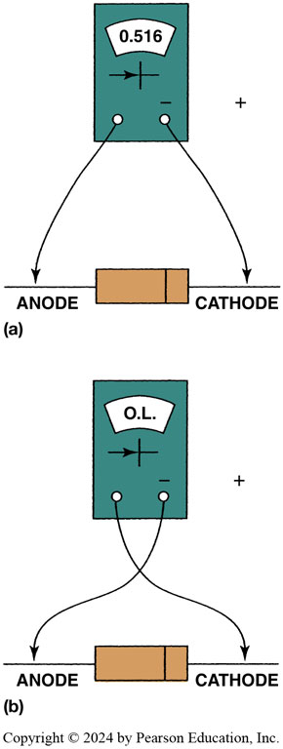
Figure 45.29 Diode Testing
To check a diode, select “diode check” on a digital multimeter. The display indicates the voltage drop (difference) between the meter leads. The meter itself applies a low-voltage signal (usually about 3 volts) and displays the difference on the display. (a) When the diode is forward biased, meter should display a voltage between 0.500 and 0.700 volt (500 to 700 millivolts). (b) When the meter leads are reversed, meter should read OL (over limit) because the diode is reverse biased and blocking current flow.

Slide 74
How to Test Diodes/Transistors (2 of 2)
Transistors
Using a digital meter set to the diode-check position, a good transistor should show a voltage drop of 0.400 to 0.600 volt between the following:
  The emitter (E) and the base (B) and between the base (B) and the collector (C) with a meter connected one way, and O L when the meter test leads are reversed.
  An O L reading (no continuity) in both directions when a transistor is tested between the emitter (E) and the collector (C).

Slide 75
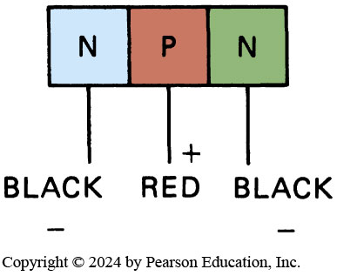
Figure 45.30 Testing Diodes
If the red (positive) lead of the ohmmeter (or a multimeter set to diode check) is touched to the center and the black (negative lead) touched to either end of the electrode, the meter should forward bias the P-N junction and indicate on the meter as low resistance. If the meter reads high resistance, reverse the meter leads, putting the black on the center lead and the red on either end lead. If the meter indicates low resistance, the transistor is a good PNP type. Check all P-N junctions in the same way

Slide 76
Converters and Inverters
Converters
  D C to D C converters (usually written as D C–D C converter) are electronic devices used to transform D C voltage from one level to another higher or lower level.
Inverters
  An inverter is an electronic circuit that changes D C into A C. In most D C-A C inverters, the switching transistors, which are usually M O S F E T s, are turned on alternately for short pulses.

Slide 77
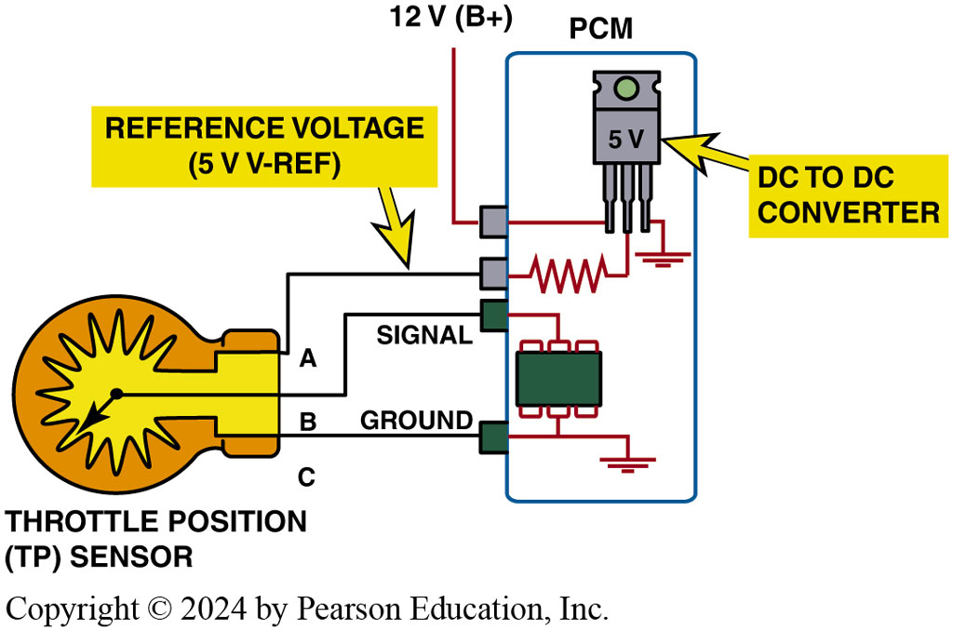
Figure 45.31 DC to DC Converter
DC to DC converter is built into most powertrain control modules (PCM s) and is used to supply the 5-volt reference, called V-ref, to many sensors used to control the internal combustion engine

Slide 78
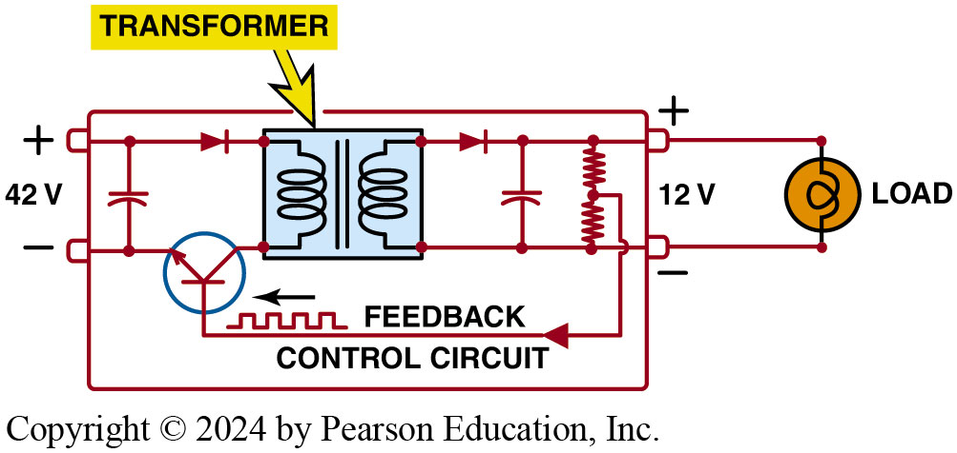
Figure 45.32 DC-DC Converter
DC –DC converter is designed to convert 42 volts to 14 volts, to provide 12-volts power to accessories on a hybrid-electric vehicle operating with a 42-volt electrical system

Slide 79
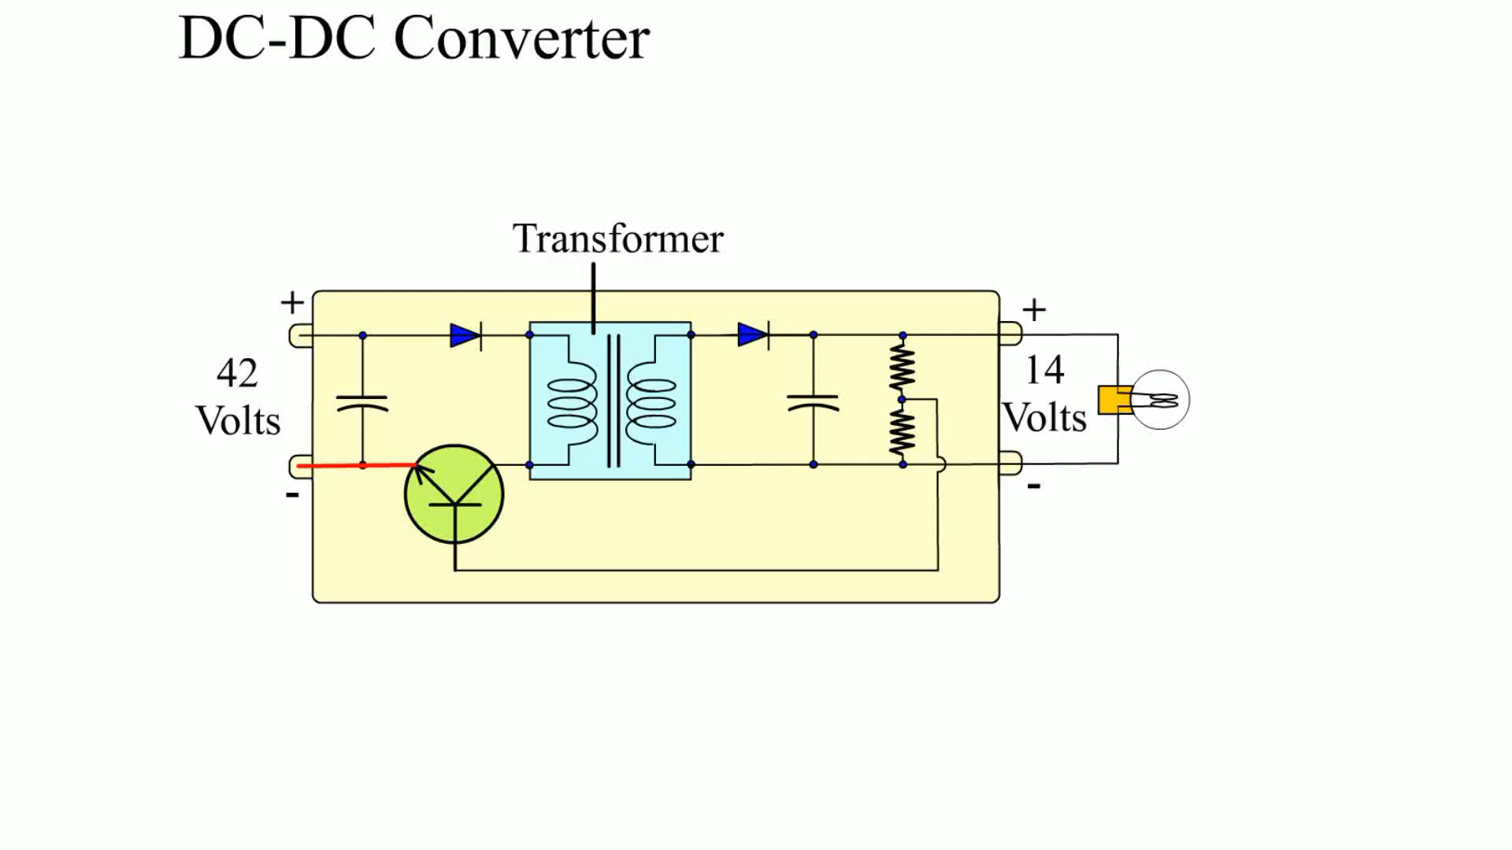
Animation: DC-DC Converter
(Animation will automatically start)

Slide 80
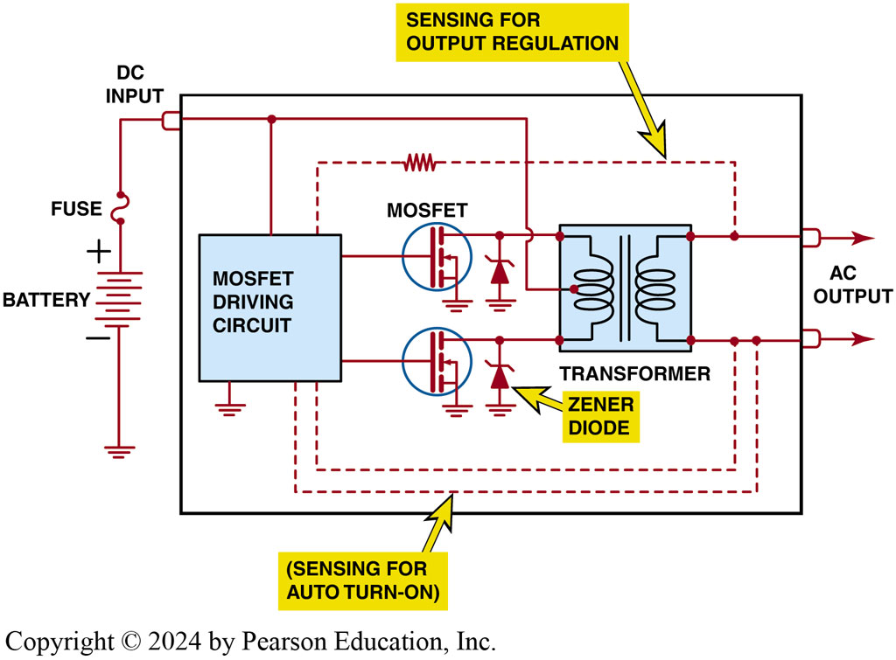
Figure 45.33 Inverter
A typical circuit for an inverter designed to change direct current from a battery to alternating current for use by electric motors used in a hybrid-electric vehicle

Slide 81
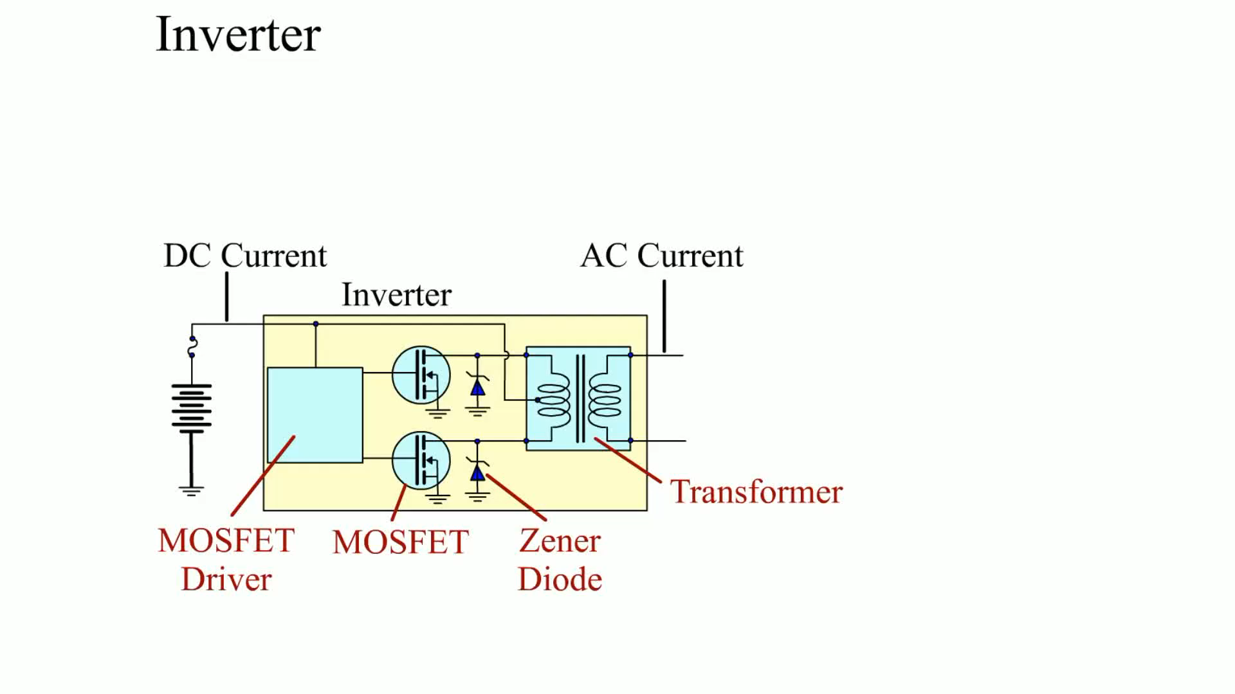
Animation: Inverter
(Animation will automatically start)

Slide 82
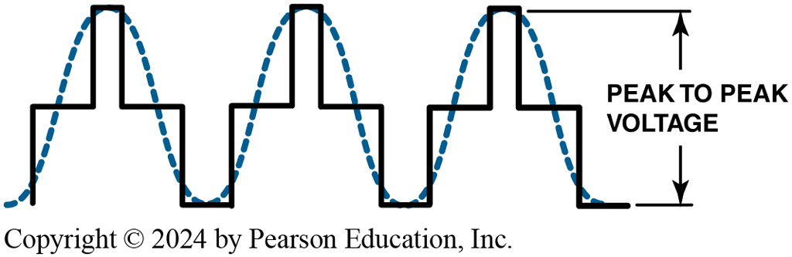
Figure 45.34 MOSFET
The switching (pulsing) MOSFETs create a waveform called a modified sine wave (solid lines), compared to a true sine wave (dotted lines)

Slide 83
Electrostatic Discharge
Definition
  Electrostatic discharge (E S D) is created when static charges build up on the human body when movement occurs.
Avoiding E S D
  Before handling any electronic component, ground yourself by touching a metal surface to drain away any static charge.
  Do not touch the terminals of electronic components.

Slide 84
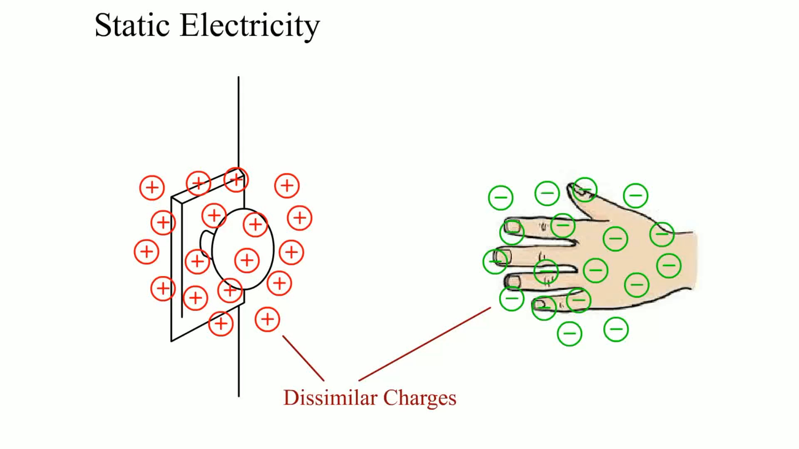
Animation: Static Electricity
(Animation will automatically start)

Slide 85
Question 3: ?
To what precautions should all service technicians adhere, to avoid damage to electronic and computer circuits?

Slide 86
Answer 3
Before handling any electronic component, ground yourself by touching a metal surface to drain away any static charge, and do not touch the terminals of electronic components.

Slide 87
Electrical and Electronic Systems Videos and Animations
Videos Link: (A6) Electrical/Electronic Systems Videos
Animations Link: (A6) Electrical/Electronic Systems Animations

Slide 88

Copyright
This work is protected by United States copyright laws and is provided solely for the use of instructors in teaching their courses and assessing student learning. Dissemination or sale of any part of this work (including on the World Wide Web) will destroy the integrity of the work and is not permitted. The work and materials from it should never be made available to students except by instructors using the accompanying text in their classes. All recipients of this work are expected to abide by these restrictions and to honor the intended pedagogical purposes and the needs of other instructors who rely on these materials.

