Slide 1
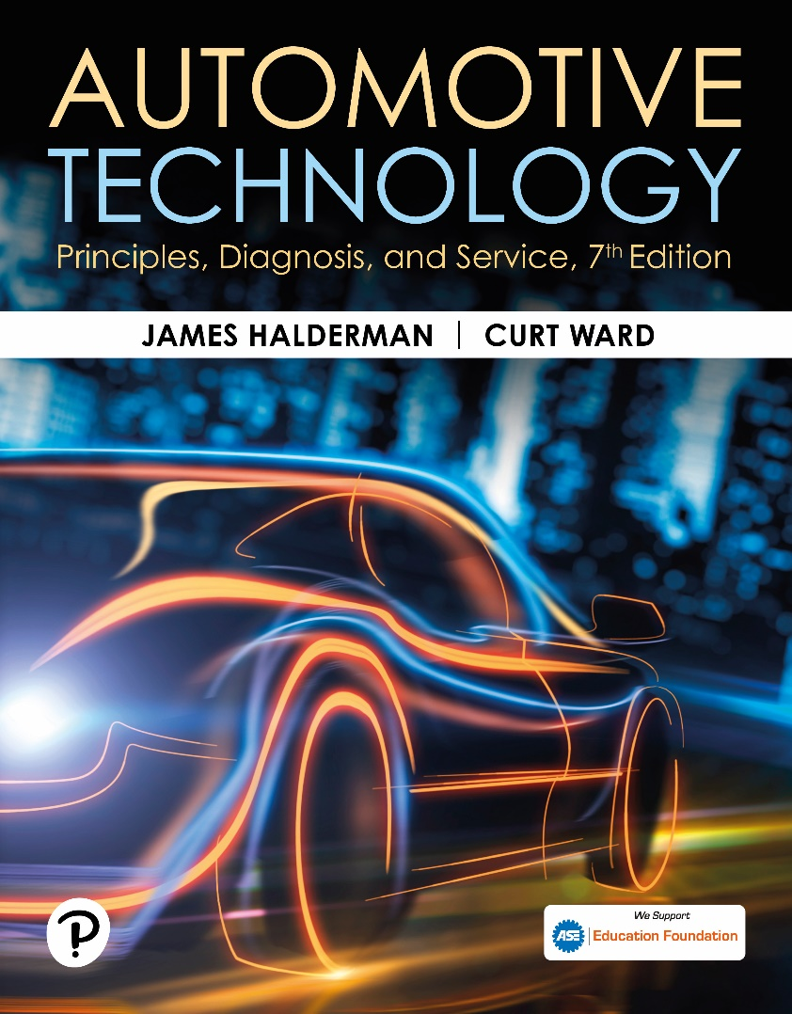
Automotive Technology: Principles, Diagnosis, and Service
Seventh Edition
Chapter 43
Capacitance and Capacitors
Copyright © 2023 Pearson Education, Inc. All Rights Reserved
Notes:
INSTRUCTOR NOTE: This presentation includes text explanation notes, you can use to teach the course. When in SLIDE SHOW mode, you RIGHT CLICK and select SHOW PRESENTER VIEW, to use the notes.

Slide 2
Learning Objectives
43.1 Explain capacitance
43.2 Explain the construction and operation of capacitors.
43.3 Explain factors of capacitance.
43.4 Explain the uses of capacitors.
43.5 Discuss capacitors connected in series and parallel.

Slide 3
Capacitance
Definition
Capacitance is the ability of an object or surface to store an electrical charge.
Capacitors are also called condensers.

Slide 4
Capacitor Construction & Operation
Construction
Capacitor (also called a condenser) consists of two conductive plates with an insulating material between them. The insulating material is commonly called a dielectric.
Operation
When a capacitor is placed in a closed circuit, the voltage source (battery) forces electrons around the circuit. Because electrons cannot flow through the dielectric of the capacitor, excess electrons collect on what becomes the negatively charged plate.

Slide 5
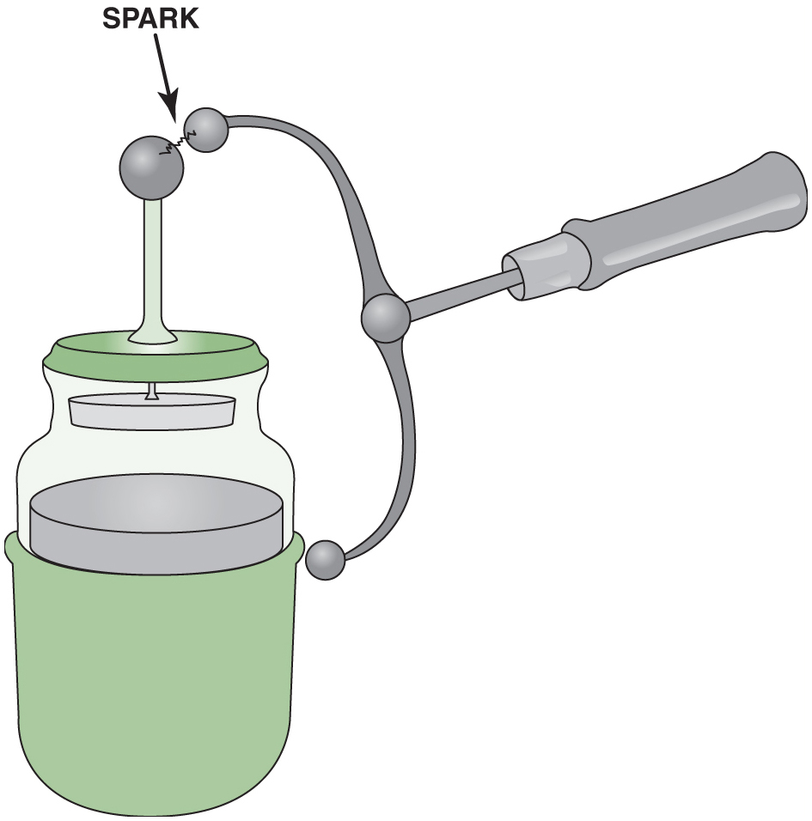
Figure 46.1

Slide 6
Animation: Potentiometer (Animation will automatically start)

Slide 7
Chart 43.1 Dielectric Constant
MATERIAL | DIELECTRIC CONSTANT
Vacuum | 1
Air | 1.00059
Polystyrene | 2.5
Paper | 3.5
Mica | 5.4
Flint glass | 9.9
Methyl alcohol | 35
Glycerin | 56.2
Pure water | 81
Notes:
CHART 43-1 The higher the dielectric constant is, the better are the insulating properties between the plates of the capacitor.

Slide 8
Figure 43.1 Leyden Jar
A Leyden Jar can be Used to Store an Electrical Charge

Slide 9
Figure 43.2 Simple Capacitor
This Simple Capacitor is Made of Two Plates Separated by an Insulating Material, Called a Dielectric

Slide 10
Figure 43.3 Capacitor Charging
As the Capacitor is Charging, the Battery Forces Electrons Through the Circuit

Slide 11
Figure 43.4 Capacitor Charged
When the Capacitor is Charged, there is Equal Voltage Across the Capacitor and the Battery. An Electrostatic Field Exists Between the Capacitor Plates. No Current Flows in the Circuit

Slide 12
Figure 43.5 Top and Bottom Circuit
The Capacitor is Charged Through One Circuit (Top) and Discharged Through Another (Bottom)

Slide 13
Animation: Capacitor (Animation will automatically start)

Slide 14
Figure 43.6 Capacitor Symbols
Capacitor Symbols as Shown in Electrical Diagrams. The Negative Plate Is Often Shown Curved

Slide 15
Frequently Asked Question: What Are “Points and Condenser”?
? Frequently Asked Question
What Are “Points and Condenser”? Points and condenser are used in point-type ignition systems. Points. A set of points use one stationary contact and a movable contact that is opened by a cam lobe inside the ignition distributor. When the points are closed, current flows through the primary windings of the ignition coil and creates a strong magnetic field. As the engine rotates, the distributor can open the contact points, which opens the circuit to the coil. The stored magnetic field in the coil collapses and generates a high- voltage arc from the secondary winding of the coil. It is this spark that is sent to the spark plugs that ignites the air–fuel mixture inside the engine. Condenser. The condenser (capacitor) is attached to the points and the case of the condenser is grounded. When the points start to open, the charge built up in the primary winding of the coil likely starts to arc across the opening points. To prevent the points from arcing and to increase how rapidly the current is turned off, the condenser stores the current temporarily. Points and condenser were used in vehicles and small gasoline engines until the mid-1970s. Figure 43-7

Slide 16
Figure 43.7 Points and Condenser
A Point-Type Distributor Shown with the Condenser from an Old Vehicle Being Tested on a Distributor Machine

Slide 17
Question 1: ?
How does a capacitor store an electrical charge?

Slide 18
Answer 1
The capacitor holds its charge until it is connected into an external circuit through which it can discharge.

Slide 19
Factors of Capacitance
Capacitance is governed by three main factors.
The surface area of the plates
The distance between the plates
The dielectric material
Measurement of Capacitance
Capacitance is measured in farads, which is named after Michael Faraday (1791–1867), an English physicist.

Slide 20
Uses for Capacitors
Spike Suppression
Noise Filtering
Supplemental Power Source
Timer Circuits
Computer Memory
Condenser Microphones

Slide 21
Figure 43.8 Passes AC Blocks DC
A Capacitor Blocks Direct Current (D C), but Passes Alternating Current (A C). A Capacitor Makes a Very Good Noise Suppressor Because Most of the Interference is A C

Slide 22
Question 2: ?
How can a capacitor be used as a noise filter?

Slide 23
Answer 2
Block the D C signal as this is where most of the noise comes from.

Slide 24
Figure 43.9 Power Boost
1 Farad Capacitor Used to Boost the Power to Large Speakers

Slide 25
Capacitors in Circuits
Capacitors in Parallel Circuits
Capacitance can be increased in a circuit by connecting capacitors in parallel.
Capacitors in Series Circuits
Capacitance in a circuit can be decreased by placing capacitors in series.

Slide 26
Figure 43.10 Capacitors in Parallel
Capacitors in Parallel Effectively Increase the Capacitance

Slide 27
Figure 43.11 Capacitors in Series
Capacitors in Series Decrease the Capacitance

Slide 28
Question 3: ?
Where can a capacitor be used as a power source?

Slide 29
Answer 3
In a speaker.

Slide 30
Electrical and Electronic Systems Videos and Animations
Videos Link: (A6) Electrical/Electronic Systems Videos
Animations Link: (A6) Electrical/Electronic Systems Animations

Slide 31
Copyright
This work is protected by United States copyright laws and is provided solely for the use of instructors in teaching their courses and assessing student learning. Dissemination or sale of any part of this work (including on the World Wide Web) will destroy the integrity of the work and is not permitted. The work and materials from it should never be made available to students except by instructors using the accompanying text in their classes. All recipients of this work are expected to abide by these restrictions and to honor the intended pedagogical purposes and the needs of other instructors who rely on these materials.

