Slide 1
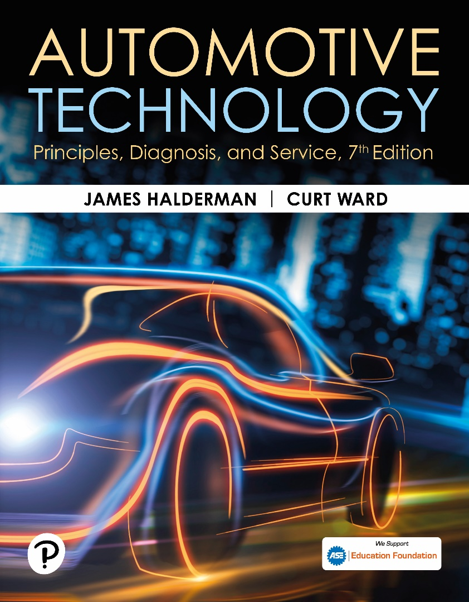
Automotive Technology: Principles, Diagnosis, and Service
Seventh Edition
Chapter 40
Digital Storage Oscilloscopes
Copyright © 2023 Pearson Education, Inc. All Rights Reserved
Notes:
INSTRUCTOR NOTE: This presentation includes text explanation notes, you can use to teach the course. When in SLIDE SHOW mode, you RIGHT CLICK and select SHOW PRESENTER VIEW, to use the notes.

Slide 2
Learning Objectives (1 of 2)
40.1 Compare the different types of oscilloscopes.
40.2 Explain scope setup and adjustments.
40.3 Define AC voltage.
40.4 Describe the use of DC or AC coupling when displaying waveforms on an oscilloscope.
40.5 Explain how to interpret pulse trains on a scope.

Slide 3
Learning Objectives (2 of 2)
40.6 Explain how to interpret channels on a scope.
40.7 Explain how to interpret triggers on a scope.
40.8 Explain how to use a scope.
40.9 Discuss graphing multimeters and scan.

Slide 4
Types of Oscilloscopes
An oscilloscope (usually called a scope) is a visual voltmeter with a timer that shows when a voltage changes.
An analog scope uses a cathode ray tube (C R T)
A digital scope commonly uses a liquid crystal display (L C D)

Slide 5
Question 1: ?
What are the differences between an analog and a digital oscilloscope?

Slide 6
Answer 1
An analog scope uses a cathode ray tube (C R T)
A digital scope commonly uses a liquid crystal display (L C D)

Slide 7
Oscilloscope Display Grid
A typical scope face usually has eight or ten grids vertically (up and down) and ten grids horizontally (left to right).
Transparent scale (grid), used for measurements, is called a graticule.
Voltage is displayed on a scope starting with zero volts at the bottom and higher voltage being displayed vertically.
The scope illustrates time left to right.

Slide 8
Chart 40.1 Scope Time Base
MILLISECONDS PER DIVISION (MS/DIV) | TOTAL TIME DISPLAYED
1 ms | 10 ms (0.010 sec.)
10 ms | 100 ms (0.100 sec.)
50 ms | 500 ms (0.500 sec.)
100 ms | 1 sec. (1.000 sec.)
500 ms | 5 sec. (5.0 sec.)
1, 000 ms | 10 sec. (10.0 sec.)
Notes:
The time base is milliseconds (ms) and total time of an event that can be displayed.

Slide 9
Figure 40.1
Scope Display Allows Technicians to Take Measurements of Voltage Patterns. Each Vertical Division is 1 Volt and Each Horizontal Division is Set to Represent 50 Milliseconds

Slide 10
Scope Setup and Adjustments
Setting the Time Base
Setting time base means setting how much time is displayed in each block, called a division.
Volts Per Division
Volts per division, abbreviated V/div, should be set so that the entire anticipated waveform can be viewed.

Slide 11
Figure 40.2 DSO Waveform
The Digital Storage Oscilloscope (D S O) Displays the Entire Waveform of a Throttle Position (T P) Sensor from Idle to Wide-Open Throttle and Returns to Idle

Slide 12
A C Voltage
Definition
Whereas direct current (D C) flows in one direction, alternating current (A C) voltage changes direction continuously. The voltage varies over time and the waveform is a sine wave.

Slide 13
Figure 40.3 AC Voltage Varies
AC voltage varies over time from positive voltage to negative voltage. The effective value (0.707 of peak) is the level of DC required to deliver the same power

Slide 14
D C and A C Coupling
D C Coupling
D C coupling is the most used position on a scope because it allows the scope to display both A C and D C voltage signals present in the circuit.
A C Coupling
When the A C coupling position is selected, a capacitor is placed into the meter lead circuit, which effectively blocks all D C voltage signals, but allows the A C portion of the signal to pass and be displayed.

Slide 15
Figure 40.4 Ripple Voltage
Ripple voltage is created from the AC voltage from an alternator. Some AC ripple voltage is normal, but if the AC portion exceeds 0.5 V, then a bad diode is the most likely cause

Slide 16
Animation: Oscilloscope, Display AC Ripple (Animation will automatically start)

Slide 17
Question 2: ?
What is the difference between D C coupling and A C coupling?

Slide 18
Answer 2
When the A C coupling position is selected, a capacitor is placed into the meter lead circuit, which effectively blocks all D C voltage signals, but allows the A C portion of the signal to pass and be displayed.

Slide 19
Pulse Trains
Frequency
Frequency is the number of cycles per second measured in hertz.
Duty Cycle
Duty cycle refers to the percentage of on-time of the signal during one complete cycle.
Pulse Width
The pulse width is a measure of the actual on-time measured in milliseconds.

Slide 20
Figure 40.5 Pulse Train
A pulse train is any electrical signal that turns on and off, or goes high and low in a series of pulses. Ignition module and fuel-injector pulses are examples of a pulse train signal

Slide 21
Figure 40.6 Complete Cycle
(A) A scope representation of a complete cycle, showing both on-time and off-time (b) A meter display, indicating the on-time duty cycle in percentage (%). note the trigger and negative (−) symbol

Slide 22
Figure 40.7 Ground Control
Most automotive computer systems control the device by opening and closing the ground to the component.

Slide 23
Number of Channels
Single Channel
A single-channel scope is capable of displaying only one sensor signal waveform at a time.
Two Channel
A two-channel scope can display the waveform from two separate sensors or components at the same time.
Four Channel
A four-channel scope allows the technician to view up to four different sensors or actuators on one display.

Slide 24
Figure 40.8 Scope Channels
A two-channel scope being used to compare two signals on the same vehicle

Slide 25
Animation: Oscilloscope Display, Dual Trace (Animation will automatically start)

Slide 26
Triggers
External Trigger
An external trigger is when the waveform starts when a signal is received from another external source, rather than from the signal pickup lead.
Trigger Level
Trigger level is the voltage that must be detected by the scope before the pattern is displayed.
Trigger Slope
The trigger slope is the voltage direction that a waveform must have in order to start the display.

Slide 27
Figure 40.9 Triggers
(A) A symbol for a positive trigger—a trigger occurs at a rising (positive) edge of the signal (waveform). (B) a symbol for a negative trigger—a trigger occurs at a falling (negative) edge of the signal (waveform)

Slide 28
Question 3: ?
What is the difference between a positive trigger and a negative trigger?

Slide 29
Answer 3
A positive trigger occurs at a rising (positive) edge of the signal (waveform) where a negative trigger occurs at a falling (negative) edge of the signal (waveform).

Slide 30
Using a Scope
Using Scope Leads
Most scopes, both analog and digital, normally use the same test leads.
These leads usually attach to the scope through a B N C connector.
Measuring Battery Voltage with a Scope
Easy to do
Great way to practice the techniques

Slide 31
Graphing Multimeter
A graphing multimeter, abbreviated G M M, is a cross between a digital meter and a digital storage oscilloscope.
A graphing multimeter displays the voltage levels at two places:
On a display screen
In a digital readout

Slide 32
Figure 40.10 Example
Constant Battery Voltage is Represented by a Flat Horizontal Line. In this Example, the Engine was Started and the Battery Voltage Dropped to About 10 V, as Shown on the Left Side of the Scope Display. When the Engine Started, the Voltage Is Shown as Climbing

Slide 33
Graphing Scan Tool
Many scan tools are capable of displaying the voltage levels captured by the scan tool through the data link connector (D L C) on a screen.
This feature is helpful where changes in voltage levels are difficult to detect by looking at numbers that are constantly changing.

Slide 34
Figure 40.11 Graphing Multimeter
A Typical Graphing Multimeter that can be Used as a Digital Meter, plus it can Show the Voltage Levels on the Display Screen

Slide 35
Electrical and Electronic Systems Videos and Animations
Videos Link: (A6) Electrical/Electronic Systems Videos
Animations Link: (A6) Electrical/Electronic Systems Animations

Slide 36
Copyright
This work is protected by United States copyright laws and is provided solely for the use of instructors in teaching their courses and assessing student learning. Dissemination or sale of any part of this work (including on the World Wide Web) will destroy the integrity of the work and is not permitted. The work and materials from it should never be made available to students except by instructors using the accompanying text in their classes. All recipients of this work are expected to abide by these restrictions and to honor the intended pedagogical purposes and the needs of other instructors who rely on these materials.

