Slide 1
Automotive Technology: Principles, Diagnosis, and Service
Seventh Edition
Chapter 39
Circuit Testers and Digital Meters
Copyright © 2023 Pearson Education, Inc. All Rights Reserved
Notes:
INSTRUCTOR NOTE: This presentation includes text explanation notes, you can use to teach the course. When in SLIDE SHOW mode, you RIGHT CLICK and select SHOW PRESENTER VIEW, to use the notes.

Slide 2
Learning Objectives
39.1 Discuss how to safely set up and use a fused jumper wire.
39.2 Discuss how to safely set up and use a test light.
39.3 Discuss how to safely set up and use a logic probe.
39.4 Describe the uses of digital multimeters.
37.5 Describe the uses of inductive ammeters.
39.6 Discuss diode check and frequency.
39.7 Describe the prefixes used with electrical units.
39.8 Describe how to read digital meters.

Slide 3
Fused Jumper Wire
A fused jumper wire is used to check a circuit by bypassing the switch or to provide a power or ground to a component.
It should include a fuse, an alligator clip ends, and a good-quality insulated wire.
A fused jumper wire can be used to help diagnose a component or circuit by performing the following procedures.
Supply power or ground.

Slide 4
Figure 39.1 Fused Jumper
A technician-made fused jumper lead, which is equipped with a red 10-ampere fuse. This fused jumper wire uses terminals for testing circuits at a connector instead of alligator clips

Slide 5
Test Lights
Nonpowered Test Lights
A test light is simply a lightbulb with a probe and a ground wire attached.
Use of a 12-Volt Test Light
Check electrical power
Check grounds
High-Impedance Test Light
Has a high internal resistance and, therefore, draws very low current in order to light

Slide 6
Figure 39.2 Test Light
A 12-volt test light is attached to a good ground while probing for power

Slide 7
Animation: Test Light Check (Animation will automatically start)

Slide 8
Figure 39.3 Test Light Use
A test light can be used to locate an open in a circuit. Note that the test light is grounded at a different location than the circuit itself

Slide 9
Animation: Circuit Test, Test Light (Animation will automatically start)

Slide 10
Logic Probe
A logic probe is an electronic device that lights up a red (usually) LED if the probe is touched to battery voltage. If the probe is touched to ground, a green (usually) LED lights.
A logic probe must first be connected to a power and ground source, such as the vehicle battery.

Slide 11
Figure 39.4 Logic Probe
Logic probe connected to the vehicle battery. When the tip probe is connected to a circuit, it can check for power, ground, or a pulse

Slide 12
Digital Multimeters (1 of 2)
Terminology
Digital multimeter (DMM) and digital volt-ohm-meter (D VOM) are terms commonly used for electronic high-impedance test meters.
High impedance means that the electronic internal resistance of the meter is high enough to prevent excessive current draw from any circuit being tested.
Most meters today have a minimum of 10 million ohms (10 megohms) of resistance.

Slide 13
Digital Multimeters (2 of 2)
Measuring Voltage
DC volts (DCV) and AC volts (ACV)
Manual or automatically ranged
Measuring Resistance
Measure when no current is flowing in the circuit.
Measuring Current
The ammeter has to be installed in the circuit (in series) so that it can measure all the current flow in that circuit.

Slide 14
Figure 39.5 DMM Features
Typical digital multimeter. The black meter lead is always placed in the COM terminal. The red meter test lead should be in the volt-ohm terminal, except when measuring current in amperes

Slide 15
Chart 39.6 DMM Symbols
SYMBOL | MEANING
AC | Alternating current or voltage
DC | Direct current or voltage
V | Volts
mV | Millivolts (1/1, 000 volts)
A | Ampere (amps), current
mA | Milliampere (1/1, 000 amps)
% | Percent (for duty-cycle readings only)
Ω | Ohms, resistance
kΩ | Kilohm (1, 000 ohms), resistance
MΩ | Megohm (1, 000, 000 ohms), resistance
Hz | Hertz (cycles per second), frequency
kHz | Kilohertz (1, 000 cycles/sec.), frequency
ms | Milliseconds (1/1, 000 sec.) for pulse-width measurements

Slide 16
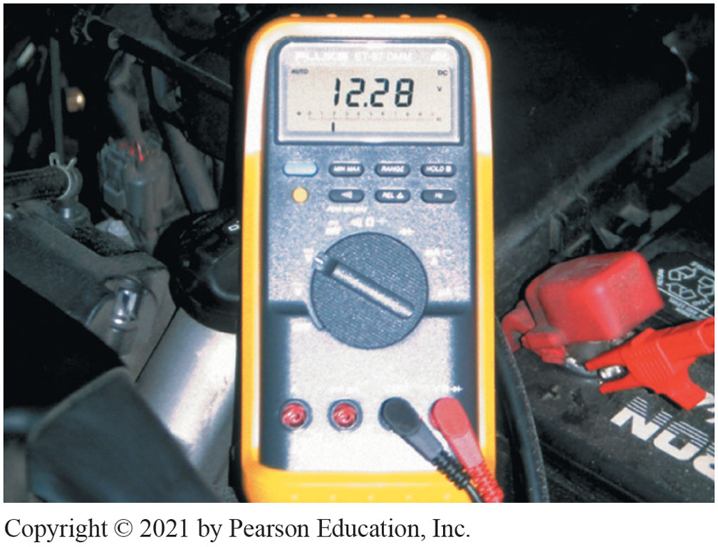
Figure 39.6 D M M set to read D C volts

Slide 17
Figure 39.7 Autoranging
A typical autoranging digital multimeter automatically selects the proper scale to read the voltage being tested. The scale selected is usually displayed on the meter face. Note that the display indicates “4,” meaning that this range can read up to 4 volts

Slide 18
Figure 39.8 Measuring Ohms
Using a digital multimeter set to read ohms (Ω) to test this light bulb. The meter reads the resistance of the filament

Slide 19
Animation: Meter Usage, Measure Ohms (Animation will automatically start)

Slide 20
Figure 39.9 Testing Meter Ω
Many digital multimeters can have the display indicate zero to compensate for test lead resistance. (1) Connect leads in the VΩ and COM meter terminals. (2) Select the Ω scale. (3) Touch the two meter leads together. (4) Push the “zero” or “relative” button on the meter. (5) The meter display now indicates zero ohms of resistance

Slide 21
Question 1: ?
Why must an ohmmeter be connected to a disconnected circuit or component?

Slide 22
Answer 1
The meter provides power to the circuit/component being tested.

Slide 23
Figure 39.10 Current Measure
Measuring the current flow required by a horn requires that the ammeter be connected to the circuit in series and the horn button be depressed by an assistant

Slide 24
Animation: Meter Usage, Measure Amps (Animation will automatically start)

Slide 25
Frequently Asked Question: How Much Voltage Does an Ohmmeter Apply?
? Frequently Asked Question
How Much Voltage Does an Ohmmeter Apply? Most digital meters that are set to measure ohms (resistance) apply 0.3 to1 volt to the component being measured. The voltage comes from the meter itself to measure the resistance. Two things are important to remember about an ohmmeter: 1. The component or circuit must be disconnected from any electrical circuit while the resistance is being measured. 2. Because the meter itself applies a voltage (even though it is relatively low), a meter set to measure ohms can damage electronic circuits. Computer or electronic chips can be easily damaged if subjected to only a few milliamperes of current, similar to the ohmmeter applies when a resistance measurement is being performed.

Slide 26
Figure 39.11 Fused DMM Lead
Note the blade-type fuse holder soldered in series with one of the meter leads. A 10-ampere fuse helps protect the internal meter fuse (if equipped), and the meter itself, from damage that may result from excessive current flow, if accidentally used incorrectly
Notes:
TECH TIP: Fuse Your Meter Leads!
Most digital meters include an ammeter capability. When reading amperes, the leads of the meter must be changed from volts or ohms (V or Ω) to amperes (A), milliamperes (mA), or microamperes (μA). A common problem may occur the next time voltage is measured. Although the technician may switch the selector to read volts, often the leads are not switched back to the volt or ohm position. Because the ammeter lead position results in zero ohms of resistance to current flow through the meter, the meter or the fuse inside the meter is destroyed if the meter is connected to a battery. Many meter fuses are expensive and difficult to find. To avoid this problem, simply solder an inline 10 ampere blade-fuse holder into one meter lead. .
Do not think that this technique is for beginners only. Experienced technicians often get in a hurry and forget to switch the lead. A blade fuse is faster, easier, and less expensive to replace than a meter fuse, or the meter itself. Also, if the soldering is done properly, the addition of an inline fuse holder and fuse does not increase the resistance of the meter leads.
WARNING: Do not use a meter equipped with an external add-on fuse when testing a high-voltage circuit to prevent possible shock hazard.

Slide 27
Frequently Asked Question: What Does “CE” Mean on Many Meters?
? Frequently Asked Question
What Does “CE” Mean on Many Meters? The “CE” means that the meter meets the newest European Standards and the CE mark stands for Conformité Europeenne, which is French for “European Conformity.”
.

Slide 28
Inductive Ammeters
Operation
Inductive ammeters do not make physical contact with the circuit.
They measure the strength of the magnetic field surrounding the wire carrying the current and use a Hall-effect sensor to measure current.
AC/DC Clamp-on Digital Multimeters
There is no need to break the circuit to measure current (amperes).

Slide 29
Figure 39.12 Inductive Ammeter
An inductive ammeter clamp is used with all starting and charging testers to measure the current flow through the battery cables

Slide 30
Figure 39.13 Mini-Clamp ON
Typical mini clamp-on-type digital multimeter capable of measuring alternating current (A C) and direct current (D C) without requiring that the circuit be disconnected to install the meter in series. The jaws are simply placed over the wire and current flow through the circuit is displayed

Slide 31
Animation: Test Compressor Clutch Circuit, Clamp Meter (Animation will automatically start)

Slide 32
Question 2: ?
How is an ammeter connected to an electrical circuit?

Slide 33
Answer 2
In series.

Slide 34
Figure 39.14 OL Meaning
Typical digital multimeter showing OL (over limit) on the readout with the ohms (Ω) unit selected. This usually means that the unit being measured is open (infinite resistance) and has no continuity
Notes:
TECH TIP: Over-Limit Display Does Not Mean the Meter Is Reading “Nothing” The meaning of the over-limit display on a digital meter often confuses beginning technicians. When asked what the meter is reading when an over limit (OL) is displayed on the meter face, the response is often, “Nothing.” Many meters indicate over limit or over load, which simply means that the reading is over the maximum that can be displayed for the selected range. For example, the meter displays OL if 12 volts are being measured, but the meter has been set to read a maximum of 4 volts. Autoranging meters adjust the range to match
what is being measured. Here OL means a value higher than the meter can read (unlikely on the voltage scale for automobile usage), or infinity when measuring resistance (ohms). Therefore, OL means infinity when measuring resistance or an open circuit is being indicated. The meter reads 00.0 if the resistance is zero, so “nothing” in this case indicates continuity (zero resistance), whereas OL indicates infinite resistance. Therefore, when talking with another technician about a meter reading, make sure you know exactly what the reading on the face of the meter means. Also be sure that you are connecting the meter leads correctly. ● SEE FIGURE 39–14.

Slide 35
Diode Check, Duty Cycle, and Frequency
Diode Check
Used to check diodes, including light-emitting diodes (LEDs).
Duty Cycle
Duty cycle is the amount of time, by percentage, that a signal is on compared to being off.
Frequency
Frequency is a measure of how many times per second a signal changes.

Slide 36
Animation: Meter Usage, Testing a Diode (Animation will automatically start)

Slide 37
Electrical Unit Prefixes
Always check the face of the meter display for the unit being measured.
The prefixes can be confusing because most digital meters can express values in more than one unit, especially if the meter is autoranging.

Slide 38
Figure 39.15 DMM Display
Always look at the meter display when a measurement is being made, especially if using an autoranging meter

Slide 39
Chart 39.2 DMM Prefixes
TO/FROM | MEGA | KILO | BASE | MILLI
Mega | 0 places | 3 places to right | 6 places to right | 9 places to right
Kilo | 3 places to left | 0 places | 3 places to right | 6 places to right
Base | 6 places to left | 3 places to left | 0 places | 3 places to right
Milli | 9 places to left | 6 places to left | 3 places to left | 0 places

Slide 40
How To Read Digital Meters
Select the proper unit of electricity for what is being measured.
Place the meter leads into the proper input terminals.
Measure the component being tested.
Interpret the reading.

Slide 41
Figure 39.16 True RMS Meter
When reading A C voltage signals, true RMS meter ( Fluke 87) provides a different reading than an average responding meter (such as a Fluke 88). The only place this difference is important is when a reading is to be compared with a specifications
Notes:
Chart 39-3 Sample meter readings, using manually set and autoranging selection on the digital meter control. Page 449

Slide 42
Figure 39.17 Volts AC
This meter display shows 052.2 AC volts. Notice that the zero beside the 5 indicates that the meter can read over 100 volts AC with a resolution of 0.1 volt
Notes:
TECH TIP: Purchase a Digital Meter That Works for Automotive Use
Try to purchase a digital meter that is capable of reading the following:
• DC volts
• AC volts
• DC amperes (up to 10 A or more is helpful)
• Ohms (Ω) up to 40 MΩ (40 million ohms)
• Diode check
Additional features for advanced automotive diagnosis include
• Frequency (hertz, abbreviated Hz)
• Temperature probe (°F and/or °C)
• Pulse width (millisecond, abbreviated ms)
• Duty cycle (%)

Slide 43
Animation: Meter Usage, Measure Volts (Animation will automatically start)

Slide 44
Figure 39.18 CAT III DMM
Be sure to use only a meter that is CAT III-rated when taking electrical voltage measurements on a hybrid vehicle
Notes:
SAFETY TIP: Meter Usage on Hybrid-Electric Vehicles Many hybrid-electric vehicles use system voltage as high as 650 volts DC. Be sure to follow all vehicle manufacturer’s testing procedures. If a voltage measurement is needed, be sure to use a meter and test leads that are designed to insulate against high voltages.
The International Electrotechnical Commission (IEC) has several categories of voltage standards for meter and meter leads. These categories are ratings for overvoltage protection and are rated CAT I, CAT II, CAT III, and CAT IV. The higher the category rating, the greater the protection against voltage spikes caused by high- energy circuits. Under each category, there are various energy and voltage ratings. CAT I Typically, a CAT I meter is used for low-energy voltage measurements, such as at wall outlets in the home. Meters with a CAT I rating are usually rated at 300 to 800 volts. CAT II This higher rated meter is typically used for checking higher energy level voltages at the fuse panel in the home. Meters with a CAT II rating are usually rated at 300 to 600 volts.
CAT III This minimum-rated meter should be used for hybrid vehicles. The CAT III category is designed for high-energy levels and voltage measurements at the service pole at the transformer. Meters with this rating are usually rated at 600 to 1, 000 volts. CAT IV CAT IV meters are for clamp-on meters only.
If a clamp-on meter also has meter leads for voltage measurements, that part of the meter is rated as CAT III.
NOTE: Always use the highest CAT rating meter, especially when working with hybrid vehicles. A CAT III, 600 volt meter is safer than a CAT II, 1, 000 volt meter because of the energy level of the CAT ratings. Therefore, for best personal protection, use only meters and meter leads that are CAT III or CAT IV rated when measuring voltage on a hybrid vehicle. FIGURES 39–18 AND 39–19

Slide 45
Figure 39.19 CAT III Meter Leads
Always use meter leads that are CAT III-rated on a meter that is also CAT III-rated, to maintain the protection needed when working on hybrid vehicles

Slide 46
Question 3: ?
What is meant when a meter reads “OL” when measuring ohms?

Slide 47
Answer 3
Over limit or “open circuit.”

Slide 48
Digital Meter Usage

Slide 49
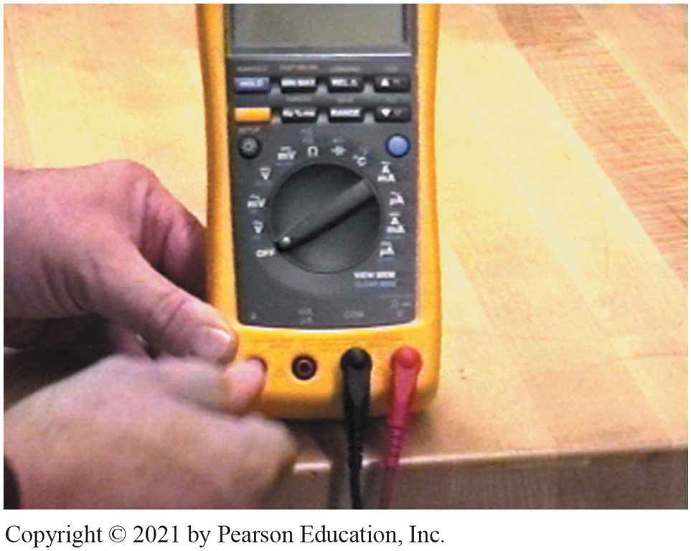
Lead Connection
Notes:
1. For most electrical measurements, the black meter lead is inserted in the terminal labeled “COM” and the red meter lead is inserted into the terminal labeled “V”

Slide 50
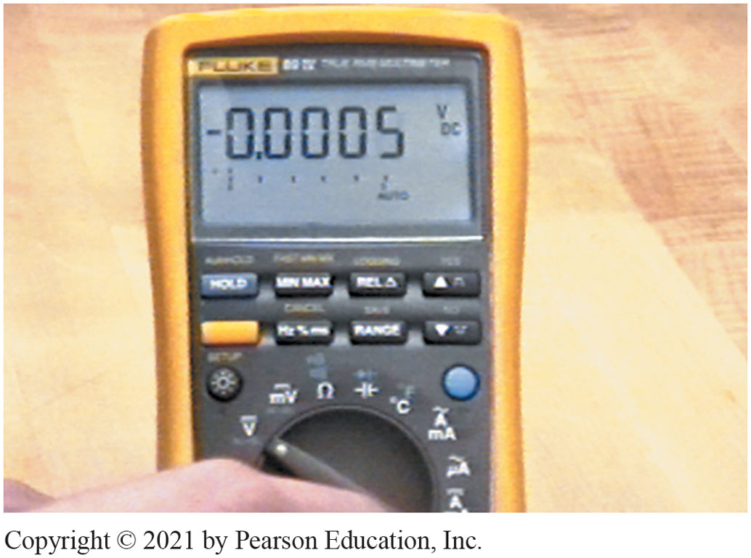
Rotary Switch to DC Volts
Notes:
2. To use a digital meter, turn the power switch and select the unit of electricity to be measured. In this case, the rotary switch is turned to select DC volts V

Slide 51
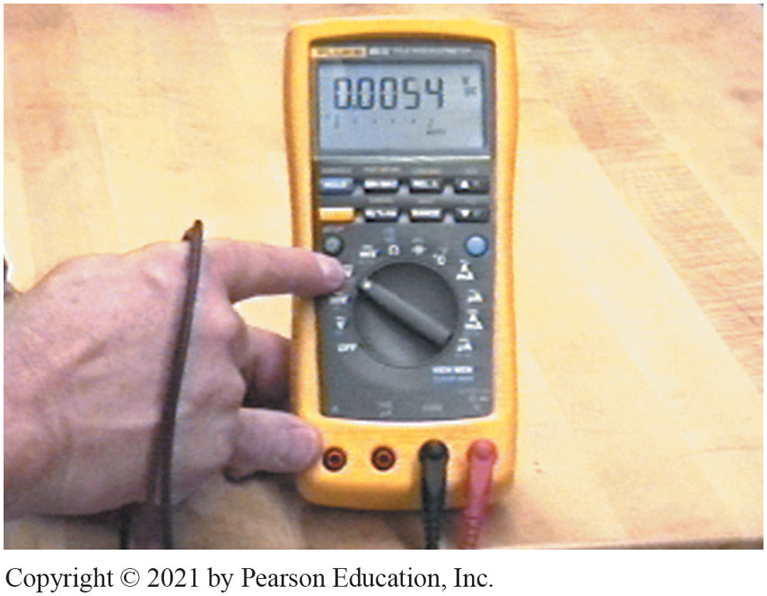
Battery Voltage, Select DC volts
Notes:
3. For most automotive electrical use, such as measuring battery voltage, select DC volts

Slide 52
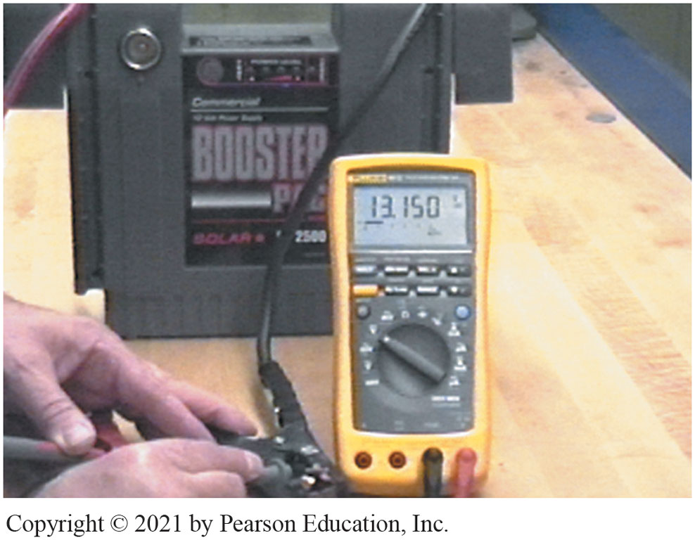
Meter Reads Voltage Difference Between Leads
Notes:
4. Connect the red meter lead to the positive (+) terminal of a battery and the black meter lead to the negative (-) terminal. The meter reads the voltage difference between the leads

Slide 53
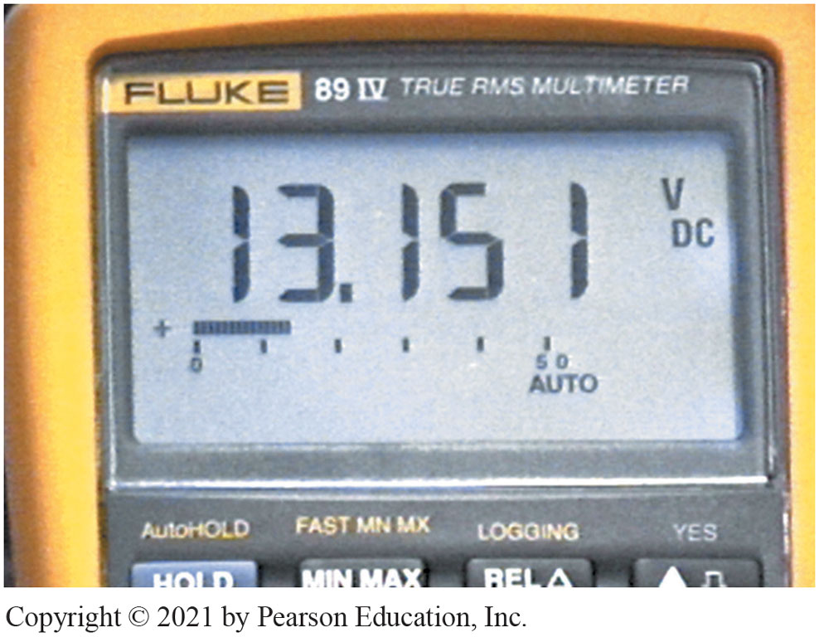
Measures 13.151 Volts
Notes:
This jump-start battery unit measures 13.151 volts with the meter set on autoranging on the DC voltage scale

Slide 54
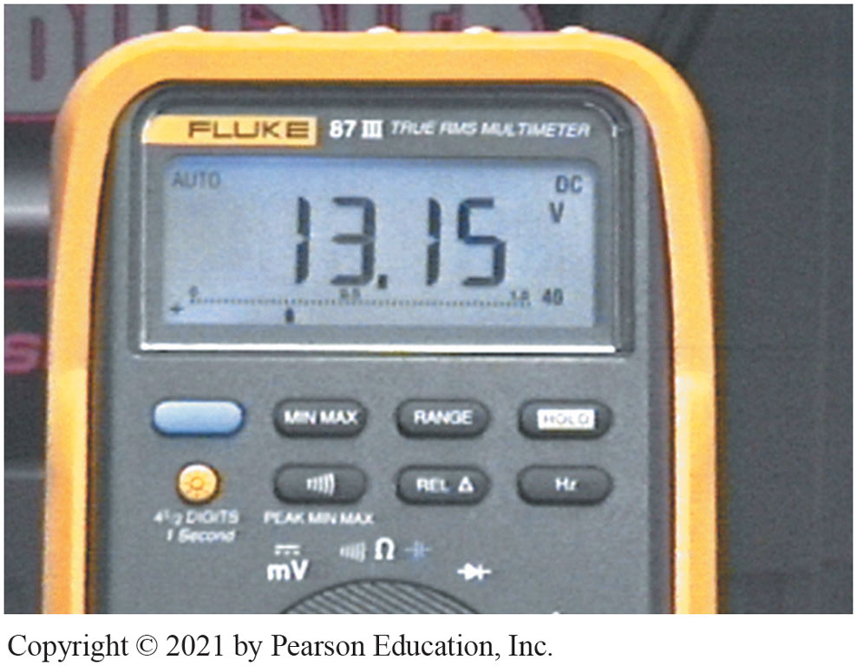
Fluke 87 Displays Four Digits
Notes:
6. Another meter (Fluke 87 I I I) displays four digits when measuring the voltage of the battery jump-start unit

Slide 55
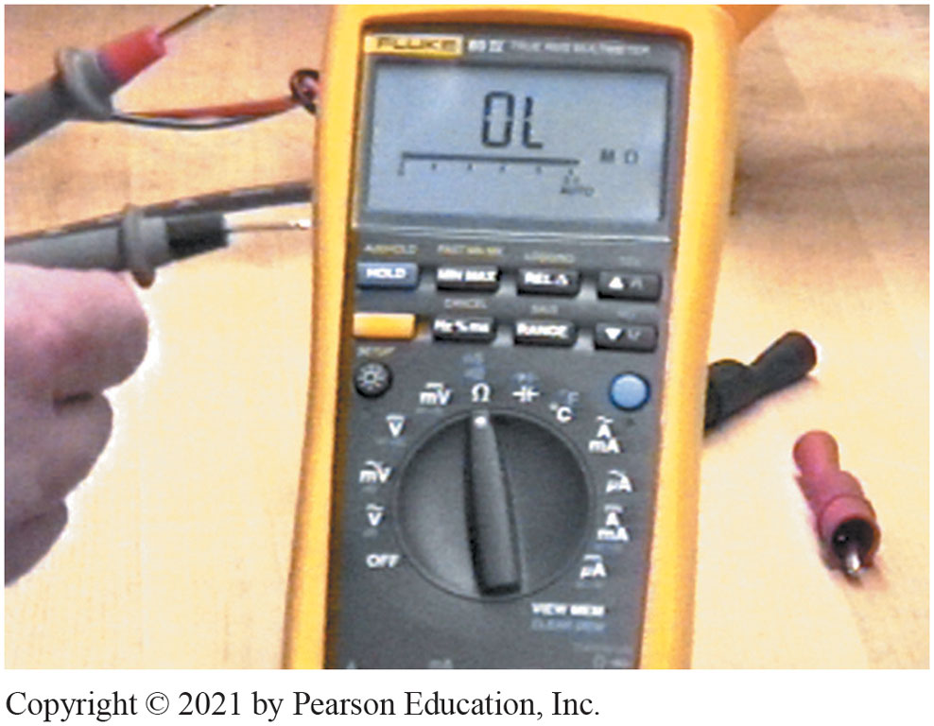
Measure Resistance Reads OL
Notes:
7. To measure resistance, turn the rotary dial to the ohm (Ω) symbol. With the meter leads separated, the meter display reads OL (over limit)

Slide 56
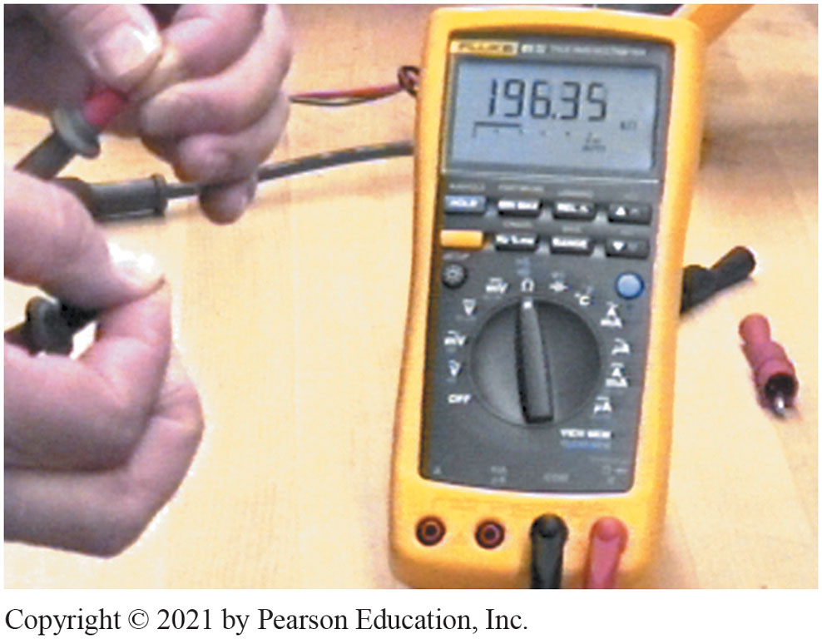
Read Your Own Body Resistance
Notes:
8. The meter can read your own body resistance if you grasp the meter lead terminals with your fingers. The reading on the display indicates 196.35 kΩ

Slide 57
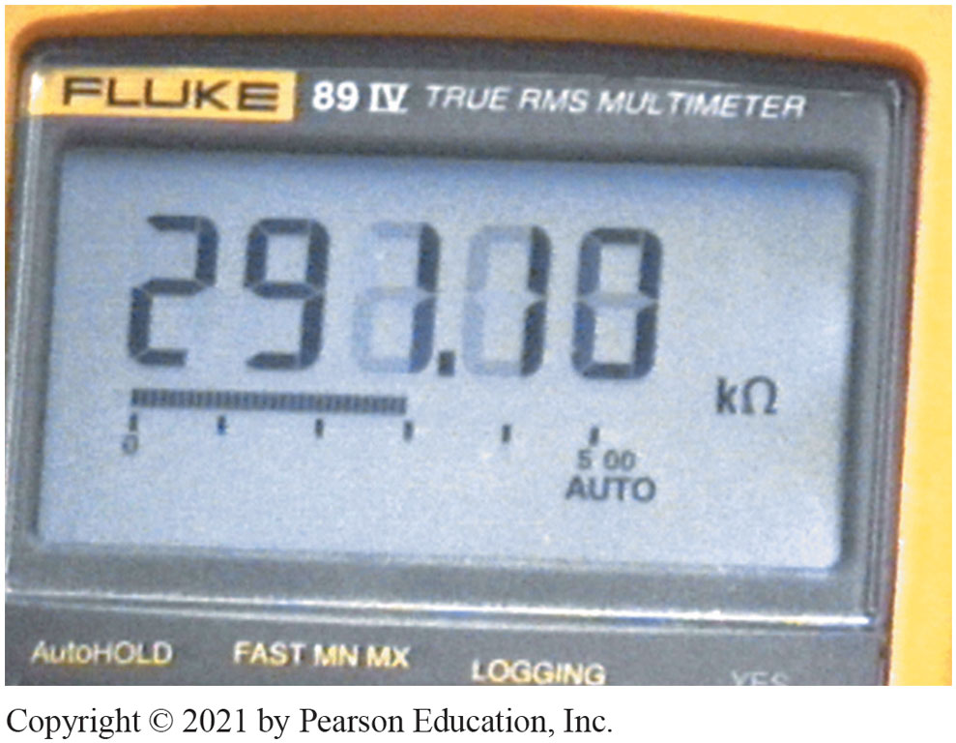
Meter Reading 291.10 kΩ
Notes:
9. When measuring anything, be sure to read the symbol on the meter face. In this case, the meter reading is 291.10 kΩ

Slide 58
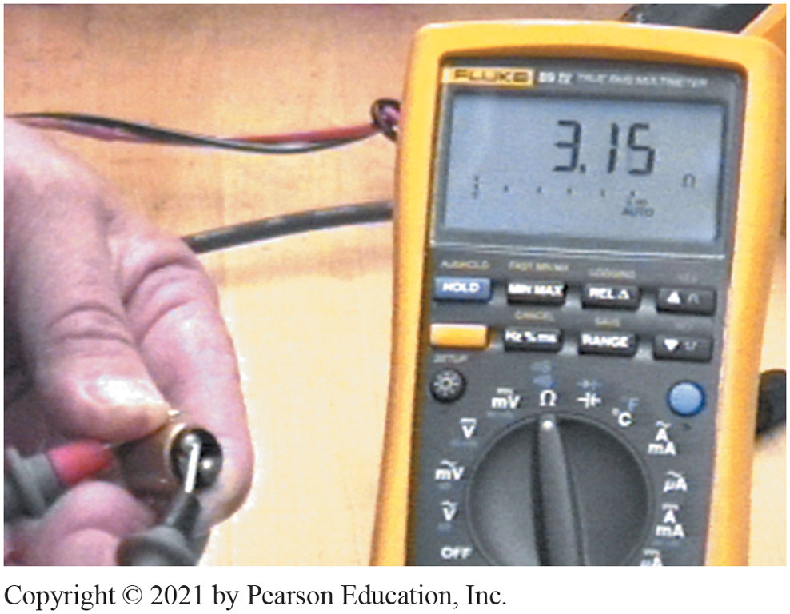
Resistance of Light Bulb Filament
Notes:
10. A meter set on ohms can be used to check the resistance of a light bulb filament. In this case, the meter reads 3.15 ohms. If the bulb were bad (filament open), the meter displays OL

Slide 59
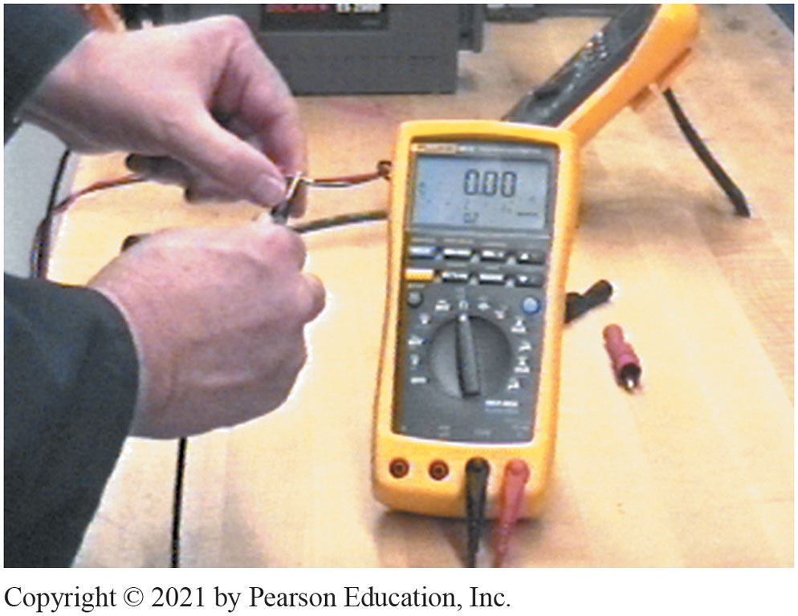
DMM Measure 0.00 Leads Together
Notes:
11. A digital meter set to read ohms should measure 0.00, as shown, when the meter leads are touched together

Slide 60
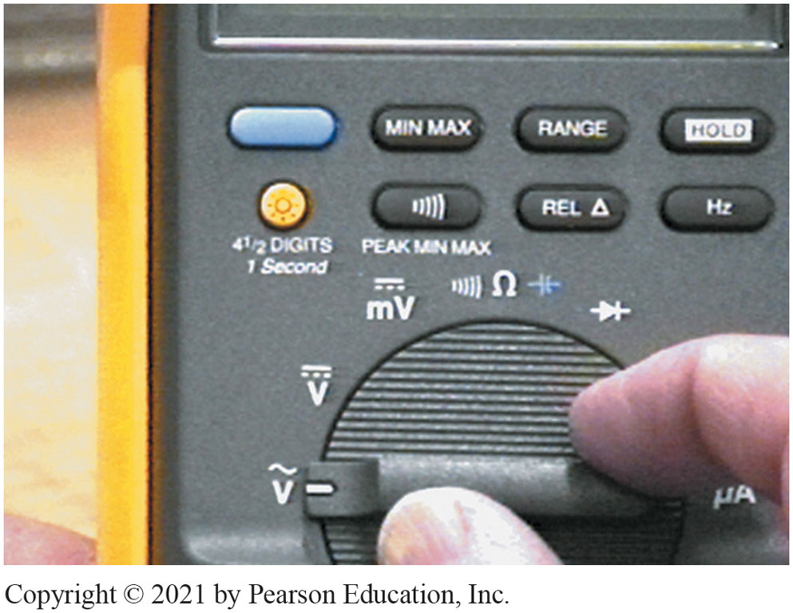
Wavy Symbol Over “V” AC Voltage
Notes:
12. The large letter V means volts and the wavy symbol over the V means that the meter measures alternating-current (AC) voltage, if this position is selected

Slide 61
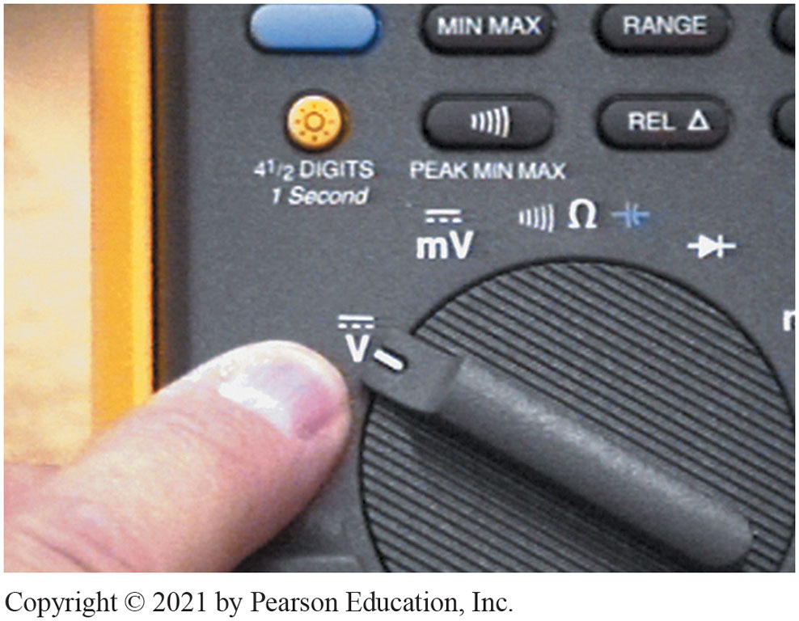
V With Dotted/Straight Line DC Volts
Notes:
13. The next symbol is a V with a dotted and a straight line overhead. This symbol stands for direct-current (DC) volts. This position is most used for automotive service

Slide 62
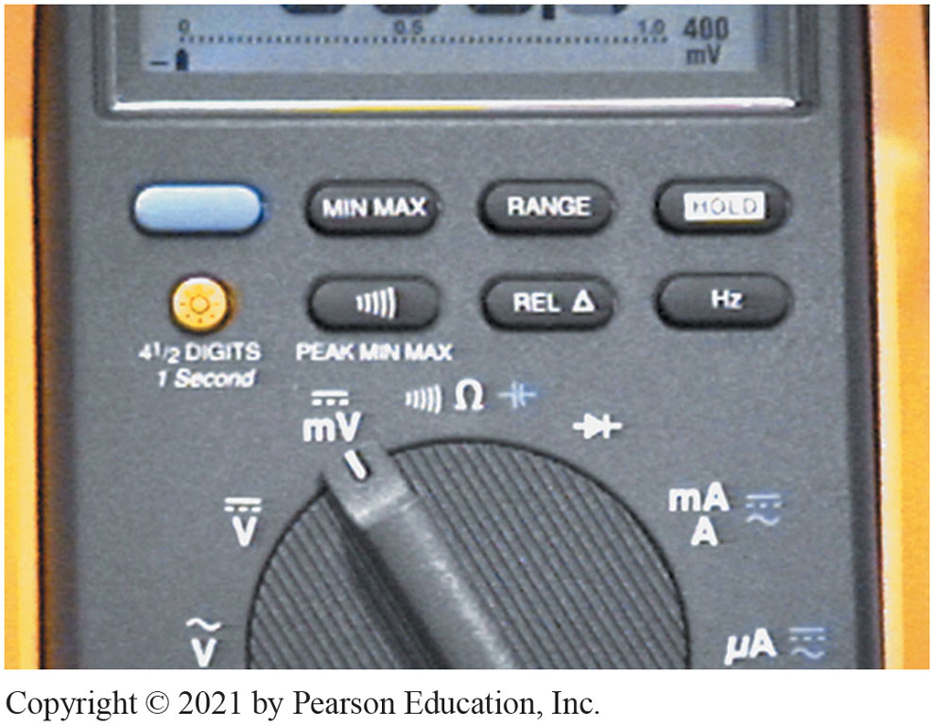
mV Indicates Millivolts
Notes:
14. The symbol mV indicates millivolts or 1/1,000 of a volt (0.001). The solid and dashed line above the mV means DC mV

Slide 63
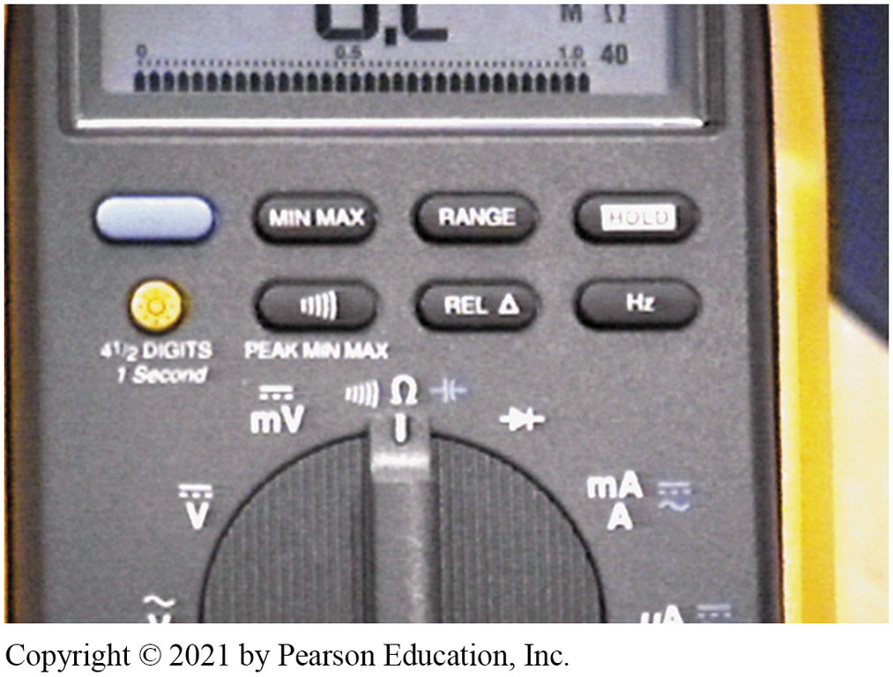
Ω (Ohms) Resistance Measure
Notes:
15. The rotary switch is turned to Ω (ohms) unit of resistance measure. The symbol to the left of the Ω symbol is the beeper or continuity indicator

Slide 64
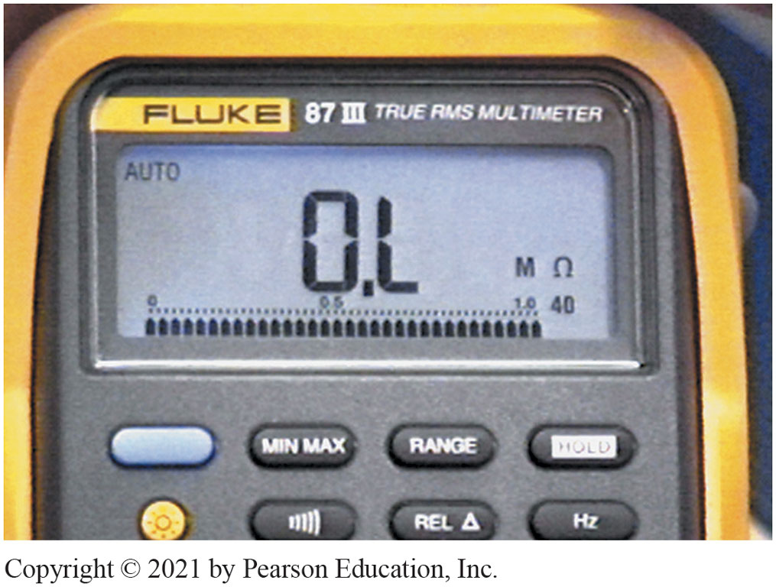
AUTO Autoranging Millions of Ohms
Notes:
16. Notice that AUTO is in the upper left and the MΩ is in the lower right. MΩ means megaohms or that the meter is set to read in millions of ohms

Slide 65
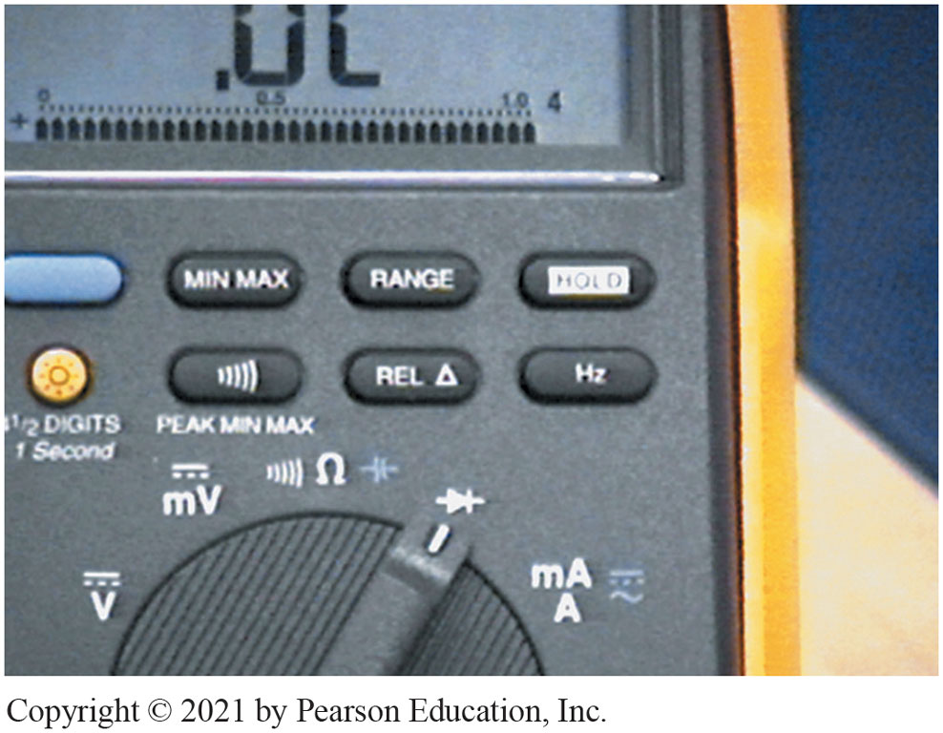
Applies Voltage To Diode
Notes:
17. The symbol shown is that of a diode. In this position, the meter applies a voltage to a diode and the meter reads the voltage drop across the junction of a diode

Slide 66
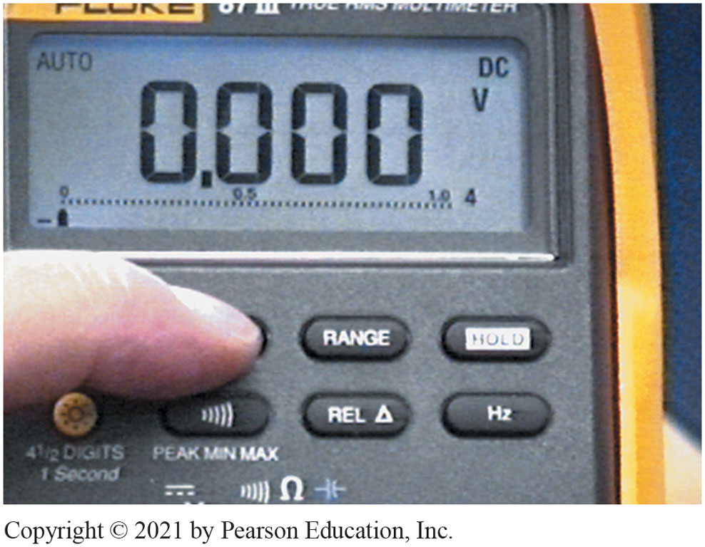
M I N/M A X Feature
Notes:
18. One of the most useful features of this meter is the M I N/M A X feature. By pushing the M I N/M A X button, the meter is able to display the highest (M A X) and the lowest (M I N) reading

Slide 67
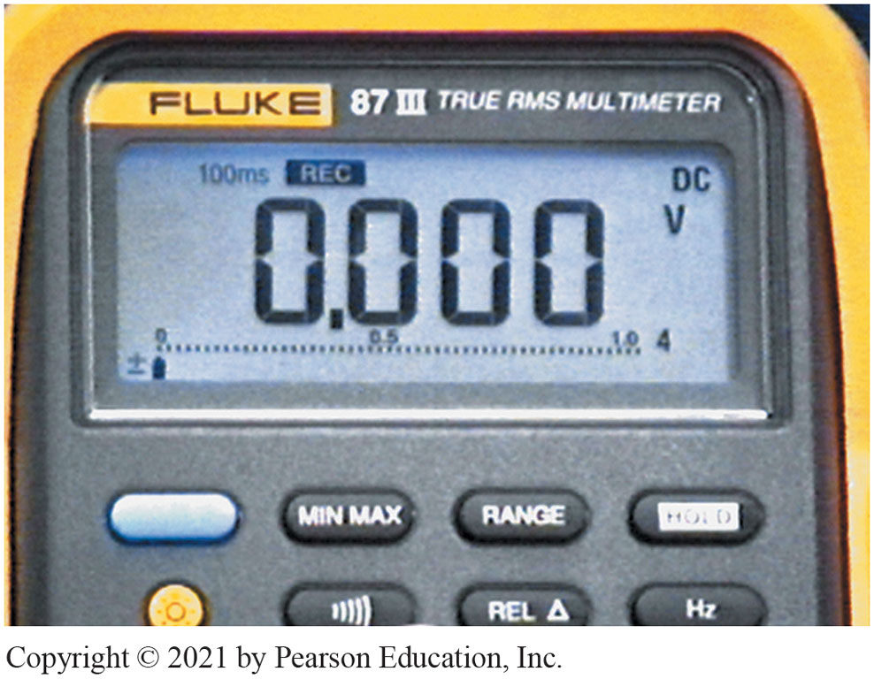
Pushing M I N/M A X Button Record Mode
Notes:
19. Pushing the M I N/M A X button puts the meter into record mode. Note the 100 ms and “rec” on the display. In this position, the meter is capturing any voltage change that lasts 100 ms (0.1 sec.) or longer

Slide 68
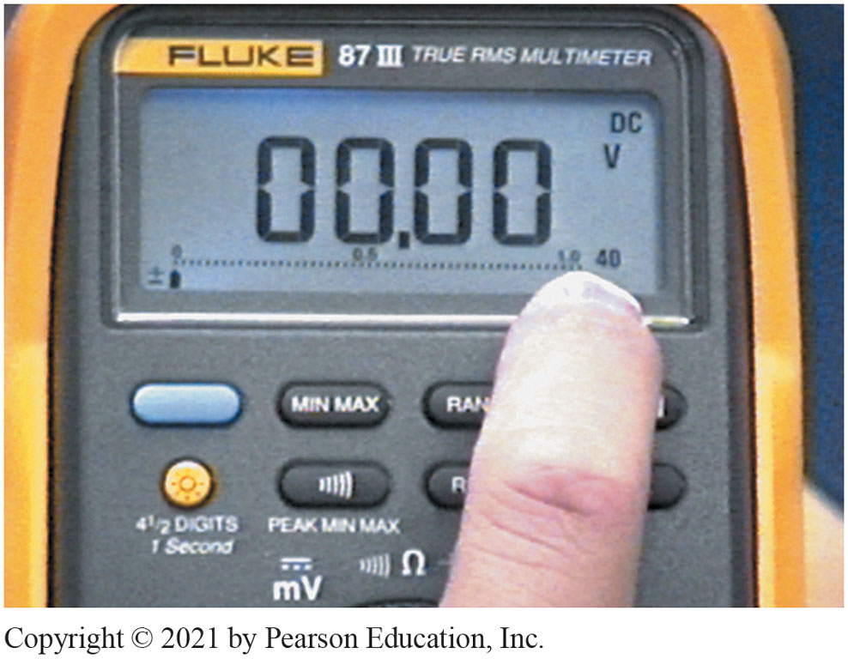
To Increase Range Touch Button
Notes:
20. To increase the range of the meter, touch the range button. Now the meter is set to read voltage up to 40-volts DC

Slide 69
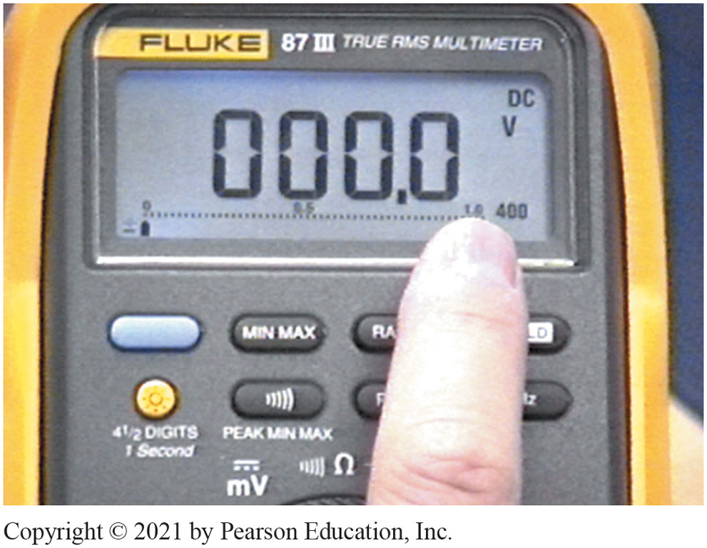
Pushing Range Button One More
Notes:
21. Pushing the range button one more time changes the meter scale to the 400-voltage range. Notice that the decimal point has moved to the right

Slide 70
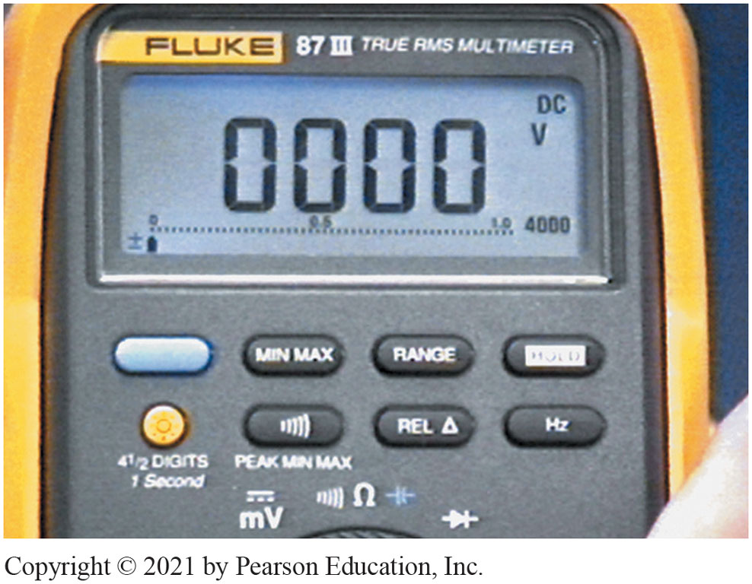
4,000-Volt Range
Notes:
22. Pushing the range button again changes the meter to the 4,000-volt range. This range is not suitable to use in automotive applications

Slide 71
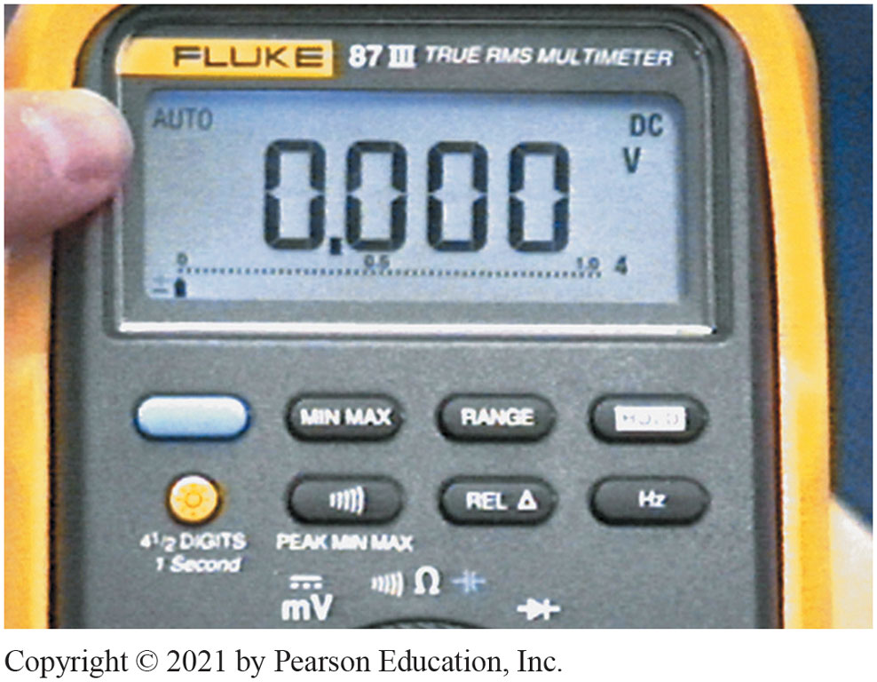
Autorange Preferred Setting
Notes:
22. Pushing the range button again changes the meter to the 4,000-volt range. This range is not suitable to use in automotive applications

Slide 72
Related Animations

Slide 73
Animation: Circuit Test, Amps, Meter (Animation will automatically start)

Slide 74
Animation: Meter Usage, Measure Frequency, Hz (Animation will automatically start)

Slide 75
Animation: Test Fuse, Meter (Animation will automatically start)

Slide 76
Animation: Meter Usage, Battery Volt Check (Animation will automatically start)

Slide 77
Animation: Battery Drain Test, Clamp Meter (Animation will automatically start)

Slide 78
Animation: Test Blower Motor, Clamp Meter (Animation will automatically start)

Slide 79
Electrical and Electronic Systems Videos and Animations
Videos Link: (A6) Electrical/Electronic Systems Videos
Animations Link: (A6) Electrical/Electronic Systems Animations

Slide 80
Copyright
This work is protected by United States copyright laws and is provided solely for the use of instructors in teaching their courses and assessing student learning. Dissemination or sale of any part of this work (including on the World Wide Web) will destroy the integrity of the work and is not permitted. The work and materials from it should never be made available to students except by instructors using the accompanying text in their classes. All recipients of this work are expected to abide by these restrictions and to honor the intended pedagogical purposes and the needs of other instructors who rely on these materials.

