Slide 1
Automotive Technology: Principles, Diagnosis, and Service
Seventh Edition
Chapter 38
Series, Parallel, and Series-Parallel Circuits
Copyright © 2023 Pearson Education, Inc. All Rights Reserved
Notes:
INSTRUCTOR NOTE: This presentation includes text explanation notes, you can use to teach the course. When in SLIDE SHOW mode, you RIGHT CLICK and select SHOW PRESENTER VIEW, to use the notes.

Slide 2
Learning Objectives (1 of 2)
38.1 Define series circuits.
38.2 Discuss Ohm’s law and series circuits.
38.3 Explain Kirchhoff’s voltage law.
38.4 Explain series circuit laws.
38.5 Define parallel circuits.
38.6 Discuss Kirchhoff’s current law.
38.7 Discuss parallel circuit laws.
.

Slide 3
Learning Objectives (2 of 2)
38.8 Determine the total resistance of a parallel circuit.
38.9 Define series-parallel circuits.
38.10 Explain how to solve series-parallel problems

Slide 4
Series Circuit
A series circuit is a complete circuit that has more than one electrical load where all of the current has only one path to flow through all of the loads.
The circuit must be continuous or have continuity in order for current to flow through the circuit.

Slide 5
Ohm’s Law and Series Circuits
Because all current flows through all resistances, the total resistance is the sum (addition) of all resistances.
Ohm’s law can be used to calculate the value of one unknown (voltage, resistance, or amperes) if the other two values are known.

Slide 6
Figure 38.1 Series Circuit
A series circuit with three bulbs. All current flows through all resistances (bulbs). The total resistance of the circuit is the sum of the total resistance of the bulbs. The bulbs light dimly because of the increased resistance and the reduction of current flow (amperes) through the circuit

Slide 7
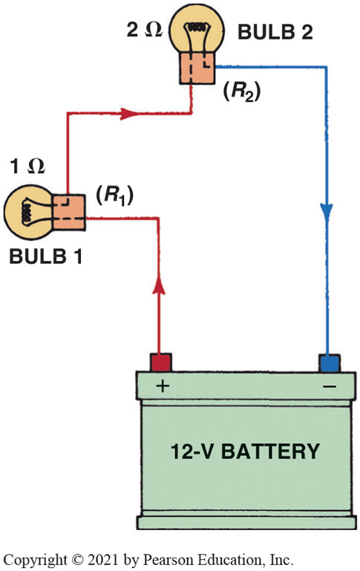
Figure 38.2 Series circuit with 2 bulbs
Notes:
TECH TIP: Farsighted Quality of Electricity
Electricity almost seems to act as if it “knows” what resistances are ahead on the long trip through a circuit. If the trip through the circuit has many high- resistance components, very few electrons (amperes) will choose to attempt to make the trip. If a circuit has little or no resistance (e.g., a short circuit), as many electrons (amperes) as possible attempt to flow through the complete circuit. If the flow exceeds the capacity of the fuse or the circuit breaker, the circuit is opened and all current flow stops.

Slide 8
Kirchhoff’s Voltage Law
Kirchhoff’s Second Law
Voltage around any closed circuit is equal to the sum (total) of the voltage drops across the resistances.
Applying Kirchhoff’s Law
Voltage drop determined by using ohm’s law and calculating for voltage (E) using value of each resistance individually.

Slide 9
Figure 38.3 Kirchhoff's Law
As current flows through a circuit, voltage drops in proportion to amount of resistance in circuit. Most, if not all, of resistance should occur across load, such as bulb in this circuit. All other components and wiring should produce little, if any, voltage drop. If a wire or connection did cause a voltage drop, less voltage would be available to light the bulb and the bulb would be dimmer than normal.

Slide 10
Figure 38.4 Series Circuit 3 Bulbs
In a series circuit, the voltage is dropped or lowered by each resistance in the circuit. The higher the resistance, the greater the drop in voltage

Slide 11
Figure 38.5 Voltmeter
Voltmeter reads the differences of voltage between test leads. The voltage read across a resistance is voltage drop that occurs when current flows through a resistance. A voltage drop is also called an “IR” drop because it is calculated by multiplying the current (I) through the resistance (electrical load) by the value of the resistance (R)

Slide 12
Frequently Asked Question: Why Check the Voltage Drop Instead of Measuring the Resistance?
? Frequently Asked Question
Why Check the Voltage Drop Instead of Measuring the Resistance? Imagine a wire with all strands cut except for one. Ohmmeter used to check resistance of this wire and the resistance would be low, indicating that the wire was okay. But this one small strand cannot properly carry current (amperes) the circuit. A voltage drop test is a better test to determine resistance in components for following 2 reasons: 1. An ohmmeter can only test a wire or component that has been disconnected from the circuit and is not carrying current. The resistance can, and does, change when current flows. 2. Voltage drop test is a dynamic test because as the current flows through a component, conductor increases in temperature, which in turn increases resistance. This means that a voltage drop test is testing circuit during normal operation and is therefore most accurate way of determining circuit conditions. A voltage drop test is also easier to perform because the resistance does not have to be known, only that the unwanted loss of voltage in a circuit should be less than 3% or less than about 0.14 volts for any 12-volt circuit.
Notes:
Why Check the Voltage Drop Instead of Measuring the Resistance?
Imagine a wire with all strands cut except for one. An ohmmeter can be used to check the resistance of this wire and the resistance would be low, indicating that the wire was okay. But this one small strand cannot properly carry the current (amperes) in the circuit. A voltage drop test is a better test to determine the resistance in components for following two reasons:
An ohmmeter can only test a wire or component that has been disconnected from the circuit and is not carrying current. The resistance can, and does, change when current flows.
A voltage drop test is a dynamic test because as the current flows through a component, the conductor increases in temperature, which in turn increases resistance. This means that a voltage drop test is testing the circuit during normal operation and is therefore the most accurate way of determining circuit conditions. A voltage drop test is also easier to perform because the resistance does not have to be known, only that the unwanted loss of voltage in a circuit should be less than 3% or less than about 0.14 volts for any 12-volt circuit.

Slide 13
Question 1: ?
What is Kirchhoff’s voltage law?

Slide 14
Answer 1
The voltage around any closed circuit is equal to the sum (total) of the voltage drops across the resistances.

Slide 15
Series Circuit Laws
Law 1
Total resistance in a series circuit is sum total of individual resistances.
Law 2
Current is constant throughout entire circuit.
Law 3
Although current is constant, the voltage drops across each resistance in the circuit. The voltage drop across each load is proportional to the value of the resistance compared to the total resistance.

Slide 16
Figure 38.6 Series with 2 Resistors
In this series circuit with a 2-ohm resistor and a 4-ohm resistor, current (2 amperes) is the same throughout, even though the voltage drops across each resistor

Slide 17
Series Circuit Examples
Each of the four examples discussed includes solving for the following:
Total resistance in the circuit
Current flow (amperes) through the circuit
Voltage drop across each resistance

Slide 18
Figure 38.7 Series Example 1
The unknown in this problem is the value of R2. The total resistance, however, can be calculated using Ohm’s law.
Notes:
See pages 433 and 434 for the equations and solutions

Slide 19
Figure 38.8 Series Example 2
The unknown in this problem is the value of R3 . The total resistance, however, can be calculated using Ohm’s law.
Notes:
See pages 433 and 434 for the equations and solutions

Slide 20
Figure 38.9 Series Example 3
The unknown value in this problem is the voltage of the battery. To solve for voltage, use Ohm’s law (E = I × R). The “R” in this problem refers to the total resistance (R). The total resistance of a series circuit is determined by adding the values of the individual resistors.
Notes:
See pages 433 and 434 for the equations and solutions

Slide 21
Figure 38.10 Series Example 4
The unknown in this example is the current (amperes) in the circuit. To solve for current, use Ohm’s law.
Notes:
See pages 433 and 434 for the equations and solutions

Slide 22
Animation: Series Circuit Law 2 (Animation will automatically start)

Slide 23
Animation: Series Circuit Law 3 (Animation will automatically start)

Slide 24
Parallel Circuits
Parallel circuit is a complete circuit that has more than one path for the current.
Separate paths that split and meet at junction points are called branches, legs, or shunts.
Current flow through each branch or leg varies, depending on the resistance in that branch.

Slide 25
Kirchhoff’s Current Law
Kirchhoff’s Current Law
Current flowing into any junction of an electrical circuit is equal to the current flowing out of that junction.

Slide 26
Figure 38.11 Kirchhoff’s Current Law
The amount of current flowing into junction point A equals the total amount of current flowing out of the junction
Notes:
TECH TIP: The Path of Least Resistance
There is an old saying that electricity will always take the path of least resistance. This is true, especially if there is a fault, such as in the secondary (high-voltage) section of the ignition system. If there is a path to ground that is lower than the path to the spark plug, the high-voltage spark will take the path of least resistance. In a parallel circuit where there is more than one path for the current to flow, most of the current will flow through the branch with the lower resistance. This does not mean that all of the current will flow through the lowest resistance, because the other path does provide a path to ground, and the amount of current flow through the other branches is determined by the resistance and the applied voltage according to Ohm’s law. Therefore, the only place where electricity takes the path of least resistance is in a series circuit where there are no other paths for the current to flow.

Slide 27
Animation: Parallel Circuit (Animation will automatically start)

Slide 28
Parallel Circuit Laws
Law 1
Total resistance of a parallel circuit is always less than that of the smallest-resistance leg.
Law 2
Voltage is same for each leg of a parallel circuit.
Law 3
Sum of the individual currents in each leg equals the total current.

Slide 29
Figure 38.12 Parallel Circuit Current
The current in a parallel circuit splits (divides) according to the resistance in each branch

Slide 30
Determining Total Resistance in a Parallel Circuit (1 of 2)
Method 1
Total current (in amperes) can be calculated first by treating each leg of the parallel circuit as a simple circuit.
Method 2
If only 2 resistors are connected in parallel, the total resistance (R _{T}) can be found using the formula R _{T} = (R₁ × R₂)/(R₁ + R₂).

Slide 31
Determining Total Resistance in a Parallel Circuit (2 of 2)
Method 3
Formula used to find the total resistance for any number of resistances in parallel is 1/R _{T} = 1/R₁ + 1/R₂ + 1/R₃ + . . .
Method 4
This method uses an electronic calculator, commonly available at very low cost.
Method 5
Method can be easily used whenever 2 or more resistances connected in parallel are of same value.

Slide 32
Figure 38.13 Parallel 3 Resistances
In a typical parallel circuit, each resistance has power and ground, and each leg operates independently of the other legs of the circuit
Notes:
See pages 435 to 436 for the calculations

Slide 33
Figure 38.14 Two Resistors Parallel
A schematic showing two resistors in parallel connected to a 12-volt battery
Notes:
See pages 435 to 436 for the calculations

Slide 34
Figure 38.15 Three Resistors Parallel
A parallel circuit with three resistors connected to a 12-volt battery
Notes:
See pages 435 to 436 for the calculations

Slide 35
Figure 38.16 3 Resistor Calculation
Using an electronic calculator to determine the total resistance of a parallel circuit

Slide 36
Figure 38.17 Three Resistor Example
Another example of how to use an electronic calculator to determine the total resistance of a parallel circuit. The answer is 13.45 ohms. Notice that the effective resistance of this circuit is less than the resistance of the lowest branch (20 ohms)

Slide 37
Figure 38.18 Equal Resistors
When a circuit has more than one resistor of equal value, the total resistance can be determined by simply dividing the value of the resistance (12 ohms in this example) by the number of equal-value resistors (4 in this example) to get 3 ohms
Notes:
SEE PAGES 436-437 FOR CALCULATIONS

Slide 38
Parallel Circuit Examples
Each of the 4 examples includes solving for following:
Total resistance
Current flow (amperes) through each branch, as well as total current flow
Voltage drop across each resistance

Slide 39
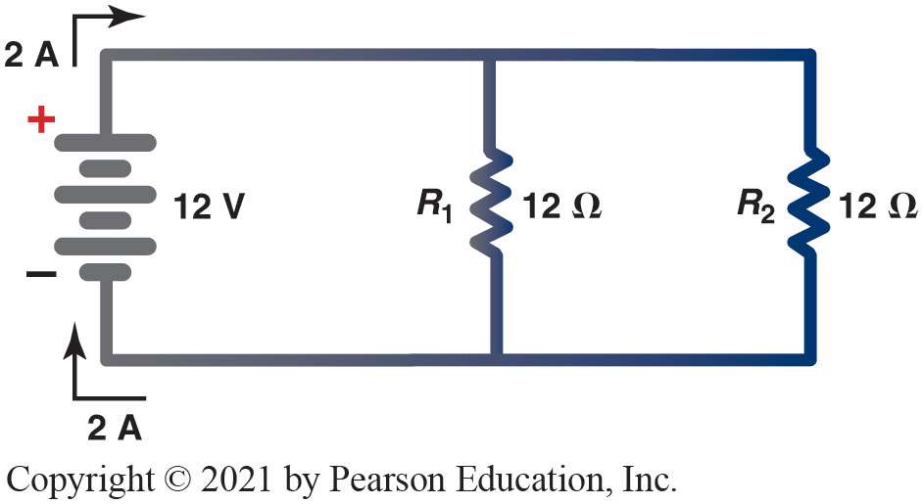
Figure 38.19 Example 1
Notes:
SEE PAGES 436-437 FOR CALCULATIONS

Slide 40
Figure 38.19 Parallel Example 1
In this example, the voltage of the battery is unknown and the equation to be used is E = I × R, where R represents total resistance of the circuit. Using the equation for two resistors in parallel, the total resistance is 6 ohms.
Notes:
See pages 436 and 437 for the specific calculations

Slide 41
Figure 38.20 Parallel Example 2
In this example, the value of R3 is unknown. Because the voltage (12 volts) and the current (12 A) are known, it is easier to solve for the unknown resistance by treating each branch or leg as a separate circuit
Notes:
In this example, the value of R3 is unknown. Because the voltage (12 volts) and the current (12 A) are known, it is easier to solve for the unknown resistance by treating
each branch or leg as a separate circuit. Using Kirchhoff’s law, the total current equals the total current flow through each branch. The current flow through R1 is 3 A (I = E/R =
12 V/4 3 = A) and the current flow through R2 is 6 A (I =E/R = 12 V/2 = 6 A). Therefore, the total current through the two known branches equals 9 A (3 A + 6 A = 9 A).
Because there are 12 A leaving and returning to the battery, the current flow through R3 must be 3 A (12 A − 9 A = 3 A). The resistance must therefore be 4 because the
current through the unknown resistance is 3 A (I = E/R =12 V/4 3 = A).

Slide 42
Figure 38.21 Parallel Example 3
The voltage of the battery is unknown. The equation to solve for voltage according to Ohm’s law is E = I × R. R in this equation refers to total resistance. Because there are 4 resistors of equal value, total can be determined by the equation: RT = Resistor Value divided by the Number of Resistors

Slide 43
Figure 38.22 Parallel Example 4
The unknown is the amount of current in the circuit. The Ohm’s law equation for determining current is I = E/R

Slide 44
Animation: Parallel Circuit Law 1 (Animation will automatically start)

Slide 45
Animation: Parallel Circuit Law 2 (Animation will automatically start)

Slide 46
Animation: Parallel Circuit Law 3 (Animation will automatically start)

Slide 47
Question 2: ?
Why is the total resistance of a parallel circuit less than the smallest resistance?

Slide 48
Answer 2
With many branches, more current can flow from the battery.

Slide 49
Series-Parallel Circuits
Series-parallel circuits are combination of series and parallel segments in one complex circuit.
There are 2 basic types of series-parallel circuits.
Circuit where load is in series with other loads in parallel.
Circuit where a parallel circuit contains resistors or loads that are in series with one or more branches.

Slide 50
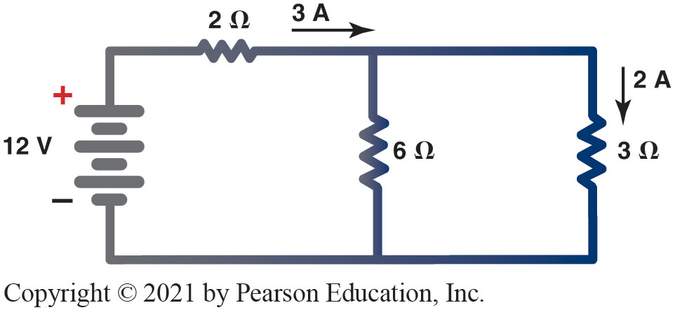
Figure 38.23 Series-Parallel Circuit

Slide 51
Animation: Series-Parallel Circuits (Animation will automatically start)

Slide 52
Solving Series-Parallel Circuits
Key to solving series-parallel circuit problems
Combine & Simplify
2 loads or resistances in series within parallel branch
Add the 2 resistances first before attempting to solve the parallel section.
Ohm's Law can be used to determine an unknown value in a series-parallel circuit
Notes:
The key to solving series-parallel circuit problems is to combine or simplify as much as possible. For example, if there are two loads or resistances in series within a parallel branch or leg, the circuit can be made simpler if the two are first added together before attempting to solve the parallel section. ● SEE FIGURE 38–24. Ohm's Law can be used to determine an unknown value in a
series-parallel circuit. ● SEE FIGURE 38–25.

Slide 53
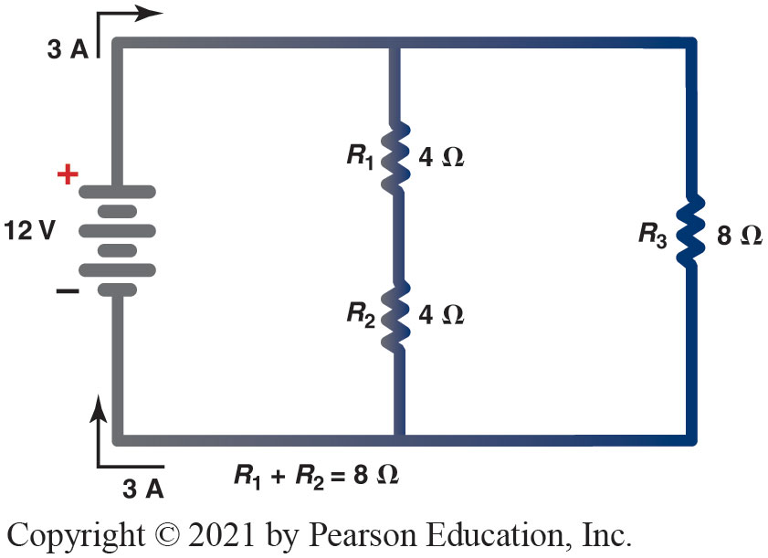
Figure 38.24 Solving Series-Parallel Circuit Problem

Slide 54
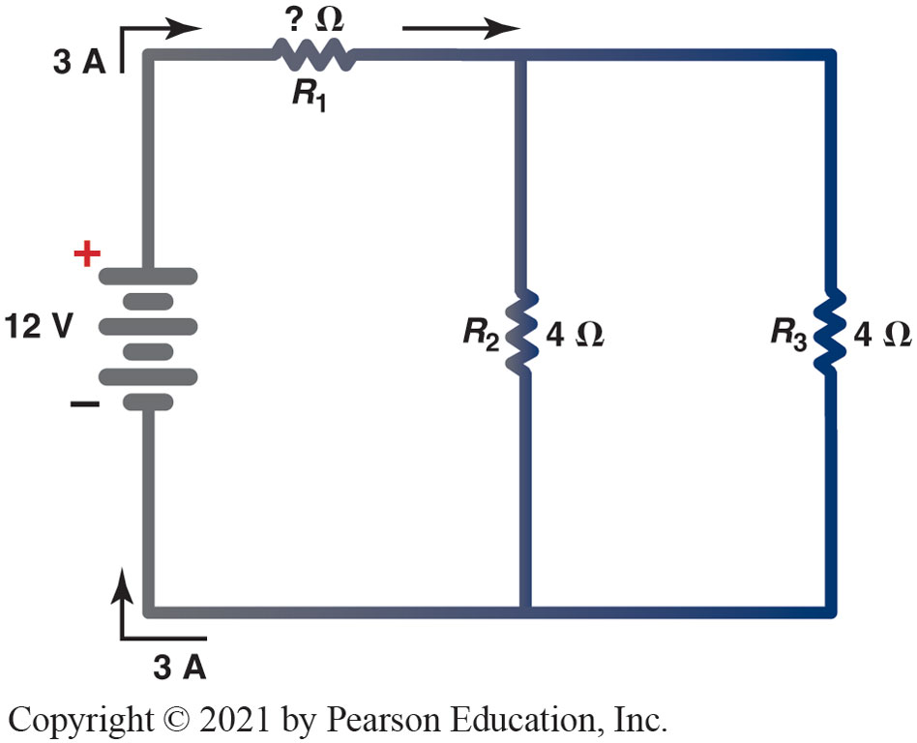
Figure 38.25 Finding R₁

Slide 55
Question 3: ?
What would be the effect of an open circuit in a series portion of a series-parallel circuit?

Slide 56
Answer 3
It would affect the entire circuit.

Slide 57
Electrical and Electronic Systems Videos and Animations
Videos Link: (A6) Electrical/Electronic Systems Videos
Animations Link: (A6) Electrical/Electronic Systems Animations

Slide 58
Copyright
This work is protected by United States copyright laws and is provided solely for the use of instructors in teaching their courses and assessing student learning. Dissemination or sale of any part of this work (including on the World Wide Web) will destroy the integrity of the work and is not permitted. The work and materials from it should never be made available to students except by instructors using the accompanying text in their classes. All recipients of this work are expected to abide by these restrictions and to honor the intended pedagogical purposes and the needs of other instructors who rely on these materials.

