Slide 1
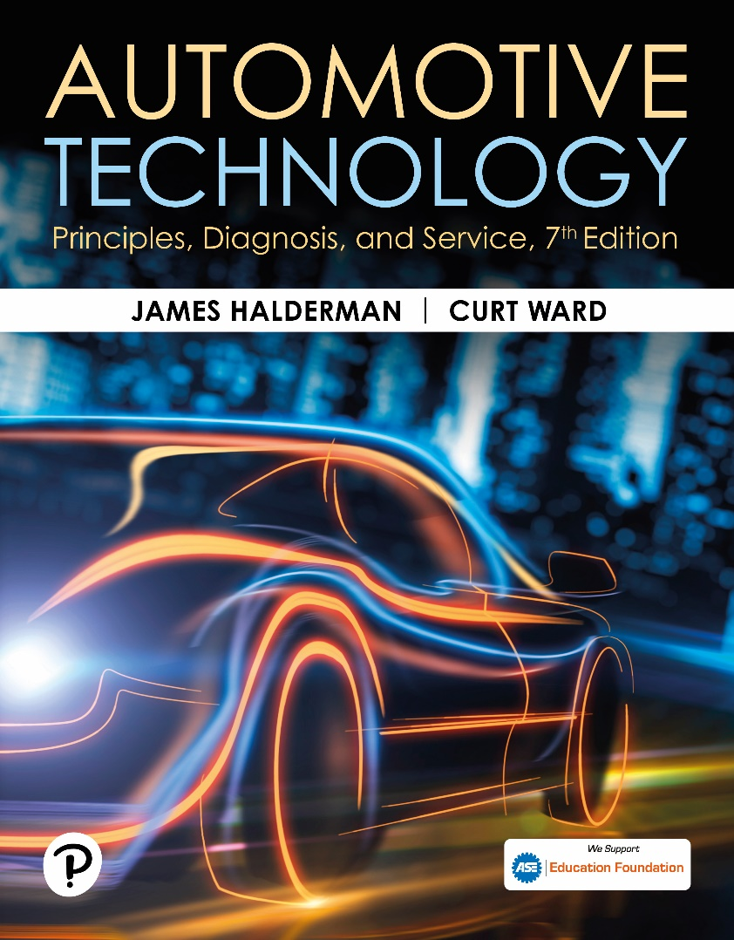
Automotive Technology: Principles, Diagnosis, and Service
Seventh Edition
Chapter 37
Electrical Circuits and Ohm’s Law
Copyright © 2023 Pearson Education, Inc. All Rights Reserved
Notes:
INSTRUCTOR NOTE: This presentation includes text explanation notes, you can use to teach the course. When in SLIDE SHOW mode, you RIGHT CLICK and select SHOW PRESENTER VIEW, to use the notes.

Slide 2
Learning Objectives
37.1 Identify the parts of a complete circuit.
37.2 Describe the characteristics of different types of circuit faults.
37.3 Explain Ohm’s law as it applies to automotive circuits.
37.4 Explain Watt’s law as it applies to automotive circuits.

Slide 3
Circuits
Definition
A circuit is a complete path that electrons travel from a power source (such as a battery) through a load, such as a lightbulb, and back to the power source.
Parts of a Complete Circuit
Power source
Protection
Power path
Electrical load
Return path

Slide 4
Figure 37.1 Complete Circuit
All complete circuits must have a power source, a power path, protection (fuse), an electrical load (lightbulb in this case), and a return path back to the power source

Slide 5
Figure 37.2 Return Path
The return path back to the battery can be any electrical conductor, such as a copper wire or the metal frame or body of the vehicle

Slide 6
Figure 37.3 Switch
An electrical switch opens the circuit and no current flows. The switch could also be on the return (ground) path wire.

Slide 7
Question 1: ?
What is included in a complete electrical circuit?

Slide 8
Answer 1
A power source, circuit protection, power path, electrical load, and a return path.

Slide 9
Circuit Fault Types (1 of 2)
Open Circuit
An open circuit is any circuit that is not complete, or that lacks continuity.
Short-to-Voltage
A short-to-voltage occurs when the power side of one circuit is electrically connected to the power side of another circuit.

Slide 10
Figure 37.4 Open Circuits
Examples of common causes of open circuits. Some of these causes are often difficult to find.
Notes:
An open circuit is any circuit that is not complete, or that lacks continuity, such as a broken wire. Open circuits have the following features: No current at all flows through an open circuit. An open circuit may be created by a break in the circuit or by a switch that opens (turns off) the circuit and prevents the flow of current. In any circuit containing a power load and ground, an opening anywhere in the circuit causes the circuit not to work. A light switch in a home and the headlight switch in a vehicle are examples of devices that open a circuit to control its operation. A fuse blows (opens) when the current in the circuit exceeds the fuse rating. This stops the current flow to prevent any harm to the components or wiring as a result of the fault.

Slide 11
Animation: Series Circuit, Open Circuit (Animation will automatically start)

Slide 12
Figure 37.5 Short-To-Voltage
A short circuit permits electrical current to bypass some or all of the resistance in the circuit.
Notes:
SHORT-TO-VOLTAGE If a wire (conductor) or component is
shorted to voltage, it is commonly referred to as being shorted.
A short-to-voltage occurs when the power side of one circuit is
electrically connected to the power side of another circuit. ● SEE
FIGURE 37–5.
TECH TIP: “Open” Is a Four-Letter Word: An open in a circuit breaks the path of current flow. The open can be any break in the power side, load, or ground side of a circuit. A switch is often used to close and open a circuit to turn it on and off. Just remember, Open = no current flow Closed = current flow Trying to locate an open circuit in a vehicle is often difficult and may cause the technician to use other four-letter words, such as “HELP”!
CASE STUDY: The Short-to-Voltage Story
A technician was working on a Chevrolet pickup truck with the following unusual electrical problems:
When the brake pedal was depressed, the dash light and the side marker lights would light.
The turn signals caused all lights to blink and the fuel gauge needle to bounce up and down.
When the brake lights were on, the front parking lights also came on.
NOTE: Using a single-filament bulb (such as a #1156) in the place of a dual-filament bulb (such as a #1157) could also cause many of these same problems.
Because most of the trouble occurred when the brake pedal was depressed, the technician decided to trace all the wires in the brake light circuit. The technician discovered the problem near the exhaust system. A small hole in the tailpipe (after the muffler) directed hot exhaust gases to the wiring harness containing all of the wires for circuits at the rear of the truck. The heat had melted the insulation and caused most of the wires to touch. Whenever one circuit was activated (such as when the brake pedal was applied), the current had a complete path to several other circuits. A fuse did not blow because there was enough resistance in the circuits being energized, so the current (in amperes) was too low to blow any fuses.
Summary:
Complaint—Customer stated that the truck lights were doing strange things when the brake pedal was depressed.
Cause—Melted wires caused by a small hole in the exhaust was found during a visual inspection.
Correction—Performing a wire repair and fixing the exhaust leak corrected the customer concern.

Slide 13
Circuit Fault Types (2 of 2)
Short-to-Ground
A short-to-ground is a type of short circuit that occurs when the current bypasses part of the normal circuit and flows directly to ground.
High Resistance
High resistance in a circuit is caused by an unwanted load.

Slide 14
Figure 37.6 Protection Device
A fuse or circuit breaker opens the circuit to prevent possible overheating damage in the event of a short circuit.

Slide 15
Figure 37.7 Short-To-Ground
A short-to-ground affects power side of the circuit. Current flows directly to the ground return, bypassing some or all of electrical loads in the circuit. There is no current in circuit past the short. A short-to-ground will also causes the fuse to blow.

Slide 16
Figure 37.8 Tech Tip Waterwheel
Electrical flow through a circuit is similar to water flowing over a waterwheel. The more water (amperes in electricity), greater amount of work (waterwheel). The amount of water remains constant, yet the pressure (voltage in electricity) drops as the current flows through the circuit
Notes:
TECH TIP: Think of a Waterwheel: A beginner technician cleaned the positive terminal of the battery when the starter was cranking the engine slowly. When questioned by the shop supervisor as to why only the positive post had been cleaned, the technician responded that the negative terminal was “only a ground.” The supervisor reminded the technician that the current, in amperes, is constant throughout a series circuit (such as the cranking motor circuit). If 200 amperes leave the positive post of the battery, then 200 amperes must return to the battery through the negative post. The technician could not understand how electricity can do work (crank an engine), yet return the same amount of current, in amperes, as left the battery. The shop supervisor explained that even though the current is constant throughout the circuit, the voltage (electrical pressure or potential) drops to zero in the circuit. To explain further, the shop supervisor drew a waterwheel. ● SEE FIGURE 37–8. As water drops from a higher level to a lower level, high potential energy (or voltage) is used to turn
the waterwheel and results in low potential energy (or lower voltage). The same amount of water (or amperes) reaches the pond under the waterwheel as
started in the fall above the waterwheel. As current (amperes) flows through a conductor, it performs work in the circuit (turns the waterwheel) while its voltage
(potential) drops.

Slide 17
Question 2: ?
What is the difference between a short-to-voltage and a short-to-ground?

Slide 18
Answer 2
A short-to-voltage is when the power of one circuit is unintentionally connected to another circuit. A short-to-ground is when part of a circuit is bypassed to ground.

Slide 19
Ohm’s Law
Definition
It requires 1 volt to push 1 ampere through 1 ohm of resistance.
Formulas
Ohm’s law can also be stated as a simple formula used to calculate one value of an electrical circuit if the other two are known.

Slide 20
Figure 37.9 Ohm’s Law Calculation
To calculate one unit of electricity when other 2 are known, simply use your finger and cover the unit you do not know. For example, if both voltage (E) and resistance (R) are known, cover letter I (amperes). Notice that the letter E is above the letter R, so divide the resistor’s value into the voltage to determine the current in the circuit

Slide 21
Chart 37.1 Ohm’s Law Chart
VOLTAGE | RESISTANCE | AMPERAGE
Up | Down | Up
Up | Same | Up
Up | Up | Same
Same | Down | Up
Same | Same | Same
Same | Up | Down
Down | Up | Down
Down | Same | Down

Slide 22
Figure 37.10 Example Ohm’s Law
This closed circuit includes: power source, power-side wire, circuit protection (fuse), resistance (bulb), and return path wire. In this circuit, if the battery has 12 volts and the electrical load has 4 ohms, then the current through the circuit is 3 amperes.

Slide 23
Animation: Ohm’s Law, Current (Animation will automatically start)

Slide 24
Animation: Ohm’s Law, Volt (Animation will automatically start)

Slide 25
Animation: Ohm’s Law, Resistance (Animation will automatically start)

Slide 26
Watt’s Law
Background
A watt is a unit of electrical power represented by a current of 1 ampere through a circuit with a potential difference of 1 volt.
Formulas
The symbol for a watt is the capital letter W. The formula for watts is: W = I x E
Magic Circle
The formulas for calculating any combination of electrical units are shown in the magic circle.

Slide 27
Animation: Math Formula: Watt (Animation will automatically start)

Slide 28
Figure 37.11 Watt’s Law
To calculate one unit when the other two are known, simply cover the unknown unit to see what unit needs to be divided or multiplied to arrive at the solution
Notes:
TECH TIP: Wattage Increases by the Square of the Voltage The brightness of a lightbulb, such as an automotive headlight or courtesy light, depends on the number of watts available. The watt is the unit by which electrical power is measured. If the battery voltage drops, even slightly, the light becomes noticeably dimmer. The formula for calculating power (P) in watts is P = I × E. This can also be expressed as Watts = Amps × Volts.
According to Ohm’s law, See page 428

Slide 29
Figure 37.12 Magic Circle
“Magic circle” of most formulas for problems involving Ohm’s law. Each quarter of “pie” has formulas used to solve for a particular unknown value: current (amperes), in the upper right segment; resistance (ohms), in the lower right; voltage (E), in the lower left; and power (watts), in the upper left.

Slide 30
Question 3: ?
What is Ohm’s law?

Slide 31
Answer 3
It requires 1 volt to push 1 ampere through 1 ohm of resistance.

Slide 32
Electrical and Electronic Systems Videos and Animations
Videos Link: (A6) Electrical/Electronic Systems Videos
Animations Link: (A6) Electrical/Electronic Systems Animations

Slide 33
Copyright
This work is protected by United States copyright laws and is provided solely for the use of instructors in teaching their courses and assessing student learning. Dissemination or sale of any part of this work (including on the World Wide Web) will destroy the integrity of the work and is not permitted. The work and materials from it should never be made available to students except by instructors using the accompanying text in their classes. All recipients of this work are expected to abide by these restrictions and to honor the intended pedagogical purposes and the needs of other instructors who rely on these materials.

