Slide 1
Automotive Technology: Principles, Diagnosis, and Service
Seventh Edition
Chapter 36
Electrical Fundamentals
Copyright © 2023 Pearson Education, Inc. All Rights Reserved
Notes:
INSTRUCTOR NOTE: This presentation includes text explanation notes, you can use to teach the course. When in SLIDE SHOW mode, you RIGHT CLICK and select SHOW PRESENTER VIEW, to use the notes.

Slide 2
Learning Objectives
39.1 Discuss the fundamentals of electricity
36.2 Explain how electrons move through a conductor.
36.3 Explain the units of electrical measurement, and discuss the relationship among volts, amperes, and ohms.
36.4 Discuss the different sources of electricity.
36.5 Explain conductors and resistance.
36.6 Describe the function of resistors.

Slide 3
Introduction
Electricity may be difficult for some people to learn for the following reasons.
It cannot be seen.
Only the results of electricity can be seen.
It has to be detected and measured.
The test results have to be interpreted.

Slide 4
Electricity (1 of 4)
Definition Electricity:
movement of electrons from one atom to another.
Dense center of each atom is called the nucleus
Nucleus contains:
Protons, have a positive charge
Neutrons, electrically neutral (have no charge)

Slide 5
Electricity (2 of 4)
Positive and Negative Charges
Orbiting electrons negatively charged, while protons positively charged.
Magnets and Electrical Charges
An ordinary magnet has two ends, a north pole and a south pole. Like poles repel and opposite poles attract.
Ions
When an atom is not balanced, it becomes a charged particle called an ion.

Slide 6
Electricity (3 of 4)
Electron Shells
Electrons orbit around the nucleus in definite paths. These paths form shells, like concentric rings, around the nucleus.
Free and Bound Electrons
A valance ring with three or less electrons will attract free electrons.
A valance ring with five or more electrons will tightly hold electrons; referred to as bound electrons.

Slide 7
Electricity (4 of 4)
Conductors
Conductors are materials with fewer than four electrons in their atom’s outer orbit.
Insulators
Insulators are materials with more than four electrons in their atom’s outer orbit.
Semiconductors
Materials with exactly four electrons in their outer orbit are neither conductors nor insulators, they are considered semiconductors.

Slide 8
Figure 36.1 Atom
In an atom (left), electrons orbit protons in the nucleus just as planets orbit the sun in our solar system (right)

Slide 9
Figure 36.2 Atom Nucleus
Nucleus of an atom has a positive (+) charge and the surrounding electrons have a negative (−) charge

Slide 10
Figure 36.3 Balanced Atom
Figure shows a balanced atom. The number of electrons is the same as the number of protons in the nucleus

Slide 11
Figure 36.4 Atom Polarity
Unlike charges attract and like charges repel

Slide 12
Animation: Magnets (Animation will automatically start)

Slide 13
Animation: Electron Travel, Magnet (Animation will automatically start)

Slide 14
Figure 36.5 Unbalanced Atom
An unbalanced, positively charged atom (ion) attracts electrons from neighboring atoms

Slide 15
Figure 36.6 Hydrogen Atom
The hydrogen atom is the simplest atom, with only one proton, one neutron, and one electron. More complex elements contain higher numbers of protons, neutrons, and electrons

Slide 16
Figure 36.7 Free Electron
Electrons in the outer orbit, or shell, can often be drawn away from the atom and become free electrons

Slide 17
Figure 36.8 Electrons Increase
As the number of electrons increases, they occupy increasing energy levels that are farther from the center of the atom

Slide 18
Figure 36.9 Conductor
A conductor is any element that has one to three electrons in its outer orbit

Slide 19
Frequently Asked Question: Is Water a Conductor?
? Frequently Asked Question
Is Water a Conductor? Pure water is an insulator; however, if anything is in the water, such as salt or dirt, then the water becomes conductive. Because it is difficult to keep it from becoming contaminated, water is usually thought of as being capable of conducting electricity, especially high-voltage household 110 or 220 volt outlets.

Slide 20
Figure 36.10 Copper Atom
Copper is an excellent conductor of electricity because it has just one electron in its outer orbit, making it easy to be knocked out of its orbit and flow to other nearby atoms

Slide 21
Animation: Copper Atom (Animation will automatically start)

Slide 22
Figure 36.11 Insulators
Insulators are elements with five to eight electrons in the outer orbit

Slide 23
Figure 36.12 Semiconductor
Semiconductor elements contain exactly four electrons in the outer orbit

Slide 24
Question 1: ?
What is electricity?

Slide 25
Answer 1
Electricity is the movement of electrons from one atom to another.

Slide 26
How Electrons Move Through a Conductor
Current Flow
For current to flow, there must be an imbalance of excess electrons at one end of circuit and a deficiency of electrons at opposite end of circuit.
Conventional Theory Versus Electron Theory
Conventional Theory: Flow of electrons from positive to negative.
Electron Theory: Flow of electrons from negative to positive.
Automotive applications use conventional theory.

Slide 27
Figure 36.13 Current
Current electricity is the movement of electrons through a conductor

Slide 28
Animation: Electron Flow (Animation will automatically start)

Slide 29
Figure 36.14 Conventional Theory
Conventional theory states that current flows through a circuit from positive (+) to negative (−). automotive electricity uses the conventional theory in all electrical diagrams and schematics

Slide 30
Frequently Asked Question: What Is Static Electricity?
? Frequently Asked Question
What Is Static Electricity? Static electricity means that isolated motionless electrical charges are present on an insulator. Static electricity is commonly created by friction. Static electricity occurs when an imbalance of electric charges is created on the surface of a material. This static charge can remain until it is discharged to a conductor. Static electricity can be created when using a hair comb or taking off a sweater. ● See Figure 36–15.

Slide 31
Figure 36.15 Static
Static electrical charge can build up in the body if walking on an insulated floor such as on carpet. Then the static charge can discharge to a conductor, such as A door knob, resulting in a mild shock and often heard as a snapping sound.

Slide 32
Animation: Static Electricity (Animation will automatically start)

Slide 33
Units of Electricity (1 of 2)
Ampere
Unit used to measure current flow.
Volts
Unit of measurement for electrical pressure.

Slide 34
Units of Electricity (2 of 2)
Ohms
Resistance to flow of current through a conductor is measured in units called ohms.
Watts
Electrical unit for power, the capacity to do work.

Slide 35
Figure 36.16 One Ampere
One ampere is the movement of 1 coulomb (6.28 billion billion electrons) past a point in 1 Second

Slide 36
Figure 36.17 Ammeter
An Ammeter Is Installed In the Path of the Electrons Similar to A Water Meter Used to Measure the Flow of Water In Gallons Per Minute. the Ammeter Displays Current Flow In Amperes.

Slide 37
Figure 36.18 Voltage
Voltage is the electrical pressure that causes the electrons to flow through a conductor

Slide 38
Animation: Voltage & Resistance (Animation will automatically start)

Slide 39
Figure 36.19 DMM
This Digital Multimeter Set to read DC volts Is being used to test the voltage of a vehicle battery. Most multimeters can also measure resistance (ohms) and current flow (amperes)

Slide 40
Animation: Meter Usage, Battery Volt Check (Animation will automatically start)

Slide 41
Figure 36.20 Resistance
Resistance to the flow of electrons through a conductor is measured in ohms

Slide 42
Figure 36.21 Hand-Cranked GEN
A display at the henry ford museum in Dearborn, Michigan, which includes A hand-cranked generator and a series of lightbulbs.

Slide 43
Sources of Electricity (1 of 3)
Friction
When certain different materials are rubbed together, the friction causes electrons to be transferred from one to the other.
Heat
When pieces of two different metals are joined together at both ends and one junction is heated, current passes through the metals.

Slide 44
Sources of Electricity (2 of 3)
Light
When certain metals are exposed to light, some of the light energy is transferred to the free electrons of the metal.
Pressure
Generation of voltage due to pressure applied to a crystal.

Slide 45
Sources of Electricity (3 of 3)
Chemical
Two different materials (usually metals) placed in a conducting and reactive chemical solution create a difference in potential, or voltage, between them.
Magnetism
Electricity can be produced if a conductor is moved through a magnetic field or a moving magnetic field is moved near a conductor.

Slide 46
Figure 36.22 Galvanometer
Electron flow is produced by heating the connection of two different metals. A galvanometer is an analog (needle type) meter designed to detect weak voltage signals

Slide 47
Animation: Electron Travel, Heat (Animation will automatically start)

Slide 48
Animation: Electron Travel Light (Animation will automatically start)

Slide 49
Figure 36.24 Piezoelectricity
Electron flow is produced by pressure on certain crystals

Slide 50
Animation: Electron Travel, Pressure (Animation will automatically start)

Slide 51
Frequently Asked Question: How Much Voltage and Current Is Discharged in a Lightning Strike?
? Frequently Asked Question
How Much Voltage and Current Is Discharged in a Lightning Strike? Cloud-to-cloud and cloud-to-ground lightning bolts are common occurrences. Most lightning strikes carry from 5,000 amperes to over 200,000 amperes with voltages from 40,000 volts to over 120,000 volts. However, the lightning strike lasts for only a few microseconds so actual power in each strike is low. Figure 36–25.

Slide 52
Figure 36.25 Lightening
Lightning created by static charges that build up in clouds can discharge to another cloud or to earth.

Slide 53
Animation: Lightening (Animation will automatically start)

Slide 54
Question 2: ?
What are the six sources of electricity?

Slide 55
Answer 2
Friction, heat, light, pressure, chemical, and magnetism.

Slide 56
Conductors and Resistance
All conductors have some resistance to current flow.
Conductor length doubled, resistance doubles.
Conductor diameter increased, resistance reduced.
Temperature increases, resistance increases.
Materials used in conductor have an impact on its resistance.

Slide 57
Chart 36.1 Conductor Ratings
1 | Silver
2 | Copper
3 | Gold
4 | Aluminum
5 | Tungsten
6 | Zinc
7 | Brass (copper and zinc)
8 | Platinum
9 | Iron
10 | Nickel
11 | Tin
12 | Steel
13 | Lead

Slide 58
Question 3: ?
What is the relationship between the length of a wire and its resistance?

Slide 59
Answer 3
If the conductor length is doubled, its resistance doubles.

Slide 60
Resistors
Fixed Resistors
Resistors represent an electrical load, or resistance to current flow.
Variable Resistors
Potentiometer is a 3-terminal variable resistor where a wiper contact provides a variable voltage output.
Rheostat is a 2-terminal unit in which all of the current flows through the movable arm.

Slide 61
Figure 36.26 Resistor Bands
This figure shows a resistor color-coded interpretation

Slide 62
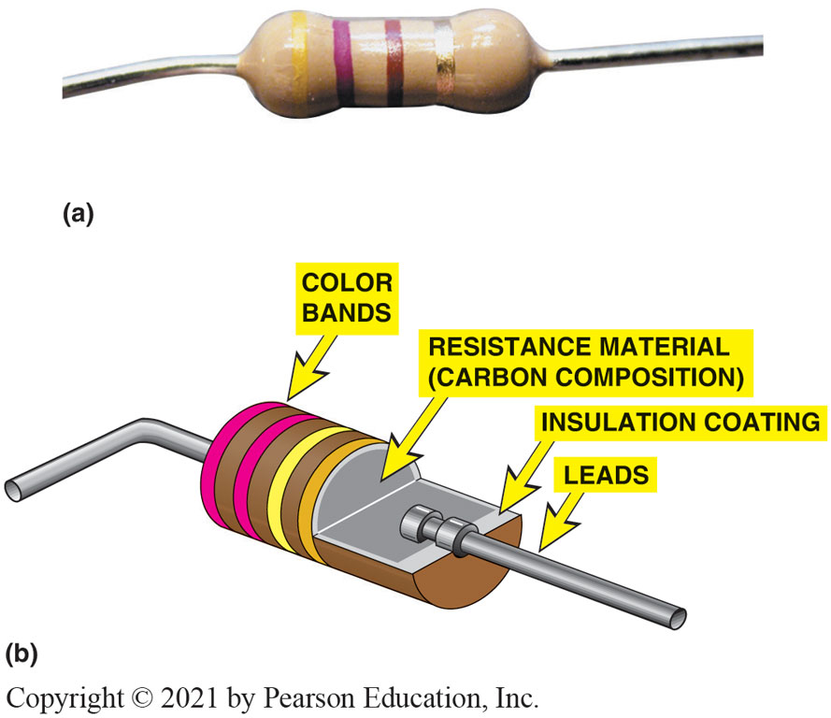
Figure 36.27 Typical Carbon Resistor

Slide 63
Frequently Asked Question: Why Is Gold Used If Copper Has Lower Resistance?
? Frequently Asked Question
Why Is Gold Used If Copper Has Lower Resistance? Copper is used for most automotive electrical components and wiring because it has low resistance and is reasonably priced. Gold is used in airbag connections and sensors because it does not corrode. Gold can be buried for hundreds of years and when dug up, is just as shiny as ever.

Slide 64
Figure 36.28 Potentiometer
Three-wire variable resistor is called a potentiometer

Slide 65
Animation: Potentiometer (Animation will automatically start)

Slide 66
Figure 36.29 Rheostat
Two-wire Variable resistor is called a rheostat

Slide 67
Electrical and Electronic Systems Videos and Animations
Videos Link: (A6) Electrical/Electronic Systems Videos
Animations Link: (A6) Electrical/Electronic Systems Animations

Slide 68
Copyright
This work is protected by United States copyright laws and is provided solely for the use of instructors in teaching their courses and assessing student learning. Dissemination or sale of any part of this work (including on the World Wide Web) will destroy the integrity of the work and is not permitted. The work and materials from it should never be made available to students except by instructors using the accompanying text in their classes. All recipients of this work are expected to abide by these restrictions and to honor the intended pedagogical purposes and the needs of other instructors who rely on these materials.

