Slide 1
Automotive Technology: Principles, Diagnosis, and Service
Seventh Edition
Chapter 34
Engine Assembly and Dynamometer Testing
Copyright © 2023 Pearson Education, Inc. All Rights Reserved
Notes:
INSTRUCTOR NOTE: This presentation includes text explanation notes, you can use to teach the course. When in SLIDE SHOW mode, you RIGHT CLICK and select SHOW PRESENTER VIEW, to use the notes.

Slide 2
Learning Objectives (1 of 2)
34.1 Describe steps to take when starting to assemble the engine.
34.2 Explain short block preparation.
34.3 Explain cylinder head preparation.
34.4 Discuss trial assembly.
34.5 Discuss final short block assembly.
34.6 Describe camshaft installation.
34.7 Describe piston/rod installation.

Slide 3
Learning Objectives (2 of 2)
34.8 Explain the cylinder head installation procedure.
34.9 Discuss torque-to-yield head bolts.
3410 Explain valve train assembly.
34.11 Explain final assembly of an engine.
34.12 Explain dynamometer testing.

Slide 4
Details, Details, Details
Successful engine assembly depends on getting all of the details right.
Read. Read all instructions that are included with all new parts and gaskets.
Understand. Be sure to fully understand everything that is stated in the instructions.
Follow. Be sure to follow all of the instructions.

Slide 5
Figure 34.1 Ford 3-Cylinder
Ford 1.0 liter 3-cylinder engine is different than many small engines and may require detailed service information for proper assembly

Slide 6
Short Block Preparation (1 of 3)
Items to Check
All passages should be clean and free of rust and debris.
All gasket surfaces are properly cleaned and checked for burrs and scratches.
All cups and plugs should be installed.
The final bore dimension is correct for the piston.
The surface finish of the cylinder bore matches with the specified finish required for the piston rings that are going to be used.
All sharp edges and burrs have been removed.

Slide 7
Short Block Preparation (2 of 3)
Surface Finish
Surface finish is measured in microinches.
The higher the microinch finish, the rougher the surface.
The lower the microinch finish, the smoother the surface.
Check Surfaces Before Assembly
All surfaces of an engine should be clean and straight and have the specified surface finish and flatness.

Slide 8
Short Block Preparation (3 of 3)
Preparing the Block for Studs
Using studs instead of head bolts for cylinder heads is recommended for all high-performance applications.
Studs provide for more accurate and consistent torque loading and clamping force.
The use of studs for the main bearing saddles helps main cap alignment.
Preparing the Thread Holes
All threads in the block should be thoroughly cleaned and free of any liquid.

Slide 9
Figure 34.2 Deburring Sharp Edges
Deburring all sharp edges is an important step to achieve proper engine assembly

Slide 10
Chart 34.1 Surface Finish
ENGINE PART MATERIAL | GASKET MATERIAL | ACCEPTABLE SURFACE FINISH (RA)
Cast iron/cast iron | Composite | 60 to 80 µinch
Aluminum/cast iron | Composite | 20 to 30 µinch
Aluminum/cast iron | Rubber-coated multilayered steel (MLS) | 15 to 30 µinch
The surface finish of the block and cylinder head depends on the type of gasket being used.

Slide 11
Figure 34.3 Installing Heli-coils®
A Cadillac Northstar engine being rebuilt. The shop doing the work is installing Heli-coils® in all threaded cylinder head bolt holes as a precaution. Using duct tape to cover the engine helps prevent aluminum chips from getting into passages.
Notes:
TECH TIP: Be Aware of BMW Engine Procedures
If rebuilding a BMW engine, check service information carefully because most BMW engines require that threaded inserts be installed in all head bolt threads. Performing this operation can increase the cost and time needed. Always follow all recommended service procedures on the engine being serviced. SEE FIGURE 34–3.

Slide 12
Figure 34.4 Thread Chaser
A thread chaser (top) is the preferred tool to clean threaded holes because it cleans without removing metal, compared to a tap (bottom)

Slide 13
Figure 34.5 Cover Engine
Using a plastic trash bag is an excellent way to keep the engine clean during all stages of assembly
Notes:
TECH TIP: Keep the Engine Covered
Using a large plastic trash bag is an excellent way to keep the engine clean when storing it between work sessions. Figure 34-5

Slide 14
Cylinder Head Preparation
Check the following details on the cylinder head(s).
The surface finish of the fire deck is as specified.
All valves should be checked for leakage.
All valve springs should be checked for even spring pressure and installed height.
Check for proper pushrod length.
If replacement rocker arms are used, be sure that the geometry and total lift is okay.
Notes:
CASE STUDY: Valve Springs Can Vary
A technician was building a small block Chevrolet V-8 and found that many of the valve springs did not have the same tension. Using a valve spring tester, the technician visited a local parts store and measured all of the valve springs that the store had in stock. The technician selected and purchased the 16 valve springs that were within specification and within a very narrow range of tension. Although having all valve springs equal may or may not affect engine operation, the technician was pleased that all of the valve springs were equal.
Summary:
Complaint—A technician discovered that valve springs did not all have the same tension.
Cause—Due to manufacturing tolerances, valve springs can vary in tension.
Correction—The technician tested all available springs and selected those that were the most equal in tension.

Slide 15
Trial Assembly
Short Block
Before performing final engine assembly, the wise technician checks that all parts fit and work.
Valve Train
Some timing chain mechanisms require more space than the stock component, so some machining may be needed.
Check the Angle Between the Heads
Use a gauge to check the angle to ensure proper intake manifold gasket sealing.

Slide 16
Figure 34.6 Trial Assembly
A trial assembly showed that some grinding of the block is needed to provide clearance for the counterweight of the crankshaft. Also, notice that the engine has been equipped with studs for the four-bolt main bearing caps

Slide 17
Figure 34.7 Fogging Oil
Fogging oil is used to cover bare metal parts when the engine is being stored to prevent corrosion
Notes:
TECH TIP: Fogging Oil and Assembly Lube
When assembling an engine, the parts should be coated with a light oil film to keep them from rusting. This type of oil is commonly referred to as fogging oil and is available in spray cans. SHOWN IN FIGURE 34-7. During engine assembly, the internal parts should be lubricated. While engine oil or grease could be used, most experts recommend the use of a specific lubricant designed for engine assembly. This lubricant, designed to remain on the parts and not drip or run, is called assembly lube. SEE Figure 34-8.

Slide 18
Figure 34.8 Assembly Lube
Engine assembly lube is recommended to be used on engine parts during assembly

Slide 19
Figure 34.9 Angle Gauge
An angle gauge being used to check the angle between the cylinder heads on this small block Chevrolet V-8 engine

Slide 20
Final Short Block Assembly (1 of 5)
Block Preparation
The block, including the oil gallery passages, should be thoroughly cleaned.
All threaded bolt holes should be chamfered.
All threaded holes should be cleaned with a thread chaser before final assembly.
Installing Cups and Plugs
Oil gallery plugs should be installed using sealant on the threads.
Core holes left in the external block wall are machined and sealed with soft core plugs or expansion plugs (also called freeze plugs or Welsh plugs).

Slide 21
Final Short Block Assembly (2 of 5)
Cam Bearings
A cam bearing installing tool is required to insert the new cam bearing without damaging the bearing.
The installed bearing must be checked to ensure that it has the correct depth and that the oil hole is indexed with the oil passage in the block.
Measuring Main Bearing Clearance
The oil clearance of both main and connecting rod bearings is set by selectively fitting the bearings. In this way, the oil clearance can be adjusted to within 0.0005 inch of the desired clearance.

Slide 22
Final Short Block Assembly (3 of 5)
Correcting Bearing Clearance
The oil clearance can be reduced by 0.001 inch by replacing both the bearing shells with bearing shells that are 0.001 inch undersize.
The clearance can be reduced by 0.0005 inch by replacing only one of the bearing shells with a bearing shell that is 0.001 inch smaller.
Lip Seal Installation
The lip of the seal should be well lubricated before the shaft and cap are installed.
Check manufacturer’s recommendations on sealant.

Slide 23
Final Short Block Assembly (4 of 5)
Rope Seal Installation
Rope-type oil seals must be compressed tightly into the groove so that no oil can leak behind them.
Special care used when trimming excess rope
Crankshaft Installation
Crankshaft should be carefully placed in the bearings to avoid damage to the thrust bearing surfaces.
Main bearing cap bolts tightened finger tight, and the crankshaft is rotated.
Should rotate freely.

Slide 24
Final Short Block Assembly (5 of 5)
Thrust Bearing Clearance
Pry crankshaft forward and rearward to align cap half of the thrust bearing with the block saddle half.
Clearance measured with dial indicator or feeler gauge
Main Bearing Tightening Sequence
Tighten the main bearing caps to the specified assembly torque, and in the specified sequence.

Slide 25
Figure 34.10 Clean Cylinders
best way to thoroughly clean cylinders is to use soap (detergent), water, and a large washing brush. This method floats the machining particles out of the block and washes them away

Slide 26
Figure 34.11 Cleaning Galleries
All oil galleries should be cleaned using soap (detergent), water, and a long oil gallery cleaning brush

Slide 27
Figure 34.12 Cup Plugs
This engine uses many cup plugs to block off coolant and oil passages, as well as a large plug over the end of the camshaft bore

Slide 28
Figure 34.13 Sealing Cup Plugs
Sealer should be applied to the cup plug before being driven into the block
Notes:
CAUTION: Avoid using Teflon tape on the threads of oil gallery plugs or coolant drain plugs. The tape is often cut by the threads, and thin strips of the tape are then free to flow through the oil galleries where the tape can cause a clog, thereby limiting lubricating engine oil to important parts of the engine.

Slide 29
Figure 34.14 Installing Cam Bearings
Screw-type puller being used to install a new cam bearing. Most cam bearings are crush fit. The full round bearing is forced into the cam bearing bore. Most vehicle manufacturers specify that the cam bearings be installed “dry” without lubrication to help prevent them from spinning, which would cause the bearing to block the oil feed hole.

Slide 30
Frequently Asked Question: What Causes Premature Bearing Failure?
? Frequently Asked Question
What Causes Premature Bearing Failure? According to a major manufacturer of engine bearings, the major causes of premature (shortly after installation) bearing failure include the following:
Dirt (45%)
Misassembly (13%)
Misalignment (13%) Lack of lubrication (11%)
Overloading or lugging (10%) Corrosion (4%)
Other (4%)
Many cases of premature bearing failure result from combination of several of these items. To prevent bearing failure, keep everything as clean as possible.

Slide 31
Figure 34.15 Main Bearings
Typical main bearing set. Note that the upper halves are grooved for better oil flow and the lower halves are plain for better load support. This bearing set uses the center main bearing for thrust control. Notice that the upper bearing set has the holes for oil, whereas the lower set does not

Slide 32
Figure 34.16 Plastigage®
Width of plastic gauging strip determines oil clearance of the main bearing. An alternate method of determining oil clearance includes careful measurement of the crankshaft journal and bearings after they are installed. The main housing bore caps are torqued to specifications

Slide 33
Figure 34.17 Rear Main Seal
Lip-type rear main bearing seal in place in the rear main bearing cap. The lip should always be pointing toward the inside of the engine

Slide 34
Figure 34.18 Seal Installer
Always use the proper driver to install a main seal. Never pound directly on the seal

Slide 35
Animation: Seal Driver (Animation will automatically start)

Slide 36
Figure 34.19 Seal Retainer
The rear seal for this engine mounts to a retainer plate. The retainer is then bolted to the engine block
Notes:
TECH TIP “One to Three”
When engine technicians are talking about clearances and specifications, the unit of measure most often used is thousandths of an inch (0.001 inch). Therefore, a clearance expressed as “one to three” would actually be a clearance of 0.001 to 0.003 inch (0.0254 to 0.076 inch). The same applies to parts of a thousandth of an inch. For example, a specification of 0.0005 to 0.0015 inch (0.0127 to 0.038 inch) would be spoken of as simply being “one-half to one and one-half.” The unit of a thousandth of an inch is Assumed, and this method of speaking reduces errors and misunderstandings.
NOTE: Most engine clearance specifications fall within one to three thousandths of an inch. The written specification could be a misprint. Therefore, if the specification does not fall within this general range, double-check the clearance value using a different source.

Slide 37
Figure 34.20 Rope-Type Seals
Many engine builders prefer to stagger the parting lines of a rope-type seal

Slide 38
Figure 34.21 Crankshaft Endplay
A dial indicator is being used to check the crankshaft end play, known as thrust bearing clearance. Always follow the manufacturer’s recommended testing procedures

Slide 39
Figure 34.22 Thrust Bearing Insert
A thrust bearing insert being installed before the crankshaft is installed

Slide 40
Installing the Camshaft
Prelubrication
When camshaft is installed
Lobes must be coated with a special lubricant that contains molydisulfide.
Camshaft Precautions
When installing a new camshaft, always install new valve lifters (tappets).
Never use a hydraulic lifter camshaft with solid lifters or hydraulic lifters with a solid lifter camshaft.

Slide 41
Figure 34.23 Installing Camshaft
Installing a camshaft is easier if the engine is vertical so gravity can help, and this method reduces the possibility of damaging the cam bearings
Notes:
TECH TIP: Use a Long Bolt to Hold the Camshaft: To help install a camshaft without harming the cam bearings, install a long bolt into one of the end threaded holes in the camshaft. Then tilt the engine vertically so that gravity will cause the camshaft to fall straight down while holding onto the camshaft using the long bolt. ● SEE FIGURE 34–23.

Slide 42
Figure 34.24 ZDDP
A commercial additive designed to protect a flat bottom lifter camshaft used in older vehicles when using newer oils that do not have enough ZDDP to protect the camshaft and lifters
Notes:
TECH TIP: Two Choices If Using Flat-Bottom Lifters
An old or rebuilt engine that uses flat-bottom lifters must use one of two lubricants.
1. Oils that contain at least 0.15% or 1,500 parts per mil- lion (ppm) of zinc in the form of ZDDP. Oils that contain this much zinc are designed for off-road use only and in a vehicle that does not have a catalytic converter, such as racing oils. If the vehicle is equipped with a catalytic converter, replace the camshaft and lifters to roller type, so that newer oils with lower levels of zinc can be used.
2. Use a newer oil and an additive such as
a. GM engine oil supplement (EOS) (Part #1052367 or #88862586)
b. Comp Cams® camshaft break-in oil additive (Part #159)
c. Crane Cams® Moly Paste (Part #99002-1)
d. Crane Cams® Super Lube oil additive (Part #99003-1)
e. Lumati Assembly lube (Part #99010)
f. Mell-Lube camshaft tube oil additive (Part # M-10012)
g. Other available additives designed to protect the camshaft (● 4–24.)

Slide 43
Piston/Rod Installation (1 of 4)
Checking Piston Rings
Before installing the piston assemblies
All piston rings should be checked for proper side clearance and ring gap.

Slide 44
Piston/Rod Installation (2 of 4)
Piston Markings
Care must be taken to ensure that the pistons and rods are in the correct cylinder and facing the correct direction.
Connecting Rod Bearing Clearance
Use Plastigage® following the same procedure discussed for main bearing clearance.

Slide 45
Piston/Rod Installation (3 of 4)
Piston Installation
Apply coating of clean engine oil to cylinder walls.
Apply oil or assembly lube to rod bearings.
Align piston ring gaps (ring gap stagger) to locations specified in service information.
Using a squirt-type oil can, squirt oil over the rings and the skirt of the piston.
Install ring compressor.
Install protectors over rod bolts.
Carefully install piston into the cylinder until the rod bearing is fully seated on the journal.

Slide 46
Piston/Rod Installation (4 of 4)
Connecting Rod Side Clearance
Measured by fitting the correct thickness of feeler gauge between the connecting rod and the crankshaft cheek of the bearing journal.
If side clearance is too great, excessive amounts of oil may escape that can cause lower-than-normal oil pressure.
If side clearance is too small, there may not be enough room for heat expansion.

Slide 47
Figure 34.25 Ring Gap
A feeler gauge is used to check piston ring gap

Slide 48
Figure 34.26 Piston Position
The notch on a piston should always face toward the front of the engine

Slide 49
Chart 34.2 Ring Gap Chart
PISTON DIAMETER (INCHES) | RING GAP (INCHES)
2 to 3 | 0.007 to 0.018
3 to 4 | 0.01 to 0.02
4 to 5 | 0.013 to 0.023
The approximate ring gap based on the size of the bore in inches. Always check service information for the exact specifications for the engine being assembled.

Slide 50
Figure 34.27 Large Chamfer
On V-type engines that use paired rod journals, the side of the rod with the large chamfer should face toward the crank throw (outward).

Slide 51
Figure 34.28 Inside Diameter
An inside micrometer can be used to measure the inside diameter of the big end of the connecting rod with the bearings installed. This dimension subtracted from the rod journal diameter is equal to the bearing clearance

Slide 52
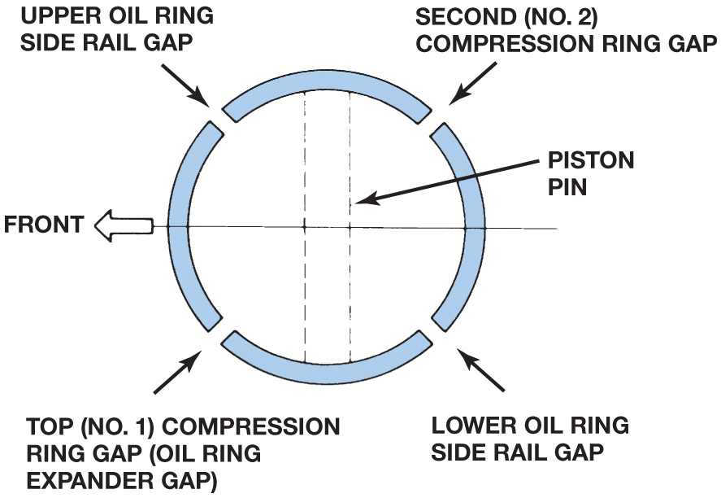
Figure 37.32 Ring Gap Location

Slide 53
Figure 34.29 Ring Stacking
One method of piston ring installation showing the location of ring gaps. Always follow the manufacturer’s recommended method for the location of ring gaps and for ring gap spacing

Slide 54
Figure 34.30 Gapless Ring
A gapless ring is made in two pieces that overlap

Slide 55
Figure 34.31 Ring Compressor
This style of ring compressor uses a ratchet to contract the spring band and compress the rings into their grooves

Slide 56
Figure 34.32 Ting Compressor
This pliers-like tool is used to close the metal band around the piston to compress the rings. An assortment of bands is available to service different size pistons

Slide 57
Figure 34.33 Rod Bolt Guards
When threaded onto the rod bolts, these guides not only help align the rod, but also protect the threads and hold the bearing shell in place. The soft ends do not damage the crankshaft journals

Slide 58
Figure 34.34 Installing Piston
Installing a piston using a ring compressor to hold the rings into the ring grooves of the piston, and then using a hammer handle to drive the piston into the bore. Connecting rod bolt protectors have been installed to help prevent possible damage to the crankshaft during piston installation

Slide 59
Figure 34.35 Rod Side Clearance
The connecting rod side clearance is measured with a feeler gauge
Notes:
TECH TIP: Tightening Tip for Rod Bearings: Even though the bearing clearances are checked, it is still a good idea to check and record the torque
required to rotate the crankshaft with all piston rings dragging on the cylinder walls. The retaining nuts on one bearing should be torqued, and then
the torque that is required to rotate the crankshaft should be rechecked and recorded. Follow the same procedure on all rod bearings. If tightening any one of the rod bearing caps causes a large increase in the torque required to rotate the crankshaft, immediately stop the tightening process. Determine the cause of the increased rotating torque using the same method as used on the main bearings. Rotate the crankshaft for several revolutions to ensure that the assembly is turning freely and that there are no tight spots. The rotating torque of the crankshaft with all connecting rod cap bolts fully torqued should be as follows:
• 4-cylinder engine: 20 lb-ft maximum (88 N-m)
• 6-cylinder engine: 25 lb-ft maximum (110 N-m)
• 8-cylinder engine: 30 lb-ft maximum (132 N-m)

Slide 60
Cylinder Head Installation (1 of 3)
Installing Camshaft for OHC Engines
On some overhead camshaft engines, the camshaft is installed before the head is fastened to the block deck.
The cam bearings on these engines can be either one piece or split.
The cam bearing caps must be tightened evenly to avoid bending the camshaft.
Some engines use shims under a follower disk.

Slide 61
Cylinder Head Installation (2 of 3)
Head Bolt Torque Sequence
In general, the head bolts are tightened in a specified torque sequence in three steps.
The procedure starts with the head bolts in the center and then moves to those farther and farther from the center.
By tightening the head bolts in three steps, the head gasket has time to compress and conform to the block deck and cylinder head gasket surfaces.

Slide 62
Cylinder Head Installation (3 of 3)
Clamping Force
Clamping force is amount of force exerted on a gasket.
Fastener Consideration
Clean threads of all fasteners before using.
Check service information for specified thread lubricant.
Thread Lubricant
Follow the manufacturer’s recommendations.

Slide 63
Figure 34.36 Valve Clearance
Valve clearance allows the metal parts to expand and maintain proper operation, both when the engine is cold and at normal operating temperature. (a) Adjustment is achieved by turning the adjusting screw

Slide 64
Animation: Valve Stem Height (Animation will automatically start)

Slide 65
Animation: Valve Spring Installed Height (Animation will automatically start)

Slide 66
Figure 34.37 Adjustment Shims
Some overhead camshaft engines use valve lash adjusting shims to adjust the valve lash. A special tool is usually required to compress the valve spring so that a magnet can remove the shim
Notes:
TECH TIP Watch Out for Wet and Dry Holes
Many engines, such as the small block Chevrolet V-8, use head bolts that extend through the top deck of the block and end in a coolant passage. These bolt holes are called wet holes. When installing head bolts into holes that end up in the coolant passage, always use sealer on the threads of the head bolt. Some engines have head bolts that are “wet,” whereas others are “dry” because they end in solid cast-iron material. Dry hole bolts do not require sealant, but they still require some oil on the threads of the bolts for lubrication. Do not put oil into a dry hole because the bolt may bottom out in the oil. The liquid oil cannot compress, so the force of the bolt being tightened is transferred to the block by hydraulic force, which can crack the block. NOTE: Apply oil to a shop cloth and rotate the bolt in the cloth to lubricate the threads. This procedure lubricates the threads without applying too much oil.

Slide 67
Figure 34.38 Tightening Head
Typical cylinder head tightening sequence
Notes:
TECH TIP: The Piece of Paper Demonstration
Some students and beginning technicians forget the correct order to tighten head bolts or other fasteners of a component. Try the following demonstration:
• Place a single sheet of paper on a table.
• Place both hands on the paper in the center and then move your hands outward.
• Nothing should have happened and the paper should have not moved.
• Now place your hands on the paper at the ends and move them toward the center.
• The paper will wrinkle as the hands move toward the center.
This demonstration shows that the forces are moved away toward the ends of the cylinder head if the fasteners are tightened from the inside toward the outside. However, if the cylinder head bolts were tightened incorrectly, the head would likely crack due to the forces exerted during the tightening.

Slide 68
Figure 34.39 Torquing Sequence
Examples of cylinder head bolt torquing sequences
Notes:
TECH TIP: Always “Exercise” New Bolts
New bolts and studs are manufactured by rolling the threads and heat treating. Due to this operation, the threads usually have some rough areas, which affect the clamping force on the gasket. Many engine building experts recommend that all new bolts be installed in the engine using a new or used gasket and torqued to specifications at least five times, except for torque-to-yield bolts. This process burnishes the ramps of the threads and makes the fastener provide a more even clamping force. Using the recommended lubricant, the bolts should be torqued and removed and then torqued again.

Slide 69
Animation: Torquing Cylinder Head Bolts, Step 1 (Animation will automatically start)

Slide 70
Animation: Torquing Cylinder Head Bolts, Step 2 (Animation will automatically start)

Slide 71
Animation: Torquing Cylinder Head Bolts, Step 3 (Animation will automatically start)

Slide 72
Figure 34.40 Marked Front
Typical head gasket markings. The front means that the gasket should be at the accessory drive belt end of the block

Slide 73
Frequently Asked Question: Why Do Both Head Gaskets Have “Front” Marked?
? Frequently Asked Question
Why Do Both Head Gaskets Have “Front” Marked? A common question asked by beginning technicians or students include how to install head gaskets on a V-6 engine that is mounted transversely (sideways) in the vehicle. The technician usually notices that “front” is marked on one gasket and therefore installs that gasket on the block, on top of the forward-facing cylinder bank. Then, the technician notices that the other gasket is also marked with “front.” How could both be marked “front”? There must be some mistake. The mistake is in the terminology used. In the case of head gaskets, the “front” means toward the accessory drive belt end of the engine and not on the cylinder bank toward the front of the vehicle. ● Figure 34–40.

Slide 74
Torque-to-Yield Head Bolts (1 of 2)
Definition and Terminology
Purpose of TTY procedure is to have a more constant clamping load from bolt to bolt.
Bolt Construction
Many torque-to-yield head bolts are made with a narrow section between the head and the threads.
As a result, many engine manufacturers specify new head bolts each time the head is installed.
Notes:
TECH TIP: Creep Up on the Torque Value
Do not jerk or rapidly rotate a torque wrench. For best
results and more even torque, slowly apply force to
the torque wrench until it reaches the preset value
or the designated torque. Jerky or rapidly moving
the torque wrench will often cause the torque to be
uneven and not accurate.

Slide 75
Torque-to-Yield Head Bolts (2 of 2)
Torque-to-Yield Procedure
Torque-to-yield bolts are tightened to a specific initial torque, from 18 to 50 pound-feet (25 to 68 N-m). The bolts are tightened an additional specified number of degrees, following the tightening sequence.
Torque Angle Method
Some engine specifications call for a beginning torque and then a specified angle, but the fastener is not designed to yield. These head bolts can often be reused.

Slide 76
Figure 34.41 Torque to Yield
Due to variations in clamping force with turning force (torque) of head bolts, some engines specify the torque-to-yield procedure. The first step is to torque the bolts by an even amount, called the initial torque. Final clamping load is achieved by turning the bolt a specified number of degrees. Bolt stretch provides the proper clamping force

Slide 77
Animation: Torque to Tield (Animation will automatically start)

Slide 78
Animation: Torque Tighten to Specifications (Animation will automatically start)

Slide 79
Figure 34.42 Torque Angle
To ensure consistent clamp force (load), many manufacturers are recommending the torque-angle or torque-to-yield method of tightening head bolts. The torque-angle method specifies tightening fasteners to a low-torque setting and then giving an additional angle of rotation. Notice that the difference in clamping force is much smaller than it would be if just a torque wrench with dirty threads were used

Slide 80
Figure 34.43 Torque Angle Tool
Torque angle can be measured using a special adaptor

Slide 81
Animation: Torque to Angle (Animation will automatically start)

Slide 82
Figure 34.44 Electronic Torque
An electronic torque wrench showing the number of degrees of rotation. These very accurate and expensive torque wrenches can be programmed to display torque or number of degrees of rotation

Slide 83
Valve Train Assembly (1 of 4)
Timing Drives for OHC Engines
Align timing marks of crankshaft and camshaft drive sprockets with their respective timing marks.
Tensioner may be on either or both sides of timing belt or chain.
Hydraulic Valve Lifter Installation
Most vehicle manufacturers recommend installing lifters without filling or pumping lifter full of oil.
Flat lifters require that engine assembly lube or extreme pressure (EP) grease be applied to the base.

Slide 84
Valve Train Assembly (2 of 4)
Bleeding Hydraulic Lifters
Air trapped inside a hydraulic valve lifter can be bled by simply operating engine at fast idle (2,500 RPM)
Some engines require special procedure at installation
Timing Chains and Gears Installation
On cam-in-block (OHV) engines, timing gears or chain and sprocket can be installed after crankshaft and camshaft.

Slide 85
Valve Train Assembly (3 of 4)
OHV Engine Lifter and Pushrod Installation
Outside of lifters and lifter bores in the block should be cleaned and coated with assembly lubricant.
Make sure that pushrods installed in proper location.
Rocker arm shafts should have their retaining bolts tightened a little at a time, alternating between the retaining bolts.
Notes:
TECH TIP: Watch Out for Different Length Pushrods
The very popular General Motors family of engines, including 2.8 liter, 3.1 liter, 3.4 liter, and 3.5 liter, each use different pushrod lengths for intake and exhaust valves. If the wrong pushrods are used, two things can occur: The pushrod(s) can be bent. The engine will run rough because the longer pushrod prevents the valve from closing all the way. Always check service information for the exact location of the pushrods.

Slide 86
Valve Train Assembly (4 of 4)
Hydraulic Lifter Adjustment
Retaining nut on some rocker arms mounted on studs can be tightened to specified torque.
Other types of rocker arms require tightening Rnut to a position that centers hydraulic lifter.
Solid Lifter Adjustment
The valve clearance or lash must be set on a solid lifter engine, so that the valves can positively seat.

Slide 87
Figure 34.45 DOHC Timing
Both camshafts have to be timed on this engine, and the timing belt also drives the water pump

Slide 88
Figure 34.46 Plated Links for Timing
Some timing chains have plated links that are used to correctly position the chain on the sprockets

Slide 89
Figure 34.47 Hydraulic Adjusters
A special tool may be needed to bleed air from the hydraulic lash adjusters (HLA) through the bleed hole. These lash adjusters are part of the valve end of the rocker arms in this example

Slide 90
Figure 34.48 Timing Marks Aligned
Timing chain and gears can be installed after the crankshaft and camshaft have been installed and the timing marks are aligned with cylinder 1 at top dead center (TDC)
Notes:
TECH TIP: Soak the Timing Chain
Many experts recommend that a new timing chain be soaked in engine oil prior to engine assembly to help ensure full lubrication at engine start-up. The timing chain is one of the last places in the engine to get lubrication when the engine first starts. This procedure may even extend the life of the chain.

Slide 91
Figure 34.49 Zero Lash
With the lifter resting on the base circle of the cam, zero lash is achieved by tightening the rocker arm lock nut until the pushrod no longer rotates freely

Slide 92
Figure 34.50 Adjustment Nut
Most adjustable valves use a nut to keep the adjustment from changing. Therefore, to adjust the valves, the nut has to be loosened and the screw rotated until the proper valve clearance is achieved. Then the screw should be held while tightening the lock nut to keep the adjustment from changing. Double-check the valve clearance after tightening the nut

Slide 93
Final Assembly (1 of 3)
Manifold Installation
Intake manifold gasket for a V-type engine may be a one-piece gasket or it may have several pieces.
Inline engines usually use one-piece intake manifold gasket.
Only some exhaust manifolds use gaskets.
Timing Cover Installation
Timing cover with seal installed and gasket are placed over timing gears and/or chain and sprockets.
Some timing covers use RTV instead of a gasket.

Slide 94
Final Assembly (2 of 3)
Vibration Damper Installation
Damper either bolted or pressed into position.
Oil Pump Installation
When an engine is rebuilt, oil pump should be replaced with a new pump and oil pickup screen.
Oil pump gears should be coated with assembly lubricant before the cover is put on the pump.
Oil Pan Installation
Pan should be checked and straightened as necessary. The bolts should be torqued to specification.

Slide 95
Final Assembly (3 of 3)
Water Pump Installation
Reconditioned, rebuilt, or new water pump should be used.
New thermostat should be installed.
Engine Painting
Painting an engine helps prevent rust and corrosion and makes the engine look new.
Prelubricating Engine
Oil pressure should be established before the engine is started.

Slide 96
Figure 34.51 Intake Gasket
This intake manifold gasket includes end seals and a full shield cover for the valley to keep hot engine oil from heating the intake manifold

Slide 97
Figure 34.52 Exhaust Gaskets
An exhaust manifold gasket is used on some engines. It seals exhaust manifold to cylinder head

Slide 98
Figure 34.53 RTV
A 1/8 to 3/16 inch (3 to 5 mm) bead of RTV silicon on a parting surface with silicon going around the bolt hole

Slide 99
Figure 34.54 Tighten Oil Pump
A beam-type torque wrench being used to tighten the oil pump pickup assembly to factory specification

Slide 100
Figure 34.55 Oil Pickup Clearance
Using clay to determine the oil pan to oil pickup clearance, which should be about 1/4 inch
Notes:
TECH TIP Check the Oil Pump Pickup to Oil Pan Clearance
Whenever installing the oil pan on a rebuilt engine, it is wise to check the clearance between the oil pump pickup and the bottom of the oil pan. This distance should be 3/16 to 3/8 inch (5 to 9 mm). To check the clearance, two methods can be used:
METHOD 1 With the engine upside down and the oil pump and pickup installed, measure the distance from the oil pan rail to the
top (actually the bottom) of the oil pump pickup. Then measure the distance from the oil pan rail to the bottom of the oil pan and subtract the two measurements to get the clearance.
METHOD 2 Place about 1/2 inch (13 mm) of modeling clay on the pickup of the oil pump. Then temporarily install the oil pan with a gasket. Press down on the oil pan to compress the modeling clay.
Remove the oil pan and measure the thickness of the clay. This thickness is the oil pan to oil pump pickup clearance.

Slide 101
Figure 34.56 Pan Straightening
Using a hammer to straighten gasket rail surface of oil pan before installing a new gasket. When retaining bolts are tightened, some distortion of sheet metal covers occurs. If the area around the bolt holes is not straightened, leaks can occur with the new gasket

Slide 102
Frequently Asked Question: What Is “Torque Paint”?
? Frequently Asked Question
What Is “Torque Paint”? Whenever a major fastener is tightened to the proper torque at the assembly plant, a dab of paint is applied to the head of the fastener to indicate that it was properly torqued. This is part of the quality control procedure used to help ensure that all fasteners are properly tightened to factory specification. See FIGURE 34–57.

Slide 103
Figure 34.57 Torque Paint
Torque paint applied to the head of the fastener indicates that it has been properly torqued to factory specification

Slide 104
Figure 34.58 Oil Seen
Oil should be seen flowing to each rocker arm as shown
Notes:
CASE STUDY: “Oops”
After overhauling a big block Ford V-8 engine, the technician used an electric drill to rotate the oil pump with a pressure gauge connected to the oil pressure sending unit hole. When the electric drill was turned on, oil pressure would start to increase (to about 10 PSI), then drop to zero. In addition, the oil was very aerated (full of air). Replacing the oil pump did not solve the problem. After hours of troubleshooting and disassembly, it was discovered that an oil gallery plug had been left out underneath the intake manifold.
The oil pump was working correctly and pumped oil throughout the engine and out of the end of the unplugged oil gallery. It did not take long for the oil
pan to empty and the oil pump began drawing in air that aerated the oil, which caused the oil pressure to drop. Installing the gallery plug solved the problem.
NOTE: Many overhead camshaft engines use an oil pas- sage check valve in the block near the deck. The purpose of this valve is to hold oil in the cylinder head around the camshaft and lifters when the engine is stopped. Failure to reinstall this check valve can cause the valve train to be noisy after engine start-up.
Summary:
Complaint—Newly overhauled engine lost oil pressure shortly after start up.
Cause—An oil gallery plug was found to be missing.
Correction—The missing plug was installed and after reassembly, the engine oil pressure was normal.

Slide 105
Figure 34.59 Heat Tabs
Heat tabs can be purchased from engine supply companies
Notes:
TECH TIP: Install Heat Tabs
The wise engine builder should install a heat tab to the back of the cylinder head(s). A heat tab uses a special heat-sensitive metal in the center of a mild steel
disc. If the temperature of the cylinder head exceeds 250°F (121°C), the center of the tab will melt and flow out indicating that the engine was overheated. ● SEE
FIGURE 34–59.

Slide 106
Dynamometer Testing (1 of 3)
Purposes
Allows completed engine to be started and run to operating temperature.
Permits checking for possible problems or leaks before engine is installed in a vehicle.
Allows piston rings to seat and the engine to be partially broken-in, before being installed in a vehicle.
Permits technician to determine output of the engine.

Slide 107
Dynamometer Testing (2 of 3)
Types of Dynamometers
A brake type, where a variable load is applied to the engine.
An inertia type, which measures engine power by using the engine to accelerate a known mass load.
Terminology
Numbers allow values to be assigned to virtually everything being measured or tested.
Measured values
Calculated values

Slide 108
Dynamometer Testing (3 of 3)
Measured Valves
Measured units are those that are obtained directly from sensors.
Calculated Numbers
Calculated numbers are those that are obtained by using the measured values and processing them through software.
Standards
For best results, perform testing on nice days with low relative humidity and high atmospheric pressure.

Slide 109
Figure 34.60 Engine Dyno
Dynamometer measures engine torque by applying a resistive force to the engine and measuring the force applied. Water is being used as the resistive load on this dynamometer

Slide 110
Figure 34.61 Chassis Dyno
Chassis dynamometer is used to measure torque at the drive wheels. There is a power loss through the drive train, so the measured values are about 20% less than when measuring engine output at the flywheel, using an engine dynamometer

Slide 111
Figure 34.62 Monitor Engine Speed
A magnetic pickup being used to monitor engine speed when the vehicle is being tested on a chassis dynamometer

Slide 112
Figure 34.63 Torque Curve
Because horsepower is calculated from measured torque, the horsepower and torque curves should always cross at exactly 5,252 RPM

Slide 113
Plastigage

Slide 114
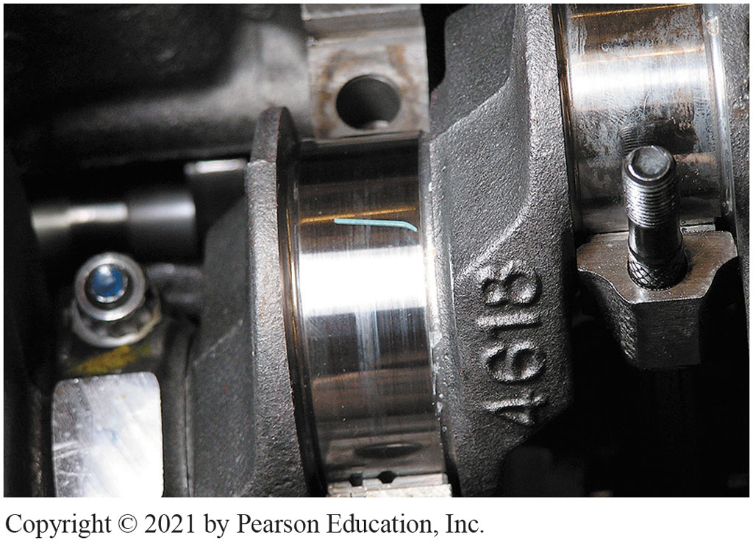
Material Across Entire Journal
Notes:
1. Clean the main bearing journal and then place a strip of Plastigage material across the entire width of the journal

Slide 115
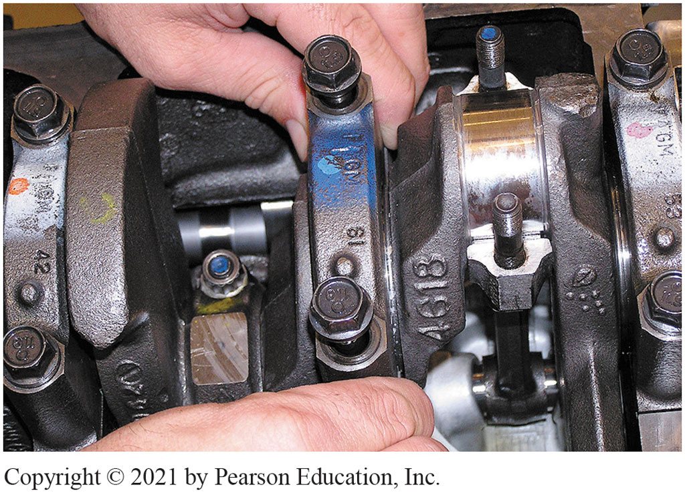
Install Main Cap
Notes:
2. Carefully install the main bearing cap with the bearing installed

Slide 116
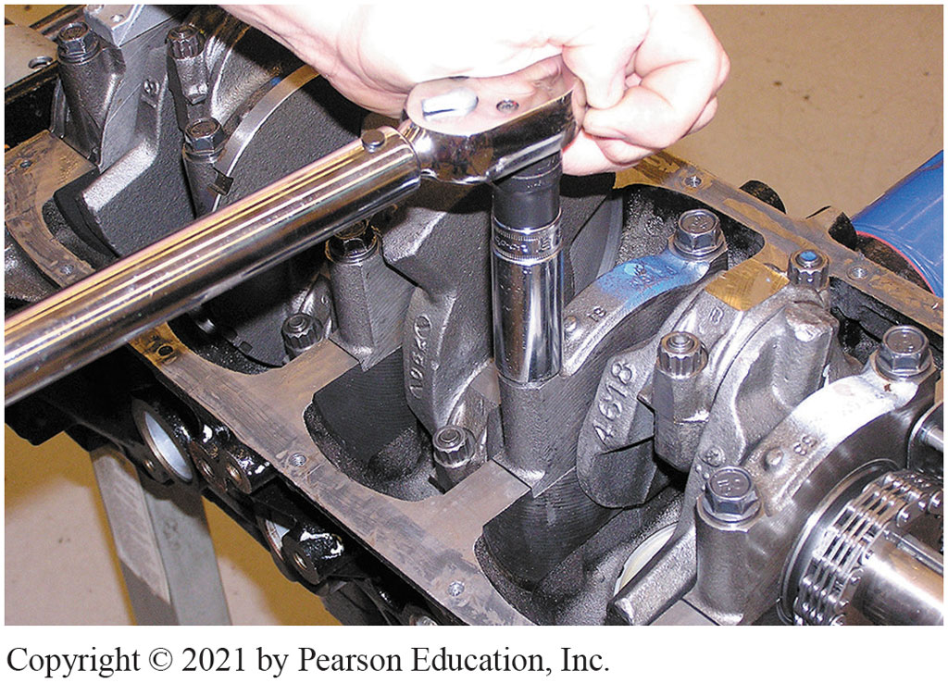
Torque Main Cap
Notes:
3. Torque main bearing cap bolts to factory specifications

Slide 117
Measure Material Width
Notes:
4. Carefully remove the bearing cap and, using the package that contained the Plastigage strips, measure the width of the compressed material. The gauge is calibrated in thousandths of the inch. Repeat for each main bearing

Slide 118
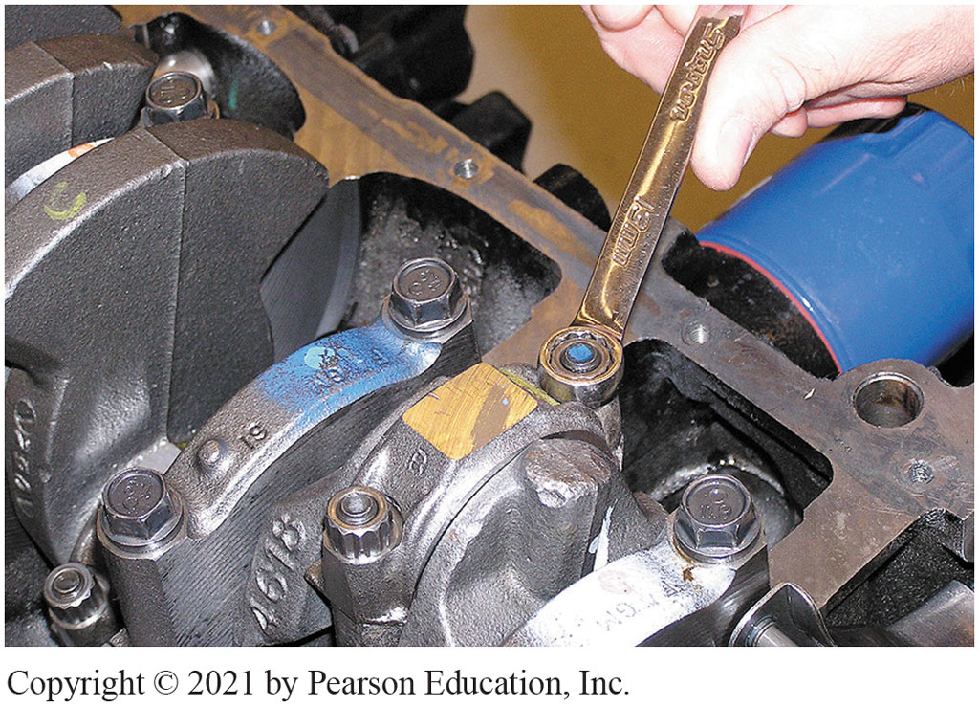
Measure Rod Bearing Oil Clearance
Notes:
5. To measure rod bearing oil clearance, start by removing the rod cap

Slide 119
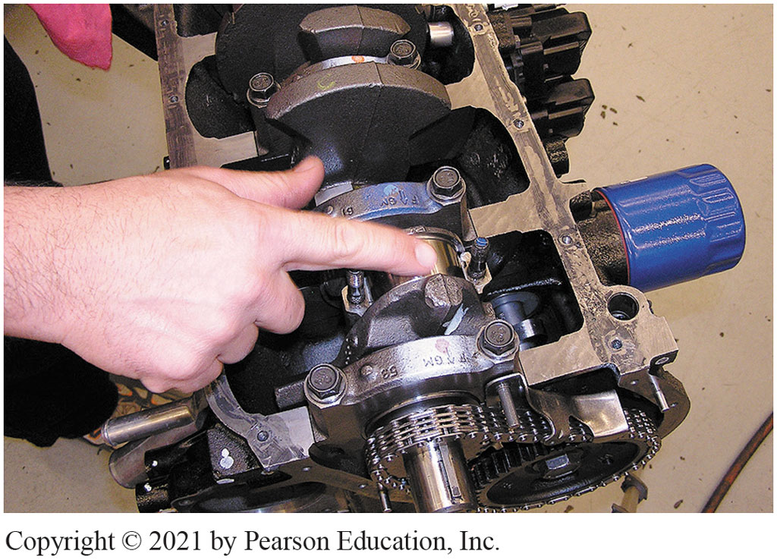
Place Plastigage Across Entire Width
Notes:
6. Clean the rod bearing journal and then place a strip of Plastigage across the entire width of the journal

Slide 120
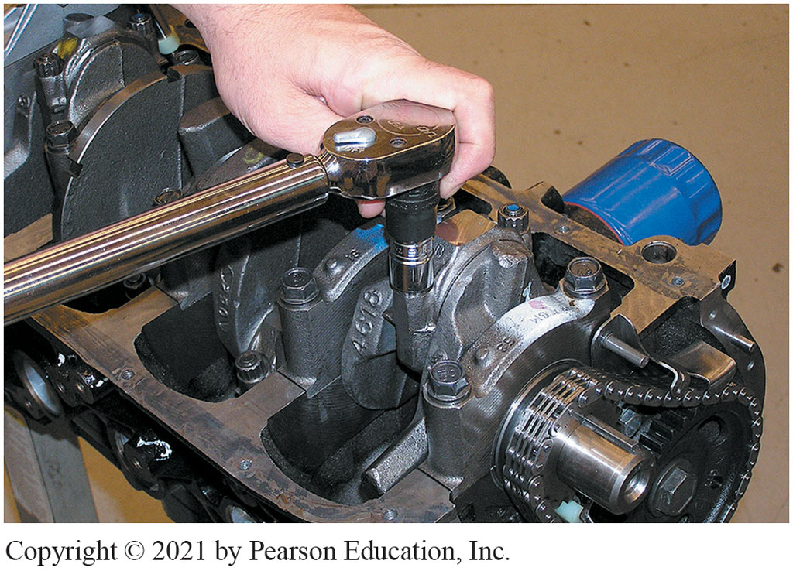
Torque Rod Bearing Cap Nuts
Notes:
7. Torque the rod bearing cap nuts to factory specifications

Slide 121
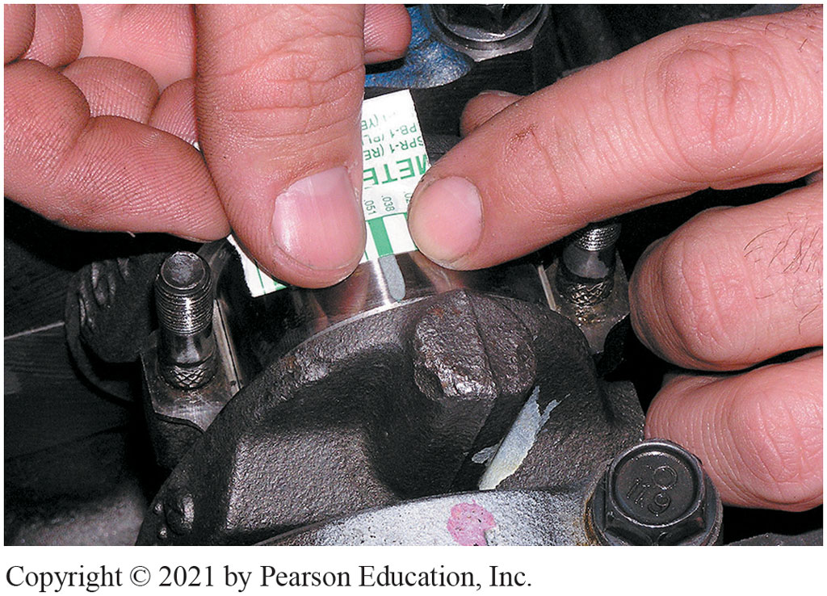
Measure Using Plastigage Package
Notes:
8. Remove the rod cap and measure the oil clearance using the markings on the Plastigage package. The wider the compressed gauge material is, the narrower the bearing oil clearance. Repeat for all rod bearings

Slide 122
Engine Repair Videos and Animations
Videos Link: (A1) Engine Repair Videos
Animations Link: (A1) Engine Repair Animations

Slide 123
Copyright
This work is protected by United States copyright laws and is provided solely for the use of instructors in teaching their courses and assessing student learning. Dissemination or sale of any part of this work (including on the World Wide Web) will destroy the integrity of the work and is not permitted. The work and materials from it should never be made available to students except by instructors using the accompanying text in their classes. All recipients of this work are expected to abide by these restrictions and to honor the intended pedagogical purposes and the needs of other instructors who rely on these materials.

