Slide 1
Automotive Technology: Principles, Diagnosis, and Service
Seventh Edition
Chapter 31
Engine Block Inspection and Service
Copyright © 2023 Pearson Education, Inc. All Rights Reserved
Notes:
INSTRUCTOR NOTE: This presentation includes text explanation notes, you can use to teach the course. When in SLIDE SHOW mode, you RIGHT CLICK and select SHOW PRESENTER VIEW, to use the notes.

Slide 2
Learning Objectives
31.1 Explain the construction of engine blocks.
31.2 Explain the procedure for engine block service.
31.3 Explain block preparation for assembly.

Slide 3
Engine Blocks (1 of 3)
Construction
Gray Cast Iron
Cast Aluminum
Die-Cast Aluminum Alloy
Block Manufacturing
Cast-iron cylinder block sand casting technology continues to be improved.
Aluminum Blocks
Styrofoam is often used as a core when casting an aluminum block

Slide 4
Engine Blocks (2 of 3)
Bedplate Design Blocks
A bedplate is a structural member that attaches to the bottom of the block and supports the crankshaft.
Casting Numbers
Casting numbers can be used to check dimensions, such as the cubic inch displacement, and other information, such as year of manufacture.
Block Deck
The cylinder head is fastened to the top surface of the block, know as the block deck.

Slide 5
Engine Blocks (3 of 3)
Cooling Passages
In most cylinder designs, the cooling passages extend nearly to the bottom of the cylinder.
Lubricating Passages
Carry lubricating oil to the required locations. This is accomplished through oil drilled galleries and oil gallery plugs.
Main Bearing Caps
The main bearing caps are cast or manufactured from sintered or billeted materials, separately from the block.

Slide 6
Question 1: ?
What is the purpose of a bedplate?

Slide 7
Answer 1
To support the crankshaft and provide the block with structural support.

Slide 8
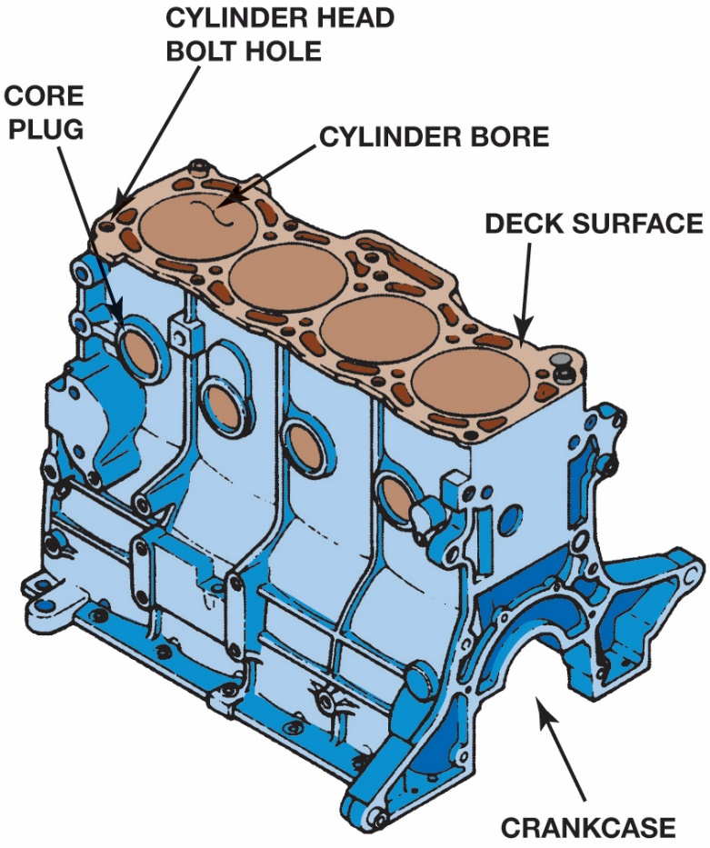
Figure 34.1

Slide 9
Figure 31.1 Cylinder Block
The Cylinder Block Usually Extends From the Oil Pan Rails at the Bottom to the Deck Surface at the Top

Slide 10
Figure 31.2 Core Plug
An expansion (core) plug is used to block the opening in the cylinder head or block the holes where The core sand was removed after the part was cast

Slide 11
Figure 31.3 Styrofoam Casting Mold
Styrofoam casting mold used to make 5 cylinder engine blocks for the Chevrolet Colorado and the Hummer H3

Slide 12
Frequently Asked Question: What Is Compacted Graphite Iron?
? Frequently Asked Question
What Is Compacted Graphite Iron? Compacted graphite iron (CGI) has increased strength, ductility, toughness, and stiffness compared to gray iron. If no magnesium is added, the iron will form gray iron when cooled, with the graphite present in flake form. If a very small amount of magnesium is added, more and more of the sulfur and oxygen form in the molten solution, and the shape of the graphite begins to change to compacted graphite forms. Compacted graphite iron is used for bedplates and many diesel engine blocks. It has higher strength, stiffness, and toughness than gray iron. The enhanced strength has been shown to permit reduced weight while still reducing noise vibration and harshness. Compacted graphite iron is commonly used in the blocks of diesel and some high-performance engines.

Slide 13
Figure 31.4 Dry Sleeves
Cast-iron dry sleeves are used in aluminium blocks to provide a hard surface for the rings

Slide 14
Figure 31.5 Dry/Wet Sleeve Support
Dry sleeve supported by surrounding cylinder block. A wet sleeve must be thicker to be able to withstand combustion pressures without total support from the block

Slide 15
Figure 31.6 Bedplate
Bedplate is a structural part of the engine, which is attached between the block and the oil pan and supports the crankshaft

Slide 16
Figure 31.7 Casting Numbers
Casting numbers identify the block

Slide 17
Figure 31.8 Block Deck
Deck is the machined top surface of the block

Slide 18
Figure 31.9 Internal Block Passages
Cutaway of a Chevrolet V-8 Block Showing All of the Internal Passages

Slide 19
Figure 31.10 Oil Gallery Plugs
Typical oil gallery plugs on the rear of a chevrolet small block V-8 engine

Slide 20
Figure 31.11 Chevrolet Block
Small block chevrolet block. Note the left-hand dipstick hole and a pad cast for a right-hand dipstick

Slide 21
Figure 31.12 Two-Bolt Mains
Two-bolt main bearing caps provide adequate bottom end strength for most engines

Slide 22
Figure 31.13 Four-Bolt Mains
High-performance and truck engines often use four-bolt main bearing caps for greater durability

Slide 23
Figure 31.14 Mains’ Cross Bolt
Some engines add to the strength of a four-bolt main bearing cap by also using cross bolts through the bolt on the sides of the main bearing caps

Slide 24
Figure 31.15 Girdle
A girdle is used to tie all of the main bearing caps together

Slide 25
Frequently Asked Question: What Are FRM-Lined Cylinders?
? Frequently Asked Question
What Are FRM-Lined Cylinders? Fiber-reinforced matrix (FRM) is used to strengthen cylinder walls in some Honda/Acura engines. FRM is a ceramic material similar to that used to construct the insulators of spark plugs. The lightweight material has excellent wear resistance and good heat transfer properties, making it ideal for use as a cylinder material. FRM inserts are placed in the mold and the engine block is cast over them. The inserts are rough and can easily adhere to the engine block. The inserts are then bored and honed to form the finished cylinders. FRM blocks were first used in a production engine on the Honda S2000 and are also used on the turbocharged Acura RDX sport utility vehicle.

Slide 26
Engine Block Service (1 of 4)
Procedures
OPERATION 1: Main bearing housing bore alignment.
OPERATION 2: Machining of the block deck surface.
OPERATION 3: Cylinder boring and honing.
Main Bearing Housing Bore Alignment
Main bearing journals of a straight crankshaft are in alignment.
If not, crankshaft tends to bend as it rotates.

Slide 27
Engine Block Service (2 of 4)
Arbor Check Method
The arbor is installed, then all main caps are tightened to specifications. After tightening, the arbor is checked to make sure it rotates freely, indicating a true centerline.
Machining The Deck Surface Of A Block
The block deck must be resurfaced in a surfacing machine that can control the amount of metal removed when it is necessary to match the size of the combustion chambers.

Slide 28
Engine Block Service (3 of 4)
Deck Surface Finishing
60 to 100 Ra (65 to 110 R M S) for cast iron
50 to 60 Ra (55 to 65 R M S) for aluminum block decks to be assured of a proper head gasket surface
Cylinder Boring
Cylinders should be measured across the engine (perpendicular to the crankshaft), where the greatest wear occurs.

Slide 29
Engine Block Service (4 of 4)
Sleeving the Cylinder
Cylinder blocks with deep gouges may be able to be salvaged by sleeving the cylinder.
Cylinder Honing
Honing the cylinder provides the proper surface finish on the cylinder wall for the rings to seat against.
Chamfering the Cylinder Bore
Removing the top edge of the cylinder bores have sharp edges.

Slide 30
Question 2: ?
Why is it important to check main bore alignment?

Slide 31
Answer 2
A crankshaft will tend to bend as it turns if the alignment is not correct.

Slide 32
Figure 31.16 Distortion in Center
Main bearing bores of a warped block usually bend into a bowed shape. The greatest distortion is in the center bores

Slide 33
Figure 31.17 Main Caps Bowed Down
When the main bearing caps bow downward, they also pinch in at the parting line

Slide 34
Figure 31.18 Bore Alignment
The main bearing bore alignment can be checked using a precision straightedge and a feeler gauge

Slide 35
Figure 31.19 Bore Alignment Tool
(a) A precision arbor can be used to check the main bearing bore alignment. (b) if the sleeve can be inserted into all of the main bearing bores, then they are aligned

Slide 36
Figure 31.20 Block Flatness
(a) Checking the flatness of the block deck surface using a straightedge and a feeler gauge. (b) to be sure that the top of the block is flat, check the block in six locations as shown

Slide 37
Figure 31.21 Block Resurfacing
Grinding the deck surface of the block

Slide 38
Figure 31.22 Cylinder Wear
Cylinders wear in a taper, with most of the wear occurring at the top of the cylinder where the greatest amount of heat and pressure are created. The ridge is formed because the very top part of the cylinder is not contacted by the rings

Slide 39
Figure 31.23 Dial-Bore Gauge
Adjust a dial bore gauge as per the gauge’s instructions and then measure the bore diameter at the top just below the ridge (maximum wear section) and at the bottom below the ring travel (minimum wear section)

Slide 40
Animation: Check Cylinder Bore Wear (Animation will automatically start)

Slide 41
Figure 31.24 Honing/Deglazing
An assortment of ball-type deglazing hones. This type of hone does not straighten wavy cylinder walls.
Notes:
It is important to have the proper surface finish on the cylinder wall for the rings to seat against. Honing includes two basic operations depending on the application:
When installing new piston rings on a cylinder that is not being bored, some ring manufacturers recommend breaking the hard surface glaze on the cylinder wall with a hone before installing new piston rings. This process is often called “deglazing” the cylinder walls.
The cylinder wall should be honed to straighten the cylinder when the wall is wavy or scuffed. If honing is being done with the crankshaft remaining in the block, the crankshaft should be protected to keep honing chips from getting on the shaft. Two types of hones are used for cylinder service:
A deglazing hone removes the hard surface glaze remaining in the cylinder. It is a flexible hone that follows the shape of the cylinder wall, even when the wall is wavy. It cannot be used to straighten the cylinder. A brush-type (ball-type) deglazing hone is shown in ● FIGURE 31–24.
A sizing hone can be used to straighten the cylinder and to provide a suitable surface for the piston rings. Honing the cylinder removes the fractured metal that is created by boring. The cylinders must be honed a minimum of 0.002 inch (0.05 mm) after boring to cut below the rough surface and provide an adequate finish. Honing leaves a plateau surface that can support the oil film for the rings and piston skirt. This plateau surface is achieved by first using a coarse stone followed by a smooth stone to achieve the desired surface. The process of using a course and fine stone is called plateau honing. ● SEE FIGURE 31–25.
The honing stones are held in a rigid fixture with an expanding mechanism to control the size of the hone. The sizing hone can be used to straighten the cylinder taper by honing the lower cylinder diameter more than the upper diameter. As it rotates, the sizing hone only cuts the high spots so that cylinder out-of-round is also reduced. The cylinder wall surface finish is about the same when the cylinder is refinished with either type of hone

Slide 42
Figure 31.25 After Boring
After boring, the cylinder surface is rough, pitted, and fractured to a depth of about 0.001 inch

Slide 43
Figure 31.26 Honing Enlarges Bore
Honing enlarges the cylinder bore to the final size and leaves a plateau surface finish that retains oil

Slide 44
Figure 31.27 Cross-Hatched Pattern
Crosshatched pattern holds oil to keep the rings from wearing excessively, and also keeps the rings against the cylinder wall for a gas-tight fit

Slide 45
Block Preparation for Assembly
Block Cleaning
The block is scrubbed until it is absolutely clean. This can be determined by wiping the cylinder wall with a clean lint-free cloth. The cloth will pick up no soil when the cylinder wall is clean.
Block Detailing
All oil passages (galleries) should be cleaned
All tapped holes should be cleaned with the correct thread chaser.
Coat the newly cleaned block with fogging oil to prevent rust.

Slide 46
Question 3: ?
Why is detailing a block important?

Slide 47
Answer 3
To remove any unwanted dirt and grit that would cause abnormal wear.

Slide 48
Figure 31.28 Cutaway Block
Notice on this cutaway engine block, some of the head bolt holes do not extend too far into the block and dead end. Debris can accumulate at the bottom of these holes and it must be cleaned out before final assembly

Slide 49
Figure 31.28 Thread Chaser
A tread chaser or bottoming tap should be used in all threaded holes before assembling the engine

Slide 50
Frequently Asked Question: What Is a Seasoned Engine?
? Frequently Asked Question
What Is a Seasoned Engine? A new engine is machined and assembled within a few hours after the heads and block are cast from melted iron. Newly cast parts have internal stresses within the metal. The stress results from the different thickness of the metal sections in the head. Forces from combustion in the engine, plus continued heating and cooling, gradually relieve these stresses. By the time the engine has accumulated 20,000 to 30,000 miles (32,000 to 48,000 km), the stresses have been completely relieved. This is why some engine rebuilders prefer to work with used heads and blocks that are stress relieved. Used engines are often called “seasoned” because of the reduced stress and movement these components have as compared with new parts.

Slide 51
Engine Repair Videos and Animations
Videos Link: (A1) Engine Repair Videos
Animations Link: (A1) Engine Repair Animations

Slide 52
Copyright
This work is protected by United States copyright laws and is provided solely for the use of instructors in teaching their courses and assessing student learning. Dissemination or sale of any part of this work (including on the World Wide Web) will destroy the integrity of the work and is not permitted. The work and materials from it should never be made available to students except by instructors using the accompanying text in their classes. All recipients of this work are expected to abide by these restrictions and to honor the intended pedagogical purposes and the needs of other instructors who rely on these materials.

