Slide 1
Automotive Technology: Principles, Diagnosis, and Service
Seventh Edition
Chapter 30
Pistons, Rings, and Connecting Rods
Copyright © 2023 Pearson Education, Inc. All Rights Reserved
Notes:
INSTRUCTOR NOTE: This presentation includes text explanation notes, you can use to teach the course. When in SLIDE SHOW mode, you RIGHT CLICK and select SHOW PRESENTER VIEW, to use the notes.

Slide 2
Learning Objectives (1 of 2)
30.1 Explain the purpose and function of pistons.
30.2 Explain piston construction.
30.3 Discuss piston pins.
30.4 Discuss piston pin retaining methods.
30.5 Explain piston rings.
30.6 Discuss piston ring construction.
30.7 Discuss connecting rods.

Slide 3
Learning Objectives (2 of 2)
30.8 Discuss connecting rod service.
30.9 Explain piston and rod assembly.
30.10 Explain piston ring service.

Slide 4
Pistons
Purpose and Function
Transfer force
Seal the combustion chamber
Conduct heat
Piston Operation
As the piston moves downward and then upward it starts, accelerates, and stops twice in each crankshaft revolution.
The reciprocating action of the piston produces large inertia forces.

Slide 5
Figure 30.1 Piston Function
The Piston Seals the Bottom of the Combustion Chamber and Is Attached to a Connecting Rod

Slide 6
Piston Construction (1 of 5)
Piston Ring Grooves
Located between the piston head and skirt
The width of the grooves and the number of rings determines minimum piston height.
Cast Pistons
Cast Aluminum pistons usually are made using gravity die casting in which molten aluminum alloy and about 10% silicon are poured into a mold.

Slide 7
Piston Construction (2 of 5)
Hypereutectic Pistons
Silicon content increased to about 16% of alloy.
25% weight reduction and lower expansion rate.
More expensive because more difficult to cast and machine.
Forged Pistons
Forged pistons have a dense grain structure and are very strong, so are often used in turbocharged or supercharged engines.

Slide 8
Piston Construction (3 of 5)
Piston Head Designs
Flat Top
Raised Domes (Pop-Ups)
Dish (Depression)
Slipper Skirt Pistons
Shorter on the two sides that are not thrust surfaces.
Lighter weight
Allows for a shorter overall engine height

Slide 9
Piston Construction (4 of 5)
Cam Ground Pistons
As the cam ground piston is heated, it expands along the piston pin so that it becomes nearly round at its normal operating temperatures.
Piston Finish
Scuffing can be reduced by coating the piston skirts with tin 0.0005 inch (0.0125 mm) thick or a moly graphite coating.

Slide 10
Piston Construction (5 of 5)
Piston Head Size
The top or head of the piston is smaller in diameter than the rest of the piston.
Piston Strut Inserts
The struts add strength to the piston in the piston pin area where additional strength is needed.
The struts help control thermal expansion.
Prevents cold piston slap and noise.

Slide 11
Figure 30.2 Piston Parts
All Pistons Share the Same Parts in Common
Notes:
TECH TIP: Piston Weight Is Important! All pistons in an engine should weigh the same to help ensure a balanced engine. Piston weight becomes a factor when changing pistons. Most aluminum pistons range in weight from 10 to 30 ounces (280 to 850 grams) (1 oz = 28.35 g ). A typical paper clip weighs 1 g . If the cylinder has been bored, larger replacement pistons are obviously required. If the replacement pistons weigh more, this puts additional inertia loads on the rod bearings. Therefore, to help prevent rod bearing failure on an overhauled engine, the replacement pistons should not weigh more than the original pistons. CAUTION: Some less expensive replacement cast pistons or high-performance forged pistons are much heavier than the stock pistons, even in the stock bore size. This means that the crankshaft may need heavy metal added to the counterweights of the crankshaft for the engine to be balanced. For the same reason, if one piston is being replaced, all pistons should be replaced or at least checked and corrected to ensure the same weight.

Slide 12
Figure 30.3 Piston Measure
Piston Diameter is Measured Across the Thrust Surfaces

Slide 13
Animation: Measure Piston Size (Animation will automatically start)

Slide 14
Figure 30.4 Piston Casting
A Cast Piston Showing the Sprues Which Were Used to Fill the Mold with Molten Aluminium Alloy

Slide 15
Figure 30.5 Piston Temperature
The Top of the Piston Temperature Can Be 100°F (38°C) Lower on a Forged Piston Compared to a Cast Piston

Slide 16
Figure 30.6 Valve Reliefs
Valve Reliefs are Used to Provide Valve Clearance
Notes:
NOTE: Newer engines do not use valve reliefs because this requires that the thickness of the top of the piston be increased to provide the necessary strength. The thicker the top of the piston, the lower down from the top the top piston ring sits. To reduce unburned hydrocarbon (HC) ex-haust emissions, engineers attempt to place the top piston ring as close to the top of the piston as possible to prevent the unburned fuel from being trapped (and not burned) between the top of the piston and the top of the top piston ring.

Slide 17
Figure 30.7 Piston Cam Shape
Piston Cam Shape. The Largest Diameter is Across the Thrust Surfaces and Perpendicular to the Piston Pin (Labelled A)

Slide 18
Figure 30.8 Moly Graphite Coating
Moly Graphite Coating on this Piston from a GM 3800 V-6 Engine Helps to Prevent Piston Scuffing

Slide 19
Figure 30.9 Piston Head
The Head of the Piston is Smaller in Diameter than the Skirt of the Piston to Allow It to Expand When the Engine Is Running

Slide 20
Figure 30.10 Piston Struts
Steel Struts Cast Inside the Piston Help Control Expansion and Add Strength to the Piston Pin Area

Slide 21
Question 1: ?
What make a piston a Hypereutectic piston?

Slide 22
Answer 1
The silicon content is increased to about 16% of the alloy.

Slide 23
Piston Pins
Piston pins used to attach the piston to the connecting rod.
Piston Pin Offset
They are located toward the major thrust surface, from the piston centerline to reduce piston slap and noise.
Piston Pin Fit
If the piston pin is loose in the piston or in the connecting rod, it makes a sound while the engine is running. This is often described as a double knock.

Slide 24
Figure 30.11 Piston Pins
Most Piston Pins are Hollow to Reduce Weight and Have a Straight Bore. Some Pins Have a Tapered Bore to Reinforce the Pin

Slide 25
Figure 30.12 Piston Pin Offset
Piston Pin Offset Toward the Major Thrust Surface

Slide 26
Figure 30.13 Major Thrust Area
Engine Rotation and Rod Angle During the Power Stroke Cause the Piston to Press Harder Against One Side of the Cylinder, Called the Major Thrust Surface

Slide 27
Animation: Piston Side Thrust (Animation will automatically start)

Slide 28
Frequently Asked Question: Which Side Is the Major Thrust Side?
? Frequently Asked Question
Which Side Is the Major Thrust Side? The thrust side is the side the rod points to when the piston is on the power stroke. Any V-block engine (V-6 or V-8) that rotates clockwise is viewed from the front of the engine. The left bank piston thrust side faces the inside (center) of the engine. The right bank piston thrust side faces the outside of the block. This rule, called the left-hand rule, states the following: Stand at the rear of the engine and point toward the front of the engine with your left hand. Raise your thumb straight up, indicating the top of the engine. Point your other fingers toward the right. This represents the major thrust side of the piston. Always assemble the connecting rods onto the rods so that the notch or “F” on the piston is pointing toward the front of the engine and the oil squirt hole on the connecting rod is pointing toward the major thrust side with your left hand.

Slide 29
Piston Pin Retaining Methods
Full Floating
Most full-floating piston pins use some type of lock ring to retain the piston pin.
Internal snap ring called a circle clip
Spiral lock ring
Interference Fit
The pin is installed by heating the rod to expand the hole or by pressing the pin into the rod.

Slide 30
Figure 30.14 Full-Floating Pin
Circlips Hold Full-Floating Piston Pins in Place

Slide 31
Figure 30.15 Interference Fit Pin
Typical Interference Fit Piston Pin

Slide 32
Question 2: ?
How is the piston pin retained in the piston and rod assembly?

Slide 33
Answer 2
A lock ring or an interference fit.

Slide 34
Piston Rings (1 of 3)
Purpose and Function
Form sliding combustion chamber seal that prevents high-pressure combustion gases from leaking past the piston.
Keep engine oil from getting into the combustion chamber.
Rings transfer some of the piston heat to the cylinder wall, where it is removed from the engine through the cooling system.

Slide 35
Piston Rings (2 of 3)
Classifications
Compression rings
Oil control rings
Compression Rings
A compression ring is designed to form a seal between the moving piston and the cylinder wall, while at the same time keeping friction to a minimum.
Oil Control Rings
The scraping action allows oil to return through the expander and openings in the piston.

Slide 36
Piston Rings (3 of 3)
Ring Gap
The piston ring gap allows some leakage past the top compression ring. This leakage is useful in providing pressure on the second ring to develop a dynamic sealing force.
Piston Ring Shapes
Tapered Face
Positive Twist
Reverse Twist
Scraper or Barrel Face

Slide 37
Figure 30.16 Conduct Heat
The Rings Conduct Heat from the Piston to the Cylinder Wall
Notes:
CASE STUDY: Big Problem, No Noise: Sometimes the piston pin can “walk” off the center of the piston and score the cylinder wall. This scoring is often not noticed because this type of wear does not create noise. Because the piston pin is below the piston rings, little combustion pressure is lost past the rings until the groove worn by the piston pin has worn the piston rings. Troubleshooting the exact cause of the increased oil consumption is difficult because the damage done to the oil control rings by the groove usually affects only one cylinder. Often, compression tests indicate good compression because of the cylinder seals, especially at the top. More than one technician has been surprised to see the cylinder gouged by a piston pin when the cylinder head has been removed for service. In such a case, the cost of the engine repair immediately increases far beyond that of normal cylinder head service.
Summary:
Complaint—Engine was burning oil yet the compression was good leading the technician to remove the head.
Cause—A piston pin had moved and scored the cylinder wall.
Correction—The engine was replaced to correct the oil burning concern.

Slide 38
Animation: Coolant Flow-World Engine (Animation will automatically start)

Slide 39
Figure 30.17 Forces Ring
Combustion Chamber Pressure Forces the Ring Against the Cylinder Wall and the Bottom of the Ring Groove to Effectively Seal the Cylinder

Slide 40
Animation: Top Ring Pressure (Animation will automatically start)

Slide 41
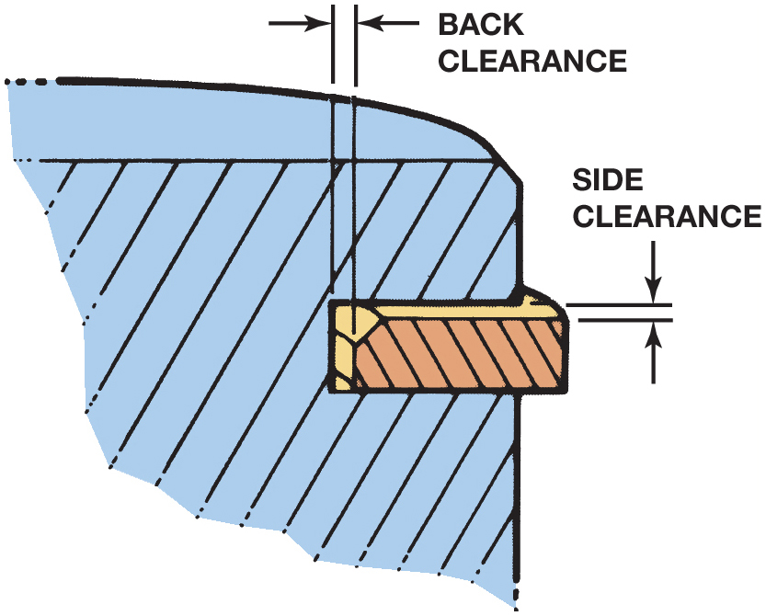
Figure 33.18 Piston Ring Clearance

Slide 42
Figure 30.18 Side and Back
Side and Back Clearances must be Correct for the Compression Rings to Seal Properly

Slide 43
Figure 30.19 Oil-Control Ring
Typical Three-Piece Oil Control Ring Uses a Hump-Type Stainless Steel Spacer-Expander. The Expander Separates the Two Steel Rails and Presses Them Against the Cylinder Wall

Slide 44
Figure 30.20 Piston Ring Gaps
Typical Piston Ring Gaps

Slide 45
Figure 30.21 Taper Face Ring
Taper Face Ring Provides Oil Control by Scraping the Cylinder Wall. This Style of Ring must be Installed Right Side up or the Ring Does Not Seal and Oil is Drawn into the Combustion Chamber

Slide 46
Figure 30.22 Twist Rings
Torsional Twist Rings Provide Better Compression Sealing and Oil Control than Regular Taper Rings

Slide 47
Figure 30.23 Scraper-Type Rings
Scraper-Type Rings Provide Improved Oil Control

Slide 48
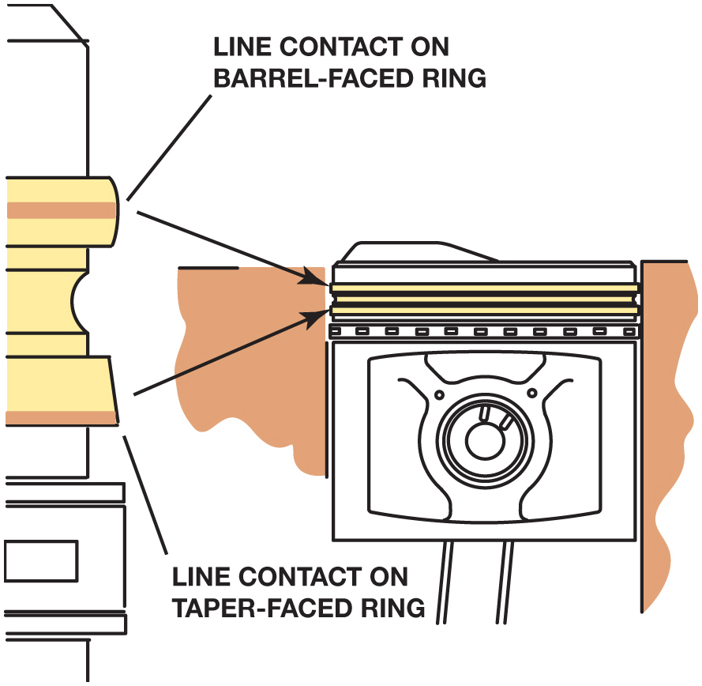
Figure 33.24 Cylinder Wall Contact

Slide 49
Figure 30.24 Upper Barrel Face
Upper Barrel Face Ring has a Line Showing Contact with the Cylinder Wall. The Second Taper Face Ring Shows Contact Along the Lower Edge of the Ring

Slide 50
Piston Ring Construction (1 of 3)
Materials
Plain cast iron
Pearlitic cast iron
Nodular cast iron
Steel
Ductile iron
Chromium Piston Rings
About 0.004 inch (0.01 mm) of chrome is then plated on the ring face.

Slide 51
Piston Ring Construction (2 of 3)
Molybdenum Piston Rings
Most molybdenum face piston rings have a groove that is 0.004 to 0.008 inch (0.1 to 0.2 mm) deep cut into the ring face. This groove is filled with molybdenum, using a metallic (or plasma) spray method.
Moly-Chrome-Carbide Rings
The coating has properties that include the hardness of the chrome and carbide combined with the heat resistance of molybdenum.

Slide 52
Piston Ring Construction (3 of 3)
Ceramic-Coated Rings
The ceramic-coated ring surface is created by applying a ceramic coating to the ring using a process called physical vapour deposition (P V D).

Slide 53
Figure 30.25 Chrome Facing
The Chrome Facing on this Compression Ring is About 0.004 Inch (0.10 Mm) Thick

Slide 54
Figure 30.26 Moly Facing
Moly Facing on this Compression Ring is About 0.005 Inch (0.13 Mm) Thick

Slide 55
Connecting Rods (1 of 2)
Purpose and Function
The connecting rod transfers the force and reciprocating motion of the piston to the crankshaft.
Cast Connecting Rods
Cast connecting rods can be identified by their narrow parting line.
Forged Connecting Rods
The forging method produces lighter weight and stronger, but more expensive, connecting rods.

Slide 56
Connecting Rods (2 of 2)
Powdered Metal Connecting Rods
Each rod is created using a measured amount of material so that rod balancing and engine balancing, achieved without extra weighting and machining operations.
Powder placed in a die and compacted (forged) under a pressure of 30 to 50 tons per square inch.
Big end is then fractured using a large press. The uneven parting line helps ensure a perfect match when the pieces are assembled.

Slide 57
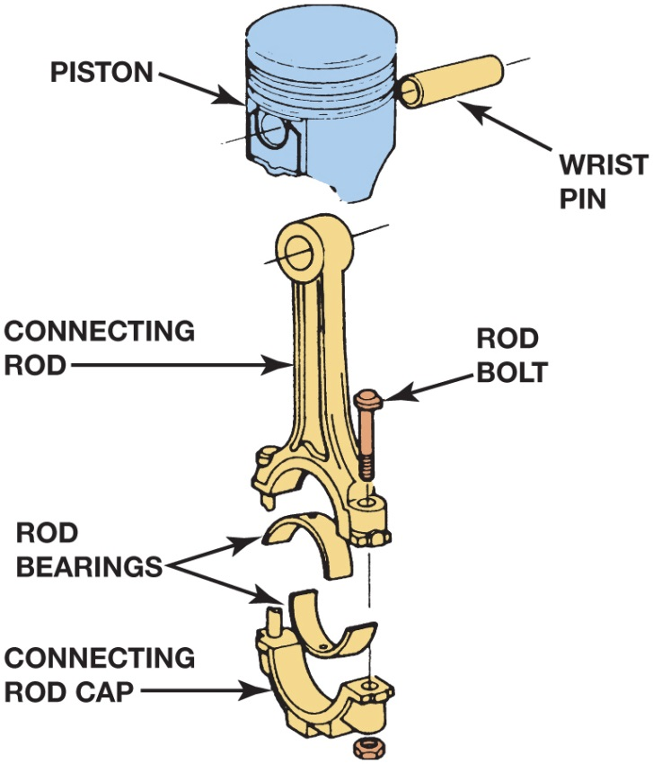
Figure 33.27 The

Slide 58
Figure 30.27 Connecting Rod
Connecting Rod is the most Highly Stressed Part of Any Engine Because Combustion Pressure Tries to Compress it and Piston Inertia Tries to Pull It Apart

Slide 59
Frequently Asked Question: How Much Heat Do the Piston Rings Transfer?
? Frequently Asked Question
How Much Heat Do the Piston Rings Transfer? Piston rings are in continuous contact with the cylinder wall, and the amount of heat varies according to the position, with the upper ring transferring up to 45% of the combustion chamber heat. Se e Figure 30–28.

Slide 60
Figure 30.28 Ring Heat Transfer
Piston rings transfer about 70% of the combustion chamber heat from the piston to the cylinder wall.

Slide 61
Figure 30.29
I-Beam Shape is the Most Common (Top Connecting Rod), but the H-Beam Shape is Common in High-Performance and Racing Engine Applications

Slide 62
Figure 30.20 Rod Bolt Removal
Rod Bolts are Quickly Removed Using a Press

Slide 63
Figure 30.31 Balancing pads
Some Rods Have Balancing Pads on Each End of the Connecting Rod

Slide 64
Figure 30.32 Piston Cooling Jets
Some Connecting Rods Have Spit Holes to Help Lubricate the Cylinder Wall or Piston Pin

Slide 65
Animation: Cooling the Piston (Animation will automatically start)

Slide 66
Figure 30.33 Oil Squirters
Some Engines, Such as this Ford Diesel, are Equipped with Oil Squirters that Spray or Stream Oil Toward the Underneath Side of the Piston Head to Cool the Piston

Slide 67
Figure 30.34 Cast Rod
Cast Connecting Rod Is Found on Many Stock Engines and Can Be Identified by the Thin Parting Line

Slide 68
Figure 30.35 High Performance Rod
This High-Performance Connecting Rod Uses a Bronze Bushing in the Small End of the Rod and an Oil Hole to Allow Oil to Reach the Full-Floating Piston Pin

Slide 69
Figure 30.36 Powdered Rod
Powdered Metal Connecting Rods Feature a Fractured Parting Line at the Big End of the Rod

Slide 70
Connecting Rod Service
Removing Pistons From Rod
Requires special holding fixture.
Inspection
Before connecting rod reconditioning, rod checked for twist.
Reconditioning Procedure
The parting surfaces of the rod and cap are smoothed to remove all high spots before resizing.
The hole is then bored or honed to be perfectly round and of the size and finish required

Slide 71
Figure 30.37 Removing Rod
Press Used to Remove the Connecting Rod from the Piston

Slide 72
Figure 30.38 Twisted Rod
If the Rod is Twisted, it Causes Diagonal-Type Wear on the Piston Skirt

Slide 73
Figure 30.39 Rod Alignment Fixture
Rod Alignment Fixture is Used to Check a Connecting Rod for Bends or Twists

Slide 74
Figure 30.40 Heating Small End
The small end of the rod is being heated in an electric heater and the piston is positioned properly so the piston pin can be installed as soon as the rod is removed from the heater.

Slide 75
Figure 30.41 Ring Side Clearance
Side clearance of the piston ring is checked with a feeler gauge.

Slide 76
Piston and Rod Assembly
Interference Fit Rods
The small eye of the connecting rod is heated before the pin is installed.
Full-Floating Rods
The full-floating piston pin is held in place with a lock ring at each end of the piston pin.

Slide 77
Figure 30.42 Ring Gap
The ring gap is measured using a feeler gauge
Notes:
TECH TIP: Second Ring Gap
Most vehicle manufacturers recommend the ring gap of the second ring should be greater than the gap used in the top ring. If the second ring end gap is
small, combustion gases can become trapped between the top and the second ring. This pressure can cause the top ring to be lifted up and off the piston land and cause blowby. The top ring seals in two positions:
• The ring seals against the cylinder wall.
• The ring seals against the piston ring groove land.
By increasing the second piston ring end gap, combustion gases are not allowed to build up enough to cause the top ring to be lifted up off its seal on the piston land. Always follow the vehicle manufacture’s recommended instructions and specifications.

Slide 78
Piston Ring Service
Step 1: Check the side clearance
Step 2: Check the ring gap
Step 3: Install oil control rings
Step 4: Install the compression rings
Step 5: Double check everything

Slide 79
Figure 30.43 Ring-Gap Grinder
A Hand-Operated Piston Ring End Gap Grinder Being Used to Increase the End Gap of a Piston Ring so that it is Within Factory Specifications

Slide 80
Figure 30.44 Ring Expander
Typical Ring Expander Being Used to Install a Piston Ring on a Piston

Slide 81
Figure 30.45 Ring ID Marks
(a) Identification marks used to indicate the side of the piston ring to be placed toward the head of the piston. (b) Preferred location of the ring gaps.

Slide 82
Question 3: ?
What causes the piston ring groove clearance to widen in service?

Slide 83
Answer 3
The pounding of each ring in its groove gradually increases the piston ring side clearance.

Slide 84
Engine Repair Videos and Animations
Videos Link: (A1) Engine Repair Videos
Animations Link: (A1) Engine Repair Animations

Slide 85
Copyright
This work is protected by United States copyright laws and is provided solely for the use of instructors in teaching their courses and assessing student learning. Dissemination or sale of any part of this work (including on the World Wide Web) will destroy the integrity of the work and is not permitted. The work and materials from it should never be made available to students except by instructors using the accompanying text in their classes. All recipients of this work are expected to abide by these restrictions and to honor the intended pedagogical purposes and the needs of other instructors who rely on these materials.

